Slide 1
Field quality of HCQCXF_S006-CR000001 (Corrector package with LMCXF01)
L. Fiscarelli
MAB meeting 03/02/2025

Slide 2
Performed tests
Bare magnets
At 4.5 K vertical (LASA)
  Field quality with Rotating Coils of HO Correctors
At 1.9 K vertical (SM18)
  Field quality with Rotating Coils of MCBXFA
Cold mass
At ambient temperature in bld.180
  Magnetic centers and angles with Stretched wire
Final assembly
At 1.9 K horizontal (SM18)
  Main field, magnetic centers and angles with Stretched wire

Slide 3
Main field (stretched wire )
Main Field (integral field at 50 mm)
 | Current (A) | Main Field (Tm) | Field direction (mrad)
MCBXFAV | 1593 | 4.5130 | -0.50
MCBXFAH | 1340 | 4.5297 | 0.18
MQSXF | 174 | 0.7210 | -0.31
MCTXF | 85 | 0.0883 | 0.15
MCTSXF | 84 | 0.0173 | -0.08
MCDXF | 92 | 0.0396 | 0.48
MCDSXF | 92 | 0.0396 | 0.51
MCOXF | 102 | 0.0715 | 0.70
MCOSXF | 102 | 0.0715 | 0.43
MCSXF | 99 | 0.0952 | 0.65
MCSSXF | 99 | 0.0953 | -0.01

Slide 4
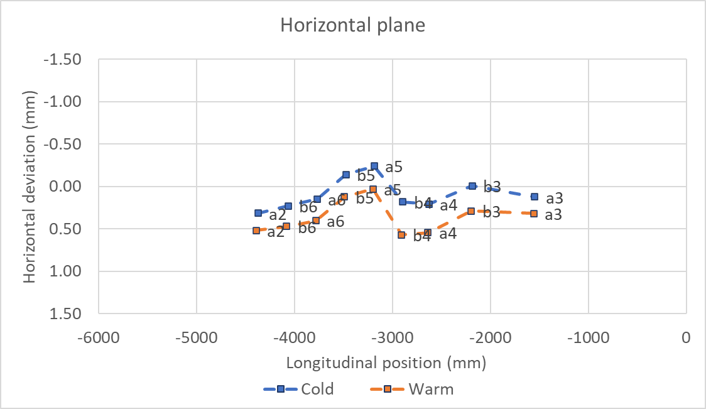
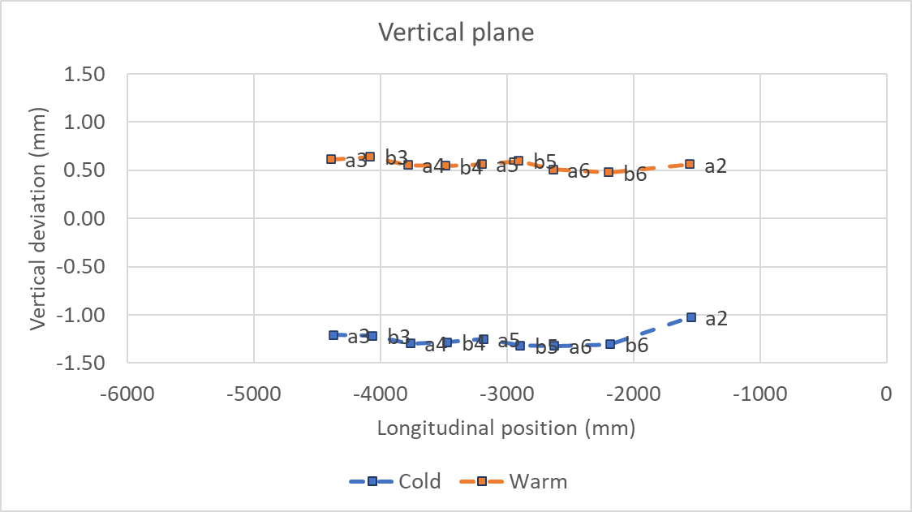
Magnetic centers

Slide 5
MCBXFAP1
INNER at 1593A OUTER at 0A |  |  | INNER at 0A OUTER at 1340A |  |  | INNER at 1593A OUTER at 740A |  |  | INNER at 895A OUTER at 1340A
 | Unit | Value |  | Unit | Value |  | Unit | Value |  | Unit | Value
B1 | Tm | 4.499 | B1 | Tm | 0.002 | B1 | Tm | 4.484 | B1 | Tm | 2.490
A1 | Tm | -0.003 | A1 | Tm | 4.514 | A1 | Tm | 2.505 | A1 | Tm | 4.498
n | bn | an | n | bn | an | n | bn | an | n | bn | an
2 | -0.58 | 2.02 | 2 | 0.16 | 2.00 | 2 | -0.35 | -0.86 | 2 | 0.20 | 0.70
3 | -5.83 | -0.90 | 3 | -0.97 | 11.49 | 3 | -2.01 | 1.94 | 3 | 6.60 | 5.30
4 | -0.95 | 1.64 | 4 | -0.02 | -0.00 | 4 | -0.77 | -1.43 | 4 | -0.45 | -0.76
5 | -4.96 | -0.95 | 5 | -0.01 | 0.10 | 5 | -3.94 | 0.64 | 5 | -1.88 | 0.78
6 | -0.27 | 0.29 | 6 | -0.16 | -0.55 | 6 | -0.11 | -0.56 | 6 | 0.01 | -0.62
7 | -1.27 | -0.15 | 7 | 0.61 | -2.95 | 7 | -1.41 | -1.37 | 7 | -1.14 | -2.58
8 | 0.05 | 0.16 | 8 | -0.44 | -0.44 | 8 | 0.27 | -0.36 | 8 | 0.38 | -0.43
9 | -0.17 | 0.60 | 9 | 0.05 | 0.10 | 9 | -0.09 | -0.48 | 9 | -0.04 | -0.31
10 | 0.78 | -0.19 | 10 | -0.06 | 0.11 | 10 | 0.69 | 0.27 | 10 | 0.41 | 0.24
11 | 2.27 | 1.00 | 11 | 0.04 | -0.02 | 11 | 2.06 | -0.82 | 11 | 1.10 | -0.47
12 | -0.78 | 0.17 | 12 | 0.04 | -0.07 | 12 | -0.72 | -0.19 | 12 | -0.44 | -0.19
13 | -1.54 | -0.59 | 13 | 0.07 | 0.07 | 13 | -1.31 | 0.44 | 13 | -0.68 | 0.31
14 | 0.11 | -0.01 | 14 | -0.25 | 0.01 | 14 | 0.09 | -0.06 | 14 | 0.27 | 0.01
15 | 0.02 | 0.18 | 15 | -0.13 | 0.05 | 15 | 0.01 | -0.12 | 15 | 0.08 | -0.14

Slide 6
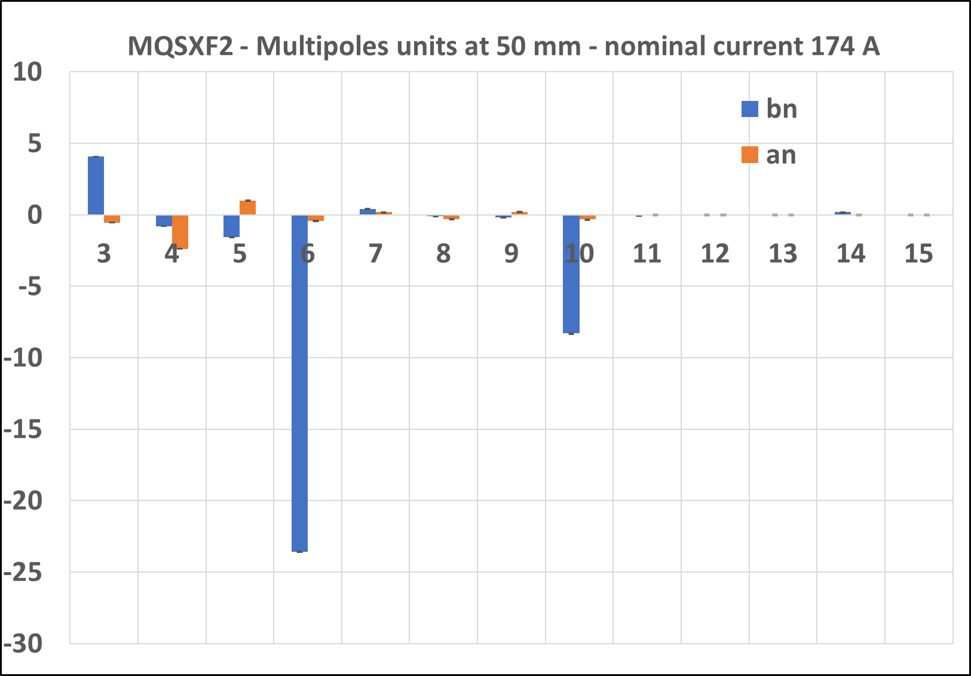
MQSXF2
Current[A] | BdL [Tmm] Calc. | BdL [Tmm] Meas. | Δ[%]
174 A 197 A | 700.0 753.2 | 720.0 772.4 | 2.9 2.6

Slide 7
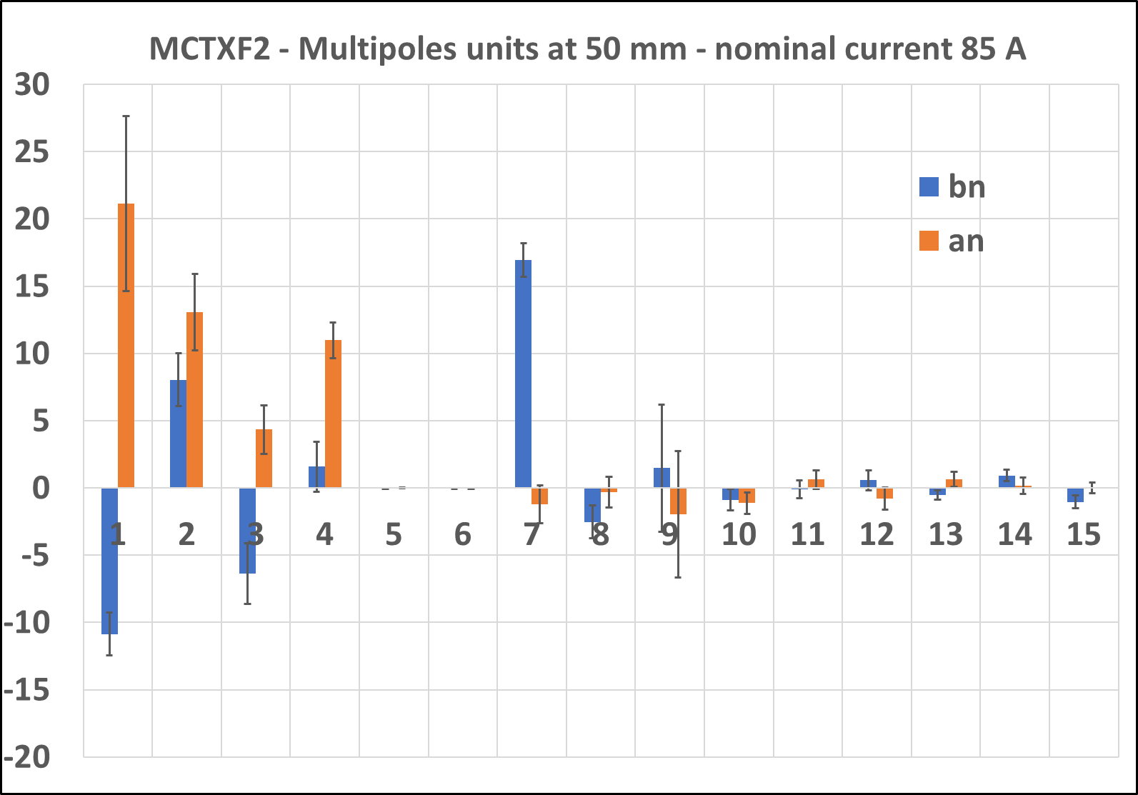
MCTXF2
Current[A] | BdL [Tmm] Calc. | BdL [Tmm] Meas. | Δ[%]
85 A 97 A | 86.1 92.9 | 88.8 95.8 | 3.2 3.2

Slide 8
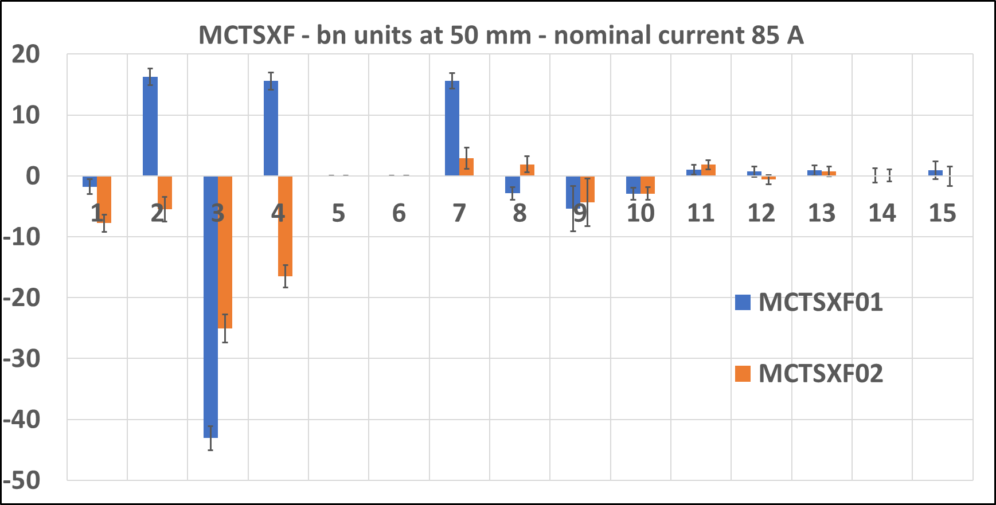
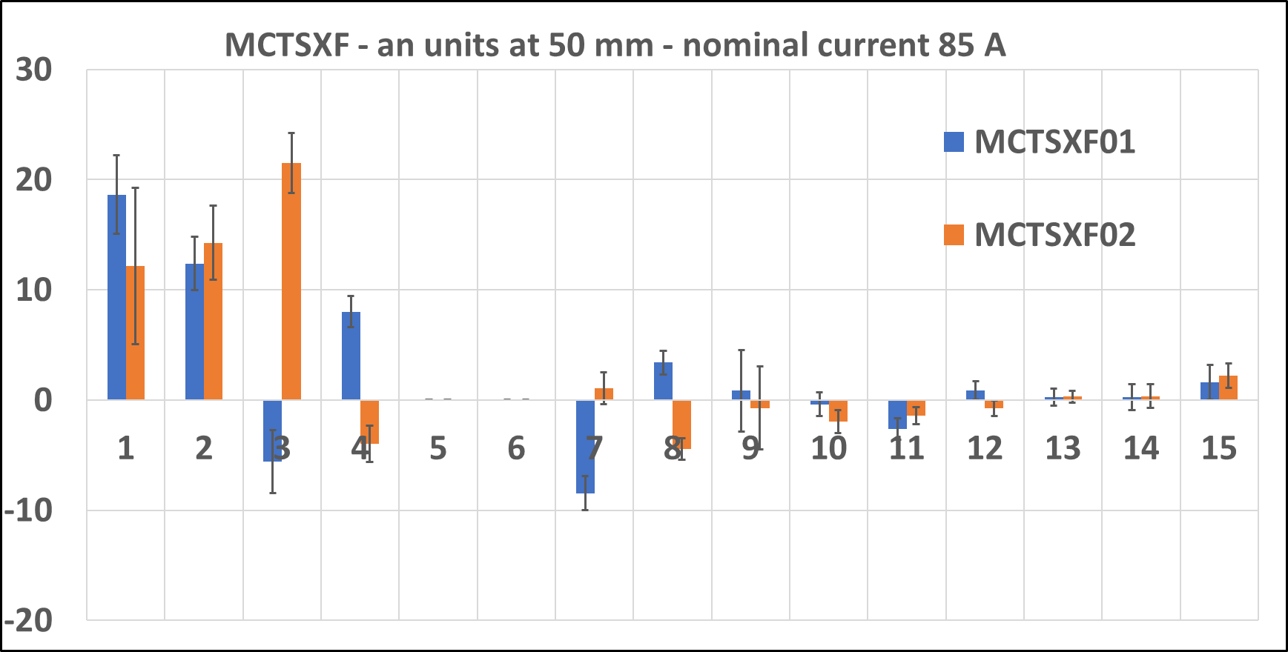
MCTSXF1
Order | Magnet |  | Model | Measured at LASA
 |  | Current [A] | BdL [T mm] | BdL [T mm] | diff [%]
6S | MCTSXF01 | 84 | 17.2 | 17.33 | 0.6
 | MCTSXF02 |  |  | 17.39 | 0.9

Slide 9
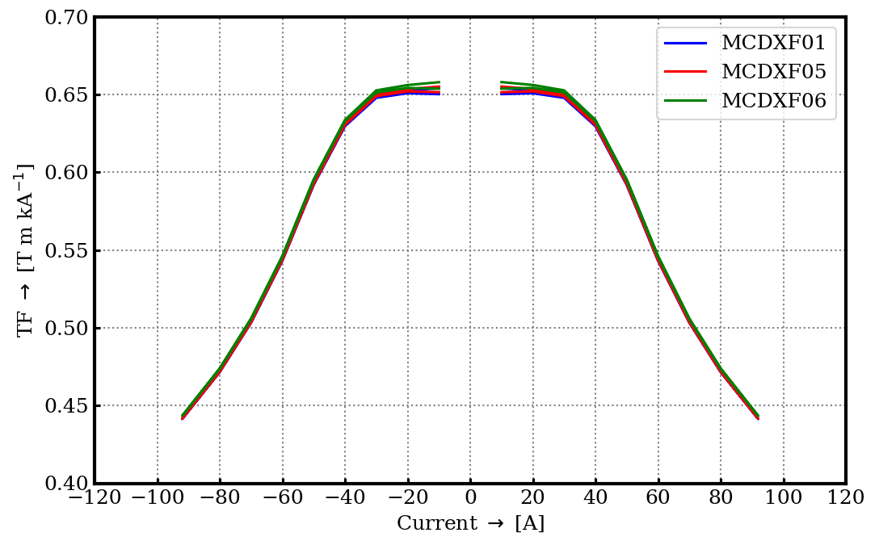
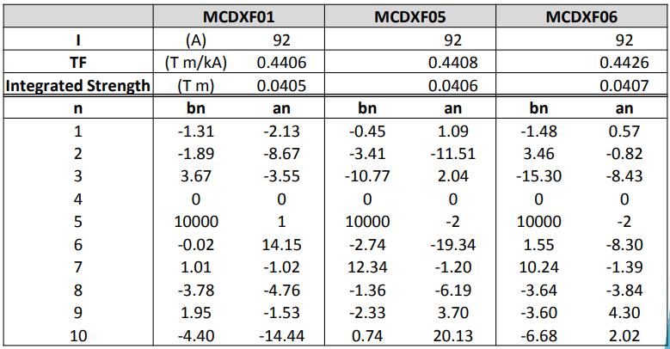
MCDXF01b

Slide 10
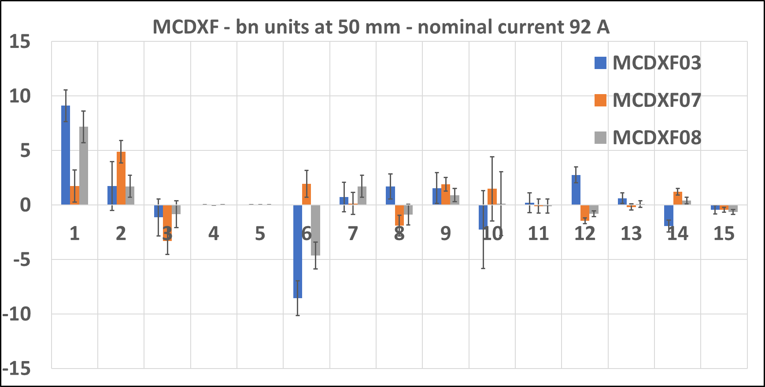
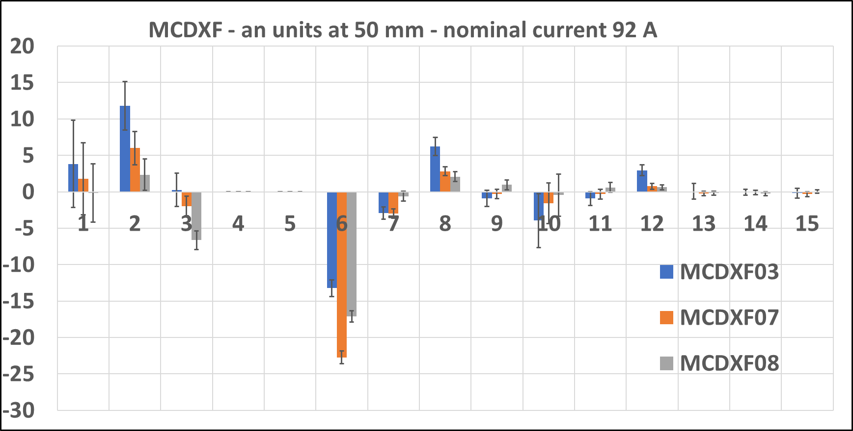
MCDXF02 (no measurement available)
Order | Magnet |  | Model | Measured at LASA
 |  | Current [A] | BdL [T mm] | BdL [T mm] | diff [%]
5 | MCDXF03 | 92 | 38.7 | 39.56 | 2.2
 | MCDXF07 |  |  | 39.60 | 2.3
 | MCDXF08 |  |  | 39.62 | 2.4

Slide 11
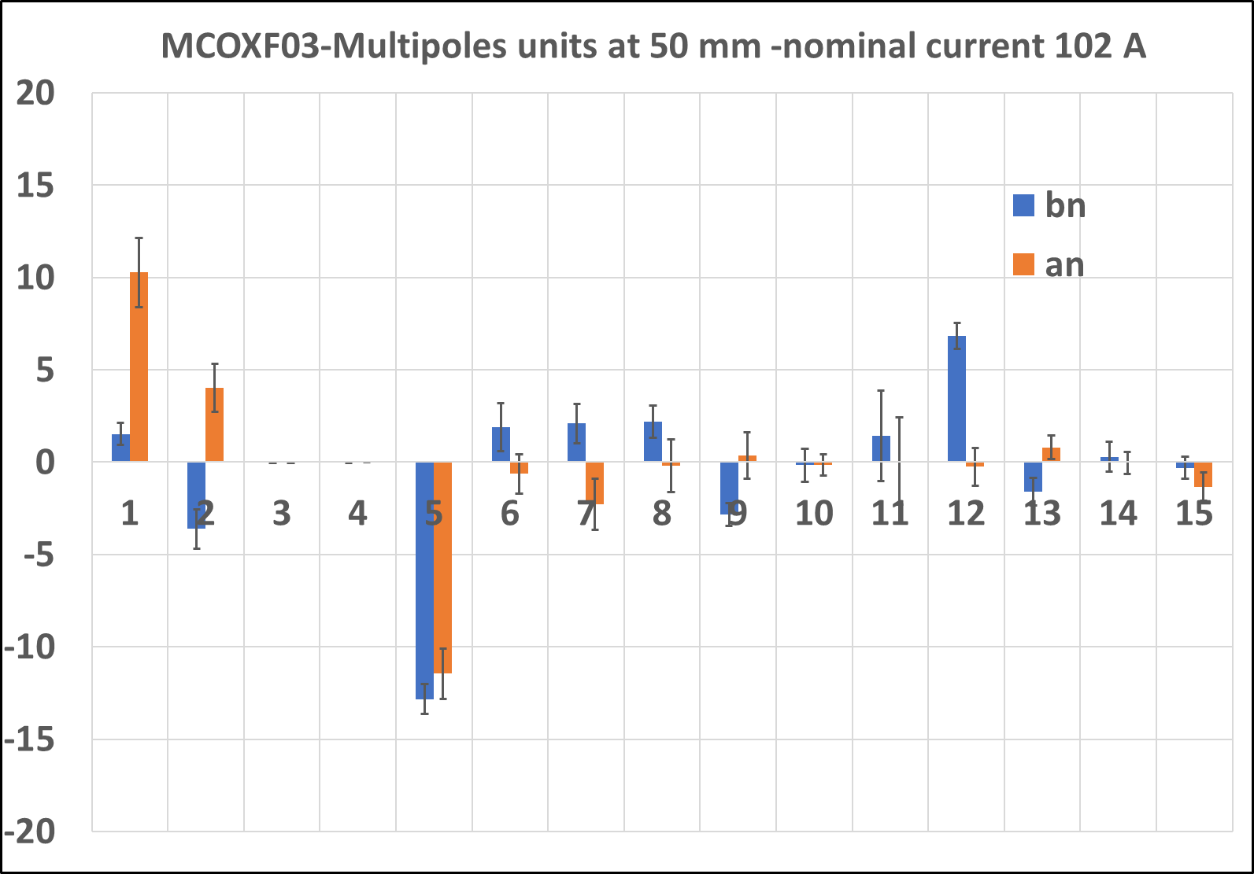
MCOXF03
Current[A] | BdL [Tmm] Calc. | BdL [Tmm] Meas. | Δ[%]
102 A 115 A | 70.7 75.7 | 71.6 77.2 | 1.3 1.9

Slide 12
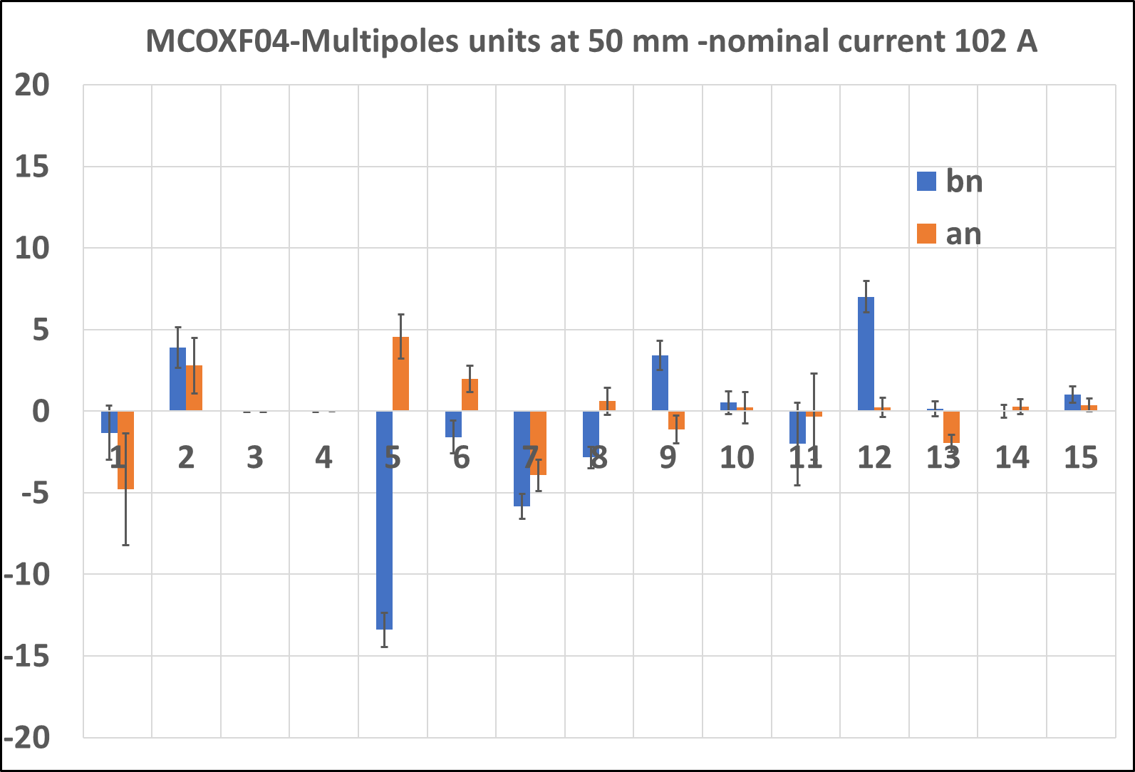
MCOXF04
Current[A] | BdL [Tmm] Calc. | BdL [Tmm] Meas. | Δ[%]
102 A 115 A | 70.7 75.7 | 71.5 76.4 | 1.2 1.0

Slide 13
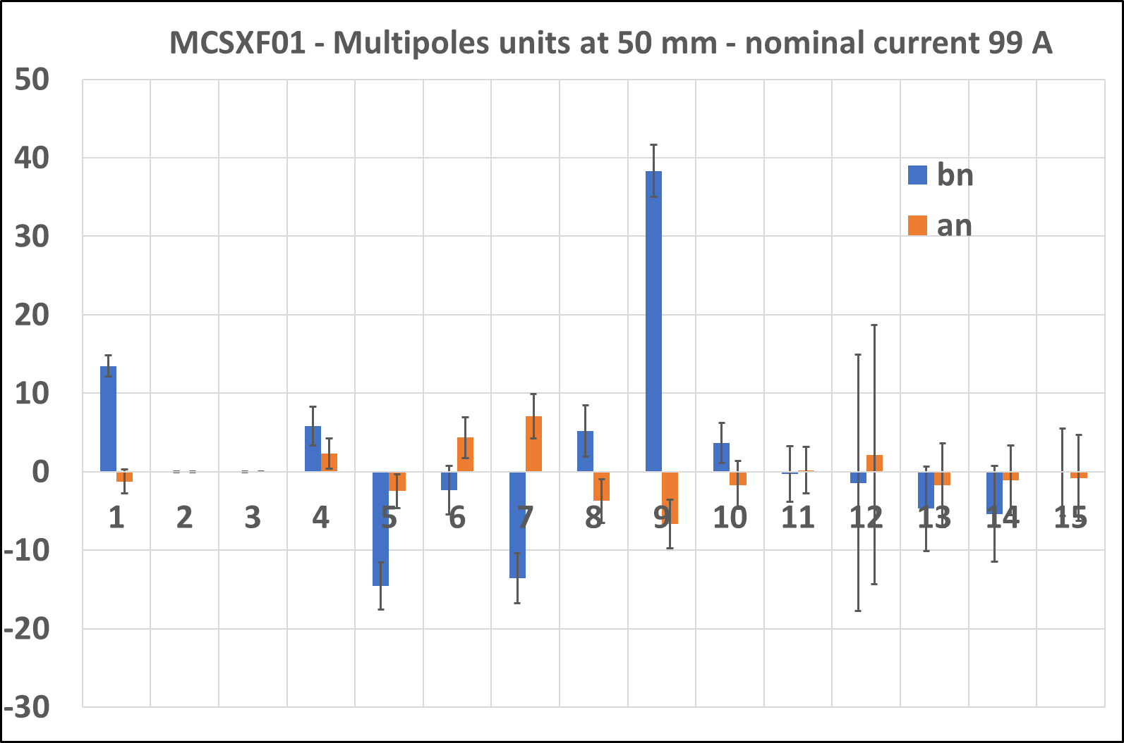
MCSXF01
Current[A] | BdL [Tmm] Calc. | BdL [Tmm] Meas. | Δ[%]
99 A 112 A | 93.5 100.4 | 95.3 101.8 | 1.9 1.4

Slide 14
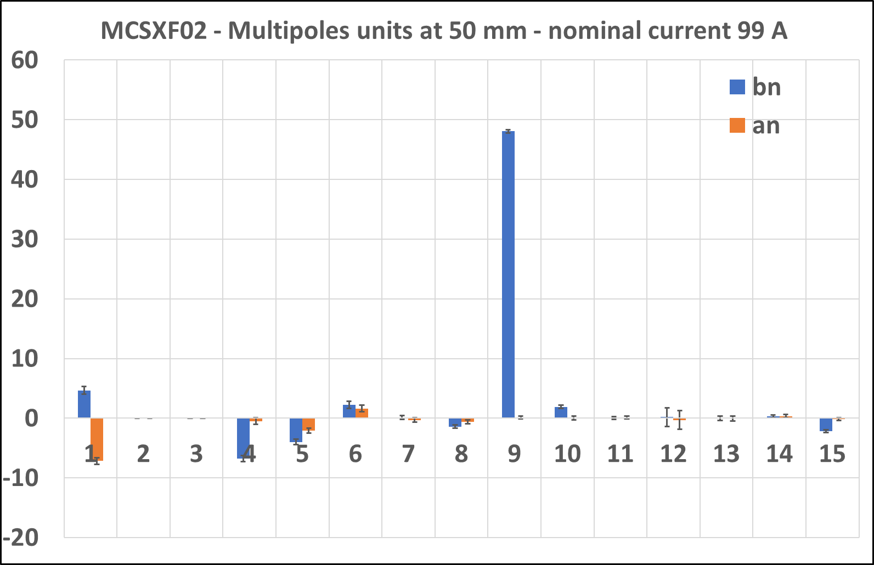
MCSXF02
Current[A] | BdL [Tmm] Calc. | BdL [Tmm] Meas. | Δ[%]
99 A 112 A | 93.5 100.5 | 95.2 101.8 | 1.8 1.3

