Slide 1
SAT at CERN for collimator supports - 16/12/2024
EDMS 3212394
Thibaut Parmentier

Slide 2
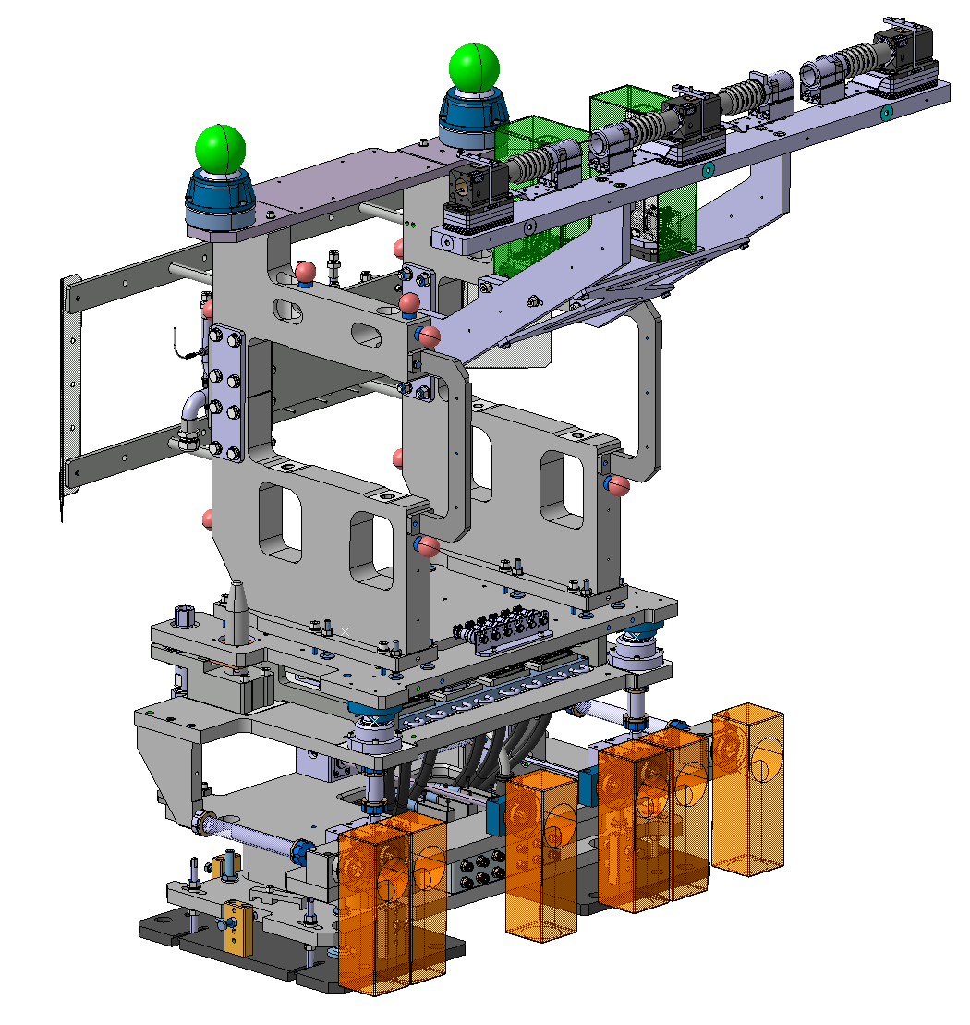
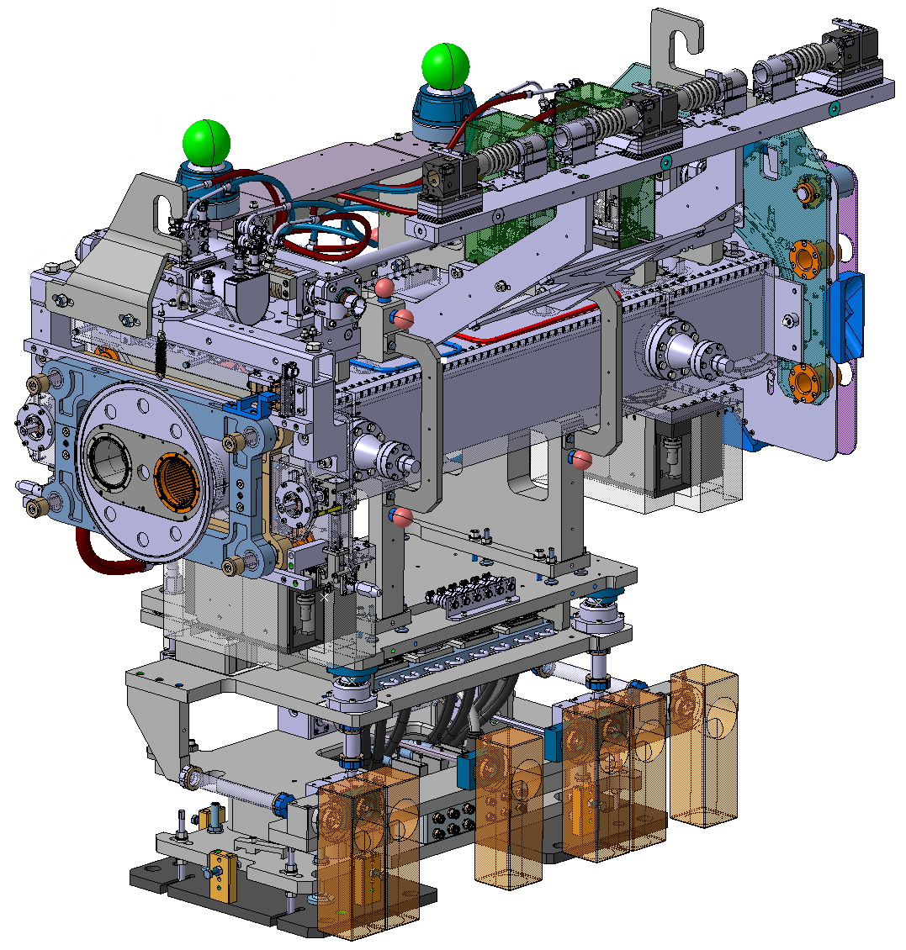
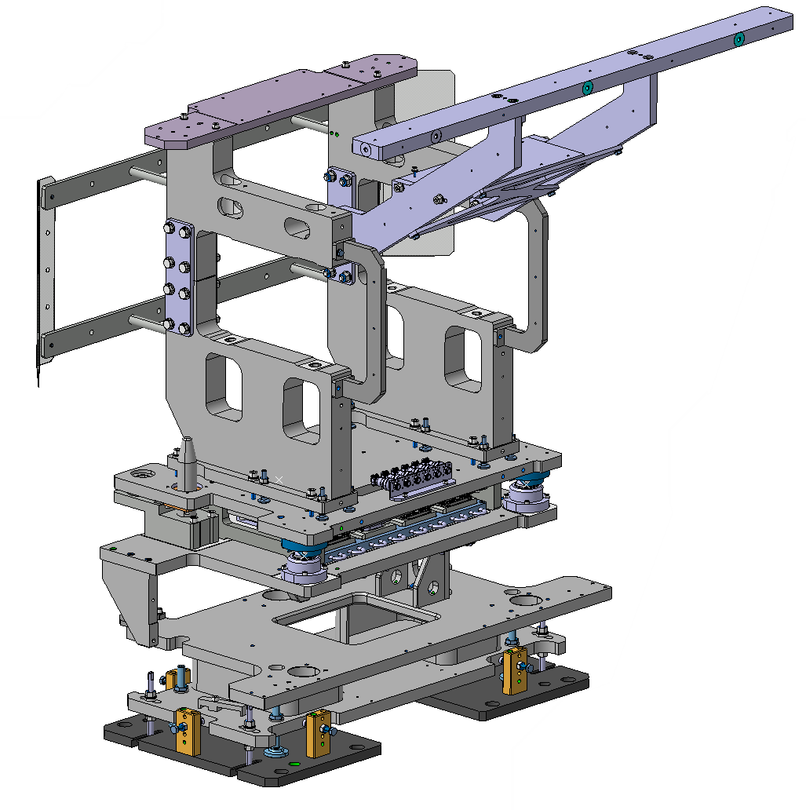
Supports for X-series and masks
Installed collimator (TCLPX)
Collimator support
Produced by MC Uldall

Slide 3
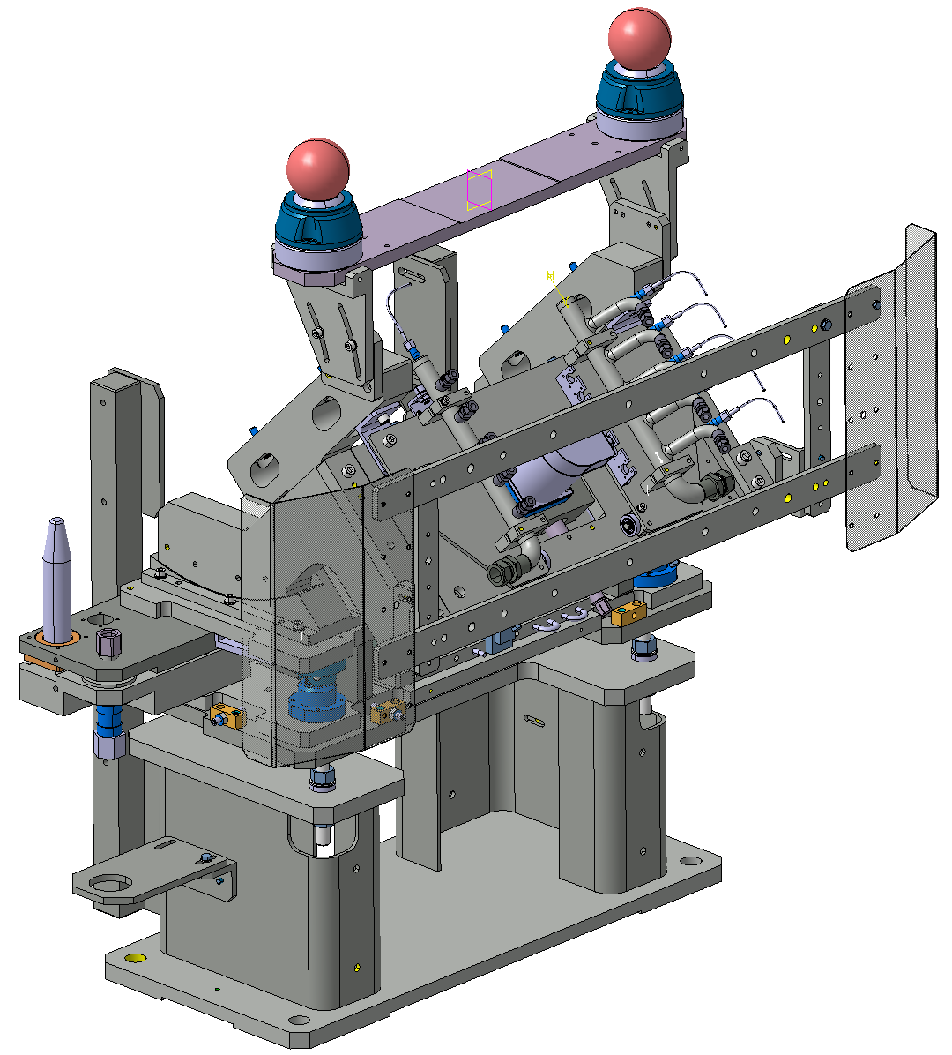
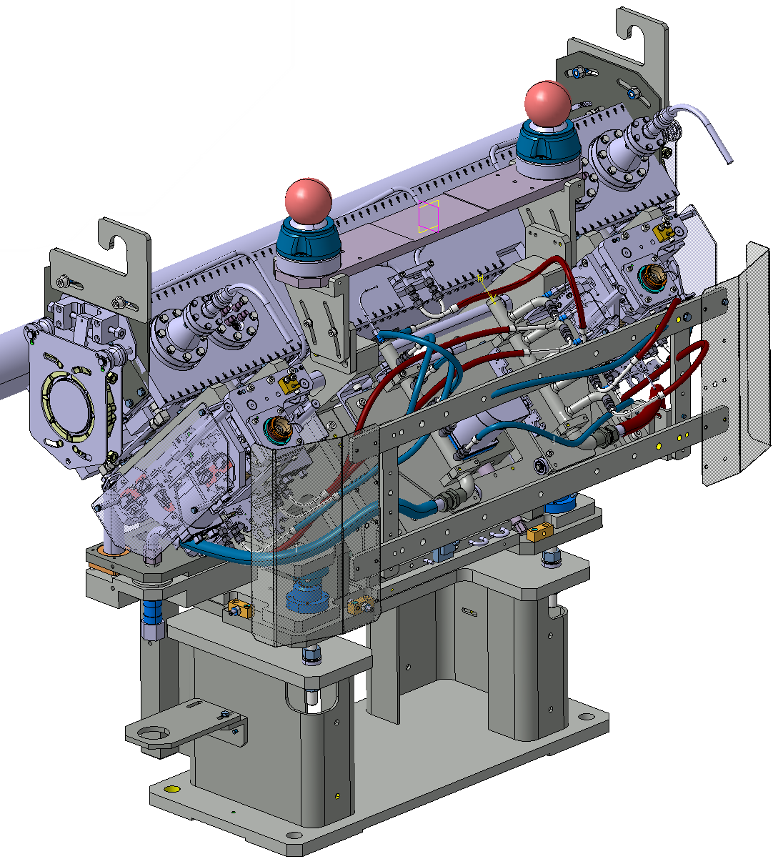
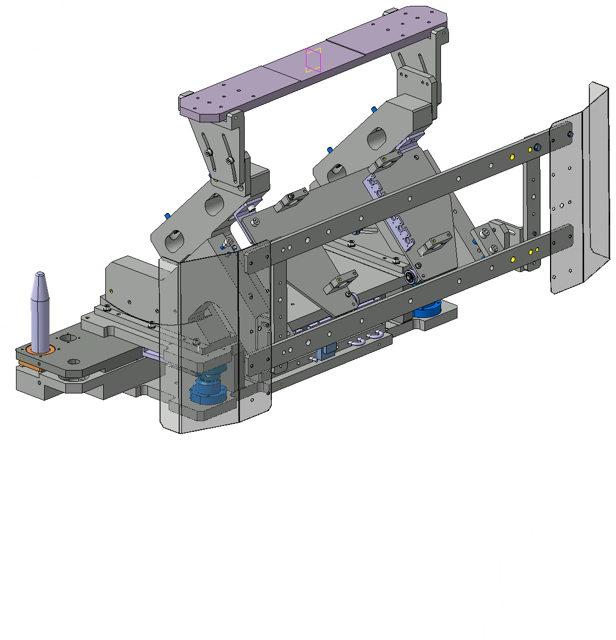
Supports for TCSPM and TCTPM
Installed collimator (TCSPM 45°)
Collimator support
Produced by MC Uldall

Slide 4
Schedule
Week 47 2024: Delivery of the Pre-series units
          3 Supports for X-series and masks
          1 Support for TCSPM
          7 Supports for tests at CERN
          Loose parts for linear stage
Week 27 2025: Delivery of the Series units
          28 Supports for X-series and masks
          11 Supports for TCSPM
          10 Supports for TCTPM

Slide 5
Description of the SAT
Reception and inventory
Assembly of a linear stage & TCSPM support
Mounting of commercial components
Insertion tests

Slide 6
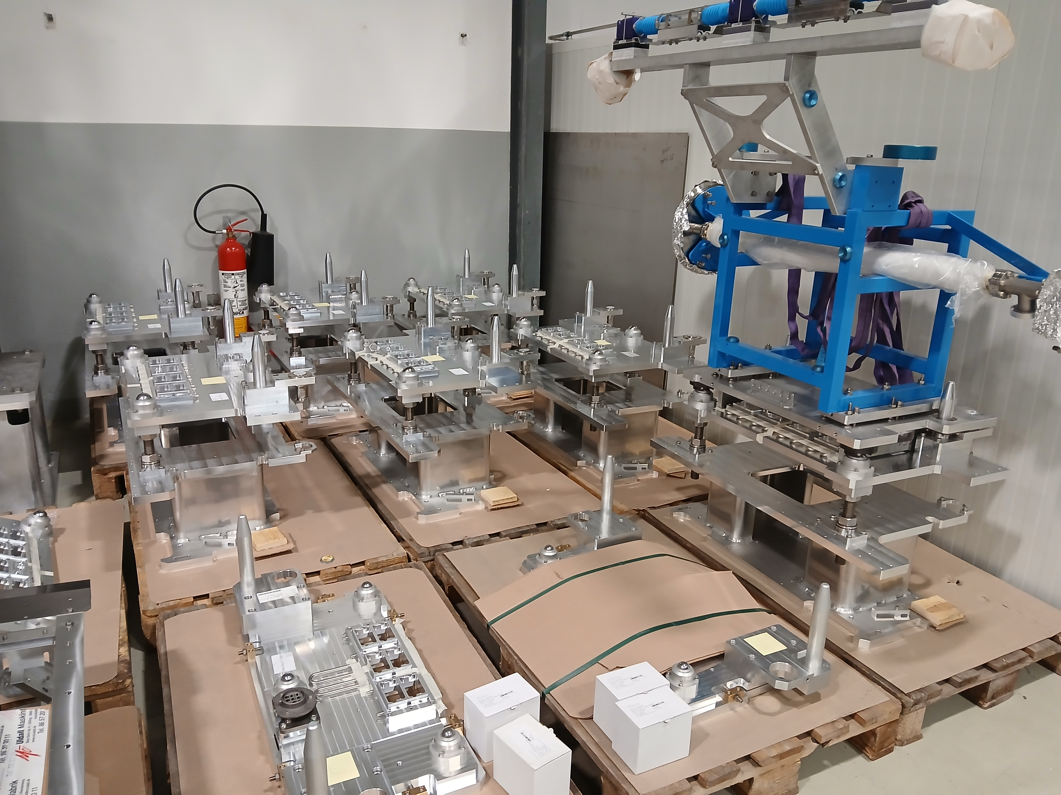
Description of the SAT
Reception and inventory

Slide 7
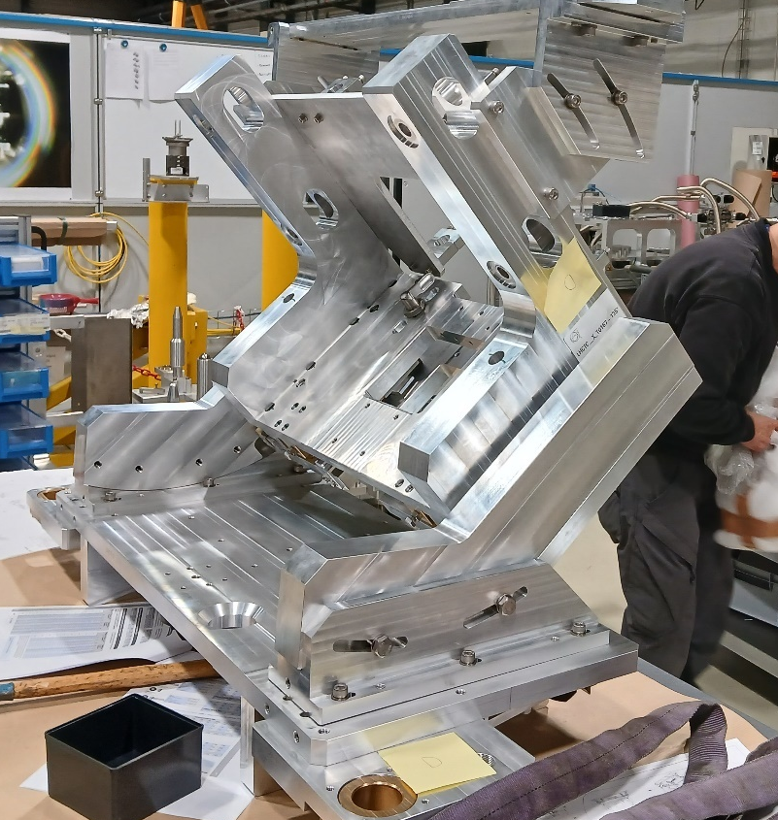
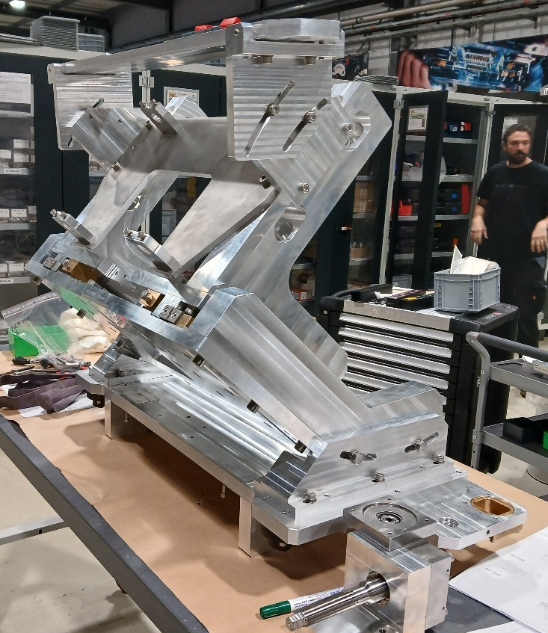
Description of the SAT
Assembly of a linear stage & TCSPM support

Slide 8
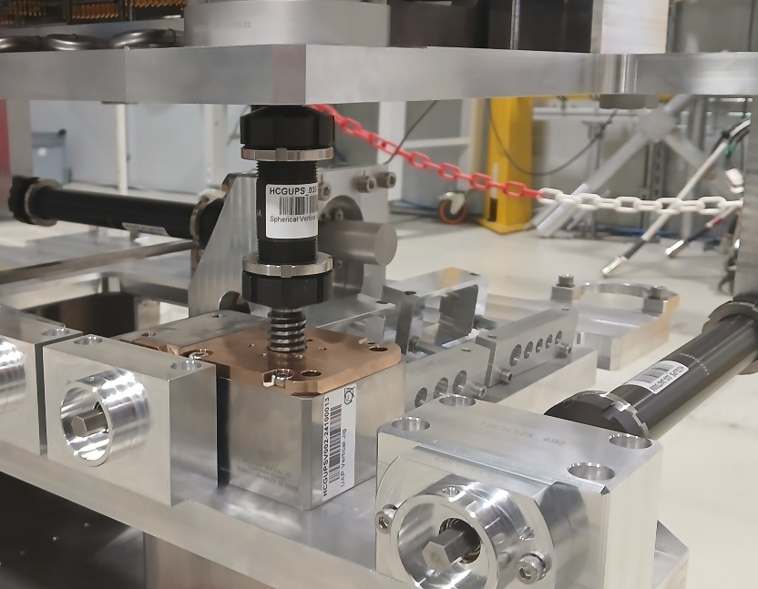
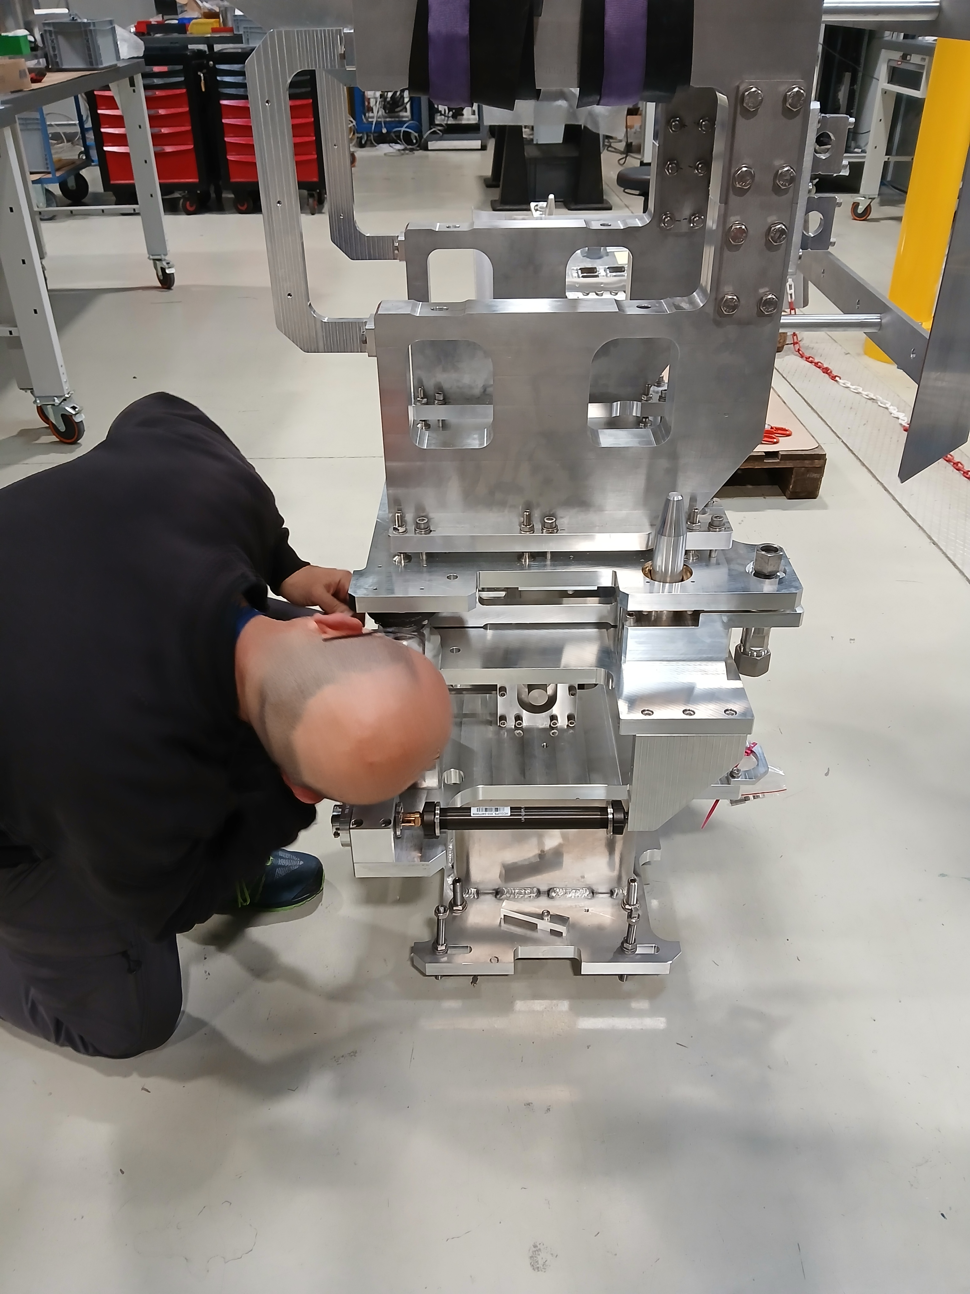
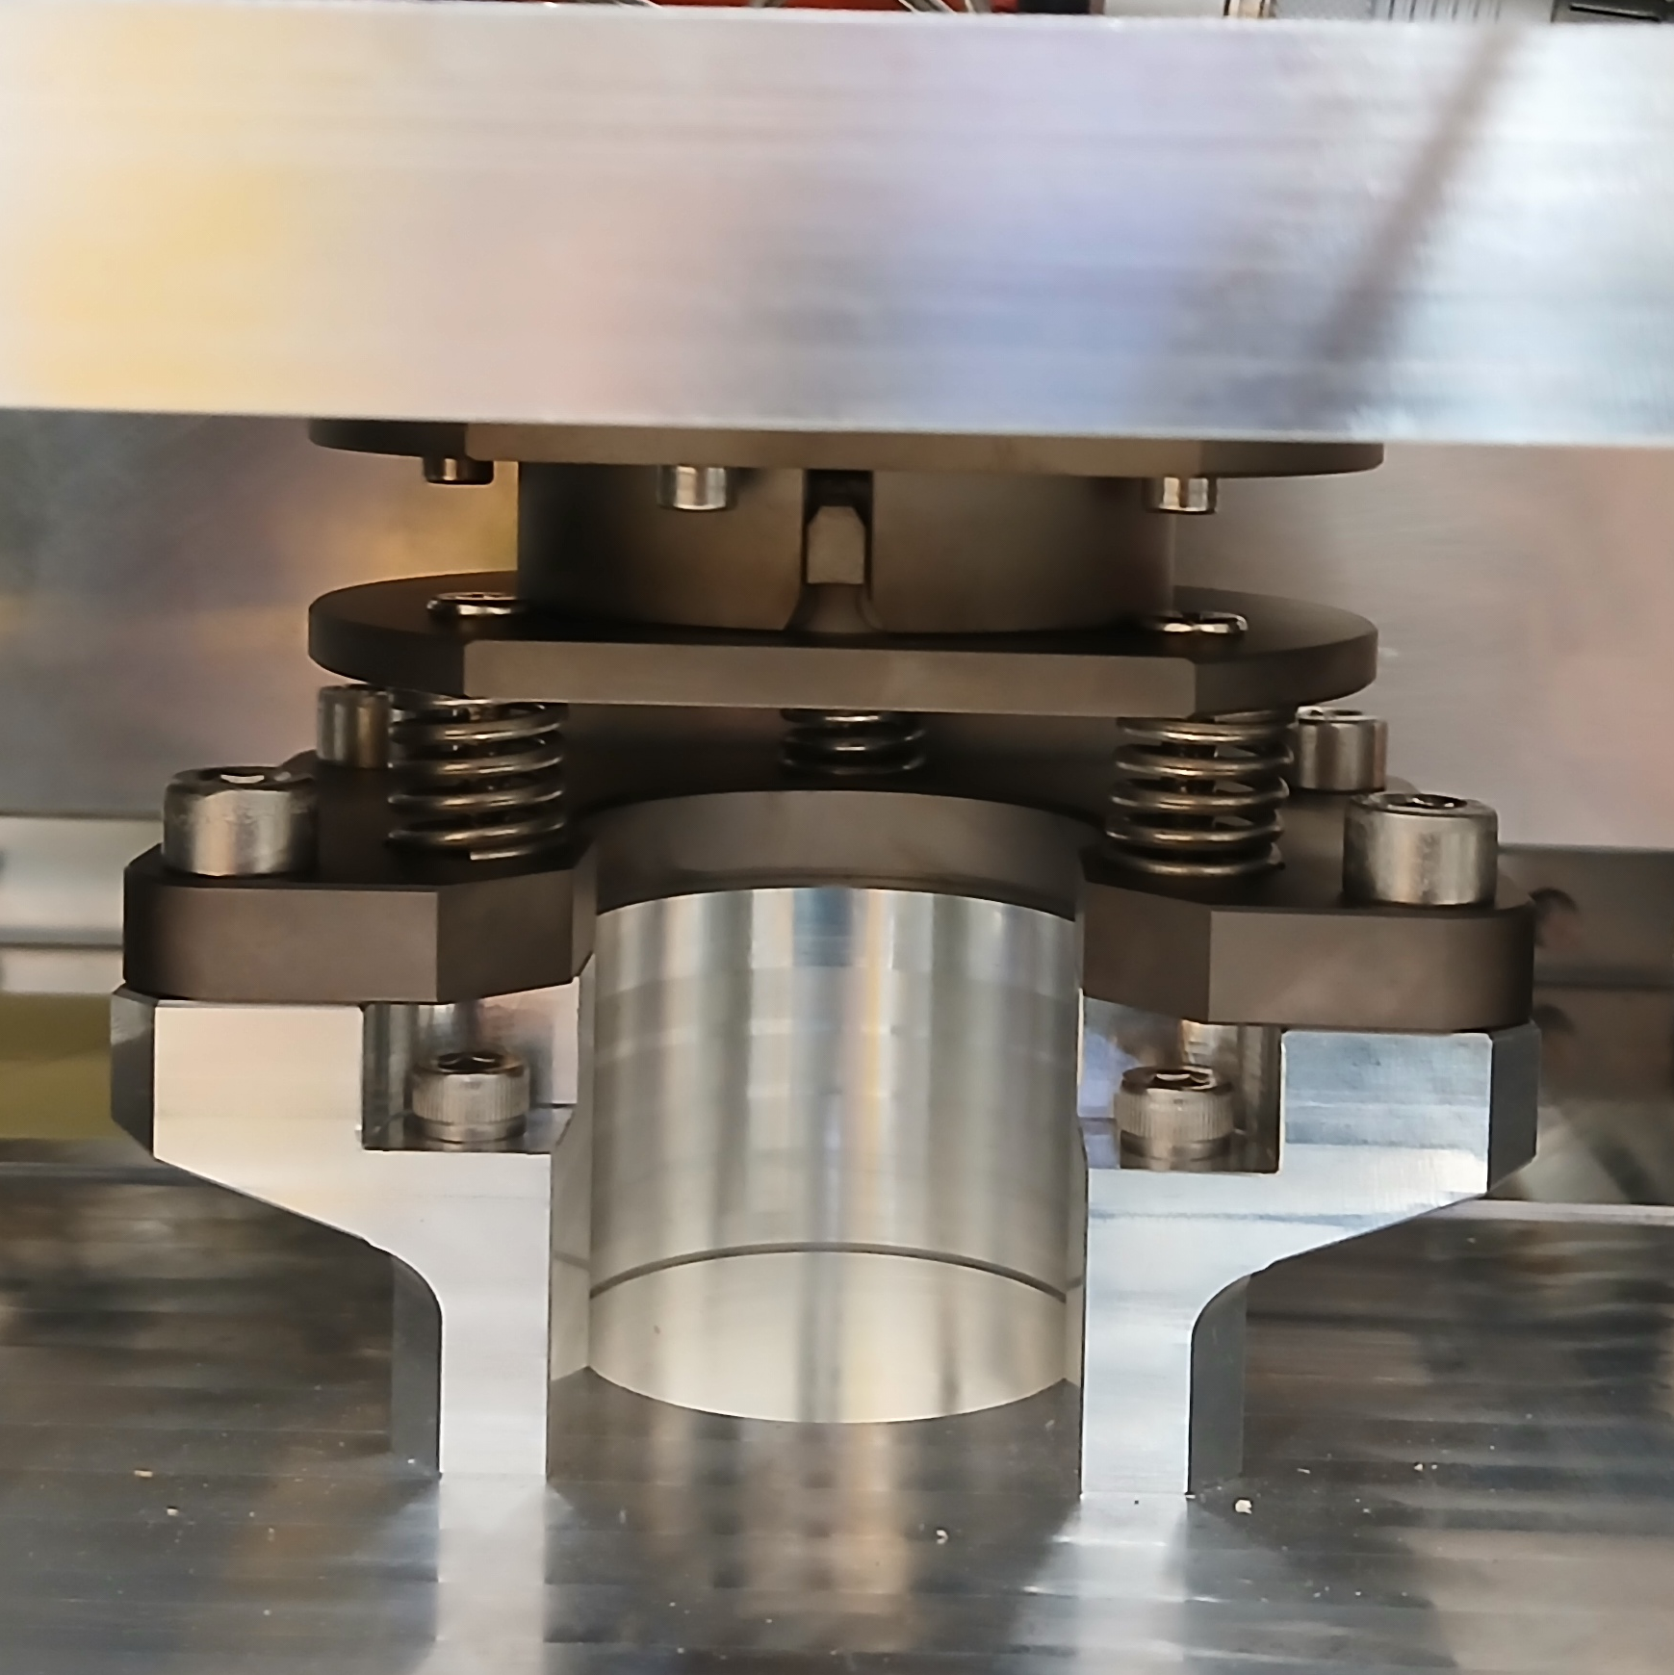
Description of the SAT
Mounting of commercial components

Slide 9
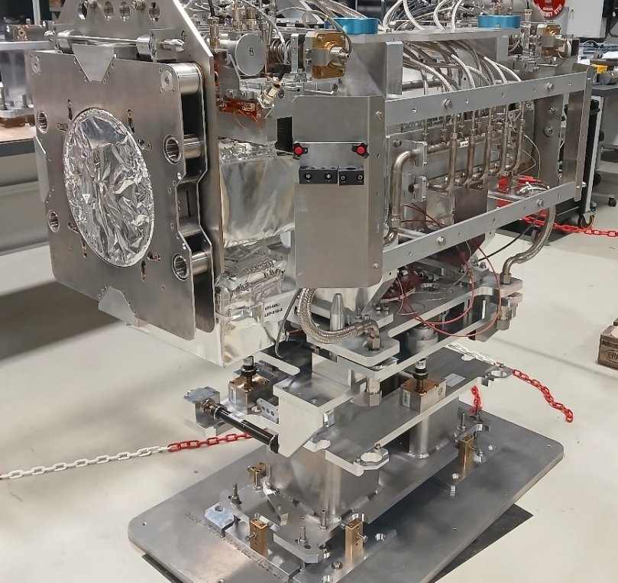
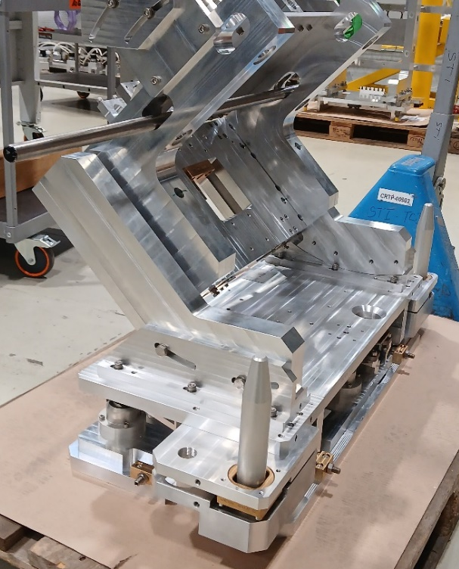
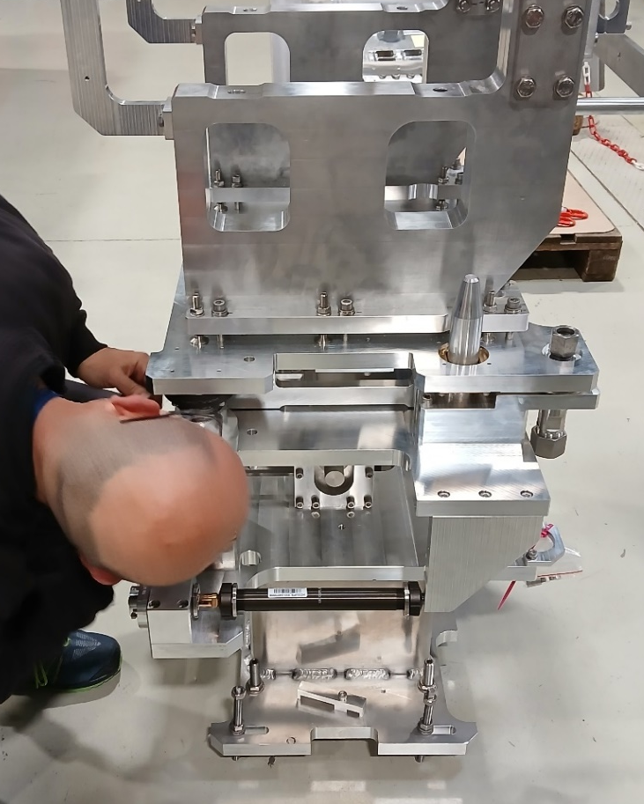
Description of the SAT
Insertion tests

Slide 10
Next steps
Remarks for the series production
Acceptance of the pre-series and green light for the series production
Storage

Slide 11
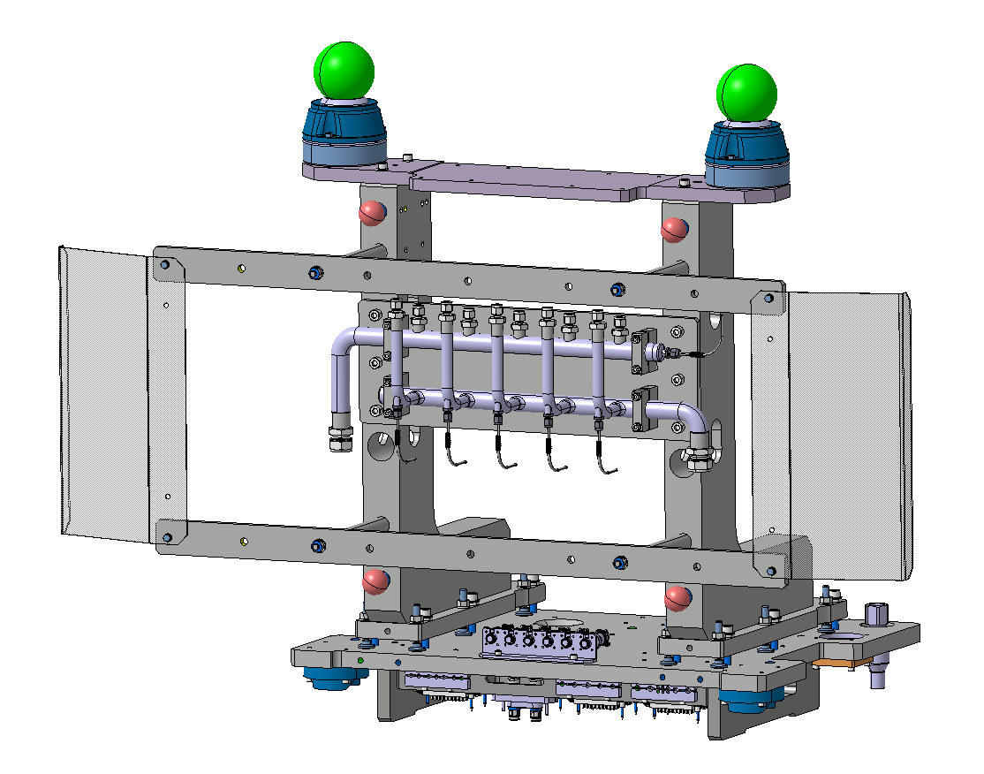
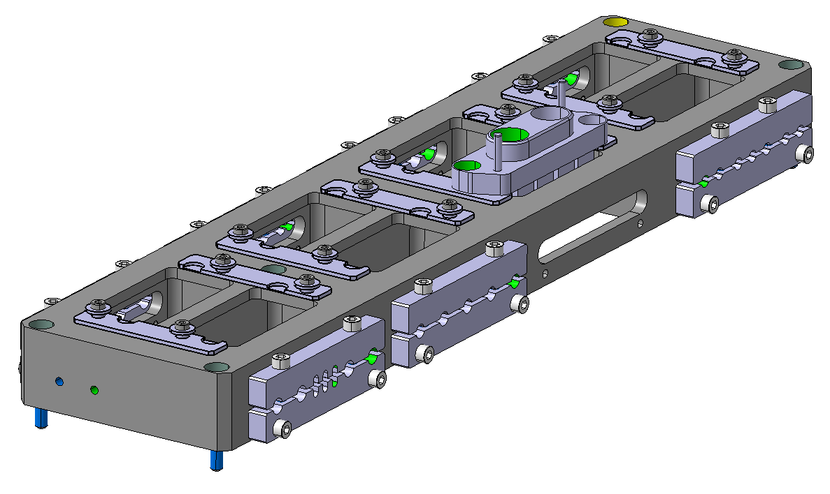
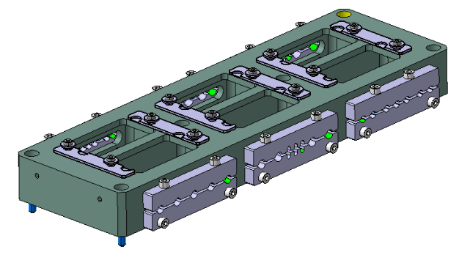
Next steps
Remarks for the series production
  Partial delivery, order to be defined
  Compression of assemblies for shipment
  Hypertack patch panels to be sent separately
  Modification for GM reflectors on TCTPXH supports

Slide 12
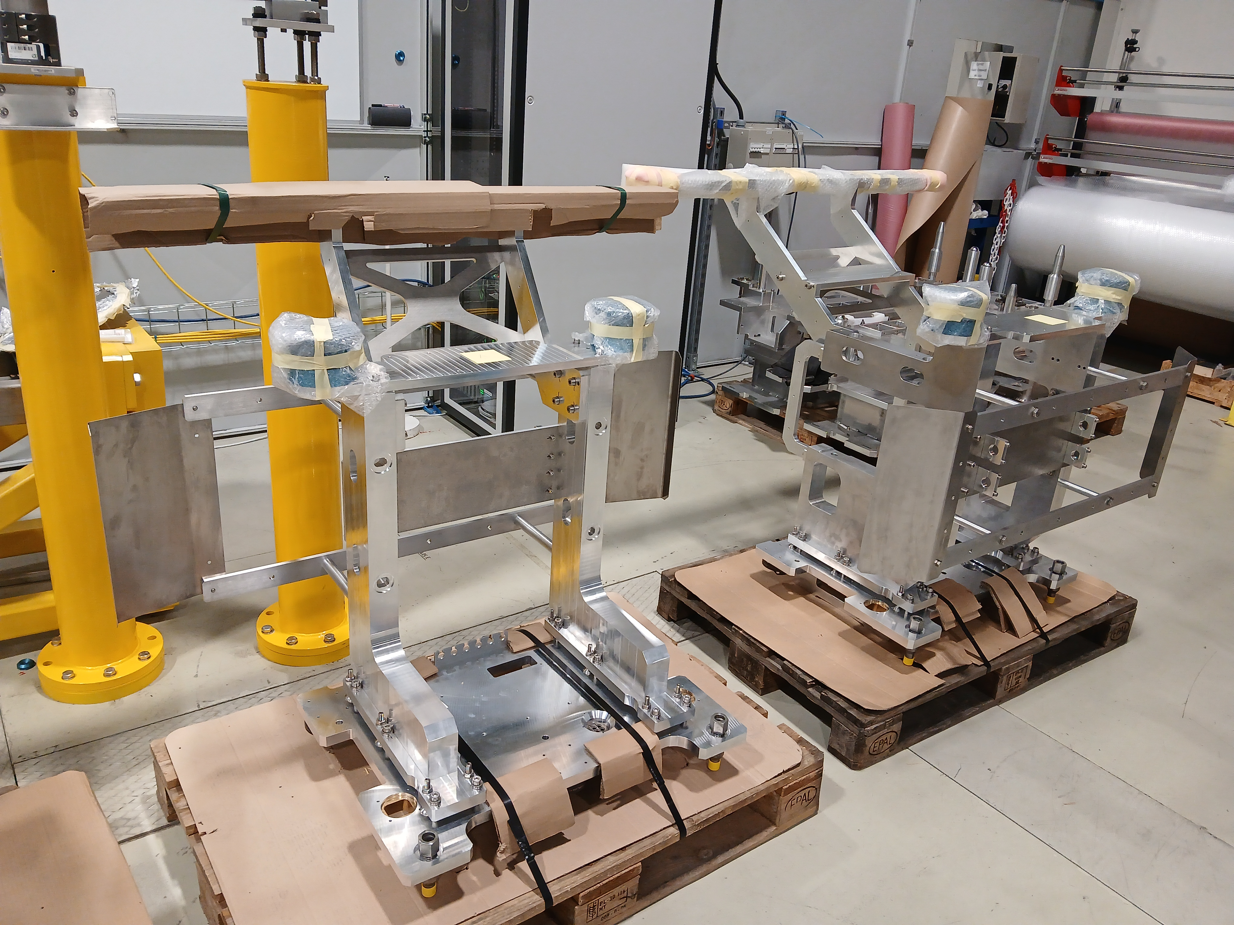
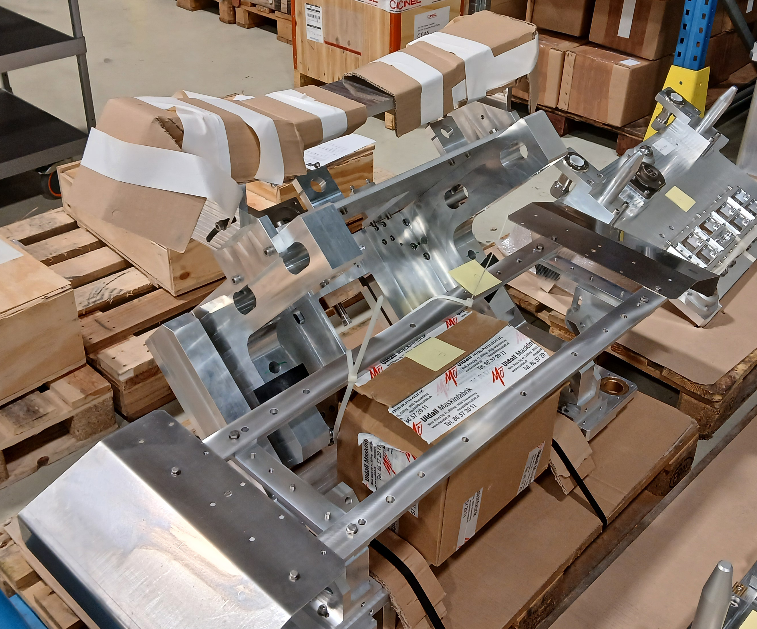
Next steps
Acceptance of the pre-series and green light for the series production
  Pre-series acceptance: end of week 51
  Green light series production: 04/12/2024
Storage

Slide 13
Questions

