Slide 1

WP5.2 – Transport Analysis Collimator Jaws
L. Hannemann, F. Carra, L. Puddu
16/12/2024

Slide 2
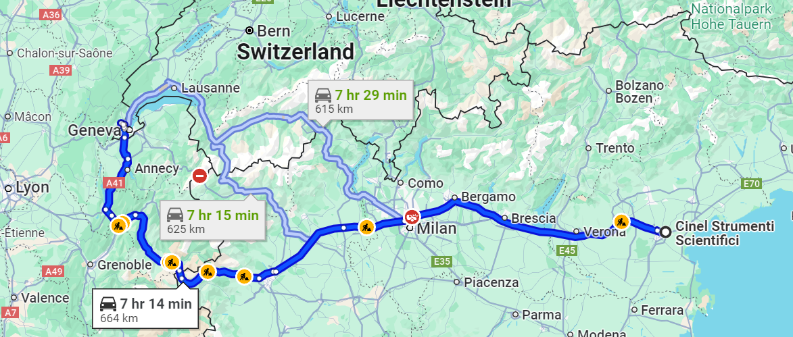
Background – Need for Simulation
Collimator production at CINEL, Italy
Street transport of produced collimators to CERN

Slide 3
Purpose of the Simulation
1. Identify Imposed Loads:
  Goal: Understand the mechanical loads and stresses applied to the collimators during street transport.
2. Assess Structural Integrity:
  Critical Element Identification: Pinpoint the most vulnerable parts of the collimator system.
  Damage Assessment: Ensure the collimators can withstand transportation without suffering damage or deformation.
3. Find suitable transportation frame

Slide 4
Critical Element Identification
Initial Focus:
  Jaw selected as primary component for assessment (importance and vulnerability).
Broader Considerations:
  Other critical components: e.g., parallel “drift tube” in 2-in-1 collimators or RF fingers.
Flexible Approach:
  Open to expanding analysis for comprehensive transport readiness.

Slide 5
TCLP Analysis and Future Considerations
TCLP as First Analysis: benchmarking the analysis procedure
Further Considerations
  TCSPM Jaws: To be analysed later due to the delicate nature of the graphite jaw material.
  TCSP Jaws
  TCLPX Jaws: Less critical due to the bulkiness of the design, though will be reviewed for completeness.

Slide 6
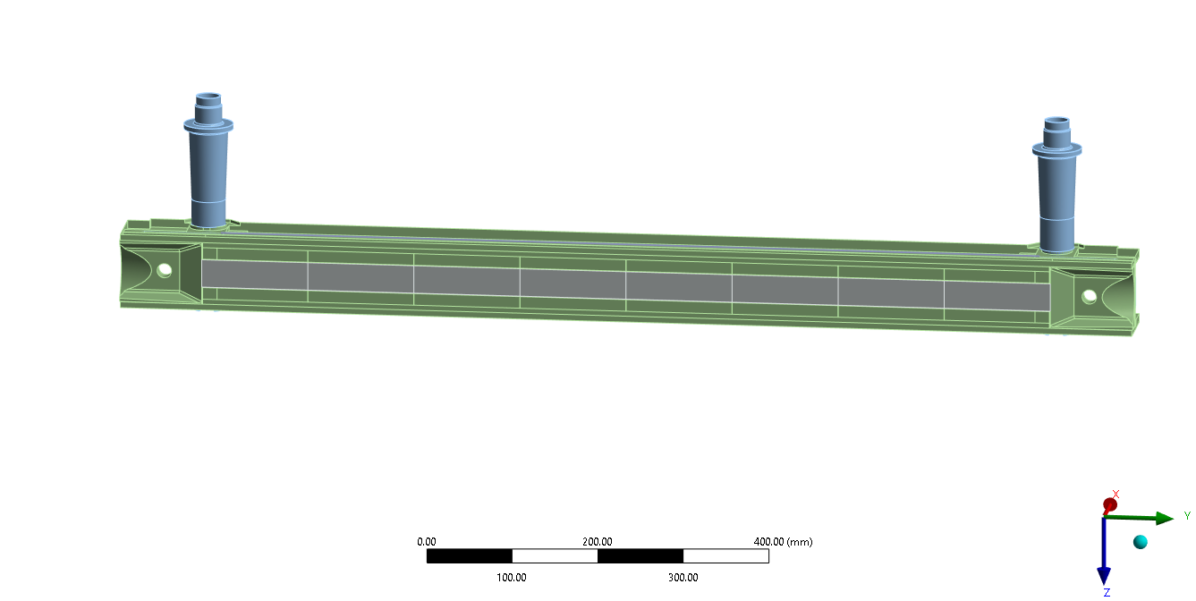
Background – Collimator Setup TCLP
TCLP Collimator cross Section
Jaw with shafts in vertical orientation
shafts
tapering
Absorber blocks
Clamping system
Assembly: The jaws are fixed to two shafts and are positioned within a housing.
Orientation: Vertical orientation during transport.

Slide 7
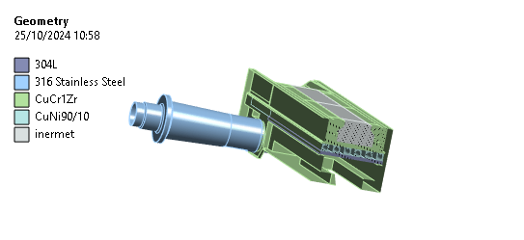
Material Properties TCLP and Collimator Setup
Material | Yield Strength [MPa] | Ultimate Strength [MPa]
Steel 304 L | 210 | 515
Steel 316L | 205 | 515
CuCr1Zr | 293 | 510
CuNi90/10 | 109.2 | 319.5
Inermet180 | 613 | 681

Slide 8
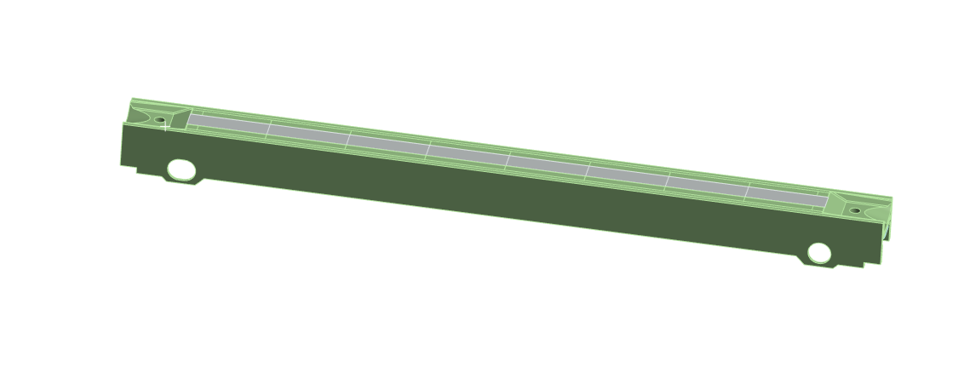
First Step: Modal Analysis
Jaw without shafts
Objective of Simulation:
  Conduct a modal analysis on the jaw without the shaft to evaluate its vibrational characteristics.
Reasoning:
  Benchmark simulation results against real measurements on a jaw in the same condition.
  Validate the accuracy of the simulation through comparison with actual data.
Expected Outcome:
  If the simulation accurately reflects real measurements, it confirms the reliability of further vibrational analysis.
  A successful modal benchmarking provides confidence that subsequent simulations will accurately predict vibrational behavior.

Slide 9
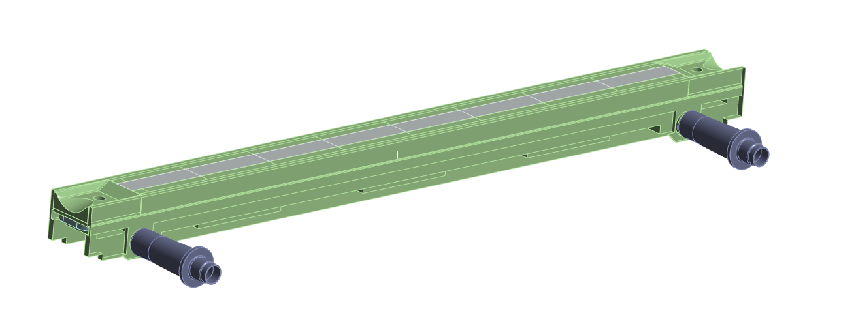
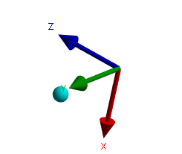
TCLP Jaw with shaft: Simulation Setup
Static Structural
Modal Analysis
Random Vibrations

Slide 10
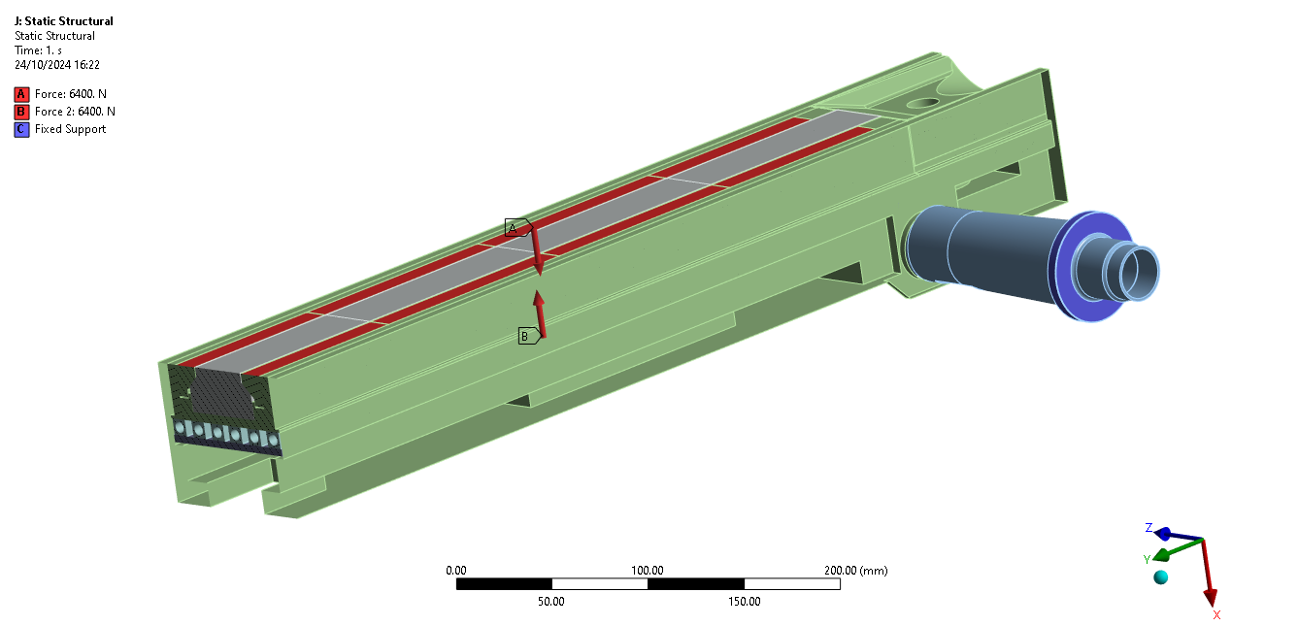
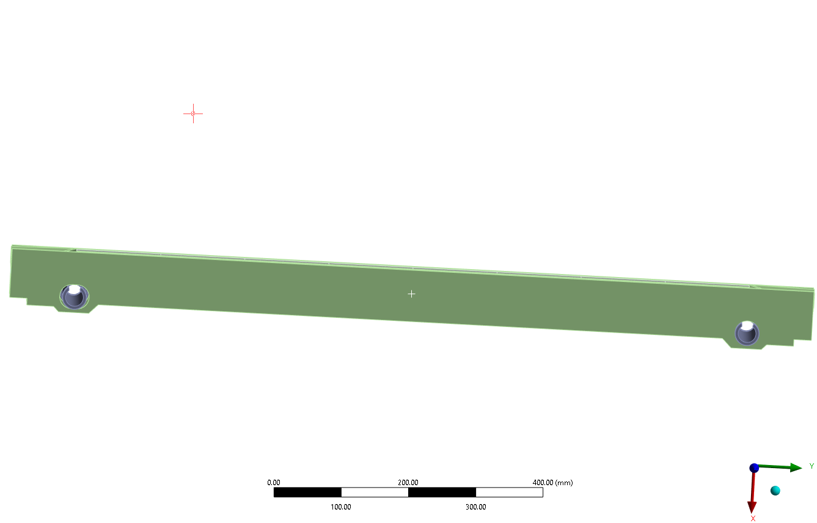
Boundary Conditions and Assumptions
1. Forces Applied:
  Two forces (64KN) are simulated to represent the clamping system on the blocks.
  2. Fixed Support:
  Fixed support is applied where the shafts are connected to the collimator setup.
DoF:
Rotational and translational
Rotational

Slide 11
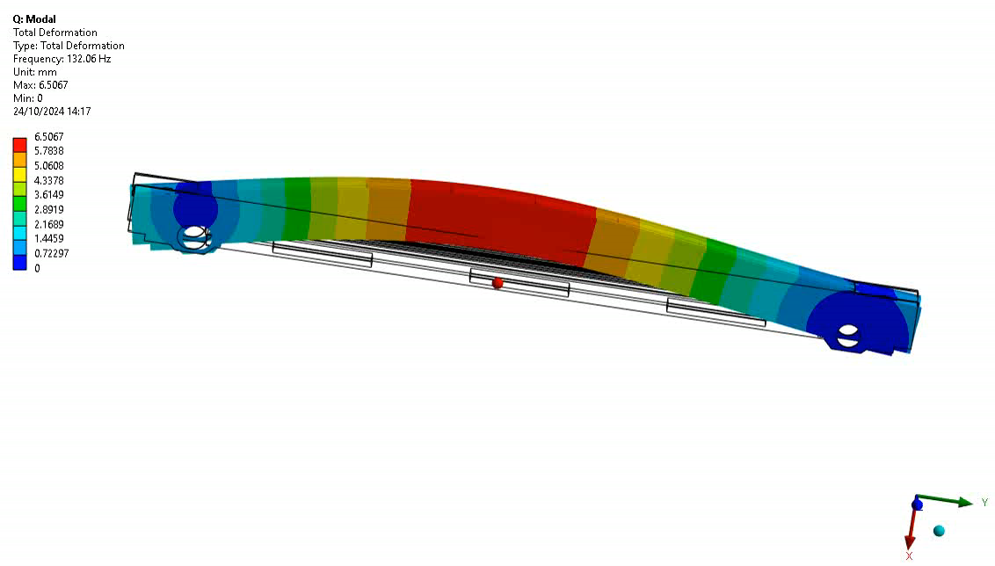
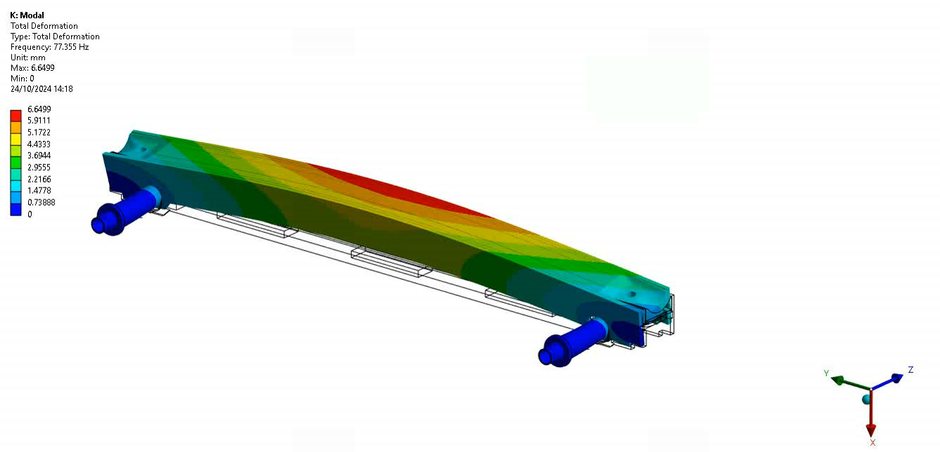
First Bending Modes
Jaw without shaft
Jaw with shaft
First bending moment: 132Hz
First bending moment: 77Hz

Slide 12
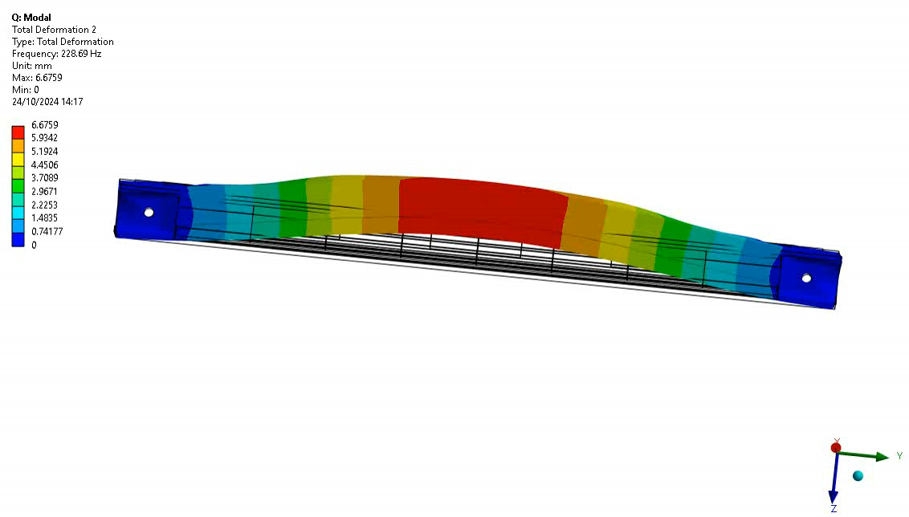
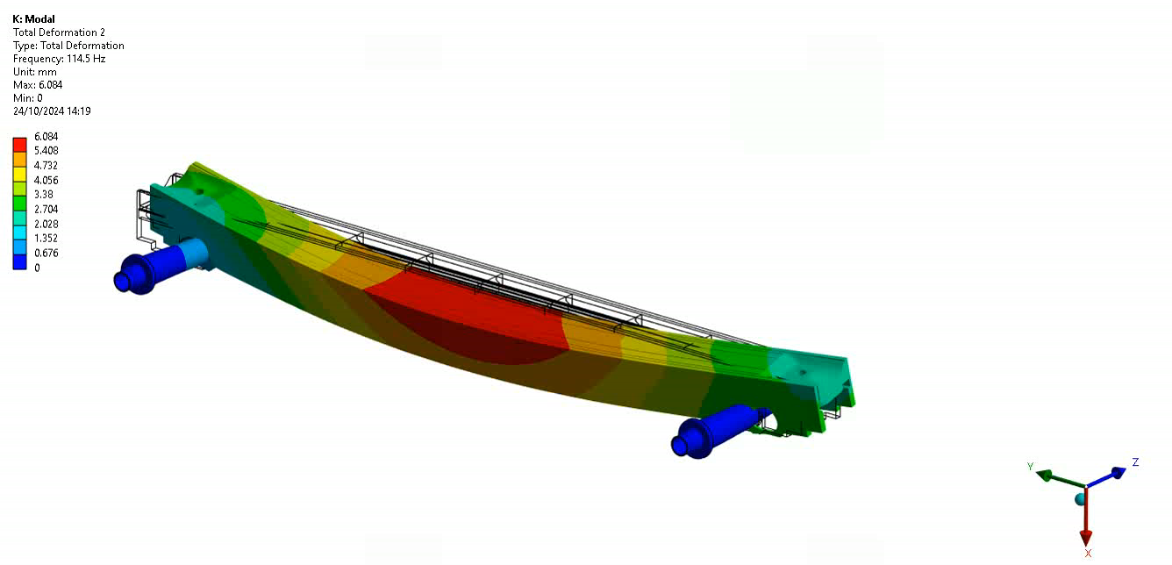
Second Bending Modes
Jaw without shaft
Jaw with shaft
Second bending moment: 228 Hz
Second bending moment: 114 Hz

Slide 13
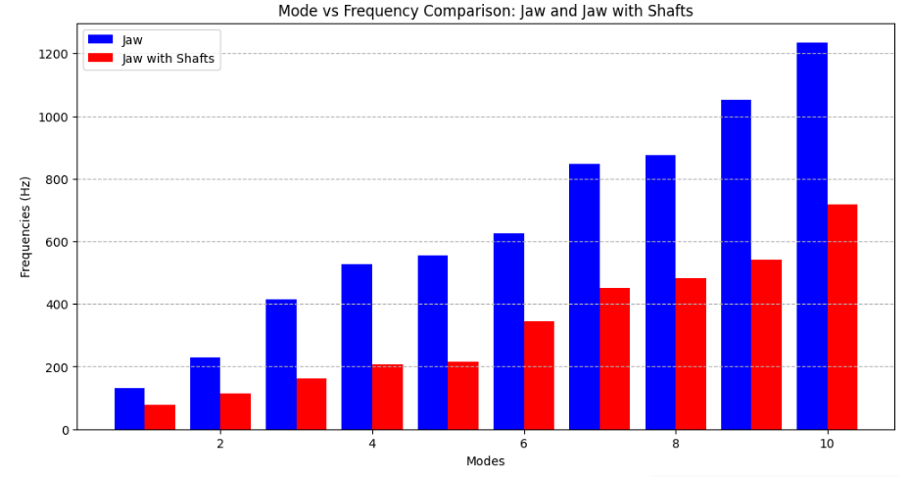
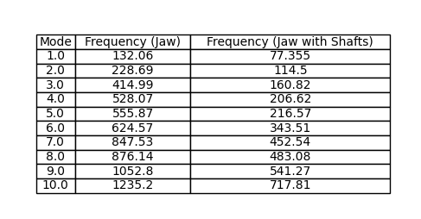
Results Modal Analysis
Natural Frequencies
Observation: Modes with the shaft are approximately 50% smaller compared to the modes without the shaft.
Next Steps: We will continue the analysis focusing on the jaws with the shaft.

Slide 14
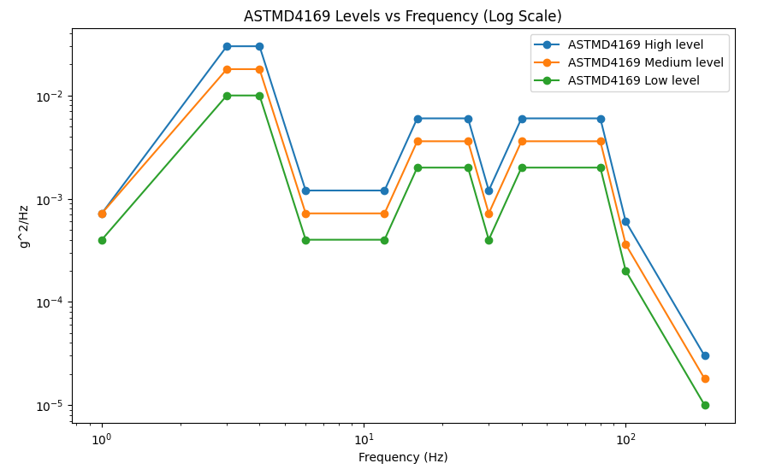
Random Vibrations – PSD Norm Input
Acceleration PSD
Input
Random Vibrations
ASTMD4169 Norm
Evaluate the durability of packaging for products transported by road (trucks, vans, etc.)
3 PSD levels provided by standard
High level PSD applied in z-direction on the shafts.

Slide 15
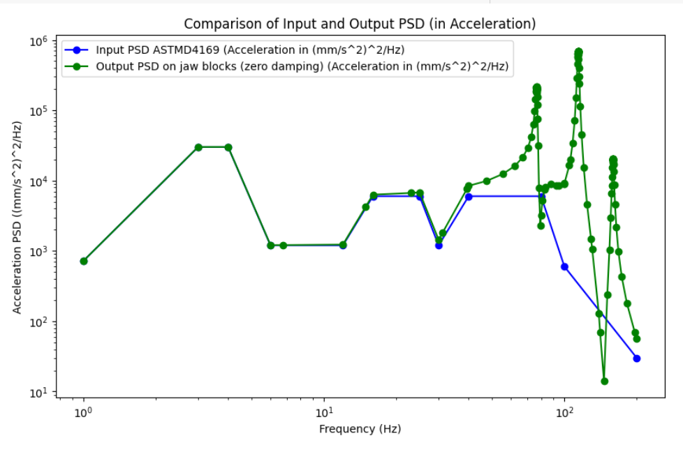
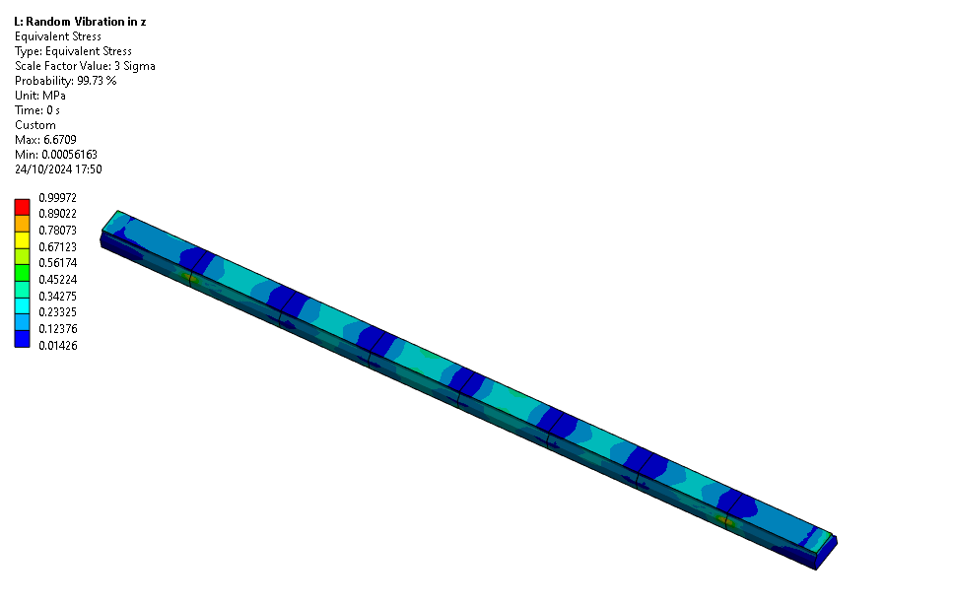
Stress on Blocks for ASTMD4169 Input
Z-Direction
Maximum stress:
1 MPa for a scale factor of 3 sigma

Slide 16
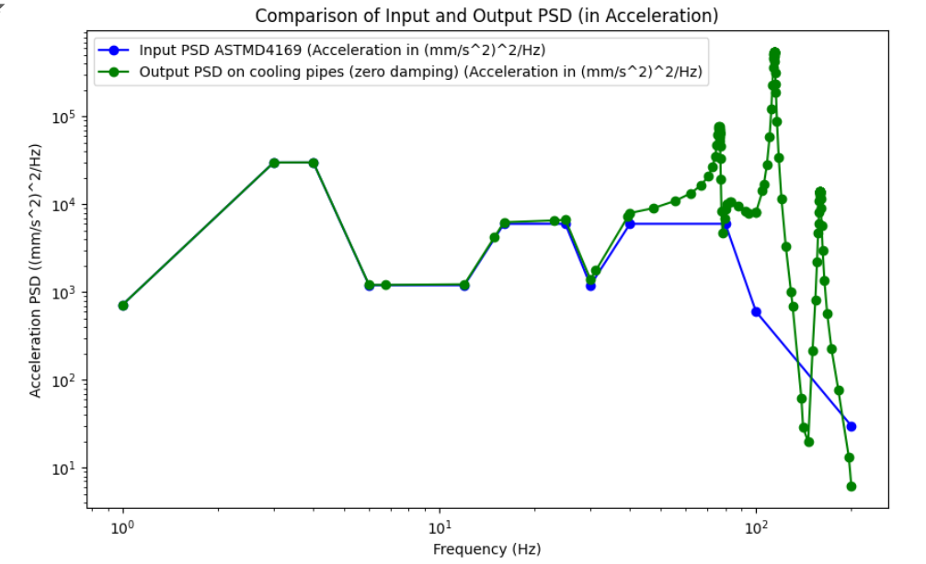
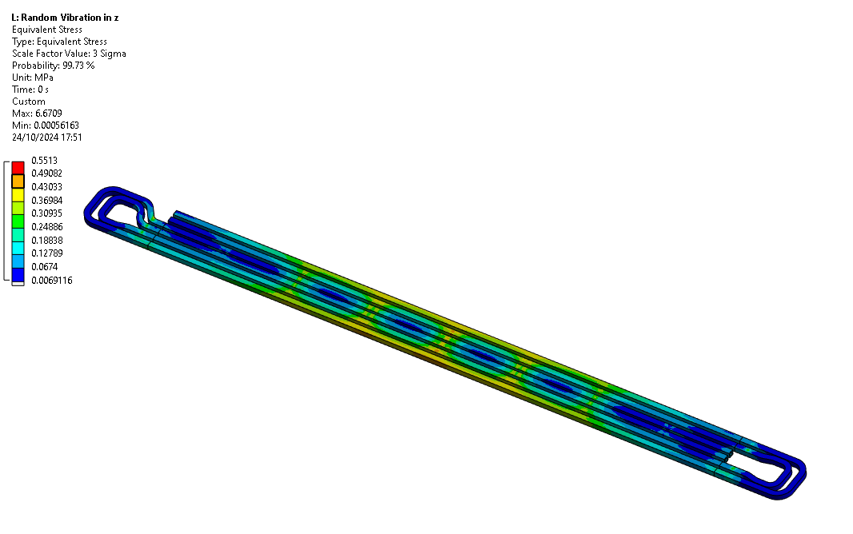
Stress on Blocks for ASTMD4169 Input
Z-Direction
Maximum stress:
0.5 MPa for a scale factor of 3 sigma

Slide 17
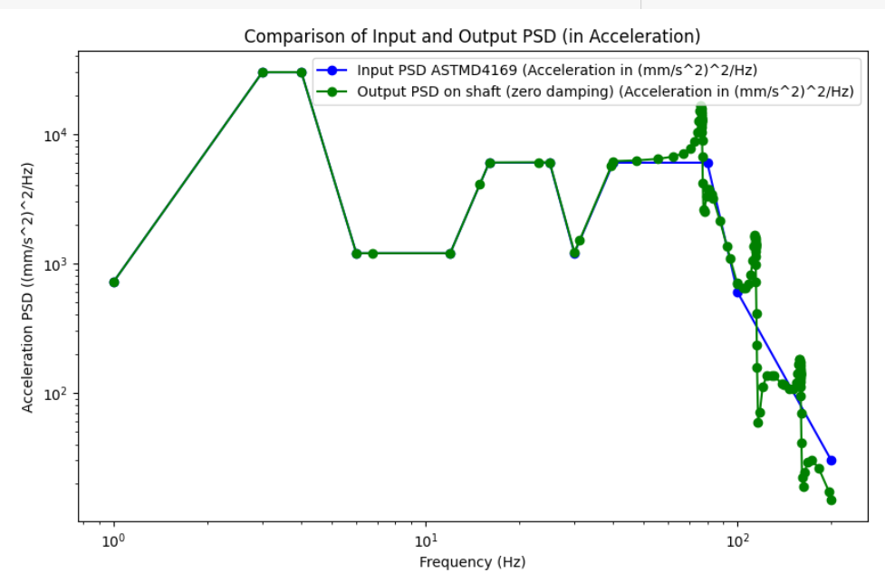
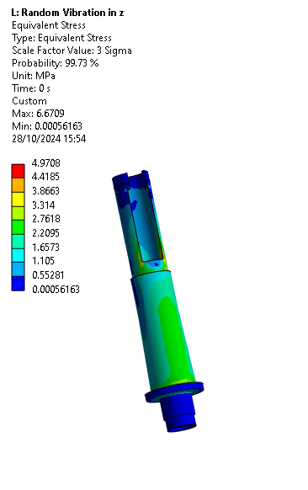
Stress on Shafts for ASTMD4169 Input
Z-Direction
Maximum stress:
5 MPa for a scale factor of 3 sigma

Slide 18
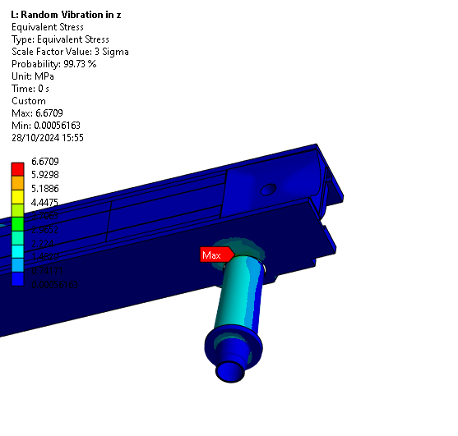
Max Stress for ASTMD4169 Input
Maximum overall stress:
6.7 MPa for a scale factor of 3 sigma

Slide 19
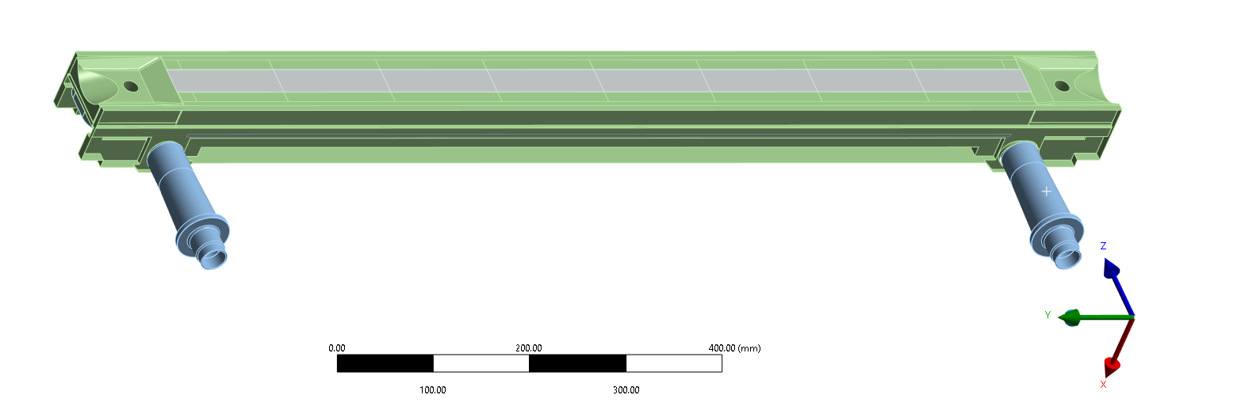
Comparison ASTMD4169 Input
Z- and X- direction
 | Directional Deformation in x-direction [mm] | Directional deformation in z- direction [mm]
Blocks | 0.095 | 0.026
Shaft | 0.05 | 0.002
Cooling pipes | 0.1 | 0.01

Slide 20
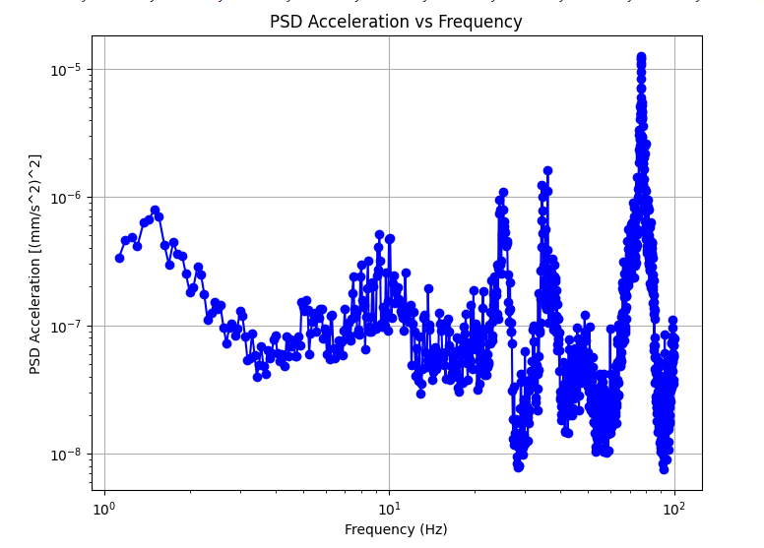
Random Vibrations – Experimental Input
EDMS reference: https://edms.cern.ch/document/2755675/2
Maximum PSD acceleration on the frame of the cryomodule in z-direction
Acceleration PSD
Input
Random Vibrations

Slide 21
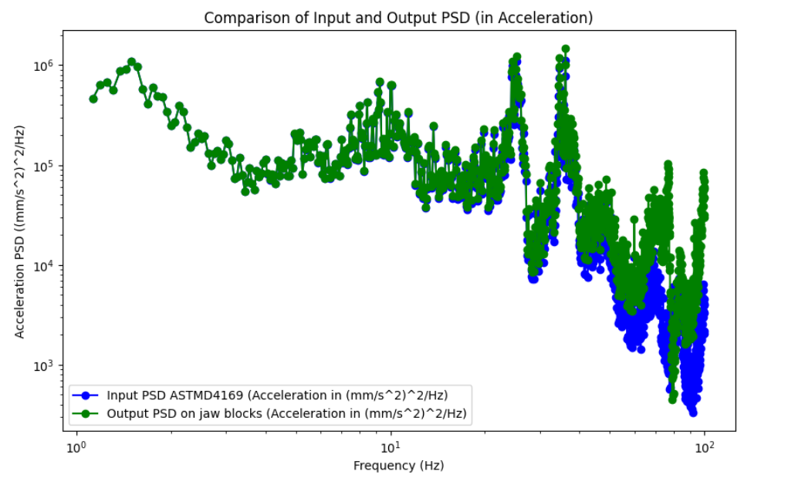
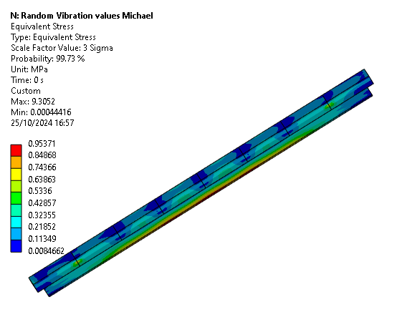
Stress on Blocks for Z-Frame Input
Max. equivalent stress: 1MPa for 3 sigma scaling

Slide 22
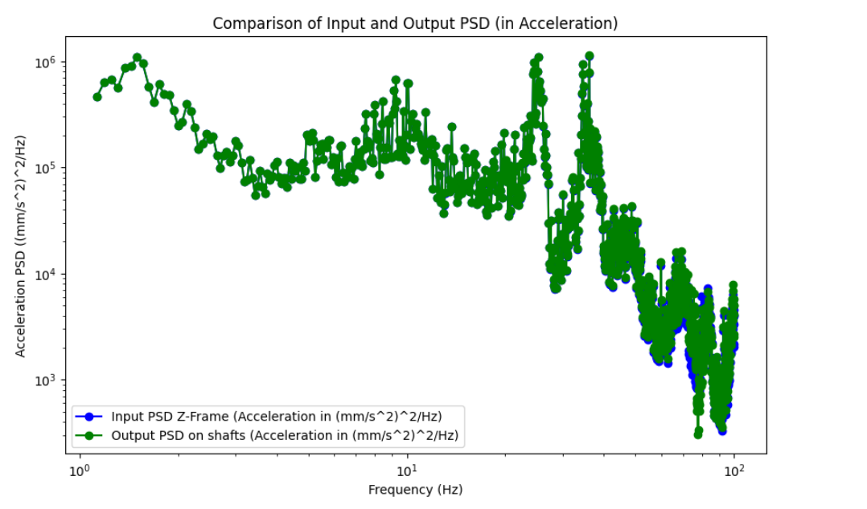
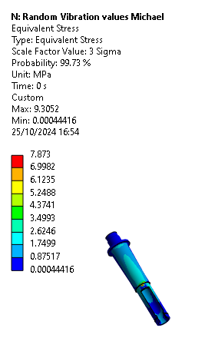
Stress on Shafts for Z-Frame Input
Max. equivalent stress: 8MPa for 3 sigma scaling

Slide 23
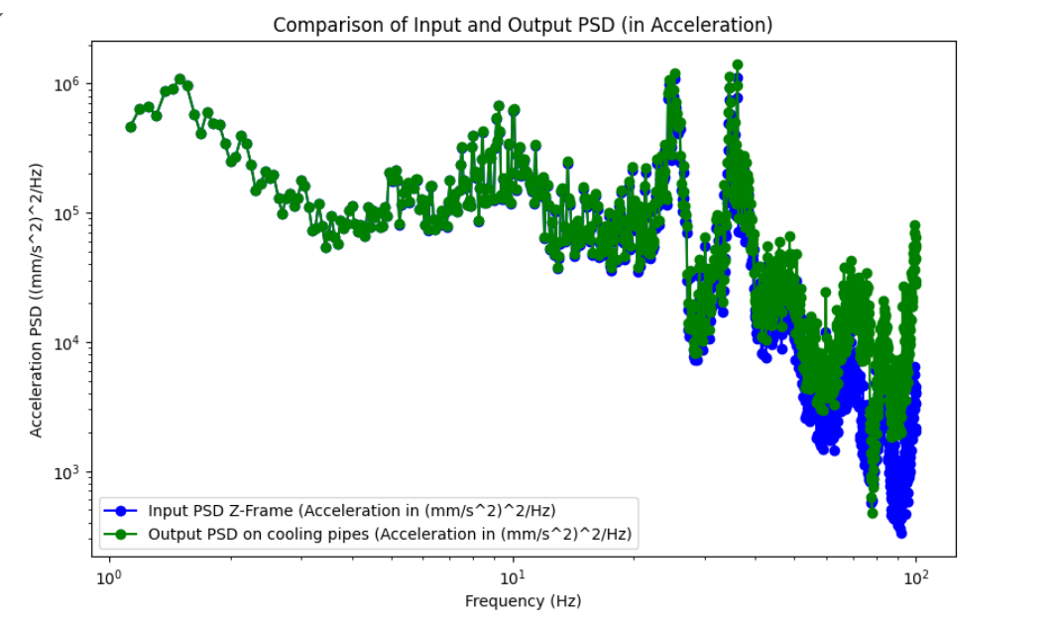
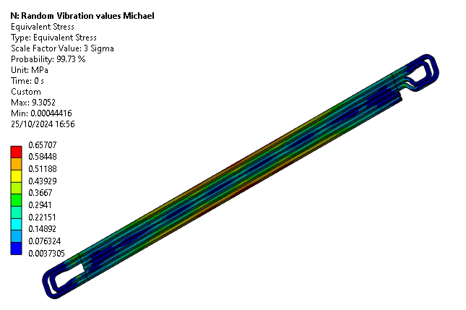
Stress on Cooling pipes for Z-Frame Input
Max. equivalent stress: 0.7 MPa for 3 sigma scaling

Slide 24
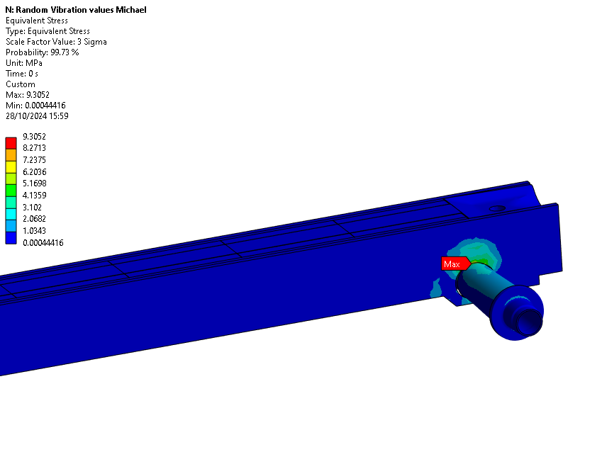
Maximum Stress for Z-Frame Input
Maximum overall stress:
9.3 MPa for a scale factor of 3 sigma

Slide 25
Summary TCLP
 | Max Equivalent Stress [MPa] |  | Max Directional Deformation [mm]
 | ASTMD4169 | Cryomodule z-frame | ASTMD4169 | Cryomodule z-frame
Blocks | 1 | 0.72 | 0.03 (x-direction) | 0.02 (z-direction)
Shaft | 4.97 | 7.87 | 0.0014 (x- direction) | 0.013 (x-direction)
Cooling pipes | 0.55 | 0.65 | 0.027 (x-direction) | 0.017 (z-direction)
Z-direction input

Slide 26
Conclusion: Current Progress and Key Observations
Methodology Applied
  New Analysis Approach: Method applied to collimator equipment for the first time.
  Starting Focus: Began with TCLP and jaws as the initial subjects of analysis.
Preliminary Observations
  No Major Issues: Early review indicates no significant concerns.
  Additional Focus: Potential optimization of the transport frame could be beneficial.

Slide 27
Next Steps and Future Analysis Plans
Future Analysis
  Broader Analysis for LS3 Collimators:
    TCSPM: Pay close attention to graphite blocks due to their fragility.
    2-in-1 Drift Tube: Potentially analyse further.
Upcoming WP5.2 Meeting
  Discussions with M. Guinchard: Review results and assess any experimental needs.
  Strategy Presentation: Share proposed approach and findings at the next WP5.2 meeting.

Slide 28
Thank you for your attention

