Slide 1
Graphite and Inermet Assets on EDMS
WP5.2 Meeting
December 16th , 2024
L. Hannemann, C. Accettura, F. Carra, L. Puddu

Slide 2
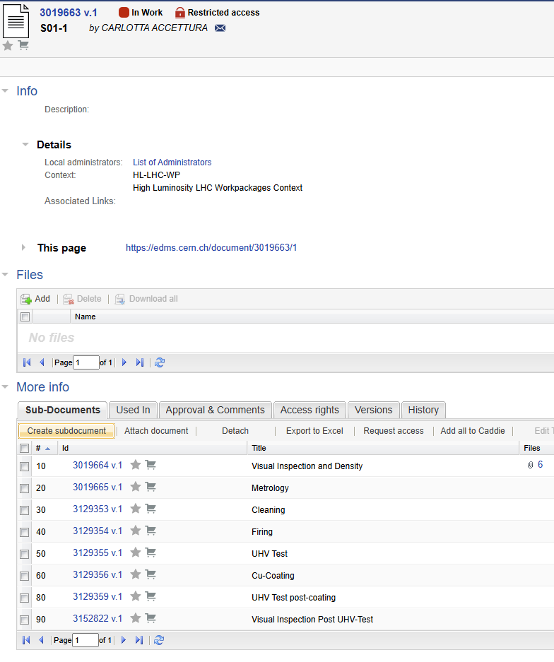
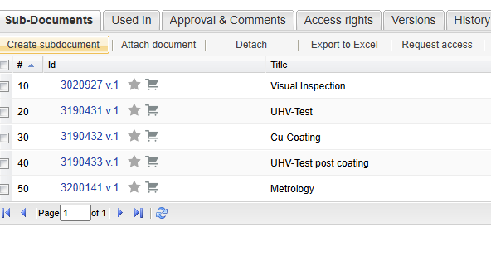
Graphite EDMS Structure
EDMS folder for each o the 60 blocks and taperings
https://edms.cern.ch/project/CERN-0000249793

Slide 3

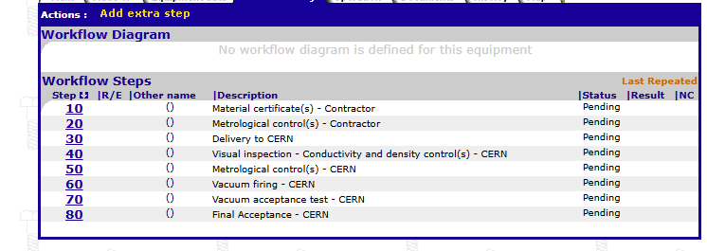


Graphite Assets
Manufacturing records: https://edms.cern.ch/project/CERN-0000248426
EDMS folders of each block and tapering attached to the Asset under “Final Acceptance”

Slide 4
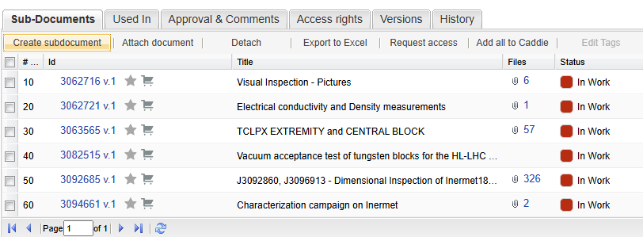
Inermet EDMS Structure
Different approach than Graphite due to big amount of Inermet blocks
All validation documentation (https://edms.cern.ch/document/3062715/1) attached to assets

Slide 5
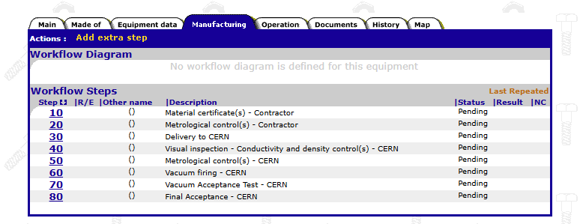

Inermet Assets
Manufacturing Records: TCLPX & TCTPXV/TCTPXH/TCLP/TCTPM
https://edms.cern.ch/project/CERN-0000248425

Slide 6
Thank you!

