Slide 1



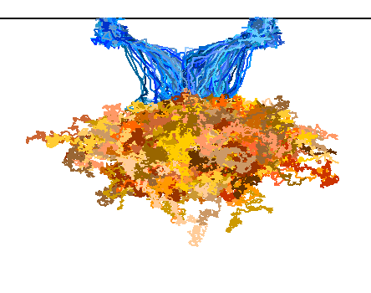
Charge collection studies of
65 nm CMOS MAPS
for ALICE ITS3
S. Perciballi* on behalf of ALICE
*Università di Torino, stefania.perciballi@unito.it
6th Allpix Squared User Workshop 2025 – Amsterdam 7-9 May

Slide 2
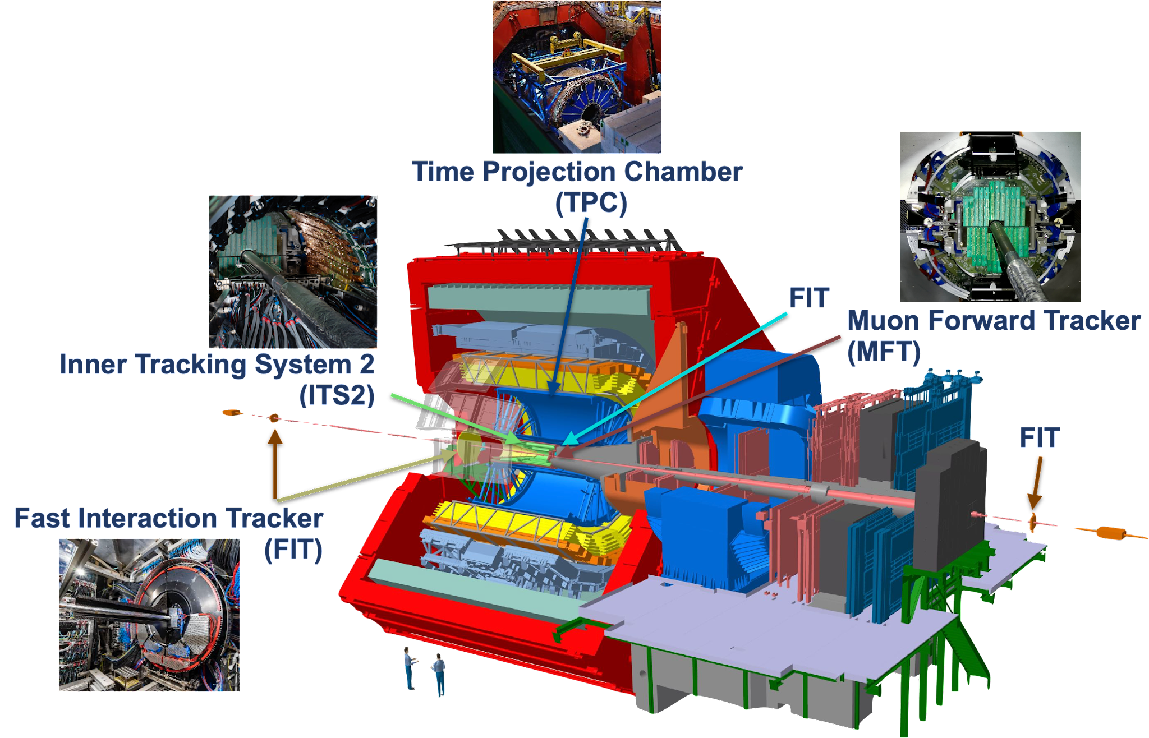
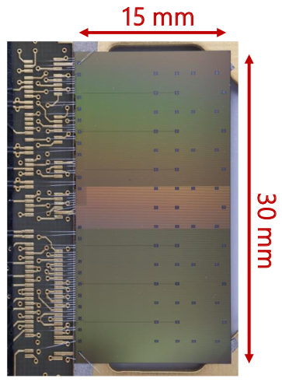
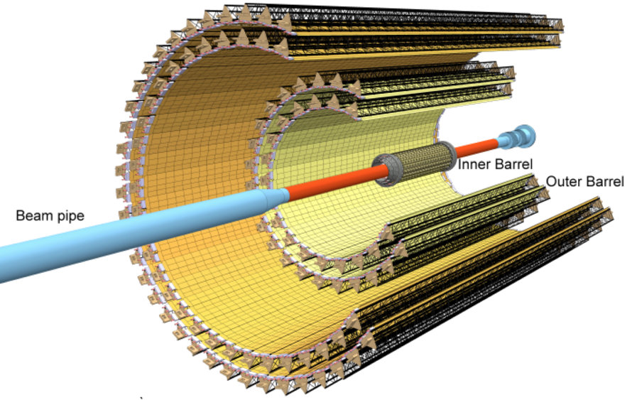
ALICE Inner Tracking System (ITS2)
ITS2 first large-area (∼10 m² ) silicon tracker → MAPS
ALPIDE chip: TowerJazz 180 nm CMOS imaging process
Main characteristics:
7 layers of MAPS (3 inner - 4 outer barrel)
close to interaction point (23 mm)
single point resolution ∼ 5µm (pixel ∼ 29×27 µm²)
low material budget: 0.36% X0/X
fast readout:
    Pb-Pb collisions at 50 kHz (ITS1: 1 kHz)
    p-p at 400 kHz
The ALICE upgrade for Run3
properties of the quark-gluon plasma produced in heavy-ion collisions
low momentum (≲1 GeV/c) particle reconstruction
6th Allpix Squared User Workshop 2025 – S. Perciballi / 7-9 May
2

Slide 3
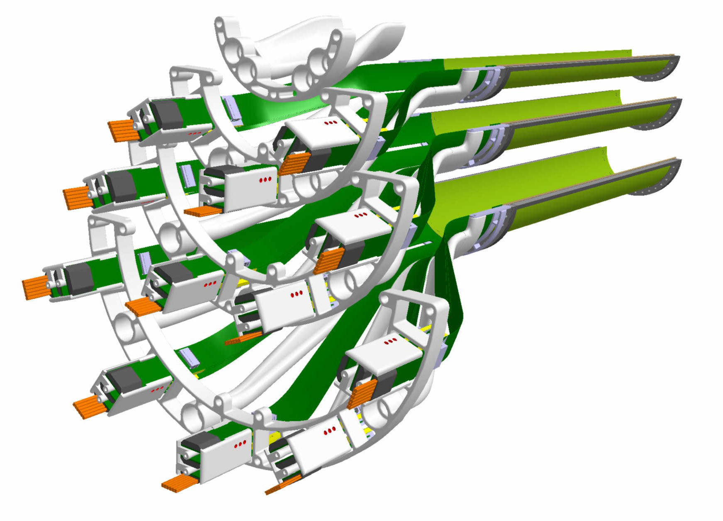
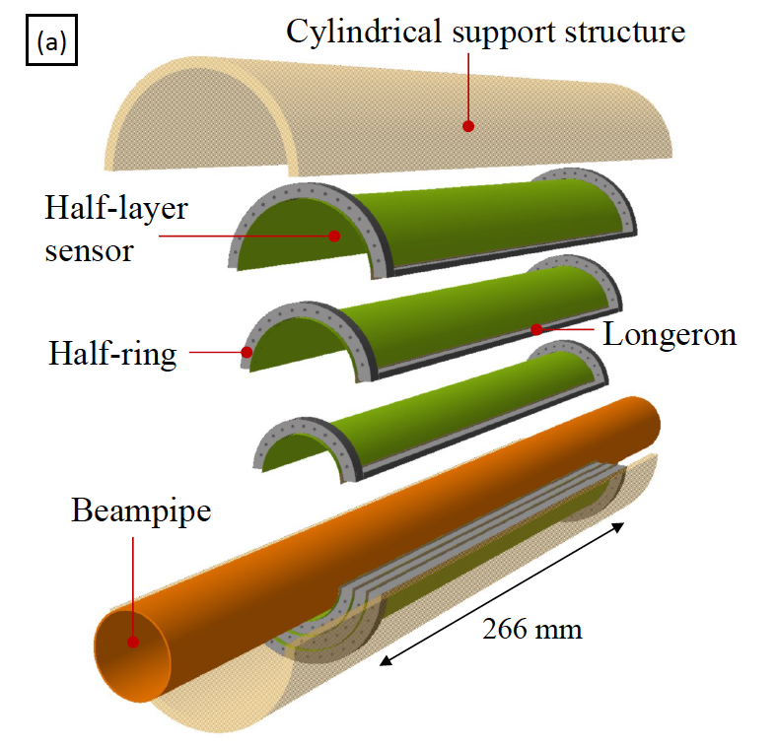
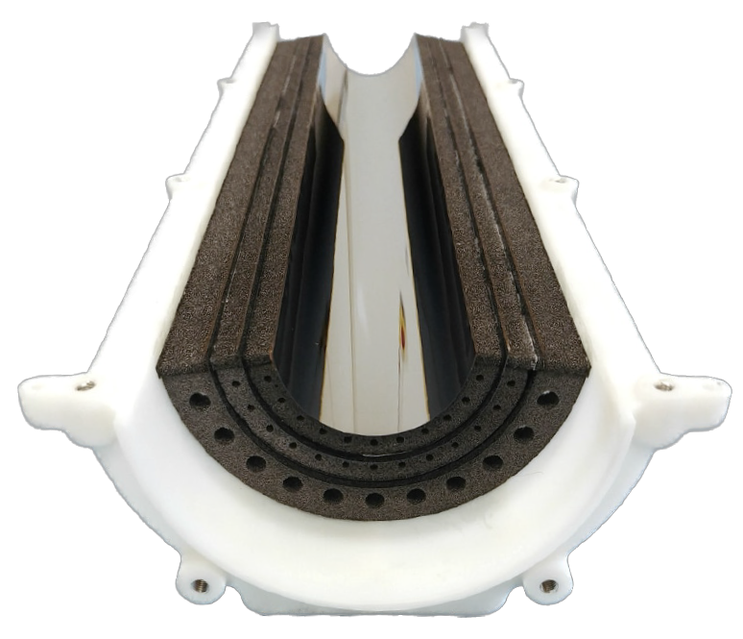
ITS3 – truly cylindrical wafer-scale MAPS tracker
Layout:
3 layers → replace ITS2 Inner Barrel
beam pipe inner radius (to 16 mm with 500 μm thickness)
closer to the beam pipe 23 mm → 18 mm
Technology:
65 nm CMOS from TPSCo (Tower Partners Semiconductor):
    300 mm wafer-scale chips, fabricated using stitching
thinned down to 50 µm
    flexible (bent to target radii)
mechanically held by carbon foam ribs with low density and high thermal conductivity
Benefits:
extremely low material budget: 0.09% X0/X per layer
homogeneous material distribution
6th Allpix Squared User Workshop 2025 – S. Perciballi / 7-9 May
3

Slide 4
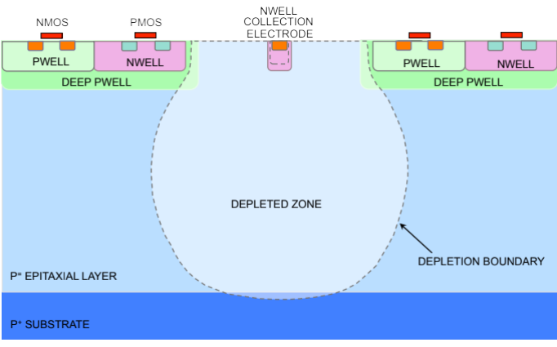
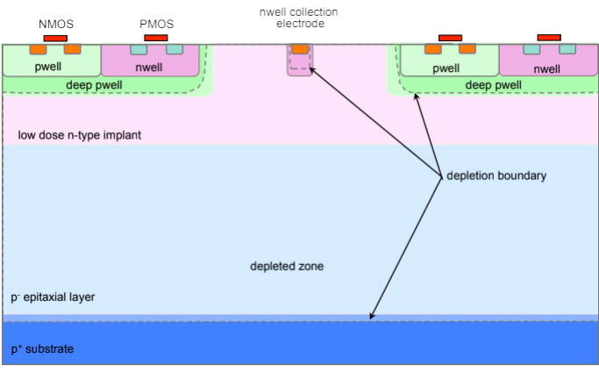
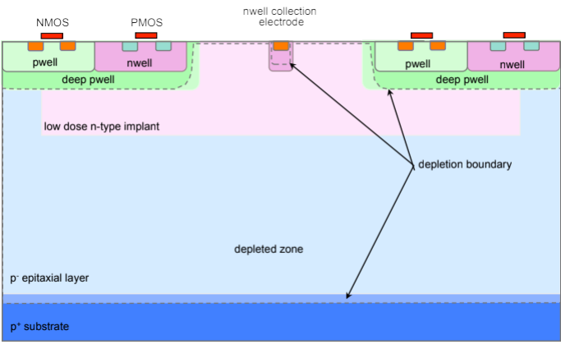
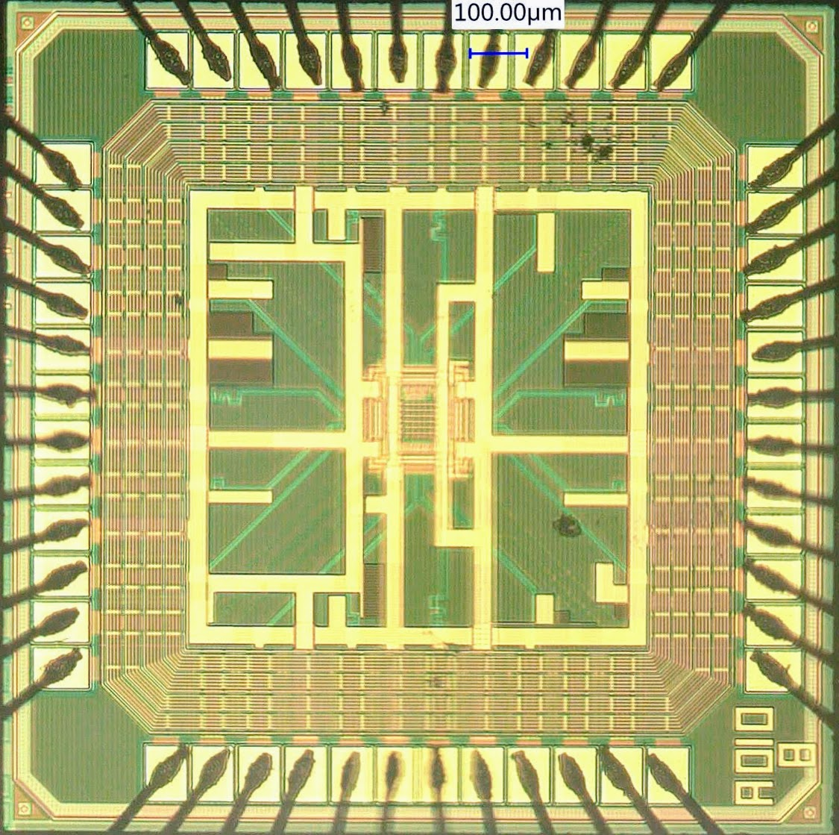
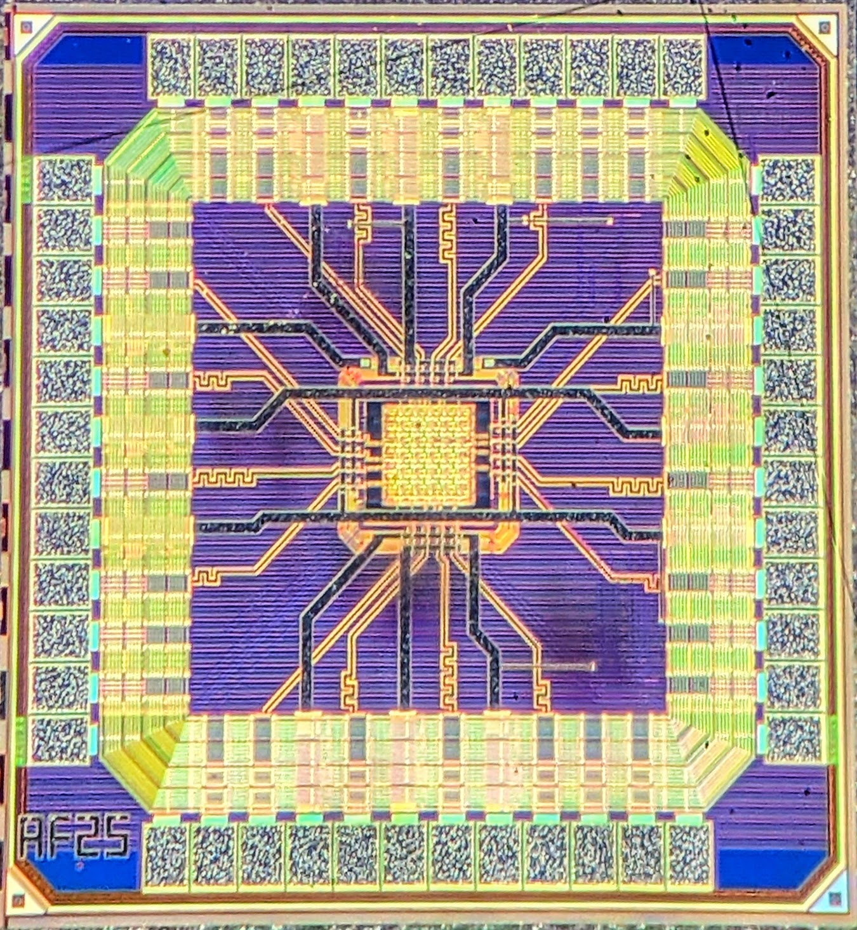
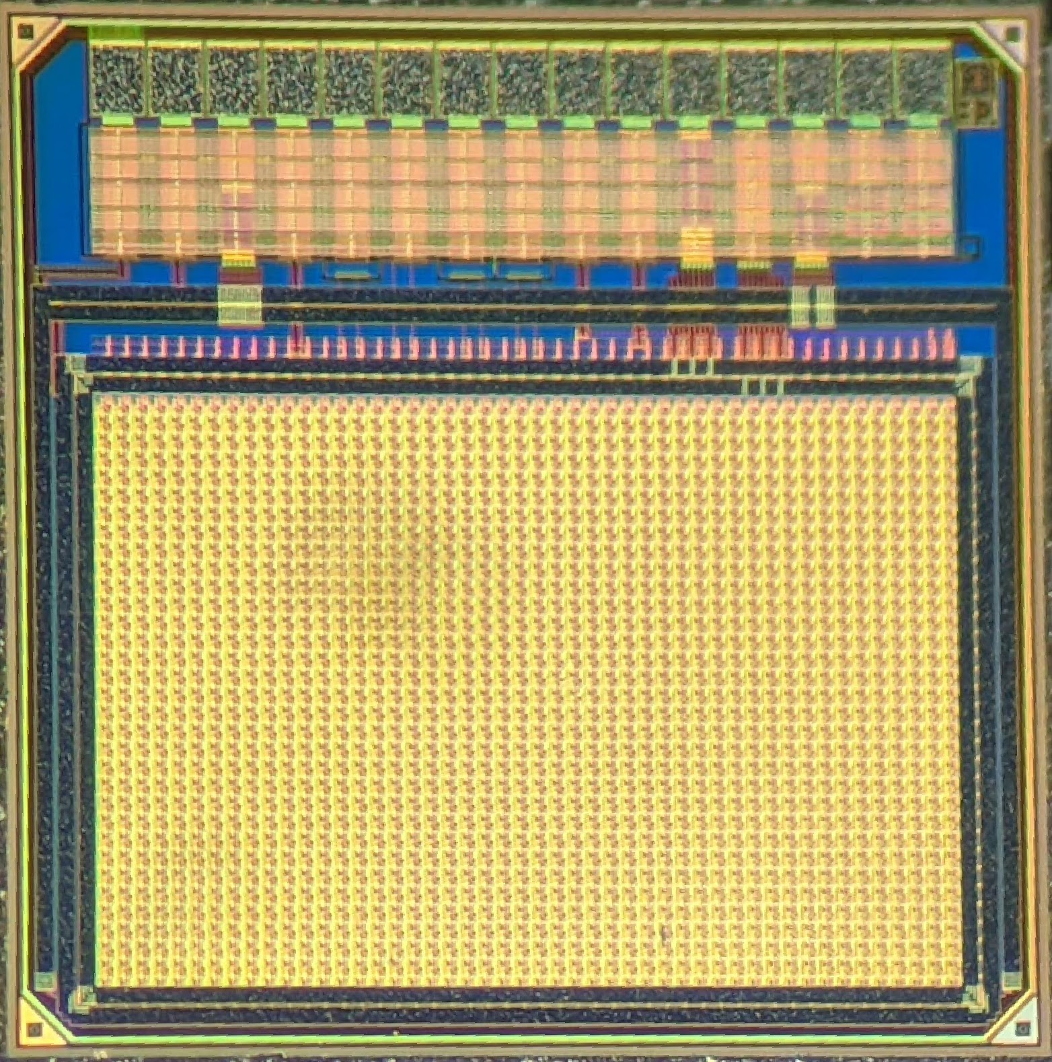
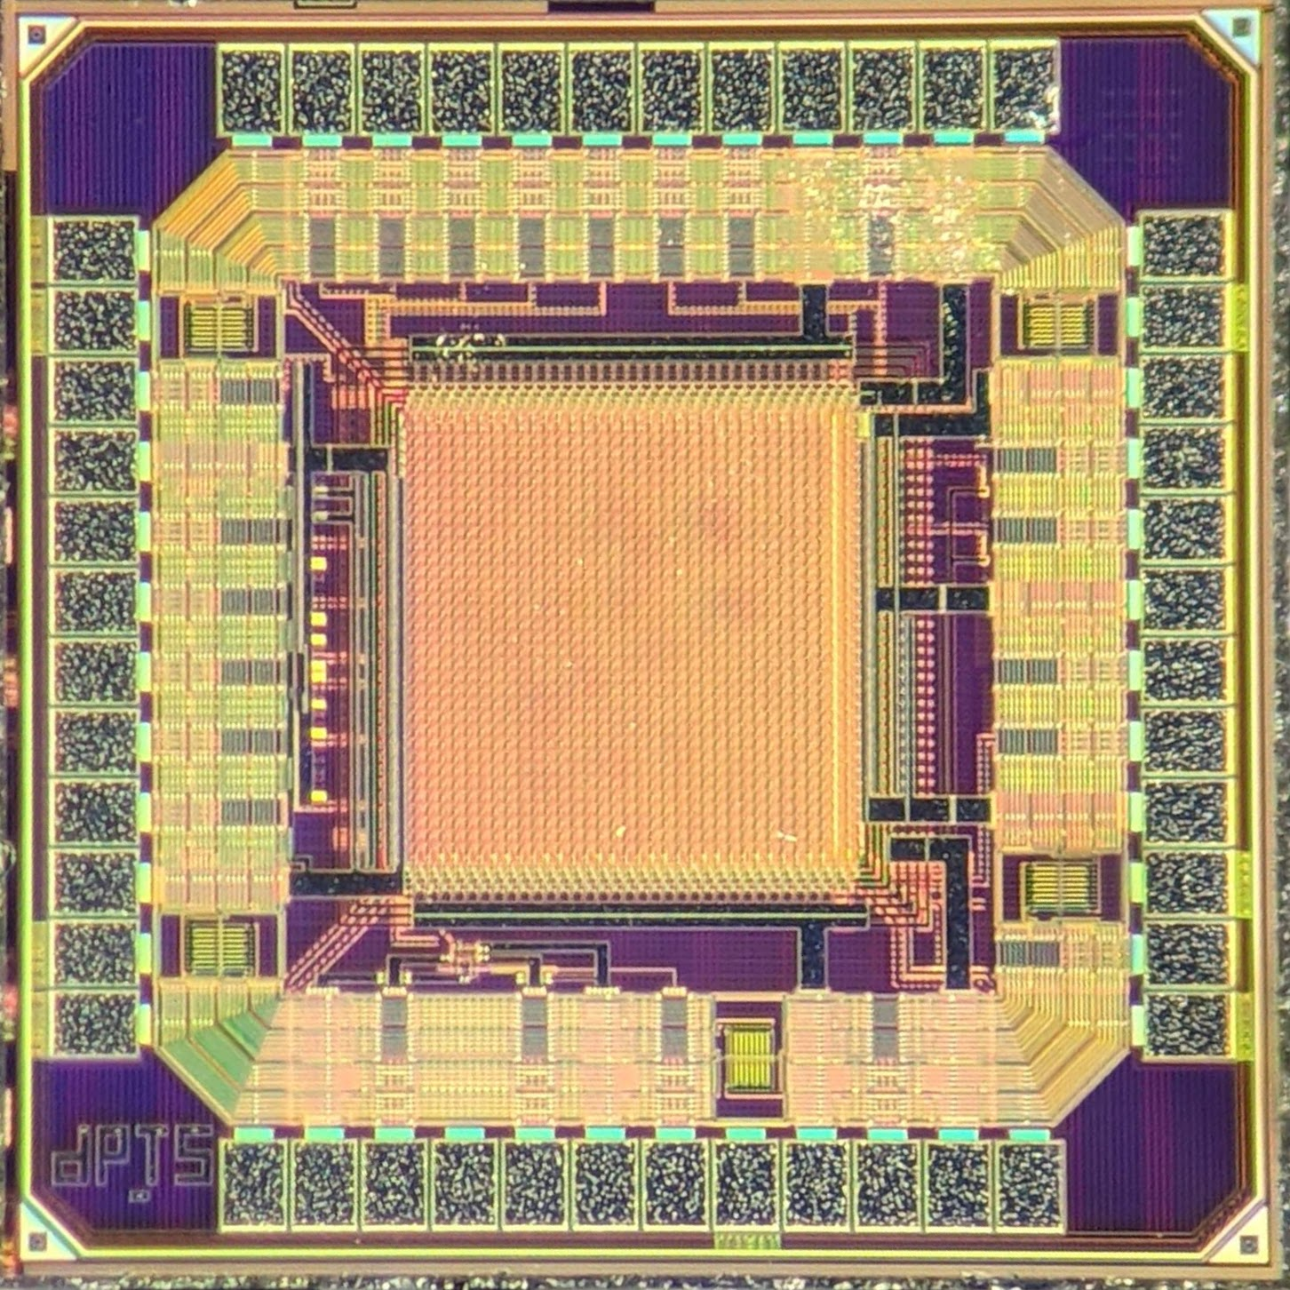
MAPS in the 65 nm CMOS technology
Process modification for fully depleted sensor:
  standard → ALPIDE like design
  modified → completely depleted
  modified with gap → increase the lateral field to speed up the charge collection process
STANDARD
Charge Collection Speed
Charge Sharing
MODIFIED
MLR1: Multi Layer Reticle 1 → first submission in the TPSCo 65 nm technology
APTS
CE65
DPTS
MODIFIED WITH GAP
6th Allpix Squared User Workshop 2025 – S. Perciballi / 7-9 May
4

Slide 5
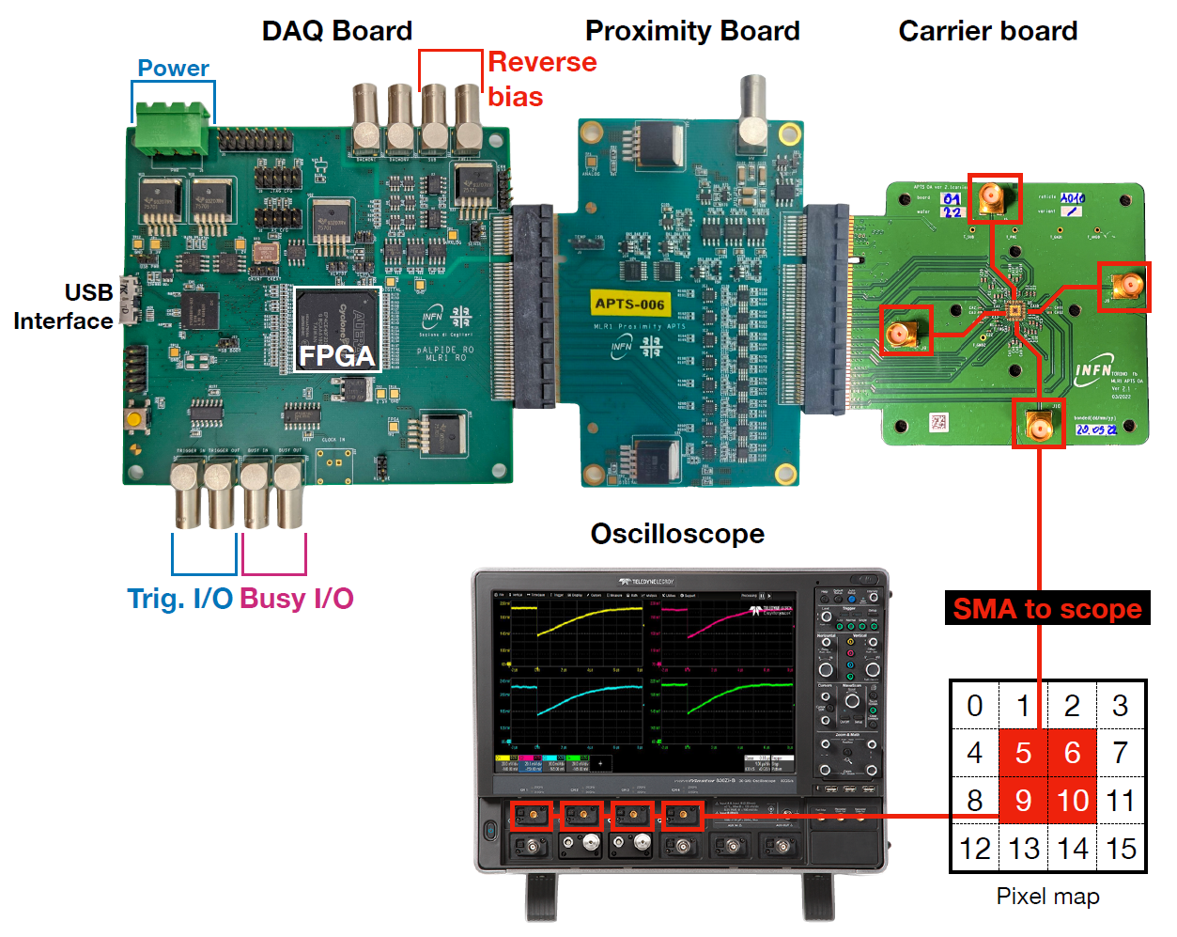
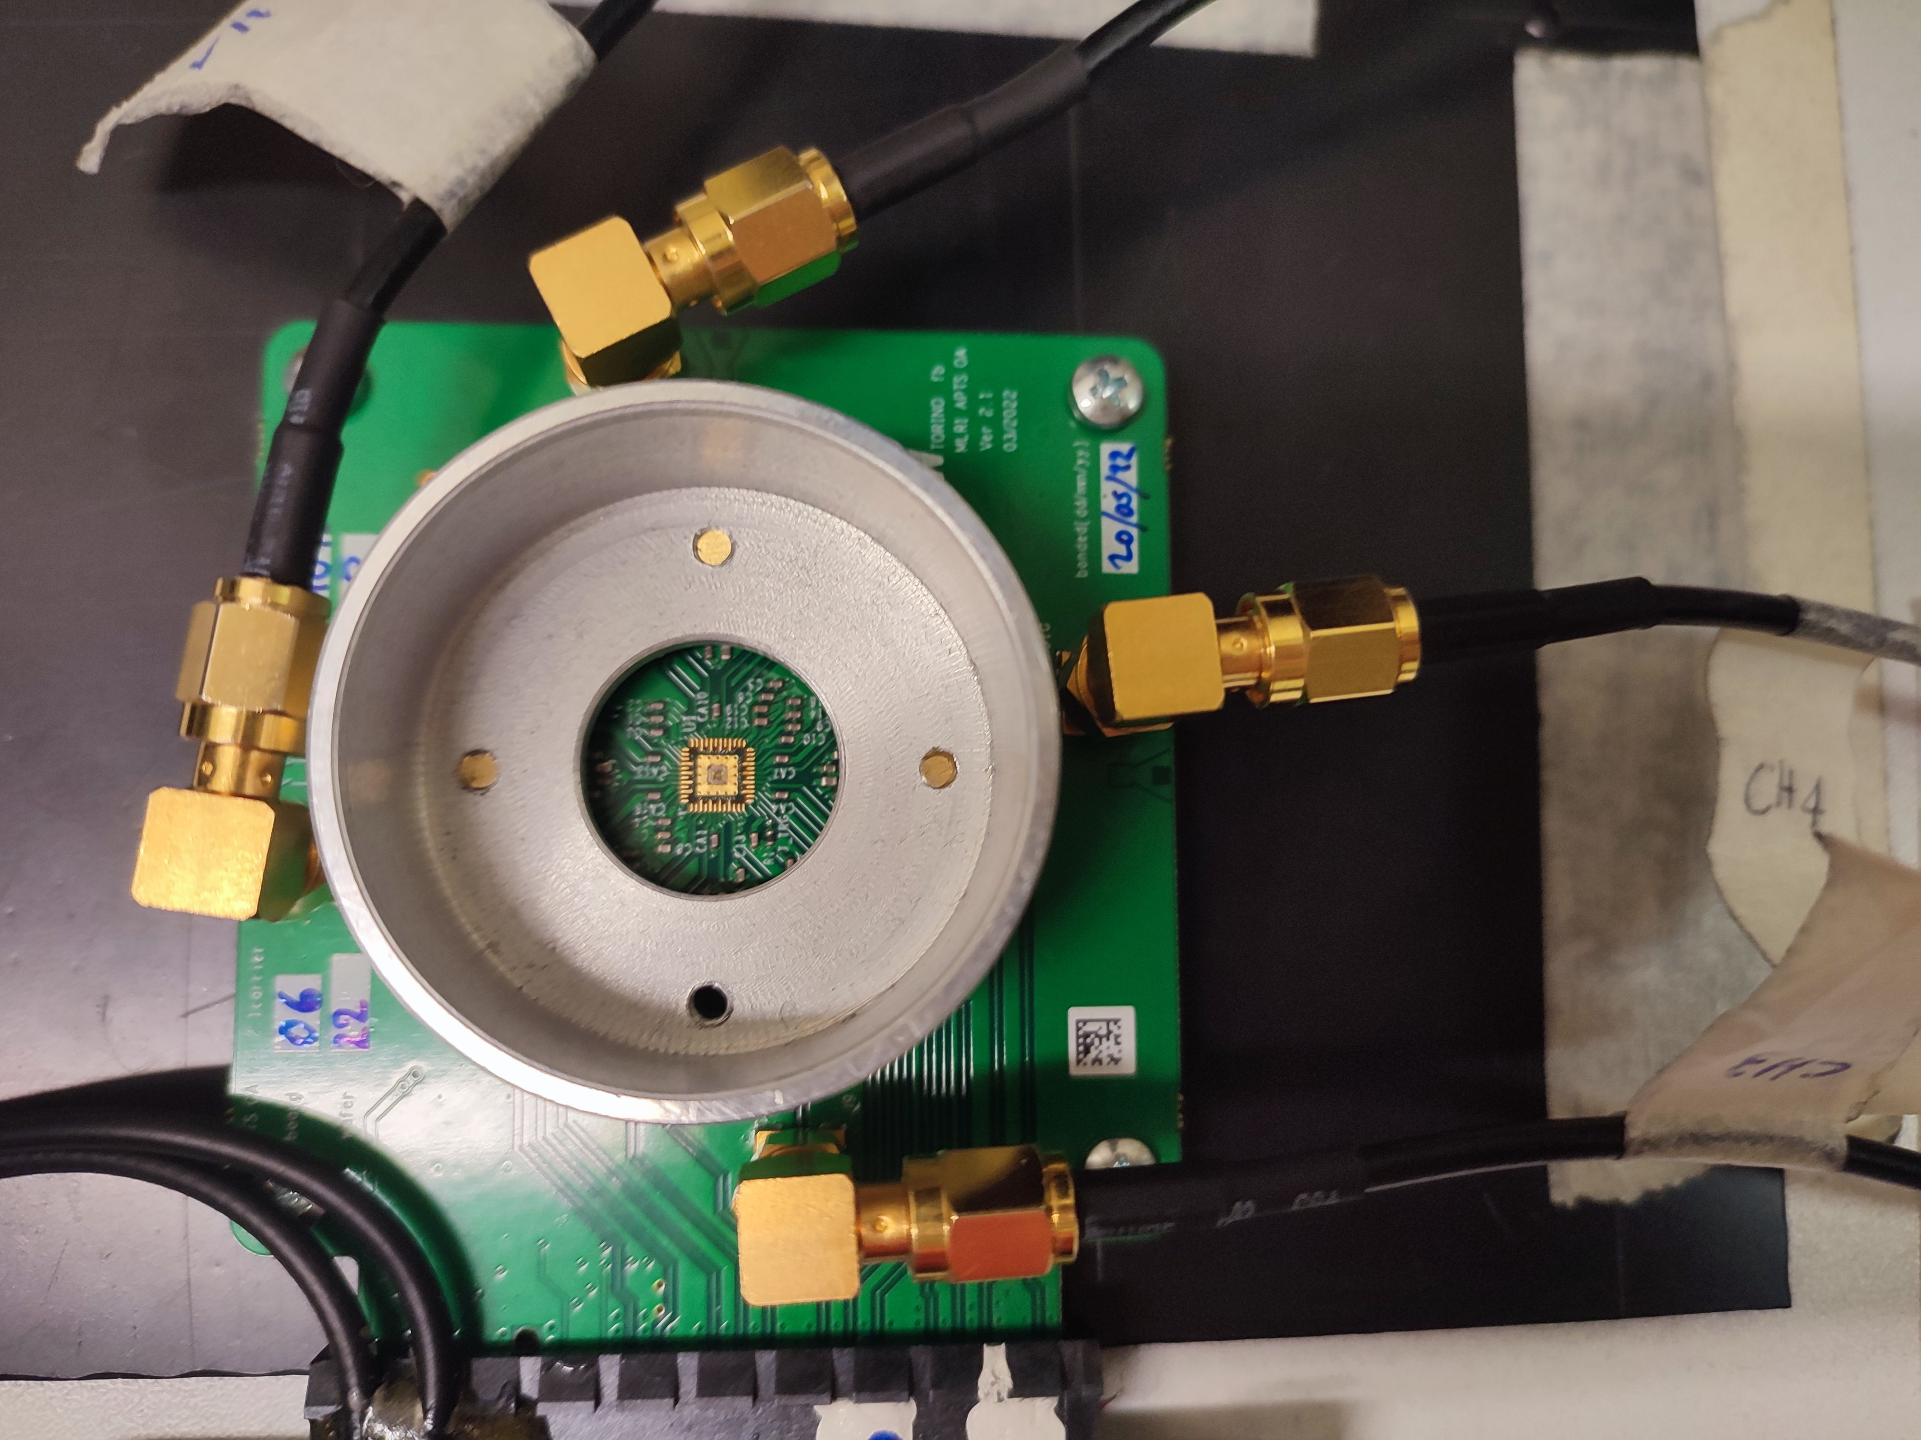
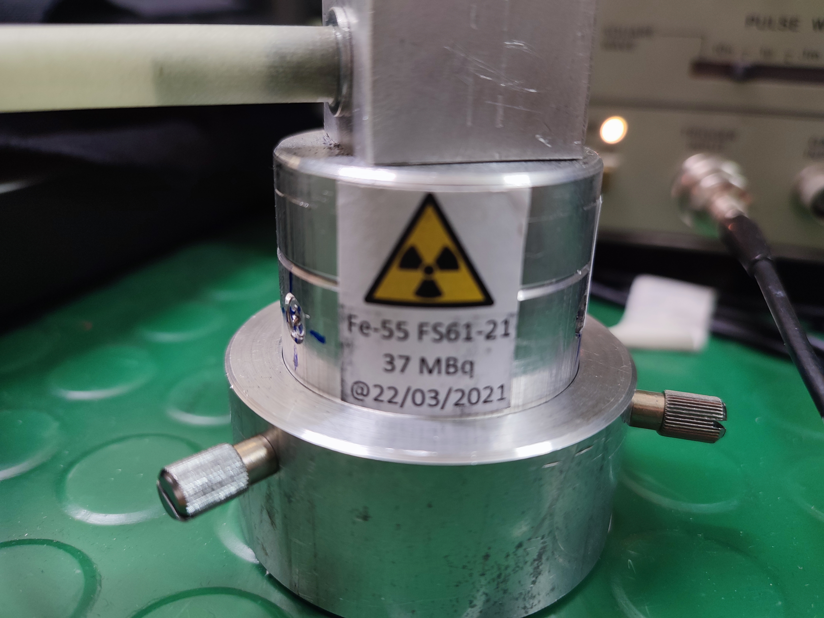
APTS-OA characterization setup
APTS (Analogue Pixel Test Structure) – OA (Operational Amplifier)
matrix sizes: 4×4
pixel pitch: 10 µm
→ preserve timing information
4 inner pixels read out by the Oscilloscope → Sampling rate 40 GS/s
12 outer pixels read out by a custom made proximity board → Sampling rate 4 MS/s
Measurements with a ⁵⁵Fe X-ray source
6th Allpix Squared User Workshop 2025 – S. Perciballi / 7-9 May
5

Slide 6
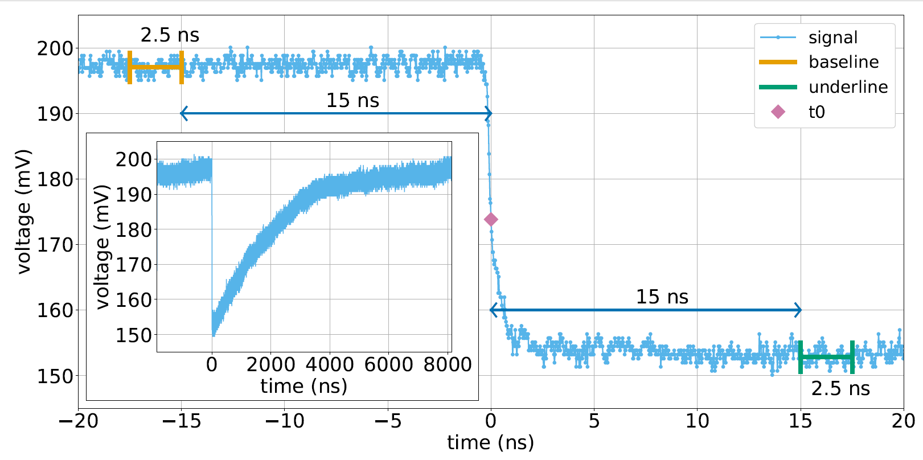
APTS-OA: waveform analysis
Waveform parameters:
t₀: minimum of signal derivative
baseline: average over 2.5 ns, at 15 ns before t₀
underline: average over 2.5 ns, at 15 ns after t₀
Amplitude: difference between baseline and underline
Fall time: time difference between 50% and 10% of the signal amplitude
Details can be found in https://doi.org/10.1016/j.nima.2024.169896
6th Allpix Squared User Workshop 2025 – S. Perciballi / 7-9 May
6

Slide 7
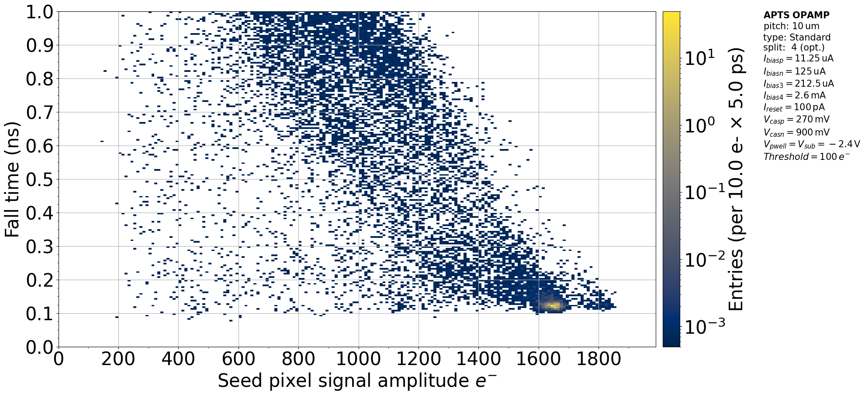
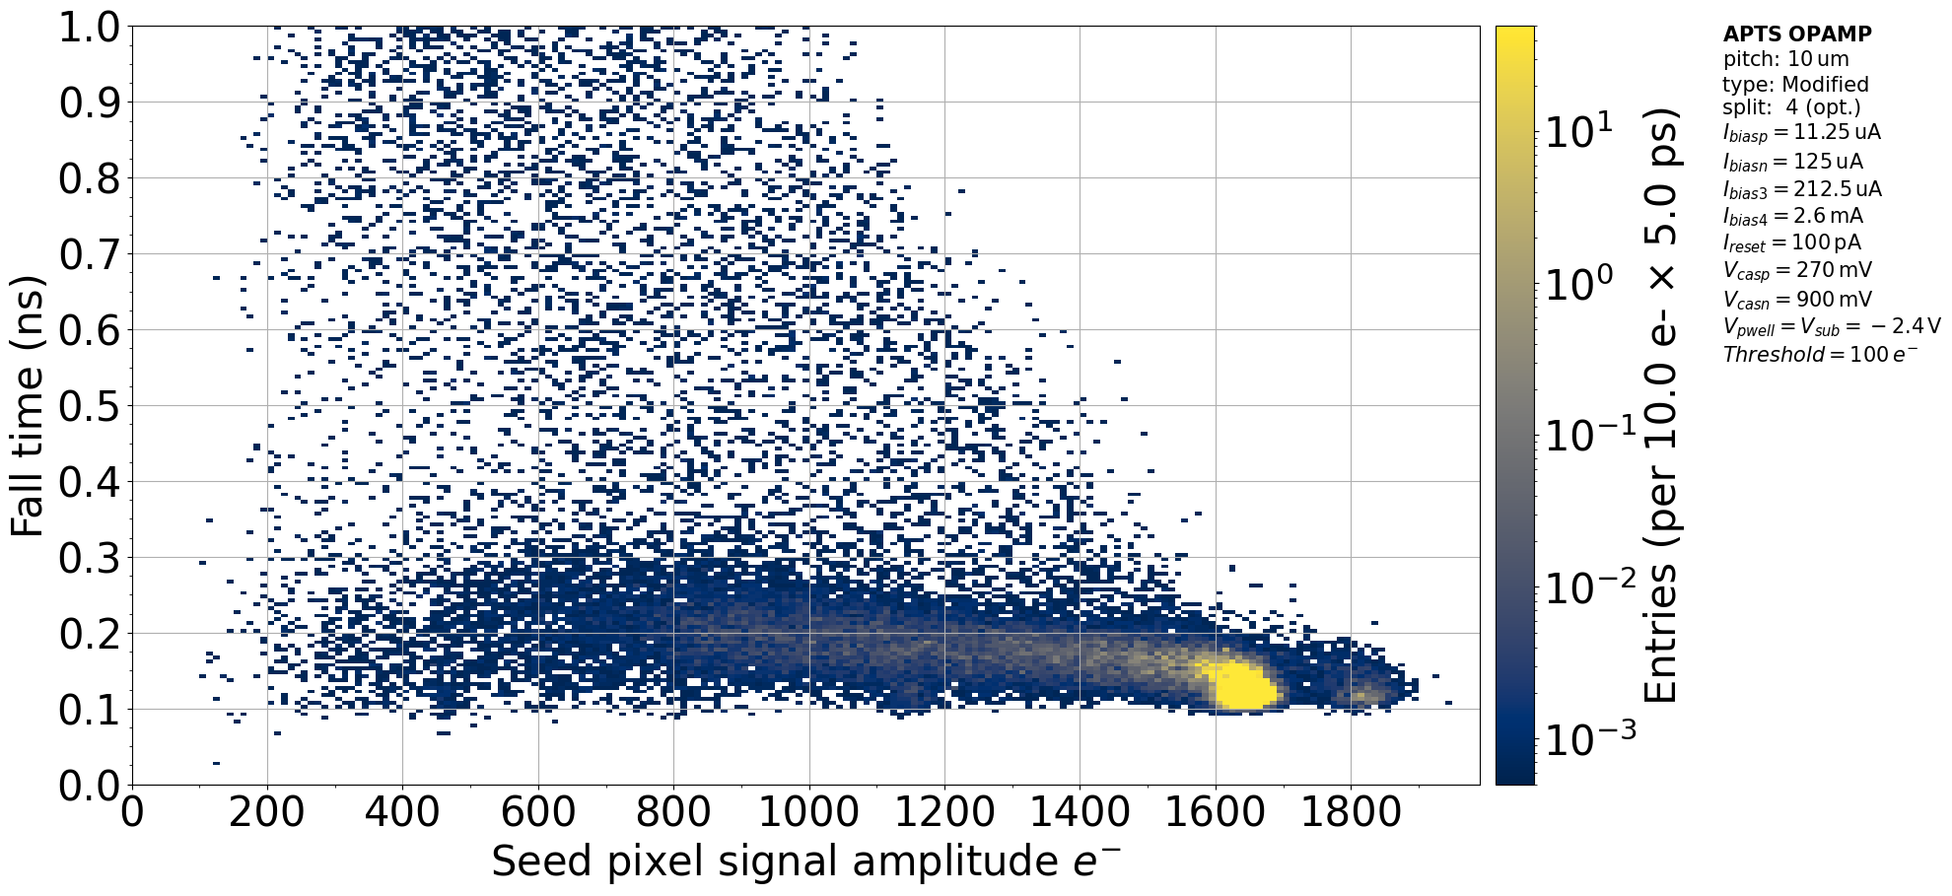
Charge Collection with ⁵⁵Fe
Reverse bias equal to -2.4V
STANDARD
MODIFIED
Charge collection mainly by diffusion
Charge collection mainly by drift
6th Allpix Squared User Workshop 2025 – S. Perciballi / 7-9 May
7

Slide 8
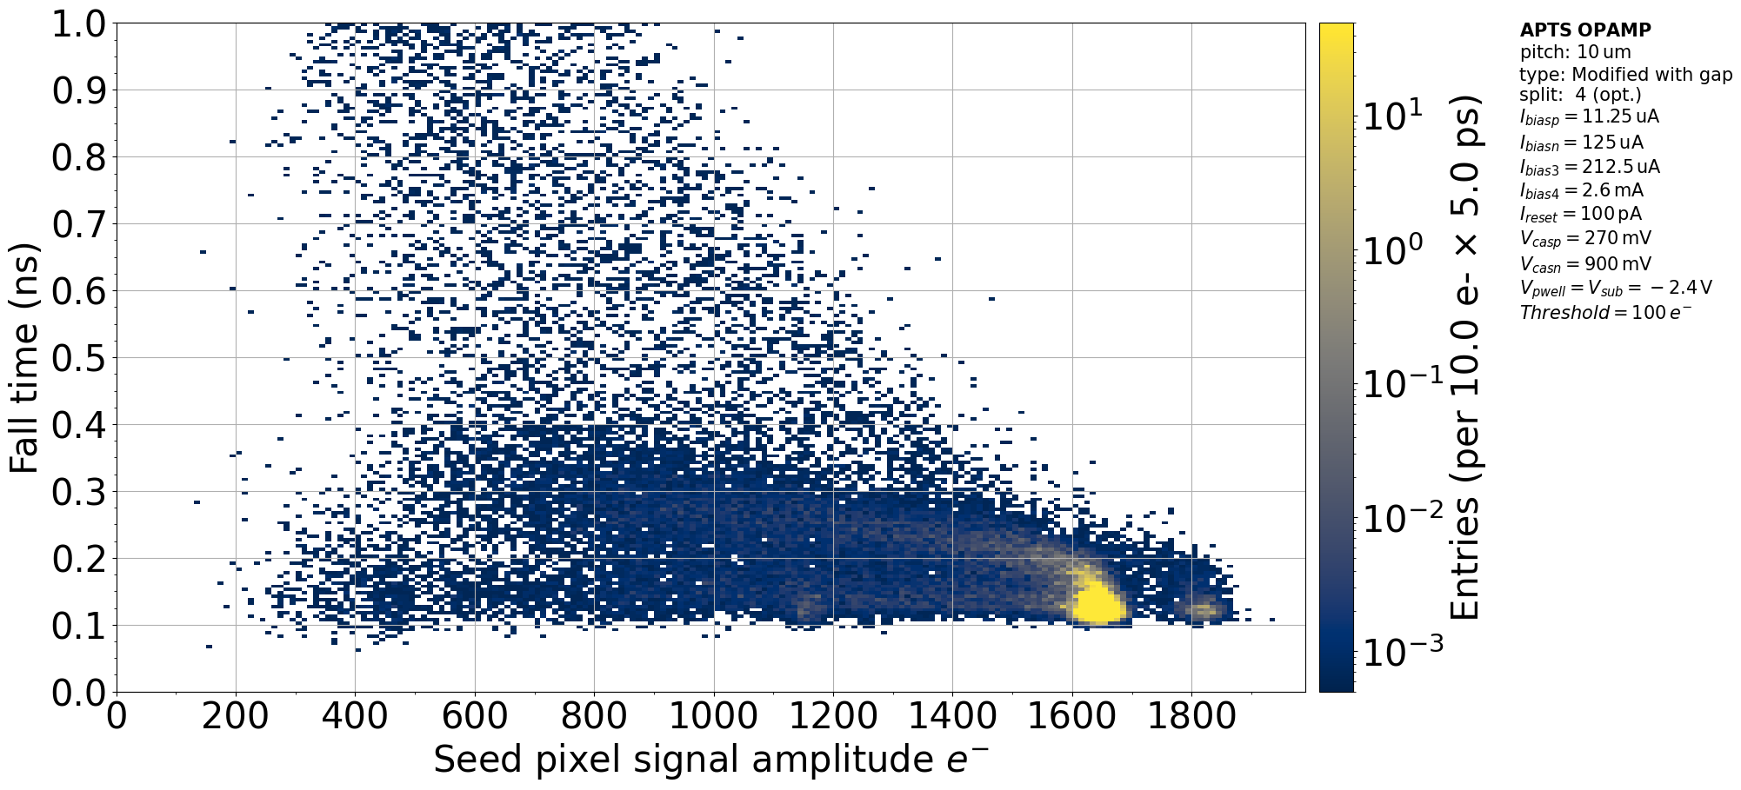
Charge Collection with ⁵⁵Fe on modified sensors
Reverse bias equal to -2.4V
MODIFIED
MODIFIED WITH GAP
It presents one main component
in charge collection
It presents a slower component
in charge collection
6th Allpix Squared User Workshop 2025 – S. Perciballi / 7-9 May
8

Slide 9
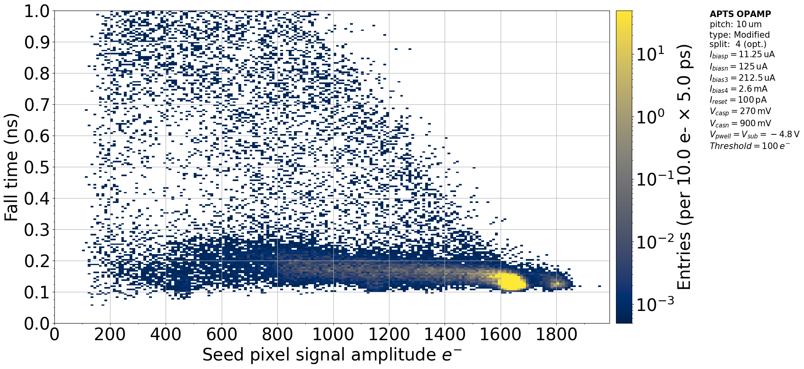
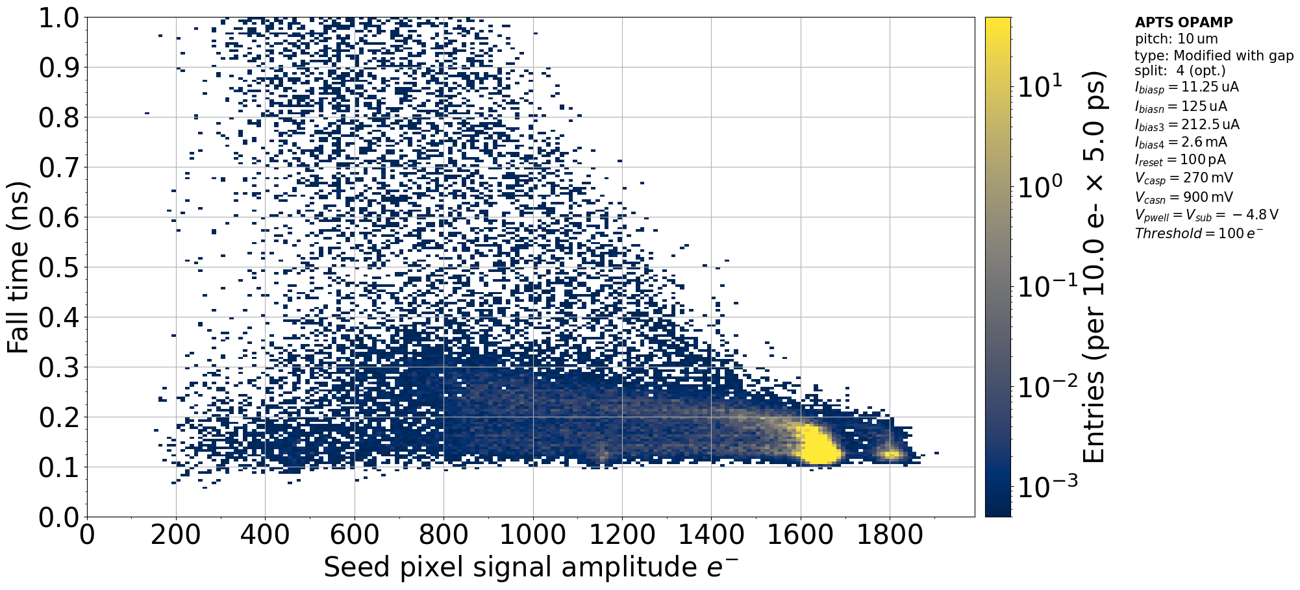
Charge Collection with ⁵⁵Fe on modified sensors
Reverse bias equal to -4.8V
MODIFIED
MODIFIED WITH GAP
It doesn’t change much with reverse bias
it becomes increasingly faster with reverse bias
6th Allpix Squared User Workshop 2025 – S. Perciballi / 7-9 May
9

Slide 10
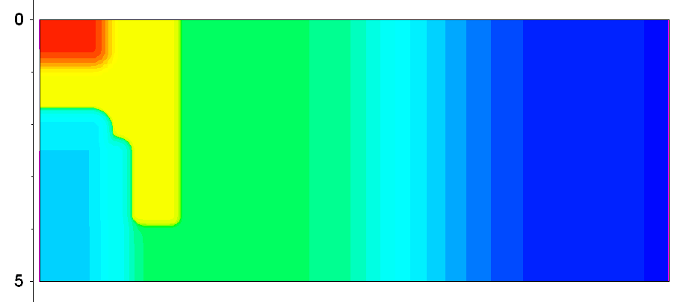
Simulations: Pixel Geometry
n+
p-well
p-well
Doping Profiles are covered by Non-Disclosure Agreement
The doping profiles shown in this presentation give comparable results to the proper doping profiles
low dose n
p-
MODIFIED WITH GAP
p+
6th Allpix Squared User Workshop 2025 – S. Perciballi / 7-9 May
10

Slide 11
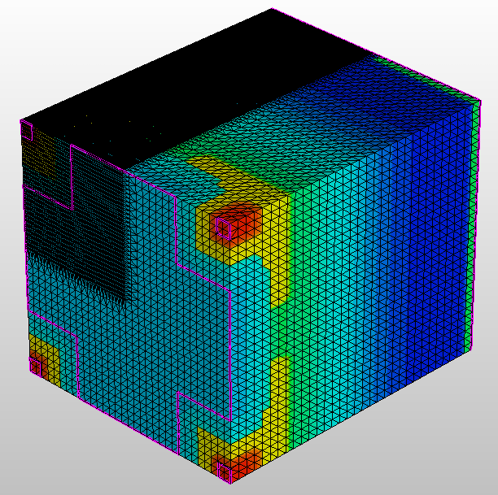
TCAD Mesh
mesh = 0.1x0.1x0.1 µm³
12 µm of sensor depth
3D TCAD simulation
Weighting potential evaluation
Mesh cut
Final mesh to be exported into AllPix2
6th Allpix Squared User Workshop 2025 – S. Perciballi / 7-9 May
11
Notes:
3D TCAD simulation of a 2x2 pixel matrix of 10 µm pitch:
Finer mesh in one pixel corner (0.1x0.1x0.1) µm³
Simulating only 12 µm of the sensor depth to reduce computational time
From TCAD Mesh to AllPix2:
Mesh cut to consider only the corner pixel with finer mesh
Weighting Potential: 2 TCAD simulations of a 2x2 matrix with V_{el} of 0.4V and 0.41V → the weighting potential is calculated as the potential difference for each grid point
Final mesh exported into AllPix2
AllPix2 can reproduce the mesh for a full pixel and repeat it for the entire pixel matrix that we want to consider - field_mapping = ‘PIXEL_QUADRANT_I’’

Slide 12
AllPix2 Flow
Mesh Converter
Simulation of ⁵⁵Fe X-ray source
AllPix2 simulation
Pulse analysis
6th Allpix Squared User Workshop 2025 – S. Perciballi / 7-9 May
12
Notes:
Mesh Converter: used to convert TCAD mesh into a mesh that can be imported into AllPix2 → the number of divisions must be ~ equal to the mesh in TCAD divisions = 50 50 120 xyz = x y z
Simulations of ⁵⁵Fe X-Ray source using a macro: the physical process is completely simulated from the photon impinging on the sensor to the collected charge by the electrode
AllPix2 simulation: a 4x4 pixel matrix is simulated
Pulse analysis: the same analysis method is used both for the experimental data and the pulses collected by the simulation. For each event, the amplitude and fall time are extracted and the pixel coordinates are saved.

Slide 13
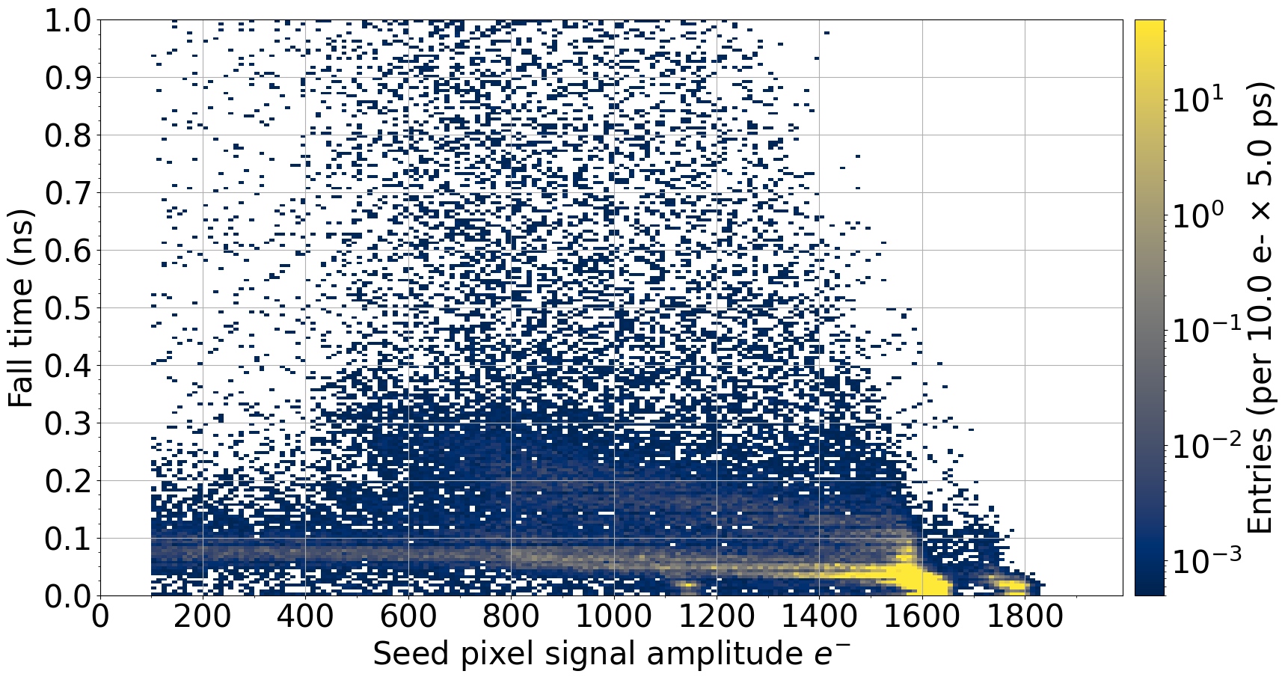
AllPix2 Simulations – Modified with Gap
Data
Simulations
Simulation
6th Allpix Squared User Workshop 2025 – S. Perciballi / 7-9 May
13

Slide 14
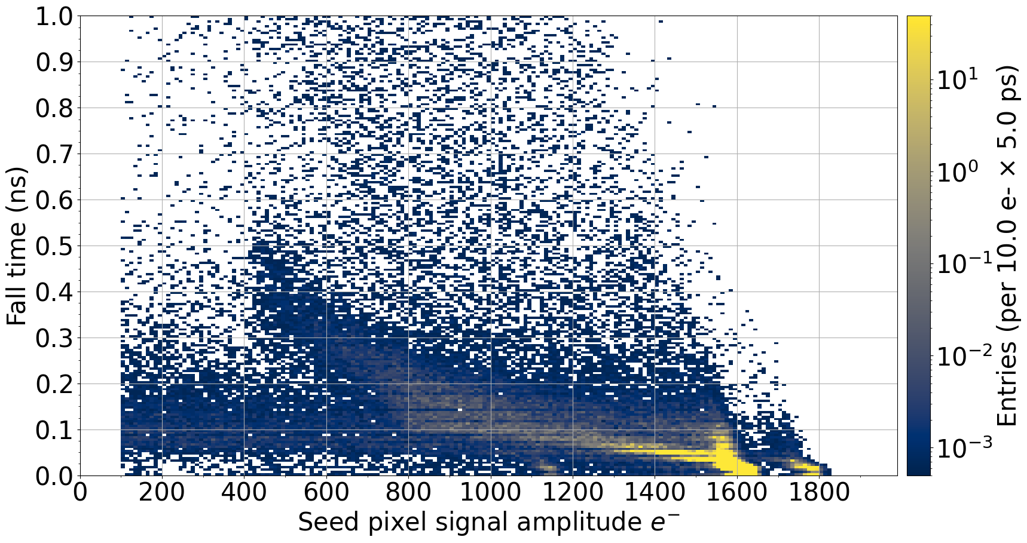
AllPix2 Simulations – Modified
Data
Simulations
Simulation
6th Allpix Squared User Workshop 2025 – S. Perciballi / 7-9 May
14

Slide 15
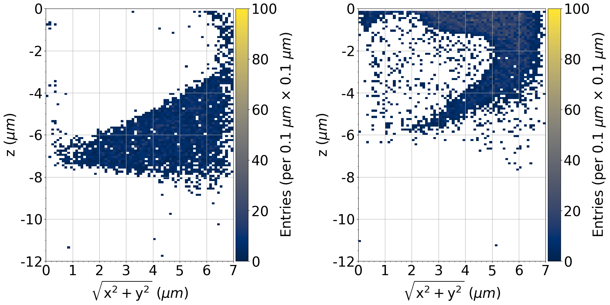
AllPix2 Simulations Results
Fall time versus amplitude from the simulation: by separating the fast and slow component it is possible to obtain the conversion points in the sensor
Electrode
Electrode
6th Allpix Squared User Workshop 2025 – S. Perciballi / 7-9 May
15

Slide 16
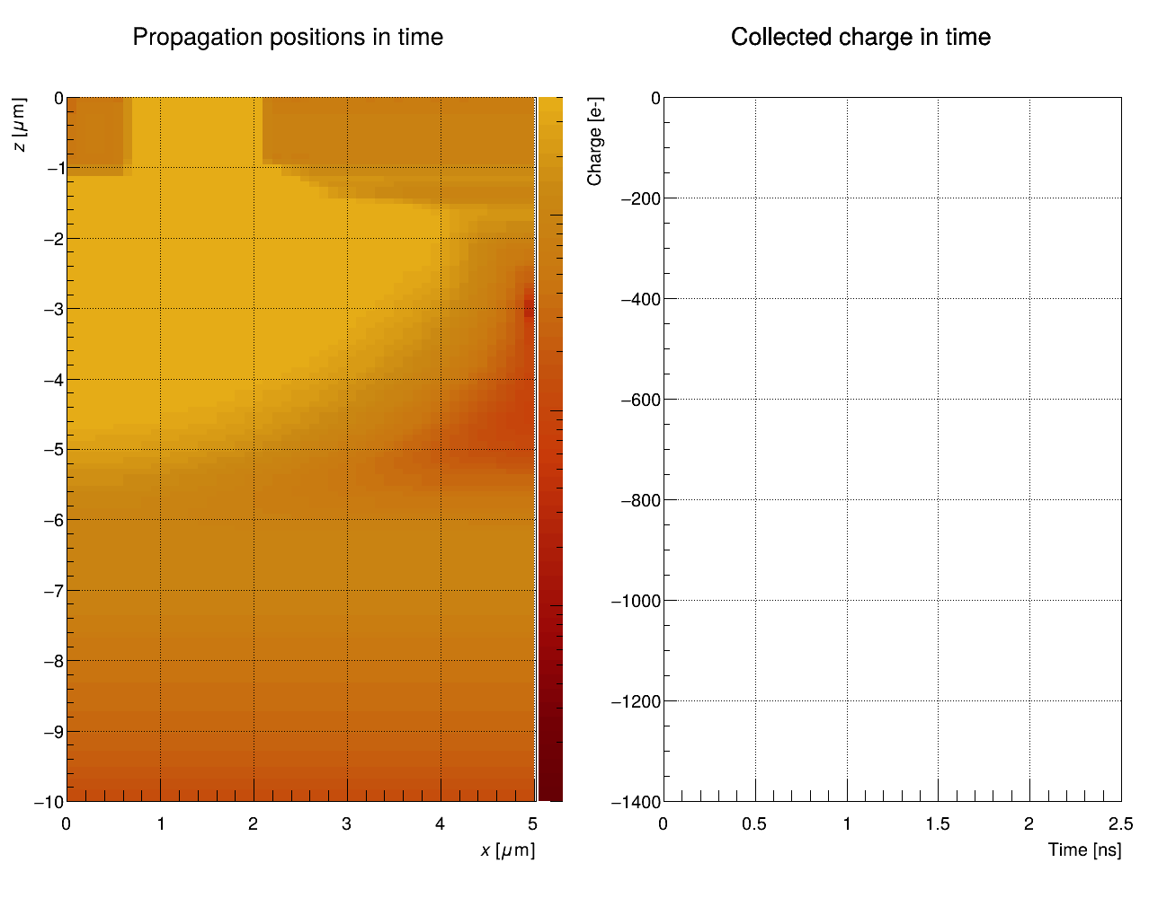
Fast Tail
Electric Field [V/cm]
One event animation of the fast tail population: the signal reaches almost the final amplitude after 500 ps
6th Allpix Squared User Workshop 2025 – S. Perciballi / 7-9 May
16

Slide 17
Slow Tail
Electric Field [V/cm]
One event animation of the slow tail population: the signal reaches almost the final amplitude after 1.25 ns
6th Allpix Squared User Workshop 2025 – S. Perciballi / 7-9 May
17

Slide 18
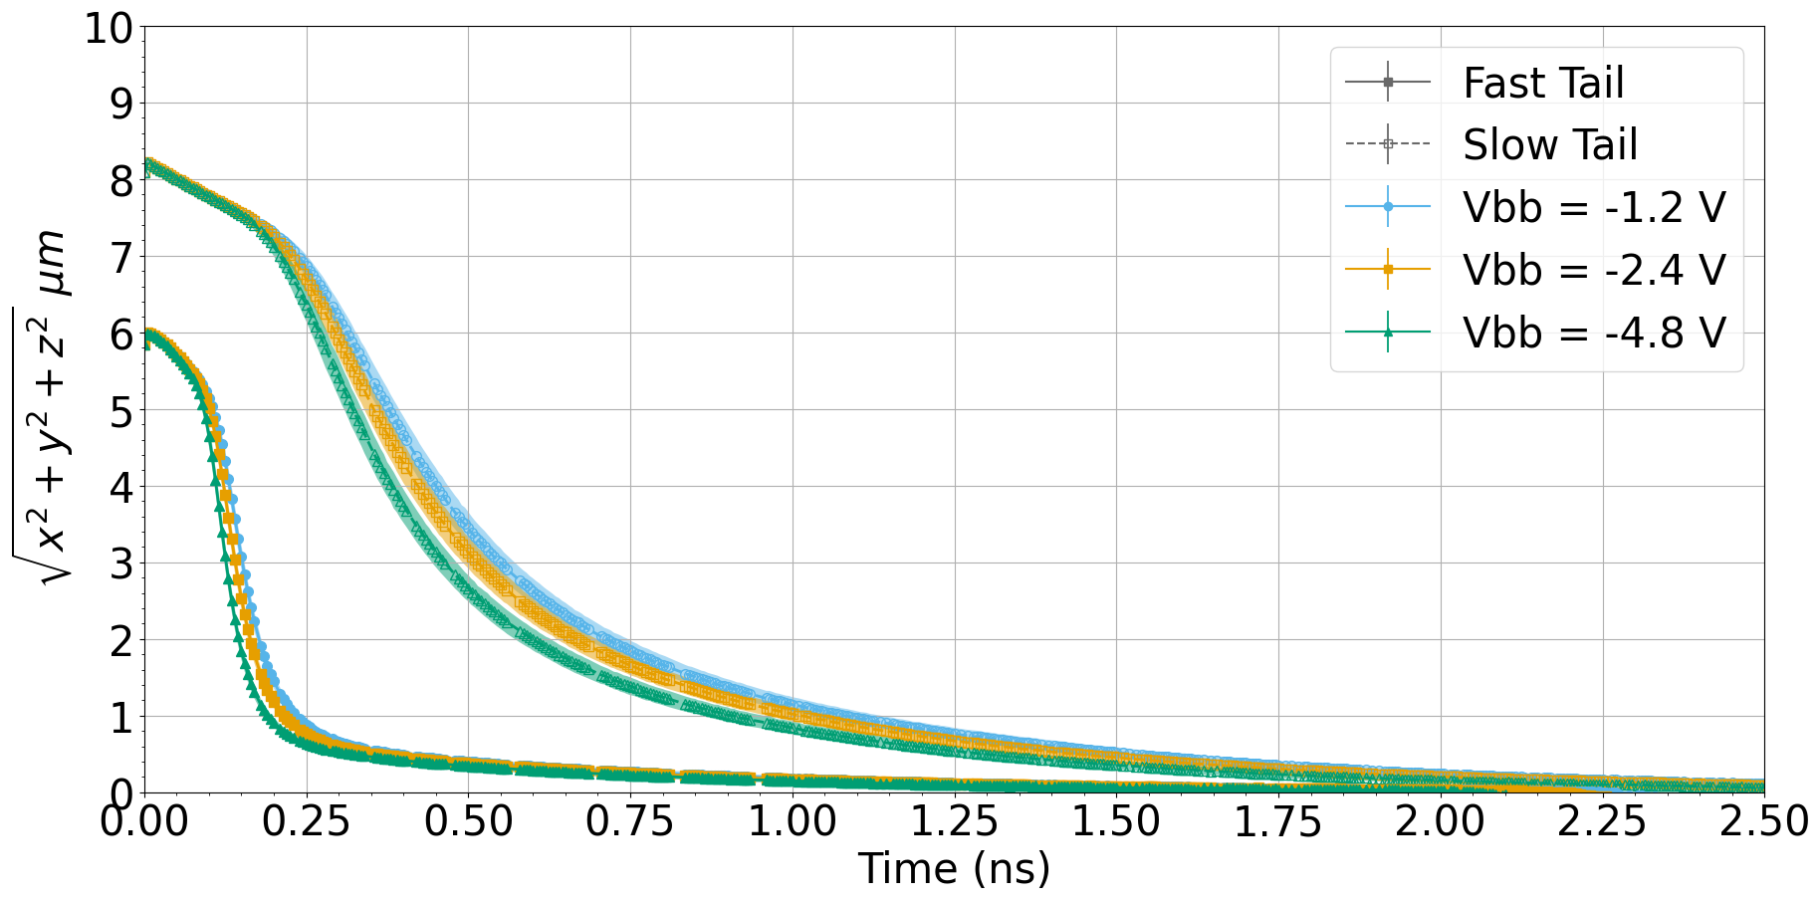
Charge Collection Speed
By comparing charge collection at different reverse biases, it is possible to observe that the fast tail events don’t undergo significant differences, when changing reverse bias, while a decrease of charge collection speed is observed in the slow tail events.
A linear trend is observed for the slow tail events at times less than 200 ps, not changing with reverse bias: this is due to the diffusion contribution (isotropic and independent to reverse bias) in the first part of the charge collection process.
6th Allpix Squared User Workshop 2025 – S. Perciballi / 7-9 May
18

Slide 19
Conclusions
An unexpected behavior was observed on the modified with gap sensor with the ⁵⁵Fe source
Some simulations using approximated doping profiles were made to fully understand the data
Even if approximate doping profiles were used, the experimental results can be reproduced
From the simulations, it can be established that this behavior is due to a feature of the electric field
These results and simulations helped to better understand sensors performance
The experimental data and the simulation results were confirmed using the proper doping profiles
6th Allpix Squared User Workshop 2025 – S. Perciballi / 7-9 May
19

Slide 20
Thank you!
6th Allpix Squared User Workshop
6th Allpix Squared User Workshop 2025 – S. Perciballi / 7-9 May
20

Slide 21
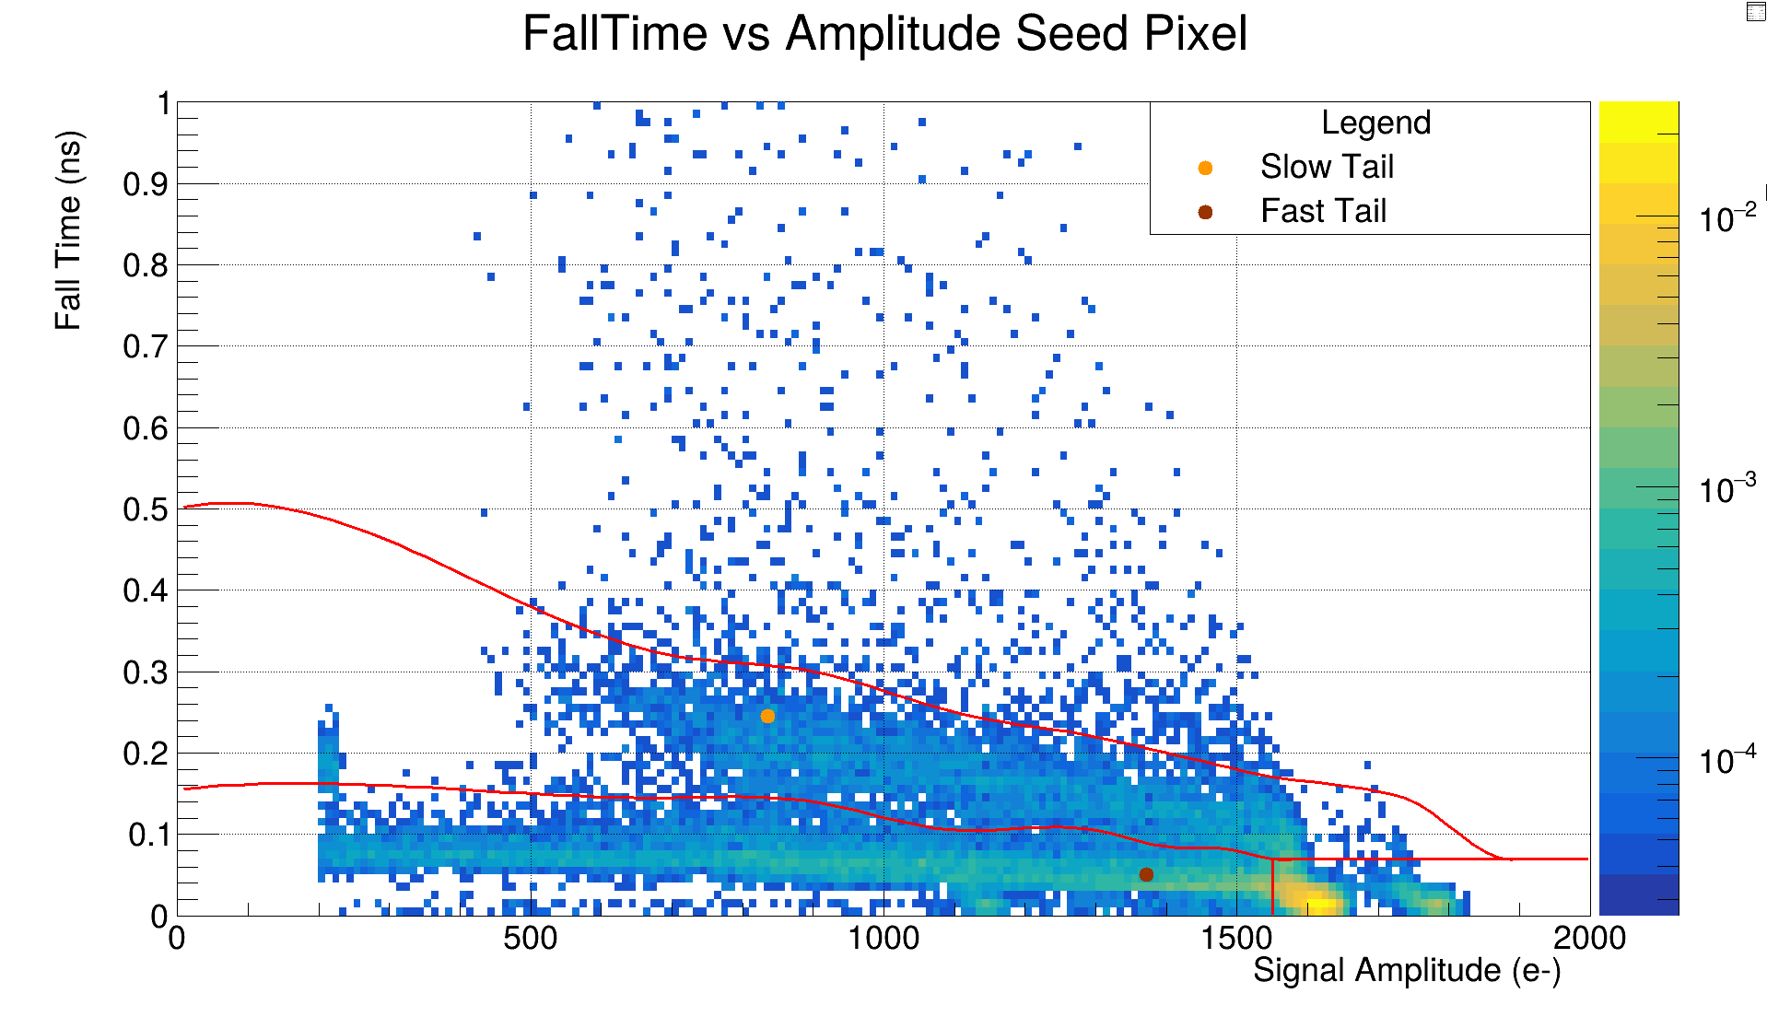
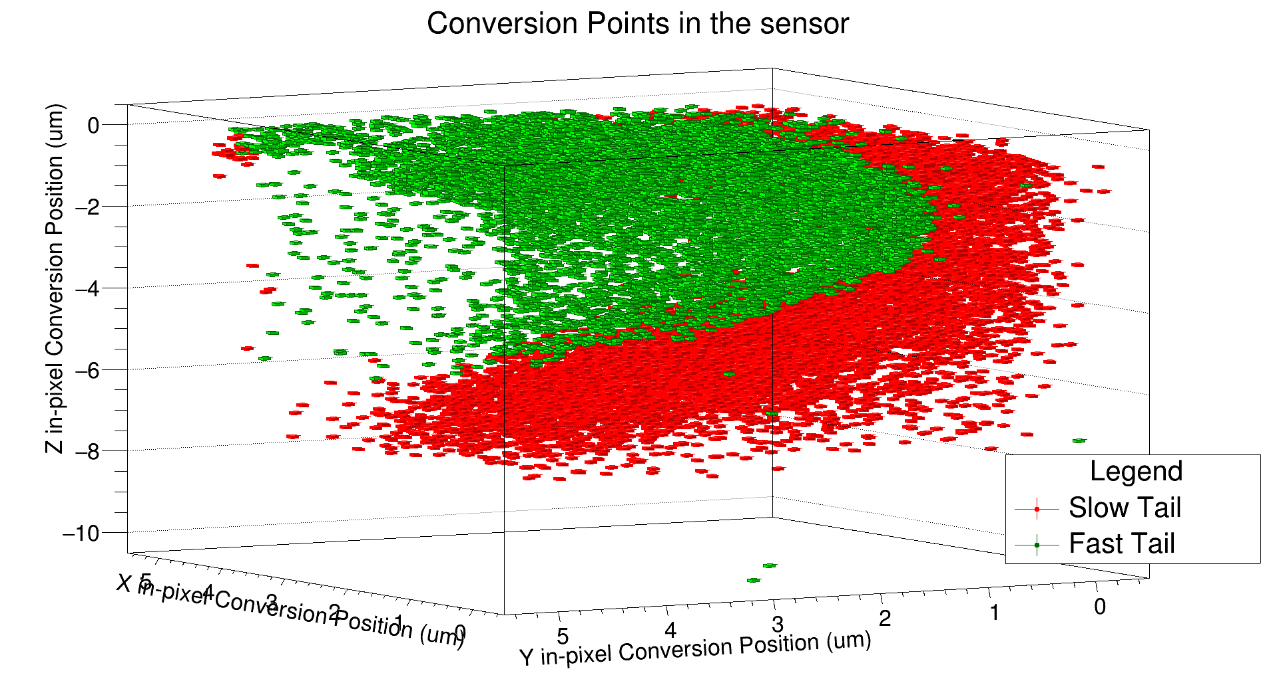
Tail Conversion Points
Fall time versus amplitude from the simulation: by separating the fast and slow component it is possible to obtain the conversion points in the sensor
Electrode
6th Allpix Squared User Workshop 2025 – S. Perciballi / 7-9 May
21

Slide 22
Charge Collection with ⁵⁵Fe
MODIFIED
MODIFIED WITH GAP
Increasing V_{reverse bias}
6th Allpix Squared User Workshop 2025 – S. Perciballi / 7-9 May
22

Slide 23
MLR1 Test Structures
MLR1: Multi Layer Reticle 1 → first submission in the TPSCo 65 nm technology
APTS (Analogue Pixel Test Structure)
CE65 (Circuit Exploratoire)
DPTS (Digital Pixel TS)
aim: explore different pixel designs
matrix sizes: 4×4
pixel pitch: (10, 15, 20, 25) µm
Two types of output drivers:
Source follower (APTS-SF)
Operational Amplifier (APTS-OA) → preserve timing information
aim: study pixel matrix uniformity
matrix sizes: 64x32, 48x32
pixel pitch: 25, 15 μm
aim: study in-pixel discrimination
matrix sizes: 32×32
pixel pitch: 15 µm
6th Allpix Squared User Workshop 2025 – S. Perciballi / 7-9 May
23

