Slide 1
Charge Carrier Propagation based on pre-calculated Lookup-Tables
Corentin Lemoine (CERN / IPHC-Strasbourg)
Simon Spannagel (DESY)
Isabella Sanna (CERN)
Walter Snoeys (CERN)

Slide 2
Context
Mix between "application" done at CERN and Allpix² development done by Simon Spannagel (DESY)
Look-up method already used in the past (at least in ALICE ITS2)
Initially developed with Garfield++, being ported to Allpix²
I will talk about Garfield++ and Allpix² -> the goal is not to compare but to improve (both ideally)

Slide 3
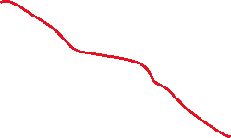
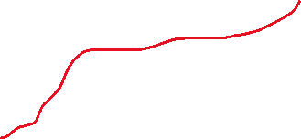
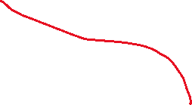

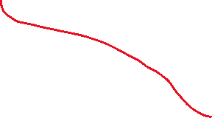
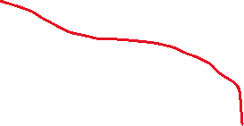

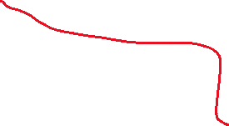
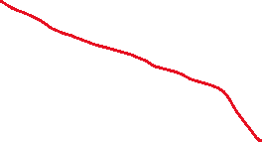
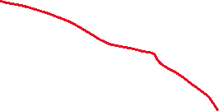
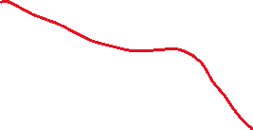
Look-up propagation concept
70% of the charges collected by pixel A
PIXEL A
COLLECTION ELECTRODE
10% of the charges collected by pixel B
PIXEL B
COLLECTION ELECTRODE
P-WELL
P-WELL
LOW DOSE N-TYPE IMPLANT
LOW DOSE N-TYPE IMPLANT
P⁻ EPITAXIAL LAYER
P⁺ SUBSTRATE
Propagate large number of charges from a fixed position e.g. with GenericPropagation
20% of the charges ‘lost’ (e.g. recombined)

Slide 4
Look-up propagation concept
PIXEL A
COLLECTION ELECTRODE
PIXEL B
COLLECTION ELECTRODE
~700 e-
~100 e-
P-WELL
P-WELL
LOW DOSE N-TYPE IMPLANT
LOW DOSE N-TYPE IMPLANT
1000 e-
P⁻ EPITAXIAL LAYER
P⁺ SUBSTRATE
If you get a new charge deposit in the same position,
-Do you rerun the ‘same’ (modulo random variation) propagation algorithm ?
-Do you exploit previous results ?

Slide 5
Look-up propagation concept
N.B. This method remove all notion of timing of the signal
When deposited here, ~100% of the charge is collected in pixel A
PIXEL A
COLLECTION ELECTRODE
PIXEL B
COLLECTION ELECTRODE
P-WELL
P-WELL
LOW DOSE N-TYPE IMPLANT
LOW DOSE N-TYPE IMPLANT
When deposited here, ~50% of the charge is collected in pixel A and ~50% in pixel B
P⁻ EPITAXIAL LAYER
P⁺ SUBSTRATE
Divide the pixel in a grid
Inject a ‘large’ fixed number of charges in each point of the grid
Propagate with your favorite algorithm
Save result into a look-up table
Use the look up table for fast charge propagation

Slide 6


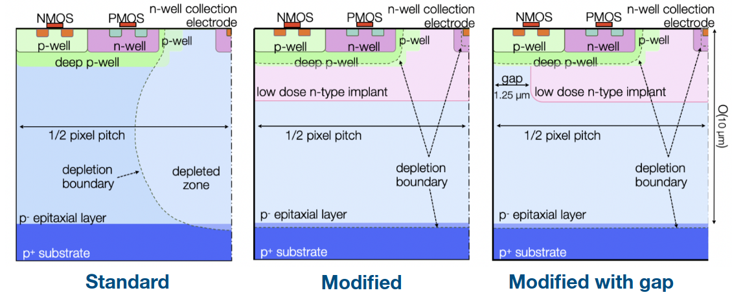
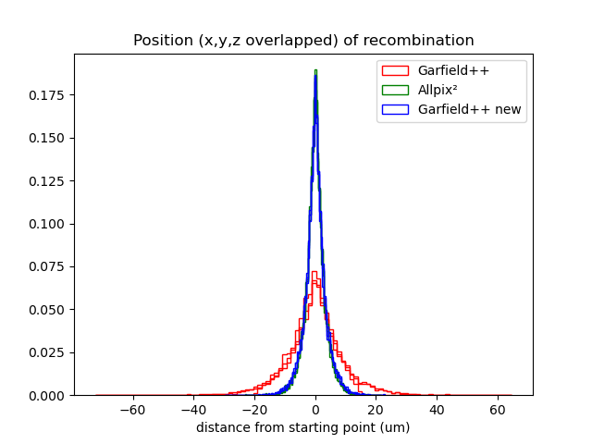
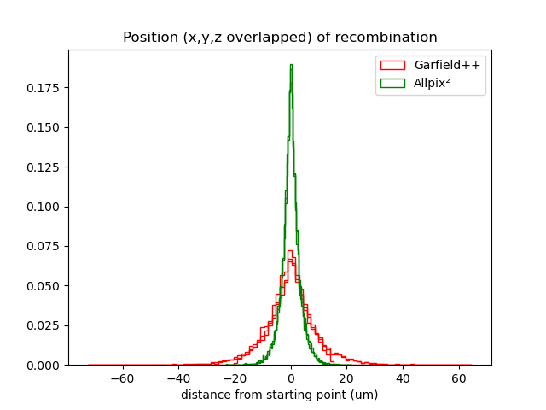
Application example: with Garfield++
65nm CMOS MAPS (see presentations early afternoon today)
Analog readout prototype (APTS)
Fe radioactive source characterisation
Garfield++ required some debugging (e.g. lifetime was not correctly implemented in low field regions). Allpix² was extremely helpful to compare and converge to a correct solution (now in Garfield++ master)
See: I. Sanna et al., TCAD and charge transport simulations of MAPS in 65nm for the ALICE ITS3, PIXEL 2024

Slide 7
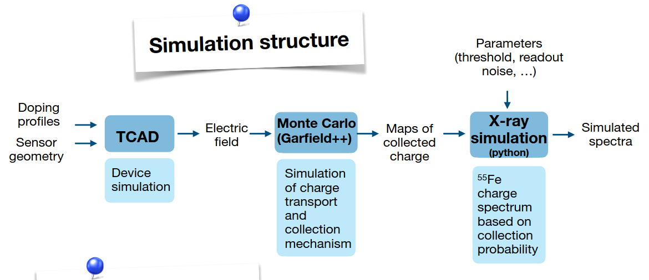
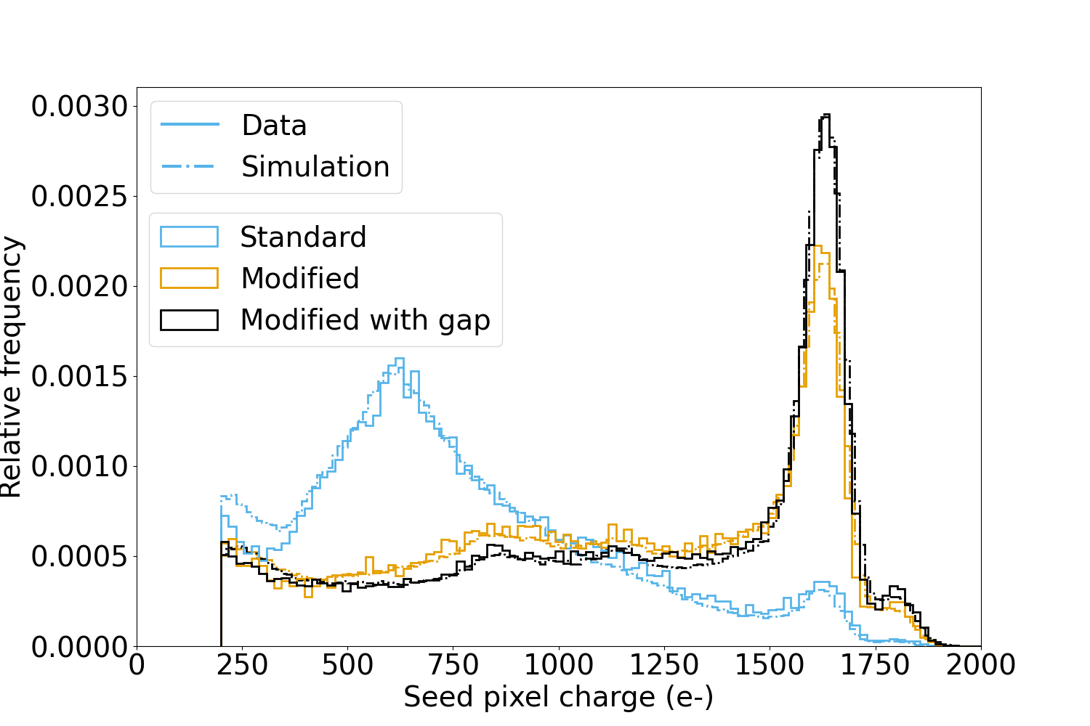


Application example: with Garfield++
Charge propagation maps produced with Garfield++ for ¼ of pixel
Garfield++ imports electric field + mobility + lifetime from 3D TCAD
Inject 1000e-, charge collection recorded in a 5x5 matrix (plain text for readability, can be shared for physics performance studies)
Fe55 like deposition and propagation from custom python script
Smeared with measured noise and compared with measurement
Excellent matching, including diffusion dominated 'standard' type
See: I. Sanna et al., TCAD and charge transport simulations of MAPS in 65nm for the ALICE ITS3, PIXEL 2024

Slide 8
And with Allpix² ?
Scan deposition point in a pixel with DepositionPointLike
Simulation of the charge transport with your favorite propagation module (recommend GenericPropagation)
Missing something to consolidate results into charge propagation maps -> new module PropagationMapWriter (!1190)
Charge deposition with your favorite module
Use the look up table for fast charge propagation -> new module MappedPropagation (!1173)
Developed by Simon Spannagel

Slide 9
MappedPropagation
Use INIT format as for electric field or doping concentration
Read propagation maps for a matrix of 5x5 (hardcoded)
Allow configuration of the map depth and of the represented volume (¼ pixel, full pixel...) similarly to other fields
Read closest propagation map for each deposition position and sample from it to propagate each charge group.
Fast charge propagation in O(deposited charge groups). Independant of sensor complexity

Slide 10

INIT file format for charge propagation map
Header: (X = unused value)
X X
X X X
X X X
Size_z_um Size_x_um Size_y_um X X X X nb_bins_x nb_bins_y nb_bins_z X
Data:
index_x index_y index_z followed by 25 numbers describing the number of
charge collected in each pixel of the 5x5 matrix
Example INIT file, to be used with
field_mapping=PIXEL_QUADRANT_I and mapping_depth=24um
5x5 matrix example:
0 0 0 0 0
0 0 238 245 0
0 0 248 265 0
0 0 0 0 0
0 0 0 0 0
X X
X X X
X X X
24 7.5 7.5 X X X X 26 26 81 X
1 1 65 0 0 0 0 0 0 0 0 0 0 0 0 996 0 0 0 0 0 0 0 0 0 0 0 0
1 1 40 0 0 0 0 0 0 2 3 2 0 0 7 314 8 0 0 0 6 0 0 0 0 0 0 0
26 1 65 0 0 0 0 0 0 0 0 3 0 0 0 492 498 0 0 0 0 2 0 0 0 0 0 0
26 26 65 0 0 0 0 0 0 0 0 0 0 0 0 248 265 0 0 0 238 245 0 0 0 0 0 0

Slide 11
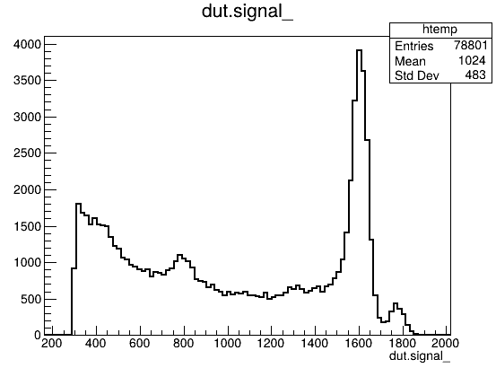

How fast ?
multithreading =false
number_of_events = 100000
[DepositionReader]
model = "root"
file_name = "deposition.root"
...
[MappedPropagation]
file_name = "maps_15um_1p2V_prerad_flip.init"
field_offset = 0, 0
field_mapping = PIXEL_QUADRANT_I
mapping_depth = 24um
charge_per_step=1
max_charge_groups=10000
[SimpleTransfer]
[DefaultDigitizer]
threshold = 300e
threshold_smearing=0e
electronics_noise=27e
>6 M charges propagated per second, on a single core
(>1500e-/event*100000events) / (0.36*66)

Slide 12
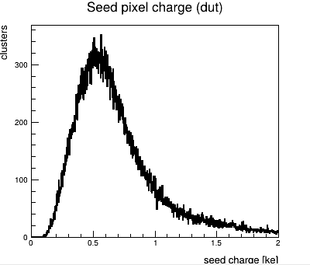

How fast?
multithreading =false
number_of_events = 100000
[GeometryBuilderGeant4]
[DepositionGeant4]
physics_list = QGSP_BERT_EMZ
enable_pai = 1
number_of_particles = 1
particle_type = "pi+"
source_energy = 120GeV
source_type = "beam"
source_position = 0 0 -10mm
beam_size = 100um
beam_divergence = 0mrad 0mrad
beam_direction = 0 0 1
max_step_length = 0.5um
With a more realistic deposition, charge propagation is not the slowest module.

Slide 13
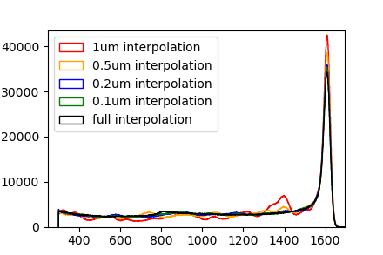
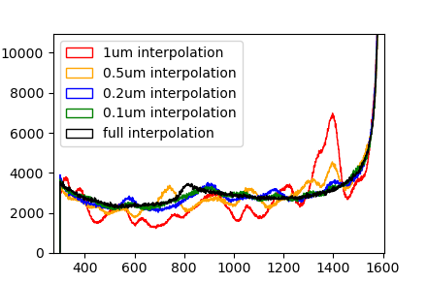
Should we use interpolation ?
So far the closest propagation map is used without interpolation
For performance reasons interpolating fields is not usually done (finer mesh usually not costly but interpolation is)
For propagation maps, building the map is long, using it is very fast
Scan of a 15um pitch sensor with ~1616e- (sigma of 14e-) point like deposition for different map mesh sizes
Charge (e-)

Slide 14
Should we use interpolation ?
So far the closest propagation map is used without interpolation
For performance reasons interpolating fields is not usually done (finer mesh usually not costly but interpolation is)
For propagation maps building the map is long, using it is very fast
Fine mesh is needed for the map
But generating a fine meshed map is long
  Generate reasonably fine mesh map and preprocess it to a finer mesh
  Or consider implementing interpolation for this field only
Charge (e-)

Slide 15
Importing mobility + lifetime from TCAD
Garfield++ allows this possibility, Allpix² imports 'only' doping concentration and electric field + uses models within Allpix²
Interesting possibility in some circumstances in my opinion
Might be a slightly faster (simple look up for e.g. mobility instead of computing from a formula)
Allows to exploit models available in e.g. TCAD before implementing it in Allpix²
But only suitable if importing fields...
Also in development in Allpix² (!1175)

Slide 16
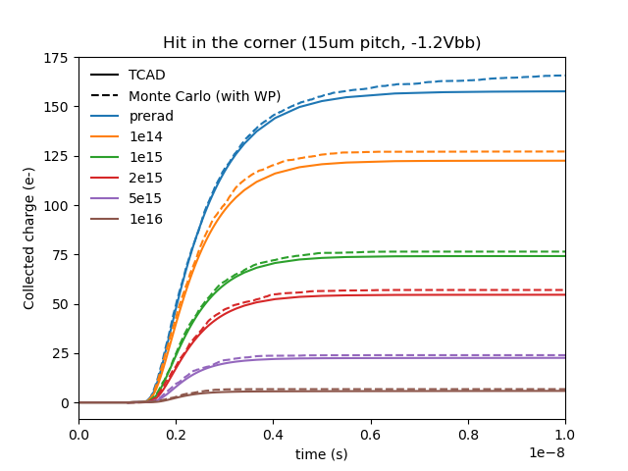
Importing lifetime: effective lifetime
Imported lifetime can embed e.g. recombination+trapping lifetime
Include the effect of irradiation (in the form of trapping) directly in the lifetime read by Garfield++ from TCAD.
The irradiated sensor simulation in Garfield++ is exactly the same (not even a parameter to change)
Not perfect but quite good trend.
Effective_lifetime =
1/(1/lifetime_recomb + trapping_rate)
trapping_rate =
Σv_{th}*available_trap_concentration*trap_cross_section
"Available" trap is either full or empty trap depending on carrier and trap type

Slide 17
Conclusion
Inspired by previous developments (from Garfield++, ALICE, CERN EP-R&D WP1.2, …)
Development ongoing in Allpix² of a (super) fast look-up based charge propagation module and surrounding utilities (map generation).
Importing mobility or lifetime as external field is also under development.
Big thanks to Simon for volunteering to develop all this in Allpix²
Status: most development done fast, validation needed (I am late)

