Slide 1
Si3: Simulation-Driven Design of a Next-Generation Semiconductor Detector for PET and SPECT Imaging
Luca Terenzi, Per Lundhammar, Mats Danielsson

Slide 2
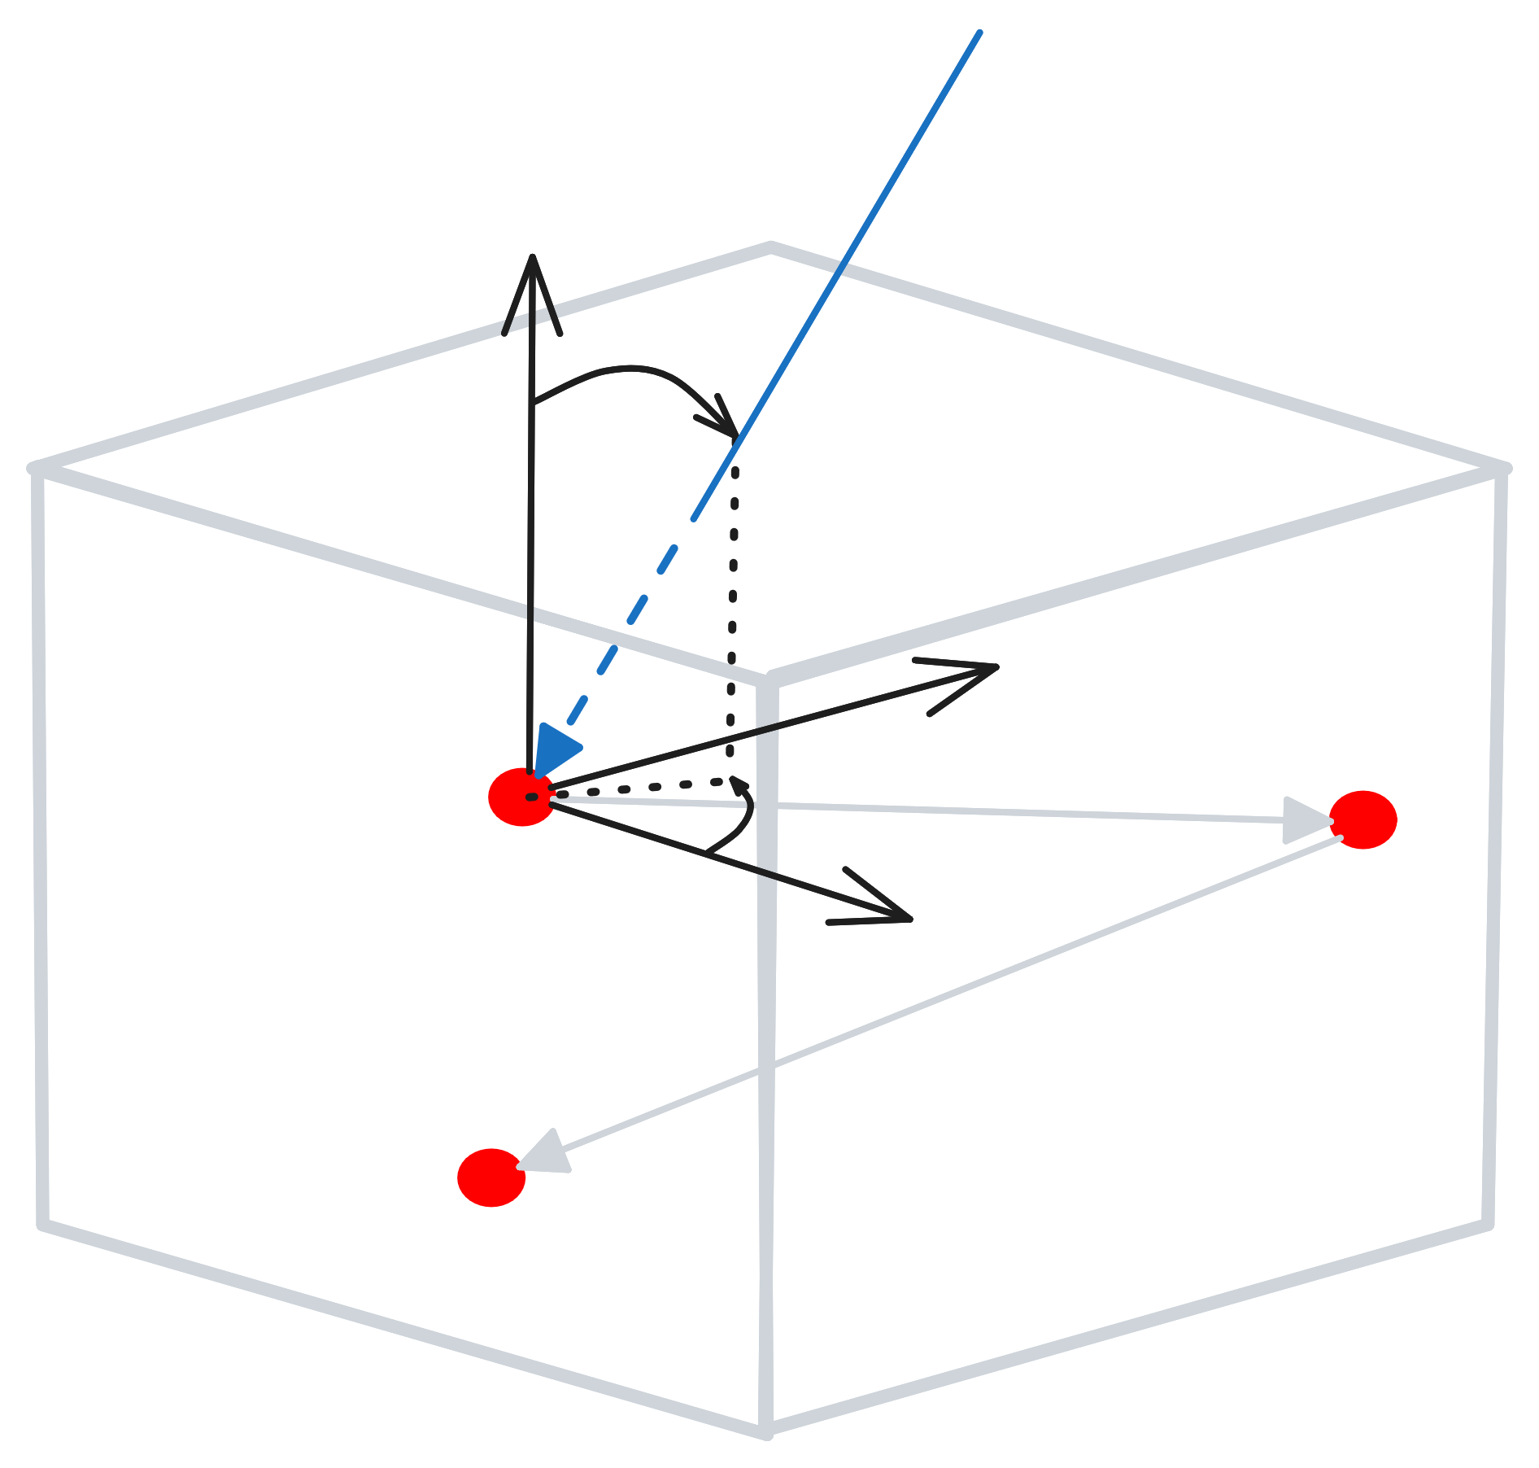
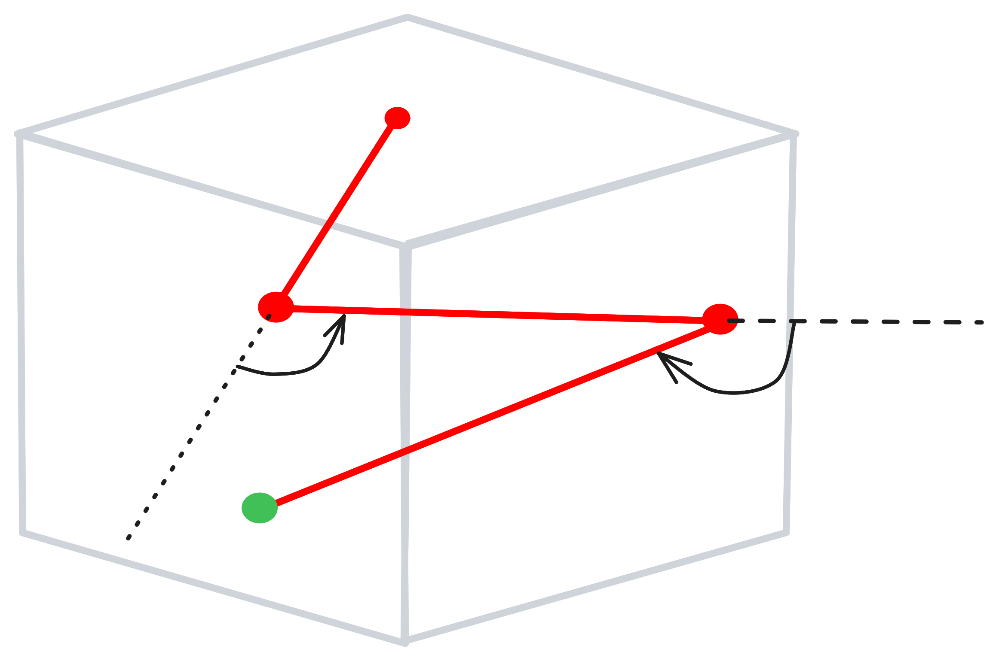
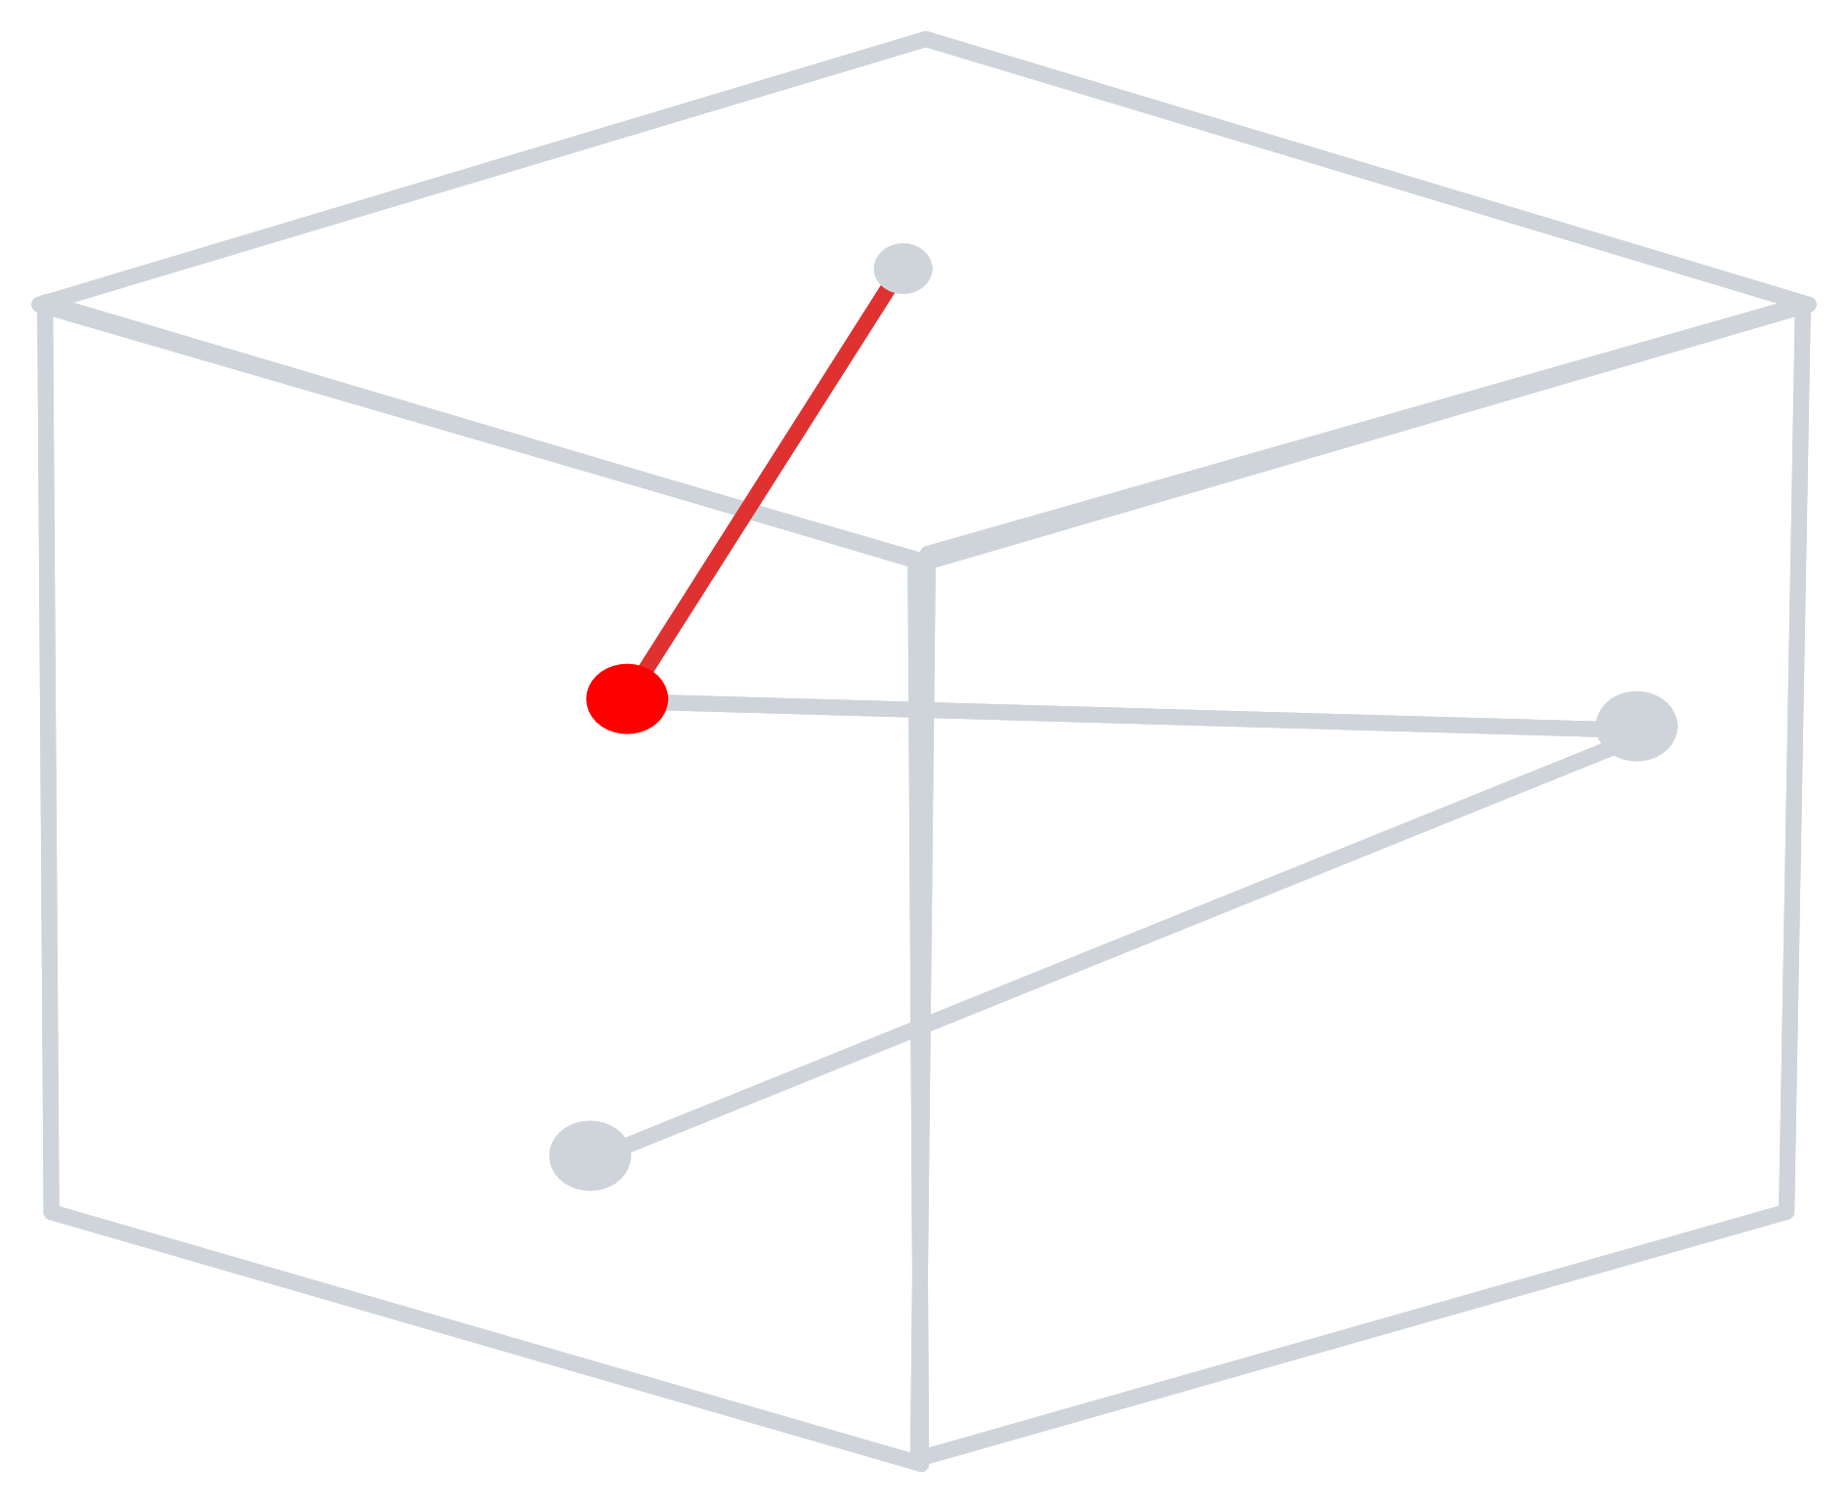
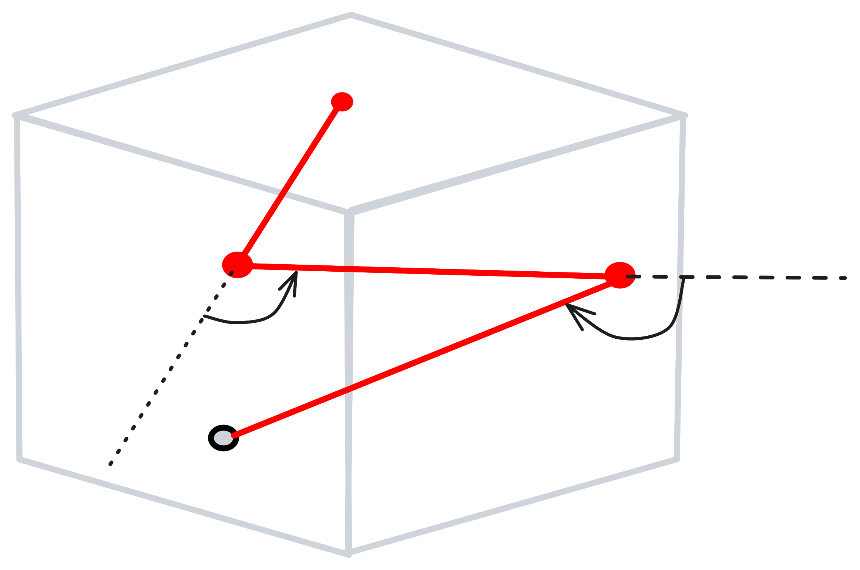
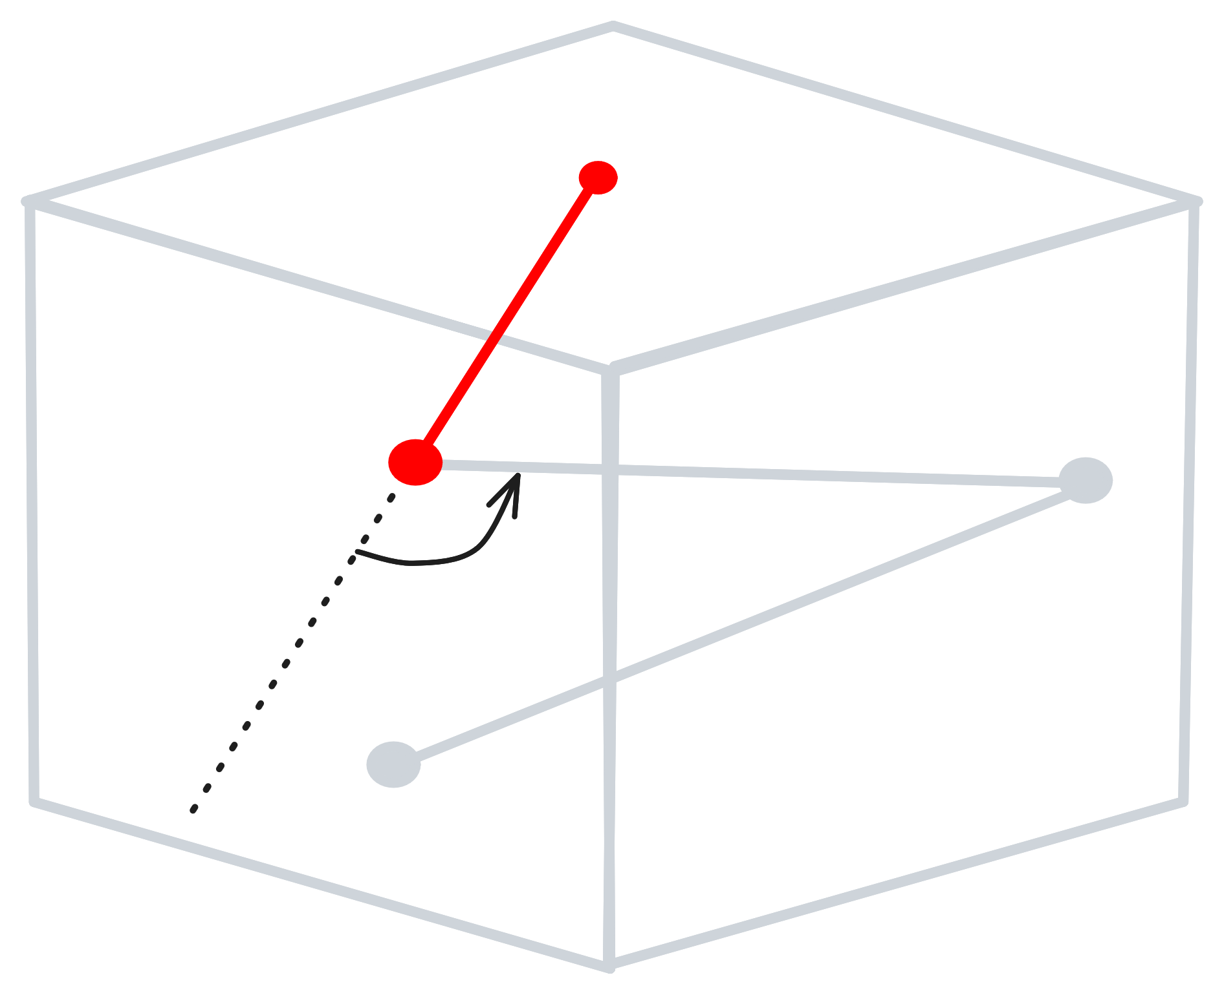
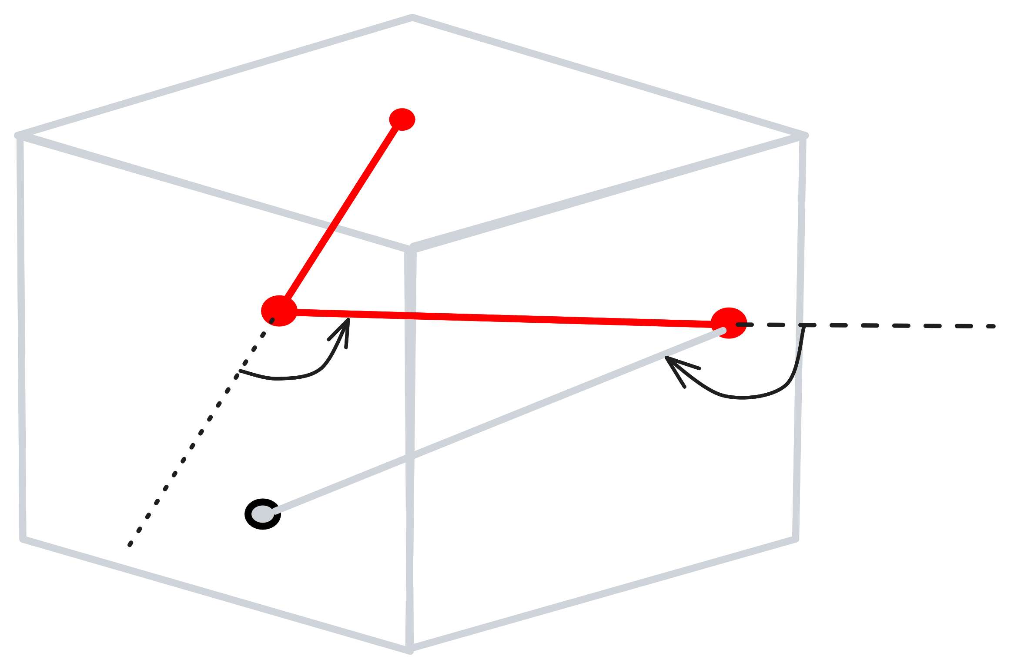



Detector concept
$$E$$
$$θ$$
$$φ$$

Slide 3

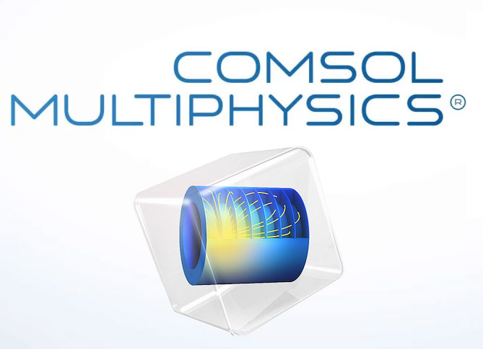

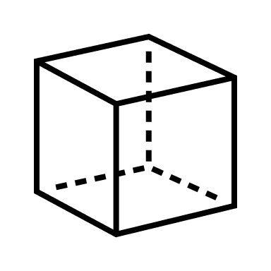
Simulation chain
Photon source
10 cm
electron source

Slide 4
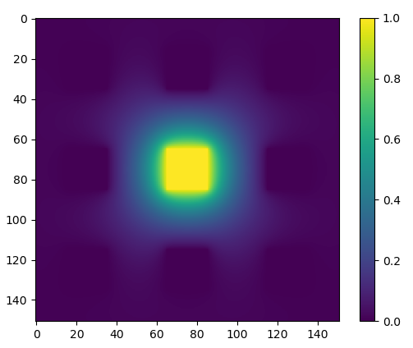
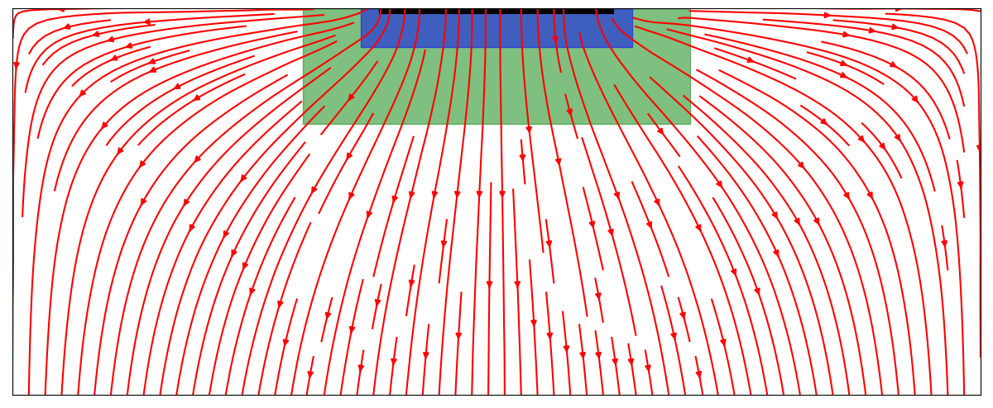
Simulation chain
Example for a 25x25x750 um pixel with 6x6 um electrodes
Unit weighting potential (10x10x3 um)
Allpix implant (7x7x1 um, stops charge carriers’ propagation)
Electrode (6x6x0 um)
Electric field
Pixel
Weighting potential [-]
Electrode

Slide 5
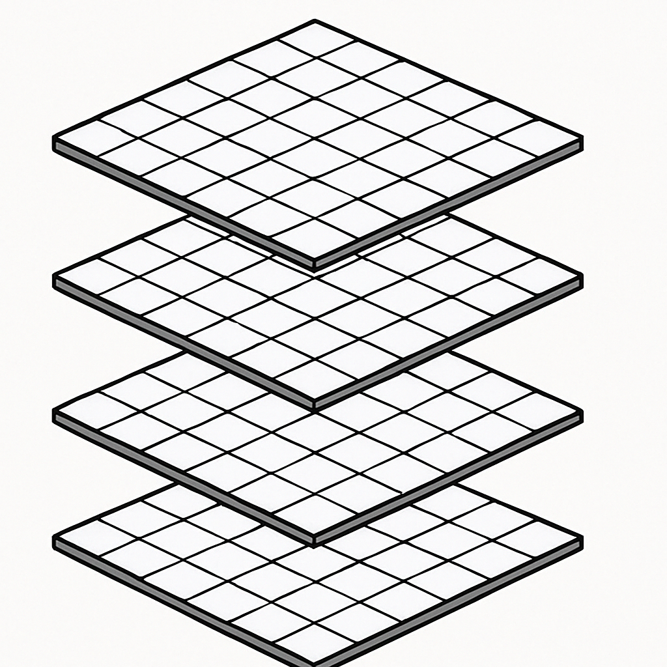
Simulation chain
Detector volume
In total, tens of millions of pixels simulated!

Slide 6
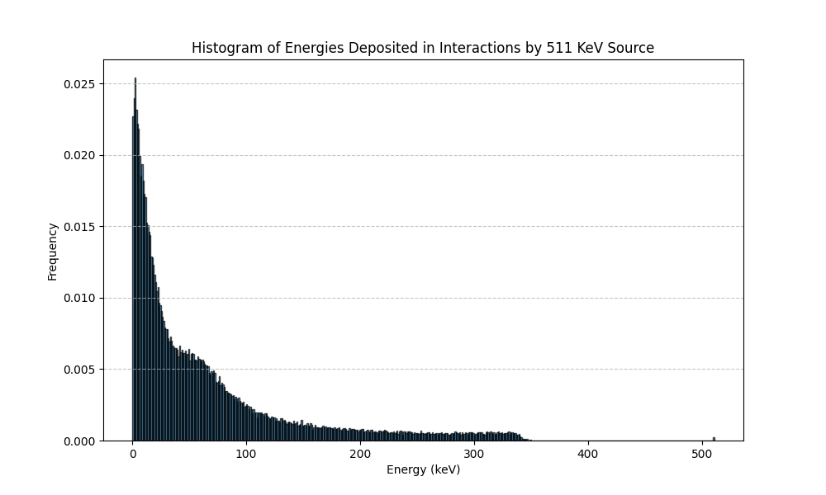
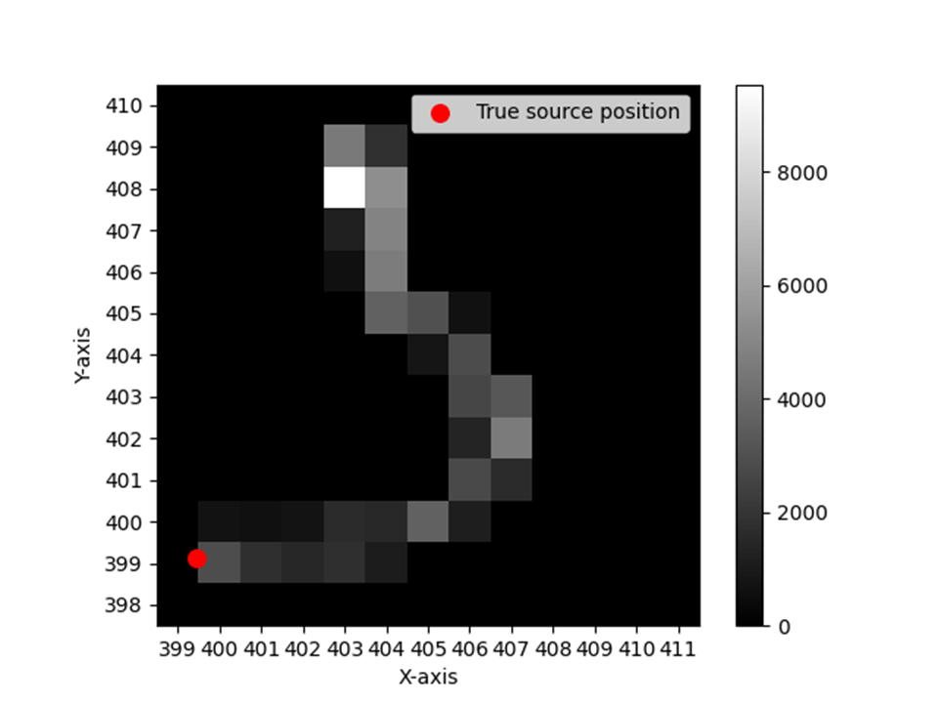
Simulation chain
Photon source
10 cm
Water cylinder
electron source

Slide 7
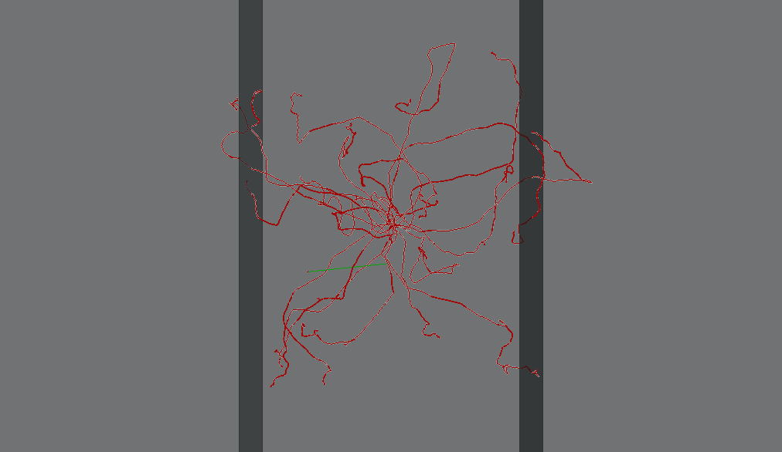
Simulation chain
Sensor 2
Sensor 1
Sensor 3

Slide 8
In plane spatial resolution
Electrodes
Silicon bulk
Photon
Compton interaction

Slide 9
In plane spatial resolution
Electrodes
Silicon bulk
Electron cloud
Notes:
2.939*10^11 charges/cm^3 n type doping for silicon

Slide 10
In plane spatial resolution
Electrodes
Silicon bulk
Electron cloud

Slide 11
In plane spatial resolution
Electrodes
Silicon bulk
Electron cloud
20 e⁻
78 e⁻
2 e⁻
Interaction coordinates?

Slide 12
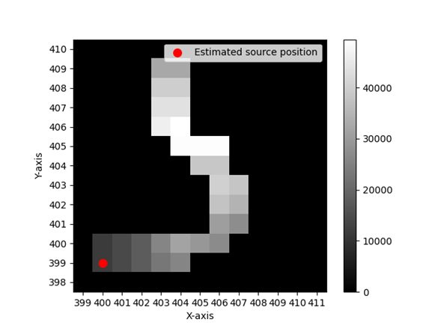
In plane spatial resolution
Gridsum Algorithm
# Induced electrons
# Induced electrons
0 | 0 | 4 | 2 | 0 | 0 | 0
0 | 0 | 1 | 8 | 2 | 0 | 0
0 | 0 | 0 | 3 | 5 | 0 | 0
0 | 0 | 0 | 2 | 6 | 0 | 0
0 | 0 | 0 | 4 | 2 | 0 | 0
1 | 2 | 3 | 2 | 0 | 0 | 0
1 | 1 | 0 | 0 | 0 | 0 | 0
= 49

Slide 13
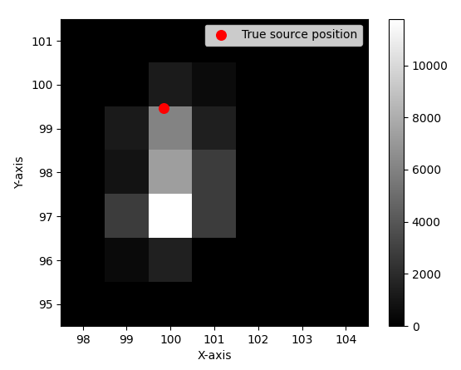
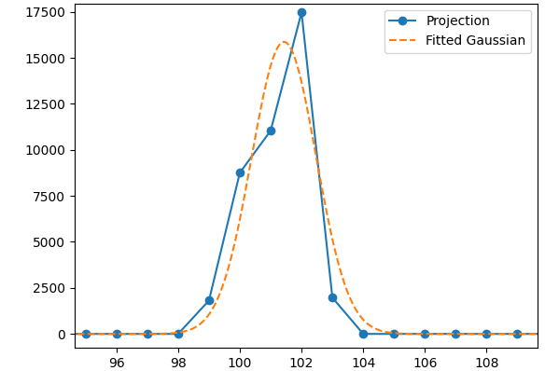
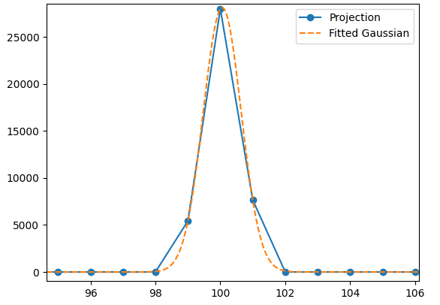
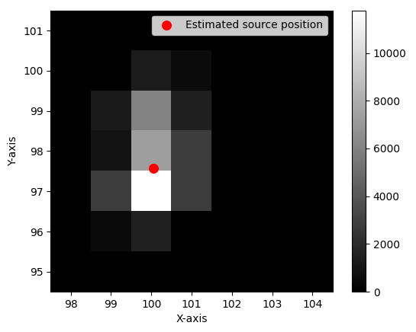
In plane spatial resolution
Gaussian fit Algorithm
Projection and gaussian fit along Y axis
Projection and gaussian fit along X axis
# Collected electrons
# Induced electrons
Pixel number
Pixel number
# Collected electrons

Slide 14
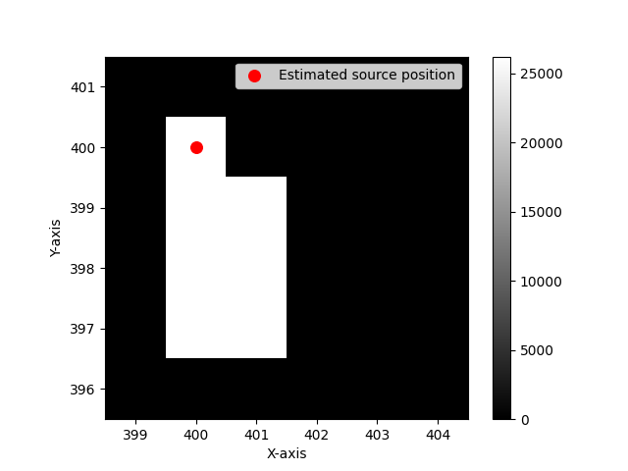
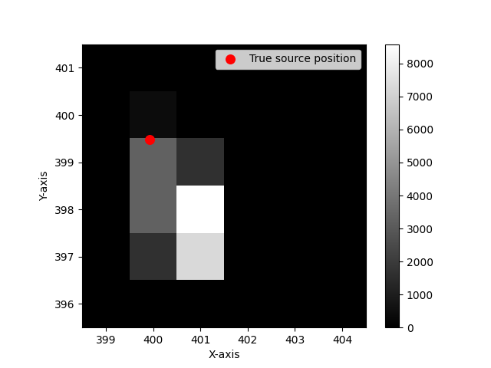
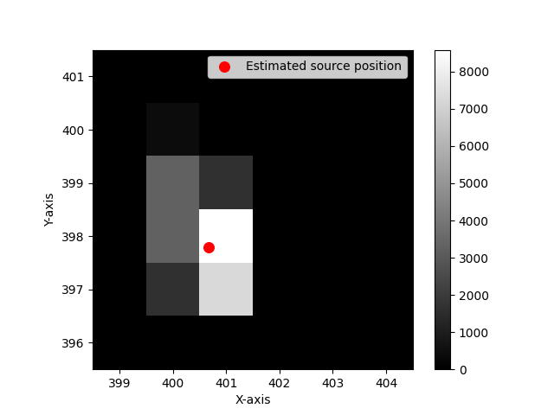
Gridsum
Algorithm results: 50 kev
Detected signal
Gaussian fit
In case of a draw, the pixel with the lowest detected signal is chosen!

Slide 15
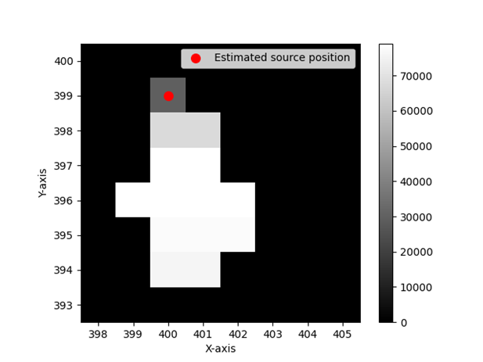
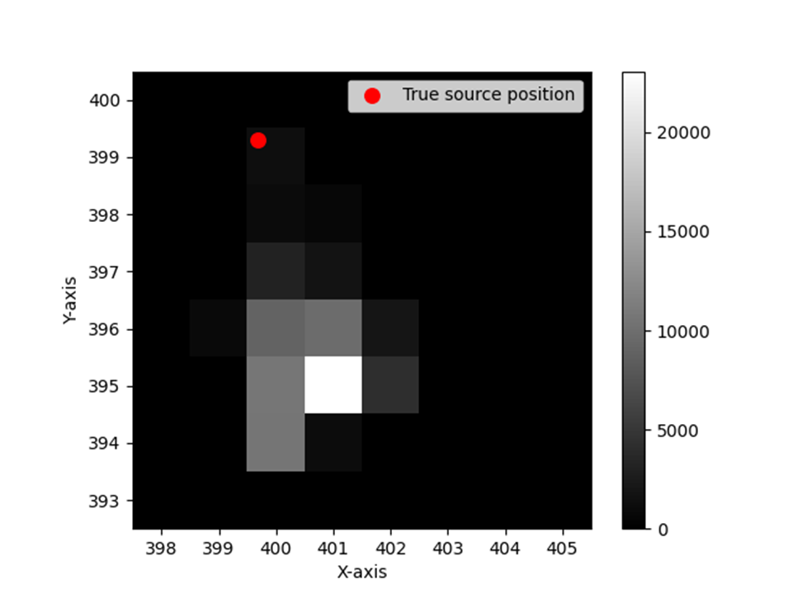
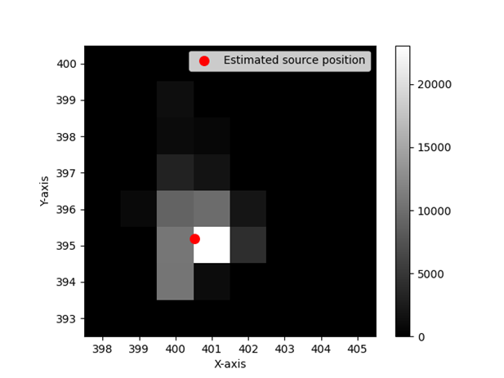
Gridsum
Algorithm results: 300 kev
Detected signal
Gaussian fit

Slide 16
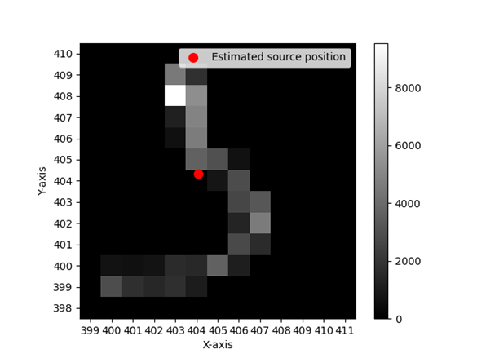
Gridsum
Algorithm results: 300 kev
Detected signal
Gaussian fit

Slide 17
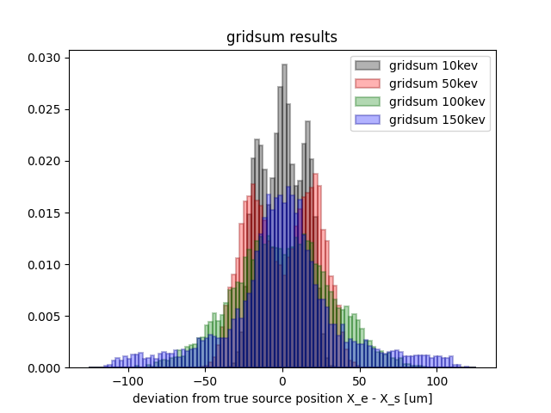
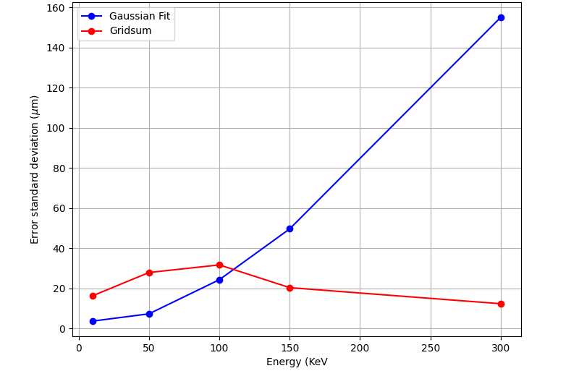
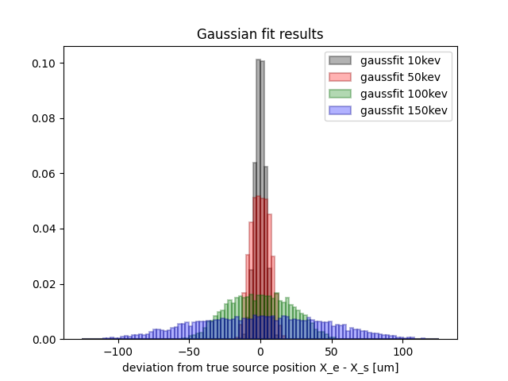
Algorithm results: 25 um pixel 6 um electrodes
Notes:
5000 run for each energy

Slide 18
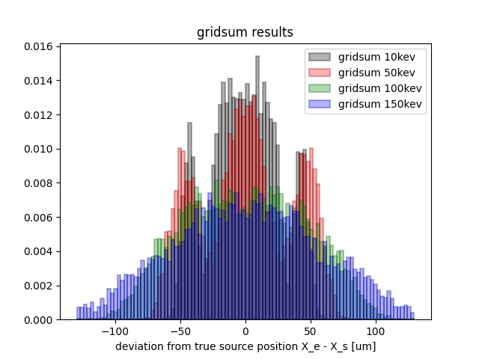
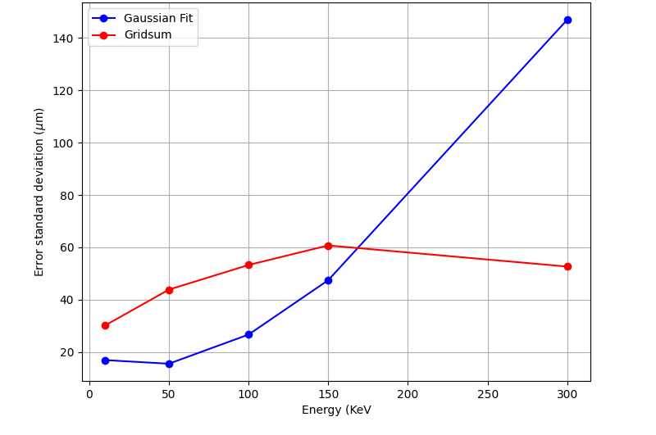
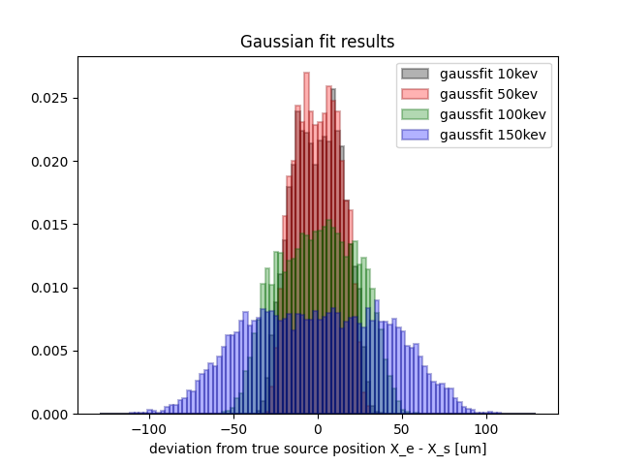
Algorithm results: 75 um pixel 9 um electrodes

Slide 19
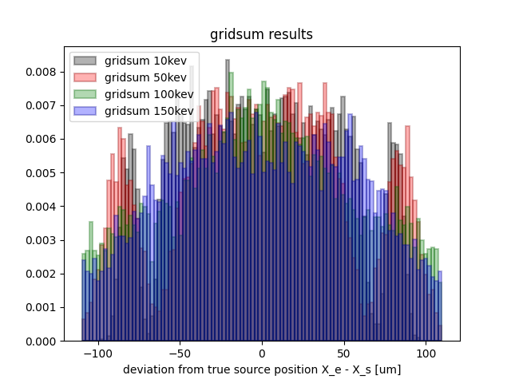
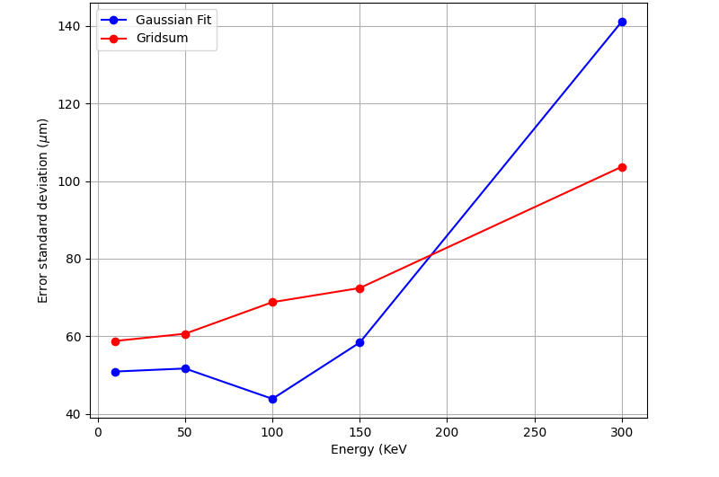
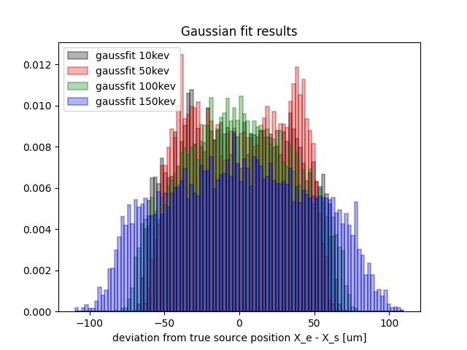
Algorithm results: 125 um pixel 18 um electrodes
Gridsum outperform Gaussian fit above 100-150 kev

Slide 20
Depth of interaction spatial resolution
|Z_{e} – Z₀|
|Z_{e} – Z₀|
Results from simulations with a previous software (Penelope)
Gaussian fit used from the diffusion of the electron cloud to estimate the depth of interaction
Gaussian fit does not seem to outperform the pixel center estimation method → further investigations needed

Slide 21
Impact of timing
Photon (A)
Electrodes
Silicon bulk
Photon (B)
Normally many events (photons) interacting with the detector, each can have 1 or more interactions
Cannot use timing information to resolve interaction order within a single event
Timing information is useful to separate different events
Important to avoid mixing up interactions from different events! (Time coincidences)

Slide 22
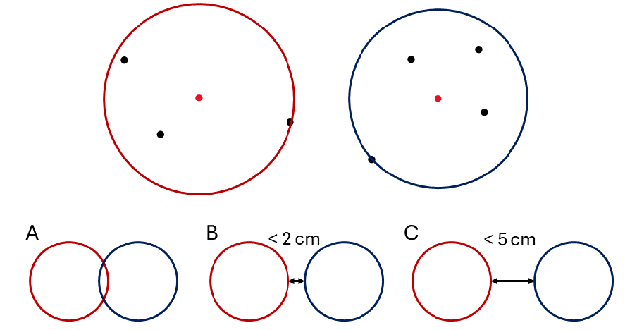
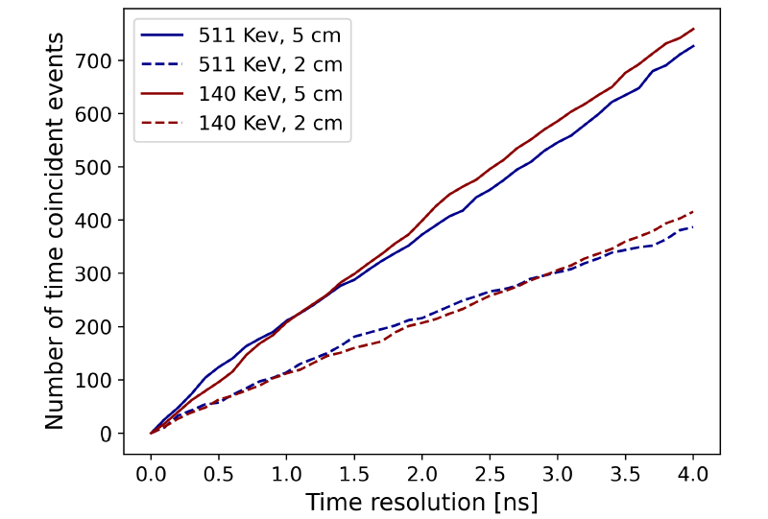
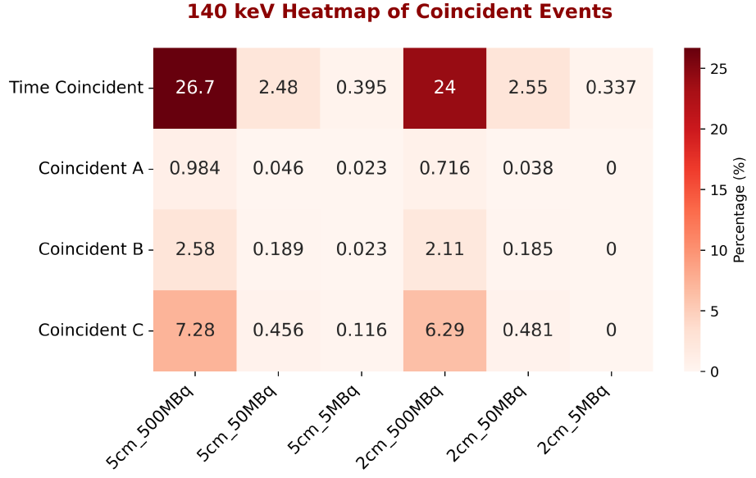
Time coincident events (lost events)
Investigated number of time coincidences varying the time resolution
Investigated number of time coincidences for fixed time resolution (2ns) and implementing spatial considerations
Notes:
Sdd also

Slide 23
Time coincident events (lost events)
If we assume 2 ns time resolution, we can keep low the number of events lost due to time coincidences
Notes:
Sdd also

Slide 24
Future steps
Find a way to efficiently simulate the fully pixelized detector with million of events
Develop more realistic phantoms for allpix simulations
Include Coulomb repulsion
Explore more the out of plane resolution
Notes:
Sdd also

Slide 25
Thank you for your attention!
Any questions?

