Slide 1
Exhibit brainstorm
Section meeting 23 01 2025

Slide 2
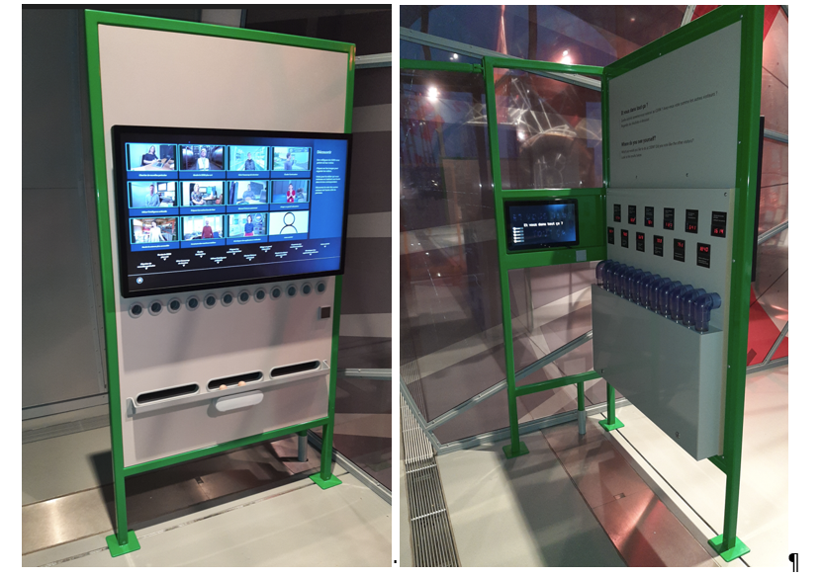
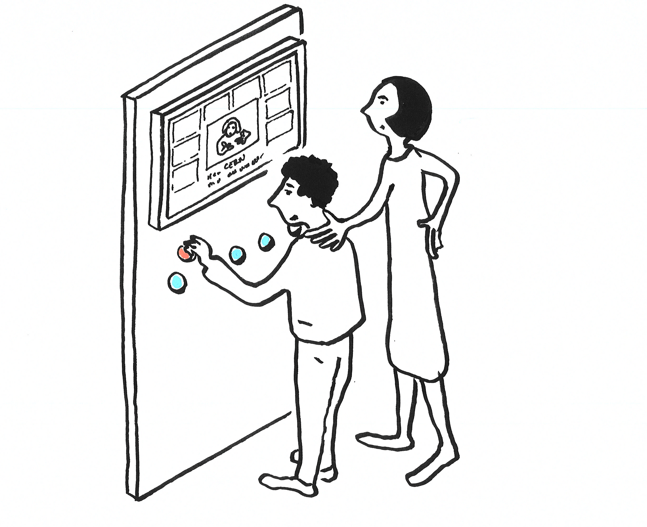
Where do you see yourself?
From engineers in micro-electronics through to theoretical cosmologists and computer scientists, there are over 100 different professions collaborating to make CERN work. There are of course a lot of scientists, but not only.
After watching videos where people working at CERN talk about their job, visitors can vote for which job they would most like to do.

Slide 3
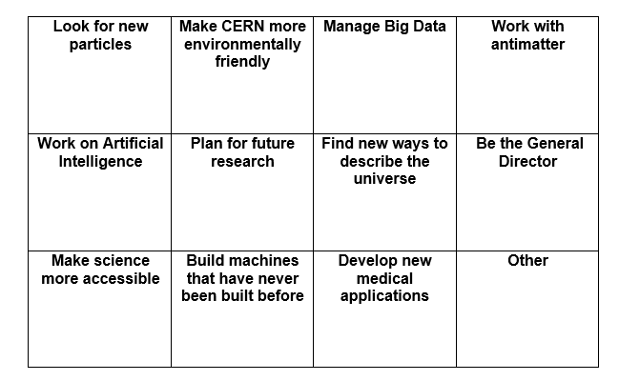
Some issues
Voting
  Kids
  Max 9999
“Other”
Limited professions
  Now 11

Slide 4
Some history: original idea
Massive histogram consisting of several tubes. Every visitor gets an event with a certain energy. They add their event to the graph by adding their cube to the correct tube (based on color & number corresponding to a mass)
  Resulting histogram is photographed on a regular basis -> a time-lapse is created and is visible on line
  People who don’t put their event will get missed -> equivalence to reality, systematic error
  Little peaks will build up and go away
Where do visitors get their “event”?
How many can they get? (one ? more?)
Visitors who put their token in wrong tube:
Corresponds to read out error (that also happens in real experiments)

Slide 5
Questions we had?
How long should it take to see a result?
  Restart each day/week/month/ a year?
  Possibly a month is a good interval (we also have to take into account the operational work of emptying the tubes, mixing the tokens, getting them back into the dispensers, restarting the video,…)
Too long might be disappointing for visitors/not lead to understanding
  We do not necessarily need to start with empty tubes,
  Each visitor could also get more than one cube
  Video of current and previous build ups also accessible in exhibition.
How to make visitors understand what this is about?
At which mass do we want the peak to build up?
Do we use cubes or balls?

Slide 6
Make it accessible
Testing with blind and visually impaired

Slide 7
Working with suppliers
Questions about working with real data
Issues with the tubes/balls idea
  Mechanical
  Safety
  Accessibility
After many detours this then led to
  Current exhibit “where do you see yourself”
  Find the Higgs part on third screen of the data flow exhibit

Slide 8
Brainstorm today
Better version of the exhibit on the jobs at CERN
New exhibit on data analysis
  Accessible for blind and VI visitors

