Slide 1
Test results
CP cold mass – LMCXF01
MTF: HCLMCXF001-CR000001
Nov-Dec 2025
Gerard Willering
Franco Mangiarotti, Gaëlle Ninet, Guillaume Pichon, Stian Juberg, Olivier Ditsch
Many thanks to Raphaël Bouvier and all colleagues involved.
Test plan: EDMS 3177216
Test results: EDMS 3213574

Slide 2
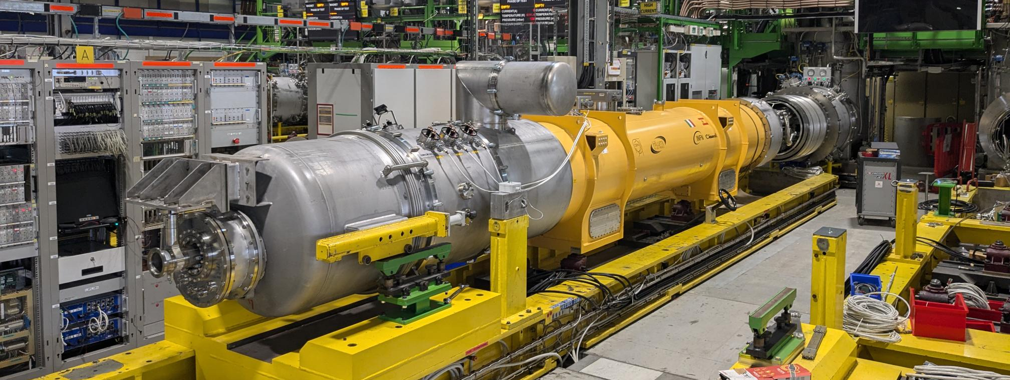
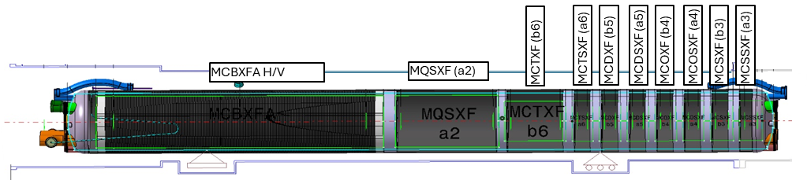
CP-assembly on the SM18 test bench
10 magnets are in the cold mass:
MCBXFAP1
MQSXF2
MCTXF2
MCTXF1
MCDXF01b
MCDXF02b
MCOXF03
MCOXF04b
MCSXF01b
MCSXF02
CFB
MRB

Slide 3
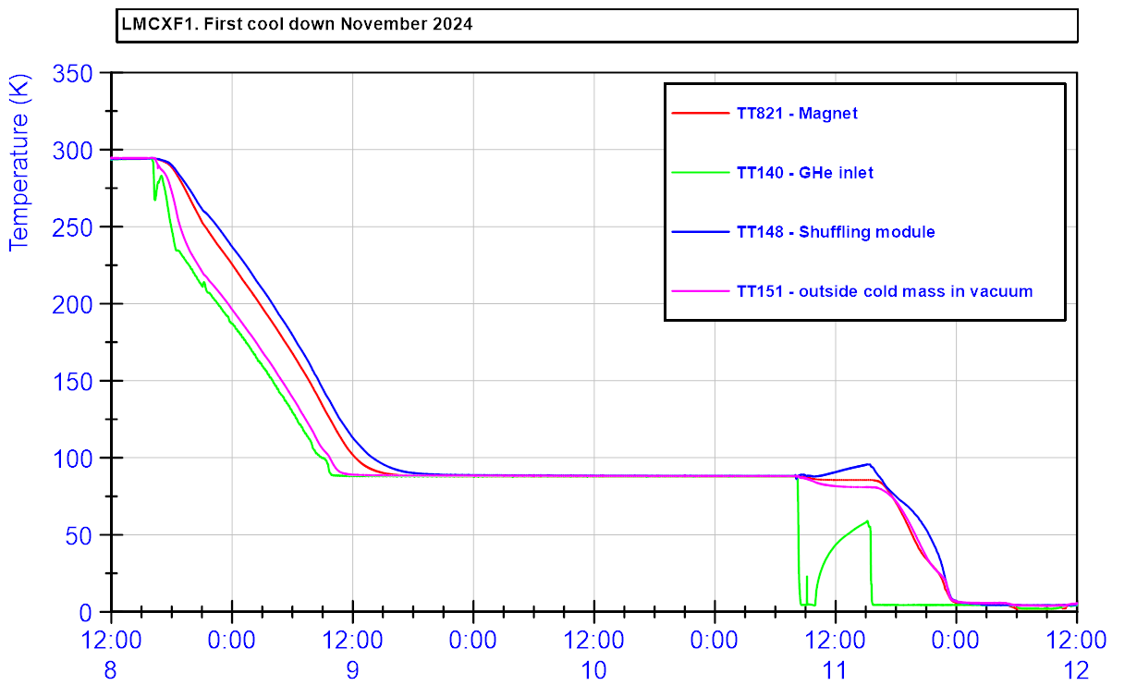
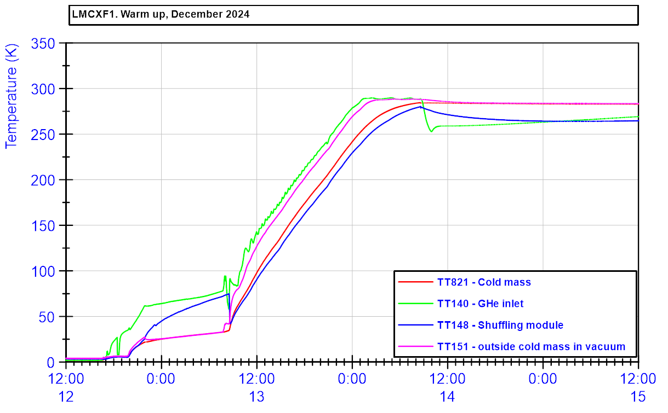
Test period - cool down and warm up.
The cool down was performed starting on November 8 2024.
The active cool down time was about 2 days.
Due to commissioning, the gas to liquid cooling step was not in automatic mode and needed to wait for the end of the weekend.
The warm up started on December 12 and took about 1.5 days.
ΔT = 50 K for warm up and cool down.

Slide 4
Electrical testing
All high voltage insulation tests passed, see table. Detailed results reported in EDMS ……
All instrumentation wires were connected and OK. Two minor non-conformities on inversed wiring and connectors were observed and reported in EDMS 3177310 and EDMS 3072946.
Capacitive discharge tests and transfer function measurements are preformed for obtaining reference data.
Additional tests were performed by the TE-MPE ElQA team, with results reported in EDMS 3220708.

Slide 5
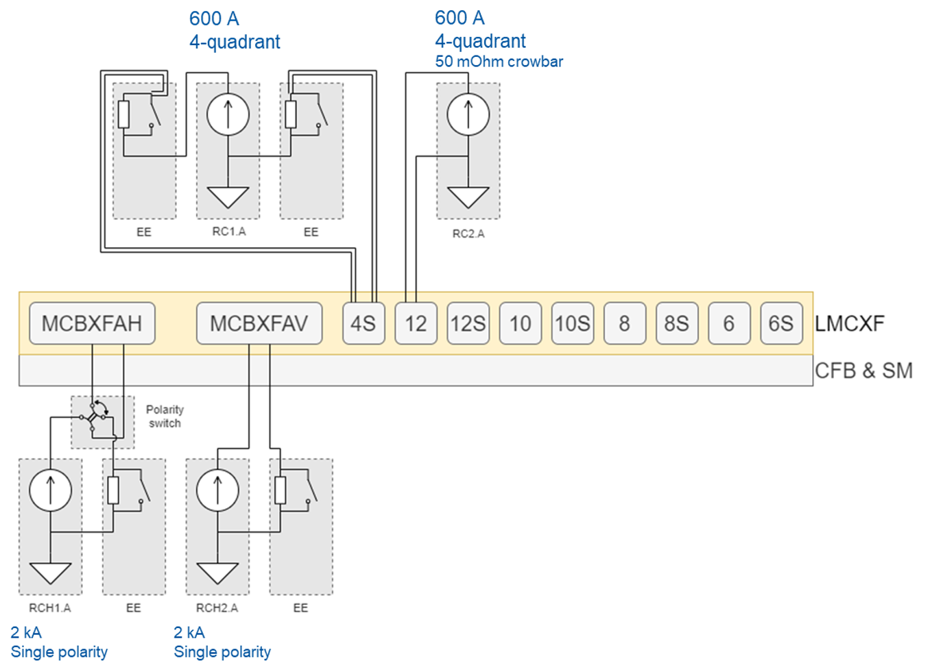
Powering circuits layout
4 power converters are available for 11 magnet circuits.
Two 2 kA single quadrant power converters are always connected to the MCBXFA circuits.
The horizontal circuit has a polarity switch such that we can change quadrant
One 600 A power converter is connected with two LHC type Energy Extractions of 0.7 Ohm each. This is always connected to the MQSXF magnet. (197 A maximum)
The second 600 A power converter without energy extractions is connected one by one to the other HO correctors. (115 A maximum)

Slide 6
HO correctors

Slide 7
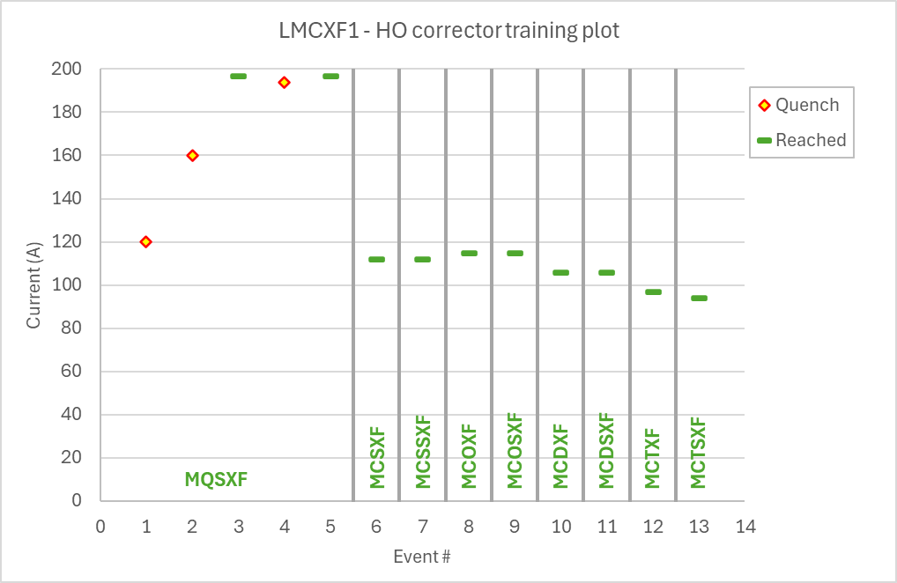
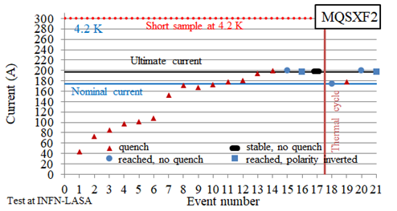
Training overview HO correctors
All HO correctors have been qualified at LASA, some were retested at CERN.
The MQSXF magnet (MQSXF2) needed two training quenches to reach ultimate current of 197 A. It also quenched during another cycle to ultimate current at 194 A.
All other HO corrector magnets did not quench up to ultimate current.
For comparison: Training plot MQXFS2 during acceptance tests at LASA. EDMS 2617235.

Slide 8
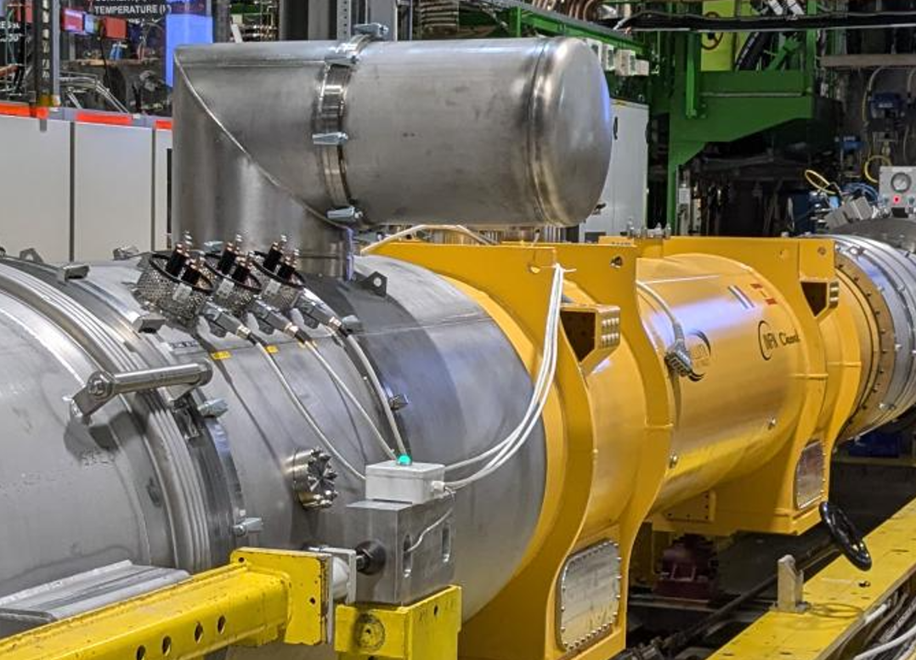
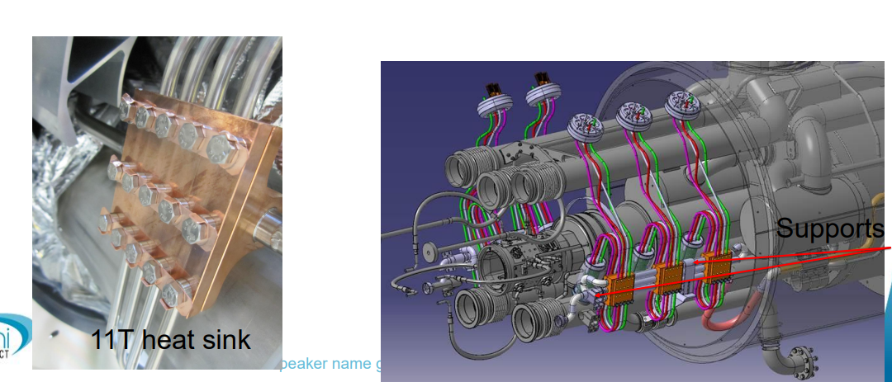
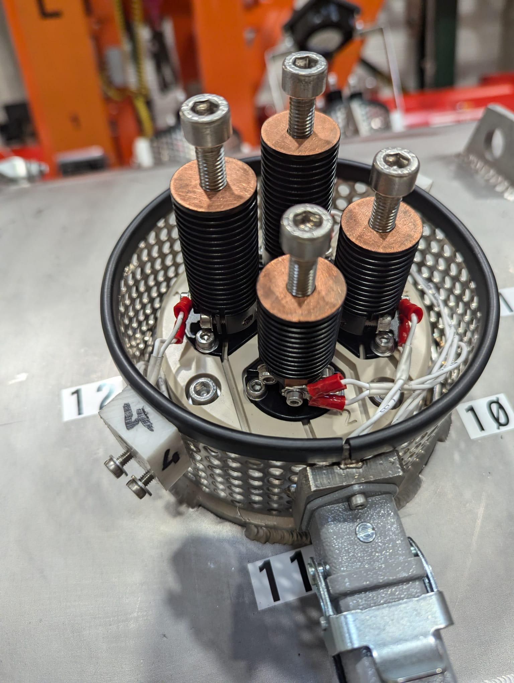
Focus with corrector tests is also on the leads
Resistive leads going from 1.9 K to 300 K, exiting on the side of the cryo-assembly.
Heat sink ‘mid-point’, cooled by helium gas of 60 – 80 K He in the LHC.
On the test bench, the CRG team controlled the He gas temperature at 80 K for the qualification.
The maximum nominal current per lead is 102 A.
The MQSXF magnet has two leads per polarity, all others one lead per polarity.
This lead technology has been used in 120 A circuits in the LHC and for the 11T trim (2*125 A), but it had not been validated yet for the corrector package.
From: J. Fleiter, https://indico.cern.ch/event/1045460/

Slide 9
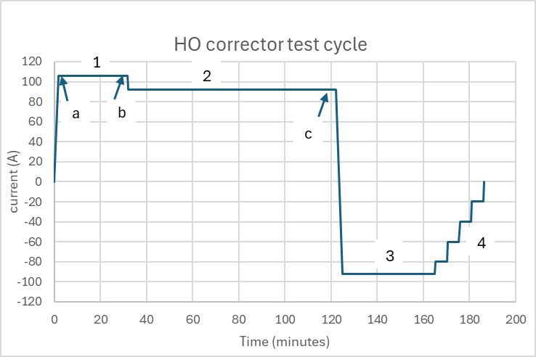
Powering test HO correctors
To efficiently test each magnet circuit a standard cycle was made, see on the right:
  Training to ultimate current
  Phase 1: Stay at I_{ultimate} for 30 minutes
  Phase 2: Continue with 1h30 at I_{nominal}
  Phase 3: Minus I_{nominal} for 30-40 min to completed magnetic measurements
  Phase 4: Current lead resistance measurements at intermediate temperatures.
At moments a, b and c the lead voltage is evaluated, see table next slides.
 | MQSXF | MCTXF | MCTSXF | MCDXF MCDSXF | MCOXF MCOSXF | MCSXF MCSSXF
L_{low current} (mH) L_{nominal current} (mH) | 5100 1539 | 5351 813 | 1126 179 | 329 109 | 794 224 | 484 212
I_{nominal} (A) I_{ultimate} (A) | 197 174 | 85 97 | 84 94 | 92 106 | 102 115 | 99 112

Slide 10
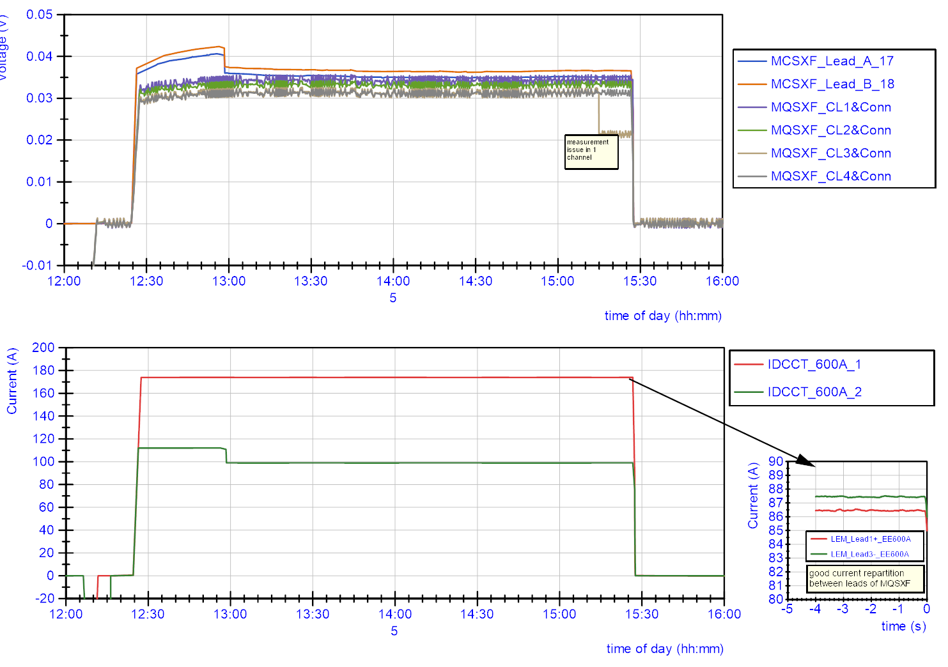
Example of long duration tests and lead voltage investigation
b
a
c
At moments a, b and c the voltage is evaluated.
At reaching ultimate current
After 30 min at ultimate
After 1.5 to 2 hours at nominal
Stabilization time in the order of 30 minutes.
For MQSXF two leads per polarity are used.
At 174 A, the current is well distributed at 87 ± 0.5 A, measured using LEM sensors.

Slide 11
Result table HO corrector leads
Leads results with 80 K He gas cooling.
All leads showed stable behavior at nominal current plateaus (and stabilizing at ultimate current after ~30 min.)
Lead voltage at nominal current: between 29 and 41 mV. Resistance between 0.34 and 0.40 mΩ.

Slide 12
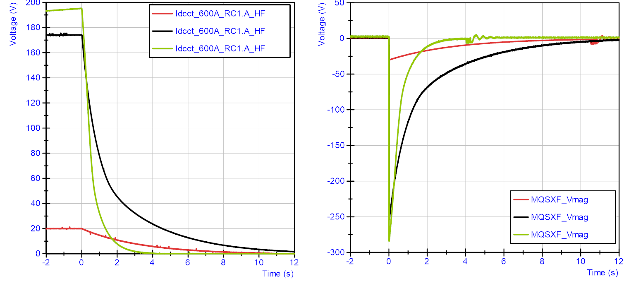
Reference discharge plots MQSXF
MQSXF circuit has 1.4 Ohm energy extraction. Other HO correctors are self-protected.
The green curve represents a quench with energy extraction opening.
The black curve represents a trip with energy extraction opening.

Slide 13
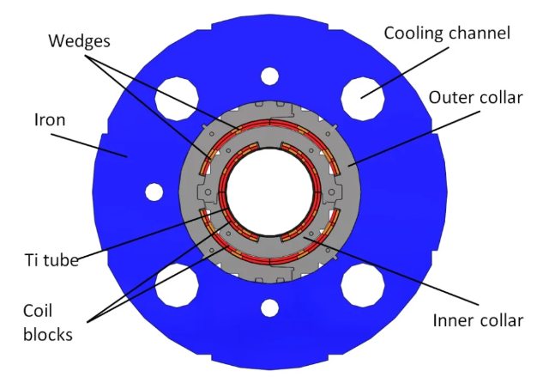
MCBXFA
CFB
MRB

Slide 14
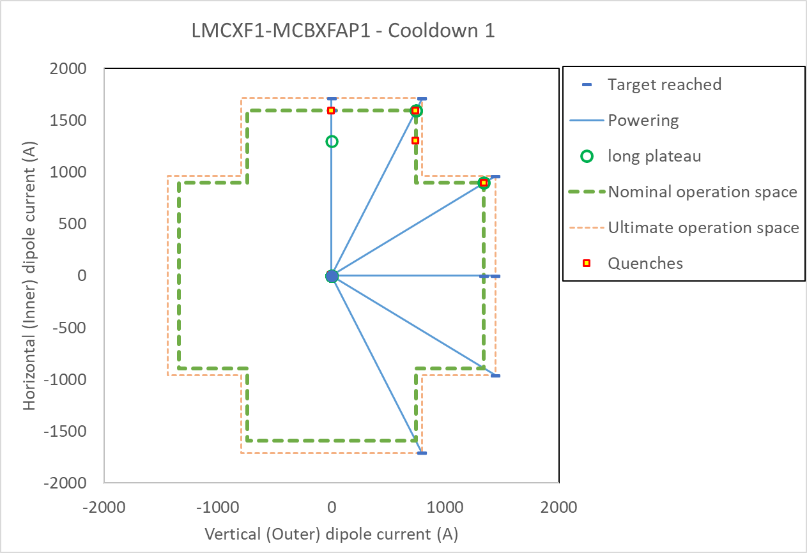
Powering tests MCBXFAH and MCBXFAV
The training of the MCBXFAH and MCXBXFAV magnets is done in the following order:
Individual training horizontal dipole
Individual training vertical dipole
Combined training in two angles in two quadrants, see table below.
Test # | MCBXFAH current [A] | MCBXFAV current [A]
1 | 1709 | 0
2 | 0 | 1441
3 | 1709 | 794
4 | -1709 | 794
5 | 962 | 1441
6 | -962 | 1441
7 | 1709 | 794
The training was performed without quench, showing excellent memory.
The quenches shown in the plot were during holding current tests, see next slides.

Slide 15
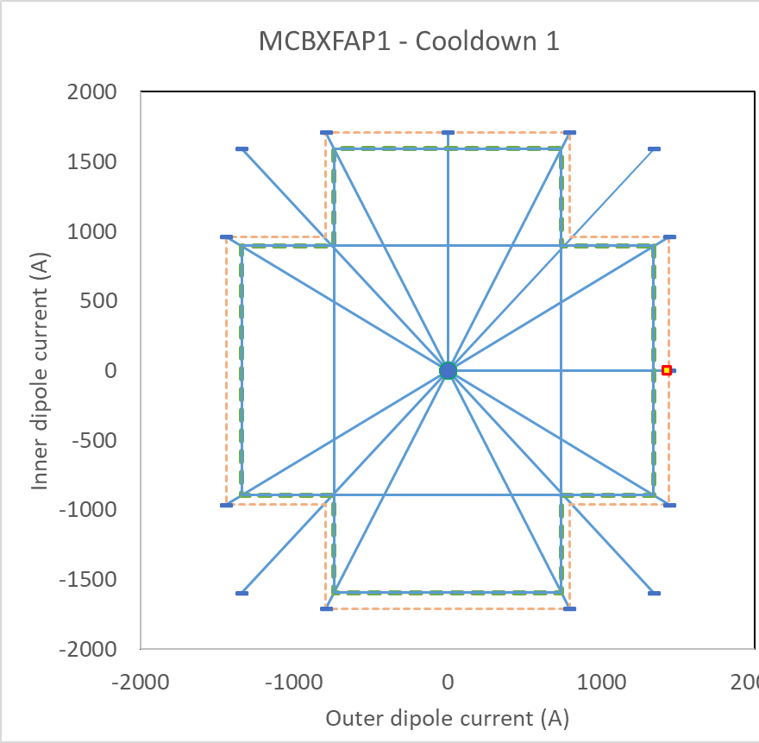
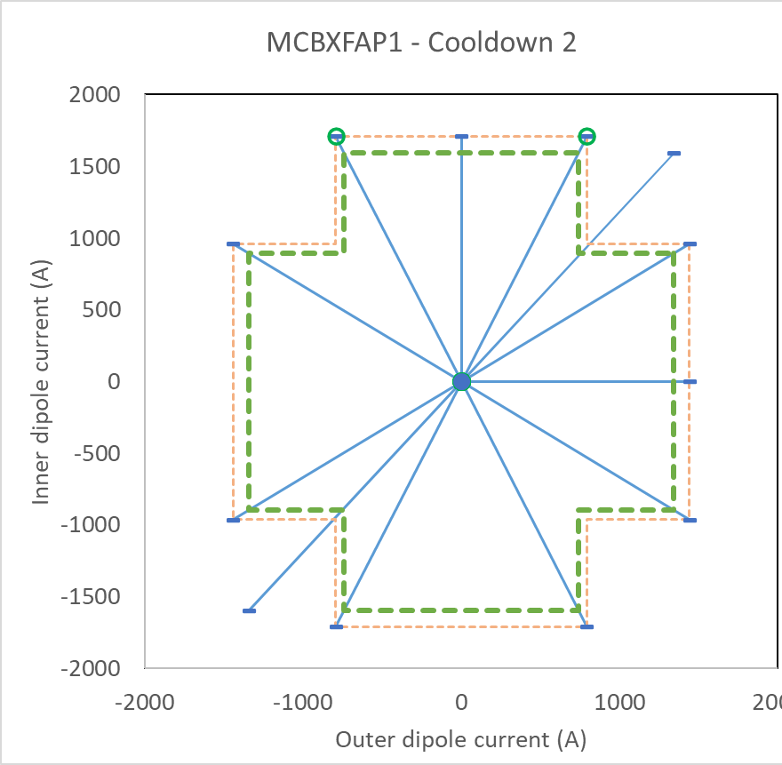
Comparison powering MCBXFAP1 in vertical tests compared to horizontal tests
Vertical test, 1st cool down.
One quench in individual powering.
No quench in combined powering, including going beyond defined nominal operation space.
Vertical test, 2nd cool down.
No quenches, including going beyond defined nominal operation space.
Maximum flattop duration 2 hours.
MCXBFAP1 installed in the Corrector Package.
No quenches during training, consistent behavior to vertical tests.
4 quenches at flattop of 3 hours or more.

Slide 16
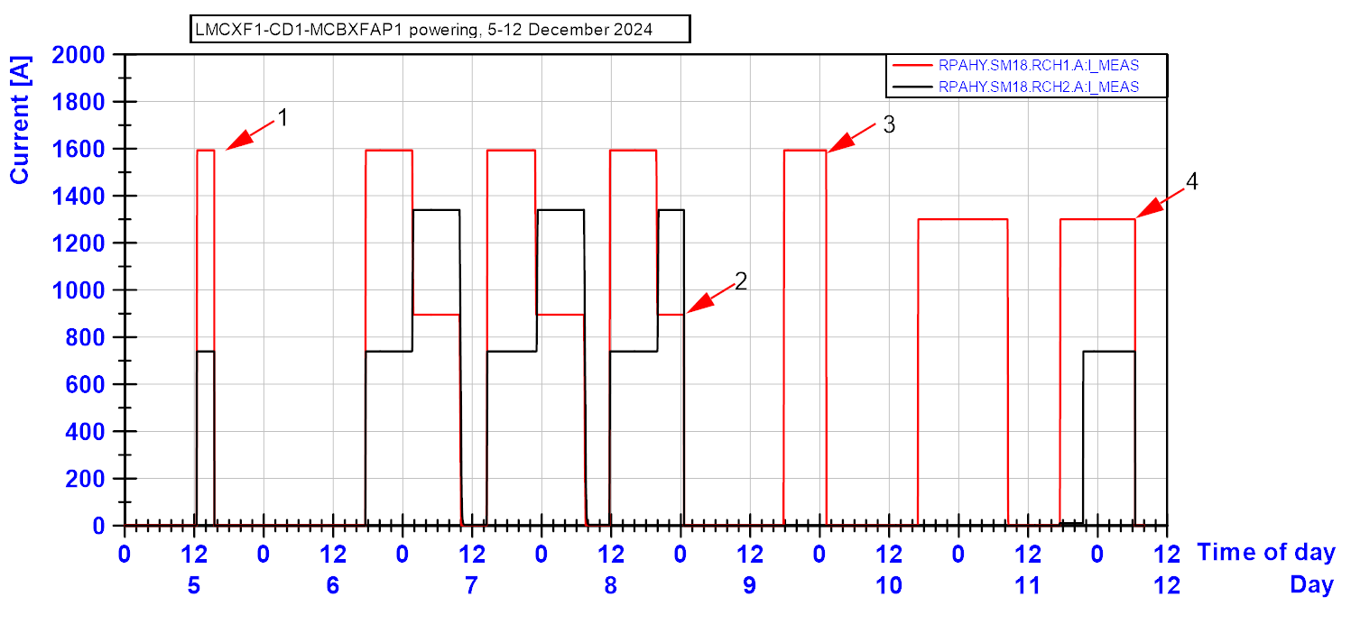
Holding current tests MCBXFAH and MCBXFAV
3
1
4
2
During the 4 hours holding current test, quench 1 was recorded after 3 hours in the MCBXFAH circuit (inner dipole).
A decision was made to perform additional holding current tests, and in total 4 flattop quenches were recorded in the same coil at different currents on the nominal perimeter for in total 74 hours of holding current tests, all at 1.9 K.

Slide 17
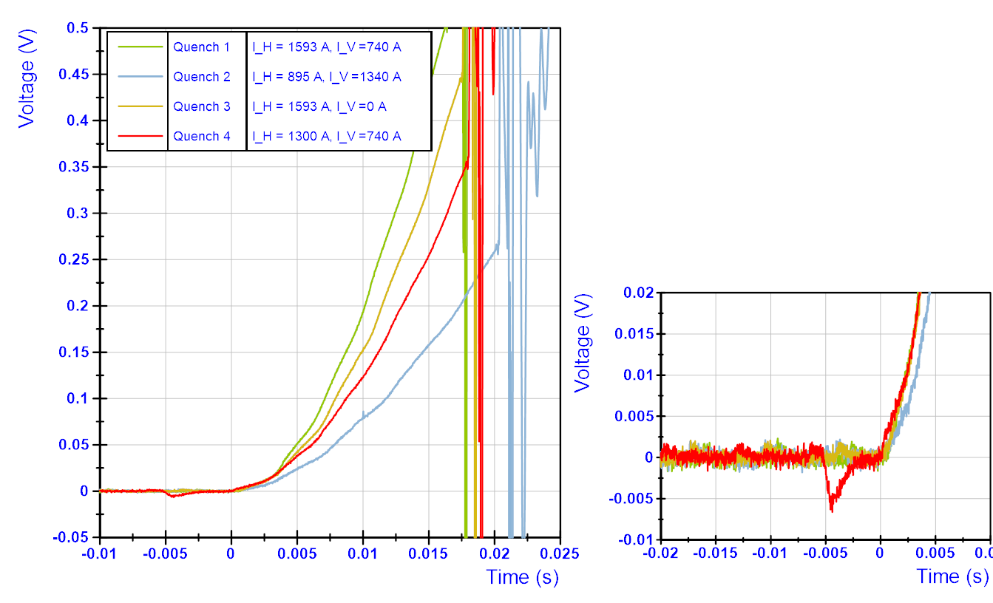
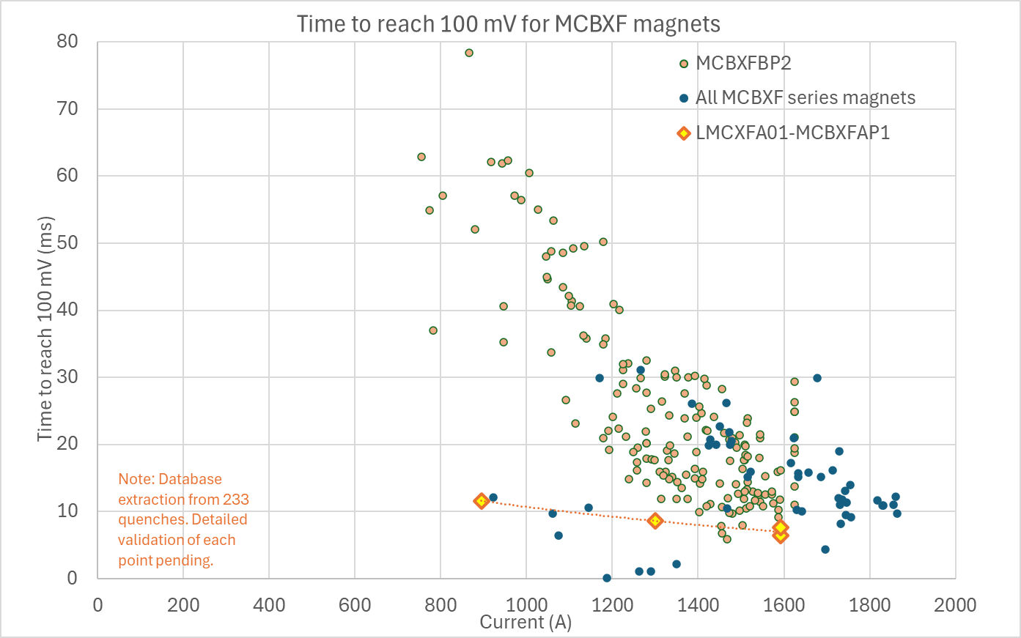
Characteristics flattop quenches MCBXFAH
The voltage buildup for the 4 quenches are shown.
Normal characteristic shape, but a faster propagation then normal.
No precursor, so no sign of mechanical origin of these quenches.
In quench 4 a small, but a-typical negative voltage is visible just before quench.
While for quench 1, 2 and 4 the helium bath temperature was stable, for quench 3 during a 15 min period before the quench the temperature rose to 2.15 K due to external changes in cryo system.
Operation in superfluid helium at 1.9 K should exclude thermal impact from outside (conductor needs to reach > 6.5 K to quench).

Slide 18
MCBXFA training and quench summary
No training quenches, good memory.
Flattop quenches repeatedly occurred in one of the horizontal (inner) dipole coils at flattop.
Flattop quenches occurred at different current levels, were independent of the current in the vertical magnet.
Operation in superfluid helium at 1.9 K should exclude thermal impact from outside (conductor needs to reach > 6.5 K to quench).
Flattop quench has not been observed before in MCXBF magnets.
NC draft report written in EDMS 3219461
Actions
Longer holding current tests foreseen for all future MCBXFA and MCBXFB test campaigns (vertical and in Q2 and CP).

Slide 19
Magnetic measurements
Large set of stretched wire measurements done.
Focus on magnetic axis and magnet position. Many geometric measurements done too.
Will be reported by Mariano and Lucio in a future meeting.

Slide 20
Overall qualification of the Corrector Package
Smooth test campaign
Cool down and warm up OK
Instrumentation and HV insulation OK
Powering HO correctors OK
Leads HO correctors OK
Training MCBXFA OK
MCBXFA flattop quenches under investigation, including NCR. No major impact foreseen for IT-string.
MAB to make a recommendation on installation of this CP in the IT-string. Installation foreseen end of this month.

Slide 23
