Slide 1
MCBXF test results
MCBXFB05 – June 2024
MCBXFA1 – September 2024
MCBXFB06 – December 2024
Test plan reference:
MCBXFA: EDMS 2801912
MCBXFB: EDMS 2783919
Test report reference:
MCBXFB05: EDMS 3123996
MCBXFA1: EDMS 3162193
MCBXFB06: EDMS 3221448 (no document yet)
Gerard Willering
Franco Mangiarotti, Lucio Fiscarelli, Piotr Rogacki, Jerome Feuvrier, Michael Boczan, Jean-Luc Guyon. Many thanks to all involved.
WP3 meeting – 15 January 2025

Slide 2
MCBXFB05

Slide 3
MCBXFB05
HCMCBXFB012-E9000005
HV insulation tests
Reception tests at 2000 V: Passed
On insert in air at 300 K before cool down 1 at 200 V: Passed
Cool down 1 at 1.9 K before powering at 1000 V: Passed
Cool down 1 at 1.9 K after powering at 1000 V: Passed
Cool down 2 at 1.9 K before powering at 1000 V: Passed
Cool down 2 at 1.9 K after powering at 1000 V: Passed
Performed tests are inner dipole vs (outer dipole + ground) and outer dipole vs (inner dipole + ground)

Slide 4
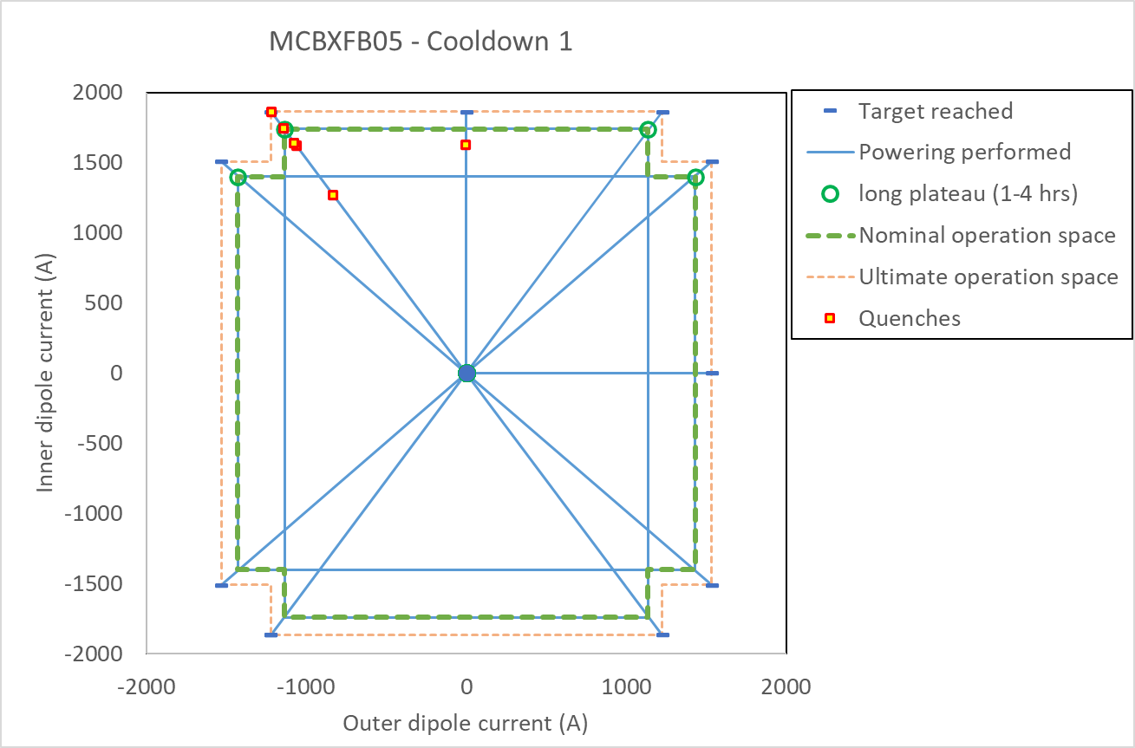
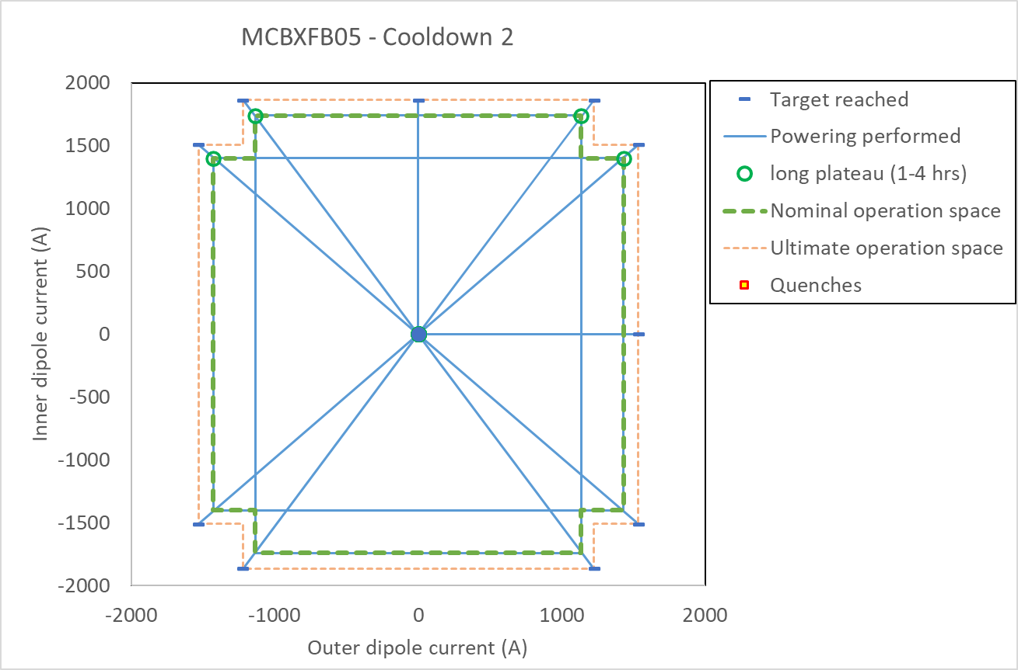
MCBXFB05 powering
Cool down 1
Individual powering one quench in inner dipole.
Combined powering: 6 quenches were registered in one angle in one of the quadrants to reach the ultimate operation space. Afterwards all powering tests showed stable operation.
Cool down 2
Individual powering without quench
Combined powering: All powering was stable to ultimate current.

Slide 5
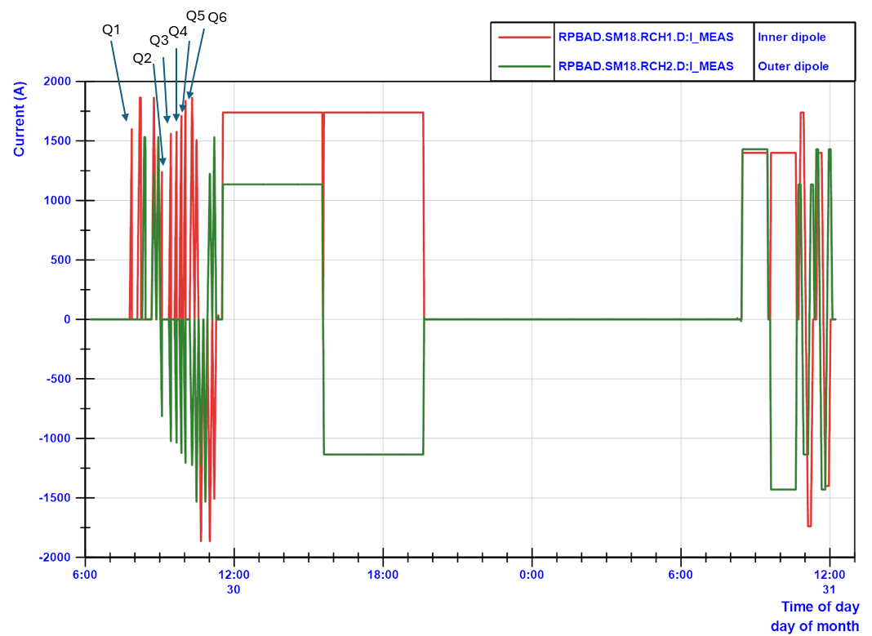
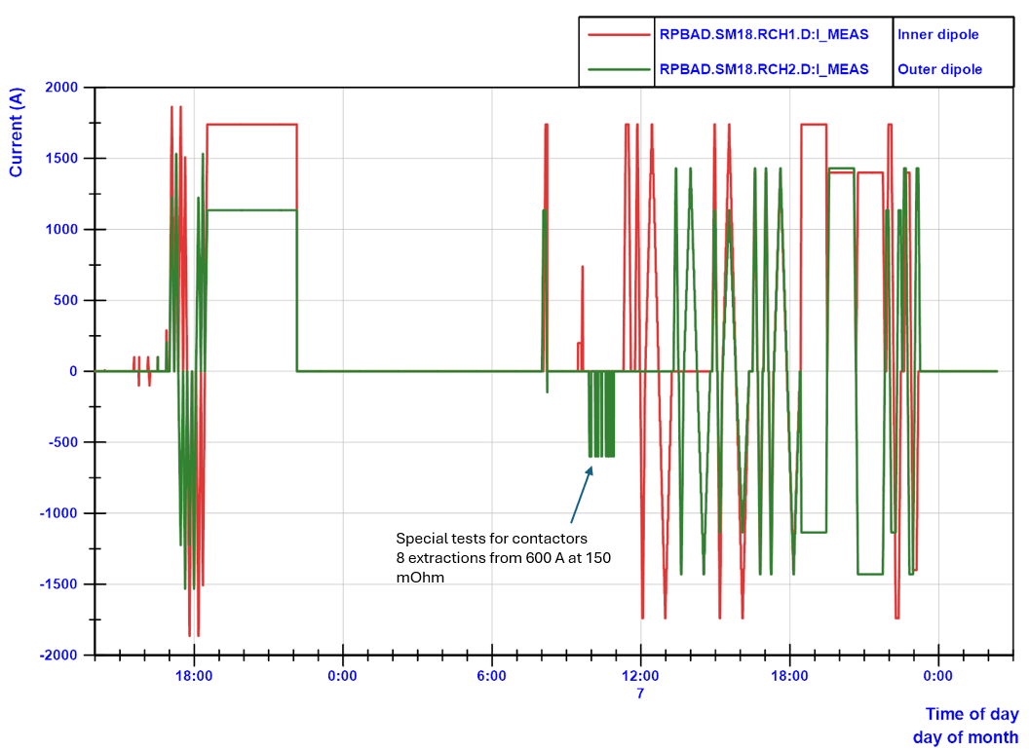
MCBXFB05 powering overview
Cool down 1 powering overview with the indication of the 6 quenches.
Cool down 2 powering overview

Slide 6
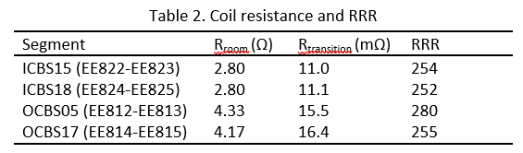
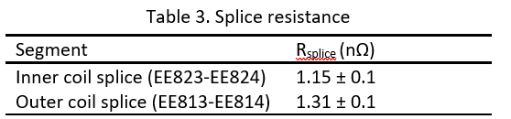
MCBXFB05 resistances

Slide 7
MCBXFA1

Slide 8
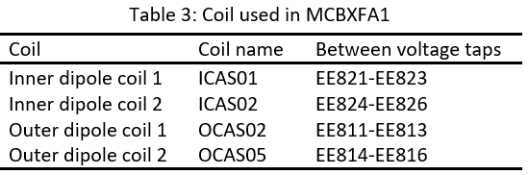
MCBXFA1
HCMCBXFA011-E9000001
HV insulation tests
Reception tests at 2000 V: Passed
On insert in air at 300 K before cool down 1 at 200 V: Passed
Cool down 1 at 1.9 K before powering at 1000 V: Passed
Cool down 1 at 1.9 K after powering at 1000 V: Passed
Cool down 2 at 1.9 K before powering at 1000 V: Passed
Cool down 2 at 1.9 K after powering at 1000 V: Passed
Performed tests are inner dipole vs (outer dipole + ground) and outer dipole vs (inner dipole + ground)

Slide 9
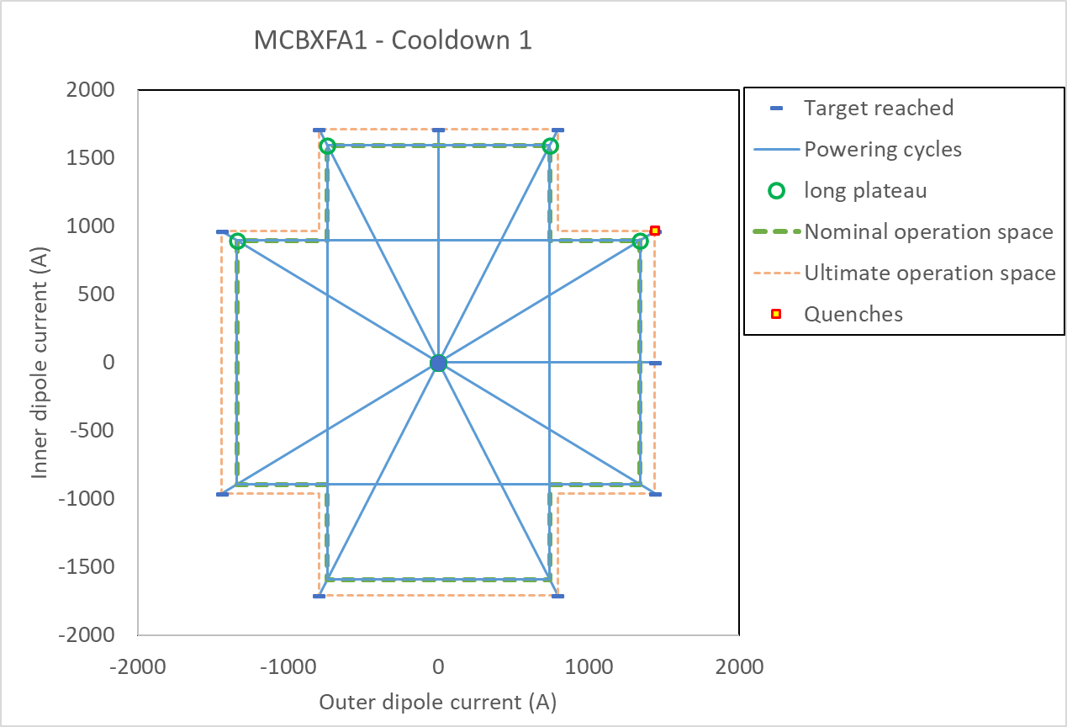
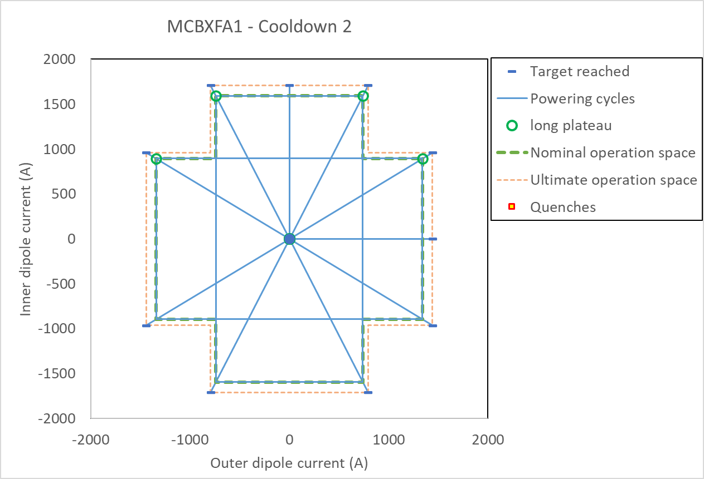
MCBXFA1 powering
Cool down 1
Individual powering: without quench.
Combined powering: One quench outside nominal perimeter
Cool down 2
Individual powering without quench
Combined powering: All powering was stable to ultimate current.

Slide 10
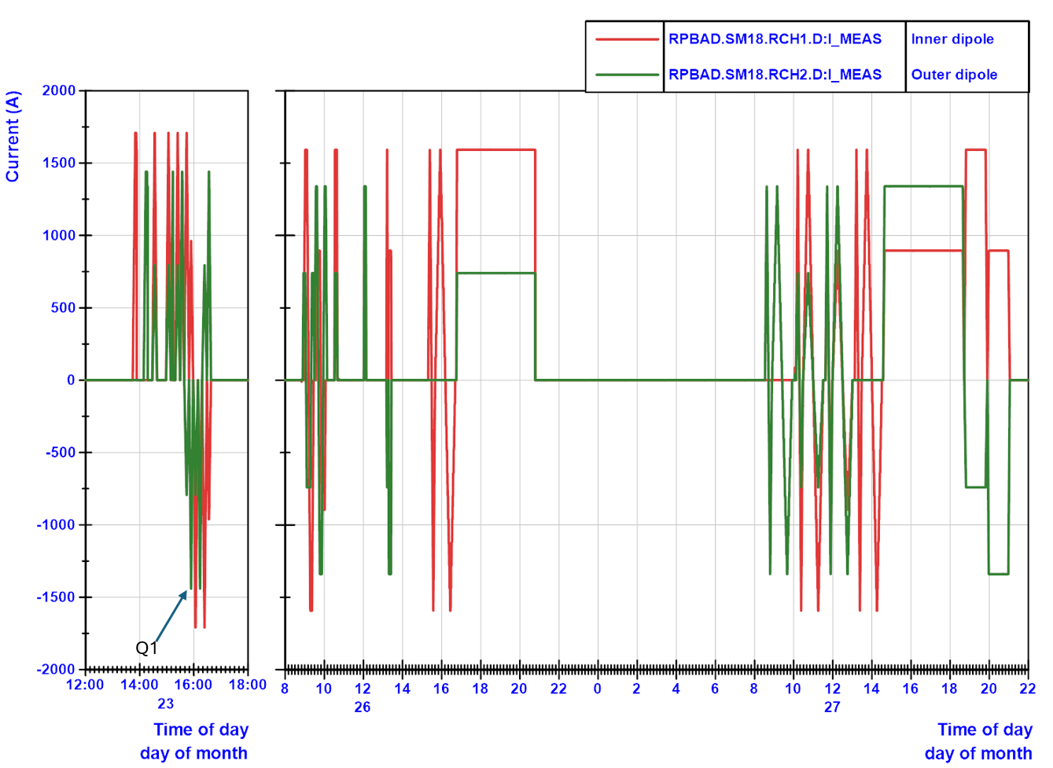
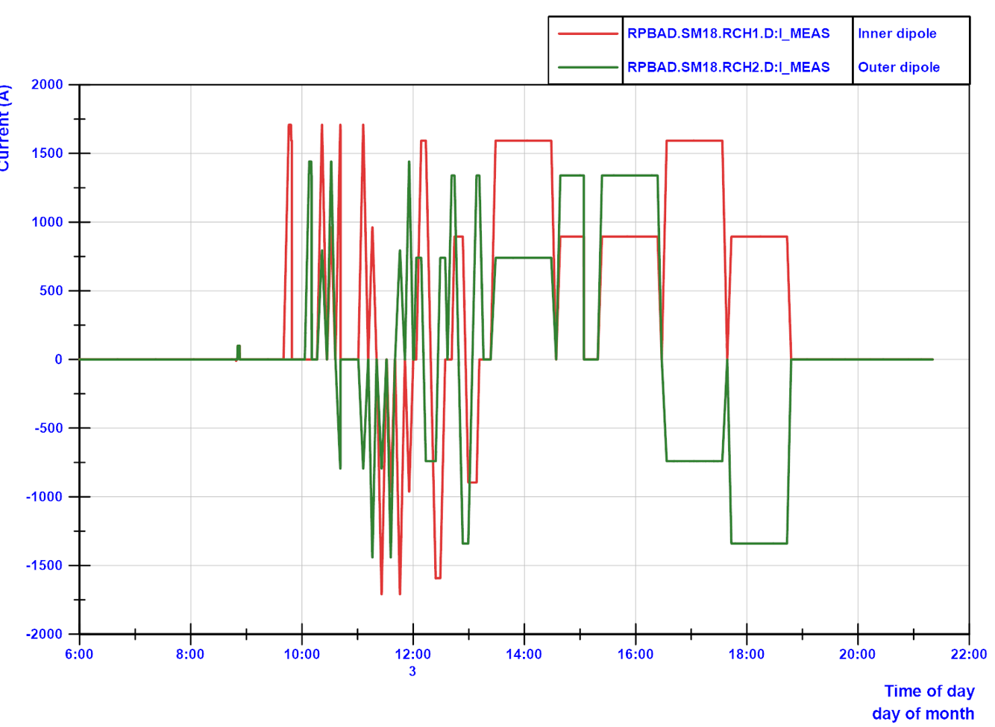
MCBXFA1 powering overview
Cool down 2 powering overview
Cool down 1 powering overview with the indication of the quench.

Slide 11
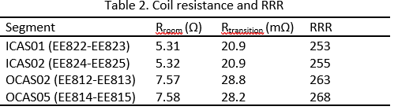
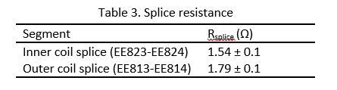
MCBXFA1 resistances

Slide 12
MCBXFB06

Slide 13
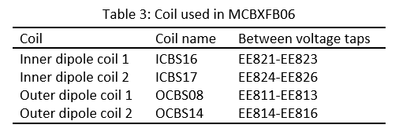
MCBXFB06
HCMCBXFA011-E9000001
HV insulation tests
Reception tests at 2000 V: Passed
On insert in air at 300 K before cool down 1 at 200 V: Passed
Cool down 1 at 1.9 K before powering at 1000 V: Passed
Cool down 1 at 1.9 K after powering at 1000 V: Passed
Cool down 2 at 1.9 K before powering at 1000 V: Passed
Cool down 2 at 1.9 K after powering at 1000 V: Passed
Performed tests are inner dipole vs (outer dipole + ground) and outer dipole vs (inner dipole + ground)

Slide 14
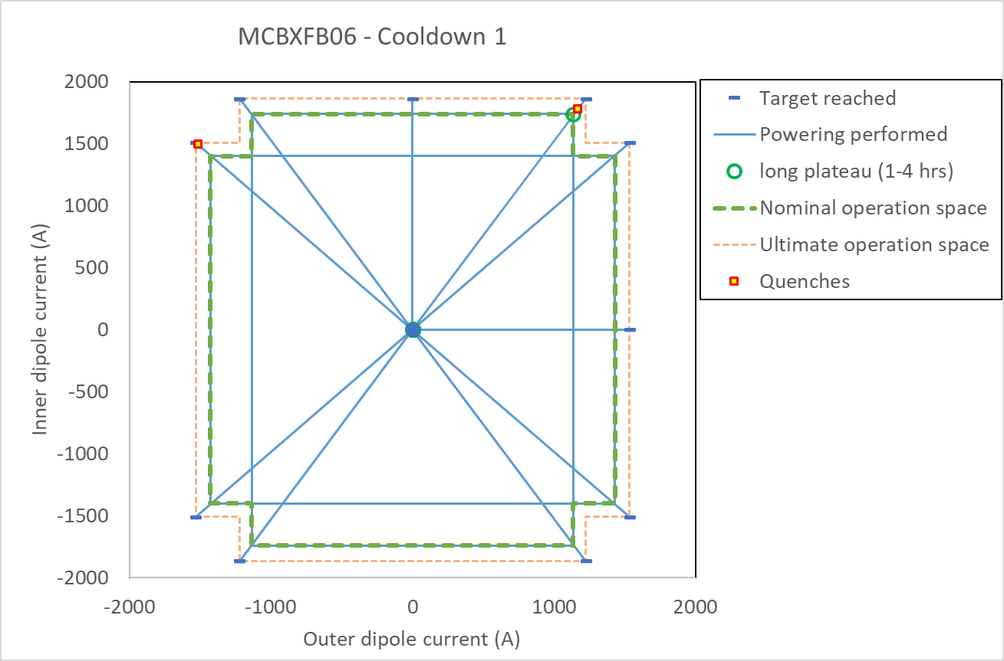
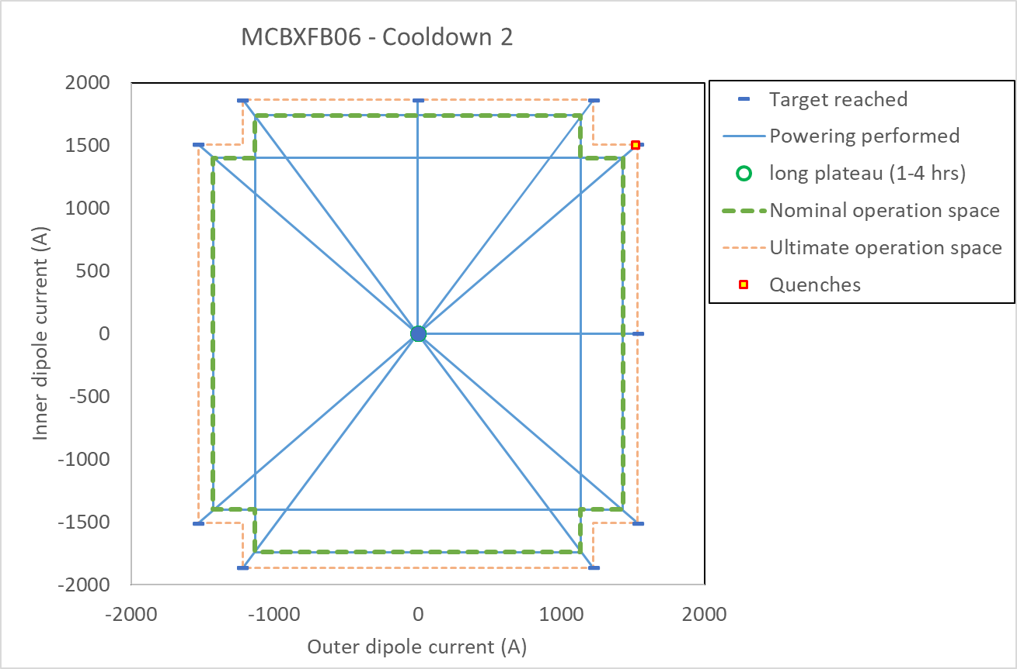
MCBXFA1 powering
Cool down 1
Individual powering: without quench.
Combined powering: Two quenches outside nominal perimeter
Cool down 2
Individual powering without quench
Combined powering: One quench outside nominal perimeter

Slide 15
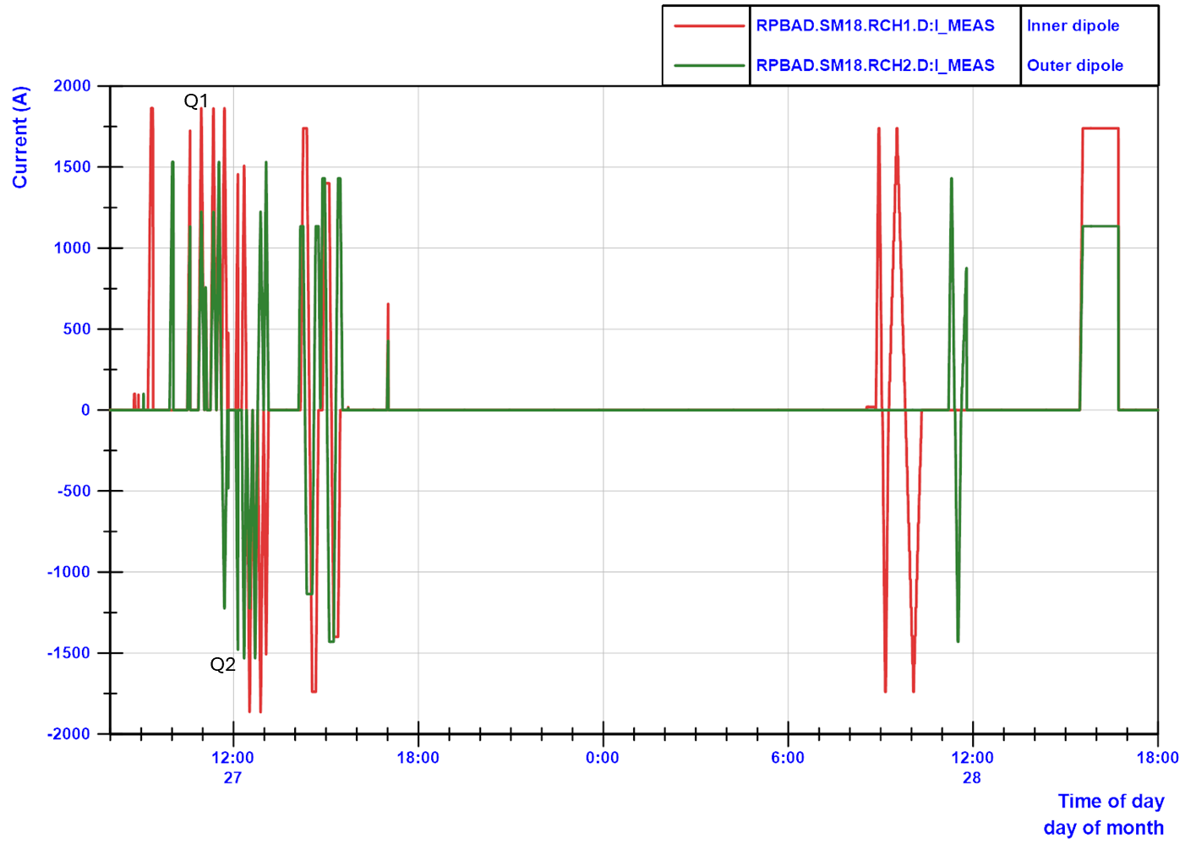
MCBXFA1 powering overview Cool down 1
Cool down 1 powering overview with the indication of the two quenches.
Due to issues with the powering, only one 1-hour holding current test was done.

Slide 16
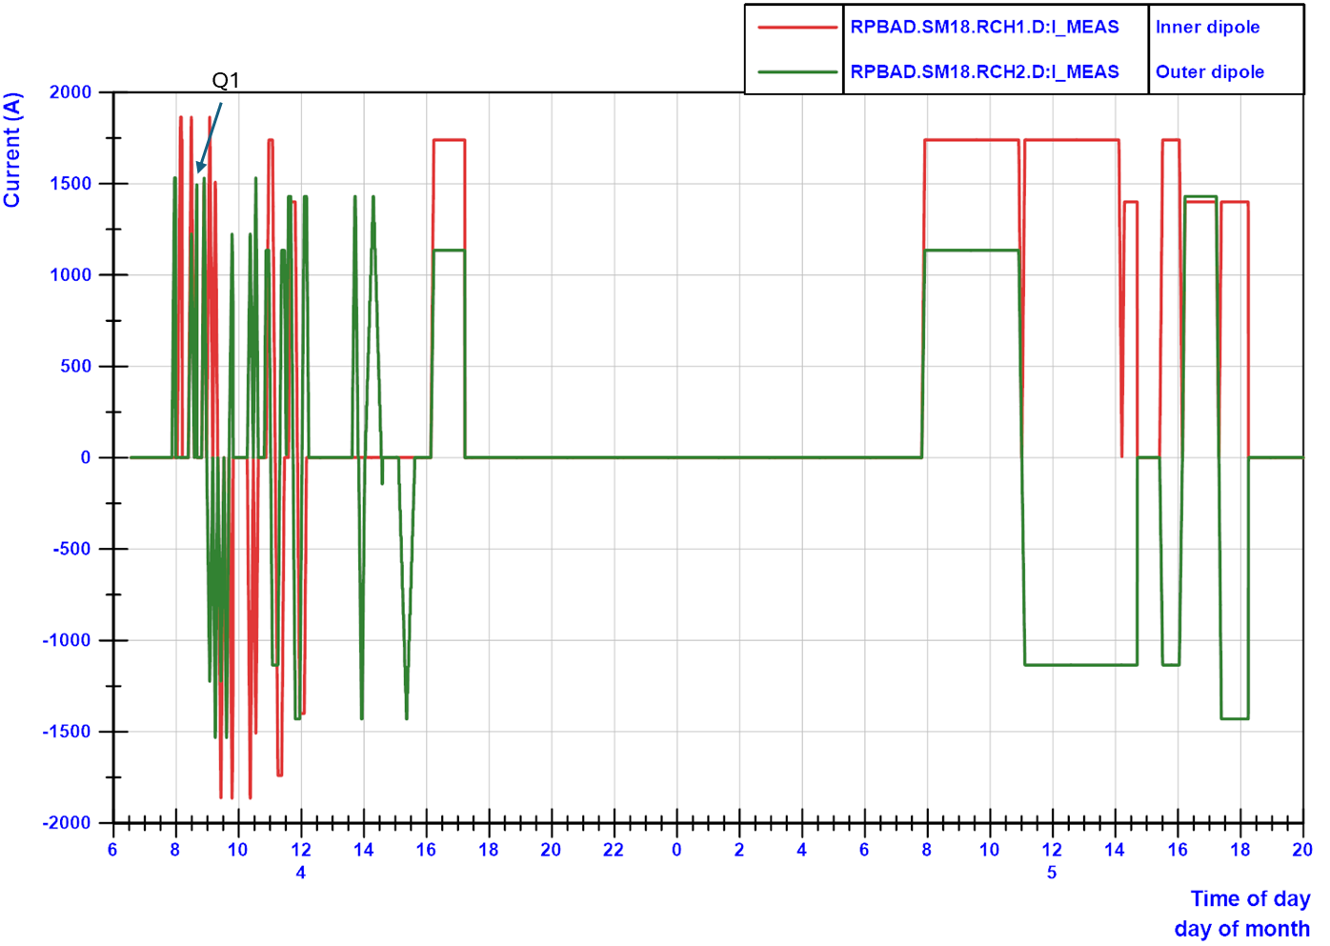
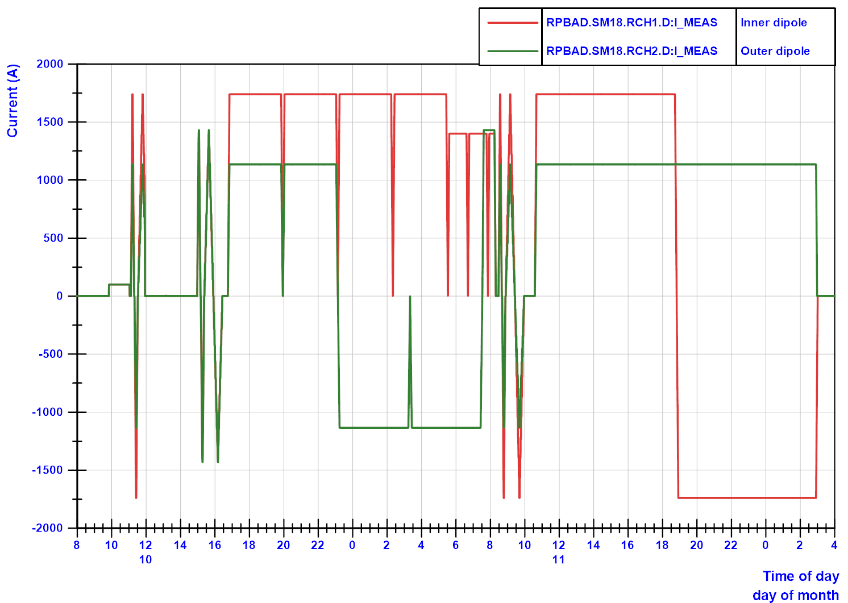
MCBXFA1 powering overview Cool down 2
Cool down 2 powering overview with the indication of the one quench.
Additional holding current tests were performed, with 4 time 4 hours and 2 times 8 hours. All without quench.

Slide 17
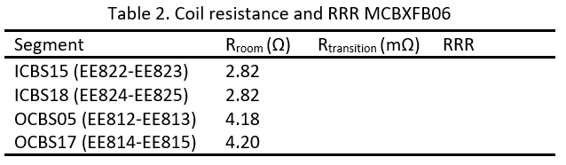
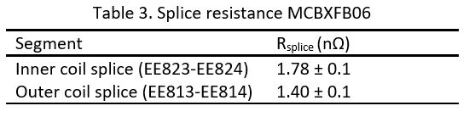
MCBXFB06 resistances
The room temperature resistance was measured, but during SC to normal transition the measurement could not be done. Therefore Table 2 only shows the room temperature resistance.

Slide 18
Conclusions powering performance of MCBXF magnets tested vertically in 2024
For MCBXFB05, MBXFA1 and MCBXFB06:
Very good training performance in first and second cool down
All instrumentation OK.
All HV insulation tests passed
All holding current tests passed (1st CD: 2 times 4 hours and 2 times 1 hour, 2nd CD 4 times 4 hours). Additional holding current tests were performed up to 2*8 hours duration for MCBXFB06.

Slide 19
Magnetic measurements
By Lucio Fiscarelli and Piotr Rogacki

Slide 20
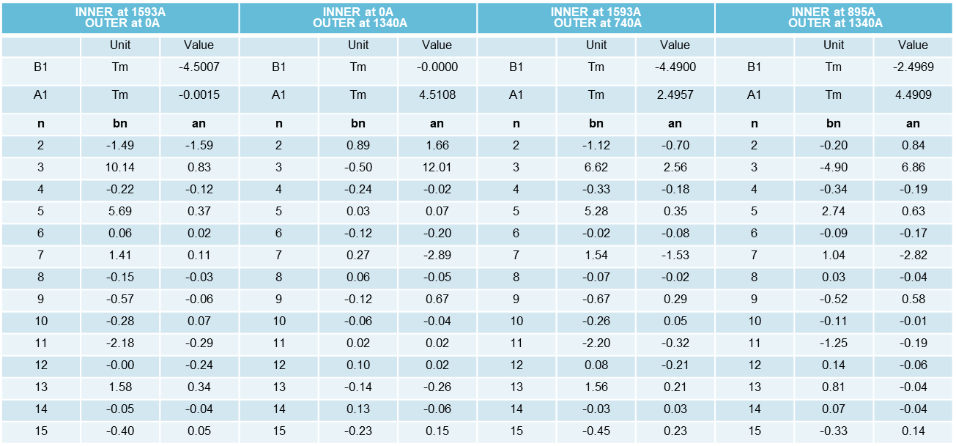
MCBXFA01 – Field quality
All harmonics are within requirements

Slide 21
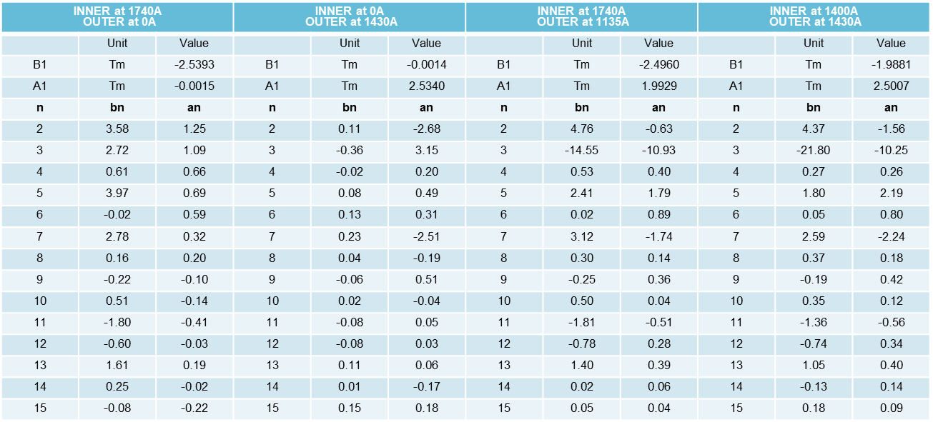
MCBXFB05 – Field quality
All harmonics are within requirements, except for the b3 in combined powering at 2/2.5 Tm

Slide 22
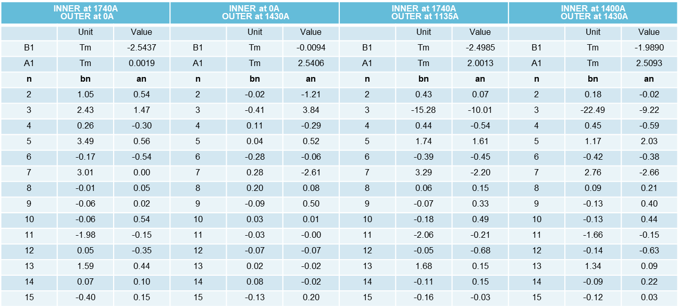
MCBXFB06 – Field quality
All harmonics are within requirements, except for the b3 in combined powering at 2/2.5 Tm

Slide 23
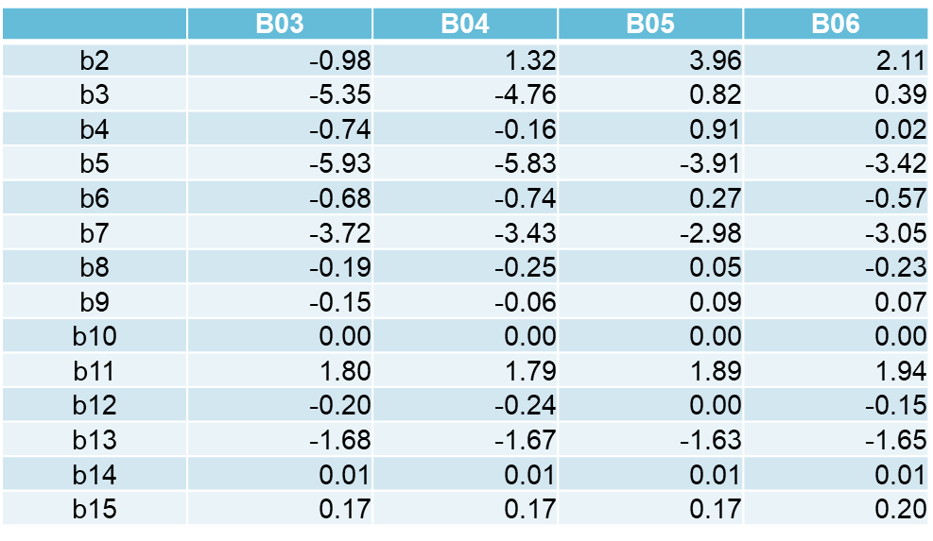
Measurements at room temperature on MCBXFB magnets

Slide 24
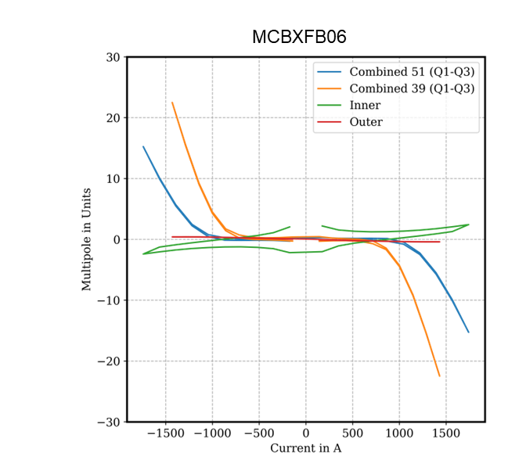
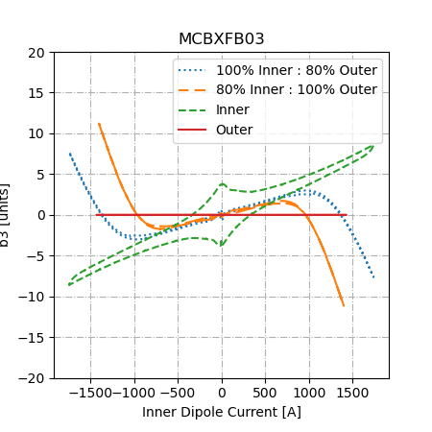
b3 - MCBXFB06 vs MCBXFB03

Slide 25
Remarks on magnetic field characteristics
For MCBXFA01, all harmonics are within requirements for all powering configurations
For MCBXFB05 and MCBXFB06
The Transfer Function (TF), compared to previous magnets, is
    within ±20 units in individual powering,
    within ±30 units in combined powering.
Harmonics are within requirements except for the b3 in combined powering 2/2.5 Tm (±22 units).
The change of b3 (+5 units) measured at warm on B05/B06 with respect to previous magnets is confirmed by the measurements at cold. This, added to the saturation, contributes to the larger value of the b3.

Slide 27
