Slide 1
MCBXF series production at CERN
Update (January 2025)
Juan Carlos Perez, Jose Ferradas and Gonzalo Hernando
on behalf of the full team!
15/01/2025
HL-LHC WP3

Slide 2
Outline
MCBXF general status at CERN
MCBXFB05 assembly
MCBXFA1 assembly
MCBXFB06 assembly
MCBXFB07 assembly
Summary and outlook

Slide 3
Outline
MCBXF general status at CERN
MCBXFB05 assembly
MCBXFA1 assembly
MCBXFB06 assembly
MCBXFB07 assembly
Summary and outlook

Slide 4
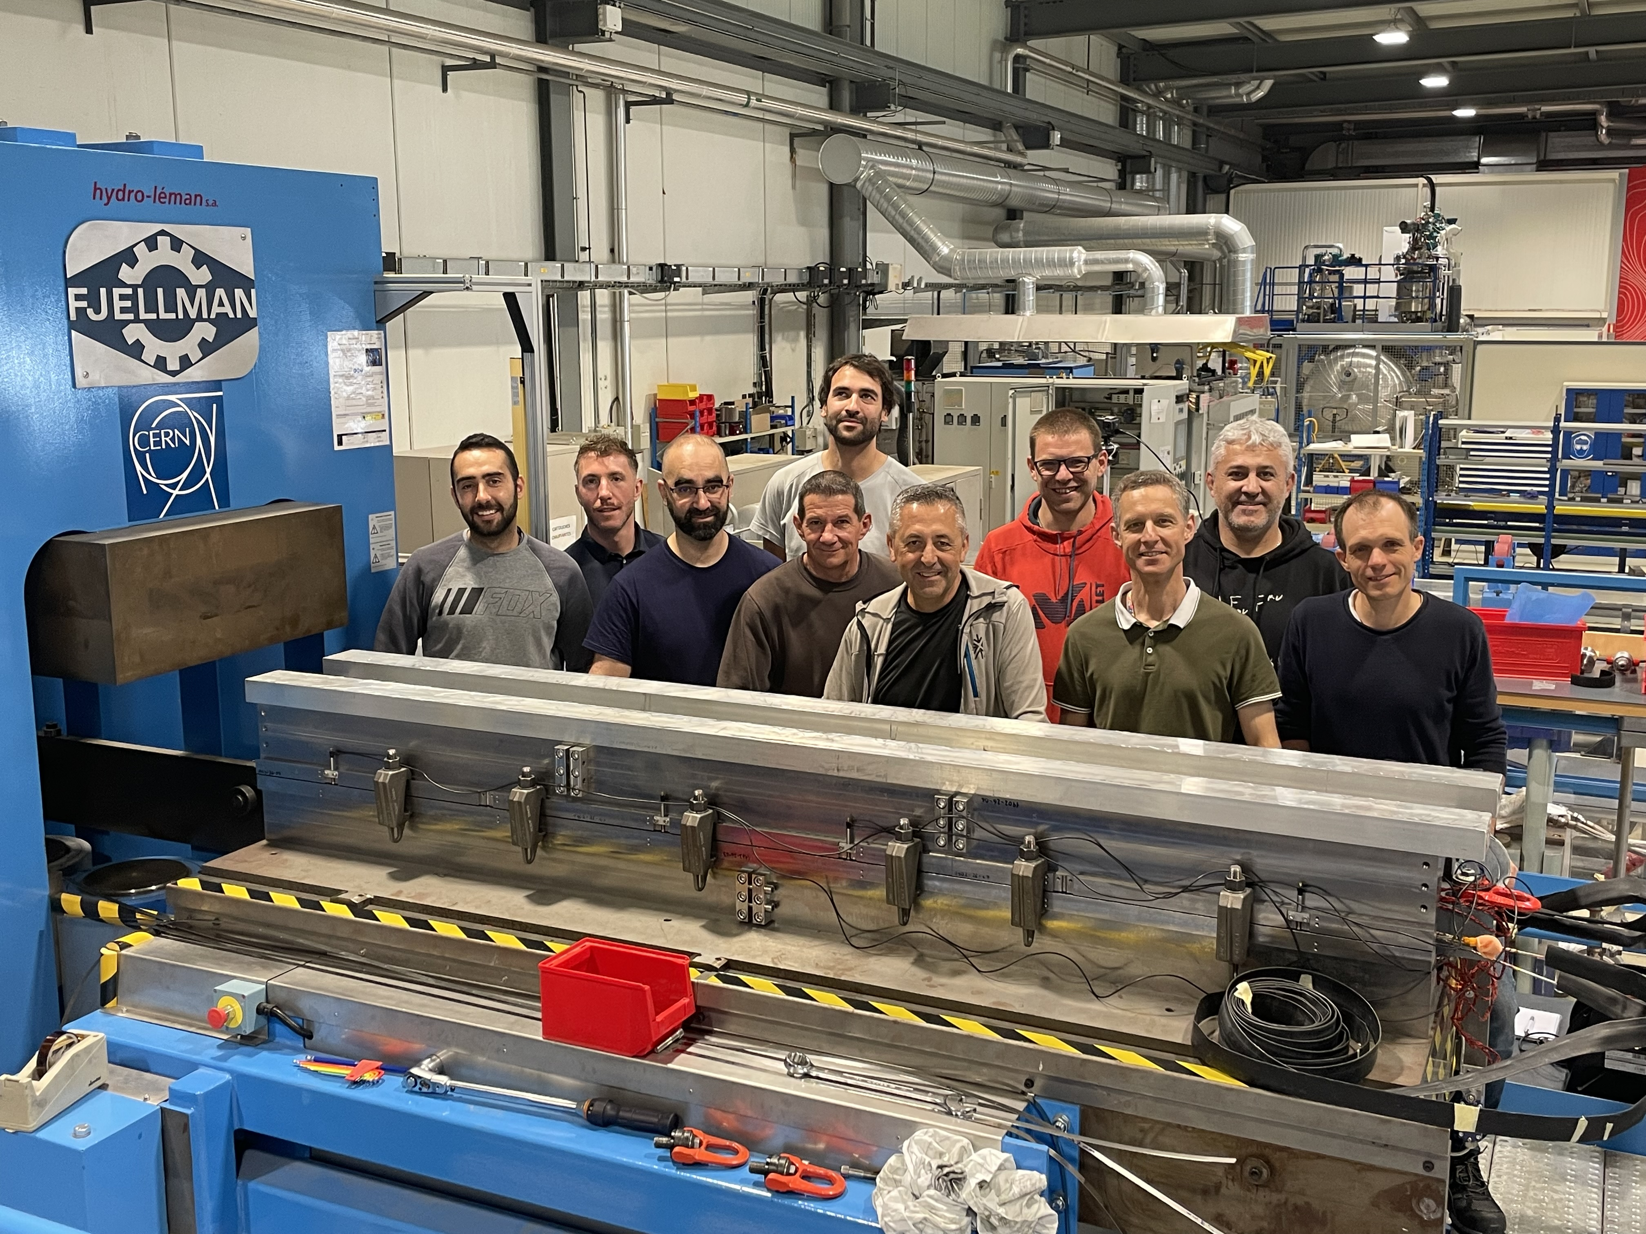
MCBXF status at CERN
Organization:
WP3 Project engineer: J.C. Perez
Magnet assembly activities:
  Gonzalo Hernando (TE-MSC-SMT)
  Jose Ferradas (TE-MSC-SMT)
  Federico Ismail Ben el Caid (TE-MSC-SMT)
  Sebastien Luzieux (TE-MSC-LMF)
  Karim Kallat (TE-MSC-LMF)
  Nicolas Eyraud (TE-MSC-LMF), in charge of knowledge transfer during MCBXFB05 and MCBXFA1 assembly!
Logistics (TE-MSC-LMF):
  Steve Becle, Laurent Boulonguet and Sylvain Caille
Mechanical measurements (EN-MME):
  Sylvain Mugnier and Michael Guinchard
Additional support from LMF and SMT (machining, electrical and magnetic measurements, etc): Pietro Rizzo, P.A. Contat, Ludovic Grand-Clement, Jeremy Pechiney, Franck Evrard, Piotr Rogacki and Lucio Fiscarelli.

Slide 5
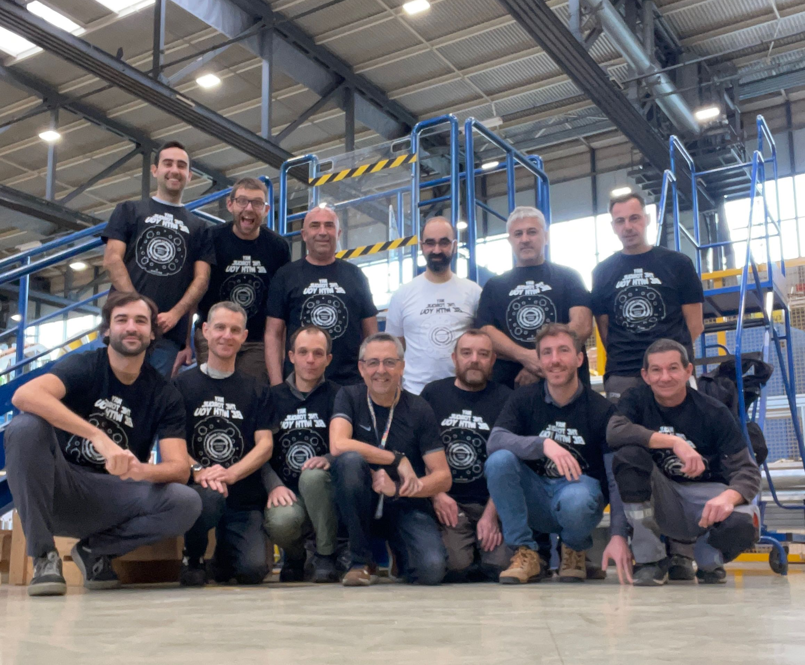

Slide 6
MCBXF status at CERN
Where are we?:
Today
 | 2024 |  |  |  |  |  |  |  |  |  |  |  |  |  |  |  |  |  |  |  |  |  |  |  | 2025 |  |  |  |  |  |  |  |  |  |  |  |  |  |  |  |  |  |  |  |  |  |  |  | 2026
 | Jan |  | Feb |  | Mar |  | Apr |  | May |  | Jun |  | Jul |  | Aug |  | Sep |  | Oct |  | Nov |  | Dec |  | Jan |  | Feb |  | Mar |  | Apr |  | May |  | Jun |  | Jul |  | Aug |  | Sep |  | Oct |  | Nov |  | Dec |  | Jan |  | Feb |  | Mar |  | April |  | May
MCBXFB05 |  |  |  | B05
MCBXFA1 |  |  |  |  |  |  |  |  |  | A1
MCBXFB06 |  |  |  |  |  |  |  |  |  |  |  |  |  |  | B06
MCBXFB07 |  |  |  |  |  |  |  |  |  |  |  |  |  |  |  |  |  |  |  | B07
MCBXFA2 |  |  |  |  |  |  |  |  |  |  |  |  |  |  |  |  |  |  |  |  |  |  |  |  | A2
MCBXFB08 |  |  |  |  |  |  |  |  |  |  |  |  |  |  |  |  |  |  |  |  |  |  |  |  |  |  |  |  |  | B08
MCBXFA3 |  |  |  |  |  |  |  |  |  |  |  |  |  |  |  |  |  |  |  |  |  |  |  |  |  |  |  |  |  |  |  |  |  | A3
MCBXFB09 |  |  |  |  |  |  |  |  |  |  |  |  |  |  |  |  |  |  |  |  |  |  |  |  |  |  |  |  |  |  |  |  |  |  |  |  |  |  | B09
MCBXFA4 |  |  |  |  |  |  |  |  |  |  |  |  |  |  |  |  |  |  |  |  |  |  |  |  |  |  |  |  |  |  |  |  |  |  |  |  |  |  |  |  |  |  | A4
MCBXFB10 |  |  |  |  |  |  |  |  |  |  |  |  |  |  |  |  |  |  |  |  |  |  |  |  |  |  |  |  |  |  |  |  |  |  |  |  |  |  |  |  |  |  |  |  |  |  |  |  | B10
MCBXFA5 |  |  |  |  |  |  |  |  |  |  |  |  |  |  |  |  |  |  |  |  |  |  |  |  |  |  |  |  |  |  |  |  |  |  |  |  |  |  |  |  |  |  |  |  |  |  |  |  |  |  |  |  | A5
MCBXFA6
MCBXFB11
MCBXFB12
Assembly activities at CERN are aligned with the planning proposed beginning of 2024.
Schedule for 2024 successfully accomplished. 5 magnets to be manufactured in 2025, in line with our 2024 delivery rate.
Notes:
MCBXFB05: TESTED IN MAY 2024 – JUNE 2024
MCBXFA1 TRANSPORT REQUEST TO SM18: 2ND AUGUST 2024
MCBXFB06 TRANSPORT REQUEST TO SM18: 7TH OCTOBER 2024
MCBXFB07 FINISHED BEFORE CHRISTMAS BREAK

Slide 7
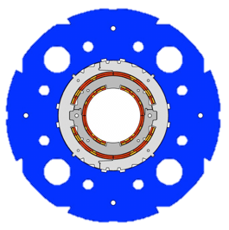
MCBXF status at CERN
Today
 | 2024 |  |  |  |  |  |  |  |  |  |  |  |  |  |  |  |  |  |  |  |  |  |  |  | 2025 |  |  |  |  |  |  |  |  |  |  |  |  |  |  |  |  |  |  |  |  |  |  |  | 2026
 | Jan |  | Feb |  | Mar |  | Apr |  | May |  | Jun |  | Jul |  | Aug |  | Sep |  | Oct |  | Nov |  | Dec |  | Jan |  | Feb |  | Mar |  | Apr |  | May |  | Jun |  | Jul |  | Aug |  | Sep |  | Oct |  | Nov |  | Dec |  | Jan |  | Feb |  | Mar |  | April |  | May
MCBXFB05 |  |  |  | B05
MCBXFA1 |  |  |  |  |  |  |  |  |  | A1
MCBXFB06 |  |  |  |  |  |  |  |  |  |  |  |  |  |  | B06
MCBXFB07 |  |  |  |  |  |  |  |  |  |  |  |  |  |  |  |  |  |  |  | B07
MCBXFA2 |  |  |  |  |  |  |  |  |  |  |  |  |  |  |  |  |  |  |  |  |  |  |  |  | A2
MCBXFB08 |  |  |  |  |  |  |  |  |  |  |  |  |  |  |  |  |  |  |  |  |  |  |  |  |  |  |  |  |  | B08
MCBXFA3 |  |  |  |  |  |  |  |  |  |  |  |  |  |  |  |  |  |  |  |  |  |  |  |  |  |  |  |  |  |  |  |  |  | A3
MCBXFB09 |  |  |  |  |  |  |  |  |  |  |  |  |  |  |  |  |  |  |  |  |  |  |  |  |  |  |  |  |  |  |  |  |  |  |  |  |  |  | B09
MCBXFA4 |  |  |  |  |  |  |  |  |  |  |  |  |  |  |  |  |  |  |  |  |  |  |  |  |  |  |  |  |  |  |  |  |  |  |  |  |  |  |  |  |  |  | A4
MCBXFB10 |  |  |  |  |  |  |  |  |  |  |  |  |  |  |  |  |  |  |  |  |  |  |  |  |  |  |  |  |  |  |  |  |  |  |  |  |  |  |  |  |  |  |  |  |  |  |  |  | B10
MCBXFA5 |  |  |  |  |  |  |  |  |  |  |  |  |  |  |  |  |  |  |  |  |  |  |  |  |  |  |  |  |  |  |  |  |  |  |  |  |  |  |  |  |  |  |  |  |  |  |  |  |  |  |  |  | A5
MCBXFA6
MCBXFB11
MCBXFB12
Coils A3
Coils A4
Coils A5
Coils B08
Coils B09
Coils B10
If we focus on magnet manufacturing, coils from CIEMAT are on schedule for 2025 (without much margin, particularly for the end of the year). Coils are in the critical path, with conflicts appearing in the schedule for 2026.
See presentation from F. Toral: Best efforts on their side are focusing on coil production (two production lines now running, one for each dipole length). All this work will try to compensate for what is needed in 2026.
Notes:
MCBXFB05: TESTED IN MAY 2024 – JUNE 2024
MCBXFA1 TRANSPORT REQUEST TO SM18: 2ND AUGUST 2024
MCBXFB06 TRANSPORT REQUEST TO SM18: 7TH OCTOBER 2024
MCBXFB07 FINISHED BEFORE CHRISTMAS BREAK

Slide 8
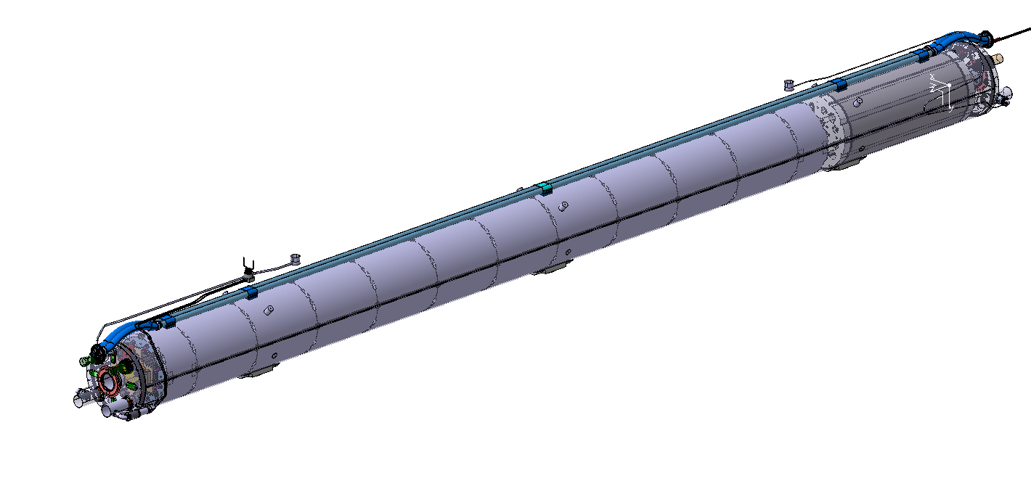
MCBXF status at CERN
Today
 | 2024 |  |  |  |  |  |  |  |  |  |  |  |  |  |  |  |  |  |  |  |  |  |  |  | 2025 |  |  |  |  |  |  |  |  |  |  |  |  |  |  |  |  |  |  |  |  |  |  |  | 2026
 | Jan |  | Feb |  | Mar |  | Apr |  | May |  | Jun |  | Jul |  | Aug |  | Sep |  | Oct |  | Nov |  | Dec |  | Jan |  | Feb |  | Mar |  | Apr |  | May |  | Jun |  | Jul |  | Aug |  | Sep |  | Oct |  | Nov |  | Dec |  | Jan |  | Feb |  | Mar |  | April |  | May
MCBXFB05 |  |  |  | B05
MCBXFA1 |  |  |  |  |  |  |  |  |  | A1
MCBXFB06 |  |  |  |  |  |  |  |  |  |  |  |  |  |  | B06
MCBXFB07 |  |  |  |  |  |  |  |  |  |  |  |  |  |  |  |  |  |  |  | B07
MCBXFA2 |  |  |  |  |  |  |  |  |  |  |  |  |  |  |  |  |  |  |  |  |  |  |  |  | A2
MCBXFB08 |  |  |  |  |  |  |  |  |  |  |  |  |  |  |  |  |  |  |  |  |  |  |  |  |  |  |  |  |  | B08
MCBXFA3 |  |  |  |  |  |  |  |  |  |  |  |  |  |  |  |  |  |  |  |  |  |  |  |  |  |  |  |  |  |  |  |  |  | A3
MCBXFB09 |  |  |  |  |  |  |  |  |  |  |  |  |  |  |  |  |  |  |  |  |  |  |  |  |  |  |  |  |  |  |  |  |  |  |  |  |  |  | B09
MCBXFA4 |  |  |  |  |  |  |  |  |  |  |  |  |  |  |  |  |  |  |  |  |  |  |  |  |  |  |  |  |  |  |  |  |  |  |  |  |  |  |  |  |  |  | A4
MCBXFB10 |  |  |  |  |  |  |  |  |  |  |  |  |  |  |  |  |  |  |  |  |  |  |  |  |  |  |  |  |  |  |  |  |  |  |  |  |  |  |  |  |  |  |  |  |  |  |  |  | B10
MCBXFA5 |  |  |  |  |  |  |  |  |  |  |  |  |  |  |  |  |  |  |  |  |  |  |  |  |  |  |  |  |  |  |  |  |  |  |  |  |  |  |  |  |  |  |  |  |  |  |  |  |  |  |  |  | A5
MCBXFA6
MCBXFB11
MCBXFB12
Needed 07/01/2025 for LMQXFB09
Needed 14/10/2025 for LMQXFB12
Needed 24/06/2025 for LMQXFB11
Needed 07/01/2026 for LMQXFB13
Needed 18/03/2025 for LMQXFB10
Regarding the magnet readiness for Q2 cold-mass preparation, our schedule for 2025 becomes tight for MCBXFB08 and beyond*. As mentioned in previous slide, efforts on-going trying to compensate for what is needed in 2026.
For CP cold-masses, the assembly will proceed as soon as MCBXFA magnets are ready (HO correctors in stock).
*Note that the magnet dates (blue/orange bars) in the slide do not account for the time needed for vertical cold test (qualification) at SM18.

Slide 9
MCBXF status at CERN
Summary on what has been done in 2024:
  MCBXFB05:
    Assembly duration: 3 months
    Used for transferring the know-how to the new team and setting-up the production line (including ancillary systems like magnetic measurements)
    Note - field quality, b3 out of range (~1-2 units in combined operation)
  MCBXFA1:
    Assembly duration: 2.5 months
    First MCBXFA series magnet. Used as well for transferring the know-how to the new team
  MCBXFB06:
    Assembly duration: 2.5 months
    Note - field quality, b3 out of range (~1-2 units in combined operation, same as MCBXFB05)
  MCBXFB07:
    Assembly duration: 2.5 months
    Modified shimming to correct field quality

Slide 10
Outline
MCBXF general status at CERN
MCBXFB05 assembly
MCBXFA1 assembly
MCBXFB06 assembly
MCBXFB07 assembly
Summary and outlook

Slide 11
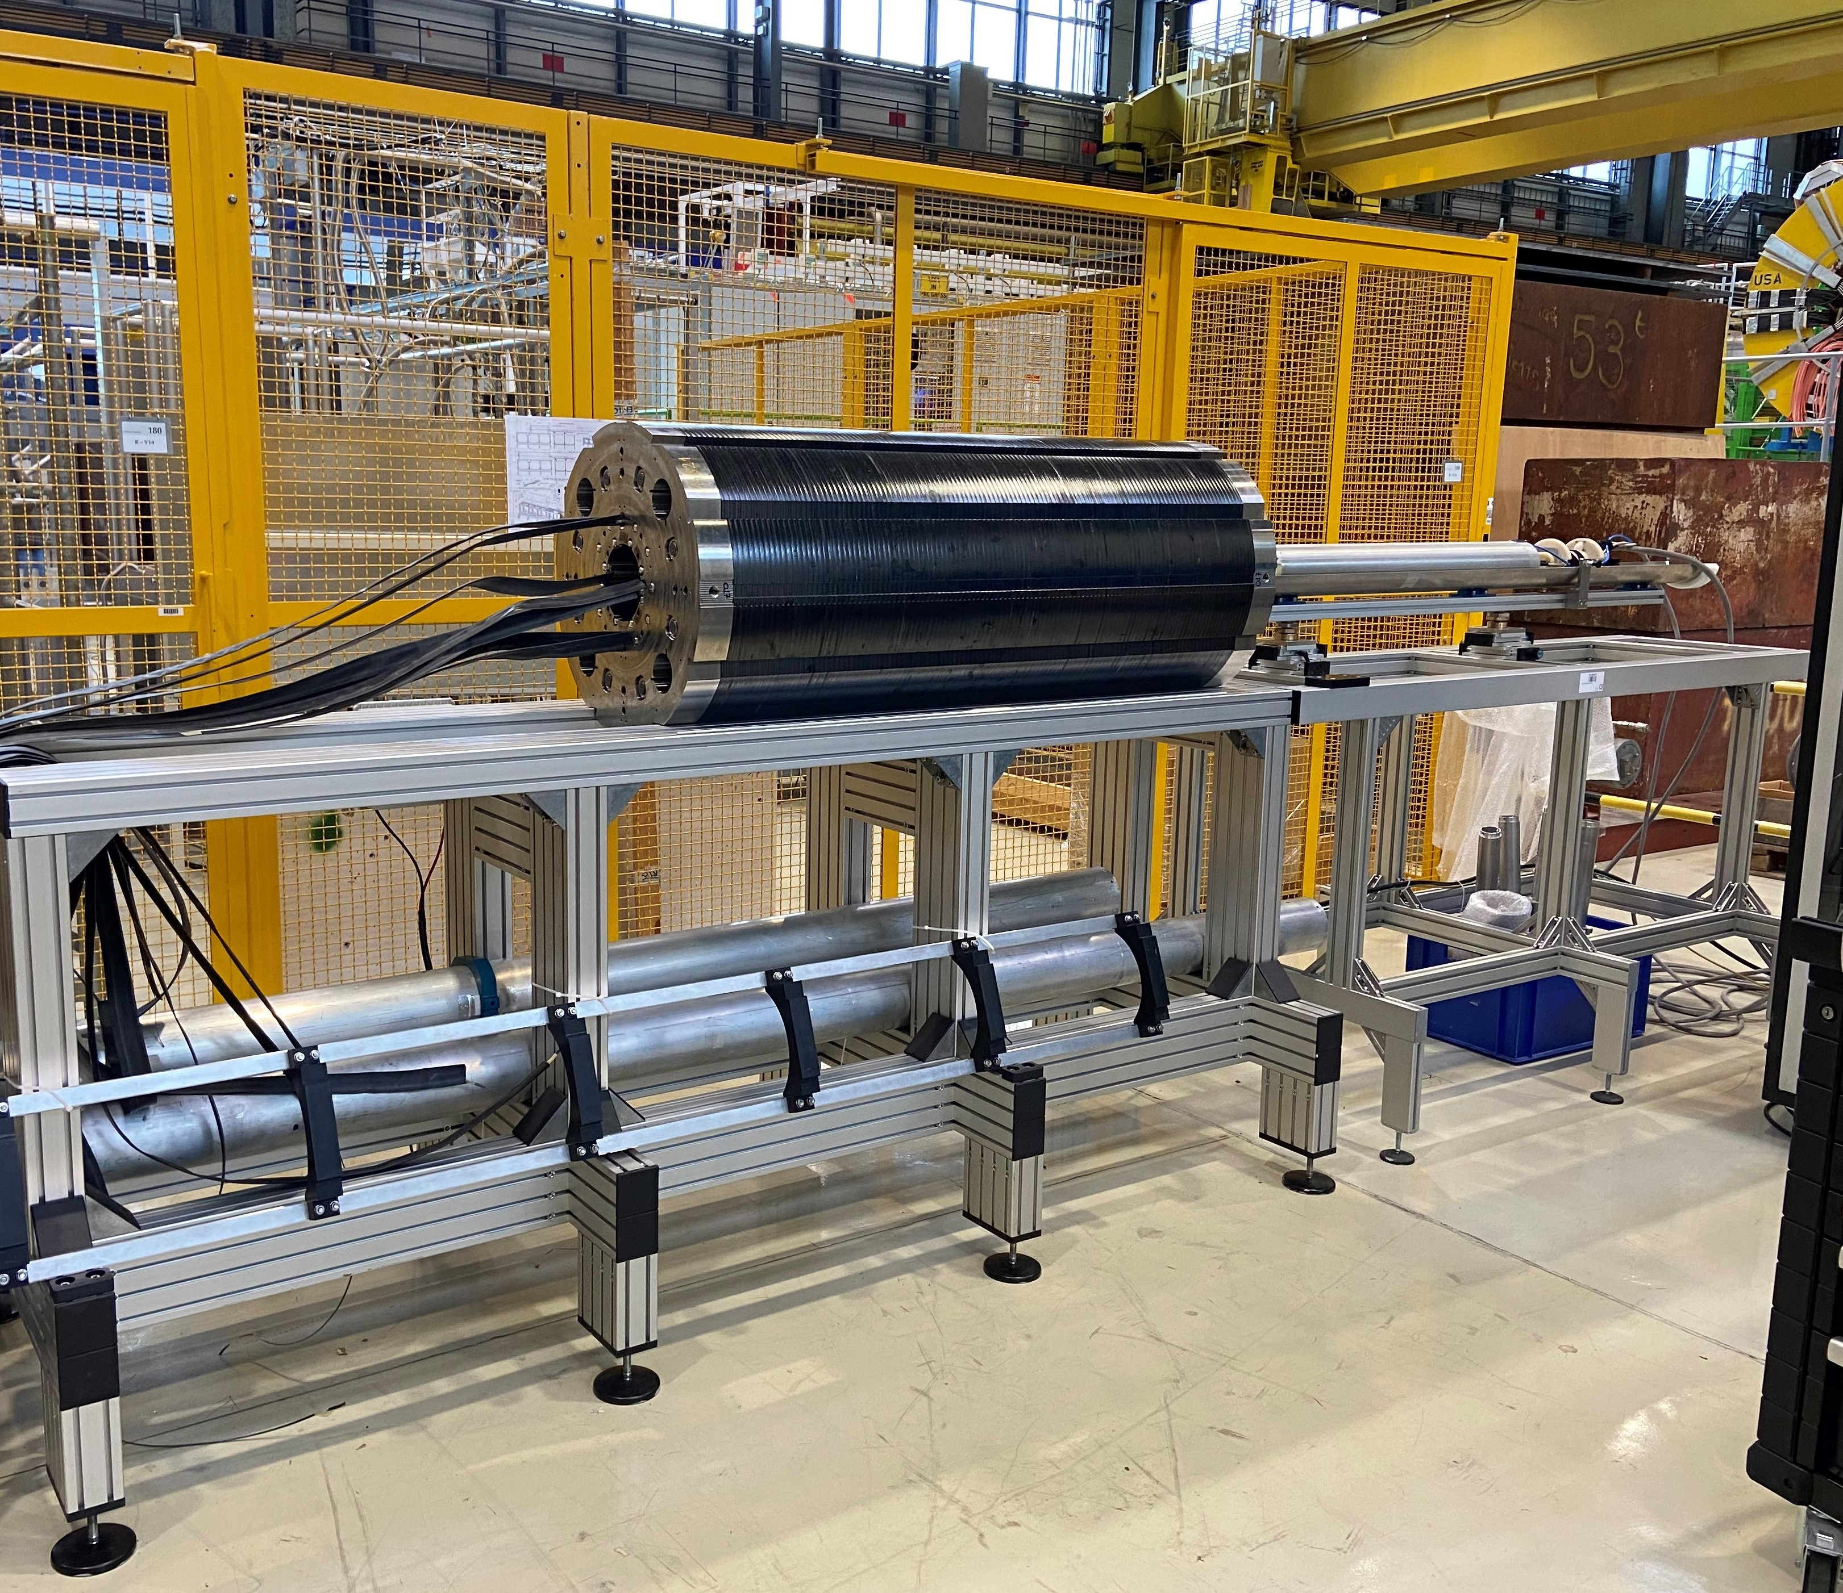

MCBXFB05
  Assembly duration / finishing date: 3 months / May 2024
First magnet for the new production line
  Mechanical measurements and coil contact homogeneity (FUJI)
    Consistent with previous magnets
  All electrical tests successfully passed
  Warm magnetic measurements
    Small difference in b3 and a3 for the inner dipole ~ 5-6 units with respect to previous magnets. As expected, also present at cold.
    Outer dipole in line with previous assemblies
  Cold test (See slides from G. Willering)
  Documentation and EDMS status:
    Documentation is up to date.

Slide 12
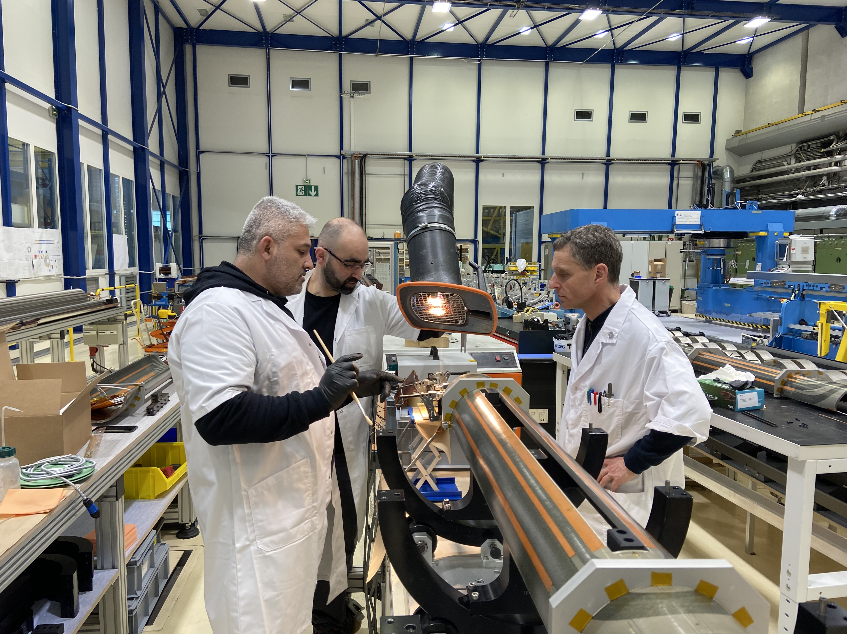
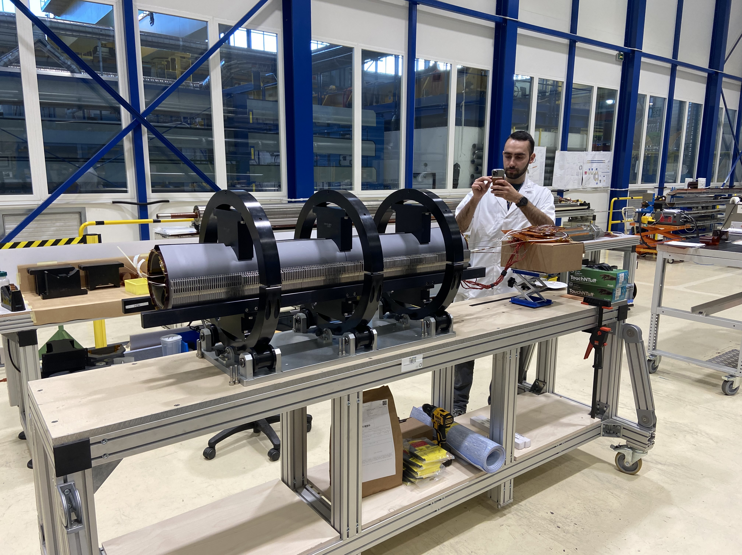
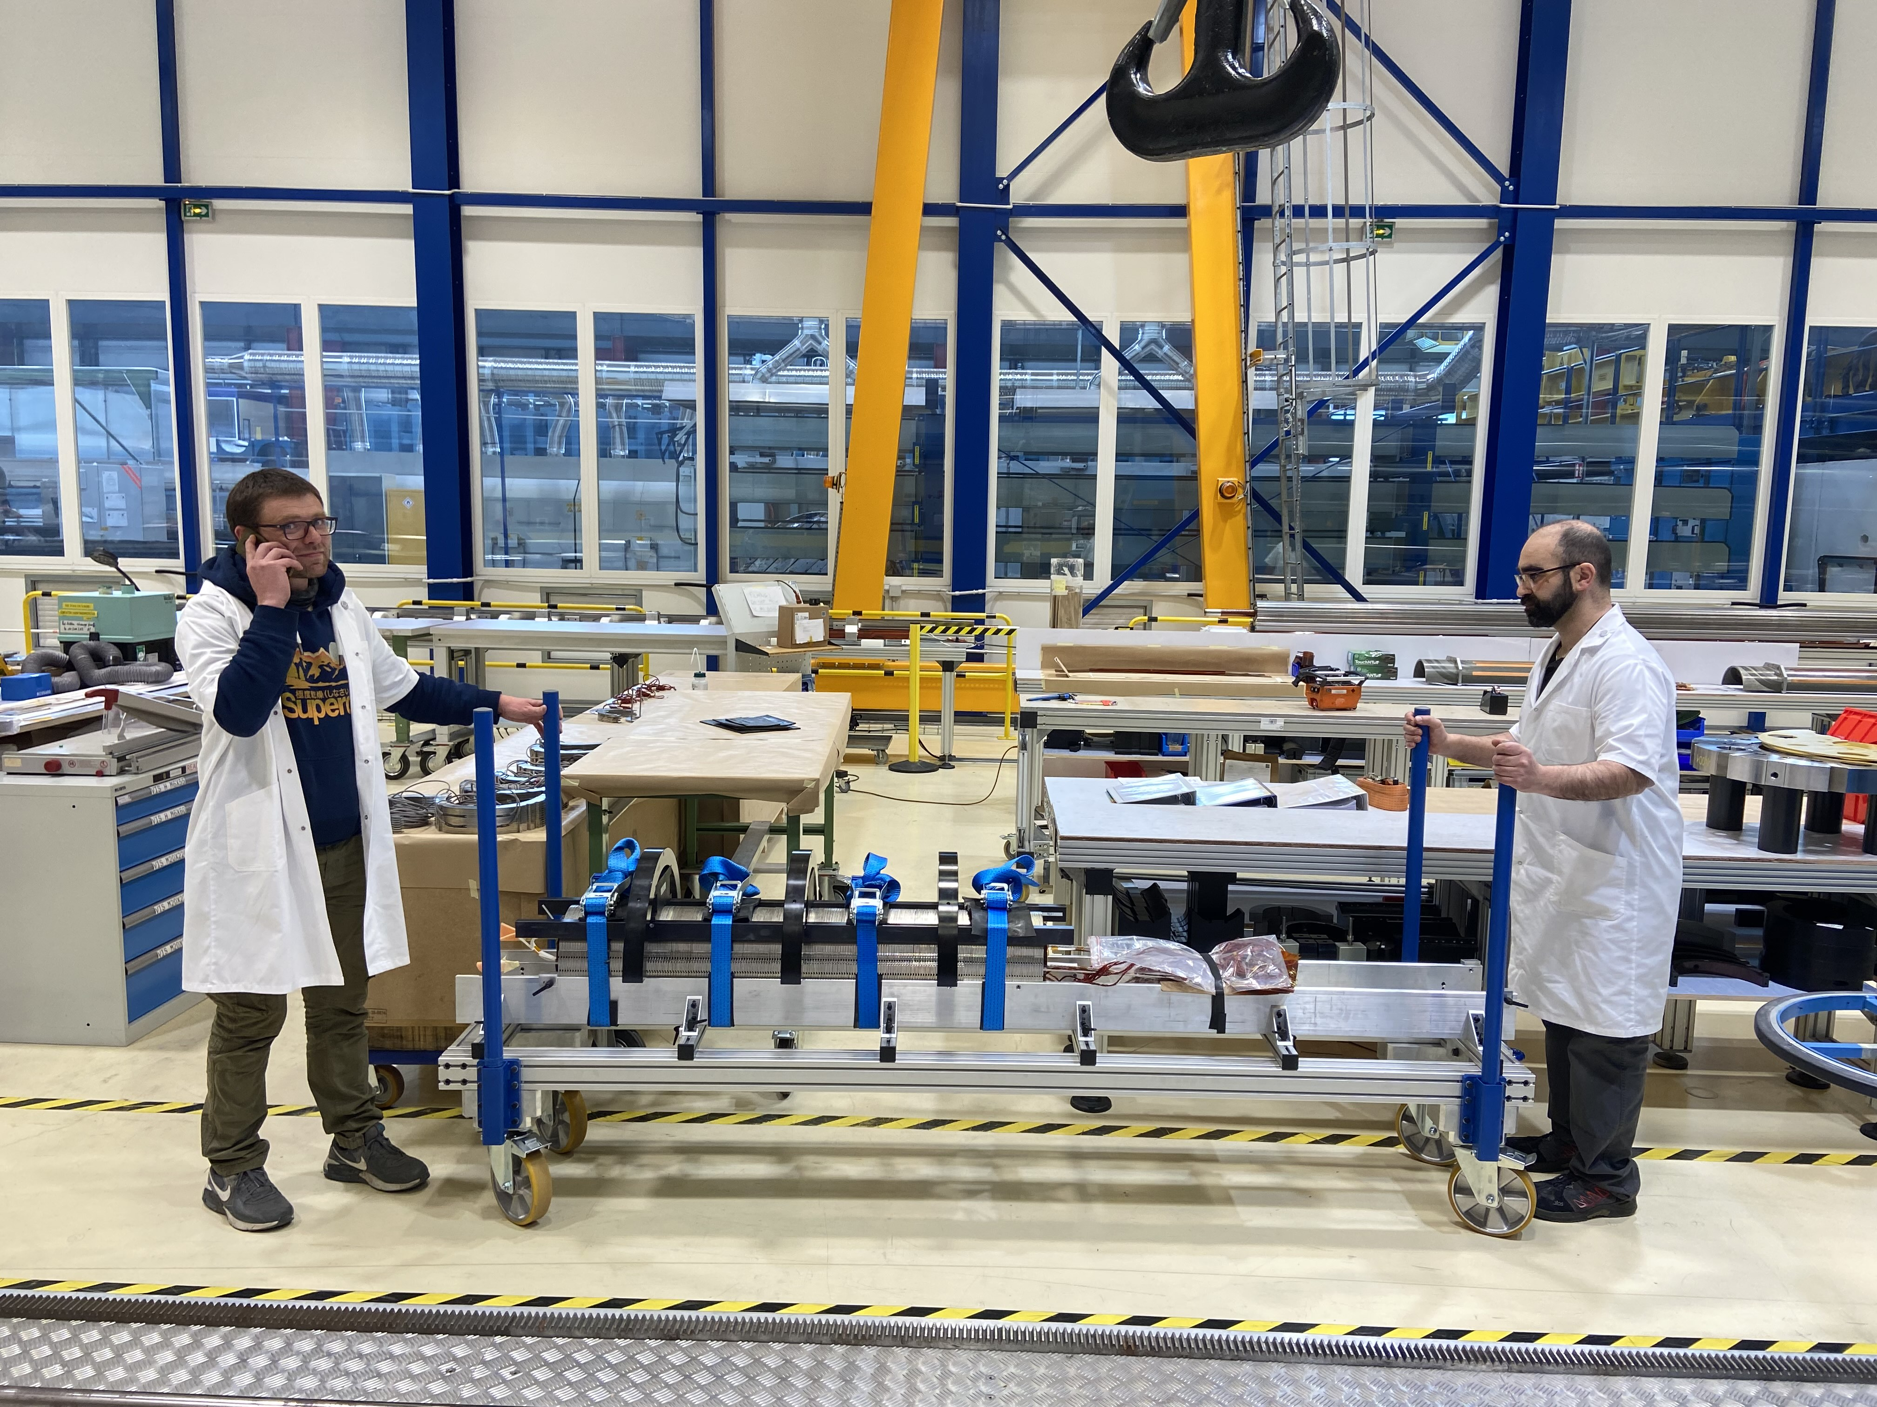
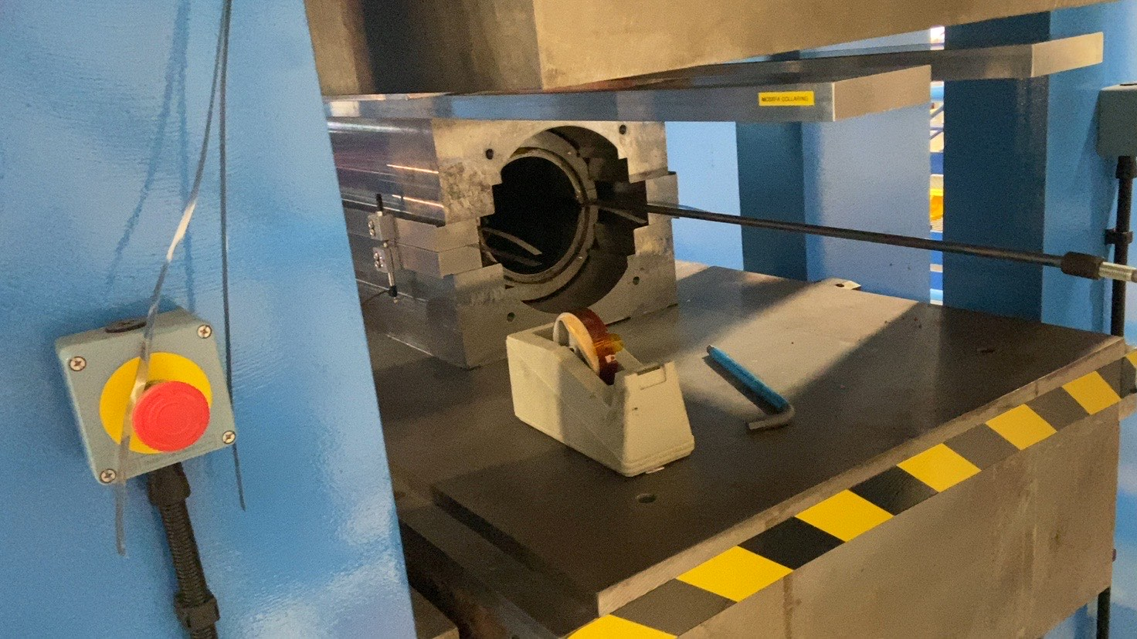
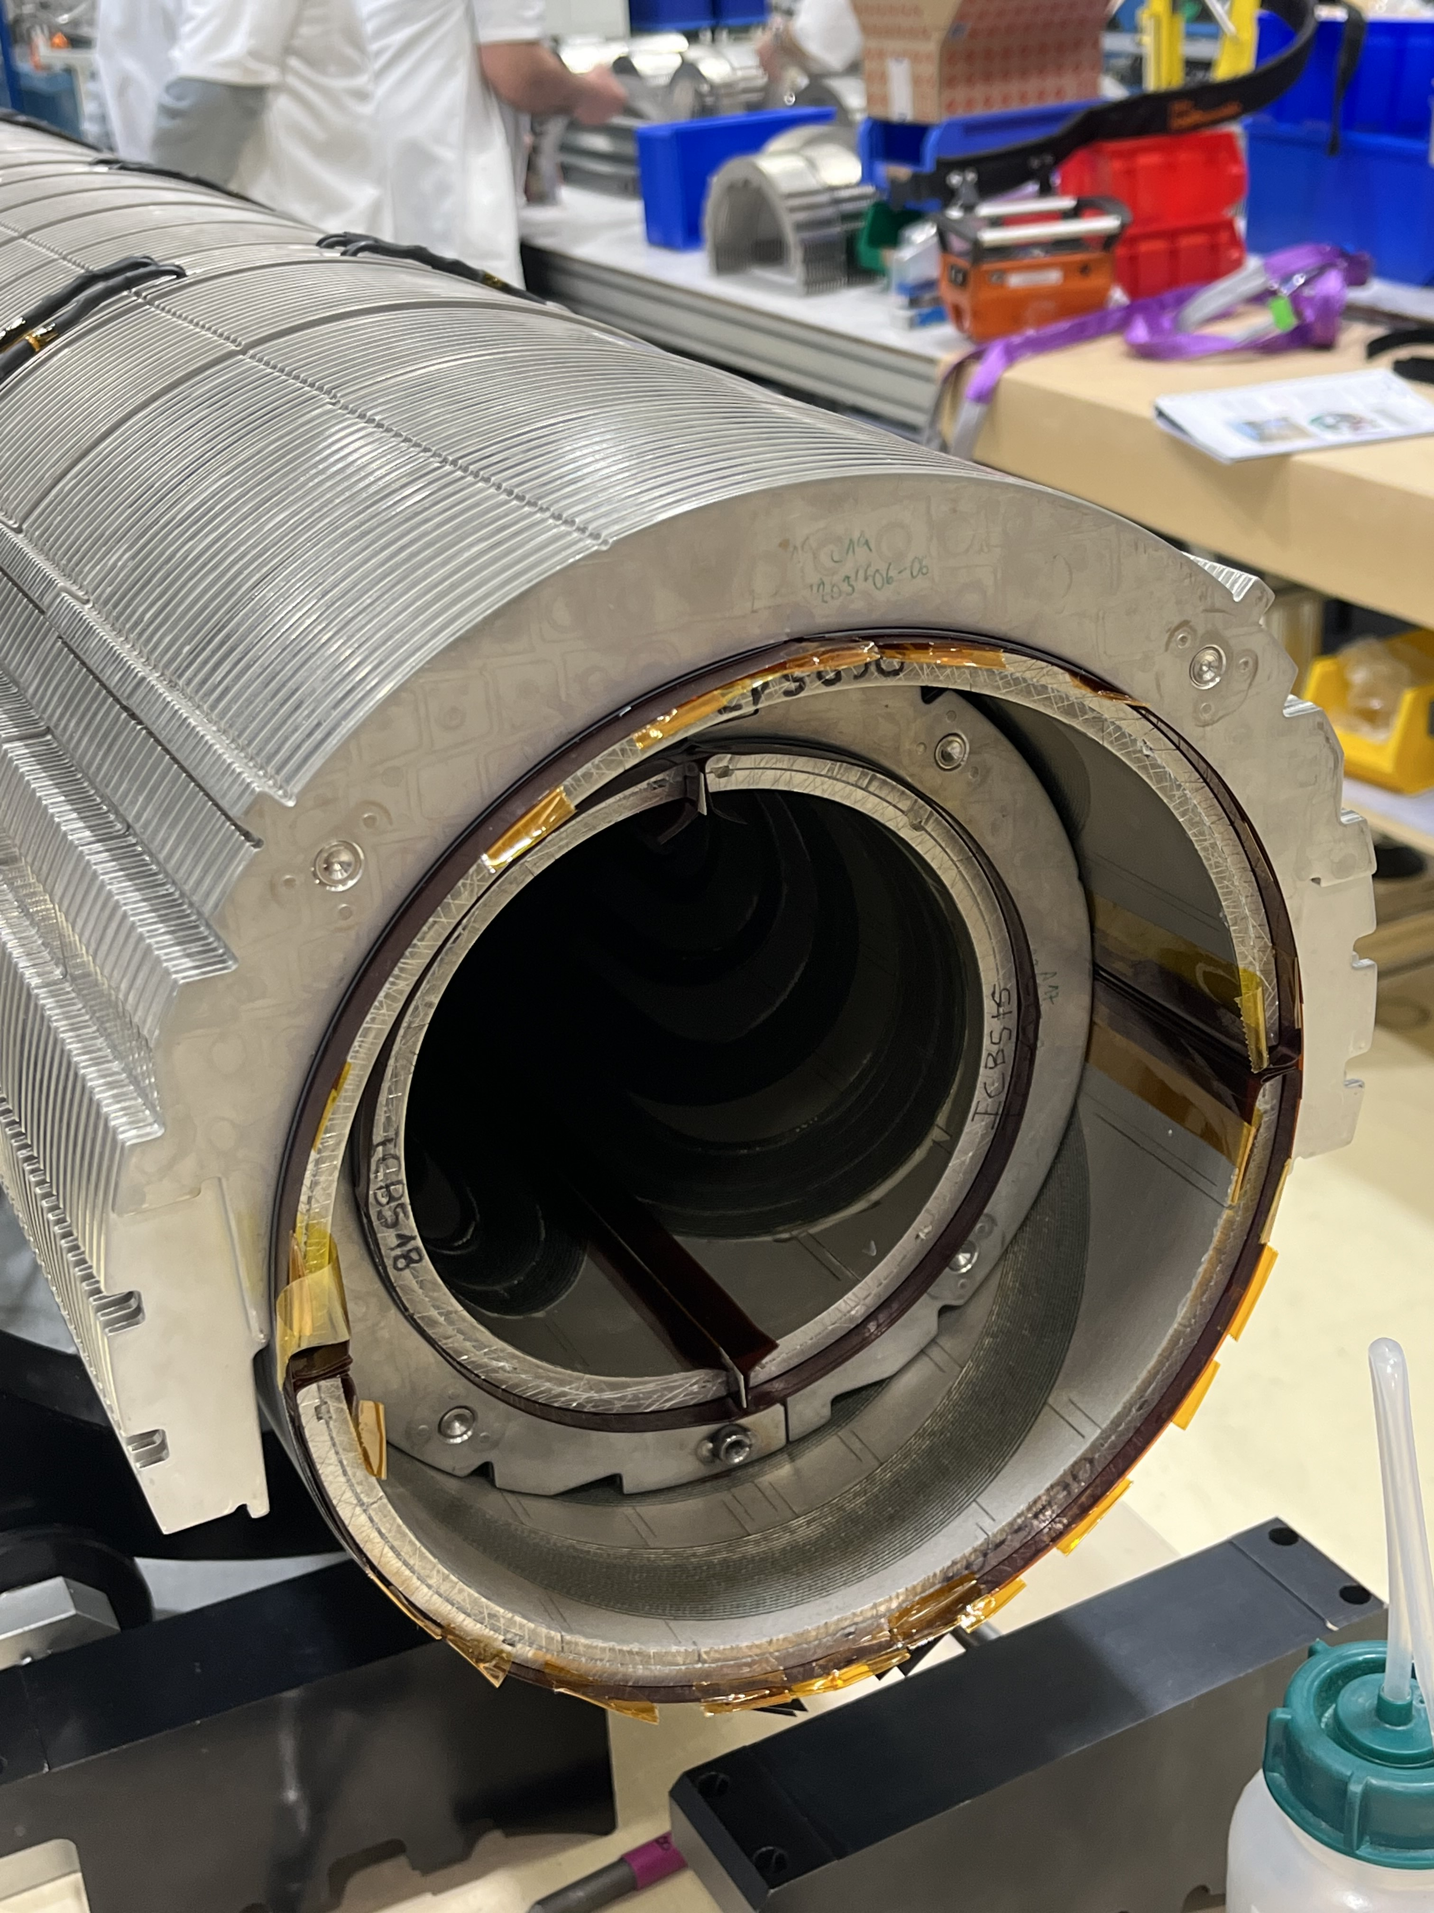
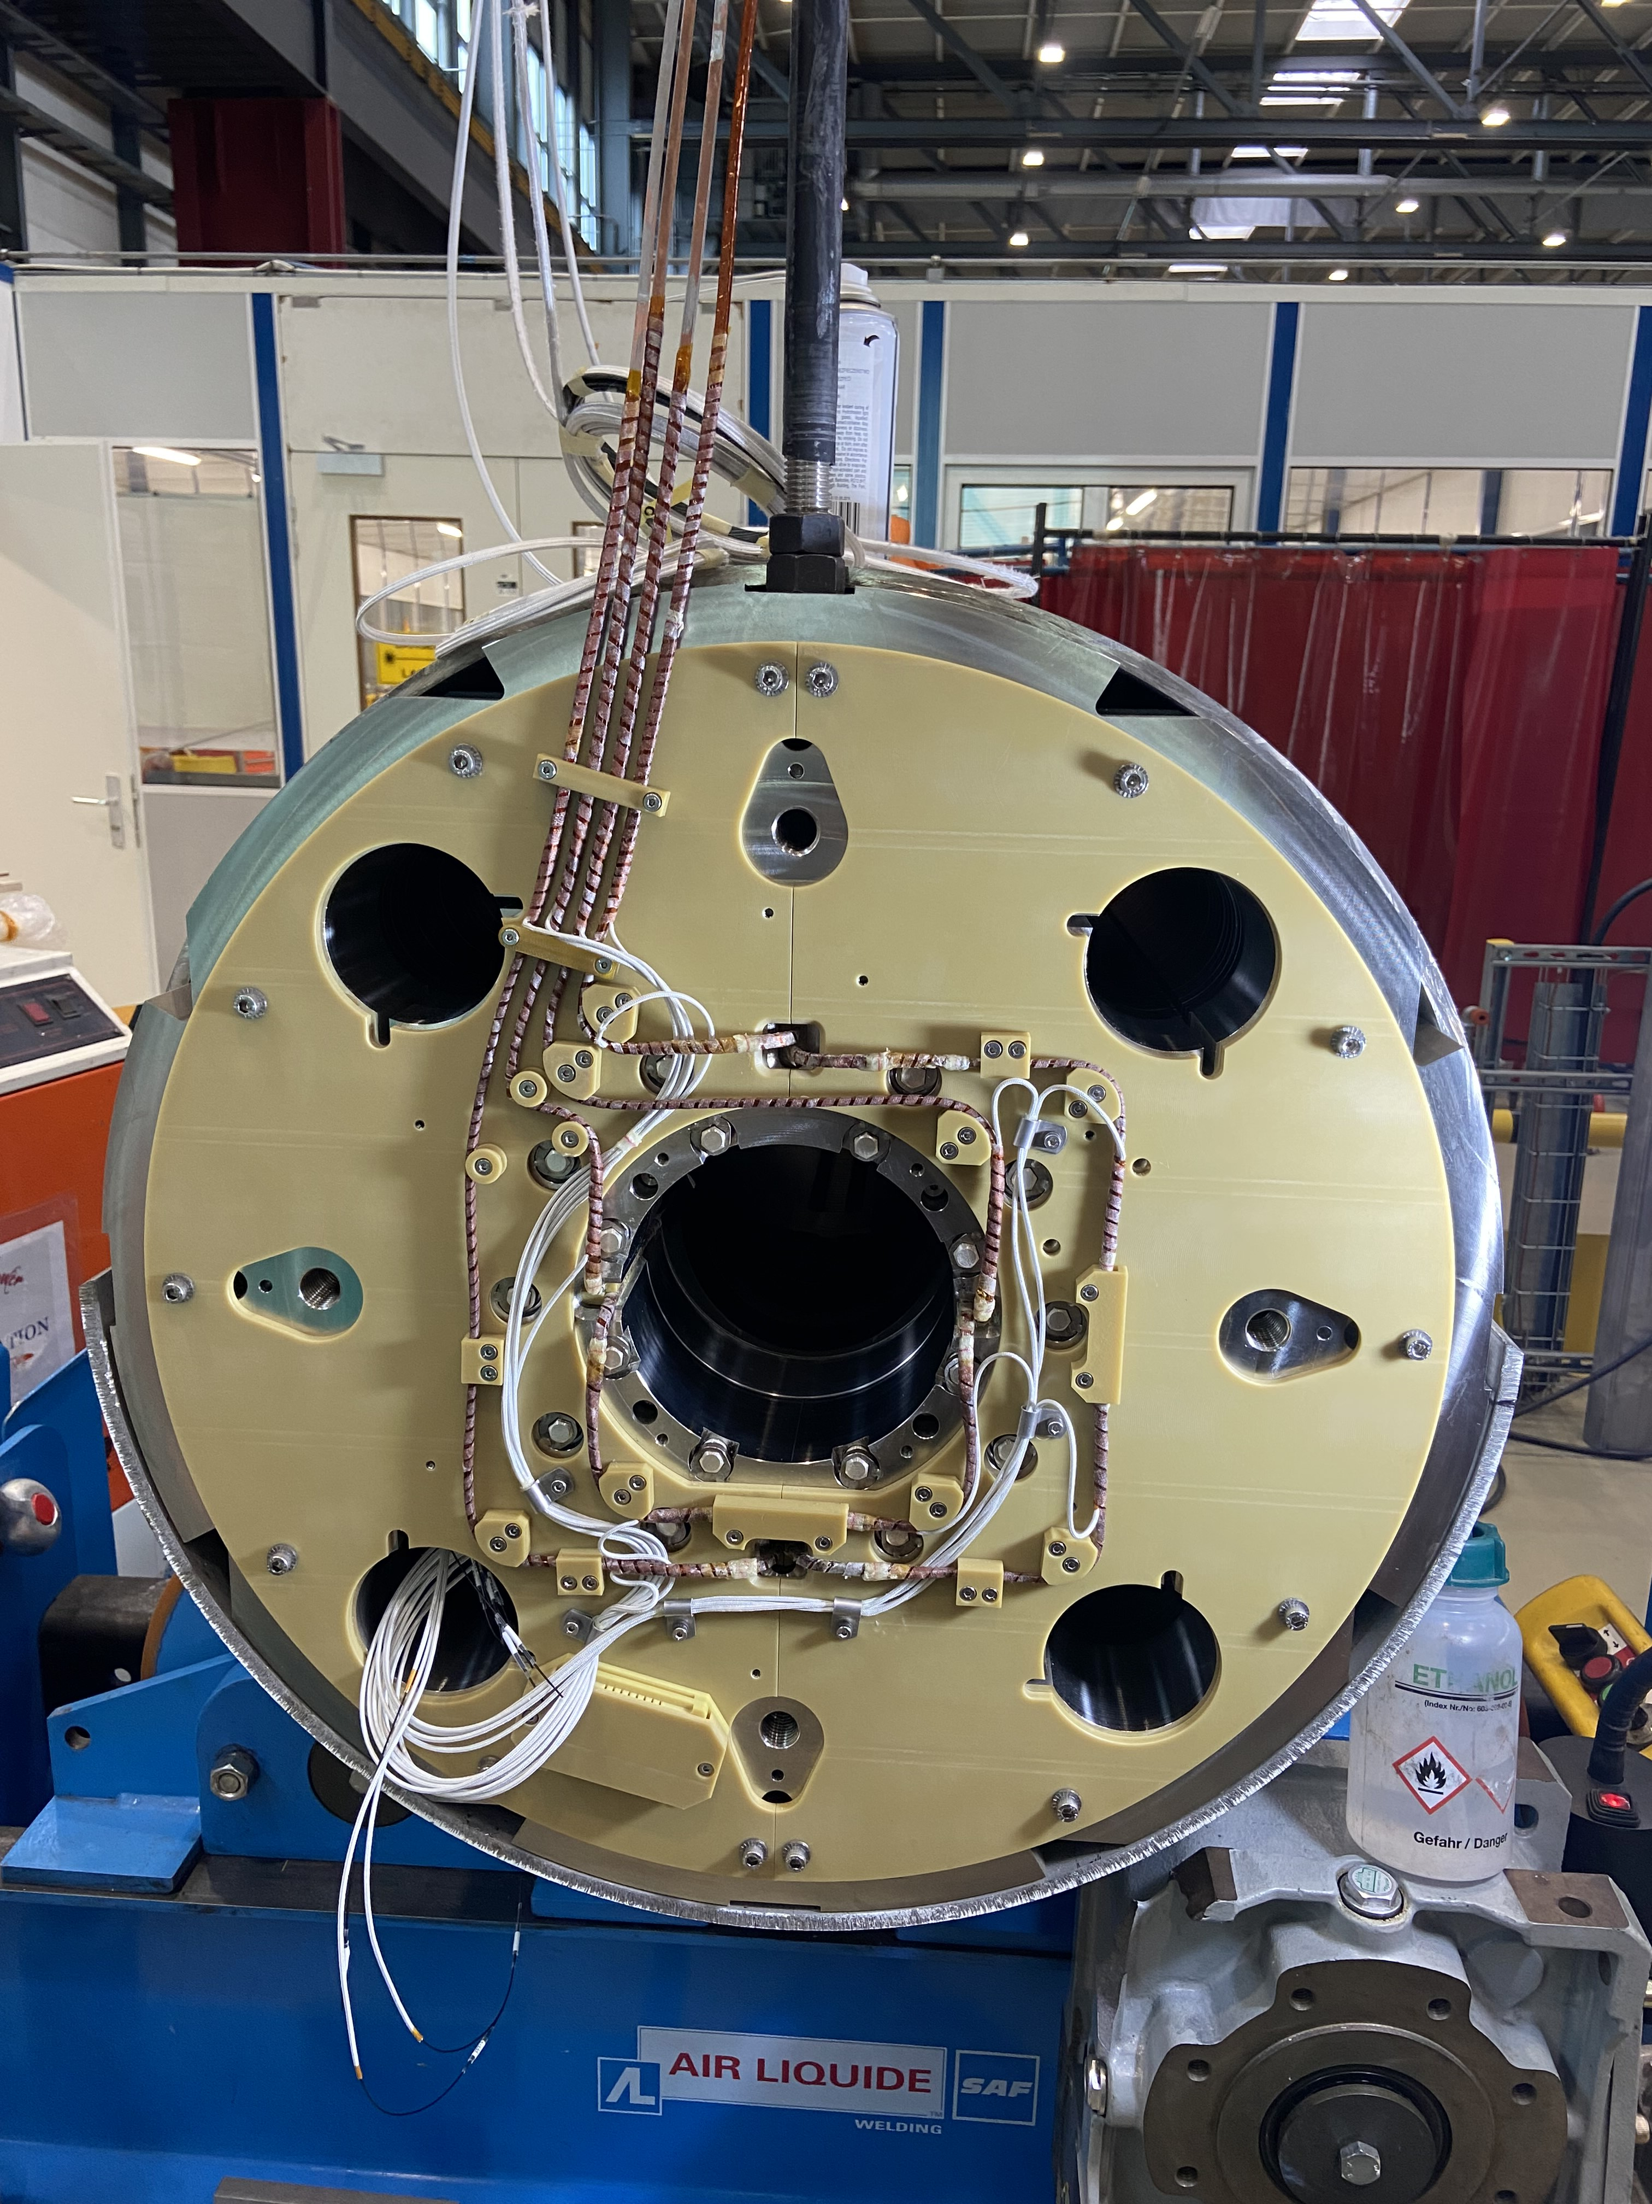
MCBXFB05

Slide 13
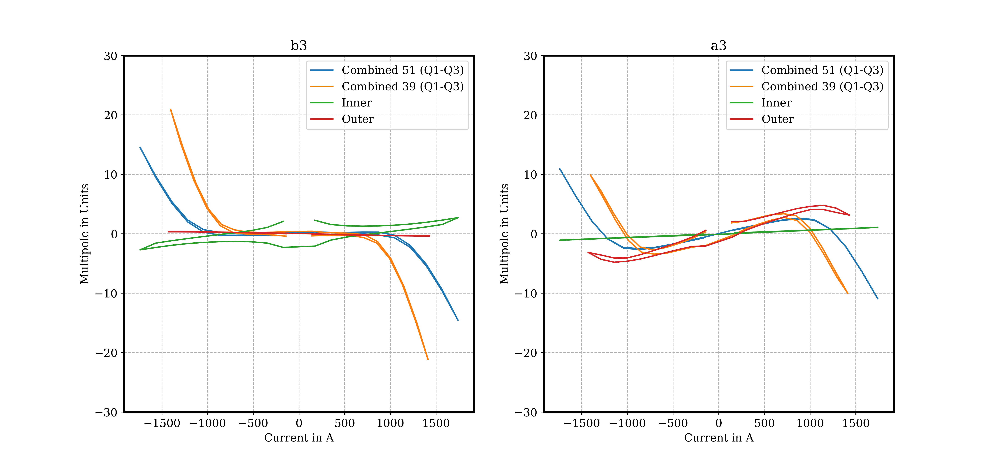
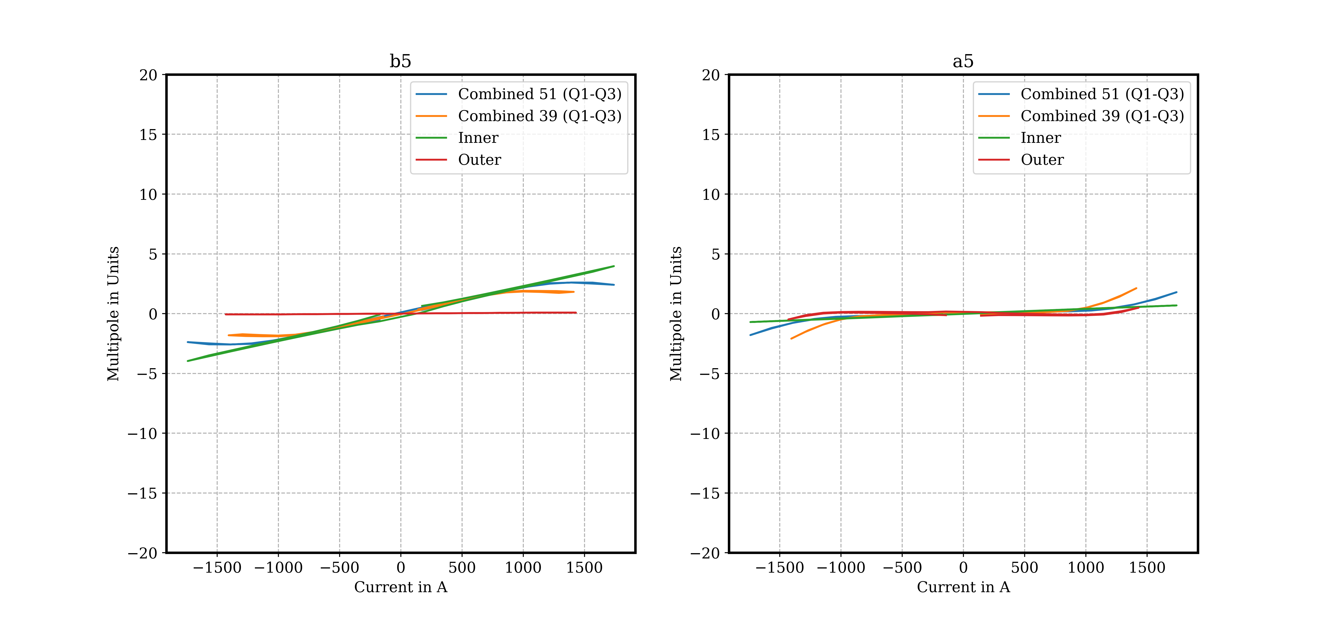
MCBXFB05
Table 4. Acceptance criteria for MCBXFB, EDMS 2051311
Requirement | Description | Measurement
Requirement 1 | Steady state operation at nominal current in 4 angles at 1 to 4 hours. Steady state operation at ultimate current combinations for 4 hours | OK Not in test plan
Requirement 2 | Maximum 1 quench to reach nominal integrated field after thermal cycle in all combinations of signs. | OK
Requirement 3 | Field harmonics (except b3, a3, b5, a5) within 5 units Field harmonics b3 and a3 within 20 units Field harmonics b5 and a5 within 7 units | OK b₃ out by 1.8 units OK
Requirement 6 | Electrical insulation test passed at reception Electrical insulation test passed at room temperature Electrical insulation test passed at nominal operating conditions | OK OK OK
Requirement 9 | The individual splice resistance is lower than 5 nΩ | OK
Requirement A | Satisfy requirement 1 after 100 quenches | Out of scope
Requirement B | Satisfy requirement 1 after 10000 cycles | Out of scope
Requirement C | Satisfy requirement 1 after 10 thermal cycles | Out of scope
Test report: EDMS 3123996

Slide 14
Outline
MCBXF general status at CERN
MCBXFB05 assembly
MCBXFA1 assembly
MCBXFB06 assembly
MCBXFB07 assembly
Summary and outlook

Slide 15
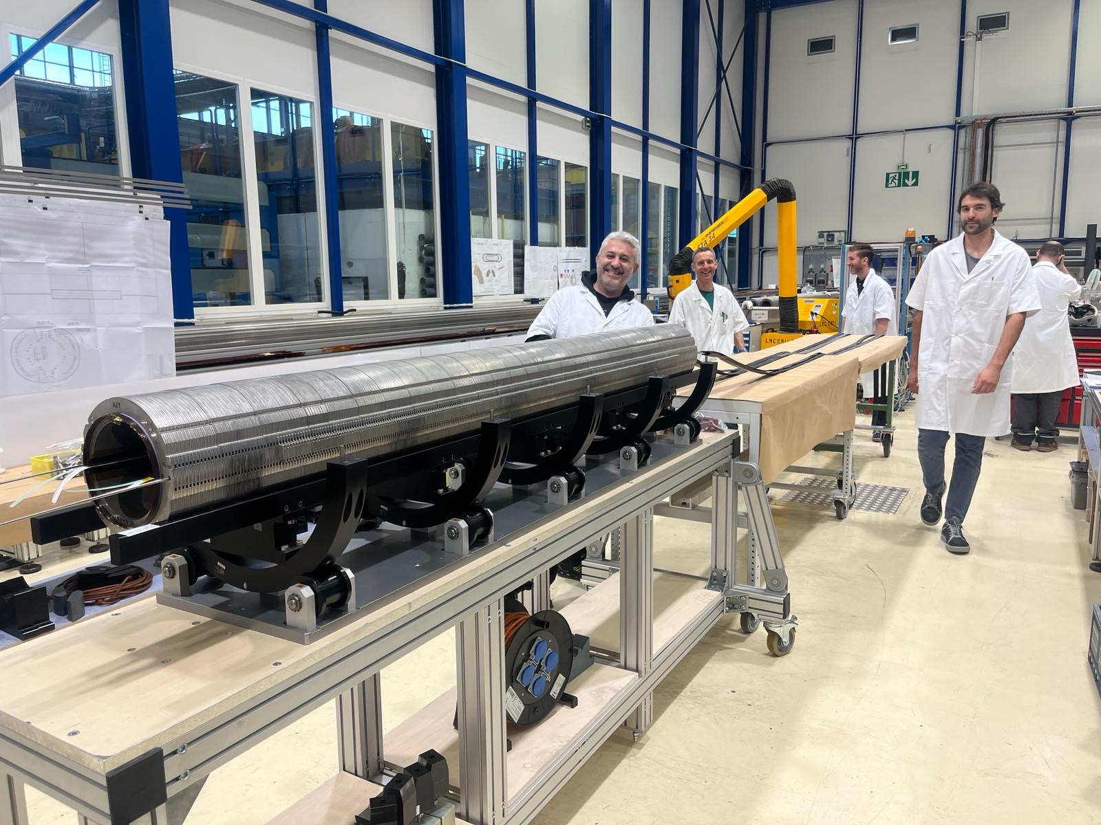
MCBXFA1
Second long MCBXF magnet ever built (no units produced at Elytt Energy)
  Assembly duration / finishing date: 2.5 months / August 2024
  Mechanical measurements and coil contact homogeneity (FUJI)
    Consistent with previous magnets
  All electrical tests successfully passed
  Warm magnetic measurements
  Cold test (See slides from G. Willering)
  Documentation and EDMS status:
    Documentation is up to date.

Slide 16
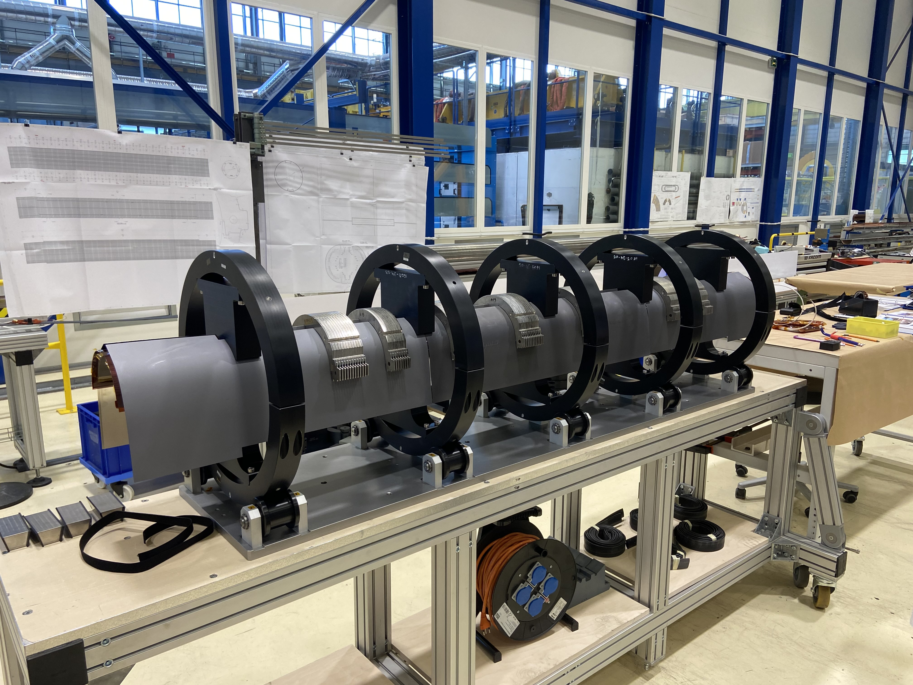
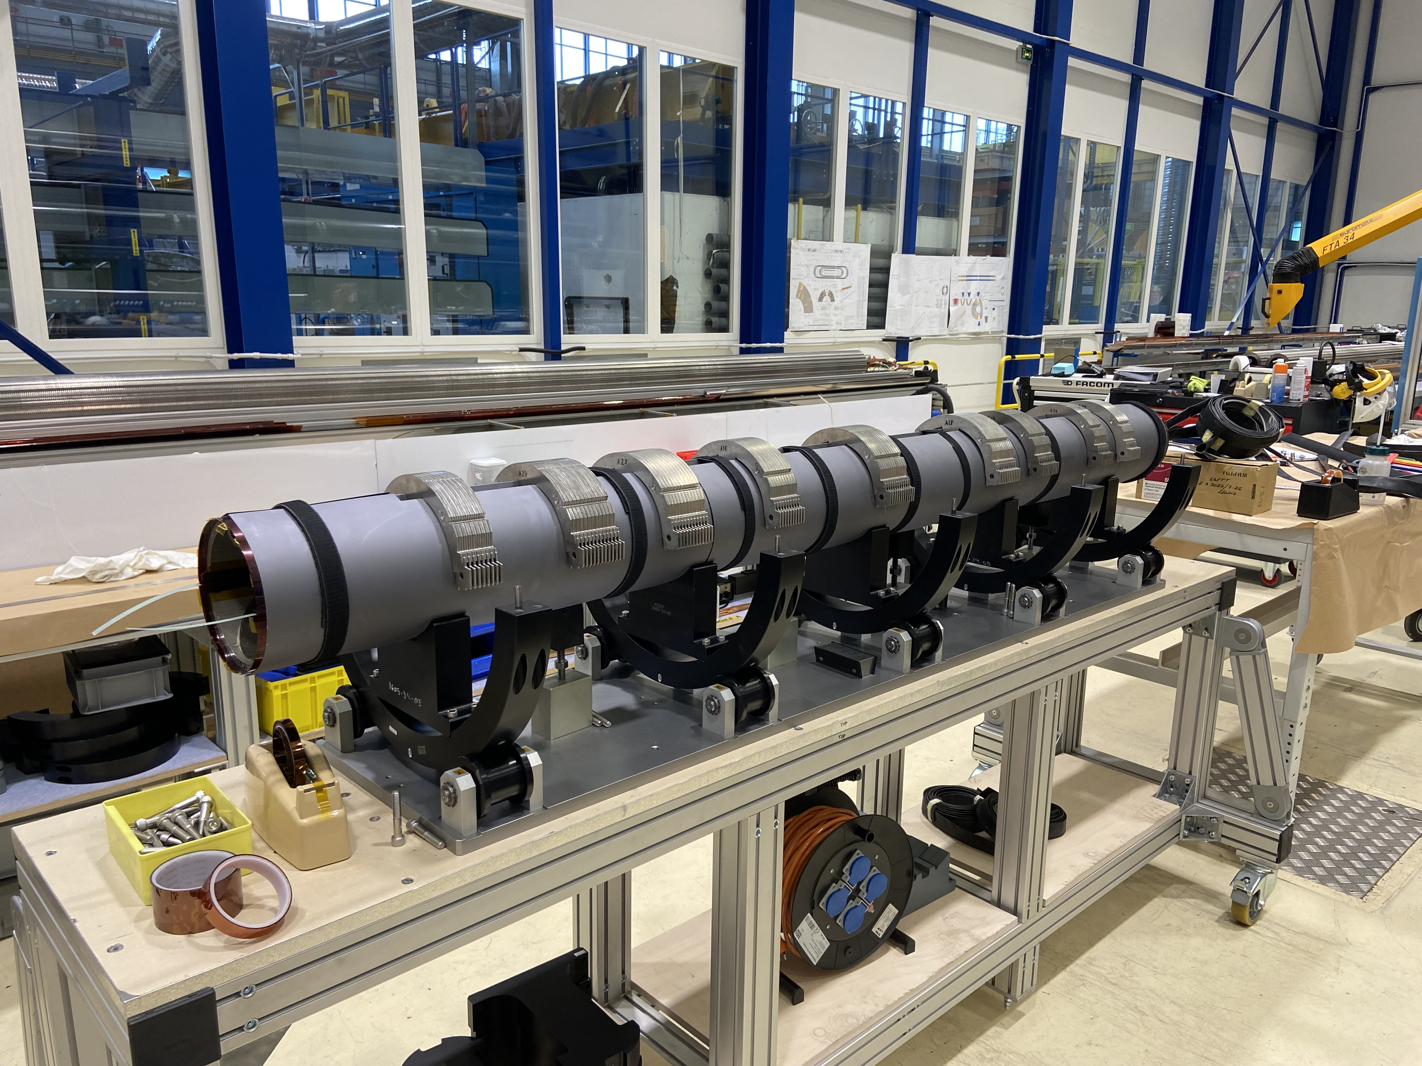
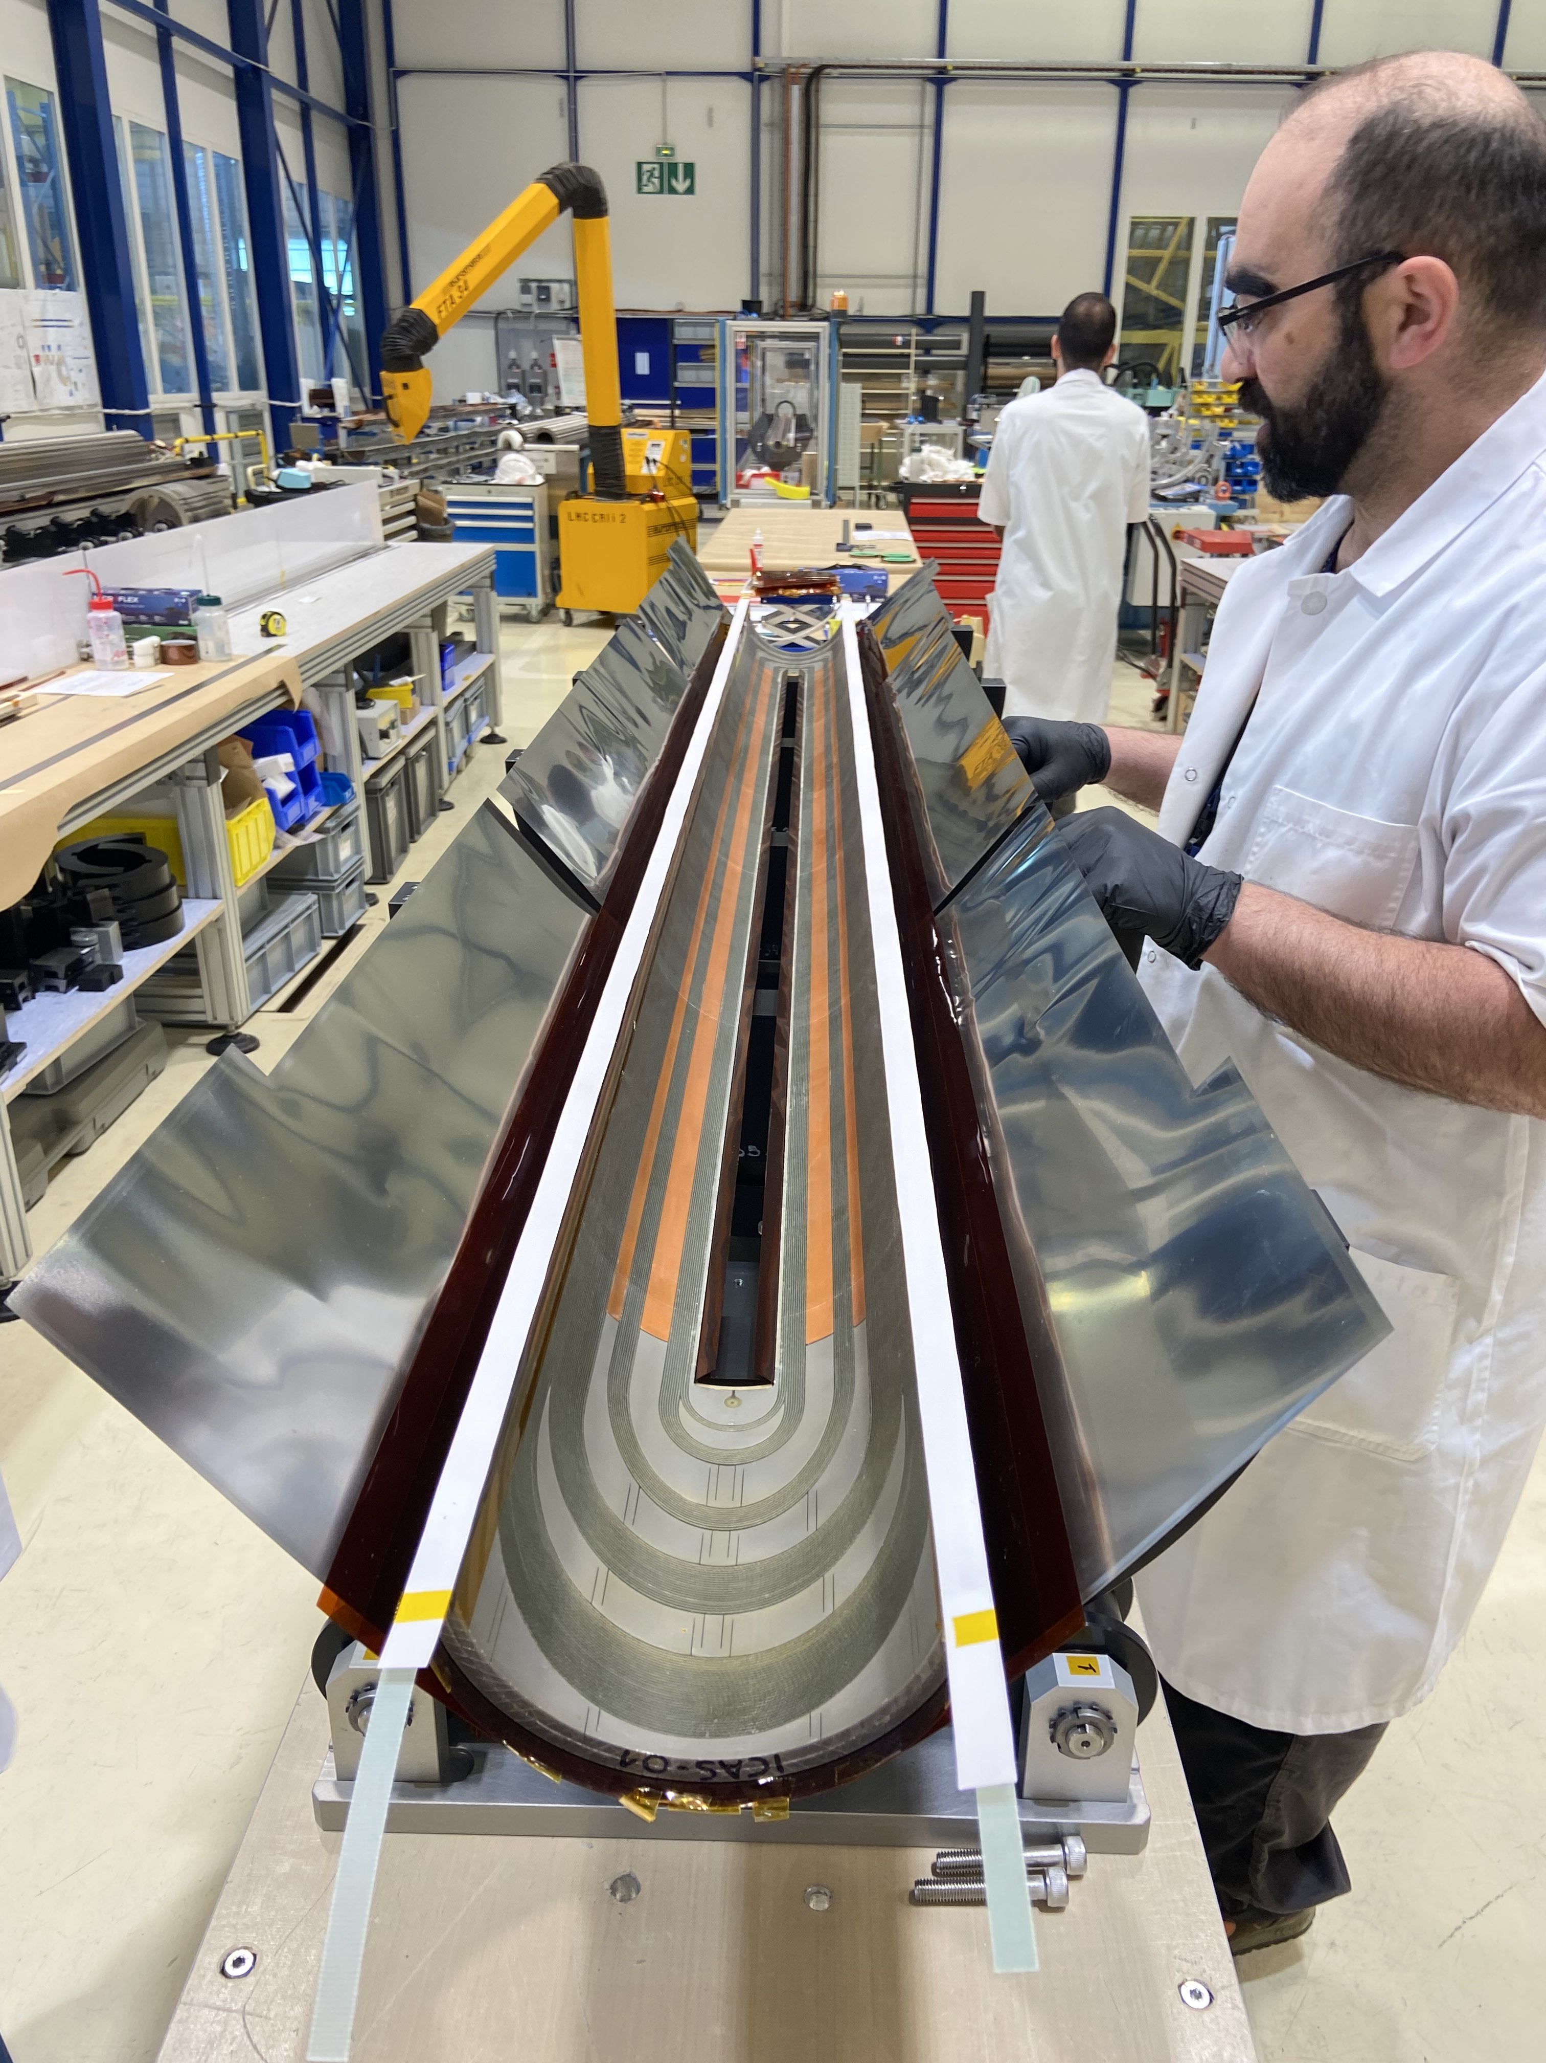
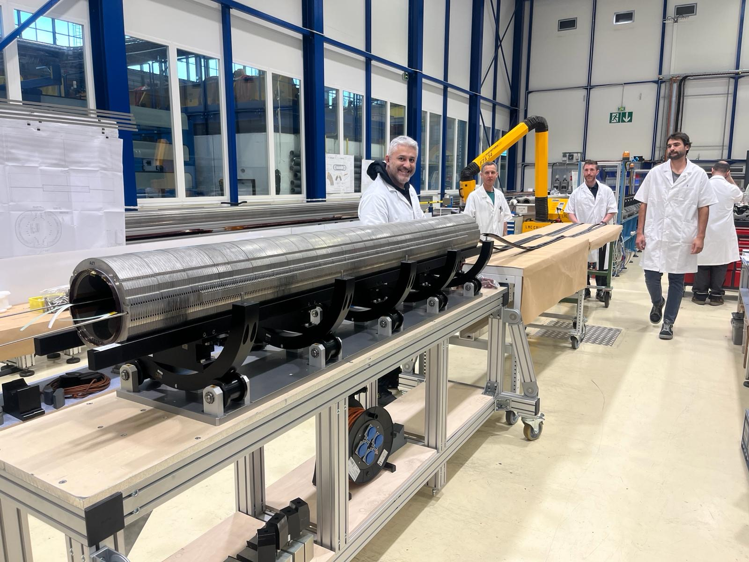
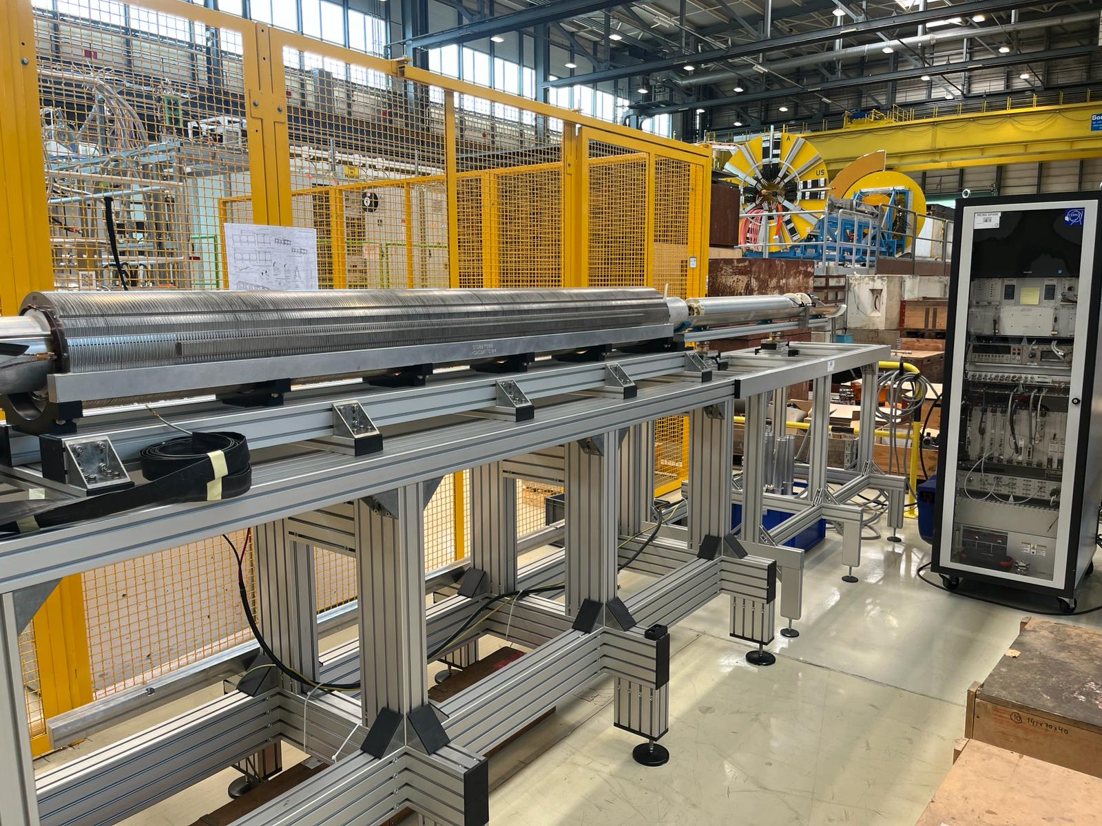
MCBXFA1

Slide 17
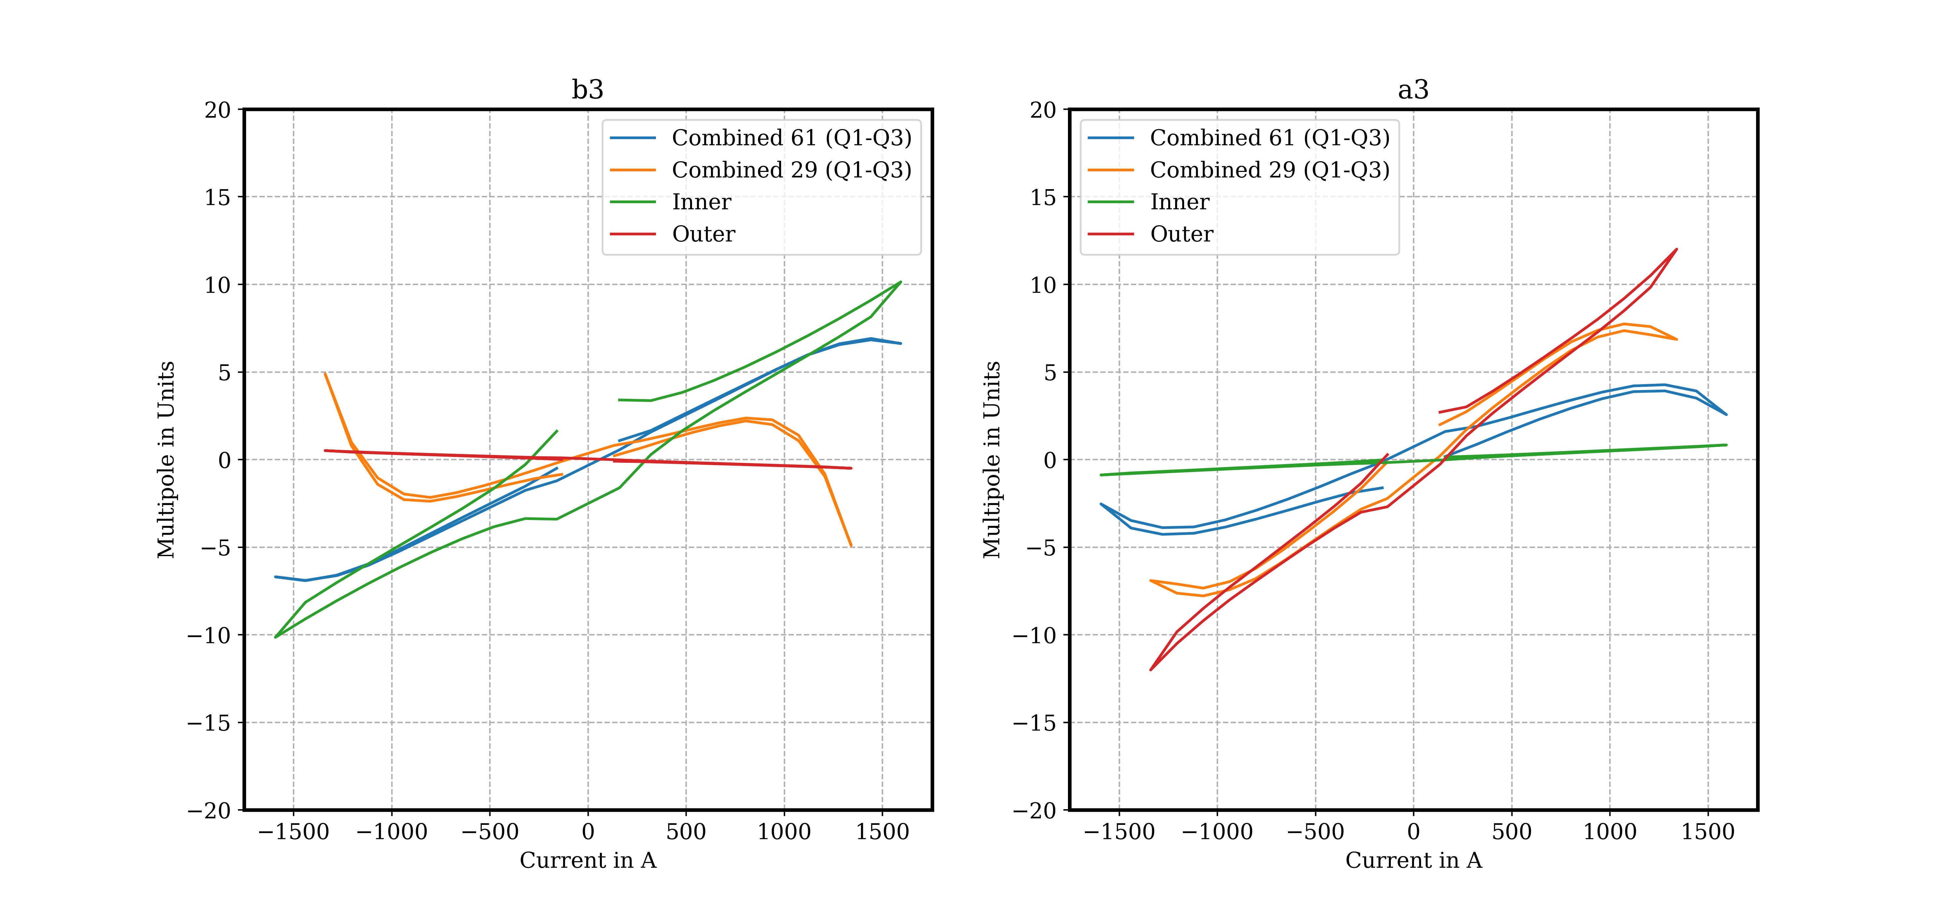
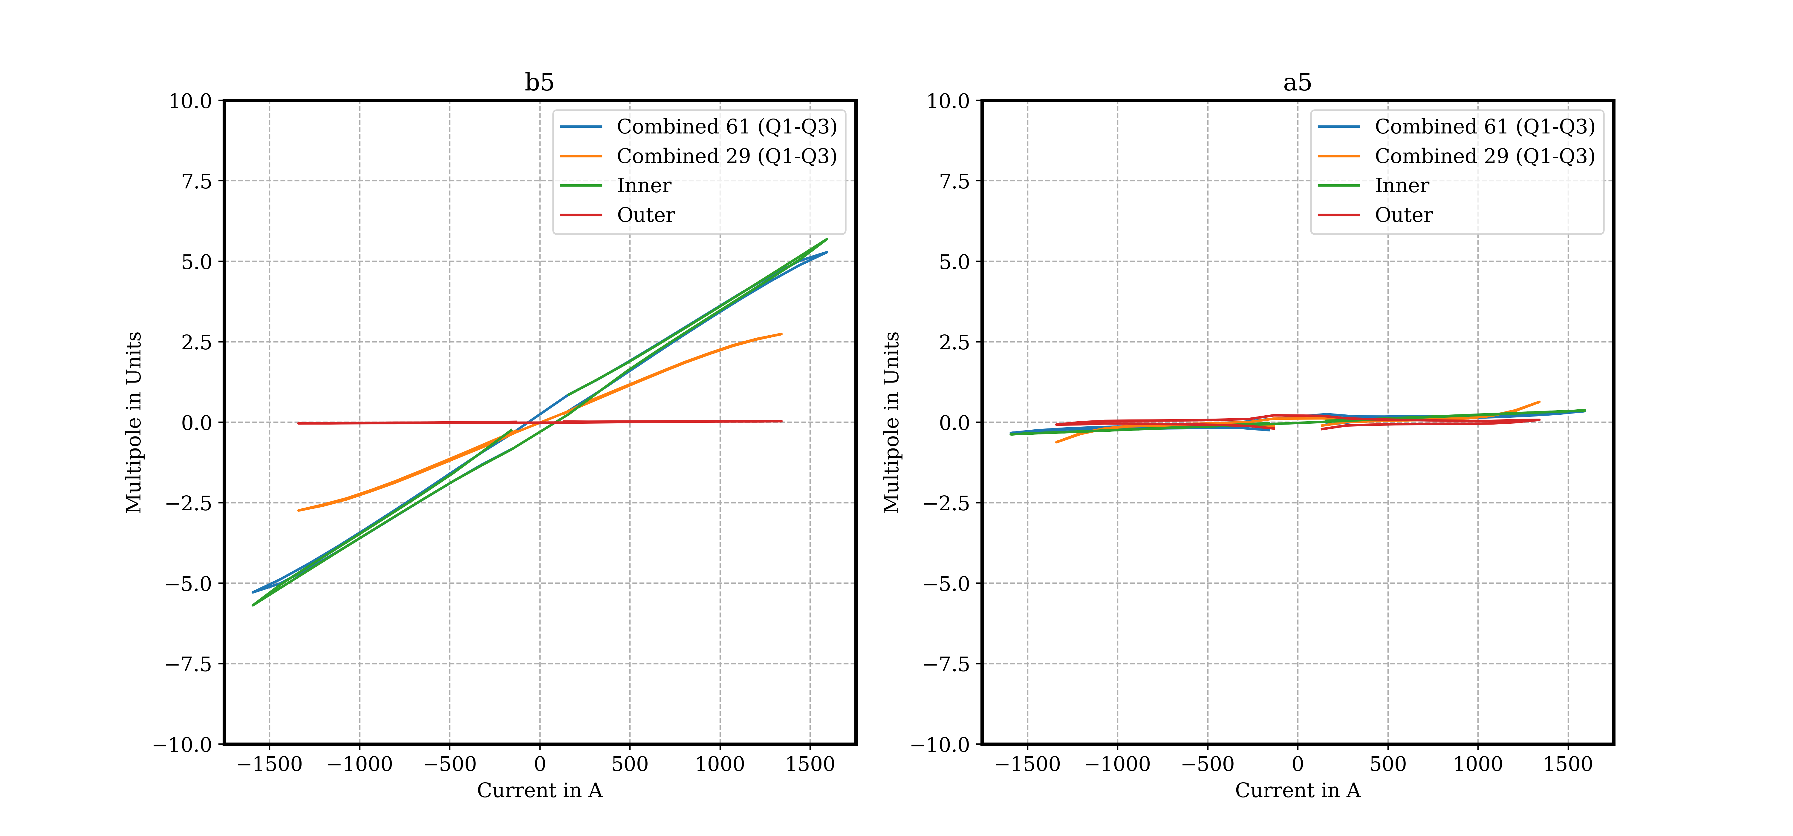
MCBXFA1
Table 4. Acceptance criteria for MCBXFA, EDMS 2051311
Requirement | Description | Measurement
Requirement 1 | Steady state operation at nominal current in 4 angles at 1 to 4 hours. Steady state operation at ultimate current combinations for 4 hours | OK Not in test plan
Requirement 2 | Maximum 1 quench to reach nominal integrated field after thermal cycle in all combinations of signs. | OK
Requirement 3 | Field harmonics (except b3, a3, b5, a5) within 5 units Field harmonics b3 and a3 within 20 units Field harmonics b5 and a5 within 7 units | OK OK OK
Requirement 6 | Electrical insulation test passed at reception Electrical insulation test passed at room temperature Electrical insulation test passed at nominal operating conditions | OK OK OK
Requirement 9 | The individual splice resistance is lower than 5 nΩ | OK
Requirement A | Satisfy requirement 1 after 100 quenches | Out of scope
Requirement B | Satisfy requirement 1 after 10000 cycles | Out of scope
Requirement C | Satisfy requirement 1 after 10 thermal cycles | Out of scope
Test report: EDMS 3162193

Slide 18
Outline
MCBXF general status at CERN
MCBXFB05 assembly
MCBXFA1 assembly
MCBXFB06 assembly
MCBXFB07 assembly
Summary and outlook

Slide 19
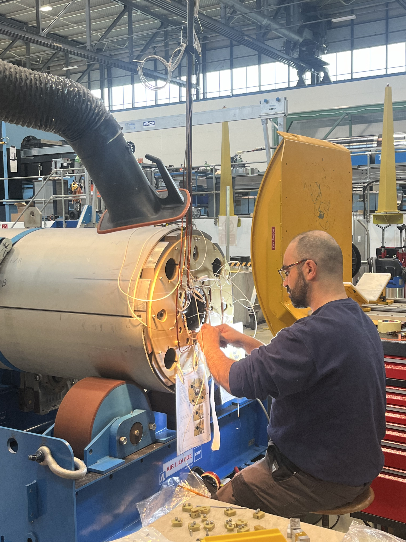
MCBXFB06
  Assembly duration / finishing date: 2.5 months / October 2024
  On schedule, including a shimming change for the inner dipole
  All electrical tests successfully passed
  Warm magnetic measurements
    As for MCBXFB05, we see a difference in b3 / a3 compared to the first magnets.
    Outer dipole in line with previous assemblies
  Cold test (See slides from G. Willering)

Slide 20
Outline
MCBXF general status at CERN
MCBXFB05 assembly
MCBXFA1 assembly
MCBXFB06 assembly
MCBXFB07 assembly
Summary and outlook

Slide 21
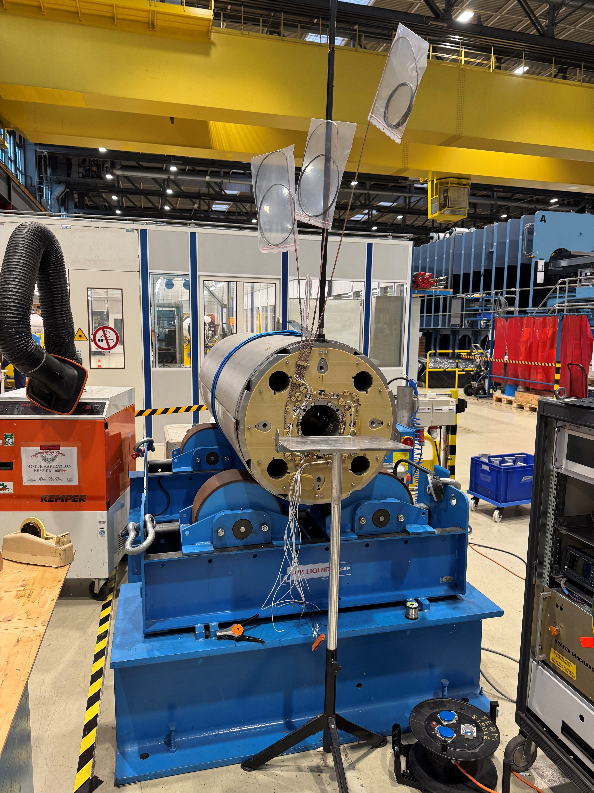
MCBXFB07
  Assembly duration / finishing date: 2.5 months / December 2024
  Modified shimming trying to correct the small field quality deviation in B05 & B06.
  All electrical tests successfully passed
  Warm magnetic measurements
    Shape of field harmonics (along the magnet longitudinal axis) is similar to B05 & B06.
    With the new shimming we have shifted the integrated harmonics back to the values of the first series magnets.
    Outer dipole in line with previous assemblies
  Cold test scheduled for February 2025

Slide 22
Outline
MCBXF general status at CERN
MCBXFB05 assembly
MCBXFA1 assembly
MCBXFB06 assembly
MCBXFB07 assembly
Summary and outlook

Slide 23
Summary and outlook
Assembly activities at CERN are aligned with the planning proposed beginning of 2024.
  The schedule for 2024 was successfully accomplished.
  5 magnets to be manufactured in 2025 (1 more w.r.t. 2024).
Based on our magnet delivery rate and the coil/components availability (see presentation from F. Toral), we are confident in achieving the target of 5 magnets to be assembled in 2025.
  Coil availability is in the critical path. Specially for the end of 2025 and beginning of 2026. CIEMAT is centering all efforts on compensating for this.
In terms of cold-mass integration, Corrector Package cold masses (CP) will be assembled following MCBXFA magnet readiness. For Q2 cold-masses, MCBXFB schedule is tight (limit) for 2025 and in conflict for the two magnets in 2026. As for the previous point, efforts trying to compensate for this.
3 out of the 4 magnets assembled in 2024 have been tested and accepted. The fourth magnet is waiting for vertical test.

Slide 24
Annex

Slide 25
