Slide 1
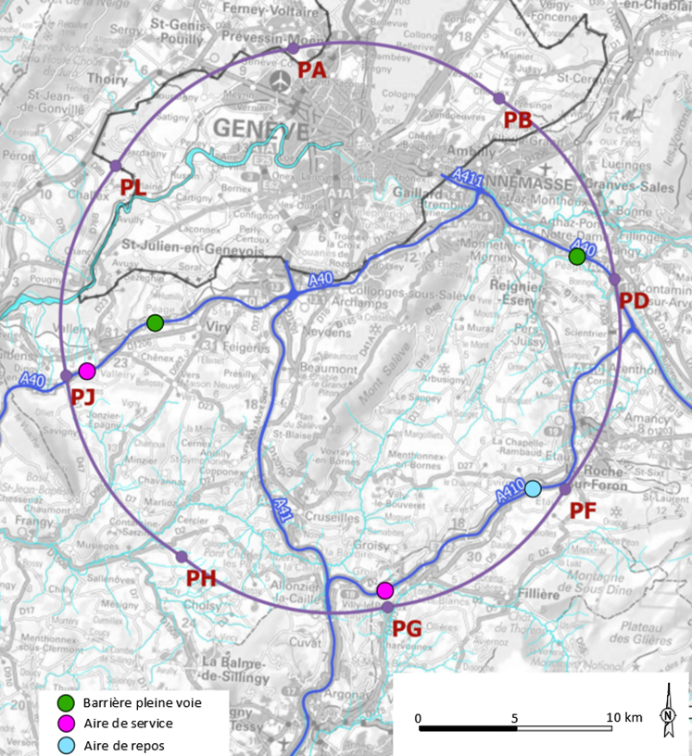










FCC Progress and Status
Alain BLONDEL
Uni. Geneva and Paris-Sorbonne
FCC Early Career Forum 13 January 2025
Much more information starting this afternoon at
https://indico.cern.ch/event/1439509/
http://cern.ch/fcc
Work supported by the European Commission under the HORIZON 2020 projects EuroCirCol, grant agreement 654305; EASITrain, grant agreement no. 764879; iFAST, grant agreement 101004730, FCCIS, grant agreement 951754; E-JADE, contract no. 645479; EAJADE, contract number 101086276; and by the Swiss CHART program
photo: J. Wenninger

Slide 2
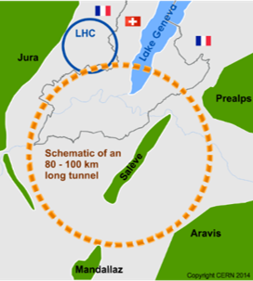
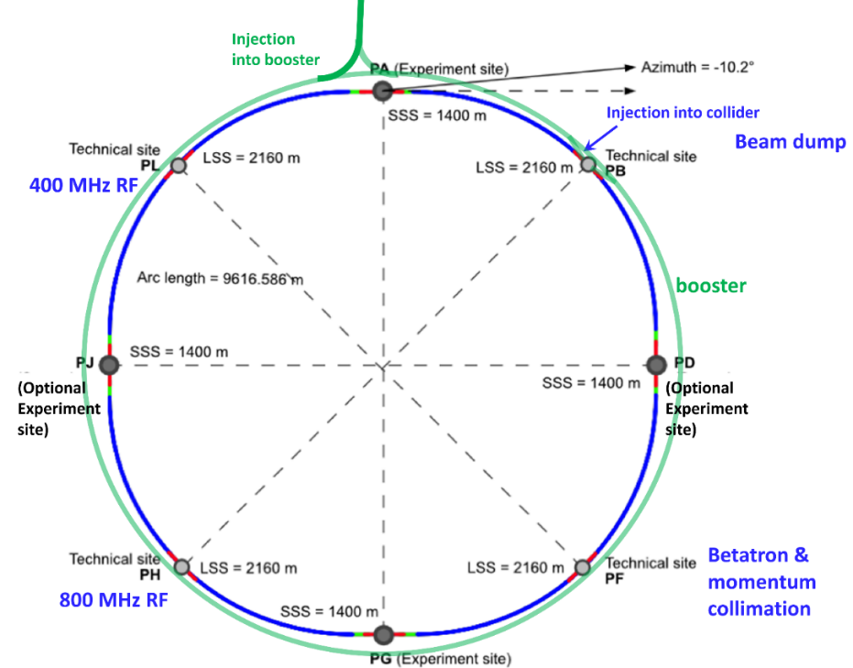
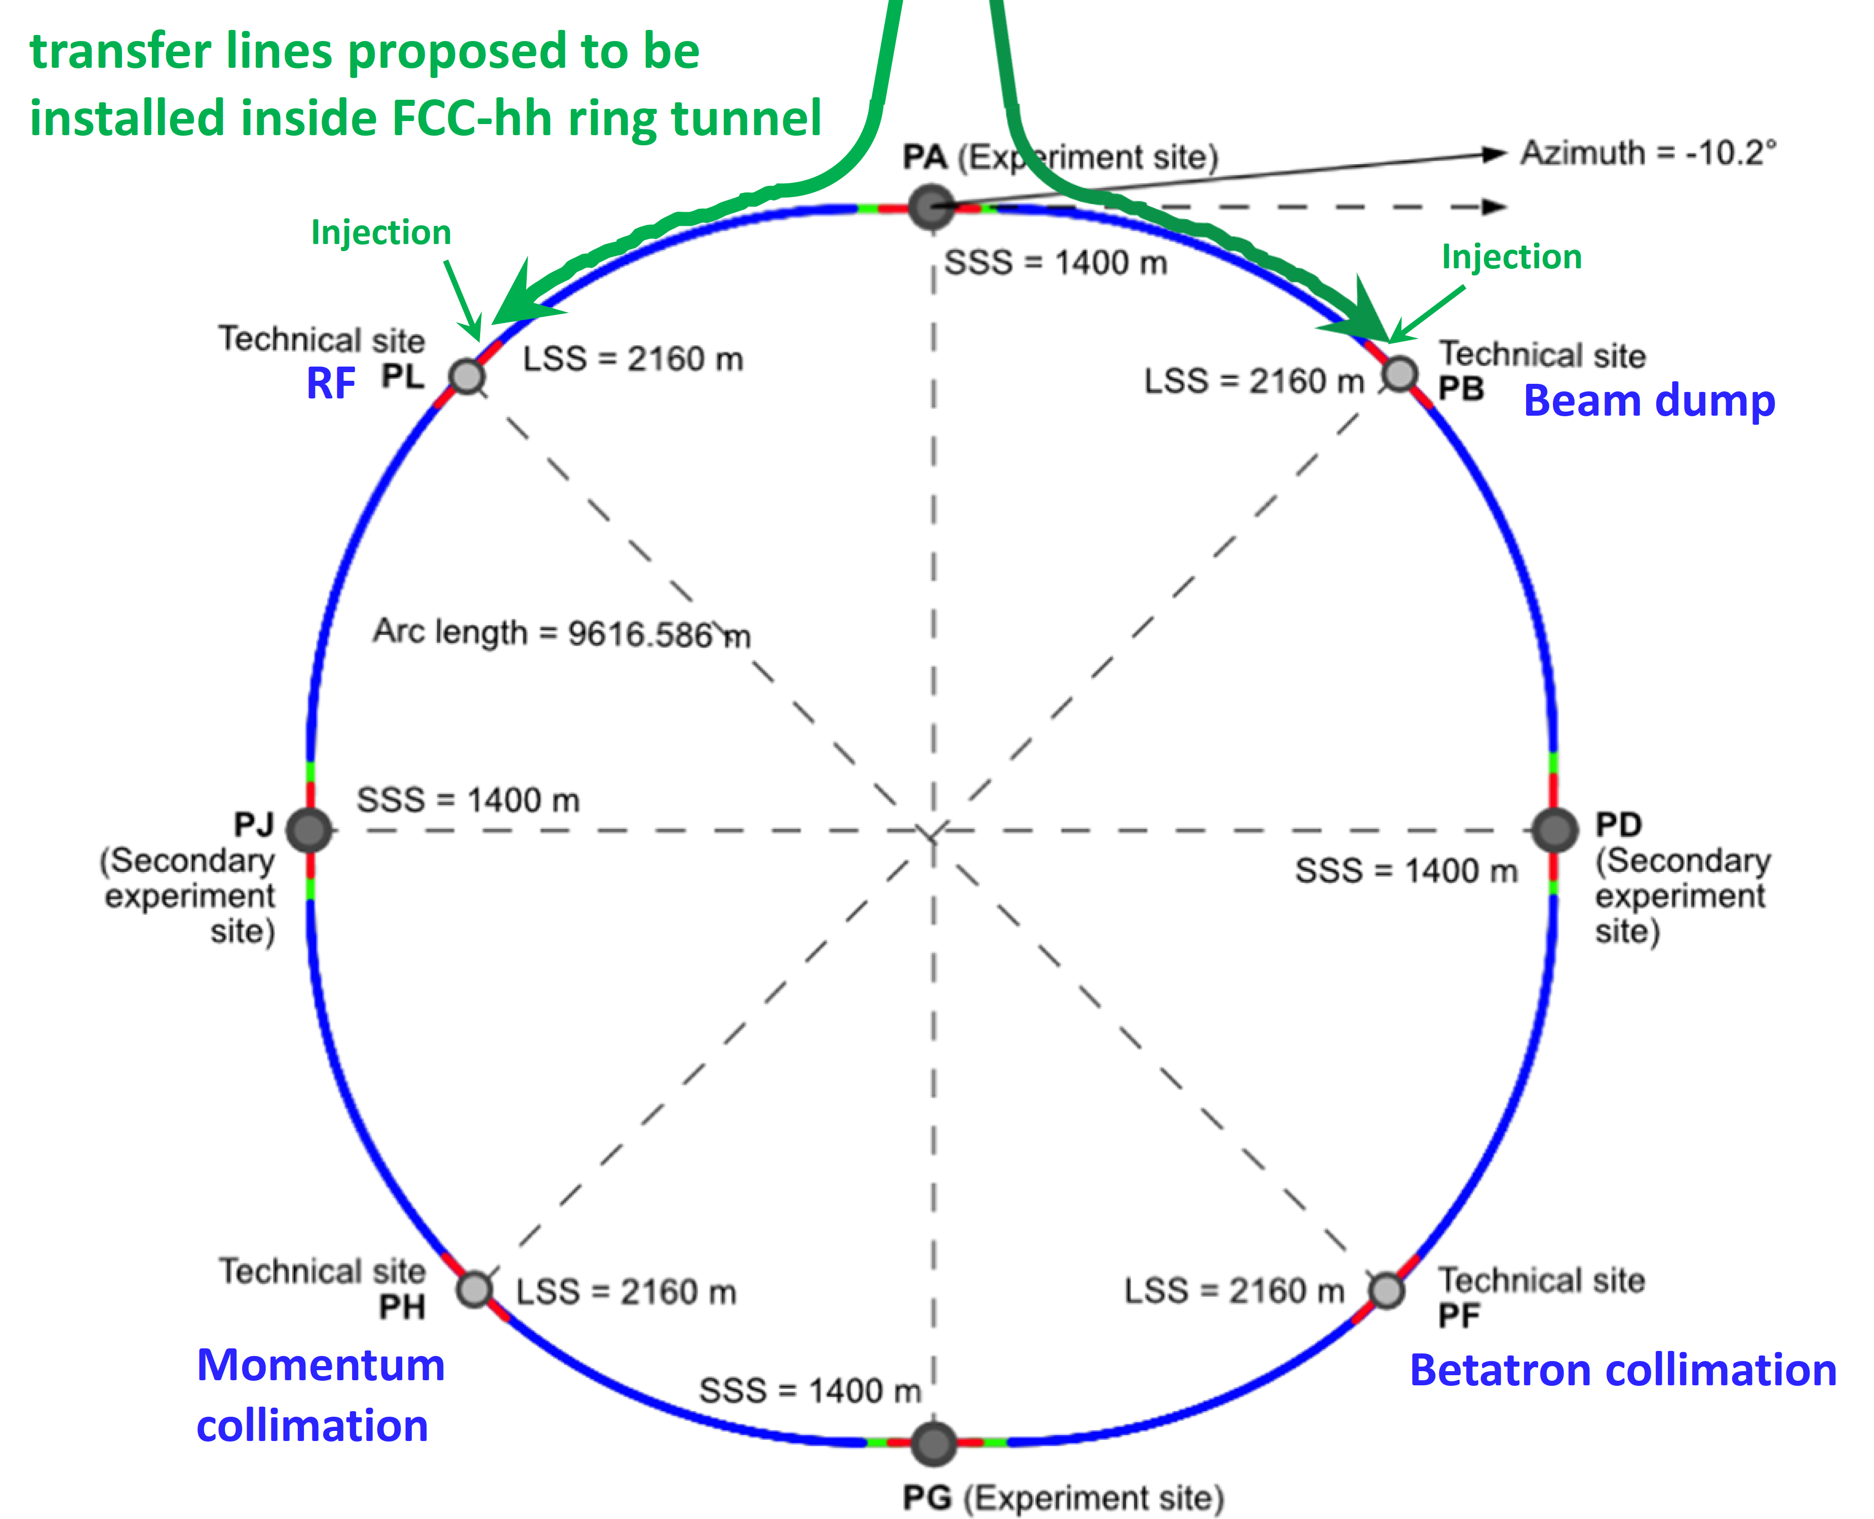
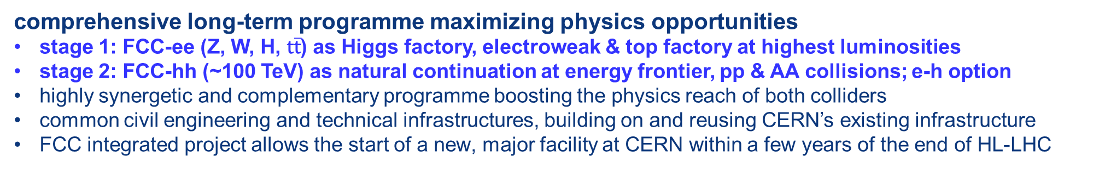
FCC integrated programme
comprehensive long-term programme maximizing physics opportunities
stage 1: FCC-ee (Z, W, H, $\text{t}\overline{\text{t}}$) as Higgs factory, electroweak & top factory at highest luminosities
stage 2: FCC-hh (~100 TeV) as natural continuation at energy frontier, pp & AA collisions; e-h option
highly synergetic and complementary programme boosting the physics reach of both colliders
common civil engineering and technical infrastructures, building on and reusing CERN’s existing infrastructure
FCC integrated project allows the start of a new, major facility at CERN within a few years of the end of HL-LHC
FCC-ee
FCC-hh
2020 - 2045
2045 - 2065
2070 -
a similar two-stage project CEPC/SppC is under study in China

Slide 3
FCC Feasibility Study (2021-2025): high-level objectives
demonstration of the geological, technical, environmental and administrative feasibility of the tunnel and surface areas and optimisation of placement and layout of the ring and related infrastructure;
pursuit, together with the Host States, of the preparatory administrative processes required for a potential project approval to identify and remove any showstopper;
optimisation of the design of the colliders and their injector chains, supported by R&D to develop the needed key technologies;
elaboration of a sustainable operational model for the colliders and experiments in terms of human and financial resource needs, as well as environmental aspects and energy efficiency;
development of a consolidated cost estimate, as well as the funding and organisational models needed to enable the project’s technical design completion, implementation and operation;
identification of substantial resources from outside CERN’s budget for the implementation of the first stage of a possible future project (tunnel and FCC-ee);
consolidation of the physics case and detector concepts for both colliders.
Results are being summarised in a Feasibility Study Report to be released by March 2025

Slide 4
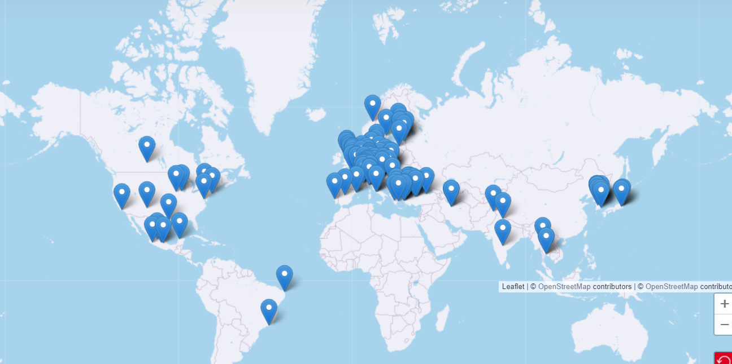


Status of FCC global collaboration
Increasing international collaboration as a prerequisite for success:
→ links with science, research & development and high-tech industry will be essential to further advance and prepare the implementation of FCC
~150 Institutes
32 countries
+
CERN
FCC Feasibility Study:
Aim is to further increase the collaboration,
on all aspects, in particular on
Accelerator and Particle/Experiments/Detectors

Slide 5
We have gone a long way!
2010-11-12 : ideas, wishes, basic concepts, (VHE-LHC, LEP3, TLEP), Higgs discovery
grassroots studies in EU context; «Higgs factory» in LHC, first, then in new 100km tunnel
LEP3 and TLEP submitted to ESPP2012 {TLEP + VHE-LHC ~FCC}
2013 ESPP2013 wants «ambitious post-LHC accelerator projet »
2014-02 Kick-off meeting of FCC design study FCC ee-ep-hh
ESPP contributions and CDR submitted
➔ FCC can be done! Starting with the e+ e- collider
-2020 ESPP2020 long term vision: a 100 TeV pp collider
shorter term priority ‘Higgs Factory’
recommends Feasibility study of 100km facity
Many new physics opportunities discovered esp. for O(10¹³) Z factory!
Great complementarity between
ee and pp programmes
Europe, together with its international partners, should investigate the technical and financial feasibility
of a future hadron collider at CERN with a centre-of-mass energy of at least 100 TeV and
with an electron-positron Higgs and electroweak factory as a possible first stage.
Such a feasibility study of the colliders and related infrastructure should be established as a global endeavour
and be completed on the timescale of the next Strategy update.

Slide 6
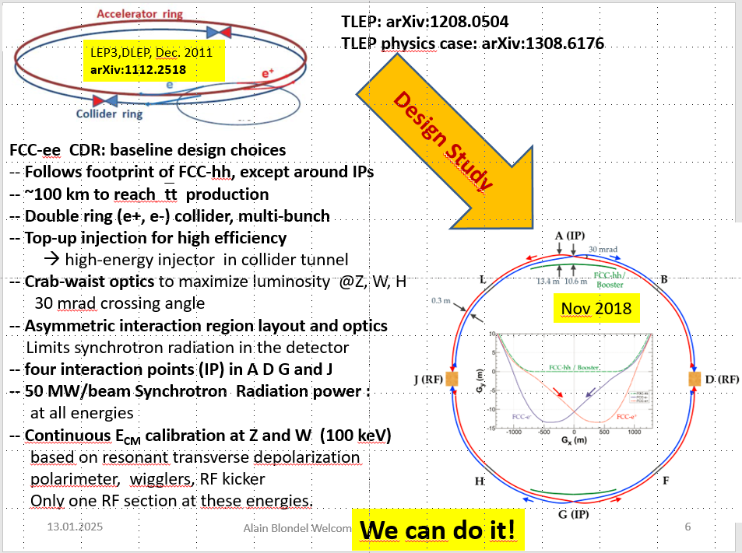
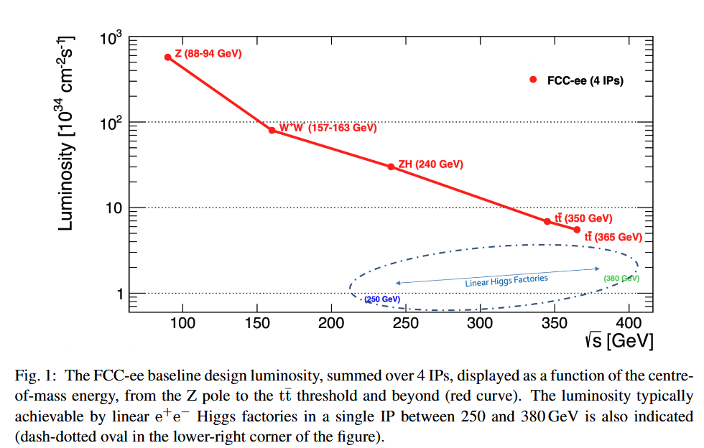
Feasibility Study
Event statistics :
E_{CM} errors:
Z peak E_{cm} : 91 GeV 6 10¹² e+e- → Z
WW threshold E_{cm} : 161 GeV 2.5 10⁸ e+e- → WW
ZH threshold E_{cm} : 240 GeV 2.4 10⁶ e+e- → ZH
‾tt threshold E_{cm} : >350 GeV 2 10⁶ e+e- →‾tt
LEP x 3 10⁵
LEP x 2.10³
Never done
Never done
110/20 ptp keV
300 keV
<1 MeV
<2 MeV
Great energy range for the heavy particles of the Standard Model.

Slide 7
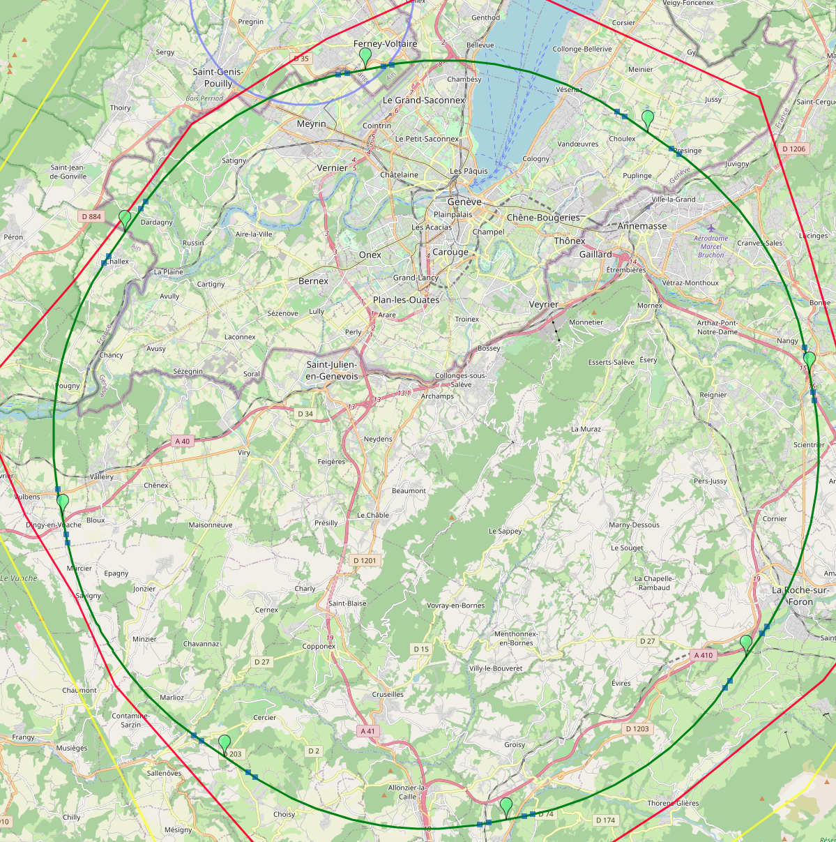
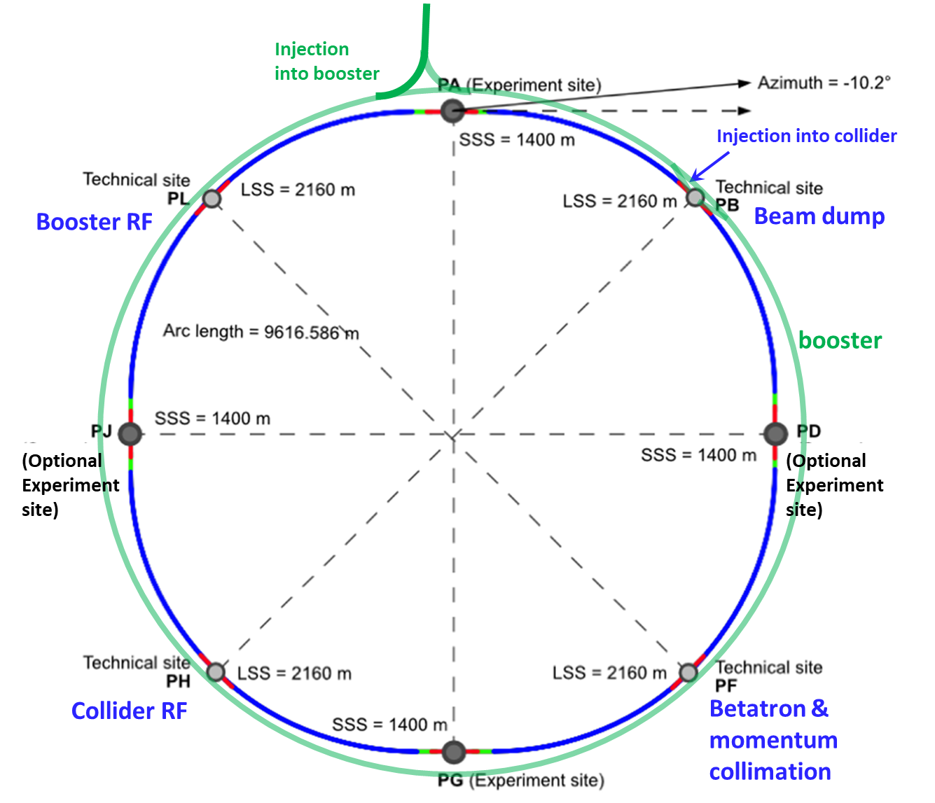
Reference layout and implementation: PA31 - 90.7 km
V. Mertens,
J. Gutleber
Layout chosen out of ~ 100 initial variants, based on geology and
surface constraints (land availability, access to roads, etc.), environment, (protected zones), infrastructure (water, electricity, transport), machine performance etc.
“Avoid-reduce-compensate” principle of EU and French regulations
PA: Experiment
PB: technical
PL: technical
Overall lowest-risk baseline: 90.7 km ring, 8 surface points,
4-fold symmetry
Number of surface sites | 8
Surface requirements | ~40 ha
LSS@IP (PA, PD, PG, PJ) | 1400 m
LSS@TECH (PB, PF, PH, PL) | 2032 m
Arc length | 9.6 km
Sum of arc lengths | 76.9 m
Total length | 90.7 km
PD: experiment
PJ: experiment
PF: technical
PH: technical
7
PG: experiment

Slide 8
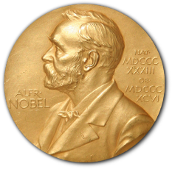
Physics at FCC-ee
HIGGS FACTORY
Higgs provides a very good reason why we need e+e- (or μμ) collider
2. ELECTROWEAK PRECISION ( 10⁻³ today → 10⁻⁵)
Z + WW + top required!
High precision determination of centre-of-mass (20-100 keV)
Test of the completeness of the SM
3. Z FACTORY
(5 10¹² Z i.e. 1.5 10¹¹ ee, μμ, ττ ; ~0.7 10¹² uu,dd,ss,cc,bb ; 10¹² νν)
High statistics for Heavy Flavours, QCD
Search for Feebly Coupled Particles
Possible insight on Higgs coupling to neutrinos if HNL (right-handed neutrino) discovery
The place for ‘direct discovery’
Aussi the most challenging for experiments!
+ comments on the synergy and complementarity of FCC-ee hh and eh

Slide 9
Complementarity: Higgs Physics at FCC
  FCC-ee → g_{HZZ} to <±0.2% from σ_{ZH}
  (model-independent standard candle)
  and Γ_{H}, g_{Hbb} , g_{Hcc} , g_{Hττ} , g_{HWW}
  →fixes all HL-LHC / FCC-hh couplings
  FCC-hh produces over 10¹⁰ Higgs bosons
  use g_{HZZ} from FCC_{ee} will give g_{Hμμ} , g_{Hγγ} , g_{HZγ} , Br_{inv}
  FCC-ee also measures top EW couplings (e⁺e⁻ ➝ tt)
  FCC-hh produces 10⁸ ttH and 2. 10⁷ HH pairs
    ➝ g_{Htt} and g_{HHH}, model-independent & precise!
FCC-ee / FCC-hh complementarity is outstanding
}
ee
}
hh
30-50
ee
hh
ee
Comparison with other e+e- colliders in spares
ee only
LHC+ee
FCC-ee+hh+ep
ep → WW mostly

Slide 10
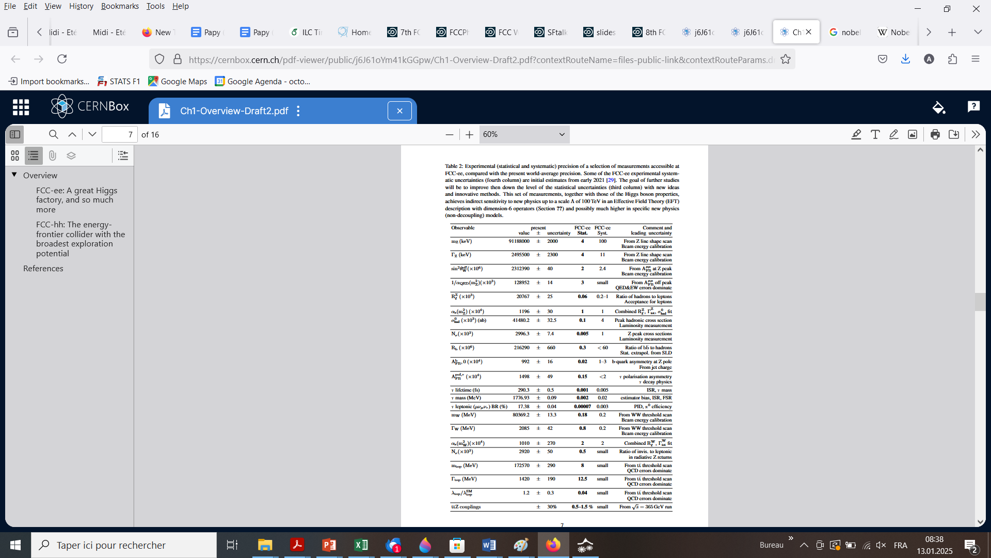
From upcoming FSReport (PED)

Slide 11
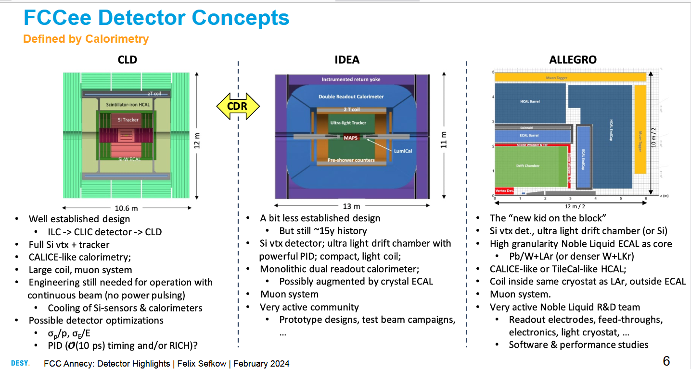
Also: ILD (IlC detector with TPC as inner tracker) working on adapting to FCC-ee – challenges due to high rate at Z-pole run

Slide 12
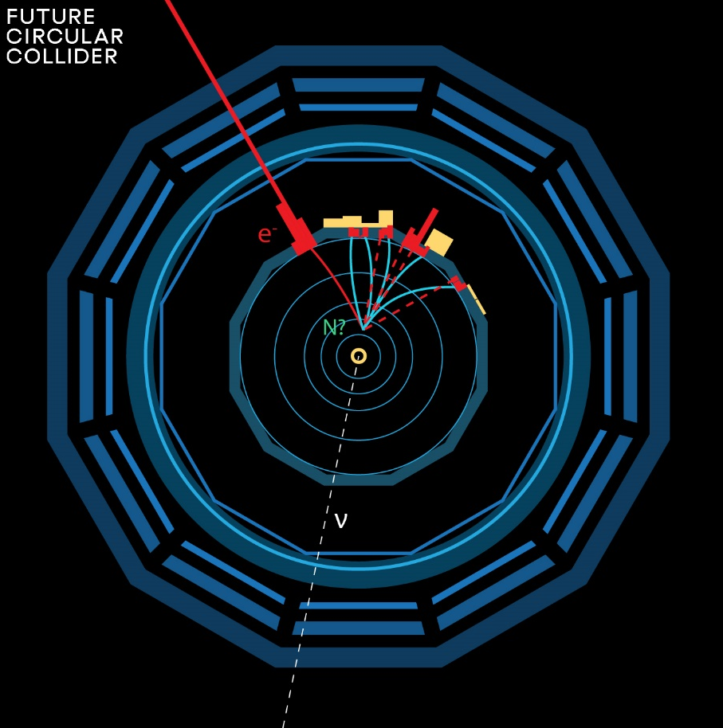
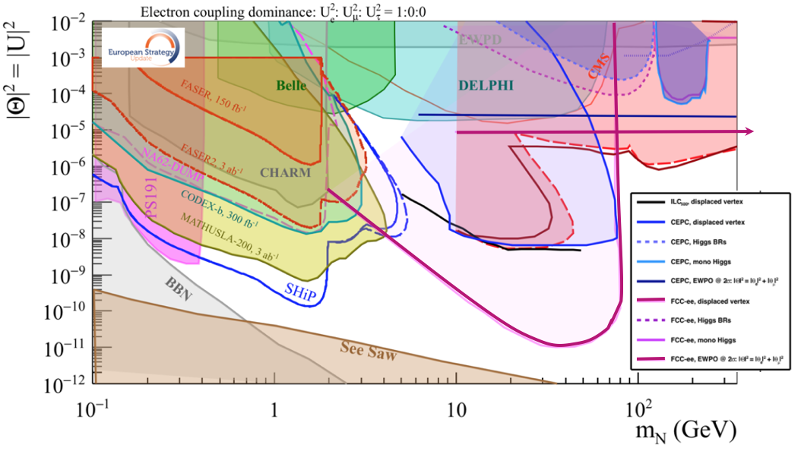
This picture is relevant to Neutrino, Dark sectors and High Energy Frontiers.
FCC-ee (Z) compared to the other machines for right-handed (sterile) neutrinos
How close can we get to the ‘see-saw limit’?
-- the purple line shows the 95% CL limit if no HNL is observed. (here for 10¹² Z),
-- the horizontal line represents the sensitivity to mixing of neutrinos to the dark sector,
using EWPOs (G_{F} vs sin²θ_{W}^{eff} and m_{Z}, m_{W}, tau decays) which extends sensitivity
to 10⁻⁵ mixing all the way to very high energies (500-1000 TeV at least). arxiv:2011.04725

Slide 13
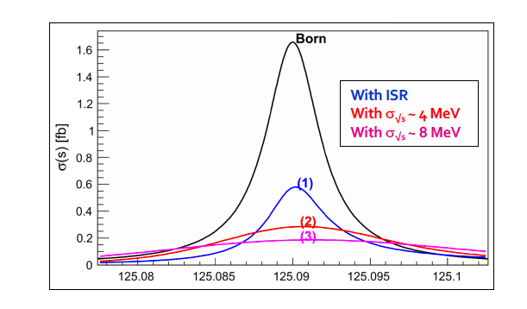
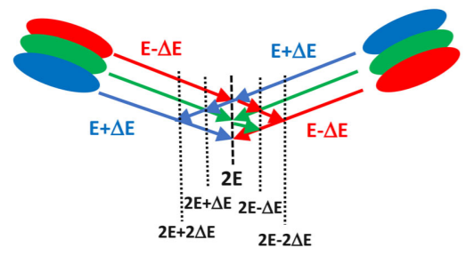
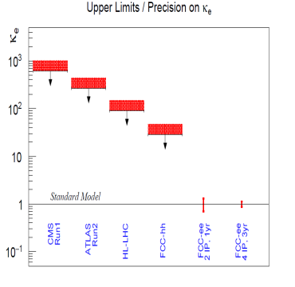
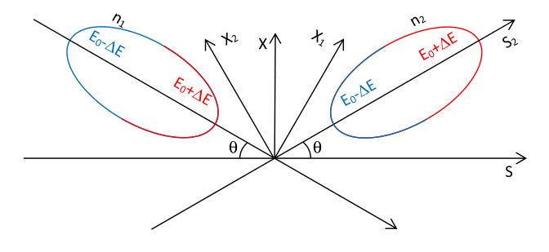
Unique: electron Yukawa coupling
Measure e+e- → H @ 125.xxx GeV
requires
-- Higgs mass to be known to <<5 MeV (OK, 3 MeV)
-- Huge luminosity (several years)
-- monochromatization to reduce σ_{ECM}
-- continuous adjustment of E_{CM} (transv. Polar.)
-- an extremely sensitive event selection
HUGE CHALLENGE
under study
Monochromatization: UNDER STUDY
taking advantage of the separate e+ and e- rings, one can distribute
in opposite way high and low energies in the beam (in x, z time)
combine?
so far,
SM level
opposite sign horizontal dispersion
opposite difference in arrival time

Slide 14
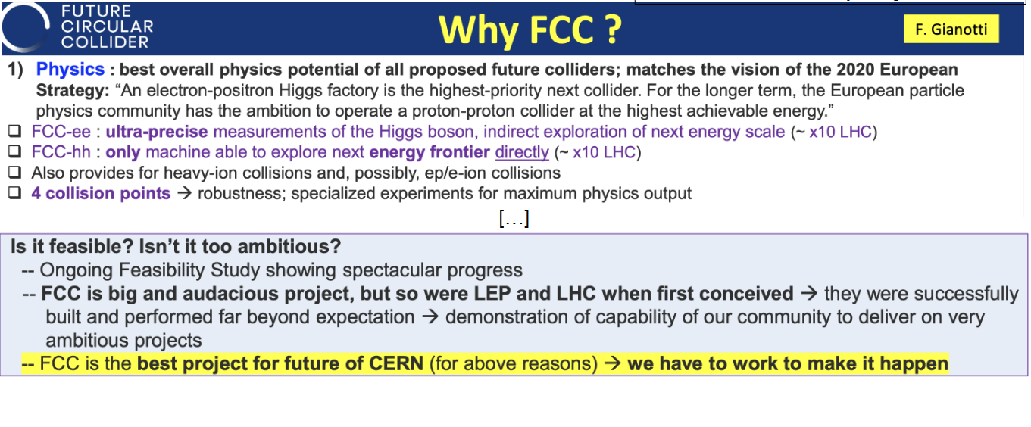

Slide 15




Expected time line till start of construction
2024 |  |  |  | 2025 |  |  |  | 2026 |  |  |  | 2027 |  |  |  | 2028 |  |  |  | 2029 |  |  |  | 2030 |  |  |  | 2031 |  |  |  | 2032 |  |  |  | 2033
Q1 | Q2 | Q3 | Q4 | Q1 | Q2 | Q3 | Q4 | Q1 | Q2 | Q3 | Q4 | Q1 | Q2 | Q3 | Q4 | Q1 | Q2 | Q3 | Q4
Feasibility Study
Pre-TDR Phase
TDR Phase
Construction →→→
FS Report
cost update
ESPPU
2025/26
pre TDR
cost update
TDR
cost update
Project Decision
accelerator design, technical infrastructure design, R&D, towards TDR
engineering design →
Environmental Impact study & Authorization Process
Phase 1 Site Investigations
Phase 2 Site Investigations
CE Concept Design update
CE Tender Design
Construction Design
Start construction
Detector EOI submissions
FC³ formation, call for CDRs
Detector CDRs submitted to FC³

Slide 16

edited by Mario Draghi, and officially handed over to Ursula von der Leyen in September 2024
EU competitiveness report
“One of CERN’s most promising current projects, with significant scientific potential, is the construction of the Future Circular Collider (FCC): a 90-km ring designed initially for an electron collider and later for a hadron collider..
Refinancing CERN and ensuring its continued global leadership in frontier research should be regarded as a top EU priority, given the objective of maintaining European prominence in this critical area of fundamental research, which is expected to generate significant business spillovers in the coming years.”
https://commission.europa.eu/topics/strengthening-european-competitiveness/eu-competitiveness-looking-ahead_en

Slide 17
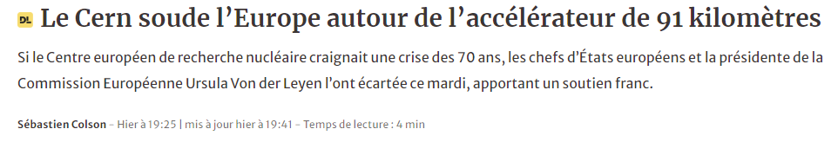

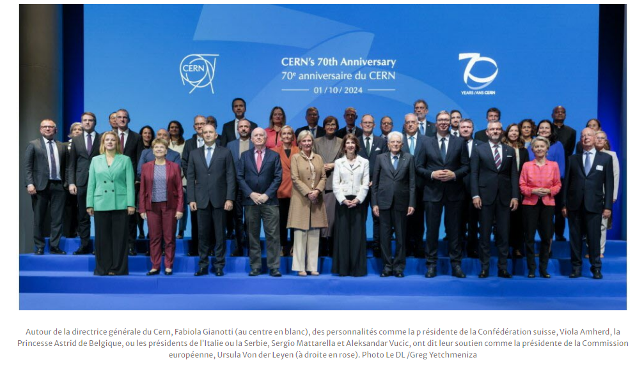
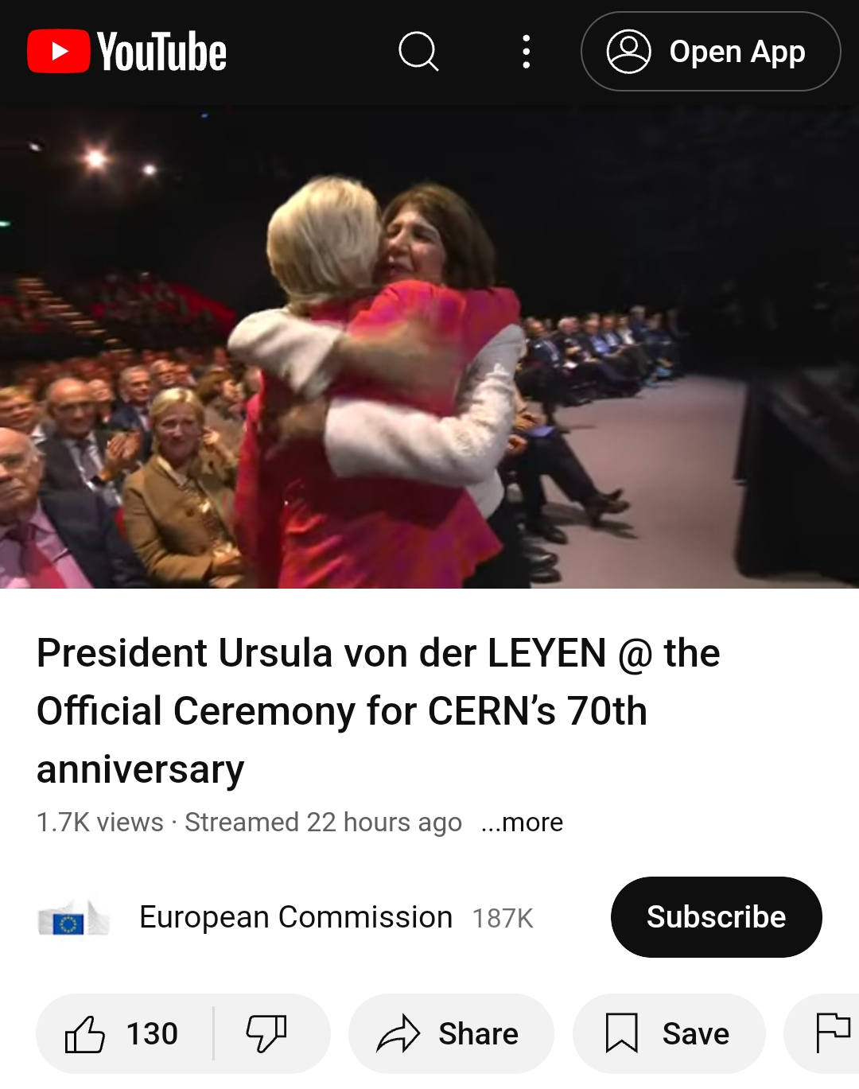
CERN 70th anniversary, 1 October 2024

Slide 18
Complementary slides to show the great progress on the accelerator
and infrastructure

Slide 19
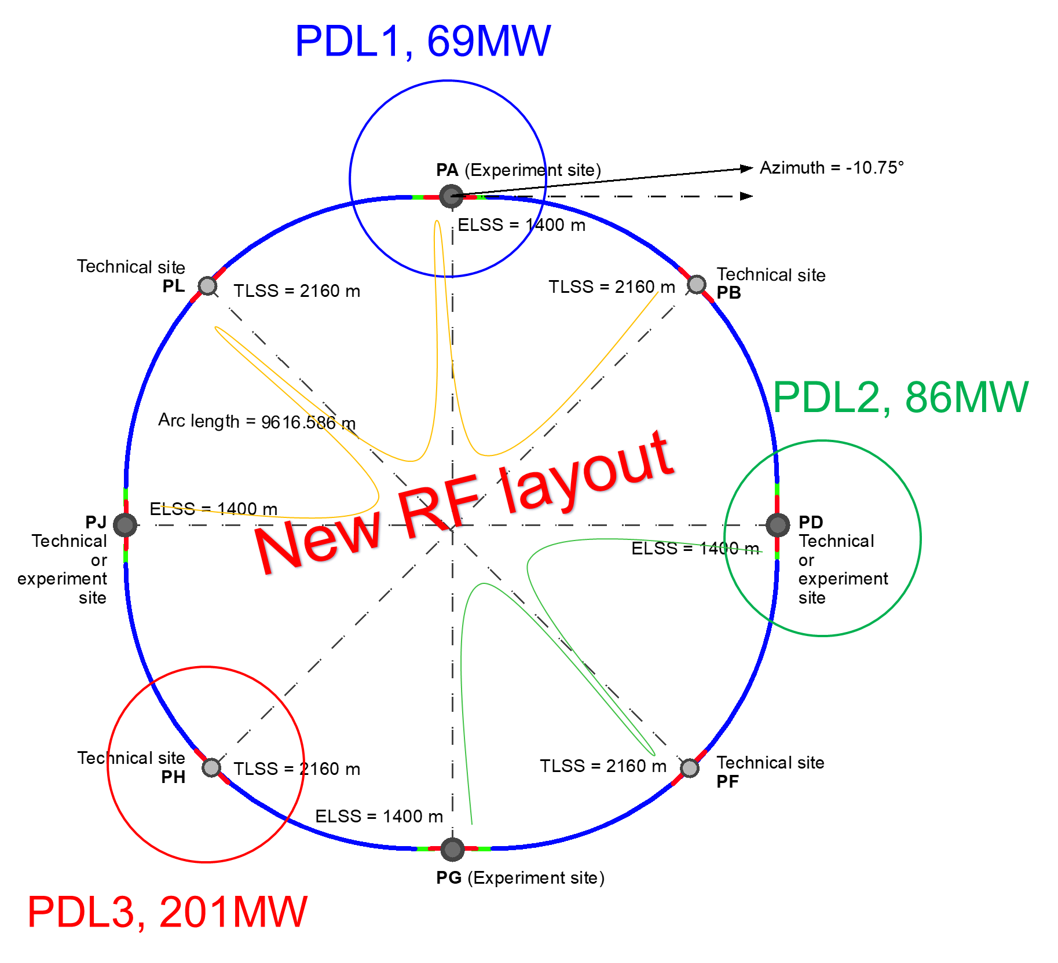
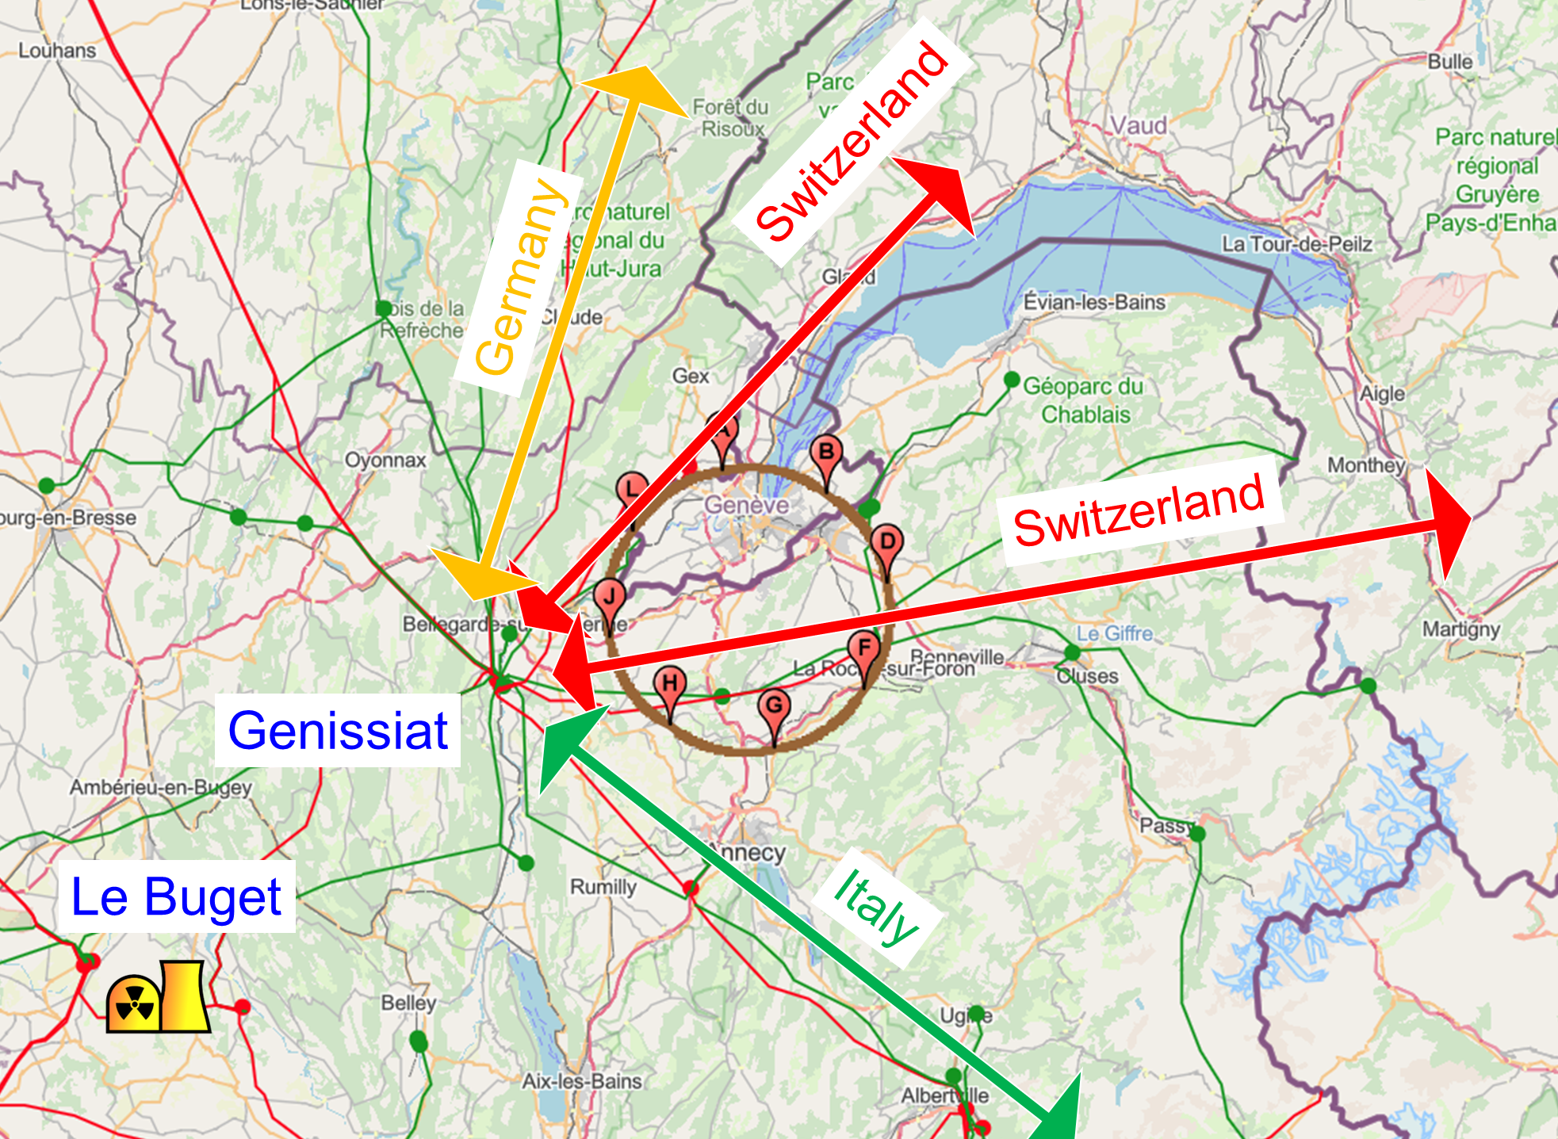
Integration with regional infrastructures
Road accesses developed for all 8 surface sites
Four possible highway connections defined
Less than 4 km of new roads required
Connections to
French electricity grid
connections with
highway network
Electrical connection concept developed with RTE (French electricity grid operator)
Three HV supply points, two new stations & CERN Prevessin
➔ requested loads have no significant impact on grid
R&D efforts aiming at reducing the energy consumption of FCC-ee and FCC-hh

Slide 20
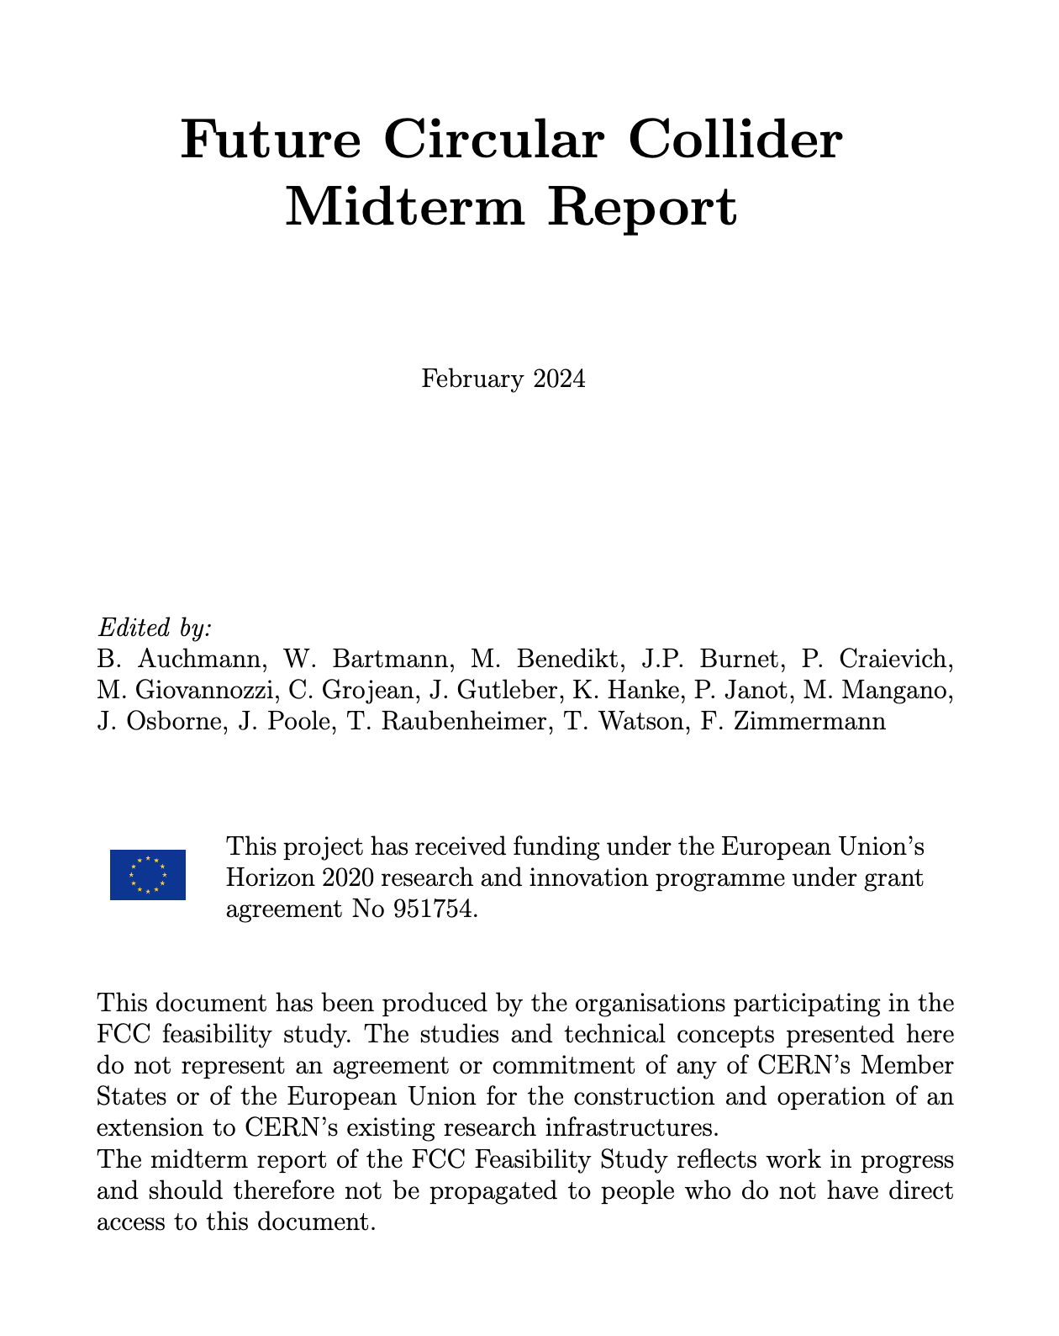
Feasibility Study Mid-Term Review passed !
The goal of the FCC FS mid-term review is to assess the progress of the Study towards the final report.
Deliverables approved by the Council in September 2022:
https://indico.cern.ch/event/1197445/contributions/5034859/attachments/2510649/4315140/spc-e-1183-Rev2-c-e-3654-Rev2_FCC_Mid_Term_Review.pdf
Full Report
8 Chapters/Deliverables
~ 700pp document
~ 16 editors
~ 500 contributors
Deliverables:
D1 : Definition of the baseline scenario
D2 : Civil engineering
D3 : Processes and implementation studies with the Host States
D4 : Technical infrastructure
D5 : FCC-ee accelerator
D6: FCC-hh accelerator
D7: Project cost and financial feasibility
D8: Physics, experiments and detectors
Many thanks to the SAC, CRP, SPC, FC and the Council for the very useful reviews!
Documents:
Mid-term report (all deliverables except D7)
Executive Summary of mid-term report
Updated cost assessment (D7)
Funding model (D7)
Review process:
Oct 2023: Scientific Advisory Committee (scientific and technical aspects)
and Cost Review Panel (ad hoc committee; cost and financial aspects)
Nov 2023: SPC and FC
2 Feb 2024: Council
All deliverables met, no technical showstoppers
→70-80 recommendations

Slide 21
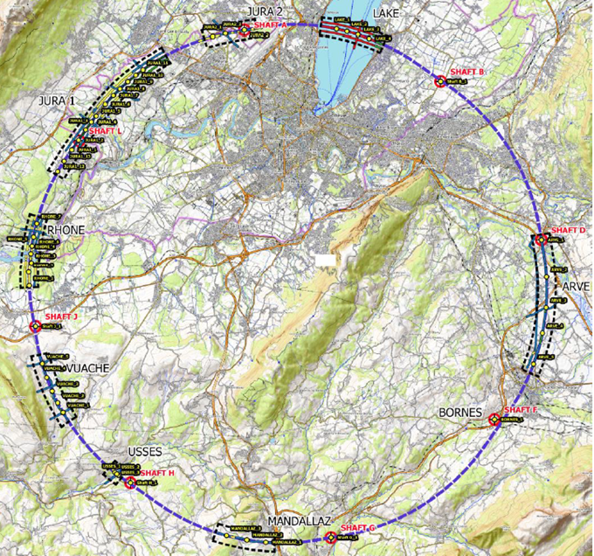
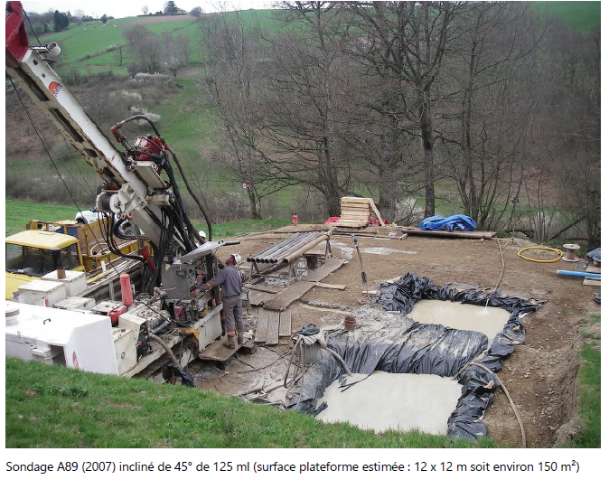
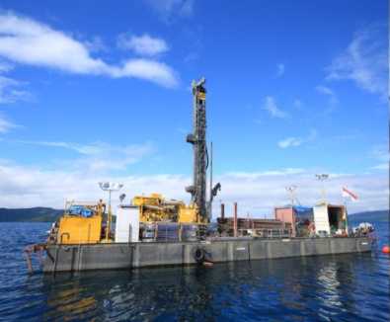
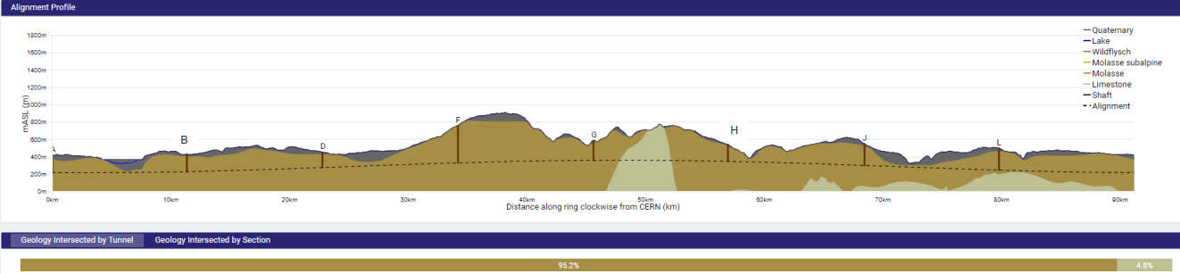
First series of site investigations
Site investigations to identify exact location of geological interfaces:
Molasse layer vs moraines/limestone
~30 drillings and ~100 km seismic lines
→ Vertical position and inclination of tunnel
Drilling works on the lake

Slide 22
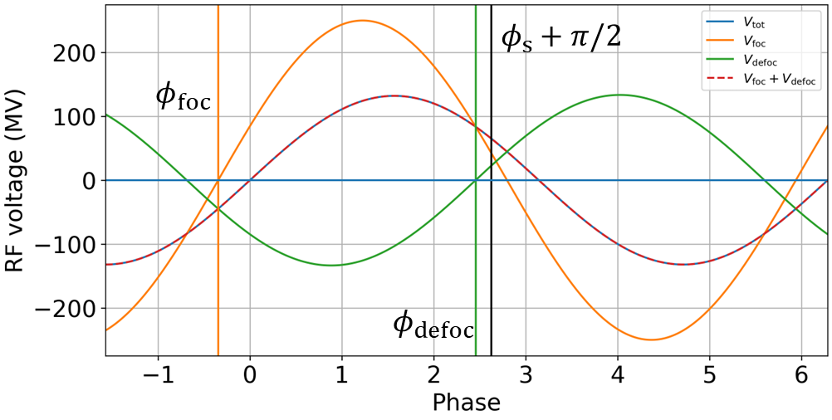
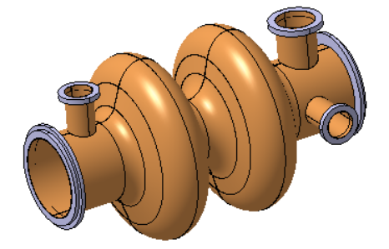
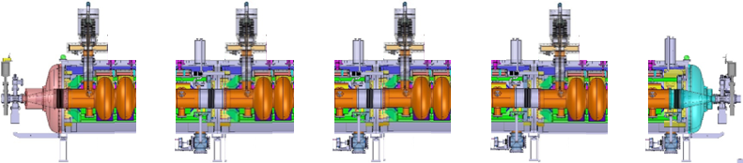
400 MHz SRF progress – one system for 3 energies
Same two-cell RF cavities for Z, WW and ZH operation with constant cavity coupling thanks to reverse phase operation: (1) experimentally verified w high beam loading at KEKB (Y. Morita et al., 2009), (2) Baseline solution US EIC
No longer any 1-cell 400 MHz cavities
Reduced installation time
Reduced commissioning effort
Fast switching between Z, WW and ZH operation
RF waves
400 MHz cavities
Z, W, ZH
cryomodule
X 264
X 66
LEP
400 MHz 2-cell cavity
Niobium thin film on Copper,
Operation at 4.5 Kelvin
Max. accel. gradient E_{acc} = 13 MV/m
Quality factor Q₀ = 3.3 x 10⁹
400 MHz cryomodule, ~12 m long

Slide 23
FCC-ee main machine parameters
Parameter | Z | WW | H (ZH) | ttbar
beam energy [GeV] | 45.6 | 80 | 120 | 182.5
beam current [mA] | 1270 | 137 | 26.7 | 4.9
number bunches/beam | 11200 | 1780 | 440 | 60
bunch intensity [10¹¹] | 2.14 | 1.45 | 1.15 | 1.55
SR energy loss / turn [GeV] | 0.0394 | 0.374 | 1.89 | 10.4
total RF voltage 400/800 MHz [GV] | 0.120/0 | 1.0/0 | 2.1/0 | 2.1/9.4
long. damping time [turns] | 1158 | 215 | 64 | 18
horizontal beta* [m] | 0.11 | 0.2 | 0.24 | 1.0
vertical beta* [mm] | 0.7 | 1.0 | 1.0 | 1.6
horizontal geometric emittance [nm] | 0.71 | 2.17 | 0.71 | 1.59
vertical geom. emittance [pm] | 1.9 | 2.2 | 1.4 | 1.6
vertical rms IP spot size [nm] | 36 | 47 | 40 | 51
beam-beam parameter x_{x} / x_{y} | 0.002/0.0973 | 0.013/0.128 | 0.010/0.088 | 0.073/0.134
rms bunch length with SR / BS [mm] | 5.6 / 15.5 | 3.5 / 5.4 | 3.4 / 4.7 | 1.8 / 2.2
luminosity per IP [10³⁴ cm⁻²s⁻¹] | 140 | 20 | ≥5.0 | 1.25
total integrated luminosity / IP / year [ab⁻¹/yr] | 17 | 2.4 | 0.6 | 0.15
beam lifetime rad Bhabha + BS [min] | 15 | 12 | 12 | 11
Design and parameters to maximise luminosity at all working points:
allow for 50 MW synchrotron radiation per beam
.
Independent vacuum systems for electrons and positrons
full energy booster ring with top-up injection, collider permanent in collision mode
Improvements:
x10-50 on all EW observables
up to x 10 on Higgs coupling (model-indep.) measurements over HL-LHC
x10 Belle II statistics for b, c, τ
indirect discovery potential up to ~ 70 TeV
direct discovery potential for feebly-interacting particles over 5-100 GeV mass range
Up to 4 interaction points
→ robustness, statistics, possibility of specialised detectors to maximise physics
4 years
5 x 10¹² Z
LEP x 10⁵
2 years
> 10⁸ WW
LEP x 10⁴
3 years
2 x 10⁶ H
5 years
2 x 10⁶ tt pairs
F. Gianotti

Slide 24
FCC-hh main machine parameters
parameter | FCC-hh | HL-LHC | LHC
collision energy cms [TeV] | 84 - 120 | 14 | 14
dipole field [T] | 14 - 20 | 8.33 | 8.33
circumference [km] | 90.7 | 26.7 | 26.7
arc length [km] | 76.9 | 22.5
beam current [A] | 0.5 | 1.1 | 0.58
bunch intensity [10¹¹] | 1 | 2.2 | 1.15
bunch spacing [ns] | 25 | 25 | 25
synchr. rad. power / ring [kW] | 1100 - 4570 | 7.3 | 3.6
SR power / length [W/m/ap.] | 14 - 58 | 0.33 | 0.17
long. emit. damping time [h] | 0.77 – 0.26 | 12.9 | 12.9
peak luminosity [10³⁴ cm⁻²s⁻¹] | ~30 | 5 (lev.) | 1
events/bunch crossing | ~1000 | 132 | 27
stored energy/beam [GJ] | 6.3 – 9.2 | 0.7 | 0.36
Integrated luminosity/main IP [fb⁻¹] | 20000 | 3000 | 300
With FCC-hh after FCC-ee: significantly
more time for high-field magnet R&D
aiming at highest possible energies
Formidable challenges:
high-field superconducting magnets: 14 - 20 T
power load in arcs from synchrotron radiation: 4 MW → cryogenics, vacuum
stored beam energy: ~ 9 GJ → machine protection
pile-up in the detectors: ~1000 events/xing
energy consumption: 4 TWh/year → R&D on cryo, HTS, beam current, …
Formidable physics reach, including:
Direct discovery potential up to ~ 40 TeV
Measurement of Higgs self to ~ 5% and ttH to ~ 1%
High-precision and model-indep (with FCC-ee input)
measurements of rare Higgs decays (𝛄𝛄, Z𝛄, µµ)
Final word about WIMP dark matter
F. Gianotti

Slide 25
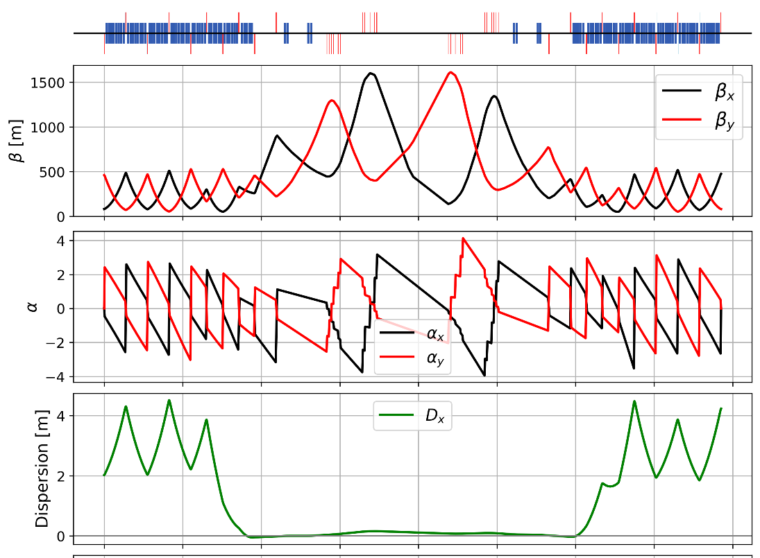
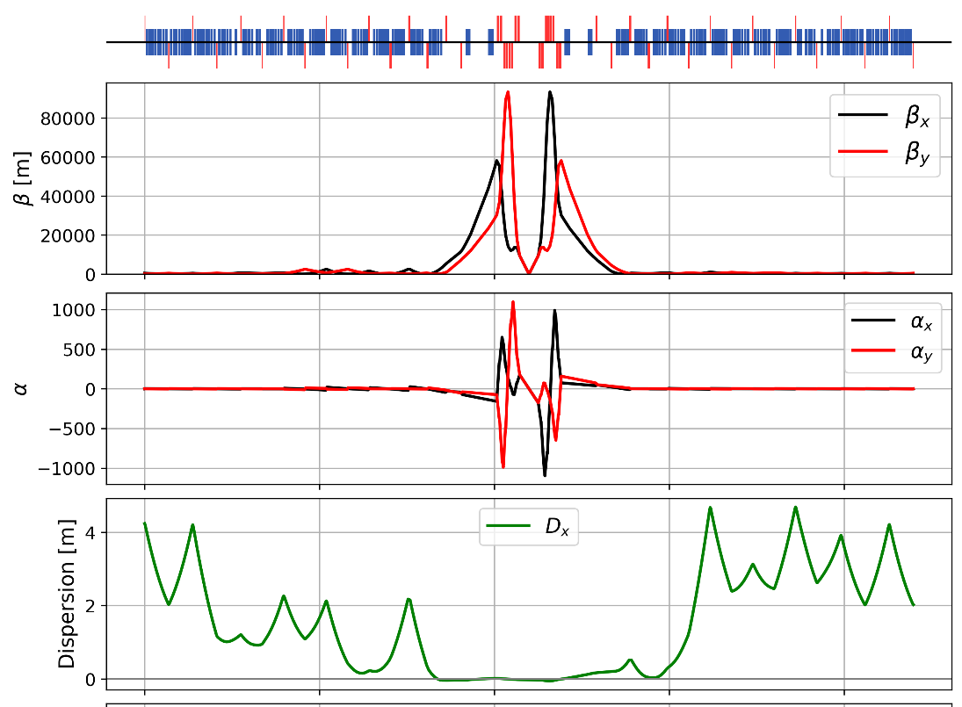
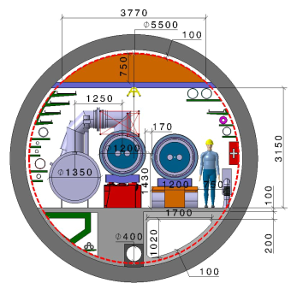
Key activities on FCC-hh: cryo magnet system & optics design
Optics design activities:
adaptation to new layout and geometry
shrink β collimation & extraction by ~30%
optics optimisation (filling factor etc.)
betatron collimation straight
experimental straight
M. Giovannozzi. G. Perez, T. Risselada
High-field cryo-magnet system design
Conceptual study of cryogenics concept and temperature layout for LTS and HTS based magnets, in view of electrical consumption
Update of integration study for the ongoing HFM designs and scaling to preliminary HTS design
  → Confirmation of tunnel diameter!
HFM R&D (LTS and HTS) on technology and magnet design, aiming also at bridging the TRL gap between HTS and Nb₃Sn
Collider Center
F. Valchkova

Slide 26
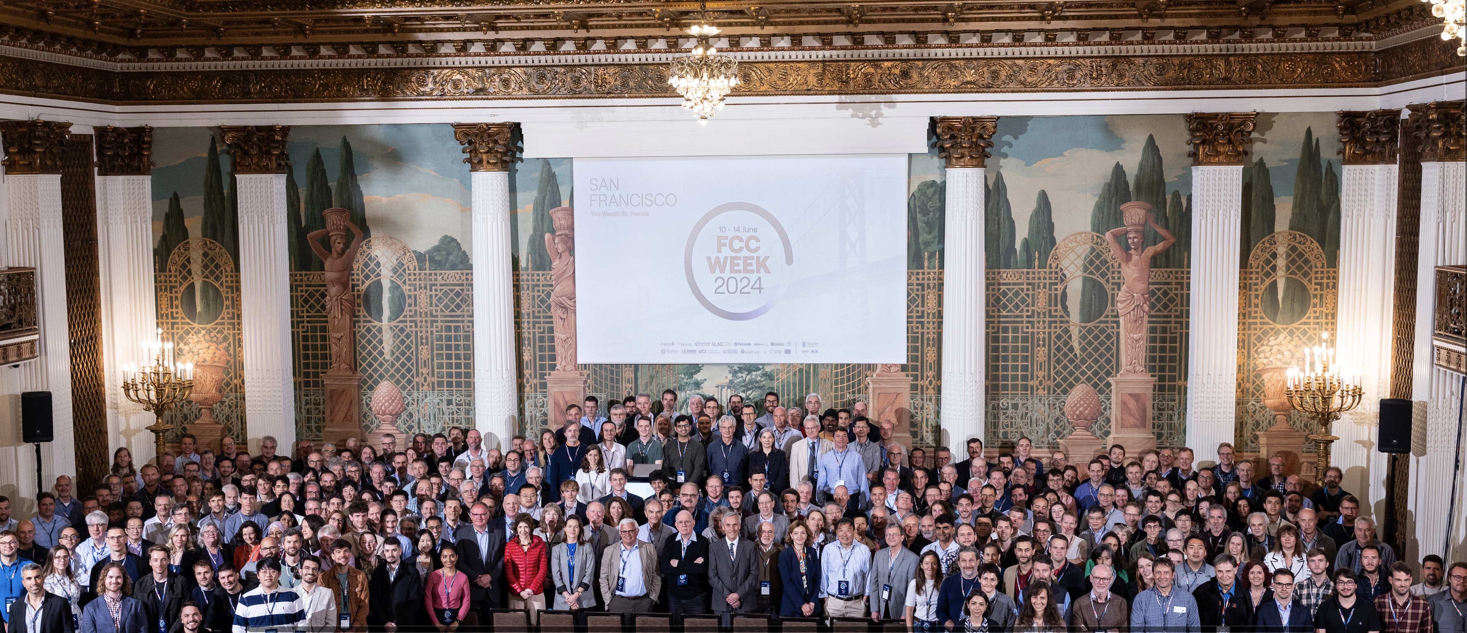
FCC Week 2024 – San Francisco – 10 to 14 June
449 participants : 75 remote, 374 on site including, 28 ‘1-day’ passes

