Slide 1
How to build a future collider?

Slide 2
How to build a future collider?
…but I will try to explain why it is so difficult from engineering point of view.
I don’t know, of course…
Safety
Develop safe concepts.
Sustainability
Reduce the environmental impact.
Feasibility
Identify challenges and propose solutions.
Affordability
Cost optimisation to respect the budget.
What must we consider to built a future collider?
Performance
Reach physics objectives.
Mounting
Integration and alignment.
Scheduling
The activities plan is crucial.
Components design
Each components of the system require a design.
Maintenance
All systems must last for decades.
Infrastructure
The tunnel and services needed for the collider.
Ad libitum
Every moment the things to be considered increase.

Slide 3
How to build a future collider?
To consider and respect each of the previous aspects, we need at least the following ingredients:
The more important thing at each level of the project is the human resources, from management to the design. To achieve results respecting budget and time schedule the only way is to create a solid working group, well organized and correctly sized. It is important the correct distribution of senior and young, in order to use the previous experiences to built the future.
1
Manpower
The existing technologies are essential, in fact, it is necessary to understand how the problems have been resolved and what kind of performances have been achieved in the present.
By studying the used solutions, it is possible to understand the strengths and the weaknesses of each process.
2
Existing Technologies
New technologies are the base of a future project. The last discoveries and inventions are necessary to project FCC in the future and to be able to achieve the result that is impossible with the existing technologies but feasible with the new ones. It is essential to investigate the latest ideas to understand how they can be developed for the project.
3
New Technologies
In such a long term project, it is essential to consider the development of the technologies and the path that each technology will follow in the next years, intending to prevent what type of technologies we will have in the next year. It is important to leave an open door to the future with the idea of integrating the new technologies during the project, during the building, without any fear of change.
4
Future Technologies

Slide 4
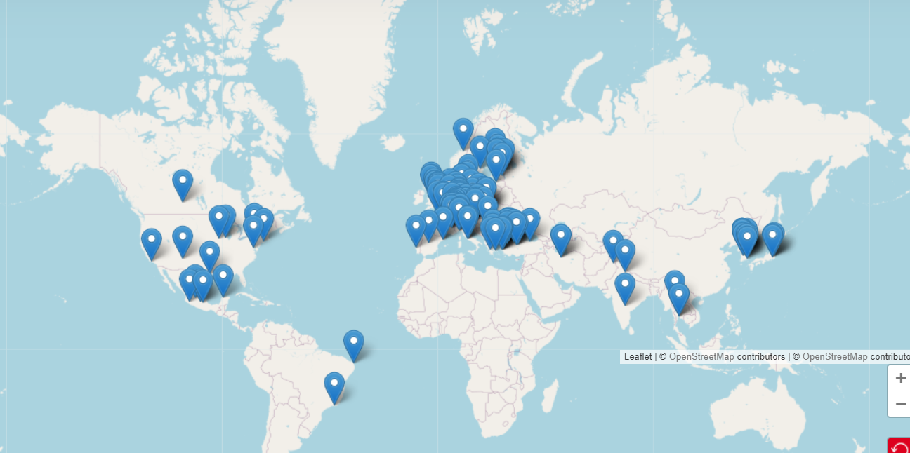
Presented by Michael Benedikt and Frank Zimmermann during the FCC week 2024
1
Manpower
141 Institutes
Particle Physicists: Develop theoretical frameworks and experimental methodologies to explore fundamental particles and forces.
Accelerator Physicists and Engineers: Design and optimize the accelerator components, such as vacuum components, magnets, radiofrequency systems, etc.
Cryogenic Engineers: Develop and manage the cryogenic systems necessary for cooling superconducting magnets and other components to extremely low temperatures.
Civil and Structural Engineers: Plan and oversee the construction of the extensive underground tunnels and surface facilities required for the collider.
Mechanical Engineers: Design and maintain mechanical systems, including support structures, vacuum systems, and cooling mechanisms.
32 countries
+
CERN
https://fcc.web.cern.ch/collaboration
Electrical and Electronics Engineers: Develop and maintain the complex electrical systems, including power supplies, control systems, and instrumentation.
Software Developers and Data Scientists: Create software for data acquisition, processing, and analysis, as well as simulation tools for modeling experiments.
Project Managers: Coordinate the various aspects of the project, ensuring timelines, budgets, and quality standards are met.
Environmental and Safety Specialists: Assess and mitigate environmental impacts and ensure compliance with safety regulations throughout the project's lifecycle.

Slide 5
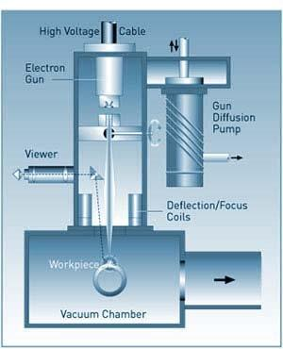
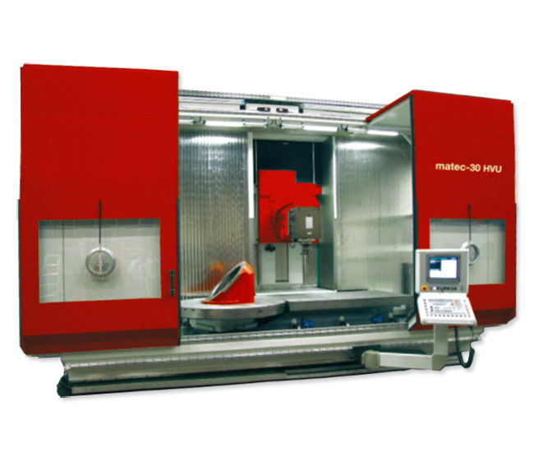
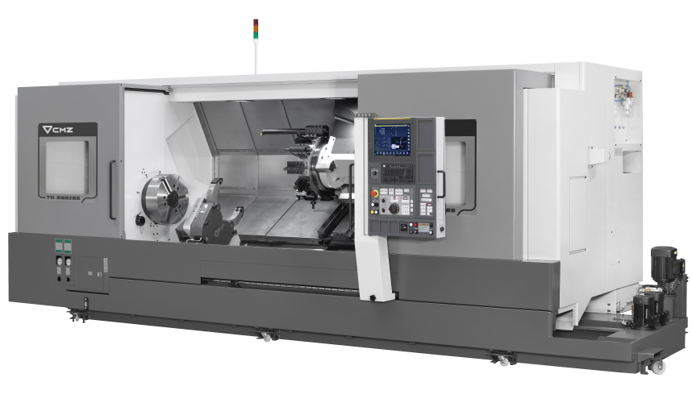
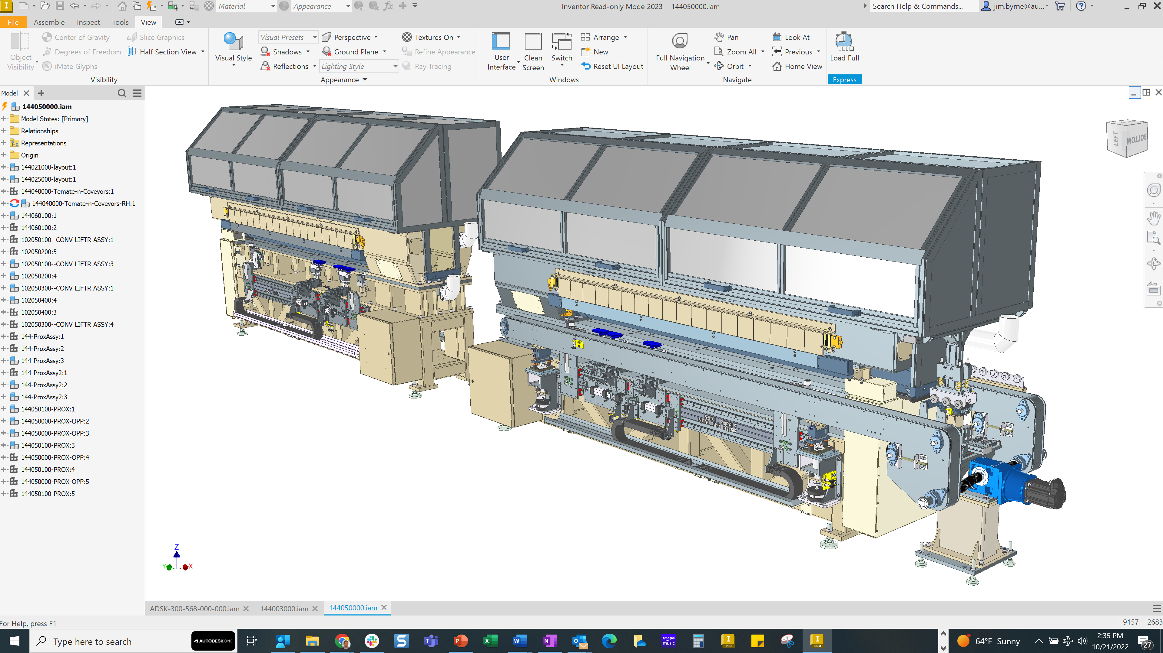
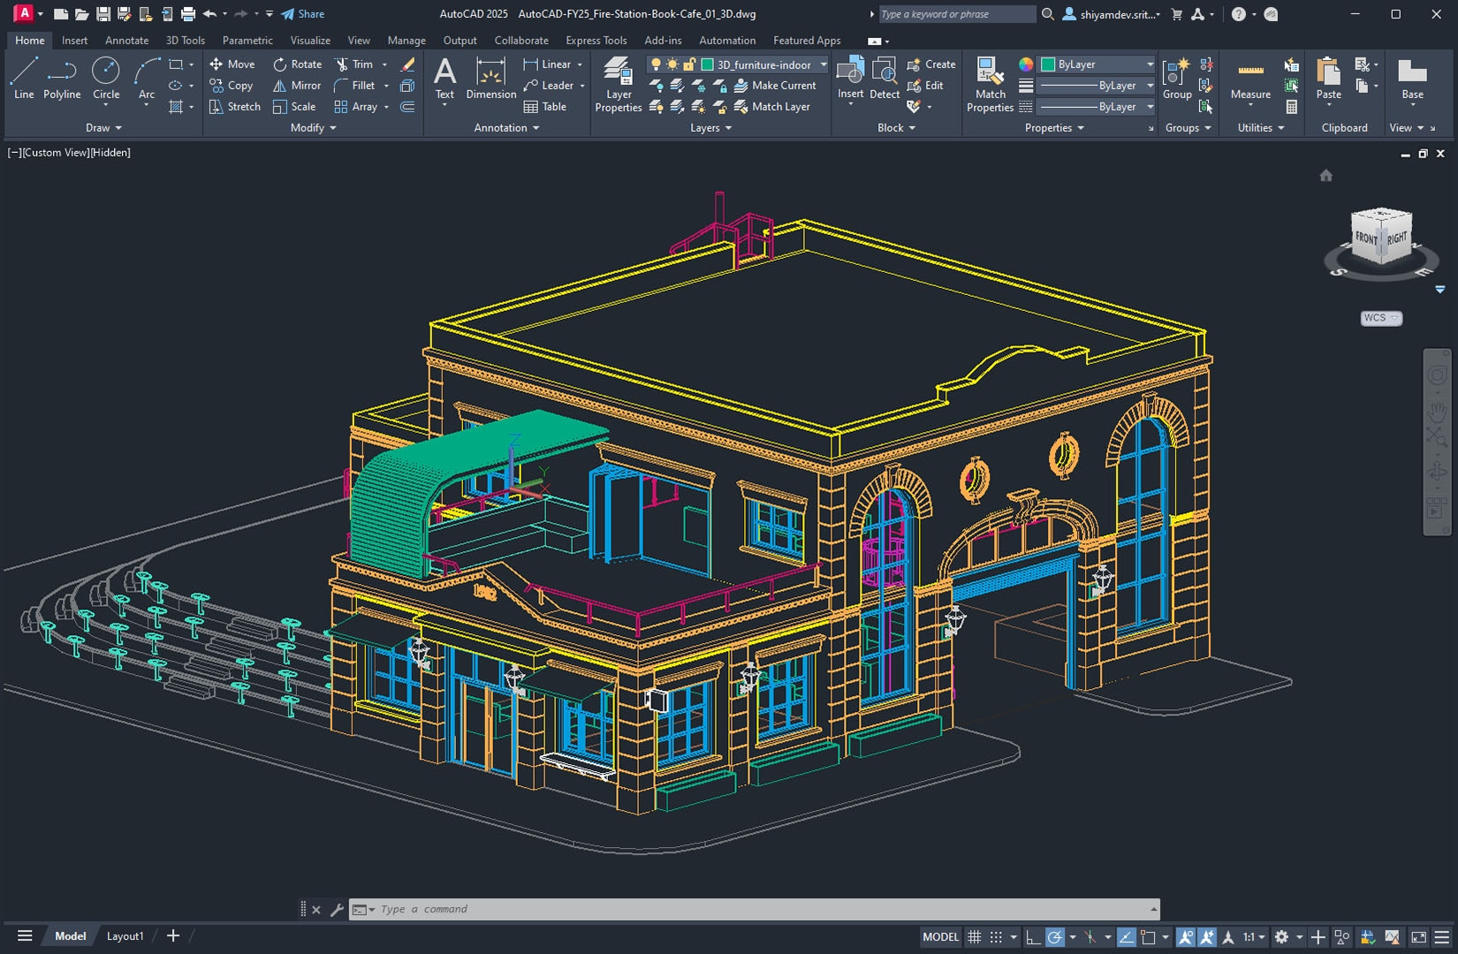
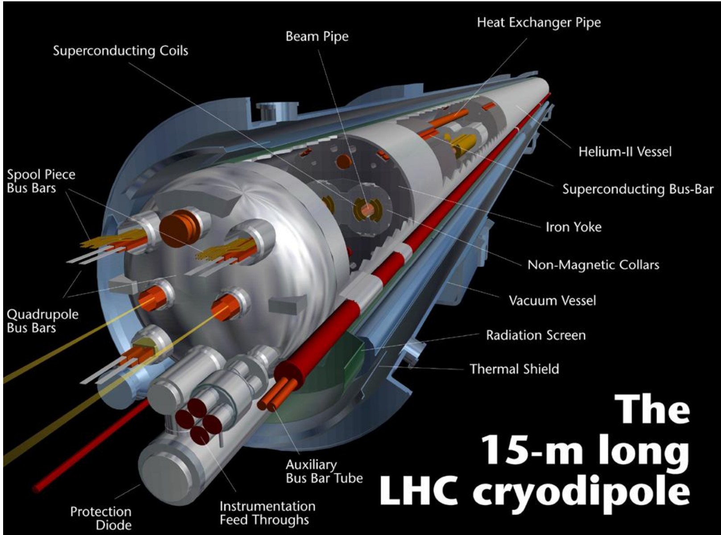
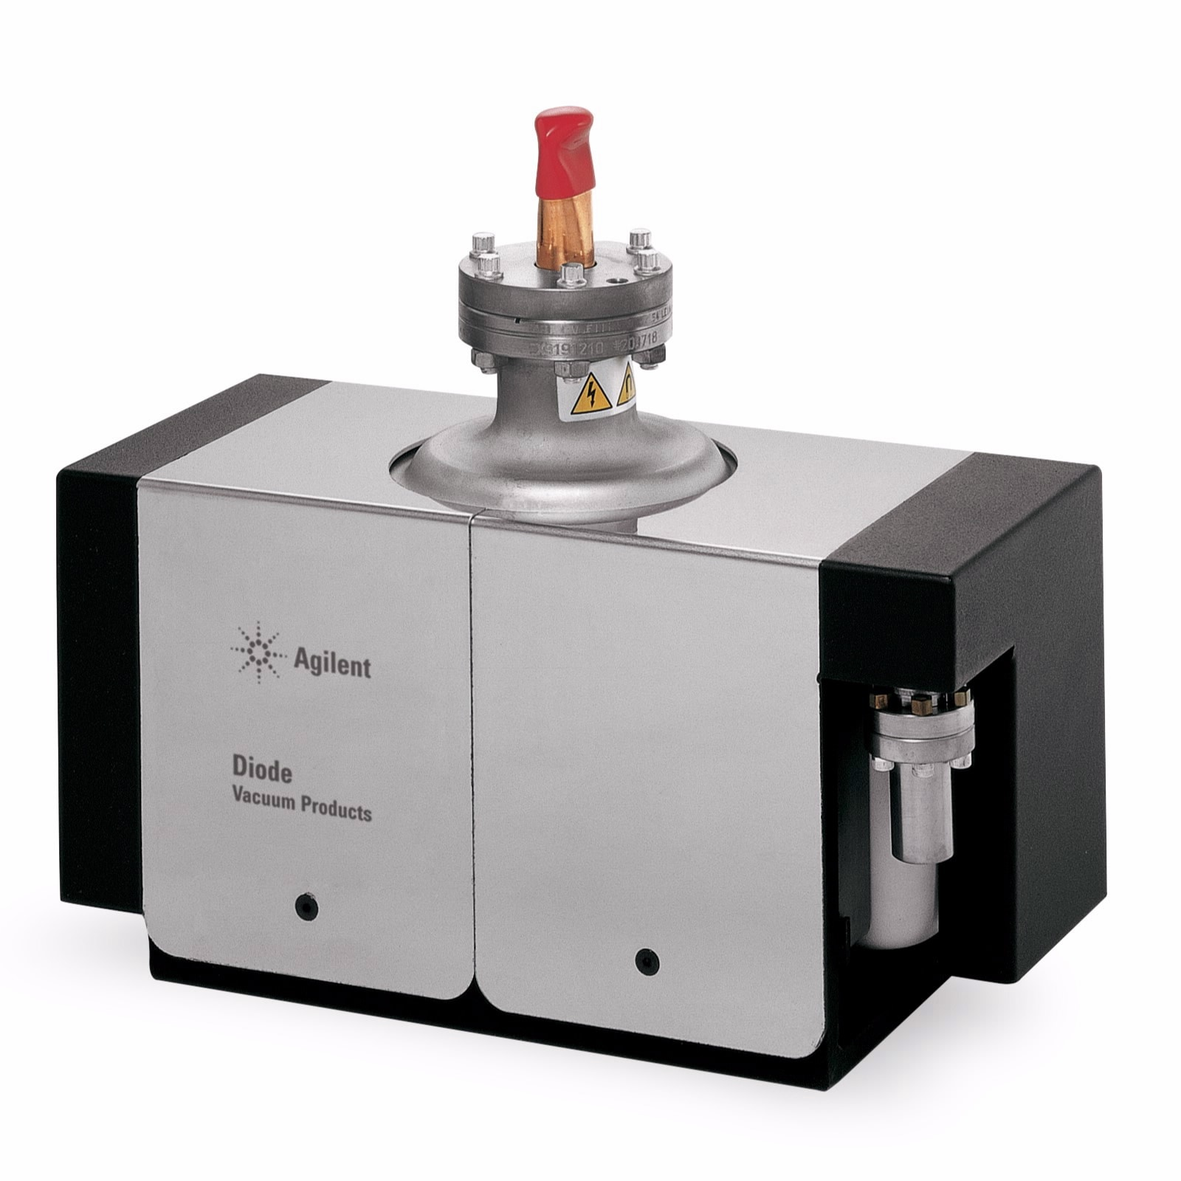
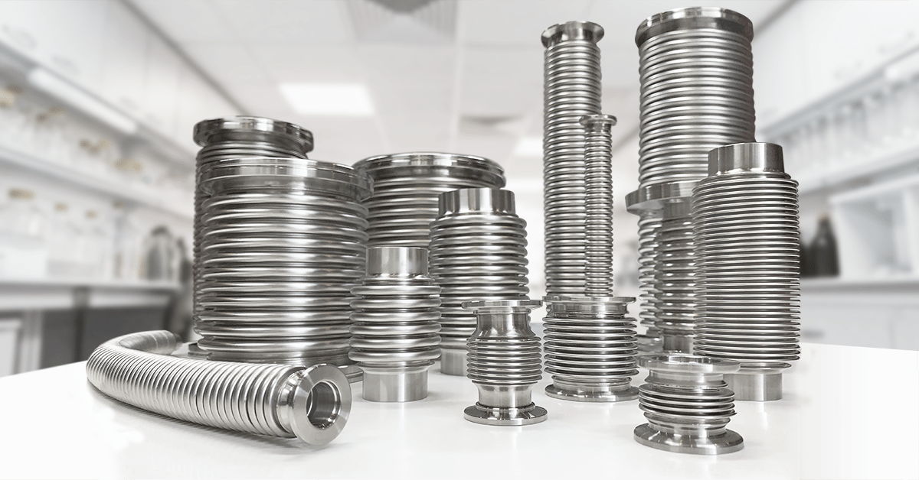
2
Existing Technologies
Ordinary manufacturing techniques (milling, turning, welding)
Ordinary engineering design process (CAD, CAM, FEM)
Usual accelerator components

Slide 6
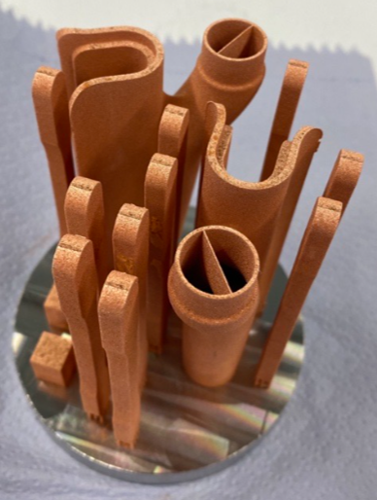
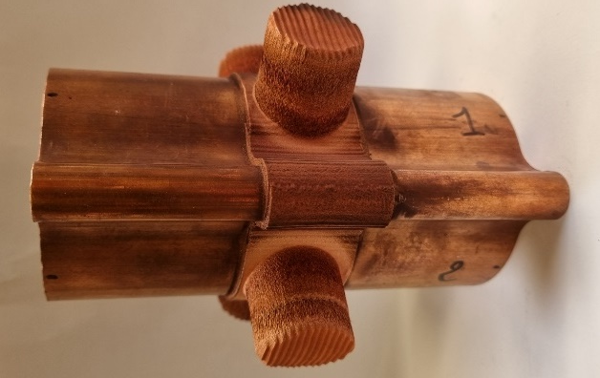
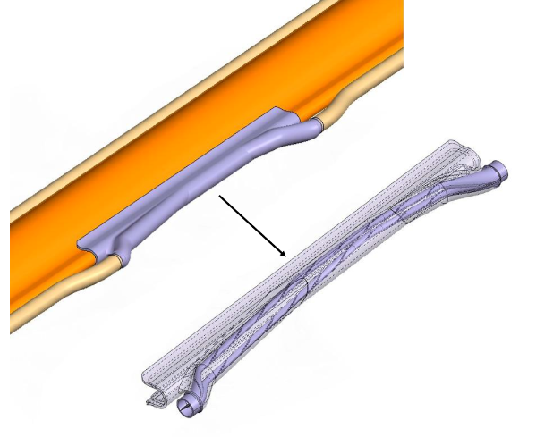
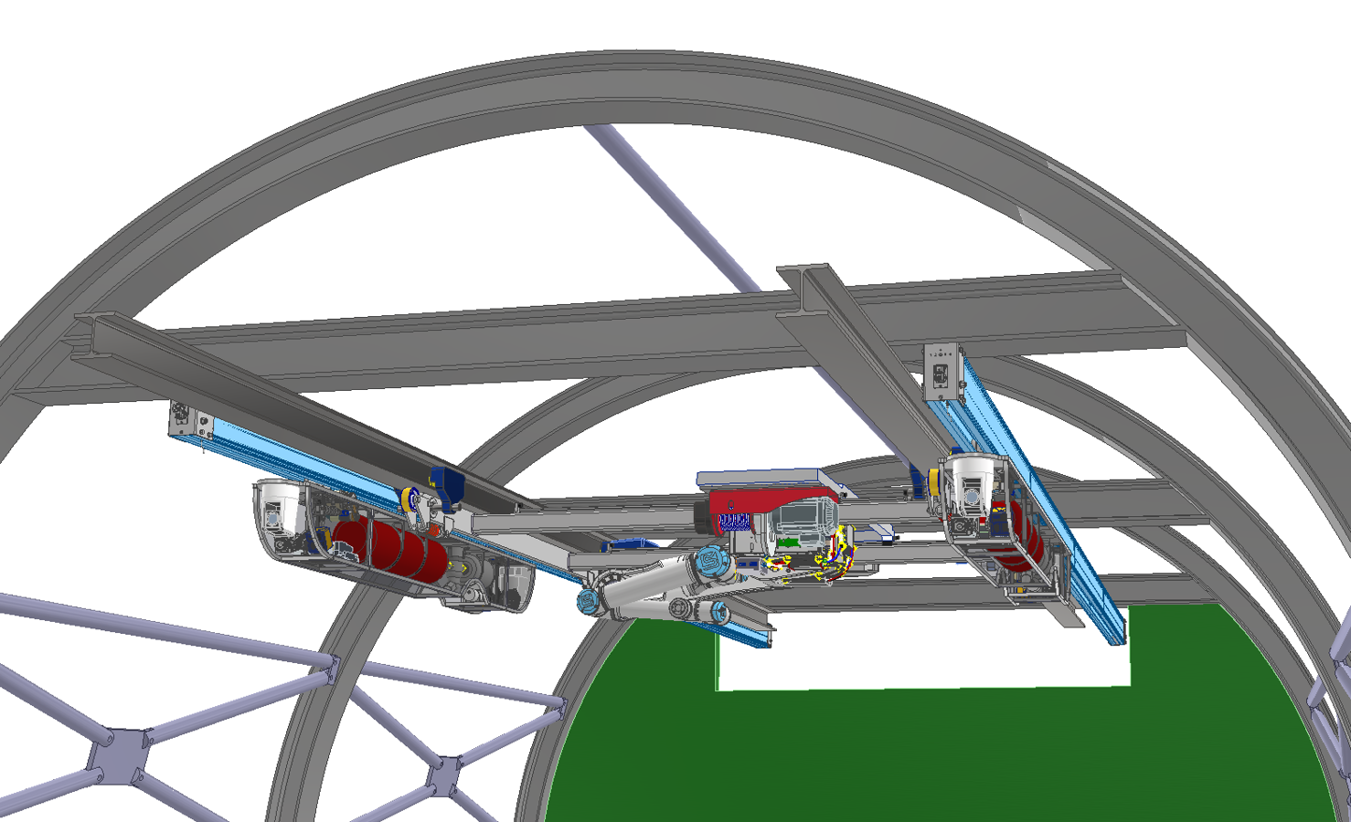
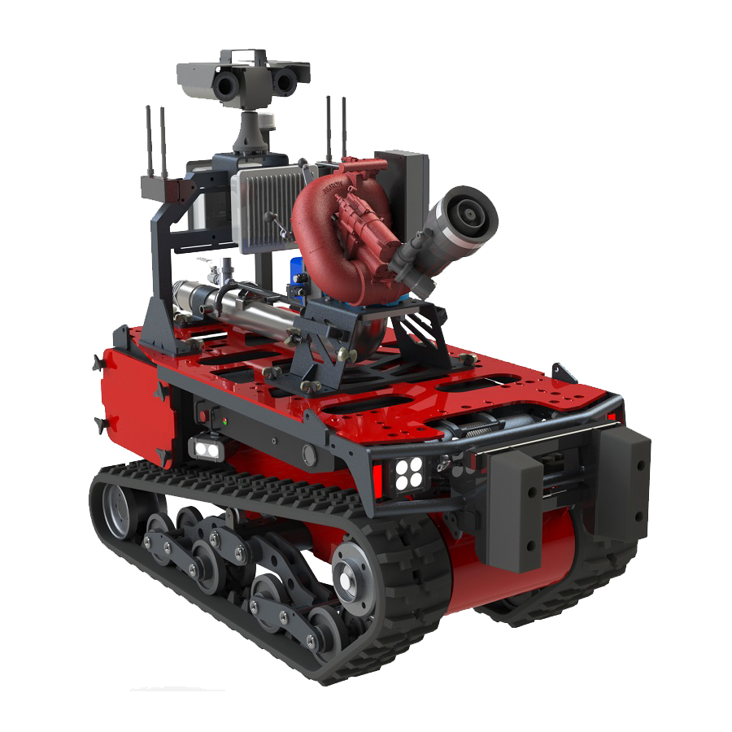
3
New Technologies
Additive manufacturing → allows to create more complex geometries, needed when it is important to achieve specific requirements.
Cold-spray for Beam Position Monitors (BPM)
Synchrotron Radiation Absorber 3D printed
Courtesy C. Garion, M. Morrone
Courtesy C. Garion, M. Morrone
Robotics →
Operational Safety - Protect workers from dangerous interventions (radiation exposure, etc.)
Availability - Corrective & preventive maintenance increasing maintainability/ Predictive maintenance increasing reliability
Emergency/safety - Technical/Medical Emergencies, Situation Awareness, Detect and engage hazards.
Example of specific fire fighting robots: Angatec TEC800
F. Carra, A. Piccini, see presentation: https://indi.to/3TgvZ
Remote Maintenance & Inspection System

Slide 7
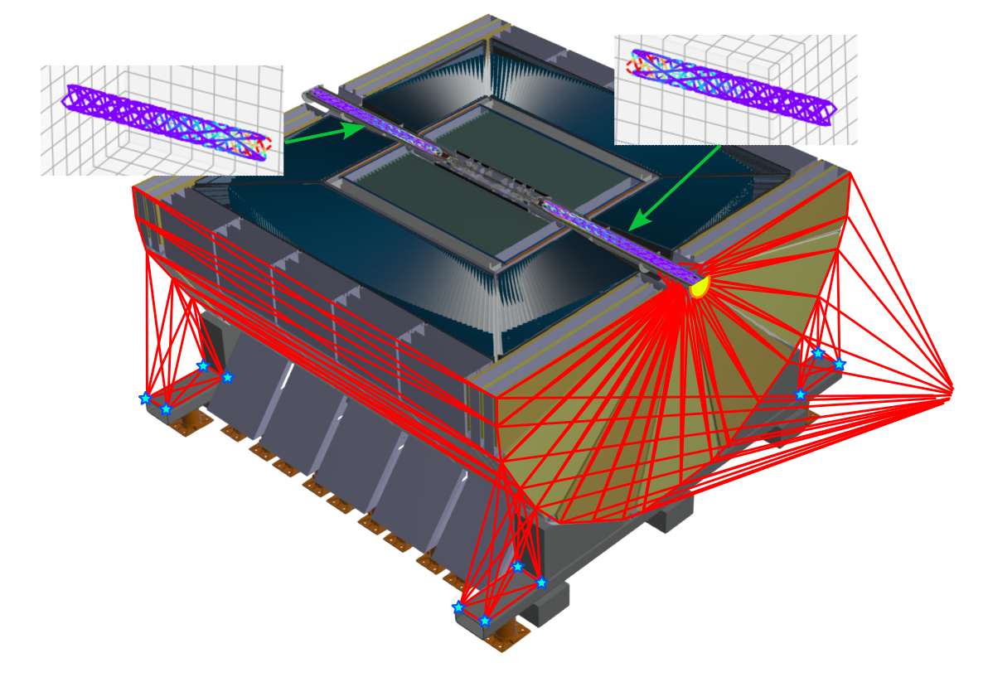
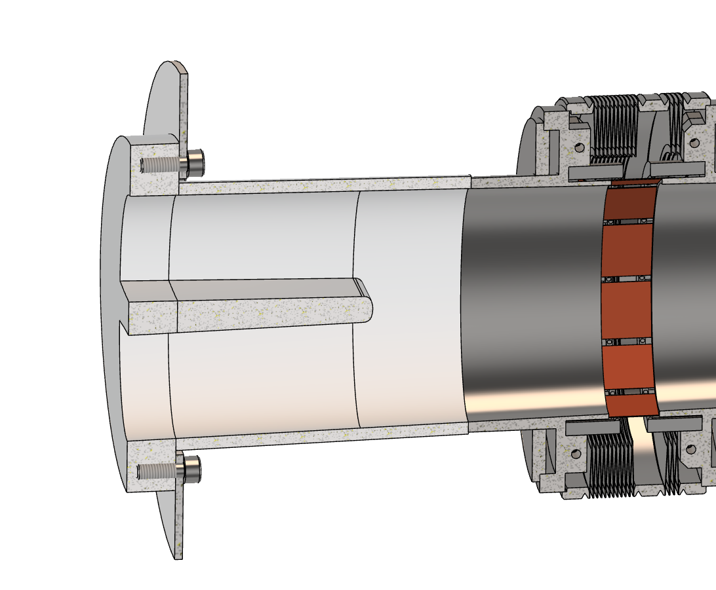
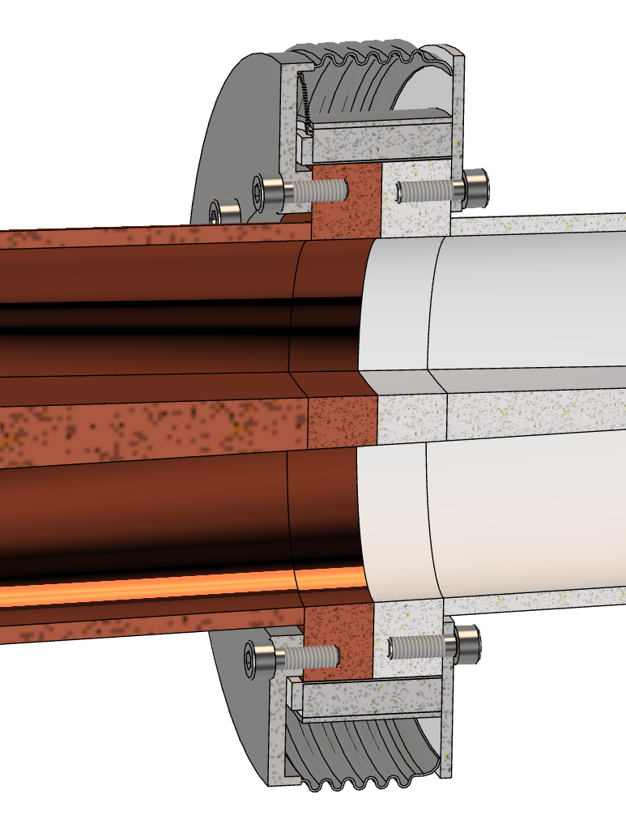
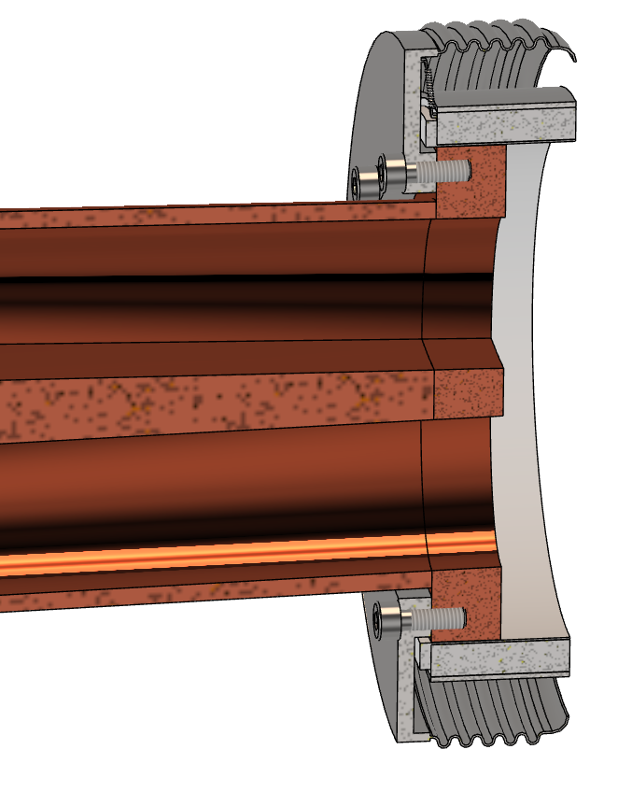
3
New Technologies
Alignment→ deformation monitoring system
For example, in the Interaction region of FCC, the idea is to use a deformation monitoring system, to follow the alignment of the final focusing quadrupoles, coupled with an interferometric distance measurements network.
Watrelot, Léonard, Mateusz Sosin, and Stéphane Durand. "Frequency scanning interferometry based deformation monitoring system for the alignment of the FCC-ee machine detector interface." Measurement Science and Technology 34.7 (2023): 075006.
Watrelot, Léonard. FCC-ee Machine Detector Interface Alignment System Concepts. Diss. HESAM Université, 2023.
Nitrogen channel for cooling
A-side slided
B
Gasket
B-side flange
New material → Shape memory alloy (SMA) is a material that can recover a large pseudoplastic deformation through heating. This process can be reversable using two-way shape memory alloy, this material can switch between two different shape simply by heating and cooling. In this way is possible to create a connection dismountable between two parts.
A-side flange
NiTi SMA
Vacuum chamber
A
B
A
Resistive collar for heating
B-side mounted on the Support Tube
F. Niccoli, F. Fransesini

Slide 8
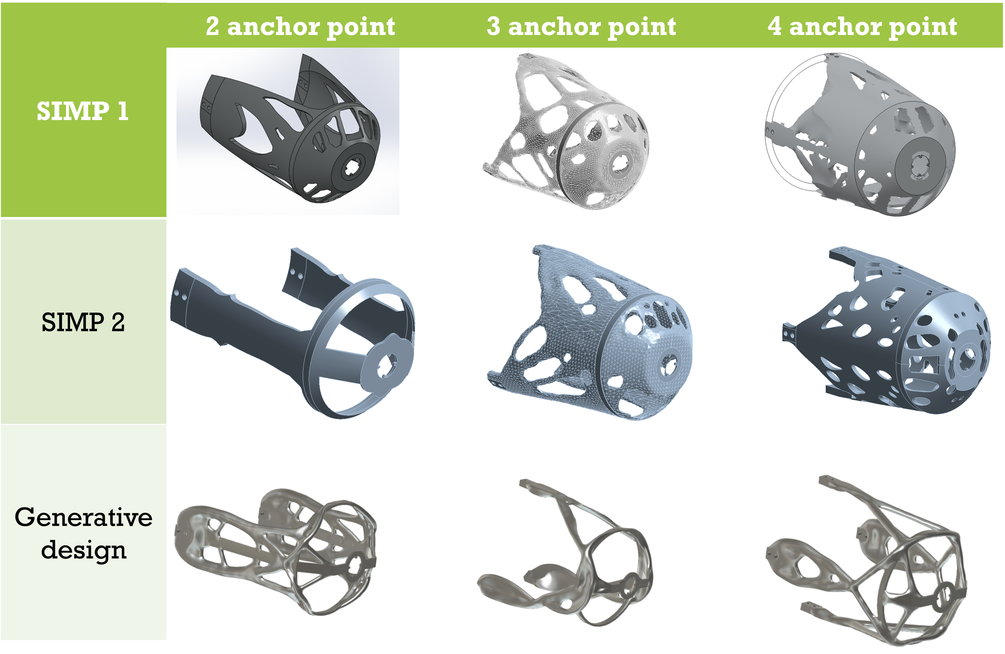
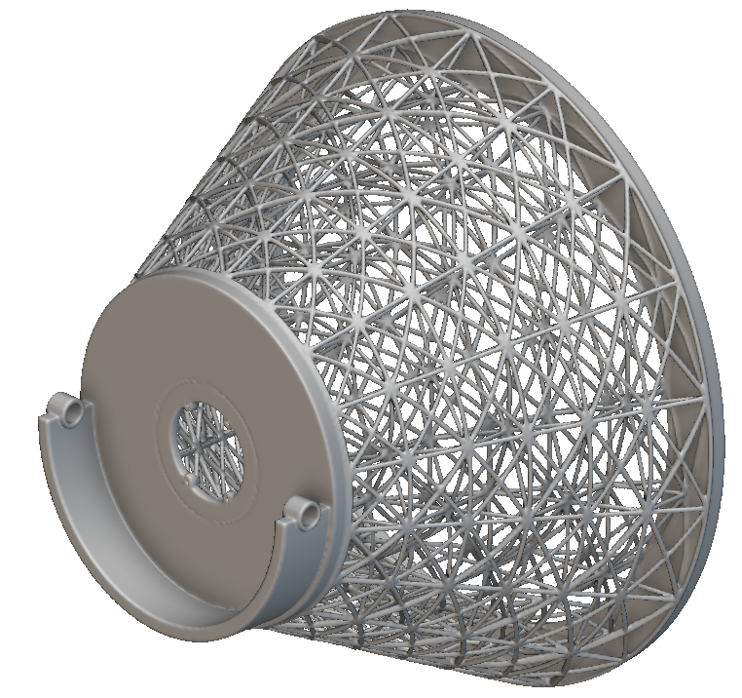
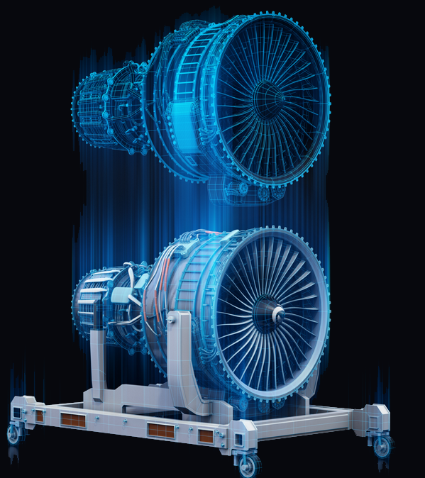
3
New Technologies
Structural optimization → is a field of engineering and design focused on improving a structure's performance by optimizing its material distribution, shape, size, and other parameters while satisfying specific constraints. The primary goal is to create structures that are as efficient, cost-effective, and high-performing as possible.
Digital twin → is a virtual representation of a physical object, system, or process that is used to simulate, monitor, and optimize its real-world counterpart. It integrates data from the physical entity with advanced technologies such as sensors, the Internet of Things (IoT), artificial intelligence (AI), and machine learning to provide real-time insights, predictions, and decision-making capabilities.
Benefits of Digital Twins:
Improved Performance: Real-time monitoring helps optimize operations.
Predictive Insights: Anticipate failures or inefficiencies before they occur.
Cost Savings: Reduce maintenance costs and downtime.
Better Decision-Making: Simulations help assess different scenarios.
Enhanced Innovation: Test and refine designs without physical prototypes.

Slide 9

4
Future Technologies
The perfect integration between Artificial Intelligence and each system of the accelerator. In the following year AI will be relevant in term of technologies development. It will be crucial during the optimization phase, in fact it could be possible to predict scenarios in order to predict the best.
Invention of new materials: in every field materials more performant are crucial:
  increasing the mechanical resistance →to reduce the weight;
  reducing the thermal conduction → to reduce the thickness of thermal shielding→ reduce the material budget;
  increasing the buckling limit you can reduce the beam pipe thickness
New data exchange technologies: WiFi N-versione, xG (after the 5G), Li-Fi, etc.

Slide 10
How to build a future collider?
Different fields are essential; each needs human resources, financial resources and management.
1
Civil engineering
2
Alignment
3
Safety Systems, Transport Logistics and Survey
4
Accelerator and detector components

Slide 11
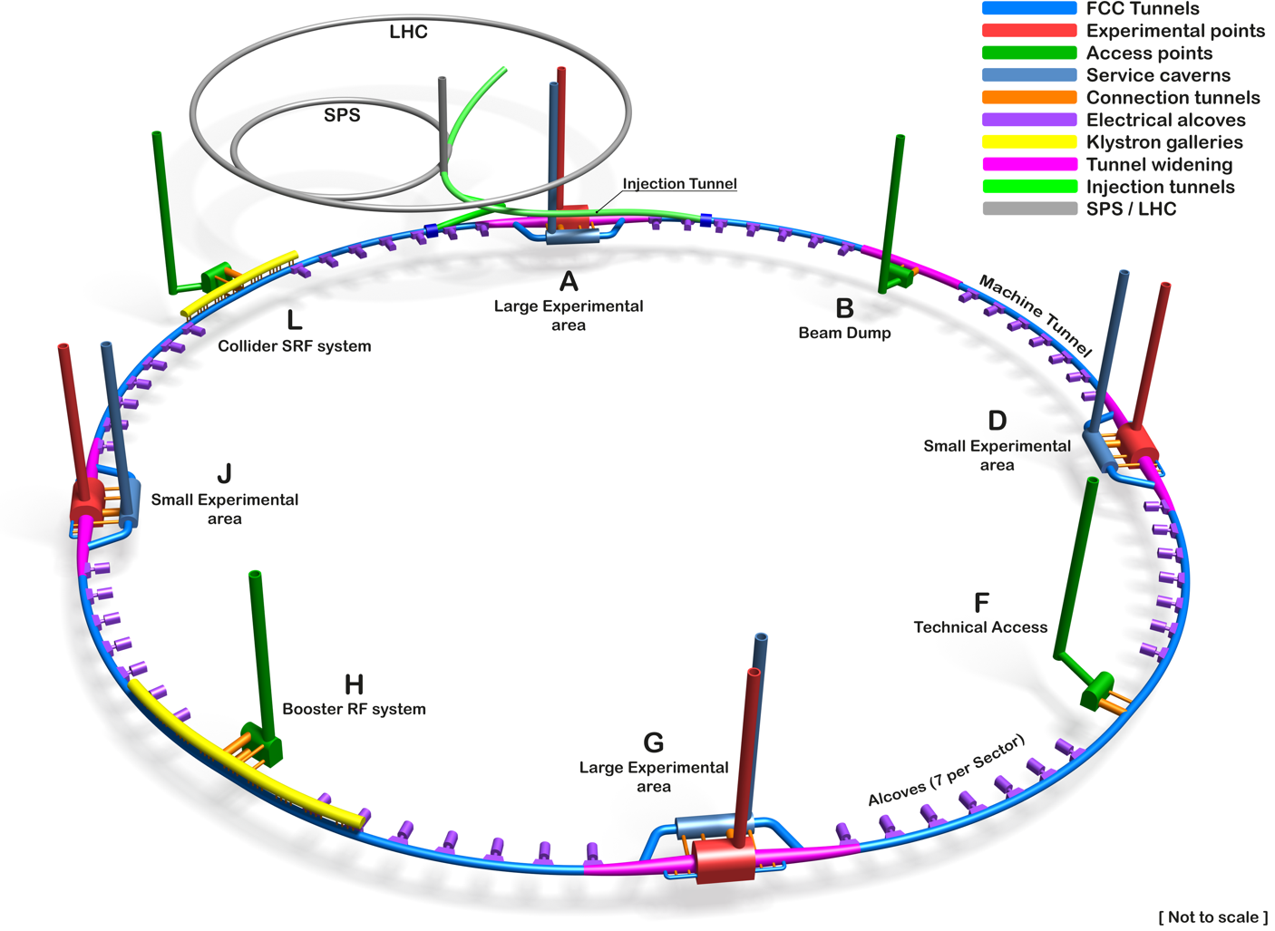
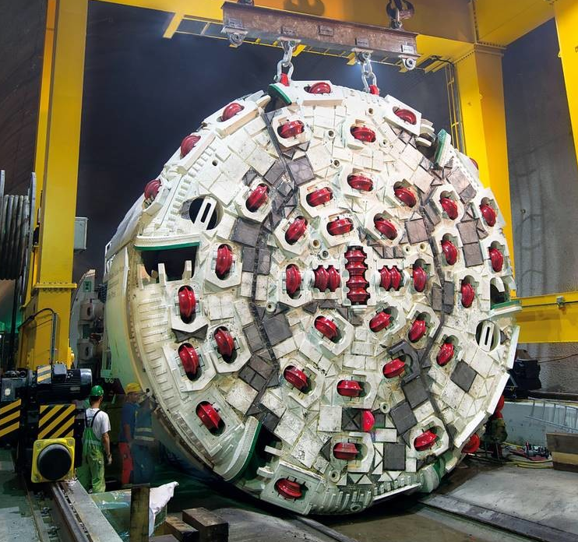
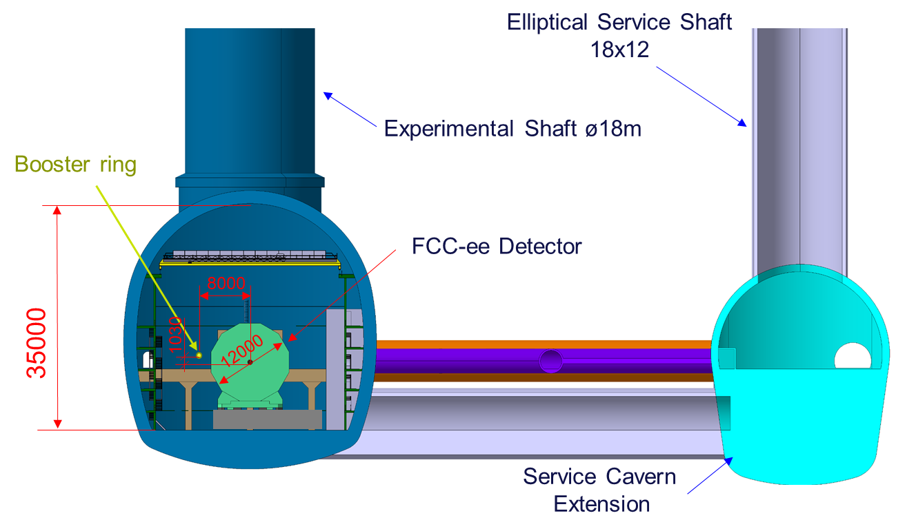
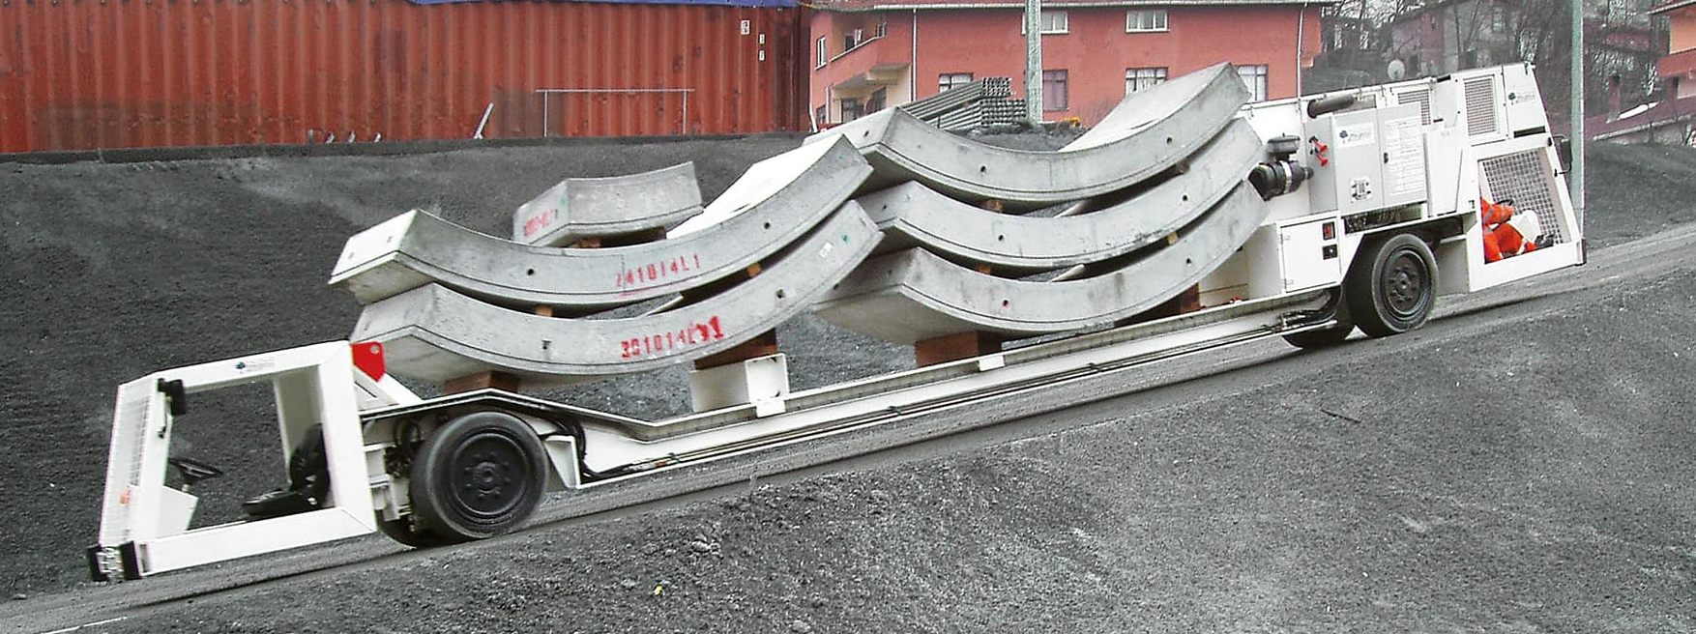
1
Civil engineering
The civil engineering job regards not only the building construction but also the construction of the tunnel.
It is important:
to respect the budget and the time scheduling.
reuse the material extract from the ground to respect the sustainability principle.
Credit: Angel Navascues Cornago
TBM (tunnel boring machine)
Multi-service vehicles

Slide 12
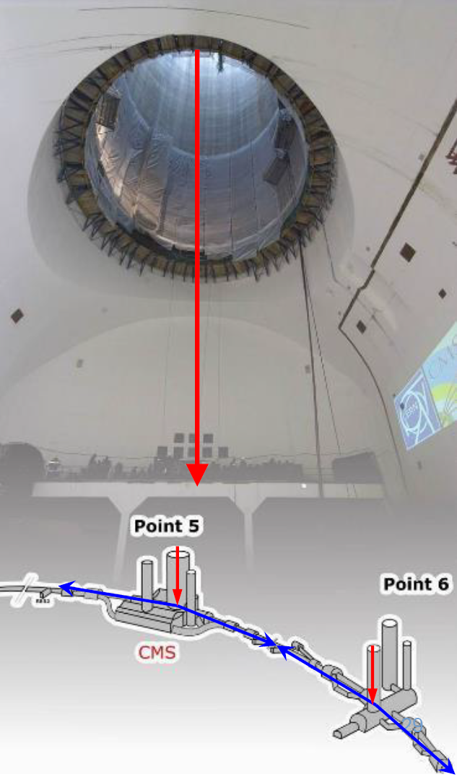
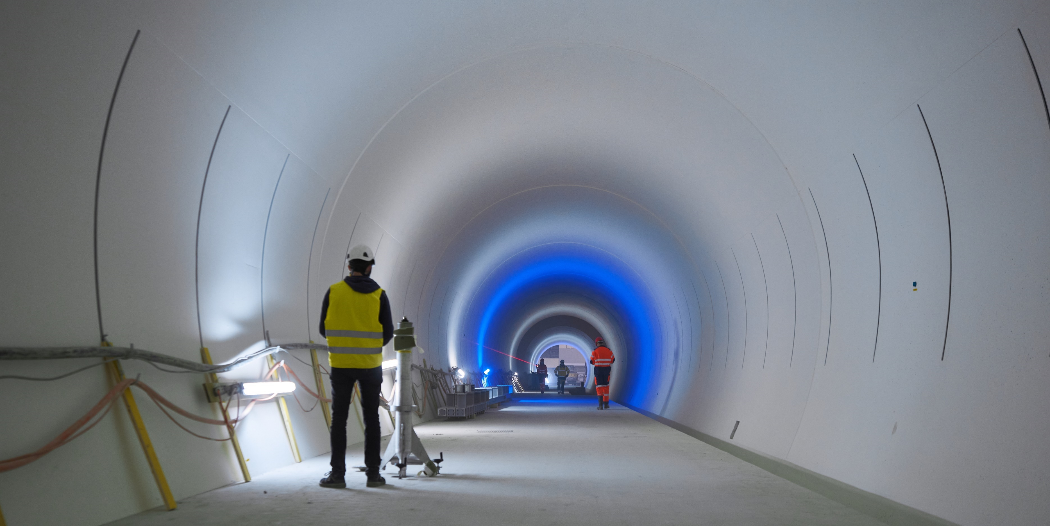
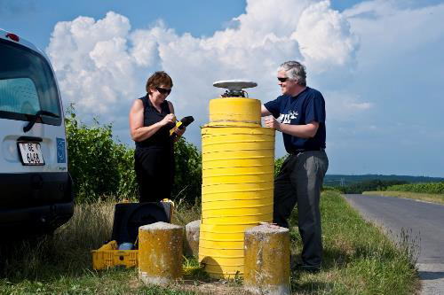
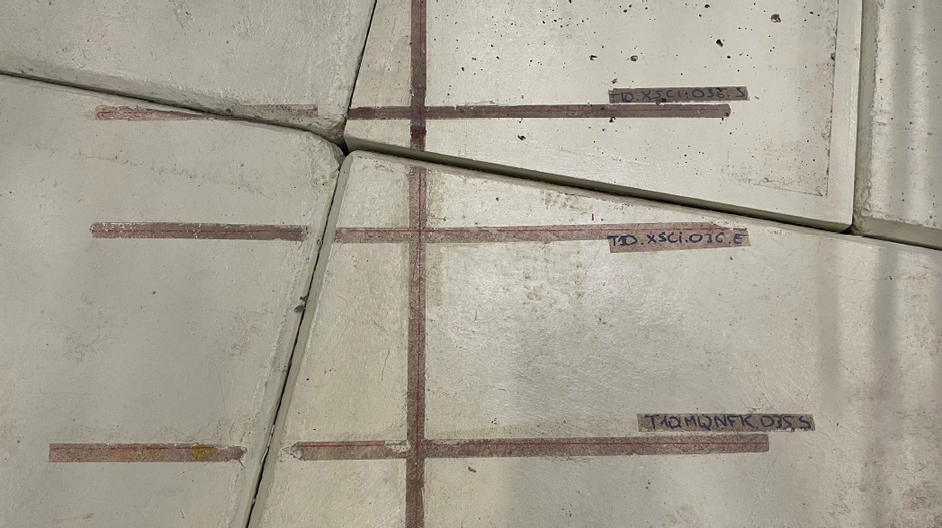
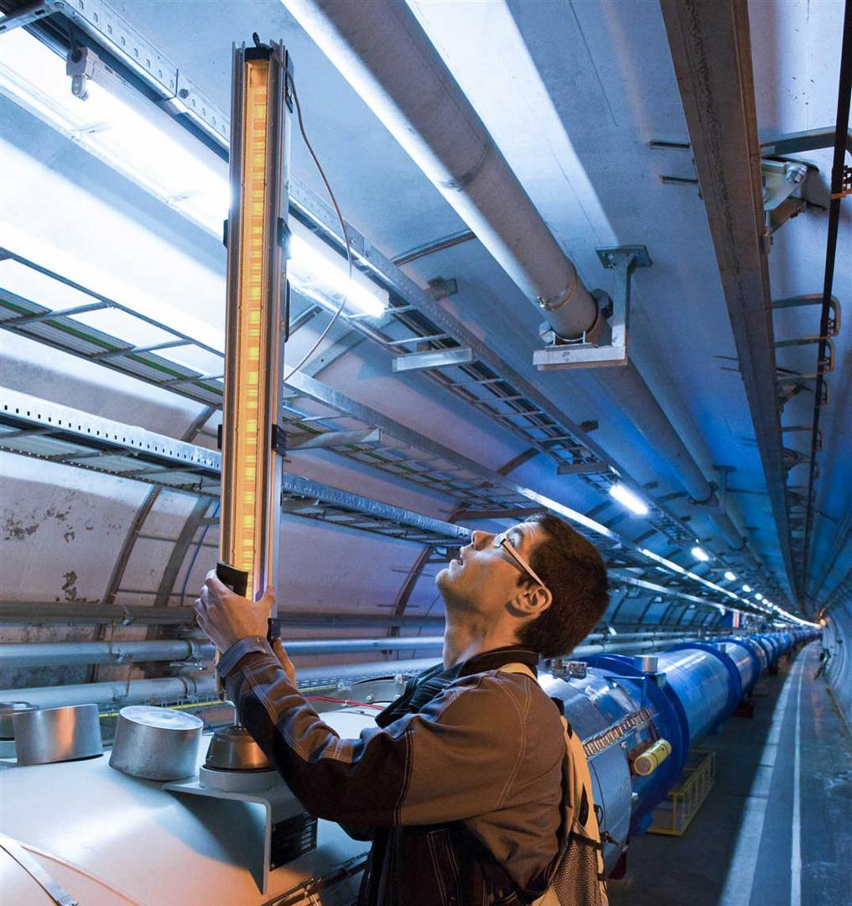
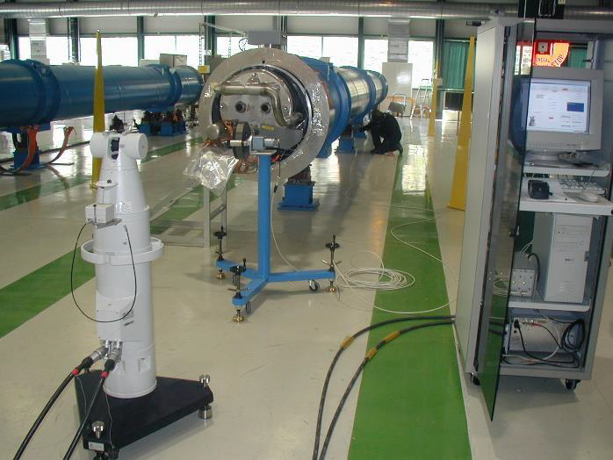
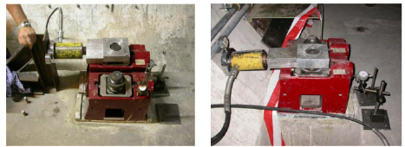
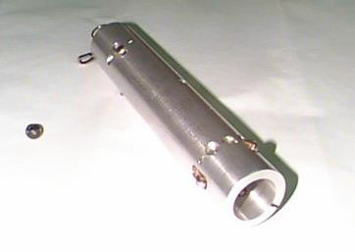
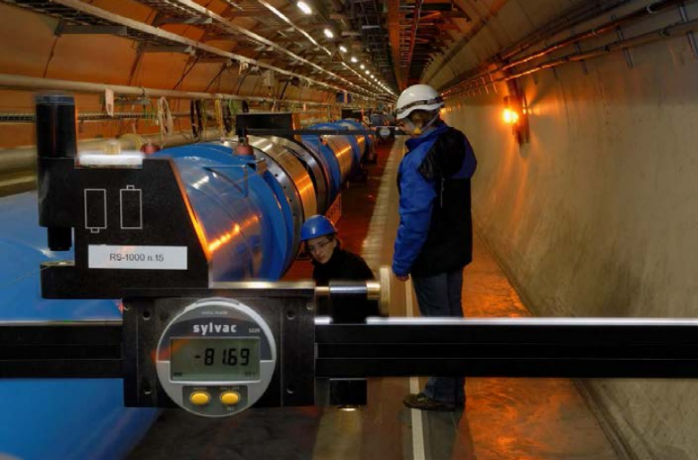
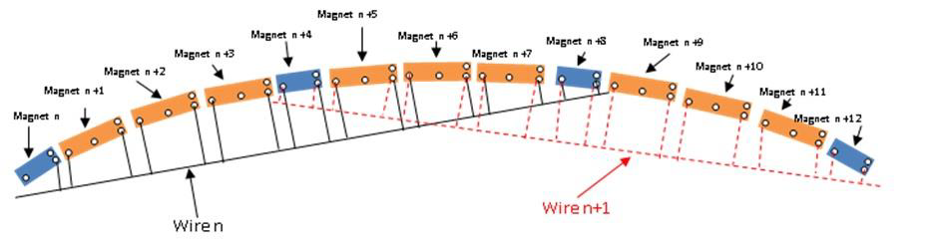
… then is transferred to the tunnel through the pits
Intervention while the tunnel is still empty, installation of the reference network.
2
Courtesy of Léonard Watrelot
Alignment
Alignment starts always from the surface …
While the tunnel is still empty, marking for all the jacks
Fiducialisation : Transfer of the reference axis on fiducials (= point references on the object).
Installation and prealignment of all the jacks
First alignment of the components in the tunnel.
“Smoothing” of the alignment, so the components are on a smooth line with no “steps”.
Maintenance of the alignment as often as required.
(as challenging as the initial installation due to the new constraints appearing with the operation of the machine)
Note :
These alignment steps are heavily time-consuming and very repetitive. FCC will be in a way bigger scale, requiring R&D to automatize as much as possible these operations.

Slide 13
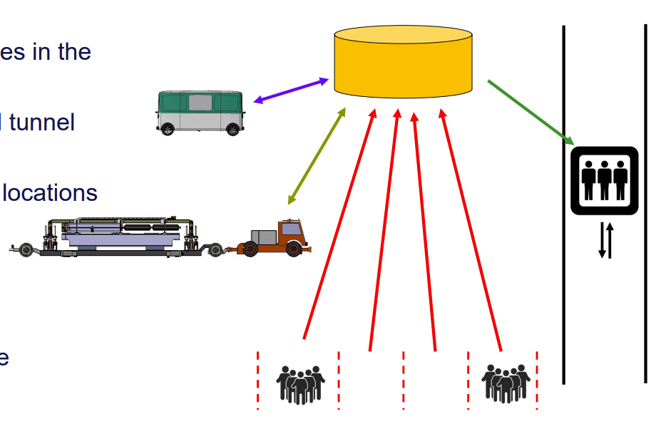
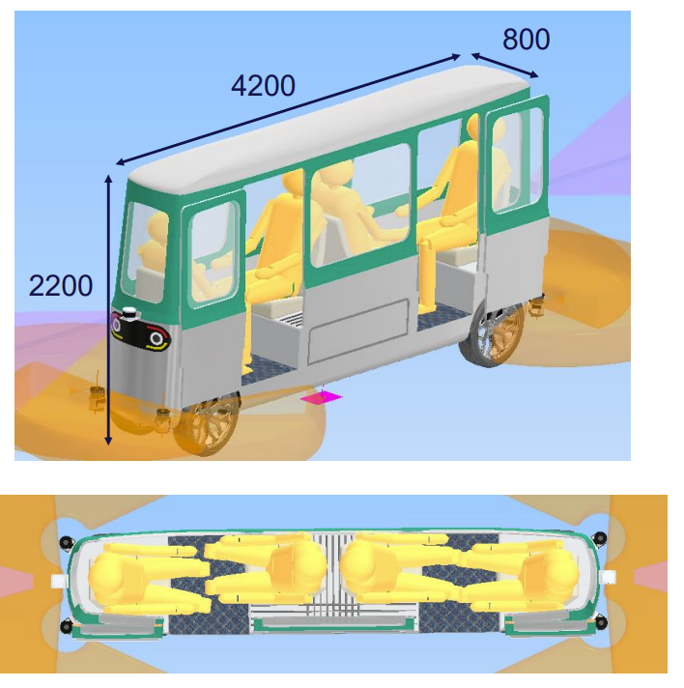
3
Safety Systems
It is important to pay attention to the safety system:
Access control;
Fire detection system
ODH (Oxygen deficiency hazard) detection system
Active safety system, evacuation plan, training, etc.
B O Müller
Autonomous personnel transport
3
Transport Logistics and Survey
Courtesy of R. Rinaldesi
It is crucial to know how to move personnel and goods in the tunnel and it is something that has to be investigated at the beginning, in order to foresee the space and the required tools inside the tunnel.
Centralized traffic management

Slide 14
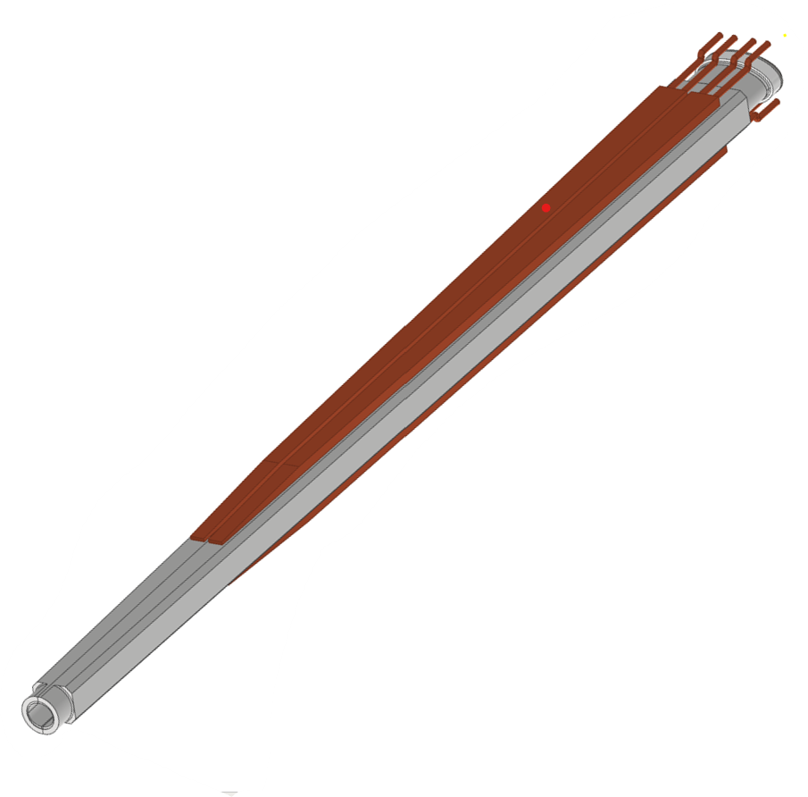
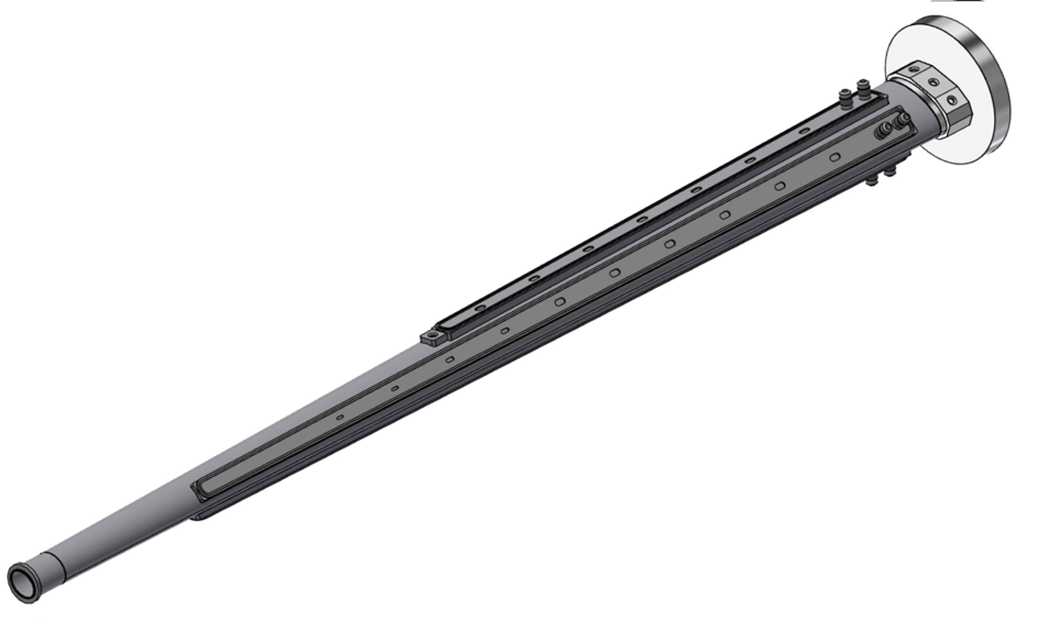
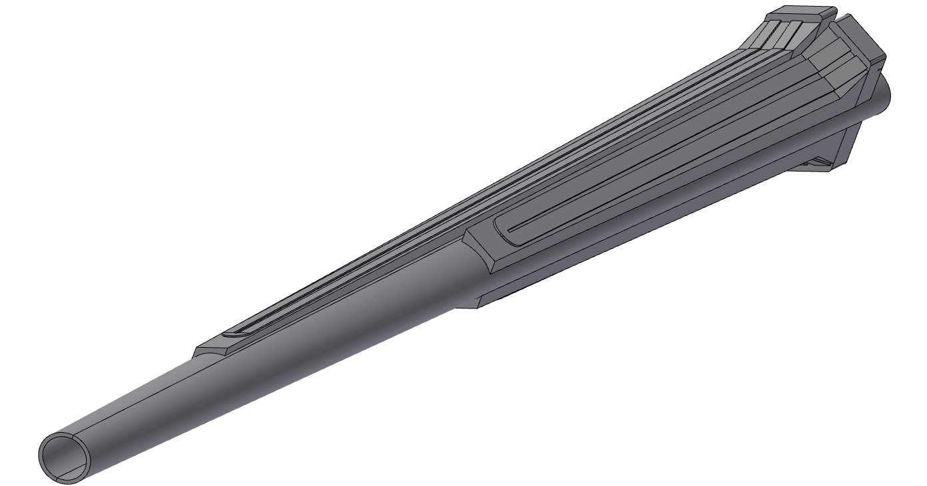
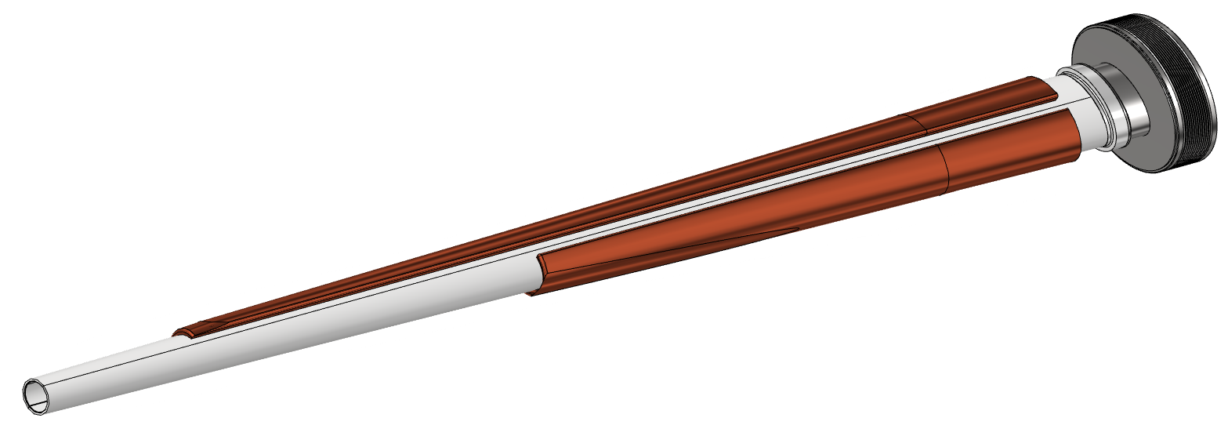
Accelerator and detector components
4
Another important aspect of the question “How to build a future collider?” is the design of all the mechanical components needed, from the accelerator side and detector side.
Simulation
Concept
Preliminary design
Final design
Updated design
FCC IR ellipto conical vacuum chamber

Slide 15
Conclusion
With this presentation, we probably know less than ever “How to build a future collider?”, but maybe we are more aware of the complexity and the ingredients needed.
The human resources and the international collaboration are foundamental for the success of the project;
In order to achieve the results aspected, collaboration between multidisciplinary figures such as physicists, engineers, economists, managers, etc. is necessary.
The technologies are crucial for each step and it is important to pay attention to the future ones, to be able to include them in the future steps of the project.
There isn’t a complete handbook with the title «How to build a future collider?”, the only way to do this is to stay aware of the progress made in each field and be able to update your own skills over the years.

