Slide 1


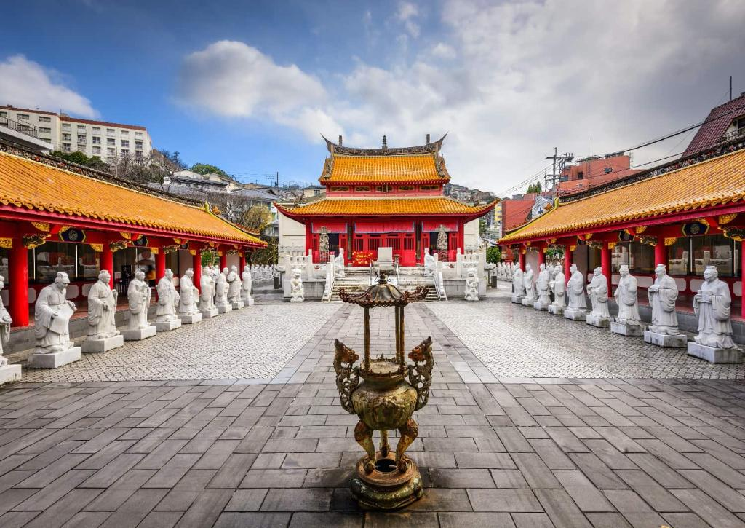
Site status and future plans - Nagasaki, Tokyo & Tsukuba
Ken Oyama
Nagasaki Institute of Applied Science
Apr. 2, 2025, ALICE Tier-1/Tier-2 Workshop in Nagasaki

Slide 2
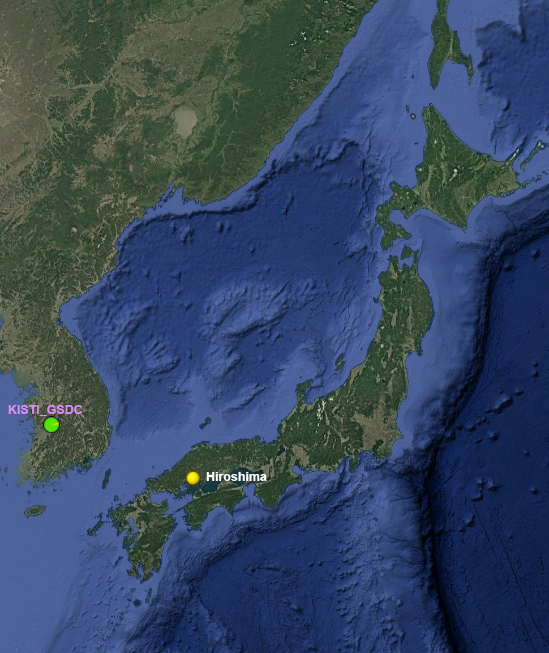
Tier-2 sites in Japan
four sites including future plan
Tsukuba … TL: Tatsuya Chujo
under construction
Tokyo … TL: Taku Gunji
planned
Hiroshima … TL: Kenta Shigaki
is up and running now, see Takuma’s talk
Nagasaki … TL: Ken Oyama
under construction
Tsukuba
Tokyo
Nagasaki

Slide 3
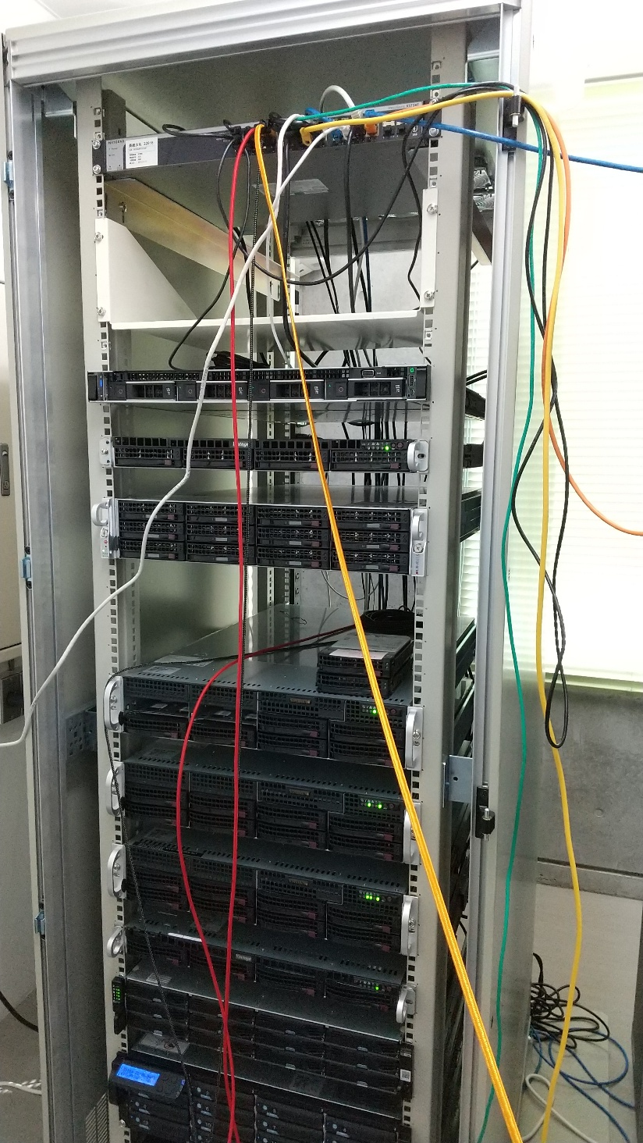
Nagasaki
A small system under construction with:
full 10G network switches
  uplink to SINET to be upgraded from 1G to 10G in 2025
disks: 280TB (2 hw. RAID system, FC) + 200TB JBODs (zfs)
cpus: 432 (216 cores)
planning to add another
~128 cpus this year
type | cpus | memory
EPYC 7402P | 48 | 128GB
Xeon Silver 4314 | 32 | 32GB
Xeon Gold 6312U | 48 | 256GB
Xeon Gold 6312U | 48 | 256GB
Ryzen 9 5950X | 32 | 64GB
Ryzen 9 5950X | 32 | 64GB
Xeon(R) Gold 6142 dual | 64 | 256GB
AMD EPYC 7502 dual | 128 | 1TB

Slide 4
Nagasaki future plan
Bringing up the worker nodes (see later slides) by summer of 2025
Japanese government recently changed their policy
  increases faculty of science and engineering, especially for digital technology (semiconductor, green energy tech., network, computer science including AI, QC, etc)
  transfer resources of whole Japanese universities from humanities & liberal arts to sciences
NiAS: faculty restructuring on going towards 2027
  “Engineering faculty” → “Green&Digital Science and Engineering faculty”
  funding of 3B JPY (~ 20M CHF) for preparation is expected (1/3 of that already secured)
  the entire project includes building of a new computing facility to contain initially CPUs and disks at scale of 200-400k CHF
  AI computing and education is a main purpose, but we can put our grid middleware to run whenever no other activities are
  electricity powered by renewable energies (demonstration experiment) funded by ministry of the environment (another 3M CHF project)
  more funding news in June

Slide 5
Tsukuba plan
Old hardware is becoming outdated
  but network switches and fast connection to SINET is ready to use
Planning to “renew” whole hardware using a new budget of this JFY 2025
  budget scale: 70k CHF
  spend for worker nodes (and service nodes?) … 500-1000 cores?
  procurement before summer of this year
  setup during summer
Idea of using Pegasus supercomputer of Center for Computational Sciences of University of Tsukuba for Tier-2 (see talk by Tatsuya Chujo)

Slide 6
Tokyo
There is always a plan to build a small Tier-2 in Tokyo
  Taku Gunji is continuously working for acquiring budget for that
They are now preparing/developing computing system/model also for EIC
  streaming DAQ

Slide 7
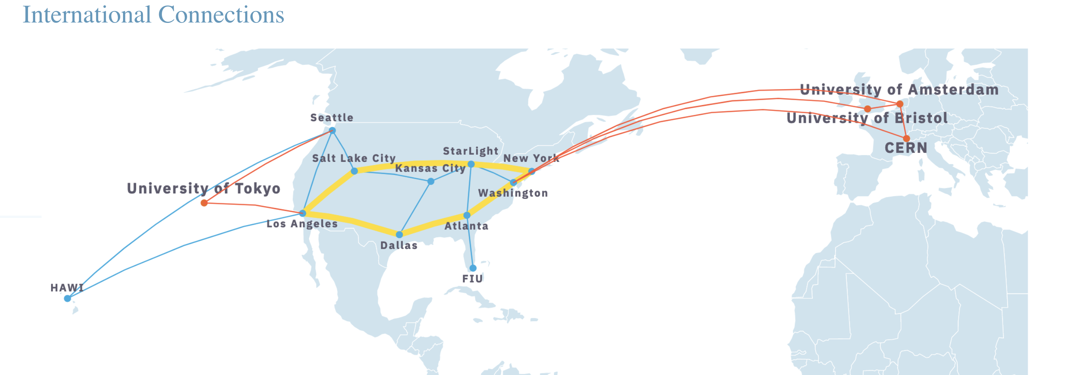
Computing for the EIC
EIC streaming DAQ and computing:
  Interests by U-Tokyo, RCNP, and RIKEN
FABRIC network in the US -> connection to Tokyo
https://portal.fabric-testbed.net/about/about-fabric

Slide 8
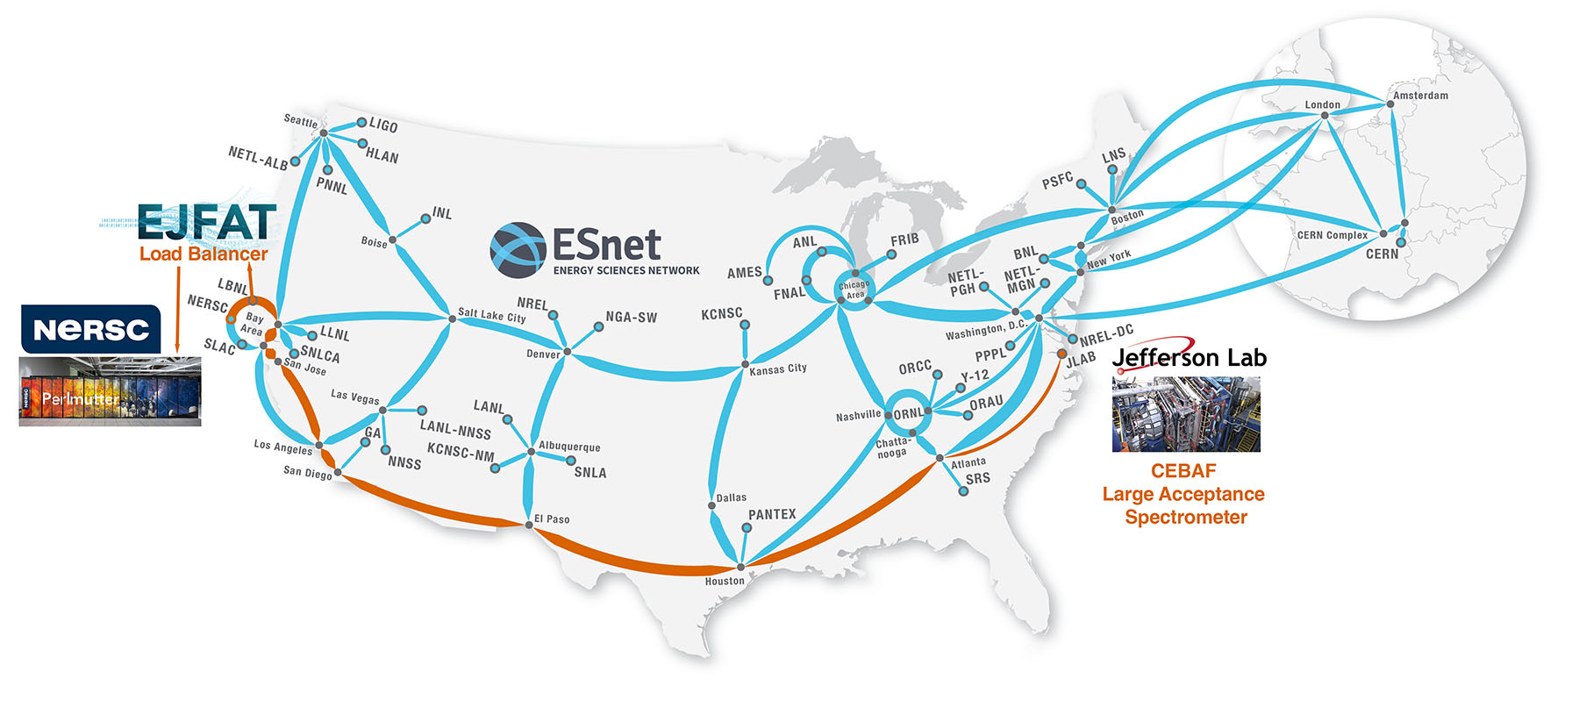
Computing for the EIC
ESnet and EJFAT in US
  Physics data from JLab was streamed across the ESnet backbone at 100 Gbps into the EJFAT load balancer, which directed it into NERSC’s Perlmutter for real time processing.
https://www.es.net/news-and-publications/esnet-news/2024/ejfat-jefferson-lab-esnet/

Slide 9
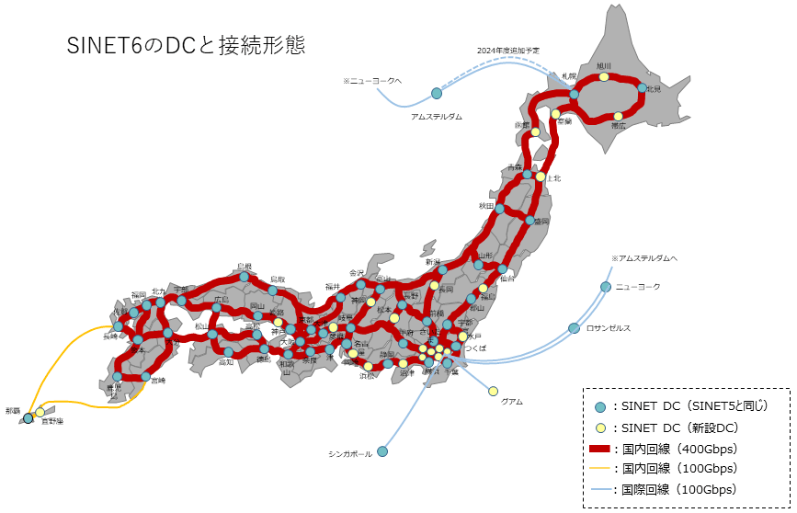
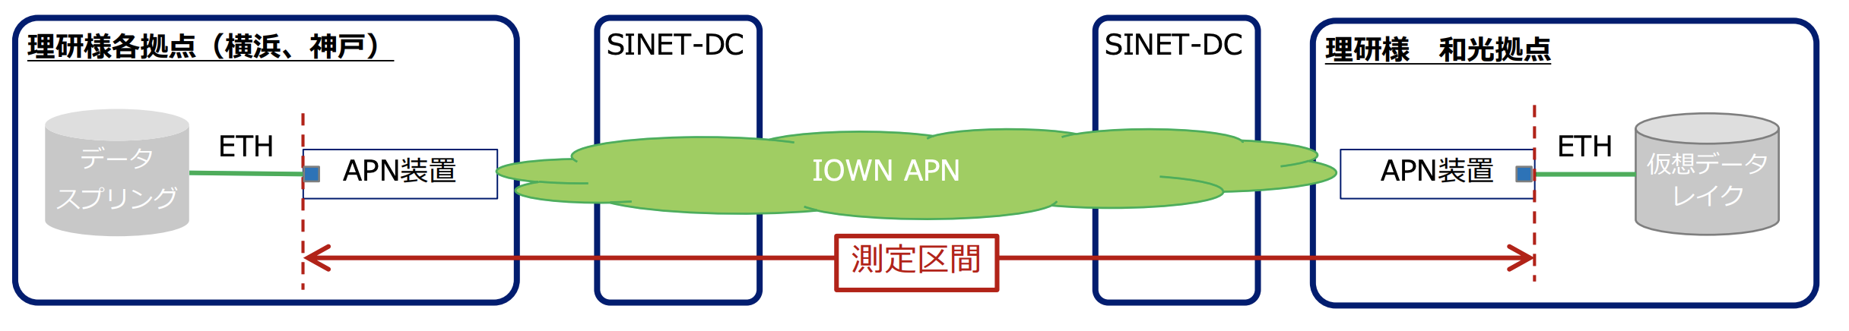

Establish Similar network in Japan?
Streaming DAQ will be the standard at many accelerator facilities in Japan (ex, RCNP,
J-PARC, RIBF)
  SPADI-Alliance collaboration in Japan (https://www.rcnp.osaka-u.ac.jp/~spadi/)
Ambitious goal is streamred data from EIC, J-PARC, RCNP, RIBF, etc will be processed synchronously at many computiing facilities (Tokyo, Osaka, etc).
The network will be based on SINET6? IOWN network?
Benfits for ALICE Tier2 sites (Hiroshima, Tsukuba, Nagasaki) to join?

Slide 10
Administration of Tier-2 in Japan
ALICE-Japan is formed by small groups
  always limited in man-power
  each institute can not hold maintainer dedicated for the Tier-2 site maintenance
  physicists or Ms. or PhD students are maintaining at small fraction of FTE
  people are replaced after several years
Solution
Decentralized co-management system among institutes, with sharing knowledge are essential
  hold always 2-3 experts (for grid middleware management) in entire ALICE-Japan
    not necessarily in the institute where Tier-2 sites are
  0-1 expert (in hardware maintenance and initial installation) in each institute
    if some institutes is missing hardware experts, experts in other institute travel to solve the problem

Slide 11
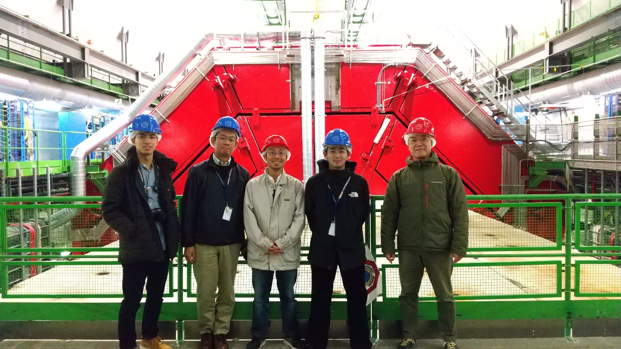
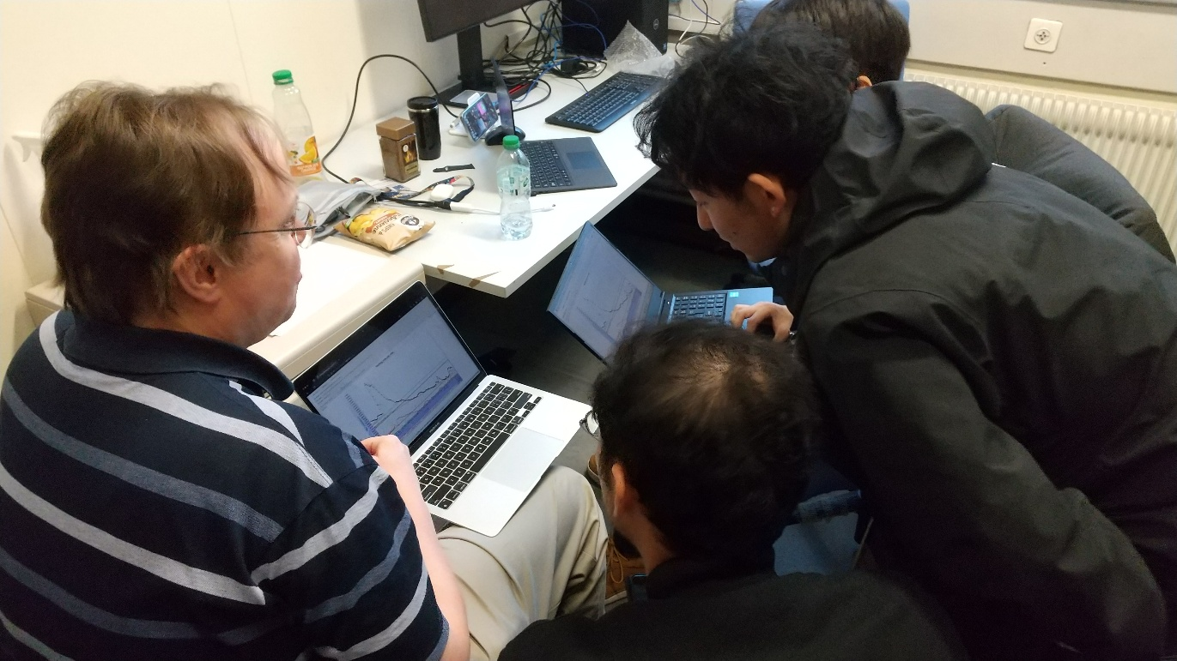
ALICE Japan Tier-2 operation crew
for next 1-2 years
  Masanori Ogino [Tokyo]
  Takuma Matsumoto [Hiroshima]
  Hiroki Osanai [Nagasaki]
  Sho Miyamoto [Nagasaki]
Recent activities and plan
  Dec. 2024 training at CERN with setting up a few worker nodes in Hiroshima with great help of CERN people!!
  Jan.-Feb. full ramping up of Hiroshima site
  Mar.-Apr. finagling Hiroshima, then start Nagasaki setup

