Slide 1
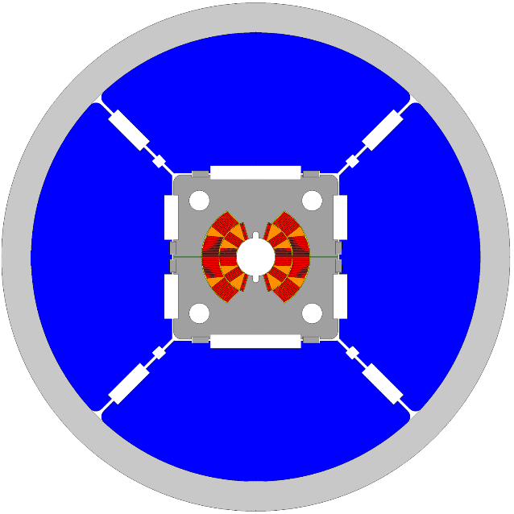
CERN/INFN meeting
FalconD status ¶
Author:
S. Farinon
Date:
December 17th 2024

Slide 2
A brief history of FalconD
FalconD is a 5-year program developed under the CERN/INFN KE 4102 agreement, signed in October 2018.
The total value of the agreement is 5.8 M€, of which:
  3050 k€ INFN contribution
  2750 k€ CERN contribution (in kind contribution of 1250 k€ + 1500 k€ cash)
The initial scope of the project was the development and production of a 16 T 4-layer cos-theta Nb₃Sn short model

Slide 3
A brief history of FalconD
The CERN/INFN KE 4102 agreement was formally revised in February 2023.
The total value of the agreement is now 6.15 M€, of which:
  3050 k€ INFN contribution
  3100 k€ CERN contribution (in kind contribution of 1600 k€ + 1500 k€ cash)
The project was re-scoped to the development and production of a 12 T 2-layer cos-theta Nb₃Sn short model

Slide 4
Additional INFN contributions
Additional INFN contributions are:
  Procurement of the HT furnace (800 k€)
    installed at ASG but INFN property, will be moved to LASA after FalconD coil fabrication
  2 additional Nb₃Sn coils (300 k€)
    the total number of coils to be fabricated is 1 dummy Cu coil and 7 Nb₃Sn coil
    This procurement saturates the maximum extra cost allowable on the contract (20% of 1.5 M€)

Slide 5
CERN Technical Coordinators
Davide Tommasini 2018 – July 2020
Friedrich Lackner July 2020 – December 2021
Diego Perini January 2022 – January 2024
Arnaud Foussat February 2024 – today

Slide 6
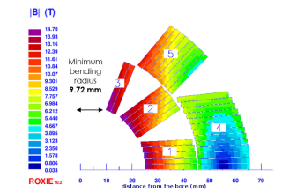
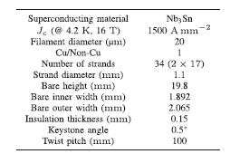
Choice of the conductor
Initial design (Sept. 2019)
bore field 14 T
R.Valente et al.,
DOI 10.1109/TASC.2020.2972219
FalconD conductor specification given by CERN on October 19.
Since 2020, bore field reduced to 12 T, with 14 T ultimate field.

Slide 7
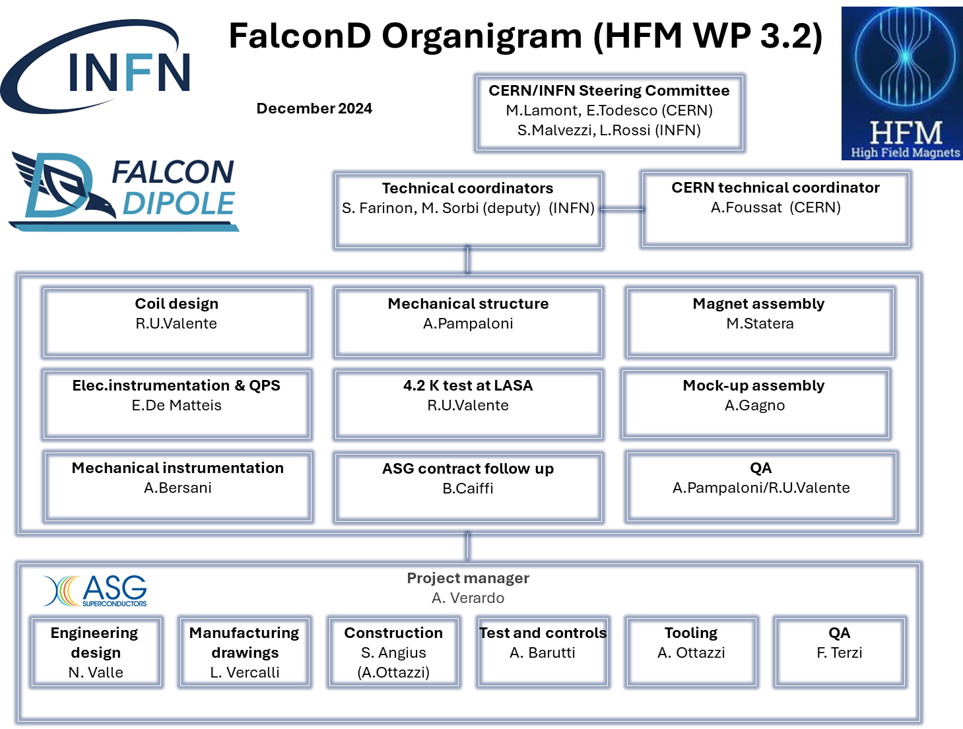

Slide 8
Deliverables

Slide 9
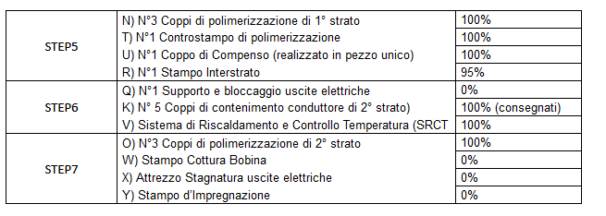
Tooling status (as of Dec. 2024)
Step 1 to 4 completed, and tooling delivered
Step 5 to 7:
Any modifications to the equipment for which there are already recorded progress can only result in economic impacts that need to be quantified.

Slide 10
1st winding test campaign @ASG ¶

Slide 11
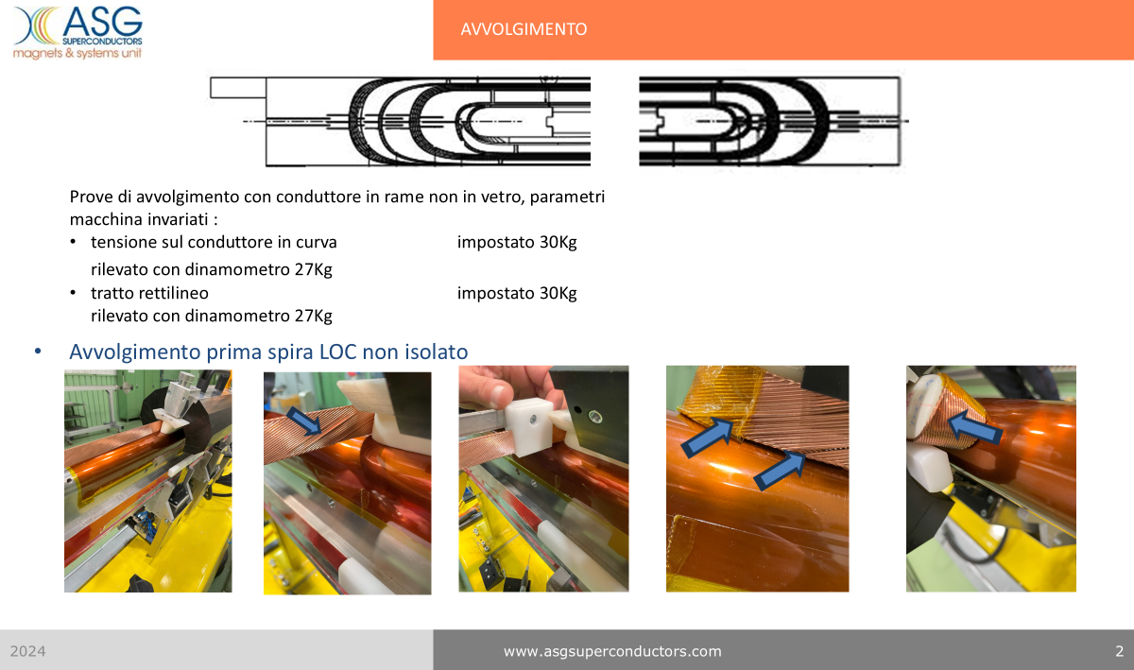

Slide 12
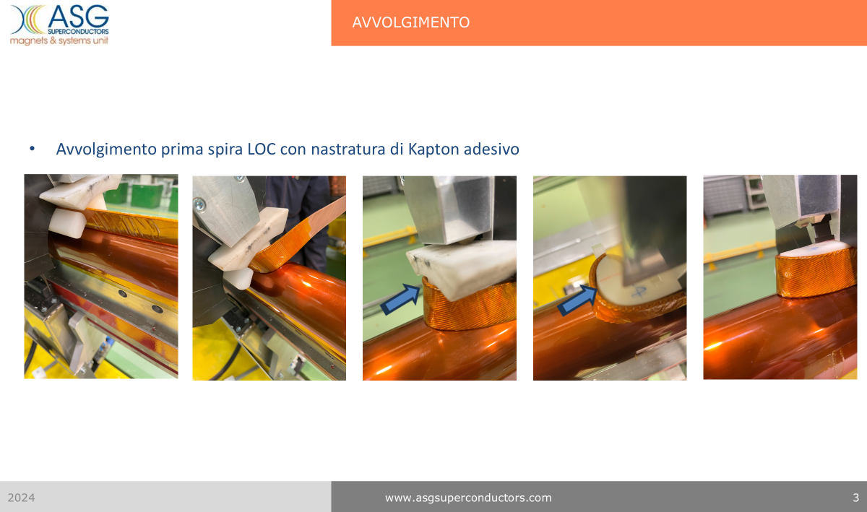

Slide 13
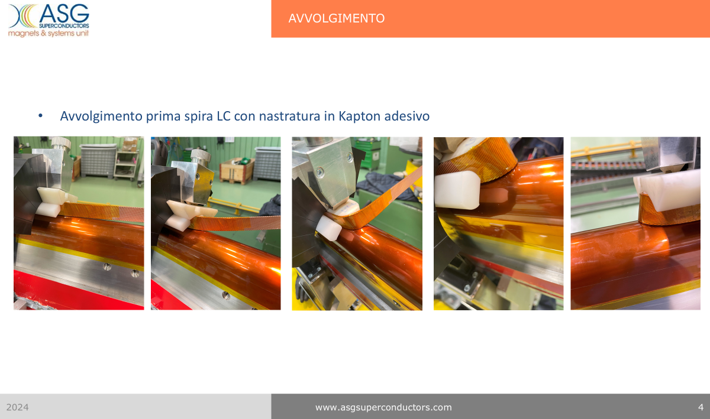

Slide 14
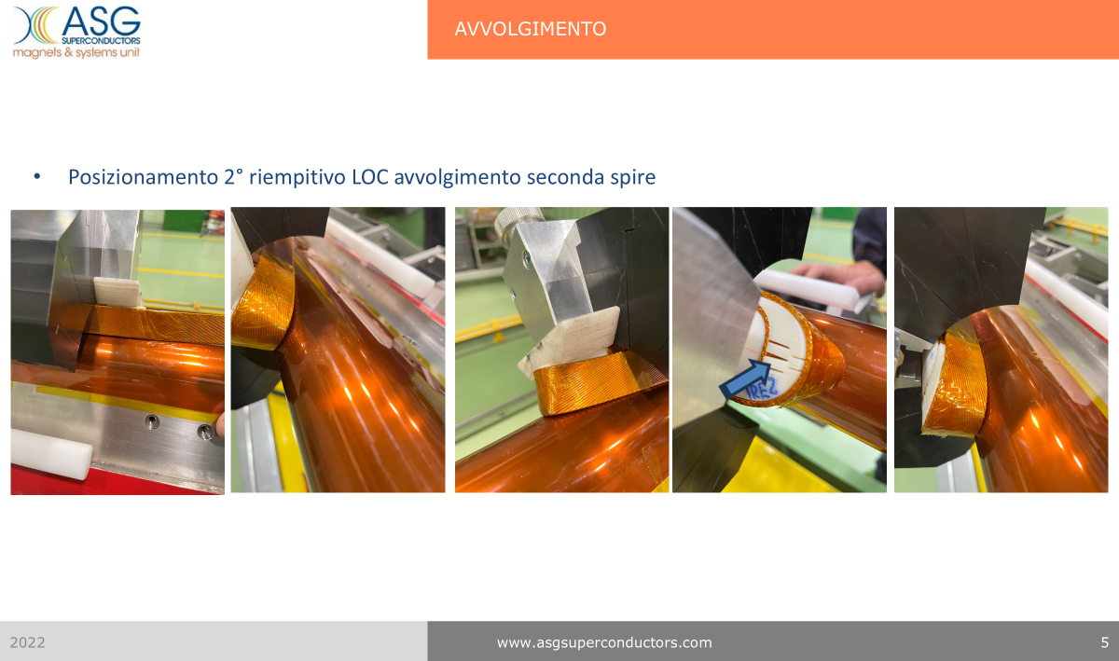

Slide 15
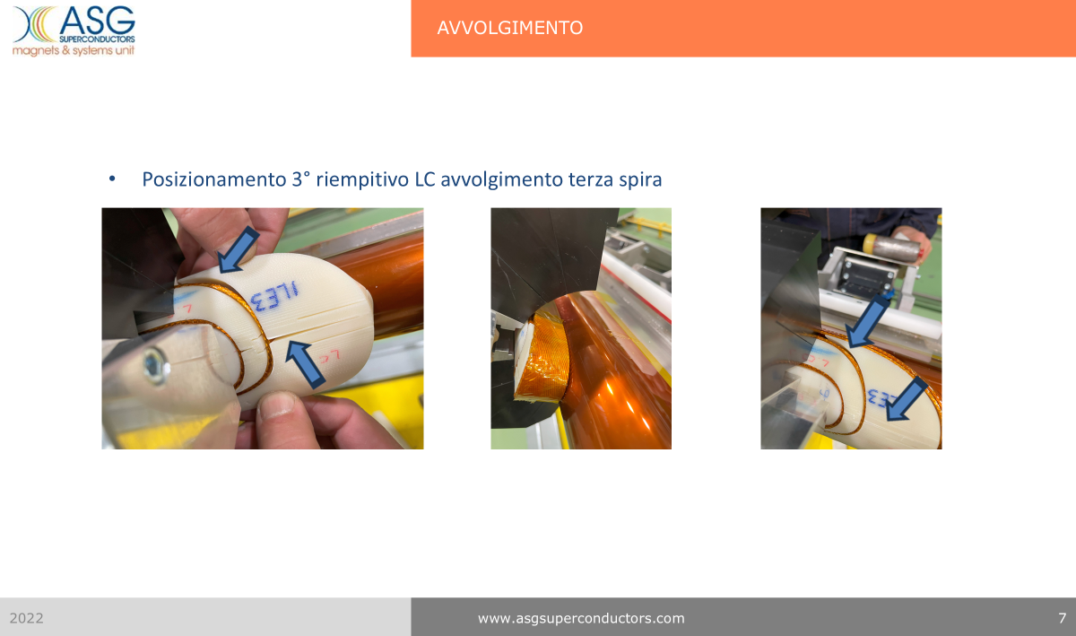

Slide 16
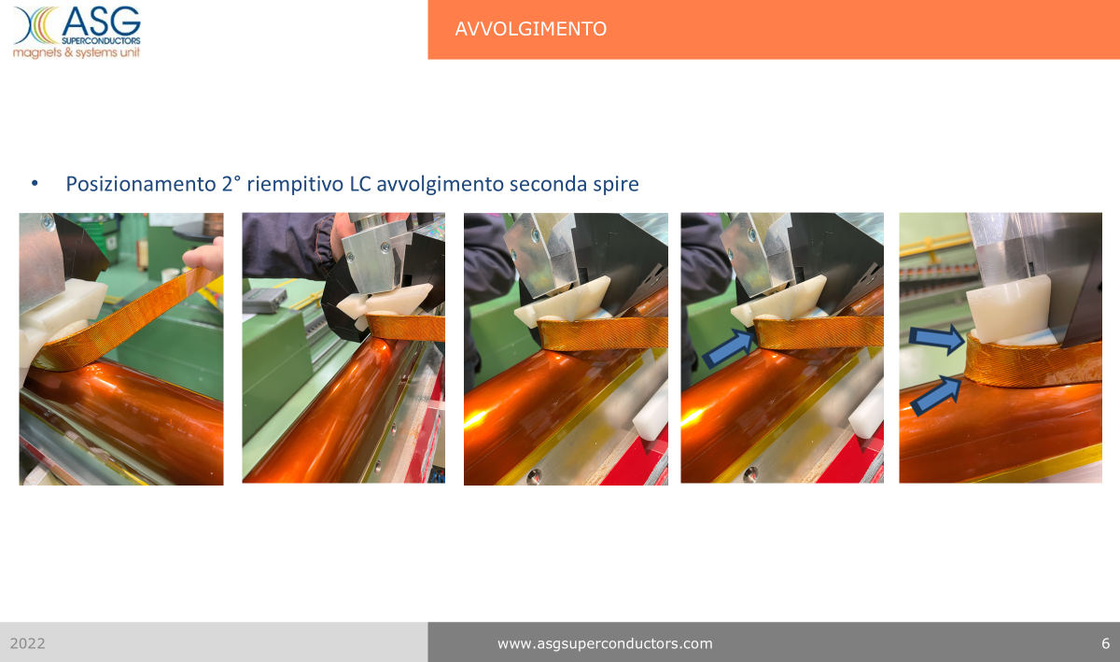

Slide 17
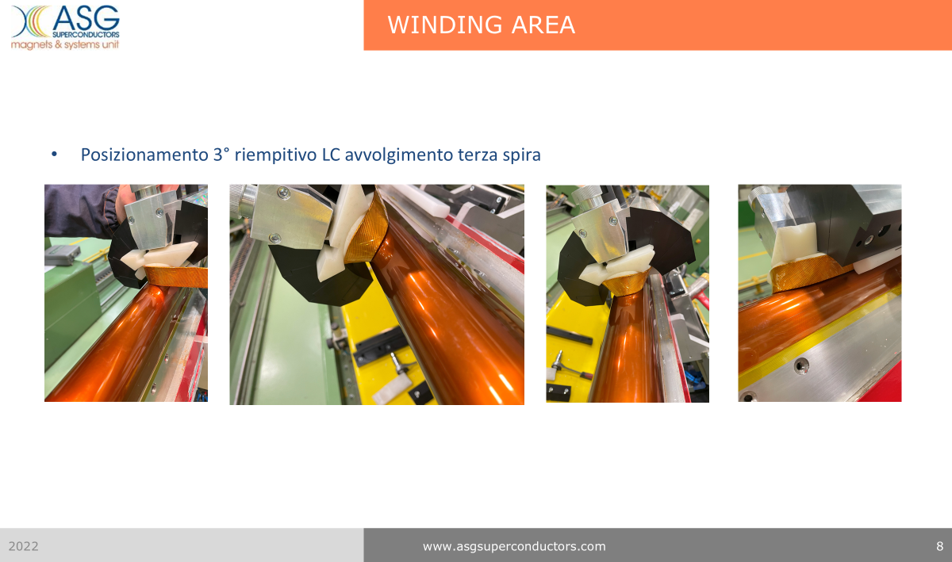

Slide 18
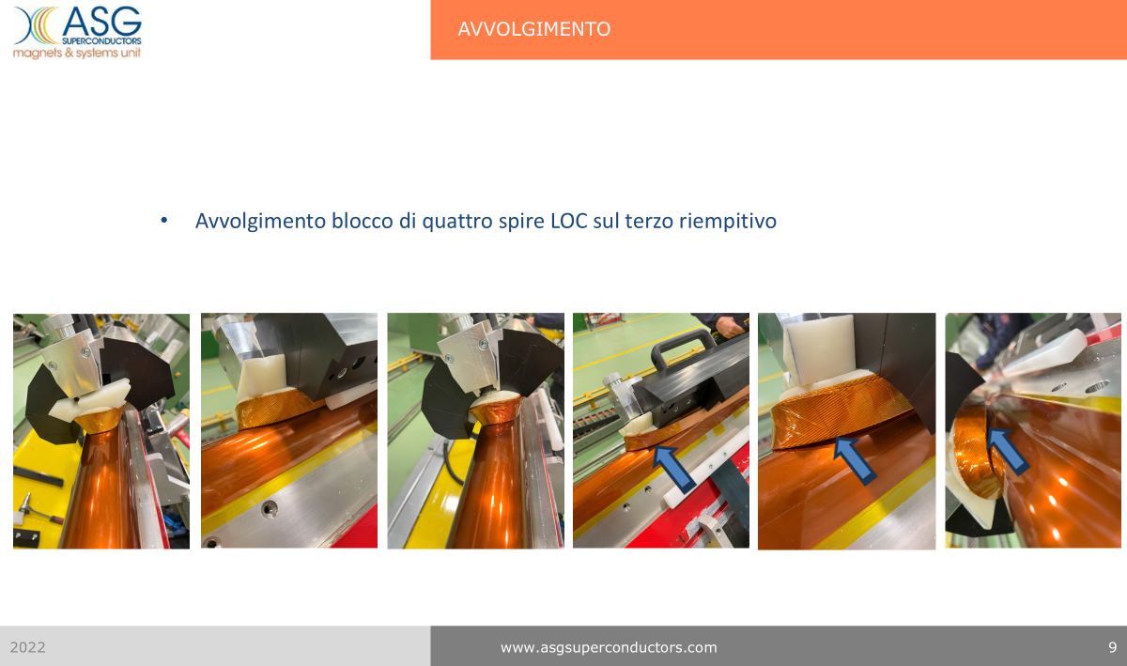

Slide 19
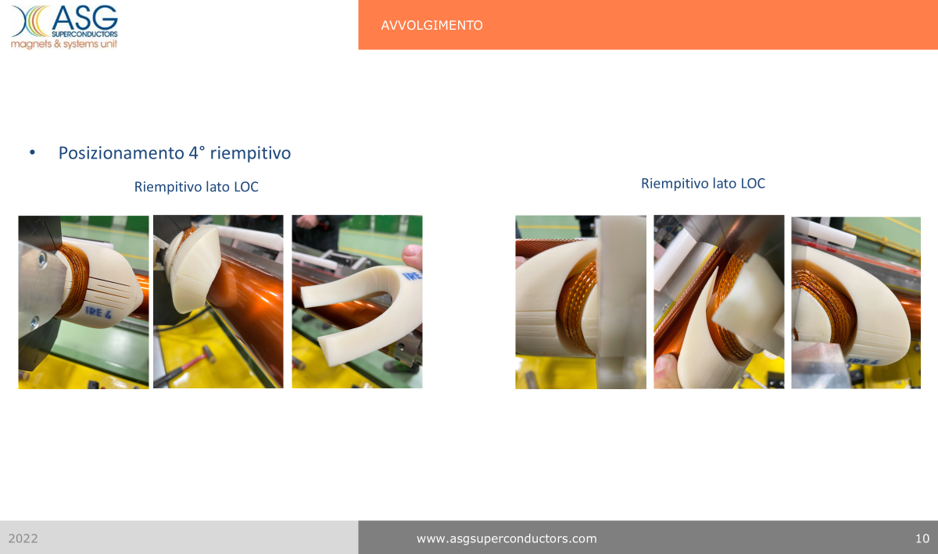

Slide 20
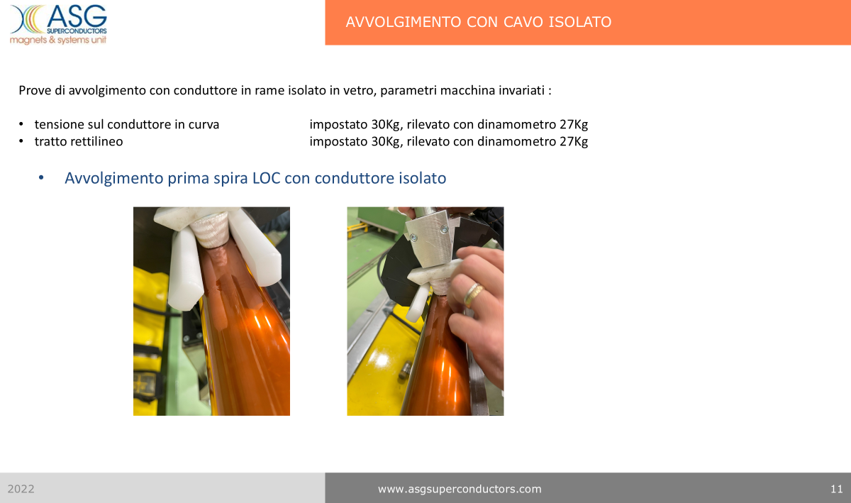
Nb₃Sn cable

Slide 21
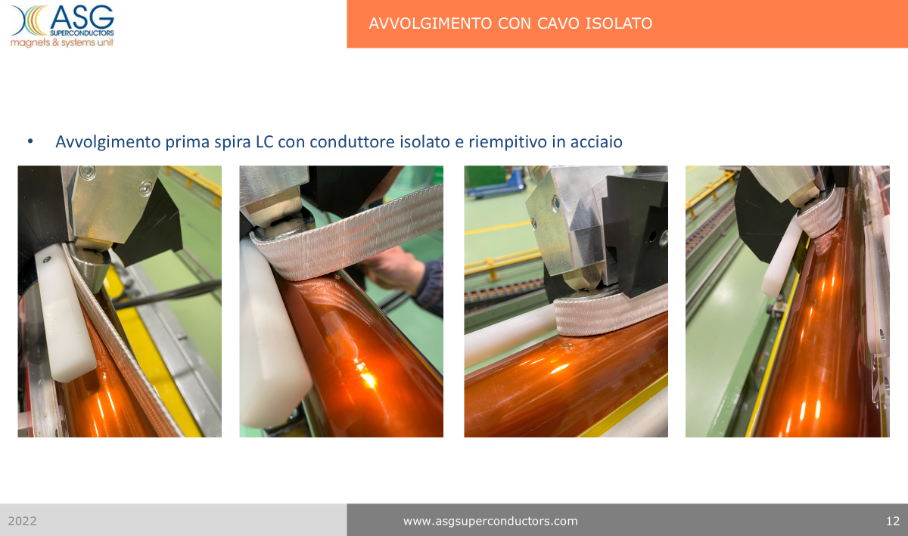

Slide 22
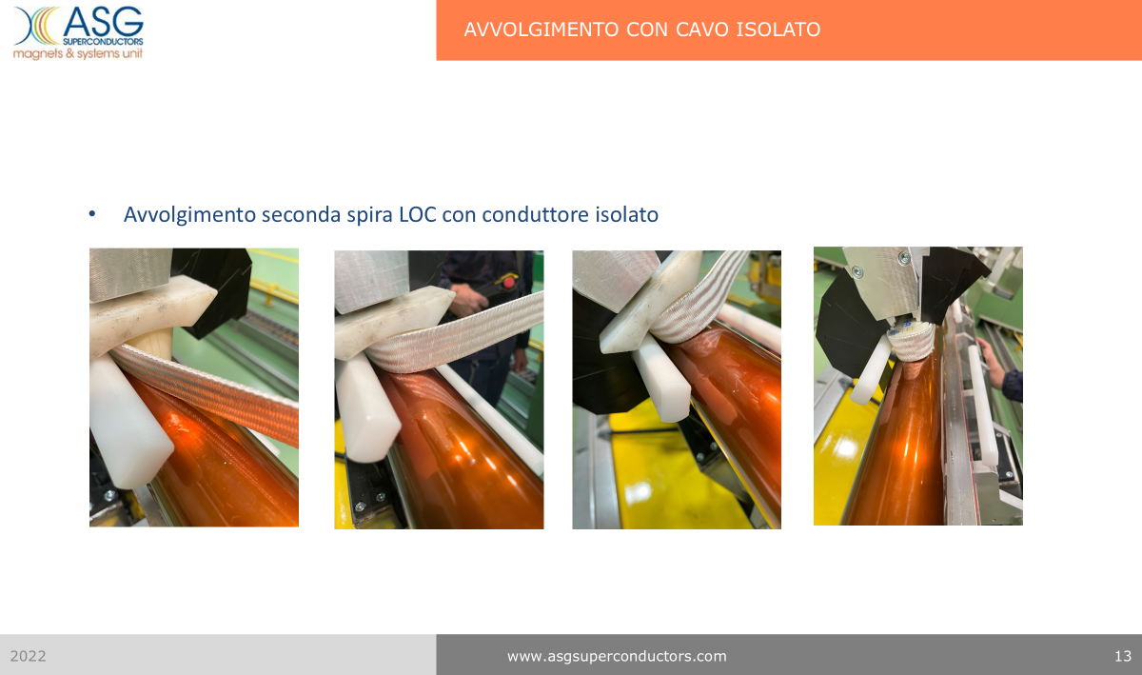

Slide 23
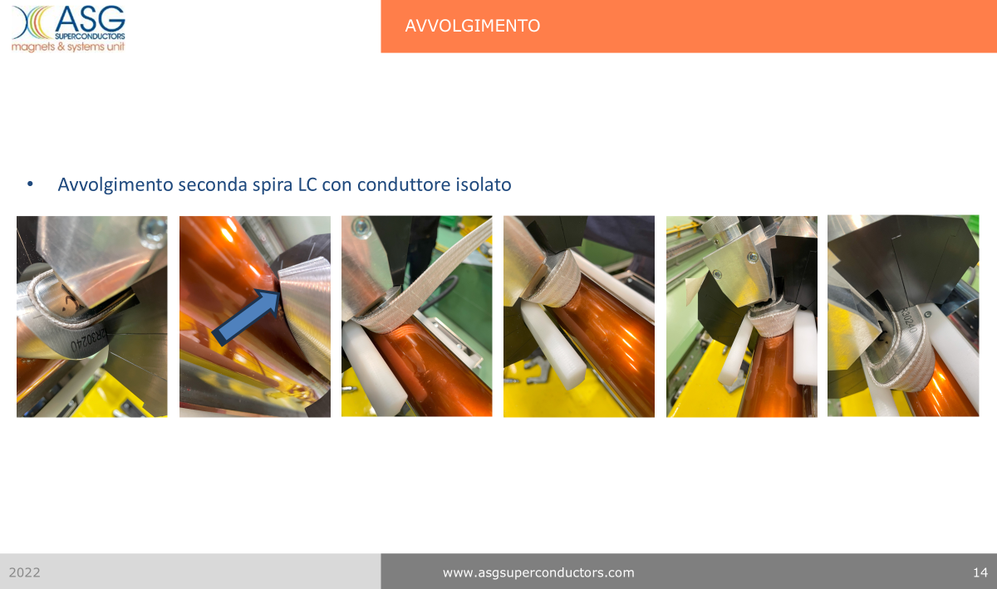

Slide 25
Mock up activity¶

Slide 26
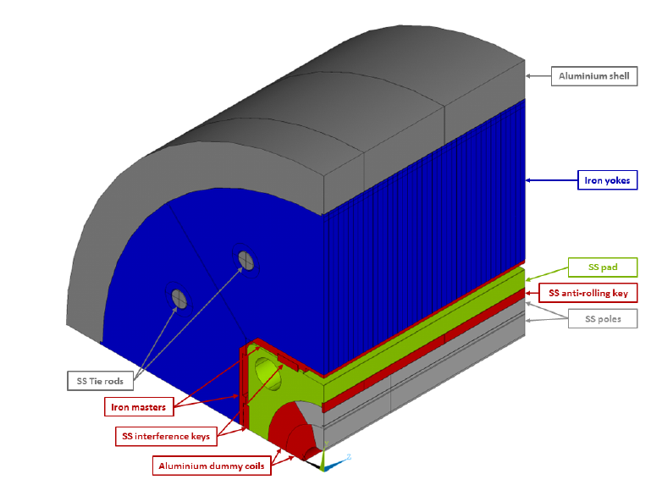
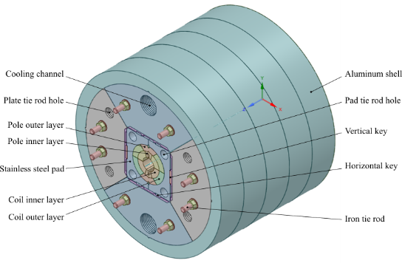
Mock-up
The mock-up is designed according to the specifications presented in the TDR and is a 500 mm long model of the central part of the magnet (~1 tons of weight)
  https://indico.cern.ch/event/1086175/
It will be beneficial for
  consolidating the mechanical finite element analysis to predict stress and strain conditions during the B&K assembly and cooling (at 77 K).
  studying the influence of mechanical tolerances on the mechanical system
  determining the most efficient assembly sequence
  providing training for personnel in B&K assembly procedures.
INFN has already acquired the pump (8 channels) for the bladders.
CERN has already procured the short bladders.
The mock-up components are ready (last machining for hosting SGs will be performed the 1st Jan. working week).
The activity will be performed between January and February next year.

Slide 27
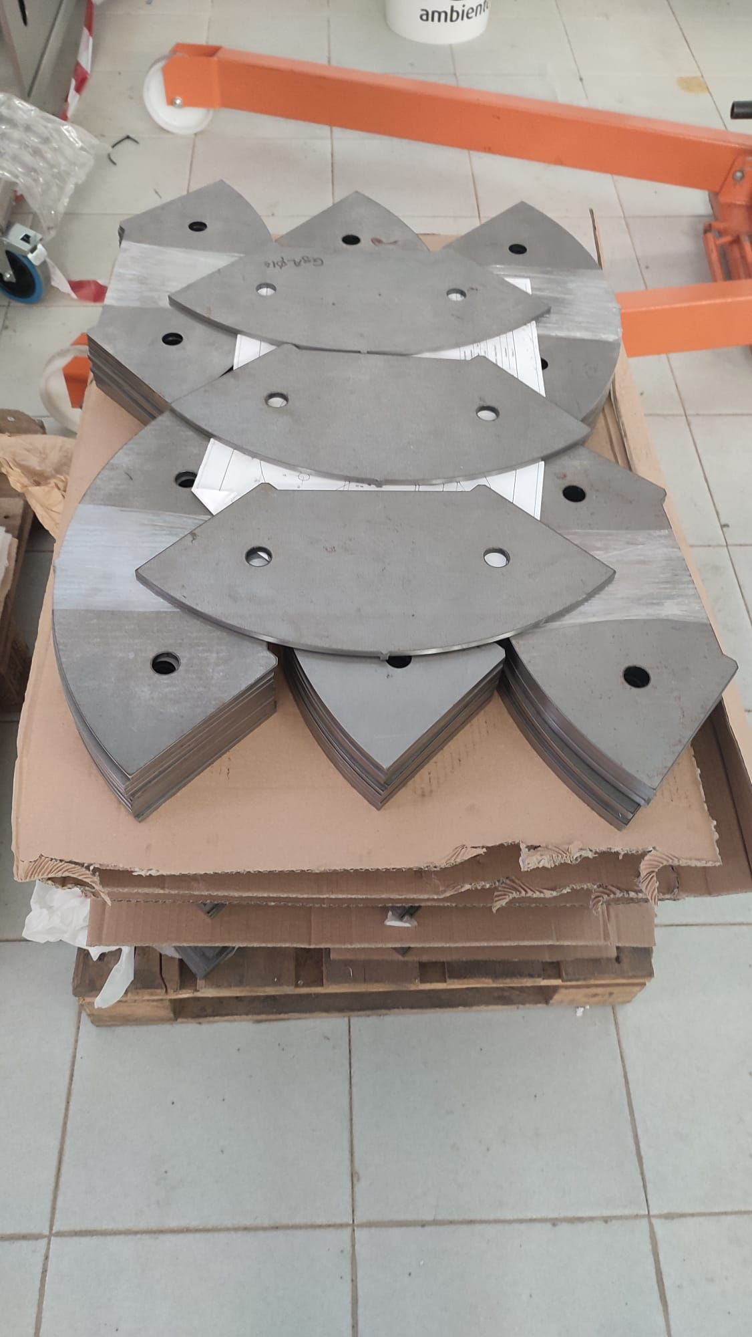
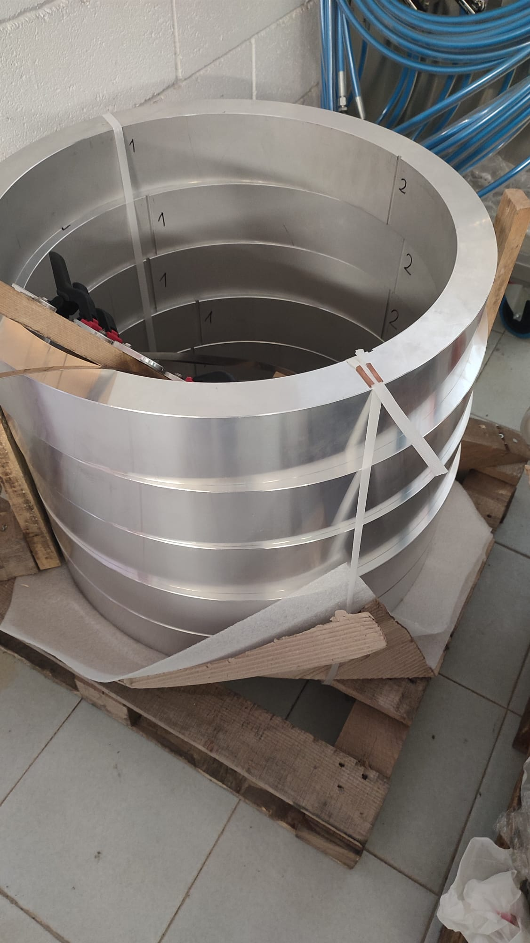
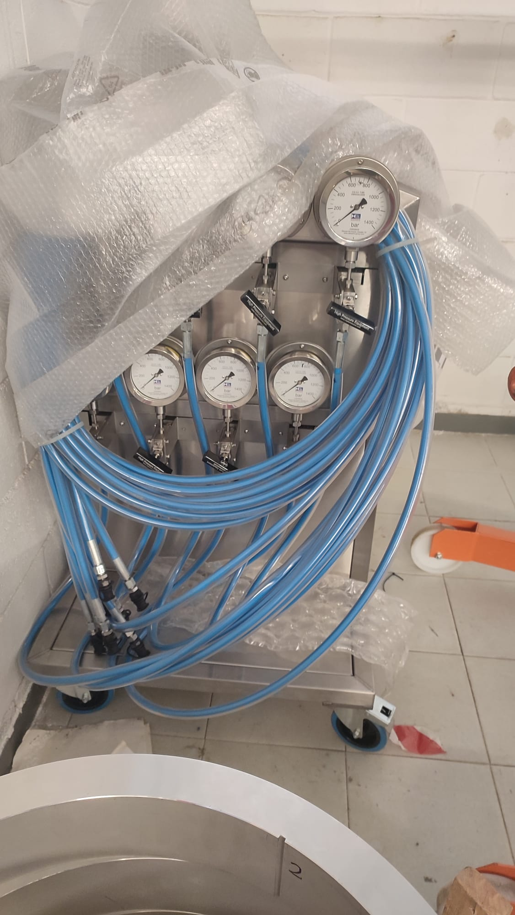
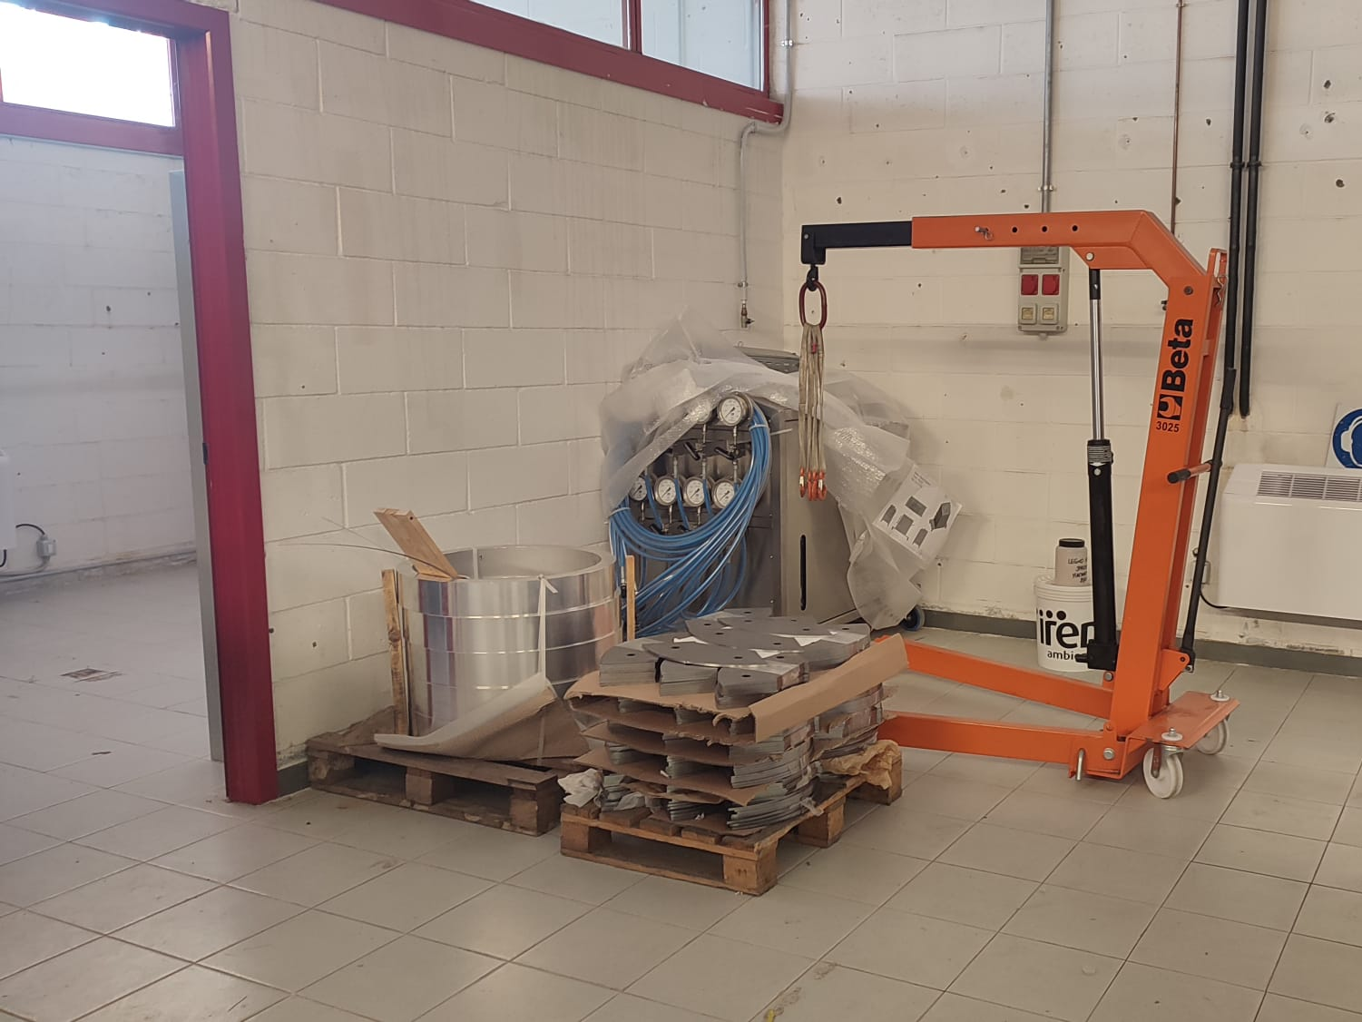
Assembly @ Genova Chemistry Department

