Slide 1
Geometrical Measurements
HCQQXF_SA008-CR000003/ MQXFB05
Patrick Bestmann
MAB meeting 05/05/2025

Slide 2
Q2A HCQQXF_SA008-CR000003
Coldmass measurements @ CERN B180
Mechanical fiducialisation SMI2 12.07.2024
Mechanical fiducialisation SMI2 18.03.2025

Slide 3
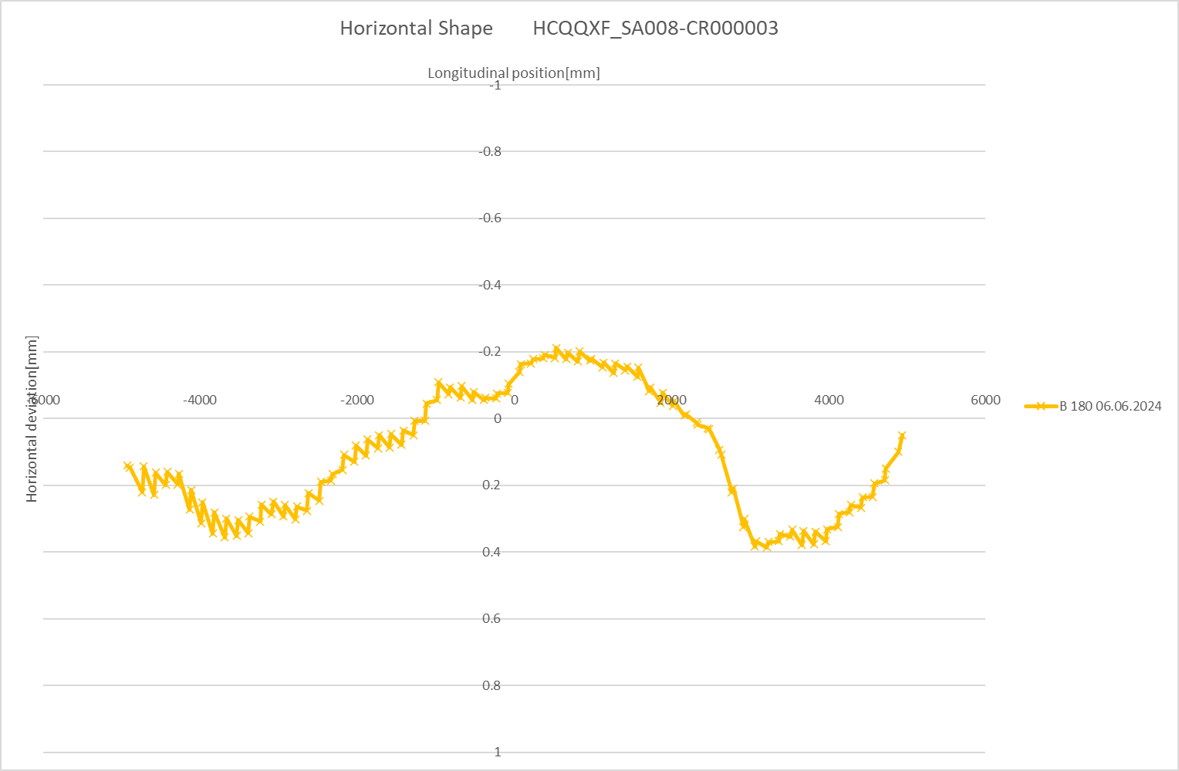
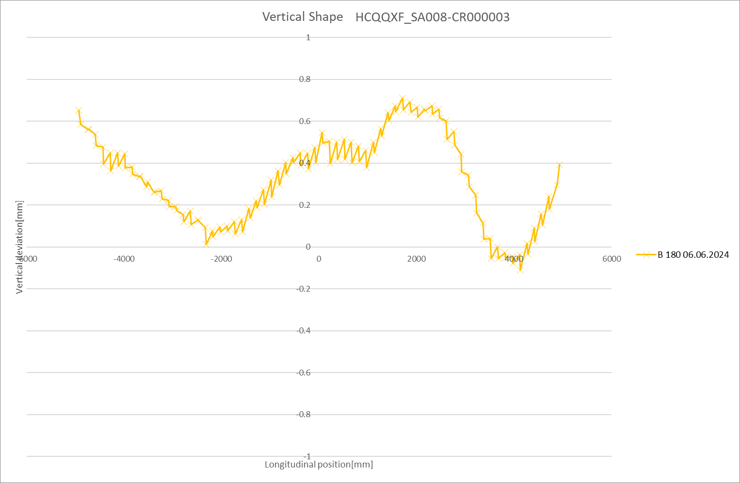
Q2A HCQQXF_SA008-CR000003
Coldmass measurements @ B180
Horizontal Shape
Vertical Shape
CS/NIP-side
NC/IP-side
CS/NIP-side
NC/IP-side

Slide 4
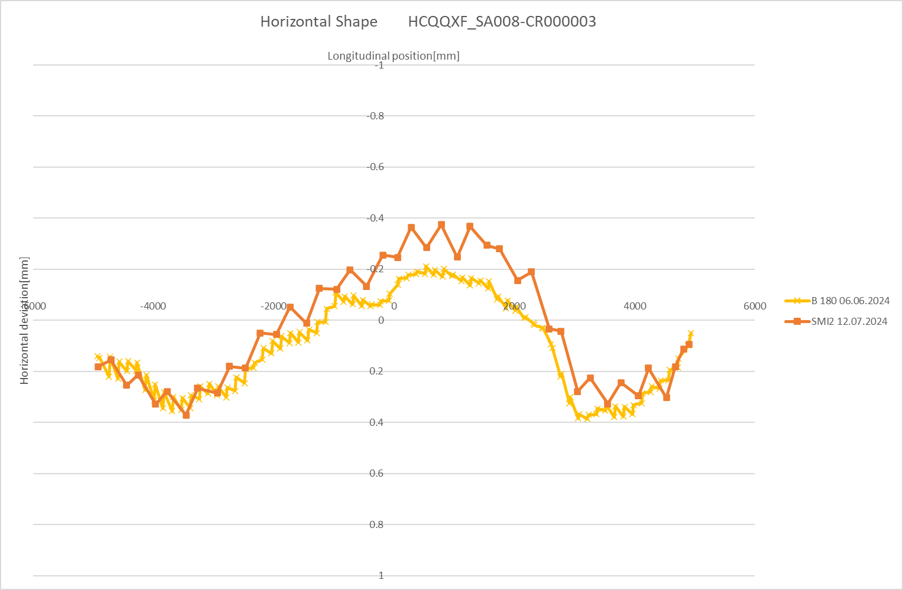
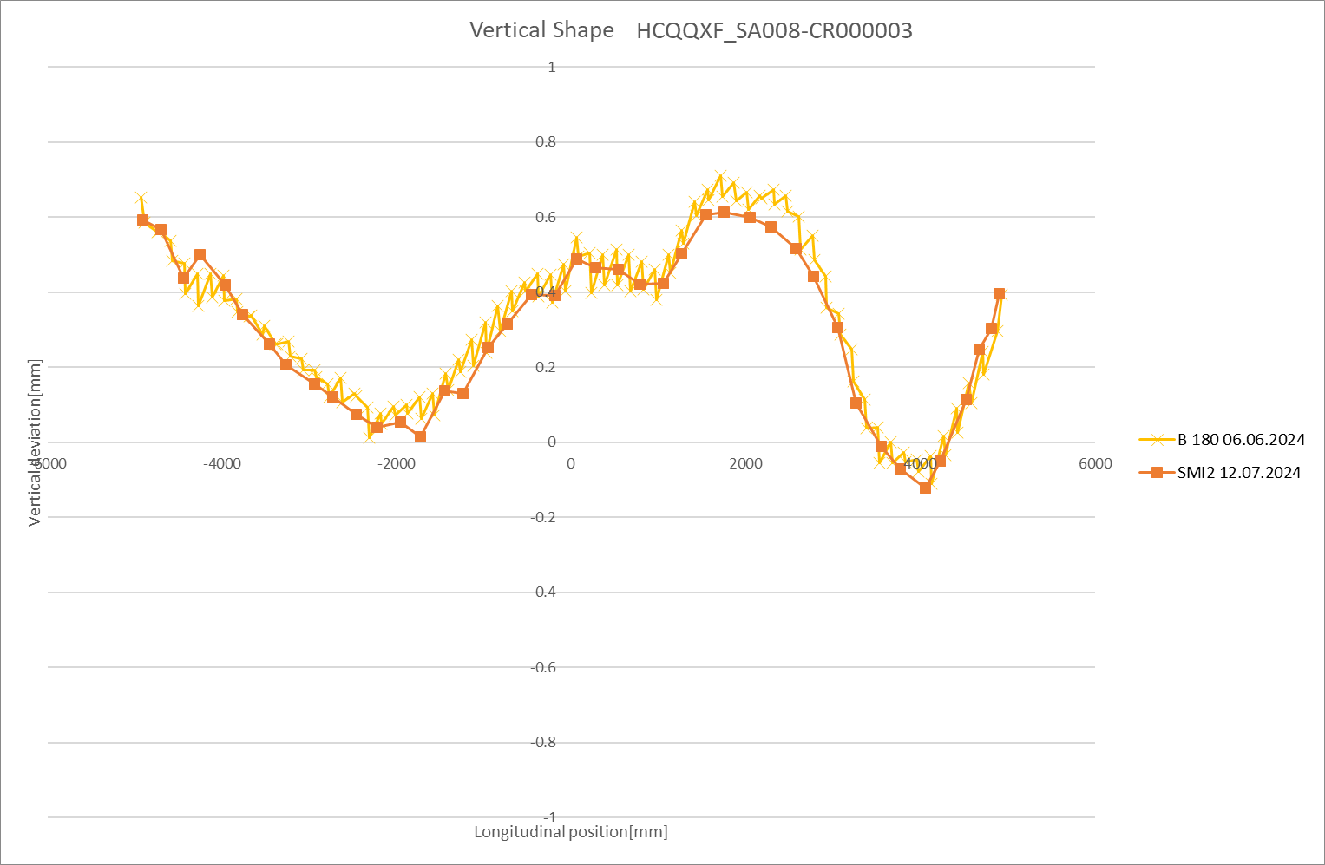
Q2A HCQQXF_SA008-CR000003
Fiducialisation before ColdTest @ CERN
Horizontal Shape
Vertical Shape
CS/NIP-side
NC/IP-side
CS/NIP-side
NC/IP-side

Slide 5
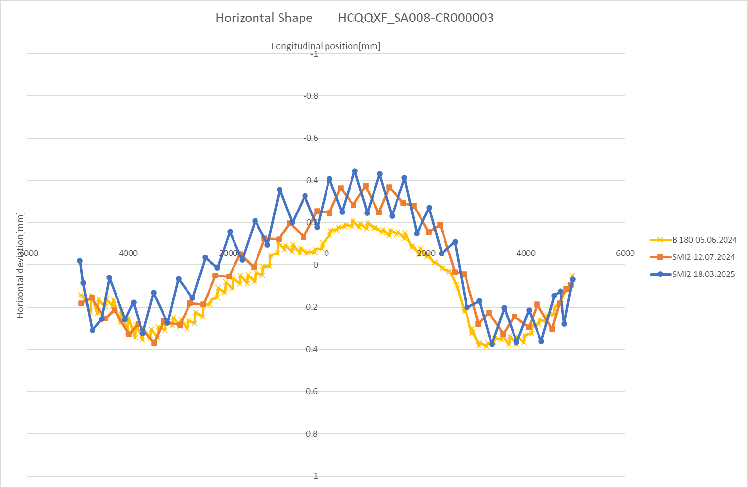
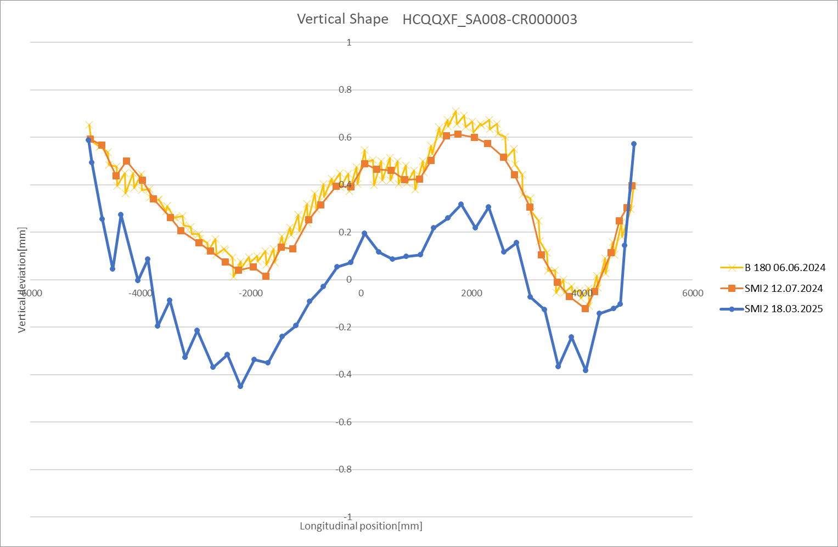
Q2A HCQQXF_SA008-CR000003
Fiducialisation after ColdTest @ CERN
Horizontal Shape
Vertical Shape
0.3mm
CS/NIP-side
NC/IP-side
CS/NIP-side
NC/IP-side

Slide 6
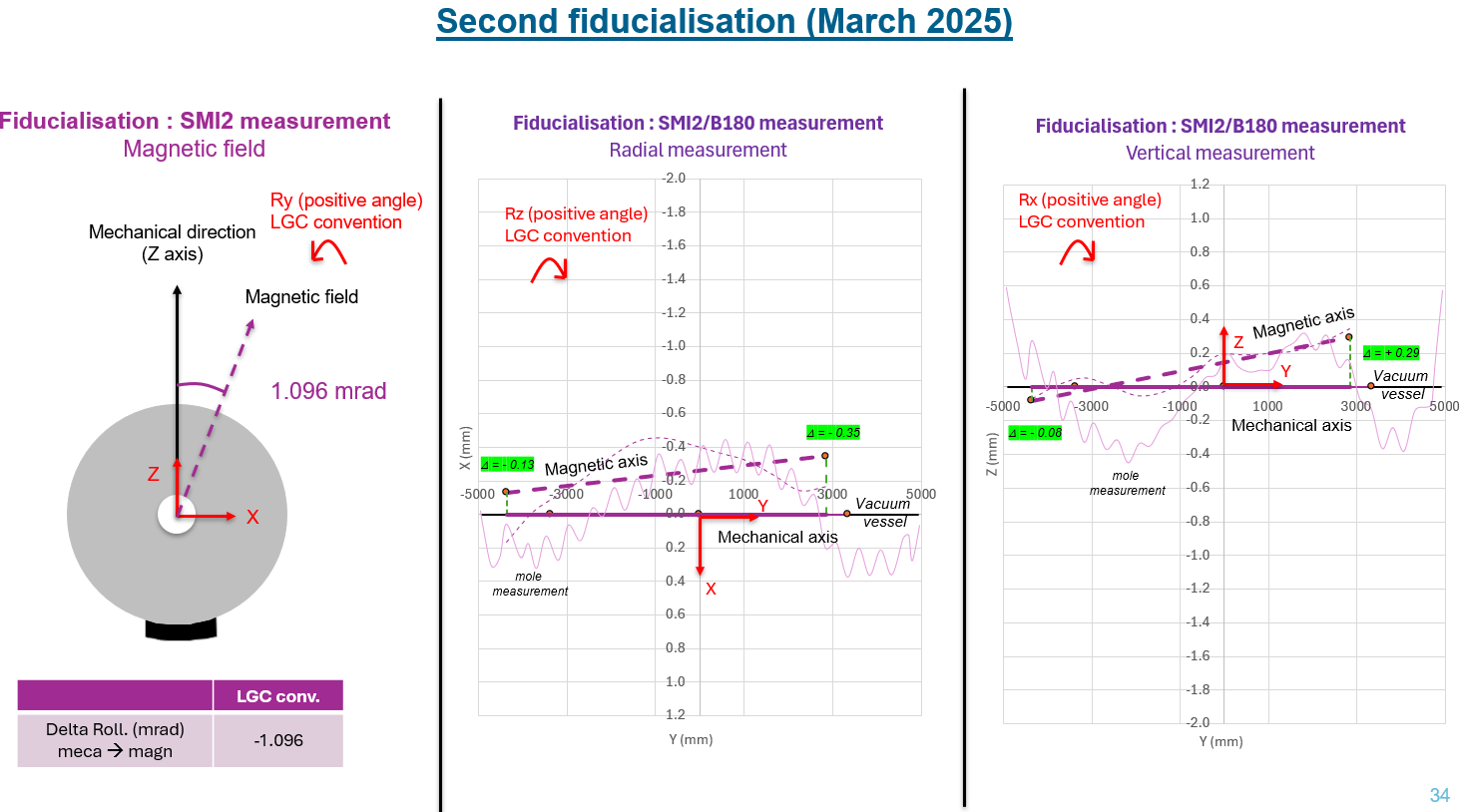
Q2A HCQQXF_SA008-CR000003
https://edms.cern.ch/document/3284695/1
J. Calmels, V. Rude

Slide 7
General Feedback Q2A HCQQXF_SA008-CR000003
Coldbore shape from 180 and first fiducialisation coherent
2nd Fiducialisation after cold test shows significant vertical shift of 0.3mm
  Not the first time this is seen!
  Not clear if it is only the coldbore or magnets including coldbore
  Investigations and more measurements are ongoing
The FSI is monitoring the coldmass w.r.t. the vacuum vessel
  Every movement inside the coldmass is transparent to the FSI

