Slide 1
Field quality of HCQQXF SA008-CR000003 (Q2a)
- Cold mass LMQXFB06
- Quadrupole MQXFB05
- Corrector MCBXFB04
Test report EDMS 3170453
ID card EDMS 3296493
L. Fiscarelli
MAB meeting 05/05/2025

Slide 2
Available test results
MCBXFB
Measurements (3x) at warm
  Inner coils, inner+outer coils, full assembly with yoke
Test in vertical at 1.9 K
MQXFB
Measurements (3x) at warm
  Coil pack, after centering, after loading
Cold mass
Final measurement at warm of the cold mass
Cryo-assembly
Test in horizontal at 1.9 K of the cryo-assembly
Measurement in horizontal at warm of the cryo-assembly
Additional test at warm of the cryo-assembly

Slide 3
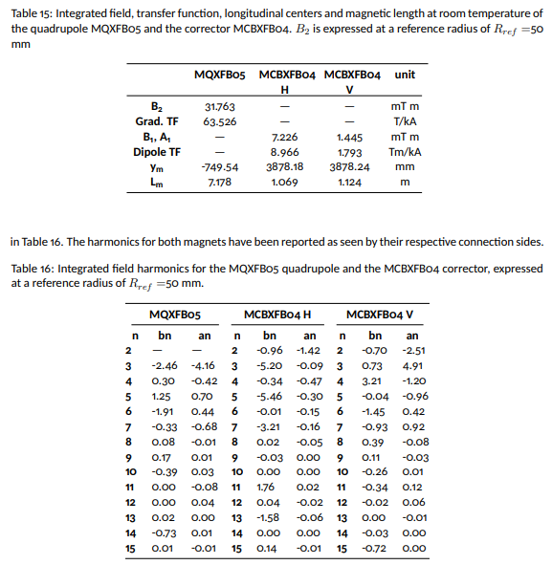
Field quality from measurement at warm

Slide 4
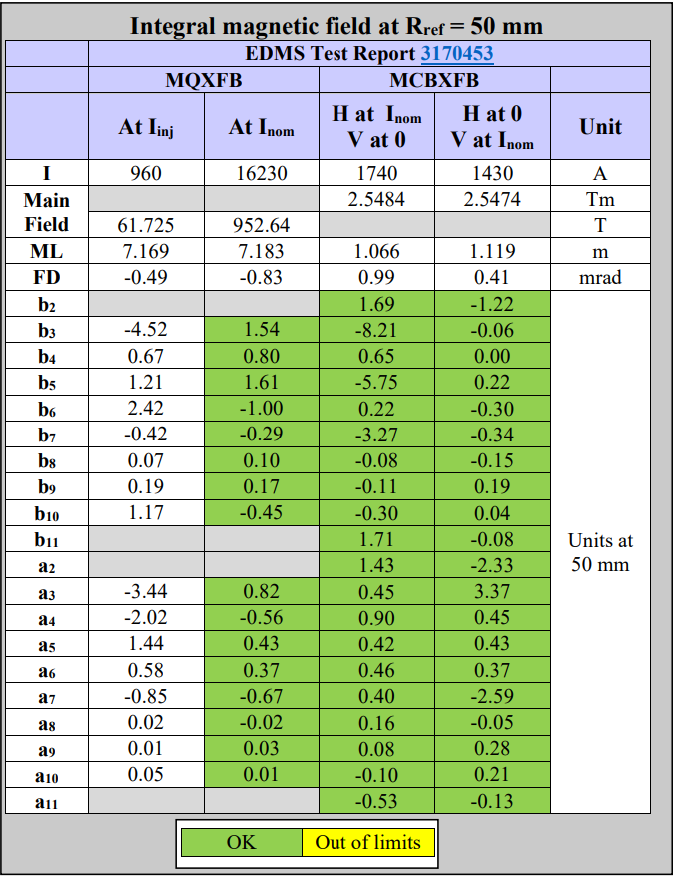
Field quality from measurements at 1.9 K

Slide 5
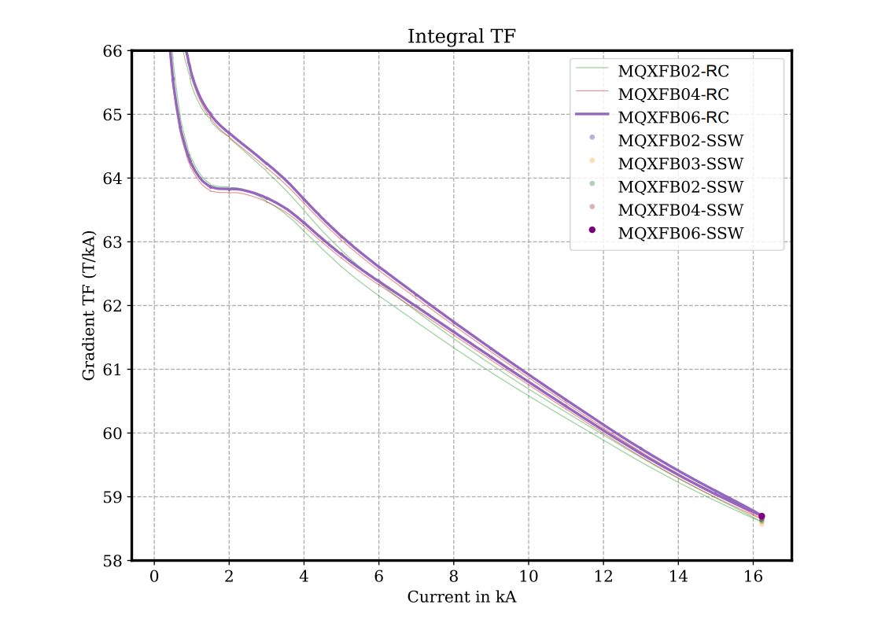
Field quality from measurements at 1.9 K
WRONG LABELLING !

Slide 6
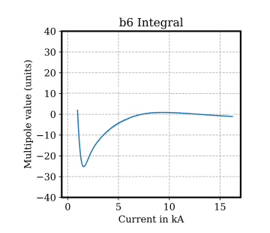
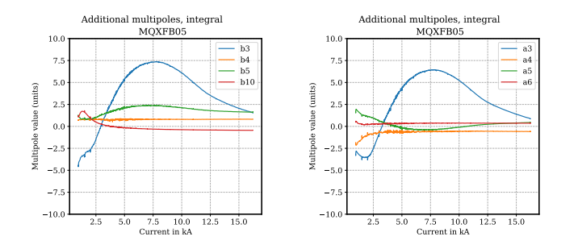
Field quality from measurements at 1.9 K

Slide 7
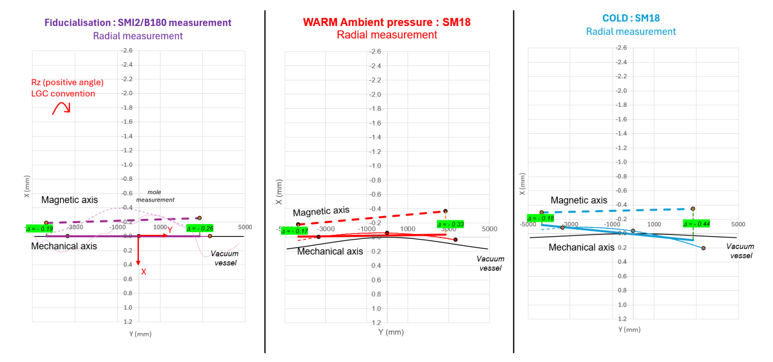
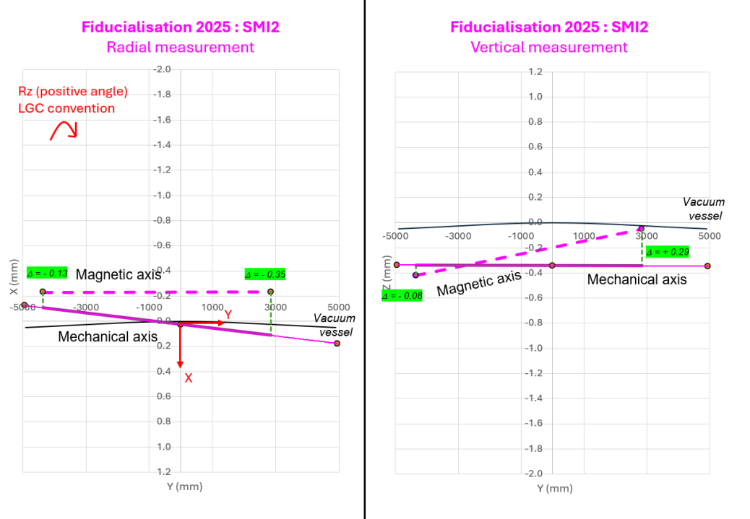
Magnetic axis - Radial

Slide 8
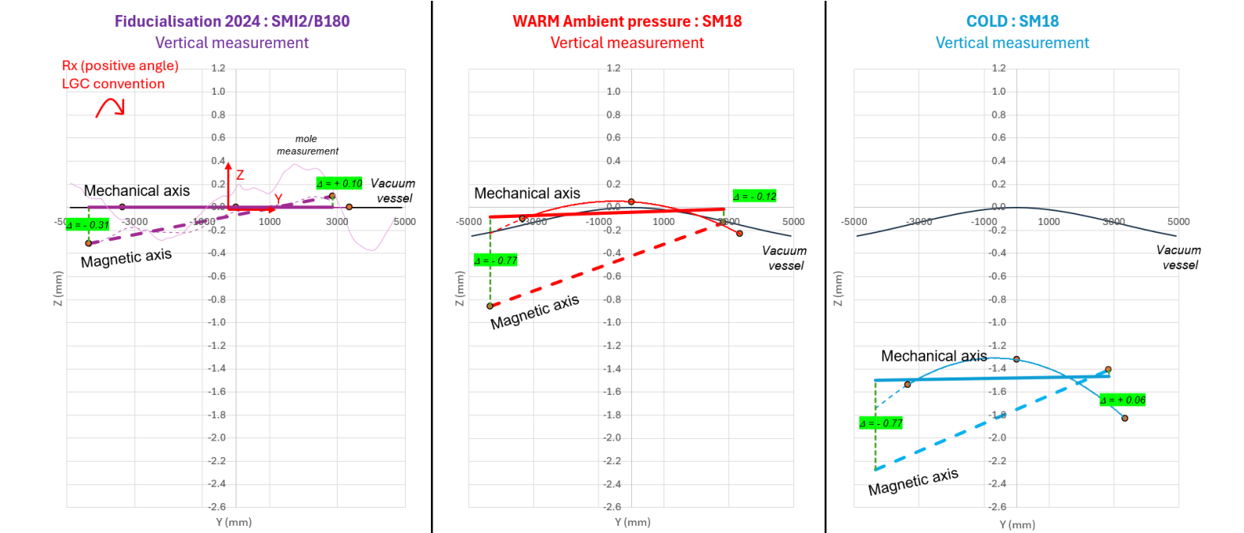
Magnetic axis - Vertical

Slide 9
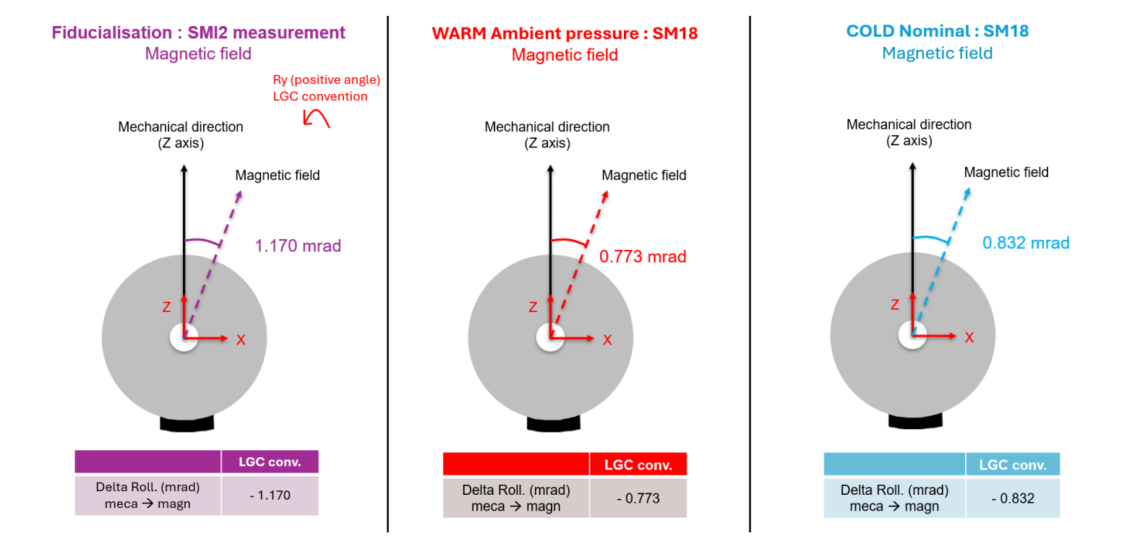
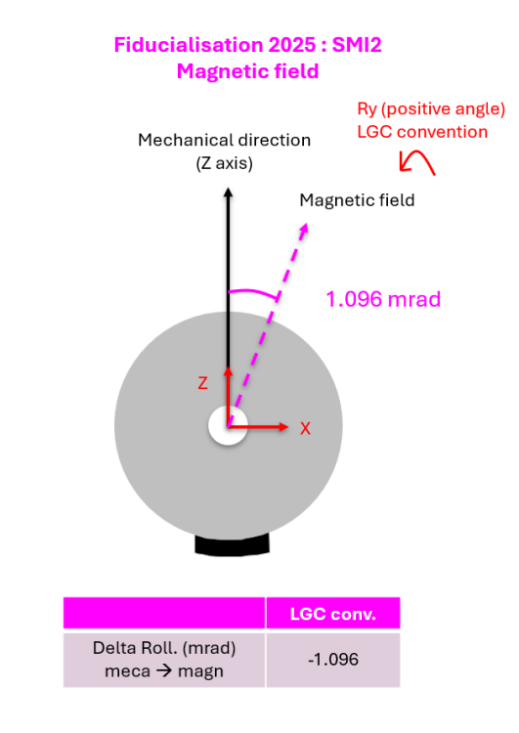
Field direction

