Slide 1
Suggestion for further work on project description
  Defined group of persons with main responsibility
  Identifying remaining work to be done plus taking comments from outside readers into account
  Proposed representatives from all institutions
    Therese/Steffen HVL
    James/Eirik UiO
    Ali/Are NTNU
    Anna/Matthias UiB
    Nadia/Ali/Turgay UiA

Slide 2
Proposed overall structure of budget (RCN funding part)
  29 3-years-equivalents PhD/postdoc positions (~130 MNOK)
  Staff hours + 1 prof II (~33 MNOK)
  Management (~19 MNOK)
  Infrastructure (~9 MNOK)
  Travel (~5 MNOK)
  Workshops/collaboration/other admin (~4 MNOK)
Staff/management costs from RCN same as PhD/postdoc
  Additional costs must be covered as own contribution

Slide 3
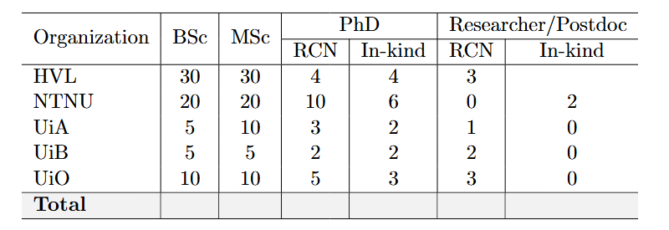
Proposals of #positions from project description

Slide 4
Realistic proposal
 | Phd RCN | PhD in-kind | Postdoc RCN | Postdoc in-kind
HVL | 4 | 4 | 3 | 0
NTNU | 10 | 6 | 0 | 2
UiA | 3 | 2 | 1 | 0
UiB | 2 | 1-2 | 1 | 0
UiO | 3 | 2 | 2 | 0
Total | 22 | 15-16 | 7 | 2

Slide 5
Next step:
  each institution proposes how to allocate personnel resources in the different WPs (requirement for the RCN application portal)
    PhDs/postdocs (RCN and in-kind)
    staff hours (RCN and in-kind)

Slide 6
Collection of LoI’s
  Industrial partners (NTNU)
  Academic partners (all)
  CERN (WLCG + NextGen) (Anna/Heidi)
  ETH (NTNU)
CV’s are needed well before the deadline
  Use RCN template from the call at RCN web
Data and computing power – FAIR principles
  James working on it

Slide 7
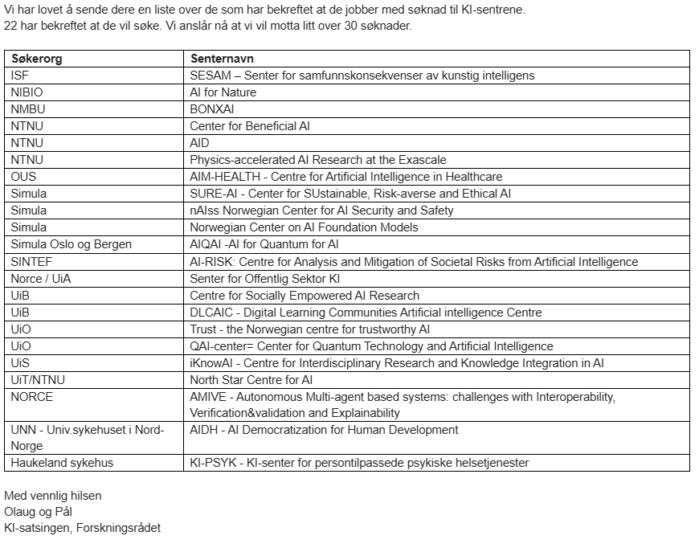
Info from RCN

