Slide 2



A multiplatform Python toolkit for beam dynamics
Giovanni Iadarola, Szymon Łopaciuk, Riccardo De Maria, Frederik Van. Der Veken, CERN, Geneva, Switzerland
We sincerely thank the Xsuite users and contributors for their enthusiasm and invaluable input.
For more material: https://xsuite.web.cern.ch
Work supported by:

Slide 3
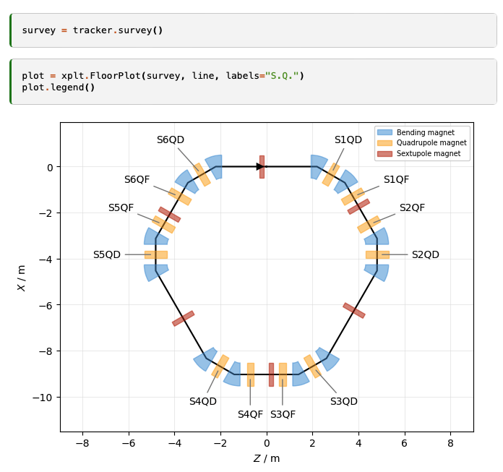
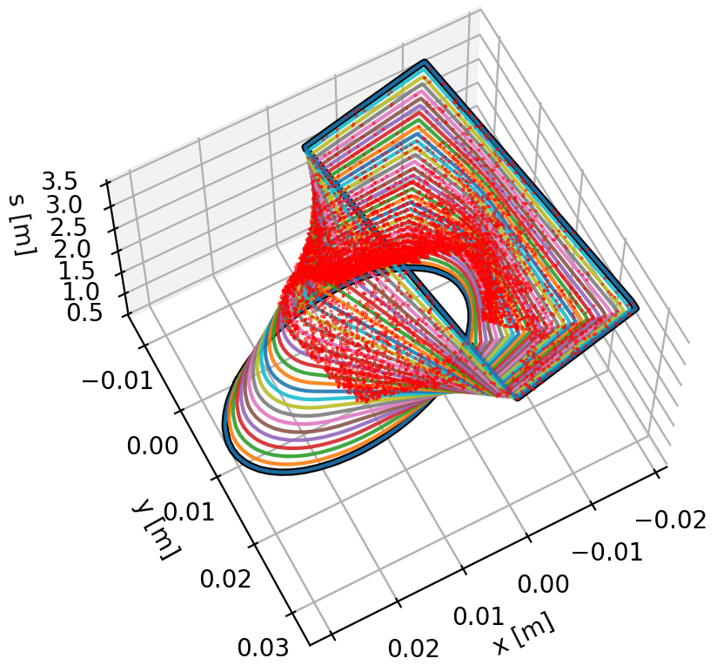
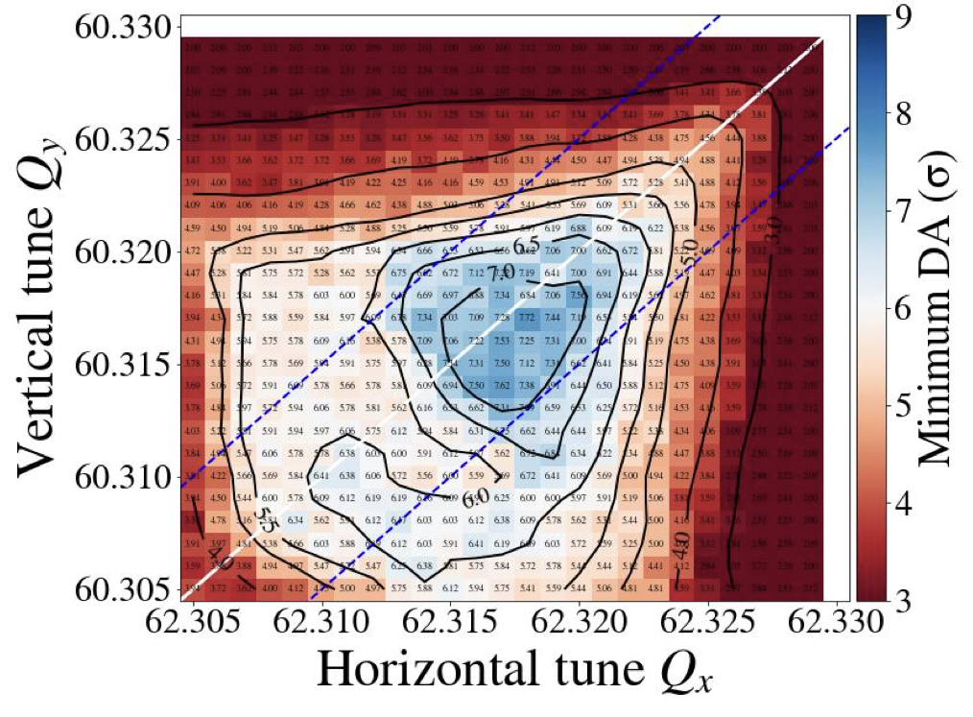
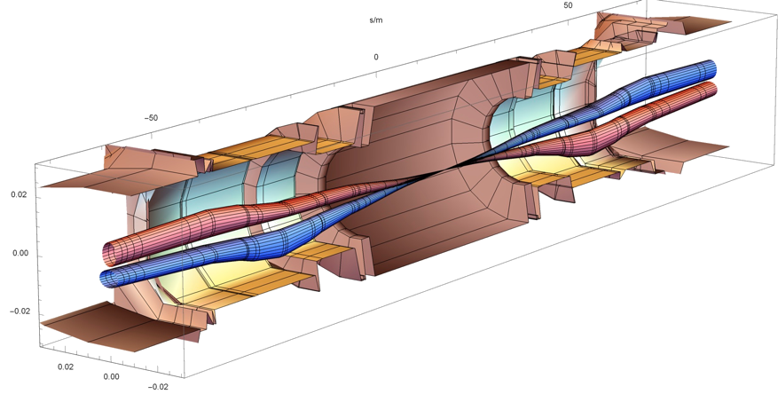
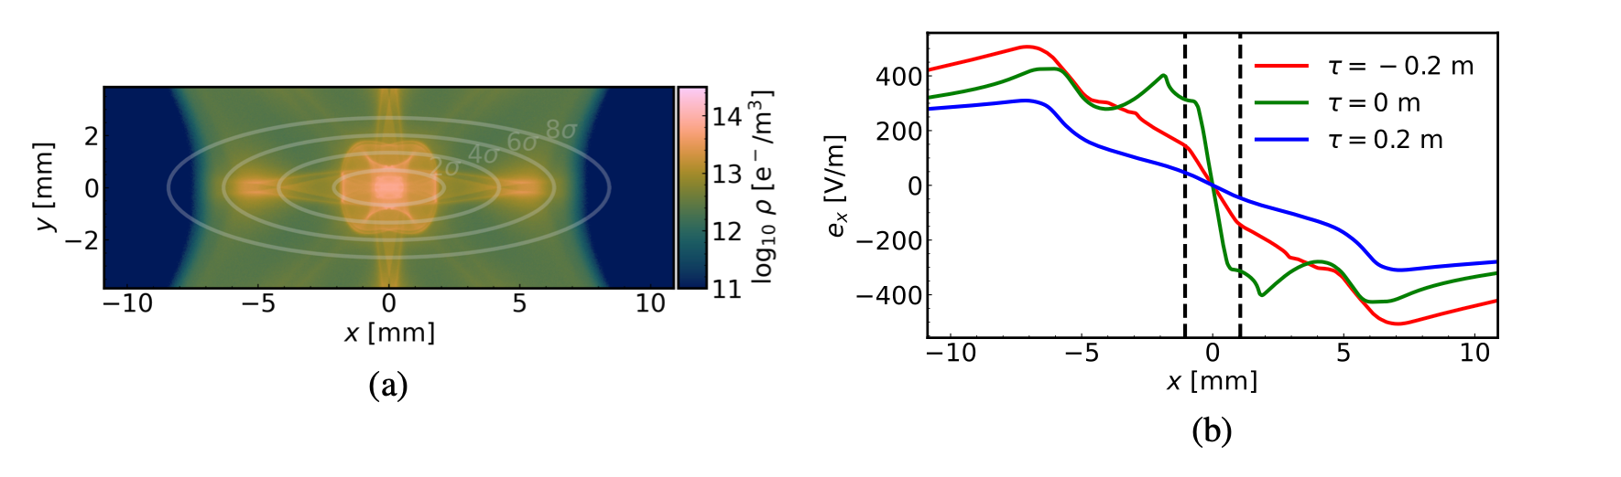
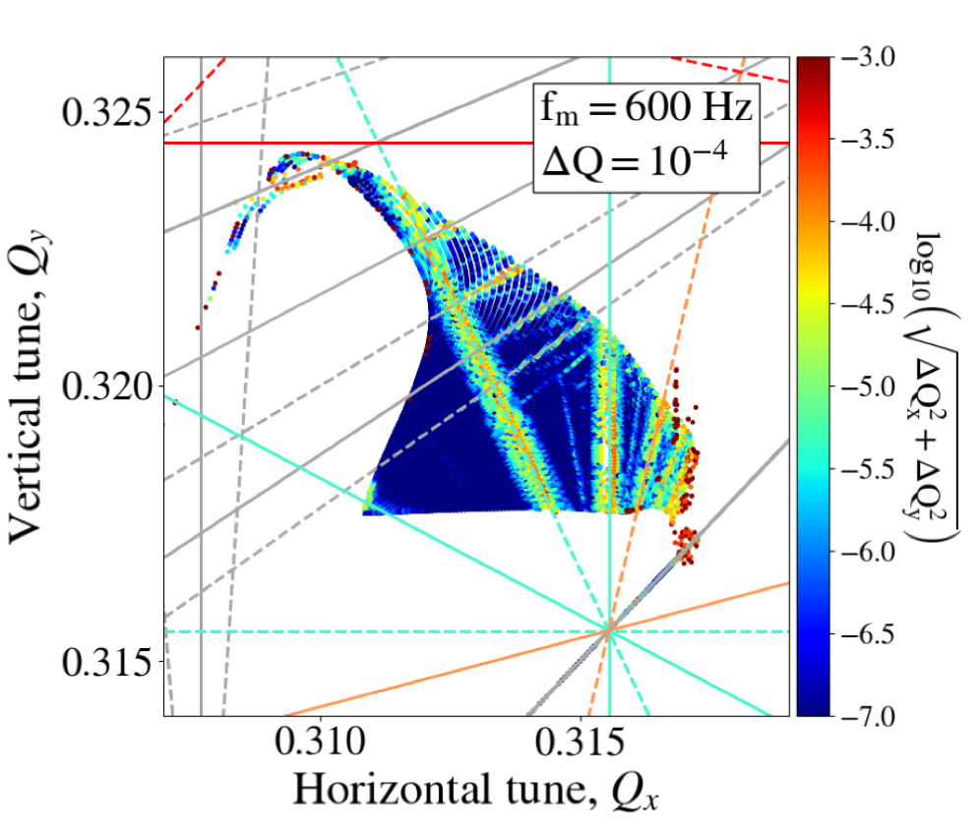
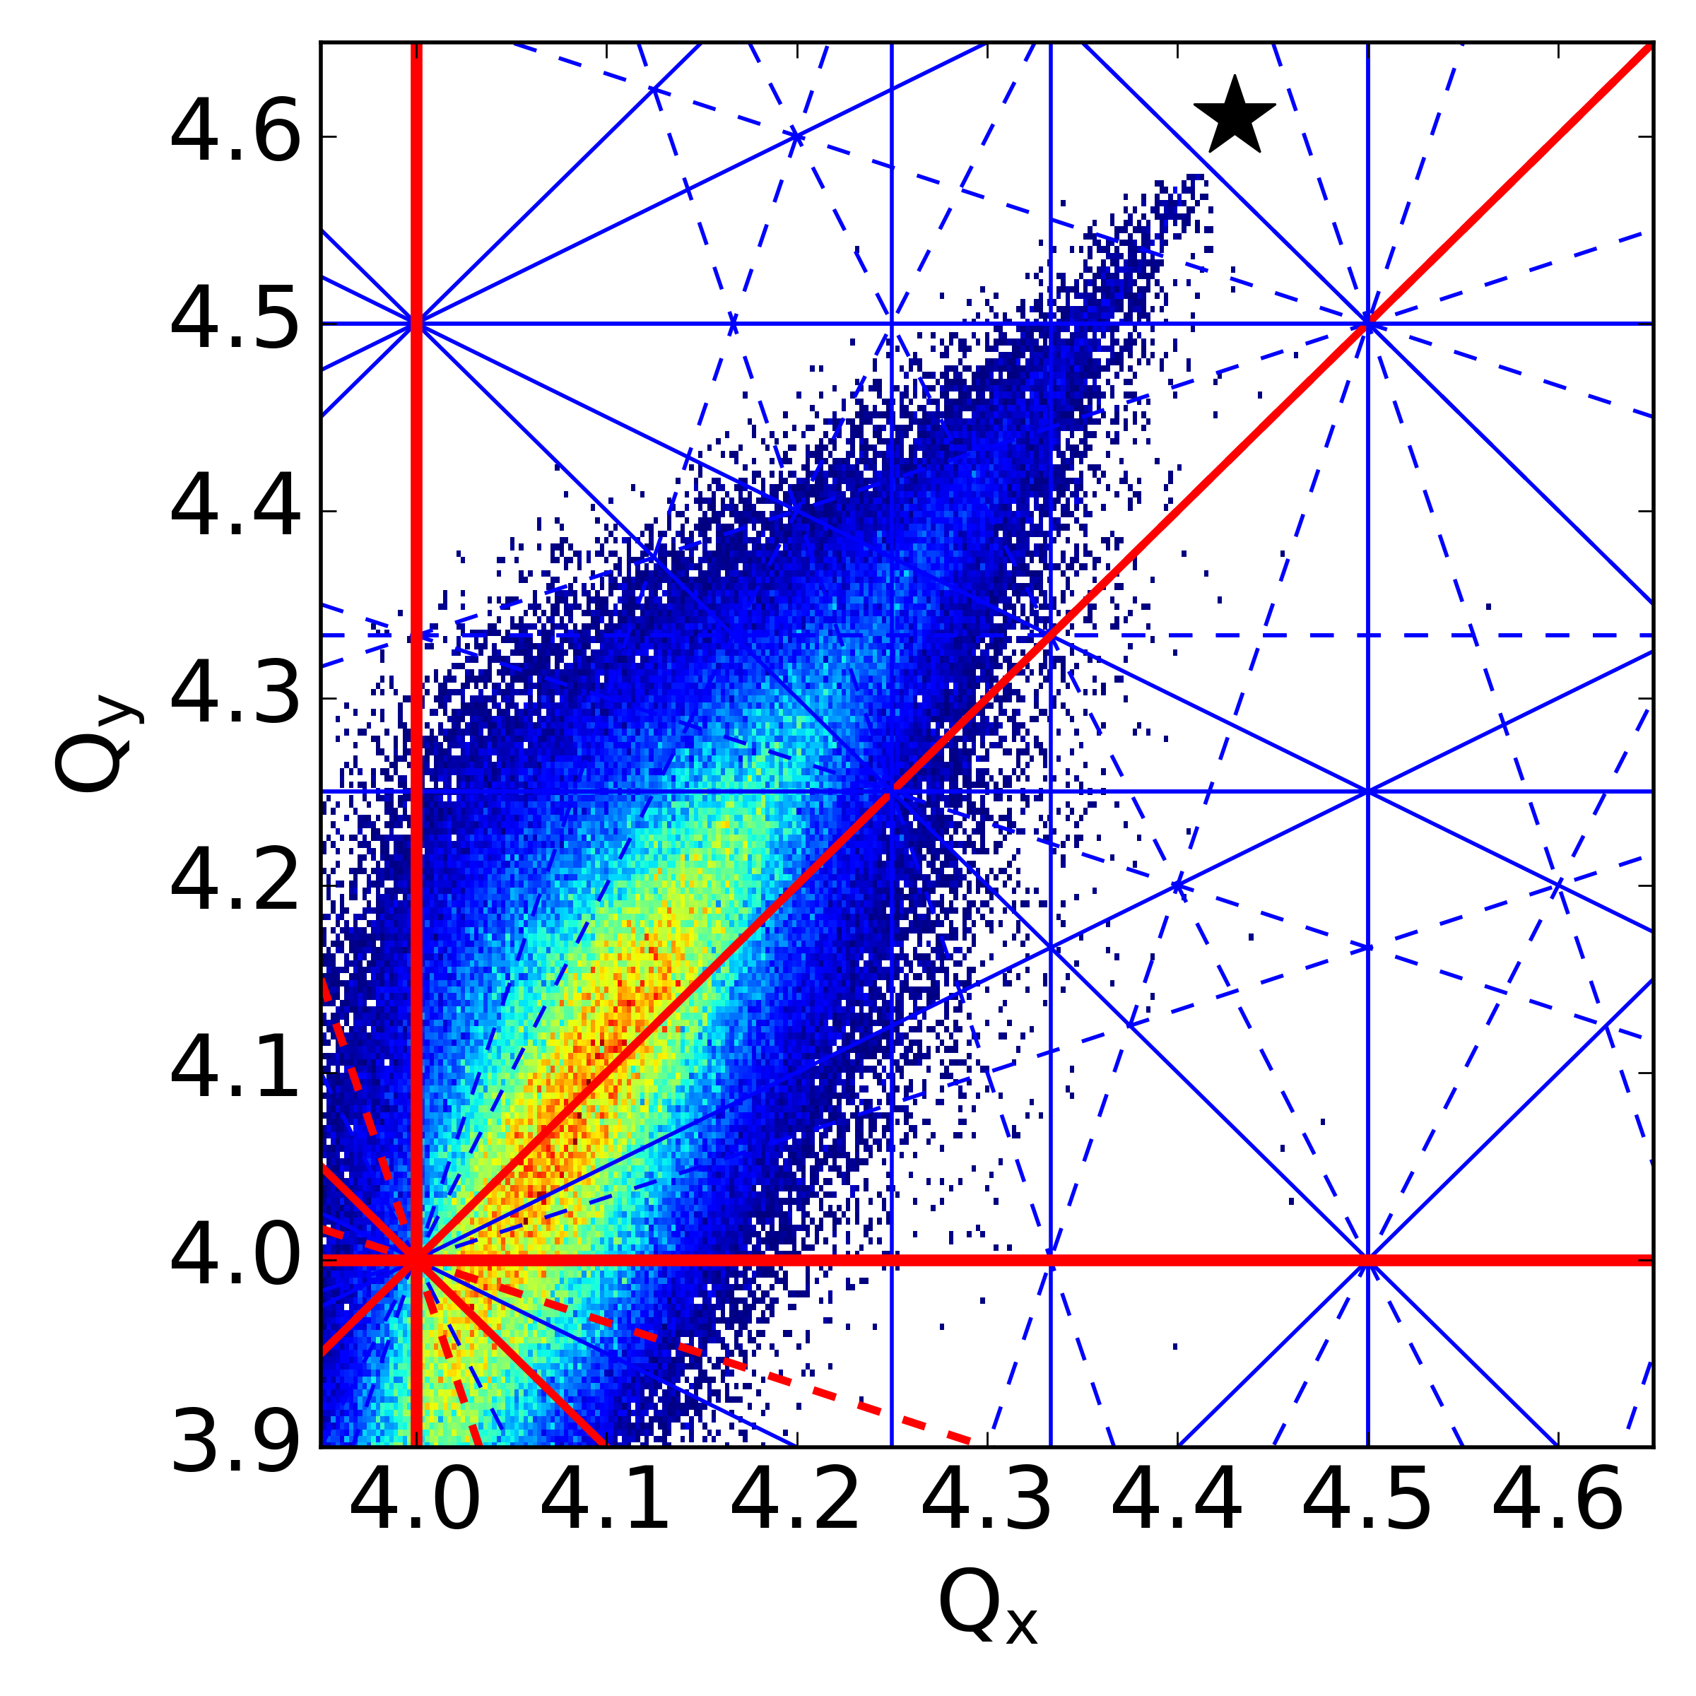
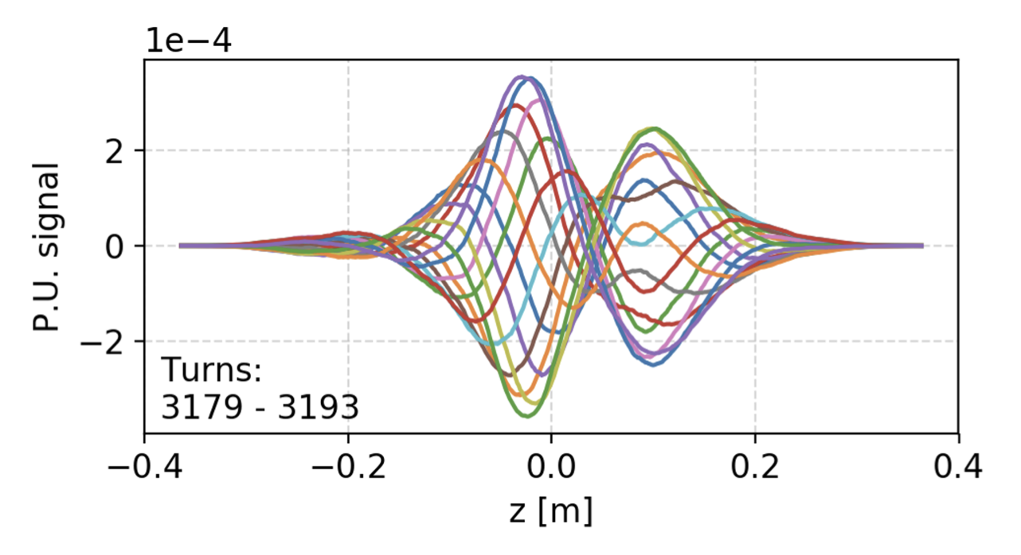
CERN software for beam dynamics
CERN has a long history of powerful software tools for beam physics applications, typical examples (BE-ABP):
MAD-X (2002)
MAD-X (2002)
SixTrack (1990)
SixTrack (1990)
Lattice Design
Optics (calculation & design)
Tracking (dynamic aperture)
Collimation
pyHEADTAIL (2014)
COMBI (2007)
SixTrack (1990)
pyORBIT (2003)
pyECLOUD (2015)
Impedances
Beam-Beam Effects
Space Charge
Electron/Ion Cloud

Slide 4

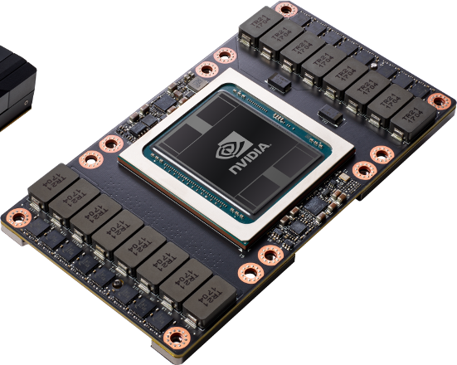
Key requirements and limitations of legacy tools
Legacy tools have several limitations, which became apparent when approaching FCC-ee
Extendibility
  Difficult and expensive to extend old tools for modeling additional effects
  Many experts have left or retired; working on old Fortran does not match skill set and interest of younger colleagues
Integration issues
  Often addressing interplay of optics, non-linear tracking, collective effects, collimation, etc.
  With legacy tools this means dealing with model translations, ad-hoc interfaces between codes, which is complicated, time-consuming, error prone, and slow.
Outdated user interfaces – today users want Python
  Python is a standard in scientific computing, especially among younger researchers.
  Many high-quality tools are available in the Python ecosystem also due to ML boom.
  Maintaining custom tools for plotting, scripting, etc. wastes effort, increases complexity, and lowers quality.
Performance
  GPU acceleration is a must-have in many applications, but often infeasible to retrofit.
Notes:
Optics only code is not needed anymore

Slide 5
Xsuite project launched in 2021 to address these issues using the know-how acquired in the development of the earlier tools.
Goals: 1st class Python, 1st class collective, 1st class GPU.
One toolkit for many applications: from low-energy hadron rings to high-energy lepton colliders.
Heterogeneous simulations made natural.
Support different computing platforms – single- and multi-threaded CPU, GPU acceleration.
References for full list of features:
Documentation: xsuite.web.cern.ch.
“Xsuite: An Integrated Beam Physics Simulation Framework,” JACoW HB2023 (2024), TUA2I1.
“Xsuite: a multiplatform toolbox for optics design, fast tracking, collimation and collective effects,” ICAP’24

Slide 6







Xsuite approach
Orthogonal architecture: split the software into independent functional blocks at all levels.
  Well structured codebase scales better and makes easier to add new features.
  Lower learning curve for users & developers
  ⇒ users can (and do!) become developers.
Agile development:
  From the beginning big effort to support users: user feedback and involvement visibly increases the quality of the package.
  Thanks to investment in continuous testing, we can afford a fast release cycle with new versions coming out multiple times a month
  Continuously incorporating fixes and modifications based on user feedback.
Xtrack
Tracking and optics engine
Xpart
Generation of particles distributions
Xfields
Computation of EM fields from particle ensembles
Xdeps
Data flow manager,
deferred expressions
Physics modules
Xcoll
Particle-matter interaction and collimation
Xwakes
Wakefields and impedances
Xobjects
Interface to different computing platforms
(CPUs and GPUs of different vendors)

Slide 7
Xsuite features - lattice modelling
  The full set of lattice elements required to model all CERN synchrotrons is now available
    Bends, multipoles, solenoids, combined-function magnets RF cavities, crab cavities, etc.
  Provide thick and thin lattice modeling
  Include dipole-edge effects and fringe fields (profited of PTC and MAD-NG experience)
  Support tilt, misalignments, multipolar errors
  Circuits can be handled through deferred expressions (as in MAD-X)

Slide 8
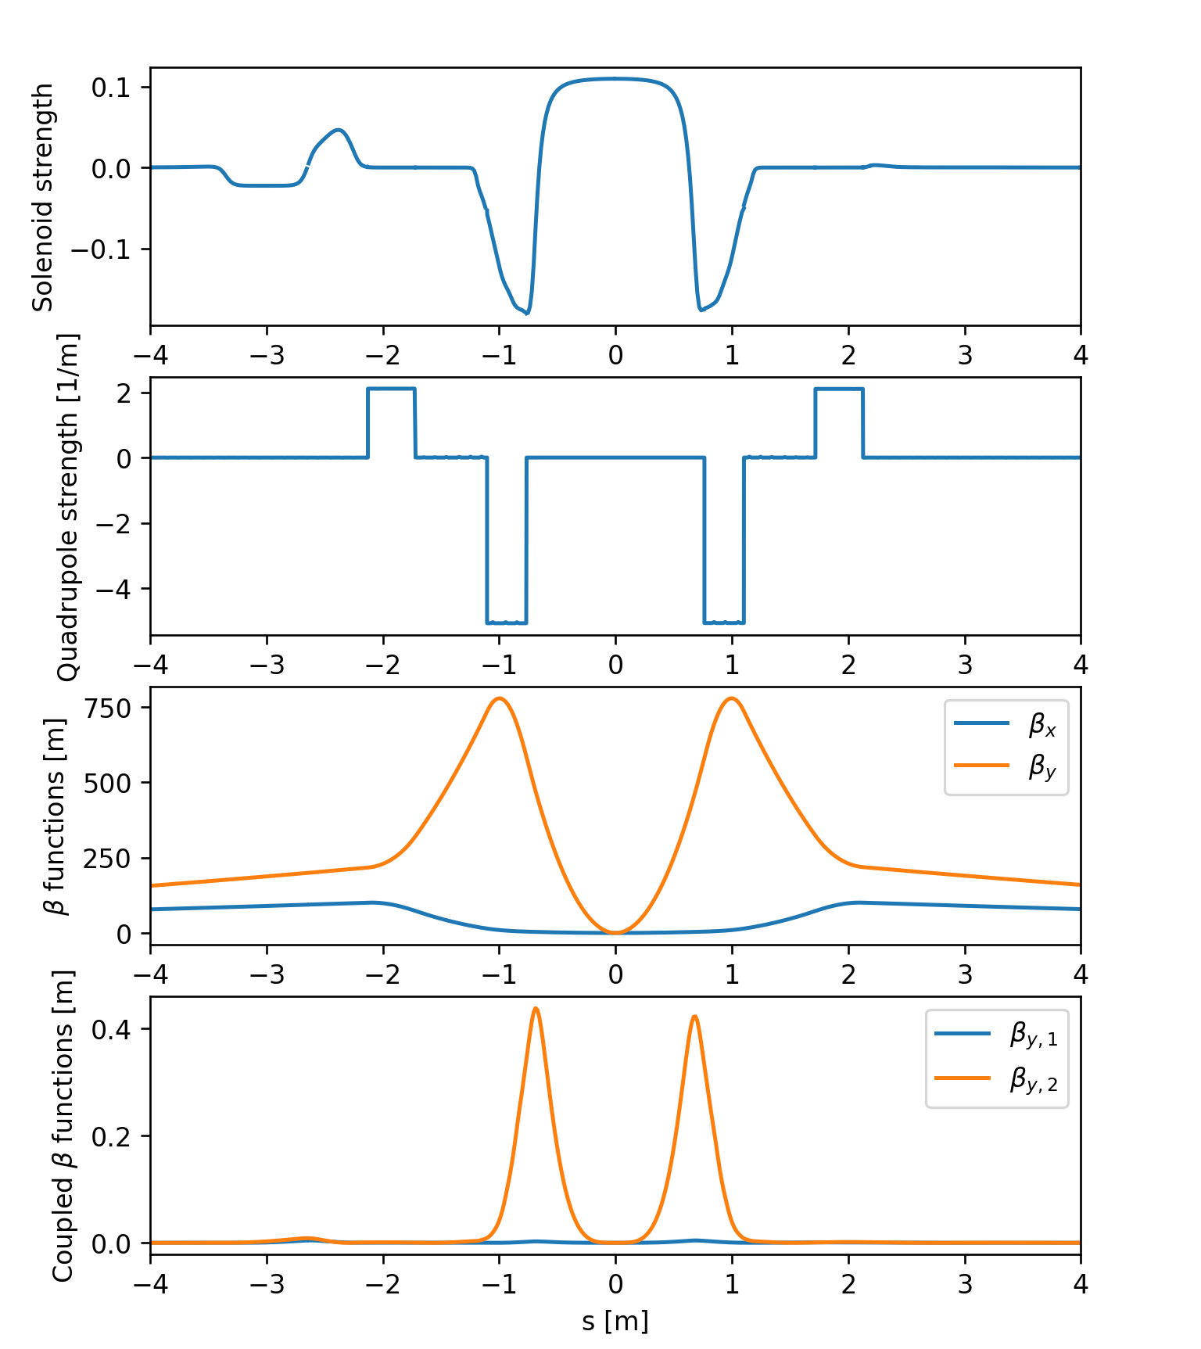
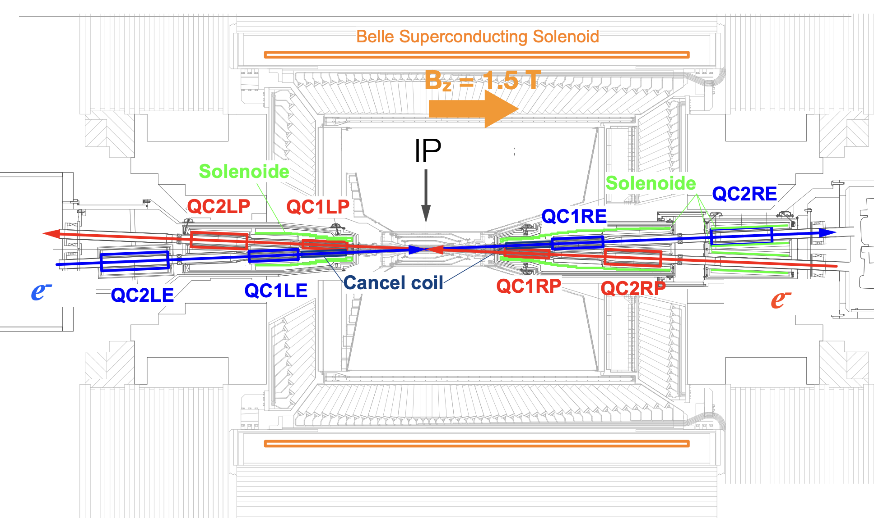
Modelling of experimental regions
Capability of modelling experimental solenoids also in the presence of tilted and overlapping multipole fields
Already tested for the case of FCC-ee
Profited of these developments to build a detailed model of SuperKEKb collider
  Being used for several studies in view of FCC including luminosity feedback and collimation studies
More info: J. Salvesen, presentation at BELLE2 meeting 29 Jan 2025

Slide 9
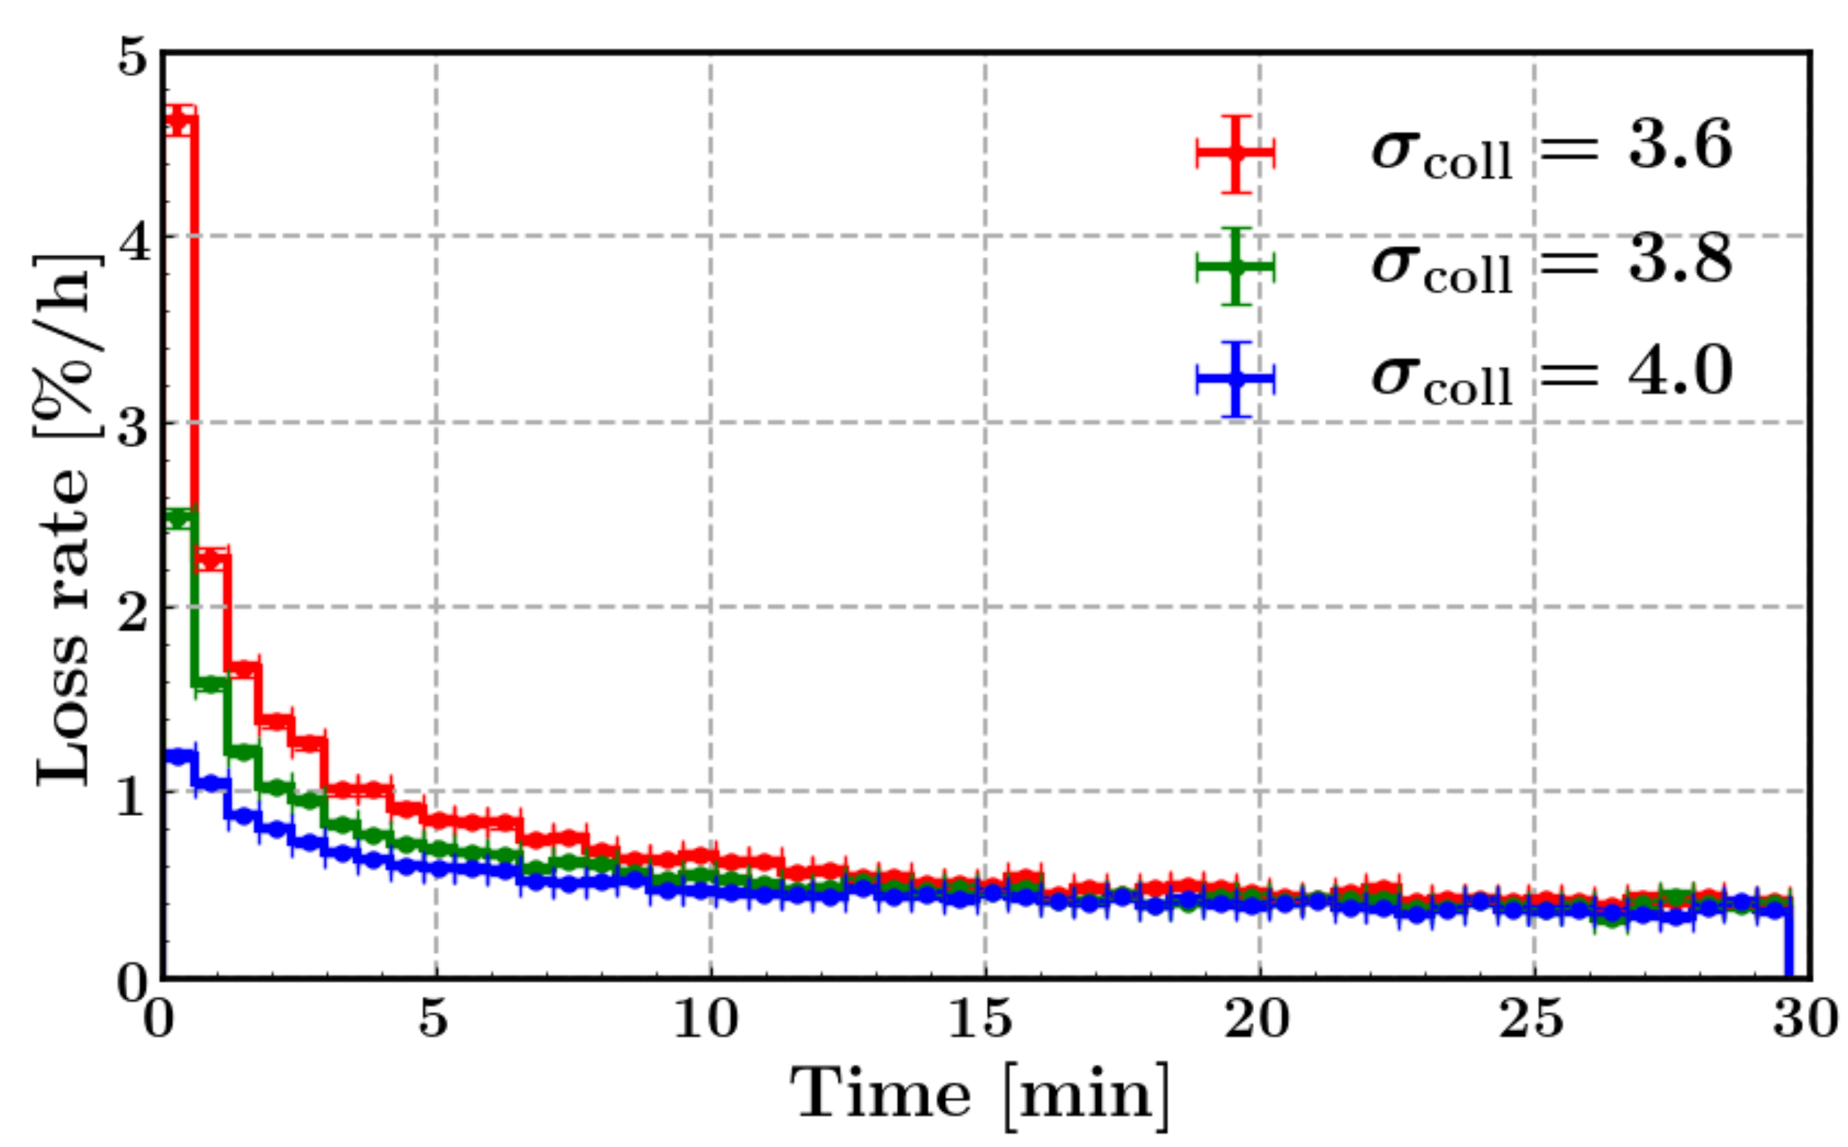
Single particle tracking
Multiturn element-by-element tracking speed is critical for several application
To speed up tracking simulations, Xsuite assembles a C kernel (called from Python) optimized for the given beamline and specialized for the chosen platform (CPU or GPU)
  The tracking speed is found to be in line with Sixtrack for single-core CPU and about two orders of magnitudes faster than that on high-end GPUs
K. Paraschou
Example for LHC:
Direct element-by-element simulation of the first 30 minutes after bringing beams in collision (20 M turns!) to study lifetime, and tail depopulation
Simulation of 20 000 particles
  On CPU (single process) would take > 2 years sim. time
  On GPU (NVIDIA V100) was done < 3 days sim. time

Slide 10
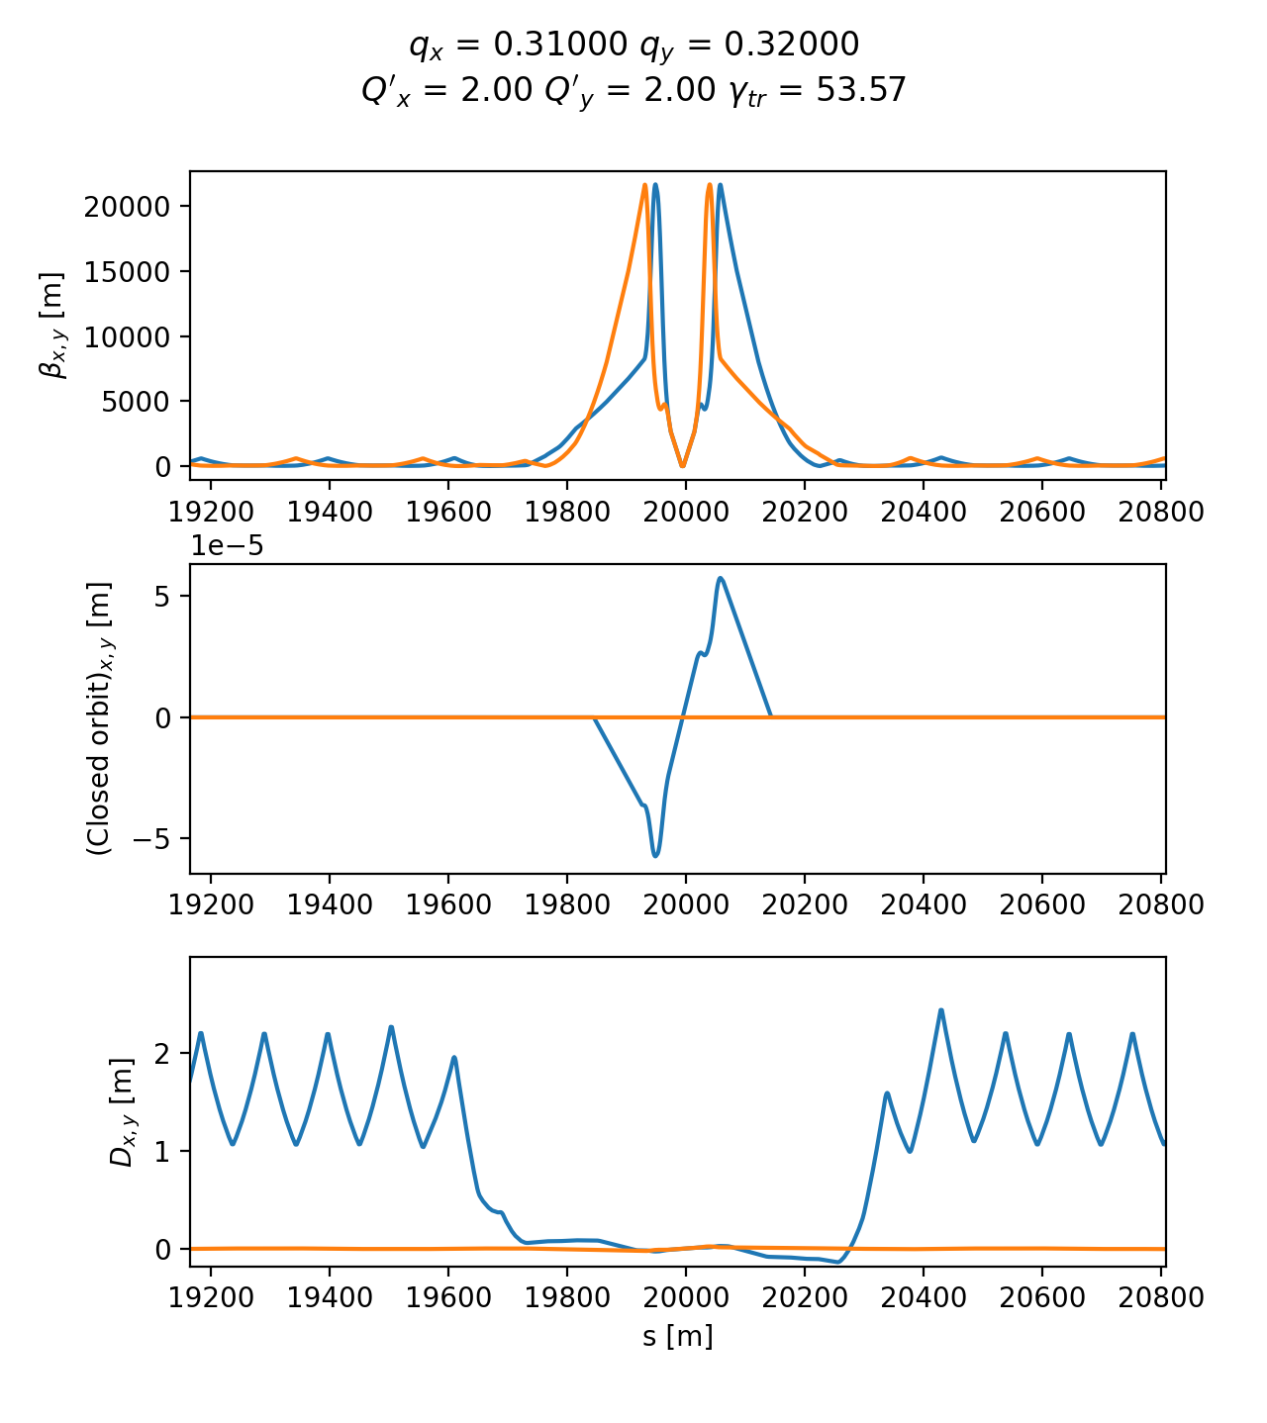
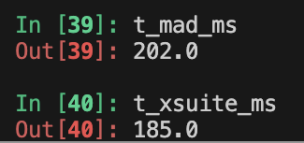
Optics calculation
HL-LHC optics
The Xsuite Twiss module can be used to extract lattice functions of a ring or a beamline
The calculation probes the lattice simply by tracking particles:
  Closed orbit obtained by applying a Python root finder on the tracking
  The Jacobian matrix obtained by tracking (central differences)
  Compute “Linear Normal Form” of the Jacobian matrix (diagonalization)
  Propagate eigenvectors by tracking
  Obtain from the eigenvectors Twiss parameters (𝛼, 𝛽, 𝛾), dispersion functions, phase advances, coupling coefficients
Computation can be done with assigned beam momentum to get off-momentum beta-beating, non-linear chromaticity, non-linear dispersion, etc.
Accuracy compared to MAD-X: Δβ / β << 10⁻⁴
Computation time is very similar

Slide 11
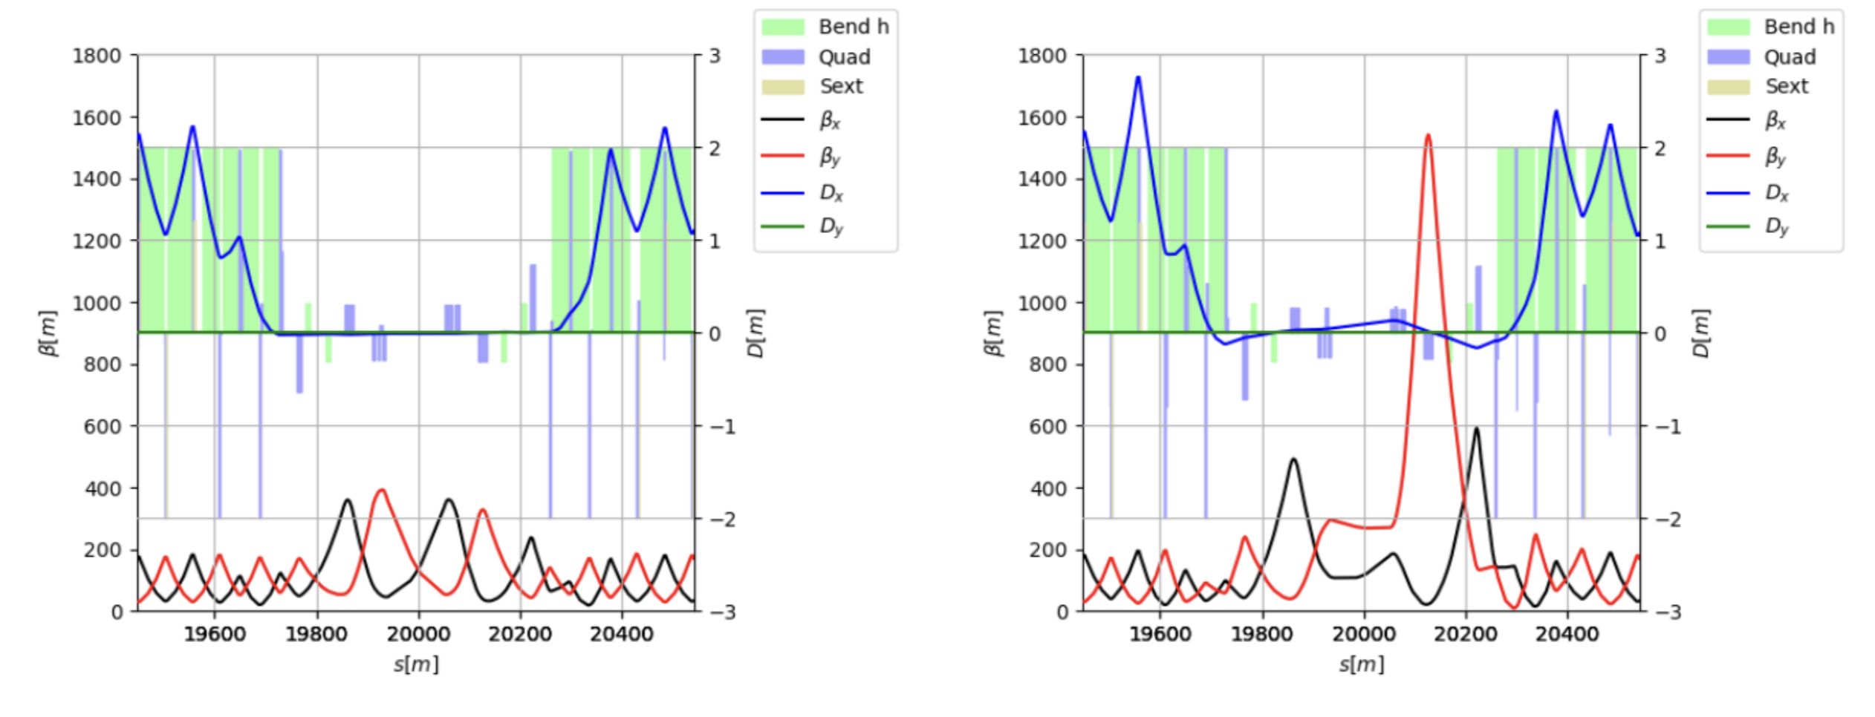
Optics design
Xsuite provides a multi-objective optimizer to "match" model parameters to assigned constraints (e.g. control tunes, chromaticity, build orbit bumps, design the optics)
Based on the extensive experience of MAD-X → Provides several optimization algorithms (including Jacobian algorithm developed for MAD-X) + easy plug-in of external python optimizers
Interface designed for usage flexibility. User can intervene in the optimization by:
  Enabling/disabling targets or knobs, rolling back optimization steps, changing knob limits, target values, convergence tolerances
Used for optics matching of the LHC and of FCC-ee colliders
IR7 (450 GeV)
IR7 (7 TeV)
First full cycle designed with Xsuite tested at the LHC in 2024
(including combined ramp&squeeze for all insertions)
R. De maria, B. Lindstrom

Slide 12
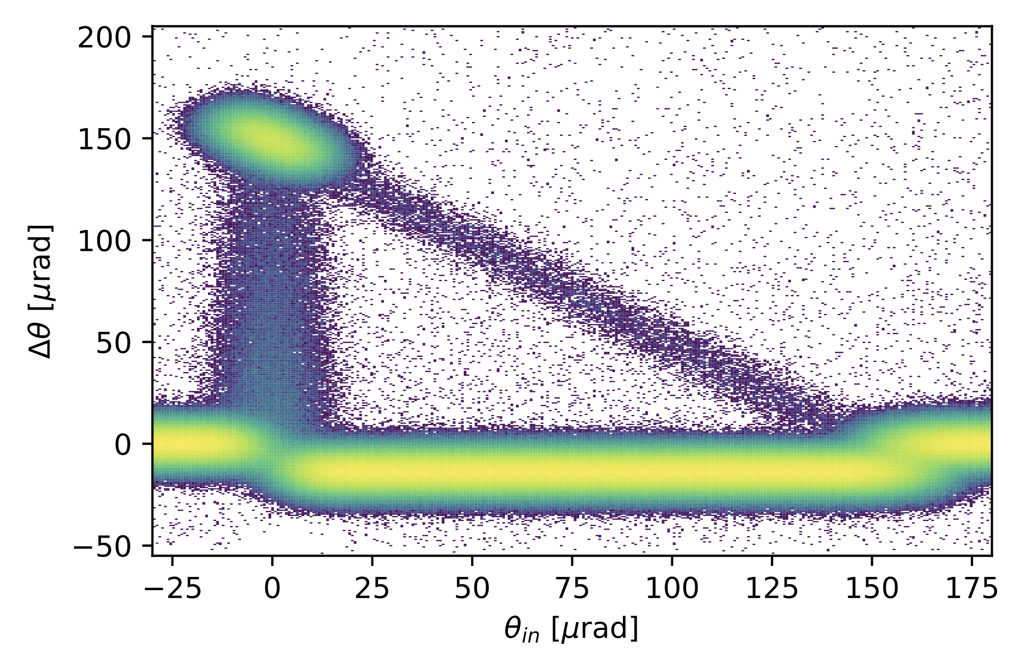
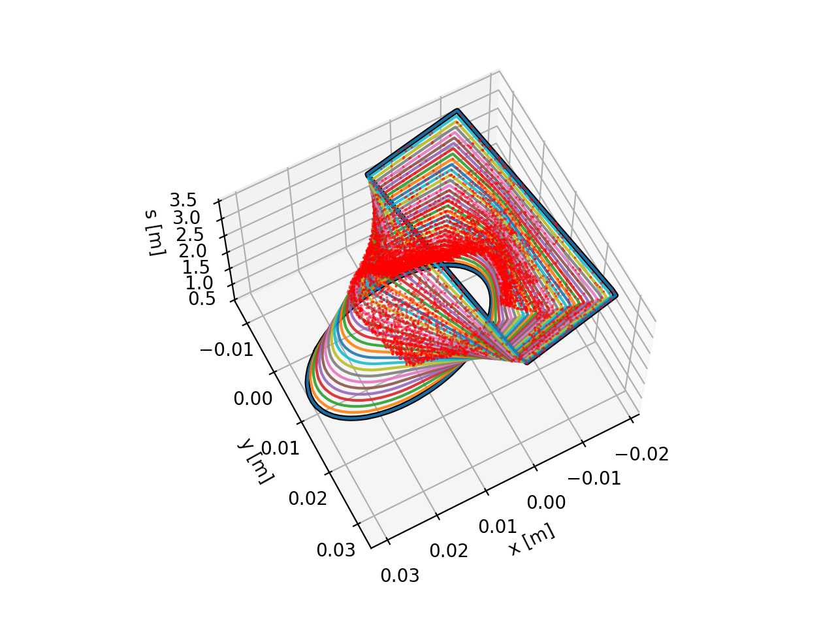
Particle-matter interaction
Particle deflection from a bent crystal (Everest engine)
For collimation studies, the Xcoll module provides three particle-matter simulation engines:
The “Everest” engine embedded in Xcoll (evolution of K2 module from Sixtrack)
The “Geant 4” engine, based on an interface with BDSIM-Geant4 (used for FCC-ee collimation studies)
The “FLUKA” engine, based on an interface with the FLUKA Monte Carlo code
Additionally, Xsuite provides:
Tools to automatically install and configure collimators in the simulation model
Support for complex aperture modelling and accurate localization of the lost particles along the beam line (typically within 1-10 cm)
Localization of lost particles along a beam pipe with changing cross section

Slide 13
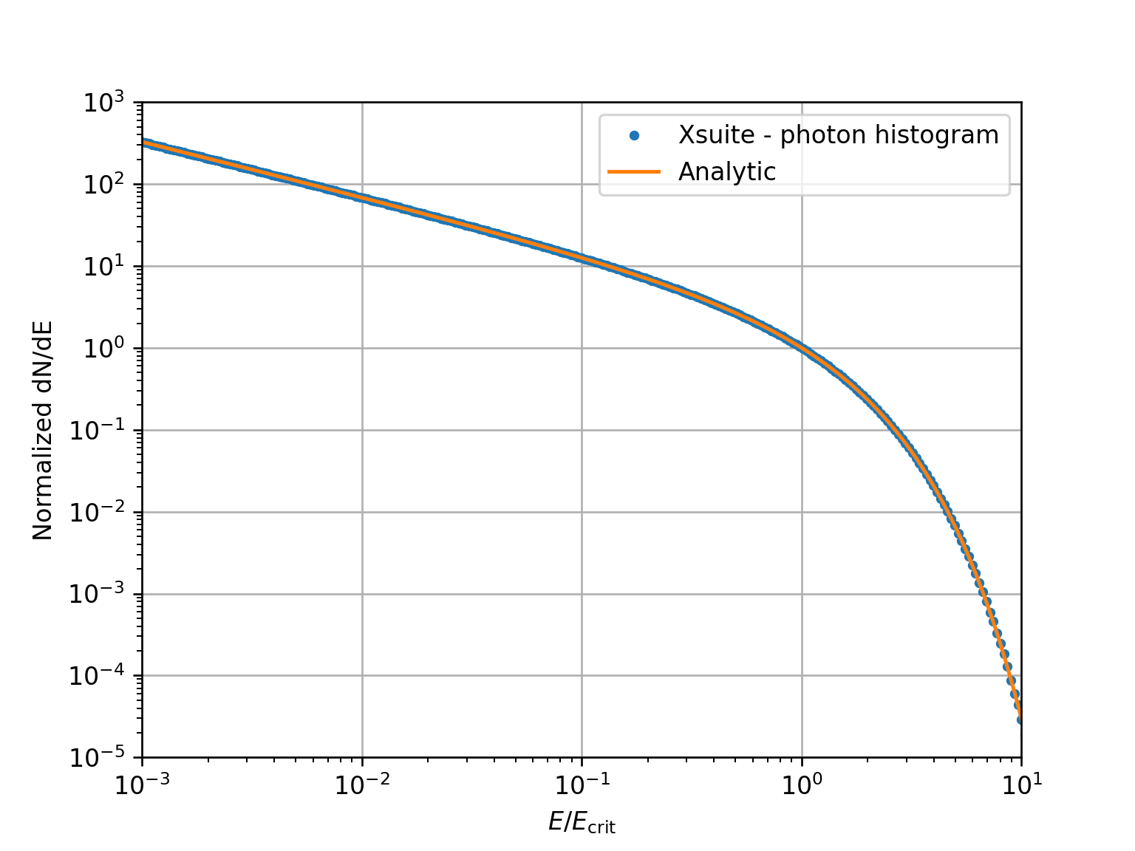
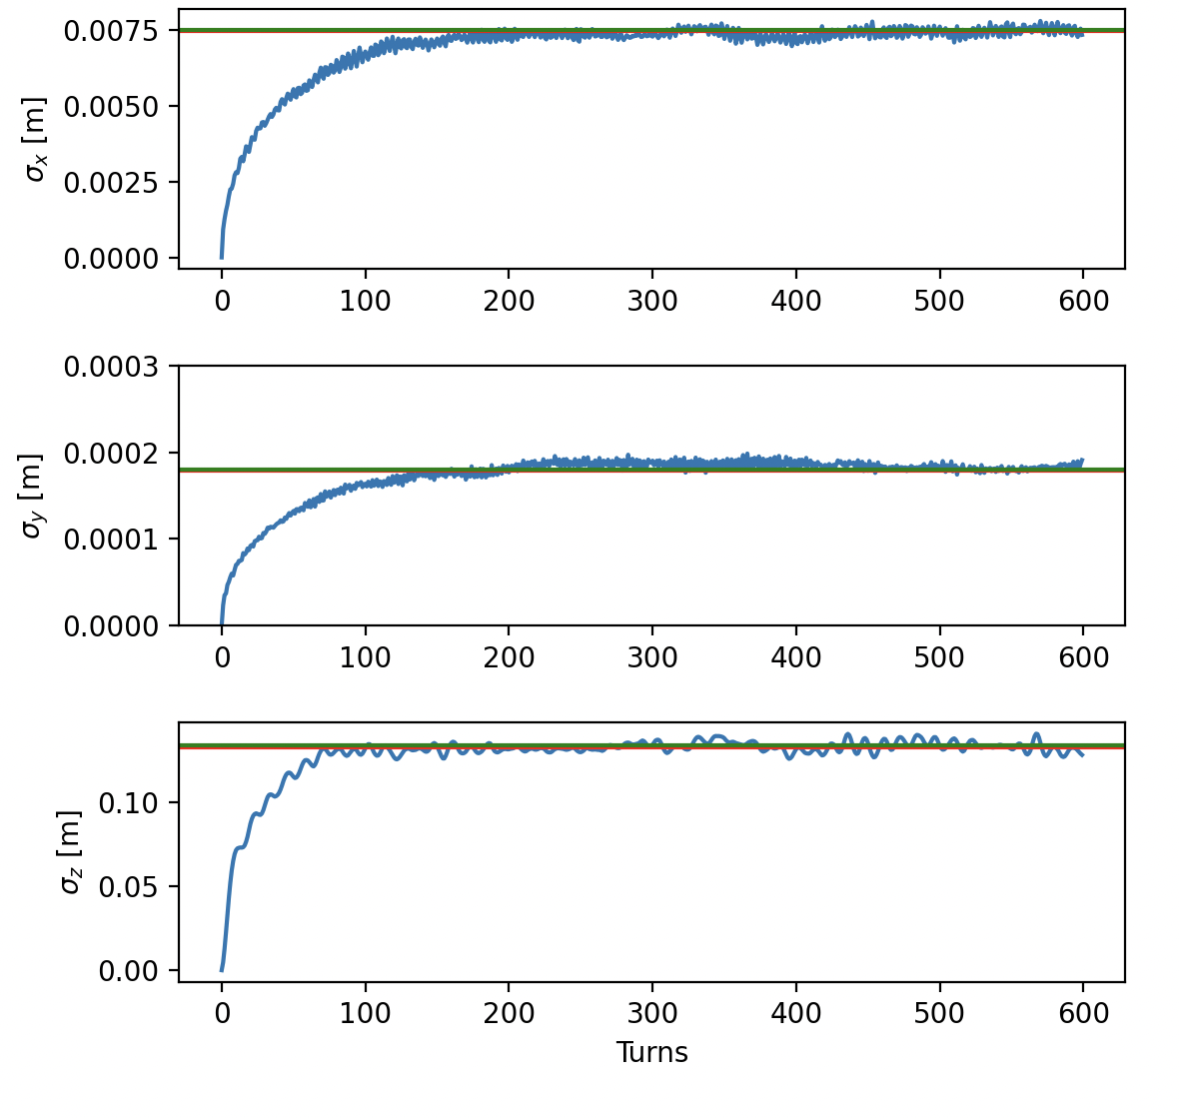
Synchrotron radiation
Validation against analytical photon spectrum
The effect of synchrotron radiation can be included in Xsuite tracking simulations. Two models available:
The “mean” model, for which the energy loss from the radiation is applied particle by particle without accounting for quantum fluctuations;
The “quantum” model for which the actual photon emission is simulated.
The Xsuite Twiss also includes:
Dedicated algorithm for optics function with non-symplectic one-turn map
Module extended to compute radiation energy loss, damping times and equilibrium emittances
To compensate the radiation energy loss (“tapering”), an automatic tool is provided for phasing the RF cavities and adjusting magnet strengths.
Eq. emittance twiss vs track
Twiss (fast)
Twiss (full)
Tracking (300 particles)

Slide 14
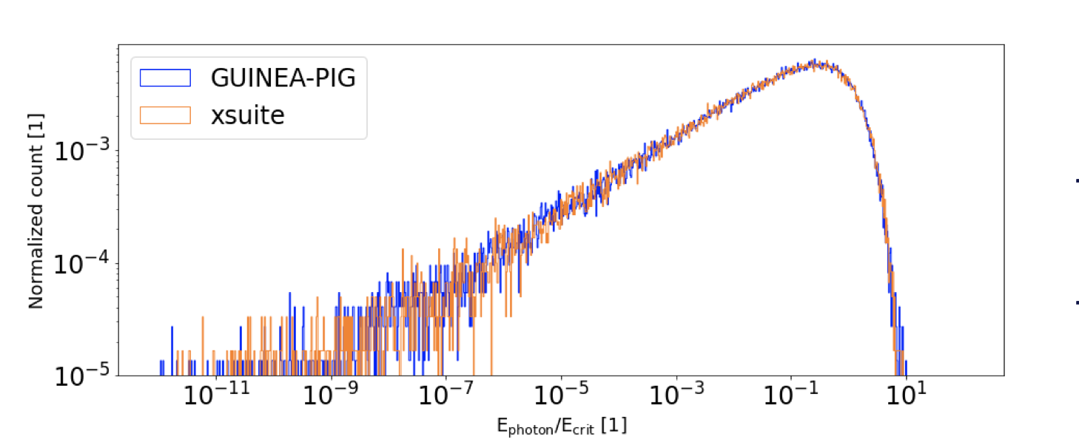
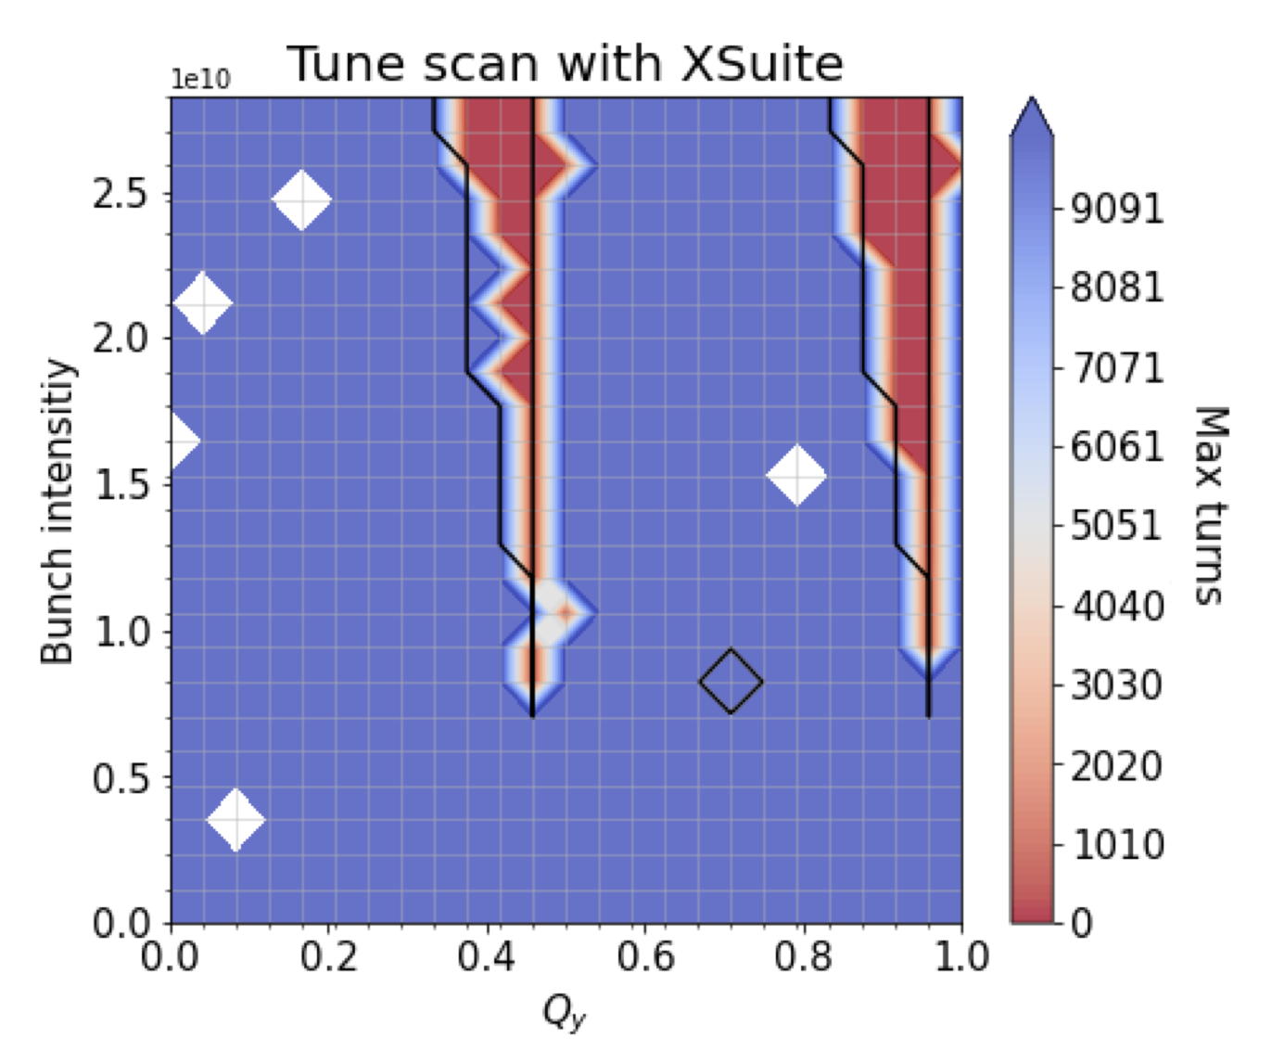
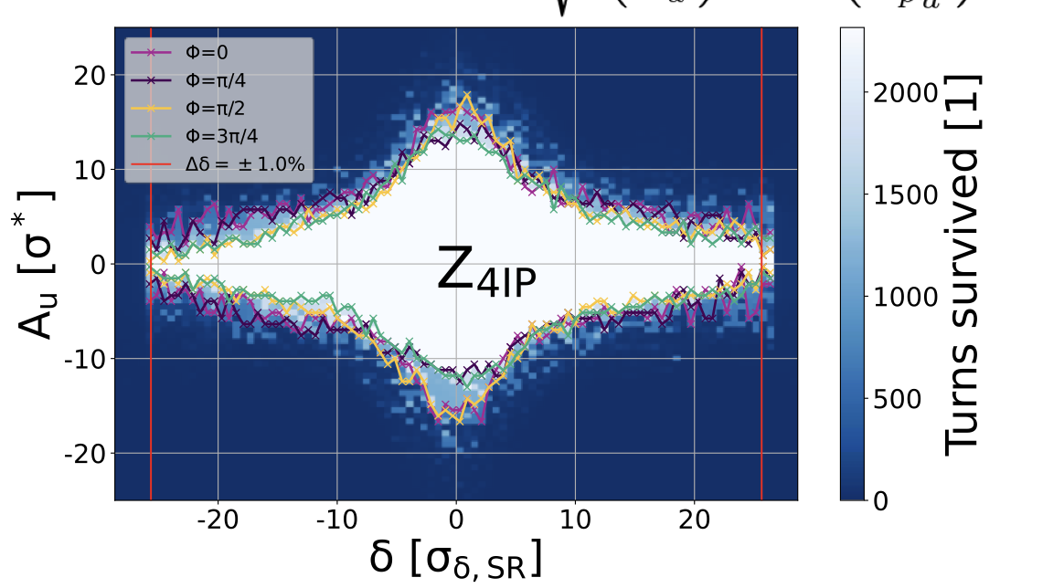
Beam-beam modeling
Beamstrahlung – validation against Guinea Pig
Largely profited from developments made for LHC
4D and 6D modelling based on Gaussian distribution
Weak-strong and strong-strong methods
Additional features added specifically for FCC-ee
Self-consistent Particle-In-Cell model
Beamstrahlung radiation
Bhabha scatting estimates
Coherent bb effects at FCC-ee
FCC-ee DA with BB
Particle In Cell
x
s
More info: P.Kicsiny, presentation at FCC Week 2024

Slide 15
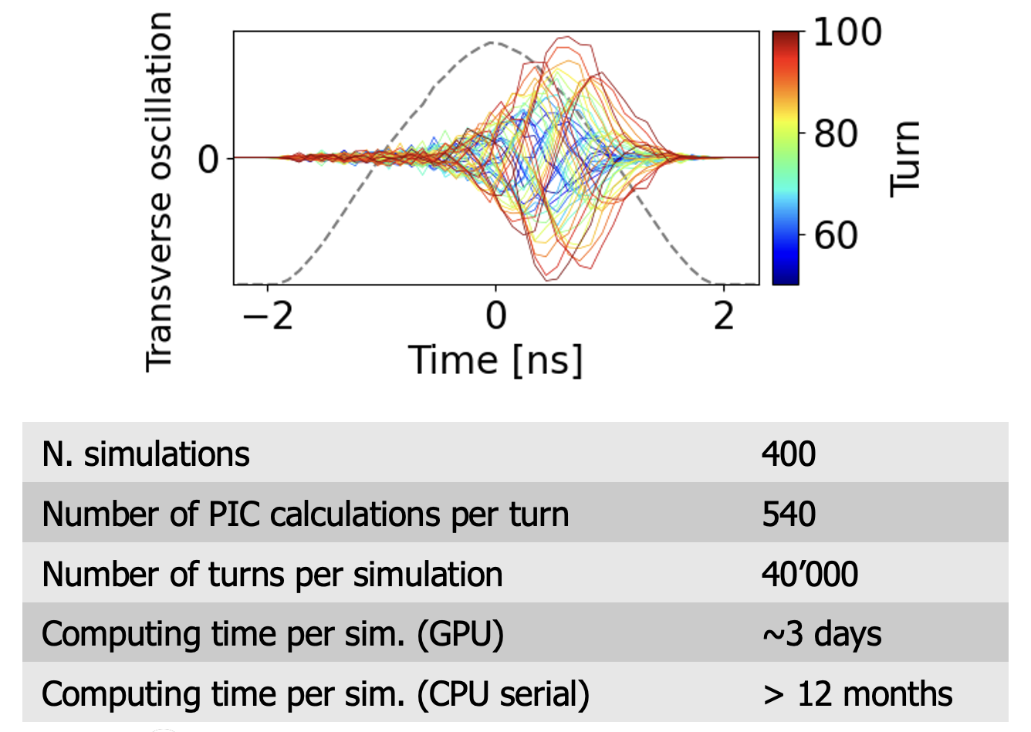
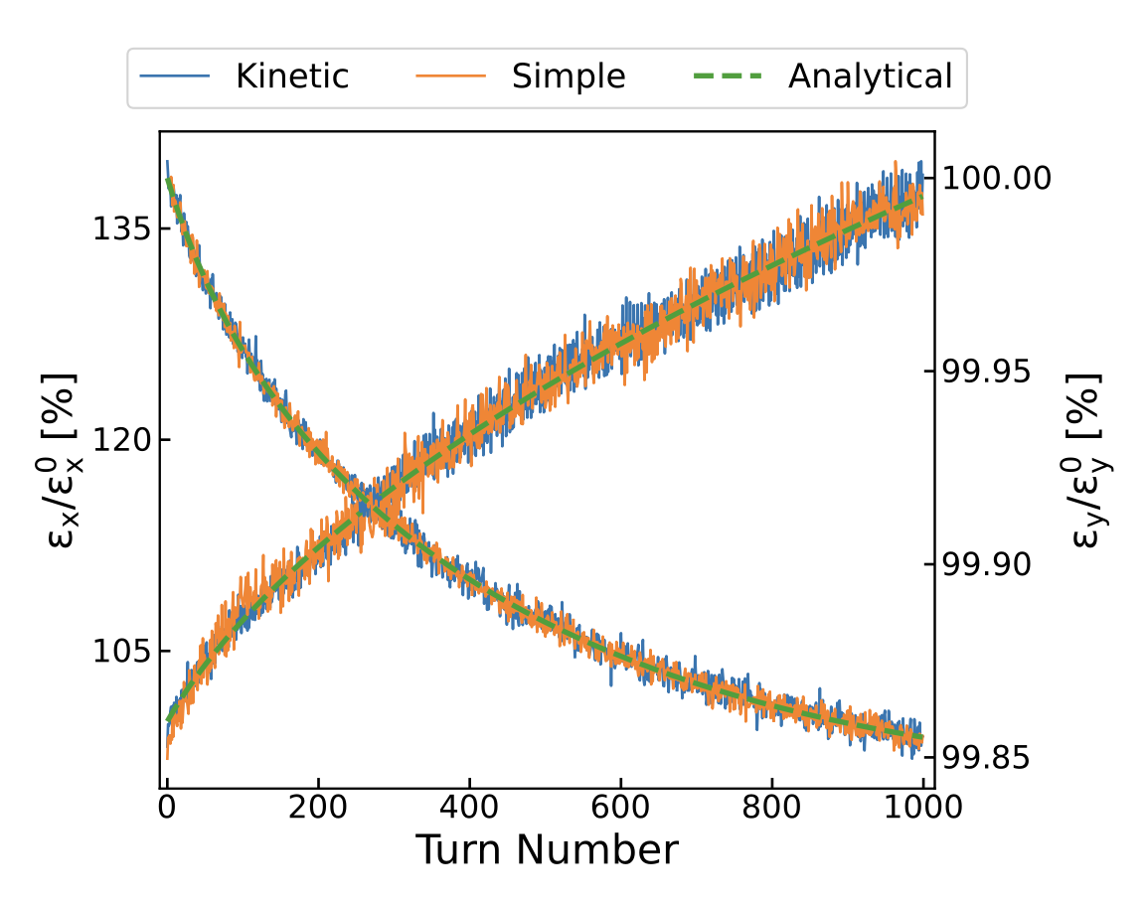
Collective effects
Coherent instability simulation with wakefields and space charge
Space-charge: different models are implemented:
“Frozen” model, fixed charge distributions
“Quasi frozen”, beam intensity and beam sizes are recomputed at each interaction
The “Particle In Cell (PIC)” model
Wakefields
Longitudinal, transverse dipolar and quadrupolar
Single-bunch and multibunch
Intra Beam Scattering (IBS) simulation capabilities have been recently introduced:
IBS growth rates computation from beam parameters and optics.
Effect of IBS can be included in multiparticle simulations.
X. Buffat
F. Soubelet
IBS Benchmark for the SPS
(Pb ions)

Slide 16
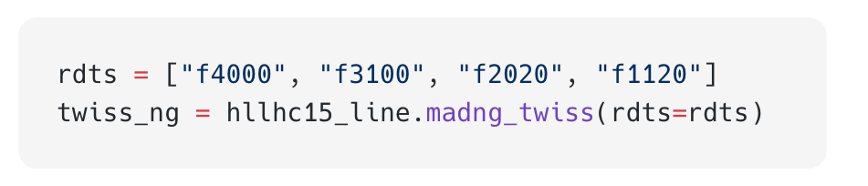
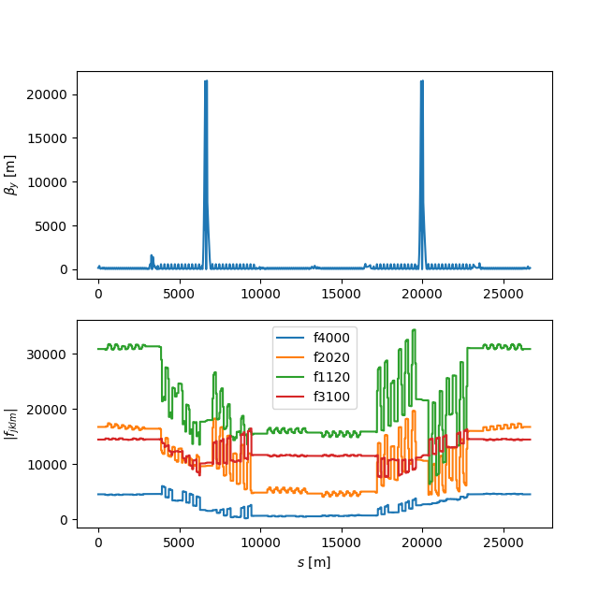
Interfaces to other tools
By design Xsuite is easy to interface and extend using other tools providing a Python API.
Several examples of interfaces providing Xsuite with features that are not natively available:
MAD-NG – computation and optimisation of parametric nonlinear normal forms, resonant driving terms, automatic differentiation.
RF-Track – particle tracking in complex field maps.
FLUKA – simulation of particle-matter interaction
(e.g. LHC collimation studies).
BDSIM-GEANT4 – particle-matter interaction
(mostly for FCC).
BLonD – advanced modelling for RF systems.
Notes:
Madng plot

Slide 17
Where we do we stand today
By now Xsuite became a production tool for many beam dynamics studies, allowing development discontinuation for many legacy tools.
Xsuite
Xsuite
Xsuite
Xsuite
Lattice Design
Optics (calculation & design)
Tracking (dynamic aperture)
Collimation
Xsuite
Xsuite
Xsuite
Xsuite
Impedances
Beam-Beam Effects
Space Charge
Electron/Ion Cloud

Slide 18
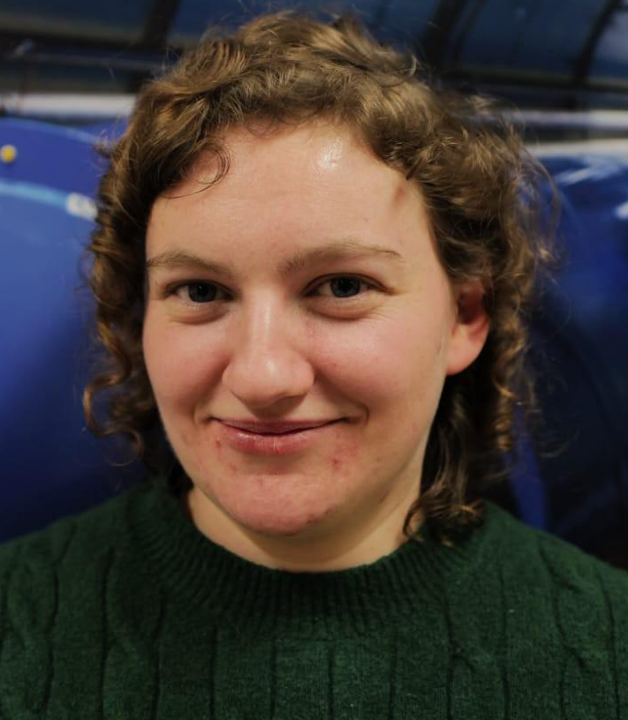


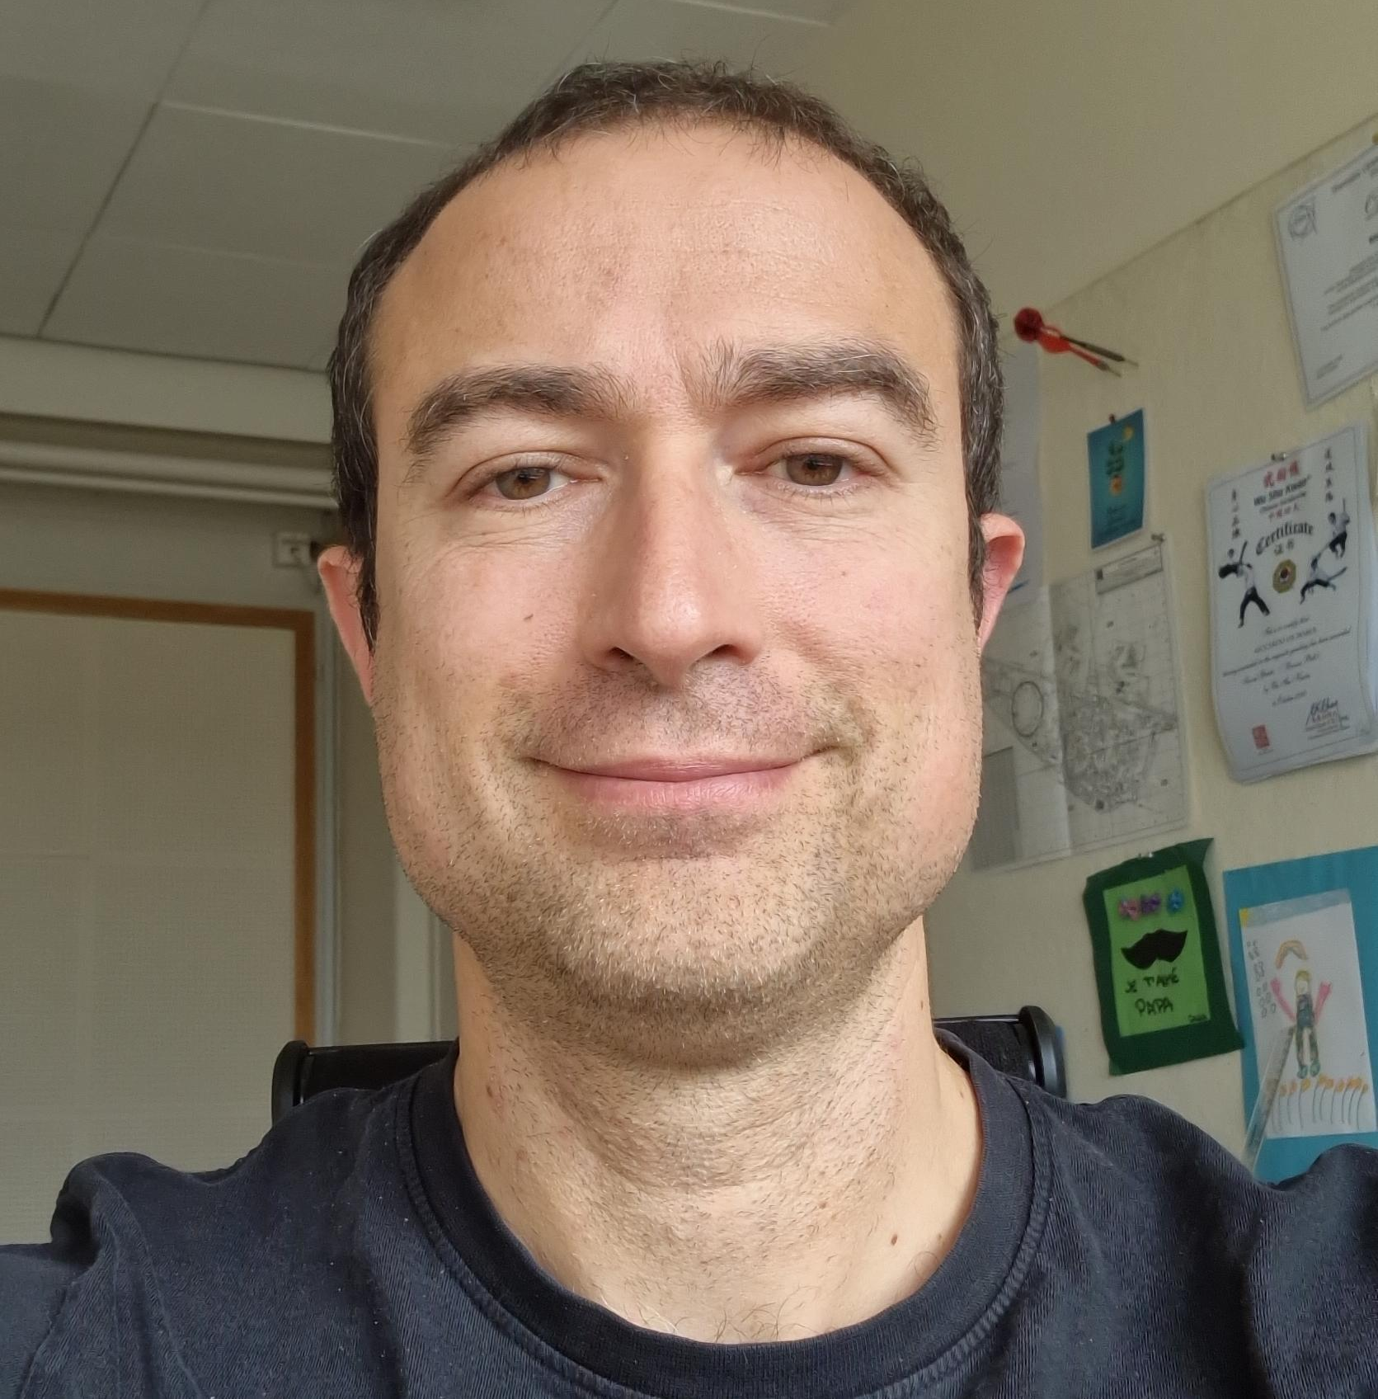
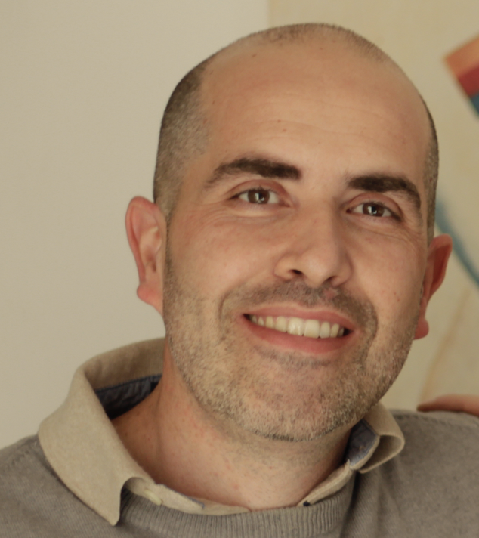
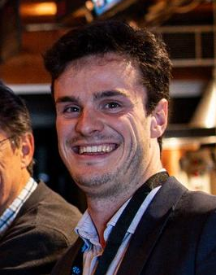

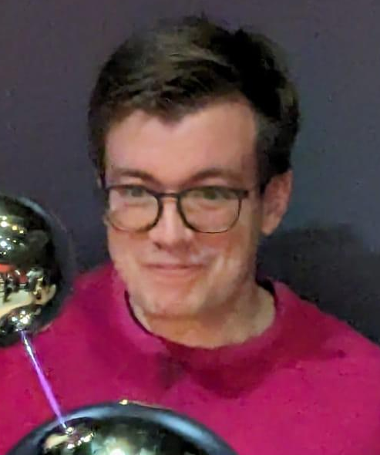
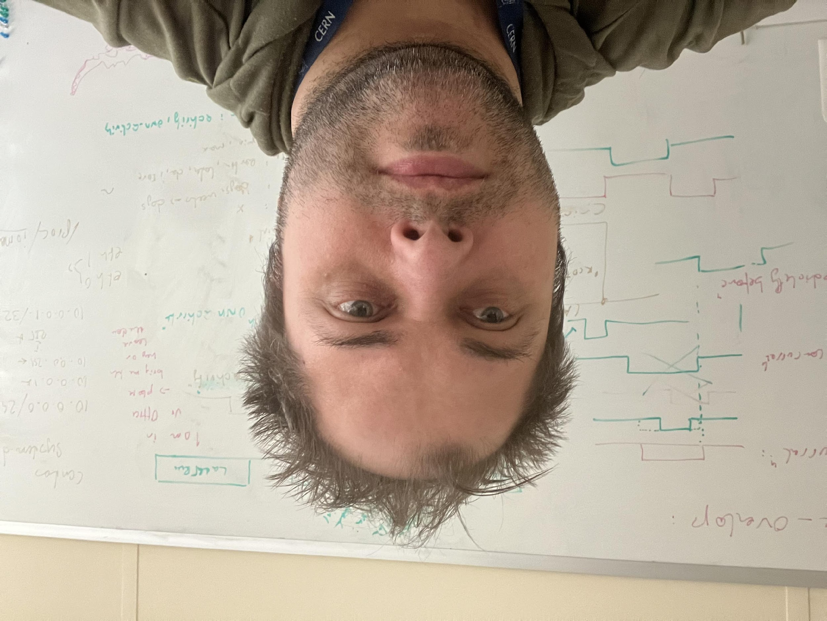
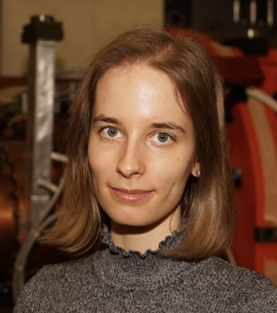

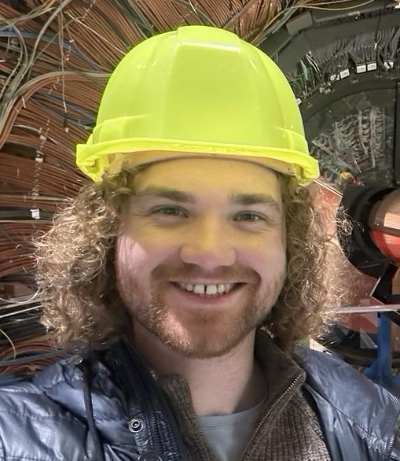

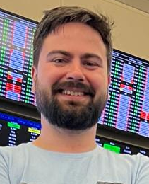
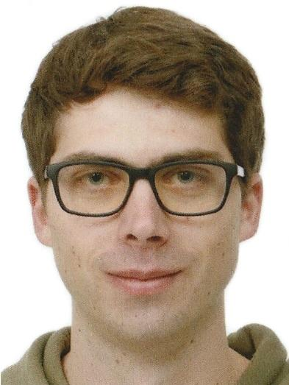
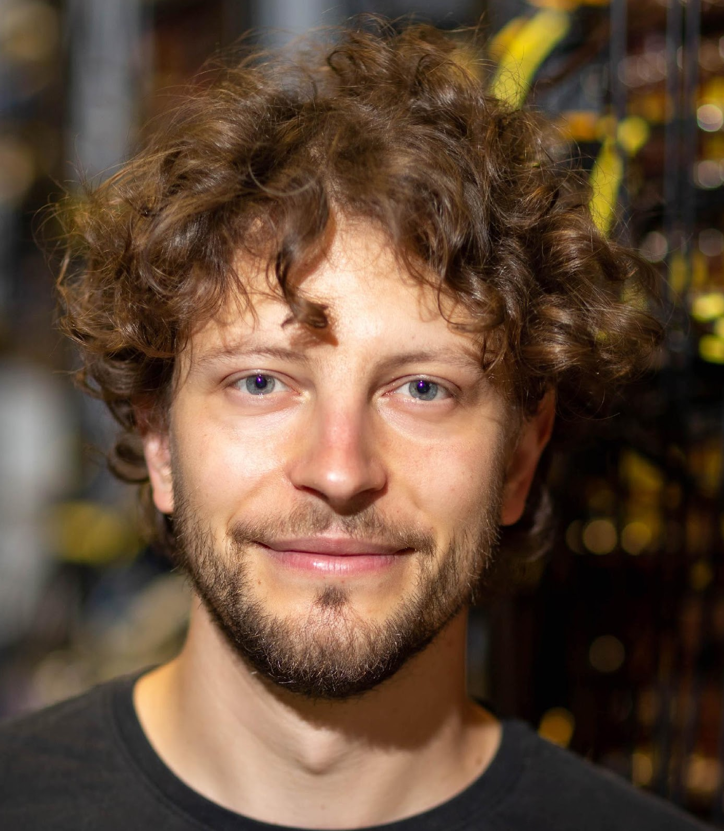
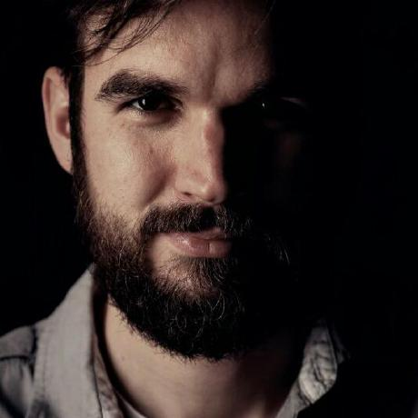

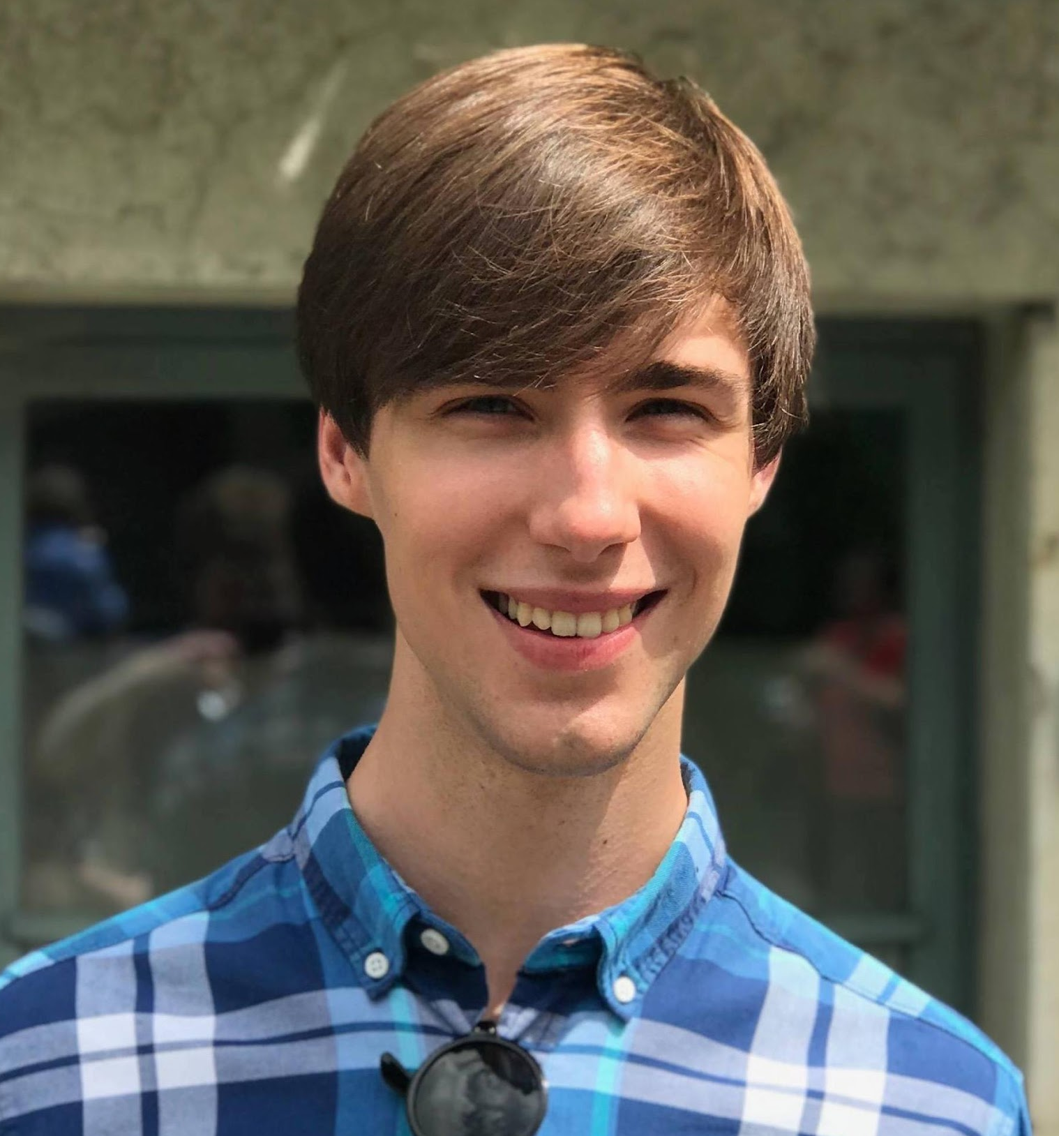
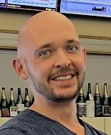
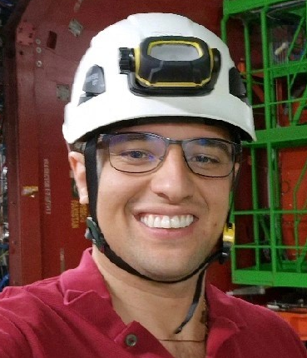
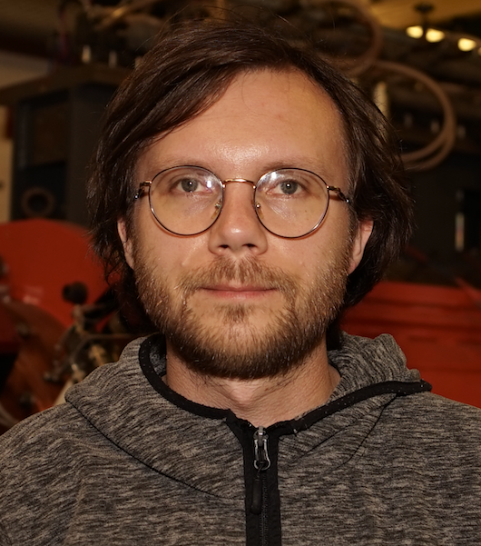
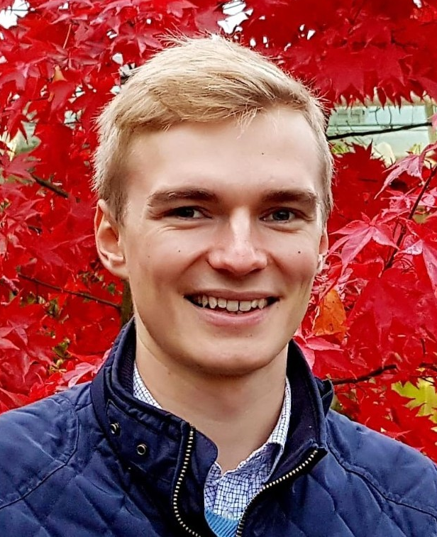
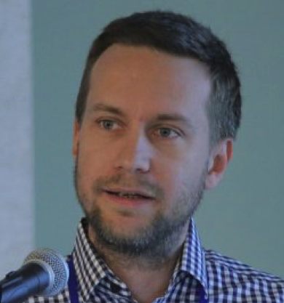

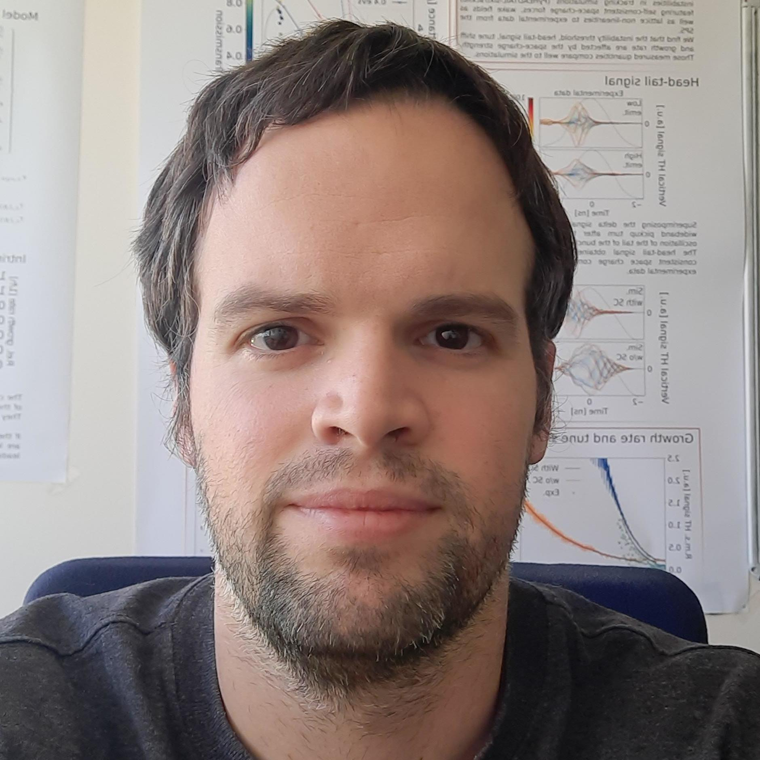




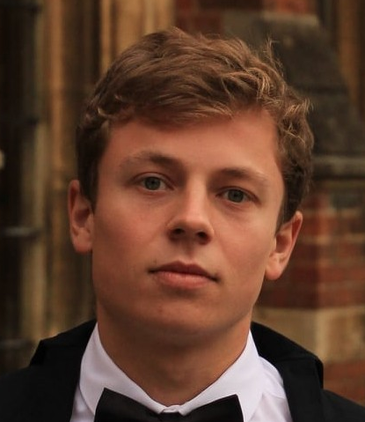

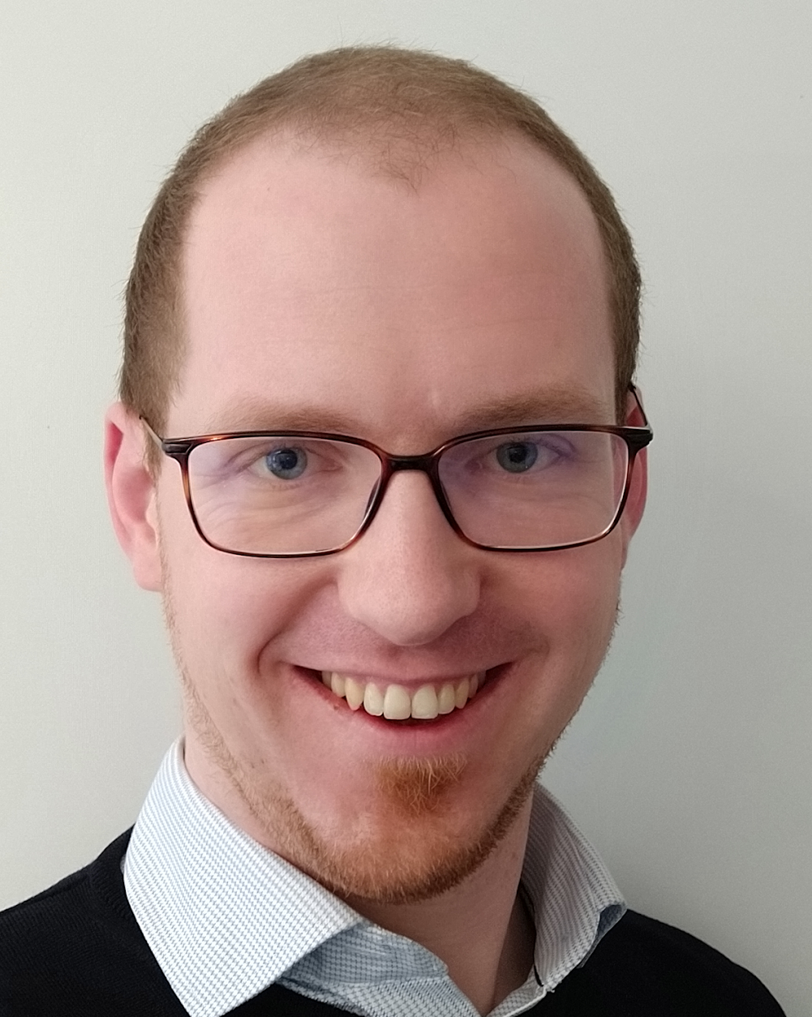

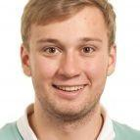
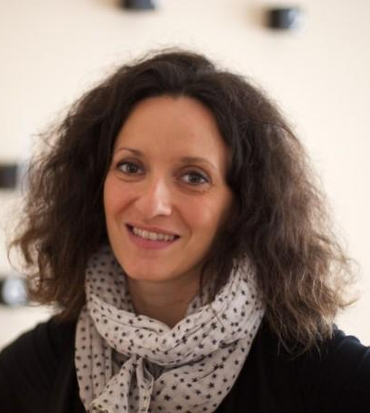

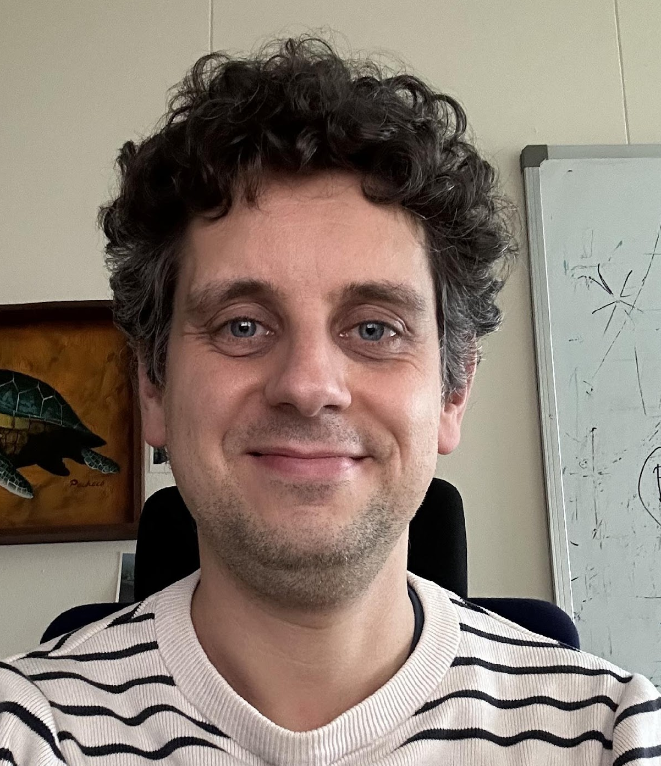






Xsuite adoption
Users’ and developers’ response was well beyond our expectations!
…

Slide 19
Xsuite adoption
Users’ and developers’ response was well beyond our expectations!
>30 contributors
>130 active users world-wide
(60: ABP, 30: other CERN groups, 40: other labs)
>200 Xsuite mentions in IPAC24 proceedings
Accelerator schools (USPAS, CAS) used Xsuite for tutorials in 2024.
Xsuite used for a large number of facilities
CERN
AD
ELENA
LEIR
PSB
PS
SPS, TI2, TI8
LHC
FCC-ee, FCC-hh
Muon Collider
Fermilab
Main injector
Recycler
Booster
IOTA
GSI
SIS-18
SIS-100
BNL
RHIC
Booster
EIC
KEK/J-PARC
Main Ring
KEK
SuperKEKB
Medical facilities
HIT (Heidelberg)
MEDAUSTRON
PIMMS
NIMMS
Light sources/damping rings:
PETRA
DESY injector ring
ELETTRA
BESSY III
PSI SLS 2.0
Canadian Light Source
CLIC-DR
and more...
…

Slide 20

Moving forward: Xsuite towards Operations
Today operation of the CERN complex (accelerators, transfer lines, experimental areas) uses MAD-X as standard tool for lattice modelling, survey, optics calculations, knob generation, etc.
First tests of Xsuite also in this context went very smoothly.
Notably, the first full LHC cycle was designed entirely with Xsuite in 2024 and tested in MDs.
Including optics matching, squeeze functions design, knob design (cross./sep. bumps, tune, chromaticity, coupling, etc.), link with LSA.

Slide 21
Moving forward: Xsuite towards Operations
Our goal: we want to move to Xsuite also for operational tasks, aiming at not depending on MAD-X for critical applications by the start of Run 4.
Several benefits:
Advantageous to use the same tool for the present complex and design studies for future machines – development synergies, using same tools makes it more natural for people to work in both environments.
Overcome shortcomings of MAD-X that today need workaround:
  e.g., modelling of optics distortion from the PSB injection chicane, reference frame curvature kept independent of bend powering, general handling of tilted magnets.
Economy of resources: high-quality support for MAD-X is expensive.
  Requires a very specific skill-set training, not useful in other contexts.
  Prefer to reinvest these resources to support users during the migration.
Notes:
Madx -> xsuite picture

Slide 22
Moving forward: Xsuite towards Operations
Preliminary discussions with main stakeholders (BE-EA, BE-OP, SY-ABT) already took place.
Response so far was very positive
  General perception that advantages of modern and supported tools outweigh the cost of transition.
We will continue engaging with the user community to get an accurate and complete overview of needs and wishes.
  Don’t hesitate to give Xsuite a try for your applications and reach out to us with feedback.
  Early feedback is important to ensure that all relevant needs are correctly incorporated in the design.
The migration of the ‘acc-models’ repositories for all accelerators and lines will be an important milestone.
  BE-ABP is committed to work on this task during LS3 in collaboration with repository owners.
Notes:
Madx -> xsuite picture

Slide 23

Xsuite in action
Material available at: https://github.com/xsuite/tutorial_cern_seminar
Notes:
Madx -> xsuite picture

Slide 24
Similar effort in the world of linacs and compact beamlines
A. Latina

Slide 25
Similar effort in the world of linacs and compact accelerators
A. Latina
Subject for a future meeting

Slide 26
Thank you!

