Slide 1
BOND 14T
Design Status
Ariel Haziot
E. Fernandez Mora, J. Ferradas Troitino, S. Izquierdo Bermudez, N. Peray, J.C. Perez, and E. Todesco
December 19th, 2024

Slide 2
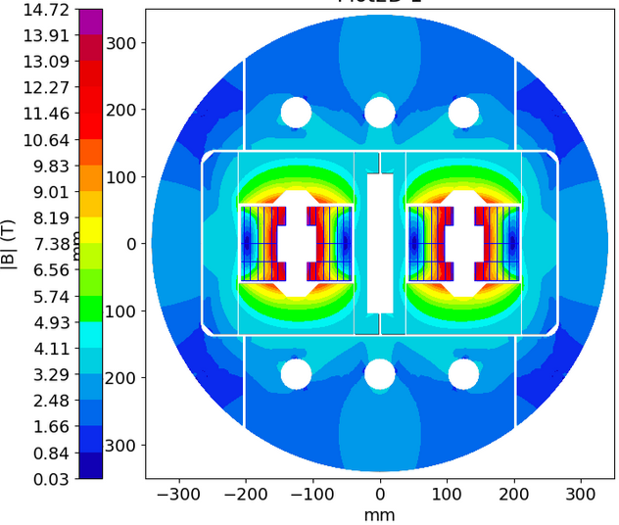
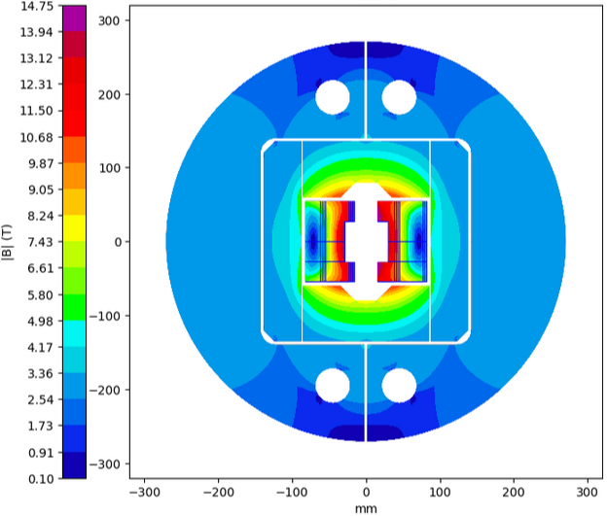
Introduction
BOND in the framework of HFM:
BOND stands for BlOck coil Nb3Sn Dipole
Block-type coils with flared ends – 14 T bore field (50 mm aperture) with ≈ 20 % load line margin at 14 T and 1.9 K.

Slide 3
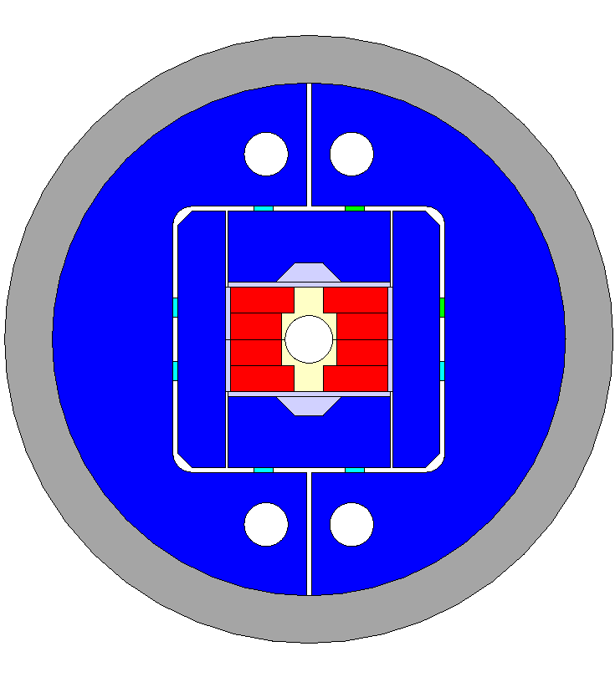
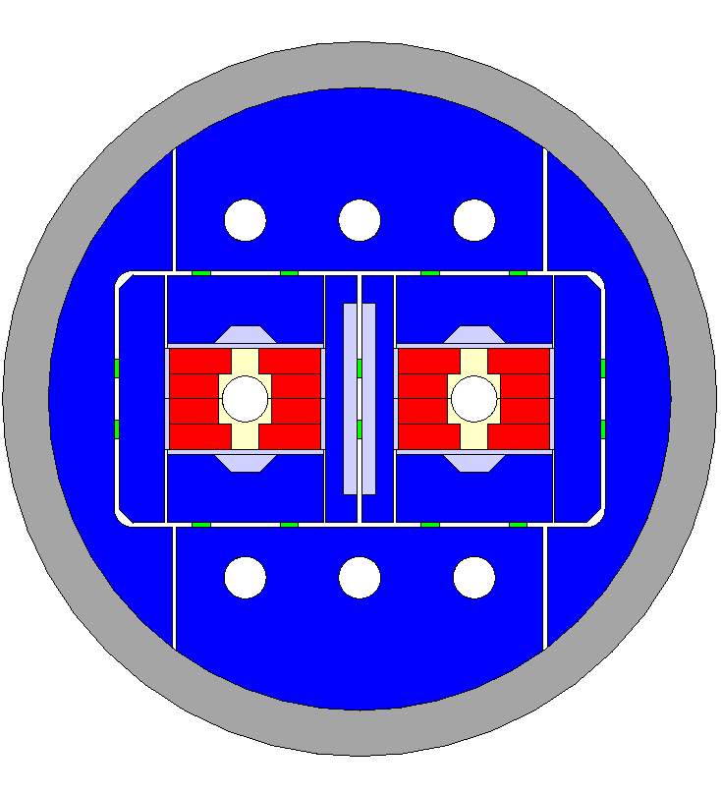
Outline
BOND Single Aperture
  Baseline - Magnetic design
  Baseline - Mechanical model
  Baseline - Engineering
  Alternative 40x1.1 design
BOND Double Aperture
  Baseline - Magnetic design
  Baseline - Mechanical model

Slide 4
BOND Single Aperture
Baseline - Magnetic Design

Slide 5
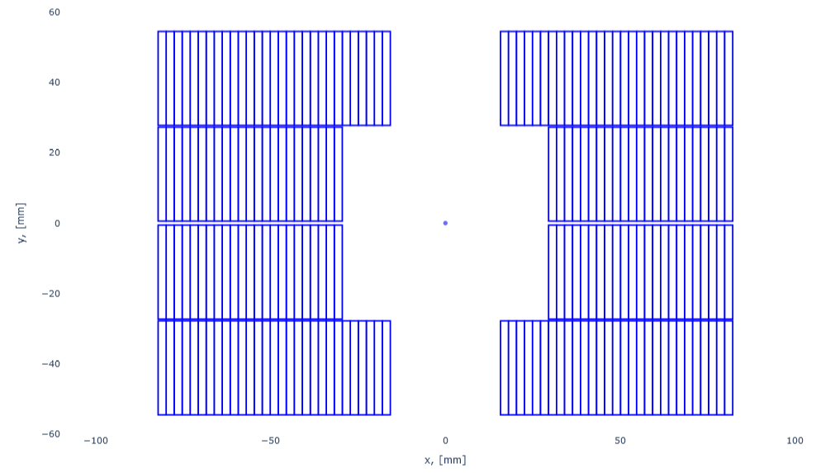
BOND single – Baseline parameters
Cable: 44 x 1.1 mm
Conductor parameters
Strand diameter | (mm) | 1.10
Layout |  | RRP 162/169
Effective filament diameter | (µm) | 64
Jc at 4.2 K and 16 T | (A/mm²) | 1200
Cu/NonCu ratio |  | 0.9
No. of strands in cable |  | 44
Bare cable thickness | (mm) | 1.91
Bare cable width | (mm) | 26.20
Bare cable thickness (reacted) | (mm) | 1.99
Bare cable width (reacted) | (mm) | 26.46
Insulation thickness | (mm) | 0.15
Insulated cable width (reacted) | (mm) | 26.76
Insulated cable thickness (reacted) | (mm) | 2.29
Astrand | (mm²) | 0.950
Asc | (mm²) | 0.500
Acu | (mm²) | 0.450
29
Interlayer
0.5 mm
23
Midplane
Aperture
1.15 mm
50 mm

Slide 6
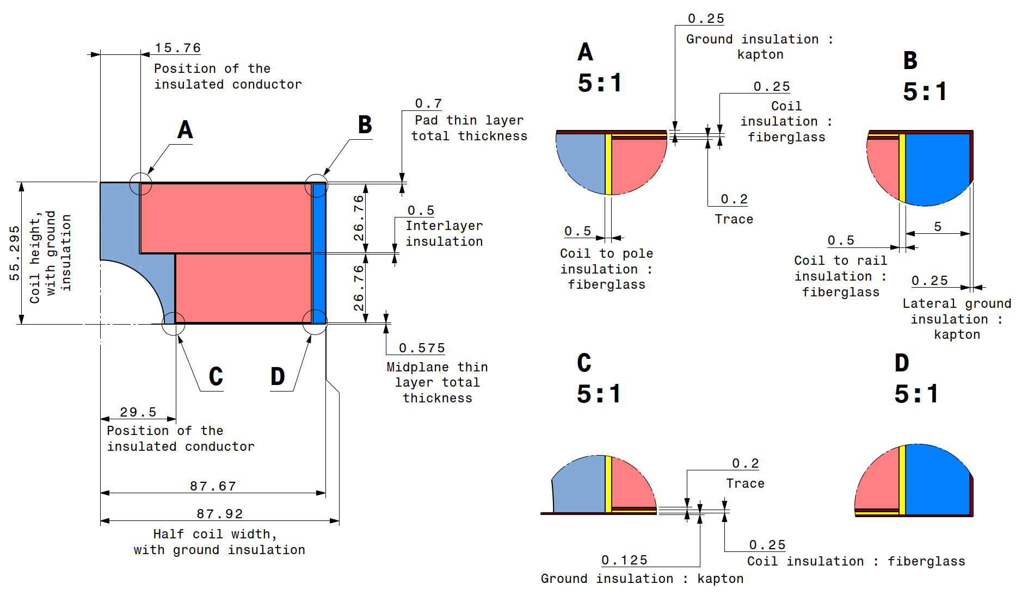
BOND single – Baseline parameters
Coil dimensions

Slide 7
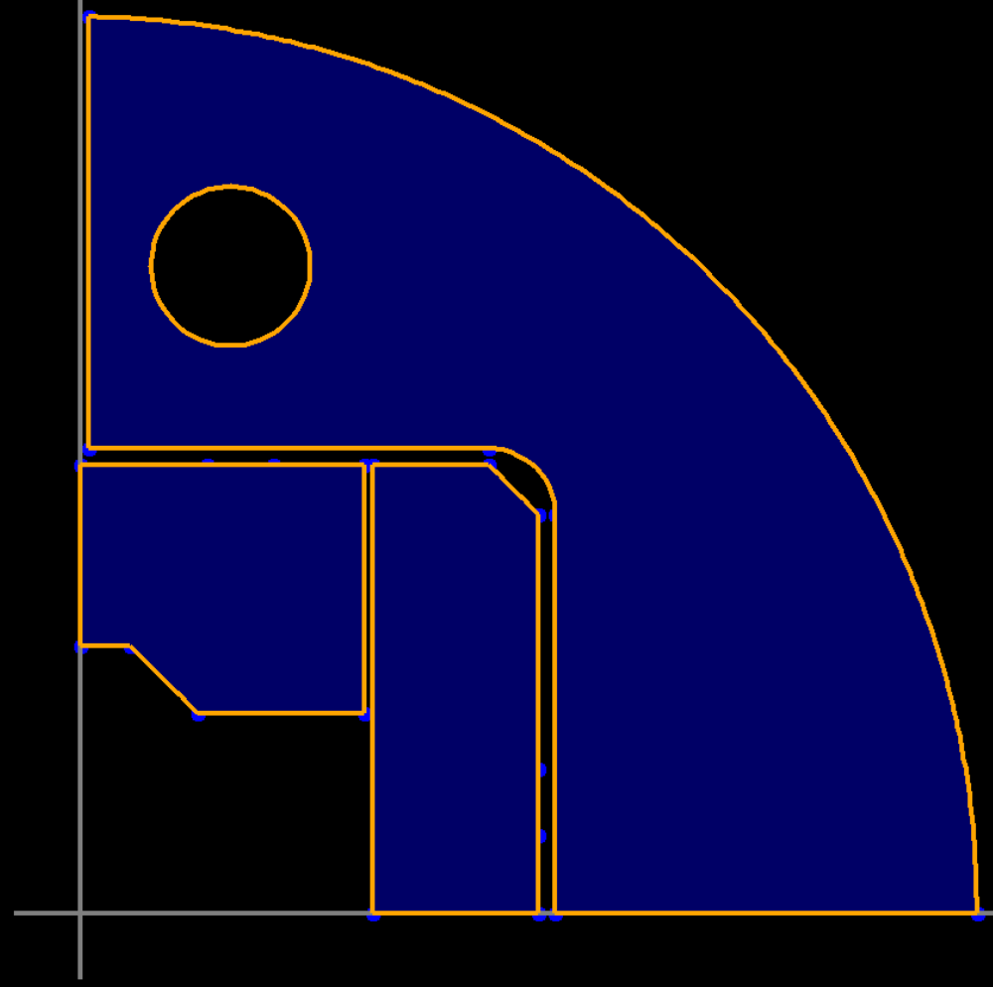
BOND single – Baseline parameters
Iron dimensions
R=24
X0: 45
Y0: 195
R=270
R=20
85.295
15
20
140
135
20
60.295
50
87.92
142.92

Slide 8
BOND single – Baseline magnetic design
2D magnetic (ROXIE)
Operational parameters
Current (Inom) | (kA) | 20.255
Peak Field | (T) | 14.75
Short sample current @ 1.9 K | (kA) | 25.300
Short sample current @ 4.5 K | (kA) | 22.560
Short sample field @ 1.9 K | (T) | 17.91
Short sample field @ 4.5 K | (T) | 16.15
j overall | (A/mm²) | 331
j strand | (A/mm²) | 484
j superconductor | (A/mm²) | 920
Loadline fraction @1.9 K | (%) | 80.1
Loadline fraction @4.5 K | (%) | 89.8
Stored energy/m | (MJ/m) | 1.030
Inductance/m | (mH/m) | 4.60
Stored energy | (MJ) | 1.45
Field quality
Harmonic b2 @ Inom | (10-4) | 0.00
Harmonic b3 @ Inom | (10⁻⁴) | 8.80
Harmonic b4 @ Inom | (10⁻⁴) | 0.00
Harmonic b5 @ Inom | (10⁻⁴) | 6.60
Harmonic b7 @ Inom | (10-4) | 1.96
Protection
Coil energy density | (J/mm³) | 0.081
j copper | (A/mm²) | 1023
Temperature margin @ 1.9 K | (K) | 4.13
Time margin | (ms) | 91
Hot spot Temperature | (K) | 108
Mechanics
Forces x ( per quadrat) | (MN/m) | 6.027
Forces y ( per quadrat) | (MN/m) | -2.688
Force z (per head) | (MN) | 0.966
Overall Parameters
Aperture | (mm) | 50
Field | (T) | 14.00
Field integral | (T m) | 16.17
Magnetic length | (m) | 1.16
Coil length | (m) | 1.40
Number of apertures | (adim) | 1
Distance between apertures | (mm) | -
Yoke outer diameter | (mm) | 540
Shell outer diameter | (mm) | 640
Cable data
Material |  | Nb3Sn
Process |  | RRP
No. strands | (adim) | 44
Strand diameter | (mm) | 1.100
Cu/NonCu | (adim) | 0.9
RRR | (adim) | 150
Bare cable thickness (R) | (mm) | 1.99
Bare cable width (R) | (mm) | 26.460
Insulation thick radial (5 Mpa) | (mm) | 0.150
Insulated cable surface | (mm²) | 61.28
Filling factor | (adim) | 0.359
Coil design
Insulated cable surface (one aperture) | (mm²) | 12746
Equivalent coil width | (mm) | 56.9
Coil efficiency | (T mm / A) | 0.00074
N. layers | (adim) | 2
N. turns/pole | (adim) | 52
Cable length/pole | (m) | 153

Slide 9
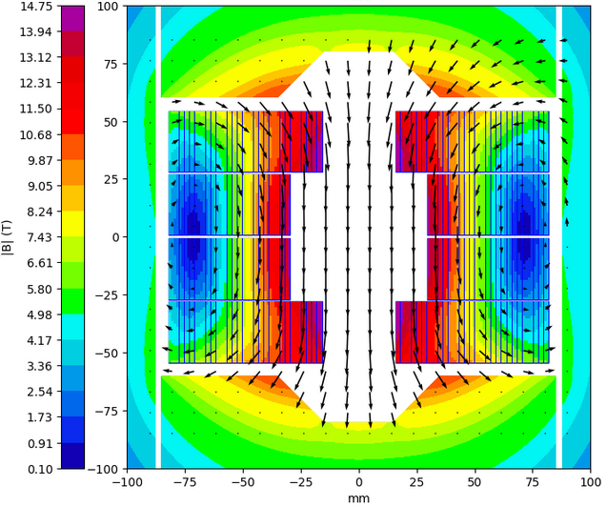
BOND single – Baseline magnetic design
2D magnetic (ROXIE)

Slide 10
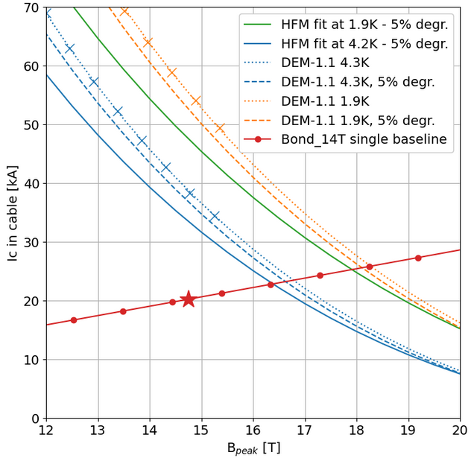
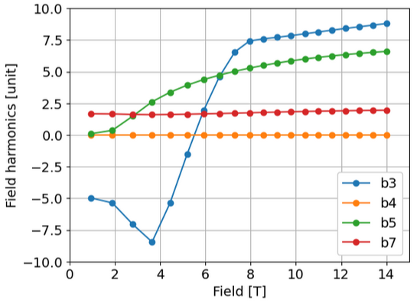
BOND single – Baseline magnetic design
2D magnetic (ROXIE)

Slide 11
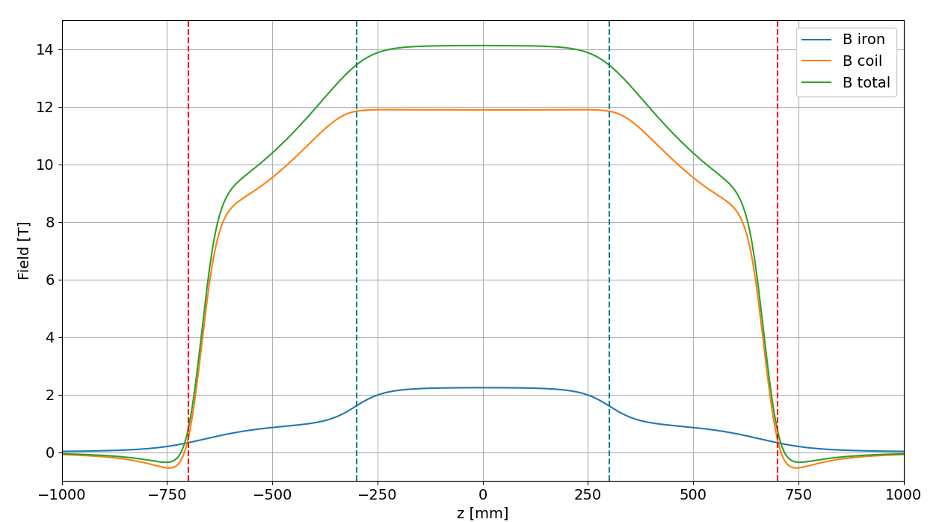
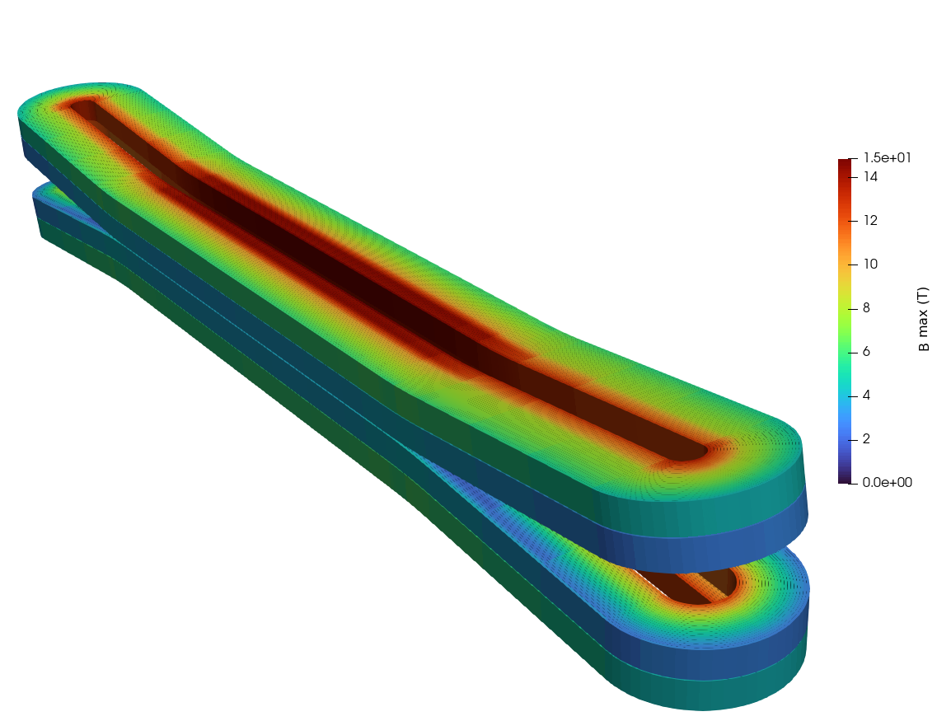
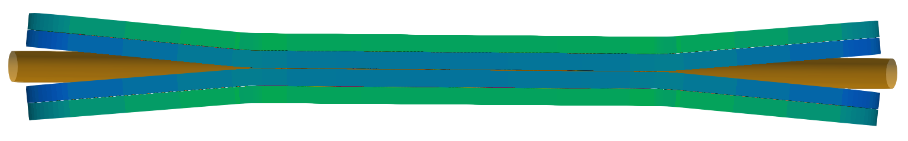
BOND single – Baseline magnetic design
3D magnetic (ROXIE)
3D parameters
Flared end curvature radius | (mm) | 750/803
Flared end angle | (º) | 5
Flared end straight part | (mm) | 250/248
Flared end length | (mm) | 402
Straight section length | (mm) | 600
Pad length | (mm) | 600
Iron yoke length | (mm) | 1400
Field at center: 14.12 T
Field integral: 16.17 T.m
Magnetic length: 1.15 m
Iron pads
Iron yoke

Slide 12
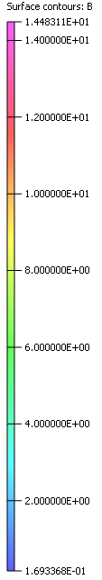
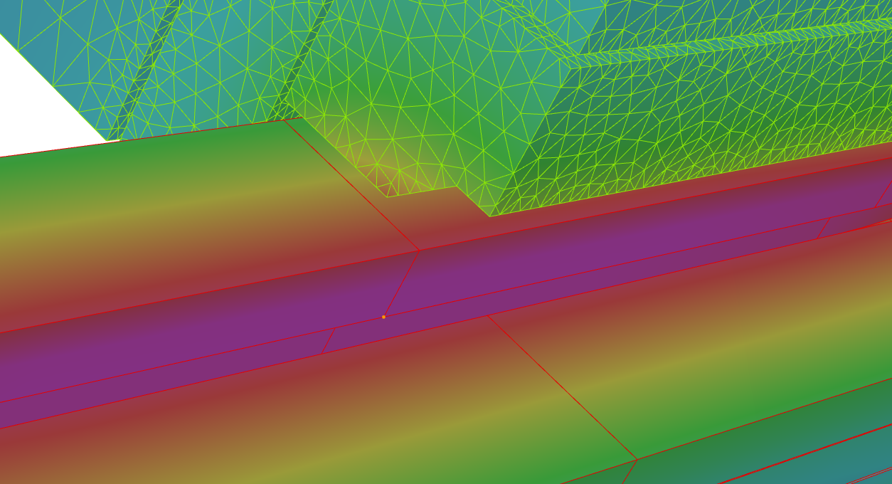
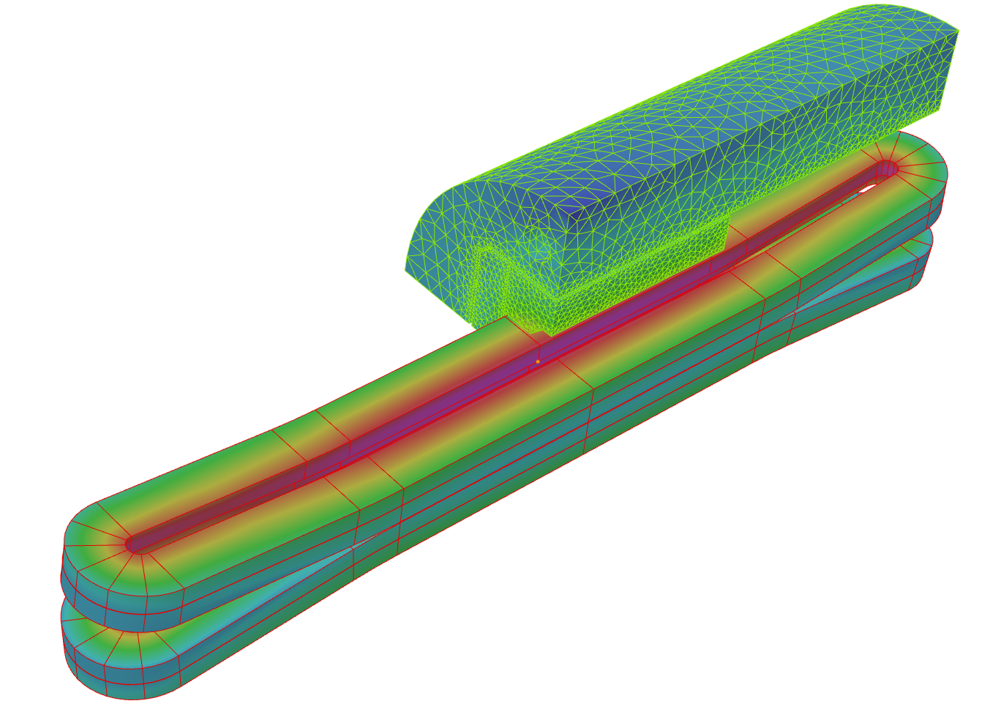
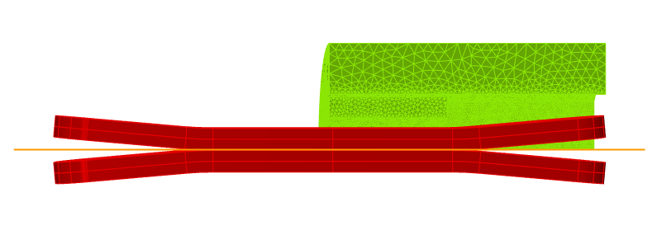
BOND single – Baseline magnetic design
3D magnetic (Opera)
Field at center: 14.11 T
Field integral: 16.22 T.m
Magnetic length: 1.15 m
B peak
Courtesy of E. Fernandez Mora

Slide 13
BOND single – Baseline magnetic model
Transfer function

Slide 14
BOND Single Aperture
Baseline - Mechanical Model

Slide 15
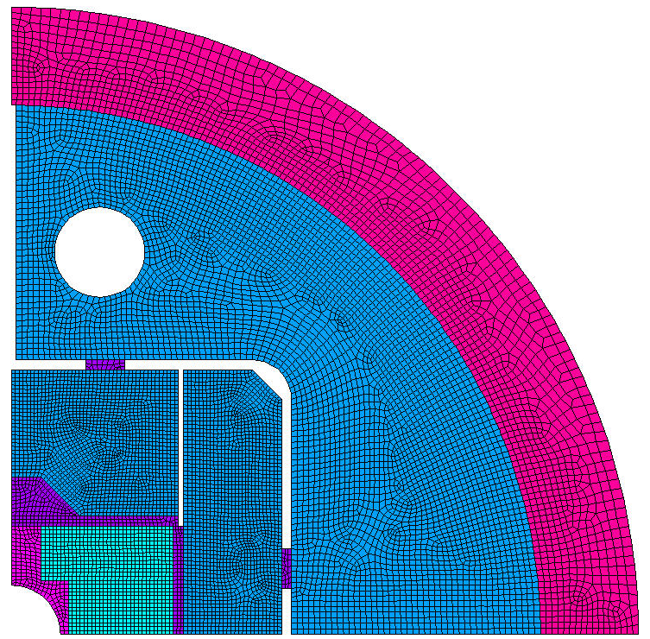
BOND single – Baseline mechanical model
Introduction to mechanical model
Al-cylinder based mechanical structure – Bladder and Key loading procedure
Bonded coil components. Frictional contacts anywhere else (µ = 0.2)
Isotropic material properties
Criteria
Use same modelling assumptions as MQXF, which we know well
Target similar coil peak stress limits at warm/cold as MQXF:
  RT below 110 - 120 MPa
  CD below 150 MPa
Maintain an average contact pressure > 5 MPa
All components below yield limits: S_{VM} or S1 at cold for brittle materials
Spacer in Stainless to improve cooling
Courtesy of J. Ferradas Troitino

Slide 16
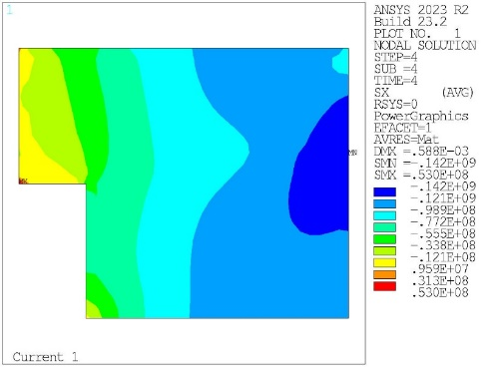
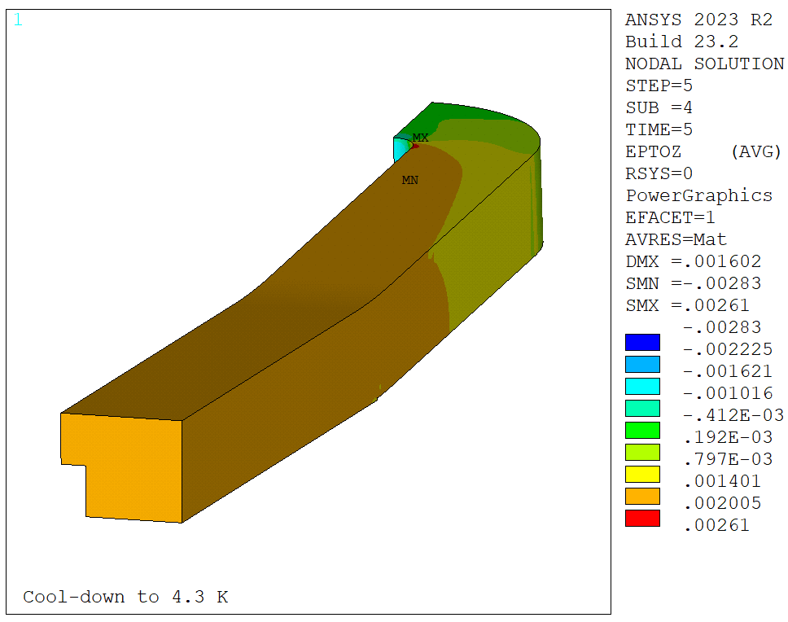
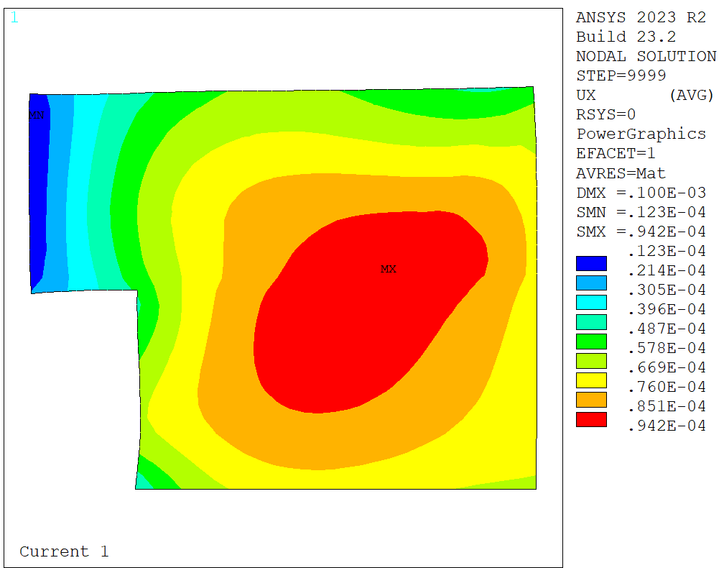
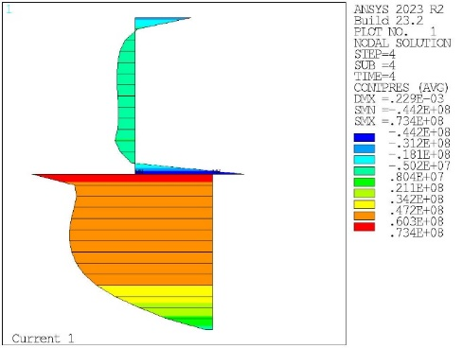
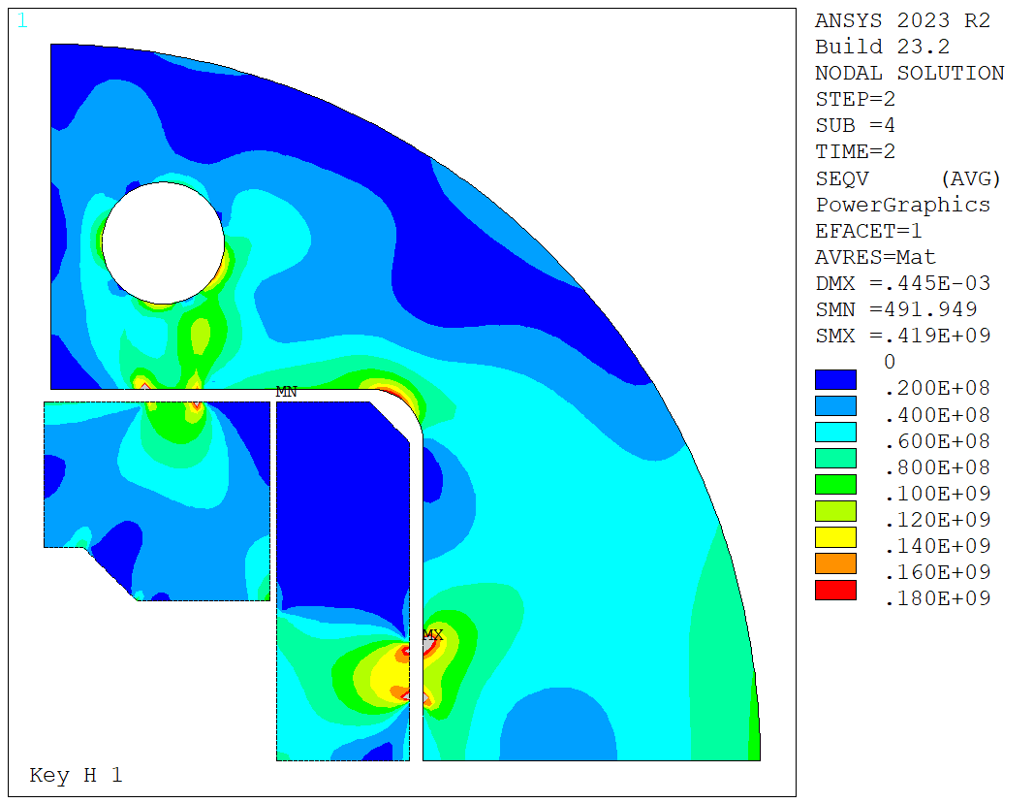
BOND single – Baseline mechanical model
Results summary
Coil stresses
Coil longitudinal strain
Coil displacements
Coil contact pressure
Stress limits in the structure
Coil is below stress limits:
σ_{VM} < 120 MPa at RT
σ_{VM} < 150 MPa at cold
Roughly: ε_{z} < 2000 µstr
Coil and pole displacements
< 0.1 mm during powering
Average contact pressure > 5 MPa during powering
All components below yield limits (S_{VM} or S1 for brittle materials)
Courtesy of J. Ferradas Troitino

Slide 17
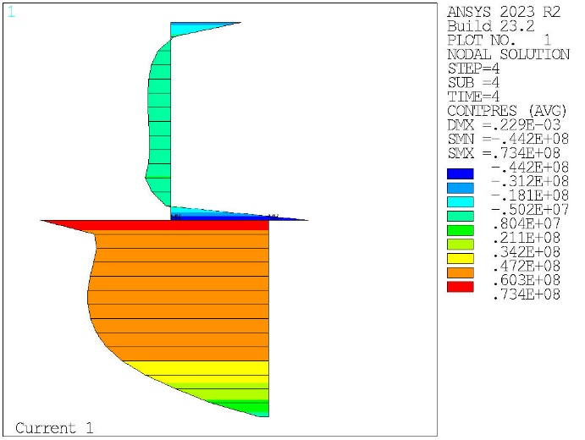
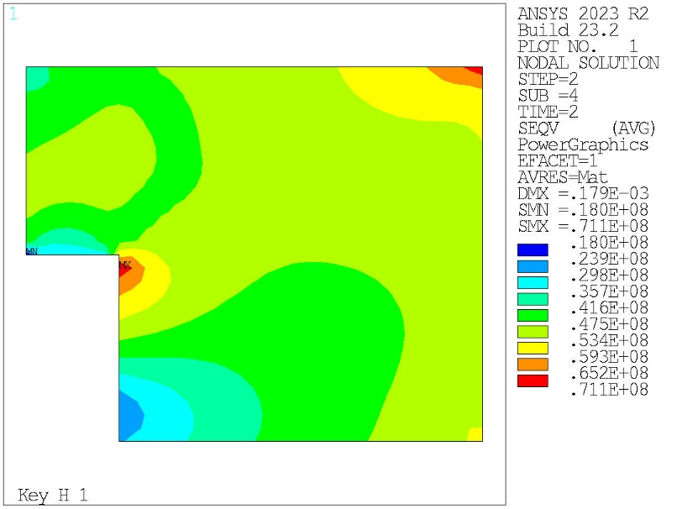
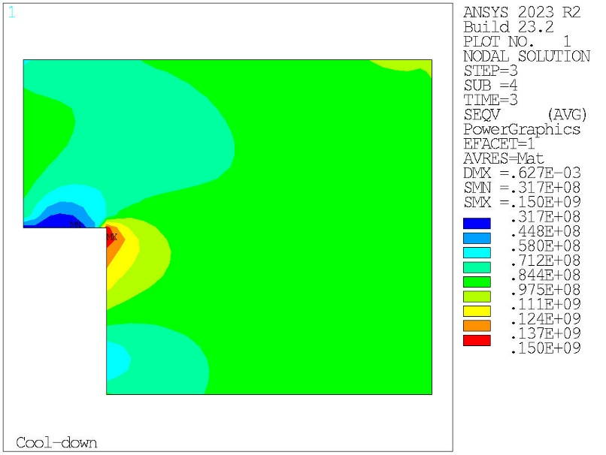
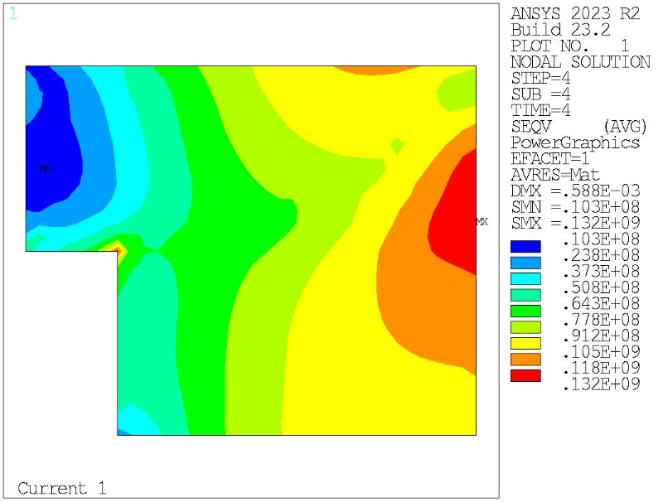
BOND single – Baseline mechanical model
Equivalent stress on coil
Contact pressure at 14 T
Warm (Peak: 71 Mpa)
Cold (Peak: 150 Mpa)
Field (Peak: 132 Mpa)
Courtesy of J. Ferradas Troitino

Slide 18
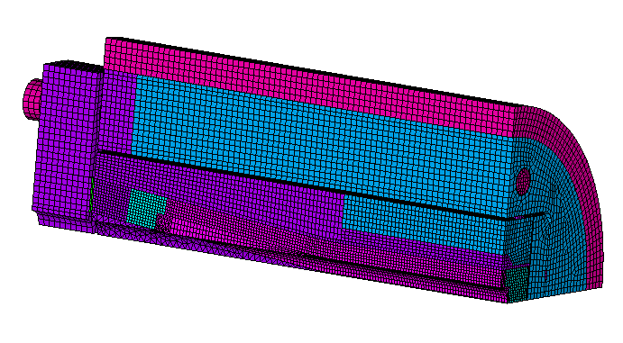
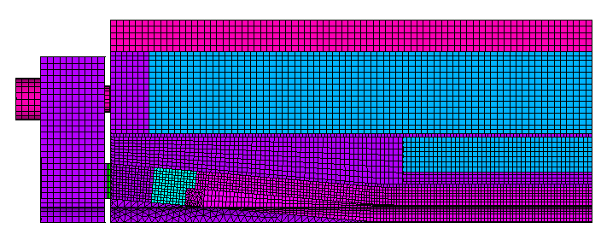
BOND single – Baseline mechanical model
3D mechanical model (Ansys)
Forces from Opera 3D model
  Total force imported:
  Fx = 3.7 MN (5.3 MN/m)*
  Fy = -1.5 MN (-2.13 MN/m)*
  Fz = -0.27 MN (-1.079 MN total)
Temporary endplate (100 mm thick)
No lateral contact with the wedge.
Endpusher only against the coils.
* Assuming 700 mm length
1522.9 mm / 2
1400 mm / 2
600 mm / 2
Isotropic coil material model (same as 2D)
Same horizontal interference as 2D (650µm horizontal), 50µm for the vertical one
Courtesy of J. Ferradas Troitino

Slide 19
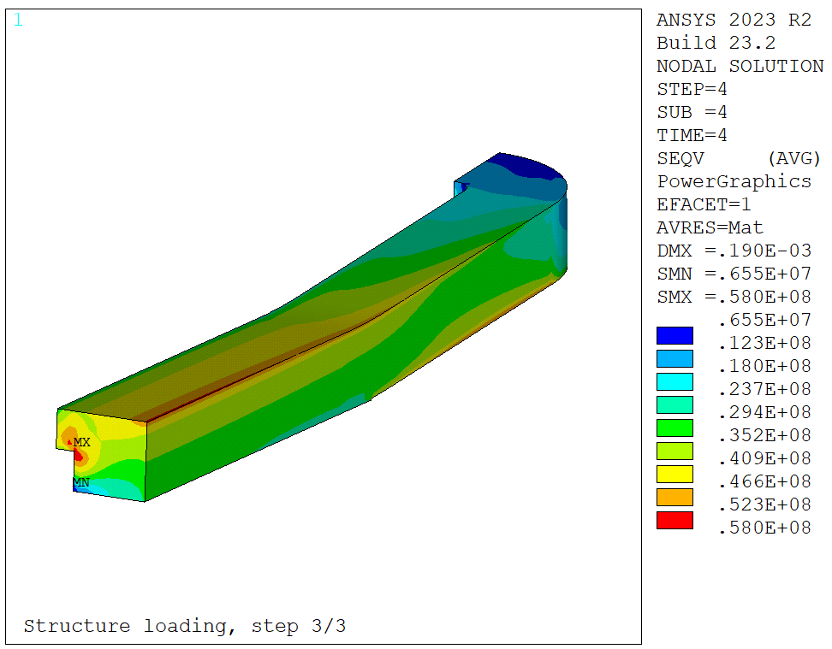
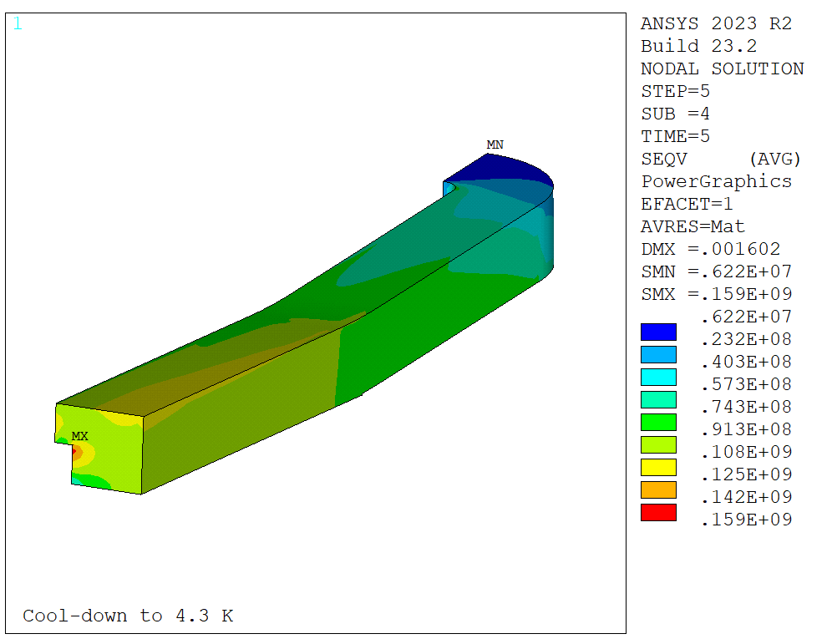
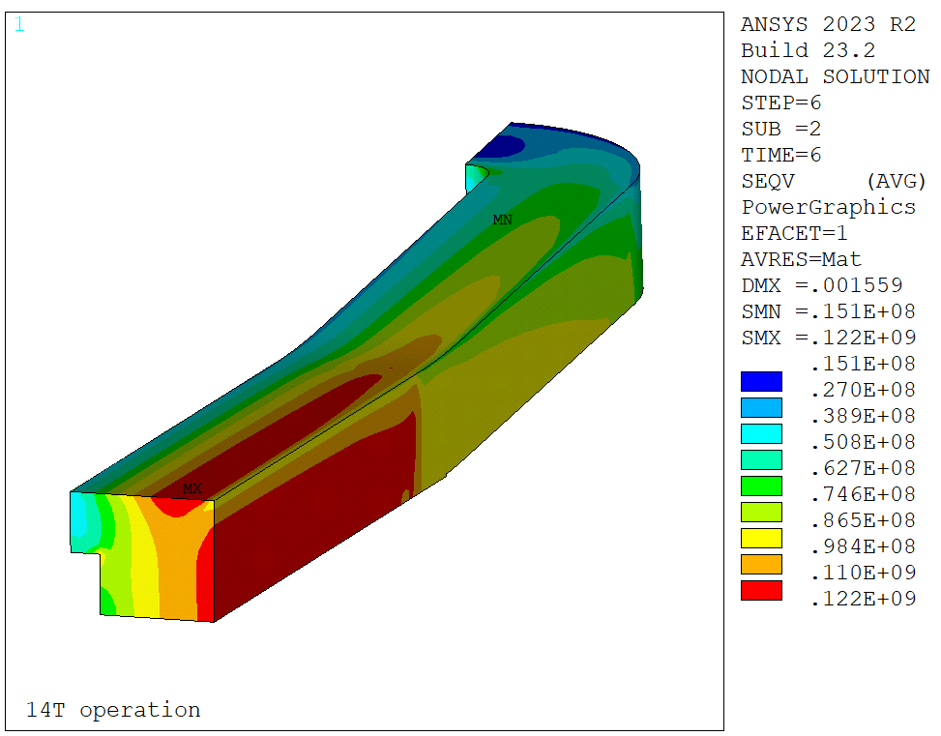
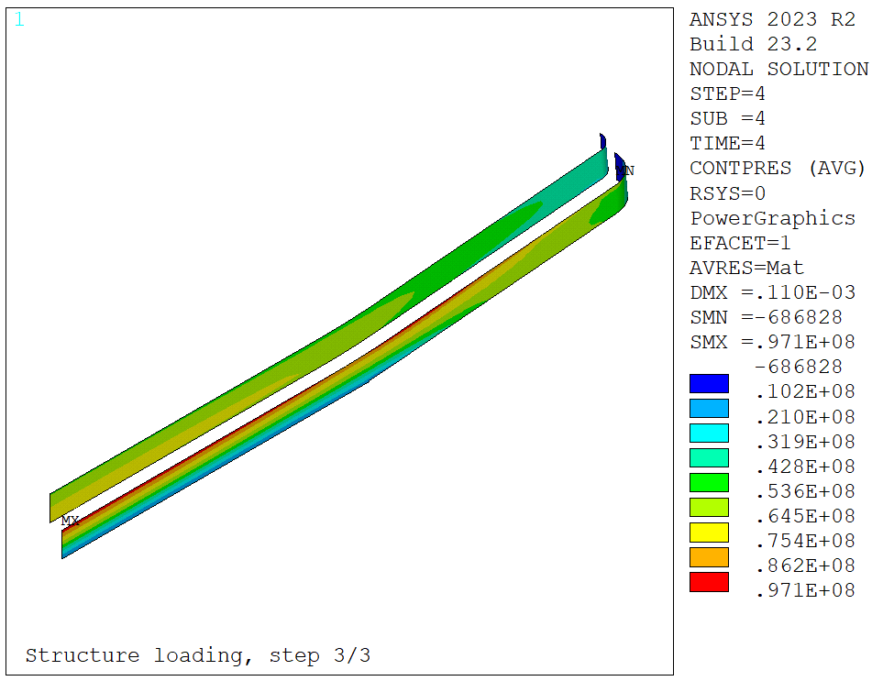
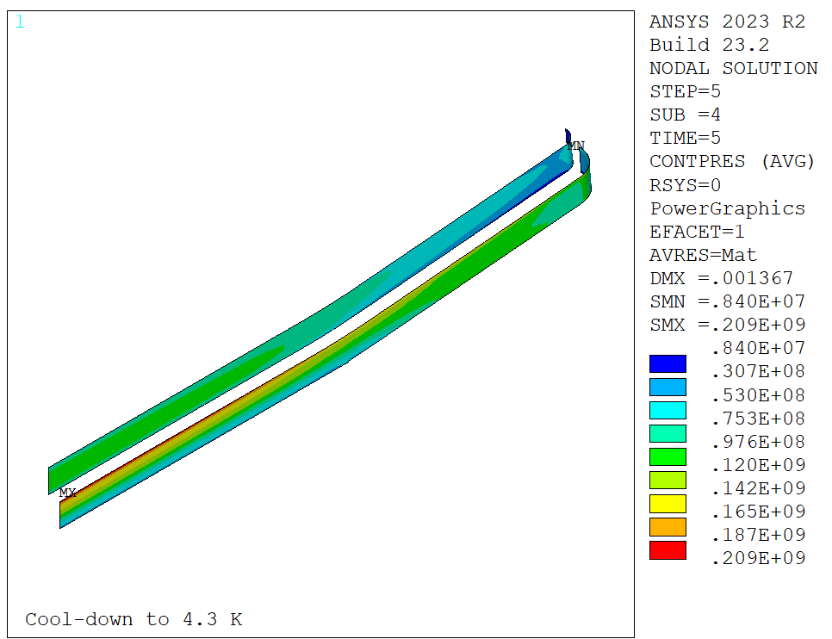
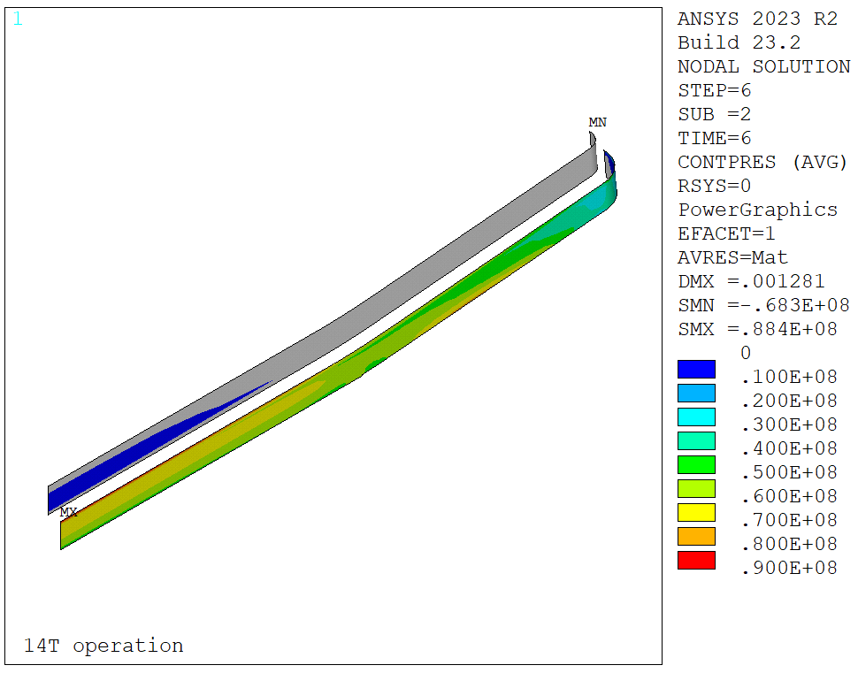
BOND single – Baseline mechanical model
3D mechanical model (Ansys)
Warm (Peak: 66 Mpa)
Cold (Peak: 159 Mpa)
Field (Peak: 122 Mpa)
Courtesy of J. Ferradas Troitino

Slide 20
BOND Single Aperture
Baseline - Mechanical Model

Slide 21
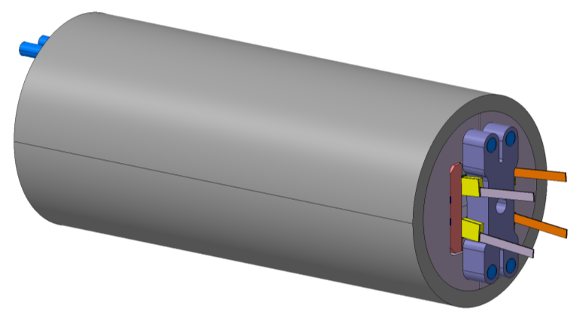
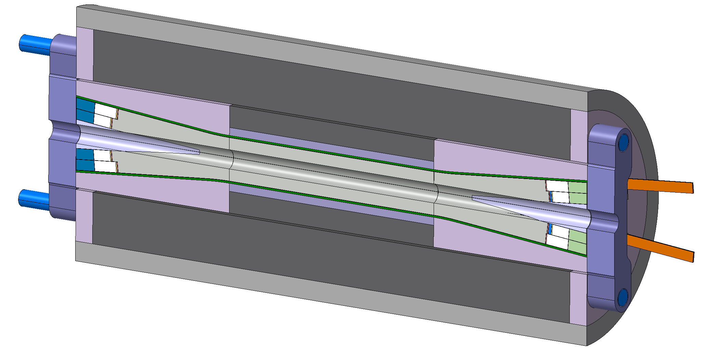
BOND single – Baseline engineering
Engineering design on-going
Courtesy of N. Peray

Slide 22
BOND single – Baseline engineering
Tooling for reaction and impregnation under development
Reaction
Impregnation
Courtesy of N. Peray

Slide 23
BOND Single Aperture
40x1.1 mm – Alternative option

Slide 24
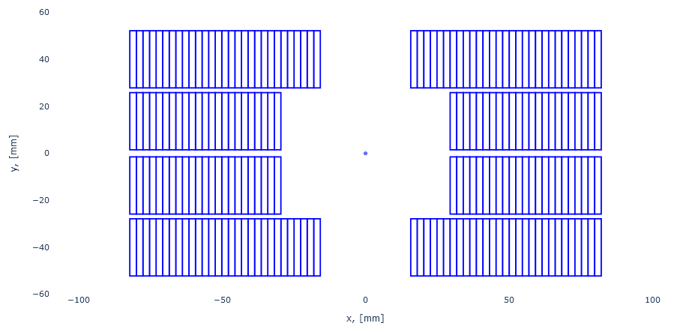
BOND single – 40x1.1 mm option
40 x 1.1 mm parameters
Conductor parameters
Strand diameter | (mm) | 1.10
Layout |  | RRP 162/169
Effective filament diameter | (µm) | 64
Jc at 4.2 K and 16 T | (A/mm²) | 1200
Cu/NonCu ratio |  | 0.9
No. of strands in cable |  | 40
Bare cable thickness | (mm) | 1.91
Bare cable width | (mm) | 23.81
Bare cable thickness (reacted) | (mm) | 1.99
Bare cable width (reacted) | (mm) | 24.05
Insulation thickness | (mm) | 0.15
Insulated cable width (reacted) | (mm) | 24.35
Insulated cable thickness (reacted) | (mm) | 2.29
A strand | (mm²) | 0.950
A sc | (mm²) | 0.500
A cu | (mm²) | 0.450
29
Interlayer
2.0 mm
23
Midplane
Aperture
50 mm
3.0 mm
Same 50 mm aperture
Same coil pack dimension as baseline
Adjustment of coil position to optimize field quality

Slide 25
Bond single - 40x1.1 mm magnetic design
2D magnetic (ROXIE)
Operational parameters
Current (Inom) | (kA) | 19.915
Peak Field | (T) | 14.83
Short sample current @ 1.9 K | (kA) | 24.283
Short sample current @ 4.5 K | (kA) | 21.657
Short sample field @ 1.9 K | (T) | 17.95
Short sample field @ 4.5 K | (T) | 15.95
j overall | (A/mm²) | 357
j strand | (A/mm²) | 524
j superconductor | (A/mm²) | 995
Loadline fraction @1.9 K | (%) | 82.0
Loadline fraction @4.5 K | (%) | 92.0
Stored energy/m | (MJ/m) | 2.194
Inductance/m | (mH/m) | 4.64
Stored energy | (MJ) | 3.07
Field quality
Harmonic b2 @ Inom | (10-4) | 0.00
Harmonic b3 @ Inom | (10⁻⁴) | 6.70
Harmonic b4 @ Inom | (10⁻⁴) | 0.00
Harmonic b5 @ Inom | (10⁻⁴) | 4.23
Harmonic b7 @ Inom | (10-4) | 1.17
Protection
Coil energy density | (J/mm³) | 0.095
j copper | (A/mm²) | 1106
Temperature margin @ 1.9 K | (K) | 4.00
Time margin | (ms) | 76
Hot spot Temperature | (K) | 112
Mechanics
Forces x ( per quadrat) | (MN/m) | 5.926
Forces y ( per quadrat) | (MN/m) | -2.651
Force z (per head) | (MN)
Overall Parameters
Aperture | (mm) | 50
Field | (T) | 14.00
Field integral | (T m) | 16.17
Magnetic length | (m) | 1.16
Coil length | (m) | 1.40
Number of apertures | (adim) | 1
Distance between apertures | (mm) | -
Yoke outer diameter | (mm) | 540
Shell outer diameter | (mm) | 640
Cable data
Material |  | Nb3Sn
Process |  | RRP
No. strands | (adim) | 40
Strand diameter | (mm) | 1.100
Cu/NonCu | (adim) | 0.9
RRR | (adim) | 152
Bare cable thickness (R) | (mm) | 1.99
Bare cable width (R) | (mm) | 24.050
Insulation thick radial (5 Mpa) | (mm) | 0.150
Insulated cable surface | (mm²) | 55.76
Filling factor | (adim) | 0.359
Coil design
Insulated cable surface (one aperture) | (mm²) | 11598
Equivalent coil width | (mm) | 53.5
Coil efficiency | (T mm / A) | 0.00073
N. layers | (adim) | 2
N. turns/pole | (adim) | 52
Cable length/pole | (m) | 153

Slide 26
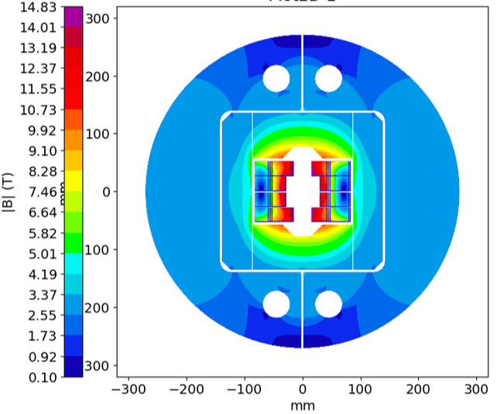
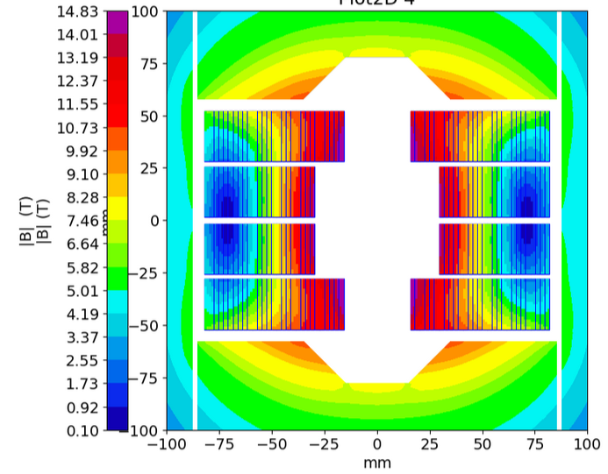
Bond single - 40x1.1 mm magnetic design
2D magnetic (ROXIE)

Slide 27
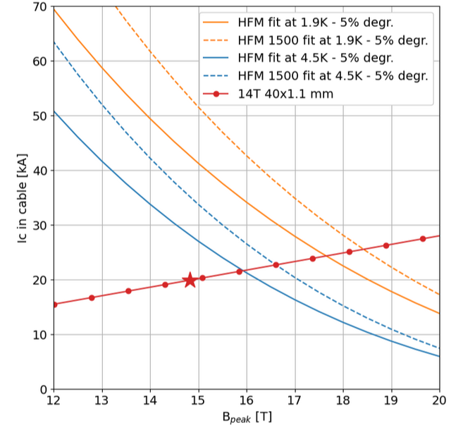
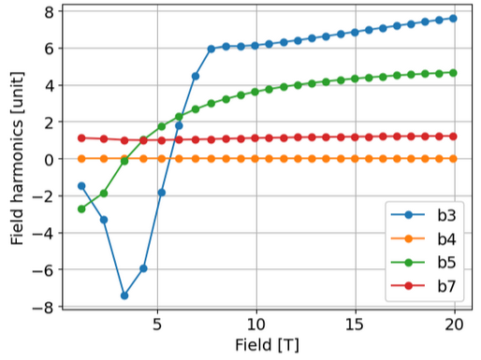
Bond single - 40x1.1 mm
2D magnetic (ROXIE)

Slide 28
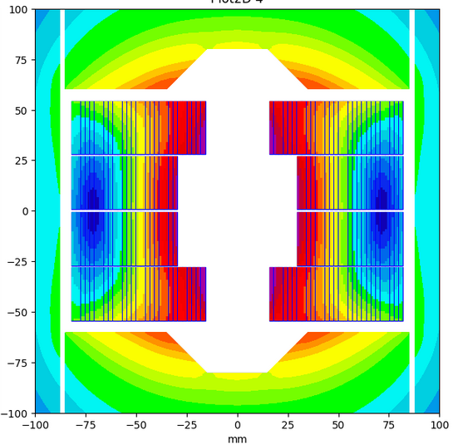
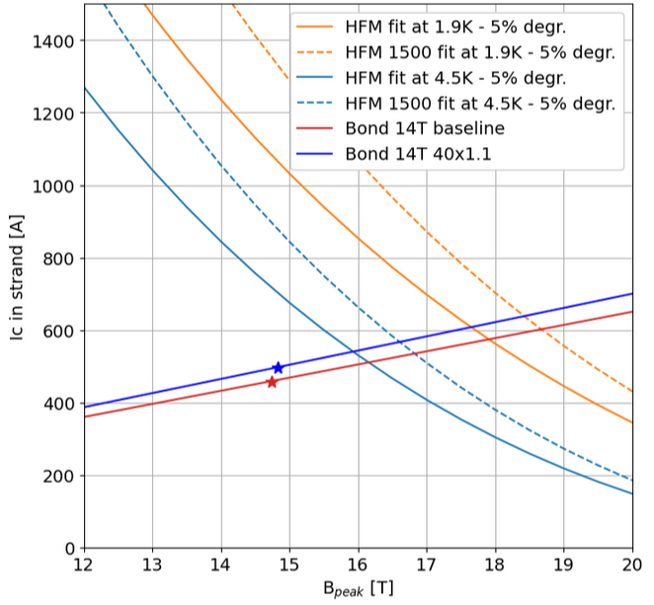
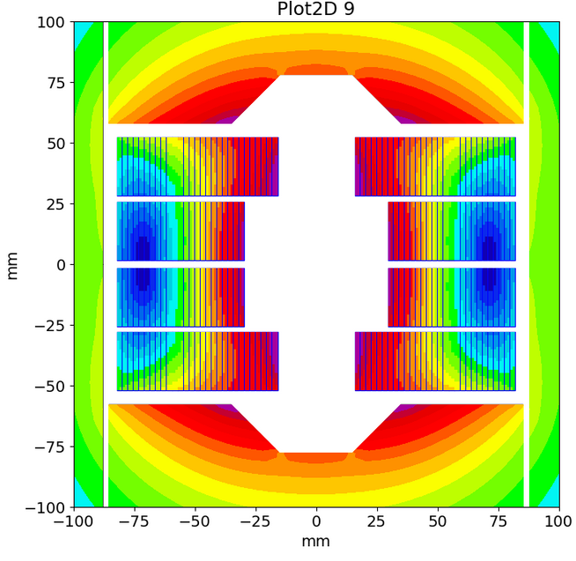
Bond single - Alternative options
2D magnetic (ROXIE)
Coil design |  | Baseline | 40x1.1
Insulated cable surface (one aperture) | (mm²) | 12746 | 11598
Equivalent coil width | (mm) | 56.9 | 53.5
Coil efficiency | (T mm / A) | 0.00074 | 0.00073
N. layers | (adim) | 2 | 2
N. turns/pole | (adim) | 52 | 52
Cable length/pole | (m) | 153 | 153
Relative conductor difference to baseline | (%) | 0 | 9.0
Operational parameters
Current | (kA) | 20.255 | 19.915
Peak Field | (T) | 14.75 | 14.83
Short sample current @ 1.9 K | (kA) | 25.300 | 24.283
Short sample current @ 4.5 K | (kA) | 22.560 | 21.657
Short sample field @ 1.9 K | (T) | 17.91 | 17.95
Short sample field @ 4.5 K | (T) | 16.15 | 15.95
j overall | (A/mm²) | 331 | 357
j strand | (A/mm²) | 484 | 524
j superconductor | (A/mm²) | 920 | 995
Loadline fraction @1.9 K | (%) | 80.1 | 82.0
Loadline fraction @4.5 K | (%) | 89.8 | 92.0

Slide 29
Bond single - Alternative options
Discussion
Pros
cable production at CERN
less conductor
  9 %
  ~3 km of strand for BOND Double
more interlayer spacings
  3 mm at midplane, 1.5 mm at interlayer
Cons
cable to be developed
less margin
  ~2 % (92% shortsample at 4.5K)
Coil design |  | Baseline | 40x1.1
Insulated cable surface (one aperture) | (mm²) | 12746 | 11598
Equivalent coil width | (mm) | 56.9 | 53.5
Coil efficiency | (T mm / A) | 0.00074 | 0.00073
N. layers | (adim) | 2 | 2
N. turns/pole | (adim) | 52 | 52
Cable length/pole | (m) | 153 | 153
Relative conductor difference to baseline | (%) | 0 | 9.0
Operational parameters
Current | (kA) | 20.255 | 19.915
Peak Field | (T) | 14.75 | 14.83
Short sample current @ 1.9 K | (kA) | 25.300 | 24.283
Short sample current @ 4.5 K | (kA) | 22.560 | 21.657
Short sample field @ 1.9 K | (T) | 17.91 | 17.95
Short sample field @ 4.5 K | (T) | 16.15 | 15.95
j overall | (A/mm²) | 331 | 357
j strand | (A/mm²) | 484 | 524
j superconductor | (A/mm²) | 920 | 995
Loadline fraction @1.9 K | (%) | 80.1 | 82.0
Loadline fraction @4.5 K | (%) | 89.8 | 92.0

Slide 30
BOND Double Aperture
2D Magnetic design

Slide 31
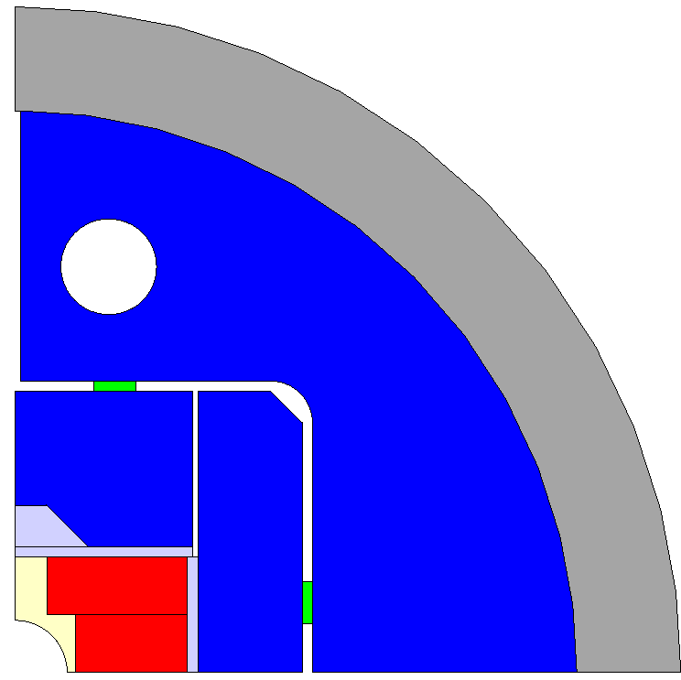
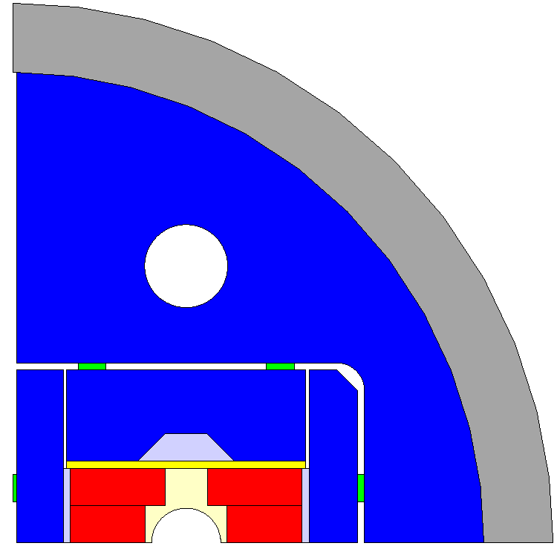
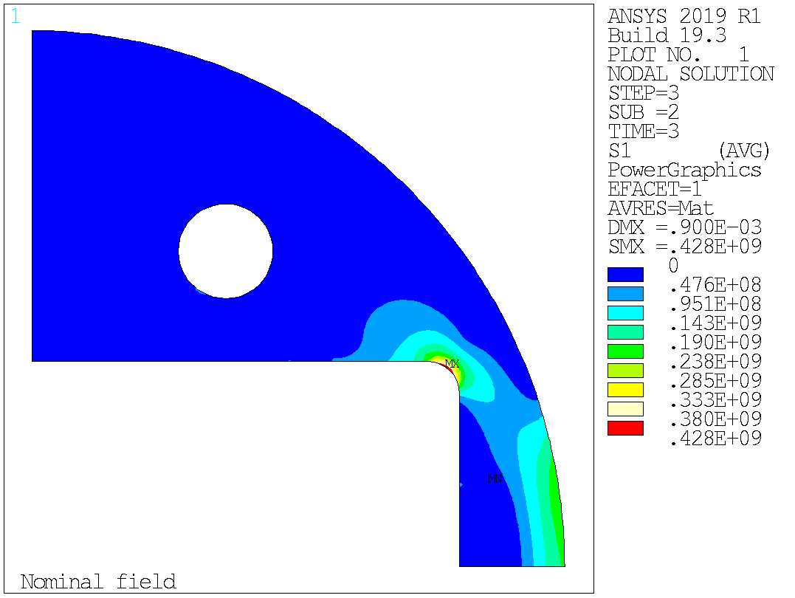
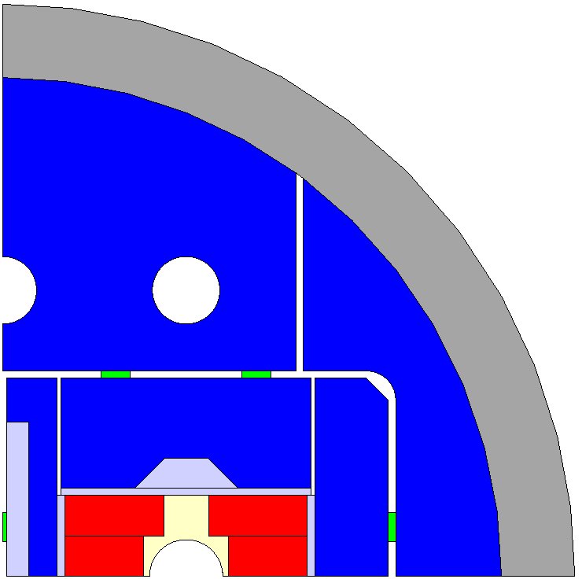
Bond Double
From Single to Double
V1: Straight from single with central pad -> too high stress at the corner
V2: Introduction of:
  4 pieces yoke,
  optimized central pad with SS master
  extra rod hole
V1
V2

Slide 32
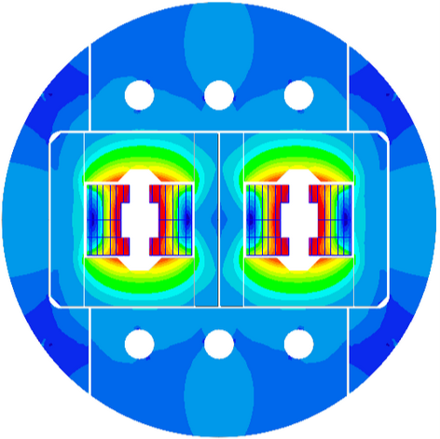











Bond Double
Magnetic field quality optimization
Close
Gap = 10 mm
Gap = 15 mm
Gap = 20 mm
Full gap
Open

Slide 33

BOND Double – Baseline parameters
Iron dimensions
R=340
R=24
R=24
X0: 0
Y0: 195
X0: 125
Y0: 195
200
R=20
85.295
135
15
20
105
20
20
140
60.295
87.92
50
125
142.92

Slide 34
BOND Double – Baseline magnetic design
2D magnetic (ROXIE)
Operational parameters
Current (Inom) | (kA) | 19.590
Peak Field | (T) | 14.72
Short sample current @ 1.9 K | (kA) | 24.581
Short sample current @ 4.2 K | (kA) | 21.904
Short sample field @ 1.9 K | (T) | 18.00
Short sample field @ 4.2 K | (T) | 16.25
j overall | (A/mm²) | 320
j strand | (A/mm²) | 468
j superconductor | (A/mm²) | 890
Loadline fraction @1.9 K | (adim) | 0.797
Loadline fraction @4.2 K | (adim) | 0.894
Stored energy/m | (MJ/m) | 2.064
Inductance/m | (mH/m) | 10.00
Stored energy | (MJ) | 2.89
Field quality
Harmonic b2 @ Inom | (10-4) | -8.12
Harmonic b3 @ Inom | (10⁻⁴) | 11.55
Harmonic b4 @ Inom | (10⁻⁴) | -0.07
Harmonic b5 @ Inom | (10⁻⁴) | 6.37
Harmonic b7 @ Inom | (10-4) | 1.89
Protection
Coil energy density | (J/mm³) | 0.081
j copper | (A/mm²) | 989
Temperature margin @ 1.9 K | (K) | 4.13
Time margin | (ms) | 104
Hot spot Temperature | (K) | 106
Mechanics
Forces x ( per quadrat) | (MN/m) | 6.107
Forces y ( per quadrat) | (MN/m) | -2.531
Force z (per head) | (MN)
Overall Parameters
Aperture | (mm) | 50
Field | (T) | 14.00
Field integral | (T m) | 16.17
Magnetic length | (m) | 1.16
Coil length | (m) | 1.40
Number of apertures | (adim) | 2
Distance between apertures | (mm) | 250
Yoke outer diameter | (mm) | 680
Shell outer diameter | (mm) | 780
Cable data
Material |  | Nb3Sn
Process |  | RRP
No. strands | (adim) | 44
Strand diameter | (mm) | 1.100
Cu/NonCu | (adim) | 0.9
RRR | (adim) | 150
Bare cable thickness (R) | (mm) | 1.99
Bare cable width (R) | (mm) | 26.460
Insulation thick radial (5 Mpa) | (mm) | 0.150
Insulated cable surface | (mm²) | 61.28
Filling factor | (adim) | 0.359
Coil design
Insulated cable surface (one aperture) | (mm²) | 12746
Equivalent coil width | (mm) | 56.9
Coil efficiency | (T mm / A) | 0.00077
N. layers | (adim) | 2
N. turns/pole | (adim) | 52
Cable length/pole | (m) | 153

Slide 35

BOND Double – Baseline magnetic design
2D magnetic (ROXIE)

Slide 36


BOND Double – Baseline magnetic design
2D magnetic (ROXIE)

Slide 37
BOND Double Aperture
2D Mechanical model

Slide 38


BOND Double – Baseline mechanical model
Mesh, contacts and symmetries
bonded
sliding
interference
coupled
symmetry

Slide 39



BOND Double – Baseline mechanical model
Displacement plots
Horizontal key interference: 0.8 mm
Vertical key interference: 0.03 mm
Central key interference: 0.8 mm
Warm
Cold
Field

Slide 40




BOND Double – Baseline mechanical model
Coil equivalent stress
Horizontal key interference: 0.8 mm
Vertical key interference: 0.03 mm
Central key interference: 0.8 mm
Warm (Peak: 65 MPa)
Cold (Peak: 133 MPa)
Field (Peak: 150 MPa)

Slide 41
























BOND Double – Baseline mechanical model
Stress on structural parts

Slide 42

BOND Double – Baseline mechanical model
Coil equivalent stress
Interference (0.8 mm) already high
Not enough contribution from the shell at cooling
Need for a thicker shell
Iron becomes the limiting factor
Shell: 50 mm
Shell: 80 mm

Slide 43





BOND Double – Baseline mechanical model
Coil equivalent stress
Horizontal key interference: 0.8 mm
Vertical key interference: 0.03 mm
Central key interference: 0.8 mm
Warm (Peak: 83 MPa)
Cold (Peak: 152 MPa)
Field (Peak: 162 MPa)

Slide 44
























BOND Double – Baseline mechanical model
Stress on structural parts

Slide 46

Parameters for coil optimization

Slide 47


Parameters for field homogeneity

