Slide 1
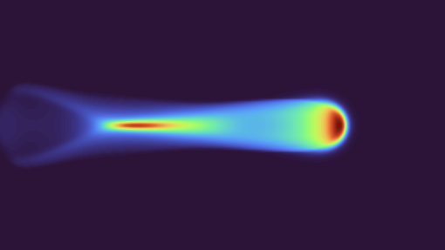

4th DRD1 Collaboration Meeting
WG4 Welcome & News
On Behalf of the WG4 Conveners
drd1-wg4-convenors@cern.ch
February 26th, 2025

Slide 2
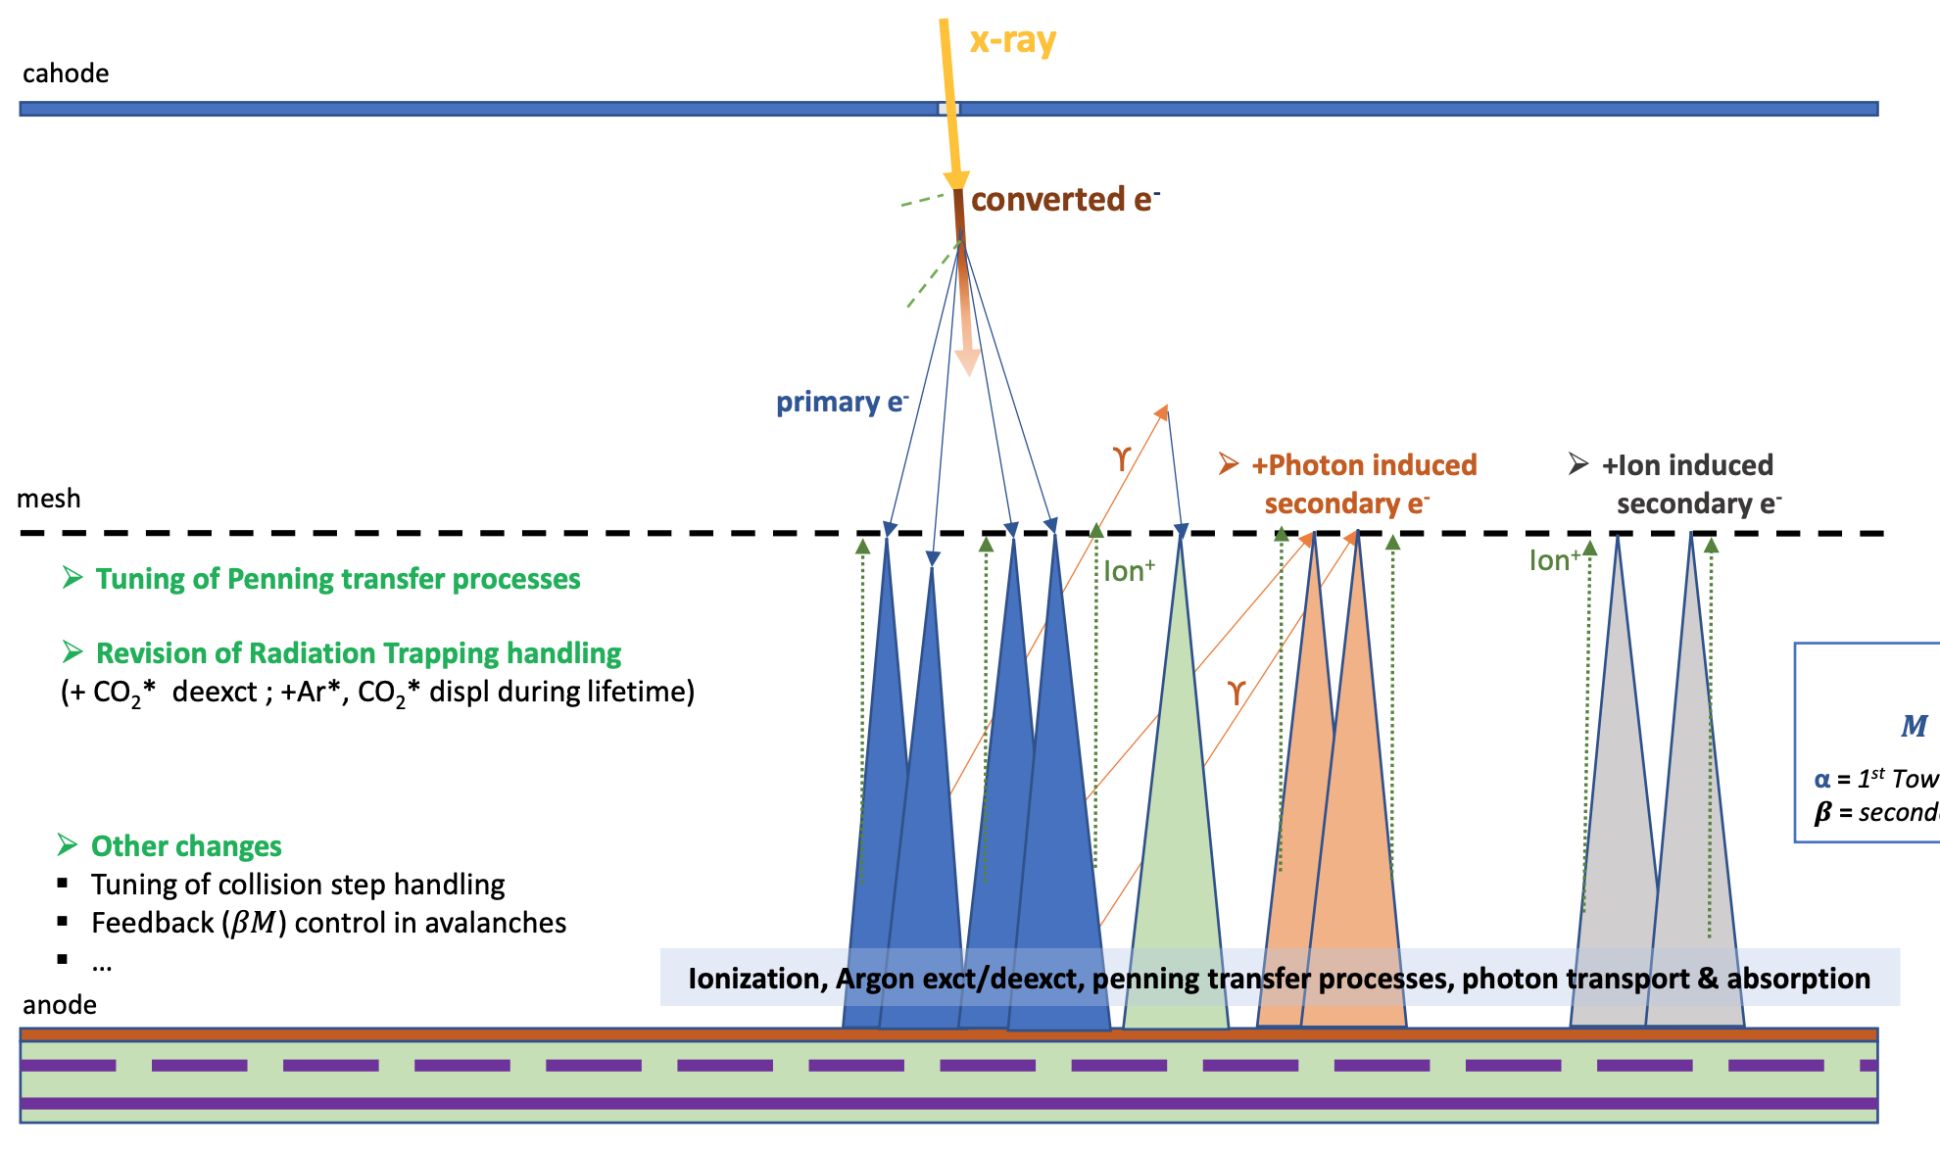
Meeting on Low-Pressure Simulations and Measurements
  On the 10th of February there was a meeting on Monte Carlo simulations of the at low pressures. This was based on a contribution of the SWEATERS project to the previous DRD1 collaboration meeting.
  Merging existing and new code to Garfield++ has started:
    Integration of the SWEATERS’ radiation trapping code into the main branch of Garfield++ (!460)
    Inclusion of a Runge-Kutta-Nyström method integration option during electron’s free flight (!458)
    Still, some work to do!
  More measurements are needed to better represent the different underlying physics processes
  Organize a WG4 topical meeting on this topic
Schematic overview of changes to the Garfield++ code
Indico page: https://indico.cern.ch/event/1510089/

Slide 3
WG4 Working Meetings
Since the last DRD1 Collaboration Meeting (CM), a convener meet-up was organized to discuss the upcoming CM, organise a meeting on low-pressure simulations, and to exchange ideas on approaches to tackle certain topics. Additionally, a proposal was made for a series of upcoming WG4 topical meetings:
Documentation & Simulation School (March 2025)
  Initiate the organization of a dedicated simulation school
    General discussion on the aims of the school
    Identify interested parties to assist in organizing and developing exercises
  Open discussion on strategies to improve the documentation of MC toolkits
Simulation and Measurements at Low-Pressures (April 2025)
  Contributions from groups working on this topic
  Open discussion on simulation strategies
  Identify key measurements needed to enhance our understanding of the underlying physics
  Explore synergies with other WGs and WPs
Multi-threaded and GPU-Accelerated Methods (May 2025?)
  Contributions from groups working on this topic
  Open discussion on the usefulness and implementation of these methods in key simulation toolkits
Past WG4 work meetings: https://indico.cern.ch/category/18031/

Slide 4
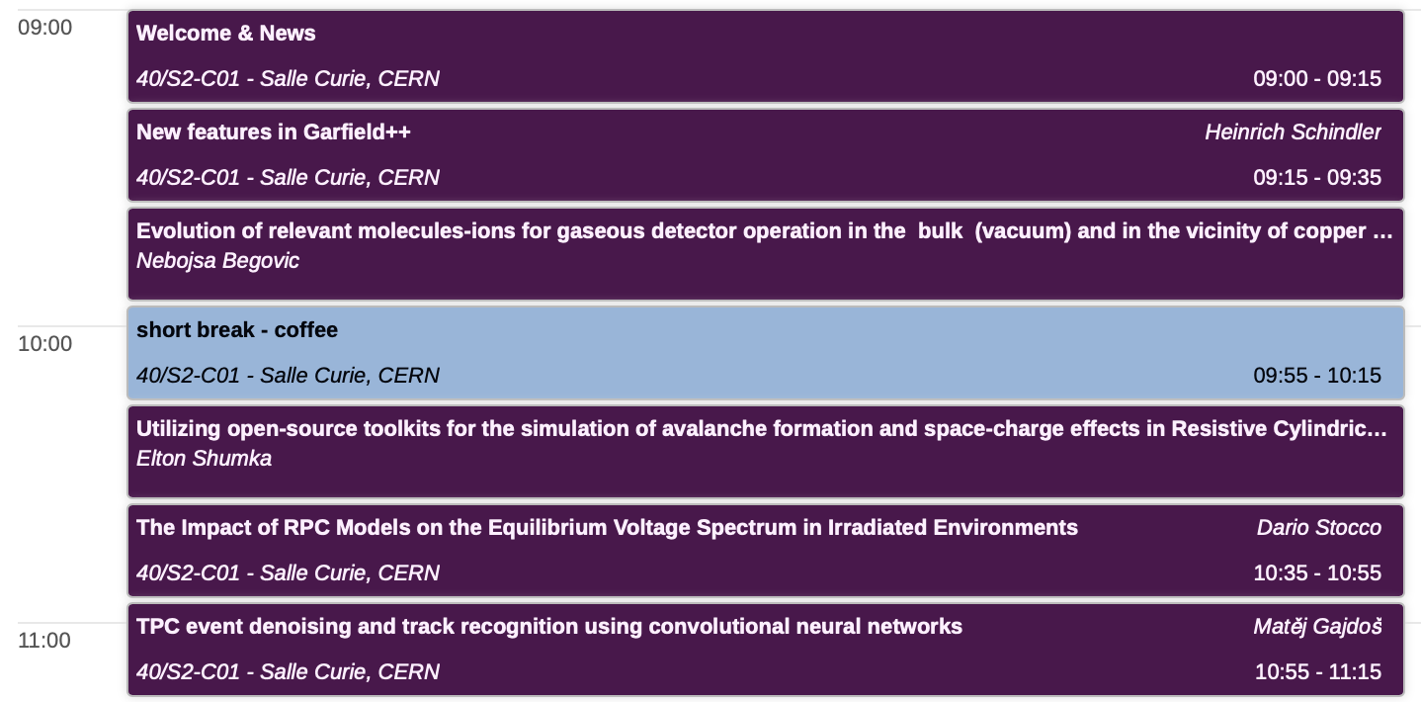
Today’s WG4 Agenda
WG4 agenda and contributions: https://indico.cern.ch/event/1489983/sessions/580472/#20250226

Slide 5
  Thank you for your attention!

