Slide 1

Technical Resources and DRD1 Bulletin
Working Group 8: Knowledge Transfer, Training, Career Promotion
Elisabetta Baracchini (GSSI)
Florian Brunbauer (CERN)
Mauro Iodice (INFN)
Raheema Hafeji (IFIC)
4th DRD1 Collaboration Meeting - CERN
24-28 February 2025

Slide 2
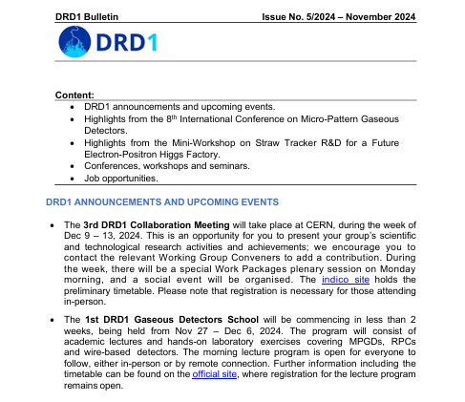
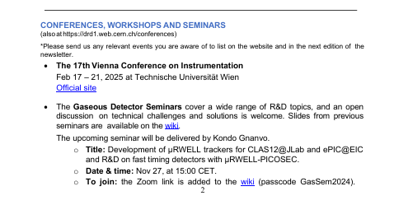
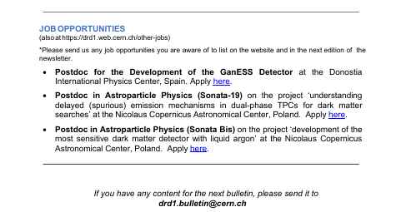
DRD1 bulletin
Monthly bulletin → emailed out to DRD1-all@cern.ch mailing list.
Content includes:
DRD1 announcements and upcoming events.*
News from work packages and working groups.
Training and schools.*
Gaseous Detector Seminar Series events.
Conferences, workshops and seminars.*
Job opportunities.*
If you have some relevant news or updates that you would like added to the bulletin, send it at anytime to drd1.bulletin@cern.ch or to DRD1-WG8-convenors@cern.ch
Comments + suggestions are also very welcome.

Slide 3
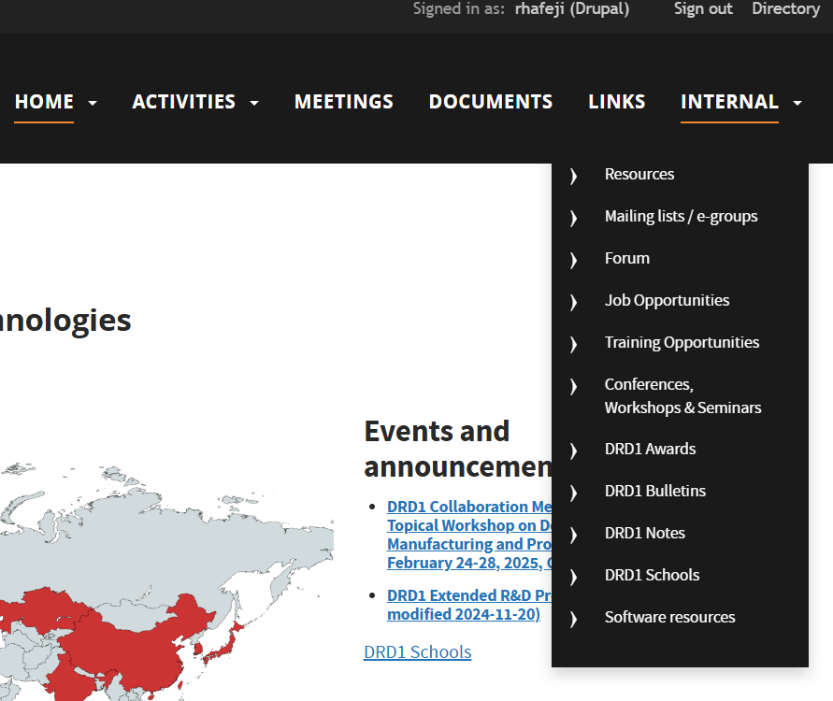
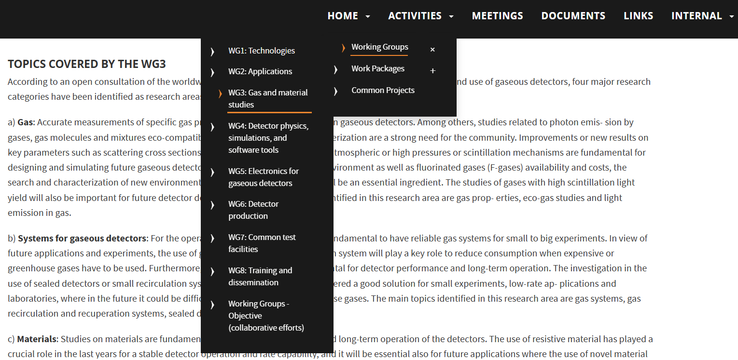
DRD1 website
Information and resources are found on the website drd1.web.cern.ch.
Scientific organisation of the collaboration.
Description of activities from each WG and WP.

Slide 4
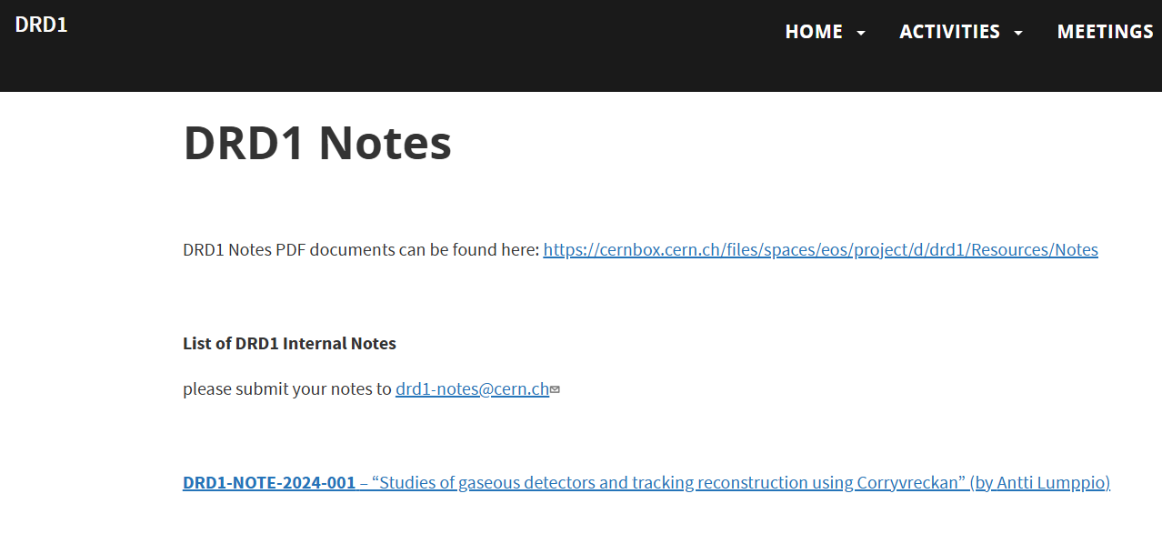
DRD1 Notes
drd1.web.cern.ch/notes
Notes can be submitted by contacting WG8 Conveners.
They will be listed on the DRD1 website.
Notes will be announced in the monthly bulletin.

Slide 5
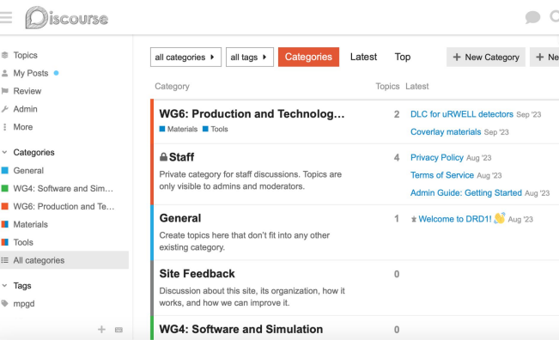
DRD1 Forums
drd1-forum.web.cern.ch
Discourse web forum for discussions.
To connect with people who have a specific area of knowledge and experience.

Slide 6
Mailing groups
Subscribe to working groups and work packages:
drd1.web.cern.ch/egroups
To participate in the WG8 meetings and follow the activities:
e-groups.cern.ch/e-groups/EgroupsSubscription.do?egroupName=drd1-wg8
To get in touch, share any suggestions or comments etc. with WG8:
DRD1-WG8-convenors@cern.ch
Contact other WG convenors by emailing:
DRD1-WGx-convenors@cern.ch

Slide 7
Mailing groups
All important communications, bulletins and updates are sent to DRD1-all@cern.ch.
Prompt reminders and communications will be sent to the newer mailing list: drd1-communications@cern.ch. If you were subscribed to DRD1-all, you will have been added to this new mailing list.
If you do not wish to receive frequent reminders, you can unsubscribe from DRD1-communications and you will still receive the important updates via DRD1-all as before.
(You can unsubscribe here: https://e-groups.cern.ch/e-groups/EgroupsSubscription.do?egroupName=drd1-communications)
THANK YOU

