Slide 1

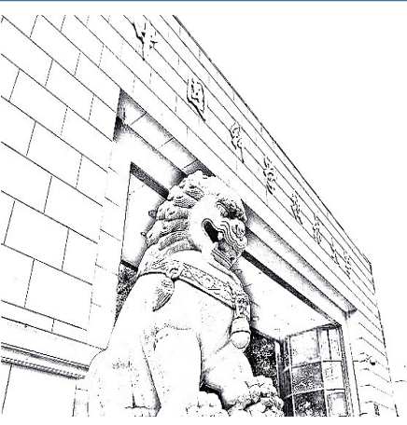
A high rate and precise photoelectric detector prototype with RPC structure
Zhao Yiding, Hu Dongdong, Shao Ming
University of Science and Technology of China
Notes:
Hello everyone, I'm Zhao Yiding from USTC. Thanks for your invitation. Here, I’ll give you a talk about A high rate and precise photoelectric detector prototype with RPC structure
we call it photo-RPC detector, this detector is somewhat similar to PICOSEC-Micromegas.

Slide 2
Outline
I
Introduction
II
Detector design
III
Simulation
IV
Rate capability
V
Single-PE performance test
VI
Eco-friendly gas test
VII
Summary
Notes:
This talk consists of the following five parts, include Introduction, simulation, experiment test of single photoelectron’s performance, eco-friendly gas test and summary.

Slide 3
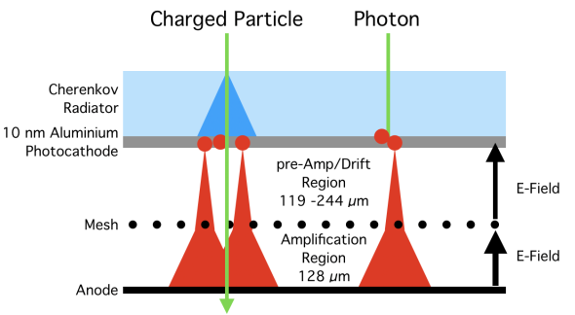
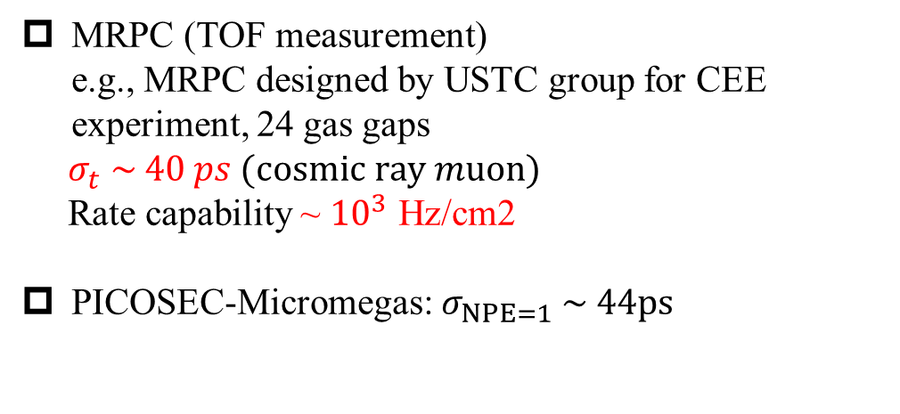
I
Introduction
Background
Timing gas detector
Future high energy physics experiment:
high luminosity
high energy
Challenges for (gas) timing detectors:
high time resolution,
high count rates,
eco-friendly gases
MRPC (TOF measurement)
e.g., MRPC designed by USTC group for CEE experiment, 24 gas gaps
$σ_{t} \sim 40 ps (cosmic ray muon)$
Rate capability ~ ${10}^{3}$ Hz/cm2
PICOSEC-Micromegas: $σ_{NPE=1} \sim 44ps$
Our research group focuses on
http://dx.doi.org/10.1088/1748-0221/15/04/C04053
Notes:
The trend in the future development of high-energy physics is towards the need for detectors with higher performance.Our research focuses on high time resolution, high rate, and eco-friendly working gases. At present, among the gas detectors, MRPC and picosec-micromegas has very good time resolution.
For example, the MRPC designed by USTC group for CEE experiment, it has 24 gas gaps, and achieve a time resolution of 40 ps. And it’s Maximum rate capability is about thousands of Hertz per square centimeter.
PICOSEC-Micromegas has a single photoelectron time resolution of 44ps.

Slide 4
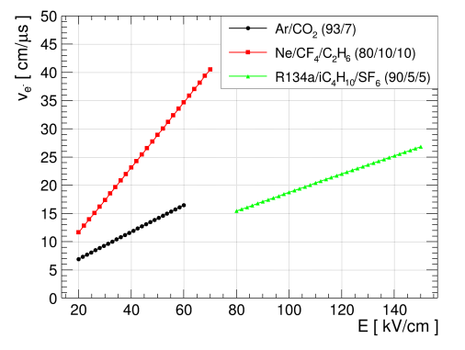
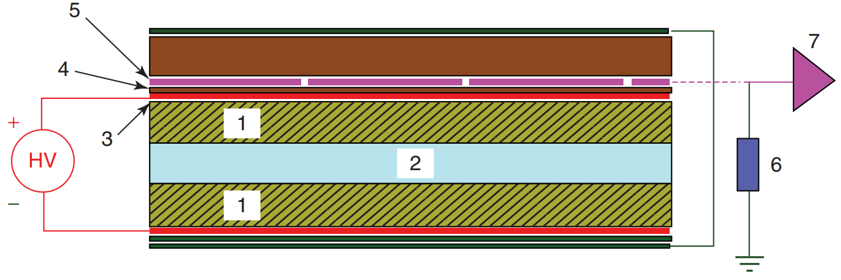

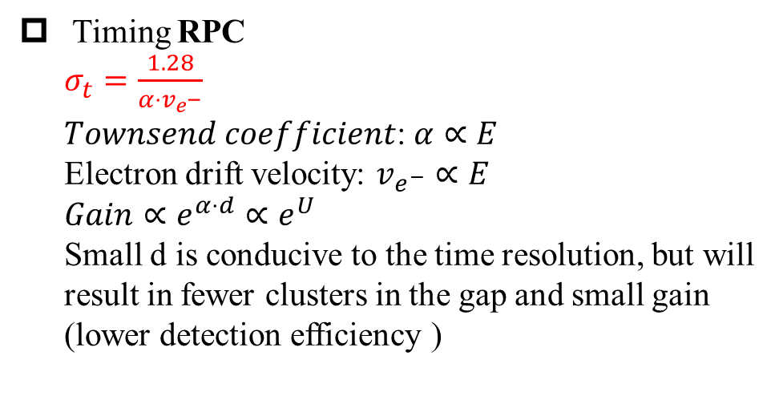
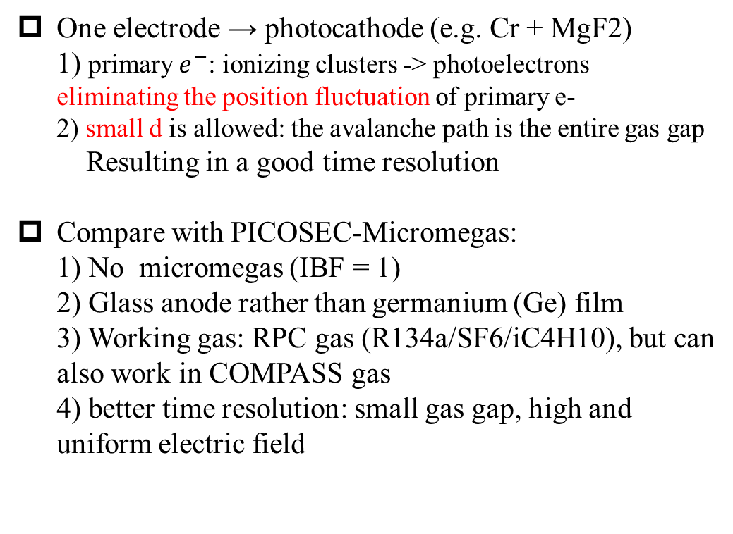

Photo-RPC
RPC + Photoelectric detection
RPC-based photodetector
Timing RPC
$σ_{t}=\frac{1.28}{α⋅v_{e^{−}}}$
𝑇𝑜𝑤𝑛𝑠𝑒𝑛𝑑 𝑐𝑜𝑒𝑓𝑓𝑖𝑐𝑖𝑒𝑛𝑡: $α∝E$
Electron drift velocity: $v_{e^{−}}∝E$
$Gain∝e^{α⋅d}∝e^{U}$
Small d is conducive to the time resolution, but will result in fewer clusters in the gap and small gain (lower detection efficiency )
One electrode → photocathode (e.g. Cr + MgF2)
1) primary $e^{−}$: ionizing clusters -> photoelectrons
eliminating the position fluctuation of primary e-
2) small d is allowed: the avalanche path is the entire gas gap
Resulting in a good time resolution
Compare with PICOSEC-Micromegas:
1) No micromegas (IBF = 1)
2) Glass anode rather than germanium (Ge) film
3) Working gas: RPC gas (R134a/SF6/iC4H10), but can also work in COMPASS gas
4) better time resolution: small gas gap, high and uniform electric field
$$E=\frac{U}{d}$$
RPC ($σ_{t}: {10}^{2}$ps ~ ns)
gap thickness = d
Replaced by photocathode
https://doi.org/10.1002/9783527698691.ch3 P.47
Notes:
Our idea is to combine RPC with photoelectric detection. For timing RPC, its time resolution can be roughly expressed by this formula, at high electric fields, the Townsend coefficient and electron drift velocity are proportional to the electric field. Smaller gap is conducive to the time resolution, but will result in fewer clusters in the gap and smaller gain, which means lower detection efficiency.
We replace one electrode with a photocathode, this will bring about two obvious changes, First, the primary electrons change from the ionization cluster to photoelectrons on the photocathode, which eliminates the position fluctuations of the primary electrons. Ionization clusters are randomly distributed along the tracks of charged particles in the gas gap, but photoelectrons are produced from the photocathode plane.
Second, smaller gas gap is allowed, because there is no position fluctuation of primary electrons, the avalanche path length of each photoelectron is equal to the thickness of the gas gap. Both of these points help to improve the time resolution.
Let's make a comparison with PICOSEC-Micromegas, firstly, it has no micromegas, which means IBF equal to one, there are high requirements for the robustness of photocathodes, second, the anode is float glass rather than germanium /dʒɜːˈmeɪniəm/ film, third, the working gas is RPC gas, but it can also work in the COMPASS gas, fourth, because small gas gap, high and uniform electric field, it has better time resolution

Slide 5
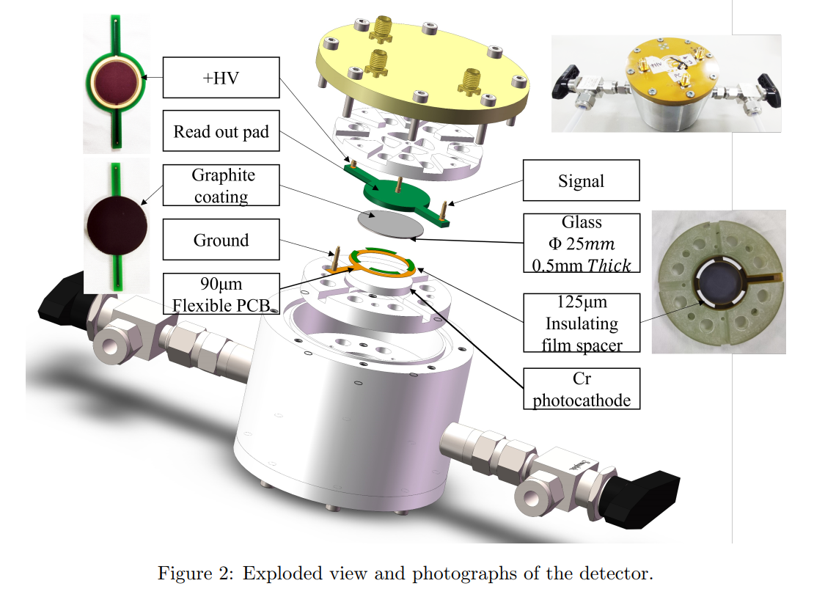
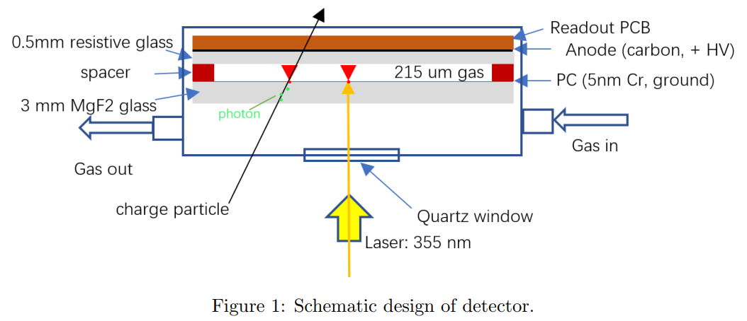
II
Detector design
Detector design and install
Resistive float glass: 0.5 mm
Gas gap: 90 + 125 = 215 (um)
Photocathode: 5nm Cr, in lab laser test, use ordinary quartz glass replace MgF2.
Notes:
Then we designed and manufactured the detector, as showing in the right figure. The anode is a 500 micron thickness float glass, with graphite /ˈɡræfaɪt/ coating. The gas gap thickness is composed of a 90 micron flexible PCB board and a 125 micron /ˈɪnsjuleɪtɪŋ/ insulating spacer. The photocathode is a 5 nanometer chromium /ˈkrəʊmiəm/ layer, it plated on the surface of a transparent quartz glass
A ultraviolet /ˌʌltrəˈvaɪələt/ laser was used to test the detector's performance. Like this, A laser pulse passes through the quartz window and quartz glass, reaching the photocathode plane, and excites photoelectrons, and then induce a avalanche in the gas gap.
The photocathode is 5 nanometer chromium /ˈkrəʊmiəm/; 90 micron flexible PCB, which ground photocathode,; 125 um insulating film spacer, the resistive glass with 25 mm diameter, 0.5 mm thickness; graphite coating; high voltage and readout PCB board; high voltage and signal readout PCB board. Finaly we assembled the detector in the ultra-clean room.
the gas gap is 215um, the pc is 5nm chromium, which plated on the surface of a transparent quartz glass. In Lab laser test, we use ordinary quartz glass replace Magnesium fluoride

Slide 6
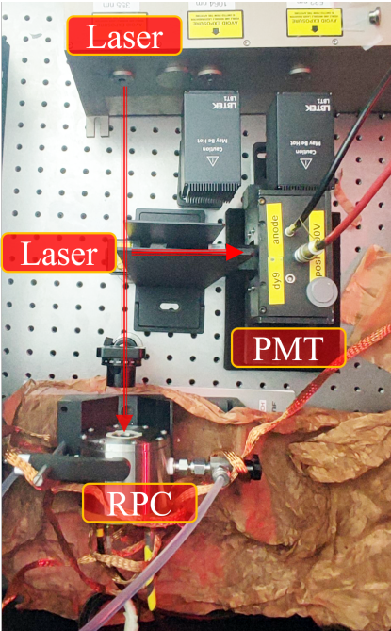
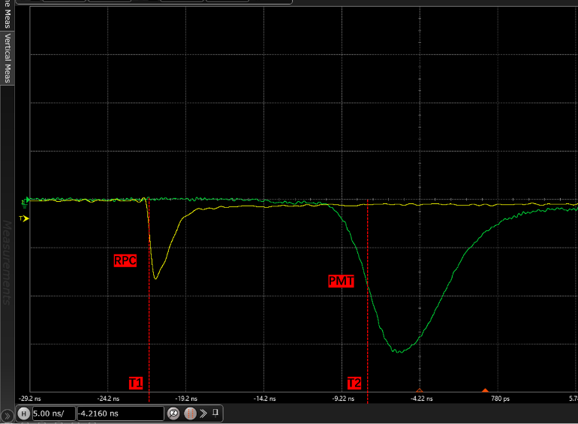
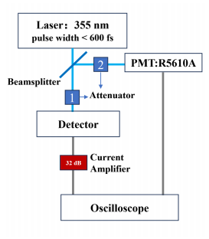
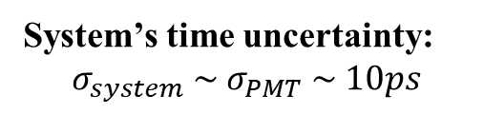
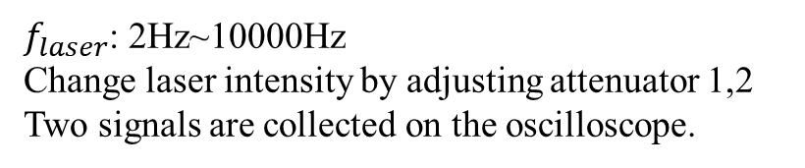
Test system
Setup in darkroom
RPC
PMT
System’s time uncertainty:
$$σ_{system} \sim σ_{PMT} \sim 10ps$$
$f_{laser}$: 2Hz~10000Hz
Change laser intensity by adjusting attenuator 1,2
Two signals are collected on the oscilloscope.
Notes:
We built a high-precision test system on an optical platform with a 355 nanometer ultraviolet picosecond laser.
The laser pulse repetition rate is adjustable, range from 2 Hz to ten thosound hertz, the outgoing laser beam is divided into 2, one into the PMT for timing, the other reaches the detector, the two signals are displayed and recorded on the oscilloscope /əˈsɪləskəʊp/,
as shown in the right figure, left is RPC signal, right is timing PMT signal. Through constant-fraction discrimination, to fit the time difference distribution of the two signals, we can get the total time resolution of system and RPC.
After calibrating, the time resolution of PMT is about 10ps

Slide 7
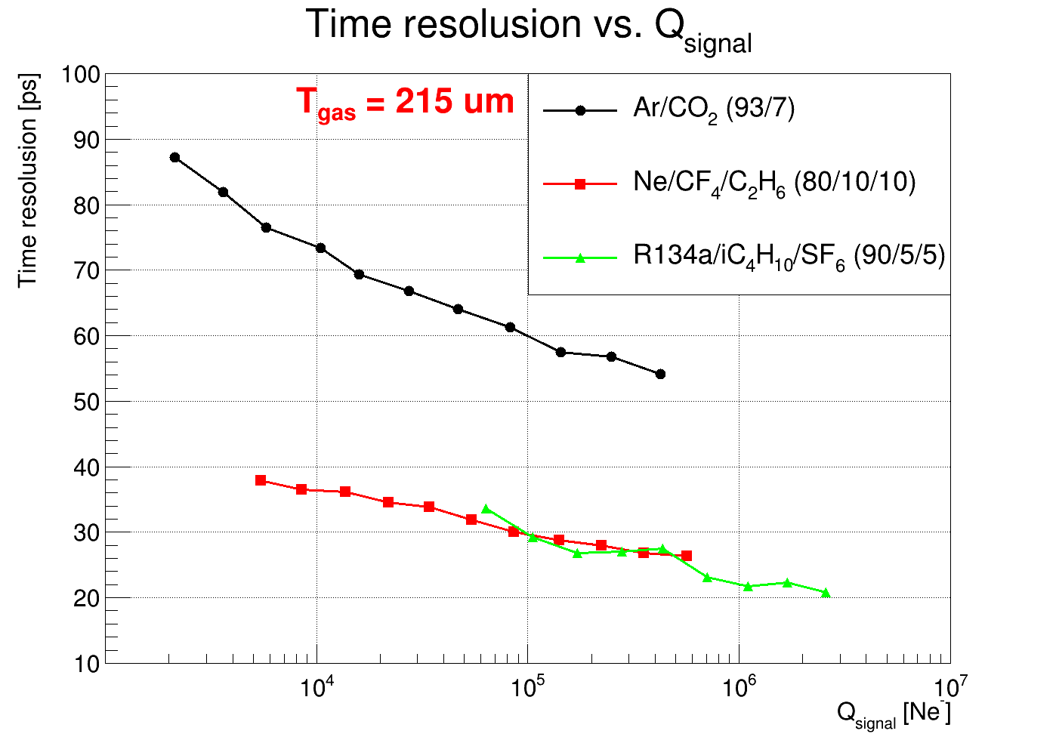
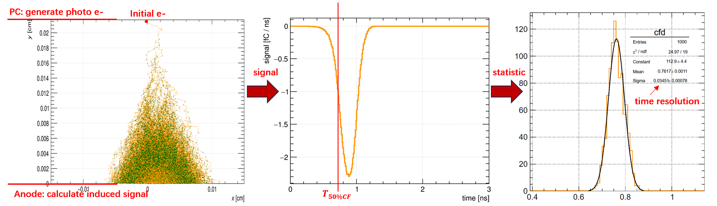
III
Simulation
Garfield++
Uniform filed inside gas, allows for a grid-based MC simulation for the avalanche dynamics (fast simulation)
RPC | Garfield++ (cern.ch)
avalanche → signal → gain, time resolution, etc.
0.2 CFD
Microscopic:
~100 e-
AvalancheGrid:
rest avalanche
$σ_{t−single e^{−}}< \sim 30ps$ @(RPC/Compass gas, 215um)
Notes:
We also used Garfield++ to simulate avalanche and induced signal of a single electron. The simulation results are shown in the right plot, it shows the time resolution as a function of signal charge in different gas, it indicates that the time can be better than 30ps in the COMPASS gas mixture and PMRC gas miture.
Due to the uniform electric field in the gas gap, a fast grid-based Monte Carlo simulation for the avalanche dynamics is allowed . The whole process is: first, simulate the avalanche of electrons in a specific gas and electric field, then use the weighting field to readout the induced signal, finally use constant-fraction discrimination to calculate the time resolution.
Garfield's simulation results are shown in the right plot, it shows the time resolution as a function of signal integral charge in different gas, it indicates that the time resolution of single electron can be better than 30ps with appropriate working gas and gap thickness.

Slide 8
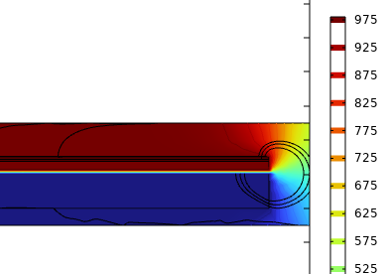
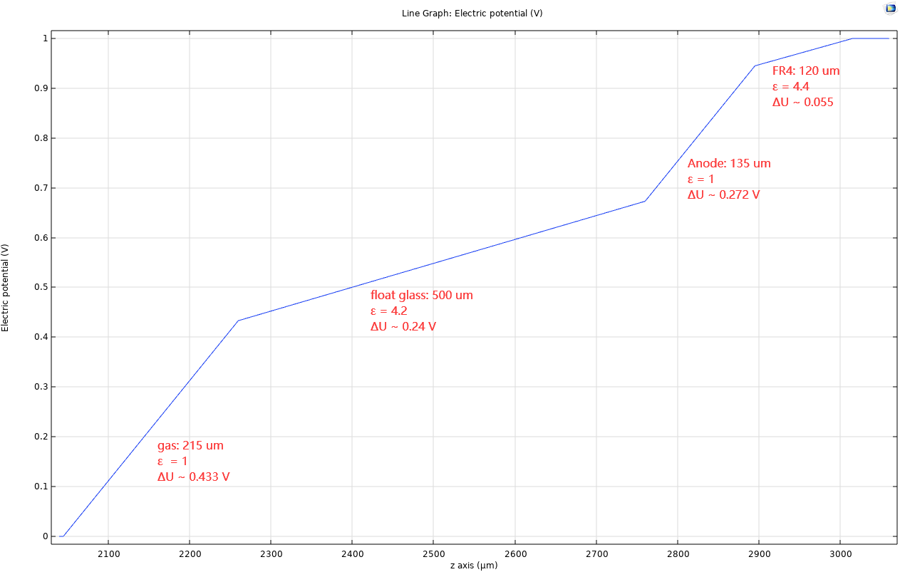
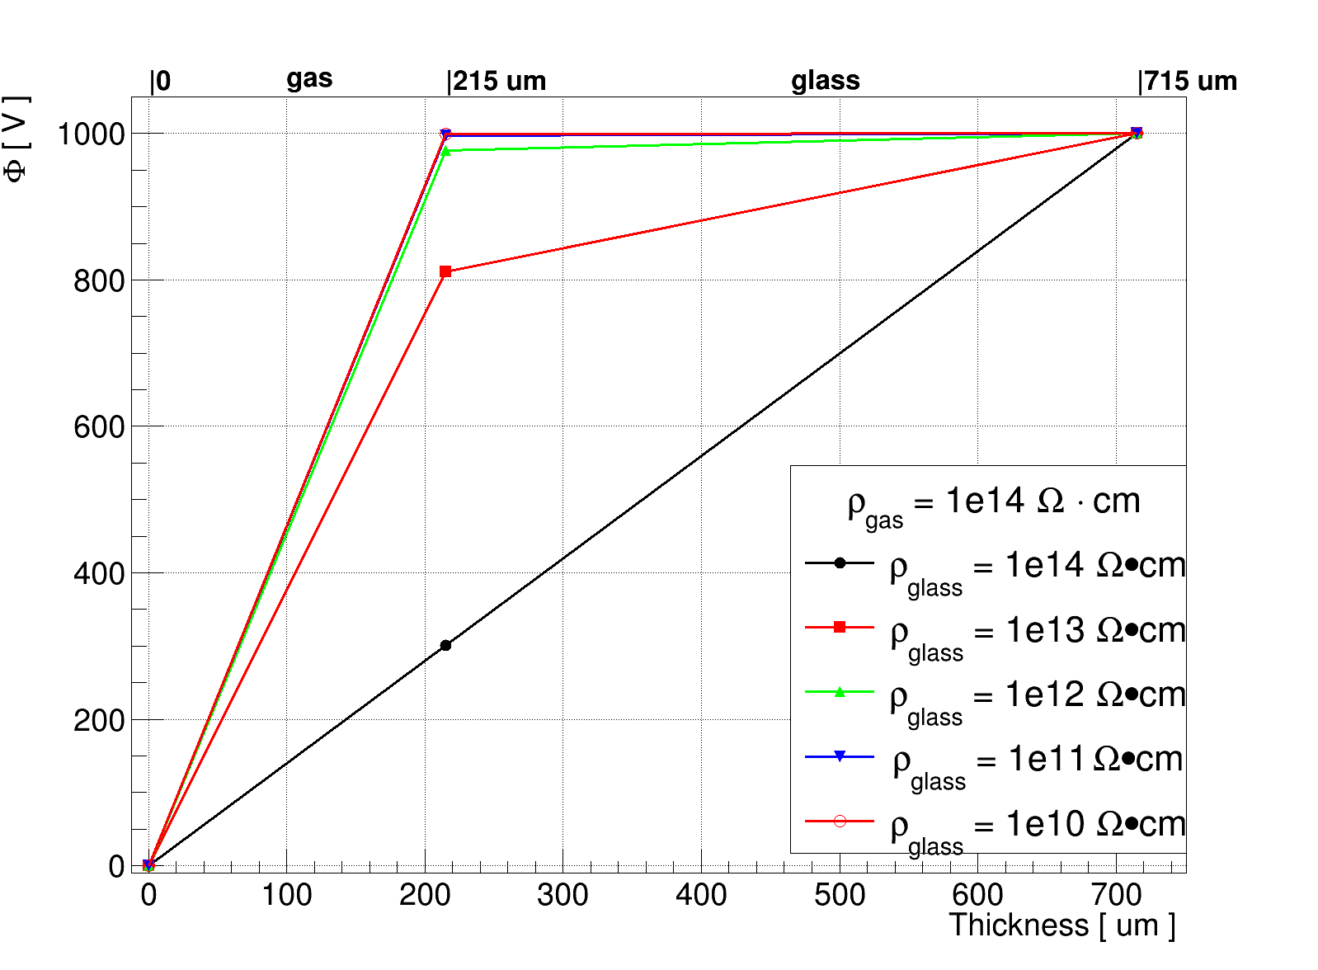

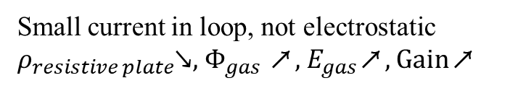

Comsol software
electric field
weighting field
Readout pad ,1V
120um PCB(FR4)
135um graphite
500um glass
PC 0V
215um gas
$$ΔU_{gas}=HV∗\frac{ρ_{gas}·l_{gas}}{ρ_{gas}·l_{gas}+ ρ_{glass}·l_{glass}}$$
Ramo’s weighting field theorem
Small current in loop, not electrostatic
$ρ_{resistive plate}$↘, $Φ_{gas}$ ↗, $E_{gas}$↗, Gain↗
$$ΔU_{W−gas} \sim 0.43 V$$
$T_{glass}$(Thicknees)↘, $T_{gas}↗$, $ΔU_{W−gas}$↗, induce signal ↗
Notes:
We use Comsol to calculate the distribution of electric field and weighting potential in detail. The results show that, under these parameters, the weighting potential of the gas gap is about 0.43 volts
Since the loop contains a small current when the detector works, it is non-electrostatic, so the gap electric field is affected by the resistivity and thickness of the gas and the resistive plate, as shown in the formula.
We assume that the resistivity of the working gas is 10 to the 14th ohm centimeter.
The electric field simulation results show that under the same applied voltage, the lower the resistivity of the resistive plate, the stronger the gas gap electric field and the larger the avalanche.
The calculation of the weighting field is based on the Rramo’s weighting field theorem, that is, the potential of the signal readout plane is set to 1 volts, the photocathode is grounded, and the thickness of each layer is the same as the subsequent practical detector.
The calculation results show that the weighting field of the gas gap is 0.43 volts. Meanwhile, the influence of the thickness of different layers and the dielectric constant on the weighting field can also be simulated quantitatively.

Slide 9
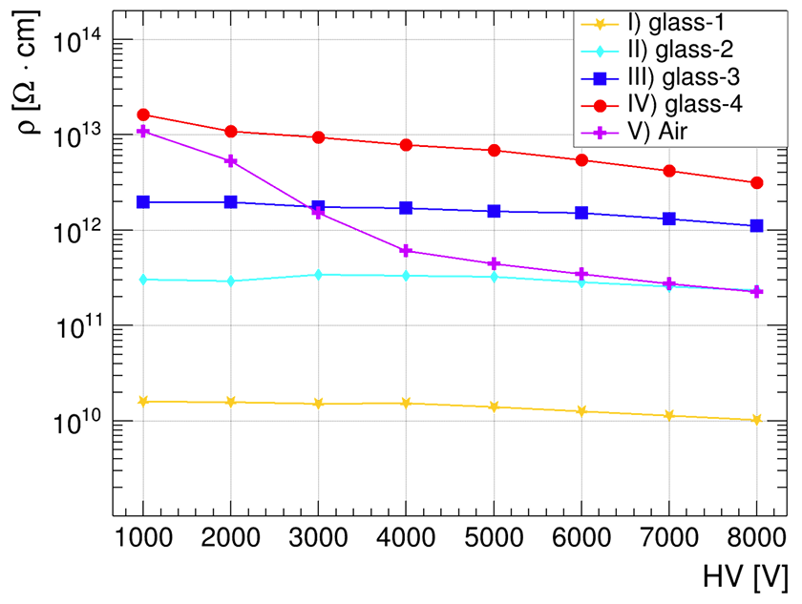
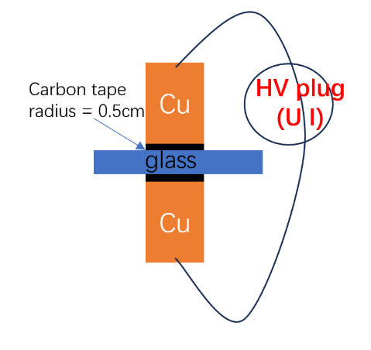
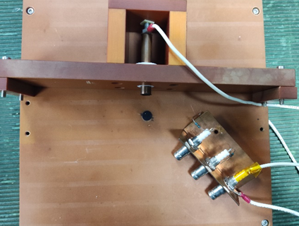
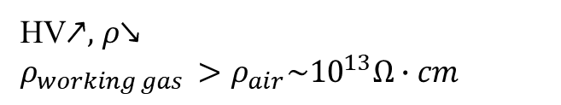
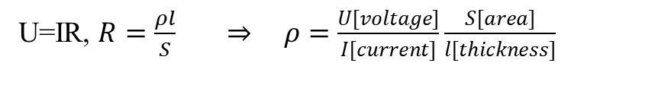
IV
Rate capability
Resistivity test of resistive plate (float glass)
Several types of float glass
Diameters = 25mm, thickness = 0.2mm, 0.3mm, 0.5mm
HV power supply
U=IR, $R=\frac{ρl}{S}$ ⇒$ρ=\frac{U[voltage]}{I[current]}\frac{S[area]}{l[thickness]}$
HV↗,$ρ$↘
$ρ_{working gas }>ρ_{air}\sim {10}^{13}Ω∙cm$
Notes:
Since the resistivity of the resistive material is crucialfor the rate capability of the resistive gas detector, in order to achieve high rate, an electrode with low resistivity is required.
We cprepared several different materials float glass, and tested their resistivity.
The plot shows the resistivity as a function of voltage. It can be seen that the resistivity will slightly decrease with the increase of voltage. The glass resistivity ranges from ten to the tenth to ten to the thirteen ohm centimeters.

Slide 10
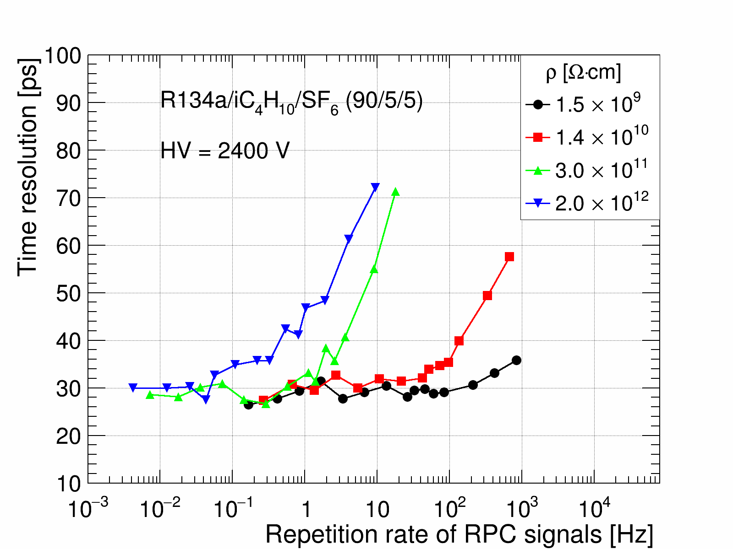
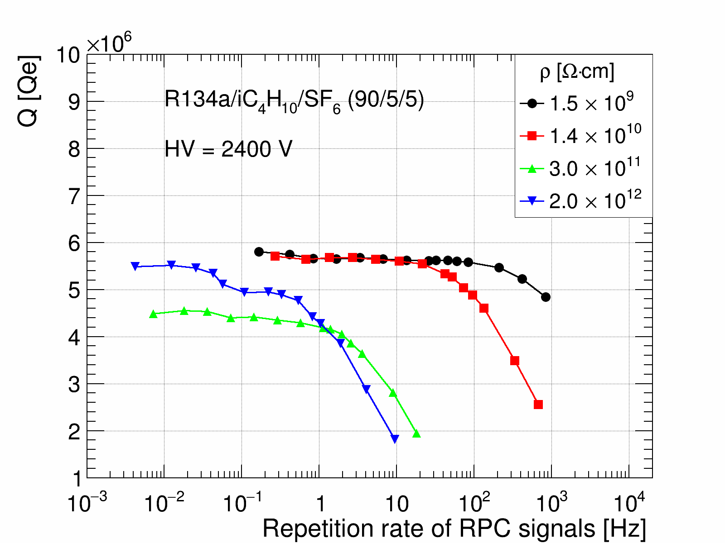
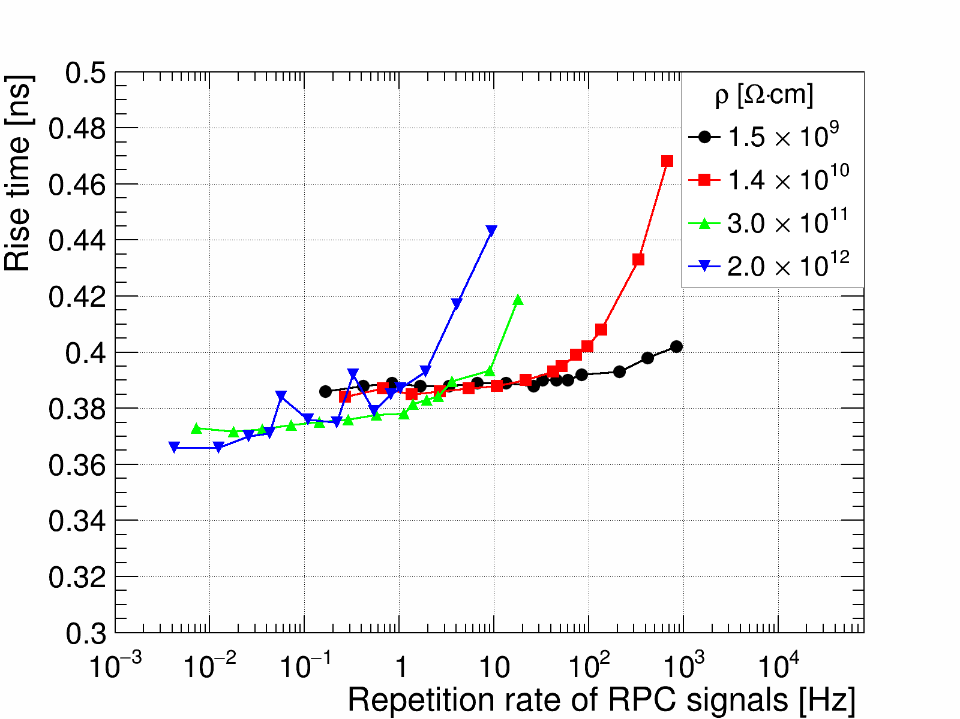
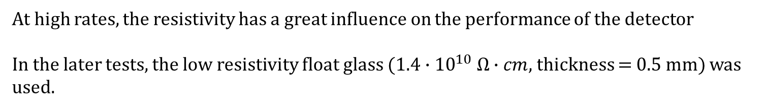

Rate capability of different $ρ_{glass}$
Single-PE in RPC gas (latest results)
Time resolution (signa charges, and signal rise time) as a function of repetition rate of RPC signals.
Time resolution
Signal charge
Signal rise time
At high rates, the resistivity has a great influence on the performance of the detector
In the later tests, the low resistivity float glass ($1.4∙{10}^{10} Ω∙cm$, thickness = 0.5 mm) was used.
Notes:
First we performed counting rate tests with different resistivity glass.
The rate capability with diferent resistivities was tested in a single photoelectron mode. There figures shows the detector performance become worse at critical frequencies of approximately $10^{-1}$, $10^{0}$, $10^{1}$, and $10^{2}$ Hz for the electrode bulk-resistivity of $10^{12}$, $10^{11}$, $10^{10}$, and $10^{9}$ $\Omega\cdot cm$, respectively.
This indicates that low-resistivity float glass significantly enhances the detector's rate capability.
In the later tests, the low resistivity float glass ($1.4∙{10}^{10} Ω∙cm$) was used.

Slide 11
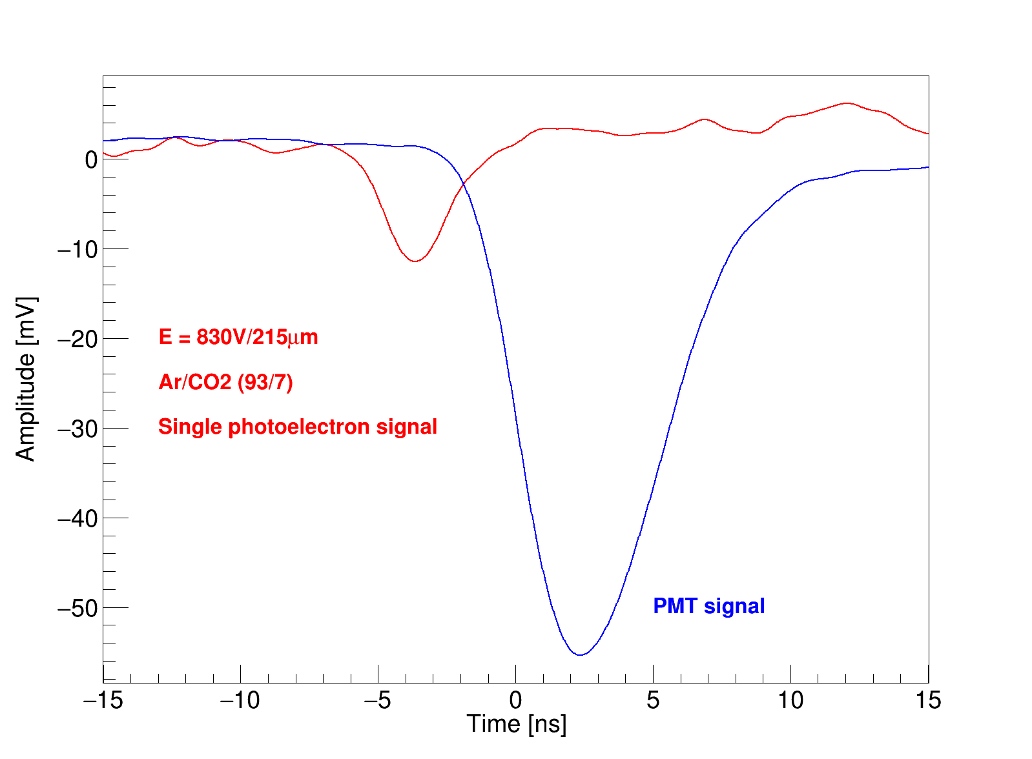
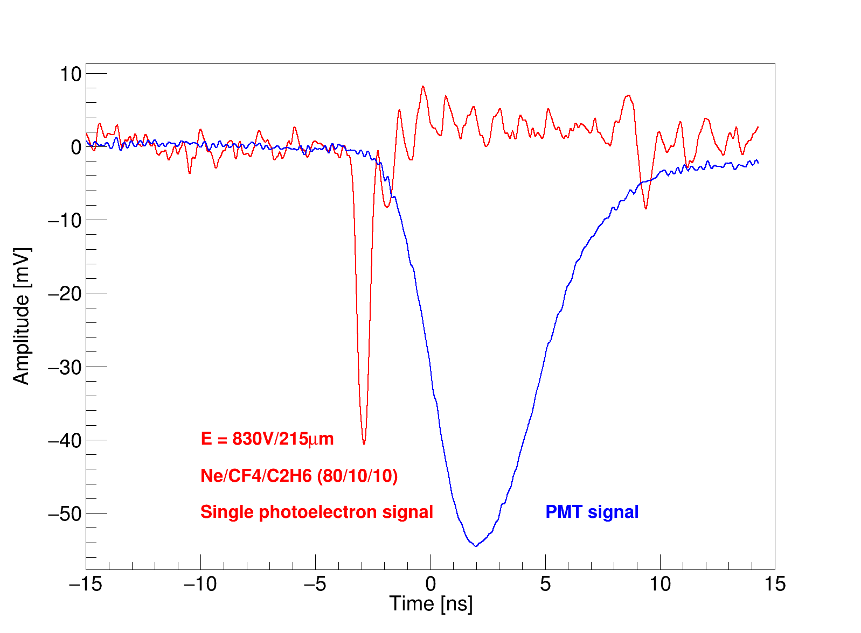
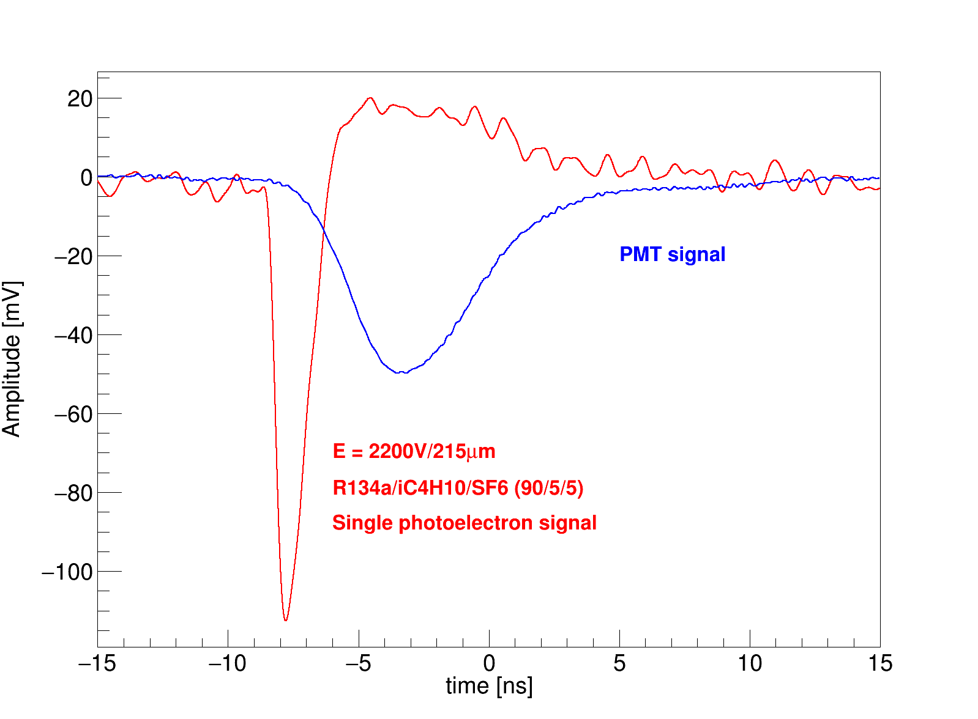
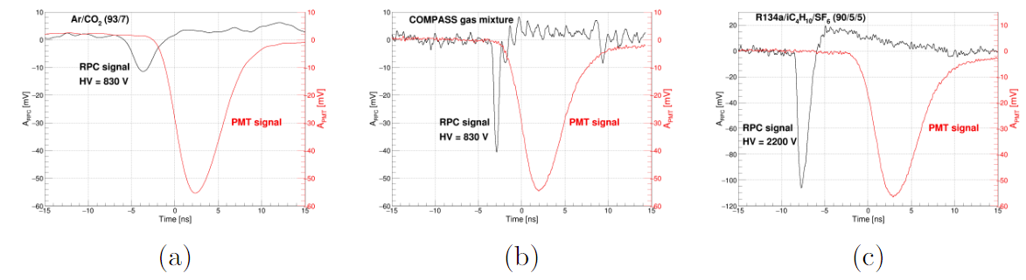
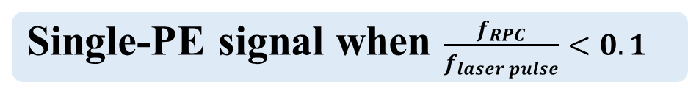
V
Single-photoelectron performance tests
Single-PE signal when $\frac{f_{RPC}}{f_{laser pulse}}<0.1$
Typical signal of single-photoelectron collected using oscilloscope.
Signal amplitude, width, rise time are obviously different in different gas.
Ar/CO2(93/7)
2 GHz BW due to big S/N
COMPASS gas
Ne/C2H6/CF4(80/10/10)
MRPC gas
R134a/iC4H10/SF6(90/5/5)
Notes:
Then we tested the single photoelectron performance.
Adjust the energy of laser pulse, when the frequency ratio between RPC signal and laser is less than 0.1, almost all RPC signals are caused by single photoelectro.
These three figures show the signals in different gases. It can be seen that the signal feature in different gases, such as the amplitude, width and rise time are significantly different, which means that the timing performance in different gases is different.

Slide 12
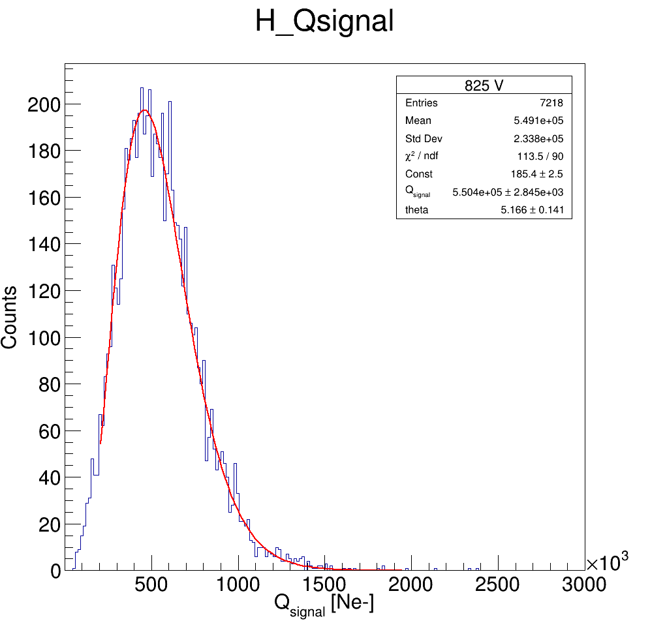
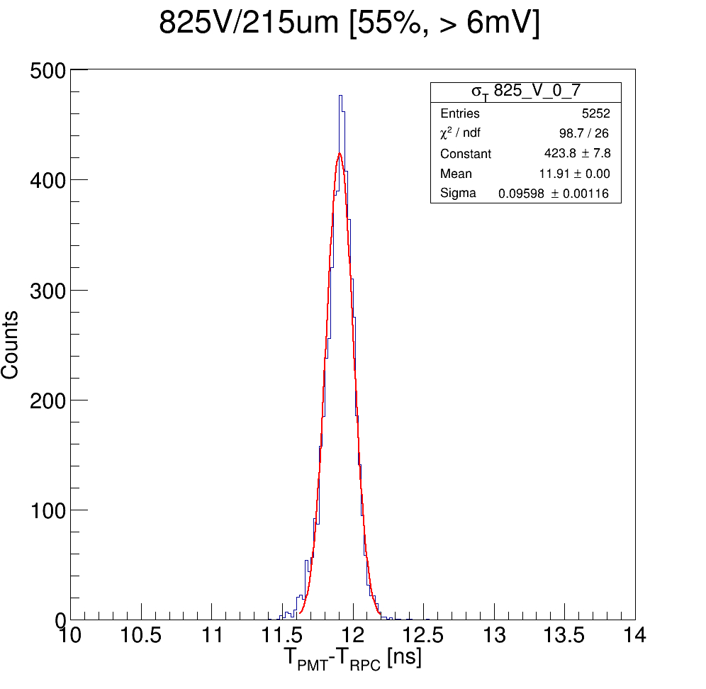
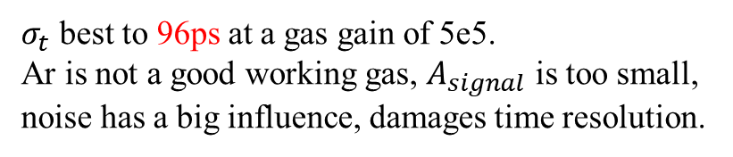
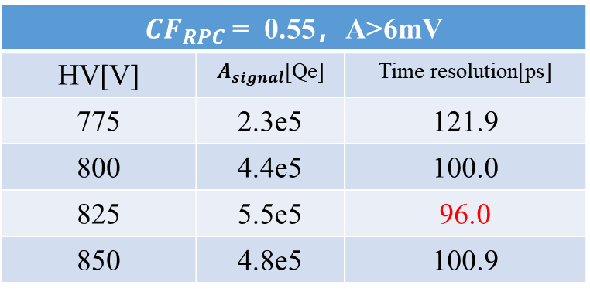

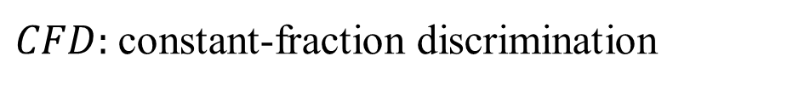
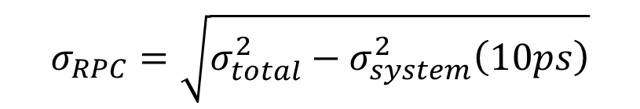
Time resolution in Ar/CO2(93/7)
$CFD:$constant-fraction discrimination
$$σ_{RPC}=\sqrt{σ_{total}^{2}−σ_{system}^{2}\left(10ps\right)}$$
825 V
$CF_{RPC}$ = 0.55，A>6mV
HV[V] | $A_{signal}$[Qe] | Time resolution[ps]
775 | 2.3e5 | 121.9
800 | 4.4e5 | 100.0
825 | 5.5e5 | 96.0
850 | 4.8e5 | 100.9
$$σ_{t}=96ps$$
Q = 5.5e5 Qe
$σ_{t}$ best to 96ps at a gas gain of 5e5.
Ar is not a good working gas, $A_{signal}$ is too small, noise has a big influence, damages time resolution.
Notes:
The total time resolution is obtained by $CFD$ method, and The single photoelectron time resolution of RPC can be obtained by this formula.
The test results in argon shows when the working voltage is 825V, the best time resolution of single photoelectron is 96ps, and the signal charge is about 5.5 times 10 to the fifth electron charge. Because the signal amplitude is too small, the signal-to-noise ratio is too bad, this gas is not a suitable working gas.

Slide 13
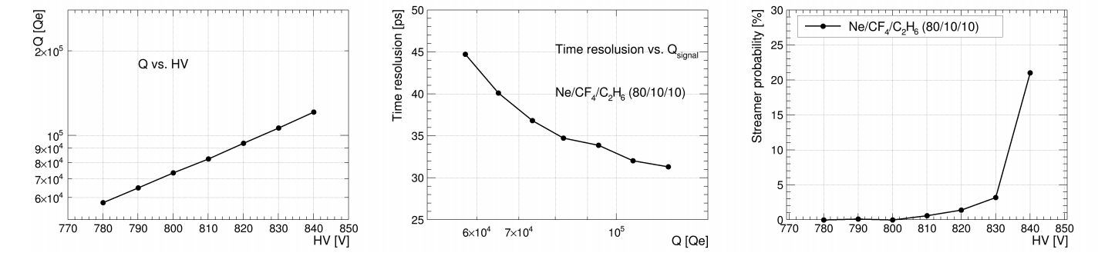
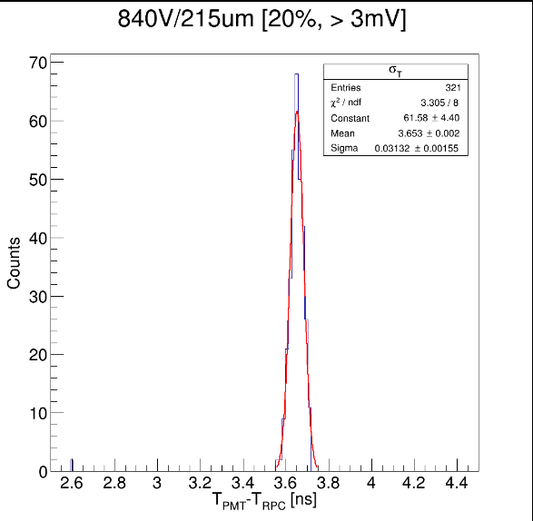
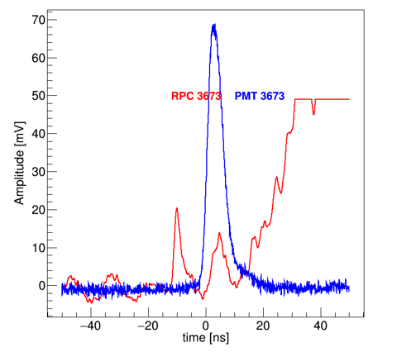


Time resolution in the COMPASS gas
Ne/C2H6/CF4(80/10/10)
$$CF_{RPC}=0.55$$
$σ_{NPE=1}$ = 45~31ps at a gas gain of 6e4 ~ 2e5.
840 V
$σ_{t}=31.3 ps$
streamer
Notes:
The two plots show the results in COMPASS gas.
The left plot shows the time resolution as a function of signal charge. It can be seen that as the signal charge increases, the time resolution of single photoelectron improves from 45ps to 31ps.
The right plot shows the signal charge as a function of working voltage, the charge increases exponentially with the voltage.

Slide 14
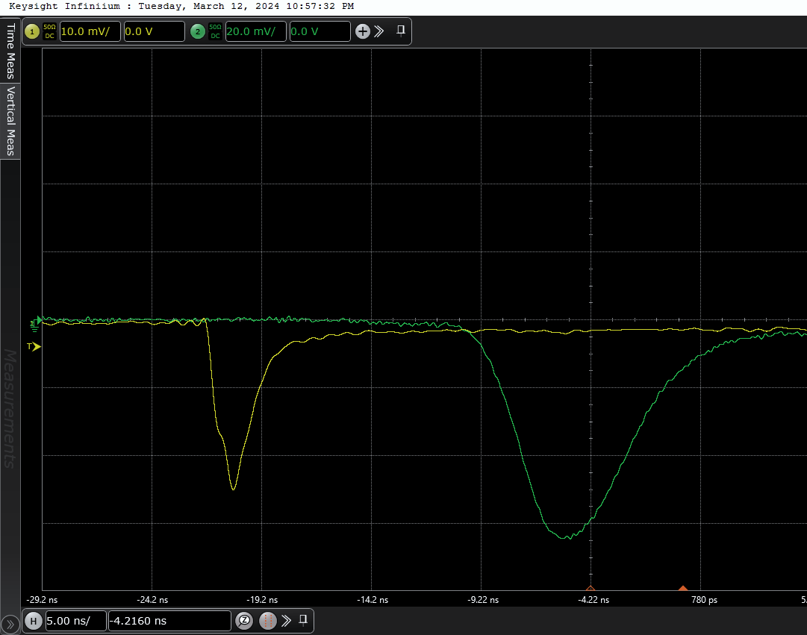
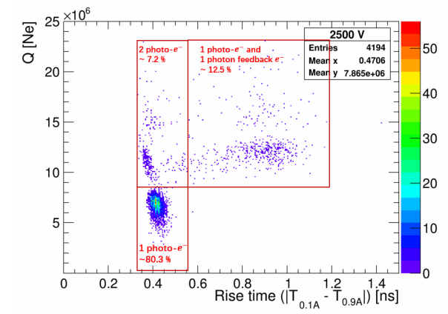
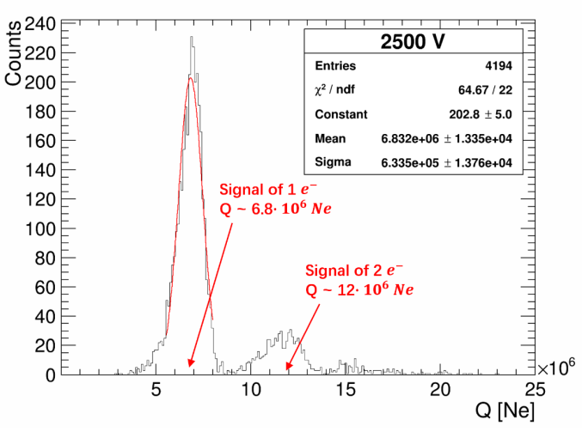
RPC gas: photons feedback
R134a/iC4H10/SF6(90/5/5)
HV=2500V
“Double peak”, caused by photon feedback: at high HV, UV photons are produced and excited PC or gas to generated a new photoelectron, create a new avalanche.
This will make the width and rise time of the signal larger, which is bad for time resolution.
Notes:
Then we test the standard RPC gas, the gas ratio is 90 to 5 to 5. At high voltage, for example, 2500v, there are some signals like this, its have a double peak. We think it cause by photon feedback: at high HV, UV photons are produced and excited PC or gas to generated a new photoelectron, create a new avalanche. This will make the width and rise time of the signal larger, which is bad for time resolution.
We plot the rise time and Q of signals, as show in middle fig, it clear that, this region is signal of only one PE, these are two or more primary PE, these region is signals of one primary PE and a photon feed back e. the right plot also show the one e signal and two e signals, there's a nearly two times difference in charge. For calculate the time resolution of single PE , we only selected these signal of only one electron s for calculating.

Slide 15
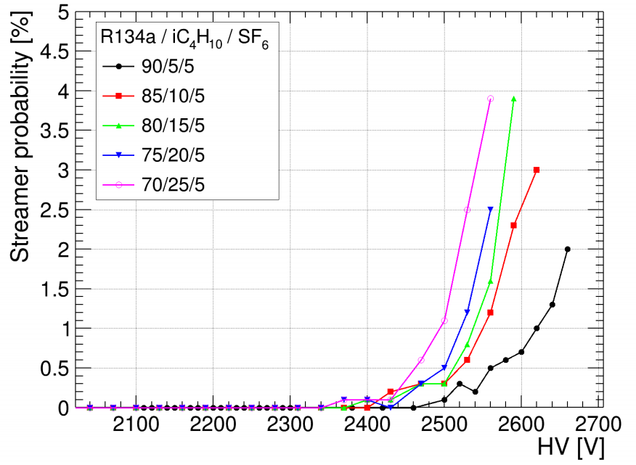
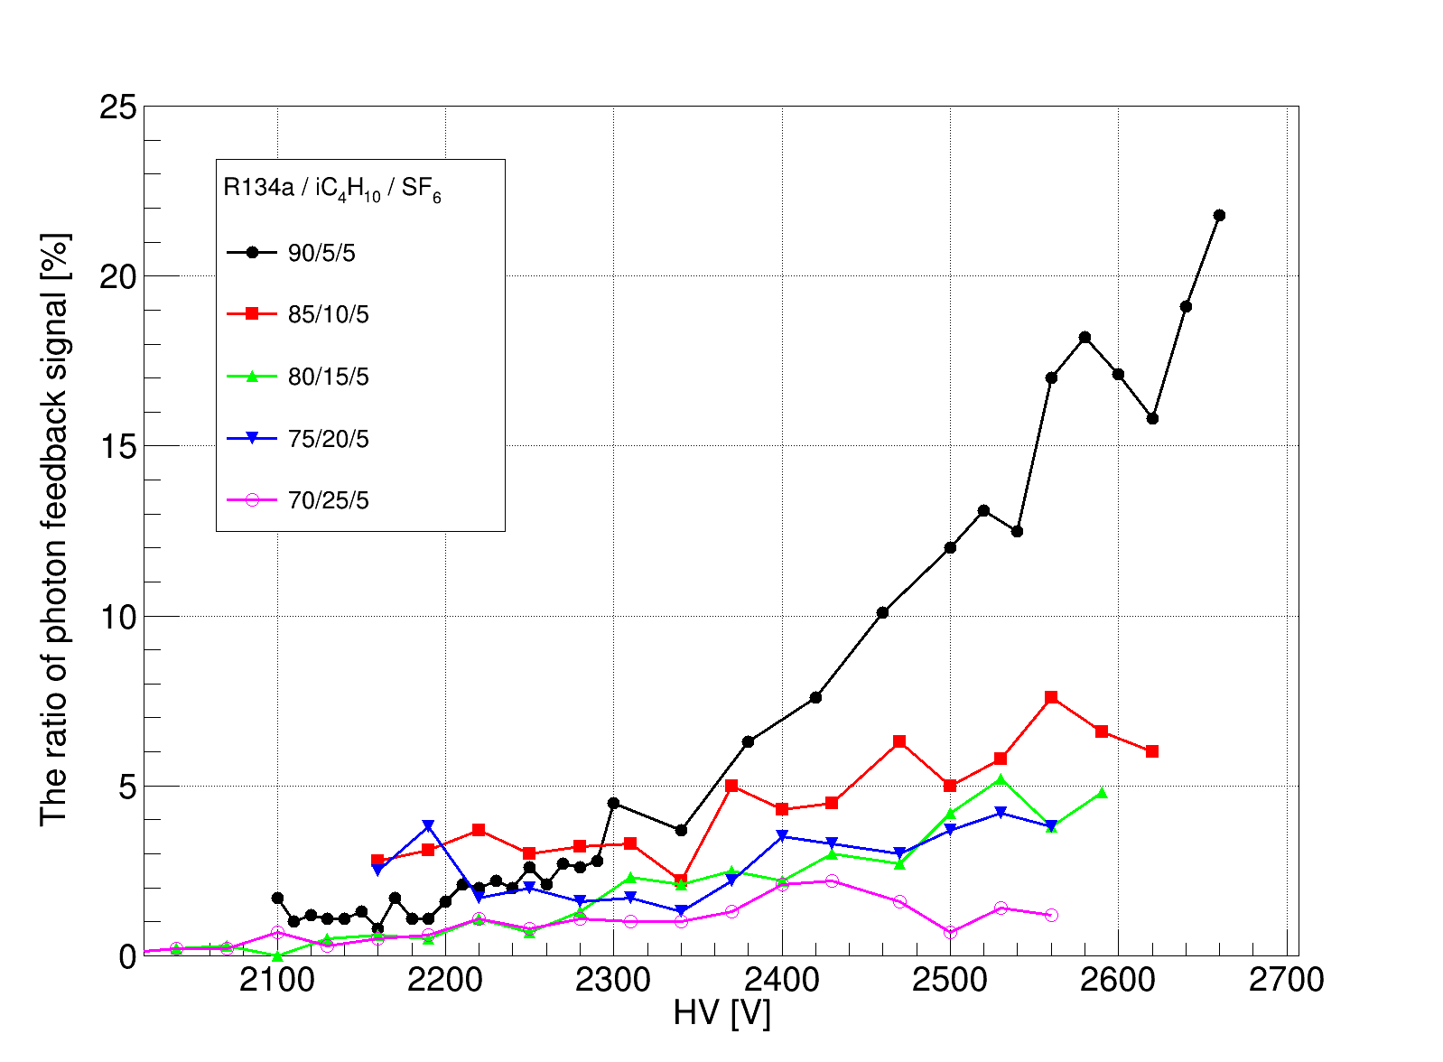
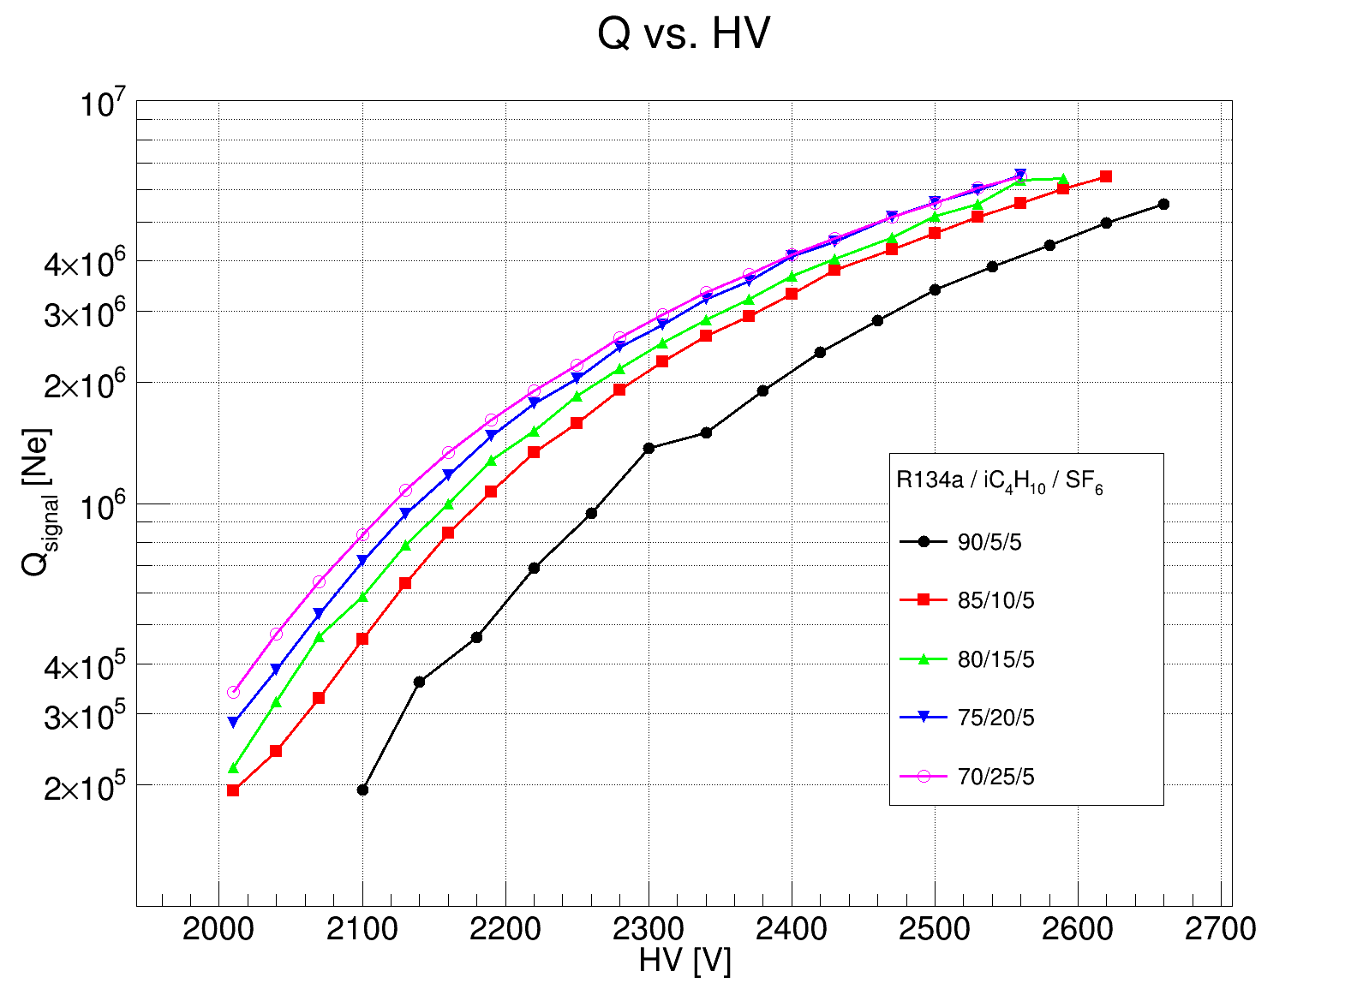
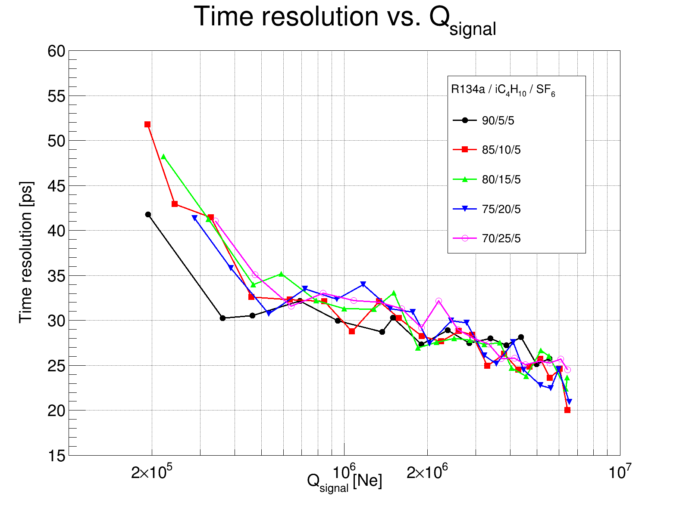



Reduce photon feedback
Fix SF6 = 5%
Select signals of only one primary PE.
$$CF_{RPC}=0.2$$
not exponentially, space charge effect
~20.3ps
Increase the proportion of iso-butane can effectively reduce photon feedback.
Increase iso-butane(decrease R134a):
1 Greater gain at same HV
2 The working voltage became smaller
3 No significant change in the time resolution
$σ_{NPE=1}$ best to ~20.3ps (85/10/5)
$σ_{NPE=1}$ = 50 ~ 20 ps at a gas gain of 2e5 ~ 7e6.
Notes:
Since iso-butane can effectively absorb UV photons, we increase its fraction, and test again, note that we fix SF6 =5%. The left plot shows the ratio of photon feedback signal as a function HV, it clear that Increase iso-butane can effectively reduce photon feedback. The right two plot are signal charge vs HV and single PE time resolution vs signal charge, we only select the signals of only one primary PE. it clear that, when increase iso-butane(Of course decrease freon), Greater gain at same HV, The max working voltage became small, No significant change in the time resolution, but
$σ_{NPE=1}$ best to ~20.3ps (85/10/5)
Q is not exponentially dependent on the HV due to space charge effect,

Slide 16
VI
Eco-friendly gas test
Test the single-PE performance
gain, time resolution, working voltage
Gas | formula | GWP
R134a | CF3-CFH2 | 1430
R1234ze | CF3-CH=CHF | <1
R1233zd | CF3-CH=CHCl | 1
R1234yf | CF3-CF==CH2 | <1
Iso-butane | iC4H10 | 3.3
 | SF6 | 22800
 | CF3I | <5
test schedule
1 | R134a/iso/SF6
2 | SF6->CF3I
3 | R134a->R123ze
4 | R134a->R1233zd
5 | R134a->R1234yf
6 | R134a->R123ze SF6->CF3I
only change the working gas
Notes:
Because this photoelectron RPC can accurately measure the single photoelectron time resolution in different gases, so we test the several low GWP gas that may replace standard gas, include R134ze, R1233zd, R1234yf, Iodo trifluoro methane eye-oh-doh-try-fluor-oh-meth-ane
The test schedule is this,. First test the standard gas as a reference, then test other gas. The detector area remains stationary, the incident point of the laser at the photocathode plane keeps unchanged, we only change the working gas

Slide 17


SF6 → CF3I
Fix iC4H10 = 5%, CF3I = (5,10,15,20,25)%
$\text{Increase} \text{CF}\text{3}\text{I}\text{: }\text{Gain} \text{↘, }\text{HV}\text{↗, }\text{TR}\text{↘}$
Notes:
First we replace sulfur hex with , Iodo trifluoro methane , We fixed isobutane at 5%. The left shows the signal charge as a function of working voltage, right is the time resolution as a function of charge, it’s clear that, , while increase Iodo trifluoro methane, the gain become smaller, working point become larger, time resolution become better

Slide 18


R134a → R1234ze
Fix SF6 = 5%, R1234ze = (90,85,80,75,70)%
$\text{Increase} \text{iC}\text{4}\text{H}\text{10 : }\text{Gain} \text{↗, }\text{HV}\text{↘, }\text{TR}\text{↗}$
Notes:
then we replace R134a with R1234ze, We fixed sulfur hex at 5%., it’s clear that, , when increase isobutane, meanwhile decrease Rze, the gain become larger, working point become smaller, time resolution become worse.

Slide 19



Result of all gas, fix iC4H10 = 5%
Q(Gain) vs. HV
Time resolution vs. HV
Time resolution vs. Q
R1234ze/iC4H10/CF3I(90/5/5) perform best:
low GWP, good TRvsQ, moderate working voltage
Notes:
Here is the Compare of all gas when the isobutane is 5%, According to these results, the Rze and Iodo trifluoro methane and iC4H10 perform best, It's the blue curve, because its low GWP, good TRvsQ, moderate working voltage

Slide 20

VII
Summary
Develop a photoelectric gas detector protype with RPC structure
Rate capability improved ${10}^{1}\sim {10}^{2} times$ than typical glass RPC
Cheap low $ρ$ float glass: $ρ\sim 1.4∙{10}^{10}Ω∙cm$ (typical: ${10}^{12}\sim {10}^{14}Ω∙cm, <kHz/cm^{2}$ )
(very hopefully for mass production)
${σ_{t}}_{NPE=1}=$ 52~20 ps (Q: 2e5 ~ 7e6) in the standard RPC gas
${σ_{t}}_{NPE=1}=$ 45~31ps (Q: 6e4 ~ 2e5) in the COMPASS gas
Eco-friendly gas test:
R1234ze/iC4H10/CF3I(90/5/5) perform best
Notes:
Based on the test results so far

Slide 21
Current status
In terms of time performance alone, this type of detector reaches the limit of gas detectors.
Practical applications are limited by aging of photocathodes (IBF=1), but excellent time performance allow robust but low quantum efficiency materials as photocathode (DLC).
Laboratory research: High-power lasers can easily produce photoelectrons (arbitrary photoelectric material ), and many quantitative studies can be done with this device:
Gas property measurements (effective Townsend coefficient, drift velocity);
Resistance material test;
Eco-friendly gas tests;
Performance of different gases at low pressure
Notes:
Based on the test results so far

Slide 22
Backup: more gas test
Num | Gas | ratio | Working HV | Time resolution
1 | Ar/CO2 | 93/7 | 790 ~850 | ~90
2 | Ne/C2H6/CF4 | 80/10/10 | 780~840 | ~30
3 | MRPC gas R134a(C2H2F4)/SF6/iC4H10 | 90/5/5 | 2100~2750 | ~29
4 |  | 85/5/10 | 2100~2620 | ~27
5 |  | 80/5/15 | 2100~2590 | ~26
 |  | 75/5/20 | 2100~2560 | ~26
6 |  | 75/5/20
 |  | 70/5/25 | 2100 ~ 2530 | ~25
7 |  | 70/5/25 | 2100 ~ 2530
8 | R134a/SF6/iC4H10/CF4 | 70/5/20/5 | 2100 ~ 2530 | ~29
9 | R134a/SF6/iC4H10/C2H6 | 70/5/20/5 | 2100 ~ 2530 | ~26

Slide 23




System’s time uncertainty
$PMT$ : Voltage = 280V, amplitude ~50 mV without amplifier(many photoelectrons) (keep constant)
Fix${ HV}_{RPC}$, increase $E_{laser}$, or fix $E_{laser}$, increase $HV_{RPC}$.
RPC
PMT
$$σ_{system} \sim σ_{PMT} \sim 10ps$$

Slide 24



Signal’s characters
Gas | Amplitude(mV) x20 | Width[ns] | Risetime[ns]
Ar\CO2 | 15 ~ 20 | 2.6 ~ 2.9 | 1.28 ~ 1.35
Compass gas | 25 ~ 38 | 0.55 ~ 0.59 | 0.36 ~ 0.39
Compass gas | 30 ~ 650 | 0.94 ~ 0.1.1 | 0.41 ~ 0.49

Slide 25







Time resolution of single-photoelectron
Constant Fraction Timing (CFD)
$$σ_{RPC}=\sqrt{σ_{total}^{2}−σ_{system}^{2}\left(10ps\right)}$$
How to decide CF coefficients? eg: Compass gas
So in COMPASS gas,
$CF_{RPC}\sim 0.55,CF_{PMT}=0.5$
Fix $CF_{RPC}=0.5, change CF_{PMT}$
$CF_{PMT}$ has no significant influence.
Fix $CF_{PMT}=0.5, change CF_{RPC}$
$CF_{RPC}\sim 0.55,$ $σ_{totla}$ is best.

Slide 26




R134a → R1234yf
iC4H10 = 5%, R1234yf = 65%, SF6 = 30%
R1234yf ratio [%] | discharge HV [V]
90 | 2300
80 | 2600
65 | 3000
$\text{R}\text{1234}\text{yf}\text{: }\text{easy} \text{discharge}\text{. }$
HV power supply turn off (rated I~3 mA),
Normal $I_{loop}$ ~ 10 nA
material breakdown.
R134a → R1233zd (<3100V)
No signal at all, can’t work.
(A flat and peaceful curve on oscilloscope until a big discharge at >~3000V)
Notes:
when we replace R134a with R1234yf, fixed iC4H10 at 5%., we found the gas Ryf is very easy to discharge, for example, when the ratio of Ryf is 90%, the HV power supply turn off at 2300 volts, when its ratio is 80%, the big discharge happened at 2600V, when we let Ryf to 65%, and sulfer hex is 30%, we can get the single photoe signals.
The gas of Rzd can’t work. There is no signal at all, There is A flat and peaceful curve on oscilloscope until a big discharge at >~3000V.
Here, the big dicharge means HV power supply turn off , there is a big current more than 3 milliampere may caused by material discharge, not gas discharge, in normal case, the dark loop current is about 10 nanoampere

Slide 27



R134a → R1234ze, SF6 → CF3I
Fix SF6 = 5%, R1234ze = (90,85,80,75,70)%
Q(Gain) vs. HV
Time resolution vs. HV
Time resolution vs. Q
$\text{Increase} \text{CF}\text{3}\text{I}\text{ : }\text{Gain} \text{↘, }\text{HV}\text{ ↗, }\text{TR}\text{ \sim }\text{unchanged}$
Notes:
We replace freon and sulfur hex with Rze and Iodo trifluoro methane at same time. Fix sulfur hex at 5%, when increase Iodo trifluoro methane ,meanwhile decrease Rze, the gain become smaller, the working point become larger, the time resolution nearly unchanged.

Slide 28
Streamer in MRPC gas

