Slide 1
The Impact of RPC Models on the
Equilibrium Voltage Spectrum in Irradiated Environments
Dario Stocco
4th DRD1 Collaboration Meeting
2025-26-02

Slide 2
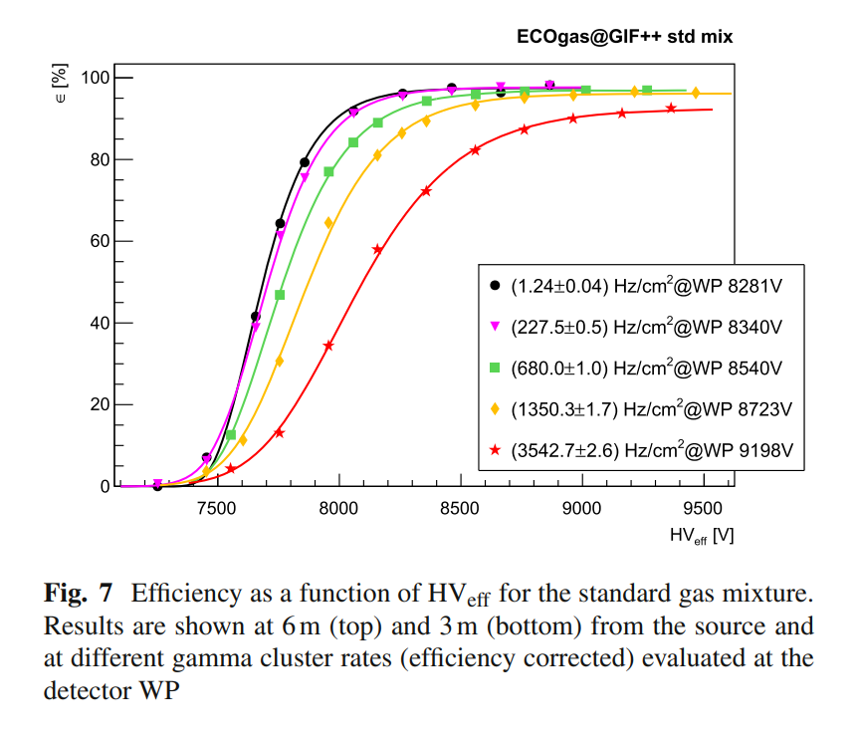
Irradiated Resistive Plate Chambers – Rate Effects
RPC impinged with background irradiation
Rate-induced performance reduction, e.g.,
  Time resolution
  Plateau efficiency
Estimating rate capability of eco-friendly alternative gas mixtures highly relevant
Figures: RPC ECOGas@GIF++ Collaboration., Abbrescia, M., Aielli, G. et al., Eur. Phys. J. C 84, 605 (2024).

Slide 3
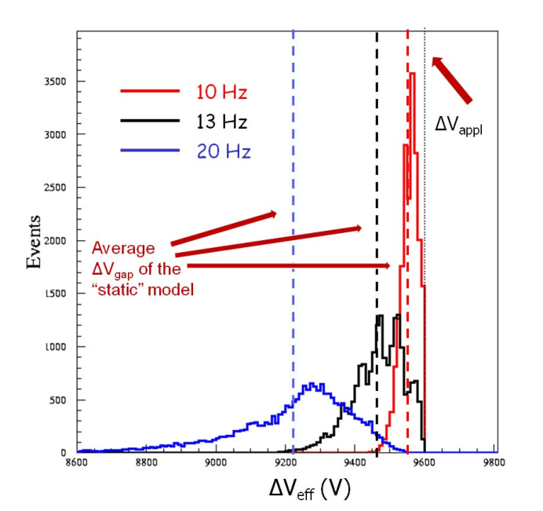
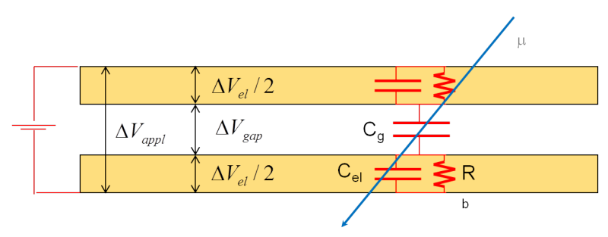
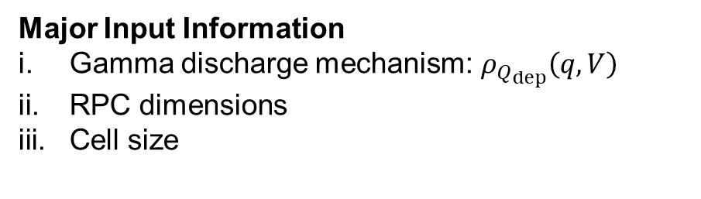

M. Abbrescia’s Single-Cell Model
$$A_{cell}$$
Figure: RPC divided into cells represented by its equivalent circuit
Major Input Information
Gamma discharge mechanism:$ρ_{Q_{dep}}\left(q, V\right)$
RPC dimensions
Cell size
Figure: Voltage spectrum within cells depends on irradiation rate
Figures: Marcello Abbrescia 2016 JINST 11 C10001

Slide 4
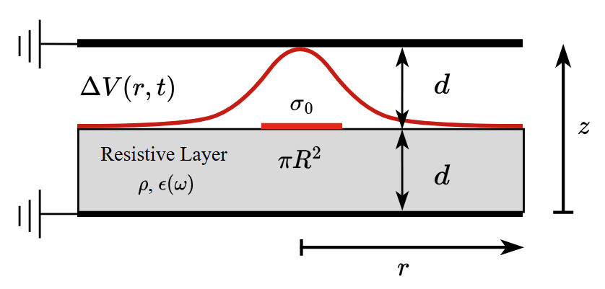
Two-Dimensional Counterpart of Single-Cell Model
Two-layer model for simplicity
Charge deposits uniformly onto disk
Voltage drop depends on radial distance and time
  Complicated expression: Bessel functions [A]
  Currents in radial distance
Monte Carlo simulation expensive
Figure: Illustration of the two-gap 2D model
[A] W. Riegler 2016 JINST 11 P11002

Slide 5
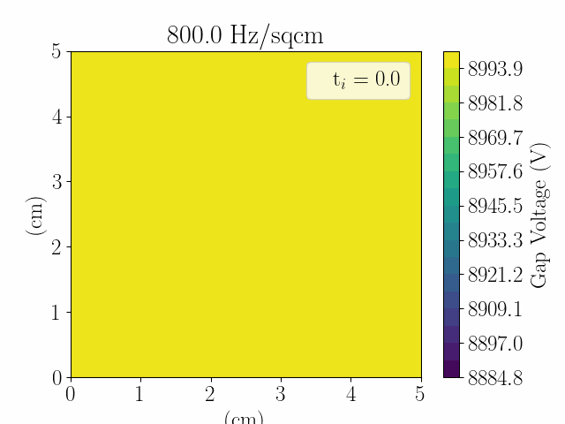
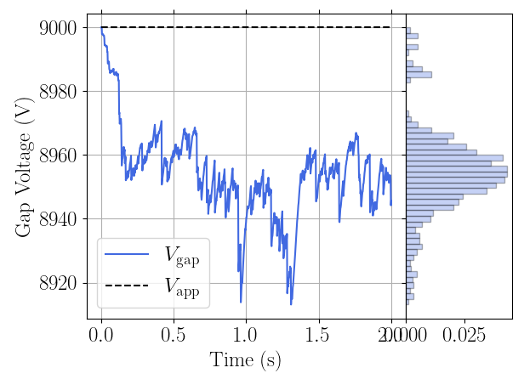

Monte Carlo Simulation of 2D Case
Transient
Equilibrium
Figure: Gap voltage evolution of single 2mm gas gap RPC at $800 Hz/sqcm$.

Slide 6
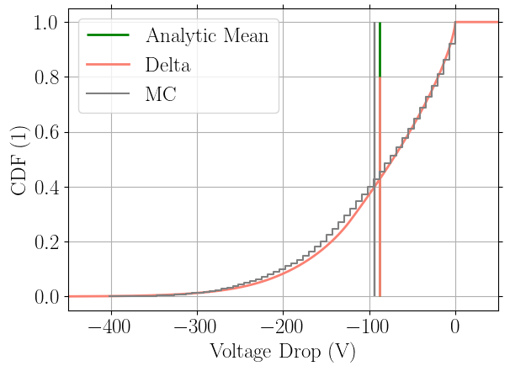
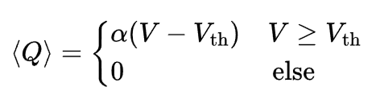
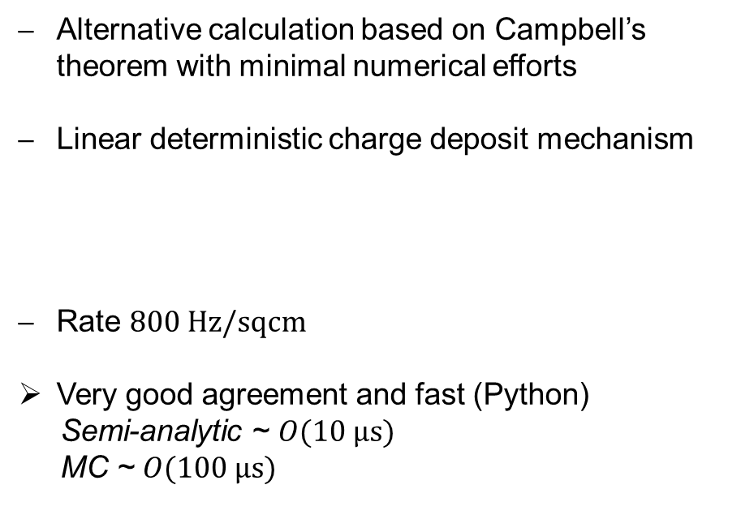
Calculating Voltage Spectrum: Semi-Analytic Method
Example Single-Cell Model
Alternative calculation based on Campbell’s theorem with minimal numerical efforts
Linear deterministic charge deposit mechanism
Rate $800 Hz/sqcm$
Very good agreement and fast (Python)
Semi-analytic ~ $O(10 μs)$
MC ~ $O(100 μs)$
Figure: Single-cell gap voltage spectrum comparison of semi-analytic
method (red) and Monte Carlo (gray)

Slide 7
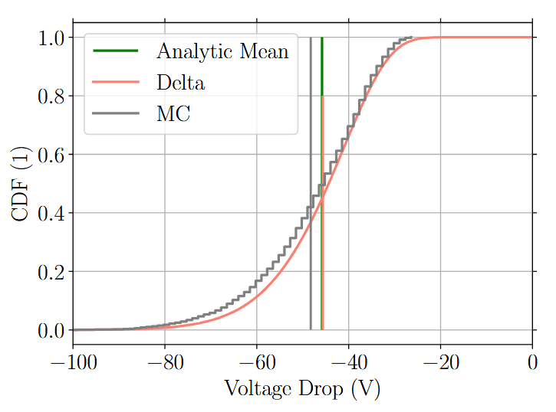
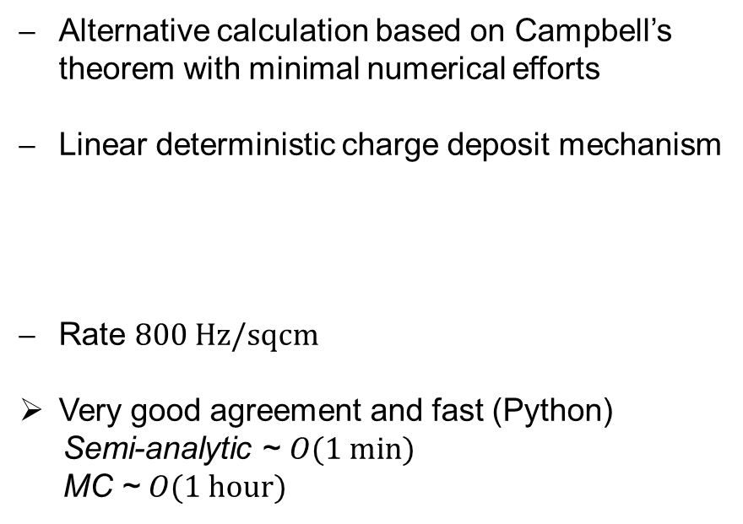
Calculating Voltage Spectrum: Semi-Analytic Method
Example 2D Model
Alternative calculation based on Campbell’s theorem with minimal numerical efforts
Linear deterministic charge deposit mechanism
Rate $800 Hz/sqcm$
Very good agreement and fast (Python)
Semi-analytic ~ $O(1 min)$
MC ~ $O(1 hour)$
Figure: 2D gap voltage spectrum comparison of semi-analytic
method (red) and Monte Carlo (gray)

Slide 8
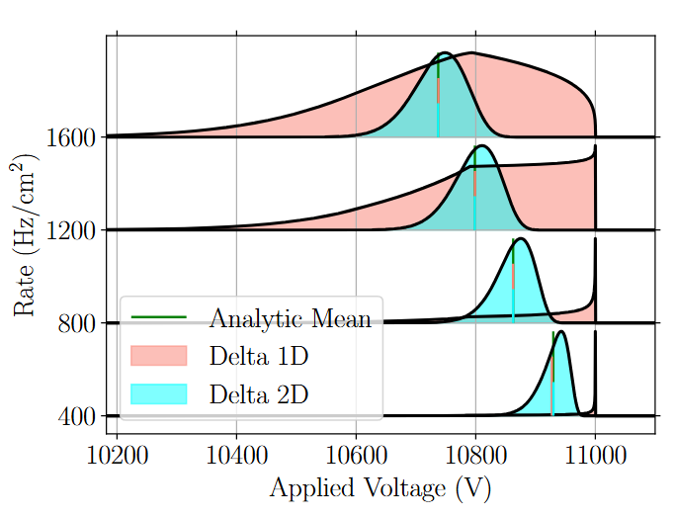
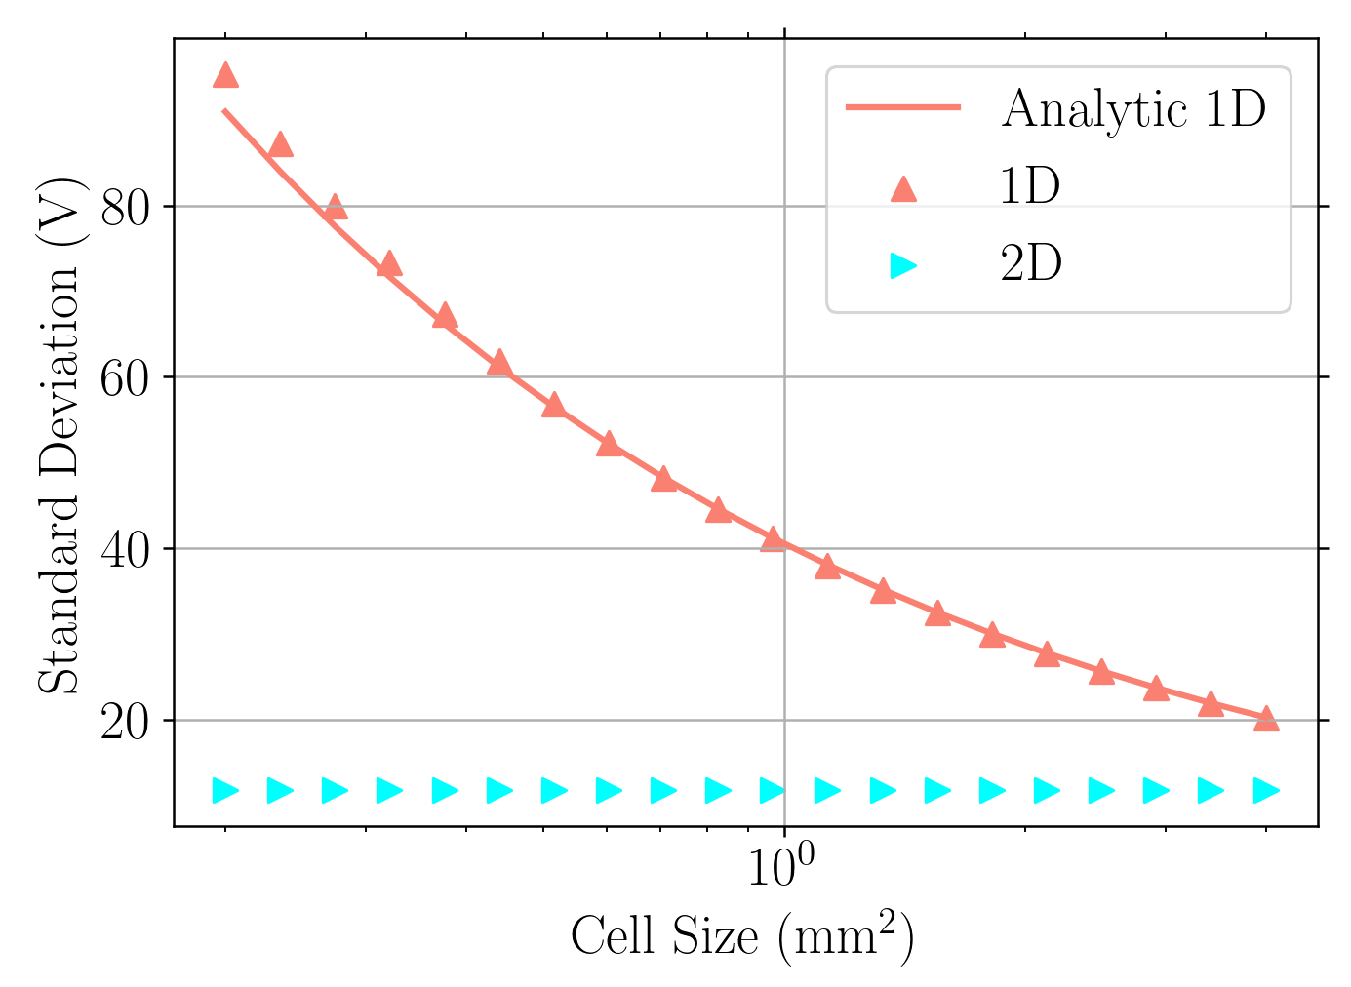
Comparison and Cell Size Dependence
Figure: Voltage spectrum comparison
Figure: Standard deviation depending on cell size
1D always covers applied voltage
2D tends not to be dependent on cell size

Slide 9
Conclusion
Conclusion:
Fast and accurate method to determine gap voltage spectrum
  1D and 2D
  Arbitrary mean charge shapes and charge spectrum possible
1D and 2D are not equivalent
2D does not have a significant cell size dependency
Outlook:
Investigation of formalism with measured data on Std Mix, ECO2 and ECO3
  Prediction strength and consistency (do we miss unexplained effects?)
  Goal is to predict rate capability, focusing on minimal reduction of maximal efficiency

Slide 10
Contact Information
Dario Stocco
PhD Student
stoccod@ethz.ch
High Voltage Laboratory, ETH Zürich
ETL H 28
Physikstrasse 3
8092 Zürich, Switzerland
hvl.ee.ethz.ch
Project financed under SNF grant 212060

Slide 11
Backup

Slide 12
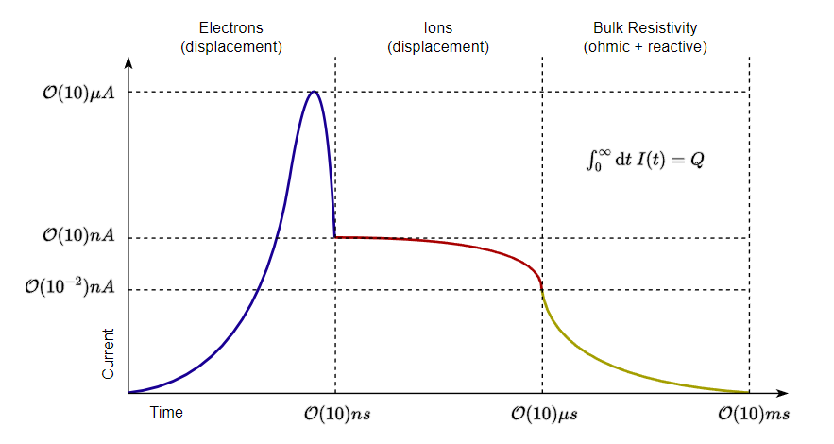
Current Evolution of Single Event
Displacement current from electron avalanches
Displacement current from ion drift (positive and negative)
Ohmic current due to charge neutralization on resistive layers

Slide 13
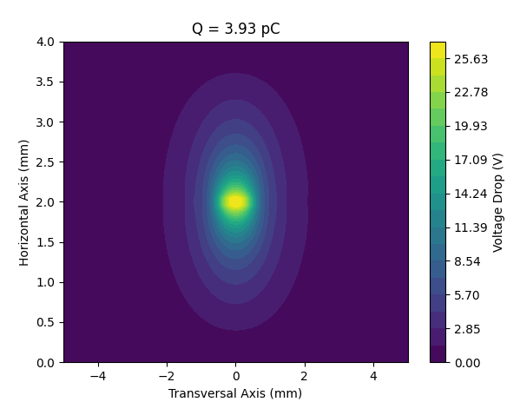
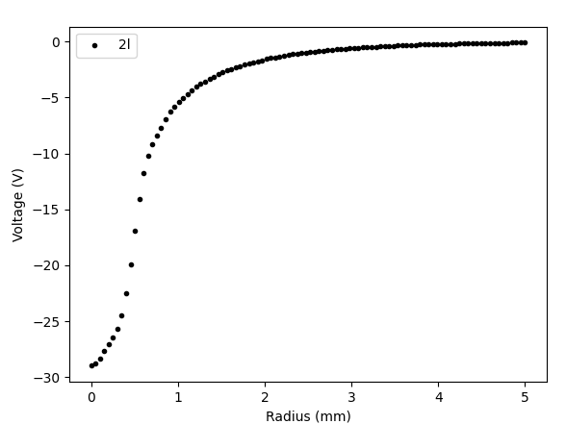
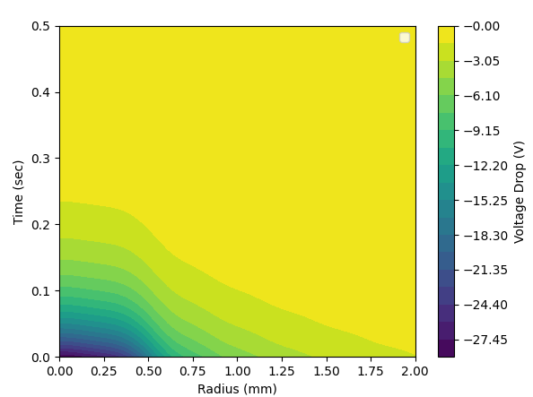

Axisymmetric Two-Layer 2D
Left: Disk with radius 0.5mm; Mid: Voltage profile over the gas gap t = 0; Right: Voltage profile over the gas gap time evolution
Time evolution dictated by ($τ_{2}\sim 80ms$)
Analytic expression of the right profile exists

Slide 14
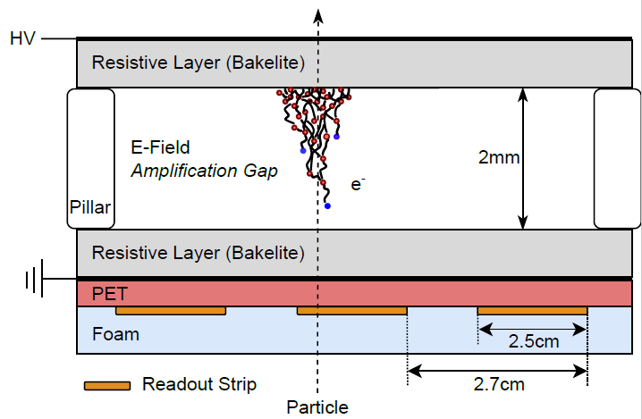

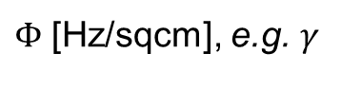



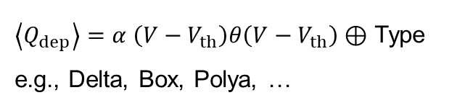
Irradiated RPC – Input Parameters
1. Controlled parameters
2. Gamma discharge mechanism
3. RPC model & discharge geometry
$Φ$ [Hz/sqcm], e.g. $γ$
Charge deposition $ρ_{Q_{dep}}\left(q, V\right)$
Time-dependent voltage drop and current
$$V_{app}$$
$$V = const$$
Gas gap
[1] Marcello Abbrescia 2016 JINST 11 C10001
$$q$$
$\left\langle Q_{dep}\right\rangle =α \left(V−V_{th}\right)θ\left(V−V_{th}\right)⊕$ Type e.g., Delta, Box, Polya, …
Resistive layer

Slide 15
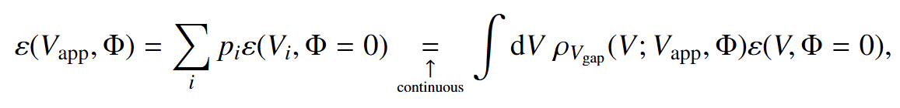
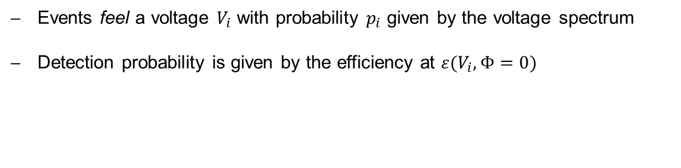
Deterioration of Efficiency
1
2
3
Events feel a voltage $V_{i}$ with probability $p_{i}$ given by the voltage spectrum
Detection probability is given by the efficiency at ${ε(V}_{i},Φ=0)$
This expression is needed
Figure: Gap voltage time series and spectrum within 2 seconds.
The red lines illustrate probes.

Slide 16
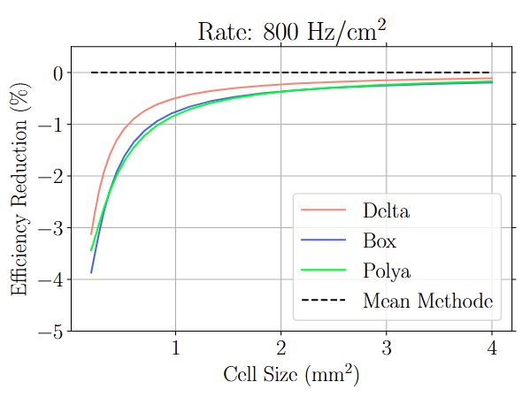
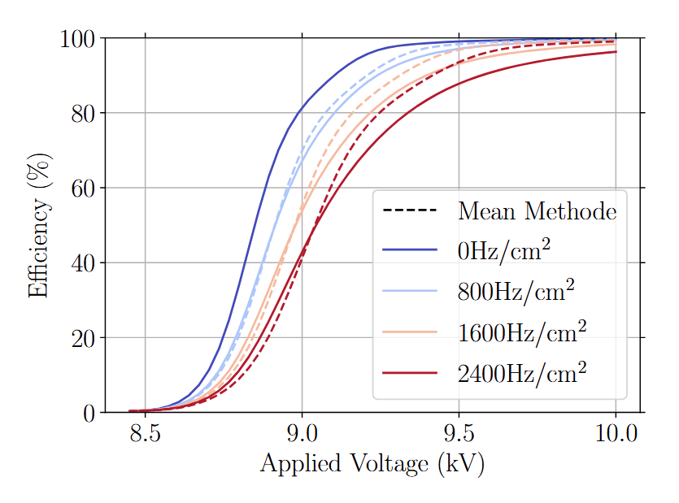
Consequences 1D
Figure: Efficiency deterioration of the single-cell model
with Delta spectrum
Figure: Efficiency deterioration in dependence of cell size
for three charge spectra
Single-cell reduces efficiency
Cell size dependency visible

Slide 17
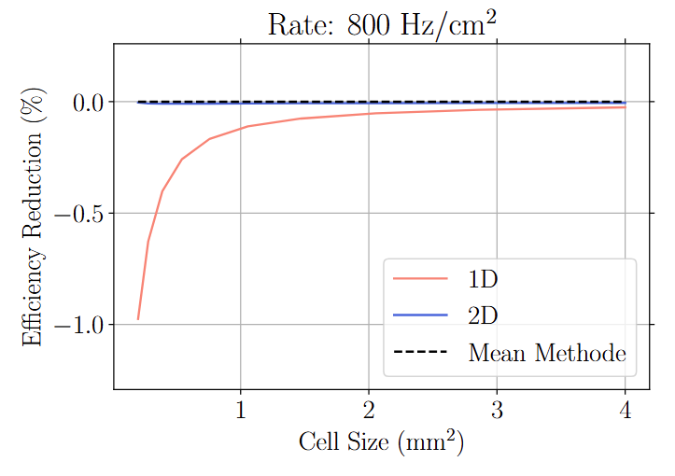
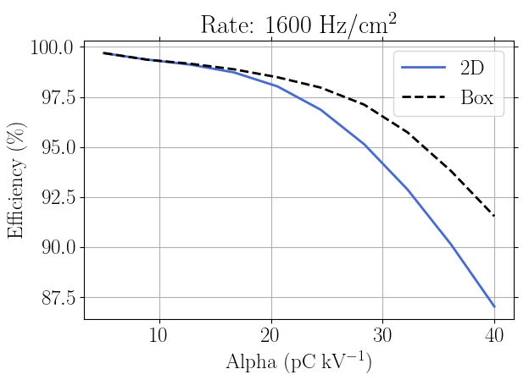


Consequences 2D
Figure: Efficiency deterioration of the 2D model with Delta
spectrum at fixed voltage and various cell sizes
Figure: Efficiency deterioration of the 2D model with Delta
spectrum at fixed voltage and various $α$
Does not depend on cell size compared to 1D model (within the presented parameters)
Similar to mean methode for small charges

