Slide 1
Future EU proposal after AIDAinnova
Colaleo
University and INFN Bari
1

Slide 2
AIDAinnova
AIDAinnova (Advanced European Infrastructures for Detectors at Accelerators) is an EU-funded Horizon 2020 project (2021–2025), aimed at enhancing detector R&D by connecting leading European research infrastructures.
The project promotes innovation in particle detection technologies to support the next generation of high-energy physics experiments.
Key Objectives:
✅ Strengthen detector R&D capabilities;
✅ Provide European-wide access to state-of-the-art test beam and irradiation facilities;
✅ Develop cutting-edge detector technologies, including silicon sensors, gas detectors, and calorimeters;
✅ Foster strong collaboration among research institutions, universities, and industry partners;
✅ Promote effective technology transfer to boost EU competitiveness;
✅ Ensure long-term sustainability through eco-friendly detector solutions and resource-efficient designs.
DRD1 Meeting 24/02/2025
2

Slide 3
AIDAinnova structure
WP1: Project management and coordination
WP2: Communication, Education and Innovation
WP3: Test beam and infrastructure
13 Work Packages (WPs)
  2 Administration WPs
  10 Scientific WPs
  1 “Blue-sky” WP
2 coordinators/WP
WP4: Upgrade of Irradiation and Characterization Facilities
WP5: Depleted Monolithic Active Pixel Sensors
WP6: Hybrid pixels sensors for 4D Tracking and Interconnection Technologies
WP7: Gaseous detectors for frontier science
WP8: Calorimeters and Particle Identification detectors
WP9: Cryogenic neutrino detectors
WP10: Advanced mechanics for tracking and vertex detectors
WP11: Microelectronics
WP12: Software
WP13: Prospective and Technology-driven Detector R&D
3

Slide 4
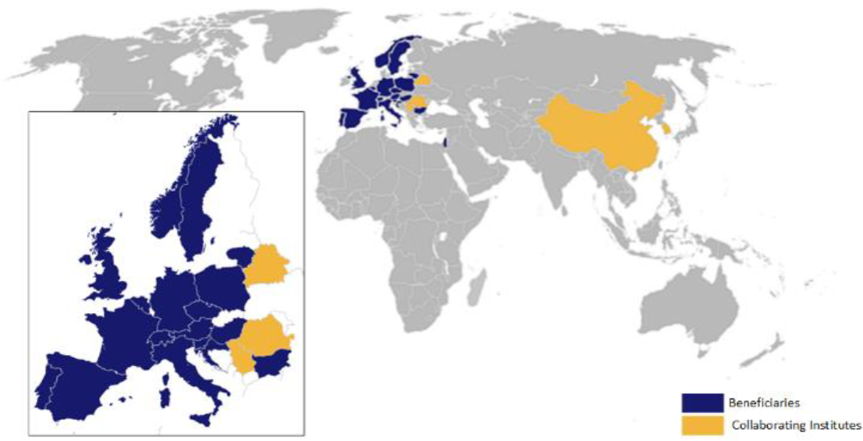
AIDAinnova: Global Collaboration & Funding Opportunities
~20 countries involved
46 beneficiaries (Academic, Industry)
Coordinated by CERN
Total budget: ~30M€
EU contribution: 10M€
Co-financing through national sources and industrial partnerships
Opportunities for Non-European Countries
Encouraging participation from non-European institutions to foster global innovation.
Participants bring in complementary competences and a balanced coverage of projects.
Facilitating knowledge transfer and joint development of advanced detector technologies.
Exploring collaboration through EU-funded initiatives and bilateral agreements.
4

Slide 5
Future EU calls of interest
The draft of the 2025 European Work Programme, WP25, has been circulated
  In WP25 there are the HORIZON-INFRA-2025-01-TECH-02 calls
    The current 3 INFRA-INNOV, AIDAinnova, I.FAST and LEAPS-INNOV, will participate to these calls
  EU Contribution: HORIZON-INFRA-2025-01-TECH-02 funding estimated at 10M€ per project.
  Co-Financing Model: Matching funds leveraged from national sources and industrial partners.
  Cost Distribution: Budget allocated across research infrastructure, technology development, and industry collaboration.
5
2

Slide 6
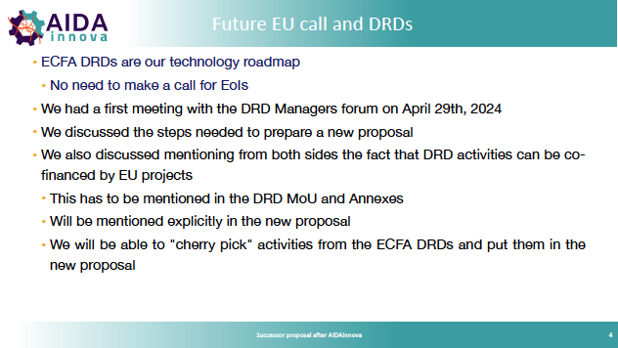
Strategic alignment
The program must be in line with the expected priorities of the European Strategy for Particle Physics, recognized by the European Strategy Forum on Research Infrastructures (ESFRI) and the European Commission (EC) as the reference roadmap for particle physics in Europe.
First meeting of proposal preparation team of AIDAxxx P. Giacomelli INFN Bologna
6
4

Slide 7
Proposal Submission Roadmap
📅 Deadline: Early Autumn 2025
✅ Team Coordination: Proposal Preparation team
Ensure collaboration between AIDAinnova management, DRDC, and technical experts (some from DRD management)
✅ Drafting Work Packages
Define objectives, partners, and funding allocation.
Structure WPs and tasks according to project needs.
✅ Financial Planning
Prepare a detailed funding breakdown for each WP and task.
✅ Finalization & Submission
Conduct proposal refinement and internal review process.
Official submission by Autumn 2025.
✅ Start 2026
7
5

Slide 8
Proposal Preparation Team
Members of the Team
  Paolo Giacomelli AIDAinnova management (IT)
  Daniela Bortoletto AIDAinnova management (UK)
  Giovanni Calderini AIDAinnova management (FR)
  Thomas Bergauer DRDC chair (AT)
  Katja Kruger AIDAinnova and calorimetry (GE)
  Anna Colaleo, gas detectors (IT)
  Guy Wilkinson, PID (UK)
  Christophe de la Taille, electronics (FR)
  Frank Gaede software (GE)
  Anna Zaborowska, software (CERN)
  Roberta Zanin, CTAO
  Domenico della Volpe, CTAO (CH)
  Burkhard Schmidt, mechanics –integration (CERN)
8
6

Slide 9
Proposal Preparation: status and next step
📅 Bi-weekly meetings of the Proposal Preparation Team to coordinate efforts and refine the proposal.
✅ Meetings held: 31 January & 14 February – Initial structuring and WP definition.
AIDAxxxx Project Structure – Version 1 (14 February):
📌 Next meeting: 28 February
  🔹 WP1 – Project Management
  🔹 WP2 – Communication, Outreach, and Knowledge Transfer
  🔹 WP3 – Test Beam, Irradiation, and Characterization Facilities
  🔹 WP4 – Solid State Sensors for Vertexing, Tracking, and Timing
  🔹 WP5 – Photodetection Sensors and Particle Identification (PID)
  🔹 WP6 – Gas Detectors
  🔹 WP7 – Calorimeters
  🔹 WP8 – Mechanics and Cooling
  🔹 WP9 – Microelectronics
  🔹 WP10 – Software and AI Tools
  🔹 WP11 – Blue Sky Research
    Define specific tasks within each WP.
    Identify (few) facilitators for each task in each WP to help in preparation
9
5

Slide 10
Proposal preparation and DRD1
A dedicate WP (WP6) exists for Gaseous detector. But to maximize funding opportunities for DRD1-related activities, we should proactively identify tasks to be proposed in other WPs that align with the broader interests of the DRD1 WGs:
➔ Even if the direct beneficiaries are fewer and mainly European, I would propose to create tasks beneficial to the entire gaseous detector community, maintaining coherence with DRD1’s shared initiatives.
🔹 Beyond WP6, key areas of interest include:
Proposed tasks should be broad enough to integrate gaseous detector developments without being specialized.
Industrial partnerships are an asset
WP3 – Test Beam, Irradiation, and Characterization Facilities
WP5 – Photodetection Sensors and Particle Identification (PID)
WP7 – Calorimeters
WP8 – Mechanics and Cooling
WP9 – Microelectronics
WP10 – Software and AI Tools
10

Slide 11
Proposal preparation and DRD1
WP6 is not formally a DRD1 project, thus no formal approval from the DRD1 Collaboration is required.
  Institutions not involved in DRD1 are also welcome to propose tasks directly by contacting me.
Limited tasks per WP (3–4):
  Budget primarily covers personnel, consumables, and instrumentation.
Avoiding fragmentation:
  Directly "cherry-picking" tasks from DRD1 proposals risks creating fragmentation and biased selection.
Next step in proposal preparation:
Profit from the existing DRD1 organizational structure (SCB coordinators and SPs) to
  Identify well-structured, community-aligned tasks, with close alignment with the main DRDT themes, maximizing broad community interest.
Identify facilitators (up to 3 per task, not necessarily beneficiaries):
  Ensure balanced and inclusive participation across institutions.
11
5

