Slide 1
DRD1 – WG7
News
Karl Jonathan Flöthner
Yorgos Tsipolitis

Slide 2
Test beams in 2025
We filed a request asking for 3 TB periods of 2 weeks each:
  late May/early June
  July
  late September/early October

Slide 3
1st attempt from SPS coordinator received on Monday 24/2

Slide 4
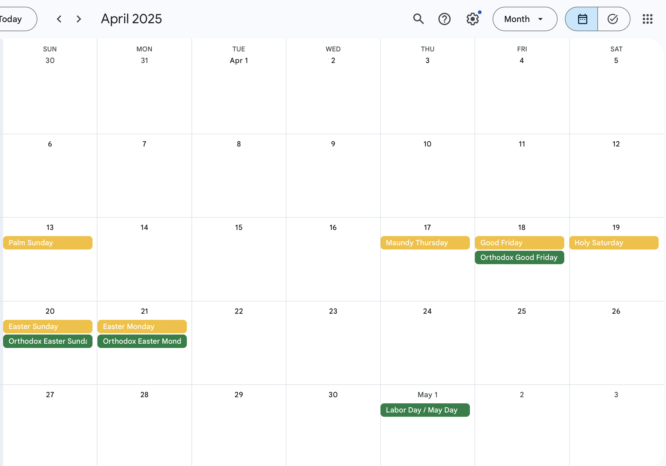
Begin: Mon, 2025-04-14
End: Mon, 2025-04-28

Slide 5
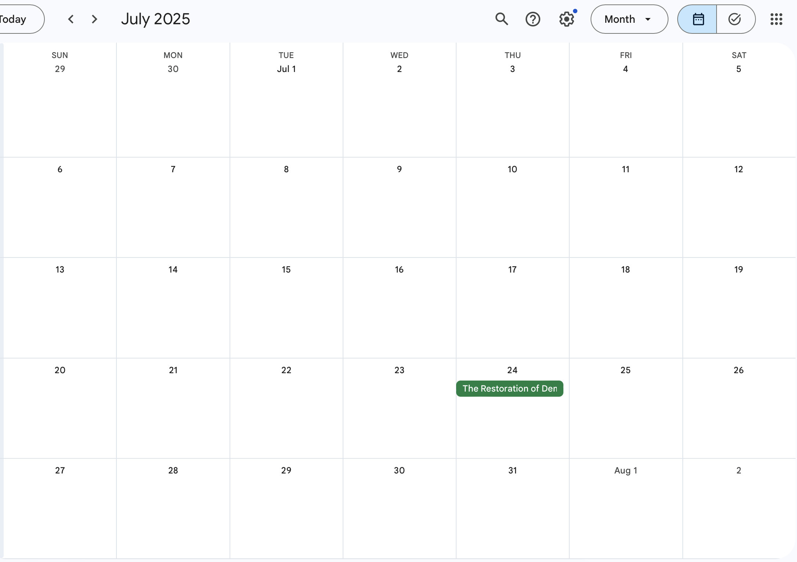
Begin: Mon, 2025-07-07
End: Mon, 2025-07-21

Slide 6
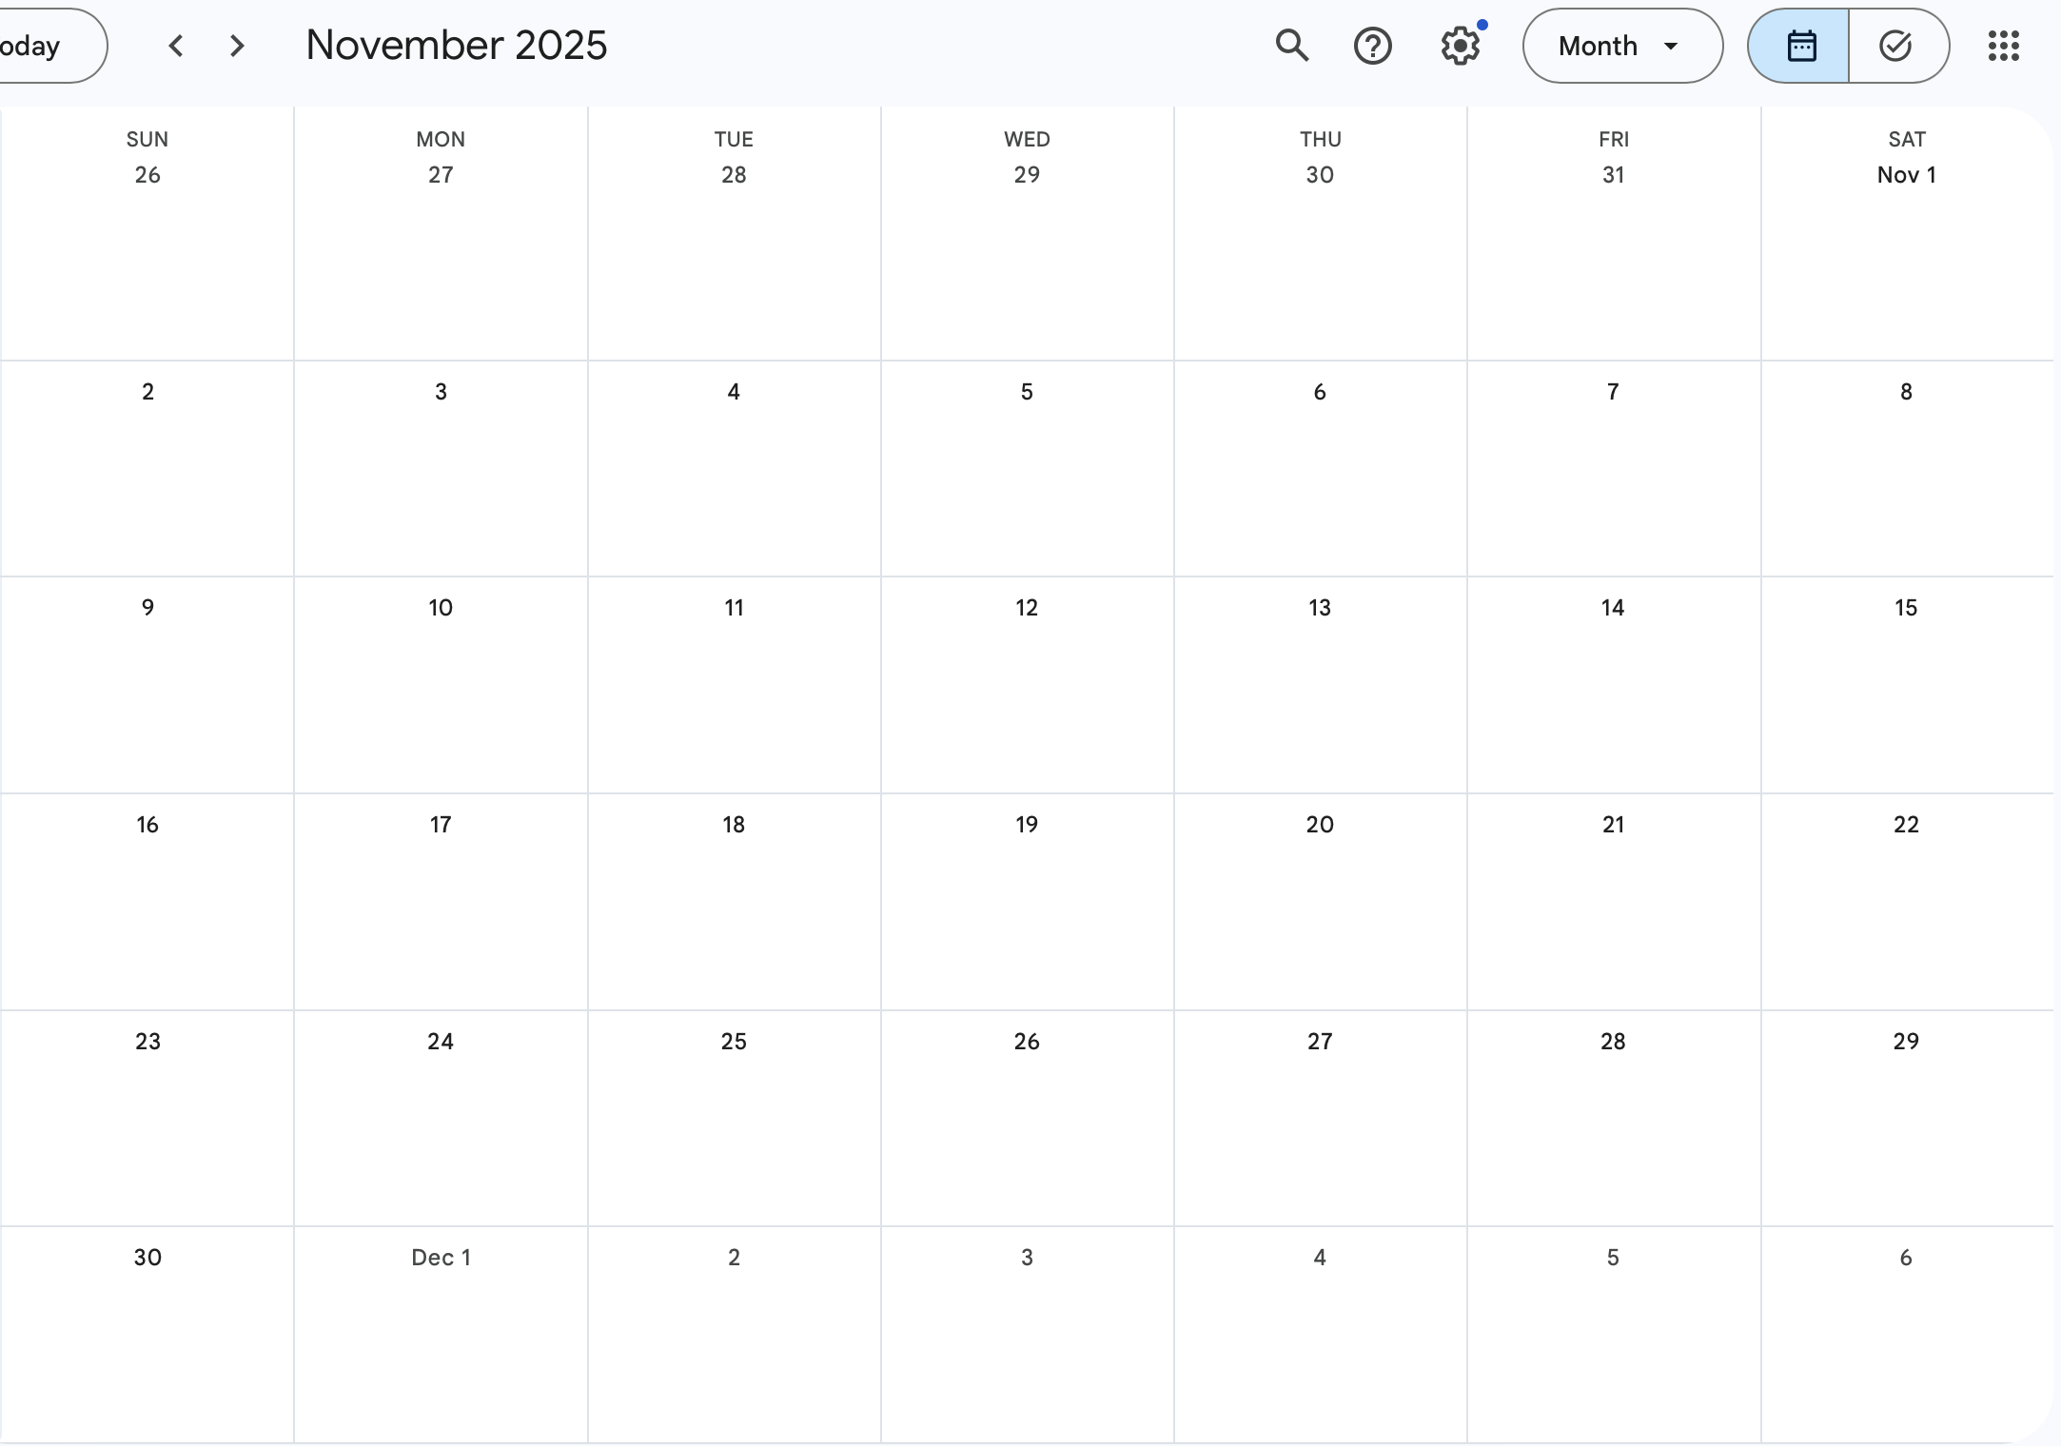
Begin: Mon, 2025-11-10
End: Mon, 2025-11-24

Slide 7
We are in contact with the SPS-coordination, trying to get TB periods closer to our request
We usually have a meeting with the groups intending to participate 3-4 weeks before the TB in order to see the needs of the groups.
We supply the standard gases but if you have a special gas you will have to order it yourself well in advance.
For general information about the test beams please have a look at: here or the attached file of this session.
For any questions , Karl & Yorgos are available to answer

Slide 8
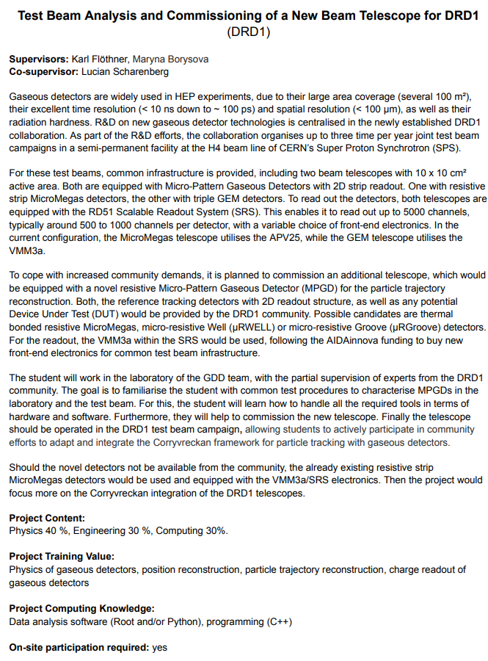
Summer Student Project
New Beam Telescope for DRD1
  Based on resistive MPGD
  Detectors might be provided by the community for first tests
Corryvreckan integration planned
  Great support from our community

Slide 9
extras

Slide 10
