Slide 1
WG2 communications
Conveners:
Giulio Aielli, Francisco Garcia, Diego Gonzalez Diaz,
F. Grancagnolo, Gabriella Pugliese, Riccardo Farinelli
Conveners email: drd1-wg2-convenors@cern.ch
Forth DRD1 Collaboration Meeting
February 25, 2025

Slide 2
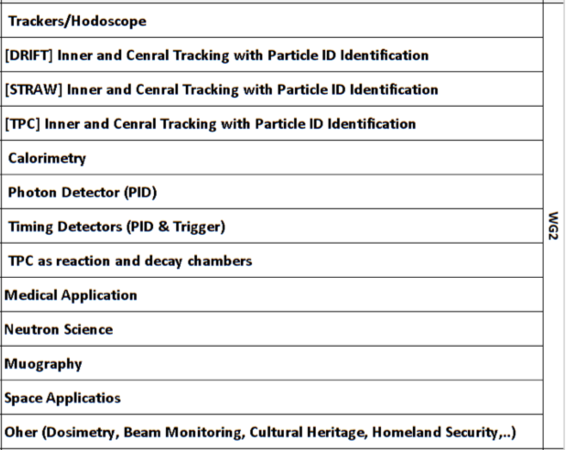
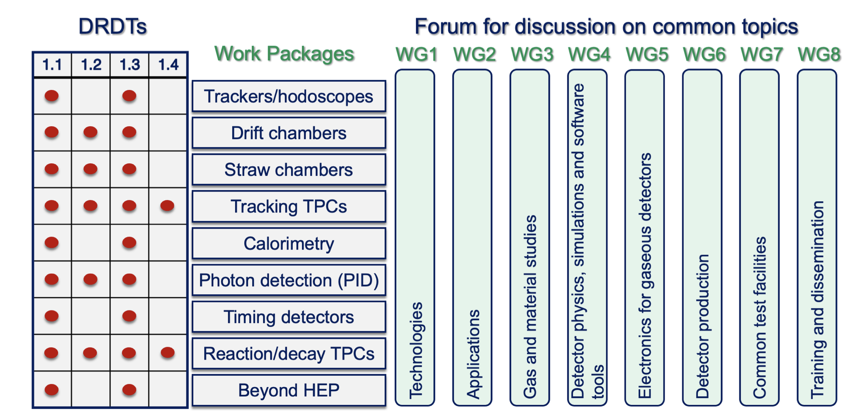
WG2 focus
Working Group 2 is focused on applications that use gaseous detectors technologies

Slide 3
WG2: Application of gaseous detector in HEP and beyond-HEP fields
The applications of interest for the WG2 are both HEP and beyond-HEP related.
WG2 should serve as a platform during collaboration meetings for the presentation of activities,
i.e. those originating from the WPs, unless such activities are more appropriately aligned with the objectives of alternative WGs.
Applications unrelated to the WPs are welcome.

Slide 4
WG2 mandate
Within WG2 it is possible to share common interest on application and create new clusters and start new WP proposal.
WG2 have to serve DRD1 in regard to dynamizing and monitor applications and not just the WP-part of DRD1: proactively guide applications outside WPs towards potential synergies with existing WPs.
Everyone participating to the WPs is included but also we should extend it to everyone else working on applications
Self-subscribe to the mailing list and e-group: DRD1-WG2 (76 member, self-added)

Slide 5
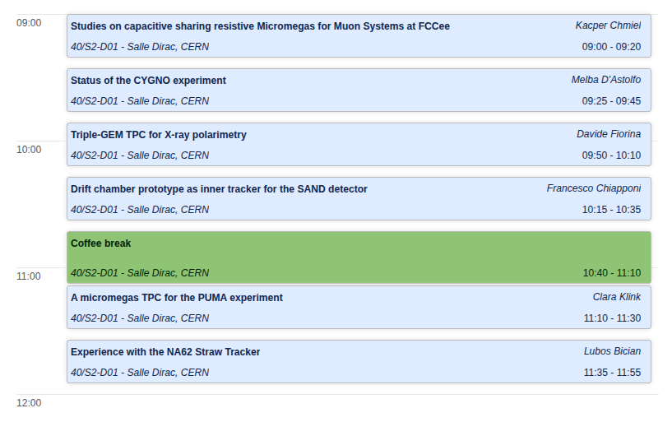
WG2 Collaboration meeting session

