Slide 1
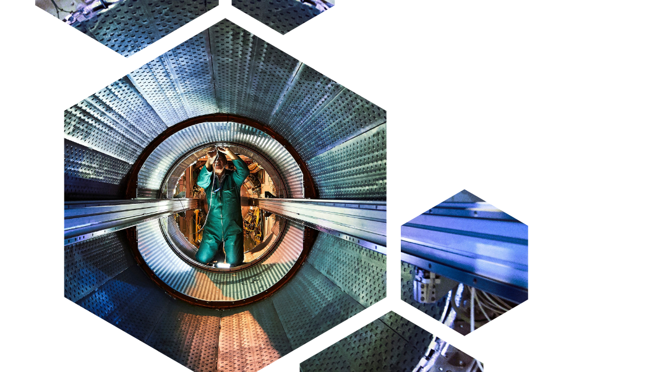
2024 Procurement Report
ILO Forum 25th March 2025

Slide 2
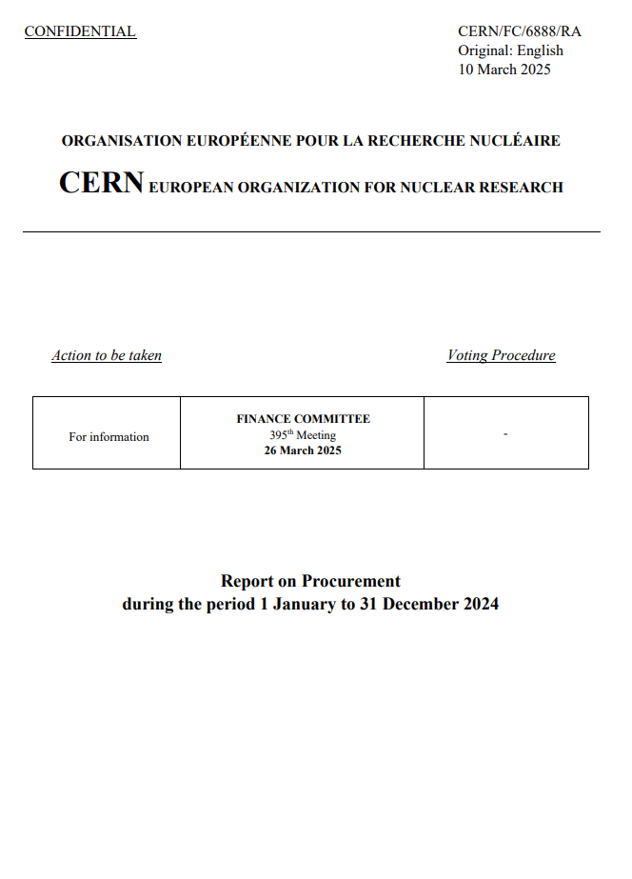
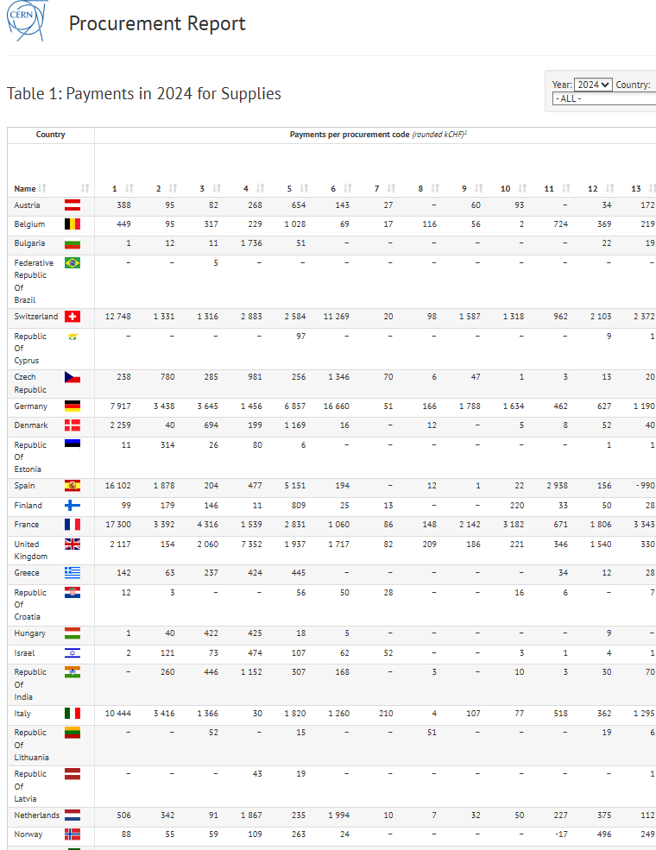
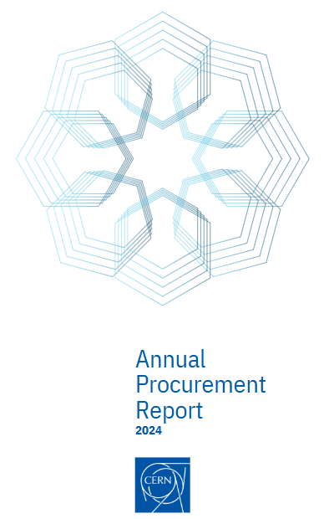
Introduction
3 different versions have been prepared for 2024
The document presented to FC
(usual format)
The web version
A polished version available on paper only
The Key Performance Indicator of less than 3 Very Poorly Balanced Member States has been achieved

Slide 3

Procurement 2024 - Figures
32’000
26'500
31’700
Suppliers
orders placed
orders placed on the
CERN Stores
260
62
Contracts signed
R&D collaboration agreements
129
118
Price inquiries above 50k CHF
Invitations to Tender

Slide 4
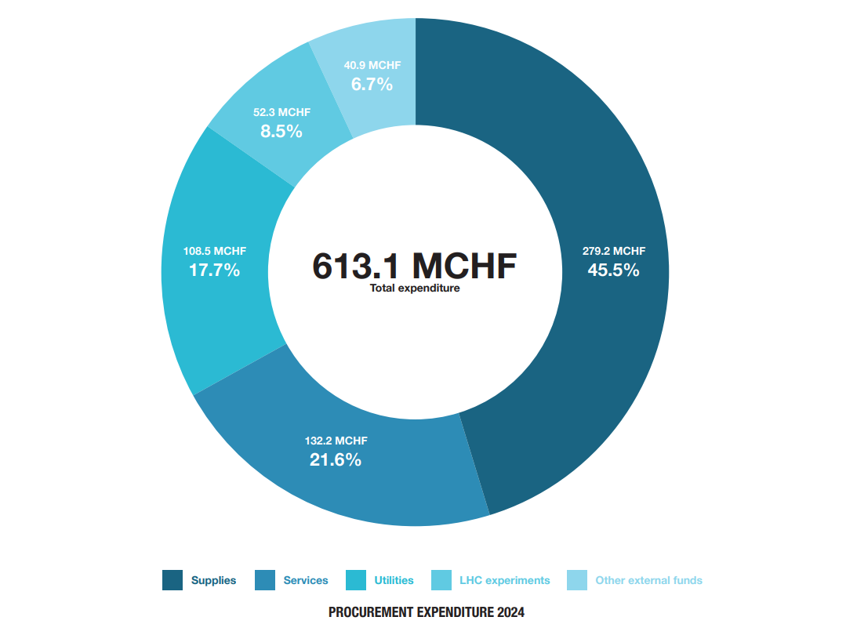
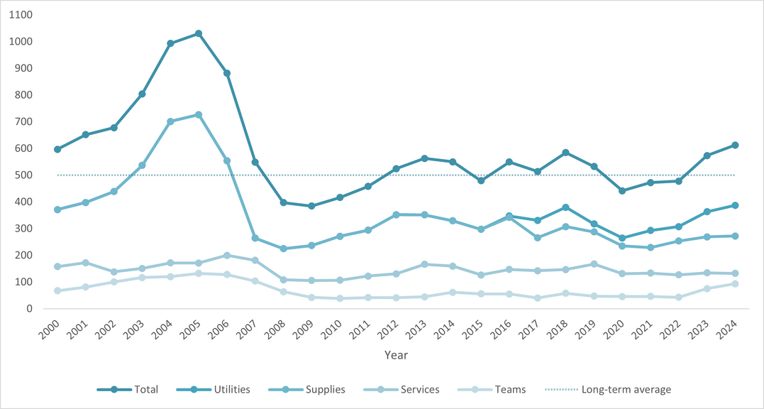
Expenditure figures
25/03/2025
Cristina Lara Arnaud

Slide 5






Highlights 2024
Procurement Values
PROCURE
PROfessionalism
CERN FINANCIAL RULES
REspect
Creativity
Unity
New Procurement Rules approved by Council in June 2024
Procurement Strategic objectives (2025-2030):
Thresholds of procurement procedures were reviewed after 59 years
Deliver world-class scientific results and knowledge
Deliver a best-in-class procurement service
The use of Limited Tendering procedures were extended to the 12 countries with the lowest return coefficients
Increase the return to Member States and Associate Member States
Promote fair competition and better balance industrial return to MS and AMS
Possibility to adjudicate supply contracts on a BVFM basis without prior FC authorisation
Strengthen CERN’s impact on society
Support the Organization in its sustainability initiatives

Slide 6

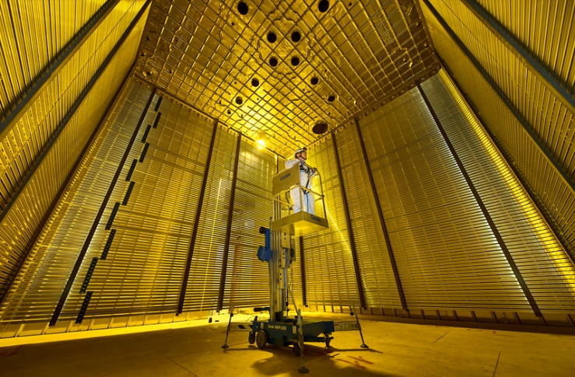
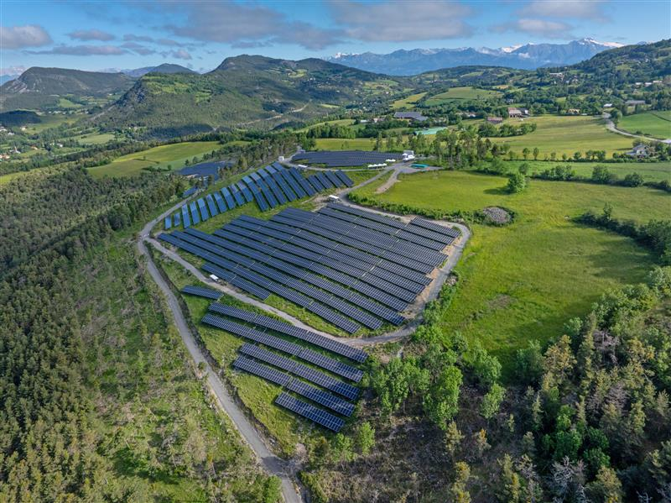
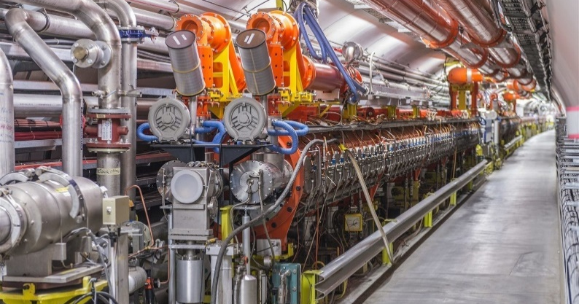
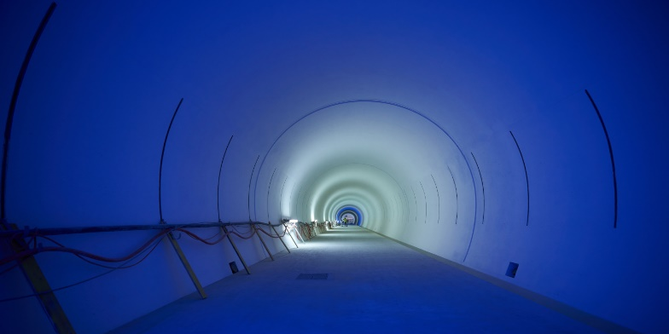
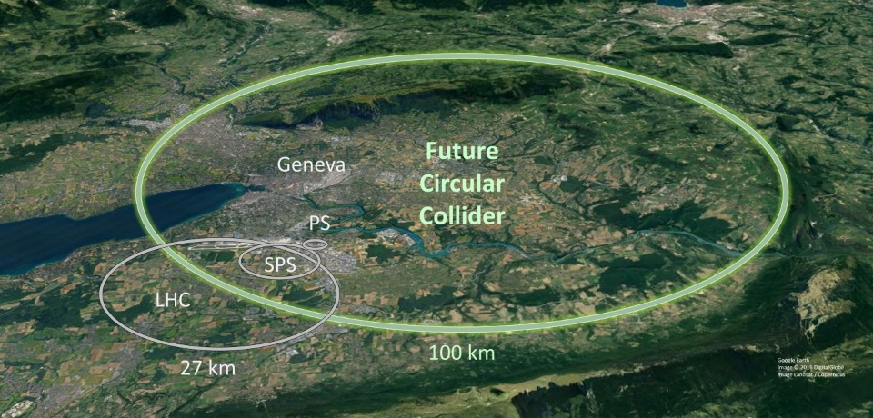

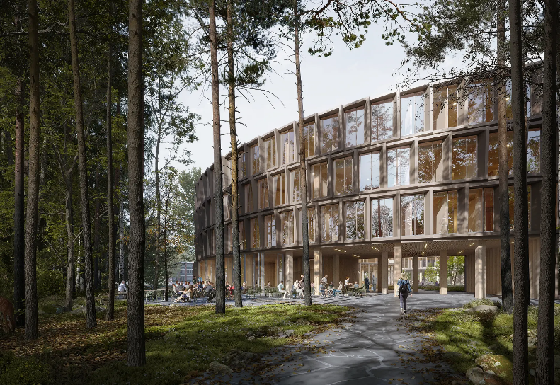
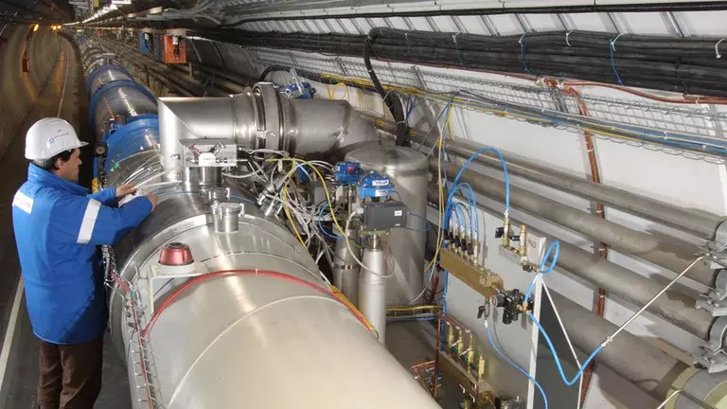
Tenders and contracts finalised in 2024
CMS Endcaps Removal and HGCAL Installation
DUNE (cold containment materials, transport of structures, installation in the USA)
3 Solar Power Purchase Agreements (PPAs) signed
HL-LHC procurements well advanced in line with budget
FCC site investigation works
Power and signal cables
Building 777 construction
IT Agile contracts
Retendering of FSU Contracts

Slide 7

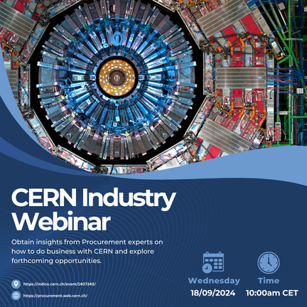

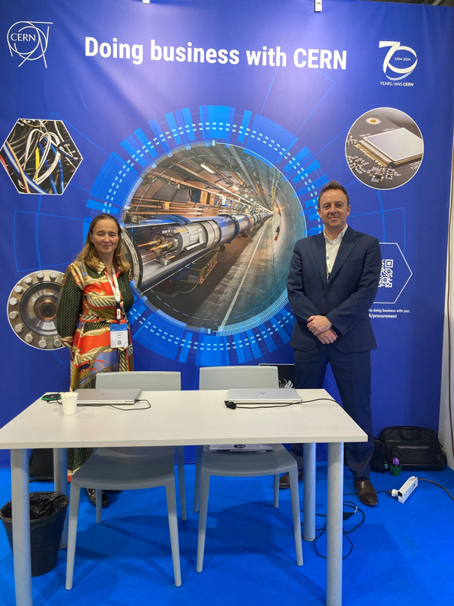
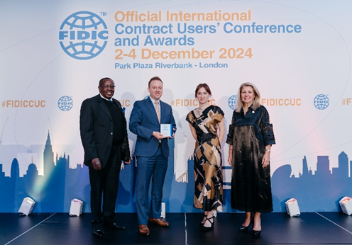

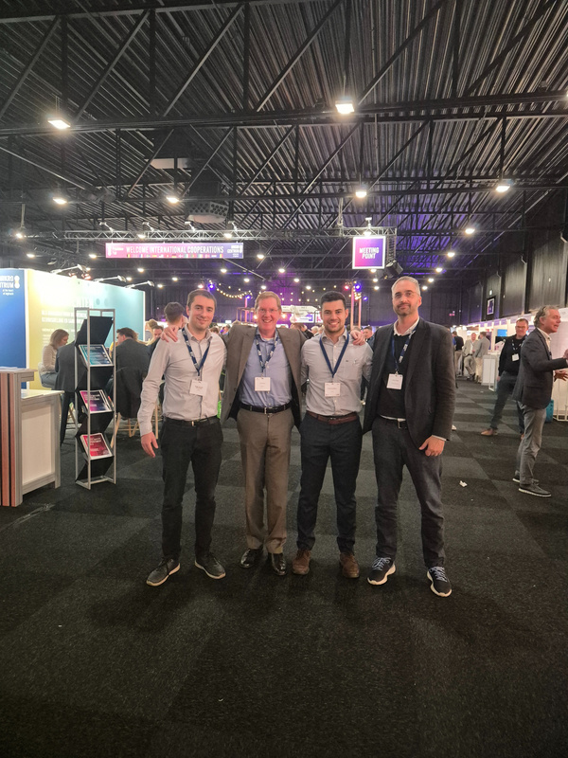
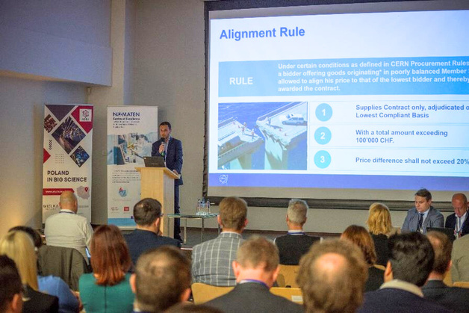
Highlights 2024 - Outreach
18 SEPTEMBER
First CERN industry webinar
22 JULY
International Cryogenics Engineering Conference (CH)
3 DECEMBER
CERN received a “Client of Year” FIDIC award
1 OCTOBER
Big Science Business Forum in Trieste (IT)
22 NOVEMBER
Thematic Day - Precision Machining webinar
15 NOVEMBER
Precision Fair in
s-Hertogenbosch (NL)
19 NOVEMBER
Big Science and Nomaten Innovation Days in Otwock (PL)

Slide 8
Industrial return coefficients for supply contracts
Definitions following change of Rules
Return coefficient
Expenditures excluded:
Defines the Member State’s status:
Orders < 2kCHF
MOCS
Utilities
Funded by external funds
Non-Member State orders
<1.0: Poorly balanced
≥1.0: Well balanced
AMS has reached its ceiling: Well balanced

Slide 9


































Industrial return coefficients for supply contracts
Country |  | Supplies
 |  | Well balanced | Poorly balanced
 | Austria |  | 0.76
 | Belgium |  | 0.45
 | Federative Republic of Brazil⁵ | N/A | N/A
 | Bulgaria | 1.19
 | Republic of Croatia² ⁴ | 0.97
 | Republic of Cyprus³ |  | 0.27
 | Czech Republic | 1
 | Denmark |  | 0.62
 | Republic of Estonia | 1.44
 | Finland |  | 0.59
 | France | 1.39
 | Germany |  | 0.85
 | Greece |  | 0.44
 | Hungary |  | 0.69
 | Republic of India² |  | 0.68
 | Israel |  | 0.25
 | Italy | 1.29
Country |  | Supplies
 |  | Well balanced | Poorly balanced
 | Republic of Latvia² |  | 0.68
 | Republic of Lithuania² |  | 0.75
 | Netherlands |  | 0.56
 | Norway |  | 0.43
 | Islamic Republic of Pakistan² ⁴ | 0.43
 | Poland |  | 0.74
 | Portugal |  | 0.72
 | Romania |  | 0.4
 | Serbia |  | 0.51
 | Slovakia |  | 0.62
 | Republic of Slovenia³ |  | 0.7
 | Spain |  | 0.93
 | Sweden |  | 0.42
 | Switzerland | 5.01
 | Republic of Turkiye² ⁴ | 2.28
 | Ukraine² ⁴ | 0.24
 | United Kingdom |  | 0.51
Croatia, Pakistan, Türkiye and Ukraine reached their ceiling in 2024, and shall be considered as well balanced
No data for Brazil as it joined CERN as an Associate Member State in March 2024

Slide 10
Industrial return coefficients for service contracts
Country |  | Supplies
 |  | Well balanced | Poorly balanced
 | Austria |  | 0.11
 | Belgium |  | 0.07
 | Federative Republic of Brazil⁵ | N/A | N/A
 | Bulgaria
 | Republic of Croatia² ⁴ | 0.38
 | Republic of Cyprus³
 | Czech Republic |  | 0.05
 | Denmark | 3.62
 | Republic of Estonia
 | Finland
 | France | 2.12
 | Germany |  | 0.11
 | Greece |  | 0.24
 | Hungary
 | Republic of India²
 | Israel
 | Italy |  | 0.07
Country |  | Supplies
 |  | Well balanced | Poorly balanced
 | Republic of Latvia²
 | Republic of Lithuania² |  | 0.03
 | Netherlands
 | Norway |  | 0.12
 | Islamic Republic of Pakistan² ⁴
 | Poland |  | 0.01
 | Portugal
 | Romania
 | Serbia
 | Slovak Republic | 1.26
 | Republic of Slovenia³
 | Spain | 1.44
 | Sweden |  | 0.02
 | Switzerland | 11.52
 | Republic of Turkiye² ⁴
 | Ukraine² ⁴
 | United Kingdom | 0.5
Croatia, Pakistan, Türkiye and Ukraine reached their ceiling in 2024, and shall be considered as well balanced
No data for Brazil as it joined CERN as an Associate Member State in March 2024

Slide 11
Status for supply contracts from 1st March 2025 until 28th February 2026
2023
2024
2021
2024
7 WB countries
10 WB countries
6 countries with IR<0.4
2 countries with IR<0.4
21% of contributions
2.4% of contributions
Well balanced
 | Bulgaria
 | Croatia
 | Czech Republic
 | Estonia
 | France
 | Italy
 | Pakistan
 | Switzerland
 | Turkey
 | Ukraine
Poorly balanced
 | Austria
 | Belgium
 | Federative Republic of Brazil
 | Republic of Cyprus
 | Denmark
 | Finland
 | Germany
 | Greece
 | Hungary
 | Republic of India
 | Israel
 | Latvia
Poorly balanced
 | Lithuania
 | Netherlands
 | Norway
 | Poland
 | Portugal
 | Romania
 | Serbia
 | Slovak Republic
 | Slovenia
 | Spain
 | Sweden
 | United Kingdom

Slide 12
Commitment to continuing improving the balance
Eligible for Limited Tendering
 | Belgium
 | Federative Republic of Brazil
 | Republic of Cyprus
 | Greece
 | Israel
 | Netherlands
 | Norway
 | Pakistan
 | Romania
 | Serbia
 | Sweden
 | United Kingdom
To improve the return coefficient to CERN’s Member States and Associate Member States with the lowest industrial return coefficient
Limited Tendering procedure
The Procurement Rules allow extended use of Limited Tendering
Collaborate with all Member States, especially via the ILOs
This list will be updated if one the following events occur:
Adhesion of one new Associate Member State during the period
Once an Associate Member State reaches its “ceiling”
(article 4.2 of the Procurement Rules)

Slide 13
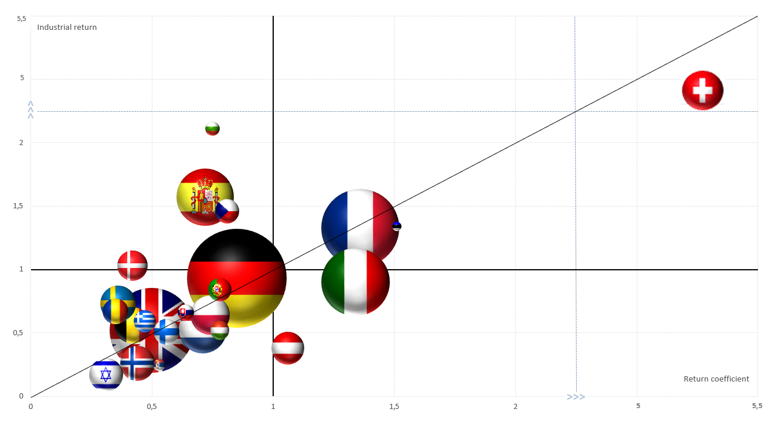
New way to present IR (MS)
Return Coefficient
2020 – 2024
Member States, 2024 Industrial Return (IR) return coefficient 2021-2024
The bubble size reflects size of contribution to the budget

Slide 14
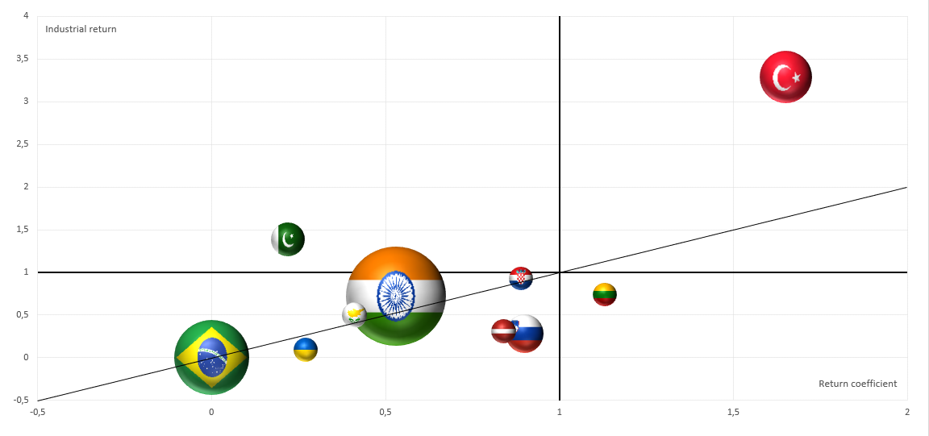
New way to present IR (AMS)
Return Coefficient
2020 – 2024
Associate Member States, 2024 Industrial Return (IR) return coefficient 2021-2024
The bubble size reflects size of contribution to the budget

