Slide 1
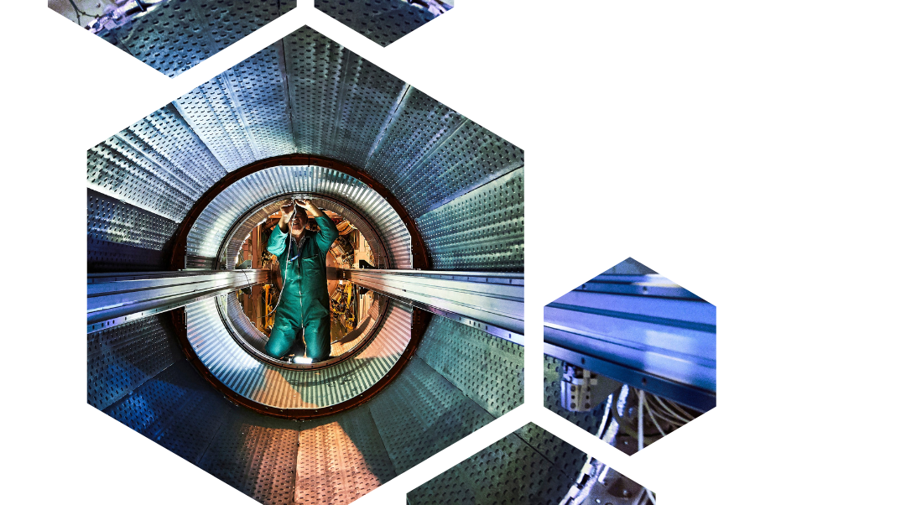
Suppliers’ database update
ILO Forum 25th March 2025
1

Slide 2
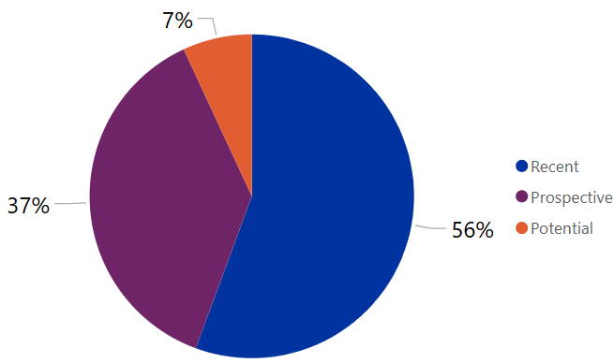
Active supplier’s classification
RECENT: Firms who have had a contract or order placed within the past 8 years
PROSPECTIVE: Firms recently in contact with CERN, including those approached for an MS/IT/DO in the past 8 years without receiving an order
POTENTIAL: Firms registered in the past 5 years but not yet contacted

Slide 3
Why keep the Database Up to Date
To improve response rates by:
Targeting appropriate suppliers (using procurement codes),
Contacting the right suppliers’ contact.
2023
To improve balanced industrial return by targeting the right supplier in specific countries.
To increase the number of orders sent via eProcurement platform.
2024
Notes:
Filtered by PC, CA, CD, DL orders

Slide 4





Results ILOs emailing
Since October emails were sent to all 34 ILOs
→ To date only 4 Member States have returned their revised list of suppliers
Actions taken with ILOs response:
    Emails sent to all suppliers with an eProcurement account requesting to update their details
    Manually updated CERN’s Suppliers Database with information provided by ILOs
    For non-registered eProcurement suppliers, we will send an email requesting them to register

Slide 5
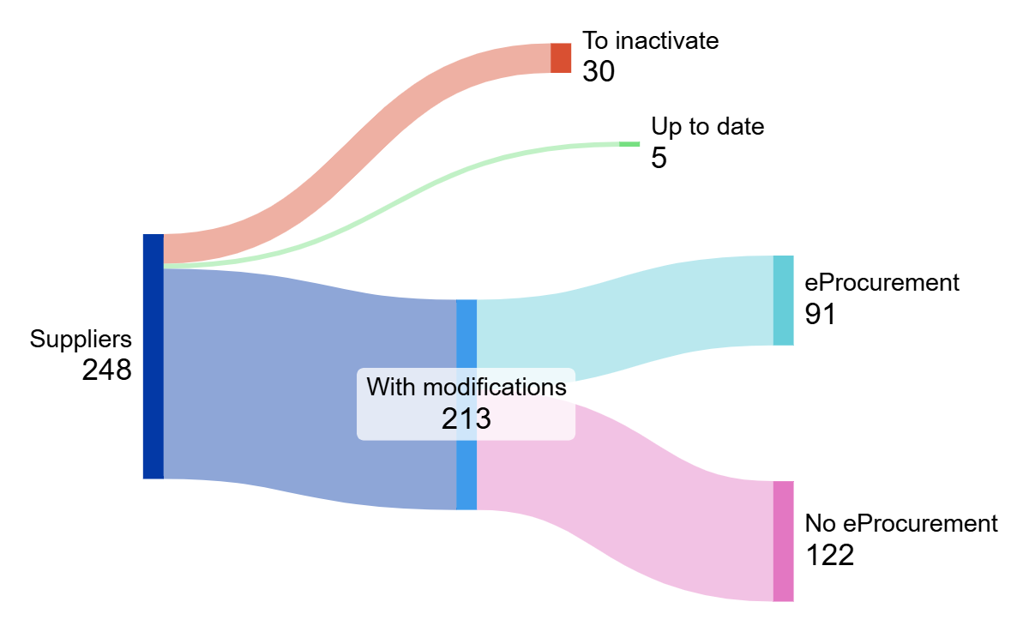
Results ILOs emailing
Example from one revised list of suppliers:
  Total number of firms (from extraction): 248
  Number of firms to inactivate: 30
  Number of firms with modifications: 213
    Have an eProcurement account: 91
    Firms manually updated with ILO data: 122

Slide 6

Improvements of data quality
New category in our database (in development)
  Suppliers will be split in:
    Active (exceptionally manually registered)
    Active (registered through eProcurement)
    Inactivated
    Blacklisted (NEW – improved and more immediate identification method)

