Slide 1
Environmentally responsible procurement Policy - Progress report
27th ILO Forum – 25.03.2025
Enrico Cennini / IPT-PI-SE
25.03.2025
EDMS 3219262

Slide 2
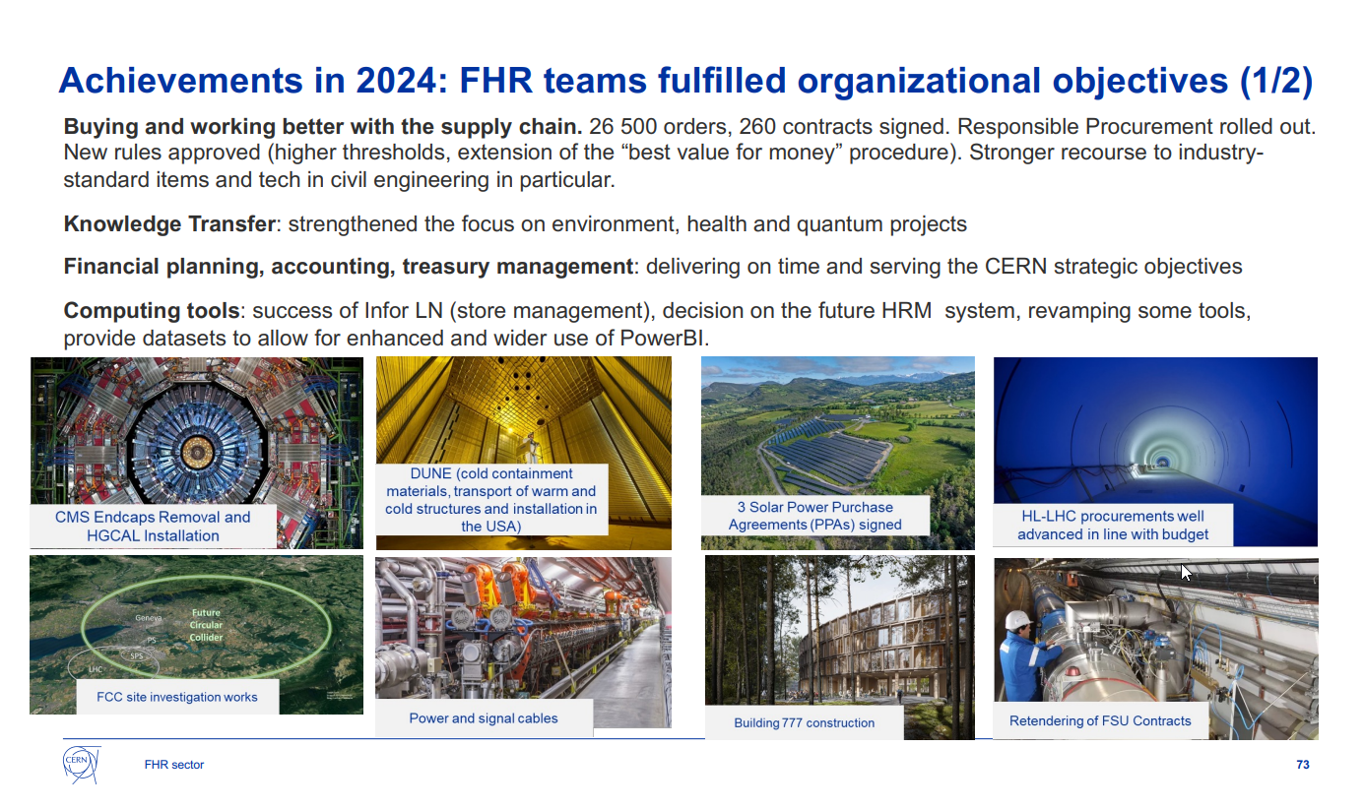
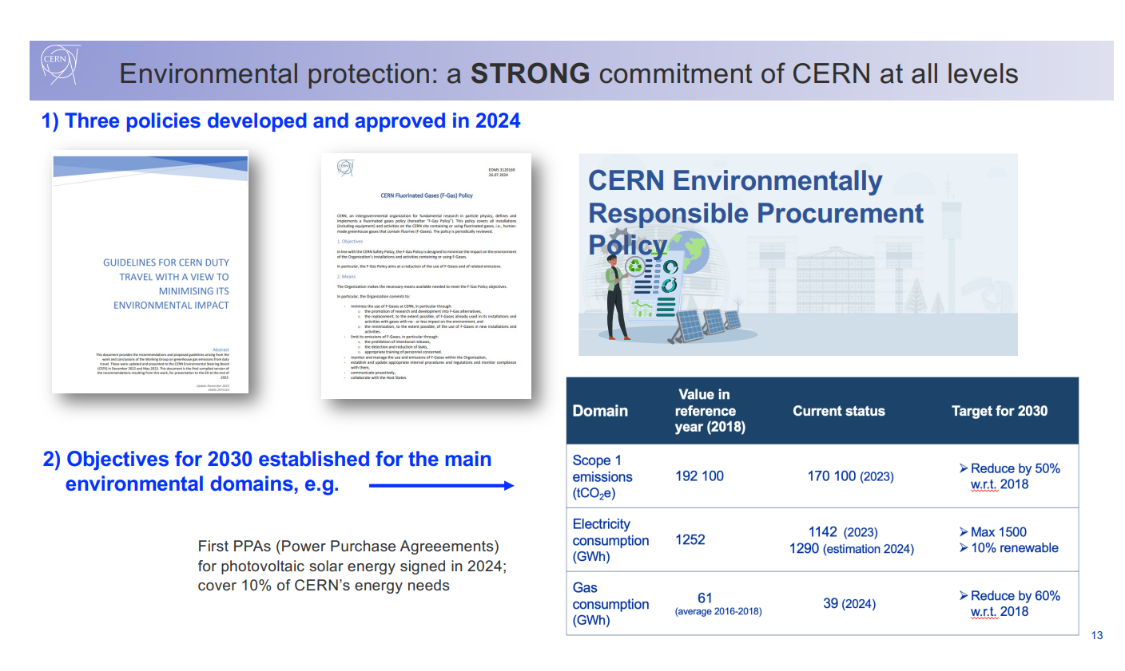
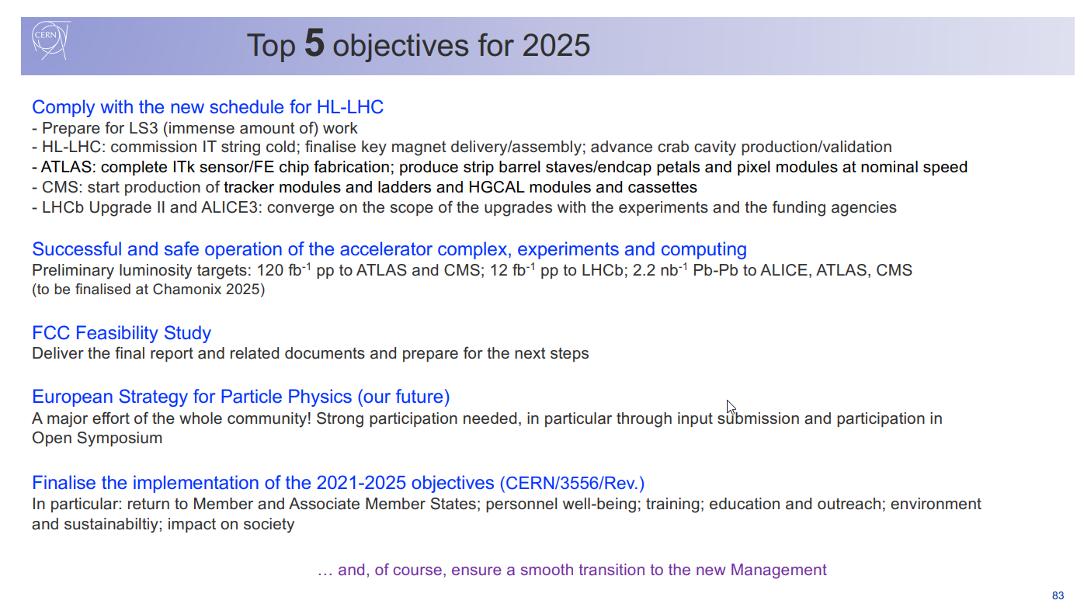
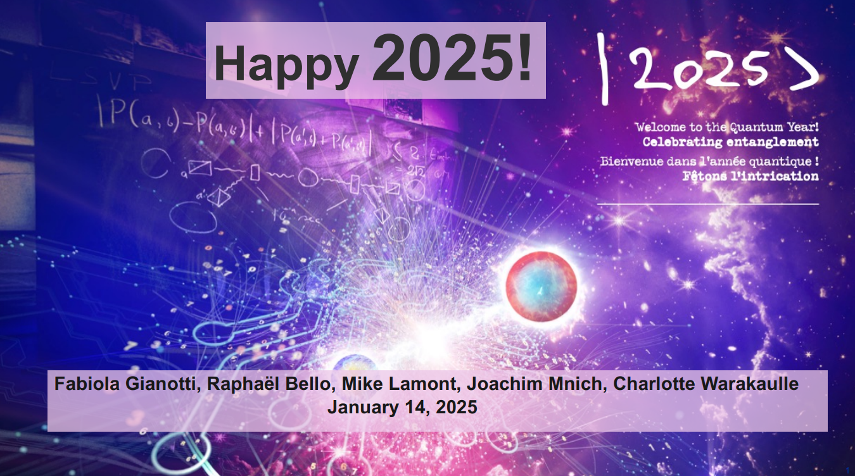
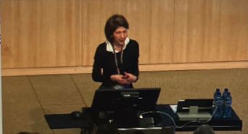
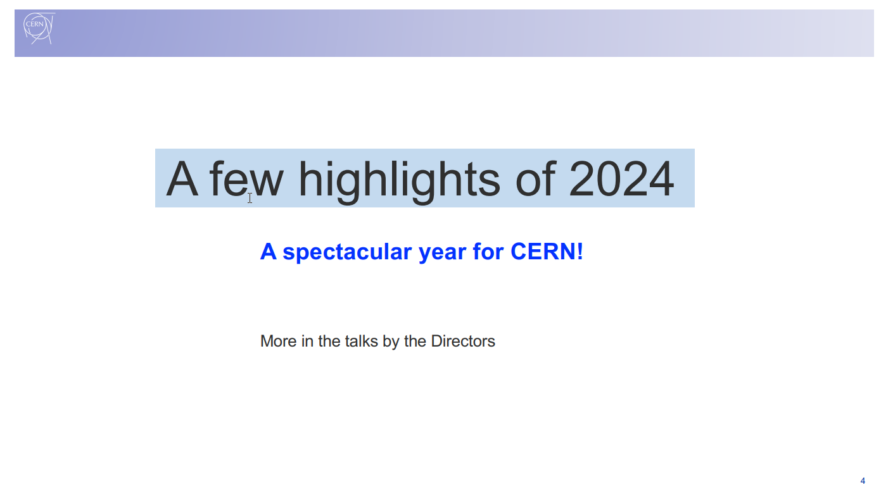
EDMS 3219262

Slide 3



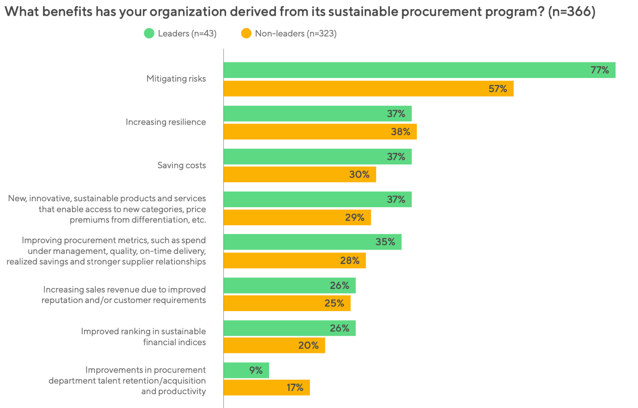
Approval of the CERN Environmentally Responsible Procurement Policy
To embed environmental responsibility, where appropriate, throughout all phases of the procurement process.
To commit to achieving sustainable results internally and throughout CERN supply chains.
Networking, benchmarking, learning sustainable procurement best practices.
Chartered Institute of Procurement & Supply
The Sustainable
Procurement Pledge
The Scope 3
Peer Group
“Sustainable Procurement Barometer 2024,” EcoVadis and Accenture, February 2024.
Based on data collected from nearly 600 buyers and more than 1,000 suppliers, worldwide.
2026
2024
Kick off phase
2024
Kick off phase
2024 - 2025

Slide 4
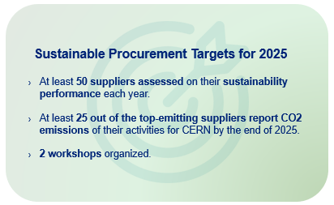
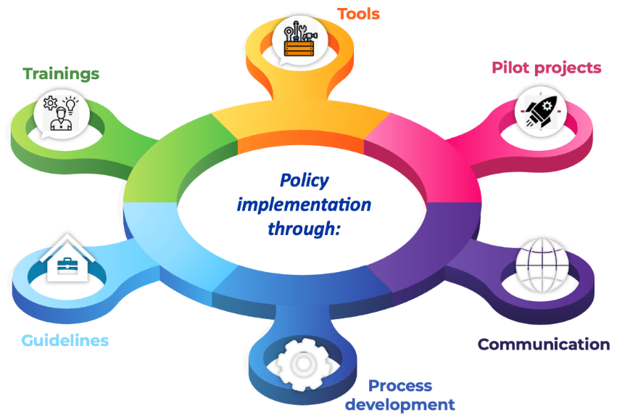



Implementing the CERN Environmentally Responsible Procurement Policy
Supplier’ sustainability
due diligence tool
Air separation units
Building 777
Cast-resin transformers
…
Awareness raising (all)
Ad’ hoc (Procurement Officers)
2025
Kick off phase
End 2025
Review
2024
Kick off phase
Lessons learnt
Feedback
Proposals
Objectives Setting
Internally
Externally
Sourcing guides
Update of procurement templates
Supplier Engagement program
Workshops with Departments
… aligned with CERN Environmental priority objectives
… and the CERN Supplier Code of Conduct
… and the European Laws and Directives
Corporate Sustainability Reporting Directive (CSRD)
Corporate sustainability due diligence (CS3D)

Slide 5
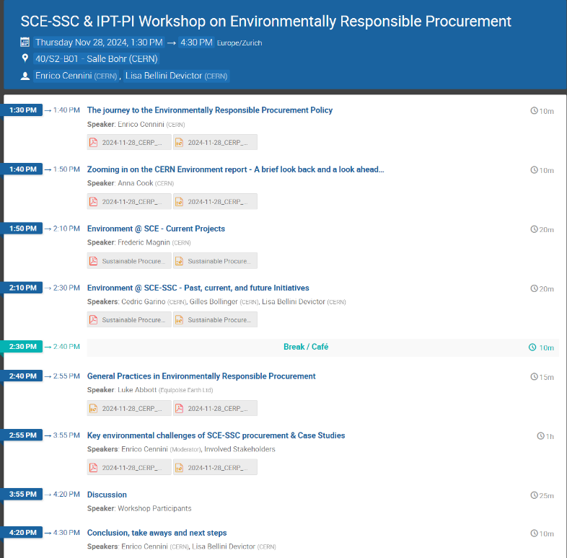
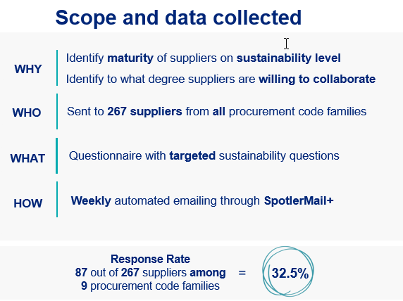
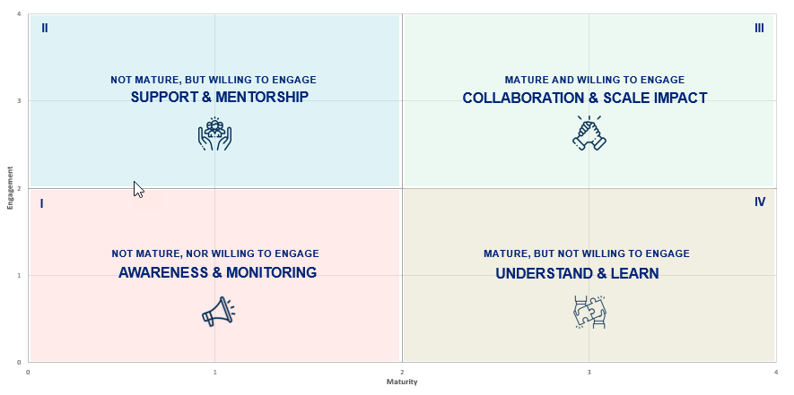
Progress during the Kick off phase on Process Development
WORKSHOPS WITH DEPARTMENTS/GROUPS
SUPPLIERS ENGAGEMENT
€ERP³
Process Development
40 %
Action plan
Workshops in preparation: A&T Sector, IT Department, EN Department.
Courtesy: V. Galmarini IPT-PI-SE
EDMS 3219262

Slide 6
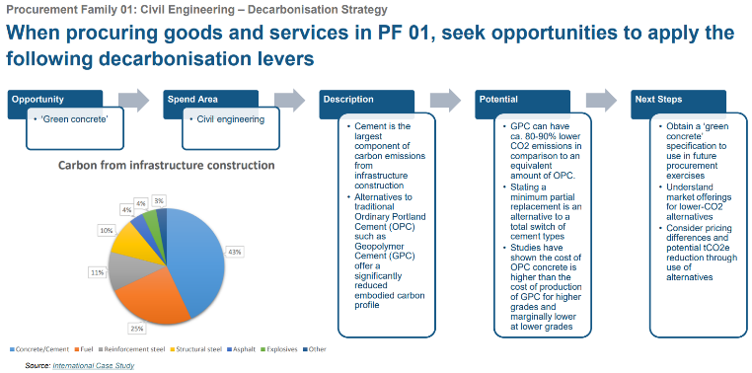
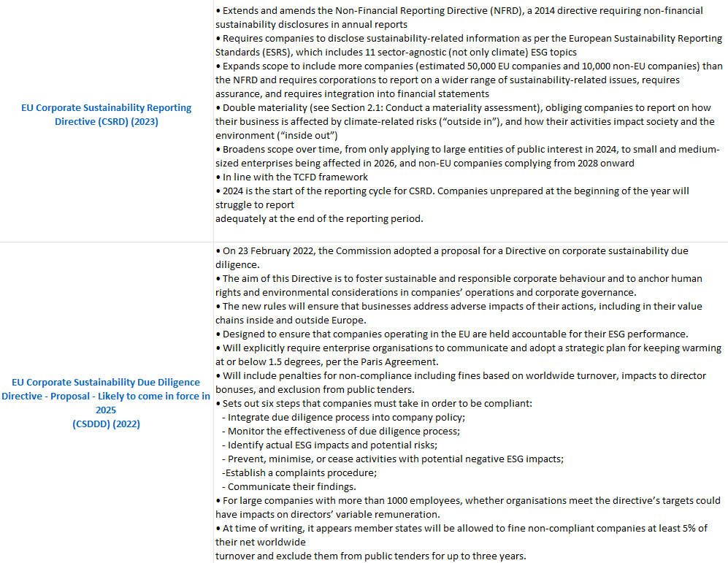
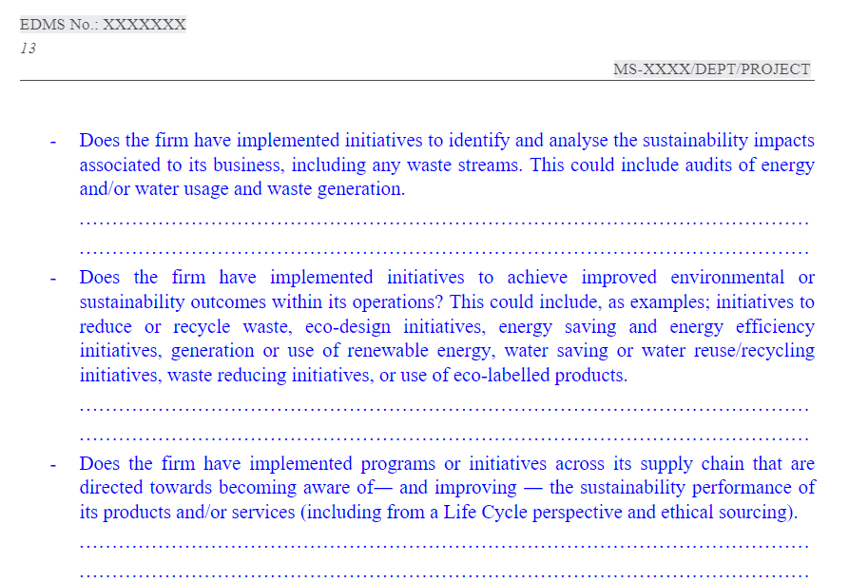

Progress during the Kick off phase on Guidelines
DECARBONIZATION STRATEGIES PER PROCUREMENT FAMILY
WATCH ON POLICIES, REGULATIONS, STANDARDS & INITIATIVES
€ERP³
Guidelines
UPDATE OF CERN PROCUREMENT TEMPLATES
50 %
EDMS 3219262

Slide 7
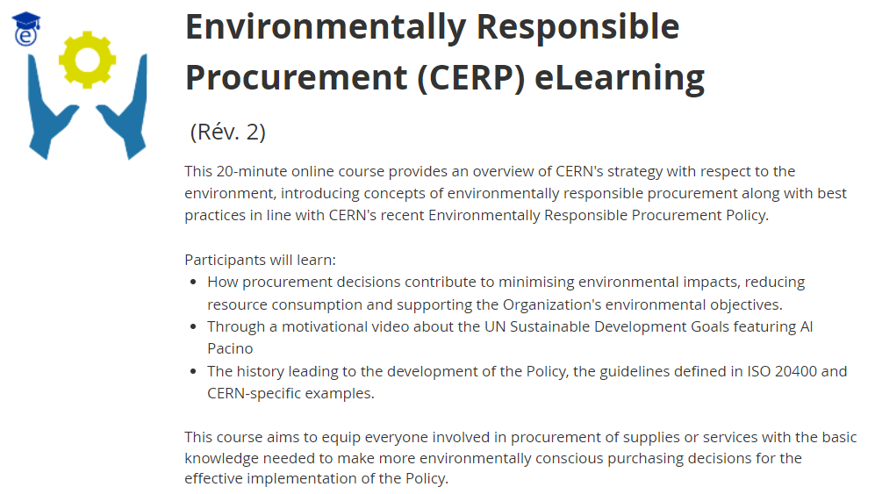
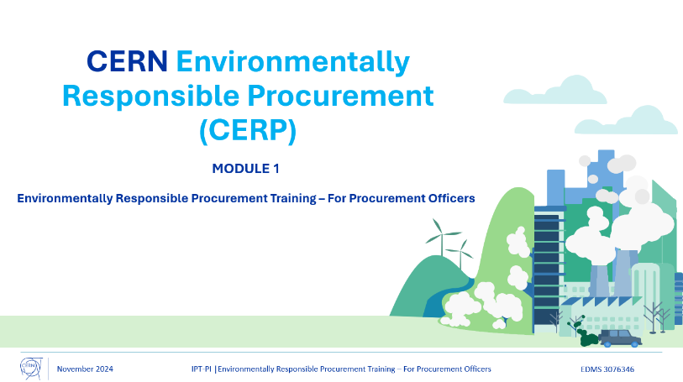
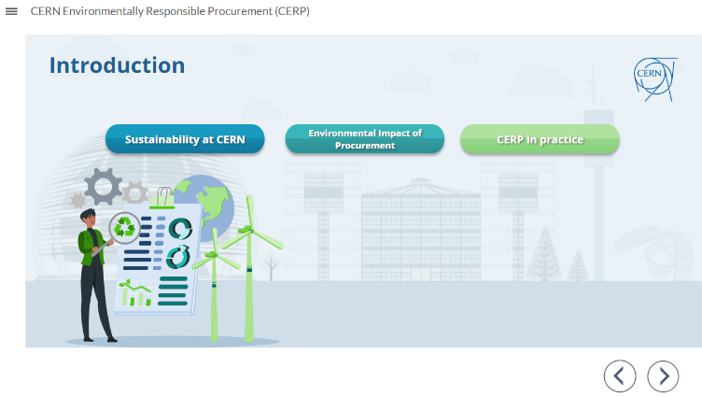
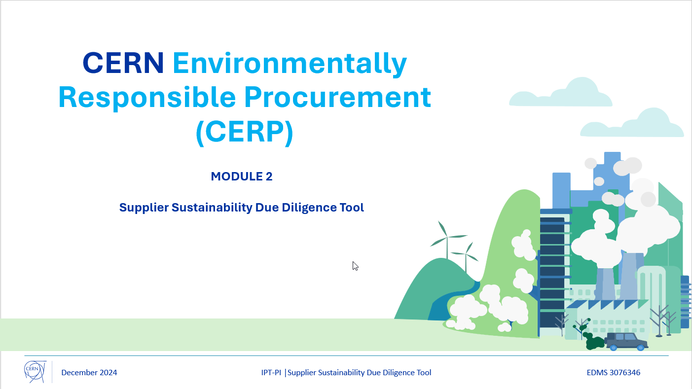
Progress during the Kick off phase on Trainings
E-LEARNING
PROCUREMENT OFFICERS AD’ HOC TRAINING
€ERP³
Trainings
90%
118 persons attended the e-learning so far.
Training under finalization.
EDMS 3219262

Slide 8
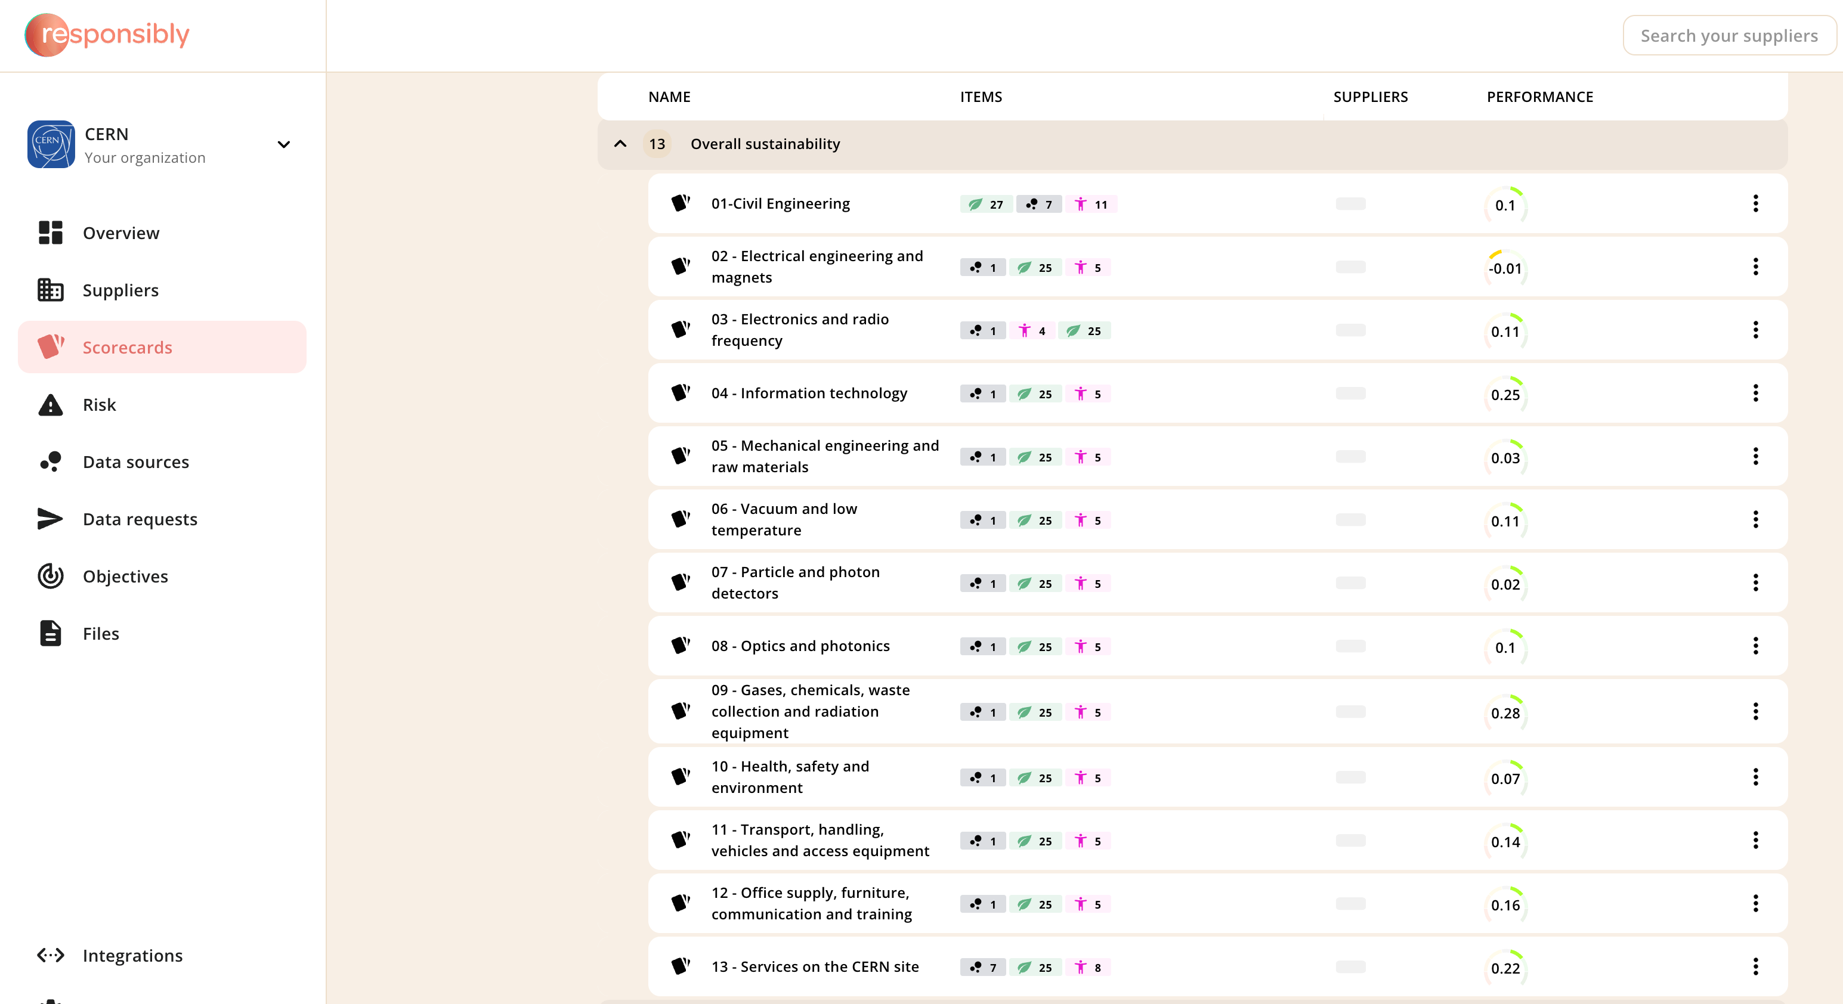
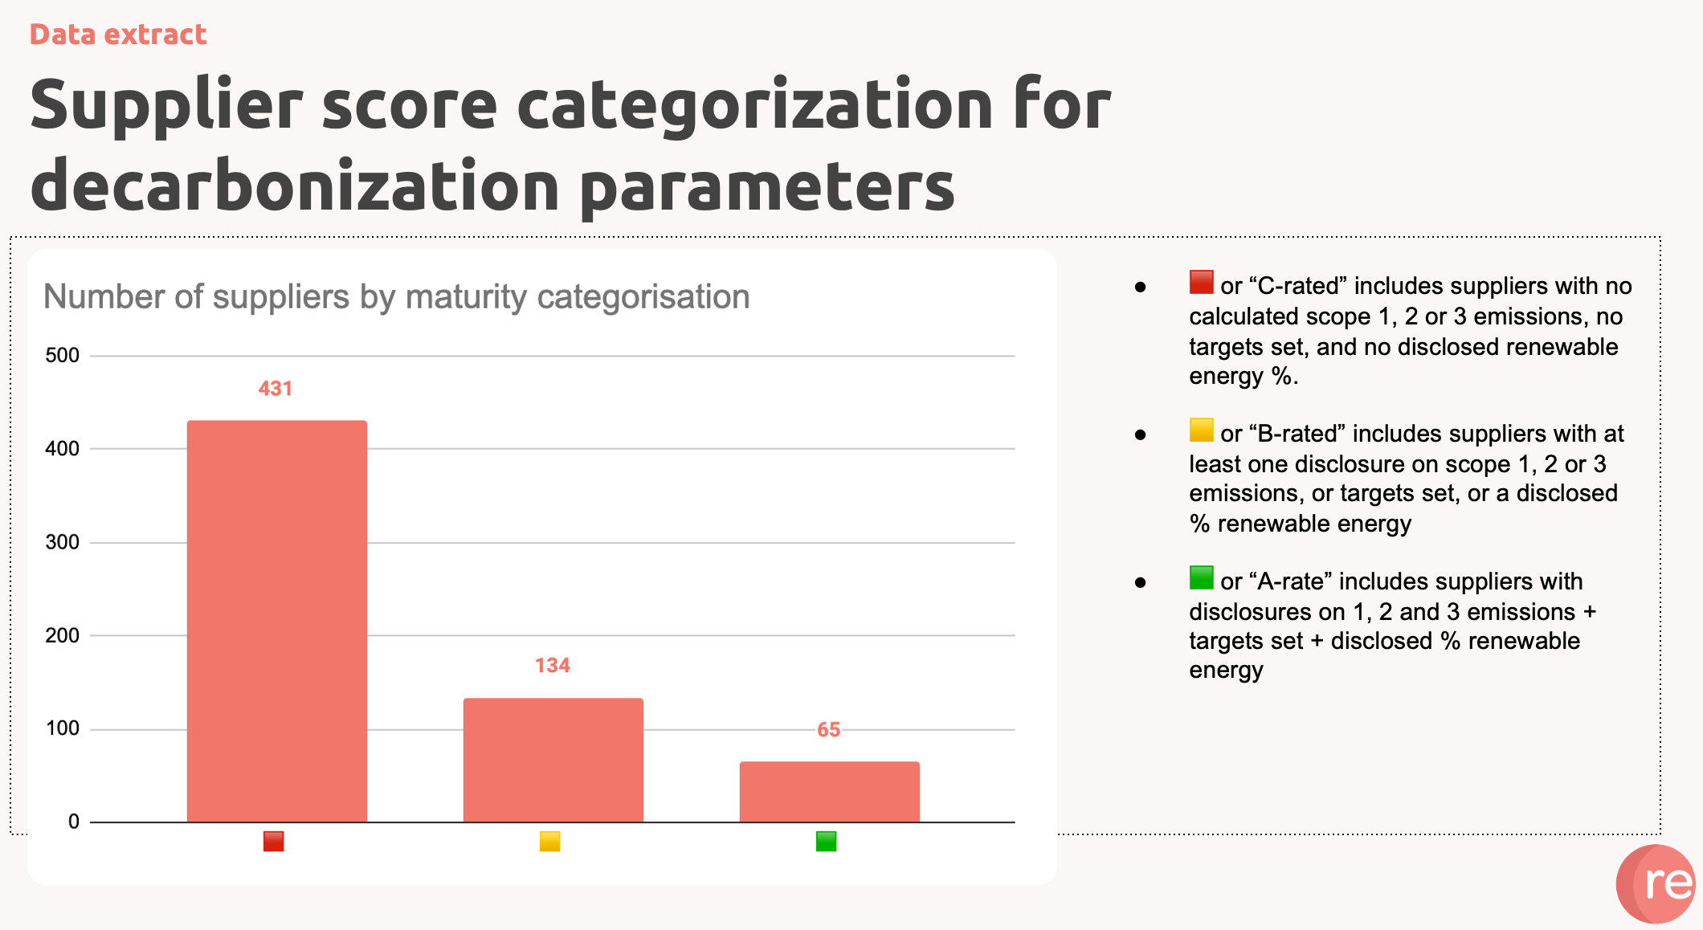
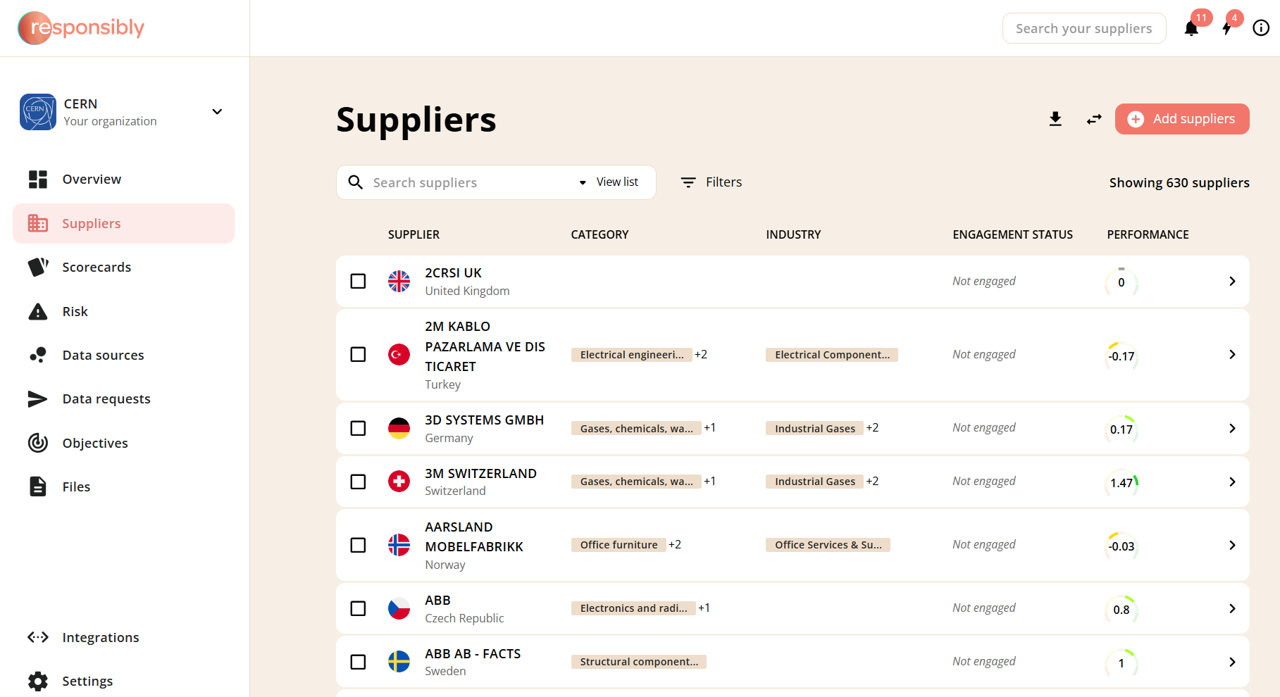
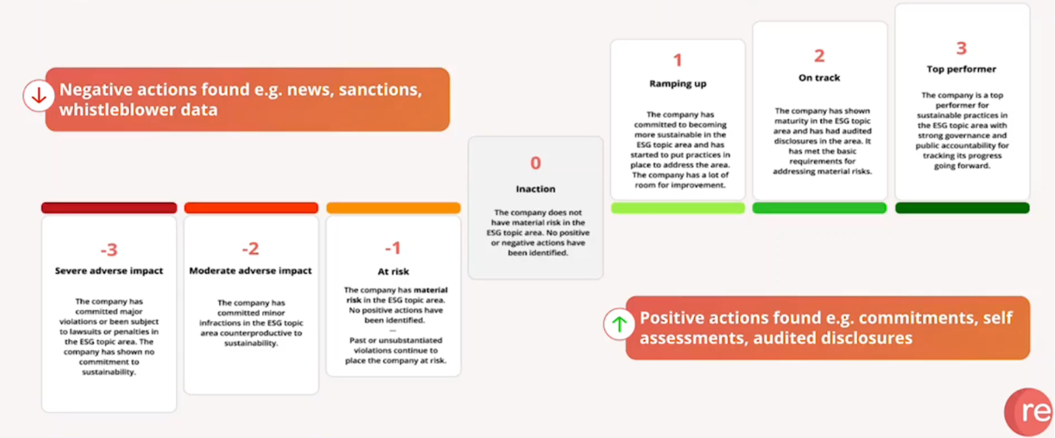
Progress during the Kick off phase on Tools - Supplier sustainability Due Diligence Tool
€ERP³
Tools
90 %
EDMS 3219262

Slide 9
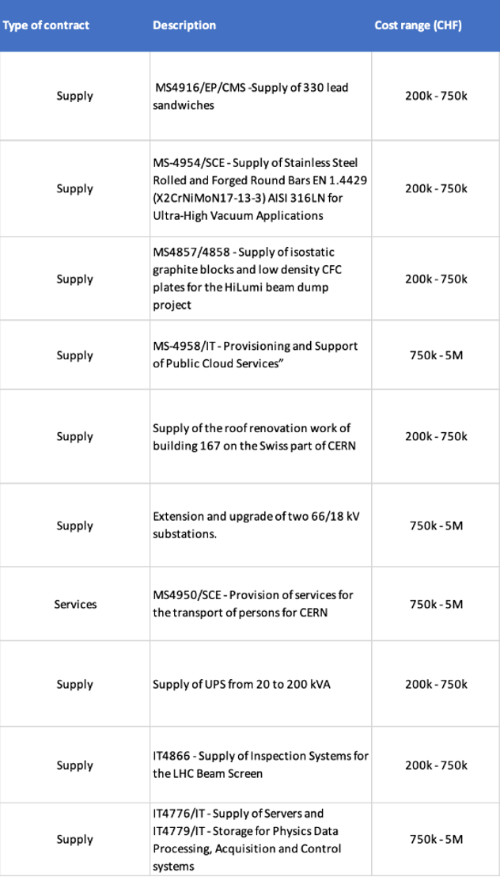
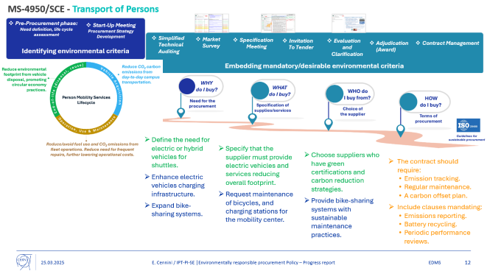
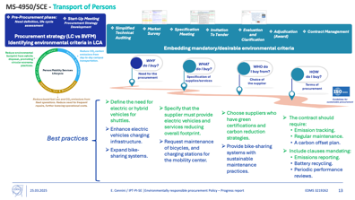
Progress during the Kick off phase on Pilot Project
18 PILOT PROJECTS
1st QUICK WIN
€ERP³
Pilot Projects
50 %
From Lowest compliant to Best Value For Money!
Imposed 30% Electric Vehicles (EVs) for Shuttles.
Finally 100% EVs provided, among other environment requirements fulfilled!
EDMS 3219262

Slide 10
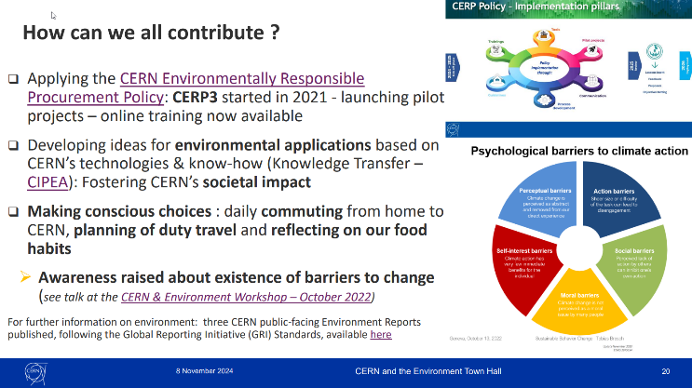
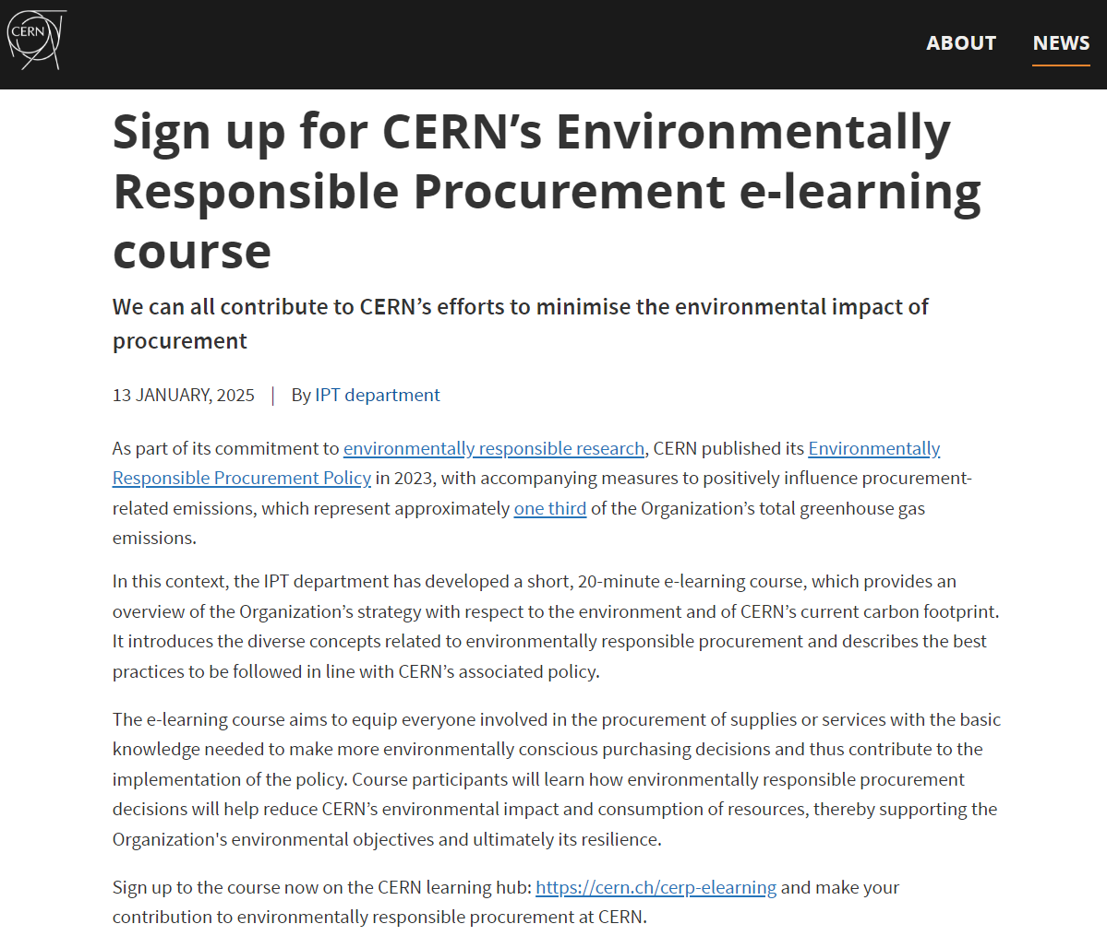

Progress during the Kick off phase on Communication
Call for Action at the CERN and the Environment Town Hall
€ERP³ Presentations
Internally:
Enlarged Directorate (Oct. and Dec. 23).
CERN Finance Committee (Sept. 24)
ILO Forums (5 times).
€ERP³
Externally:
CERN Environment Report 2021-2022.
International Technical Safety Forum (Oct. 22).
CERN & the Environment Workshop (Oct.22)
EIROforum ad’hoc Group on Environment (2 times).
CERN Green Village with Pronobo Project (Jun. 23).
Thematic Industry Day - PCB and Electronics Cards Assembly Manufacturing (Nov. 23)
Big Science Business Forum (Oct. 24).
Sustainability people at DESY and F4E Labs (Mar. 25).
Communication
50 %
CERN BULLETIN
EDMS 3219262

Slide 11
Implementing the
CERN Environmentally Responsible Procurement Policy
Where defined following the first review in 2025, CERN will:
Implement the practices decided/approved during the review.
Conduct supplier assessments.
Engage suppliers to contribute to the objectives.
Incentivize suppliers to set objectives for themselves.
Ensure continuous improvement through:
  Asking feedback to stakeholders.
  Defining objectives where possible.
  New training(s).
  Regular reviews.
2026
Deployment
2024
Kick off phase
2025
Kick off phase
End 2025
Review

Slide 12
THANK YOU!
€ERP³
QUESTIONS?
Tools
Trainings
90 %
Guidelines
90 %
Process Development
Pilot Projects
Communication
50 %
50 %
50 %
40 %
EDMS 3219262

Slide 13
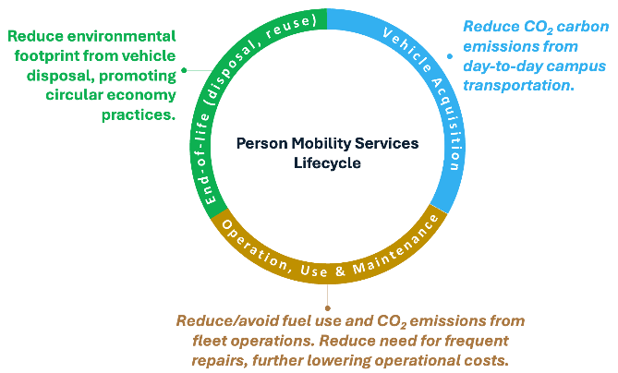
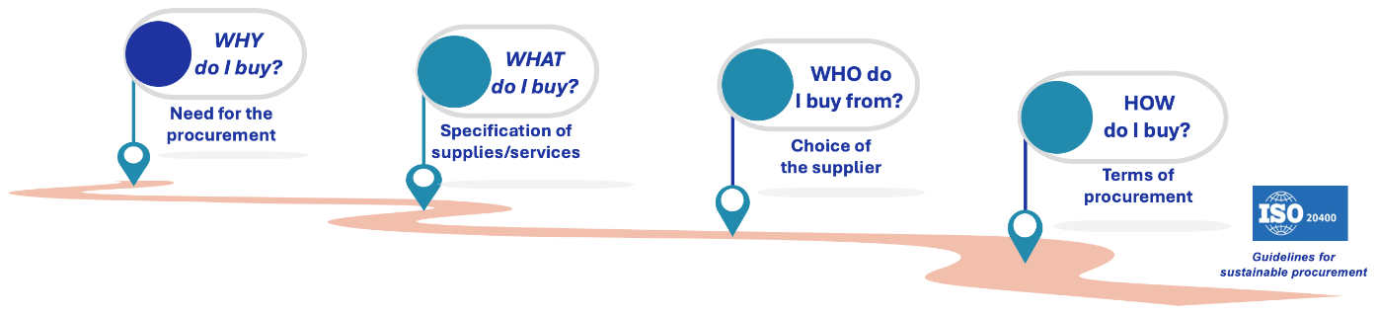






MS-4950/SCE - Transport of Persons
Procurement strategy (LC vs BVFM)
Identifying environmental criteria in LCA
Pre-Procurement phase: Need definition, life cycle assessment
Start-Up Meeting
Procurement Strategy Development
Embedding mandatory/desirable environmental criteria
Simplified Technical Auditing
Market Survey
Specification Meeting
Invitation
To Tender
Evaluation
and Clarification
Adjudication (Award)
Contract Management
Define the need for electric or hybrid vehicles for shuttles.
Enhance electric vehicles charging infrastructure.
Expand bike-sharing systems.
Specify that the supplier must provide electric vehicles and services reducing overall footprint.
Request maintenance of bicycles, and charging stations for the mobility center.
Choose suppliers who have green certifications and carbon reduction strategies.
Provide bike-sharing systems with sustainable maintenance practices.
The contract should require:
  Emission tracking.
  Regular maintenance.
  A carbon offset plan.
  Include clauses mandating:
    Emissions reporting.
    Battery recycling.
    Periodic performance reviews.
Best practices
EDMS 3219262

Slide 14
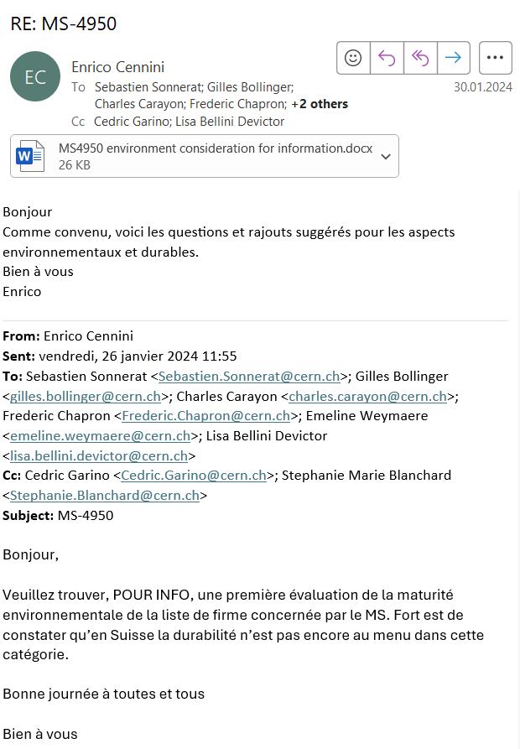
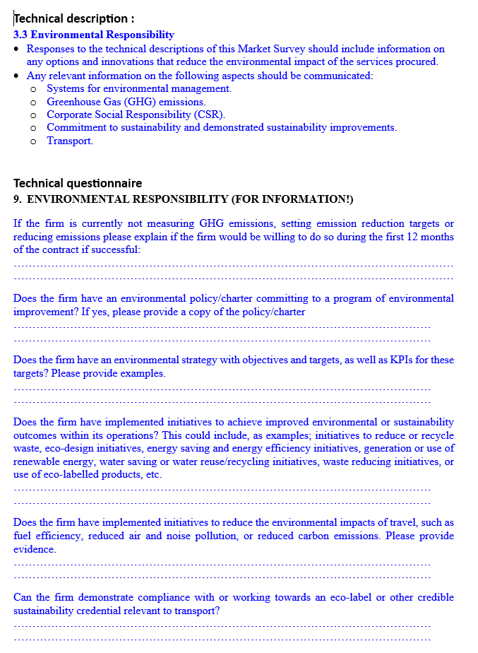
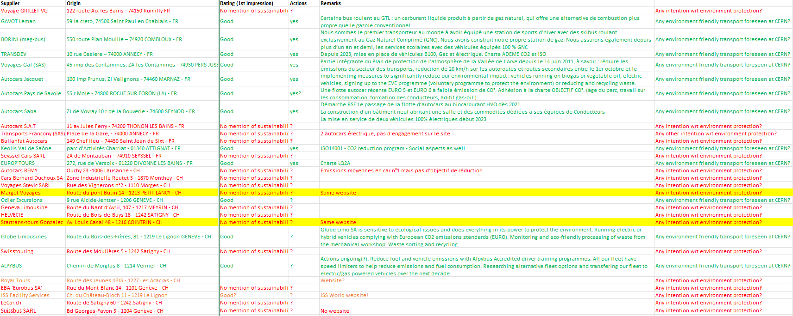
EDMS 3136898

Slide 15
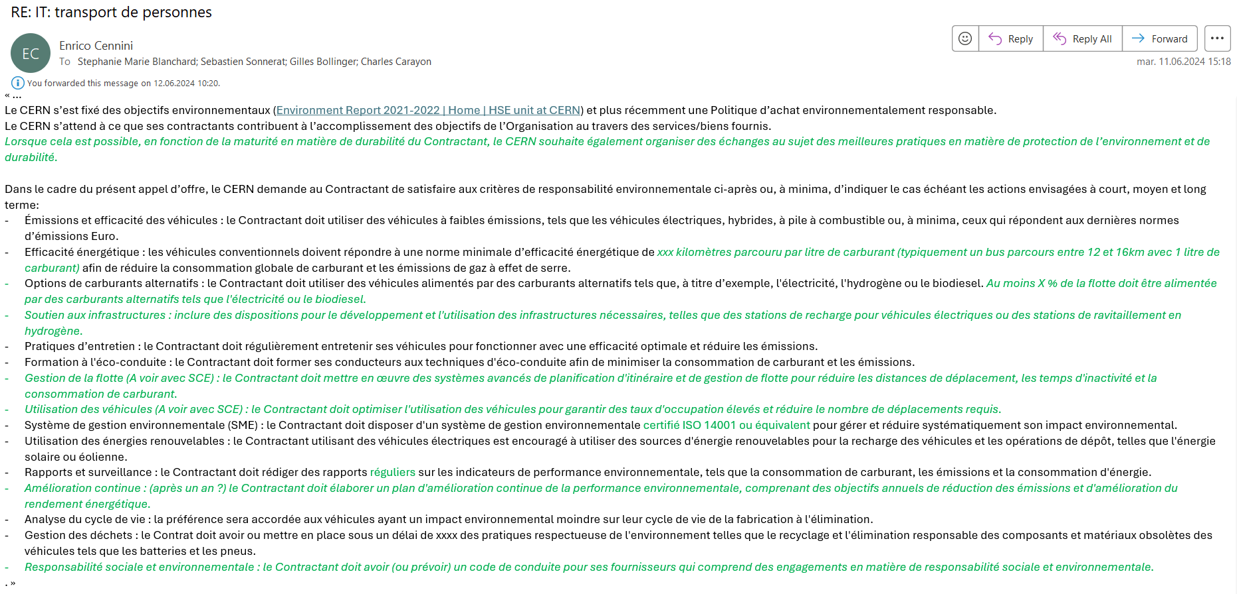
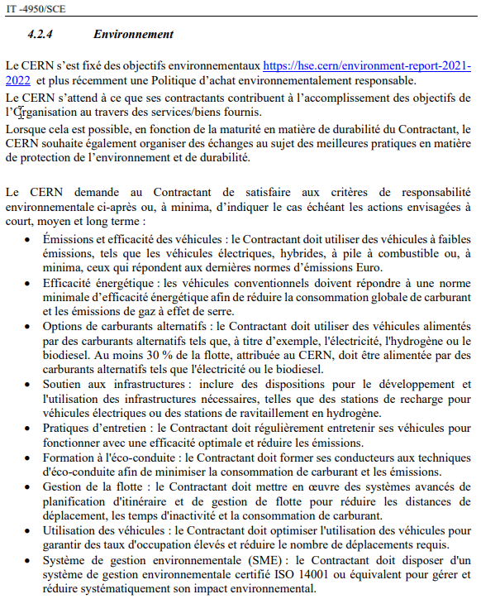
Communicating CERN environmental objectives!
Committing suppliers!
Defining environmental criteria!

Slide 16
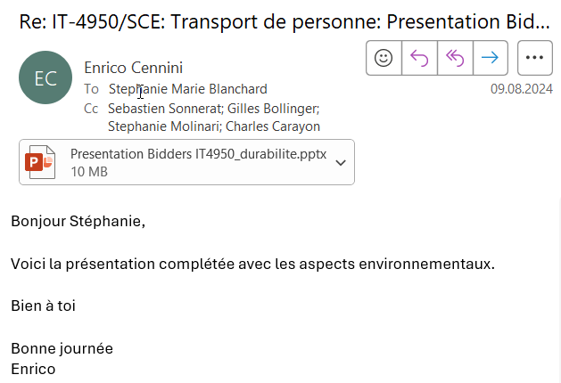
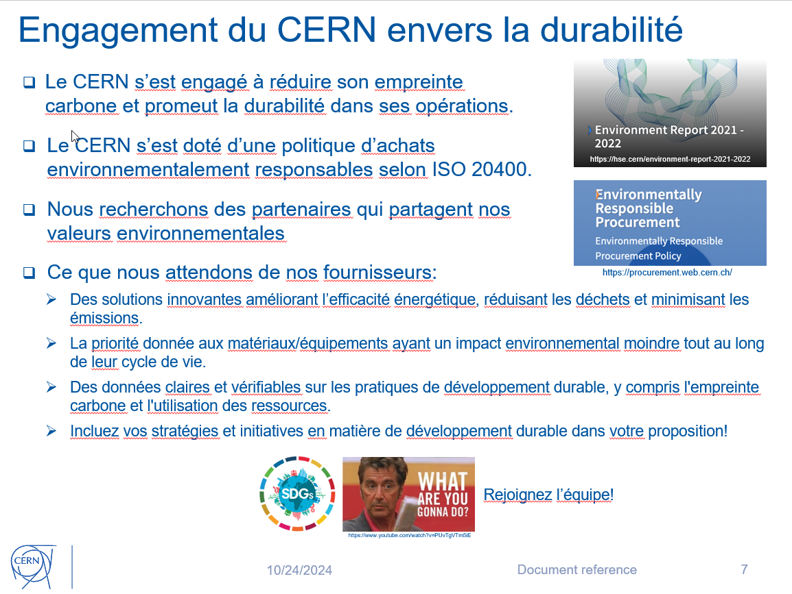

Slide 17
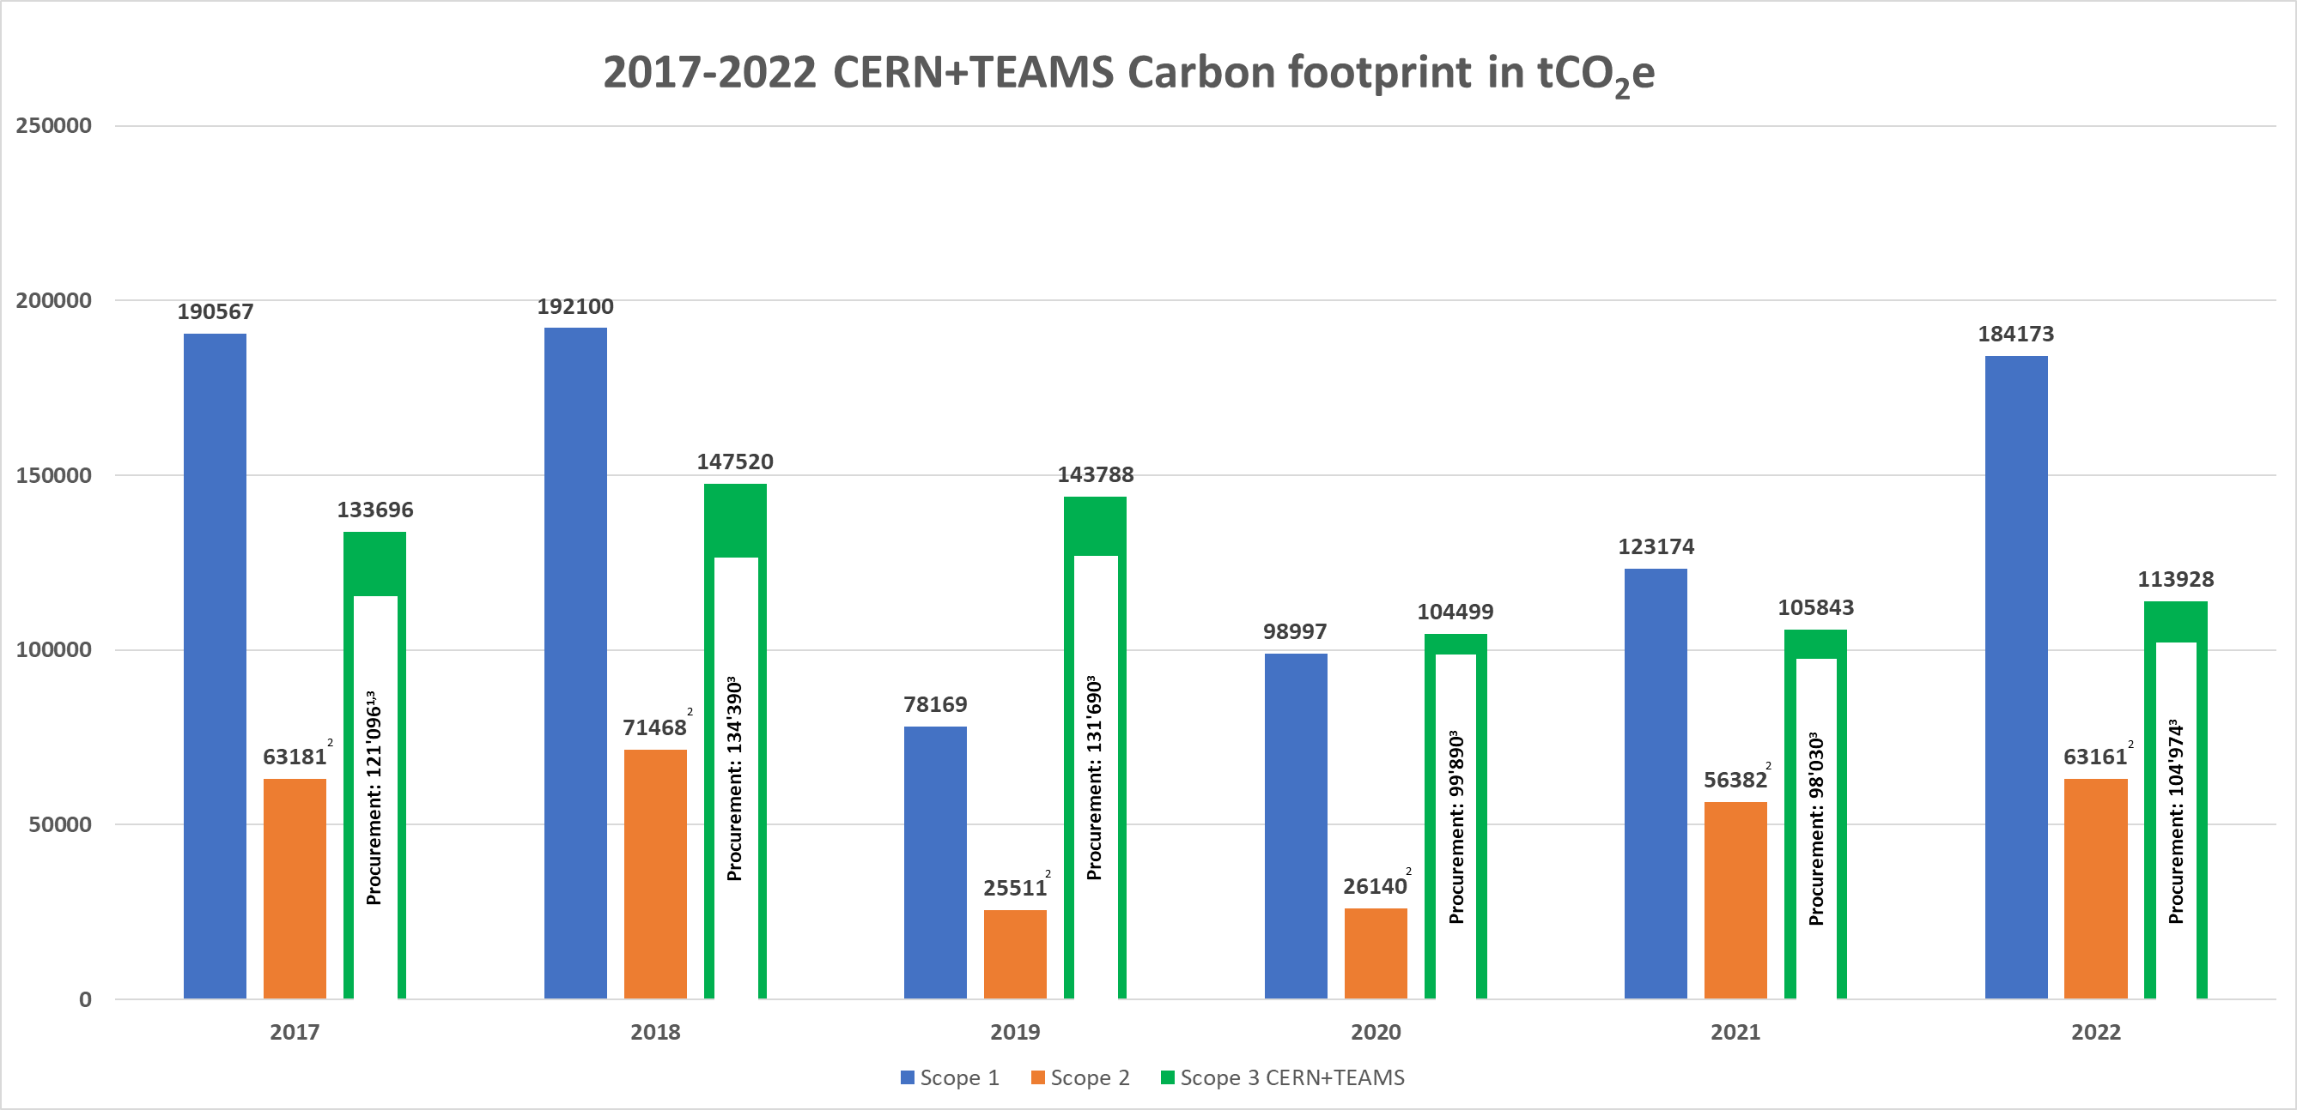
CERN Carbon footprint (Scopes 1, 2 and 3)
RUN 2
LONG SHUTDOWN 2
RUN 3
¹ 2017 data extrapolated
² Location-based Scope2 estimates
³ Spend-based Scope3 procurement estimates (Exiobase)
EDMS 3219262
Notes:
CERN carbon footprint:
Scope 1 emissions are activity based
Scope 2 are location based.
Scope 3 are activity based except for the procurement of goods and services which was estimated on a spend based approach.

Slide 18
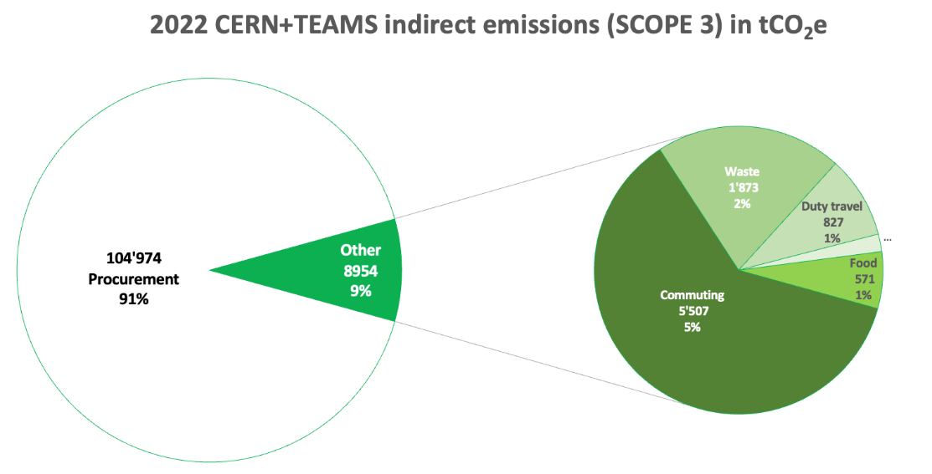
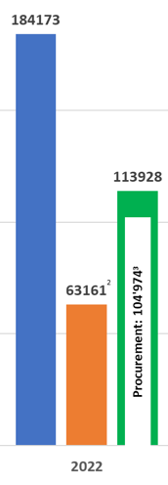






Why a CERN Environmentally Responsible Procurement Policy ?
Significant impact on CERN footprint
40% of CERN’s annual funding is spent with its suppliers.
In 2022, > 90% of CERN’s indirect (Scope 3) emissions resulted from purchases of goods & services.
35% of CERN global emissions are driven by its purchases.
Stakeholders’ expectations
Preventing the risk of supply disruption
Align procurement activities with CERN environmental goals.
Mitigate risks associated with environmental impacts.
Increasing Rules/Regulations for environment protection.
Reporting (e.g. GRI standards)
Partnership with strategic suppliers to face the highest risks.
Enhance sustainability across the supply chain.
EDMS 3219262

Slide 19
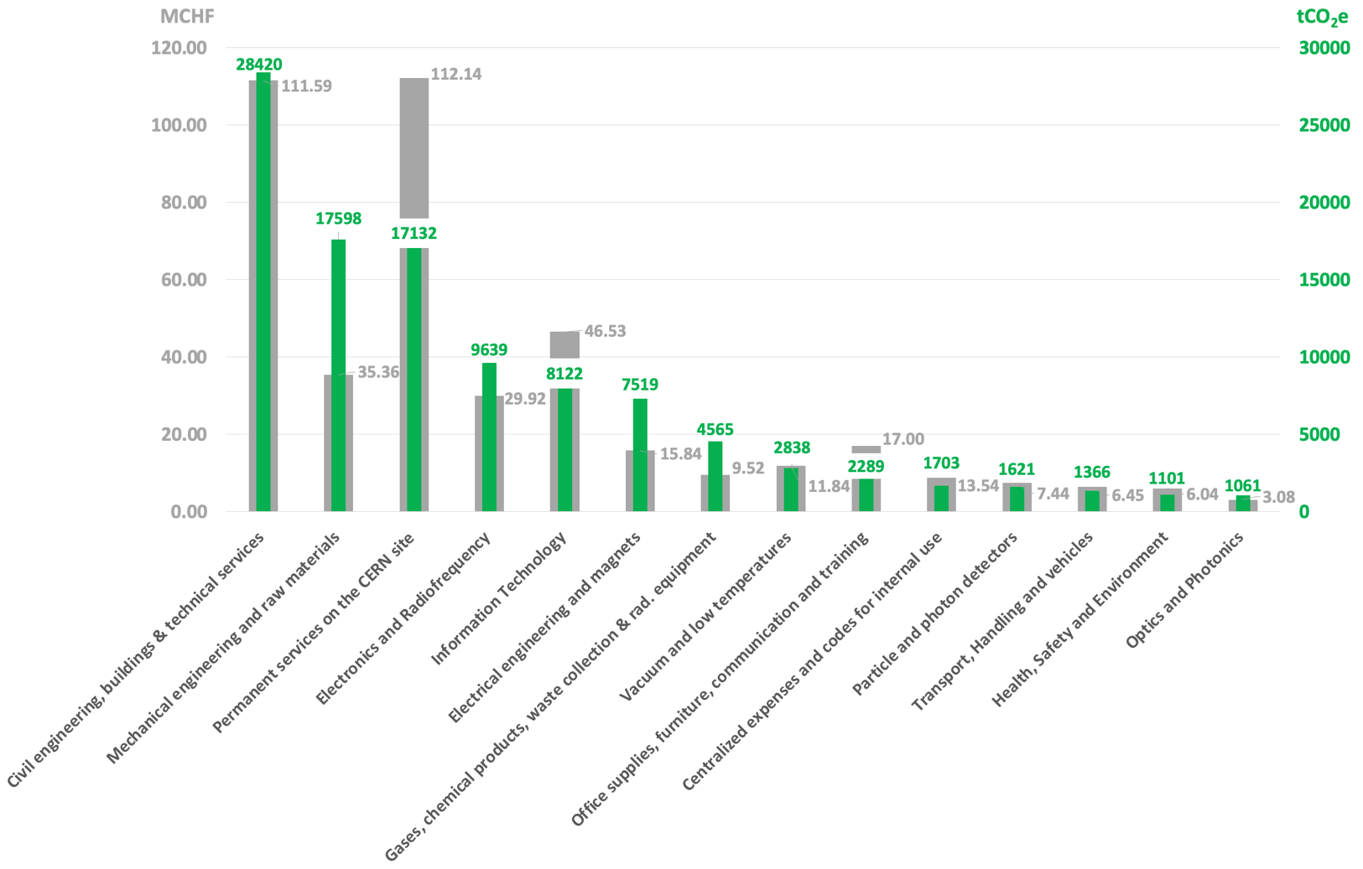
2022 total CERN + TEAMS expenses: ~430 MCHF
(excl. VAT & non procurement related)
2022 total related emissions: 104’974 tCO₂e
Top 6 CO₂ emitting
Procurement families
NB: Estimation following a spend based method (CERN 2022 expenses) using EXIOBASE conversion factors.
EDMS
Notes:
Regarding CO2 emissions linked to the purchase of goods and services at CERN, the spend-based methodology made it possible to identify the purchasing families with the highest emissions in 2022 beyond the CO2 emissions figure which remains a very rough estimate.
Each year the order changes slightly, however the 6 most emitting families remain the same.

Slide 20
Location-based vs. Market-based Scope 2 estimation
These are two different methods of calculating carbon emissions associated with electricity consumption.
Location-based Scope 2 estimates are based on the average emissions intensity of the electricity grid in a particular location.
  It considers the emissions from all electricity sources in that location, regardless of the contractual agreements or specific electricity purchases made by the consumer.
  This method assumes that consumers are using the average mix of electricity sources in their region.
  Location-based estimates may not accurately reflect the emissions impact of consumers who have made efforts to support renewable energy.
Market-based Scope 2 estimates considerthe specific contractual agreements and electricity purchases made by the consumer.
  It considers the emissions associated with specific renewable energy certificates (RECs) or power purchase agreements (PPAs) that the consumer has invested in.
  This method allows consumers to track the emissions associated with their own electricity choices and helps support the development of renewable energy projects.
  Market-based estimates are more conservative because they provide a more accurate reflection of the emissions impact of individual consumers.
In summary:
Location-based estimates provide a general overview of the emissions intensity of the electricity grid in a specific location, while market-based estimates reflect the specific choices and investments of the consumer.
Market-based estimates can give consumers more accurate information about their own emissions impact and allow them to support renewable energy projects directly.
EDMS 3219262

