Slide 1





John Adams Institute Accelerator Design Project 2025
Hybrid Asymmetric Linear Higgs Factory (HALHF)

Slide 2
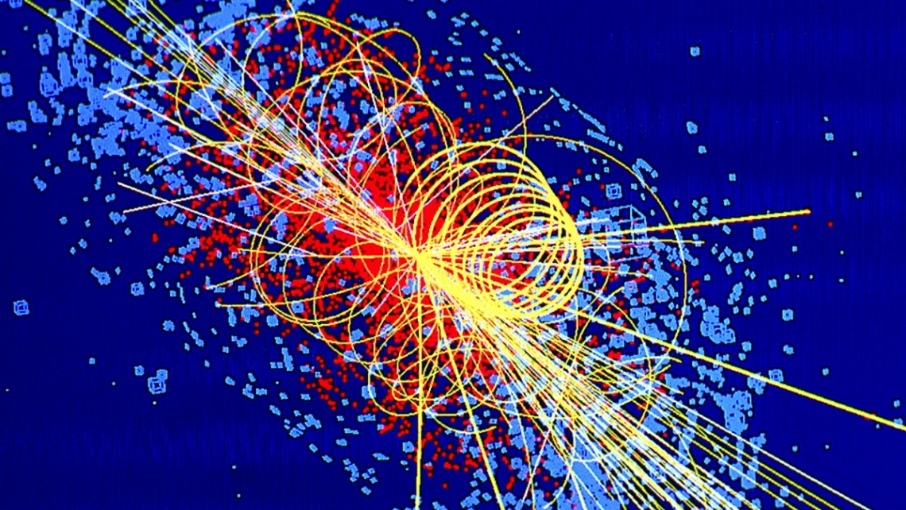
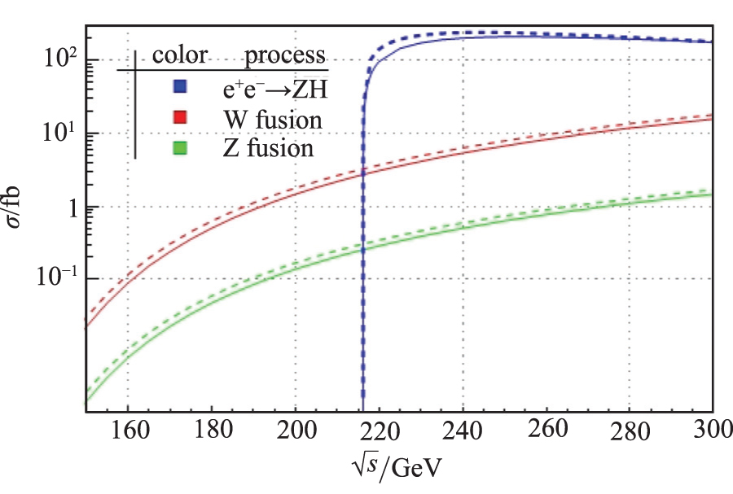
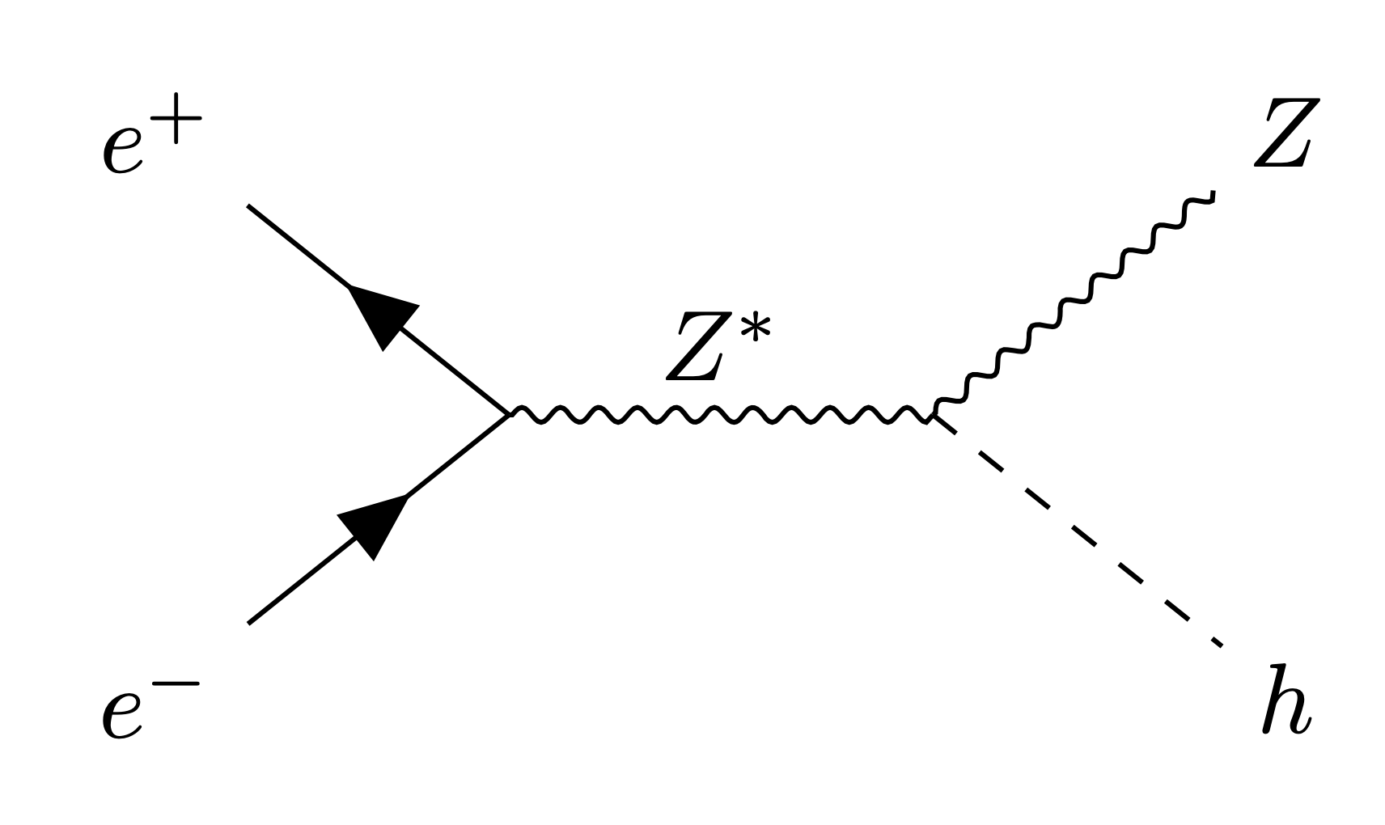
The Need for a Higgs Factory
In 2012, the Higgs Boson was discovered!
Next: Precision measurements with leptons
No QCD
High precision using elementary particles
Can resolve momenta accurately
Higgsstrahlung:
→ Peak at 250 GeV CoM
[1] CMS Collaboration, 2012
[2] M. Aiko, 2023
[3] X. Mo, et al, 2016
Notes:
Higgs boson discorvery was a MASSIVE deal, make sure to comment on it
Next gen high energy machines for post LHC era
Lepton colliders over Hadron colliders
Why?
Point particle collisions are favourable over parton showers. Easier to resolve amongst background
Leads to better precision studies of SM (such as Higgs self interaction)
Explain each diagram. The cross-section one shows us exaclty why we want this collider to operate at 250GeV CoM

Slide 3




Higgs Factory Proposals
Linear Accelerators
Acceleration = simple
Focusing = simple
"One Pass"
One interaction point
Longitudinally polarised beam allows for similar precision to half the luminosity of a circular machine
Circular Accelerators
Acceleration = simple
Focusing = more complex
"Multiple Passes"
Multiple interaction points

Slide 4
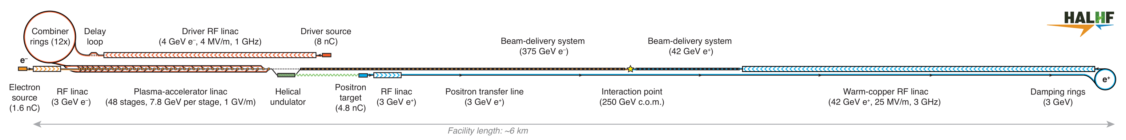
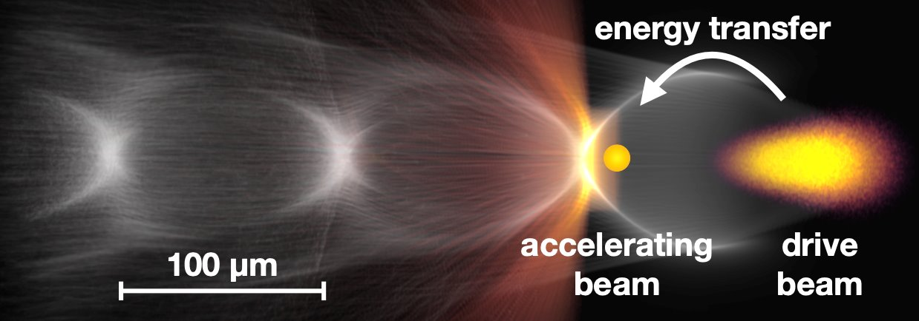
Hybrid Asymmetric Linear Higgs Factory
Novelty of HALHF:
Plasma Accelerator Linac
Asymmetry
Small overall footprint
[1] B. Foster. et al, 2023
[2] B. Foster. et al, 2025
Notes:
Size of current accelerators are driven by limit of RF cavities
Not much progression besides superconducting RF in 50 years
Clear that an alternative is required.
Plasma accelerators are looking like a very attractive alternative to RF
-> AWAKE witness beam was accelerated from 19 MeV to 2 GeV over a distance of 10m in 2018 Nature
Drive beam transfers energy via plasma to accelerating beam
No RF breakdown as the plasma is already broken down
Motivation for asymmetry lies in the fact that plasmas are charge asymmetric -> No blowout regime for e+
So will use conventional RF for e+ and PWFA for e-
Ok, but why not make them same length?
This question highlights the significance of PWFA -> If this was the case, the e+ contribution to the overall footprint would be most of the total footprint of the facility. Therefore, CoM contribution from e+ will be scaled down (reducing length), and the contribution from e- is scaled up by the same factor to accommodate for this.

Slide 5
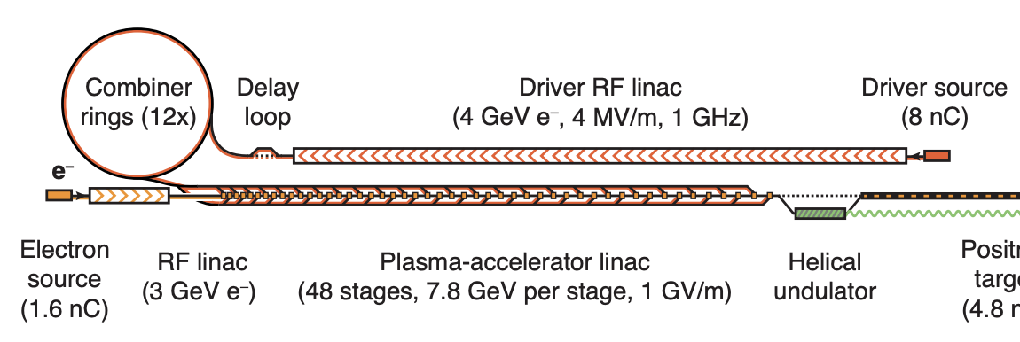
HALHF: Drive-Beam Complex
Primary objective: Accelerate particles up to 4 GeV for plasma wakefield seeding
Perform necessary bunch train manipulations:
Pulse compression
Phase manipulation

Slide 6
Using CLIC as a Baseline for HALHF
Why can we use CLIC as the baseline?
Utilises a drive beam complex for conventional RF accelerators
Needs to heavily modify bunches

Slide 7
HALHF: Drive-Beam Complex Objectives
Lattice / Optics Team:
Minimise emittance growth
Best control energy spread
Maximise filling factor of the RF system
Radio-Frequency Sources Team:
Use simulations to design an RF Cavity that is suitable while respecting the power limitations
Magnets Team:
Design quadrupole and dipole magnets for the linac and combiner ring

Slide 8
Lattice Team
Joshua Appleby, Louis Forrester,
Nela Sedlackova

Slide 9
Design Process
PLACET(tcl) ->RF-Track (csv)
Construct FODO lattice
Find quad strengths from momentum
Generate Bunch
Use output to track and optimise through recombination complex
Track bunch through FODO Cell and Optimise
Track bunch and optimise Linac
Construct Linac lattice
Notes:
Convert CLIC FODO design from PLACET (.tcl) into an easier file format to work with (.csv)
Read this file into RF Track and build the lattice
Calculate the quadrupole strengths based off momentum
Create the bunch in RF Track
Track and optimise the FODO cell
Extend this out to the full LINAC
Track and optimise the LINAC
Use the output bunch from the LINAC as the input bunch for the delay loop and combiner rings, then track and optimise them.

Slide 10
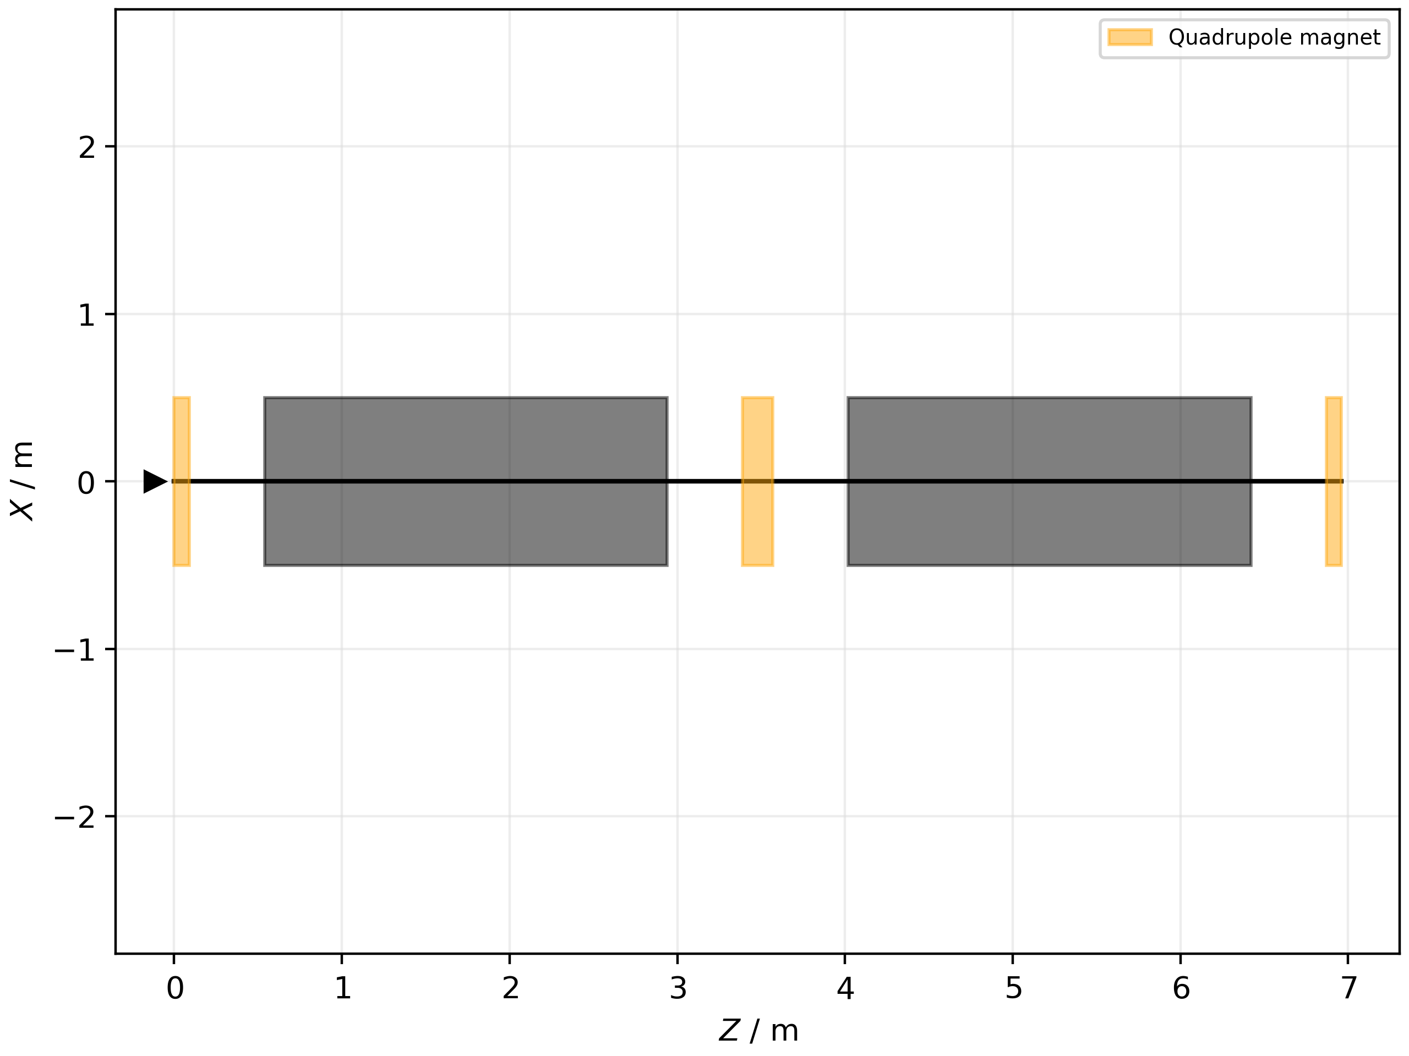
FODO Cell
Using CLIC baseline and improved gradient:
Focusing Quadrupole (0.18m)
Drift (0.45m)
Cavity (2.4m) (12 MV/m)
Drift (0.45m)
Defocusing Quadrupole (0.18m)
Drift (0.45m)
Cavity (2.4m) (12 MV/m)
Drift (0.45)
But...split the focusing quadrupole
RF Cavity

Slide 11
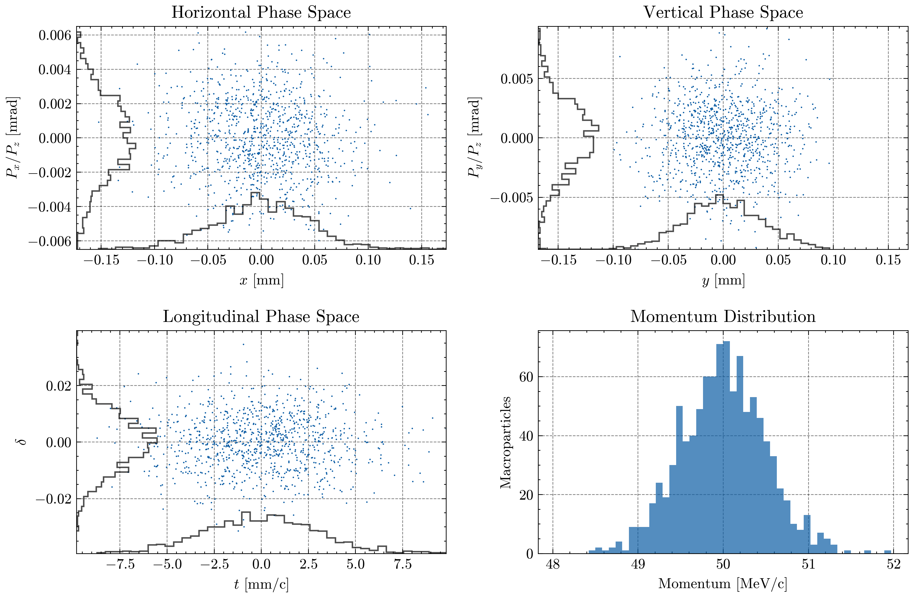
Bunch Parameters for Drive Beam
Parameter [unit] (Input / Output) | CLIC [1, 2] | HALHF [3, 4]
Energy [MeV] | 50 / 2400 | 50 / 4000
Bunch Charge [nC] | 8.4 | 8
Bunch Separation [ns] | 0.5 / 0.0167 | 4 / 0.167
Bunches per Train | 312 / | 2 / 48
Normalised Horizontal Emittance [um] | 50 / 0.5 | 10 / 50
Normalised Vertical Emittance [um] | 50 / 0.005 | 10 / 50
RMS Bunch Length [mm] | 3 / 10 | 0.253 /
Normalised Energy Spread [%] | < 1 / 0.5 | Assumed CLIC values
Calculated using RF-Track
[1] CLIC Conceptual Design Report, 2012
[2] A. Aksoy, 2014
[3] B. Foster. et al, 2023
[4] B. Foster. et al, 2025
Notes:
Think about RMS bunch len after DBL in HALHF and normalised emittance spread
Louis Ends

Slide 12
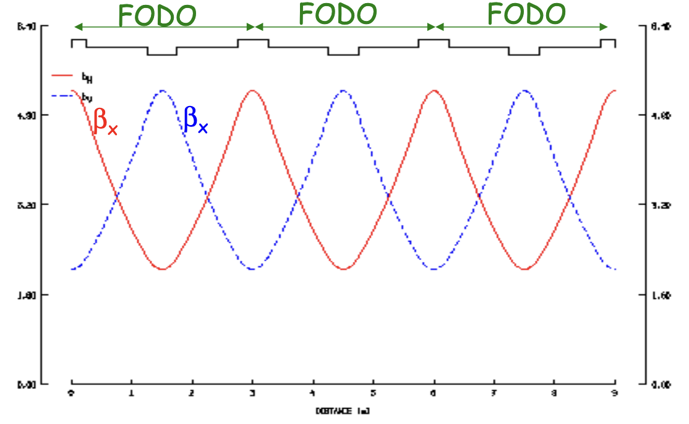
Optics Tracking and Matching
From a perfect FODO cell, the betafunction should be:
Periodic across a cell
Symmetric in X and Y
HALHF also requires:
Minimised transverse emittance
Bunch shape ideally preserved through the linac
[1] USPAS
Notes:
Josh Begins

Slide 13
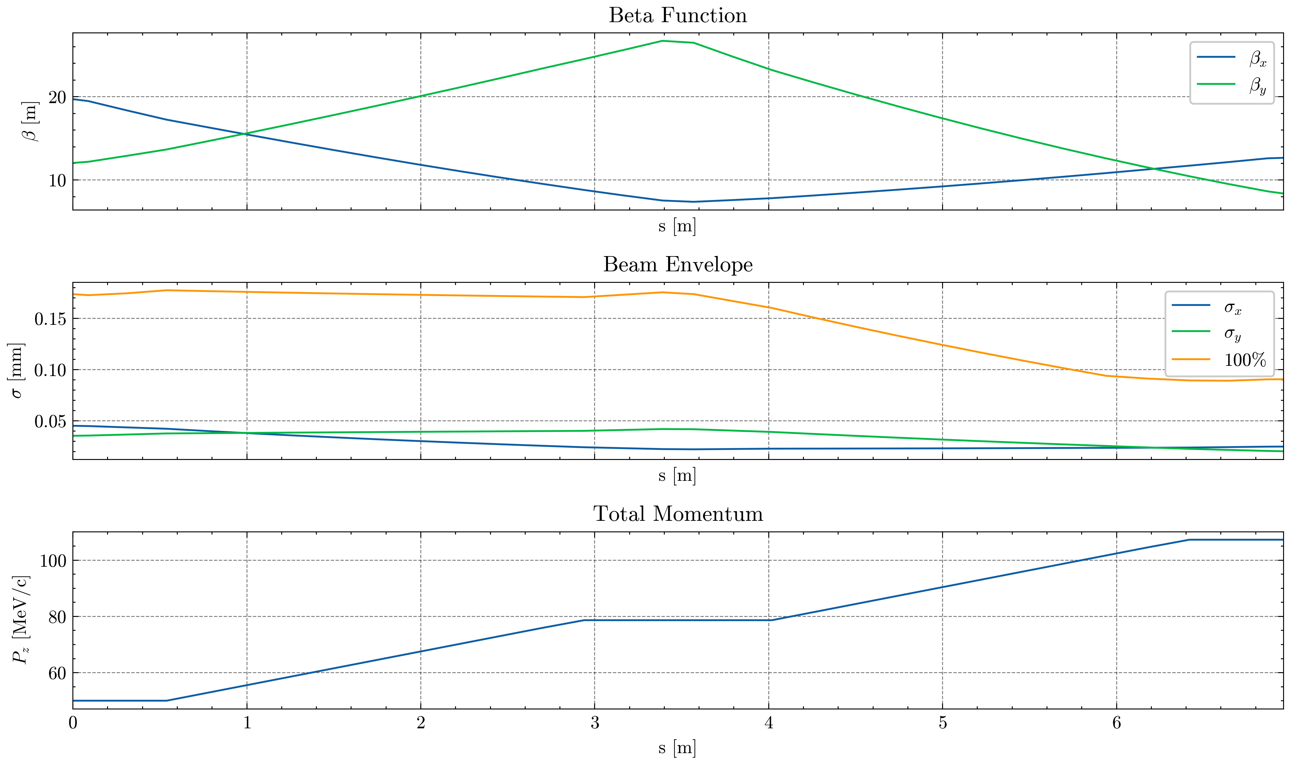
FODO Cell
When we track and match the FODO:
Betafunction is periodic
Betafunction is not symmetric
Emittance is unchanged (technical issues with plotting)
Beam envelope is reduced
Momentum is increased to approx. 107.6 MeV/c

Slide 14
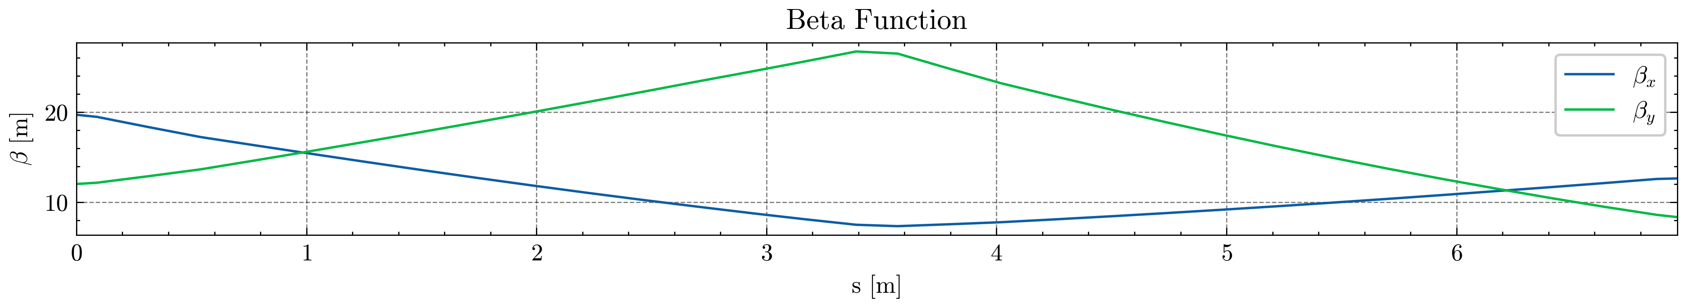
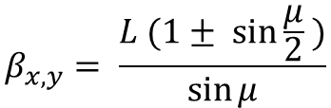
FODO Issues
Initial betafunction calculation:
Assumes a “thin” lens quadrupole
Assumes FODO cell has no accelerating elements
3a. Initial betafunction required to create a bunch (distributions)
3b. Tracking then matching yields a different final beta value each time
3c. Therefore, hard to optimise.
$$β_{x,y}= \frac{L (1± \sin{\frac{μ}{2} )}}{\sin{μ}}$$
Notes:
3. Betafunction required to make Bunch. Bunch required to track betafunction. Difficult loop to solve.
4. Initial = Final and x and y alternating at same max and min.

Slide 15
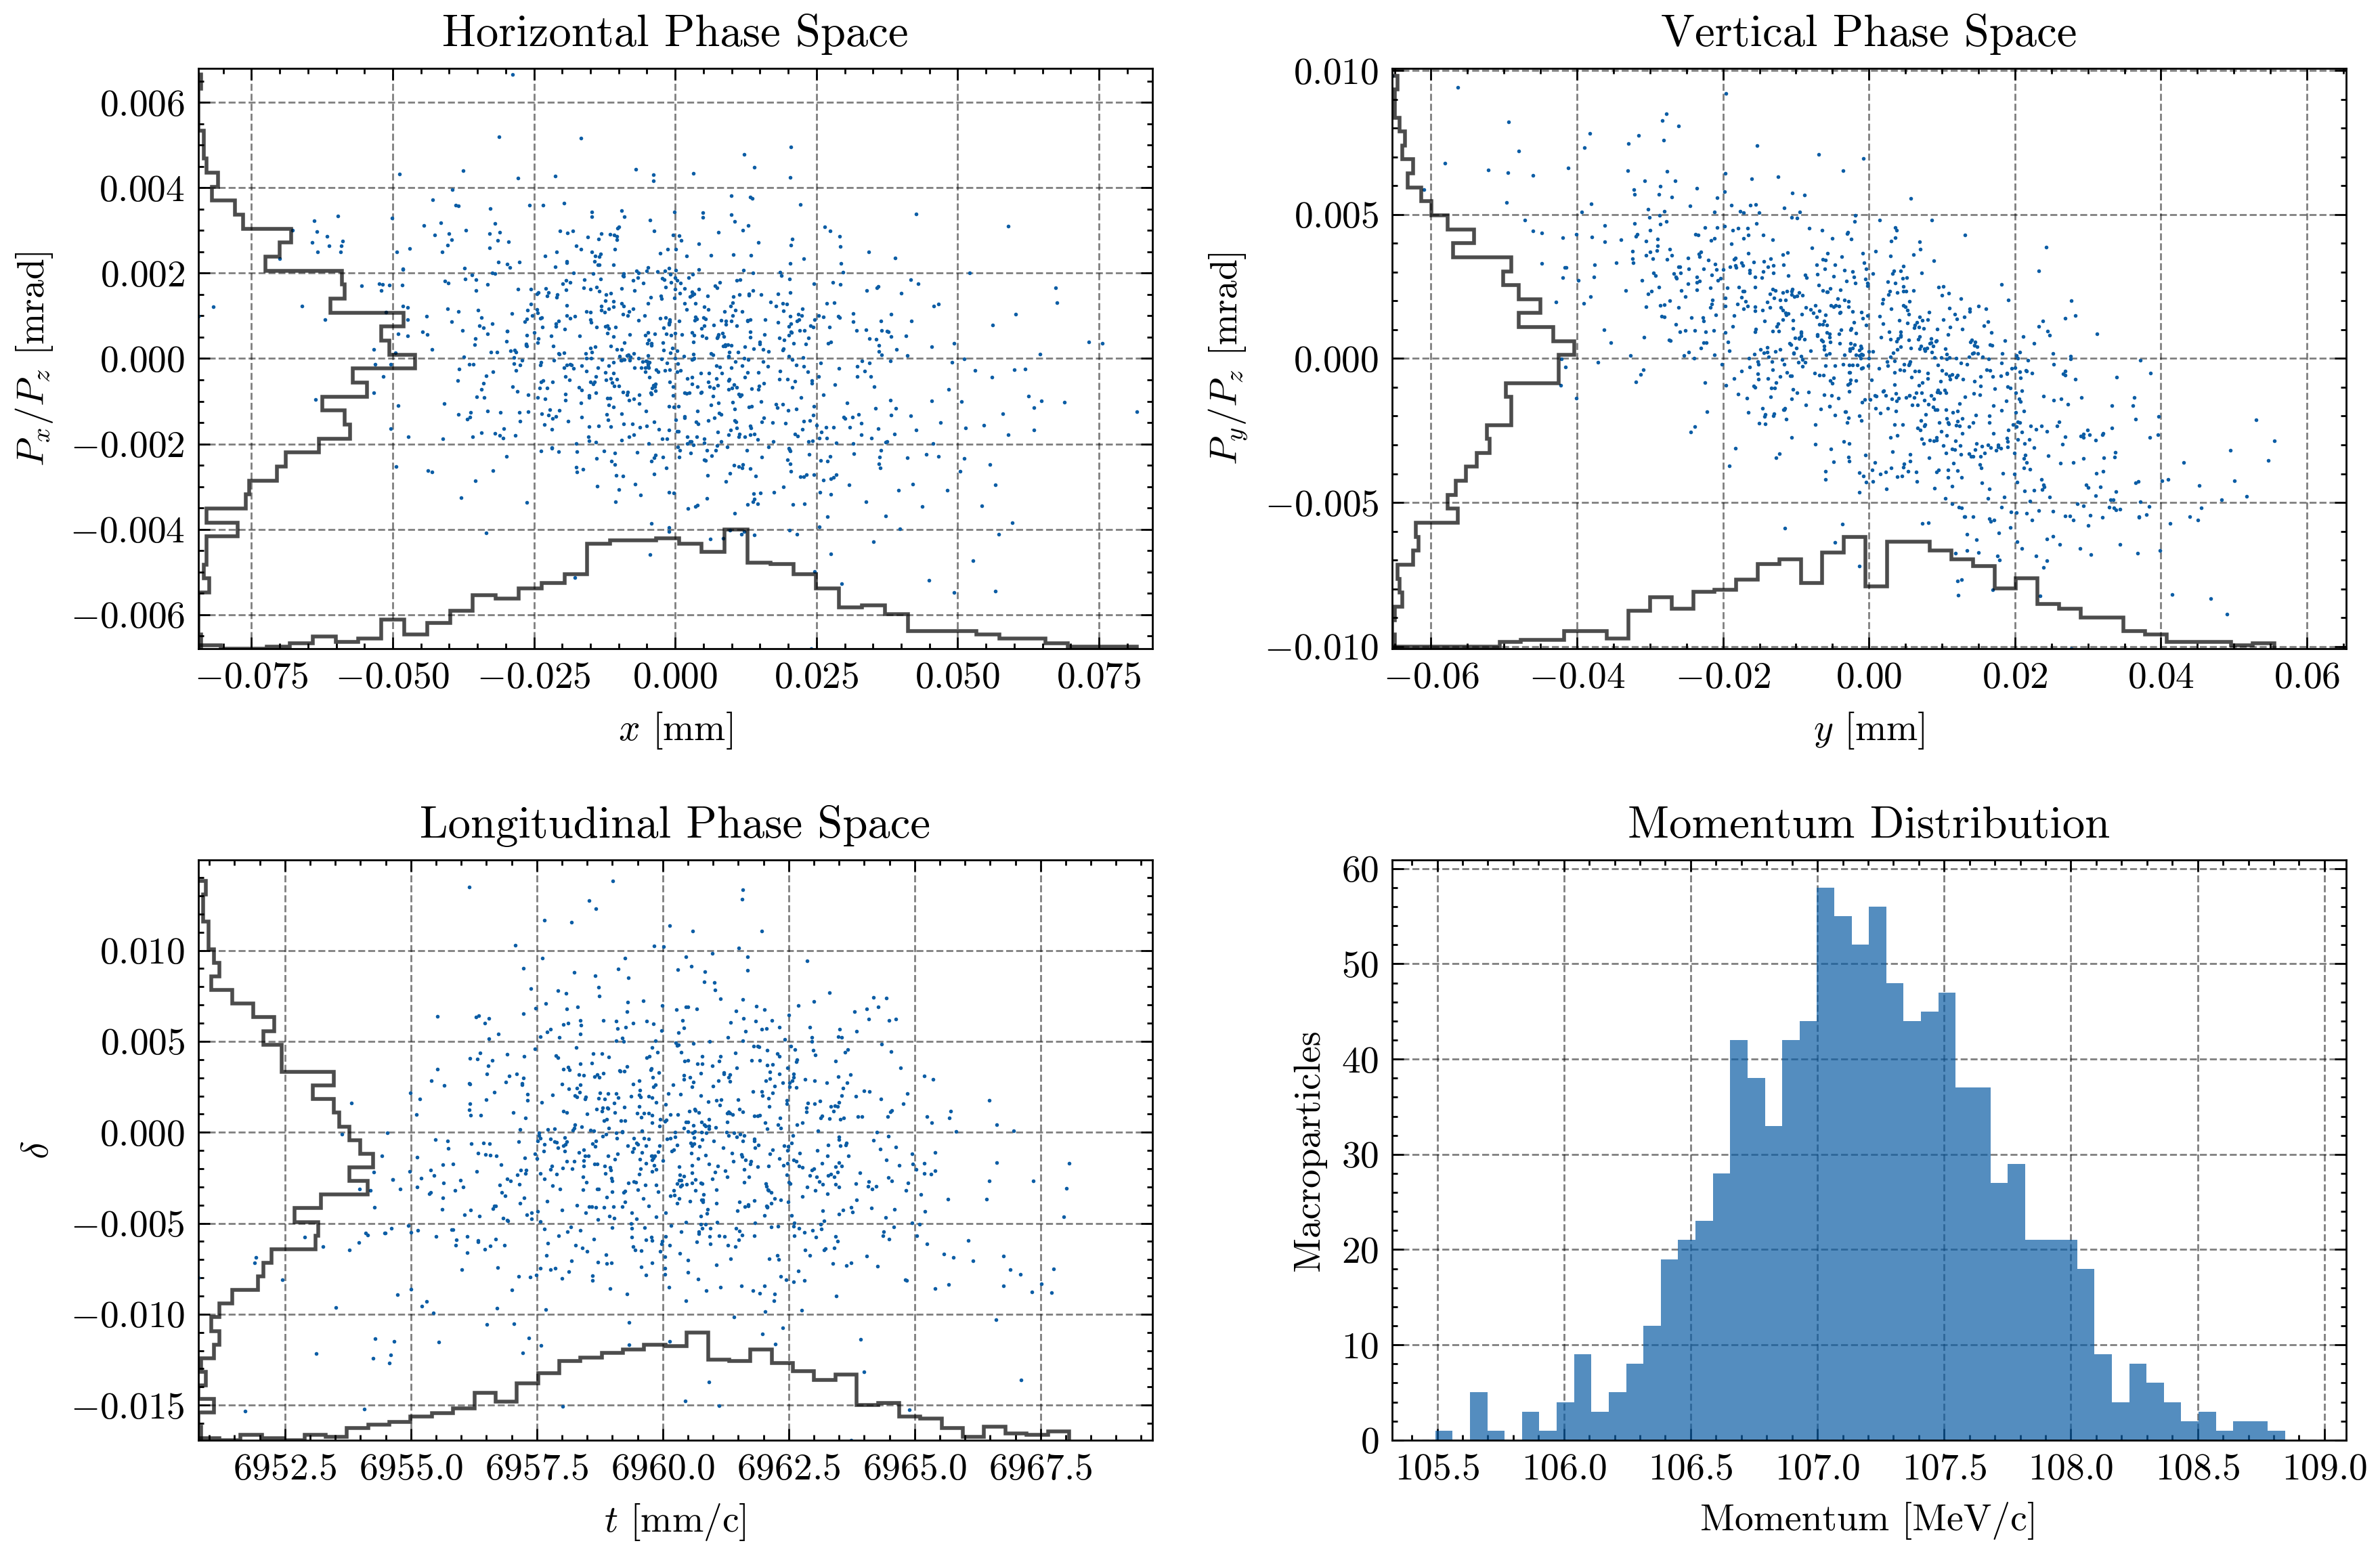
Phase Space of FODO: Before / After
Notes:
FODO cell starts and ends on horizontal focusing quadrupole which is why the distribution is converging

Slide 16
Linac
Using the optimised FODO as the starting cell
Add new (not optimised) FODO's with quadrupole strengths calculated from the momentum at that point
Replace half quadrupole pairs with a single quadrupole
Results in a 487.2 m linac with a final momentum of 4 GeV/c
RF Filling factor of 69%

Slide 17
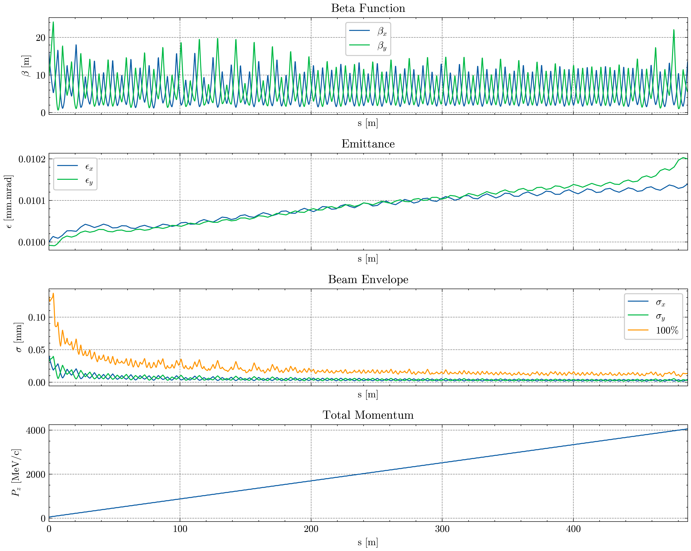
Linac
When we track and match the linac:
Betafunction is periodic
Betafunction is not symmetric, and varies a lot
Emittance is increasing, but still very small (far below the 0.05 mm.mrad limit)
Beam envelope is reduced and stable
Momentum ≥ 4 GeV/c reached

Slide 18
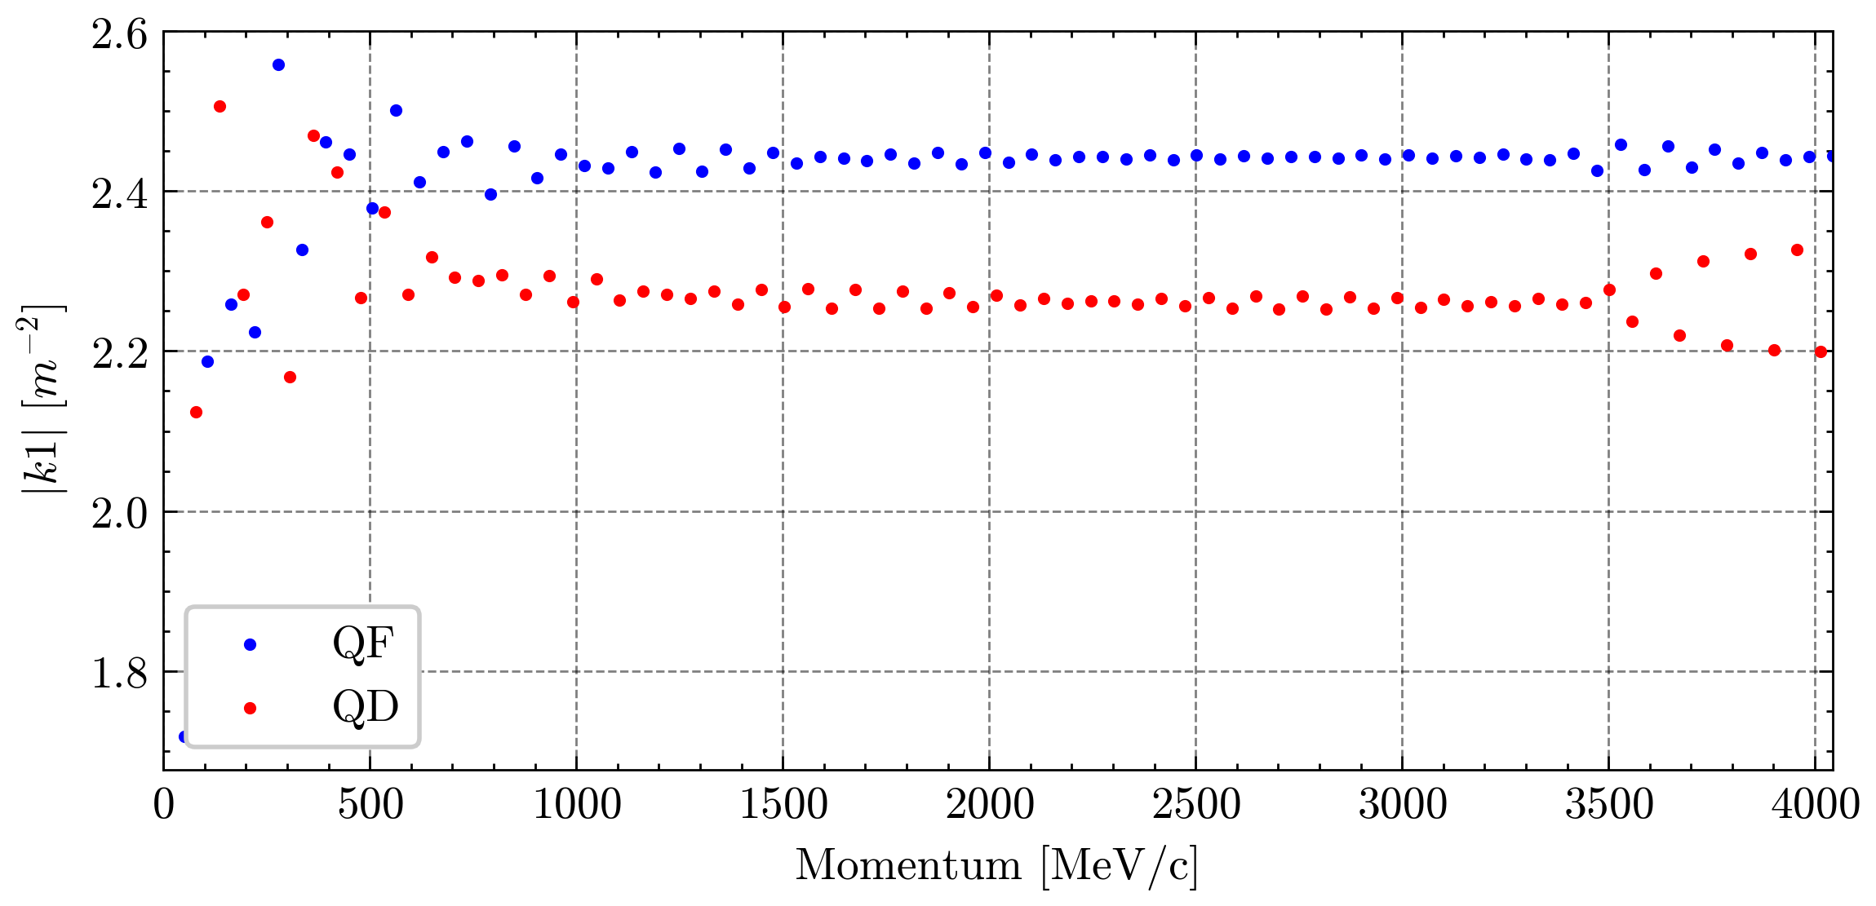
Linac: Quadrupole Focusing Strengths k1
The optimised quadrupole focusing strengths:
k1 values mostly stabilise
QD k1 values are all negative
Unsure why QF and QD have different "stabilised" values
Note the divergence on QD above 3500 MeV/c (to be investigated)

Slide 19
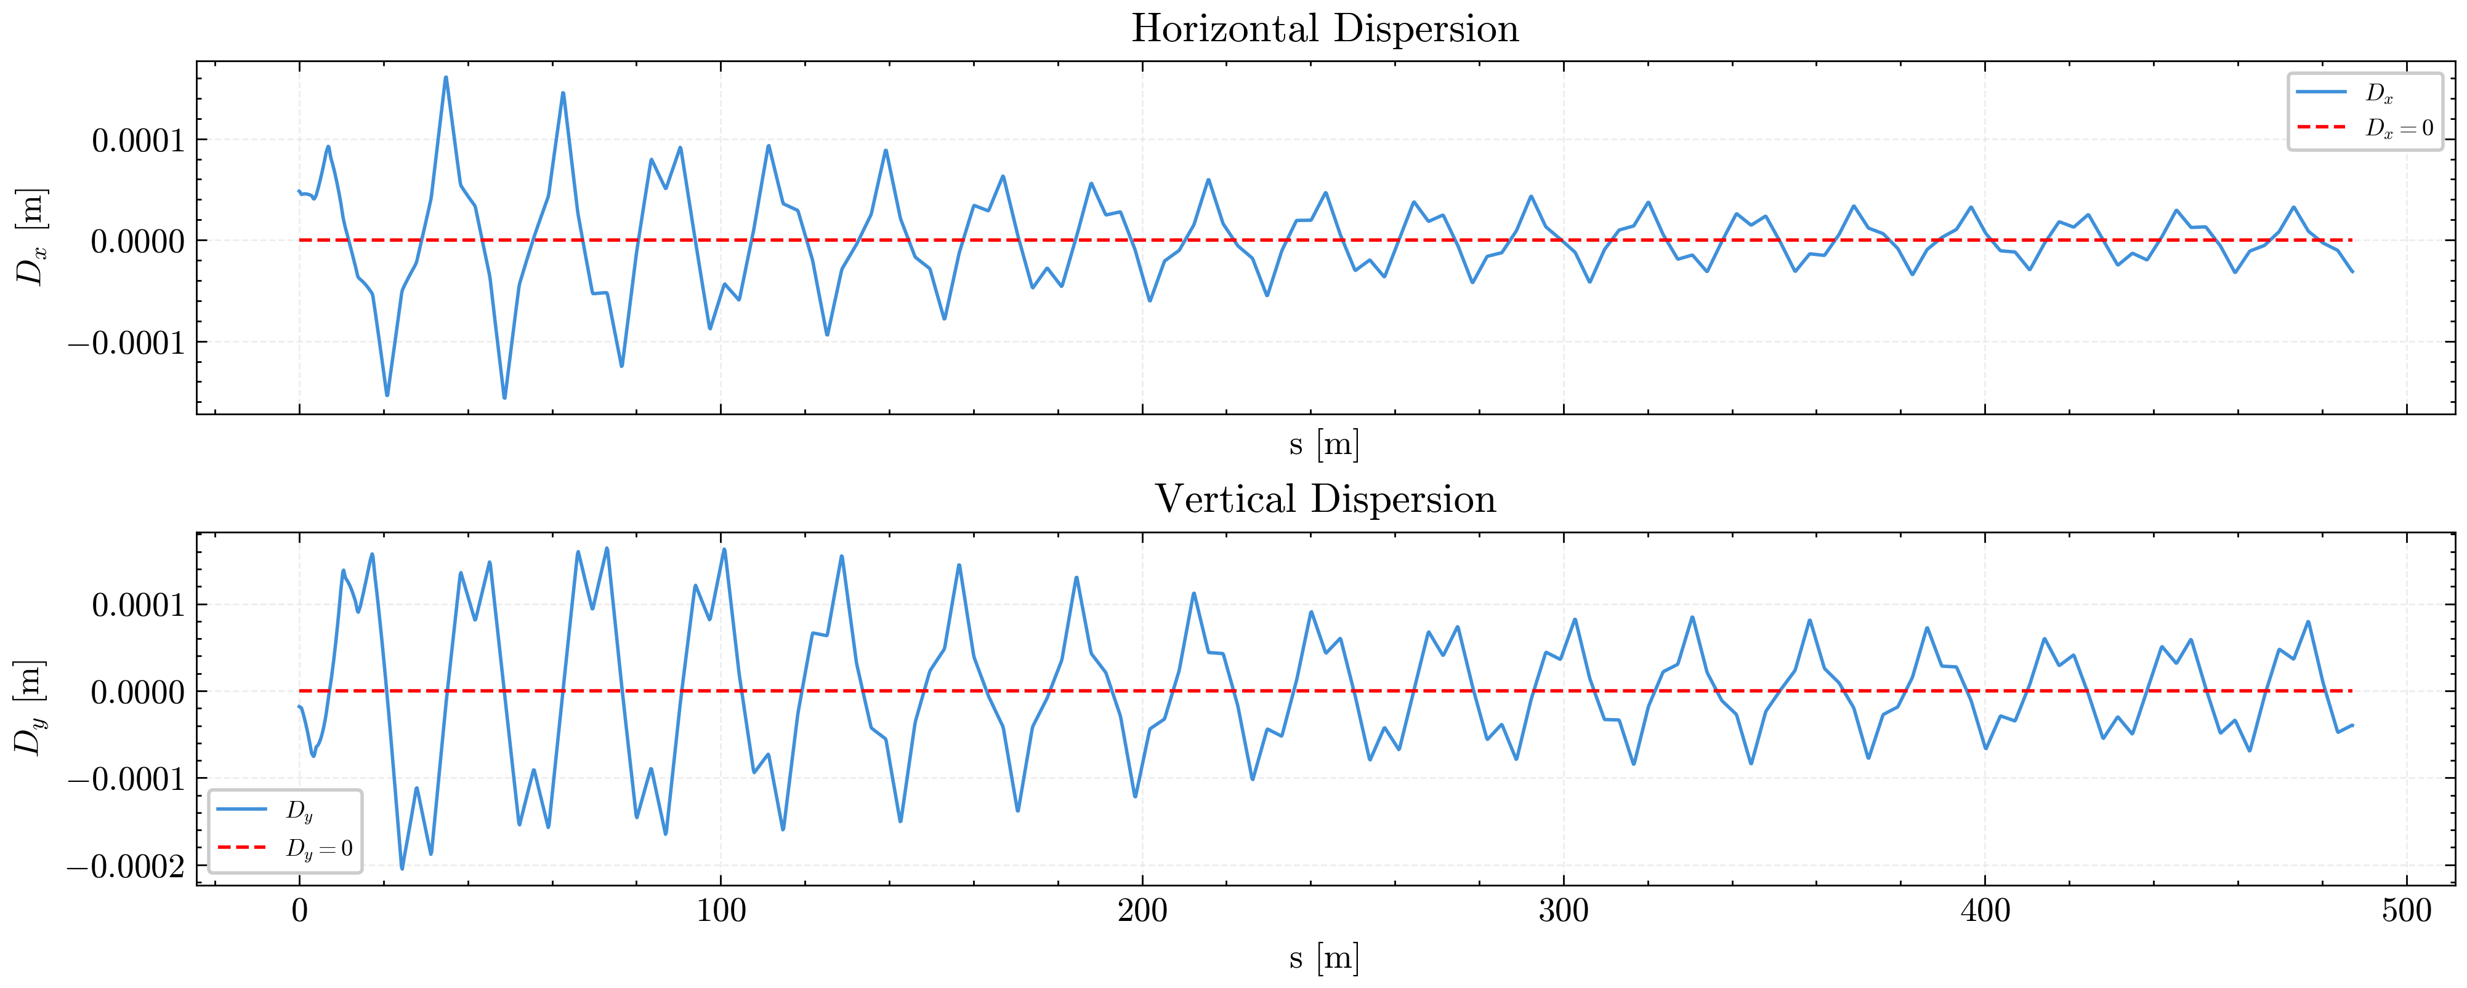
Linac Dispersion
Notes:
Dy larger than Dx across the length of the LINAC

Slide 20
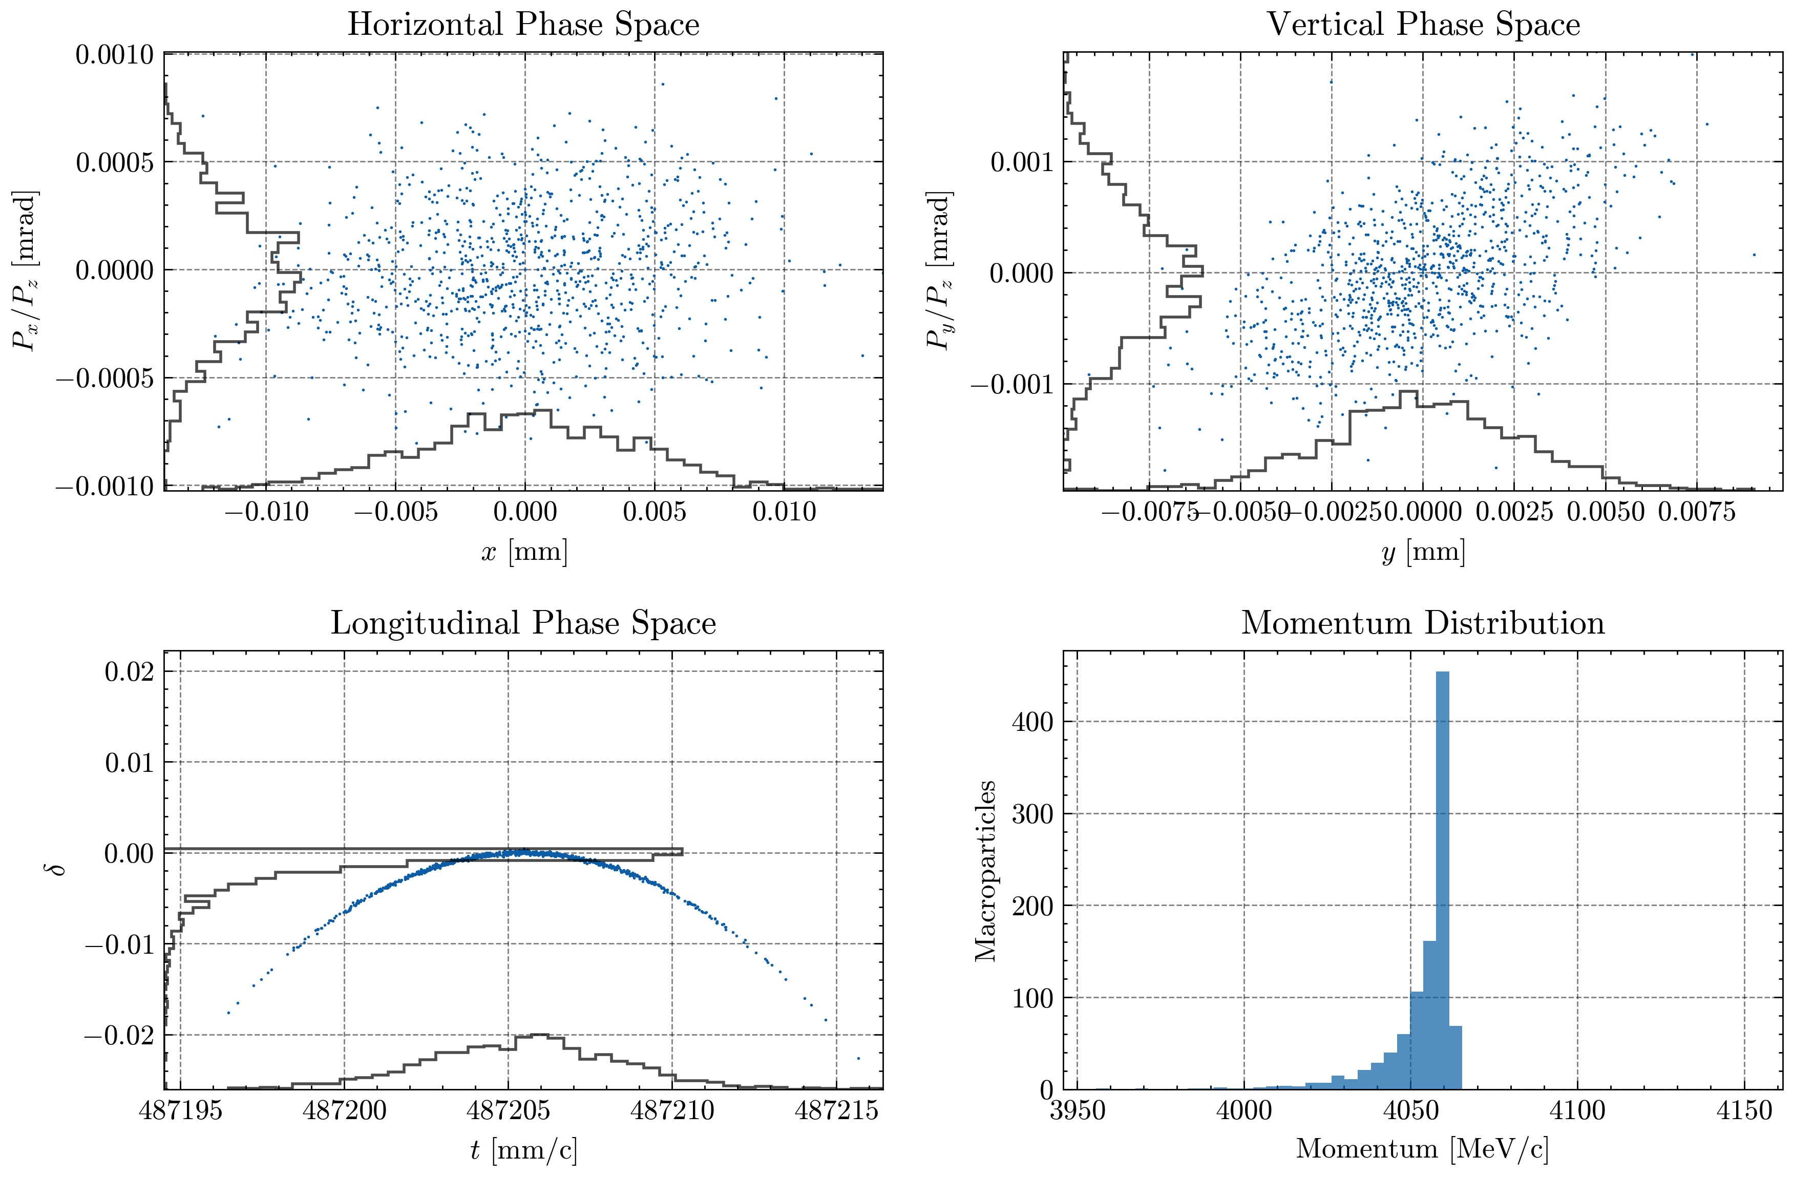
Linac Bunch Phase Space

Slide 21
Linac Successes
Accelerated to above 4000 MeV/c
Emittance stays below 0.0103 mm.mrad
Beam Envelope Range: 0.15 mm to 0.012 mm
Can be extended higher than 4 GeV/c, dependant on length and power limitations

Slide 22
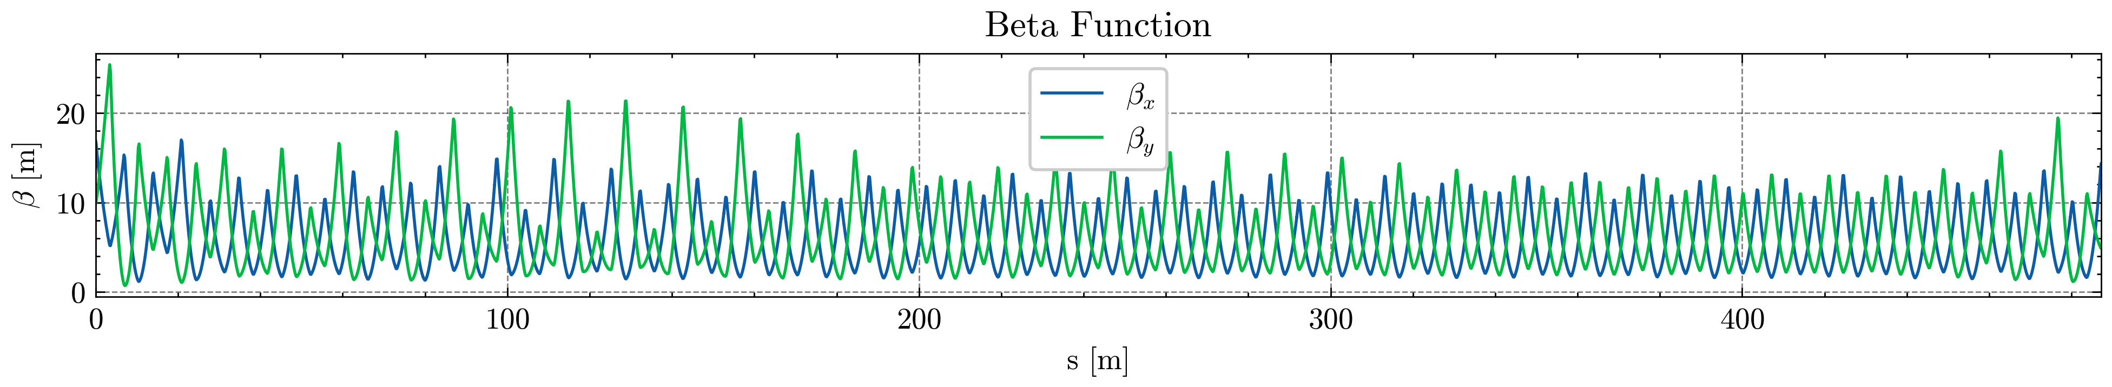
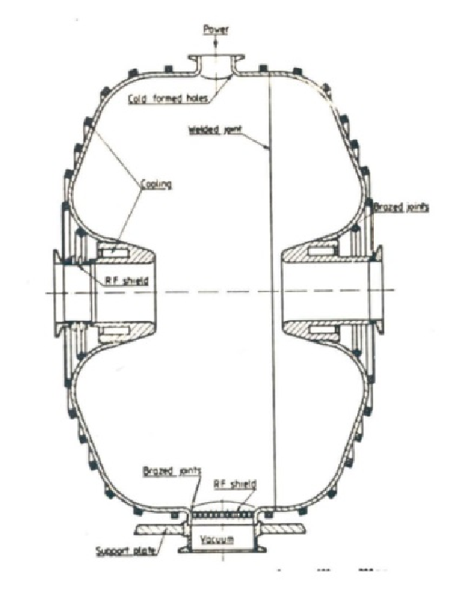
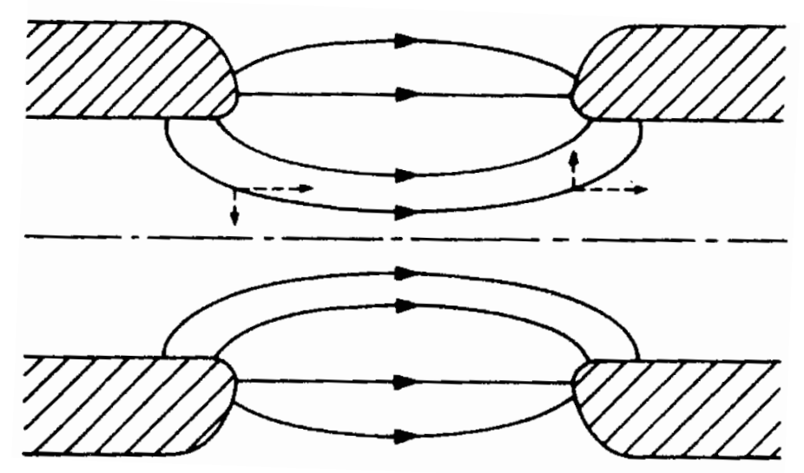
Linac Issues
Optimising for 141 independent quadrupoles
Beta-beating from transverse focusing (RF Track)
Notes:
Josh Finishes

Slide 23
Bunch Manipulation: Delay Loop and Combiner Rings
Bunch train created from electron gun
  96 pulses total (384ns)
  4ns bunch separation
Accelerated by RF Linac
  Unchanged
Delay Loop x2
  2ns bunch separation
Combiner Ring x3
  0.667ns bunch separation
Combiner Ring x4
  0.167ns bunch separation
Seeding of plasma acceleration stages
8 ns
x48
x24
x8
x2
x2

Slide 24

Drive-Beam Complex (CLIC)
Notes:
Stolen from CERN

Slide 25
Delay Loop and Combiner Rings
Delay Loop | CLIC | HALHF
Bypass Length [m] | 73 | 1.5
Loop Length [m] | 146 | 3
Recomb multiplier | x2 | x2
DL combines odd and even bunches in alternation
CR1 & CR2 decreases the bunch separation
 | CLIC |  | HALHF
Component | CR1 | CR2 | CR1 | CR2
Circumference [m] | 292.2 | 438.3 | 766.5 | 766.5
Recomb multiplier | x3 | x4 | x3 | x4
The Bypass Length is determined by the final bunch train duration
The Loop Length needs to be 2x Bypass Length
CR1 & CR2 need to be multiples of the train length
Notes:
Nela Begins

Slide 26
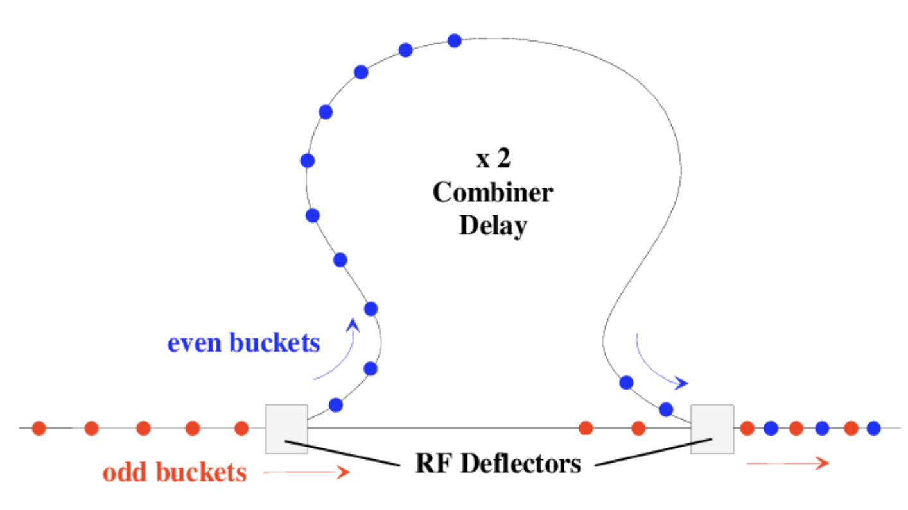
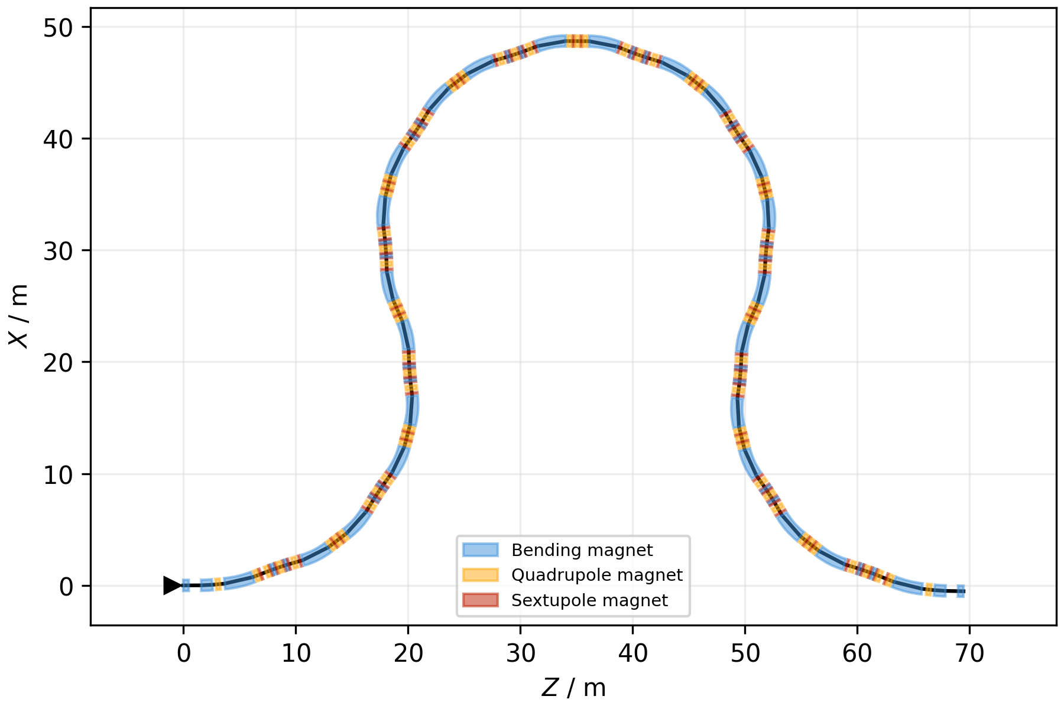
Delay Loop
[1] Rainer, P
Odd & Even buckets alternatively recombine
RFD halves the frequency of buckets entering the delay line
CLIC DL design plotted using Xsuite

Slide 27
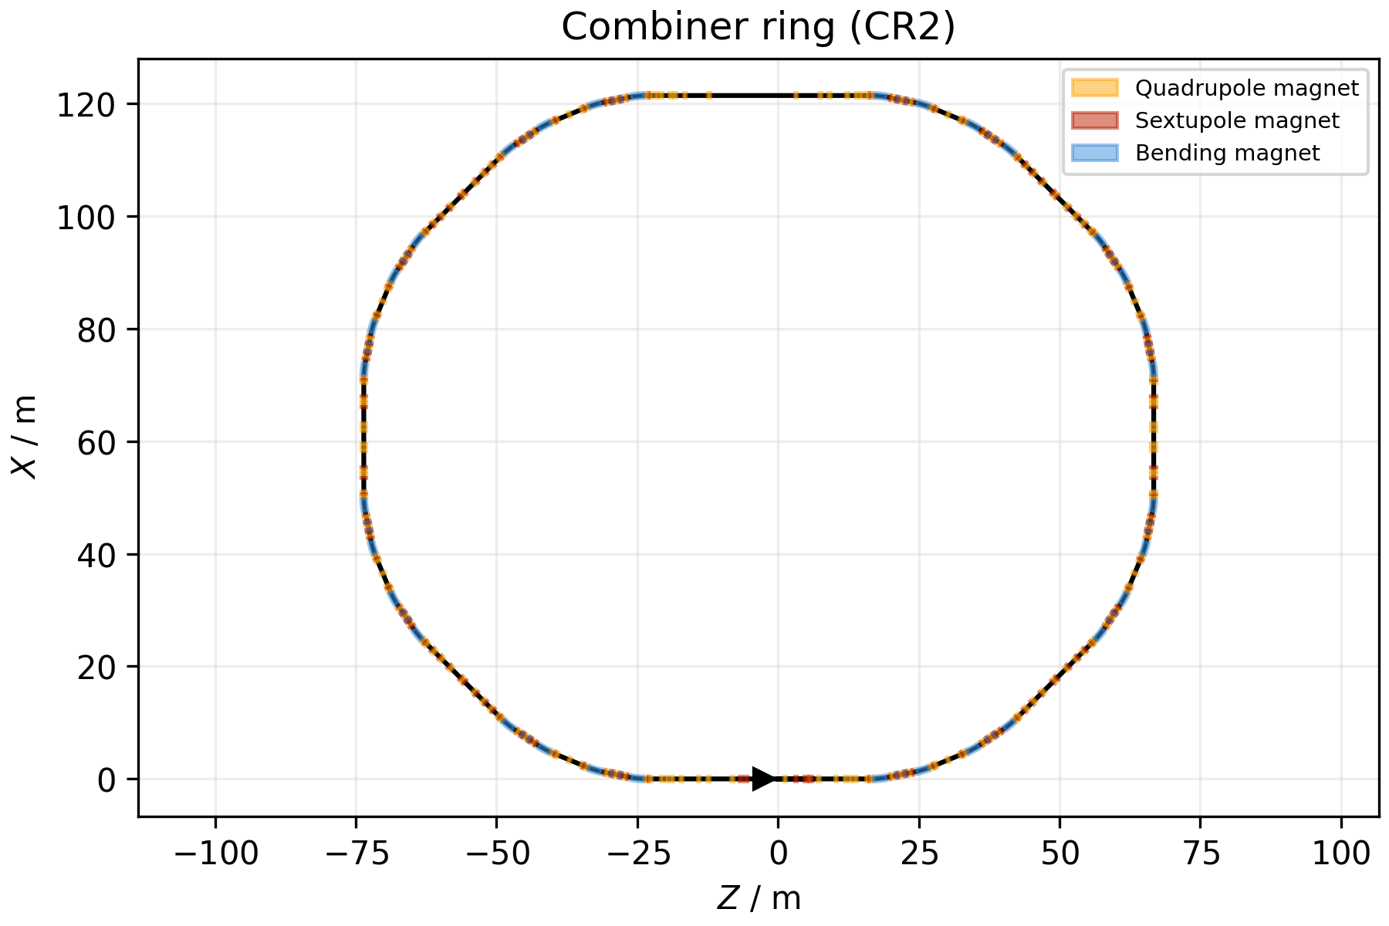
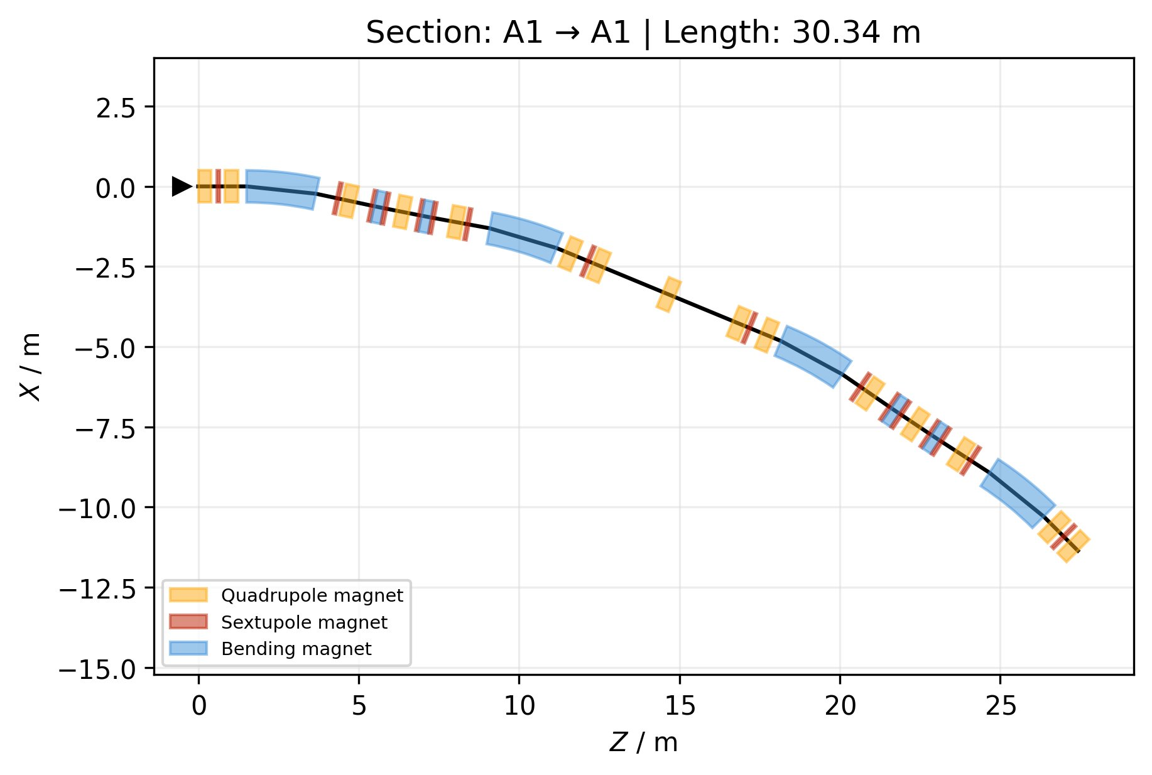
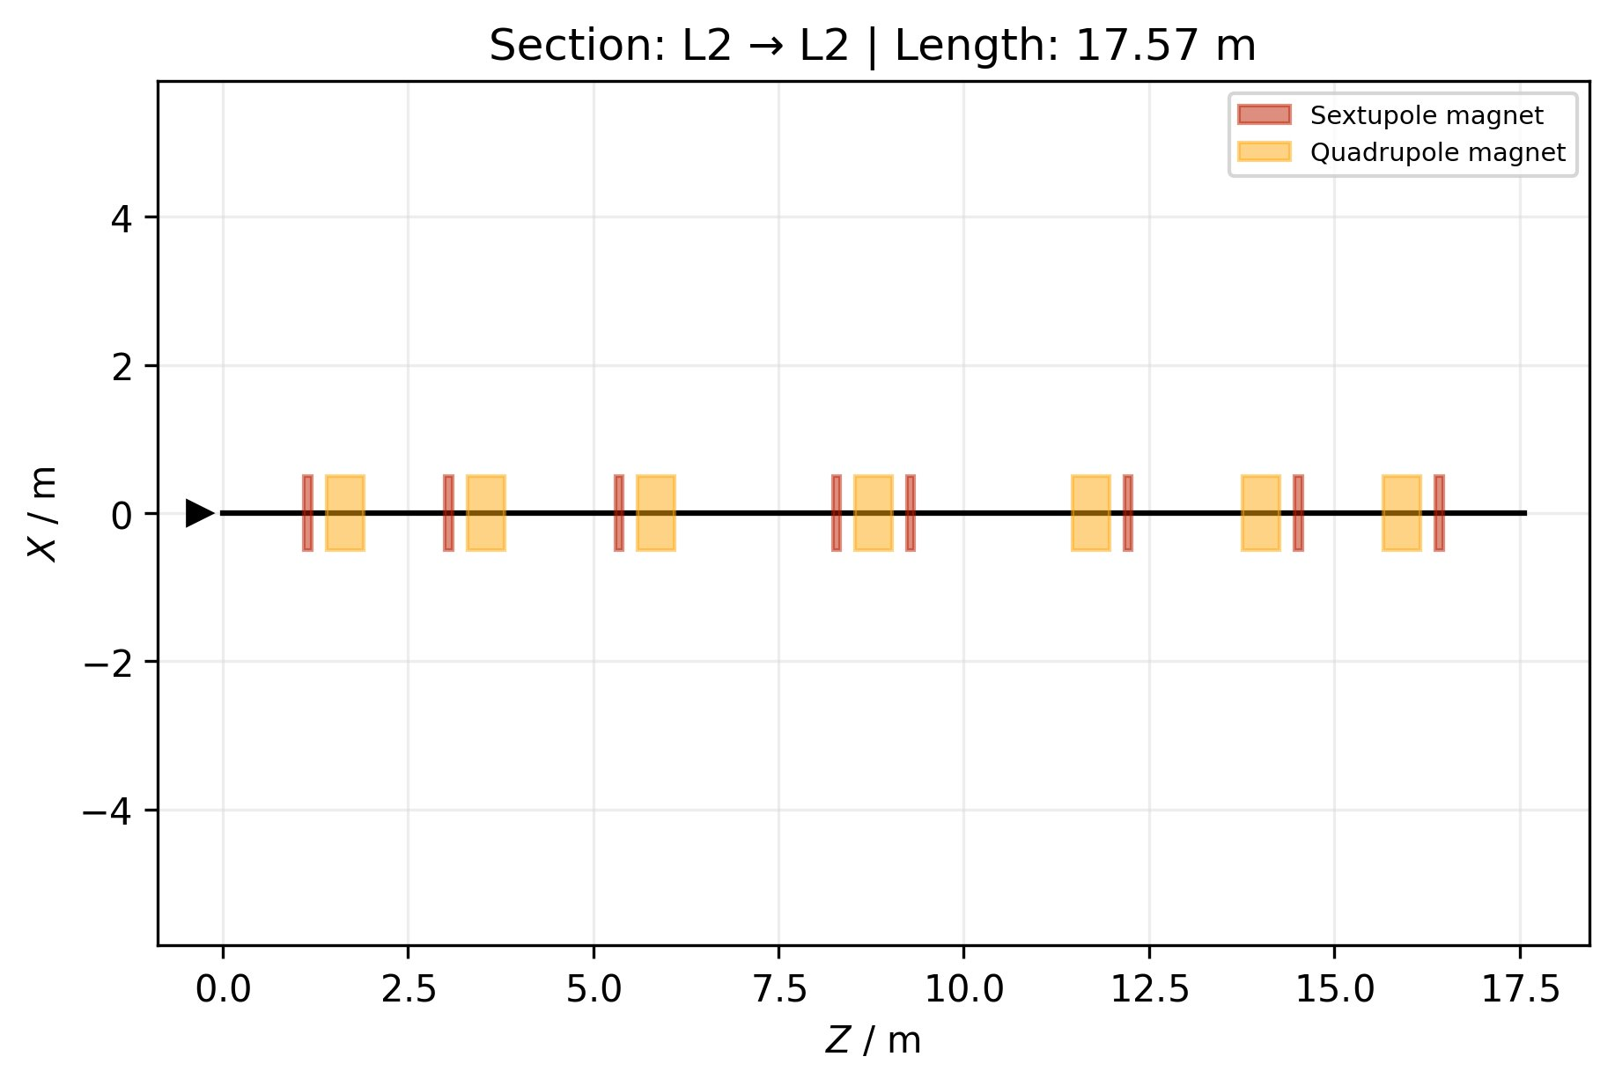
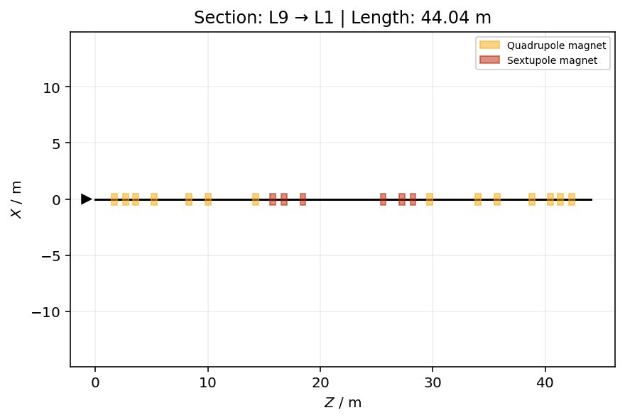
Combiner Ring
HALHF combiner rings are larger than CLIC due to the higher driver energy and longer bunch separation
CR1 & CR2 are identical in HALHF as opposed to in CLIC
CLIC CR2 design plotted using Xsuite

Slide 28
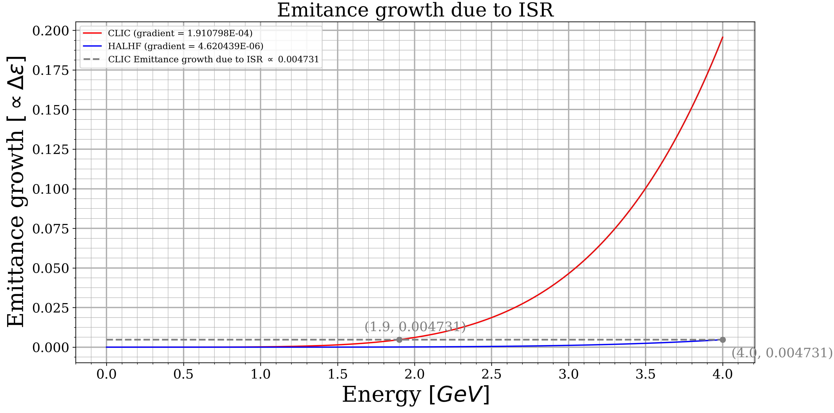
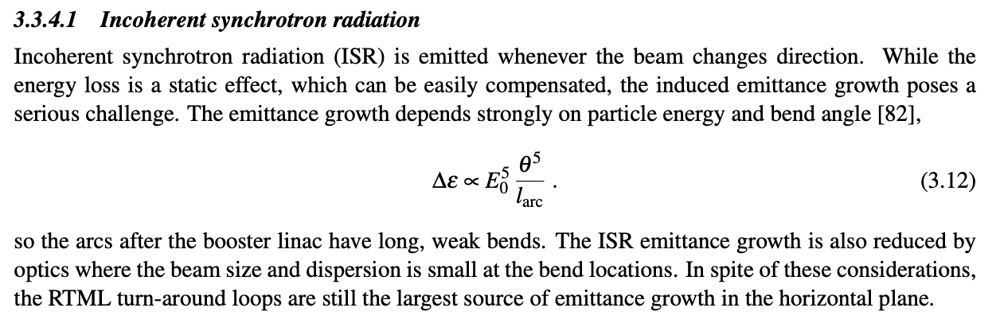
Incoherent Synchrotron Radiation (ISR)
Find value proportional to Emittance growth for 1.9GeV given S-bend CLIC parameters (0.0047).
Generate a curve using eqtn 3.12 which matches the emittance growth and retrieve the gradient.
Gradient is proportional to Sbend angle ^5 / S bend length.
Assume bend angle of CLIC and adjust bend length to match gradient.
G = A^5/l → l = A^5/G = 0.210871485^5/4.620439E-06 → l_new = 90.24 m
Assume length, new bend angle = 0.073
Parameter | CLIC | HALHF
Energy (E0) [GeV] | 1.9 | 4
Max bend angle [rads] | 0.210871485 | ??????
Corresponding S bend length [m] | 2.182098945 | ??????
Notes:
https://www.desmos.com/calculator/c89bwlq8xd Link to plotting of ISR
https://cds.cern.ch/record/1500095/files/CERN-2012-007.pdf Page 171 is where the 3.3.4.1 ISR calc comes from
Reference is https://www.slac.stanford.edu/cgi-bin/getdoc/slac-ap-047.pdf (doesn’t appear to derive fully so not sure how CLIC justified it)

Slide 29
Future Work
Investigating if sextupoles are needed for linac
Tracking and optimising the loop and ring, but it would require bunches from the previously optimised section
RF-track implementing RF deflectors/kickers
Incoherent Synchrotron Radiation calculation

Slide 30
RF Track Issues
Importing from PLACET → RF_Track (custom .csv reader)
Importing from .csv into XSuite for schematic plotting
Cavity complexity (Fourier, tracking time)
Lack of python interface / documentation / args
Lack of lattice manipulation ability, i.e. combining half quadrupoles
Crashing is frequent
Notes:
Nela Ends

Slide 31
RF Team
Alexander Harrison, Ibrahim Najmudin,
James Thistlewood

Slide 32
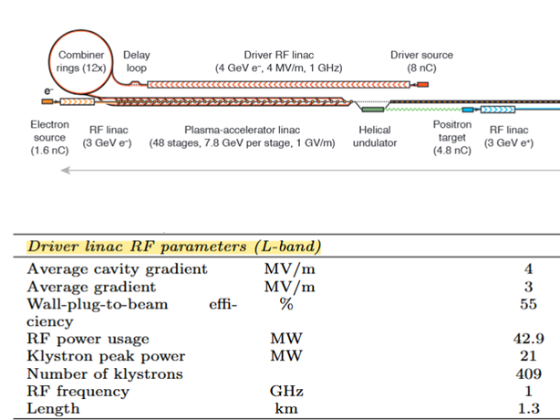
Motivation and Parameters
1.3 km
Driver linac requires at least 4 MV/m accelerating gradient
Chosen frequency is 1 GHz
Electrons from driver source are relativistic (~50 MeV, β ≈ 1)
Uses klystrons with peak power ~21 MW (requiring 409 klystrons)
Higher gradient desirable because shortens linac, reduces cost, relaxes limitations
Foster, B. et al. Proceedings of the Erice Workshop: A new baseline for the hybrid, asymmetric, linear Higgs factory HALHF. doi:10.48550/arXiv.2501.11072

Slide 33
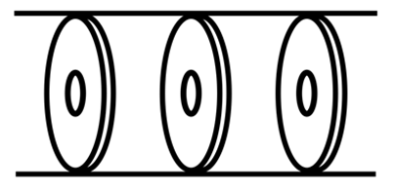
Design Choices
Travelling-wave cavity (vs standing wave):
  More suitable for relativistic single-pass accelerator [1]
  More efficient than SW – higher transit time factor, since bunch travels with wave
  Any waveguide mode will have v_{p} > c, so must slow phase velocity with iris-loaded waveguide
Warm copper normal conducting cavity:
  No cryo-plant needed
  Suitable for the low accelerating gradient required
  Wide historical use in linacs (e.g. at SLAC), proven technology, well-studied
2a
2b
Iris-loaded waveguide geometry
[1] Wangler, T. P. RF Linear Accelerators. (Wiley-VCH, Weinheim, 2008).

Slide 34
Design Requirements
Hard limits:
Peak Klystron power – 21 MW, limits E field strength
Overall drive linac power usage – 43 MW, limits E field strength
Kilpatrick limit at 1 GHz – 29 MV/m (with 'bravery factor' = 1)
1 GHz signal – fixes cavity radius via fundamental mode J₀
Phase advance per cell – 2π/3 (maximises Rs)
Cell length – βλ/3 (necessary for a correct 2π/3 phase advance)
Total cavity length – to fit within the FODO cells with enough breathing room
Notes:
Shunt impedance – the higher it is the better the cavity uses the power given

Slide 35

Simulation Methods
Poisson Superfish – 2D axially symmetric frequency-domain cavity mode solver:
More suitable for standing-wave cavities
'Homemade' Bayesian optimization of parameters via Python, tune frequency by tweaking cavity geometry
CST Studio – 3D general microwave EM solver:
Suitable for wide range of problems, handles SW and TW cavities
Built-in optimization via Trust Region / Nelder-Mead

Slide 36
Figures of Merit (FoM)
Geometric values:
Simulation values:
Symbol | Name | Description
Rs | Shunt impedance | Measure of axial voltage vs power dissipated
Q | Quality factor | Ratio of stored energy to loss per period
r/Q |  | Efficiency of acceleration vs stored energy
P | Power loss | Power lost to induced currents in cavity walls
T | Transit time factor | Quantifies amount of time beam spends in region of peak accelerating field
Ez | Axial gradient | Avg. z-component of accelerating E field on axis
Notes:
Shunt impedance – the higher it is the better the cavity uses the power given

Slide 37
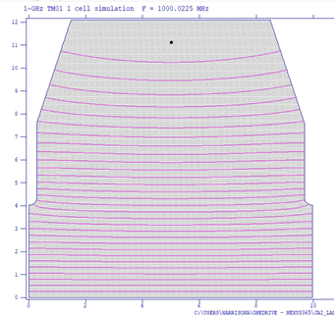
How we used Superfish
Designed a loaded Iris waveguide cell
Compared different cell designs such as domed roof, pill box, and slanted edge design.
Optimised design for FOM using a Bayesian black box design
Investigated the maximum electric field by abiding to the Kilpatrick limit.

Slide 38
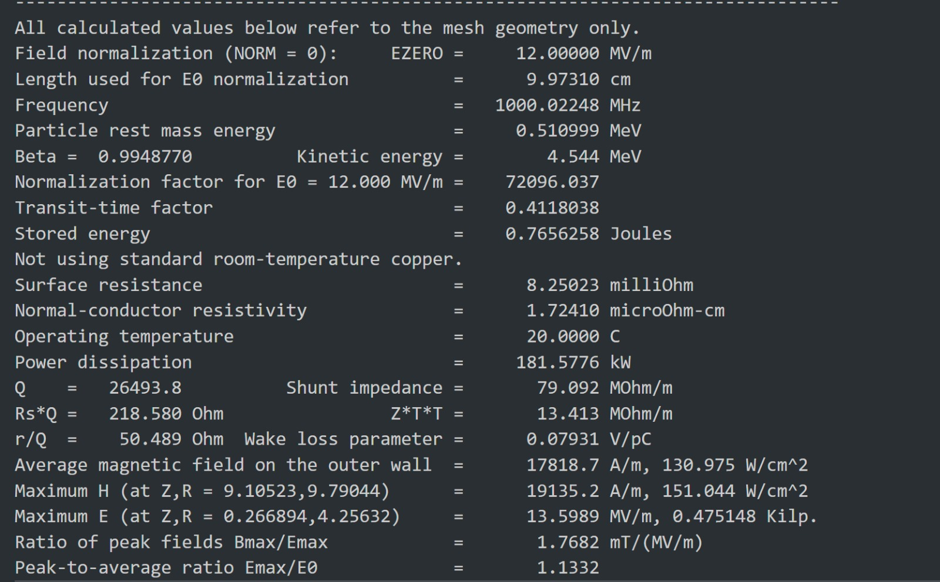
FoM in Superfish
Symbol | Name | Value | Units
f | Resonant frequency | 1000.022 | MHz
Rs | Shunt impedance | 8.25 | mΩ
Q | Quality factor | 26500
r/Q |  | 50.5 | Ω
Emax | Maximum E field | 13.6 | MV/m
Ez | Axial gradient | 12.4 | MV/m
Example output data: Electric field (Ez) visualisation...
...and SF0 output
Notes:
Shunt impedance – the higher it is the better the cavity uses the power given

Slide 39
CST Studio Suite
CST - full 3D simulation of E & H fields in a lossy conductor (e.g. pure copper)
As with Superfish, can use CST to find both the eigenmodes of the cavity and its resonant frequencies, but can also solve for E fields in time domain and obtain other FoM
3D simulations should be more accurate
Can compare our FoM from CST vs. Superfish. CST values can be used for FoM which are inaccurate in Superfish

Slide 40
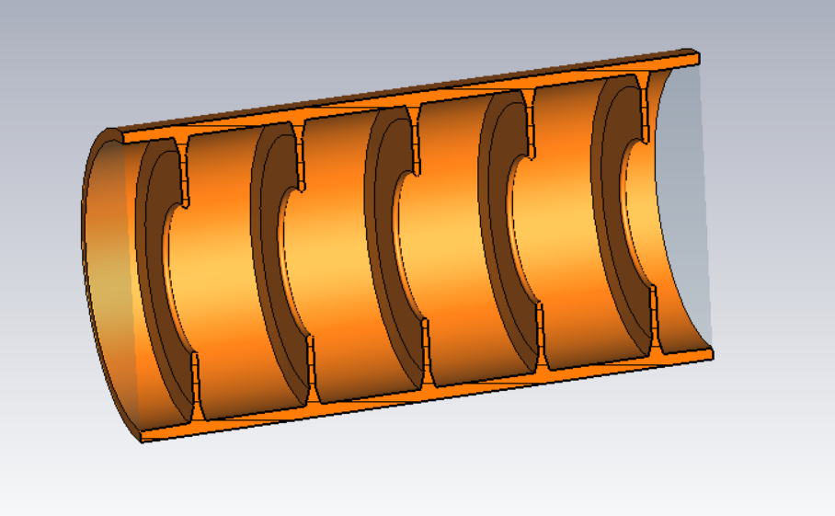
CST Studio Suite - Modelling
Iris loaded waveguide in CST
Multi cell design required for the TM01 mode to propagate
Slanted/curved edges lead to solver problems in the geometry
  Increases mesh resolution to define the curves
3D simulation greatly increases running time
3D modelling is more difficult than 2D
Time domain solver does not have tools to extract multi variable values out of 3D data

Slide 41
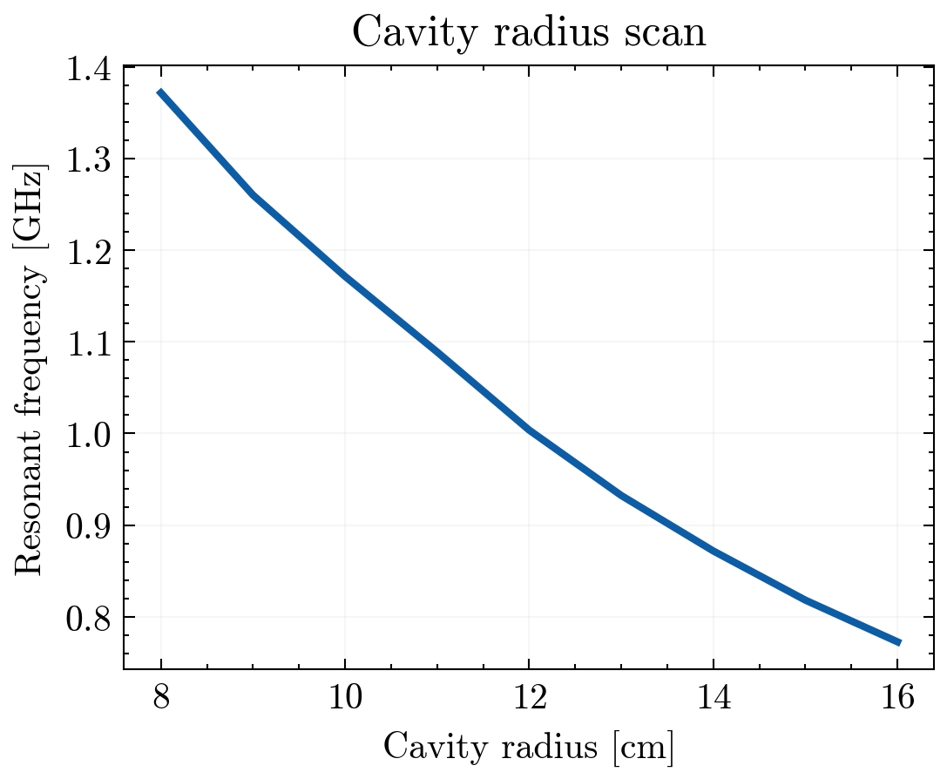
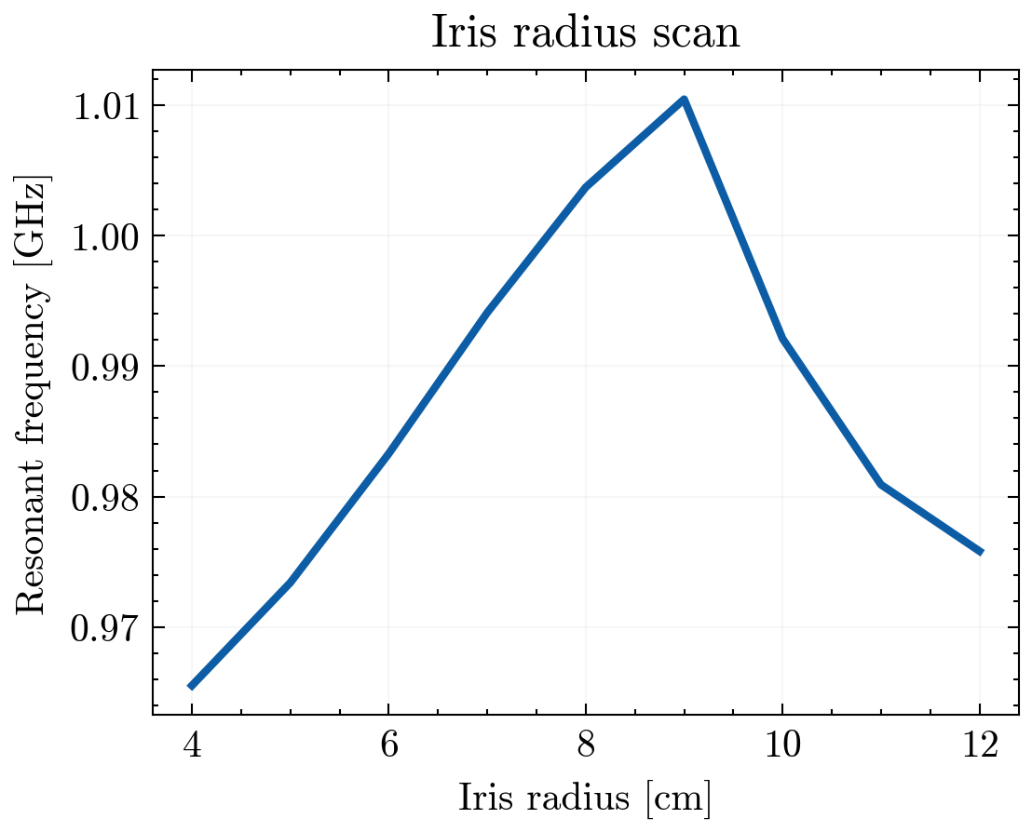
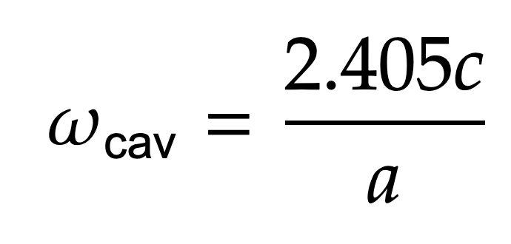
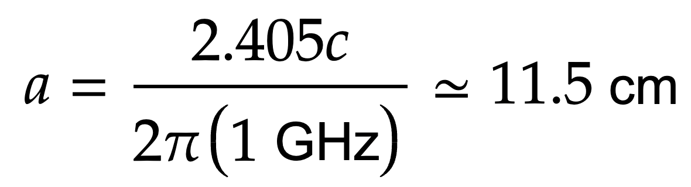
Parameter scans
Theory of cylindrical waveguides gives us the cavity modes
Predicting,
Varying cavity radius keeping iris radius at a constant ratio a:2a/3
And with fixed a, the cavity frequency is relatively insensitive to the iris's radius

Slide 42
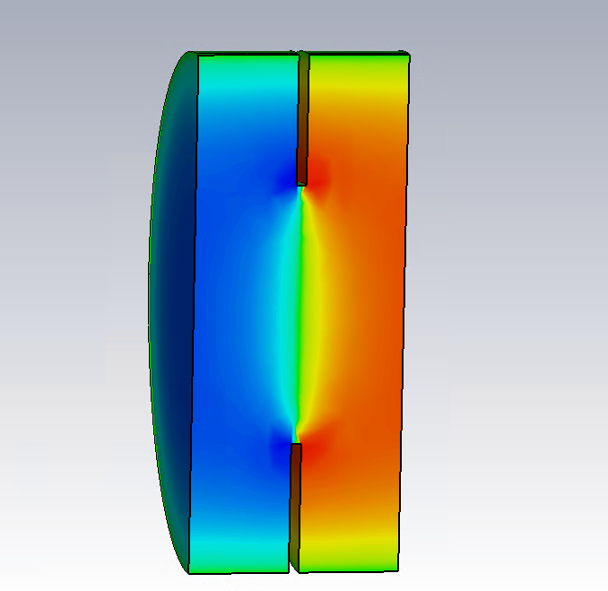
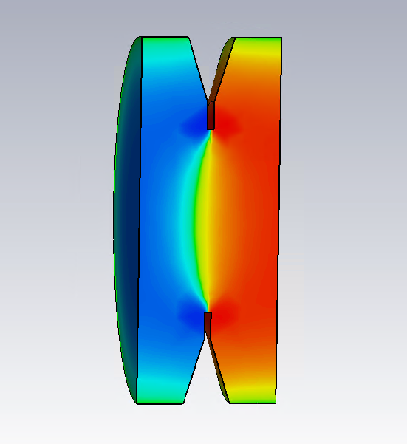
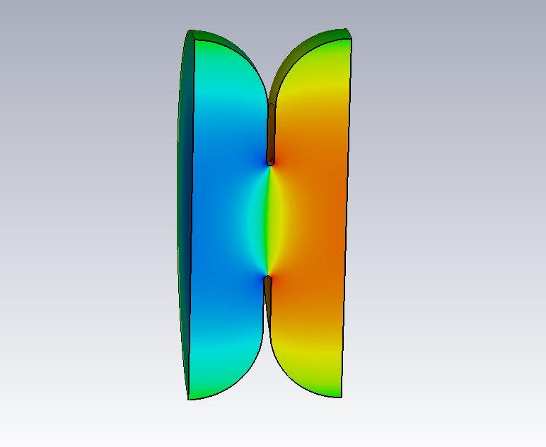
CST: single-cell geometries, 2π/3 mode
Pillbox cavity
Radius = 12.88 cm
Iris radius = 6.44 cm
f = 1000.310 MHz
Q = 27000
r/Q = 53.0 Ω
Chamfered cavity
Radius = 13.69 cm
Iris radius = 6.84 cm
f = 999.921 MHz
Q = 28700
r/Q = 48.25 Ω
Domed cavity
Radius = 12.94 cm
Iris radius = 3.97 cm
f = 999.981 MHz
Q = 29600
r/Q = 68.9 Ω

Slide 43
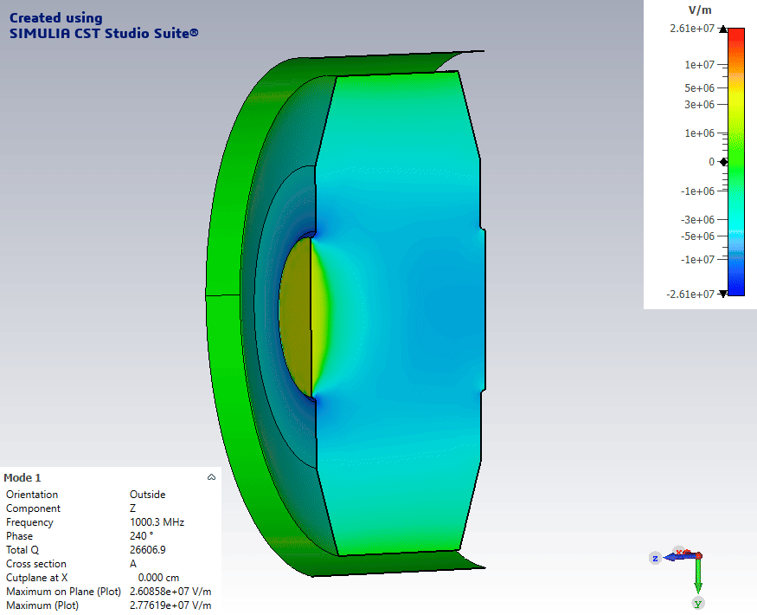
CST v Superfish
Superfish variant
Radius = 12.08 cm
Iris radius = 4.03 cm
f = 1000.310 MHz
Q = 26500
r/Q = 53.0 Ω
CST variant
Radius = 12.54 cm
Iris radius = 4.18 cm
f = 1000.296 MHz
Q = 26600
r/Q = 120 Ω

Slide 44
RF Results
Iris-loaded waveguide structure is feasible
Obtainable minimum parameters
Further optimization of geometry and full structure still required
  Full design in CST will require a consideration of input/output waveguides
Symbol | Value | Units
Ez | 6-9 | MV/m
Q | 27000
r/Q | 50 | Ω
Notes:
Shunt impedance – the higher it is the better the cavity uses the power given

Slide 45
Future Work
…would build upon these findings to fine-tune the cavities to the final needs of the HALHF drive beam linac
Suggestions:
Model longitudinal beam dynamics – wake effects
Import cavity design into beam optics code
Beam loading considerations
More accurate calculation of power usage
Notes:
Shunt impedance – the higher it is the better the cavity uses the power given

Slide 46
Magnet Team
Diya Dipac, Calvin Dyson, Sabrina Wang

Slide 47
DB Linac Goals and Parameters
Aim:
  test feasibility of parameters
  design compact quadrupole for all field strengths in linac
Given:
  139 full size quadrupoles, 2 half sized quadrupoles at either side
Beam Envelope | 0.37 mm with misalignments
Minimum Field Gradient | 0.3 T/m (k1 = 1.799 m⁻²)
Maximum Field Gradient | 30.2 T/m (k1 = 2.264 m⁻²)
Full size quadrupole length | 0.18 m

Slide 48
Linac Quadrupole Requirements
Parameter | Value
B_{max} | 2.0 T
GFR field purity | ≥ 99.9%
Quadrupole length | >5* aperture radius
Radius aperture = 7.5 mm (0.3 mm beam envelope + 3-5 mm beam pipe and chamber + 2.2 mm errors).

Slide 49
Magnet Design Process
Made a hyperbolic curve using Microsoft Excel (Quad only)
Imported the curve into AutoCAD and drew the rest of the magnet.
Imported the AutoCAD magnet design into FEMM 4.2.
Labelled materials, currents and boundaries.
Set mesh to obtain fields.

Slide 50
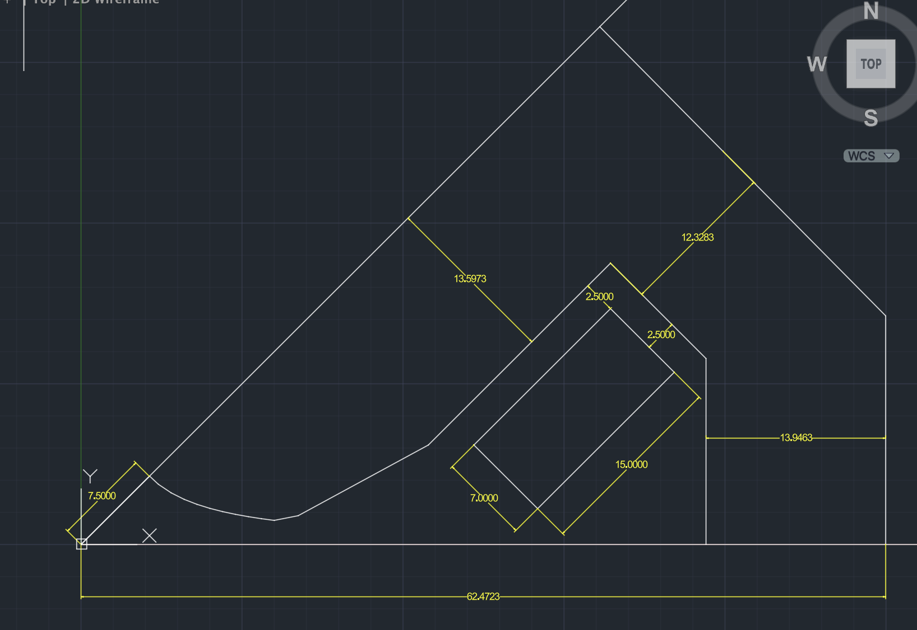
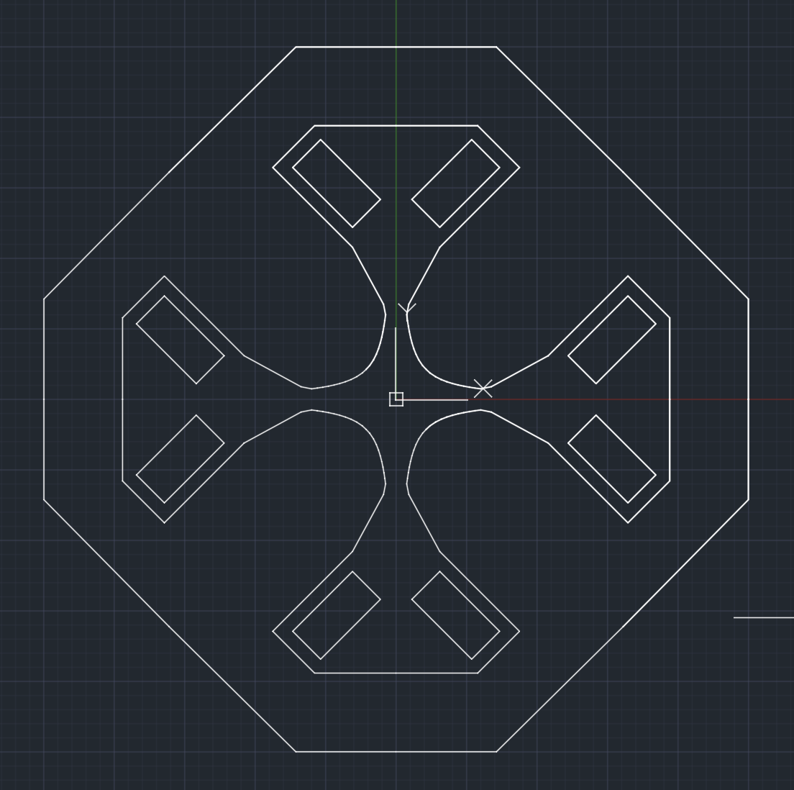
Linac Quadrupole AutoCAD Design
This unit of the quadrupole repeats 8 times:

Slide 51
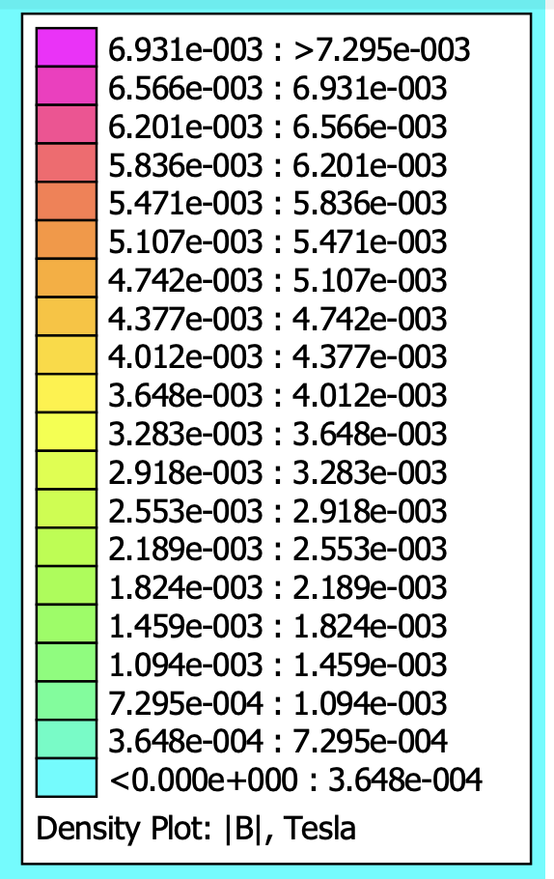
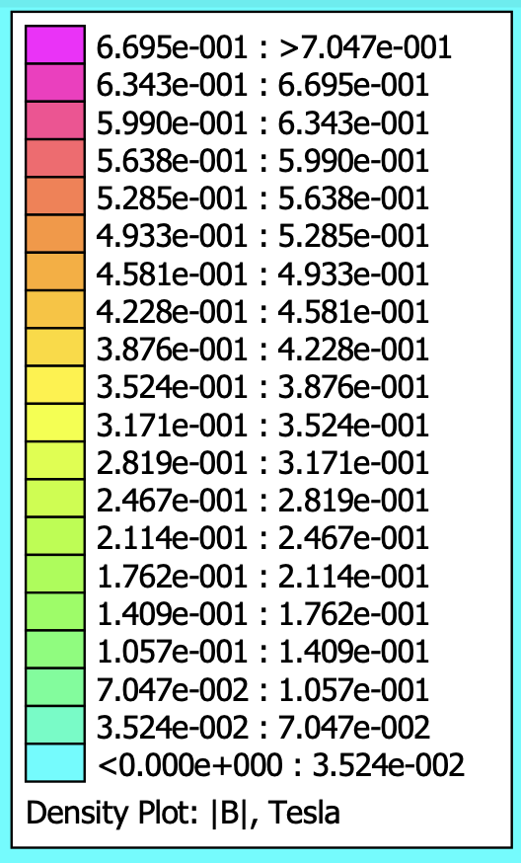
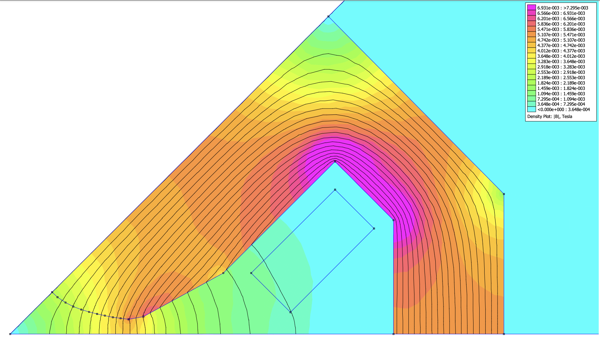
Field Densities
Component | Material
Gaps | Air
Magnet Yoke | Pure Iron
Coils | Copper
Minimum field gradient = 0.3 T/m
Maximum field gradient = 30.2 T/m

Slide 52
Linac Quadrupole Final Parameters
Parameter | Value
Magnet Radius | 63 mm
B field energy | 2.37021 Joules
Inductance | 0.0759 H/m
|H| | 625.142 A/m

Slide 53
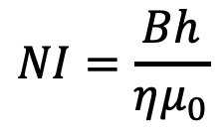
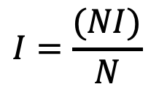
Coils
Air-cooled so current density = 1 A/mm²
Maximum current needed is 70.7 A
  Minimum area of 70.7 mm²
2.5 mm gap between coils and yoke:
  0.5 mm of conductor insulation
  1 mm of ground insulation
  1 mm of shimming.
Extra space:
  Insulators between turns of coil (1 mm)
  Additional layer of insulator outside all coils

Slide 54
Coil Parameters
Parameter | Value
Current Density | 1 A/mm²
Dimensions | 7*15 mm²
Current for min field | 0.707 A
Current for max field | 70.67 A
Turns | 10
Voltage Drop | 1.045 Volts
Flux Linkage | 0.0671 Webers
Flux/Current | 0.000948Henries
Voltage/Current | 0.0148 Ohms
Power | 73.87 Watts
Lorentz Force on coil | x-component: 16.42 N y-component: 12.37 N
At maximum field

Slide 55
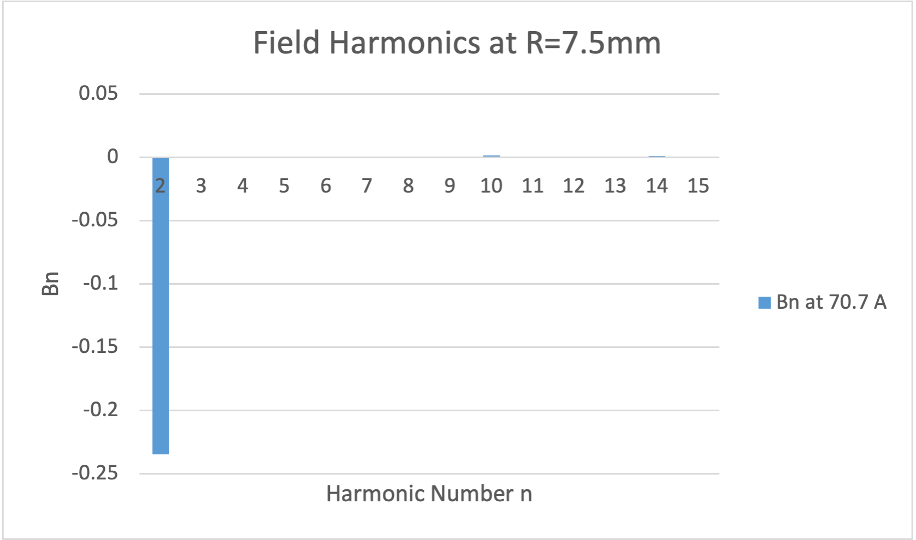
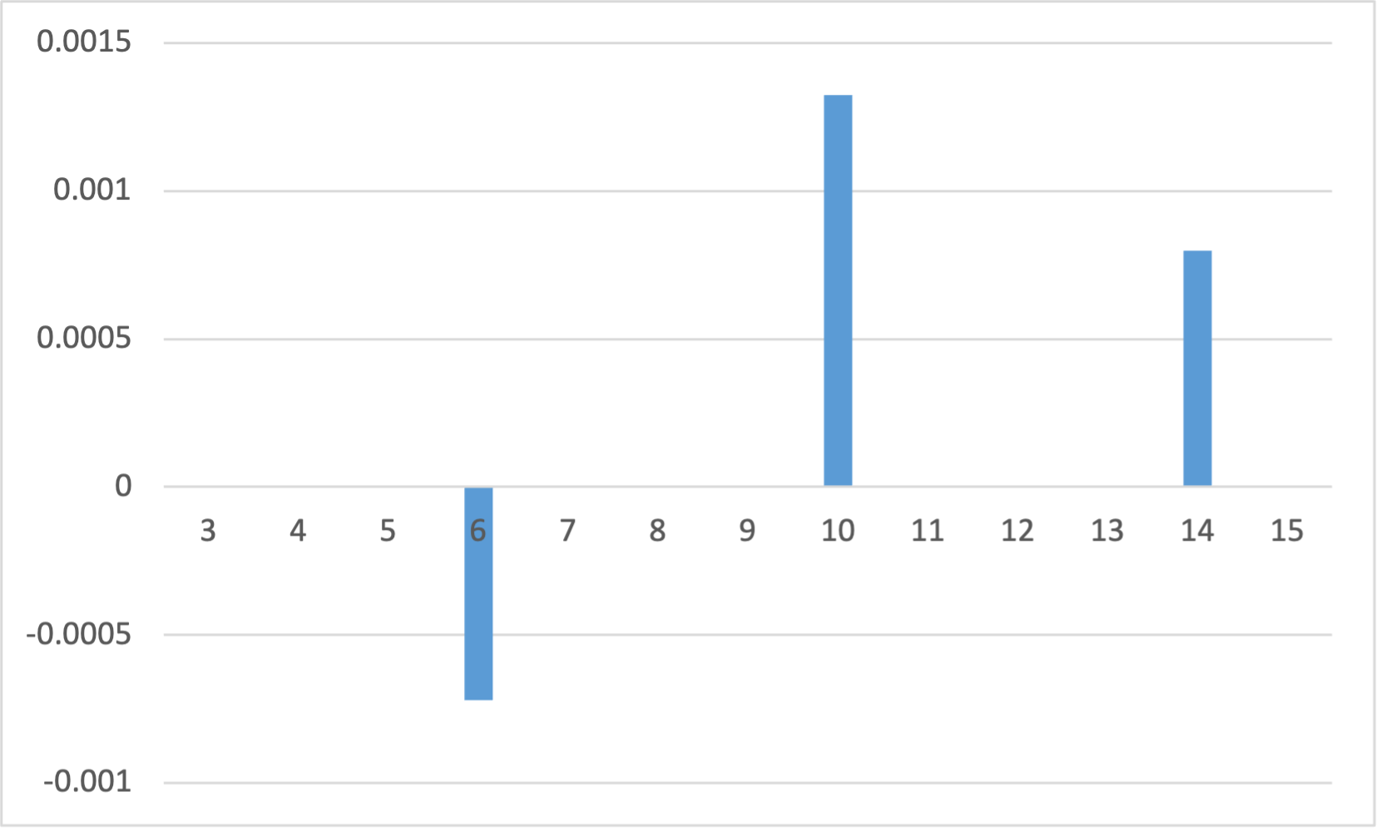
Harmonics
Computed by potential A,
Skew components =0 here for ideal magnets
B_{y}(x) = B₂(x/R) + B₆ (x/R)⁵ + B₁₀(x/R)⁹ + B₁₄(x/R)¹³+ ...
Harmonics | Field Strengths (T) (normal)
B2 | -0.2349
B6 | -7.203 *10⁻⁴
B10 | 1.3252*10⁻³
B14 | 7.970*10⁻⁴

Slide 56


Magnetic Field in Aperture
GFR = 2/3 Aperture
Fitted field gradient G = 31.307 T/m
Relative residuals mostly <0.1% inside GFR, higher residuals near 0 due to small B

Slide 57
Combiner Ring Dipole
Aim: Determine feasibility of CLIC dipoles at HALHF
2 types of C-type dipoles at CLIC.
Dipole lengths, L, and bending angles, θ, extracted from the CLIC PLACET file
Calculated dipole magnetic field strengths, B = Bρ * θ / L:
  B₁ = 0.679T
  B₂ = 1.29T
Snapshot of CLIC Recombination Stage
Snapshot of CLIC Drive Beam Complex
Notes:
Dipoles based on CLIC CR2
CLIC used 2 types of C-type dipole magnets
Lengths and bending angle extracted from PLACET file
Big difference is 1.9GeV to 4GeV
Calc B

Slide 58

Iron Yoke Dimensions
Width of Good Field Region = 60 mm [1]
Dipole height gap = 30 mm [1]
5 mm gap between coil and yoke for insulation
Air-cooled: current density = 1 A/mm²
Copper Capacity: 70%
[1] CLIC Conceptual Design Report, 2012
Notes:
Yoke dimensions require beam optics
From Damping Ring
Notice much larger
Calc dimensions from equations
Calc coil size like Sabrina
D1: Current is 8160 A
D2: Current is 16100 A
70% of coil is conductor

Slide 59


Combiner Ring Dipole AutoCAD Design
D2: B = 1.29T
D1: B = 0.679T
Generated from AutoCAD
Generated from AutoCAD
Notes:
Basic yoke dimensions of D1 and D2
D2 larger than D1 due to required magnetic strength
Cut corners at the top reduce the cost since less iron
Cut corners at pole reduce iron oversaturation at those points
Also help the field harmonics

Slide 60


Field Density Maps
D2 B-field strength: 1.29 T
Generated in FEMM
D1 B-field strength = 0.679 T
Generated in FEMM
Notes:
Can see the yoke for D2 much more saturated
Not over 2T and no concern
Lack of magnetisation in D1
Could reduce leg width but risk of mechanical failure

Slide 61


B field across the Gap
D1: B = 0.679T
D2: B = 1.29T
W_{GFR}
W_{GFR}
Generated in FEMM
Generated in FEMM
Notes:
Clearly constant over 60mm

Slide 62


Magnetic Field in Aperture
Generated in python from data collected from FEMM
Generated in python from data collected from FEMM
Notes:
For further study look at dB/B
Preferably <0.001
Which it pretty much is
CONCLUDE: Appears to be feasible but much more work required before can safely make that conclusion

Slide 63


Field Harmonics
Generated in python from data collected from FEMM
Generated in python from data collected from FEMM
Notes:
Aiming for below 0.1
Pole shaping required to reduce the field harmonics of D2

Slide 64
Future Work
Design the sextupoles in the drive-beam linac
Design the quadrupoles in the combiner ring
Design the sextupoles in the combiner ring
3D design of magnets in OPERA for edge effects
Obtain a better understanding of the beam optics to accurately determine whether the CLIC CR2 can be scaled up for the requirements of HALHF

Slide 65
Sustainability
Air-cooling coils use less energy than water-cooling coils
Total power required for quadrupoles in linac: 5.54 kW
Total power required for dipoles in combiner ring: 36.4 kW
Normal-conducting magnets and RF cavities, so no need for cryogenic cooling

Slide 66
Conclusion
Lattice / Optics Team:
  Designed and optimised a LINAC from a single FODO cell based on CLIC design.
    Ensured that 4 GeV/c is reached
    Preserved low emittance and beam size
Radio-Frequency Team:
  Iris-loaded waveguide design suitable for cavity, accelerating gradient above specification (> 4 MV/m) achievable
  Need further work to design input/output couplers and more accurately determine power dissipation
Magnets Team:
  Designed two types of quadrupoles for the drive-beam linac: lengths = 0.18 m and 0.09 m; magnetic field gradient = 0.3 T/m to 30.2 T/m
  Designed two types of dipoles for the combiner ring: magnetic field strengths = 0.679 T and 1.29 T

