Slide 1
Nonlinear Beam Dynamics
Lecture 1

Slide 2
Aims
In these two lectures, the topic of nonlinear beam dynamics is introduced for both circular and linear machines. The intention is not to provide a rigorous analysis of all aspects, but rather to introduce the various concepts and tools used for the studying the behaviour.
The first lecture concentrates on storage rings, from the description of the nonlinear magnetic elements through to the impact on the particle motion, and concludes with a few examples from Diamond which illustrate this behaviour.
In the second lecture, the analysis is continued using the Hamiltonian formalism to study the perturbations from sextupoles, before moving on to look at nonlinearities in the longitudinal plane. The lecture concludes by looking at nonlinearities in linear accelerators, both from the accelerating RF wave and from a bunch compressor.

Slide 3
Contents
Recap on linear betatron motion
Hill’s Equations
linear maps for simple elements
Courant-Snyder Invariant
Sources of nonlinear fields
fringe fields, construction errors, multipole magnets
Impact on particle motion
sensitivity to phase advances
resonances
stopbands
Examples of nonlinear effects in electron storage rings
frequency map analysis
injection efficiency vs. betatron tune
Summary

Slide 4
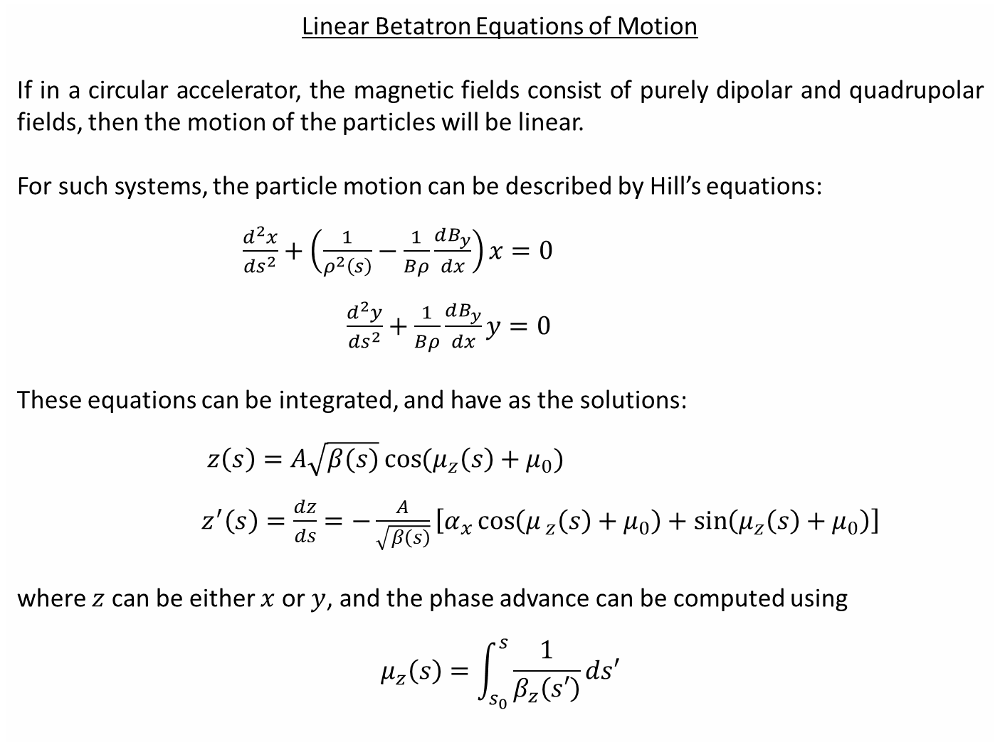
Linear Betatron Equations of Motion
If in a circular accelerator, the magnetic fields consist of purely dipolar and quadrupolar fields, then the motion of the particles will be linear.
For such systems, the particle motion can be described by Hill’s equations:
$\frac{d^{2}x}{ds^{2}}+\left(\frac{1}{ρ^{2}\left(s\right)}−\frac{1}{Bρ}\frac{dB_{y}}{dx}\right)x=0$
$\frac{d^{2}y}{ds^{2}}+\frac{1}{Bρ}\frac{dB_{y}}{dx}y=0$
These equations can be integrated, and have as the solutions:
$z\left(s\right)=A\sqrt{β(s)}\cos{(μ_{z}\left(s\right)+μ_{0})}$
$z^{′}\left(s\right)=\frac{dz}{ds}=−\frac{A}{\sqrt{β\left(s\right)}}\left[α_{x}\cos\left(μ_{ z}\left(s\right)+μ_{0}\right)+\sin\left(μ_{z}\left(s\right)+μ_{0}\right)\right]$
where $z$ can be either $x$ or $y$, and the phase advance can be computed using
$$μ_{z}\left(s\right)=\int_{s_{0}}^{s}{\frac{1}{β_{z}\left(s′\right)}ds′}$$

Slide 5
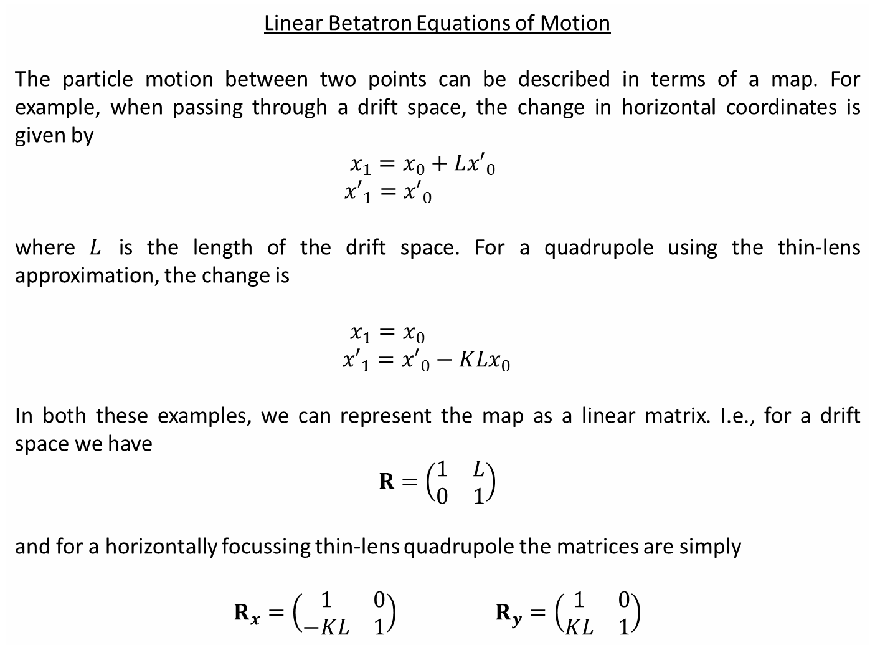
Linear Betatron Equations of Motion
The particle motion between two points can be described in terms of a map. For example, when passing through a drift space, the change in horizontal coordinates is given by
$x_{1}=x_{0}+L{x′}_{0}$
${x′}_{1}={x′}_{0}$
where $L$ is the length of the drift space. For a quadrupole using the thin-lens approximation, the change is
$x_{1}=x_{0}$
${x′}_{1}={x′}_{0}−KLx_{0}$
In both these examples, we can represent the map as a linear matrix. I.e., for a drift space we have
$$R=\left(\begin{matrix}1 & L \\ 0 & 1\end{matrix}\right)$$
and for a horizontally focussing thin-lens quadrupole the matrices are simply
$$R_{x}=\left(\begin{matrix}1 & 0 \\ −KL & 1\end{matrix}\right) R_{y}=\left(\begin{matrix}1 & 0 \\ KL & 1\end{matrix}\right)$$

Slide 6
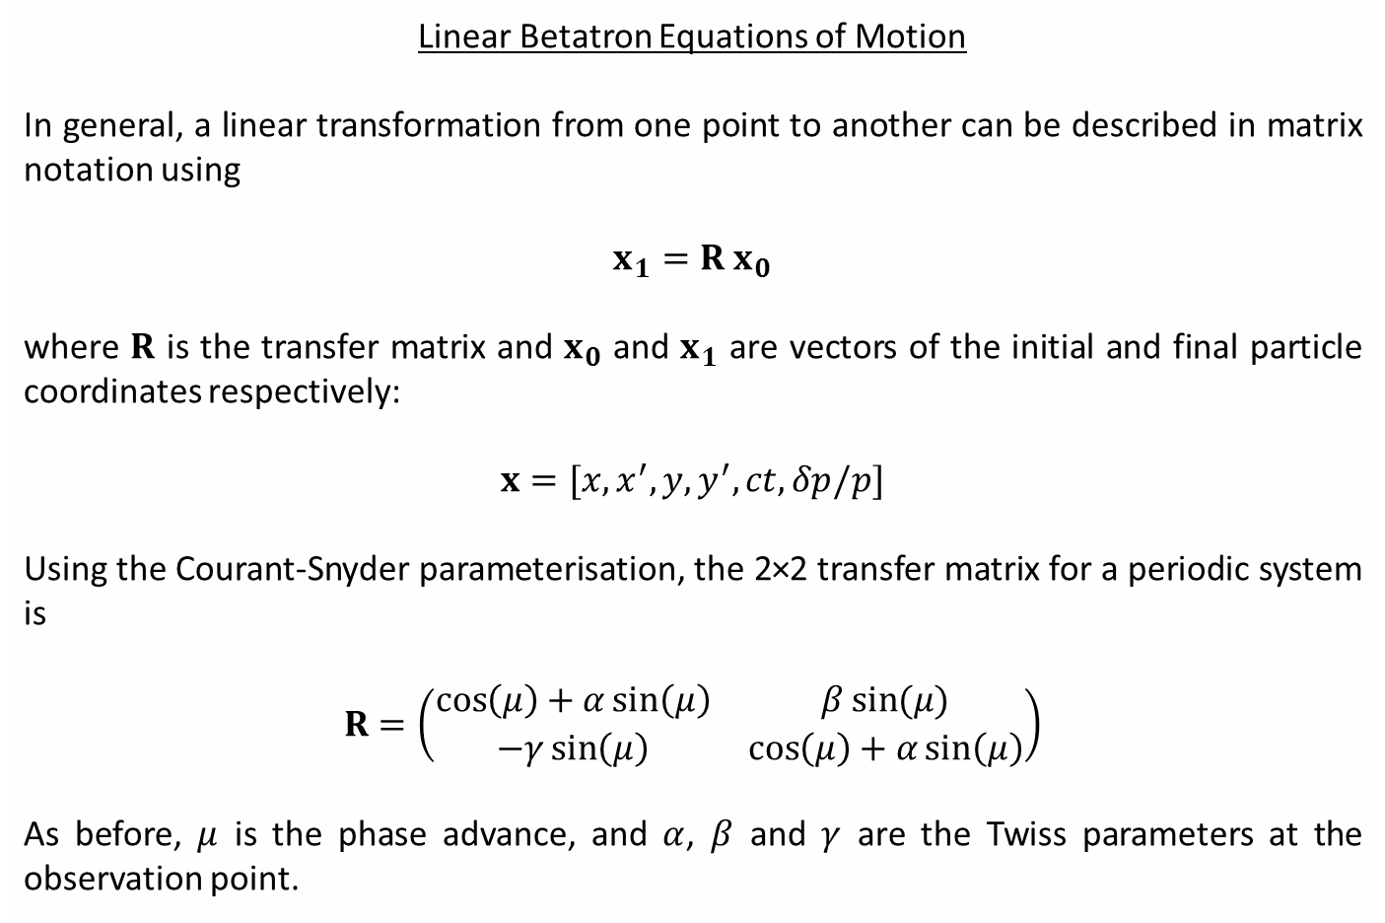
Linear Betatron Equations of Motion
In general, a linear transformation from one point to another can be described in matrix notation using
$$x_{1}=R x_{0}$$
where $R$ is the transfer matrix and $x_{0}$ and $x_{1}$ are vectors of the initial and final particle coordinates respectively:
$$x=[x,x^{′},y,y^{′},ct,δp/p]$$
Using the Courant-Snyder parameterisation, the 2×2 transfer matrix for a periodic system is
$$R=\left(\begin{matrix}\cos\left(μ\right)+α\sin\left(μ\right) & β\sin{(μ)} \\ −γ\sin\left(μ\right) & \cos\left(μ\right)+α\sin\left(μ\right)\end{matrix}\right)$$
As before, $μ$ is the phase advance, and $α$, $β$ and $γ$ are the Twiss parameters at the observation point.

Slide 7
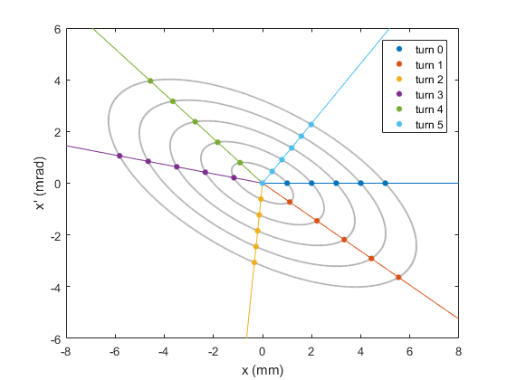
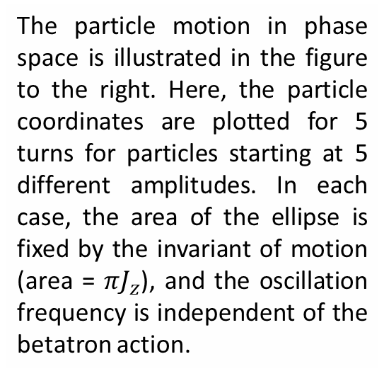
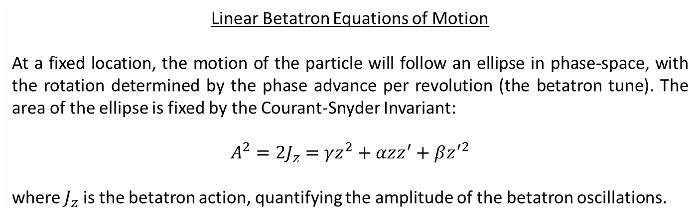
Linear Betatron Equations of Motion
At a fixed location, the motion of the particle will follow an ellipse in phase-space, with the rotation determined by the phase advance per revolution (the betatron tune). The area of the ellipse is fixed by the Courant-Snyder Invariant:
$$A^{2}=2J_{z}=γz^{2}+αzz^{′}+βz^{′2}$$
where $J_{z}$ is the betatron action, quantifying the amplitude of the betatron oscillations.
The particle motion in phase space is illustrated in the figure to the right. Here, the particle coordinates are plotted for 5 turns for particles starting at 5 different amplitudes. In each case, the area of the ellipse is fixed by the invariant of motion (area = $πJ_{z}$), and the oscillation frequency is independent of the betatron action.

Slide 8
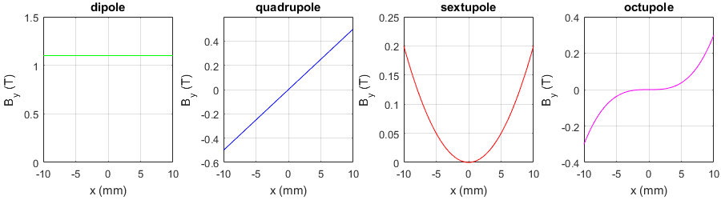
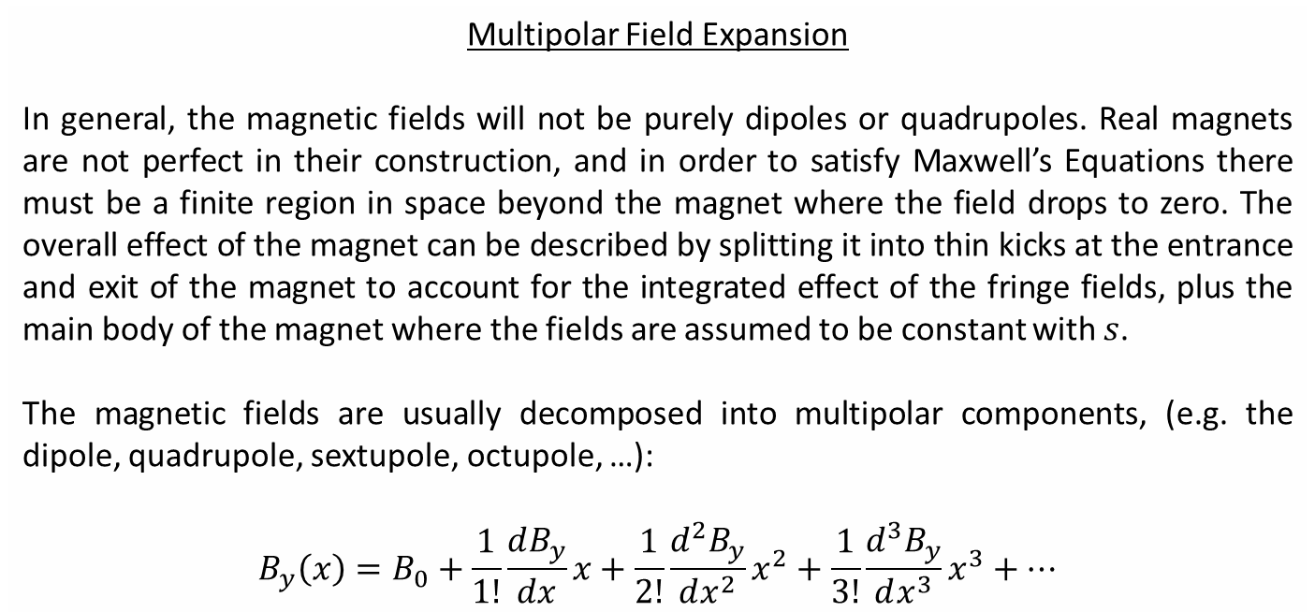
Multipolar Field Expansion
In general, the magnetic fields will not be purely dipoles or quadrupoles. Real magnets are not perfect in their construction, and in order to satisfy Maxwell’s Equations there must be a finite region in space beyond the magnet where the field drops to zero. The overall effect of the magnet can be described by splitting it into thin kicks at the entrance and exit of the magnet to account for the integrated effect of the fringe fields, plus the main body of the magnet where the fields are assumed to be constant with $s$.
The magnetic fields are usually decomposed into multipolar components, (e.g. the dipole, quadrupole, sextupole, octupole, …):
$$B_{y}\left(x\right)=B_{0}+\frac{1}{1!}\frac{dB_{y}}{dx}x+\frac{1}{2!}\frac{d^{2}B_{y}}{dx^{2}}x^{2}+\frac{1}{3!}\frac{d^{3}B_{y}}{dx^{3}}x^{3}+…$$

Slide 9
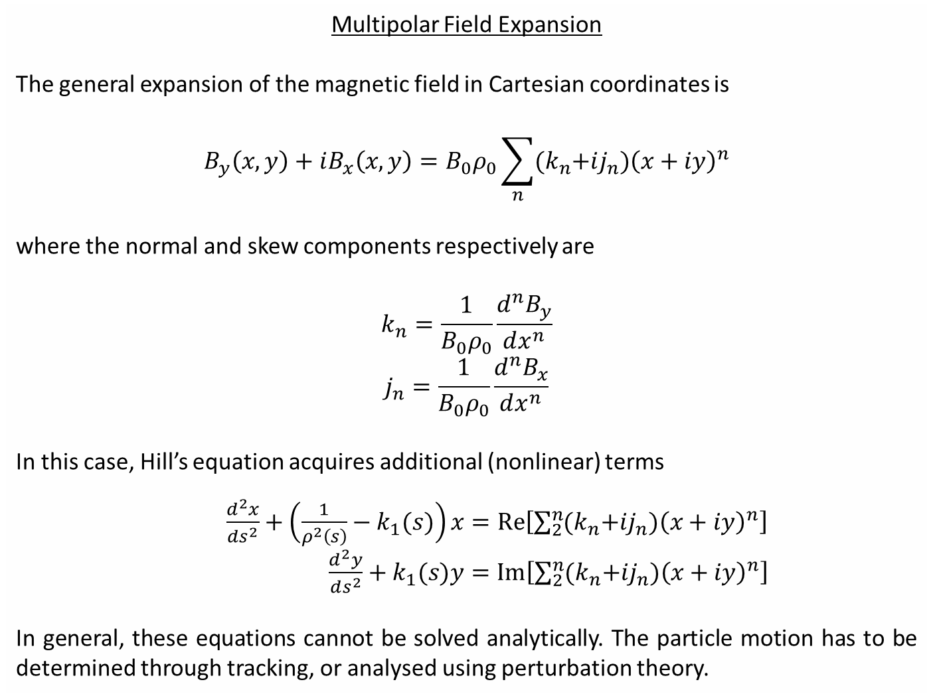
Multipolar Field Expansion
The general expansion of the magnetic field in Cartesian coordinates is
$$B_{y}\left(x,y\right)+iB_{x}\left(x,y\right)=B_{0}ρ_{0}\sum_{n}{{(k}_{n}+ij_{n}){\left(x+iy\right)}^{n}}$$
where the normal and skew components respectively are
$$k_{n}=\frac{1}{B_{0}ρ_{0}}\frac{d^{n}B_{y}}{dx^{n}}$$
$$j_{n}=\frac{1}{B_{0}ρ_{0}}\frac{d^{n}B_{x}}{dx^{n}}$$
In this case, Hill’s equation acquires additional (nonlinear) terms
$\frac{d^{2}x}{ds^{2}}+\left(\frac{1}{ρ^{2}\left(s\right)}−k_{1}(s)\right)x=Re\left[\sum_{2}^{n}{{(k}_{n}+ij_{n}){\left(x+iy\right)}^{n}}\right]$
$\frac{d^{2}y}{ds^{2}}+k_{1}(s)y=Im\left[\sum_{2}^{n}{{(k}_{n}+ij_{n}){\left(x+iy\right)}^{n}}\right]$
In general, these equations cannot be solved analytically. The particle motion has to be determined through tracking, or analysed using perturbation theory.

Slide 10
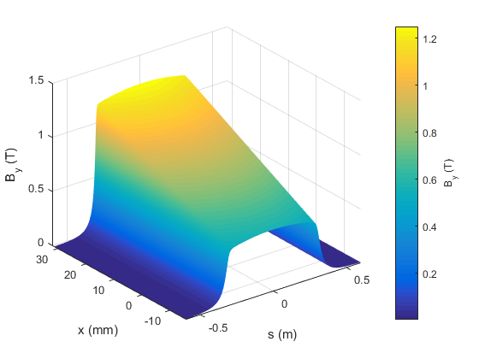
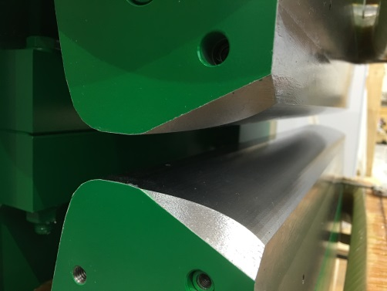
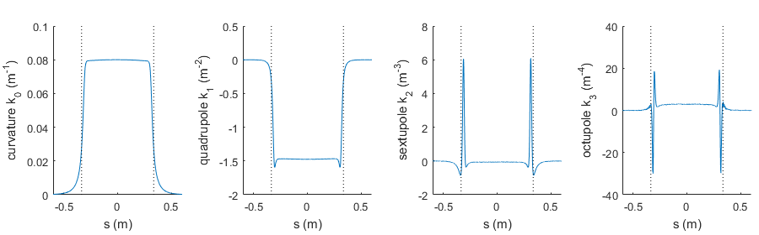
Multipolar Field Expansion For a Combined-Function Dipole
Higher-order multipolar fields exist in magnets even in the idealised models, particularly in the fringe-field regions.

Slide 11
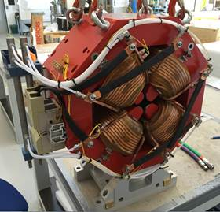
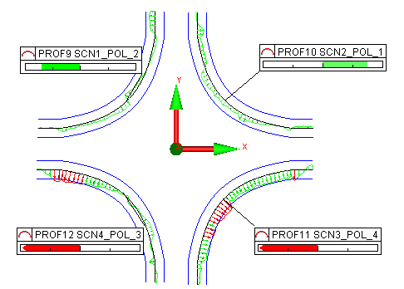
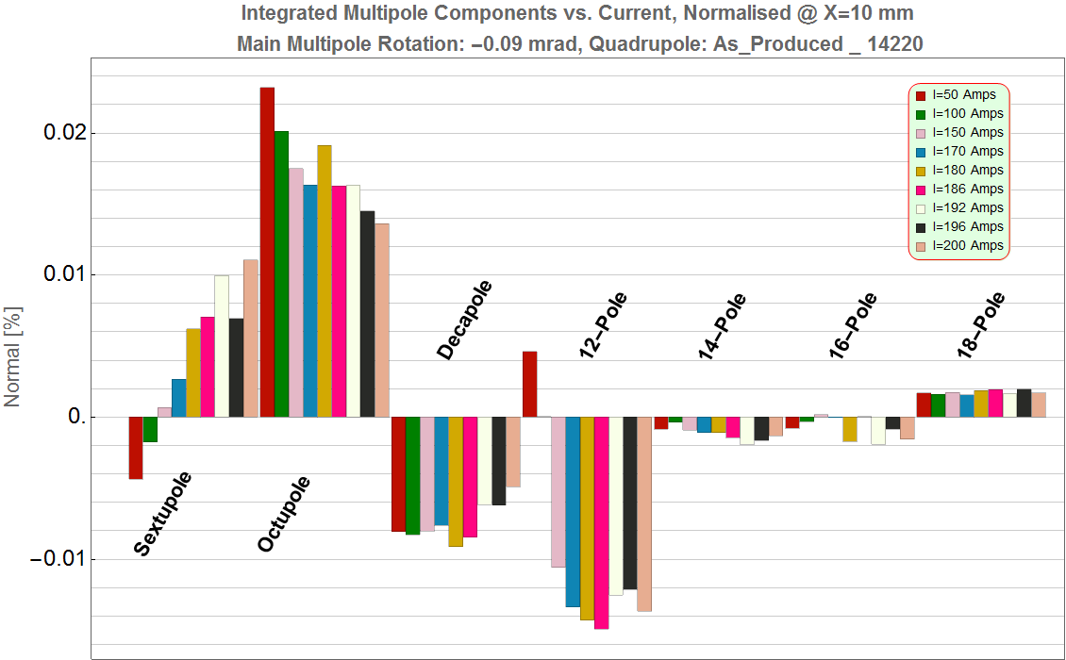
Multipolar Field Errors
Another source of higher-order multipoles in an accelerator comes from field errors originating from the magnet construction.
For example:
Systematic errors from magnet geometry (e.g. octupole component in quadrupoles)
Random and systematic errors in magnet assembly
Errors from machining tolerances
Current-dependence of the fields
Positioning / roll errors during installation
Imperfect pole-profile
Current-dependence of multipoles

Slide 12
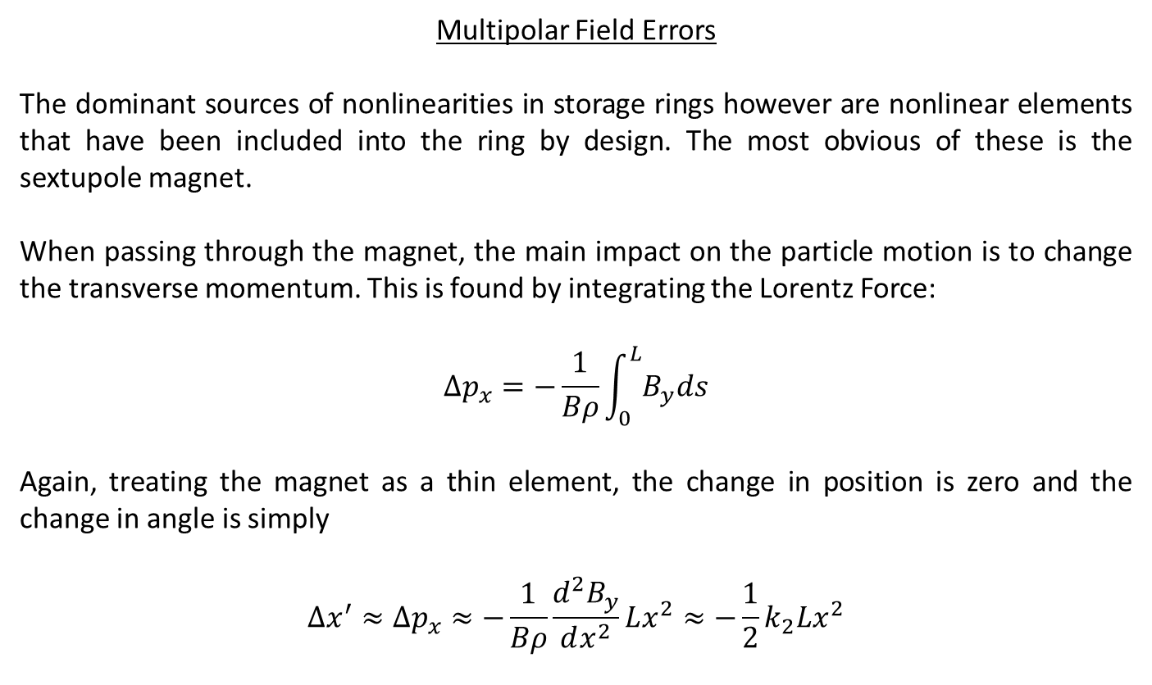
Multipolar Field Errors
The dominant sources of nonlinearities in storage rings however are nonlinear elements that have been included into the ring by design. The most obvious of these is the sextupole magnet.
When passing through the magnet, the main impact on the particle motion is to change the transverse momentum. This is found by integrating the Lorentz Force:
$$Δp_{x}=−\frac{1}{Bρ}\int_{0}^{L}{B_{y}ds}$$
Again, treating the magnet as a thin element, the change in position is zero and the change in angle is simply
$$Δx^{′}≈Δp_{x}≈−\frac{1}{Bρ}\frac{d^{2}B_{y}}{dx^{2}}Lx^{2}≈−\frac{1}{2}k_{2}Lx^{2}$$

Slide 13
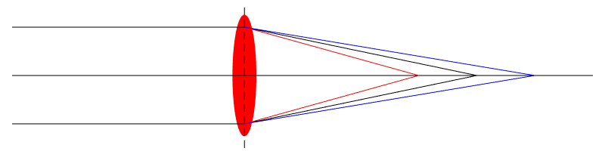
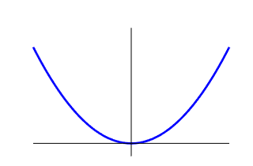
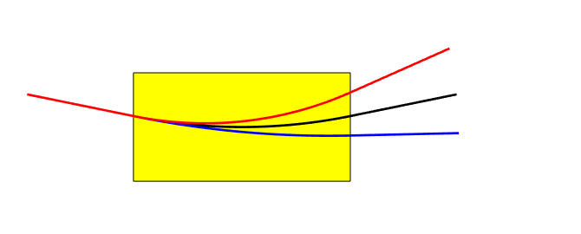







Nonlinear Elements
Sextupoles are included in order to compensate for the change in focal length with energy for the quadrupole magnets.
The sextupoles are typically placed at high dispersion points, at which point the particles are sorted according to their energy:
$$E>E_{0}$$
$$E<E_{0}$$
$$By$$
$$E>E_{0}$$
Focussing for positive position
$$E=E_{0}$$
Defocussing for negative position
$$E<E_{0}$$
$$x$$

Slide 14



Nonlinear Elements
$$E>E_{0}$$
$$E=E_{0}$$
$$E<E_{0}$$
Quadrupole
Focal plane

Slide 15
Nonlinear Elements
$$E>E_{0}$$
Focussing for high-energy particles
$$E=E_{0}$$
$$E<E_{0}$$
Defocussing for low-energy particles
Quadrupole
Sextupole
Focal plane

Slide 16
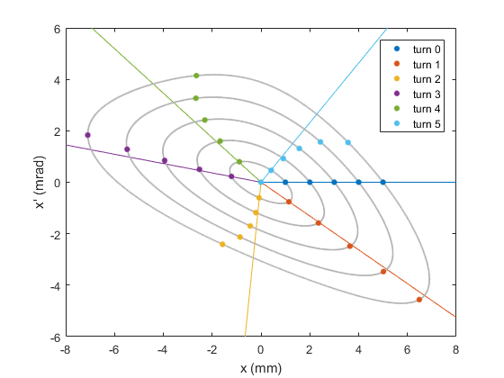
Nonlinear Motion
No Sextupoles:
Particles follow a closed ellipse in phase space
Oscillation frequency (phase advance) is constant with amplitude
No limit on stable amplitude
Sextupoles on:
Trajectories in phase space become distorted at large amplitudes
Oscillation frequency depends upon amplitude (tune-shift with amplitude)
Eventually, particle motion becomes unstable and will be lost (dynamic aperture)
No sextupoles
Q_{x} = 7.1808
Sextupoles on
Q_{x} = 7.1808

Slide 17
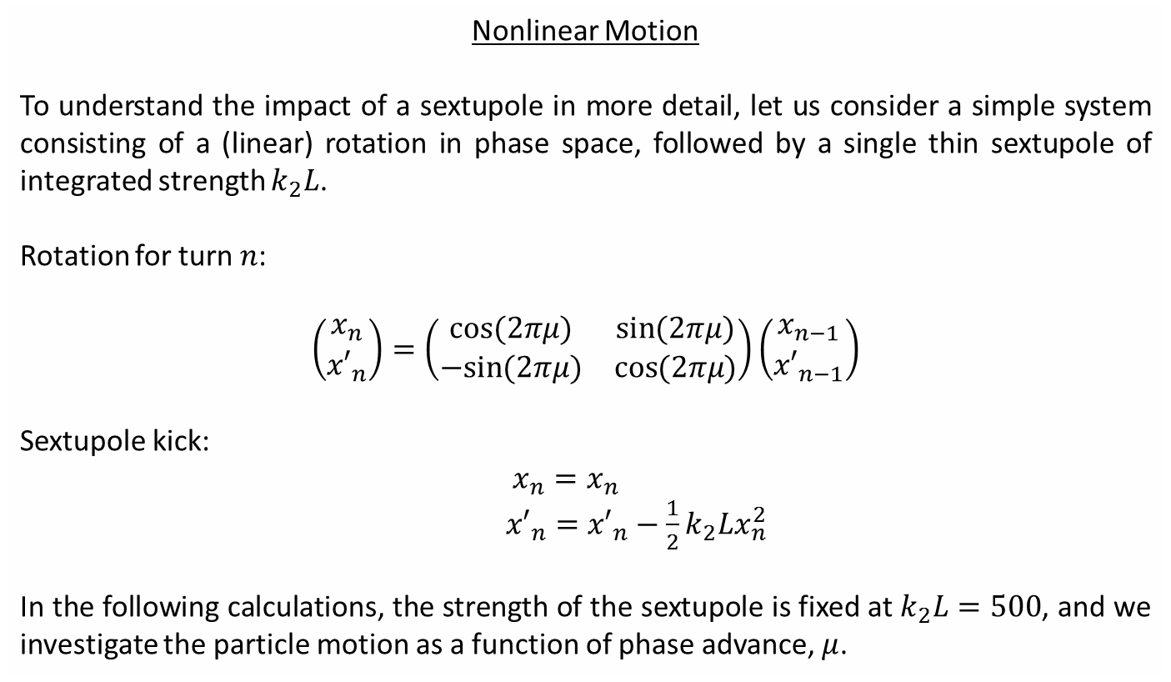
Nonlinear Motion
To understand the impact of a sextupole in more detail, let us consider a simple system consisting of a (linear) rotation in phase space, followed by a single thin sextupole of integrated strength $k_{2}L$.
Rotation for turn $n$:
$$\left(\begin{matrix}x_{n} \\ {x′}_{n}\end{matrix}\right)=\left(\begin{matrix}\cos{(2πμ)} & \sin{(2πμ)} \\ −sin{(2πμ)} & \cos{(2πμ)}\end{matrix}\right)\left(\begin{matrix}x_{n−1} \\ {x′}_{n−1}\end{matrix}\right)$$
Sextupole kick:
$x_{n}=x_{n}$
${x′}_{n}={x′}_{n}−\frac{1}{2}k_{2}Lx_{n}^{2}$
In the following calculations, the strength of the sextupole is fixed at $k_{2}L=500$, and we investigate the particle motion as a function of phase advance, $μ$.

Slide 18
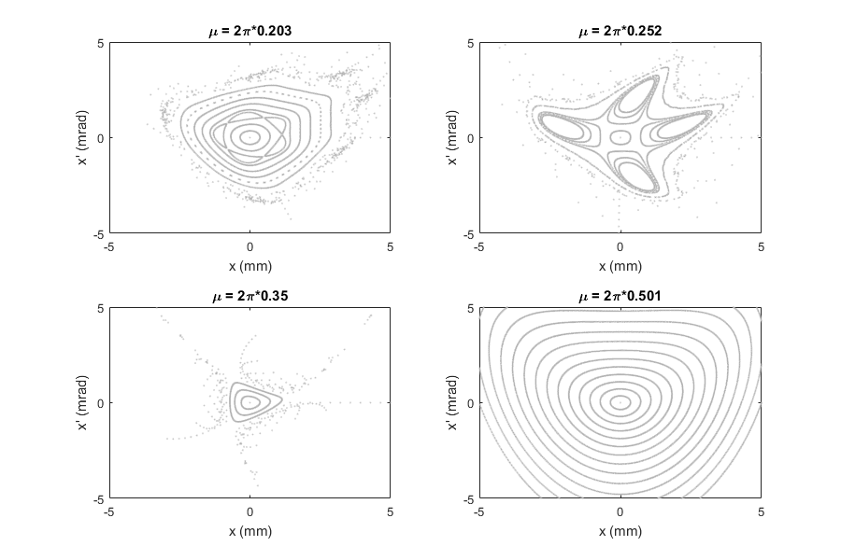
Nonlinear Motion

Slide 19
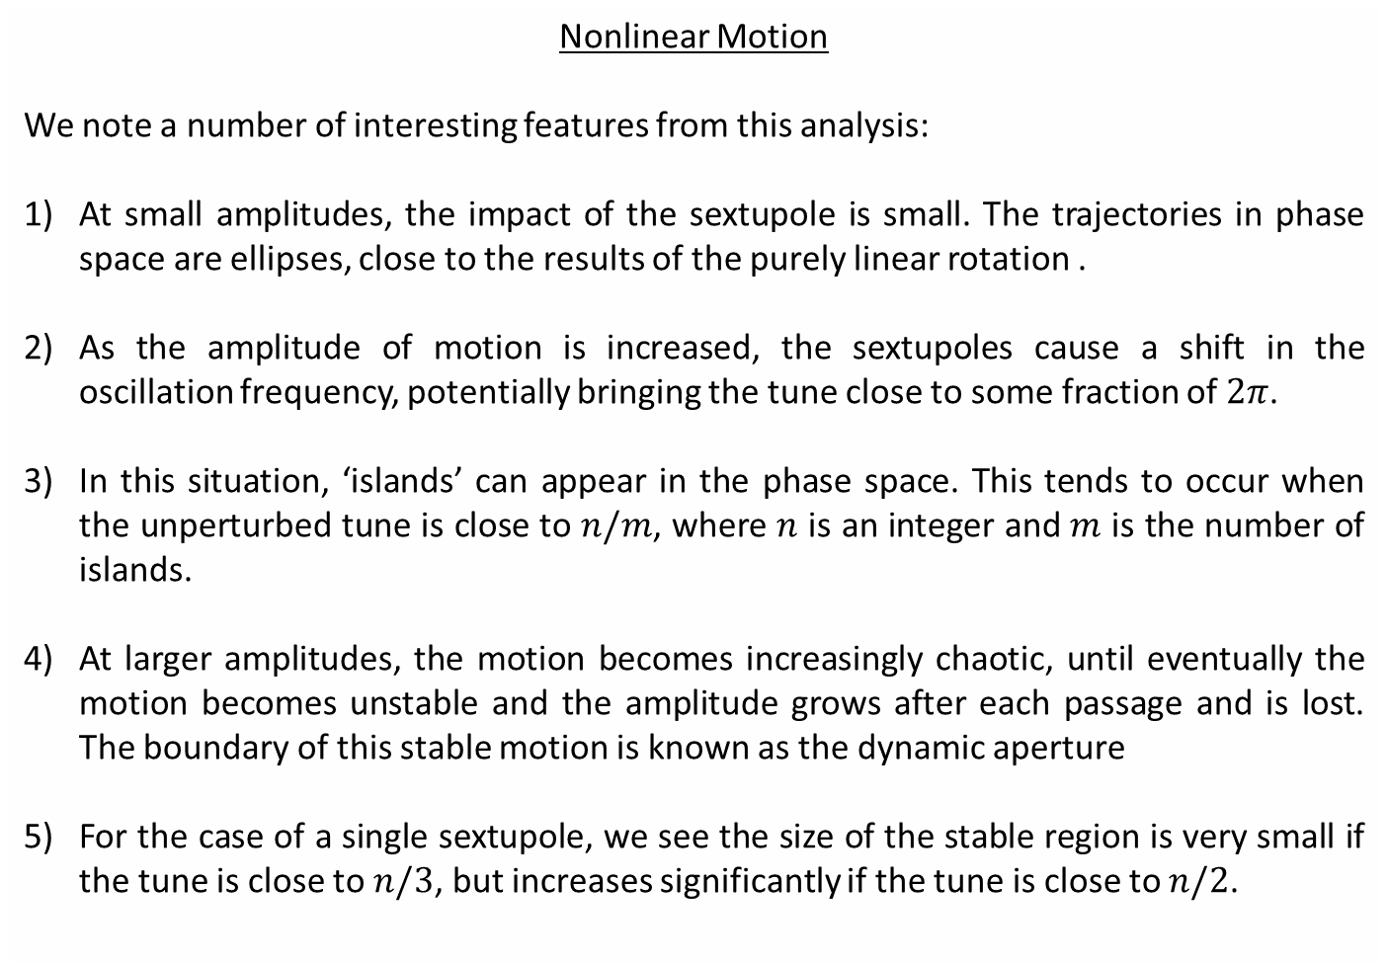
Nonlinear Motion
We note a number of interesting features from this analysis:
At small amplitudes, the impact of the sextupole is small. The trajectories in phase space are ellipses, close to the results of the purely linear rotation .
As the amplitude of motion is increased, the sextupoles cause a shift in the oscillation frequency, potentially bringing the tune close to some fraction of $2π$.
In this situation, ‘islands’ can appear in the phase space. This tends to occur when the unperturbed tune is close to $n/m$, where $n$ is an integer and $m$ is the number of islands.
At larger amplitudes, the motion becomes increasingly chaotic, until eventually the motion becomes unstable and the amplitude grows after each passage and is lost. The boundary of this stable motion is known as the dynamic aperture
For the case of a single sextupole, we see the size of the stable region is very small if the tune is close to $n/3$, but increases significantly if the tune is close to $n/2$.

Slide 20
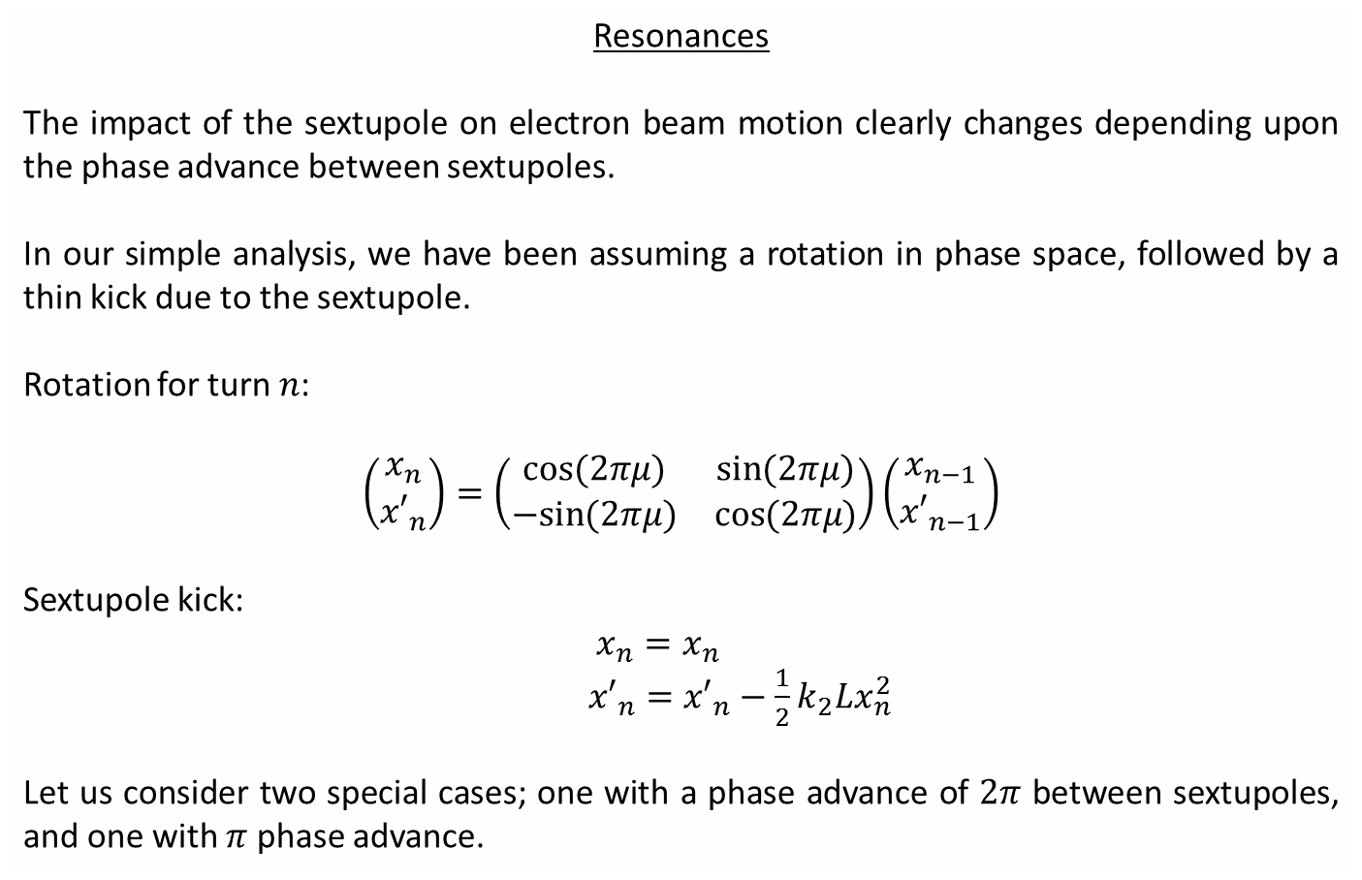
Resonances
The impact of the sextupole on electron beam motion clearly changes depending upon the phase advance between sextupoles.
In our simple analysis, we have been assuming a rotation in phase space, followed by a thin kick due to the sextupole.
Rotation for turn $n$:
$$\left(\begin{matrix}x_{n} \\ {x′}_{n}\end{matrix}\right)=\left(\begin{matrix}\cos{(2πμ)} & \sin{(2πμ)} \\ −sin{(2πμ)} & \cos{(2πμ)}\end{matrix}\right)\left(\begin{matrix}x_{n−1} \\ {x′}_{n−1}\end{matrix}\right)$$
Sextupole kick:
$x_{n}=x_{n}$
${x′}_{n}={x′}_{n}−\frac{1}{2}k_{2}Lx_{n}^{2}$
Let us consider two special cases; one with a phase advance of $2π$ between sextupoles, and one with $π$ phase advance.

Slide 21
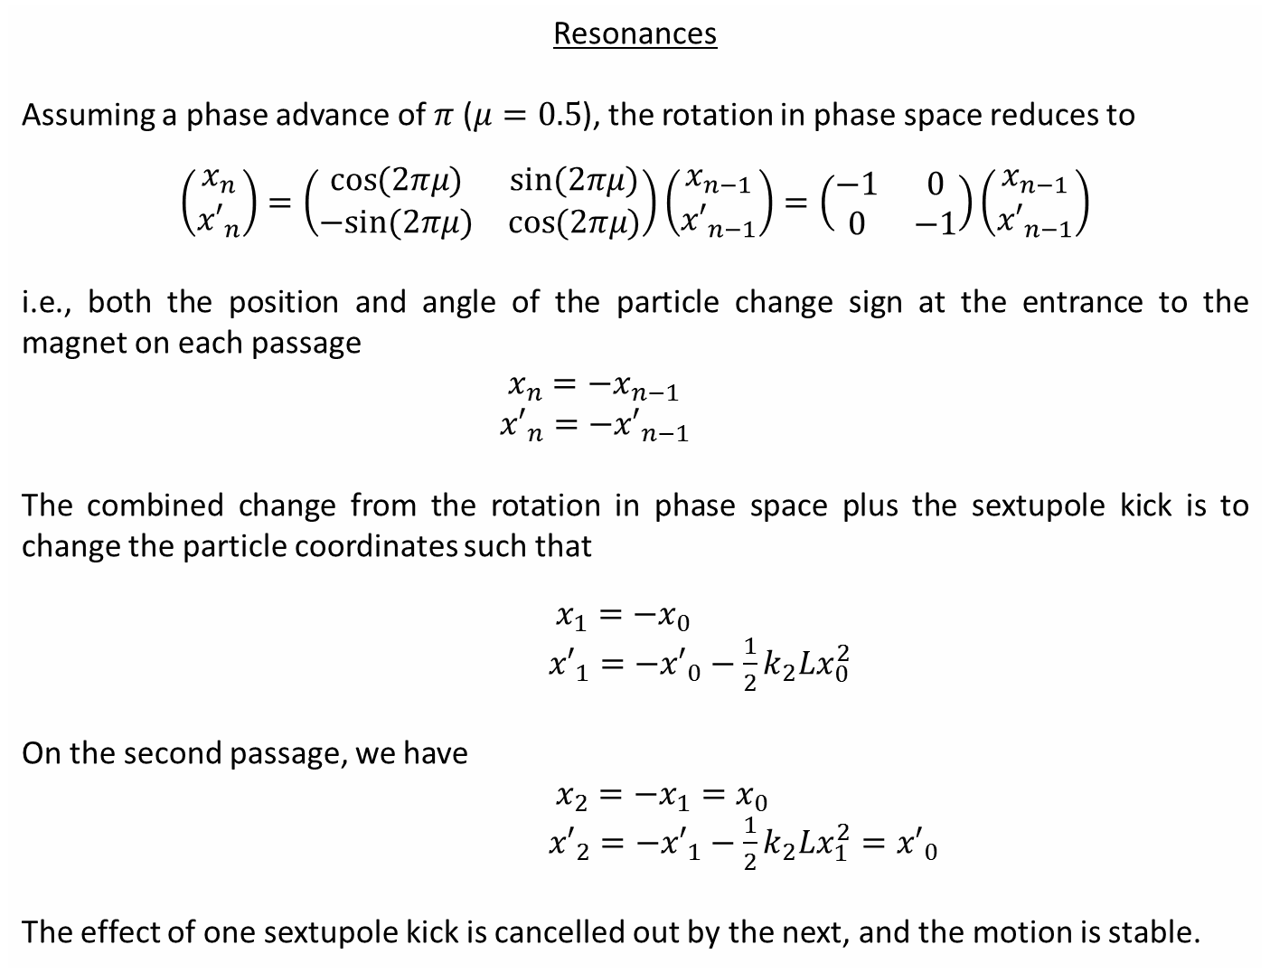
Resonances
Assuming a phase advance of $π$ ($μ=0.5$), the rotation in phase space reduces to
$$\left(\begin{matrix}x_{n} \\ {x′}_{n}\end{matrix}\right)=\left(\begin{matrix}\cos{(2πμ)} & \sin{(2πμ)} \\ −sin{(2πμ)} & \cos{(2πμ)}\end{matrix}\right)\left(\begin{matrix}x_{n−1} \\ {x′}_{n−1}\end{matrix}\right)=\left(\begin{matrix}−1 & 0 \\ 0 & −1\end{matrix}\right)\left(\begin{matrix}x_{n−1} \\ {x′}_{n−1}\end{matrix}\right)$$
i.e., both the position and angle of the particle change sign at the entrance to the magnet on each passage
$x_{n}={−x}_{n−1}$
${x′}_{n}={−x′}_{n−1}$
The combined change from the rotation in phase space plus the sextupole kick is to change the particle coordinates such that
$x_{1}=−x_{0}$
${x′}_{1}={−x′}_{0}−\frac{1}{2}k_{2}Lx_{0}^{2}$
On the second passage, we have
$x_{2}=−x_{1}=x_{0}$
${x′}_{2}={−x′}_{1}−\frac{1}{2}k_{2}Lx_{1}^{2}={x′}_{0}$
The effect of one sextupole kick is cancelled out by the next, and the motion is stable.

Slide 22
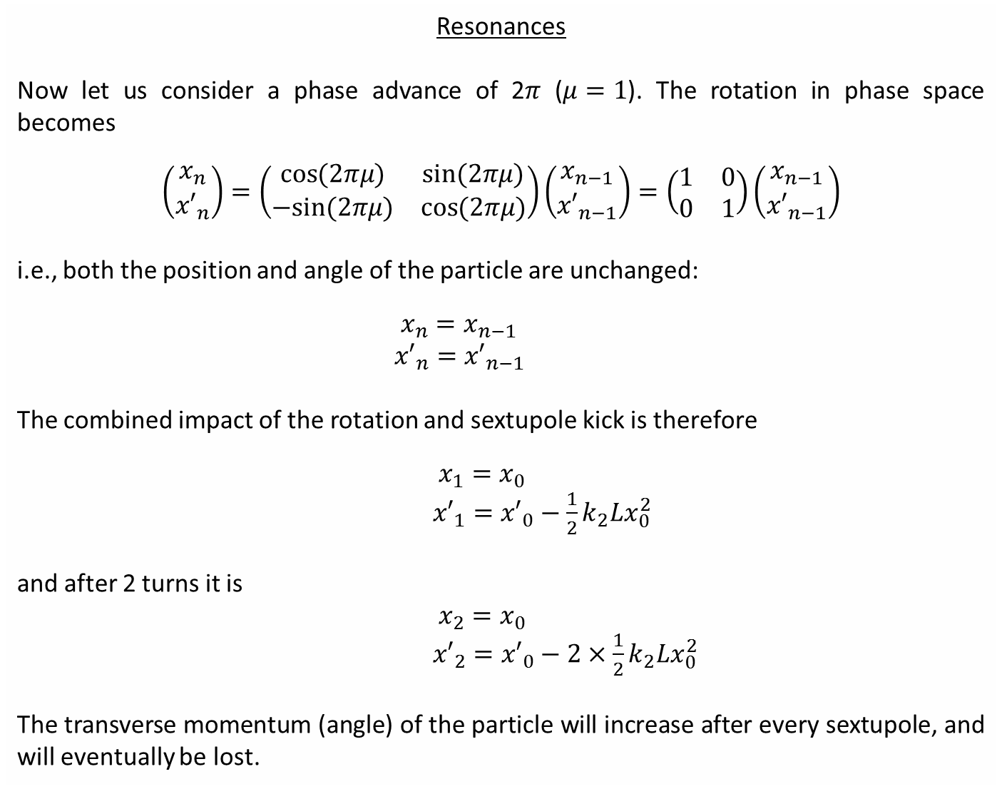
Resonances
Now let us consider a phase advance of 2$π$ ($μ=1$). The rotation in phase space becomes
$$\left(\begin{matrix}x_{n} \\ {x′}_{n}\end{matrix}\right)=\left(\begin{matrix}\cos{(2πμ)} & \sin{(2πμ)} \\ −sin{(2πμ)} & \cos{(2πμ)}\end{matrix}\right)\left(\begin{matrix}x_{n−1} \\ {x′}_{n−1}\end{matrix}\right)=\left(\begin{matrix}1 & 0 \\ 0 & 1\end{matrix}\right)\left(\begin{matrix}x_{n−1} \\ {x′}_{n−1}\end{matrix}\right)$$
i.e., both the position and angle of the particle are unchanged:
$x_{n}=x_{n−1}$
${x′}_{n}={x′}_{n−1}$
The combined impact of the rotation and sextupole kick is therefore
$x_{1}=x_{0}$
${x′}_{1}={x′}_{0}−\frac{1}{2}k_{2}Lx_{0}^{2}$
and after 2 turns it is
$x_{2}=x_{0}$
${x′}_{2}={x′}_{0}−2×\frac{1}{2}k_{2}Lx_{0}^{2}$
The transverse momentum (angle) of the particle will increase after every sextupole, and will eventually be lost.

Slide 23
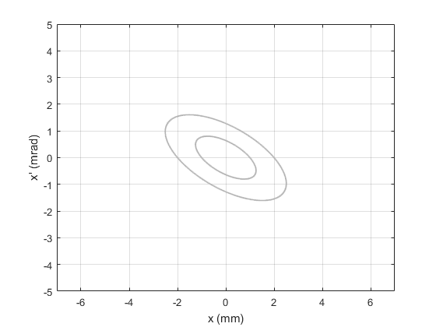
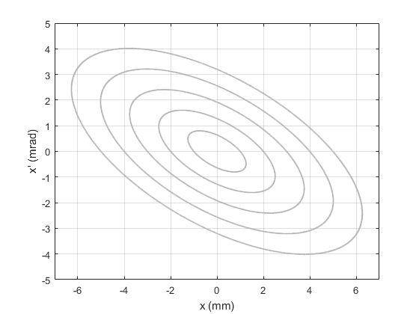
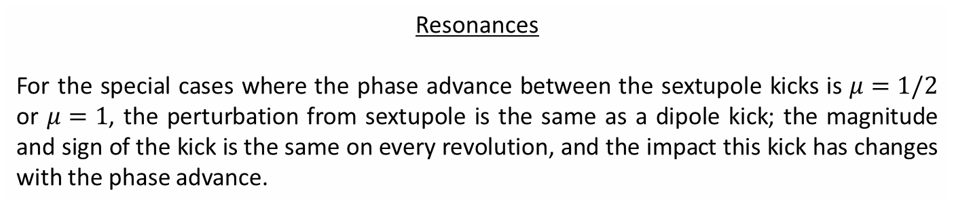


Resonances
For the special cases where the phase advance between the sextupole kicks is $μ=1/2$ or $μ=1$, the perturbation from sextupole is the same as a dipole kick; the magnitude and sign of the kick is the same on every revolution, and the impact this kick has changes with the phase advance.
Dipole kick ($μ=0.5)$
Dipole kick ($μ=1$)
The position and angle of the particle change sign on every passage
The effect of the (dipole) kick is to move the particle between two stable ellipses
The position and change in angle of the particle are the same on every passage
The kick causes the amplitude to grow on each passage

Slide 24


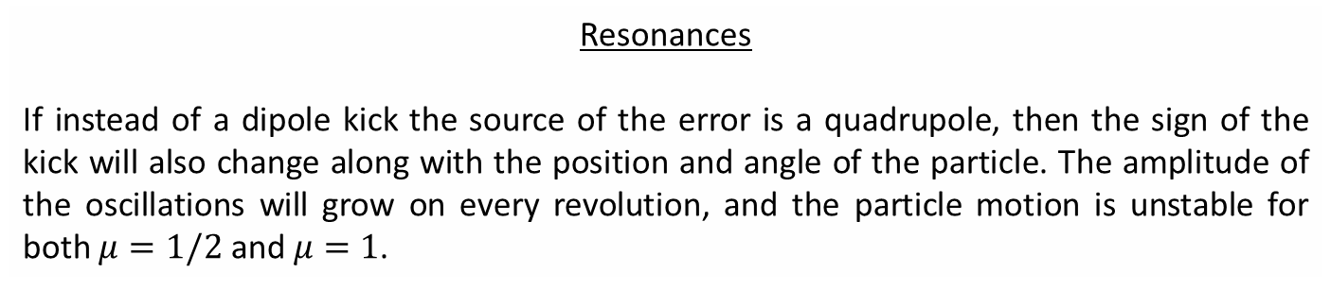
Resonances
If instead of a dipole kick the source of the error is a quadrupole, then the sign of the kick will also change along with the position and angle of the particle. The amplitude of the oscillations will grow on every revolution, and the particle motion is unstable for both $μ=1/2$ and $μ=1$.
Quadrupole kick ($μ=0.5)$
Quadrupole kick ($μ=1$)
The position and angle of the particle change sign on every passage
The (quadrupole) kick also changes sign, increasing the amplitude
The position and change in angle of the particle are the same on every passage
The kick causes the amplitude to grow

Slide 25
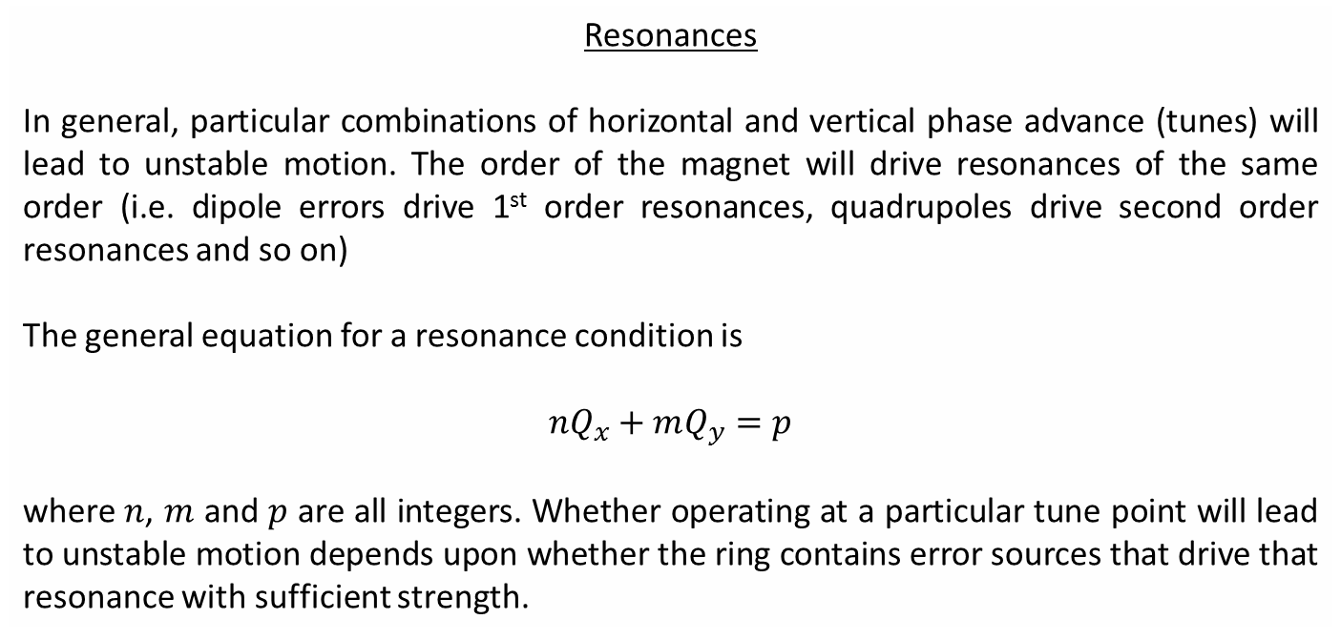
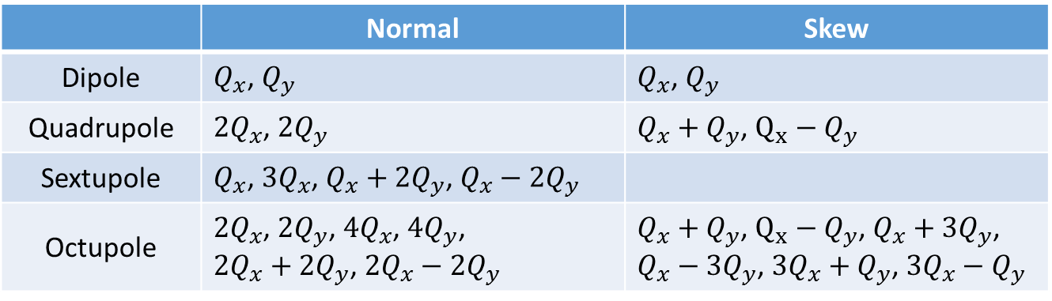
Resonances
In general, particular combinations of horizontal and vertical phase advance (tunes) will lead to unstable motion. The order of the magnet will drive resonances of the same order (i.e. dipole errors drive 1st order resonances, quadrupoles drive second order resonances and so on)
The general equation for a resonance condition is
$$nQ_{x}+mQ_{y}=p$$
where $n$, $m$ and $p$ are all integers. Whether operating at a particular tune point will lead to unstable motion depends upon whether the ring contains error sources that drive that resonance with sufficient strength.
 | Normal | Skew
Dipole | $Q_{x}$, $Q_{y}$ | $Q_{x}$, $Q_{y}$
Quadrupole | ${2Q}_{x}$, ${2Q}_{y}$ | $Q_{x}+Q_{y}$, $Q_{x}−Q_{y}$
Sextupole | $Q_{x}$, ${3Q}_{x}$, $Q_{x}+2Q_{y}$, $Q_{x}−2Q_{y}$ | $Q_{y}$, ${3Q}_{y}$, $2Q_{x}+Q_{y}$, $2Q_{x}−Q_{y}$
Octupole | ${2Q}_{x}$, $2Q_{y}$, $4Q_{x}$, $4Q_{y}$, $2Q_{x}+2Q_{y}$, $2Q_{x}−2Q_{y}$ | $Q_{x}+Q_{y}$, $Q_{x}−Q_{y}$, $Q_{x}+3Q_{y}$, $Q_{x}−3Q_{y}$, $3Q_{x}+Q_{y}$, $3Q_{x}−Q_{y}$

Slide 26
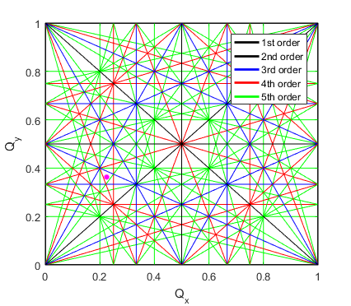
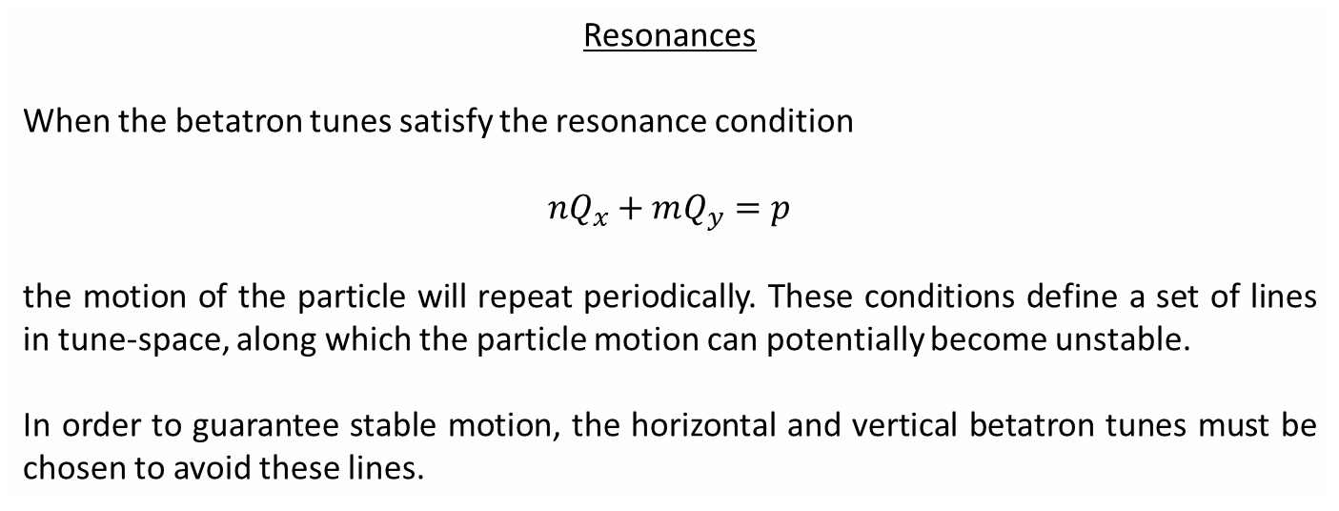
Resonances
When the betatron tunes satisfy the resonance condition
$$nQ_{x}+mQ_{y}=p$$
the motion of the particle will repeat periodically. These conditions define a set of lines in tune-space, along which the particle motion can potentially become unstable.
In order to guarantee stable motion, the horizontal and vertical betatron tunes must be chosen to avoid these lines.
If we go to high enough order, then eventually the whole of tune space will be covered with resonances. Thankfully however, sources of higher-order resonances tend to be weaker, and the fluctuations in tune-point due to power supply ripple, mechanical vibrations, etc. is such that we only need to be concerned with the lowest few orders.
Working point

Slide 27
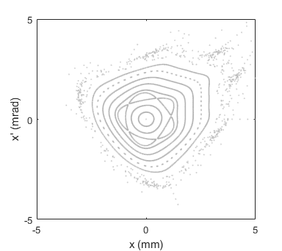
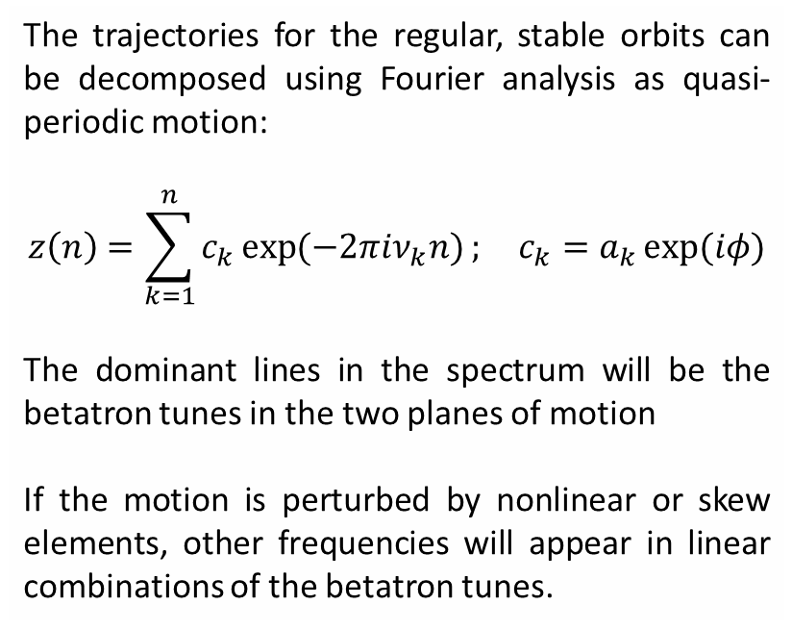
Particle Motion in a Nonlinear System
The motion of particles travelling in a nonlinear system can be broadly divided into three categories:
Regular orbit => the motion is stable
Chaotic orbit => no guarantee of stability, but the diffusion rate may be small
Unconstrained => no stable solution exists
The trajectories for the regular, stable orbits can be decomposed using Fourier analysis as quasi-periodic motion:
$$z\left(n\right)=\sum_{k=1}^{n}{c_{k}\exp{(−2πiν_{k}n)}}; c_{k}=a_{k}\exp{(iφ)}$$
The dominant lines in the spectrum will be the betatron tunes in the two planes of motion
If the motion is perturbed by nonlinear or skew elements, other frequencies will appear in linear combinations of the betatron tunes.

Slide 28
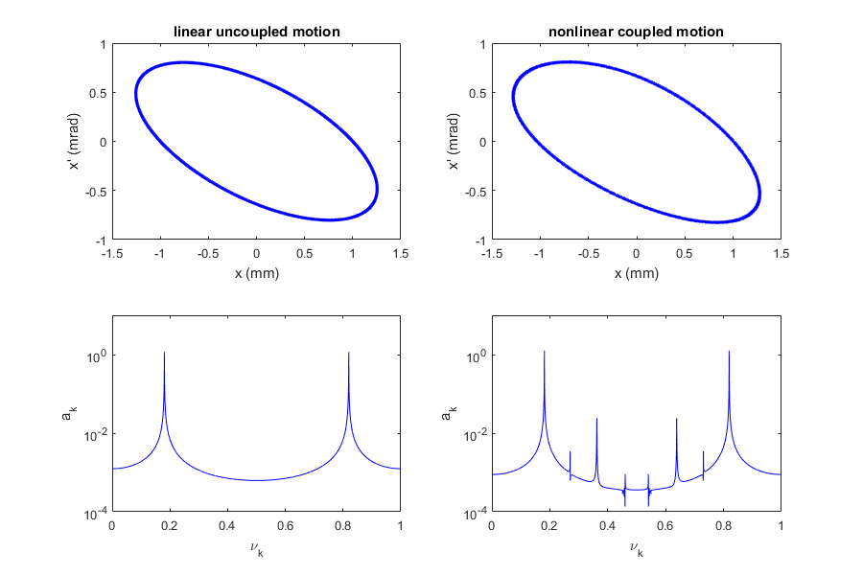







Particle Motion in a Nonlinear System
Sample tracking data with / without nonlinear perturbations:
$$Q_{x}$$
$$Q_{x}$$
$${2Q}_{x}$$
$$Q_{y}$$
$${3Q}_{x}$$
$$Q_{x}+Q_{y}$$
$${2Q}_{y}$$

Slide 29
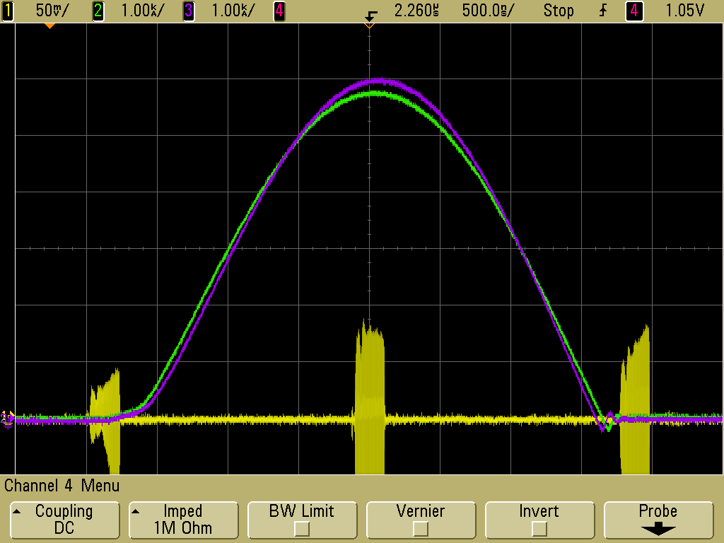
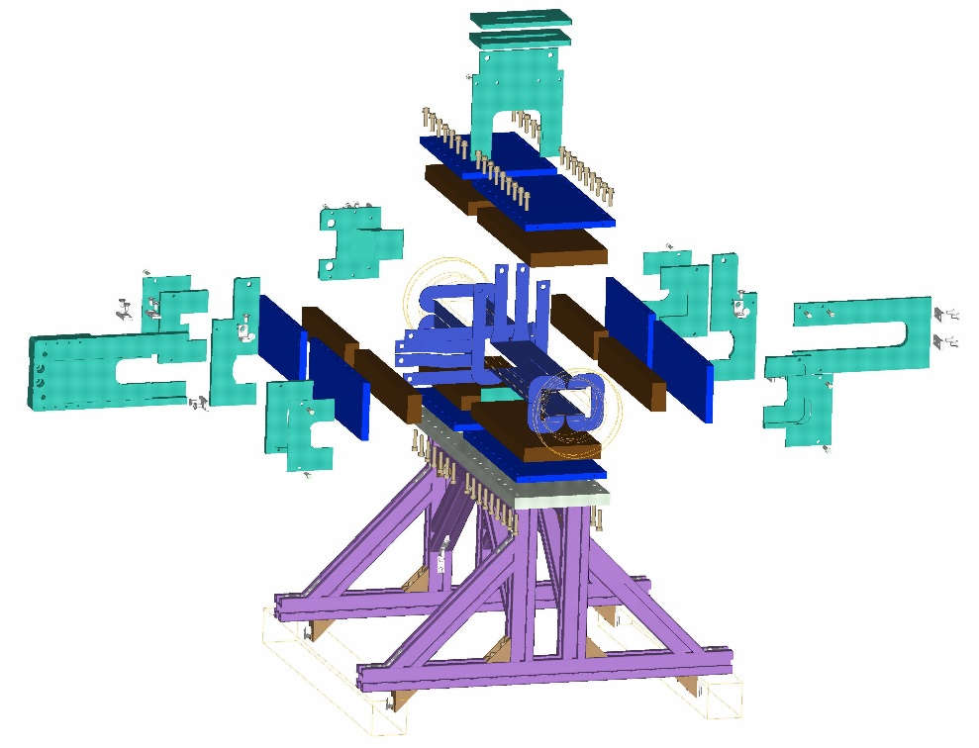
Example measurement data from diamond
Nonlinearities can also be probed via ‘frequency map analysis’
A pinger magnet is used to excite the beam on a single turn, then the motion of the beam is recorded using turn-by-turn BPMs as the beam oscillates freely
From the turn-by-turn data, the oscillation frequency can be extracted
A map can then be created tying the amplitude of motion to the betatron tune-shift

Slide 30
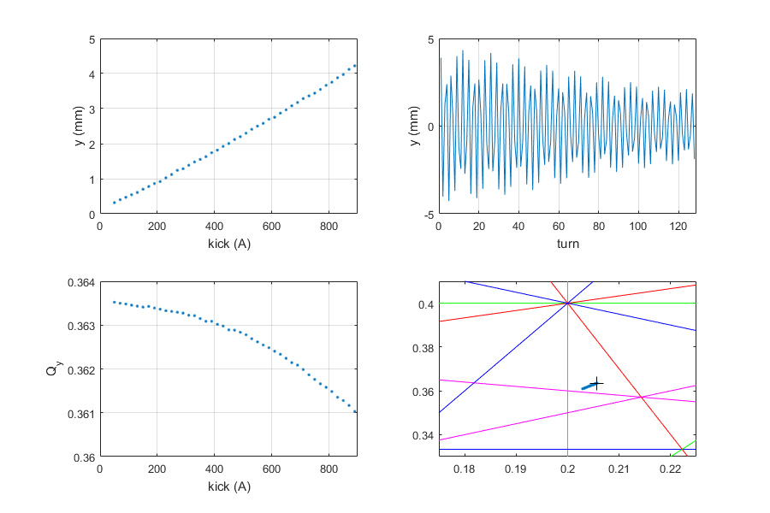
Example measurement data from diamond

Slide 31
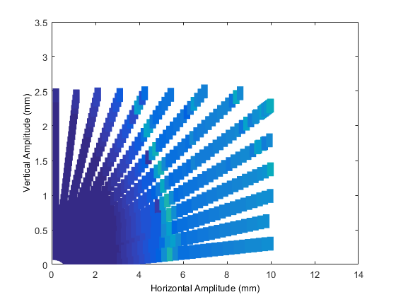
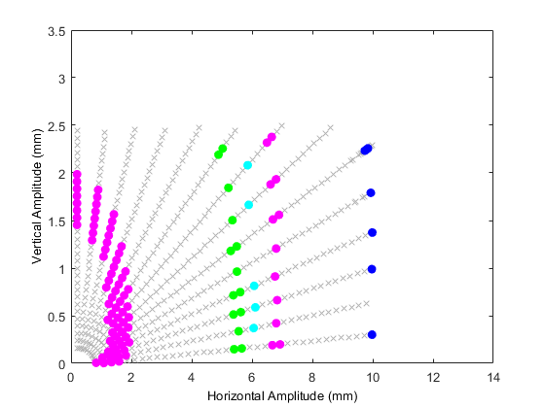
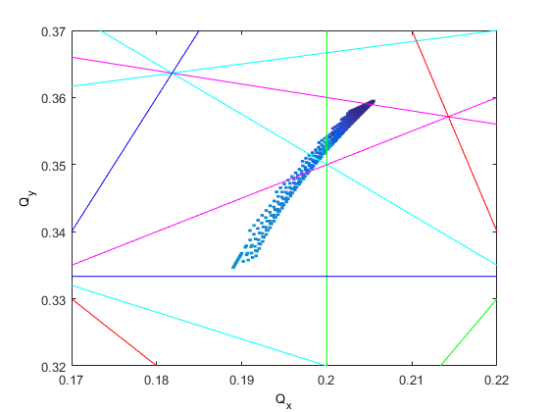
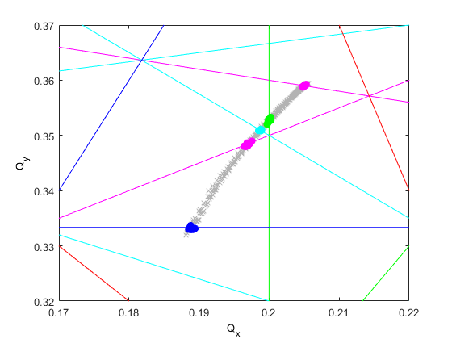
Frequency Map Analysis
model
measurement
model
measurement

Slide 32
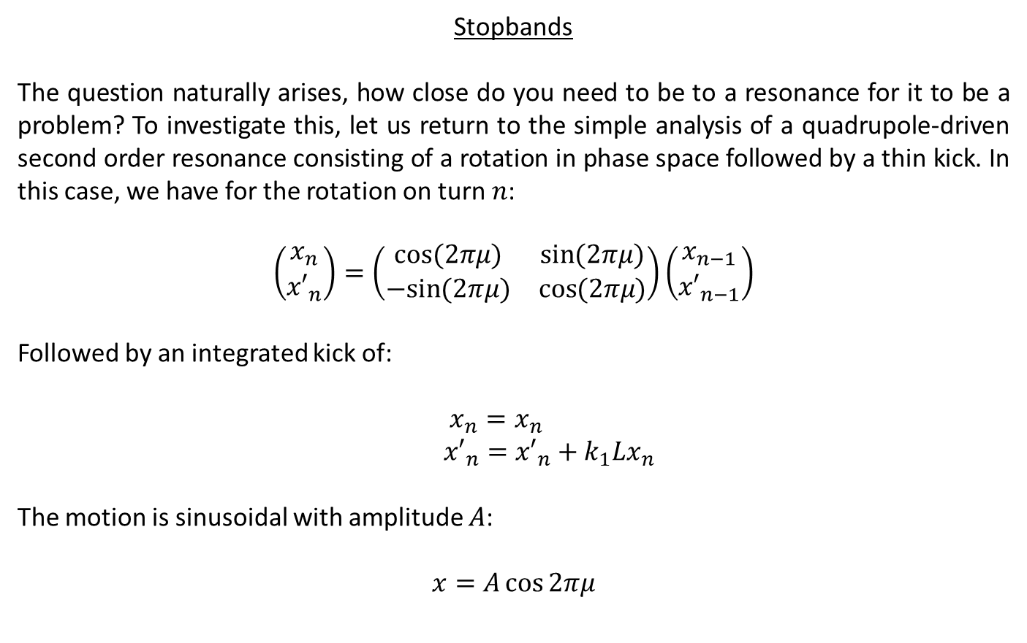
Stopbands
The question naturally arises, how close do you need to be to a resonance for it to be a problem? To investigate this, let us return to the simple analysis of a quadrupole-driven second order resonance consisting of a rotation in phase space followed by a thin kick. In this case, we have for the rotation on turn $n$:
$$\left(\begin{matrix}x_{n} \\ {x′}_{n}\end{matrix}\right)=\left(\begin{matrix}\cos{(2πμ)} & \sin{(2πμ)} \\ −sin{(2πμ)} & \cos{(2πμ)}\end{matrix}\right)\left(\begin{matrix}x_{n−1} \\ {x′}_{n−1}\end{matrix}\right)$$
Followed by an integrated kick of:
$x_{n}=x_{n}$
${x′}_{n}={x′}_{n}+k_{1}Lx_{n}$
The motion is sinusoidal with amplitude $A$:
$$x=A\cos{2πμ}$$

Slide 33
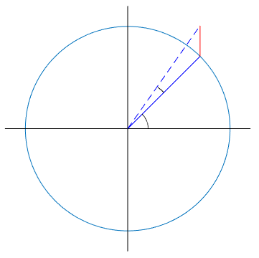

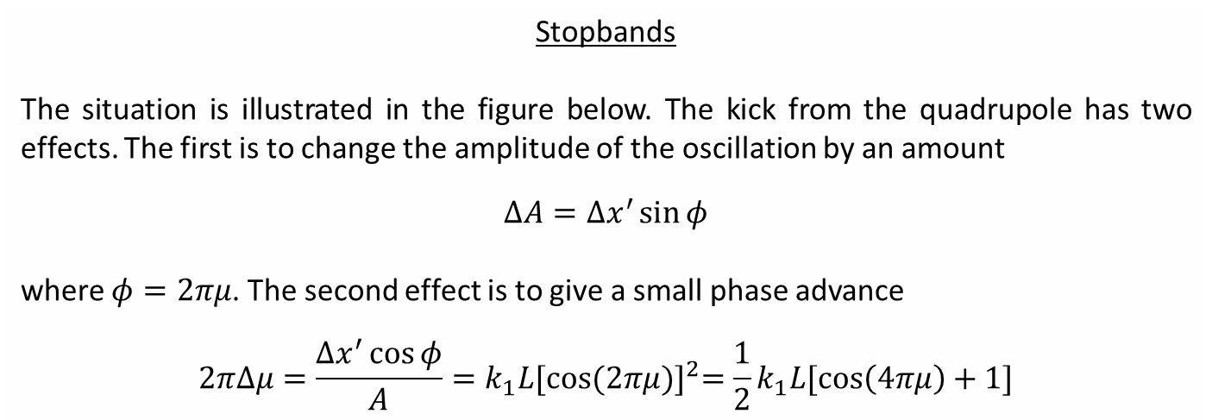







Stopbands
The situation is illustrated in the figure below. The kick from the quadrupole has two effects. The first is to change the amplitude of the oscillation by an amount
$$ΔA=Δx^{′}\sin{φ}$$
where $φ=2πμ$. The second effect is to give a small phase advance
$$2πΔμ=\frac{Δx^{′}\cos{φ}}{A}=k_{1}L{[\cos{(2πμ})]}^{2}=\frac{1}{2}k_{1}L[\cos\left(4πμ\right)+1]$$
$$x′$$
$$ΔA$$
$${Δx^{′}=k}_{1}Lx$$
$$2πΔμ$$
$$A$$
$$φ$$
$$x$$
$$2πμ≡φ$$

Slide 34
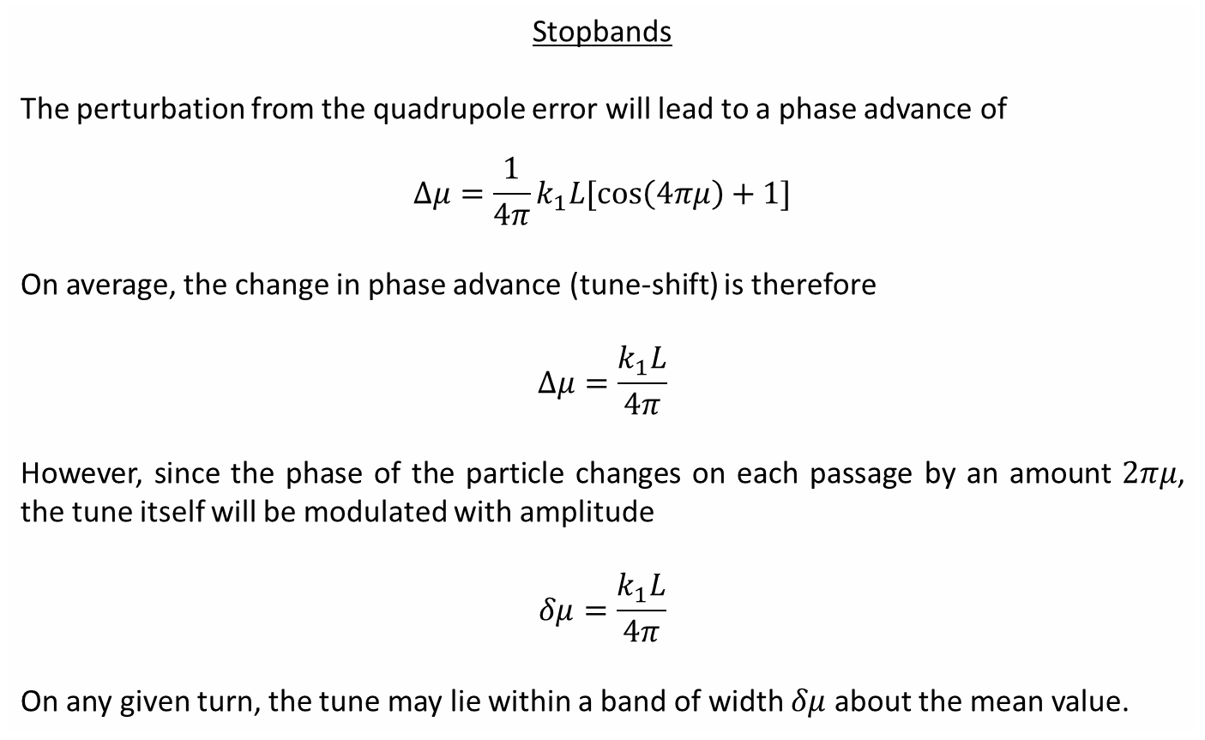
Stopbands
The perturbation from the quadrupole error will lead to a phase advance of
$$Δμ=\frac{1}{4π}k_{1}L[\cos\left(4πμ\right)+1]$$
On average, the change in phase advance (tune-shift) is therefore
$$Δμ=\frac{k_{1}L}{4π}$$
However, since the phase of the particle changes on each passage by an amount $2πμ$, the tune itself will be modulated with amplitude
$$δμ=\frac{k_{1}L}{4π}$$
On any given turn, the tune may lie within a band of width $δμ$ about the mean value.

Slide 35
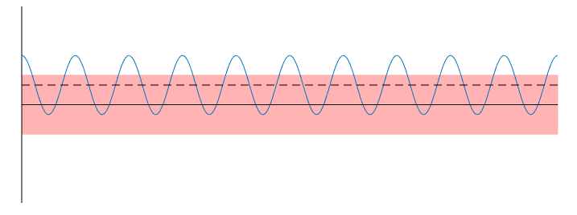
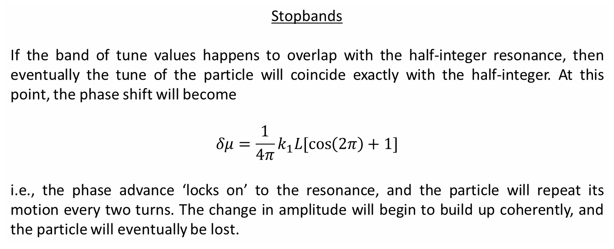



Stopbands
If the band of tune values happens to overlap with the half-integer resonance, then eventually the tune of the particle will coincide exactly with the half-integer. At this point, the phase shift will become
$$δμ=\frac{1}{4π}k_{1}L[\cos\left(2π\right)+1]$$
i.e., the phase advance ‘locks on’ to the resonance, and the particle will repeat its motion every two turns. The change in amplitude will begin to build up coherently, and the particle will eventually be lost.
$$μ$$
Modulated tune
$$δμ=\frac{k_{1}L}{4π}$$
$$μ=0.5$$
$$t$$
Resonance stopband width

Slide 36



Example measurement data from diamond
Injection efficiency recorded as a function of tune point with/without insertion device
Tune point for injected beam is offset from nominal due to tune-shift with amplitude
Impact from $Q_{y}−2Q_{x}$ and $Q_{x}+2Q_{y}$ sextupole resonances clearly visible throughout
After closing insertion device, the tune-shift with amplitude changes, shifting the harmful tune points
The impact of the $5Q_{x}$ resonance increases
ID open
ID closed

Slide 37
Summary
Storage rings have many elements which drive nonlinear motion in the transverse plane:
higher order multipoles deliberately introduced to the ring
fringe fields
construction/calibration errors
The nonlinear fields have many effects:
distortion of phase-space trajectories
variation of betatron tunes with amplitude
introduction of stable islands
chaotic motion and limited dynamic aperture
resonances and stopbands
The phase advance between nonlinear elements and the order of the multipole defines the impact that it has on the particle motion
The betatron tune is carefully chosen to minimise the impact of nonlinear elements; a working point far from structural resonances is desired!
Tools have been developed to study and mitigate the impact of nonlinear elements in rings

Slide 38
References and Acknowledgements
The material presented in this lecture follows closely the treatment in:
[1] A. Wolski, ‘Nonlinear Dynamics: Parts 1 and 2’, CERN Accelerator School, Budapest, Hungary, (2016)
[2] R. Bartolini, ‘Nonlinear Beam Dynamics: Parts 1 and 2’, JAI lectures, Oxford, UK, (2017)
For further details, the following references may also be useful:
[3] H. Wiedemann, ‘Particle Accelerator Physics’, Springer-Verlag, (1999)
[4] S.Y. Lee, ‘Accelerator Physics’, World Scientific Pub., (2004)
[5] A. Chao, M. Tigner, ‘Handbook of Accelerator Physics and Engineering’, World Scientific Pub., (1999)
[6] E. Forest, ‘Beam Dynamics: A New Attitude and Framework’, Hardwood Academic, (1998)
[7] A. Wolski, ‘Beam Dynamics in High Energy Particle Accelerators’, World Scientific Pub., (2014)
[8] J. Bengtsson, ‘Nonlinear Transverse Dynamics in Storage Rings’, CERN 88-05, (1988)

