Slide 1

FEMM tutorial
Numerical design of a C-shape dipole
Jérémie Bauche
(with slides from Attilio Milanese) jeremie.bauche@cern.ch
John Adams Institute
Accelerator Course
23 Jan. 2025

Slide 2
Support material for this tutorial on the INDICO page
These Powerpoint slides: “JAI_course_2025_FEMM_tutorial.pptx” (+ .pdf)
An Excel spreadsheet: “C-shape_dipole_templates.xlsx” for:
  Parametric definition of the yoke and coil geometries
  Post-processing of field homogeneity and harmonics
  (input parameters in green cells)
The LUA script of HIE-ISOLDE dipole we’ll use as case study: “HIE-ISOLDE_dipole.lua” (+ .txt) - for pre-processor only
The LUA script “multipoles_femm.lua” (+ .txt), for the computation of the field harmonics

Slide 3
The program of today’s tutorial
Introduction to the GUI of the FEMM software
Methodology to create and analyse a FEMM model
Walk-through example of the FEMM model of a C-shape dipole (from the HIE-ISOLDE facility at CERN) with the GUI
  Creation of the model
  Analysis and optimisation
Brief introduction to scripts with LUA language

Slide 4
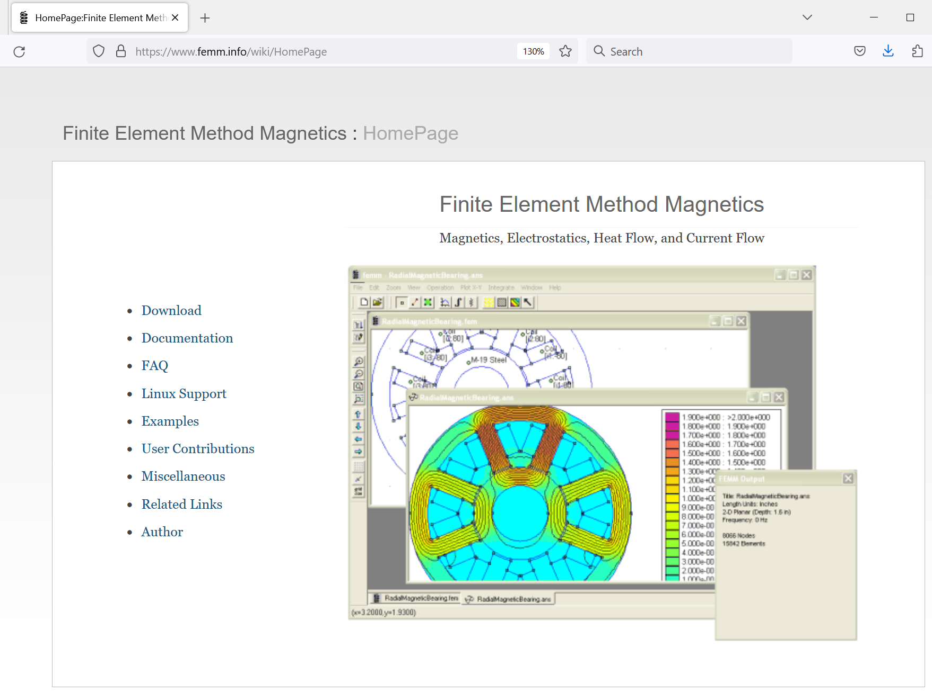
To download the software, go to www.femm.info
FEMM is a freeware!

Slide 5
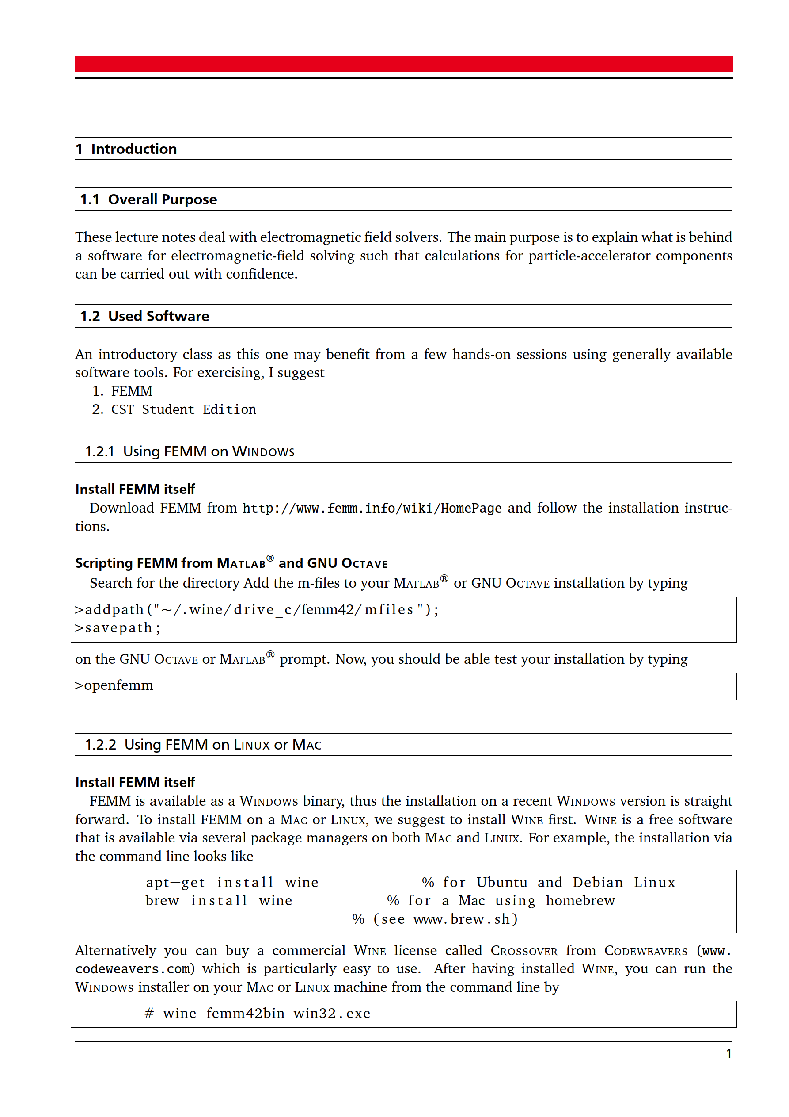
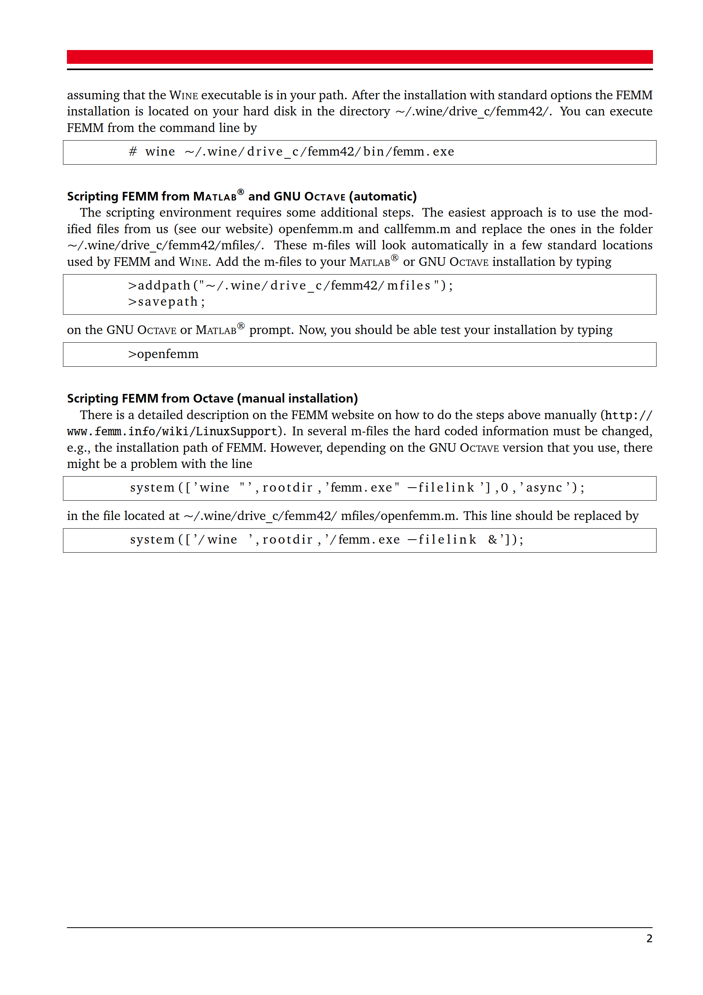
To install the software
For Windows users: just install FEMM
For Linux or Mac users: see in this slide

Slide 6
FEMM can be used in different ways
Through the GUI (Graphical User Interface)
Through scripting, either with the embedded Lua, or with MATLAB®, GNU Octave, Python, etc.
Through a mix of GUI and scripting
For details, see the excellent FEMM manual

Slide 7
A few extra references (for magnet design and this tutorial)
CAS on Resistive and Superconducting Magnets, 2023
https://indico.cern.ch/event/1227234/contributions/
See “RT magnet design, fabrication and testing” lectures from Attilio
See also “Hands-on - Block 2 - Resistive magnet design”
J. Bauche and A. Aloev, Design of the beam transfer line magnets for HIE-ISOLDE, IPAC2014 conference, Dresden
https://accelconf.web.cern.ch/IPAC2014/papers/tupro104.pdf
  This describes the bending magnet of the tutorial
T. Zickler, Numerical design of a normal-conducting, iron-dominated electro-magnet using FEMM 4.2, JUAS2016
https://indico.cern.ch/event/471931/contributions/1149654
[though you need to ask for access now]

Slide 8
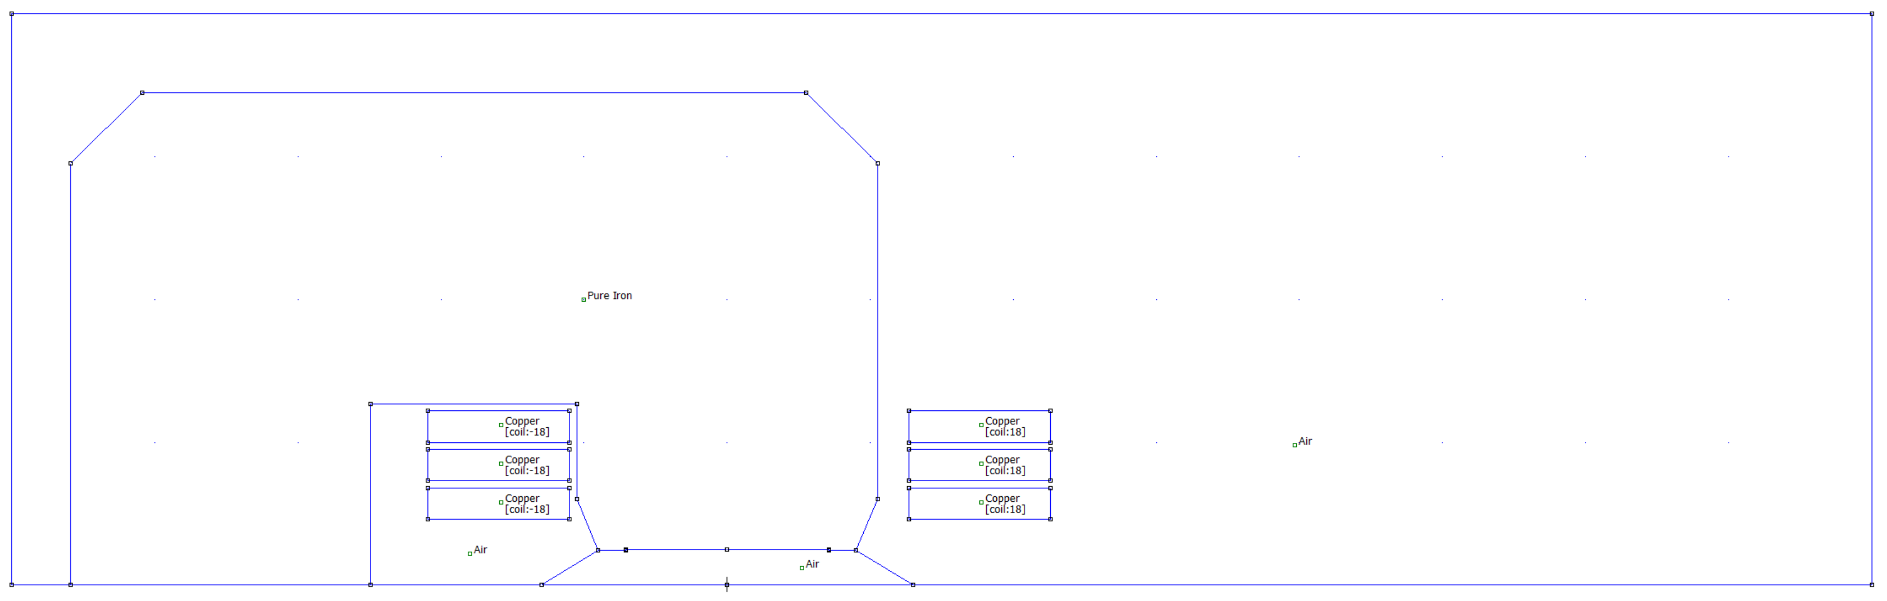
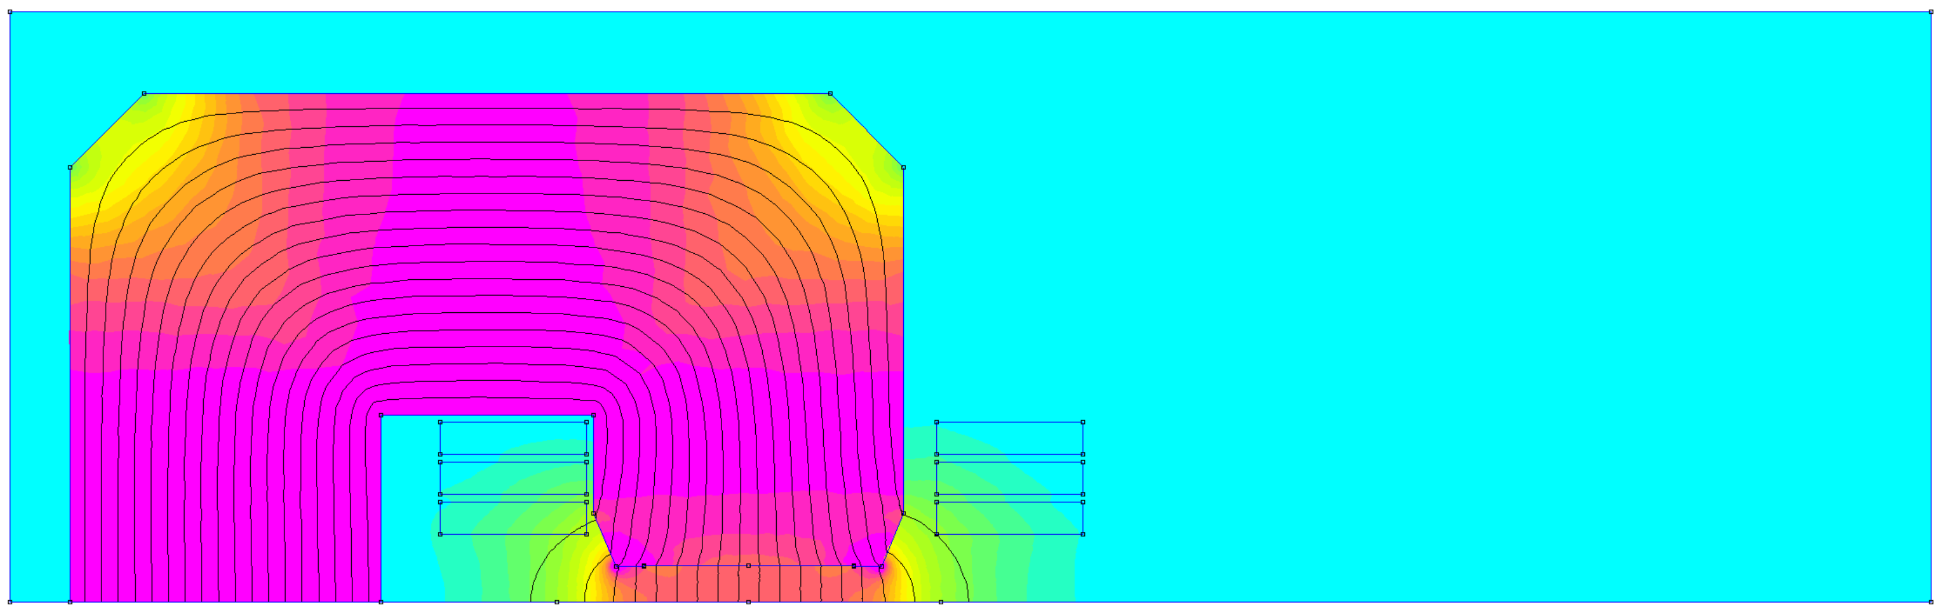
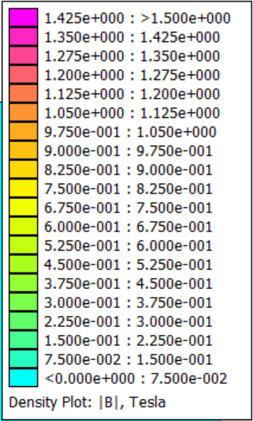
Here are the geometry in the FEMM preprocessor and the solution in the postprocessor of the HIE-ISOLDE dipole (2D)

Slide 9
The details of the geometry of the HIE-ISOLDE dipole, for the tutorial with GUI
yoke
coil
 | x [mm] | y [mm]
1 | 0 | 25
2 | 71 | 25
3 | 71 | 24.2
4 | 90 | 24.2
5 | 105 | 60
6 | 105 | 295
7 | 55 | 345
8 | -409 | 345
9 | -459 | 295
10 | -459 | 0
11 | -249 | 0
12 | -249 | 127
13 | -105 | 127
14 | -105 | 60
15 | -90 | 24.2
16 | -71 | 24.2
17 | -71 | 25
18 | 0 | 25
Number of coil pancakes: 3
(i.e. 6 blocks in the 2D cross-section)
Outer top coil block, top left corner:
(127,122) mm
Coil block size:
w_{coil} = 99 mm
h_{coil} = 22 mm
Distance between coil blocks
Vertical spacing = 5 mm
Horizontal spacing = 237 mm
Coil block ampere-turns:
NI = 18×450 A (I max)
NI = 18×110 A (I min)

Slide 10
Overall, this is a short decalogue for a FEMM simulation
Create a new file, “magnetics” category
Set main problem parameters (ex. planar, mm, 0 frequency)
Define the geometry (iron, coils, air, background)
Load and set material properties (on regions)
Set circuits properties
Set and apply boundary conditions on lines (see next slides)
Mesh and refine mesh if needed
Solve
Postprocess
Perform some sanity checks (shape of flux lines, saturation, sensitivity to background, mesh, etc.)

Slide 11
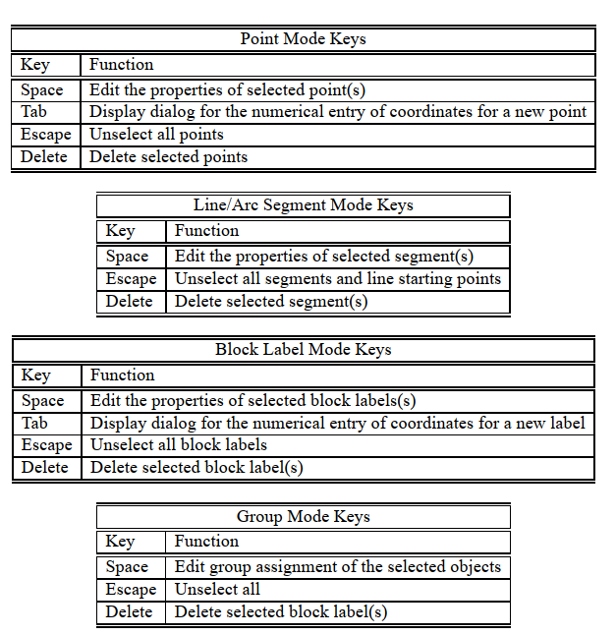
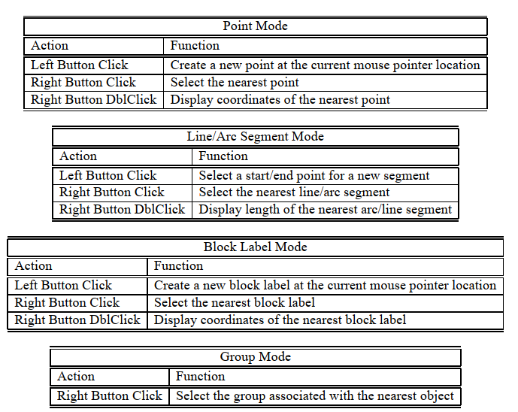
Hot keys and mouse button actions for the preprocessor
Keys
Mouse
[from the FEMM manual]

Slide 12
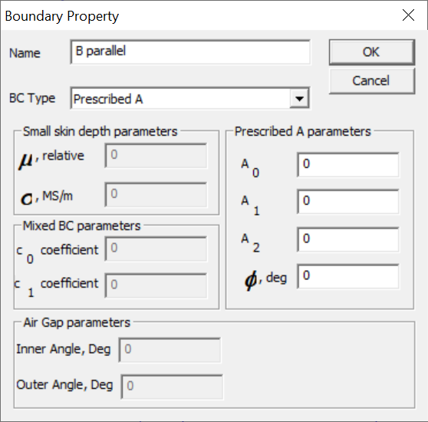
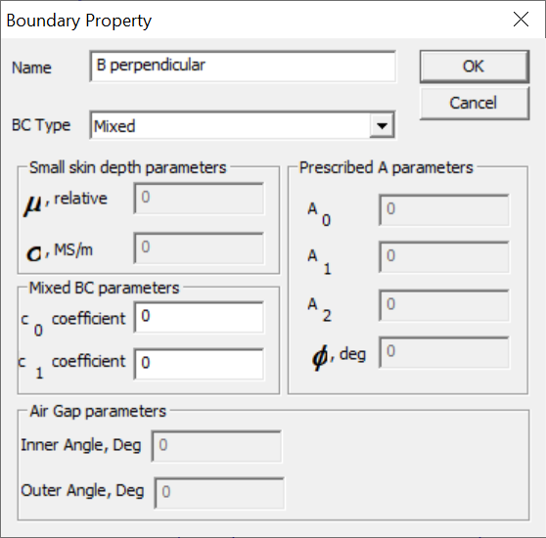
How to set the two boundary properties that we use in FEMM
B parallel
B perpendicular
Also called “Dirichlet” boundary condition
Also called “Neumann” boundary condition

Slide 13
SPARE SLIDES (from CAS 2023):
Walk-through of the C-shape dipole modelling, with details of GUI and of LUA scripts

Slide 14
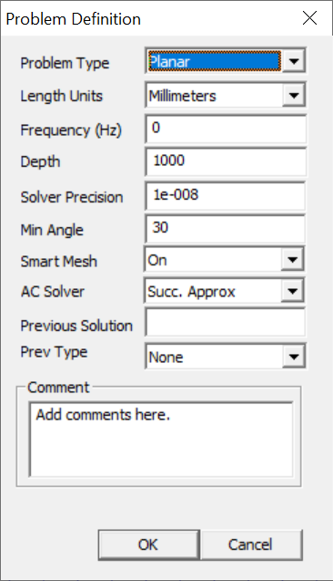
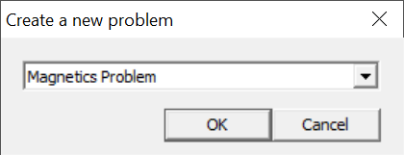
1. Create a new file and set main problem parameters
---> File ---> New
---> Problem
1 m depth, so results (energy, inductance, force, …) will be per m length
-- Creates a new preprocessor document (magnetics problem)
newdocument(0)
-- Main problem parameters
-- 0 frequency
-- mm units
-- planar problem
-- solver precision
-- depth, set to 1 m so to have results per m length
mi_probdef(0, "millimeters", "planar", 1e-8, 1000)

Slide 15
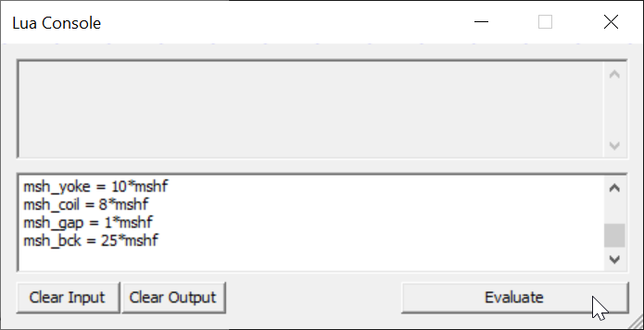
2. Declare a few variables (for parametric analyses)
Write (or copy & paste) in Lua console, then click Evaluate
-- A few variables
w_coil = 99
h_coil = 22
x_bck = 800
y_bck = 400
workfolder = "C:\\temp\\"
filename = "dipole"
-- Current and number of turns per coil block
current = 450
turns = 18
-- Mesh parameters
mshf = 1
msh_yoke = 10*mshf
msh_coil = 8*mshf
msh_gap = 1*mshf
msh_bck = 25*mshf
mesh size define via a scaling factor

Slide 16
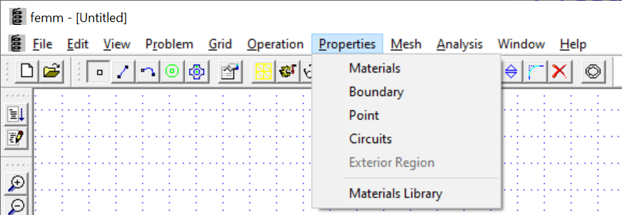
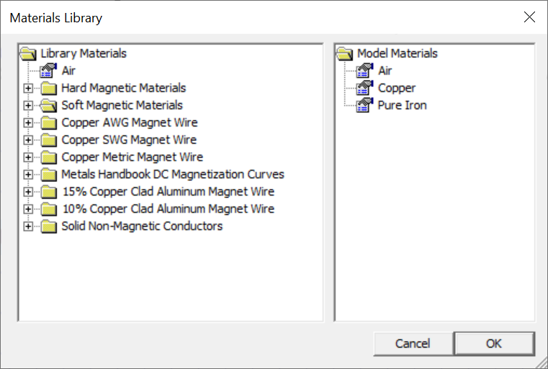
3. Load or prepare material properties (from the available library), boundary conditions and circuit elements
-- Material properties, from the available library
mi_getmaterial("Air")
mi_getmaterial("Pure Iron")
mi_getmaterial("Copper")

Slide 17
3. Load or prepare material properties (from the available library), boundary conditions and circuit elements
-- Boundary conditions
mi_addboundprop("B parallel", 0, 0, 0, 0, 0, 0, 0, 0, 0, 0, 0)
mi_addboundprop("B perpendicular", 0, 0, 0, 0, 0, 0, 0, 0, 2, 0, 0)

Slide 18
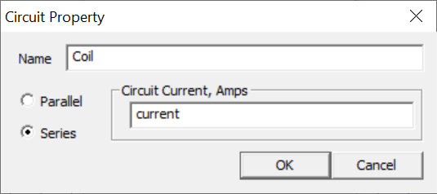
3. Load or prepare material properties (from the available library), boundary conditions and circuit elements
“current” is a previously defined variable, alternatively you can enter a number
-- A circuit, multiple ones are possible
mi_addcircprop("Coil", current, 1)

Slide 19
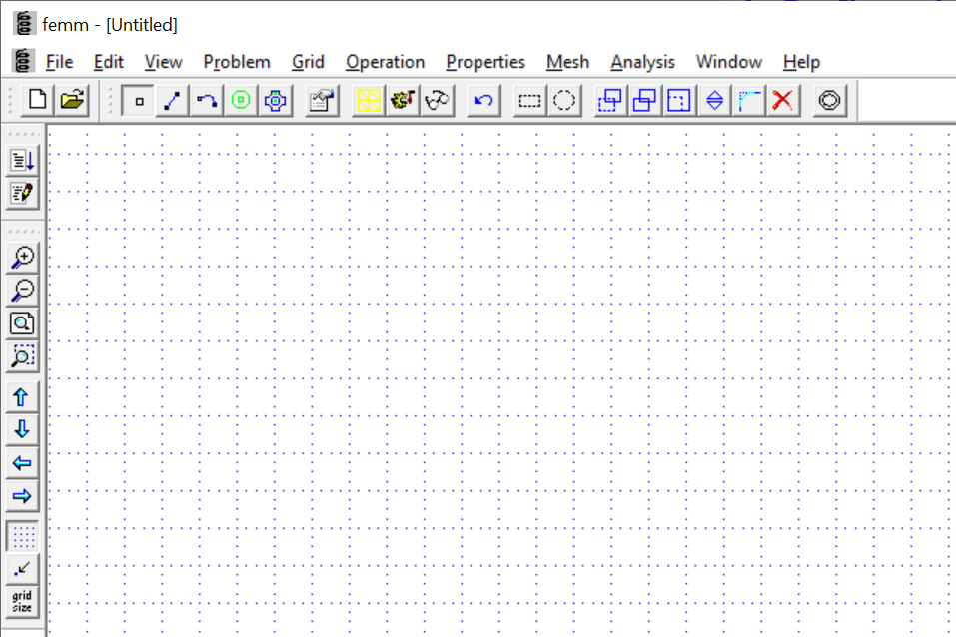
4. Define the geometry (iron, coil, air, background)
via nodes, segments, blocks, etc…
Hot keys are particularly useful, also the grid can be handy
Previously defined variables can be used to describe the geometry
Copy and paste in the Lua console is also a possibility
Another approach is to import a DXF

Slide 20
4. Define the geometry (iron, coil, air, background)
-- Yoke (array of points, for convenience)
x_yoke, y_yoke = {}, {}
x_yoke[1], y_yoke[1] = 0, 25
x_yoke[2], y_yoke[2] = 71, 25
x_yoke[3], y_yoke[3] = 71, 24.2
x_yoke[4], y_yoke[4] = 90, 24.2
x_yoke[5], y_yoke[5] = 105, 60
x_yoke[6], y_yoke[6] = 105, 295
x_yoke[7], y_yoke[7] = 55, 345
x_yoke[8], y_yoke[8] = -409, 345
x_yoke[9], y_yoke[9] = -459, 295
x_yoke[10], y_yoke[10] = -459, 0
x_yoke[11], y_yoke[11] = -249, 0
x_yoke[12], y_yoke[12] = -249, 127
x_yoke[13], y_yoke[13] = -105, 127
x_yoke[14], y_yoke[14] = -105, 60
x_yoke[15], y_yoke[15] = -90, 24.2
x_yoke[16], y_yoke[16] = -71, 24.2
x_yoke[17], y_yoke[17] = -71, 25
np_yoke = getn(x_yoke)
for ip_yoke = 1, np_yoke do
mi_addnode(x_yoke[ip_yoke], y_yoke[ip_yoke])
end
for ip_yoke = 1, np_yoke-1 do
mi_addsegment(x_yoke[ip_yoke], y_yoke[ip_yoke], x_yoke[ip_yoke+1], y_yoke[ip_yoke+1])
end
mi_addsegment(x_yoke[np_yoke], y_yoke[np_yoke], x_yoke[1], y_yoke[1])
--
mi_addblocklabel(0, 150)
mi_selectlabel(0, 150)
mi_setblockprop("Pure Iron", 0, msh_yoke)
mi_clearselected()
definition of coordinates of points via an array, for convenience
cycles to create node and then segments
block label, assign material properties and mesh size

Slide 21
4. Define the geometry (iron, coil, air, background)
-- Coil
mi_addnode(127, 100)
mi_addnode(127+w_coil, 100)
mi_addnode(127+w_coil, 100+h_coil)
mi_addnode(127, 100+h_coil)
mi_addsegment(127, 100, 127+w_coil, 100)
mi_addsegment(127+w_coil, 100, 127+w_coil, 100+h_coil)
mi_addsegment(127+w_coil, 100+h_coil, 127, 100+h_coil)
mi_addsegment(127, 100+h_coil, 127, 100)
--
mi_addblocklabel(127+w_coil/2, 100+h_coil/2)
mi_selectlabel(127+w_coil/2, 100+h_coil/2)
mi_setblockprop("Copper", 0, msh_coil, "Coil", 0, 0, turns)
-- copies
mi_selectrectangle(127, 100, 127+w_coil, 100+h_coil, 4)
mi_copytranslate(0, -(h_coil+5), 2, 4)
mi_selectrectangle(127, 100-2*(h_coil+5), 127+w_coil, 100+h_coil, 4)
mi_copytranslate(-336, 0, 1, 4)
-- change sign of current on one side
mi_selectrectangle(127, 100-2*(h_coil+5), 127+w_coil, 100+h_coil, 2)
mi_setblockprop("Copper", 0, msh_coil, "Coil", 0, 0, -turns)
mi_clearselected()
for the current carrying region, assign the relevant circuit element and number of turns

Slide 22
4. Define the geometry (iron, coil, air, background)
-- Air region (background and gap)
mi_addnode(0, 0)
mi_addnode(130, 0)
mi_addnode(-130, 0)
mi_addsegment(130, 0, x_yoke[4], y_yoke[4])
mi_addsegment(-130, 0, x_yoke[15], y_yoke[15])
--
mi_addnode(-500, 0)
mi_addnode(x_bck, 0)
mi_addnode(x_bck, y_bck)
mi_addnode(-500, y_bck)
mi_addsegment(-500, 0, x_bck, 0)
mi_addsegment(x_bck, 0, x_bck, y_bck)
mi_addsegment(x_bck, y_bck, -500, y_bck)
mi_addsegment(-500, y_bck, -500, 0)
--
mi_addblocklabel(0, 10)
mi_selectlabel(0, 10)
mi_setblockprop("Air", 0, msh_gap)
mi_clearselected()
--
mi_addblocklabel(150, 150)
mi_selectlabel(150, 150)
mi_setblockprop("Air", 0, msh_bck)
mi_clearselected()
--
mi_addblocklabel(-150, 20)
mi_selectlabel(-150, 20)
mi_setblockprop("Air", 0, 6*msh_gap)
mi_clearselected()

Slide 23
4. Define the geometry (iron, coil, air, background)
-- hide lines in post-processor
mi_selectsegment((130+x_yoke[4])/2, y_yoke[4]/2)
mi_selectsegment((-130+x_yoke[15])/2, y_yoke[15]/2)
mi_setsegmentprop("", 0, 1, 1)
mi_clearselected()
-- Boundary conditions on segments
mi_selectrectangle(-500, 0, x_bck, 0, 1)
mi_setsegmentprop("B perpendicular")
mi_clearselected()
mi_selectsegment(x_bck, y_bck/2)
mi_selectsegment((x_bck-500)/2, y_bck)
mi_selectsegment(-500, y_bck/2)
mi_setsegmentprop("B parallel")
mi_clearselected()
-- Zoom out
mi_zoomnatural()
assign boundary conditions

Slide 24
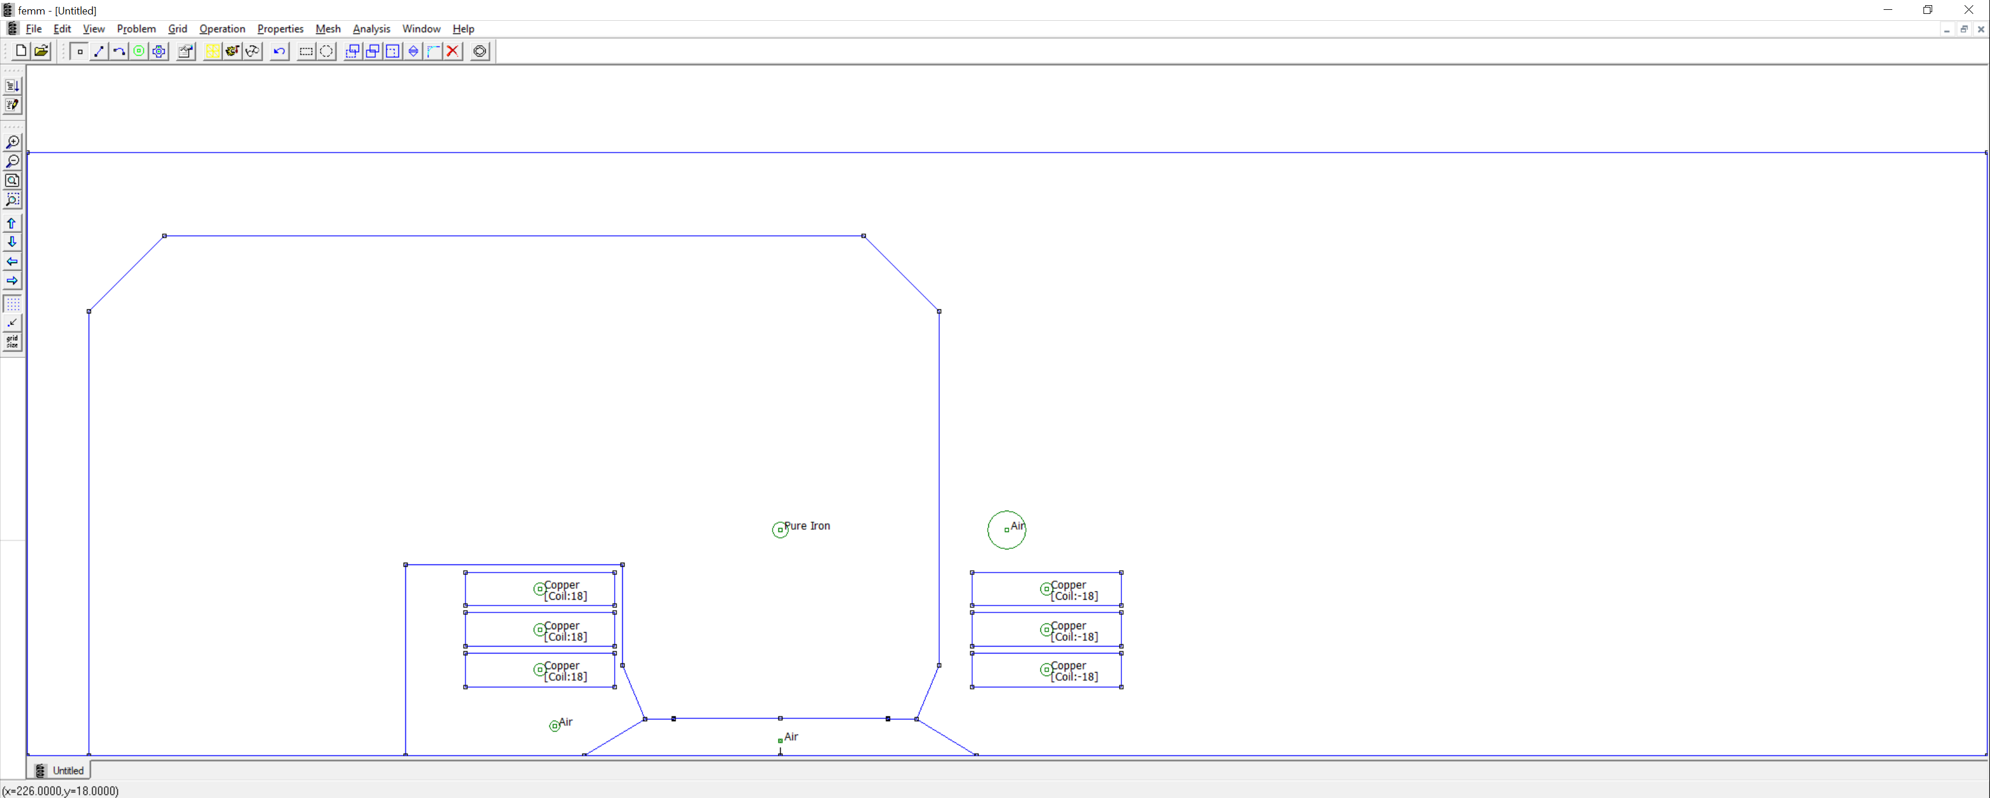
The model is now set in the pre-processor, we are ready to mesh and compute the solution
By the way, no need to model separate conductors or even coil blocks, for such designs

Slide 25

5. Save and mesh
Probably best to save before, in any case you need to save before you mesh
---> Mesh ---> Create Mesh
-- Save
mi_saveas(workfolder .. filename .. ".fem")
-- Mesh
mi_createmesh()

Slide 26
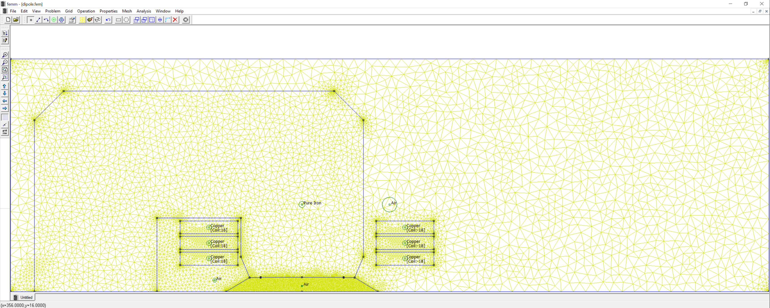
This is the meshed model
Notice the finer mesh in the gap; sometimes a separate region can be created for the pole tip, to allow for a finer mesh. The background region can have a coarser mesh – the size of the element is inversely proportional to the field gradient.
Other meshing options are available in FEMM, see under segment and region properties
[If you save via the script, the tab on the bottom left might still display “Untitled”]

Slide 27

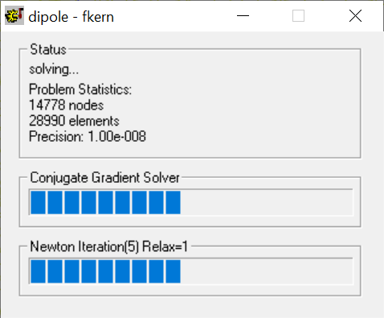
6. Solve
---> Analysis ---> Analyze
-- Solve
mi_analyze()

Slide 28
7. Post-processing: typical quantities of interest
Flux lines
Flux density, with or without flux lines
Field in the center
Polarity
Field plots along a line (absolute or in relative w.r.t. the central field)
Allowed harmonics
Energy
Inductance
Lorentz forces on coil
Fringe field
Magnetic forces on yoke
…

Slide 29

7. Post-processing: load solution
---> Analysis ---> View Results
-- Post-processing
mi_loadsolution()

Slide 30
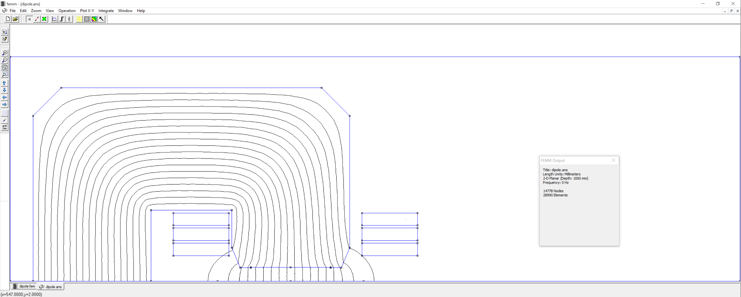
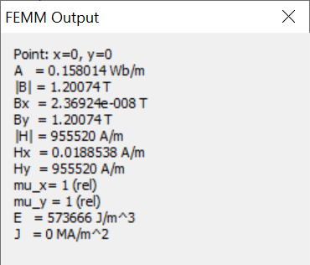
7. Post-processing: flux lines and B in the center (as a first check)
B ≈ 0.98*4e-7*pi*18*6*450/0.050 = 1.197 T
(about 3‰ difference, we report so many digits just to compare, not because they are significant)

Slide 31
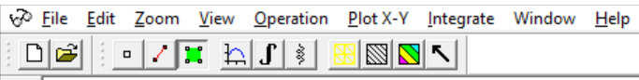
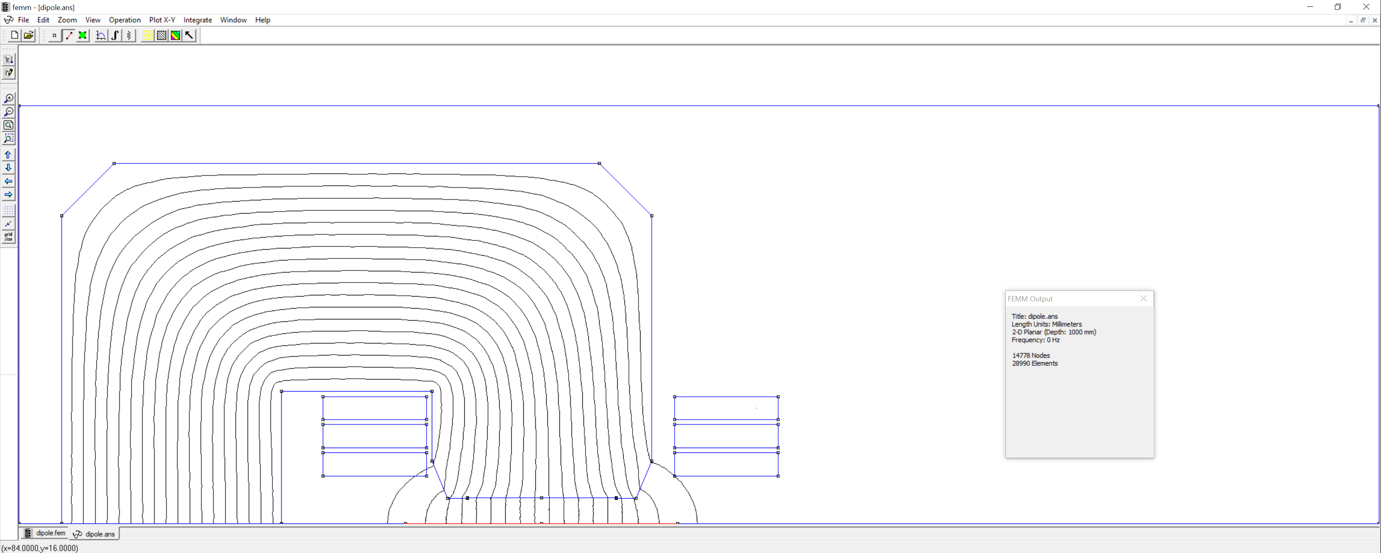
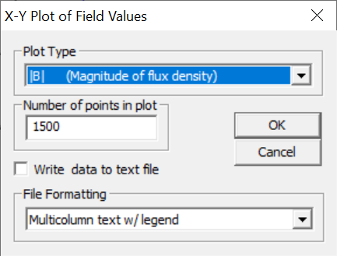
7. Post-processing: line plots
select a contour
  left mouse click for existing point
  right mouse click to add a point (snapping to grid points if convenient)
  Del to remove the last selected node
  Esc to unselect the contour

Slide 32
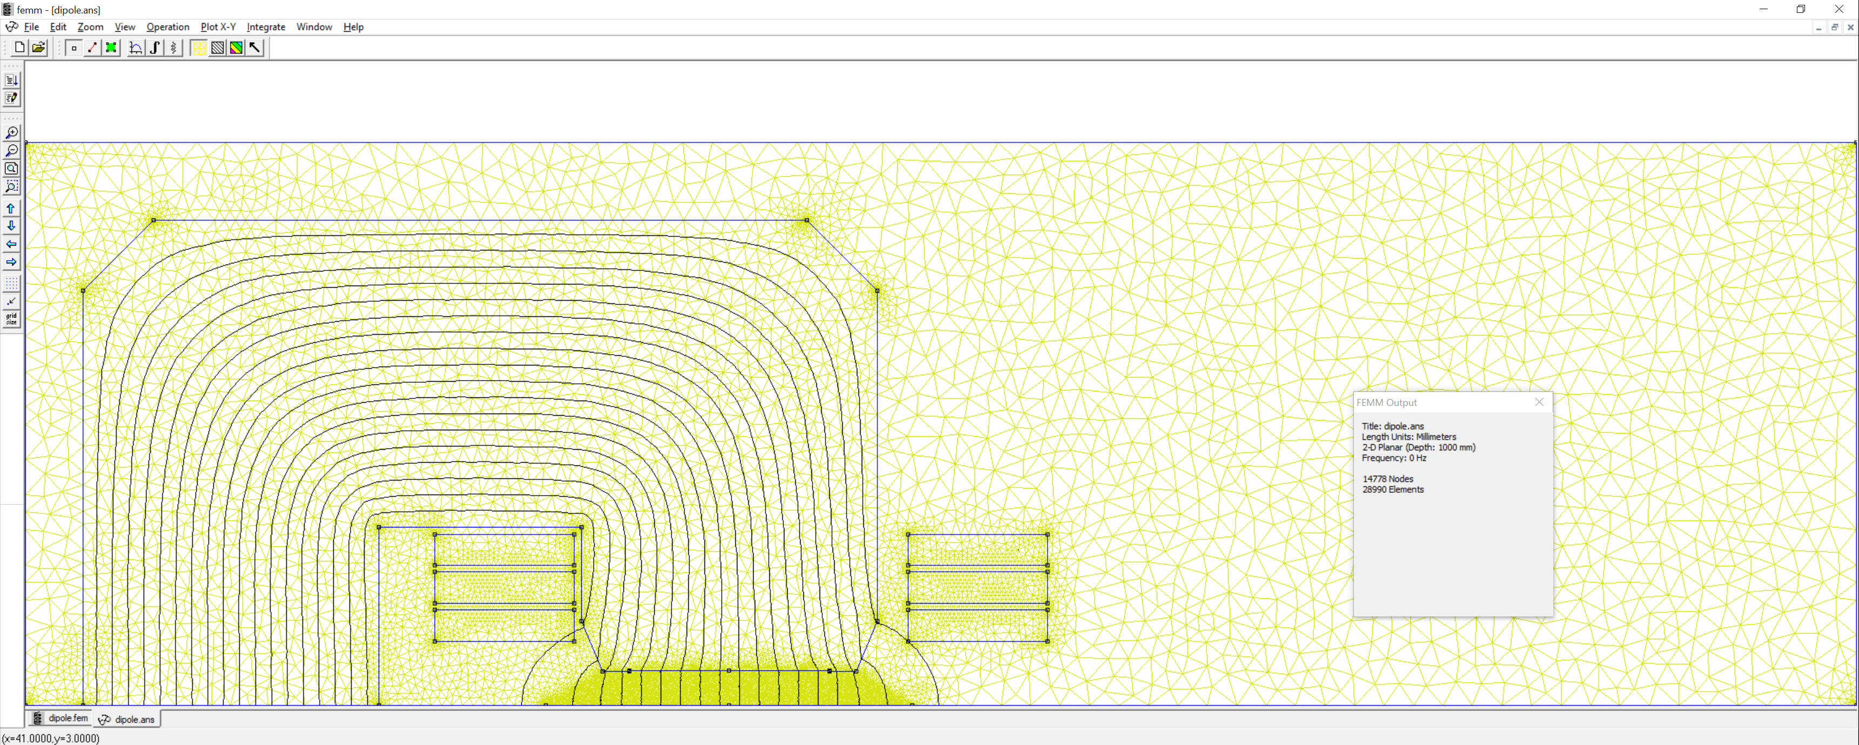
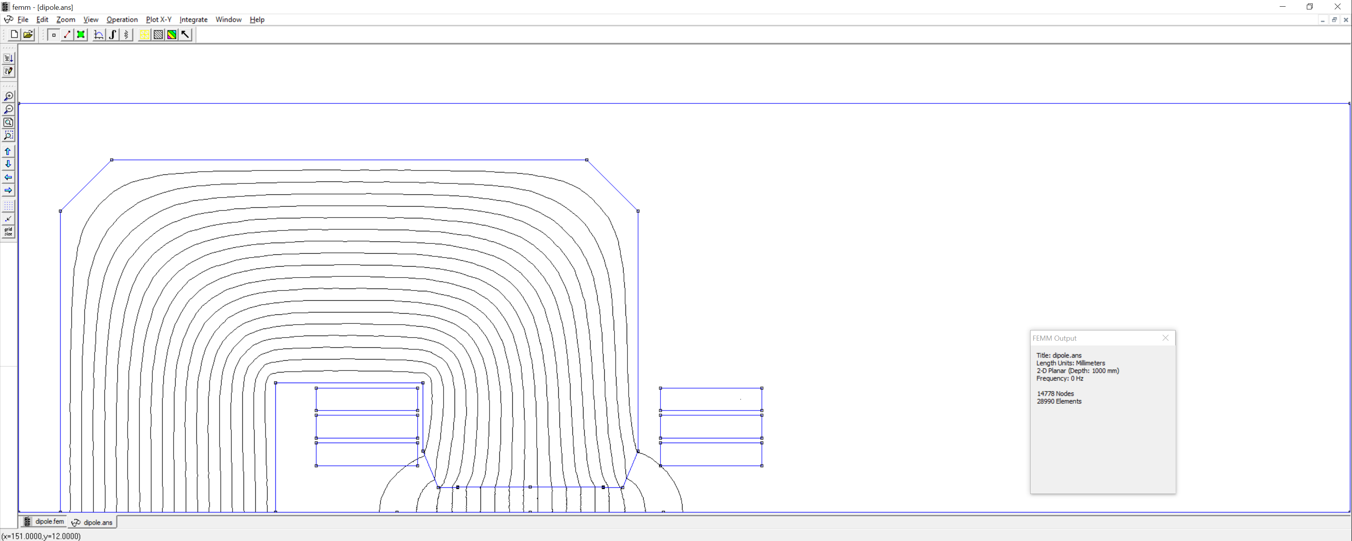
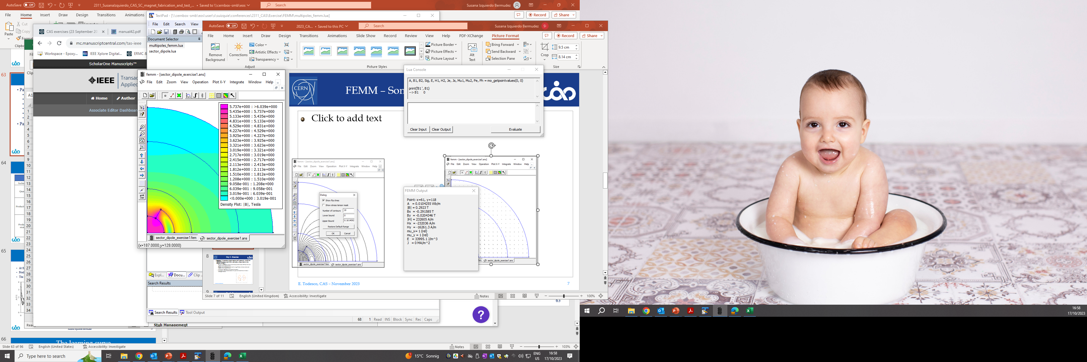
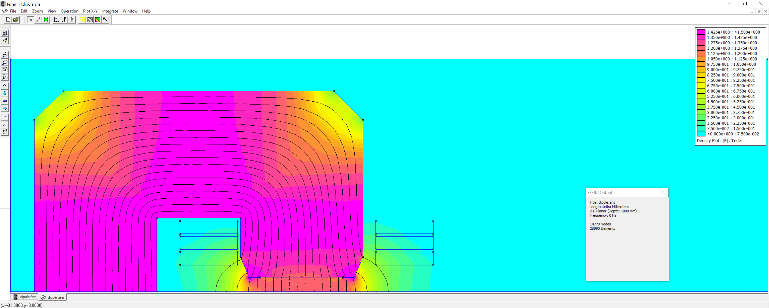

7. Post-processing: 2D plots
mesh
flux lines
field density
field vectors

Slide 33
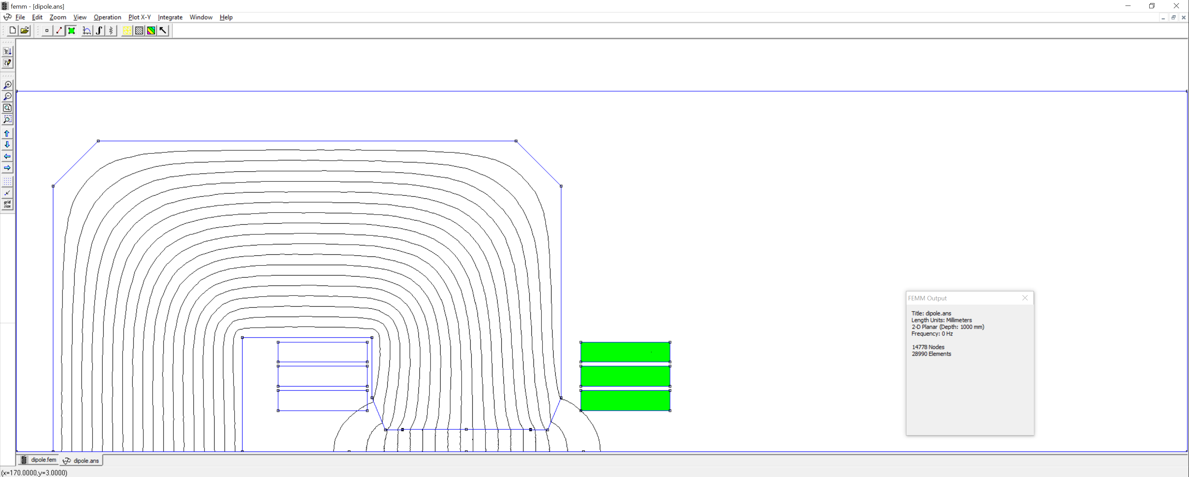
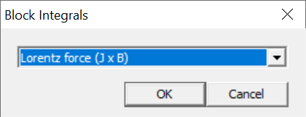
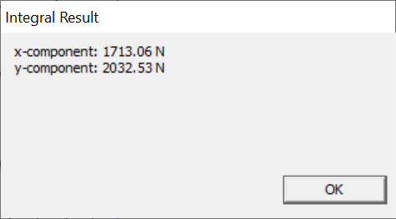
7. Post-processing: integrals over a block

Slide 34
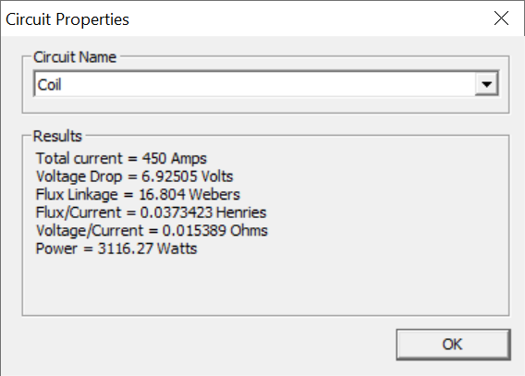
7. Post-processing: inductance (from concatenated flux)
L = 2*37.3 = 74.6 mH/m
The factor 2 is because we model only half the dipole
The result is per m, as we set 1 m depth; to get the total inductance, you can multiply by the magnetic length
L ≈ 0.98*4e-7*pi*(18*6)^2*(180+1.2*50)/50 = 68.9 mH/m
In reality, the inductance is non-linear and it depends on the current (and on the frequency), plus there is the contribution of the coil heads

Slide 35
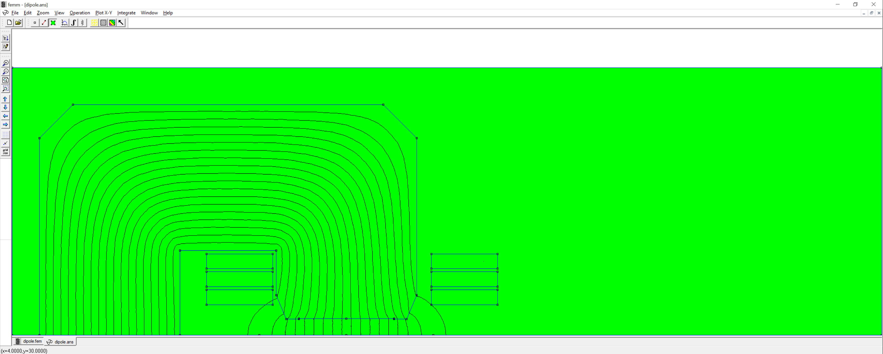
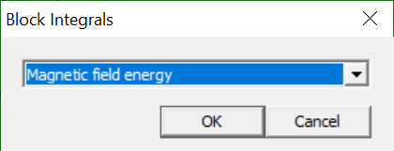
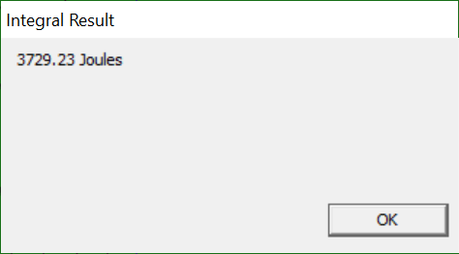
7. Post-processing: inductance (from magnetic energy)
L = 2*2*3729.23/450^2 = 73.7 mH/m

Slide 36
7. Post-processing: a few Lua commands
-- Post-processing
-- The flux lines plot is loaded by default
mi_loadsolution()
-- mo_savebitmap(workfolder .. filename .. "_flux.bmp")
mo_savemetafile(workfolder .. filename .. "_flux.emf")
-- Field density plot
B_min = 0
B_max = 1.5
mo_showdensityplot(1,B_min,B_max,0,"bmag")
-- Field at 0,0
A, B1, B2 = mo_getpointvalues(0, 0)
print("B @ x=0; y=0")
print("Bx = ", B1, " T")
print("By = ", B2, " T")
-- Plot field in the aperture
w_GFR = 120
mo_addcontour(-w_GFR/2, 0)
mo_addcontour(w_GFR/2, 0)
-- mo_makeplot(2, 200) -- plot in FEMM
mo_makeplot(2, 50, workfolder .. filename .. "_By_midplane.emf") -- save image
mo_makeplot(2, 50, workfolder .. filename .. "_By_midplane.txt", 0) -- print it to a file
mo_clearcontour()

Slide 37
7. Post-processing: a few Lua commands
-- Lorentz forces in the coil
mo_selectblock(127+w_coil/2, 100+h_coil/2)
mo_selectblock(127+w_coil/2, 100+h_coil/2-(h_coil+5))
mo_selectblock(127+w_coil/2, 100+h_coil/2-2*(h_coil+5))
Fx = mo_blockintegral(11)
print("Fx = ", Fx, " N")
Fy = mo_blockintegral(12)
print("Fy = ", Fy, " N")
mo_clearblock()
-- Energy
mo_groupselectblock()
U = mo_blockintegral(2)
print("Energy = ", U, " J")
mo_clearblock()
-- Inductance
-- --> from concatenated flux
curr, volts, flux_re = mo_getcircuitproperties("Coil")
print("Fy = ", flux_re, " N")
L_fl = 2*flux_re/curr
print("Inductance (from concatenated flux) = ", L_fl*1000, " mH")
-- alternative: select all coil blocks then get the flux linkage as mo_blockintegral(0)
-- --> from energy
mo_groupselectblock()
U = mo_blockintegral(2)
mo_clearblock()
L_en = 2*2*U/curr^2
print("Inductance (from energy) = ", L_en*1000, " mH")

Slide 38
7. Post-processing: allowed harmonics
(This is just the start, see the script multipoles_femm.lua
on the Indico page)
--
-- LUA script to compute multipoles in FEMM
--
-- Few standard cases are considered:
-- * dipole 180 deg (ex. C shape)
-- * dipole 90 deg (ex. H shape)
-- * quadrupole 45 deg (ex. standard symmetric quadrupole)
--
-- In all cases, the center is 0, 0 and the skew coefficients are 0
--
-- The script computes two sets of multipoles:
-- * one from A (the vector potential)
-- * another one from a radial projection of B
-- They should be the same, so the difference in a way shows
-- how much to trust these numbers; the ones from A should be better,
-- as this is the finite element solution without further manipulations
-- (derivation, radial projection) while B is rougher (linear elements,
-- so B is constant over each triangle), but then it's smoothed out in the postprocessor
--
case_index = 1
-- 1 ===> dipole 180 deg (ex. C shape)
-- 2 ===> dipole 90 deg (ex. H shape)
-- 3 ===> quadrupole 45 deg (ex. standard symmetric quadrupole)
nh = 15 -- number of harmonics
np = 256 -- number of samples points
R = 2*25/3 -- reference radius
Rs = 0.95*25 -- sampling radius, can be the same as R or the largest still in the air

