Slide 1

R2D2 coils insulation : the impact of the sizing
CEA Paris-Saclay
CERN HFM Insulation WG#4
January 30th 2025
Jeremy Faucheux, Françoise Rondeaux, Maria Durante, Simon Perraud, Etienne Rochepault

Slide 2
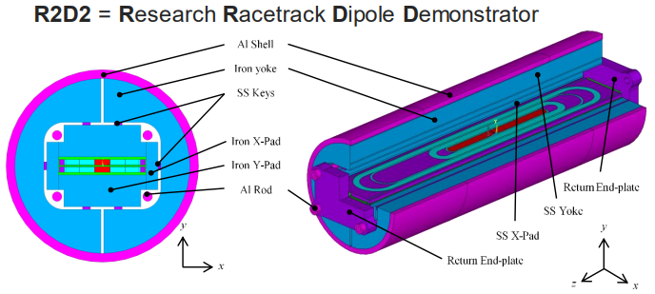
Context and Goal
R2D2 1st coil CR01 showed electrical shortcuts after curing (<200Ω)
Undetectable by employed means before heat treatment
Coils manufacturing is stopped until we unveiled the defect and fix it

Slide 3
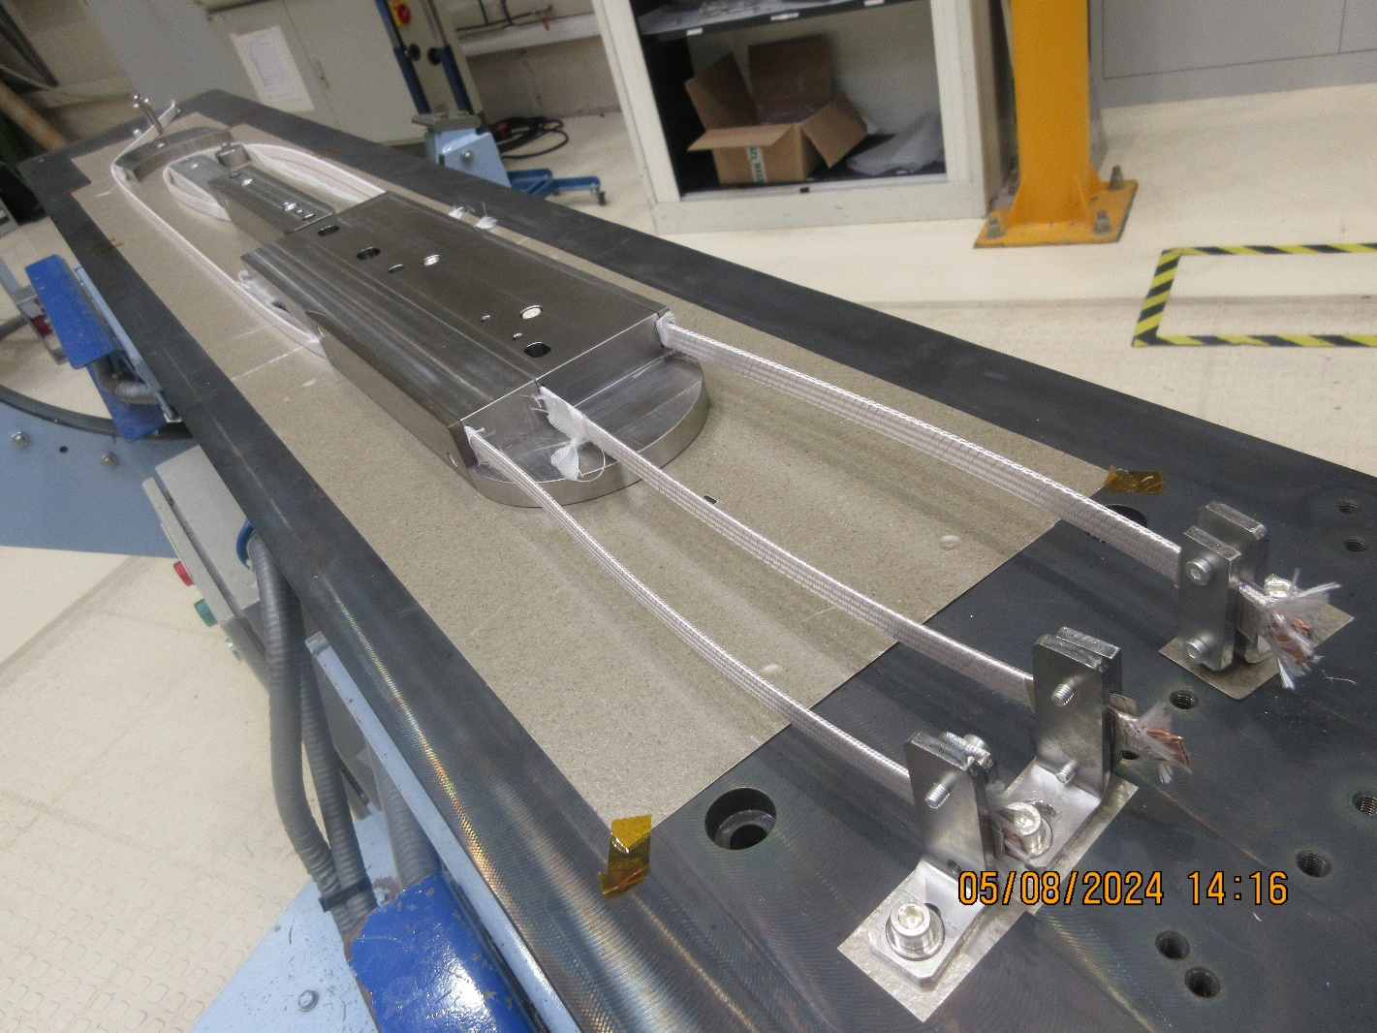
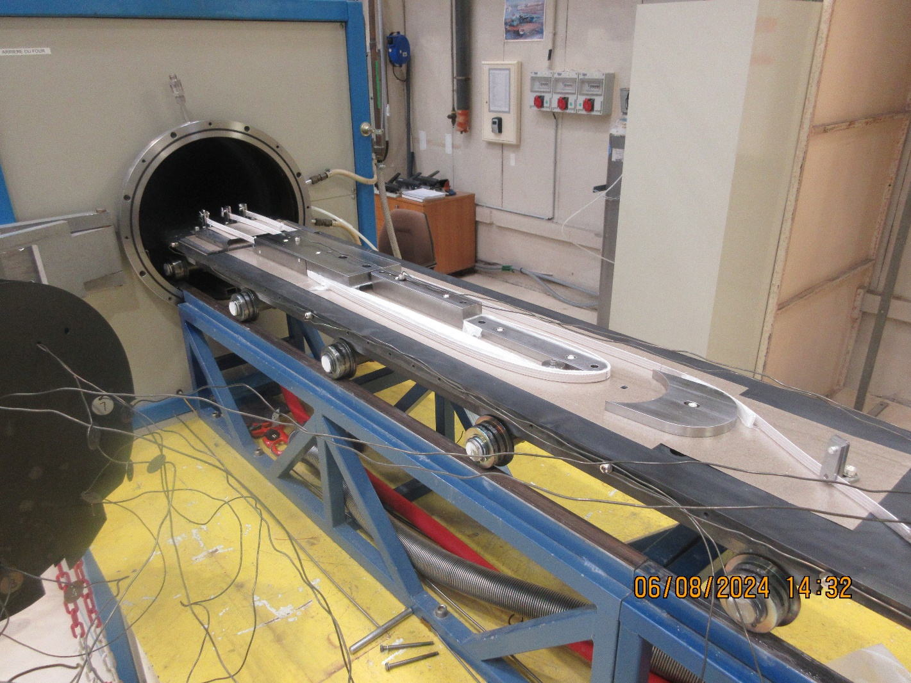
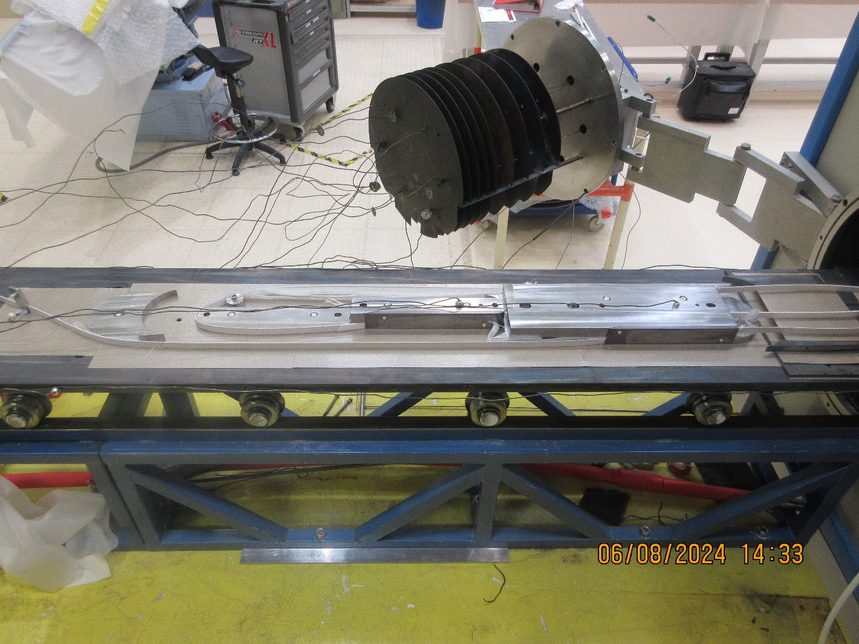
1st hypothesis : worn fiber glass inside layer jumps during heat treatment

Slide 4
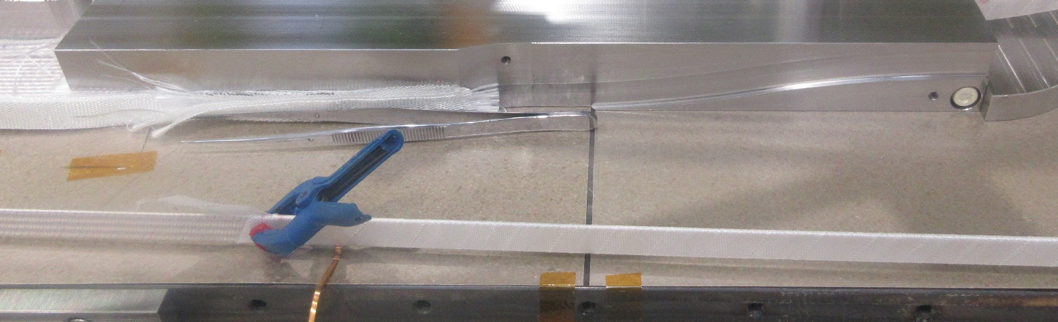
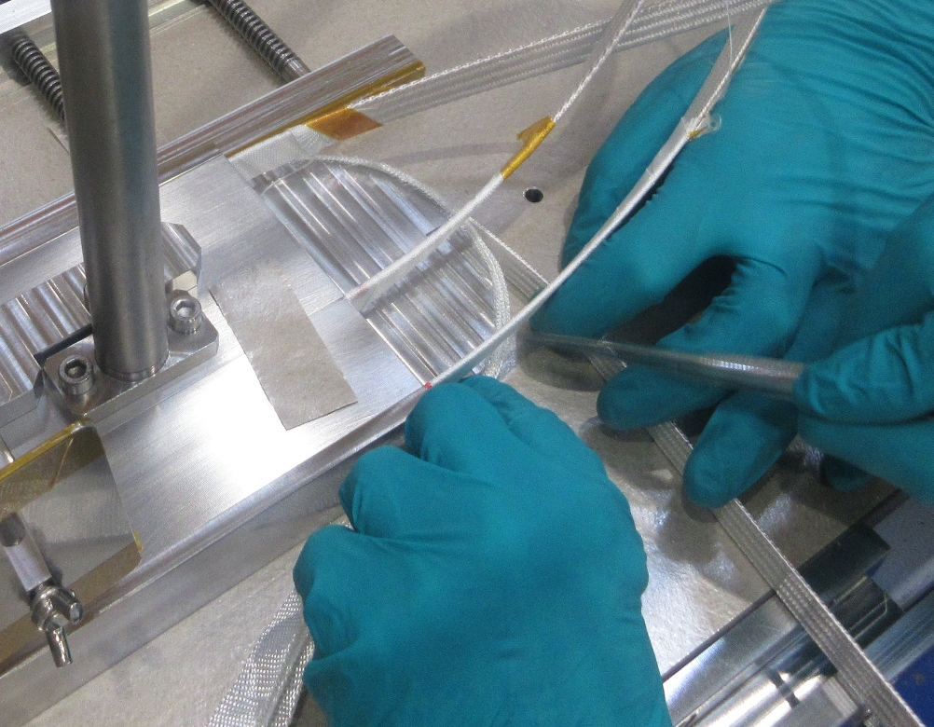
R2D2 fibre glass
Hiltex 0,1mm thick sizing ?
S2
15mm large
Used in layer jumps
2 layers wrapped around the cable with 2mm gap between each
Tisstech 0,2mm thick sizing 493
S2 66/66-20
13mm large
Used in end shoes
3 layers placed between the cable and the stainless steel part

Slide 5
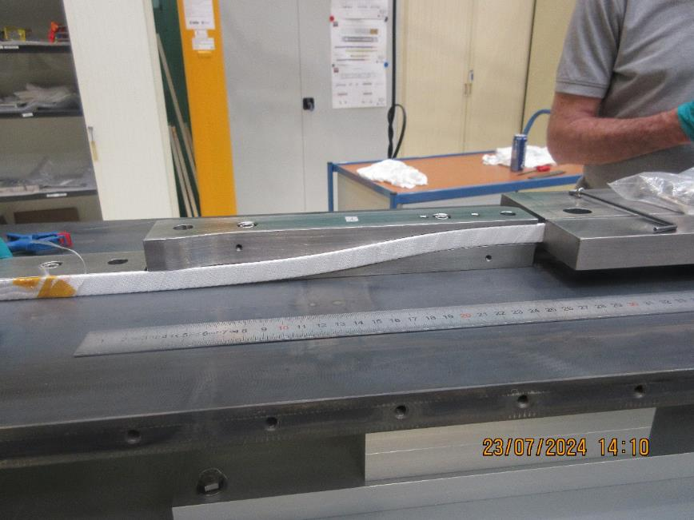
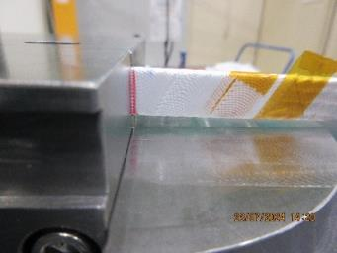
Traction trials
Quantify which tension is needed to let the cable slide → 2 possibilities
  Glass fiber wearing (due to the groove design)
  Cable strain (overconstraint during heat treatment)
HF Cu conductor wrapped with 2 Hiltex glass fiber layers 0,1mm thick (same conditions as CC01 and CR01)

Slide 6
Traction trials
Trial at 15kg (usual winding conditions) : cable sliding
Trial at 15kg with 3 Hiltex glass fiber layers 0,1mm thick : no sliding
Trial > 22kg with 3 Hiltex glass fiber layers 0,1mm thick : no sliding
→ Add more insulated layers to avoid sliding and fiber glass wearing

Slide 7
Heat treatment 1 – CR01 conditions
SETTINGS
Heat treatment set for 50h at 650°C
Samples :
  Nb₃Sn HF cable wrapped with 2 Hiltex glass fiber layers 0,1mm thick in 2 layer jumps
  Nb₃Sn LF cable wrapped with 2 Hiltex glass fiber layers 0,1mm thick in 1 layer jump
Cable HF
Post HF-RE
Cable LF
Post HF-LE
Post LF

Slide 8
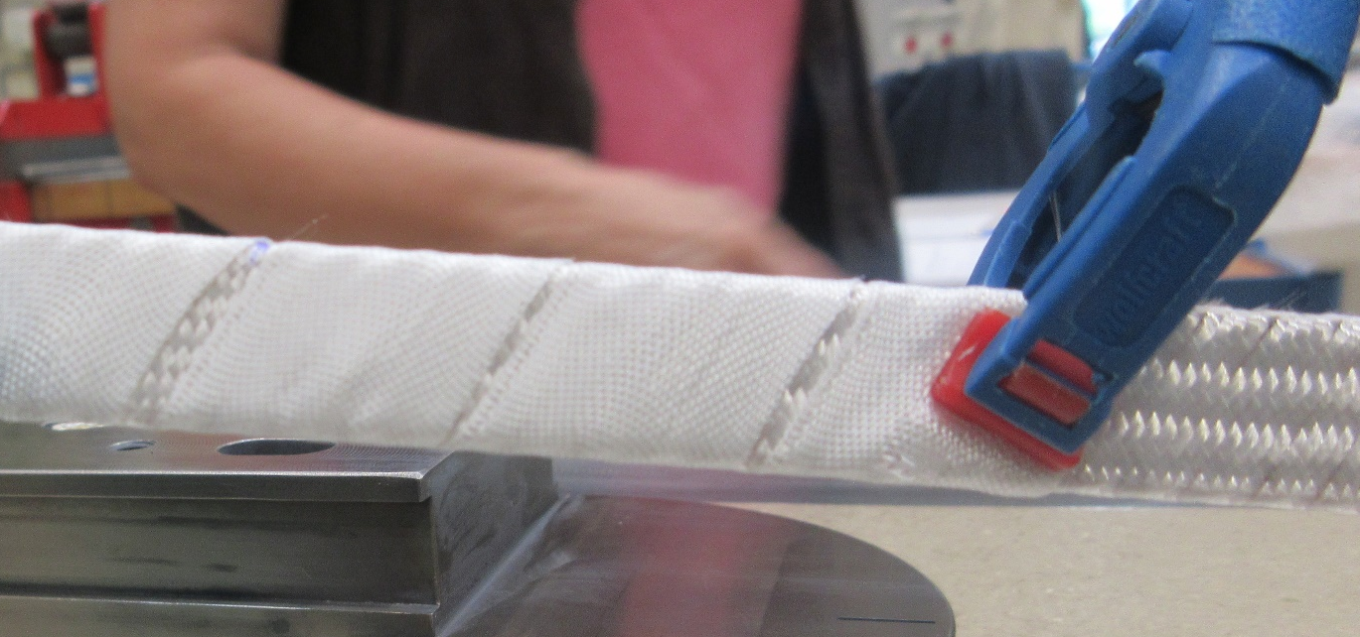
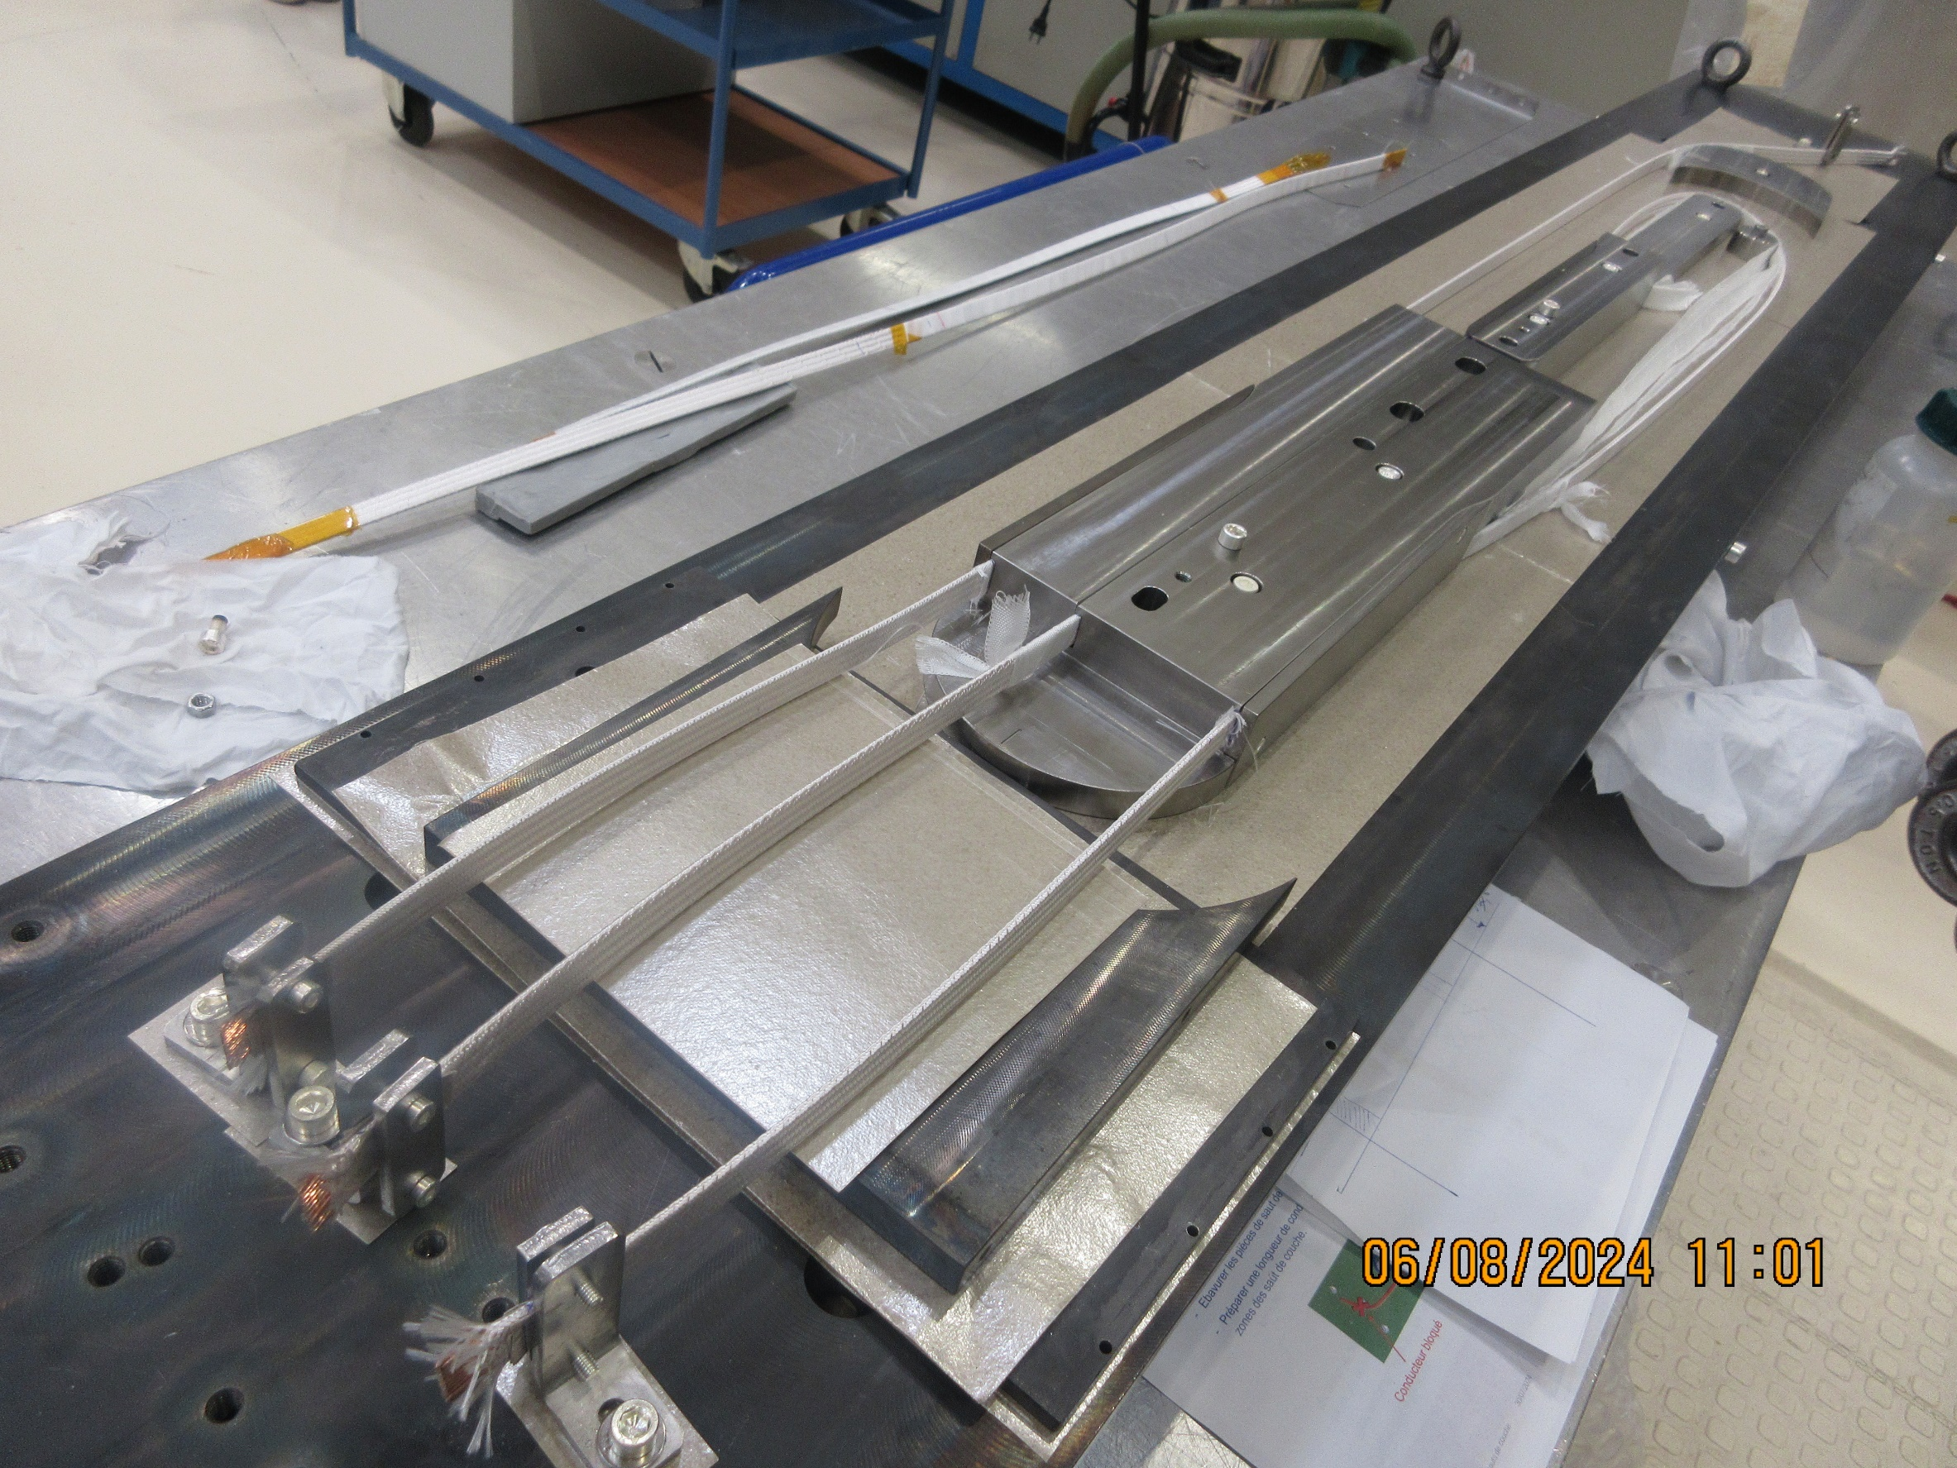
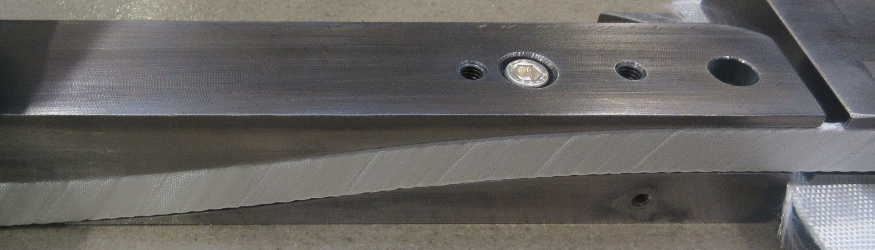
Heat treatment 1 – CR01 conditions
LF
HF
HF

Slide 9
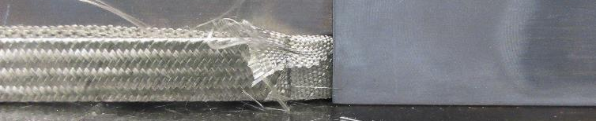
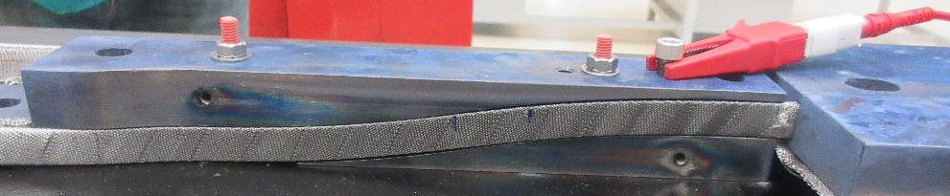
Heat treatment 1 – CR01 conditions
RESULTS
8mm sliding from layer jumps, no worn fibre glass
Electrical tests
  Continuity OK
  0,5Ω cable resistance
  Localized defaults with 4 wires measurements (+-12mm precision)
  Insulation measurements
    >1GΩ before treatment
    ≈10kΩ after
    → Increase number of layers to avoid sliding and keep a suitable insulation

Slide 10
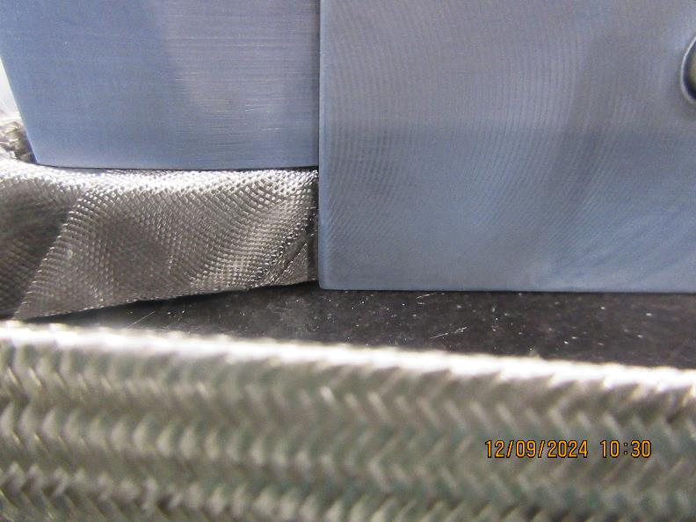
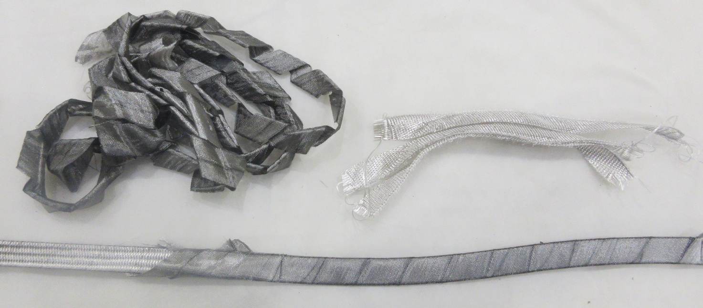
Heat treatment 2 – 5 fibre glass layers
SETTINGS
Same as previously with 5 Hiltex glass fiber layers 0,1mm thick (2mm gap between each) in each layer jump
RESULTS
No sliding, no worn fibre glass
Electrical tests
  Continuity <1kΩ
  0,5Ω cable resistance
  Same localized defaults with 4 wires measurements
  Insulation measurements
    0,6<x<2,5GΩ before treatment
    150<x<460Ω after
Bonus tests
  Shims removed from layer jumps : <10kΩ / 5 fiber glass removed from conductor : 24,6kΩ / 2 new unreacted 0,1mm Hiltex fibre glass added : 108MΩ / 2 new 0,2mm reacted Tisstech fibre glass added : 100MΩ
  Darker visual aspect in layer jumps than previous treatment → sizing reaction during heat treatment

Slide 11
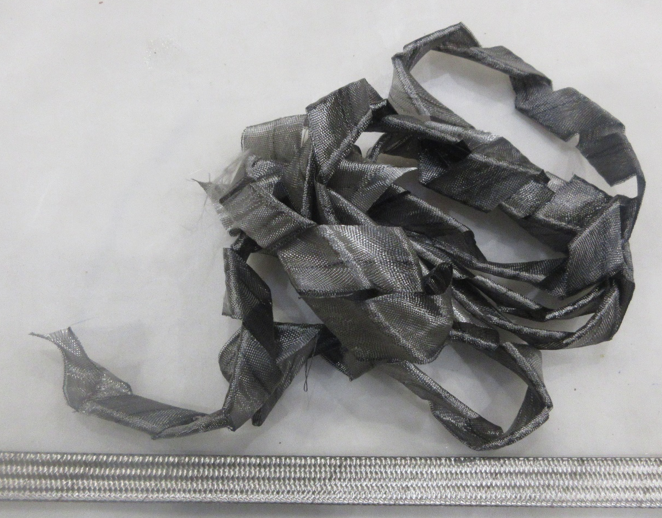
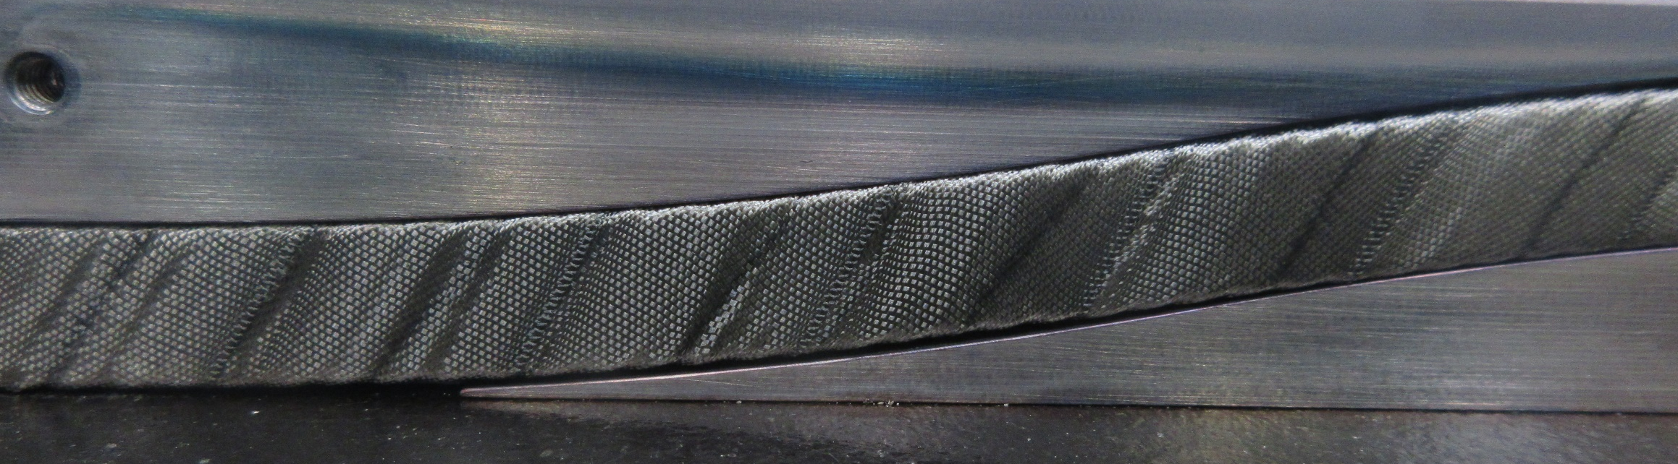
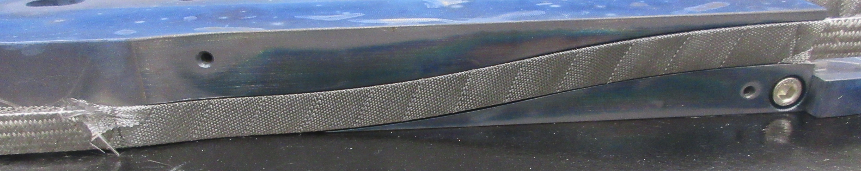
2nd hypothesis : differences in Hiltex and Tisstech fibre glass desizing

Slide 12
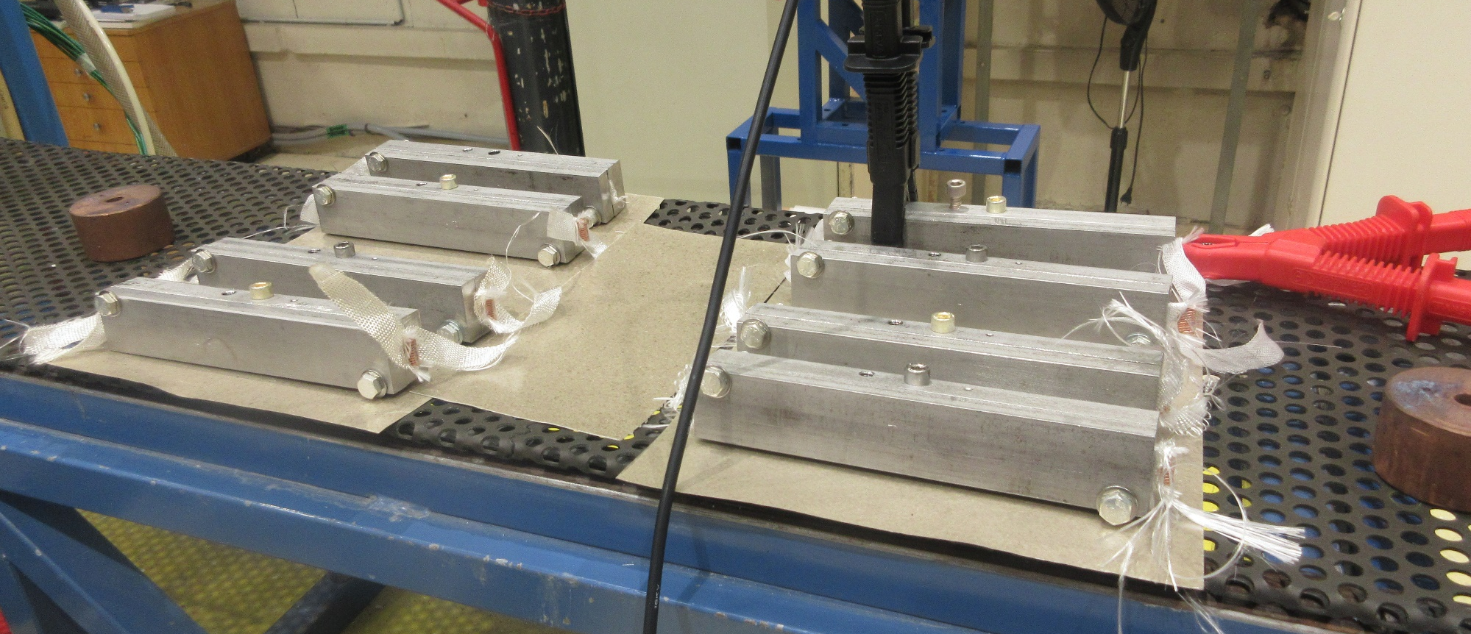
Heat treatment 3 – mini layer jumps
SETTINGS
Test multiple configurations (increase trials statistics) with 8 mini straight layer jumps manufactured (180mm long, reacted HF Cu cable used, 2 layers per configuration)
  2 desized Hiltex 0,1mm thick layers
  2 sized Hiltex 0,1mm thick layers
  2 desized Tisstech 0,2mm thick layers
  2 sized Tisstech 0,2mm thick layers
Desizing process : 16h at 350°C under atmospheric conditions

Slide 13
Heat treatment 3 – mini layer jumps
RESULTS
→ Desizing shows good insulation measurements that will be confirmed (or not) with impregnation
Sample | Insulation before reaction (Ω) | Insulation after reaction (Ω)
Conditions | 15,9°C/82,4% | 17°C/82,1%
Desized Hiltex DH1 | 45,5M | 363M
Desized Hiltex DH2 | 79,4M | 43,7G
Desized Tisstech DT1 | 28,6M | >150G
Desized Tisstech DT2 | 40,2M | >150G
Hiltex H1 | 523M | 757k
Hiltex H2 | 312M | 1,25M
Tisstech T1 | 34,3M | 11G
Tisstech T2 | 35,1M | 9G

Slide 14
Impregnation and dielectric – mini layer jumps
RESULTS
Room’s hygrometry has an influence on insulation measurements
→ Desized Hiltex fibre glass is chosen for next step with R2D2 layer jumps
Sample | Insulation before reaction (Ω) | Insulation after reaction (Ω) | Insulation before impregnation (Ω) | Insulation after impregnation (Ω)
Conditions | 15,9°C/82,4% | 17°C/82,1% | 17,4°C/81,7% | 18,1°C/73,8%
DH1 | 45,5M | 363M | 185,9M | 1,133G
DH2 | 79,4M | 43,7G | 506M | >150G
DT1 | 28,6M | >150G | 128,8M | >150G
DT2 | 40,2M | >150G | 169,7M | >150G
H1 | 523M | 757k | 3,32M | 935k
H2 | 312M | 1,25M | 2,97M | 2,04M
T1 | 34,3M | 11G | 109,1M | 42,1G
T2 | 35,1M | 9G | 253M | 40,4G

Slide 15
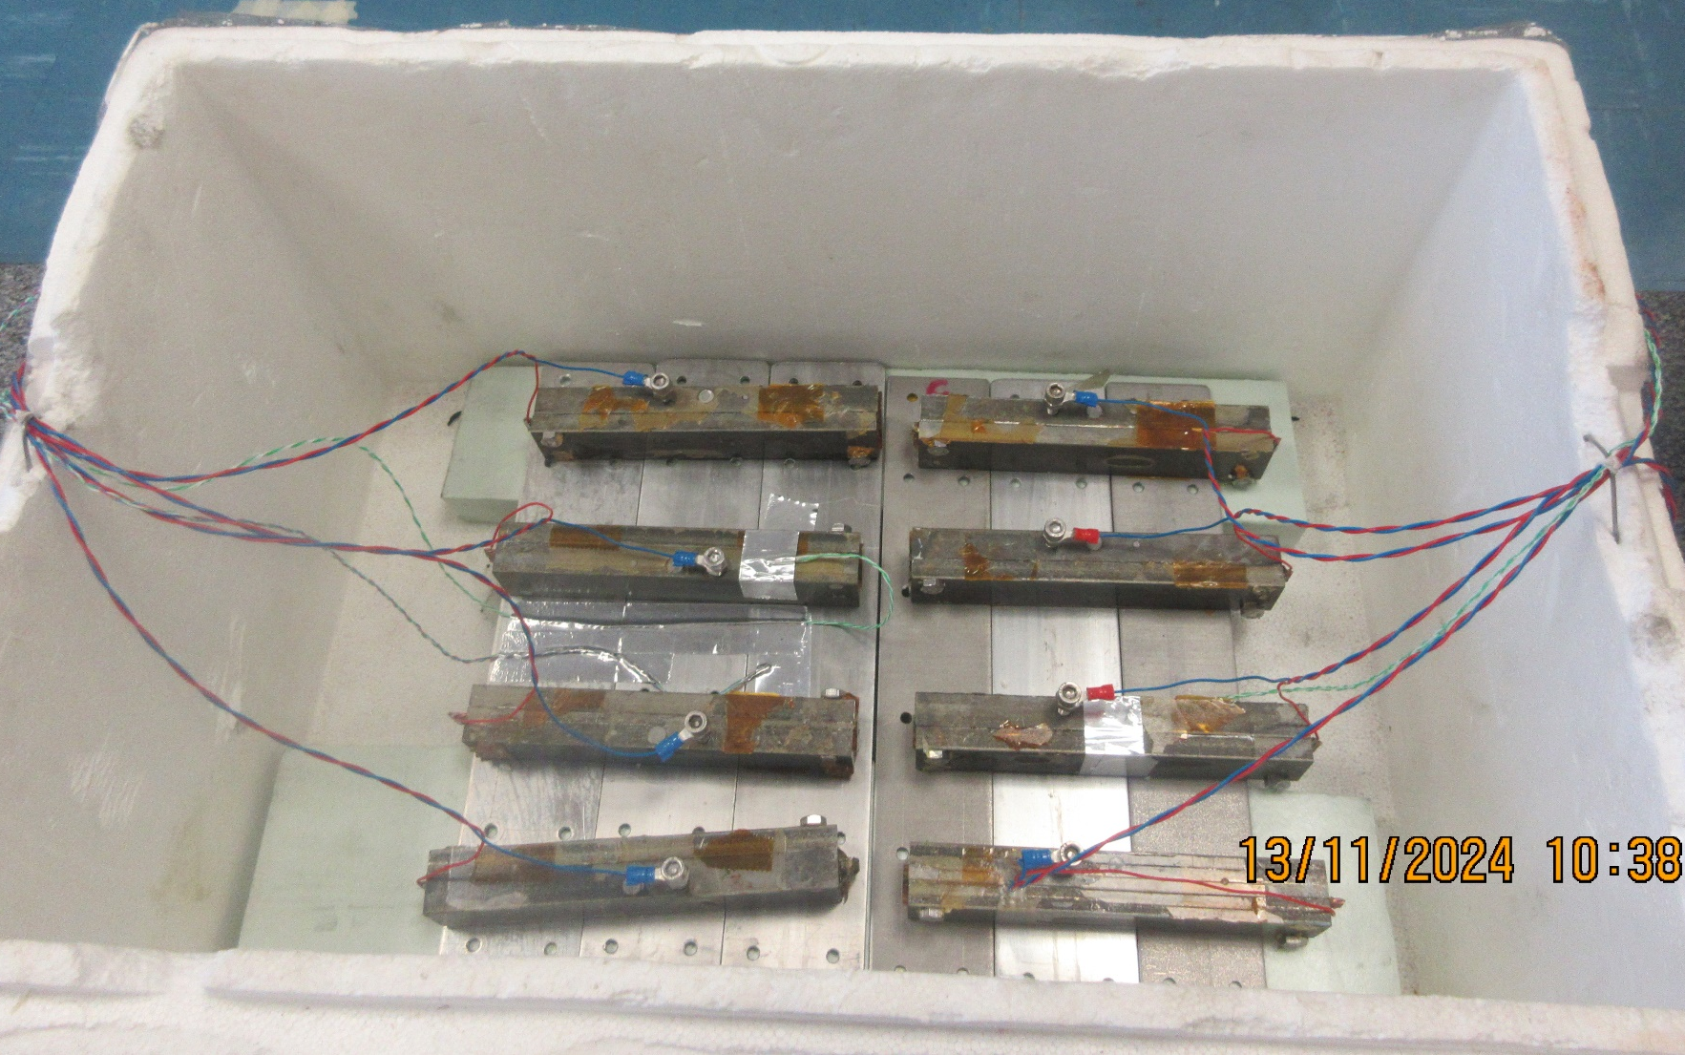
Dielectric at 77K – mini layer jumps
SETTINGS
Samples placed into a polysterene box
Temperature monitoring for a smooth cooldown
Measurements taken every 20min until 77K

Slide 16
Dielectric at 77K – mini layer jumps
RESULTS
Tisstech fibre gives GΩ results, desized or not
1 Hiltex sample out of 4 >1GΩ at 288K
Each sample ends up >150GΩ at 77K
→ Next step is to do the same test on CR01

Slide 17
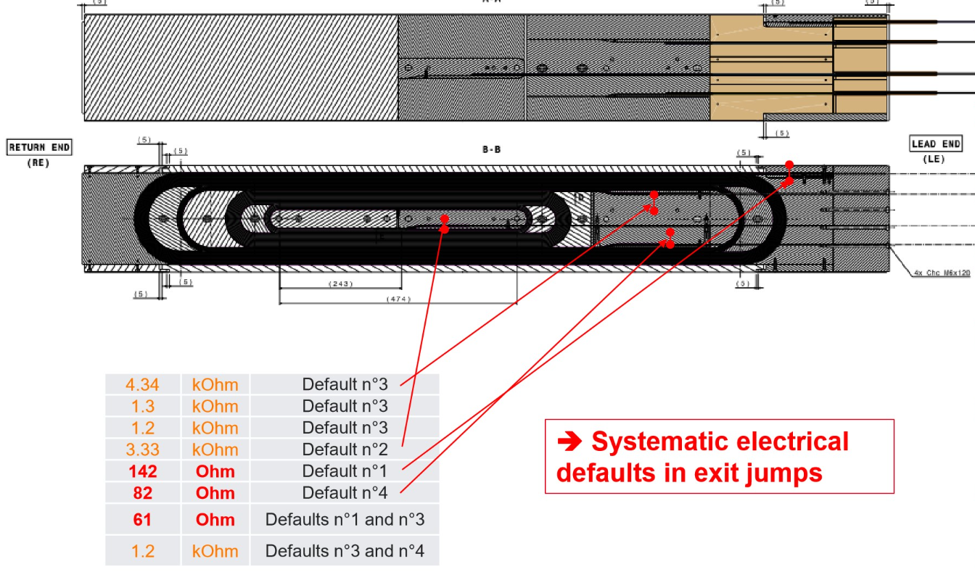
Dielectric at 77K – CR01
CONTEXT
3 exit jumps shortcuts out of 4
2 Hiltex 0,1mm thickness layers per exit jump used
SETTINGS
Same conditions as for mini layer jumps
  Coil placed into an isolated box
  Temperature monitoring for a smooth cooldown
  Measurements taken every 20min until 77K

Slide 18
Dielectric at 77K – CR01
RESULTS
Only post HF / bobine HF shortcut follow the same trend as the mini layer jumps results
Post LF / bobine LF insulation increase up to 2,8kΩ until 160K where it plummets down to 200Ω
Post LF / bobine HF never reaches 1kΩ
Thermal shrinkage do have an influence on insulation value

Slide 19
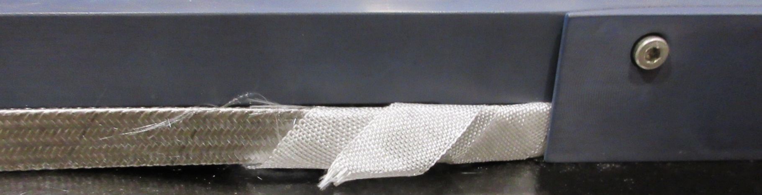
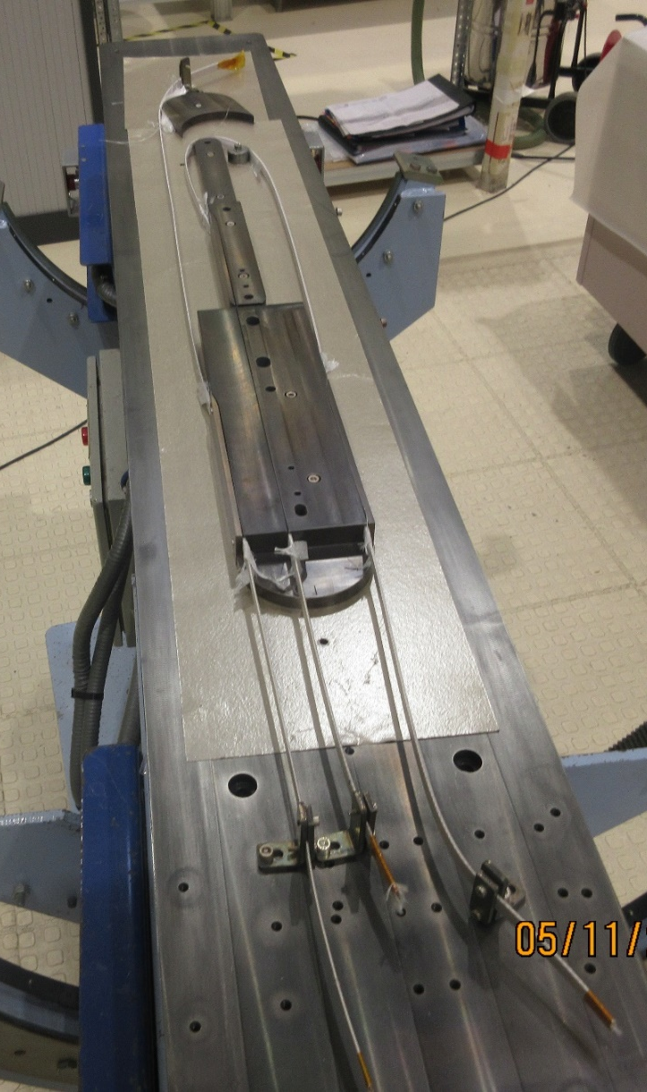
Heat treatment 4 – CR01 conditions with desized Hiltex fibre glass
SETTINGS
3 desized Hiltex glass fiber layers 0,1mm thick (2mm gap between each) in each layer jump
RESULTS
No sliding, no wearing fibre glass
Electrical tests
  Continuity OK
  0,5Ω cable resistance
  Insulation measurements average at 4GΩ
Whiter visual aspect in layer jumps than last reaction → influence of desizing

Slide 20
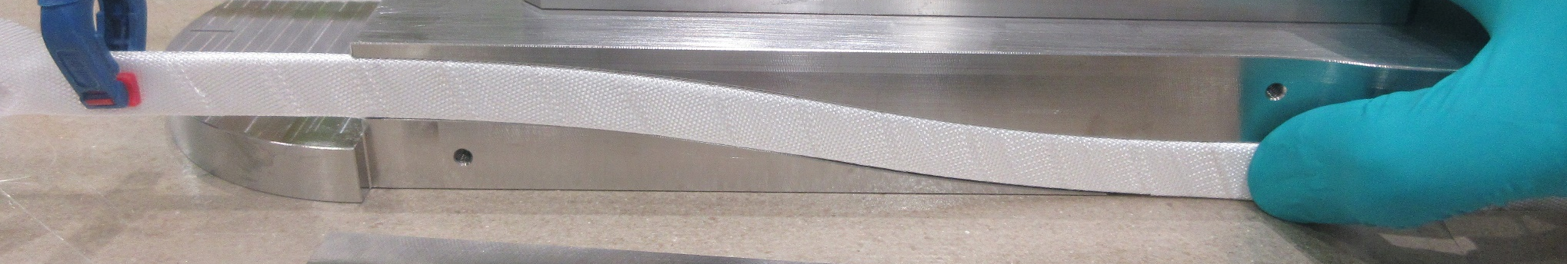
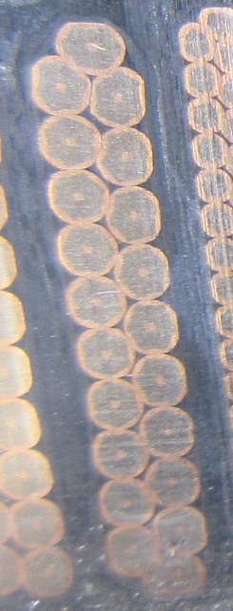
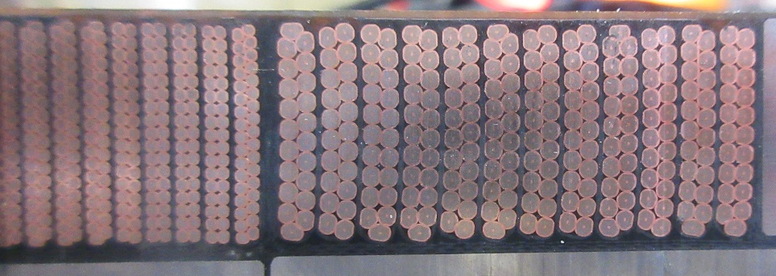
Decision taken for R2D2 magnet
CR02
Option chosen : 3 Hiltex 0,1mm thick desized layers for each layer jump → keep gaps into the jumps
No difficulties during CR02 coil manufacturing
CR01
Coil cutting in progress to check shortcuts visual aspects

Slide 21
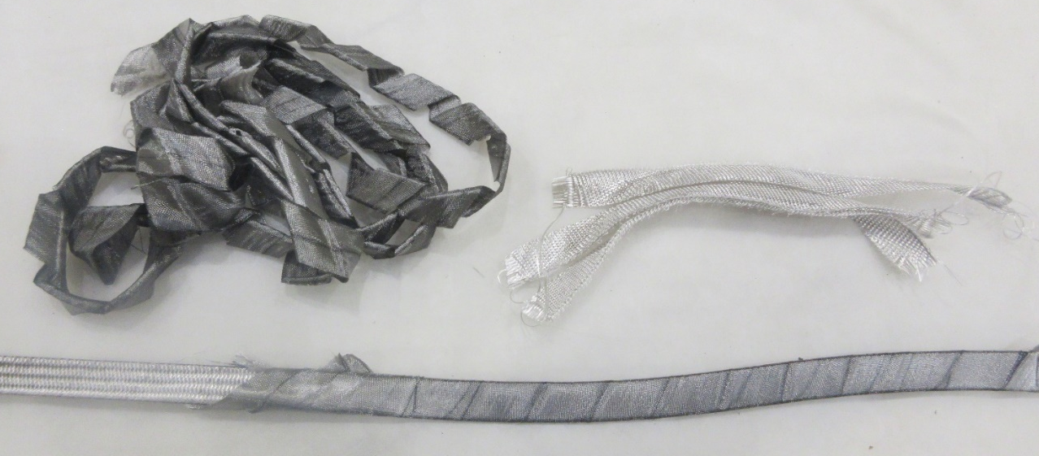
Conlusions and future work
Conlusions
Trials to come on mini layer jumps
Tisstech 0,12mm thick fiber glass delivered to CEA
  Sized and desized samples manufacturing to come
  Same insulation tests before/after heat treatment
  Same insulation dielectric tests after impregnation at ambient and 77K
Perspectives
Elements identification from sized and desized fiber glass
Fibre glass | Hiltex ? | Desized Hiltex | Tisstech 493 | Desized Tisstech
Results | Dark and oily aspect | White and dry aspect, poor mechanical robustness when wrapped around cable | Grey aspect | White and dry aspect
Insulation

