Slide 1
Electron cloud report
22nd August 2011
J.M. Jimenez with contributions from G. Arduini, V. Baglin,
S. Claudet, E. Metral and F. Zimmerman

Slide 2
Main topics
- Introduction
- Scrubbing run
50 ns beams in Physics
Other vacuum induced effects
- Perspectives and limitations
- Closing remarks

Slide 3
Introduction

Slide 4
Introduction
The electron cloud build-up:
  Is a threshold phenomenon
  Is attenuated by the spacing between bunches and bunch trains and by satellite
  bunches
  Depends highly on the Secondary Electron Yield (SEY): δ_{max}, E_{δmax}, reflectivity
    Is enhanced by the low energy electrons surviving the gaps between bunches
  Is affected by many other parameters like:
    Size of the beam vacuum pipe
    Magnetic field (field free, dipole, quadrupole or solenoid field)
    Gasses condensed on cryogenic beampipe walls
bunch population
number of bunches in the train
Linear build-up

Slide 5
Introduction (2/4)
The electron cloud induced limitation are:
  Vacuum pressure rise
    Resulting from electron stimulated desorption (ESD)
    ΔP signal depend on the ratio: Multipacting length vs effective pumping speed
  Cryogenic cooling capacity
    Induced by the electron flux to the beam screen inner wall (heat deposition)
    Heat load limited by the available cooling capacity (capillaries / cryoplants)
  Beam instability
    Depends on both the electron density and the integrated length over LHC ring
    Can become a limiting factor for the scrubbing run (emittance blow-up and losses)
  Beam-gas scattering induced radiation and beam losses
    Depends on both the pressure bump amplitude and length (and on gas species)
    Can become a limitation by increasing:
      The single event probability and radiation to cables and electronics
      The background to the Detectors
  LHC vacuum pressure interlocks are set to keep the beam-gas scattering negligible ; at least 1 order of magnitude of margin is available.

Slide 6
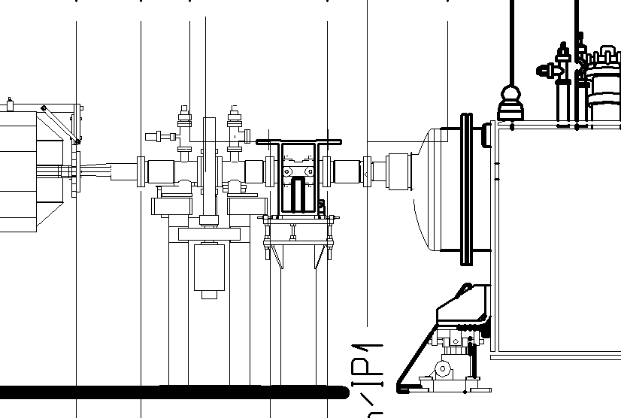
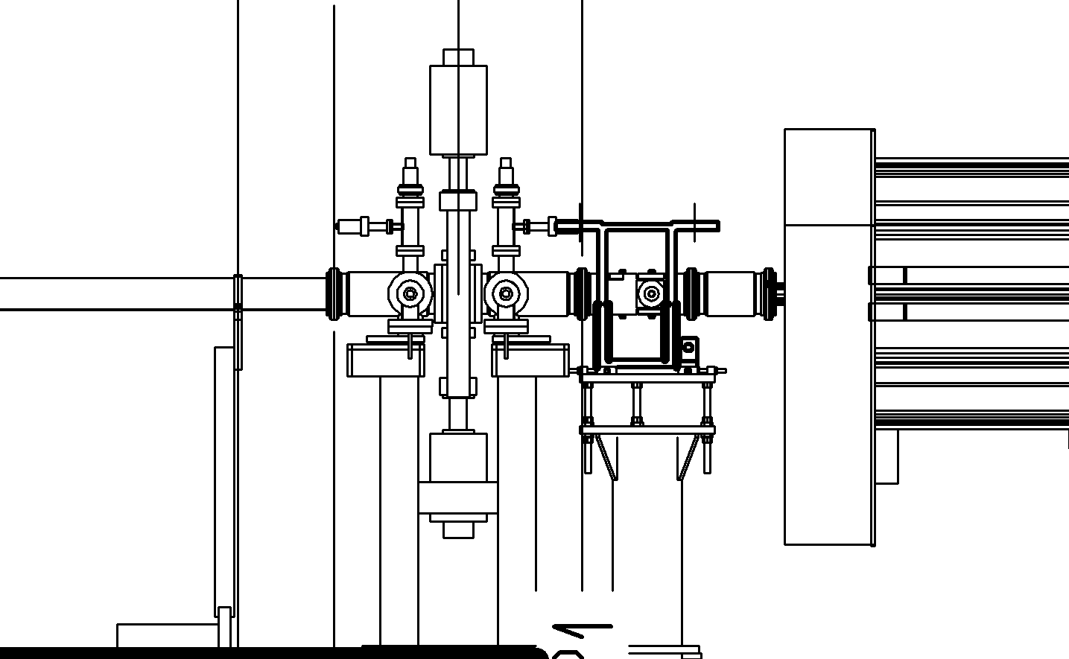
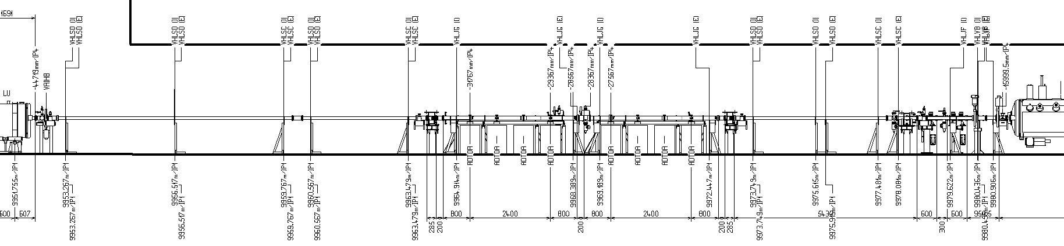
Introduction (3/4)
The electron cloud induced pressure rise need a careful analysis since depending on:
  Number of circulating beams, magnetic field conditions, beam pipe size, multipacting length, effective pumping speed and location and type of probe
Cold
NEG
Gauges
Gauges
ΔP_{observed} ∝ L
Pumping speed ≈ cte
L ~ 1.3 m
L~2 m
Gauges
L~9.2 m
Gauges
Gauges

Slide 7
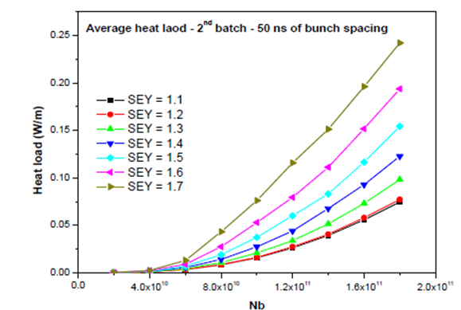
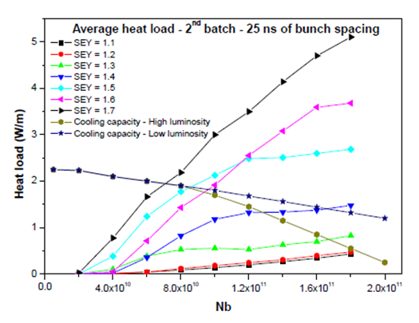
Introduction (4/4)
The electron cloud induced heat load depends on:
  Electron flux to the inner beam screen wall
  Average energy of the electrons
  Measurements integrated over a half period and for 2 apertures
Factor ∼20 confirmed by SPS measurements
M.H. Cuna, EuCARD-DIS-2009-002, Nov 2010
...assuming that beams limitations are not dominated by single bunch instabilities or pressure rise!

Slide 8
Scrubbing run

Slide 9
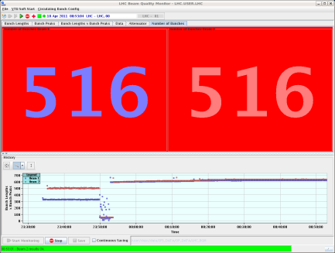
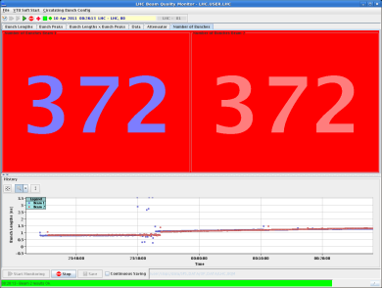
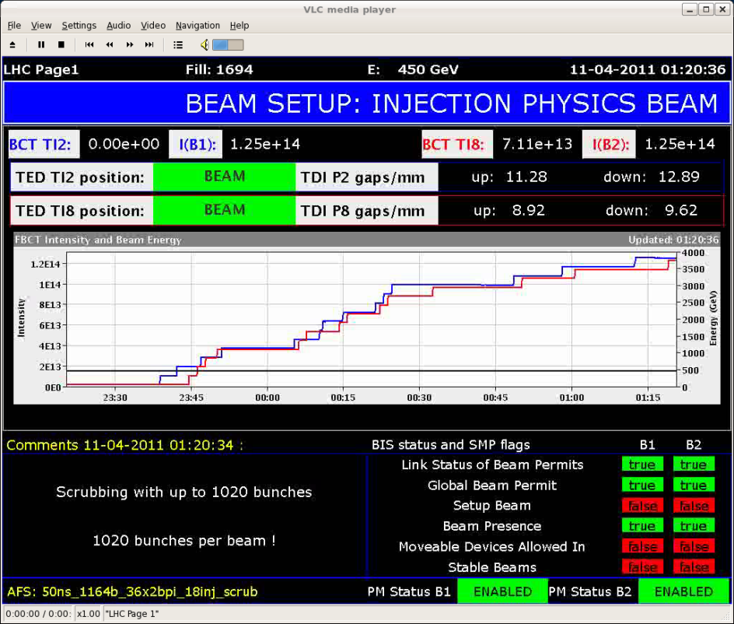
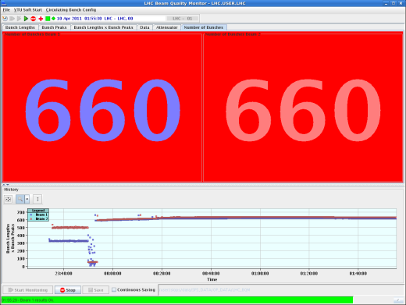
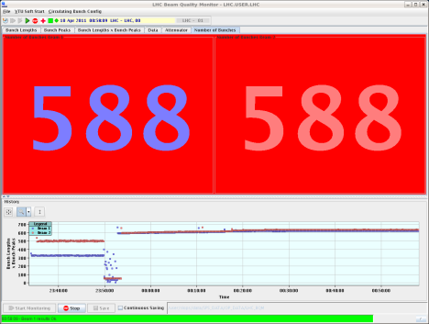
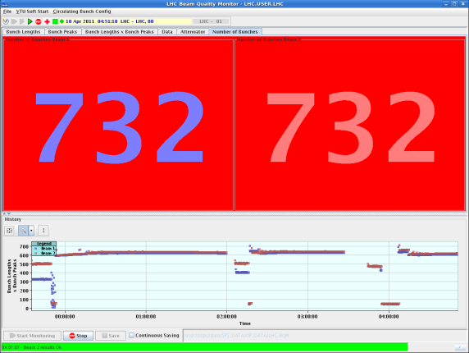
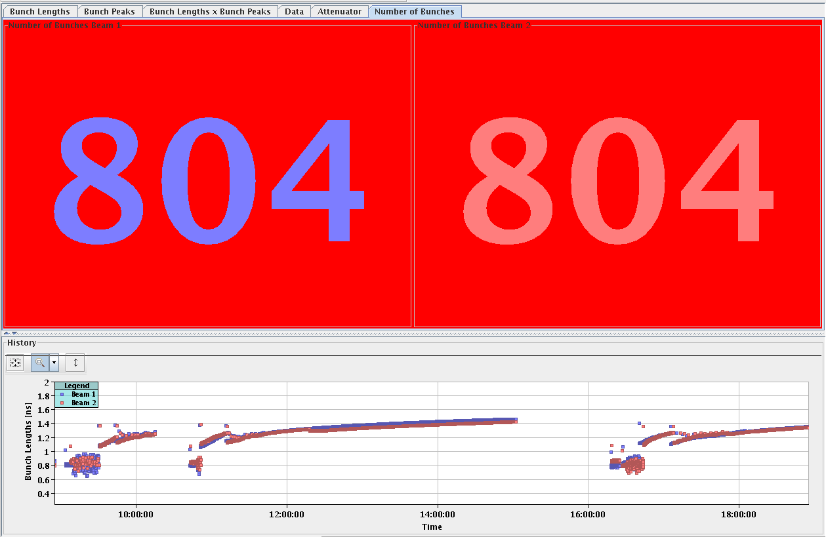
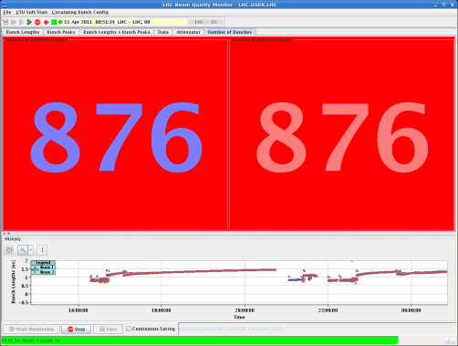
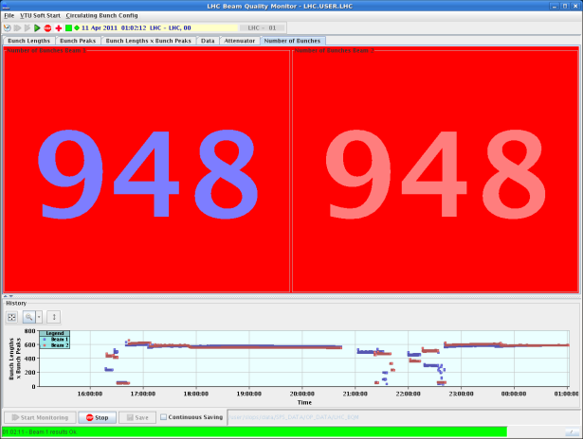
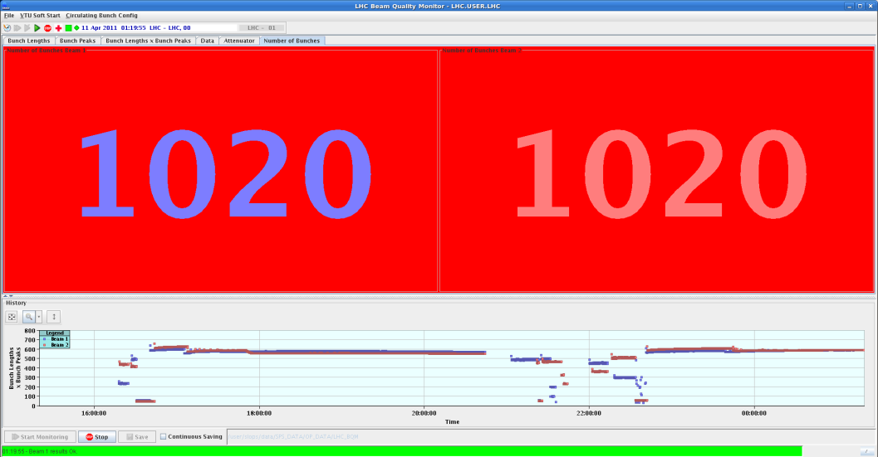
Scrubbing run (1/4)
A success story !
1020 bunches injected after only 15 hours of scrubbing run !
(@50 ns bunch spacing)

Slide 10
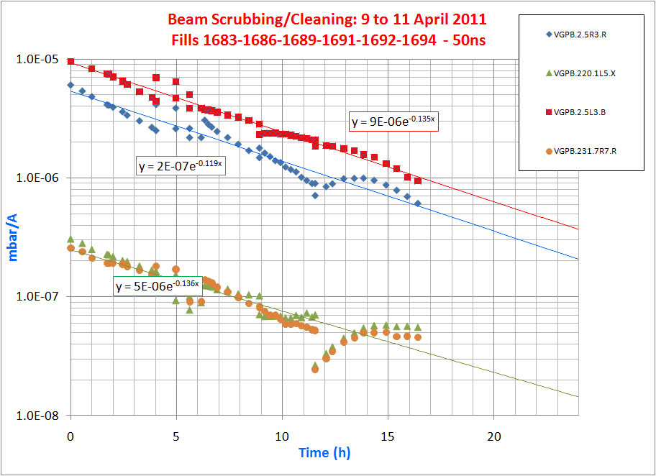
Scrubbing run (2/4)
The decrease results simultaneously from the decrease of the electron cloud activity (δ) and to the vacuum cleaning (η)
Today, LHC runs with 1380 bunches and pressure rise stay in the 10⁻⁸ mbar range...
More than 3 orders of magnitude below with
1380 bunches as compared to runs with 588 b (April)!
No electron cloud in arcs (50 ns bunch spacing) and in NEG coated beampipes, as expected.

Slide 11
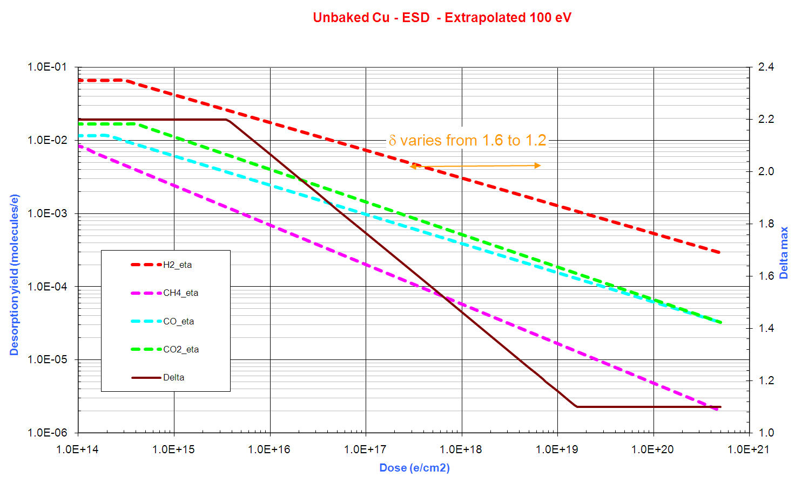
Scrubbing run (3/4)
Decrease of δ and η as a function of dose
Assuming 20 mW/m induced heat load (10¹⁵ e-/m/s or 2 10¹⁶ e-/cm²/h). About 5 10¹⁷ e-/cm² accumulated during the 15 h of scrubbing (integrated beam time)
One order of
Magnitude in pressures
Electron multiplication decreased from 2.2 down
to 1.6

Slide 12
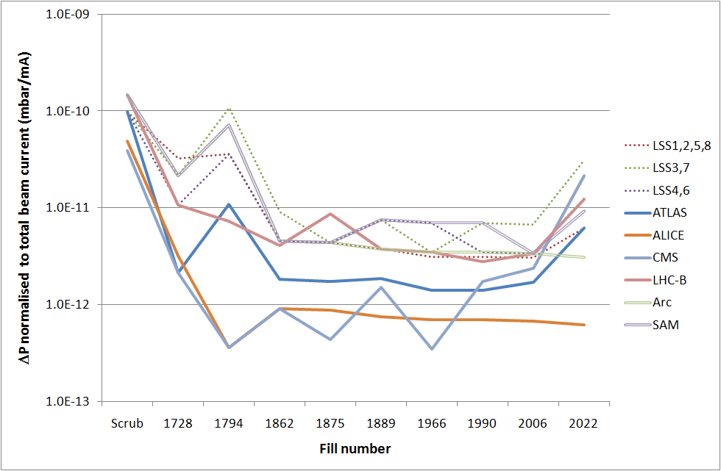
Scrubbing run (4/4)
Limits of the Scrubbing run
  A log conditioning can be observed (as expected)
  Runs above the scrubbing threshold induce pressure rise

Slide 13
50 ns beams in Physics

Slide 14
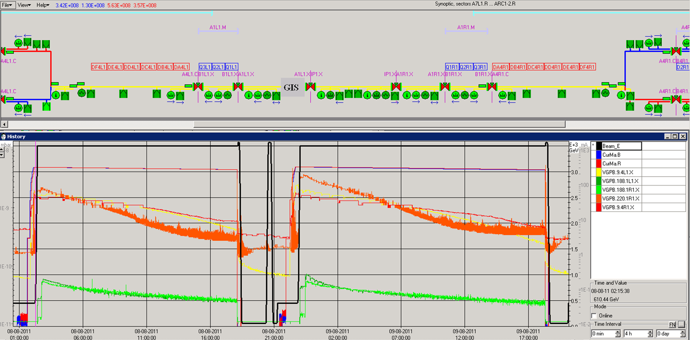
50 ns beams in Physics (1/4)
- ATLAS zone (1/2)
Fast conditioning
after injecting higher
bunch population
10⁻⁹
1.3 10¹¹ p/b
ATLAS central beampipe

Slide 15
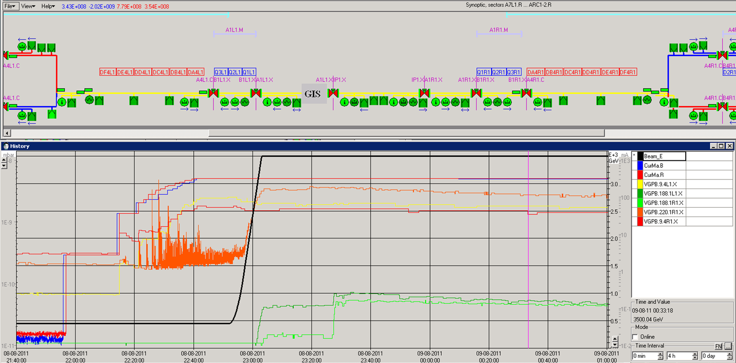
50 ns beams in Physics (2/4)
- ATLAS zone (2/2)
10⁻⁹
Stimulated desorption: electron cloud / beam losses
Stimulated desorption: nuclear cascade

Slide 16
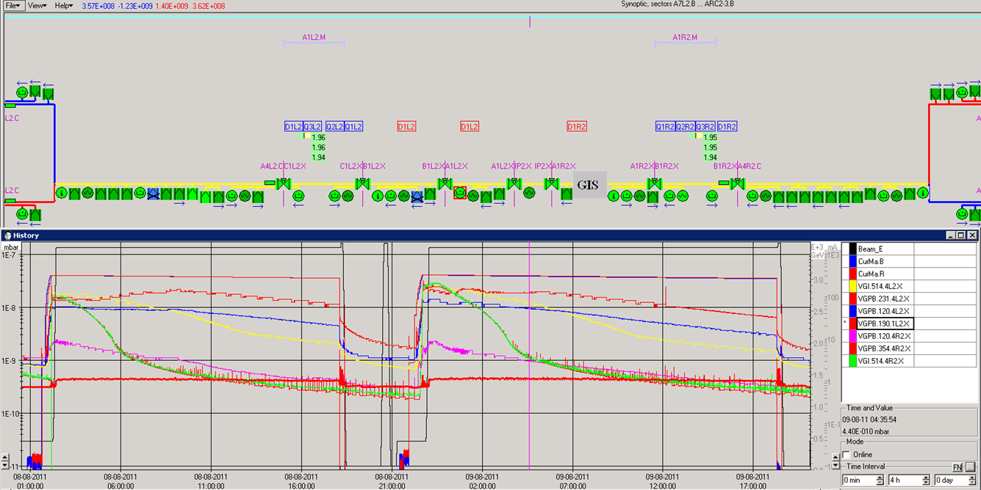
50 ns beams in Physics (3/4)
- Alice
Pressure rise dominated by beam losses and thermal stimulated desorption from injection collimators
10⁻⁸

Slide 17
50 ns beams in Physics (4/4)
Summary
  Pressures in experimental beam pipes are factor 10 below the specified values (LHC Design Report)
  Upstream and downstream electron cloud activity at cold/warm transitions in recombination areas (2 circulating beams) is still visible. Nothing where only 1 beam circulates in beam pipe.
    Operation close to the electron cloud threshold and gas recycling during stoppage of cryogenics (partly solved)
  Fast pressure spikes observed:
    At injection, during the ramp in energy, simultaneously with beam tuning and orbit optimisations
  Situation more favorable in ATLAS and CMS:
    Warm D1 with NEG coatings,
    Not an injection point,
    No collimator to protect the cold D1,
    Vacuum layout at D1 more favorable (to be modified at LS1).

Slide 18
Other vacuum induced effects

Slide 19
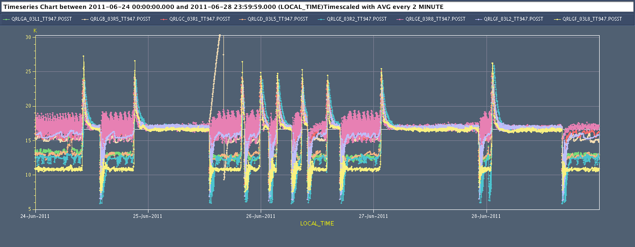
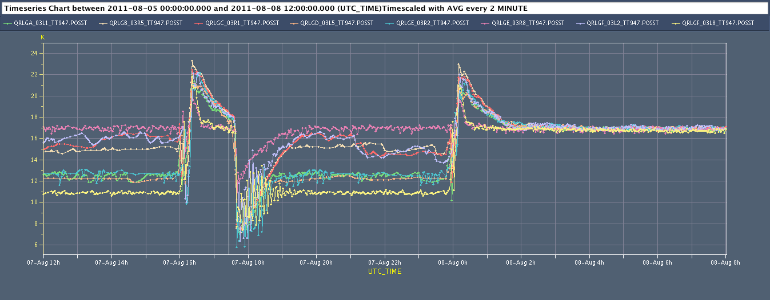
Other vacuum induced effects (1/4)
Temperature dependence of the cryo-beam vacuum: Procedure to optimise the Beam Screen temperature stability
Jun’11
Peaks 25-27K
Aug’11
Peaks 22-23K
Automatism now in place
Lower peak values, reproducibility

Slide 20
Other vacuum induced effects (2/4)
  Temperature dependence of the cryo-beam vacuum: Procedure to flash gas from Beam Screen to Cold Bore
Gas redesorbed from
BS and “flashed” to the CB which is always kept at a lower temperature
Inner triplets IR8R

Slide 21
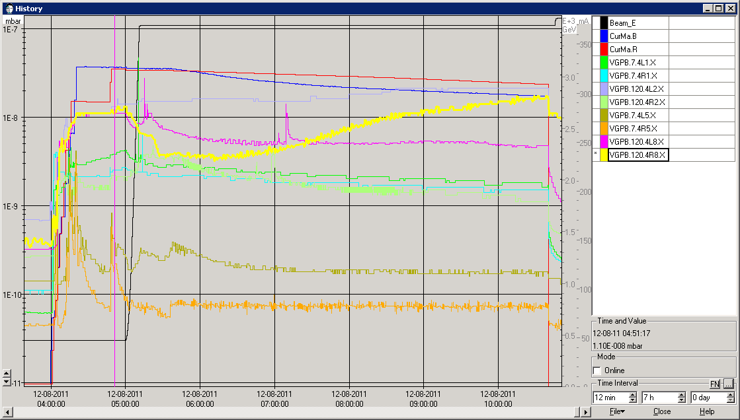
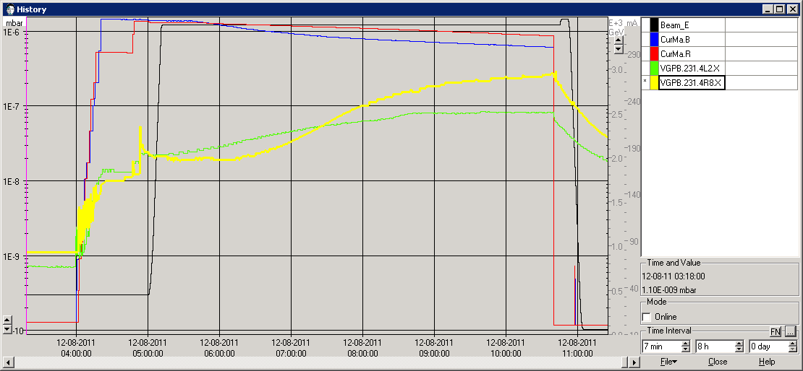
Other vacuum induced effects (3/4)
Injection collimators operated as “active” collimators and no longer as passive absorbers?
...could become an issue for Alice and
LHCb background !
Already some complains
10⁻⁸
10⁻⁷
Evolution of the pressure at TDI levels
during fill 2022. Both TDIs drift with time.
This drift is also seen on D1R8 by
conductance effect

Slide 22
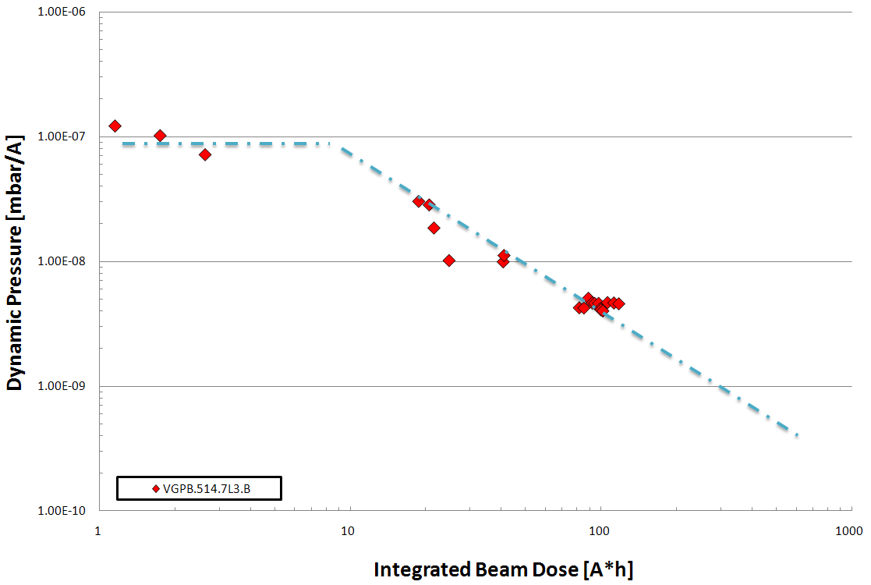
Other vacuum induced effects (4/4)
Synchrotron Radiation effects
  With 25 ns beams, more photon flux, from 2.5 10¹⁶ ph/m/s to
  5 10¹⁶ ph/m/s with nominal current (2804 bunches) BUT same critical energy (5.5 eV)
  Twice the Pressure increase, still conditioning but it is a log scale !
Evolution of arc’s extremity pressure
10⁻⁷
This benefit will be lost
during the LS1 since
entire machine (arcs) will
be vented for months...

Slide 23
Perspectives and limitations

Slide 24
Perspectives and limitations (1/5)
Operation with 25 ns beams: 10 times more electron dose required
One order of
Magnitude in pressures
Factor 10 less dose
to be expected
in field free regions
Electron multiplication decreased from 2.2 down
to 1.6
Target for 25 ns operation
10 times more scrubbing time

Slide 25
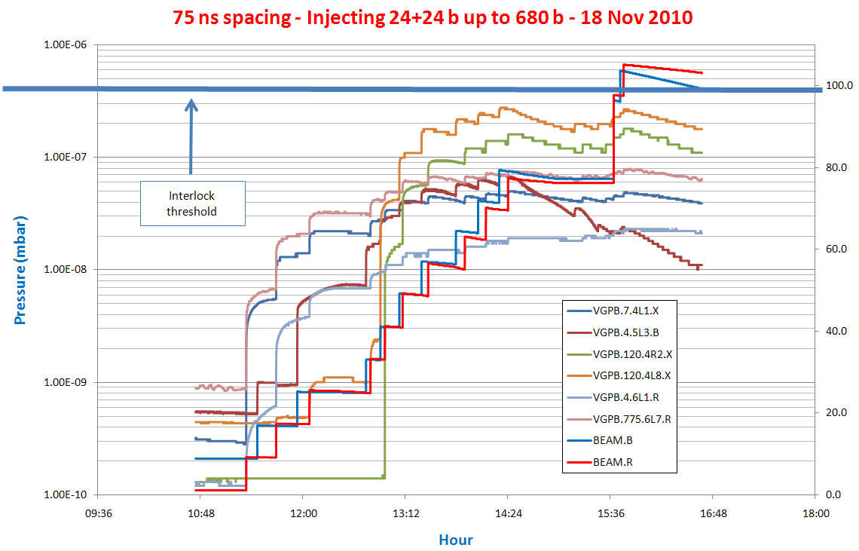
Perspectives and limitations (2/5)
Operation with 25 ns beams: more multipacting length expected
  Arcs and standalone magnets with 1 circulating beam per beam pipe will be multipacting: 50 times more!

Slide 26
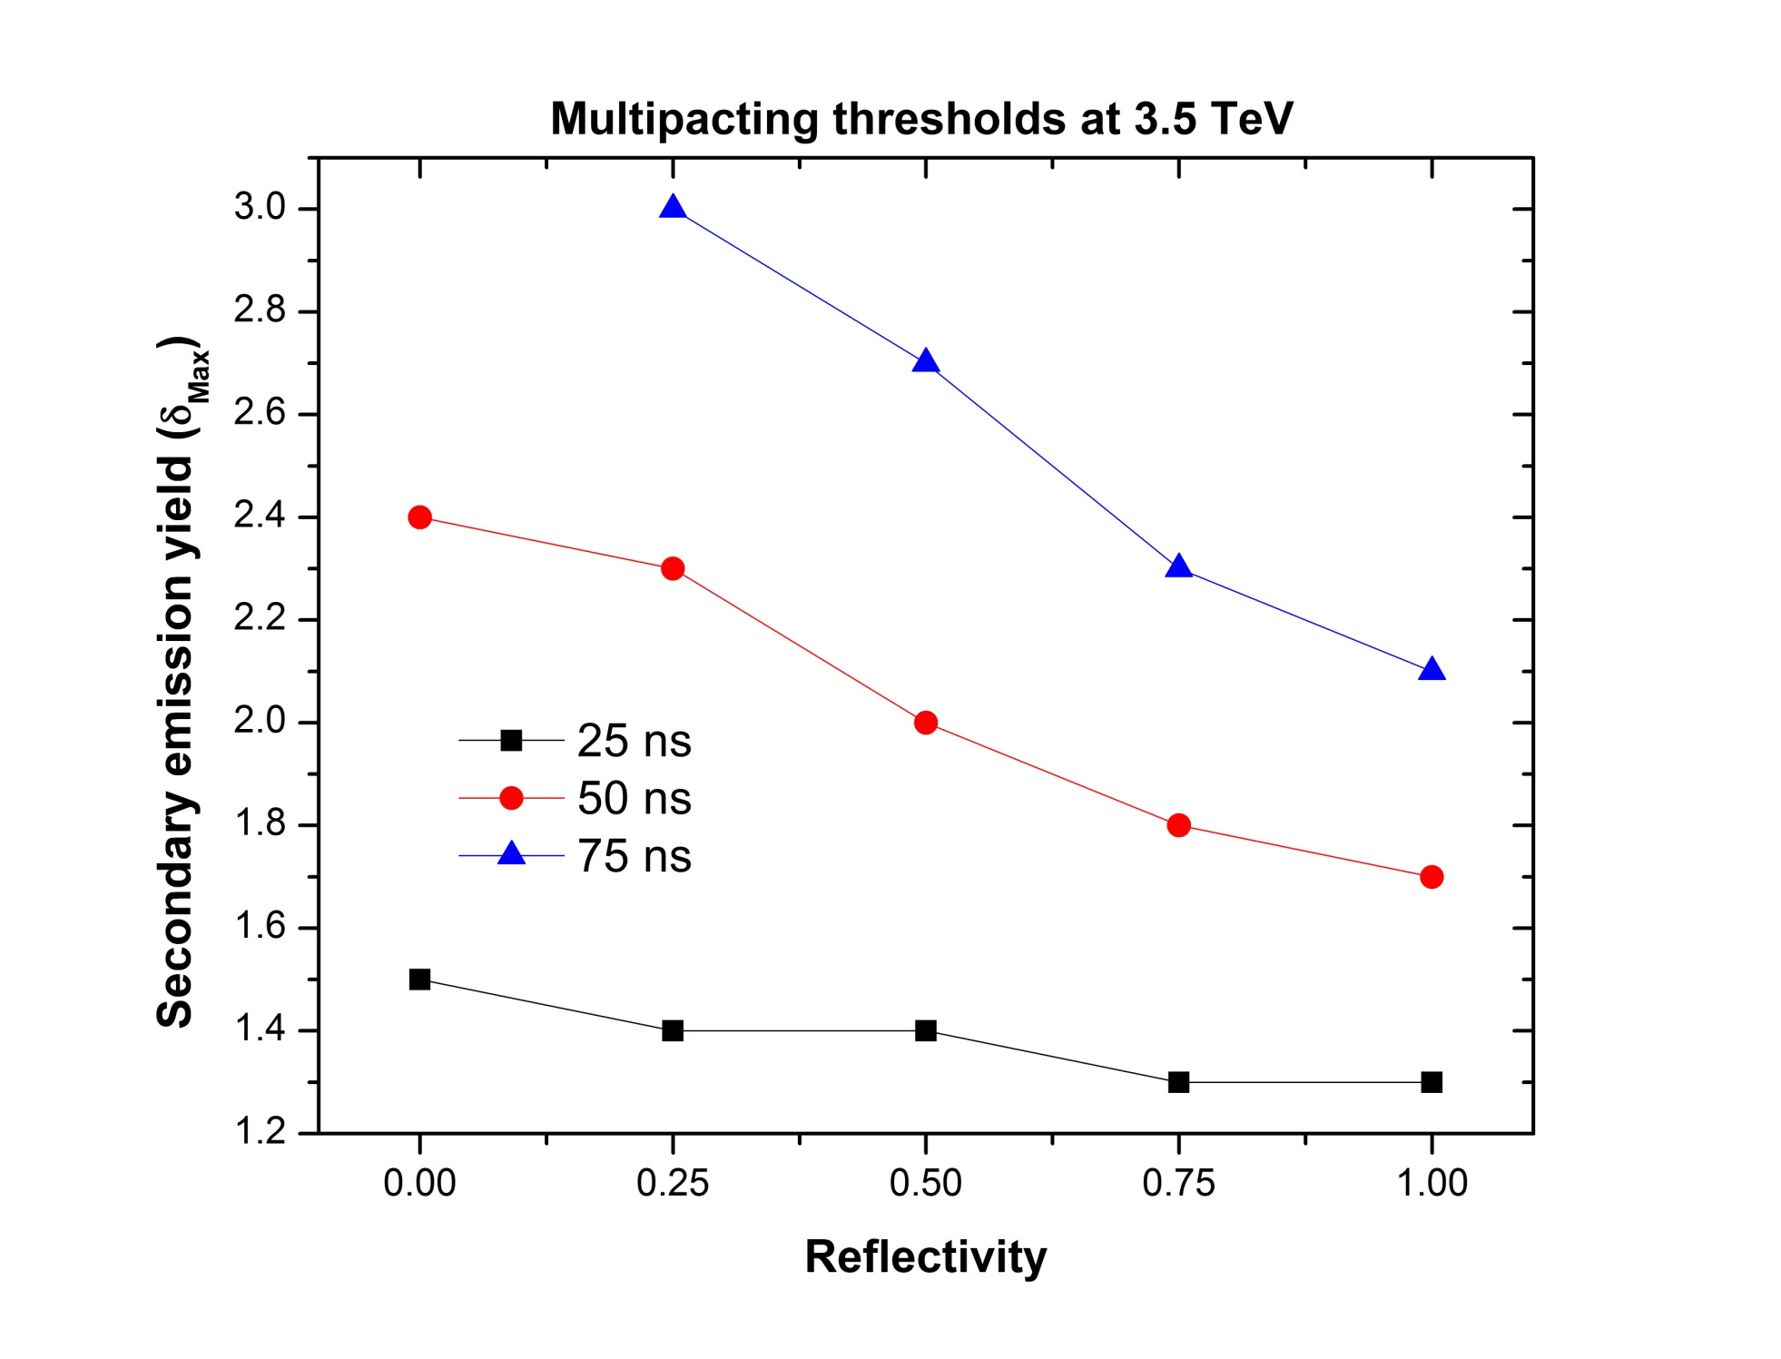
Perspectives and limitations (3/5)
Operation with 25 ns beams: Dependence with reflection of low energy electrons
  25 ns beam are less depending than 50 ns
  Reflected electrons could become an issue
now
H. Maury
of low-energy e-

Slide 27
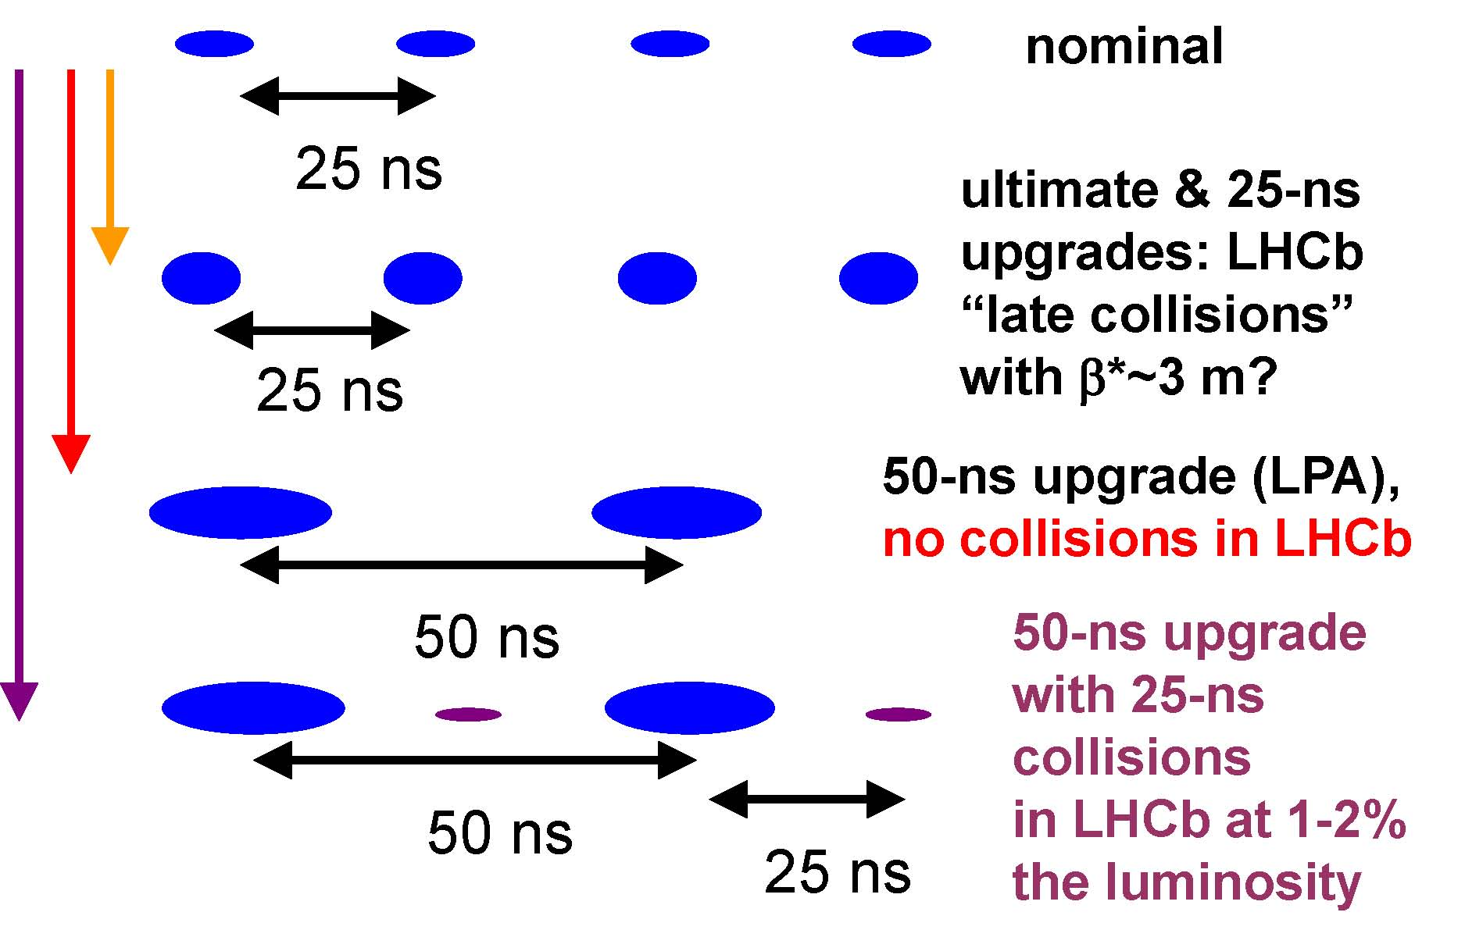
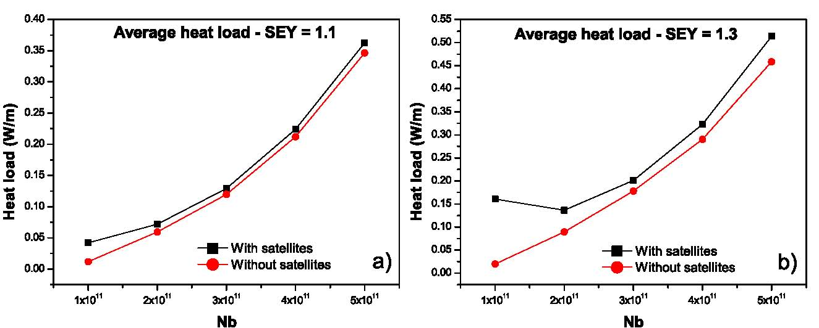
Perspectives and limitations (4/5)
Operation with 25 ns beams: Effect of
LHCb satellite bunches
  Electron cloud induced heat load fits the
  cooling power for 50 ns beams
H. Maury
L. Tavian

Slide 28
Perspectives and limitations (5/5)
Summary (Operation with 25 ns beams)
  2-3 weeks of scrubbing will be required to go from δ=1.6 down to 1.2
  10 times more dose (~150 hours of beams)
  Multipacting length will be 50 times longer (entire ring)
  Reflectivity of low energy electrons will impact the filling scheme
  50 ns beams with interleaved LHCb satellite bunches should not be an issue

Slide 29
Closing remarks

Slide 30
Closing remarks (1/2)
Confirmations
  Scrubbing runs baseline was confirmed as an efficient way to decrease the electron cloud
    Less than 1 hour needed in the arcs and the straight sections with one circulating beams at 50 ns bunch spacing
    15 hours in beampipe with two circulating beams
  NEG coatings provide, as predicted, both a distributed pumping and an electron cloud mitigation (no build-up observed)
  Solenoids help to avoid electron cloud build-up upstream and downstream the experimental areas (background issues)
  Background and beam lifetime fully compatible with operation in Physics (1 order of magnitude margin with present beam parameters)

Slide 31
Closing remarks (2/2)
Concerns
  Vacuum system very sensitive to beam losses which induce fast pressure spikes. Cannot be filtered ⇨ machine protection
  Non-NEG coated beam components like beam instrumentation and RF equipments are increasing the electron cloud and gas load
  Cold vacuum strongly dependant on temperature variations between 12 and 30 K ⇨ More demanding for the cryogenic system
    New procedure are successfully applied
Pending issues
  Operation with 25 ns beams will be challenging
    Beam instabilities, longer scrubbing runs (×10 more than with
    50 ns), heat load issues all around the ring (and not only in the inner triplet as observed today)
    Needs to keep constant electron flux, still realistic if all arcs are multipacting? (single bunch instabilities)

Slide 32
Reserve (slides)

Slide 33
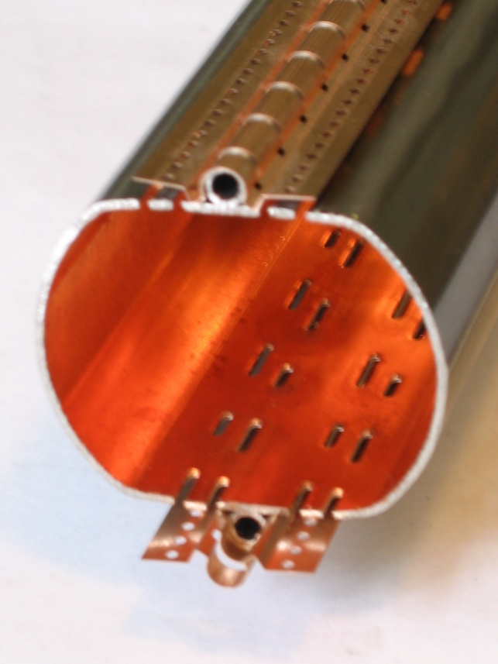
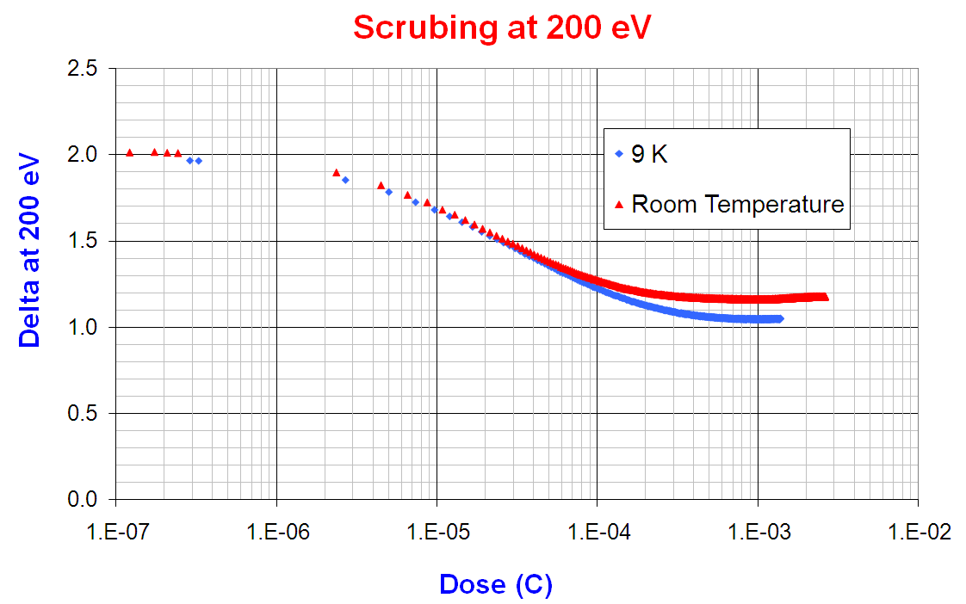
Introduction (5/)
Specificities of beampipes at cryogenic temperatures
Unbaked vacuum system by design
Beam screen’s hole provide pumping speed by the cold bore
Primary and recycling desorption yields : η’_{monolayer} >> η
Beam screen’s surface coverage should stay below a monolayer : minimize the
accumulation of gas on the BS (results from electron cloud and synchrotron
radiation)
Scrubbing rate at cryogenic temperature of a bare surface is similar to RT

Slide 34
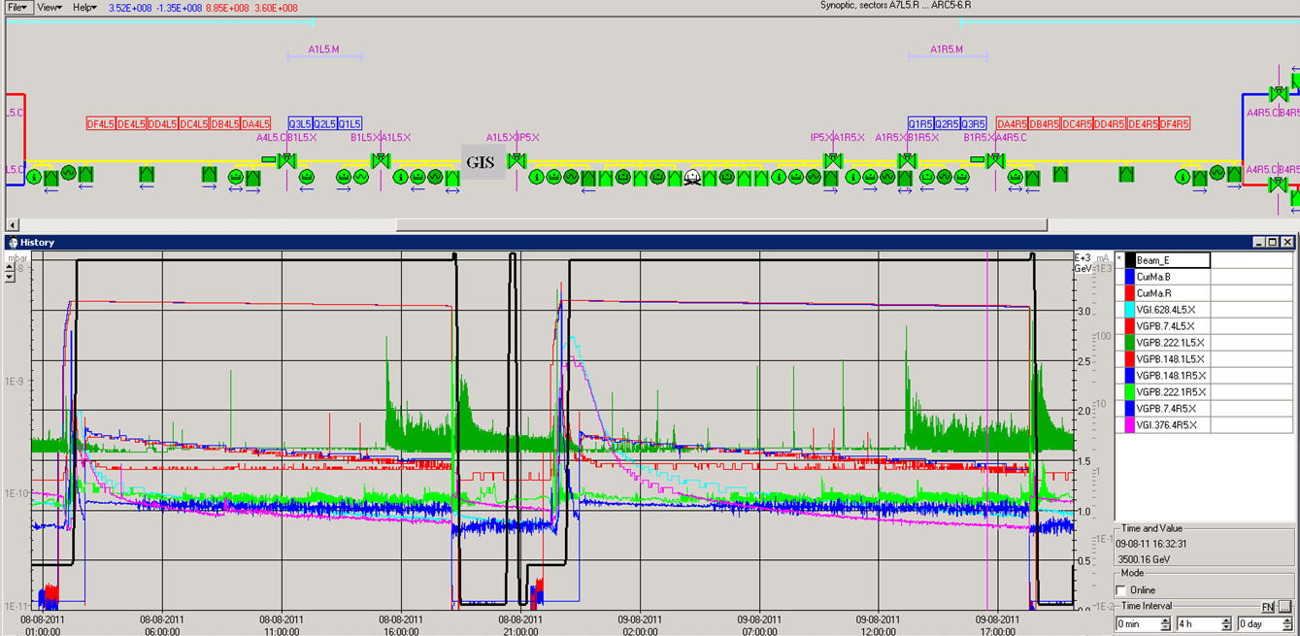
50 ns Beams in Physics (3/7)
- CMS (1/)
Fast transient close to D2
during the ramp on both sides
Fast recovery...

Slide 35
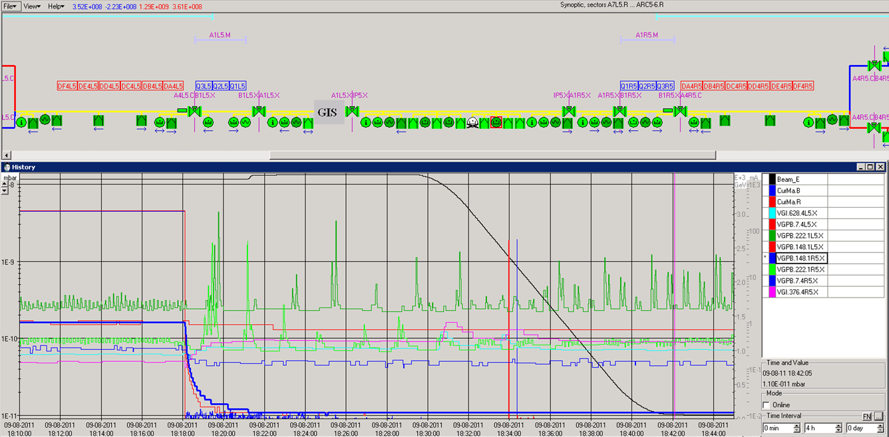
50 ns Beams in Physics (4/7)
- CMS (2/)
Pressures measured in CMS are real pressures and not noise induced by ionisation in gauge’s cables

Slide 36
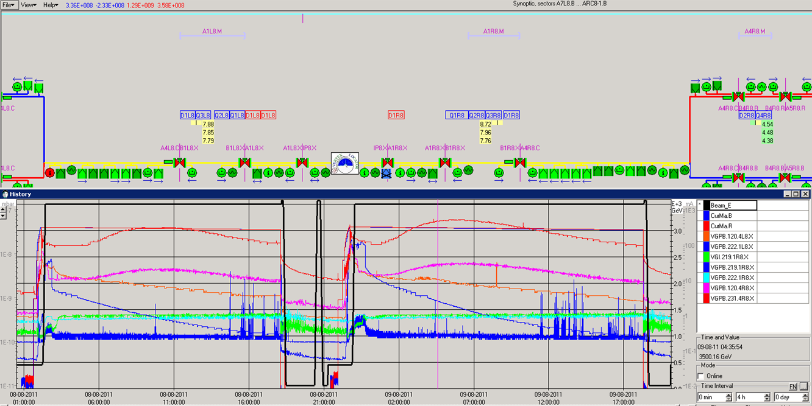
50 ns Beams in Physics (6/7)
- LHCb
Pressure rise dominated by beam losses and thermal stimulated desorption from injection collimators

