Slide 1
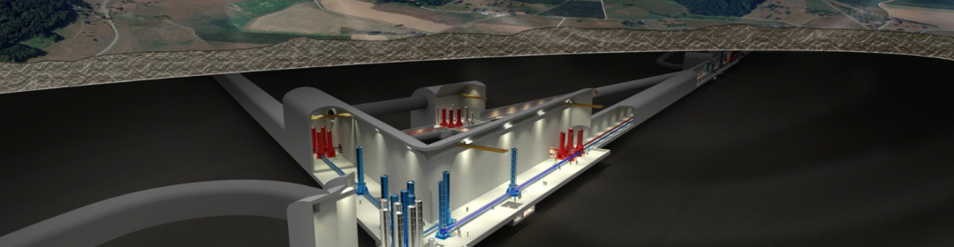

Einstein Telescope
ET-PP MEETING — 00.00.000
WP5 Progress Status
ET-PP MEETING. Thursday December 19th

Slide 2

Einstein Telescope
ET-PP WP5 - December 19, 2024
PROJECT OFFICE
1) Waiting for the officer feedback on the proposed document for the definition of
the project office structure and mandate and Functionalities required from the tools in support of the project management. (Received yesterday)
After the feedback we will implement the required modifications
b) Working on the next deliverable (functional project office). This has to be evaluated .
We are in touch with M.Martinez to assess the contents of this document and
the correct timeline
c) Project office is functional? List of activities in the next slides:

Slide 3
Einstein Telescope
ET-PP WP5 - December 19, 2024
PROJECT OFFICE
1) ETO Management, General activities and news:
Working on the roadmap, implementing the documents in the WBS
Supporting the task force
Organizing the Suspensions PBS reviews
Finalizing the review and creating the PBS baseline 1.0
2) Scope management
New version of PBS and WBS. Change process to be implemented for the new
version of PBS
Participation in the Vacuum TDR review
3) Configuration & IT
Discussing a Configuration strategy for IT
Creating bridges to EDMS
Finalizing the acquisition of JAMA for requirements management
Kick off meeting with Aachen for the MBSE test on selected systems

Slide 4
Einstein Telescope
ET-PP WP5 - December 19, 2024
PROJECT OFFICE
4) Risks management
Progressing with the technical risks definition and interviews
Supporting the risk analysis for the task force
5) Quality management
Elaborating a methodology for nomenclature in different context
Change process waiting for a validation procedure
6) Scheduling management
Proposed training session to ten managers of the collaboration to validate the methodology.
Full information on the wiki
Training videos realised
7) Costing
a) Activity pending due to the CERN refusal to sign the contract on this activity

Slide 5
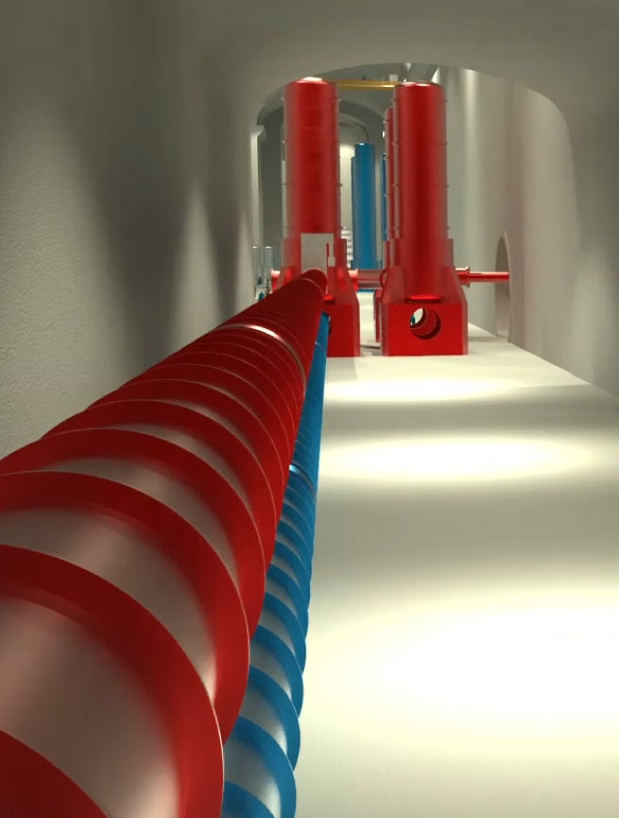
Einstein Telescope
ET-PP WP5 - December 19, 2024
Engineering Department: Mandate
The Engineering Department will design, procure, install, commission, operate, maintain and eventually, dismantle:
The special systems (e.g. vacuum, cryogenics and survey) associated with the gravitational wave detector
and
The technical infrastructure systems needed to operate the interferometer (e.g. civil engineering, technical Infrastructures (power distribution, cooling & ventilation, …)

Slide 6
Einstein Telescope
ET-PP WP5 - December 19, 2024
Engineering Department
Engineering Department
Patrick Werneke (Nikhef)
External Contracts CERN
ET Phase 1
Luigi Scibile (CERN Coordinator)
Civil Engineering
Maria Marsella (INFN)
Technical Infrastructure
……
Engineering Technology
……
Mechanical Engineering
….
Coordination and Integration
…..
Civil Engineering MoU with CERN
Responsibles:
CERN:
John Osborne (SCE-SAM-FS)
ETO Coordinators:
Maria Marsella (INFN)
Patrick Werneke (Nikhef)
Mario Martinez (IFAE)
Civil Engineering:
Jonathan Bratanata (Nikhef)
Wissam Wahbeh (FHNW)
…..
Cooling and Ventilation
…..
Vacuum:
Marije Barel (Nikhef)
Alexandre Lacroix (CNRS LAPP)
Guillaume Deleglise (CNRS LAPP)
Rafael Garcia (IFAE)
…..
Design and Simulation:
Max Majoor (Nikhef)
Tommaso Napolitano (INFN LNF)
Gregory Iaquaniello (CNRS IJCLab)
Integration:
…..
Integration:
…..
Vacuum Beampipe MoU with CERN
Responsibles:
CERN:
Paolo Chiggiato (TE-VSC)
ETO Coordinators:
Fernando Ferroni (INFN)
Patrick Werneke (Nikhef)
Access and Alarms
…..
Operational Safety:
Phase 2
Integration:
…..
Electrical Engineering
…..
Cryogenics:
…..
Fabrication and Installation:
Phase 2
Under dicussion MoU’s with CERN:
Occupational Health and Safety
Cooling and Ventilation
Access and Alarms
Electricity Engineering
Coordination and Integration
Cryogenics
Survey
Survey:
…..

Slide 7
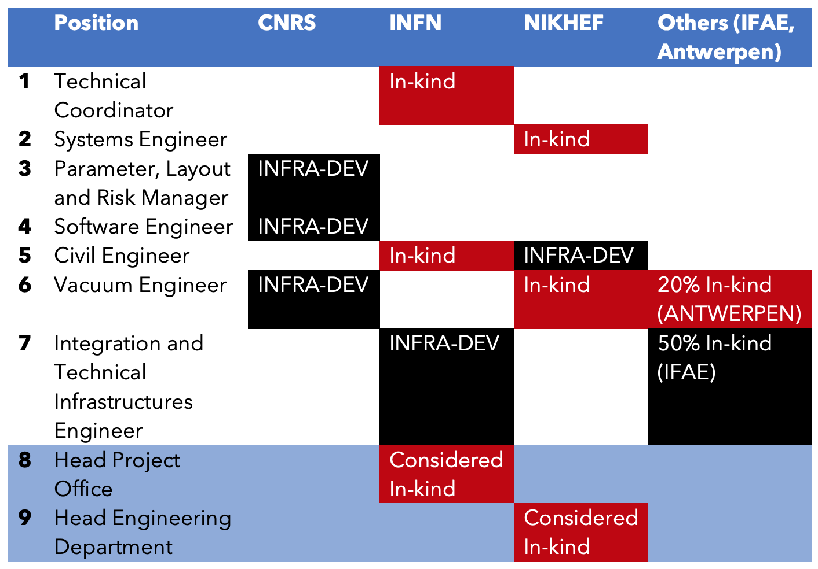
Einstein Telescope
ET-PP WP5 - December 19, 2024
Engineering Department – Personnel
New colleagues in 2024:
Jonathan Bratanata – Nikhef – civil engineering
Tommaso Napolitano – LNF – mechanical engineer
Gregory Iaquaniello (CNRS IJCLab) – mechanical engineer
Missing is still the Integration and Technical Infrastructures engineer, but will hopefully be solved soon with the help of Tommaso.

Slide 8
Einstein Telescope
ET-PP WP5 - December 19, 2024
Engineering Department – Personnel
Collaboration agreement with CERN:
Agreement with civil engineering until end 2026
Extend the contract with vacuum group until Q3 2027
Agreement with the Engineering Department for the Technical Infrastructure and HSE for underground Health and Safety issues until Q3 2027

Slide 9
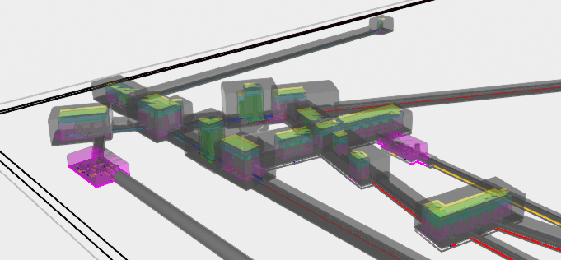
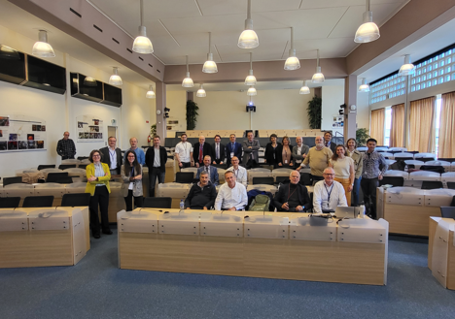
Einstein Telescope
ET-PP WP5 - December 19, 2024
Engineering Department
Optical Layout and Detector Layout → Task Force
Improved collaboration with the Local Teams
– workshop at CERN, roadmap
D5.3 delivered in September on time, but needs some
revision
  More specific summary
  Mandate more specific – position inside ETO
  More details on vertical team structure
  Uncertainty on resources
D5.4 Functional Engineering Department. (M28)
Were waiting for feedback – should be ready early 2025

