Slide 1


Connection between H(x) and Geometric Scaling
in elastic proton-proton collisions
T. Csörgő^{1,2}
¹ Wigner RCP, Budapest, Hungary
² MATE KRC, Gyöngyös, Hungary
Odderon exchange in elastic pp
Model independently: at least 6.26 σ
Model dependently: at least 7.08 σ
Geometric Scaling
why it fails at LHC energies
Derivations of H(x) scaling
Model independently
Model dependently (ReBB)
Generalized Geometric Scaling
why it works at LHC energies

Slide 2
AN OLD STORY REVIVED
GEOMETRIC SCALING

Slide 3
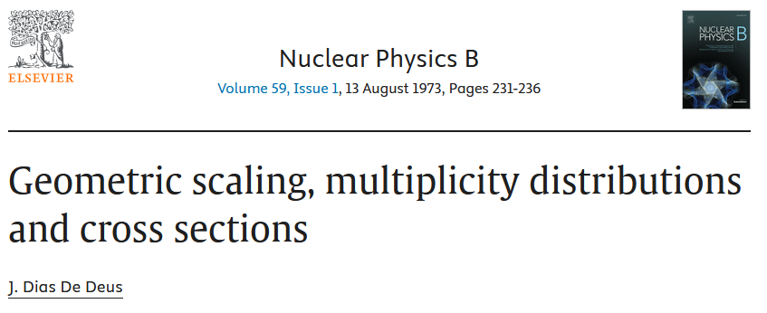
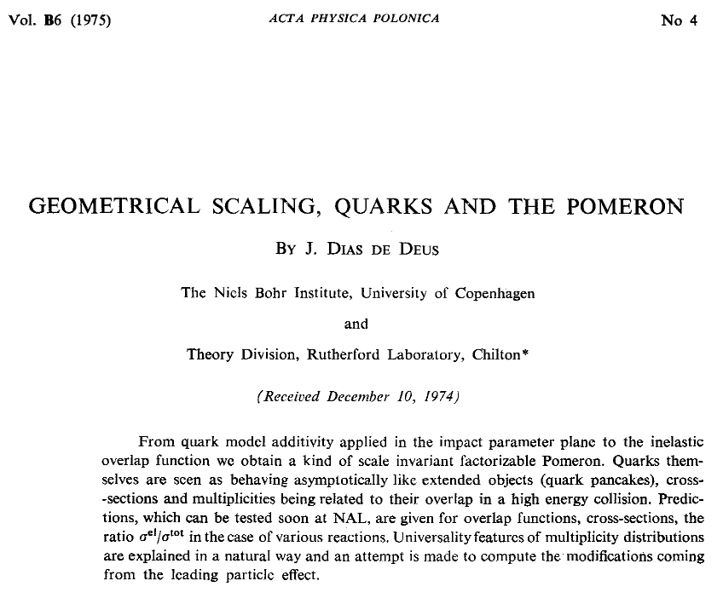
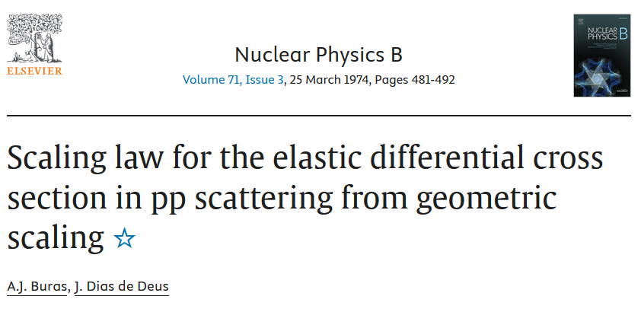
GEOMETRIC SCALING (GS)

Slide 4
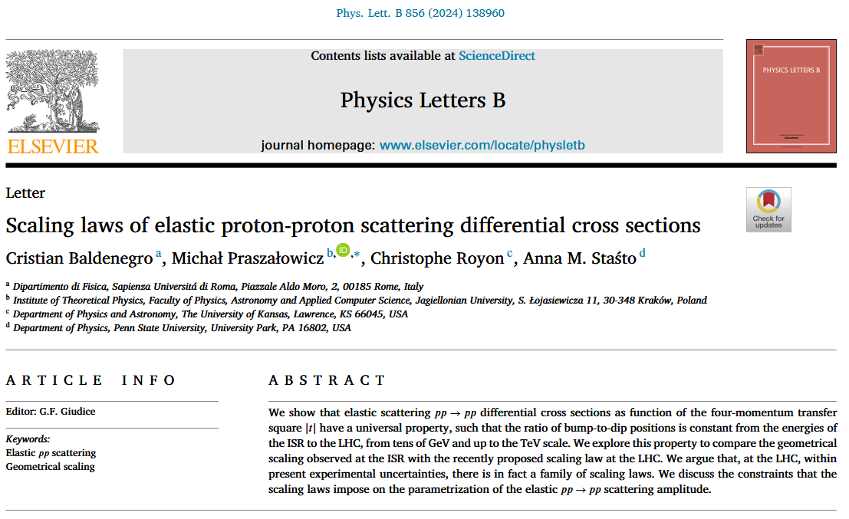
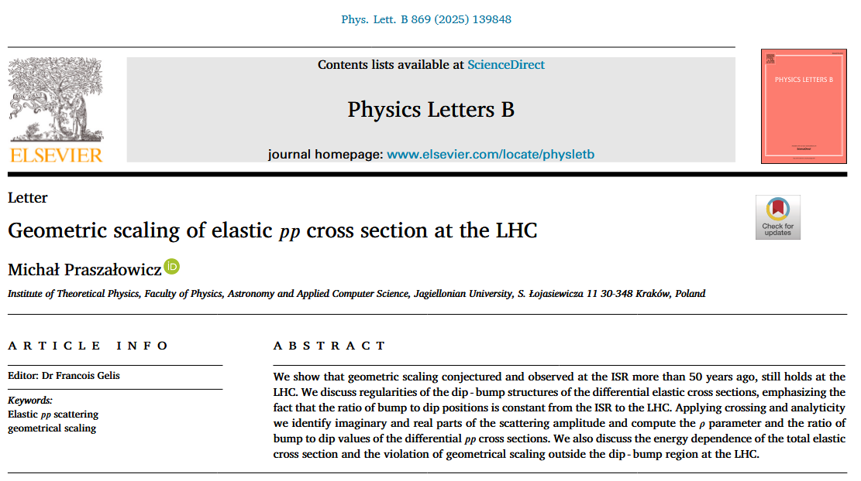
AN OLD STORY REVIVED

Slide 5
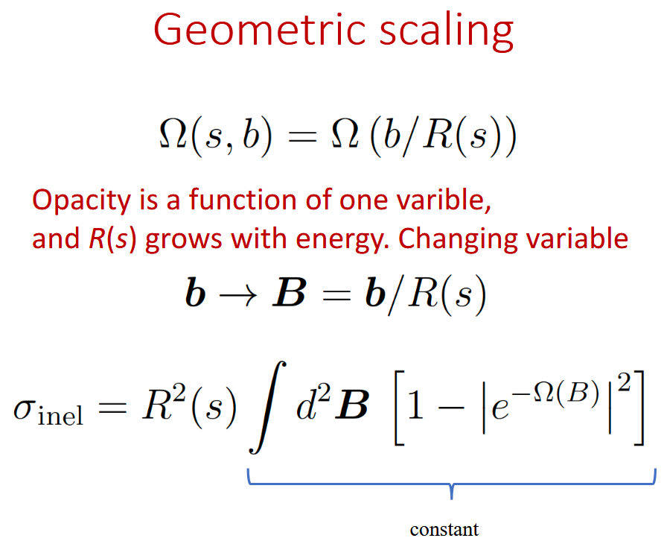
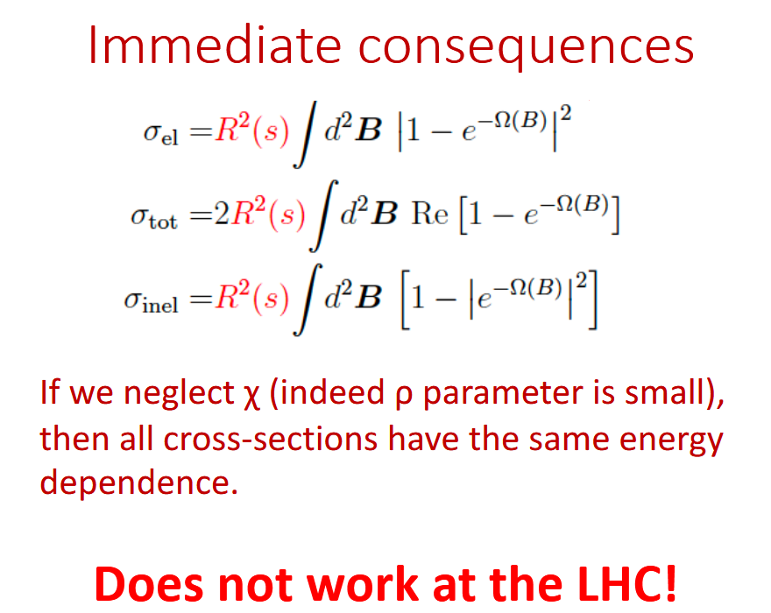
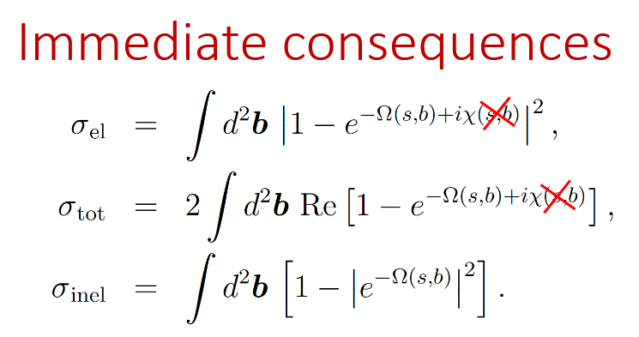
GS: DEFINITIONS
M. Praszalowitz:
PLB 869 (2025) 1398-48,
M. Praszalowitz:
Talk at Moriond QCD 2025,
Motivating issue (Cs.T.):
Opacity in general complex,
Why not scaling for its imaginary part too?

Slide 6
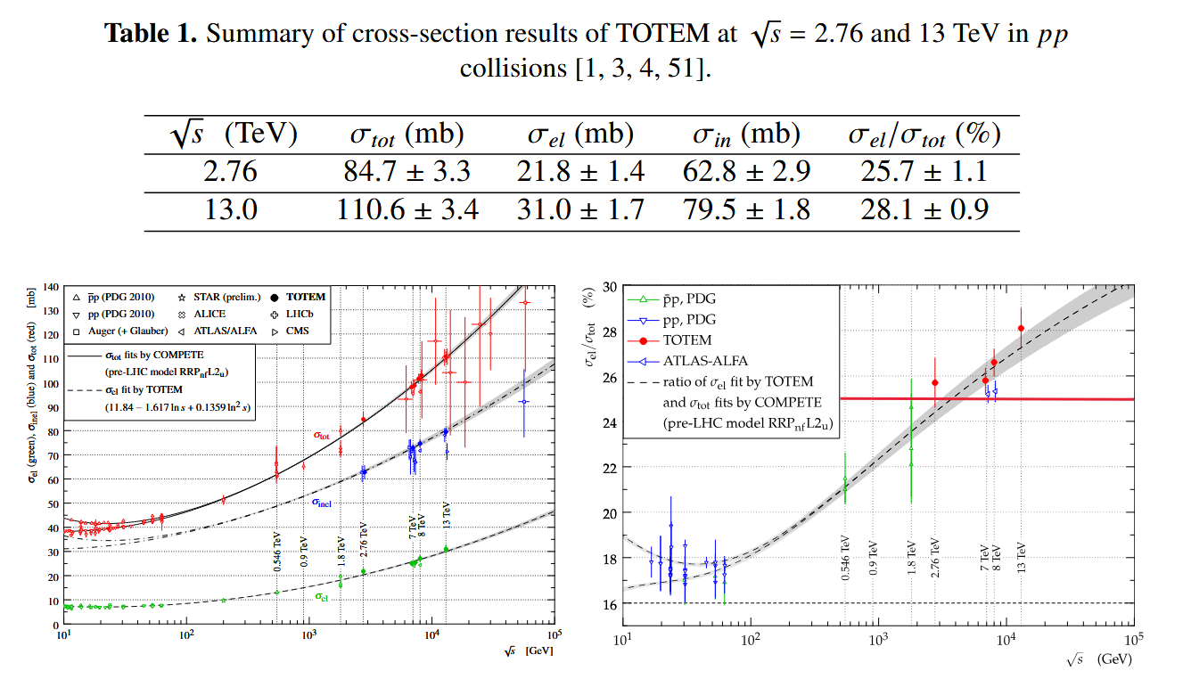
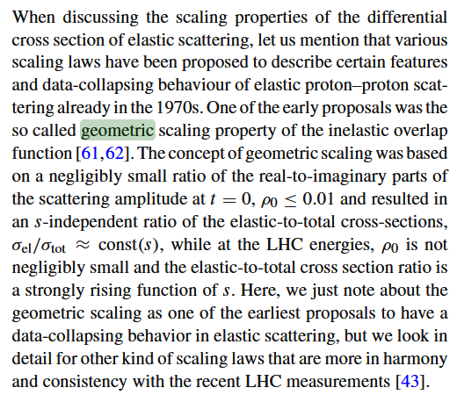

GS: WHY DOES NOT WORK AT LHC?
Hungarian-Swedish team:
Eur. Phys. J. C (2021) 81: 180,
σ_{el}(s)/σ_{tot}(s) is not a constant of s at LHC energies:
Table 1 and Fig, 1 from T. Csörgő for TOTEM, Proc. ISMD 2018
M. Praszalowitz:
PLB 869 (2025) 1398-48,

Slide 7
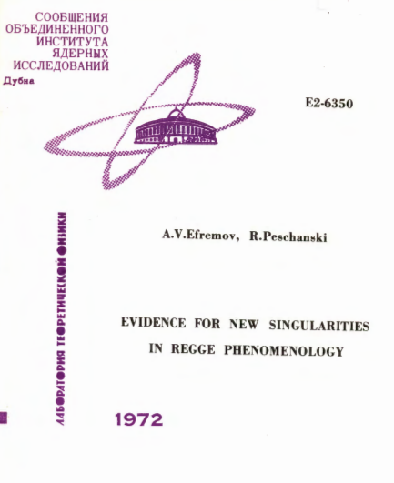
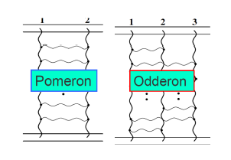
Odderon: extremely elusive, for 48 years
Odderon: L. Lukaszuk, B. Nicolescu,
Lett. Nuovo Cim. 8, 405 (1973)
Received: 31 July 1973
Odderon is an odd component of elastic scattering:
Changes sign for crossing
Odderon name coined: D. Joynson, E. Leader, B. Nicolescu, C. Lopez, Nuovo Cim. 30A, 345 (1975) - Well established in QCD by now !
Honorable mention: A. V. Efremov, R. Peschanski, JINR-E2-6350 (1972)
7

Slide 8
Odderon: elusive experimentally
Odderon search at ISR: indication but no conclusive result
Breakstone et al, Phys. Rev. Lett. 54, 2180 (1985): CL = 99.9 %
Indication of Odderon
CL = 99.9 %,
Significance: 3.35 σ
Terminology for this talk:
Agreement if statistical significance is < 3 σ
Indication of signal if 3 σ ≤ significance < 5 σ
Evidence or observation of signal if 5 σ ≤ significance
Discovery of signal if 5 σ ≤ significance, for the first time.
Accepted: Discovery if Clay Mathematical Institute (CMI) criteria satisfied.
Miscovery if CMI criteria for Millenium Prize Problems are not satisfied.
8

Slide 9
Odderon: well established in QCD
Odderon proposed in Regge phenomenology:
L. Lukaszuk, B. Nicolescu, Lett. Nuovo Cim. 8, 405 (1973)
Three Gluon Integral Equation and Odd c Singlet Regge Singularities in QCD
BKP evolution equation
J. Bartels, Nucl. Phys. B 175 (1980) 365-401
J. Kwiecinski, M. Praszalowicz, Phys.Lett.B 94 (1980) 413-416
A new Odderon intercept from QCD:
R. A. Janik, J. Wosiek, Phys. Rev. Lett. 82 (1999) 1092
Odderon in QCD:
J. Bartels, L.N. Lipatov, G. P. Vacca: Phys. Lett. B (2000) 178
Odderon in QCD with running coupling:
J. Bartels, C. Contreras, G. P. Vacca, JHEP 04 (2020) 183
For an excellent theory intro/review, see Yu. Kovchegov’s
CTEQ Webinar, April 28, 2021
http://youtu.be/yHBO3zcB3V4
9

Slide 10
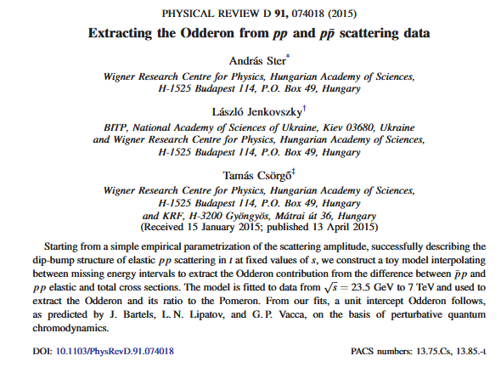
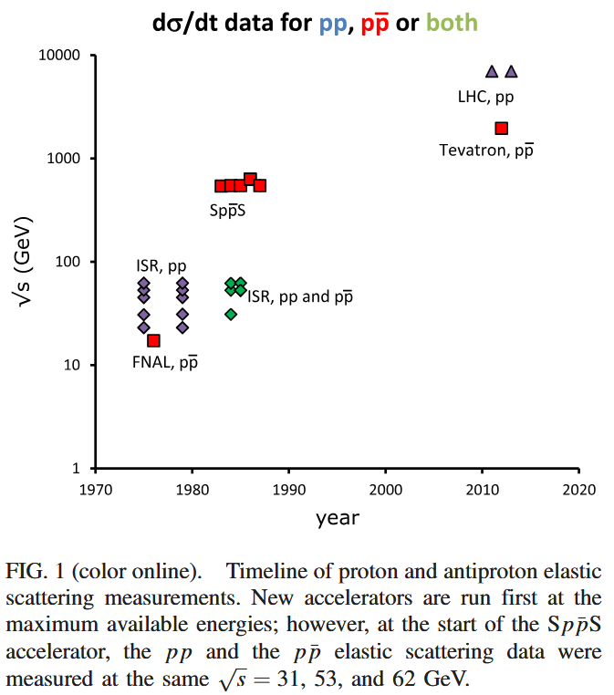
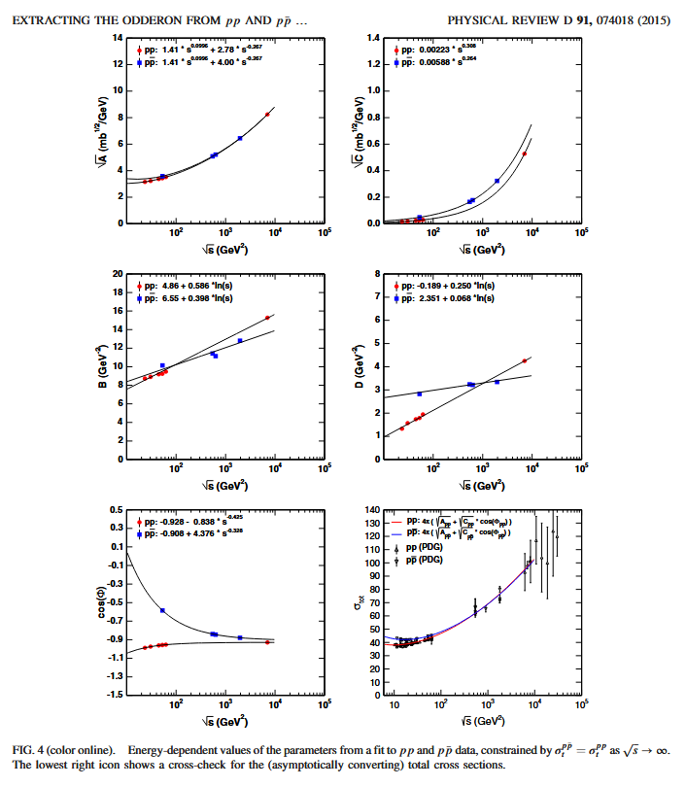
STER, L. JENKOVSZKY, T. Cs. (PRD 2015):
PREDICTION OF ODDERON DISCOVERY AT LHC
10

Slide 11
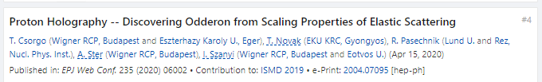
Odderon: first observation with > 5 σ
EPJ Web of Conf. (2020) 235: 06005 https://doi.org/10.1051/epjconf/202023506002
First publication of an at least 5.0 σ (6.26 σ) Odderon exchange effect:
published on May 11, 2020,
EPJ Web of Conf. 235 (2020) 06002
in an anonymously refereed / peer reviewed conference proceedigs.
(Proc. ISMD 2019, Santa Fe, USA)
BUT: „Never be the first! It is too early!”
P. Carruthers ~ 1990
11

Slide 12

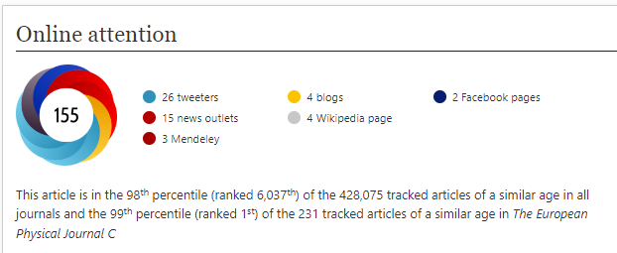
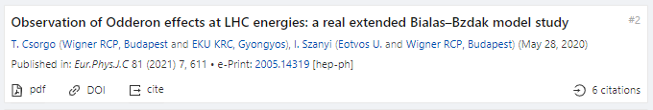
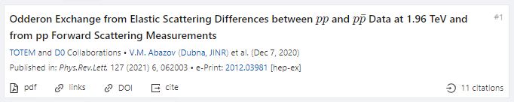
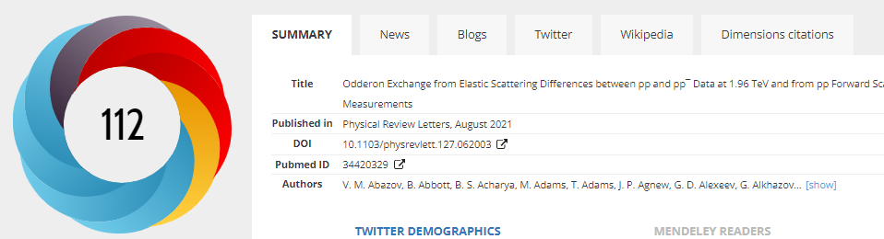
First journal publications, Odderon > 5 σ
Hungarian-Swedish team:
Eur. Phys. J. C (2021) 81: 180, Published: 23 February 2021 https://doi.org/10.1140/epjc/s10052-021-08867-6
Hungarian team, Polish-Hungarian model:
Eur. Phys. J. C (2021) 81:611 , Published: 13 July 2021
https://doi.org/10.1140/epjc/s10052-021-09381-5
D0 and TOTEM Collaborations:
Phys. Rev. Lett. 127 (2021) 6, 062003, Published: 4 August 2021
https://doi.org/10.1103/PhysRevLett.127.062003
12

Slide 13
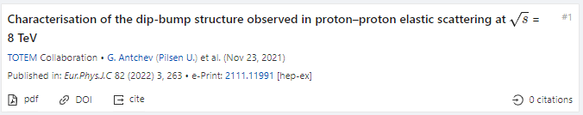
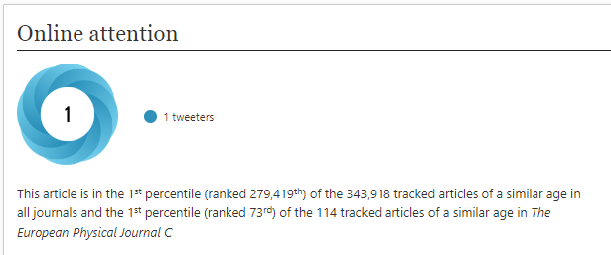

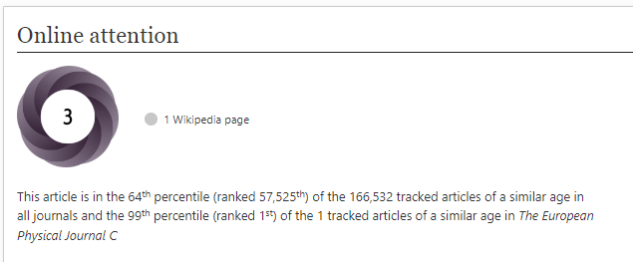
2022 observations of Odderon with > 5 σ
TOTEM Collaboration:
8 TeV: EPJ C (2022) 82, 263 (2022).Published: March 26, 2022
https://doi.org/10.1140/epjc/s10052-022-10065-x
Publishes final data for D0-TOTEM PRL published in 2021
Hungarian team, model of Polish origin:
New TOTEM 8 TeV data vs ReBB model predictions:
EPJ C 82 (2022) 9, 827. Published: Sept 19, 2022
In the ReBB model, Odderon exchange is a certainty-
What about model independent results?
13

Slide 14
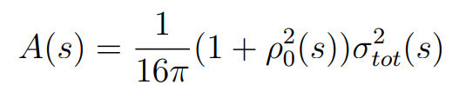
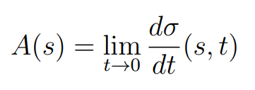
Formalism: elastic scattering
Basic problem: dσ/dt measures an amplitude, modulus squared.
If Odderon exists: signals in elastic scattering at t = 0 and at –t > 0.
14

Slide 15
Formalism in b space
Impact parameter or b space:
elastic scattering interferes with propagation w/o collisions: Genuine quantum physics.
In general, a complex opacity function Ω(s,b) (eikonal, from unitarity)
0 ≤ P(s,b) ≤ 1 : inelastic scattering has a probabilistic interpretation
15

Slide 16
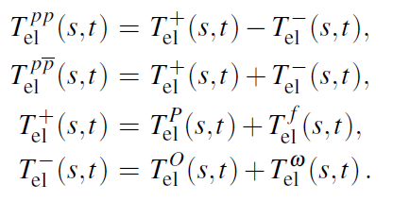
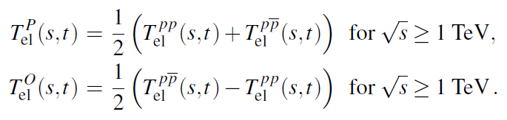
Looking for Crossing-Odd(eron) effects
Three simple consequences:
Odderon differential cross-section from pp and ppbar collisions, Reggeized Philips-Barger:
A. Ster, L. Jenkovszky, T. Cs., arxiv:1501.03860, Phys.Rev.D 91 (2015) 7, 074018
16

Slide 17
Odderon search: a possible strategy
Known trivial s-dependences in
σ_{tot}(s), σ_{el}(s), B(s), ρ(s)
Try to scale this out
Data collapsing (scaling)
Look for scaling violations
In the TeV energy range:
Odderon is equivalent with
a crossing-odd component
Look for violations of C-symmetry
17

Slide 18
DERIVATION 1
H(x) SCALING FOR SMALL x « 1

Slide 19



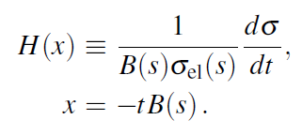
H(x) scaling for small-x, in the cone region (x « 1)
Advantages:
1) H(x) ≈ exp(-x) in the diffractive cone, for x « 1
2) H(0) = 1 → Start from a place that you know
3) Measurable both for pp and pbarp
BONUS EXTRA: An Odderon signal
H(x|pp) scales with energy, but for pbarp, no scaling
19

Slide 20

Model independent H(x|pp) scaling yields Odderon > 6.26 σ
Eur. Phys. J. C (2021) 81: 180, published February 2021 https://doi.org/10.1140/epjc/s10052-021-08867-6
H(x) = 1/(B σ_{el}) dσ/dt vs x = - B t
B ≡ B₀(s) from now on
x = - B t = - B₀(s) t
S: Model independent Odderon significance ≥ 6.26 σ
C1: All D0 and TOTEM published data at 1.96, 2.76 and 7.0 TeV
C2: domain of validity is still determined model dependently.
20

Slide 21
Test of the H(x) scaling at ISR
Hungarian-Swedish team:
Eur. Phys. J. C (2021) 81: 180,
H(x) = exp(-x) in the cone
Works better than expected, up to x ~ 10, even in the bump/tail, x > 25 region!
21

Slide 22
DERIVATION 2
H(x) SCALING FOR ALL x

Slide 23
Derivation of H(x) scaling for all x
Similarly to GS, only one s-dependent scale R(s)
Dissimilarly to GS,
ρ₀(s) is not vanishing!
Dissimilarly to GS, no singularity at minimum!
Advantages:
H(x) ≠ exp(-x) arbitrary positive def. in the dip-bump region
Measurable both for pp and p-antip. Normalized as H(0) = 1.
23

Slide 24
Test of the H(x) scaling at 7 vs 2.76 TeV
Valid between 2.76 and 7 TeV, even with stat errors only,
H(x) scaling valid even in the bump/tail region!
Between 8 and 13 TeV, scaling limited to the cone, but
scaling violated beyond stat+syst errors in dip/dump/tail region!
24

Slide 25
MINIMAL ODDERON MODEL
For a general derivation of H(x) scaling

Slide 26
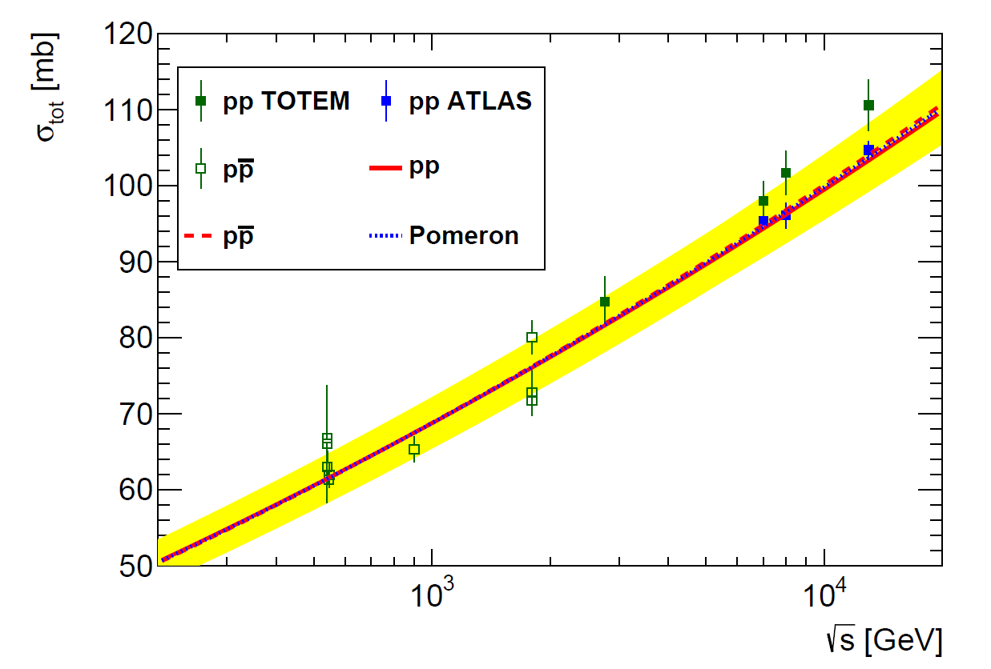
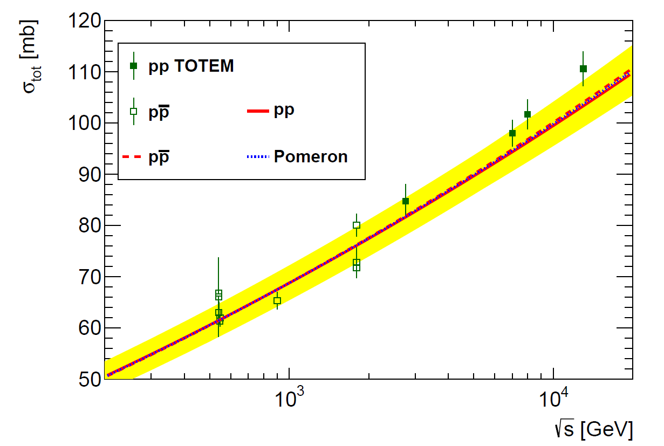
ReBB model prediction of σ_{tot} vs TOTEM and ATLAS
26
TOTEM data on σ_{tot} are systematically above ReBB result, but ...
ATLAS σ_{tot} data agree with ReBB result, published in EPJ C81 (2021) 7, 611

Slide 27
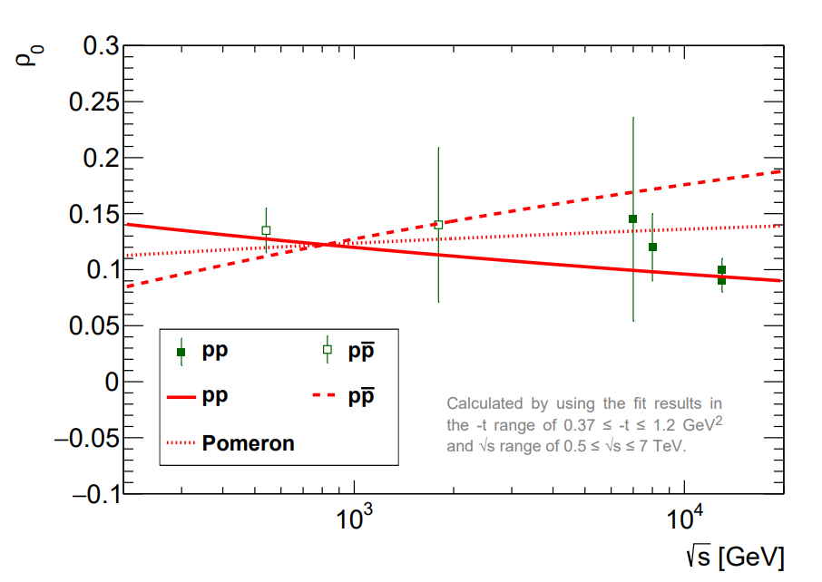
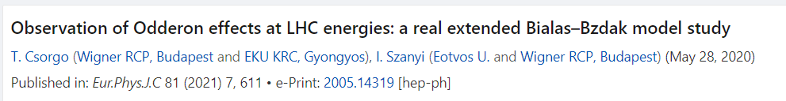

ρ₀ from ReBB fits to data
except at √s ~ 0.9 TeV
ReBB fits: R_{q}, R_{d}, R_{qd} is the same in pp and pbarp, but ρ(s) is not !
ReBB predicts: at √s ~ 0.9 TeV, ρ(s) is the same in pp and pbarb !
27

Slide 28






General derivation of H(x) scaling
Scaling assumtion: σ_{in}(s,b) = σ_{in}(b/R(s))
Result: H(x) scaling follows, but σ_{el}(s)/σ_{tot}(s) is not a constant of s
Minimal Odderon model: signal if α(pp) ≠ α(pbarp)
28

Slide 29
Summary and conclusions
Geometric scaling is revived but
Does NOT work at LHC
H(x) scaling is
a generalized geometric scaling
H(x) is valid if ρ₀(s) = const
Reason for H(x) violations at 13 TeV and at ISR
29

Slide 30
THANK YOU !

Slide 31
QUESTIONS?

Slide 32
BACKUP SLIDES

Slide 33
H(x) rebin: linear interpolations in x
Need for a comparison of different data sets
measured at different values of x:
Linear interpolation to the same x = -t B
Errors: both vertical AND horizontal, type A, B, C
type A: point-to-point fluctuating error
type B: point-to-point 100 % correlated error
type C: point independent overall correlated error
33

Slide 34
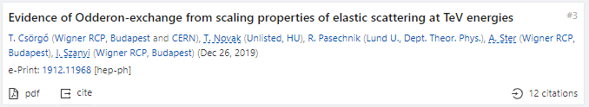
Model independent results since ISMD’19
34
T. Cs, R. Pasechnik, T. Novák, A. Ster, I. Szanyi, Eur. Phys. J. C (2021) 81: 180 https://doi.org/10.1140/epjc/s10052-021-08867-6 , 1912.11968 [hep-ph]

Slide 35
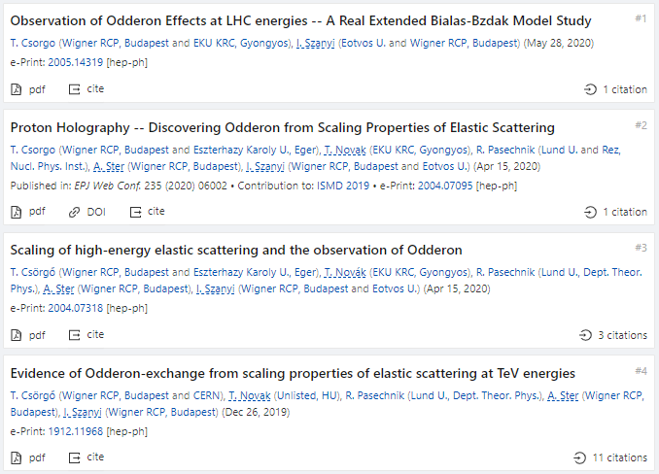
Model independent results since ISMD’19
arXiv:2004.07318v2
Model independent Odderon significance 6.26 σ
11 pages, 2 figures, synthesis of data analysis and theory results
But: domain of validity is still determined model dependently.
35

Slide 36
Model independent results since ISMD’19
arXiv:2004.07318v2
Model independent Odderon significance 6.26 σ
11 pages, 2 figures , synthesis of data analysis and theory results
New result presented in this talk: domain of validity model independently
36

Slide 37
Model independent result
H(x|pp)
s-independent:
2.76 – 7(8) TeV
H(x|pp, 7 TeV)
≠
H(x|pantip,
1.96 TeV)
Odderon,
IF scaling holds
in pp down to
1.96 TeV
6.26 σ
Odderon effect
Energy range: tested both model independently and with modelling.
Modelling is useful, but model independent tests more important!
37

Slide 38
Asymmetry parameter for C-violation
A(x|pbarp,s₁|pp,s₂)
does NOT vanish
for a C-symmetry violation AND
A(x|pp,s₁|pp,s₂)
vanishes if
H(x) scaling valid
Energy range: HAS to be tested carefully
38

Slide 39
Main result of A
A(x|pp,s₁|pp,s₂) ~ 0
vanishes if
H(x) scaling valid
A(x|pbarp,s₁|pp,s₂) ≠ 0
does NOT vanish
if Odderon term is present
39
Scaling violations: under theoretical control:
Model calculations by solid line, see e-Print: 2005.14319 [hep-ph]

Slide 40
OBSERVATION OF ODDERON
2020 → 2O2O
7 TeV data shifted
by ε_{B7,TeV} to minimize χ²
Type A errors are shown only
Both swing and dip regions important!
40

Slide 41
SLIDING WINDOW for 5 σ
Model independent results:
only datapoints,
without s-dependent extrapolations !
Where is the signal of Odderon from?
All possible sliding windows,
where the significance is at least 5 σ
41

Slide 42
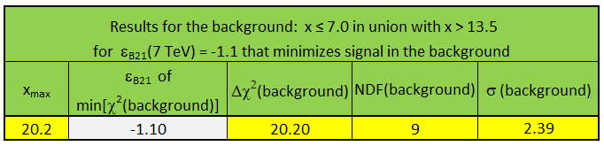
Is H(x,s) = H(x) at 1.96 TeV?
MODEL INDEPENDENTLY: YES!
In the background of the Odderon signal,
defined as x ≤ 7.0 in union with x > 13.5
H(x|pp,7 TeV) ~ H(x|pbarp, 1.96 TeV)
Agreement: a significance of 2.39 σ
New MODEL INDEPENDENT result
42

Slide 43
Is H(x,s) = H(x) at 1.96 TeV?
S IGNAL
MODEL DEPENDENTLY: Yes
1.96 TeV
Highest energy where p+antip data are available
H(x) scaling limit:
in the Bialas-Bzdak model
Fits pbarp data up to largest -t
(red line, dashed line: pp)
Pull plots:
(data-fit)/error
(data-fit)/fit
t_{max}(1.96 TeV, pp) > 1.2 GeV²
→ x_{max}(1.96 TeV, pp) > 20
43

Slide 44
Safely above the 5 σ threshold
Role of the H(x) scaling violations
Do they decrease the signal or not?
H(x) scaling: allows to project pp data ONLY
Scaling violations decrease significance at 1.96 TeV
BUT
Also allow to evaluate pbarp data at 2.76 TeV
Trade-off effect!
Odderon significance increases
from 6.26 to 7.08 σ .
44

Slide 45
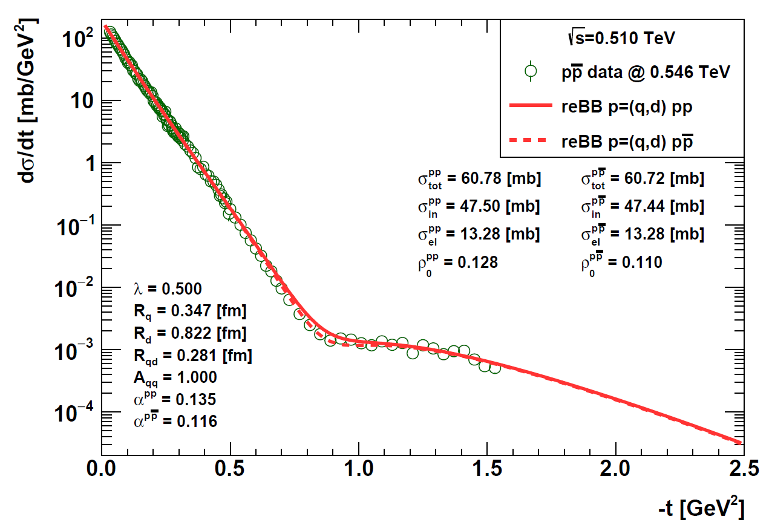
Predictions for pp and pbarp dσ/dt @ 510 GeV
Model dependent Odderon signal @510 GeV: pp above pbarp !
45

Slide 46
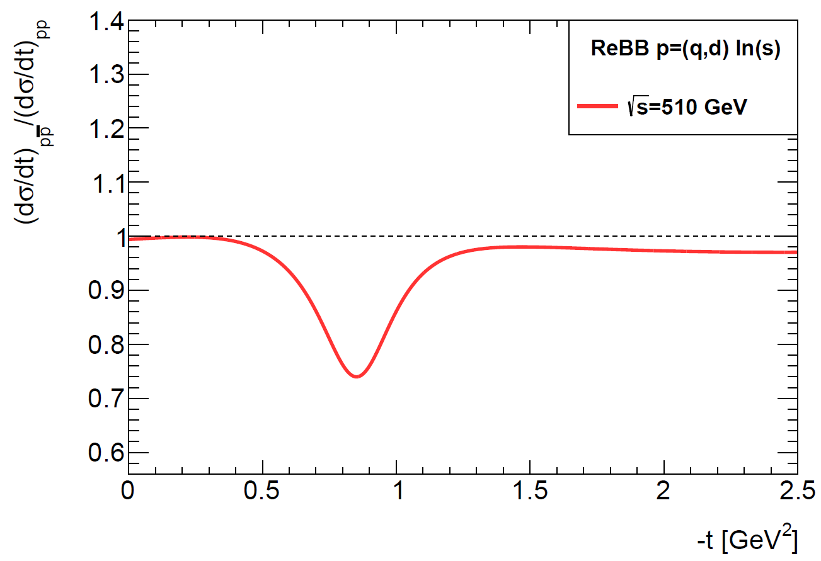
Ratio of pbarp to pp cross-sections @ 510 GeV
Model dependent Odderon signal @510 GeV: no peak, but a hole
Scaling violations: dominant @510 GeV
Model dependent Odderon signal: pbarp dσ/dt ~ 25 % below pp !!
46

Slide 47
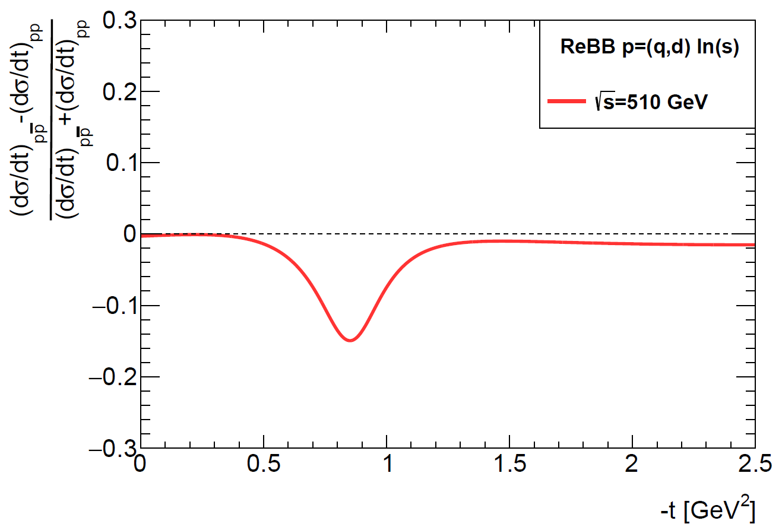
Asymmetry parameter @ 510 GeV
Model dependent Odderon signal @510 GeV: no peak, but a hole
Scaling violations: dominant @510 GeV
Model dependent Odderon signal: A ~ - 15 % @ -t ~ 0.85 GeV²
47

Slide 48
Summary: At least 6.26 σ Odderon
An at least 6.26 σ Odderon effect
A discovery level, model independent Odderon effect at TeV scale.
Published: Eur. Phys. J. C 81, 180 (2021). https://doi.org/10.1140/epjc/s10052-021-08867-6
Domain of validity of H(x) scaling: full x =-tB range of D0 at 1.96 TeV.
Published result confirmed with NEW, model INDEPENDENT result !
Model dependent results, using the ReBB model
Significance ≥ 7.08 σ , see e-Print: 2005.14319 [hep-ph]
48
48

Slide 49
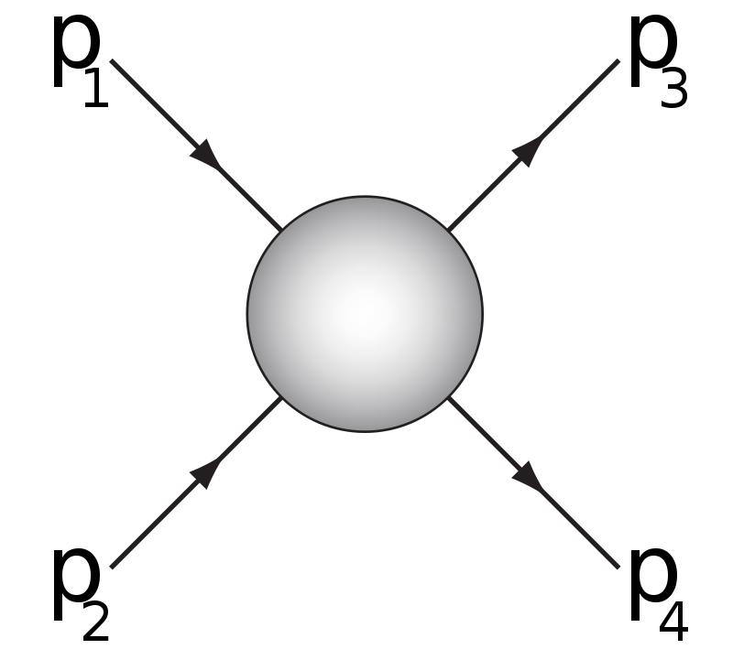

Mandelstam variables
p₁,p₂: four-momenta
before elastic scattering
p₃,p₄: four-momenta
after elastic scattering
s: square of the cms energy
t: square of four-momentum transfer
49

Slide 50
Odderon and QCD in Laymen’s Terms
p₁
p₃
g₁
g₂
g₃
O = (g₁, g₂, g₃)
p₂
p₄
Pomeron (2+4+…) gluon in pp:
(RGB)+(RGB) → (GRB)+(GRB)
Odderon (3+5+… gluon) in pp:
(RGB)+(RGB) → (GBR)+(BRG)
Well established in QCD
50

Slide 51
Odderon and elastic collisions
p₁
p₃
g₁
g₂
g₃
O = (g₁, g₂, g₃)
p₂
p₄
Odderon exchange: both pp and pp
(RGB)+(RBG) → (BRG)+(BGR)
Changes sign for crossing
p₁
p₃
g₃
g₁
g₂
O = (g₁, g₂, g₃)
p₂
p₄
51

Slide 52
SLIDING WINDOWS
7 TeV data shifted
by ε_{B7,TeV} to minimize χ²
Type A errors are shown only
Both swing and dip regions important!
2020 → 2O2O
52

Slide 53
CLOSING DOORS
7 TeV data shifted
by ε_{B7,TeV} to minimize χ²
Type A errors are shown only
Both swing and dip regions important!
2020 → 2O2O
53

Slide 54
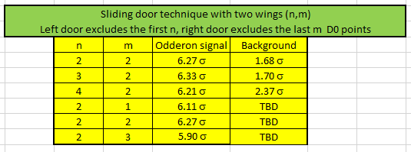
RESULTS FOR CLOSING DOORS
Two sliding doors of size n and size m:
(n,m): Leaving out the first n and last m D0 point
New MODEL INDEPENT RESULT
Odderon signal at least 6.33 σ
54

Slide 55
D0/TOTEM FIRMS UP OUR RESULTS
If we study dσ/dt and limit our analysis to the same range as
D0/TOTEM:
Significance reduces to
5.01 σ effect,
due to leaving out 9 D0 points
If we add D0’s 14.4 % overall correlated error to fluctuating errors,
for all D0 data:
Our published value is 3.27 σ
If we conservatively optimize coefficient ε_{B,7TeV}
of point-to-point correlated errors: 2.79 σ
Significance of D0/TOTEM for dσ/dt: 3.4 σ
55

Slide 56

Recent results from D0/TOTEM
including our contributions
Submitted to PRL in December 2020.
Uses 13, 8, 7 and 2.76 TeV TOTEM data,
limited in -t to the dip-bump structure.
56

Slide 57
APPENDIX: D0/TOTEM Fig. 2 OK
Our cross-test of Fig. 2 of arxiv:2012.03981:
Fits ISR and LHC data with separate lines
p₁^{LHC} = 0.034 ± 0.050
Consistent with 0 → fix it to 0!
R(pp) = 1.77 ± 0.01 @ 1.96 TeV
→ Reggeon effects negiligble @ 1.96 TeV, OK.
Fig. 2 of arxiv:2012.03981:
Fits ISR and LHC data with same curve
R(pp) = 1.77 ± 0.01 @ 1.96 TeV
Reggeon effects from ISR? Test this!
57

Slide 58
APPENDIX: D0/TOTEM FIG. 3 OK
Our cross-test of
Fig. 3 of arxiv:2012.03981:
Fits to max(s) and min(s) neglect
the constraint of Fig. 2:
R(s|pp) = max(s|pp)/min(s|pp)
measured to be 1.77 ±0.01 !
What about constrained fits?
Only two out of three quantities can be fitted independently :
max(s), min(s) and R(s) = max(s) / min(s)
Red lines: min(s|pp) = max(s|pp)/R(s|pp) constrained fits
→ Fig. 3. of D0/TOTEM OK within 1 σ
58

Slide 59
CROSS-CHECK OF D0/TOTEM FIG. 5
Empty circles from min(s|pp) = max(s|pp)/R(s|pp) constrained fits
→ Fig. 5. of D0/TOTEM OK within 1 σ
59

Slide 60
H(x) scaling for p antip scattering
H(x) = exp(-x) at low x = -Bt at ~ every s
s-dependence: in x_{max}(s|p+antip)
x_{min}(s) = 0, scaling in the diffractive cone !
Energy range: 546 GeV – 1.96 TeV
Qualitatively different from pp: scaling in the cone only for p+antip
60

Slide 61
pp: model dependent limit on H(x)
H(x) = exp(-x) at low x = -Bt at ~ every s
s-dependence: only x_{max}(s)
x_{min}(s) ~ 0 in the diffractive cone !
61
Energy range: 200 GeV – 8 TeV (nearly factor of 40)
With decreasing s, the x = -Bt range for H(x) scaling decreases

Slide 62
Where is the Odderon signal from?
Swing, interference, tail regions
Interference region is dominant

Slide 63
Model dependent evidence for Odderon
Structure:
Introduction,
Fits with CL > 0.1 % to published pp and pbarp data function
In the dip/bump region (large –t fits)
Linear excitation function in TeV range: p₀ + p₁ ln(s/s₀)
Sanity tests: Validation of the trends
Extrapolations both for pp and pbarp data
Odderon significance from pp and pbarp comparisions
From combined 1.96 and 2.76 TeV analysis:
Odderon seen at 7.08 σ
Cross-checks (quadratic trend, ISR data)
63
82 pages, 31 figures, model dependent Odderon significance 7.1 σ, submitted for publication, see also talk by I. Szanyi @ Zimányi’2020

Slide 64
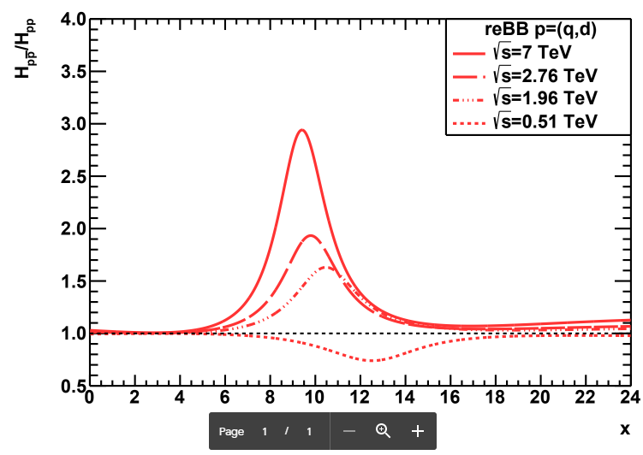
OBSERVATION OF ODDERON
2020 → 2O2O
Prediction for 510 GeV pp @ RHIC: scaling violations
64

Slide 65



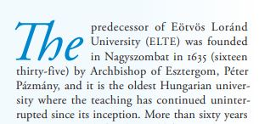
Three Oldest Hungarian Universities
University of Pécs: 1367
University of Pécs:
S: Oldest, C: in Hungary
University of Debrecen: 1538
University of Debrecen:
S: Oldest, C: in Hungary,
operating continuously and in the same city
(S,C) structure evident,
S: statement, valid if
C: condition is satisfied
See talk of R. Dardashti at ISMD21
Condition changes → Statement changes (!!)
Eötvös University:
S: Oldest, C: in Hungary,
teaching continuously
Eötvös Loránd University: 1635
65

Slide 66
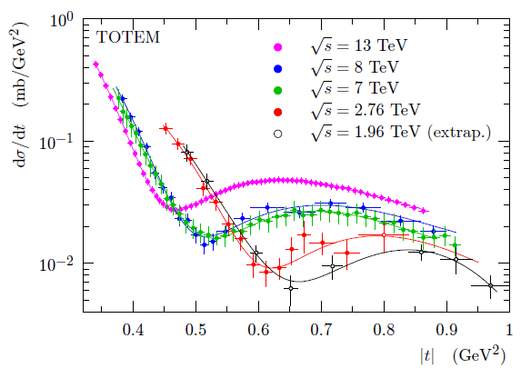



Status of D0-TOTEM Odderon search
Phys. Rev. Lett. 127 (2021) 6, 062003, Published: 4 August 2021
https://doi.org/10.1103/PhysRevLett.127.062003
sig₂ ≥ 3.4 σ
TOTEM: sig₁ (13 TeV, t = 0) ≥ 4.2 σ
TOTEM: combined (sig₁ + sig₂)/√2 ≥ 5.2 σ
Donnachie-Landshoff arxiv:2203.00290,
Phys. Lett. B831 (2022) 137199: sig₁ (13 TeV, t = 0) ~ 0 (!!)
Petrov-Tkachenko, arxiv:2204.08815,
Phys. Rev. D 106 (2022) 5, 054003 : sig₁ (13 TeV, t = 0) ≤ 1 (!!)
TOTEM – D0 detailed response :
in preparation, see also
K. Österberg’s talk at LHC Forward Physics meeting, Oct 2022
C0: if almost model independent result at t=0 and √s = 13 TeV
AND if sig₁ is not modified by new models: sig₁ ≥ 4.2 σ
66

Slide 67
Status of D0-TOTEM Odderon 2.0
Phys. Rev. Lett. 127 (2021) 6, 062003, Published: 4 August 2021
https://doi.org/10.1103/PhysRevLett.127.062003
sig₂ ≥ 3.4 σ
TOTEM: sig₁ (13 TeV, t = 0) ≥ 4.2 σ
TOTEM: combined (sig₁ + sig₂)/√2 ≥ 5.2 σ
ATLAS Collaboration, 2207.12246 [hep-ex], Eur.Phys.J.C 83 (2023) 5, 441
D0 and TOTEM either discovered the odderon, or not.
C-F. Cui et al, Phys. Lett B. 839, 137826
sig_{(Odderon)} ~ 4.8-5.2 : a bit too small
TOTEM – D0 response :
Paper in preparation, see also
K. Österberg’s talk at ISMD 2023
in August 2023 and at Diffraction and Low-x 2024
67
C0: if almost model independent result at t=0 and √s = 13 TeV
AND if sig₁ is not modified by new models: sig₁ ≥ 4.2 σ
67

Slide 68
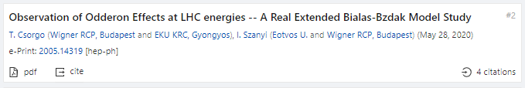
Hungarian team, Polish-Hungarian model, Odderon > 7.08 σ
Eur. Phys. J. C (2021) 81:611, published July 2021
https://doi.org/10.1140/epjc/s10052-021-09381-5
1.96 TeV
2.76 TeV
7 TeV
With new 8 TeV data:
Model dependent certainty
Eur. Phys. J. C (2022) 82, 827, published September 2022
https://doi.org/10.1140/epjc/s10052-022-10770-7
S: Model dependent Odderon significance ≥ 7.08 σ
C1: All D0 and TOTEM published data at 1.96, 2.76, and 7.0 TeV
C2: domain of validity extended to both pp and pbarp
But limited to 0.37 ≤ −t ≤ 1.2 GeV² and 0.546 ≤ sqrt(s) ≤ 7 → 8 TeV
68
Model dependent, Real Extended Bialas-Bzdak theory results,
Odderon significance ≥ 7.08 σ, from 1.96 and 2.76 TeV data only

Slide 69
NEW RESULTS 1
H(x) SCALING, USING 8 TeV

Slide 70
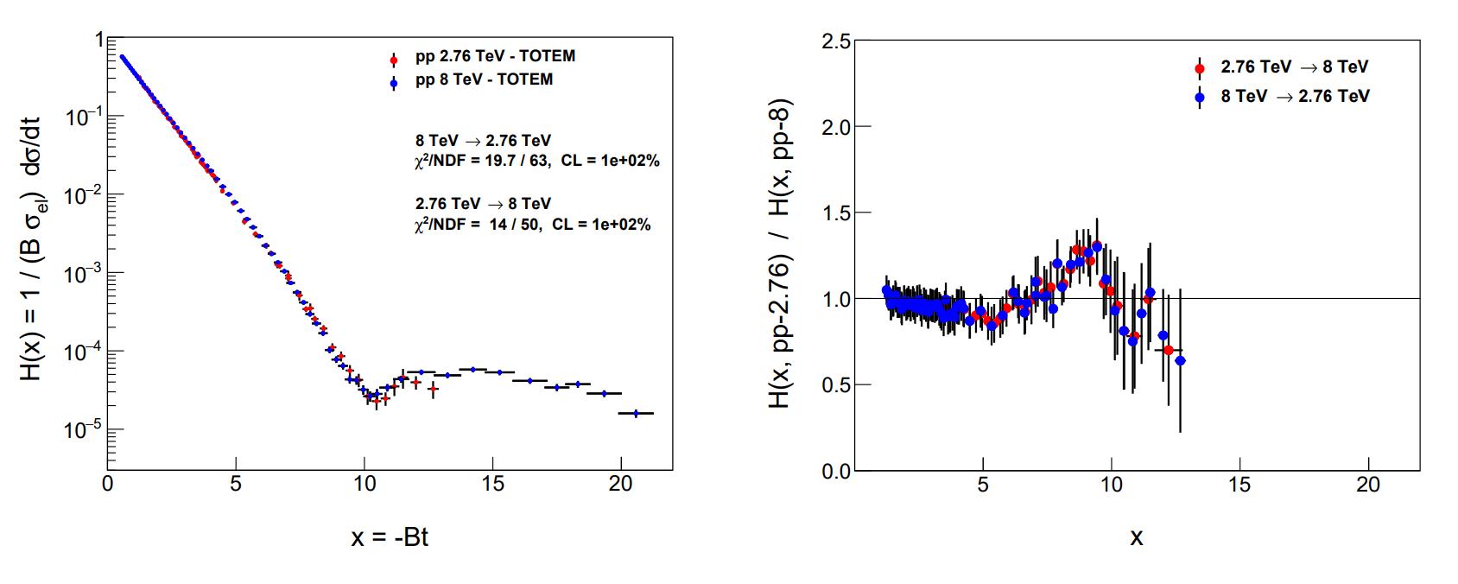
Test of H(x) scaling: 8 vs 2.76 TeV
Method of ratios, same as in M. Praszalowicz’s talk
But for H(x|pp,s₁)/H(x|pp,s₂) and to show H(x) scaling in pp
Between 2.76 and 8 TeV, H(x) scaling observed!
Hungarian-Swedish team, e-Print: 2405.06733 [hep-ph],
MDPI Universe 2024, 10(6), 264
70

Slide 71
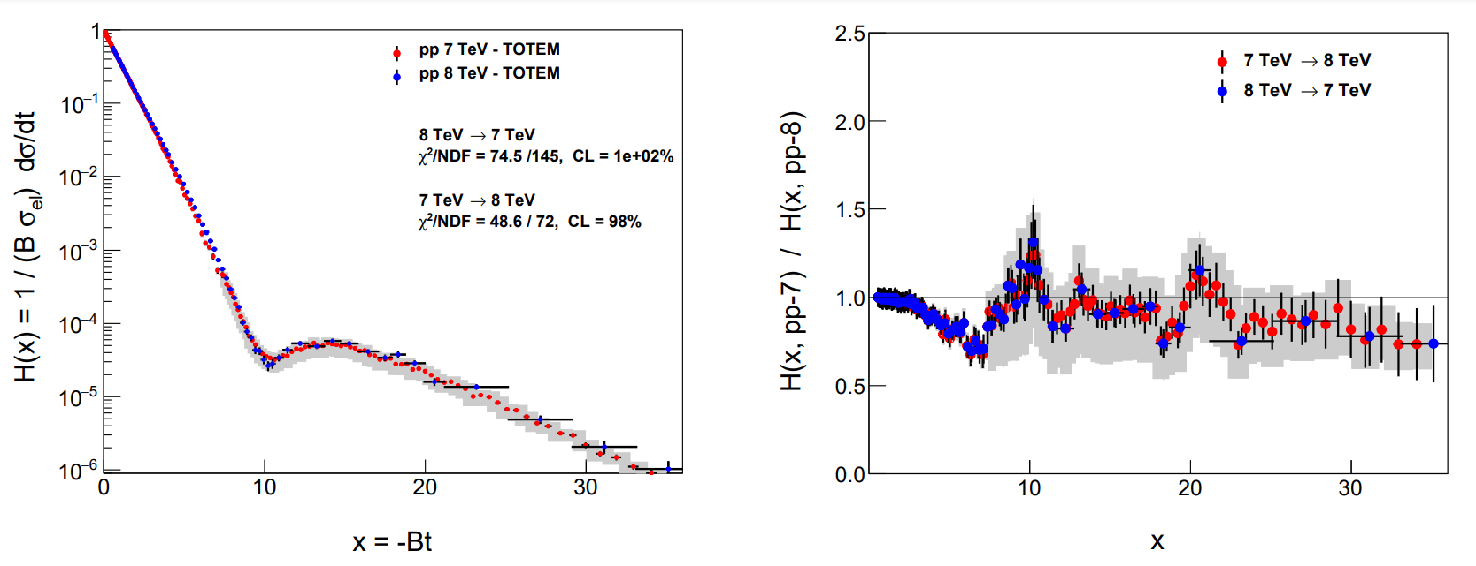
Test of H(x) scaling: 8 vs 7 TeV TOTEM
Between 7 and 8 TeV, H(x) scaling observed, but …
Hungarian-Swedish team, e-Print: 2405.06733 [hep-ph],
MDPI Universe 2024, 10(6), 264
71

Slide 72
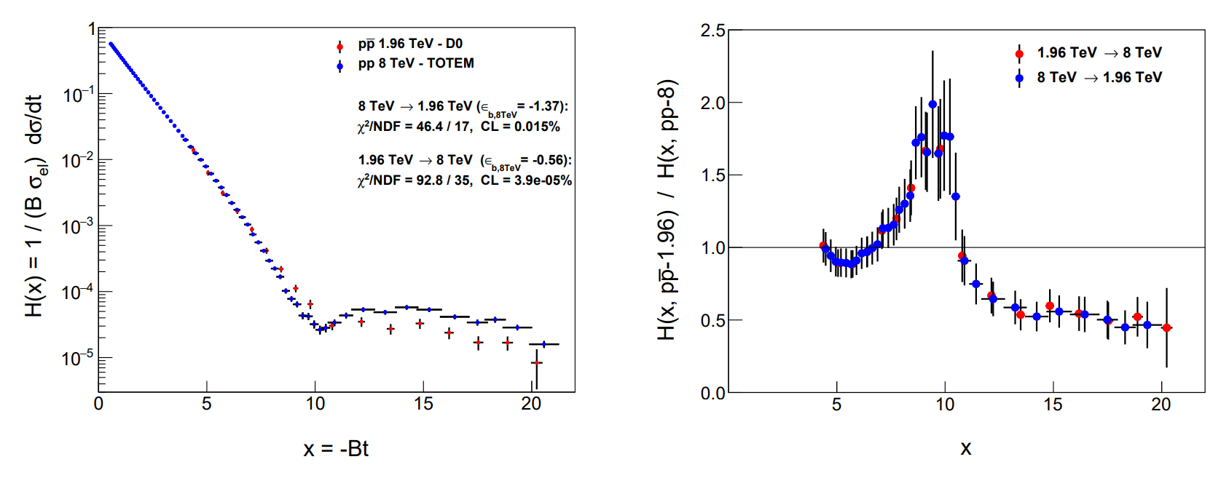
Odderon of H(x) scaling: 8 vs 1.96 TeV
Method of ratios, same as in M. Praszalowicz’s talk
But for H(x|pbarp)/H(x|pp) and to show the Odderon signal
Between 1.96 and 8 TeV, H(x|s,pp) and H(x|s,pbarp) are clearly different, with 3 < 3.79 < 5 σ
Hungarian-Swedish team, e-Print: 2405.06733 [hep-ph], MDPI Universe 2024, 10(6), 264
72

Slide 73
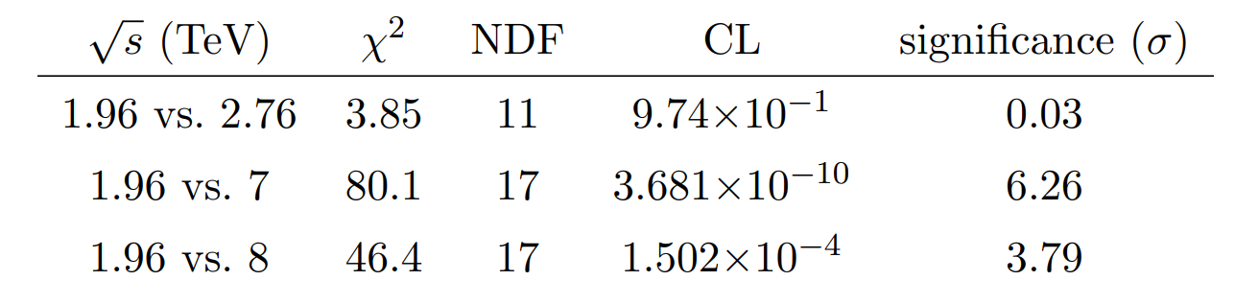
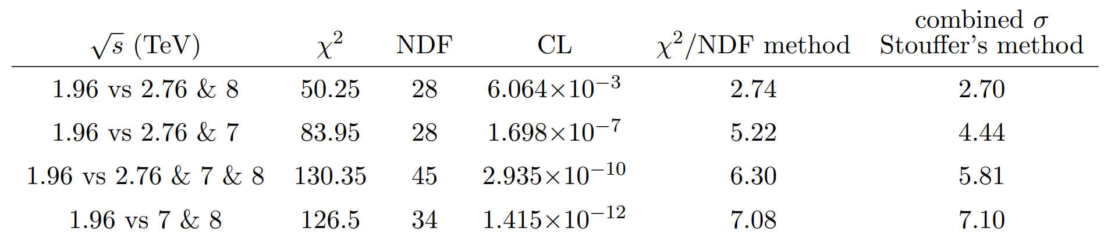
Odderon significances from H(x) scaling
If 1.96, 2.76, 7 and 8 TeV data are combined, H(x) significances on all data results in 5 < 5.8 σ
If 1.96, 7 and 8 TeV data are combined, at least 7.08 σ.
Hungarian-Swedish team, e-Print: 2405.06733 [hep-ph],
MDPI Universe 2024, 10(6), 264
73

Slide 74
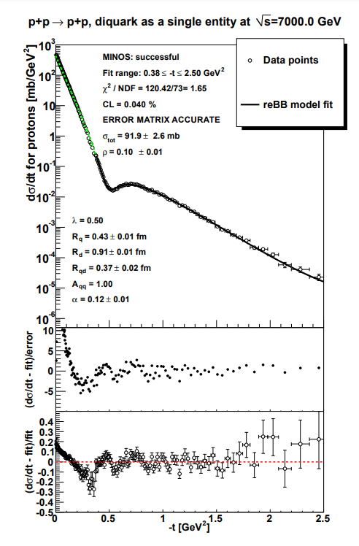



Statement of the problem, with old χ²
ReBB fits to both TOTEM low-t and TOTEM-large-t fit acceptable at 7 TeV, but
The two datasets could not be ReBB fitted simultaneously, without an advanced χ² definition !
74

Slide 75


ATLAS and TOTEM: ReBB model to low –t, 7 TeV
75
TOTEM low-t vs TOTEM-large-t fit acceptable at 7 TeV, obtained with
advanced PHENIX χ² definition, but with ε_{B} > 1, outside expected range (-1,1) ...
ATLAS low-t vs TOTEM-large-t fit successful (CL = 10.2 %) at 7 TeV !

Slide 76


ReBB model extension to low –t, 8 TeV
76
TOTEM low-t vs TOTEM-large-t fit FAILS at 8 TeV, but ...
ATLAS low-t vs TOTEM-large-t fit SUCCESSFUL with CL = 2.59 % at 8 TeV !

Slide 77


Review: Elastic scattering at small -t
77
If Odderon exists: signals possible both at t = 0 and at –t > 0.
Where the significance of the signal is coming from?

Slide 78


ReBB model: where to look for Odderon?
Recent review of Ryskin: asks for Odderon amplitude, intercept etc.
But this has been done (for ReBB) already in 2021!
Modulus and phase
for both Odderon and Pomeron
Extracted from UA4, D0 and TOTEM data using ReBB fit
Best @ dip/bump: ~ 10%
Second best @ large –t: 1 %
Most difficult @ t=0: 0.1%
78

Slide 79
NEW RESULTS 3
Simple Levy fits at small –t
(For details, see the poster of I. Szanyi)

Slide 80



Odderon Search at small -t
valid for
Some simple consequences at small –t, Gaussian sources:
If any of
is statistically significant
80

Slide 81



Odderon Search at small -t
valid for
Some simple consequences at small –t, Levy sources:
If any of
is statistically significant
81

Slide 82




Levy generalized Bialas-Bzdak Model
Simple results at small -t:
From data fits: R_{q}, R_{d}, R_{qd}, α_{L} is same in pp and pbarb
But!
82
82

Slide 83


From Glauber’s theory, p=(q,d)
Good quality fits at 8 TeV and also
at every low –t dataset for pp, pbarp
83

Slide 84

84

Slide 85

85

Slide 86


Levy + Bialas-Bzdak at small t
Dramatic consequences:
Strong form of Pomeranchuk theorem!
Signals of odderon exchange in
optical point,
ρ and
elastic cross-section!
Tests are needed…
86

