Slide 1
JLab Program on Spin and 3d Structure Physics
Jian-ping Chen, Jefferson Lab, Virginia, USA
Low-x 2025, Medulin, Croatia, Sept. 8-12, 2025
Introduction/Overview
Highlights of JLab 1-d Spin Program
Spin Moments (Sum Rules and Polarizabilities) @ Low-Q²
Spin structure (A1n/A1p) in high-x (valence quark) region
Spin Moments (d2n) @ medium-high Q²
Highlights of JLab 3-d Structure Program
CLAS12 (RGC): DVCS, SIDIS
Hall A/C: DVCS, SIDIS
Future
SoLID: spin, TMDs and GPD program
Acknowledgment: Thanks to H. Avakian, C. Camacho, A. Deur, H. Gao, C. Leung, E. Kinney, M. Nycz, S. Rafael, Y. Tian, X. Zheng, … and collaborators for the work in this talk and for providing slides

Slide 2
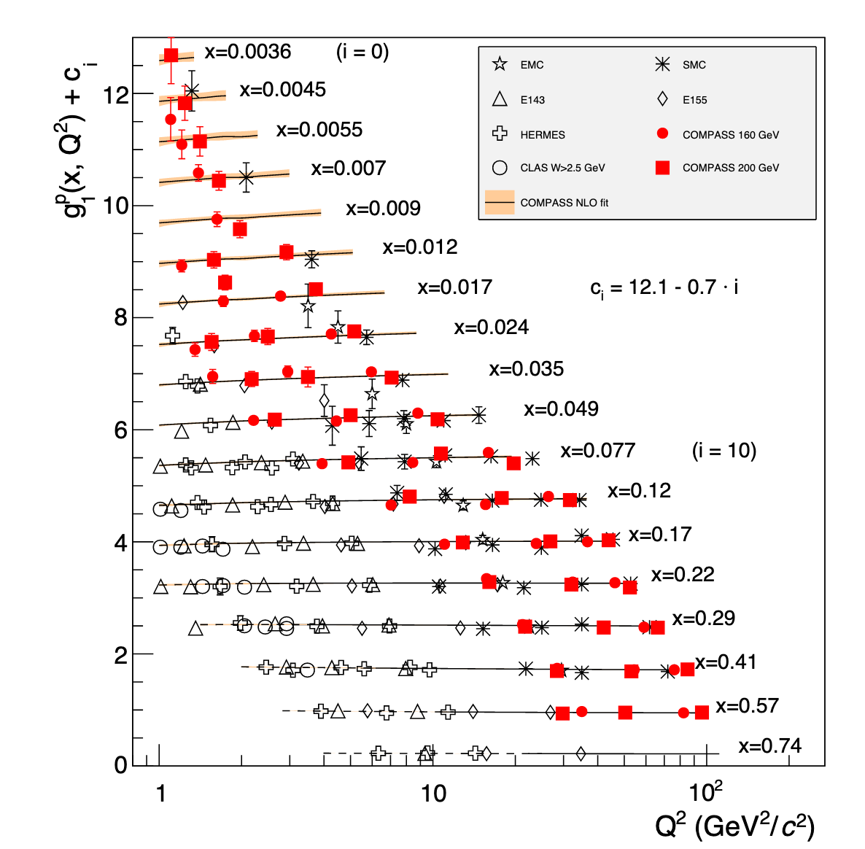
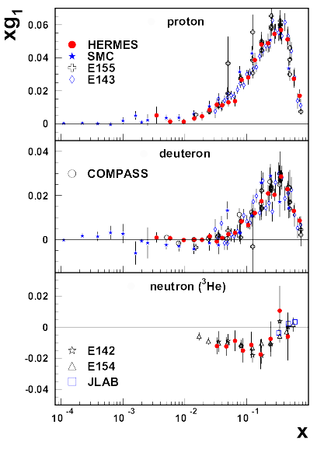
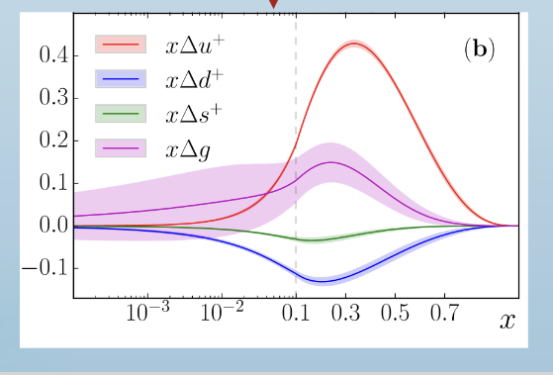
Polarized Structure functions
g₁^{p}
PDG
(online 2024)
JAM

Slide 3
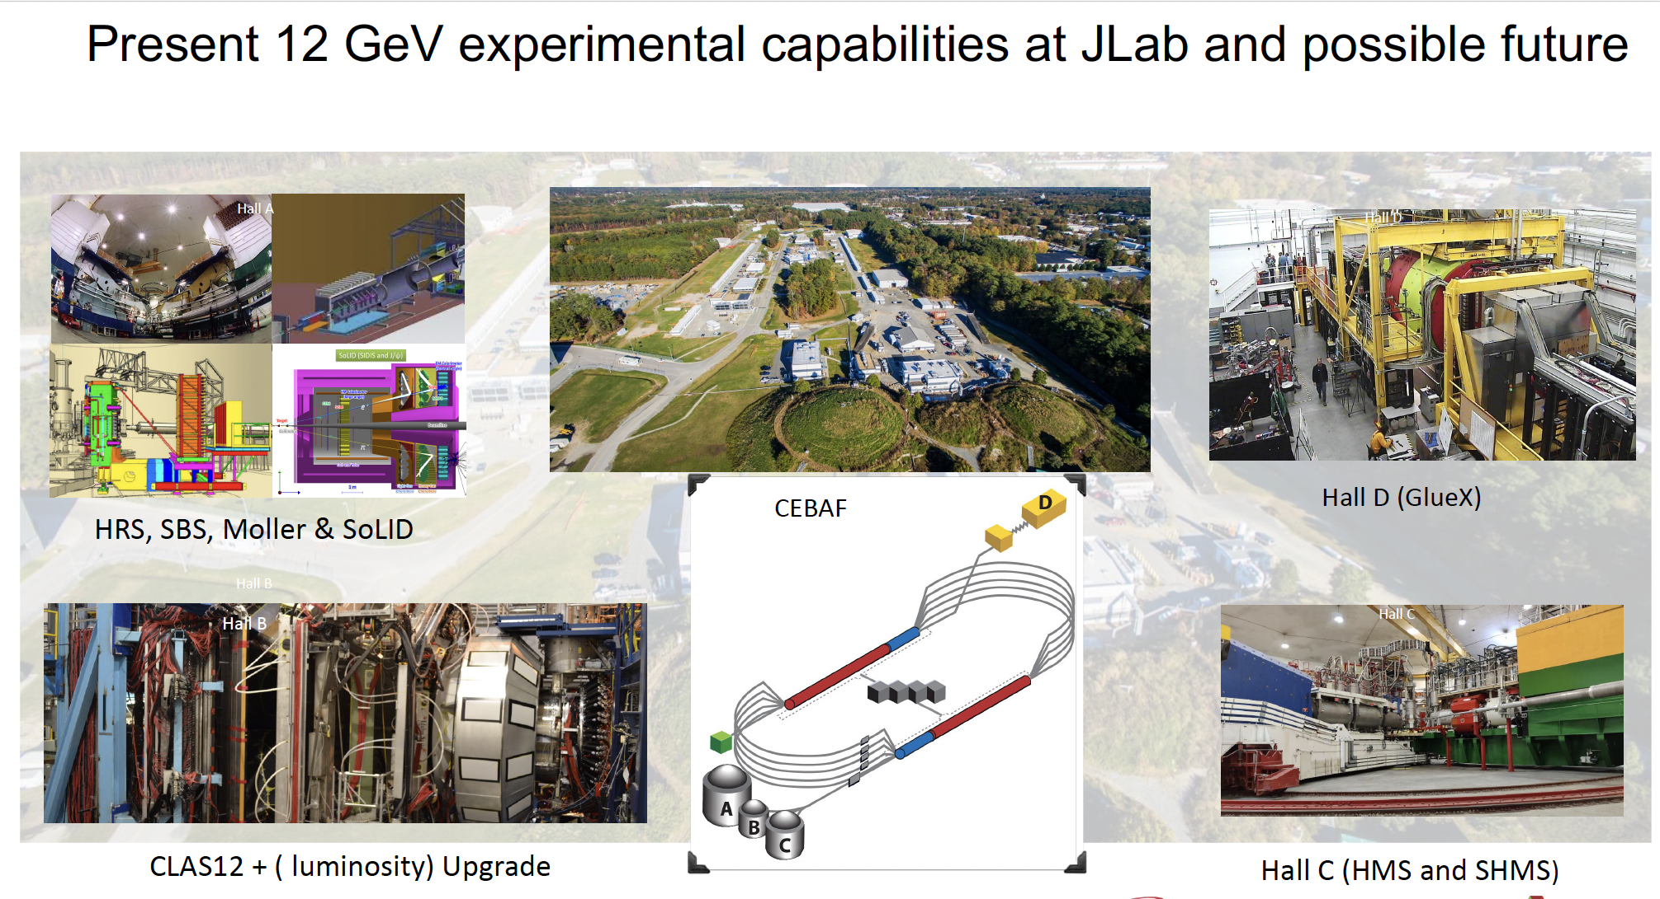
JLab and Experiment Halls

Slide 4
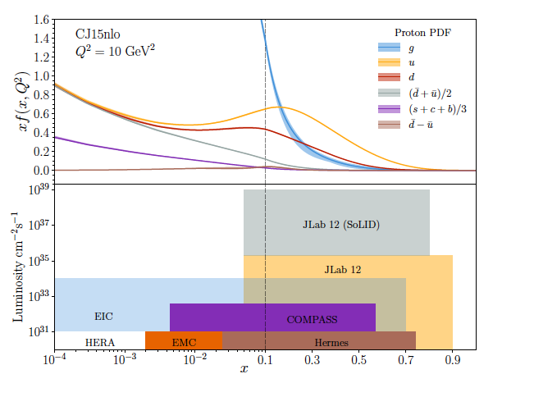
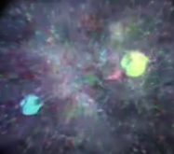
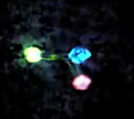
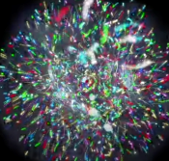
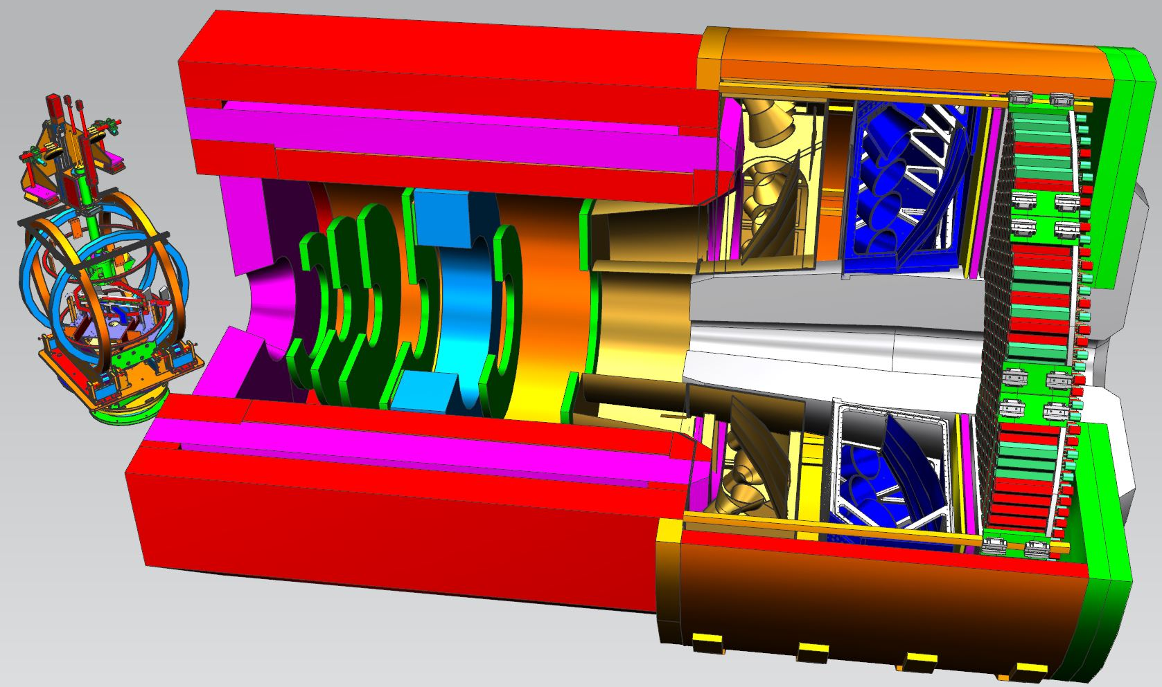
SoLID@JLab: QCD Intensity Frontier
Nucleon spin, proton mass, beyond standard model experiments require
precision measurements of small cross sections and asymmetries,
combined with multiple particle detection
critical need for high luminosity (10³⁷-10³⁹ cm⁻²s⁻¹) and large acceptance
Science reach:
Precision 3D imaging of the nucleon in the valence quark region
Beyond Standard Model searches
Exploring the origin of the proton mass and gluonic force in the non-perturbative regime.
Probability Distribution
Probability Distribution
2020s-2030s
Luminosity (cm⁻²s⁻¹)
2010s-2020s
2030s-2040s
2000s-2010s
1980s-1990s
Fraction of nucleon momentum

Slide 5
Highlights of JLab Spin/3-d Experiments
1-d Spin
Low-Q spin moments (sum rules and polarizabilties) (publications)
Hall A g2p (trans. p), Hall B EG4 (long. p and d), SAGDH (trans. and long. ³He/n)
JLab12
Hall B (CLAS12) RGC (long. p and d) (analysis on-going)
Hall C A1n and d2n (long. and trans. ³He/n) (preliminary results)
…
3-d
Ηall B (CLAS12) RGC SIDIS and DVCS with long. p and d (preliminary results)
Hall A/C DVCS (unpolarized p and d) (publications)
SIDIS (unpolarized p and d) (analysis ongoing)
Future:
SoLID Spin, TMD and GPD program (trans. and long. ³He/n; trans. p)
…

Slide 6
Spin Sum Rules and Polarizabilities
Sum Rules
Nucleon Structure ←→ Global Properties
spin, magnetic moment, polarizabilities, …
→ Study Strong QCD (LQCD, χEFT, …)

Slide 7
Bjørken Sum Rule, GDH Sum Rule, Generalized Sum Rule
Bjørken Sum Rule
(high Q²)
GDH Sum Rule
Real photon (Q²=0)
Generalized GDH Sum Rule
Q²-dependence of GDH Sum Rule provides a bridge linking strong QCD to pQCD
Bjorken and GDH sum rules are two limiting cases
High Q², Operator Product Expansion : S₁(p-n) ~ g_{A} → Bjorken
Q² → 0, Low Energy Theorem: S₁ ~ κ² → GDH
High Q²: pQCD, Operator Product Expansion
All Q² region: Lattice QCD calculations
Low Q² region (< ~0.1 GeV²): Chiral Effective Field Theory (χEFT)

Slide 8
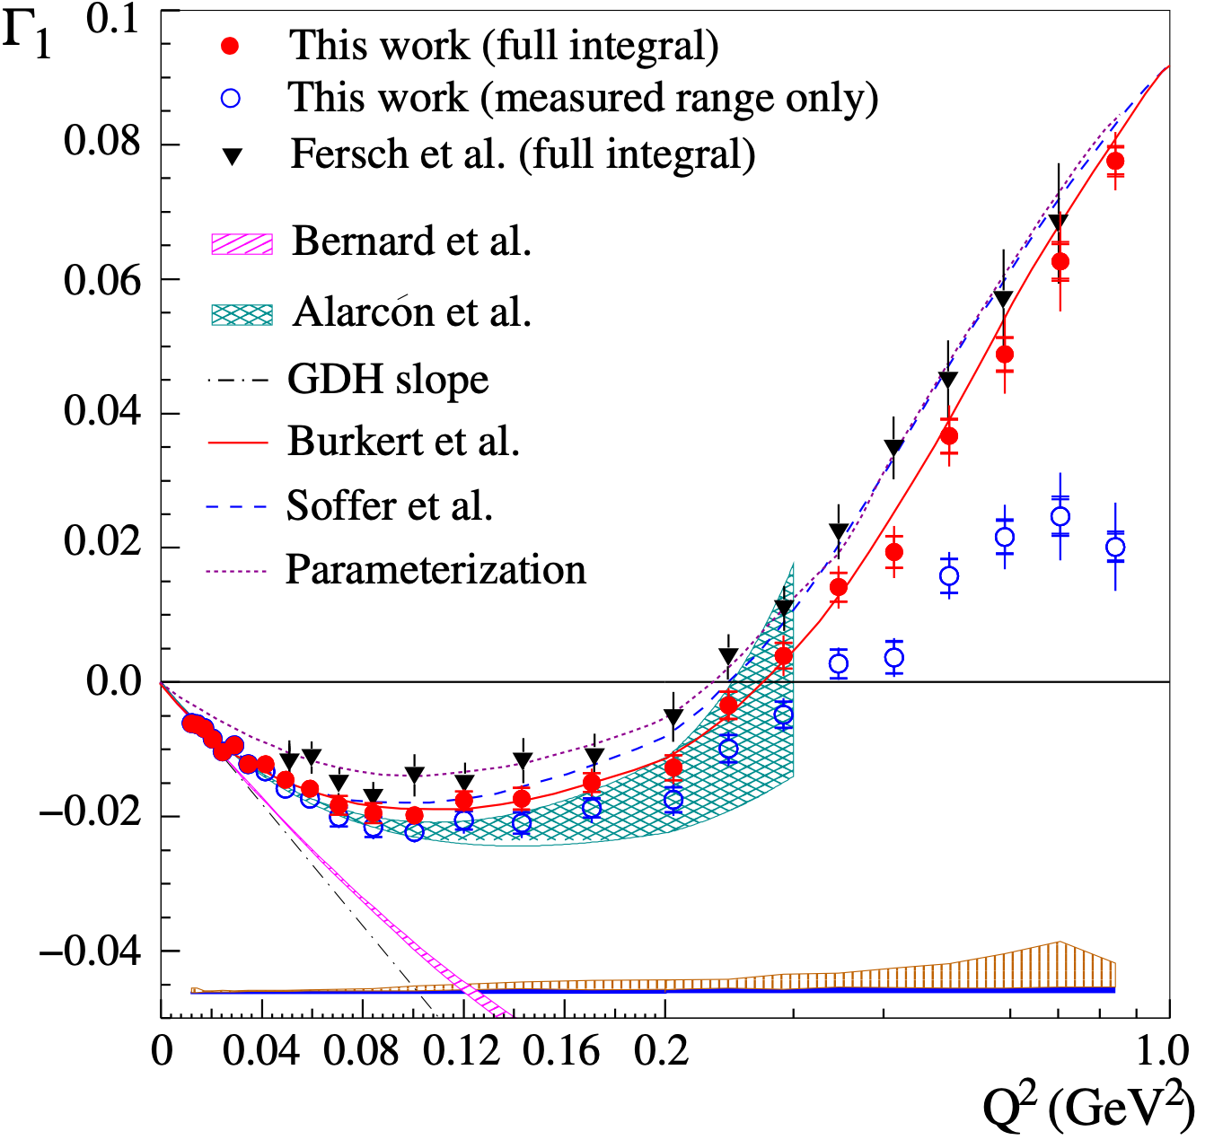
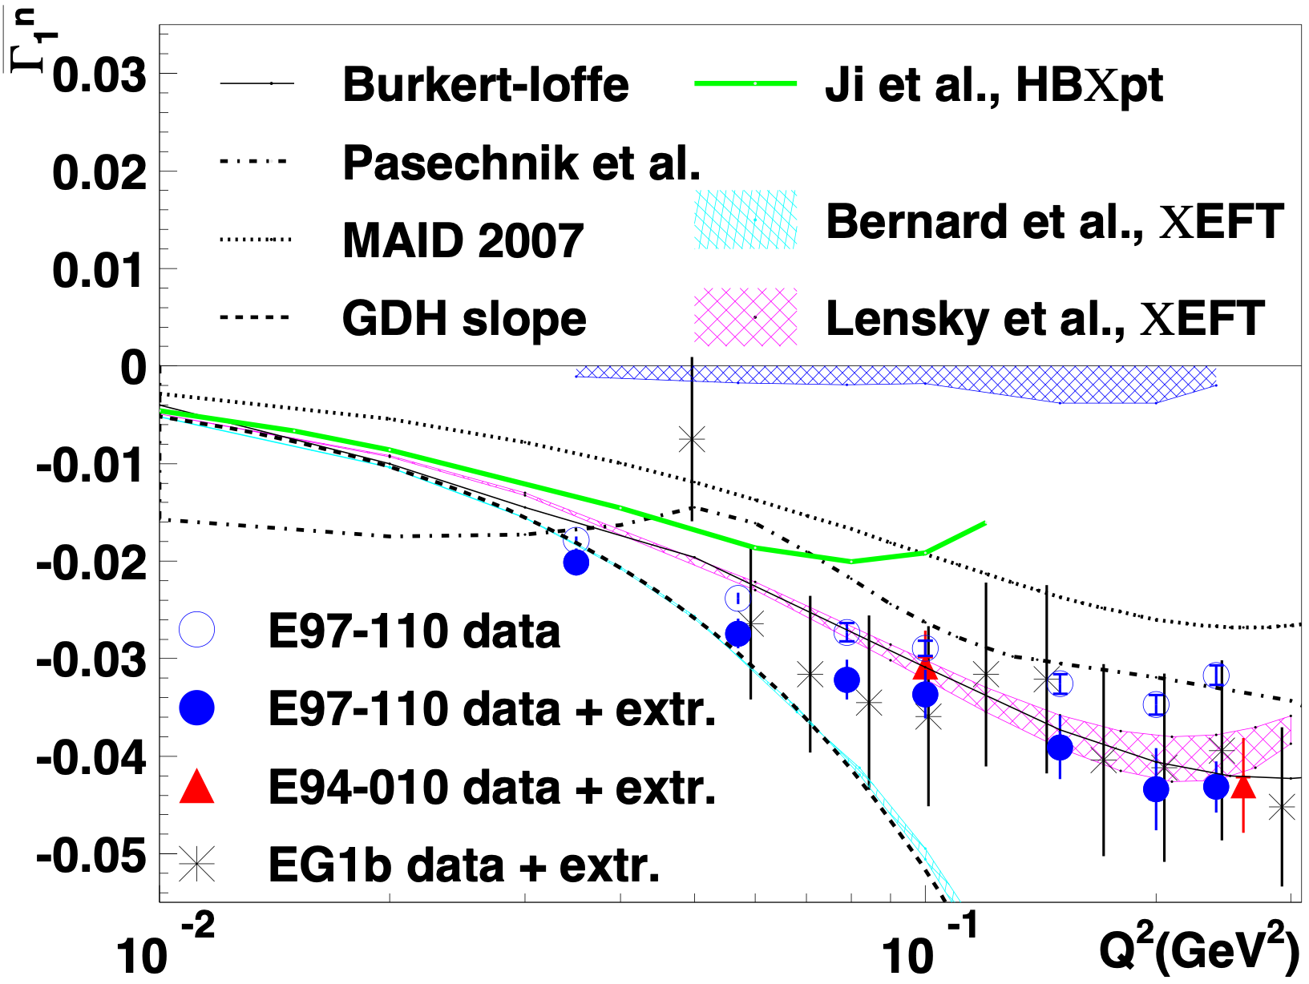
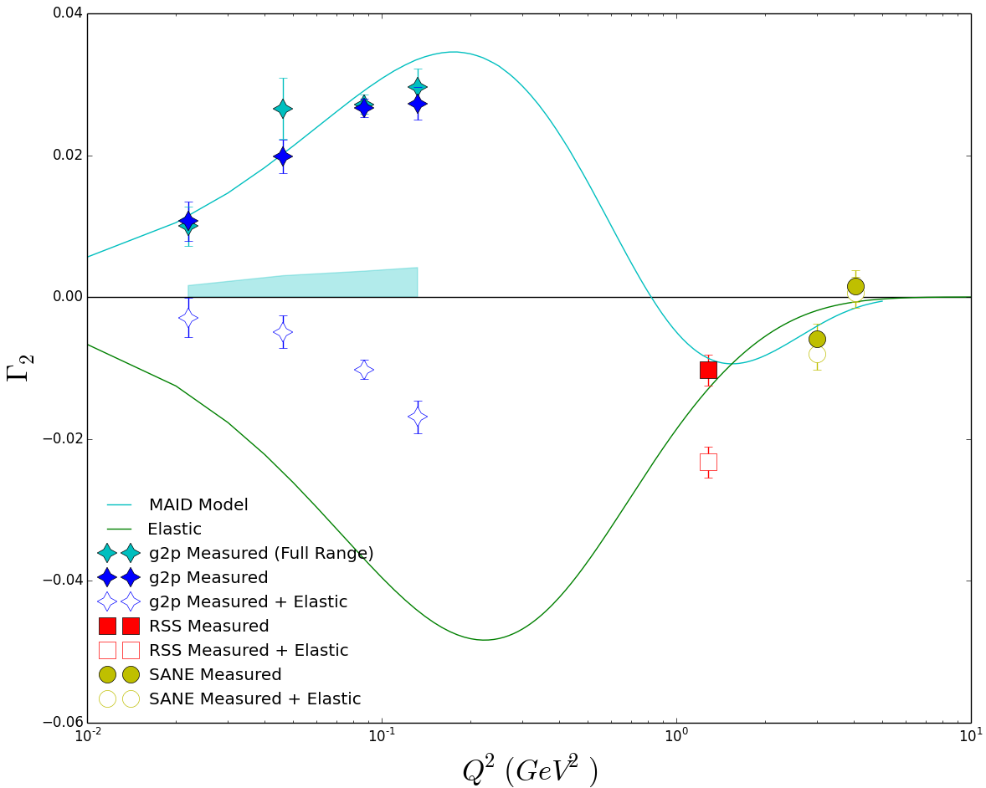
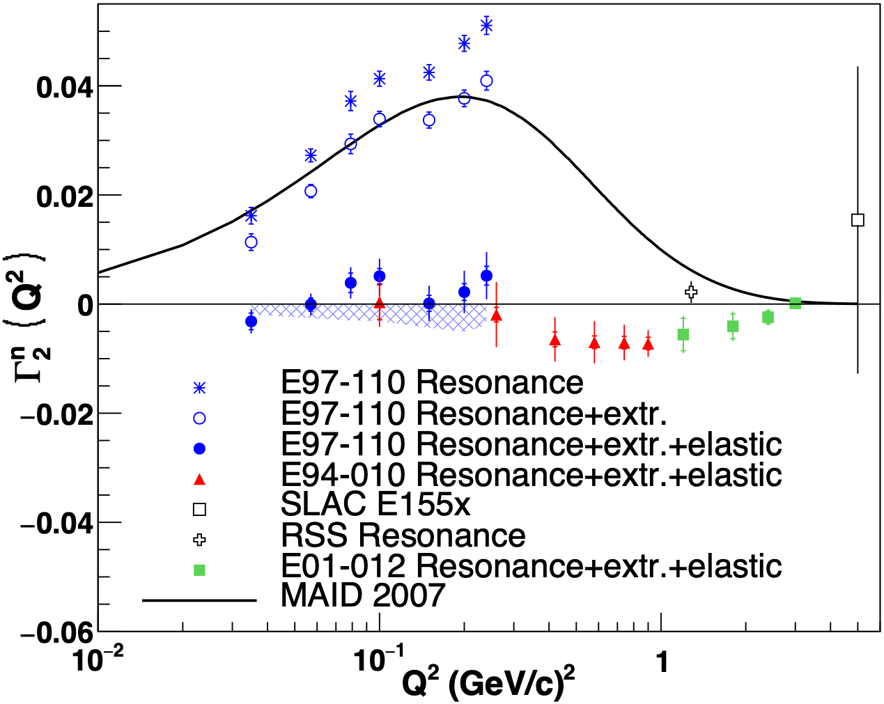
JLab low-Q data on Γ_{1,} Γ₂ for proton and neutron
proton
neutron
Γ₁
Nature Physics, 17, 736 (2021)
Physics Letter B
805, 135428 (2020)
Γ₂
Preliminary results from JLab g2p experiment

Slide 9
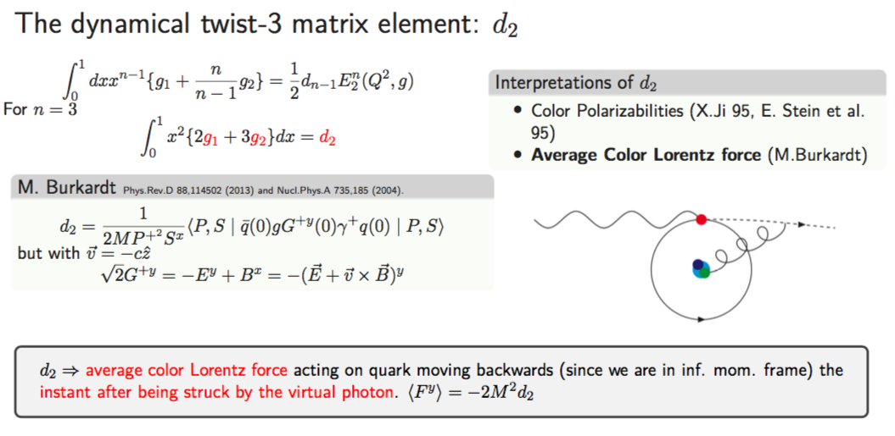
Spin Polarizabilities (higher moments)
Polarizibilities @ low Q²
They can be calculated with χEFT and Lattice QCD (4-point functions)
Polarizibilities @ Intermediate-to-high Q²
Color polarizability (X. Ji)
Color Lorentz force (M. Burkardt)
Dynamic twist-3 matrix element: quark-gluon correlations
Lattice QCD calculations

Slide 10
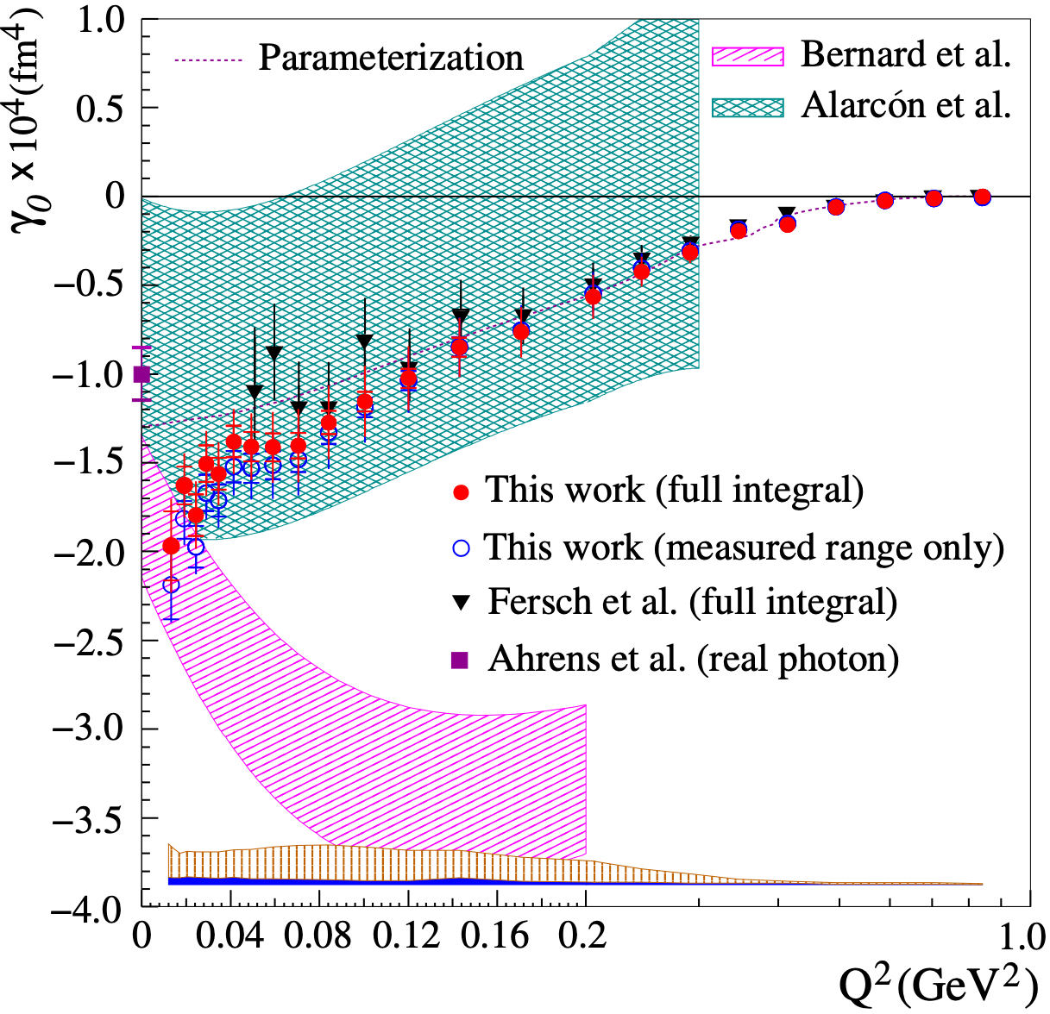
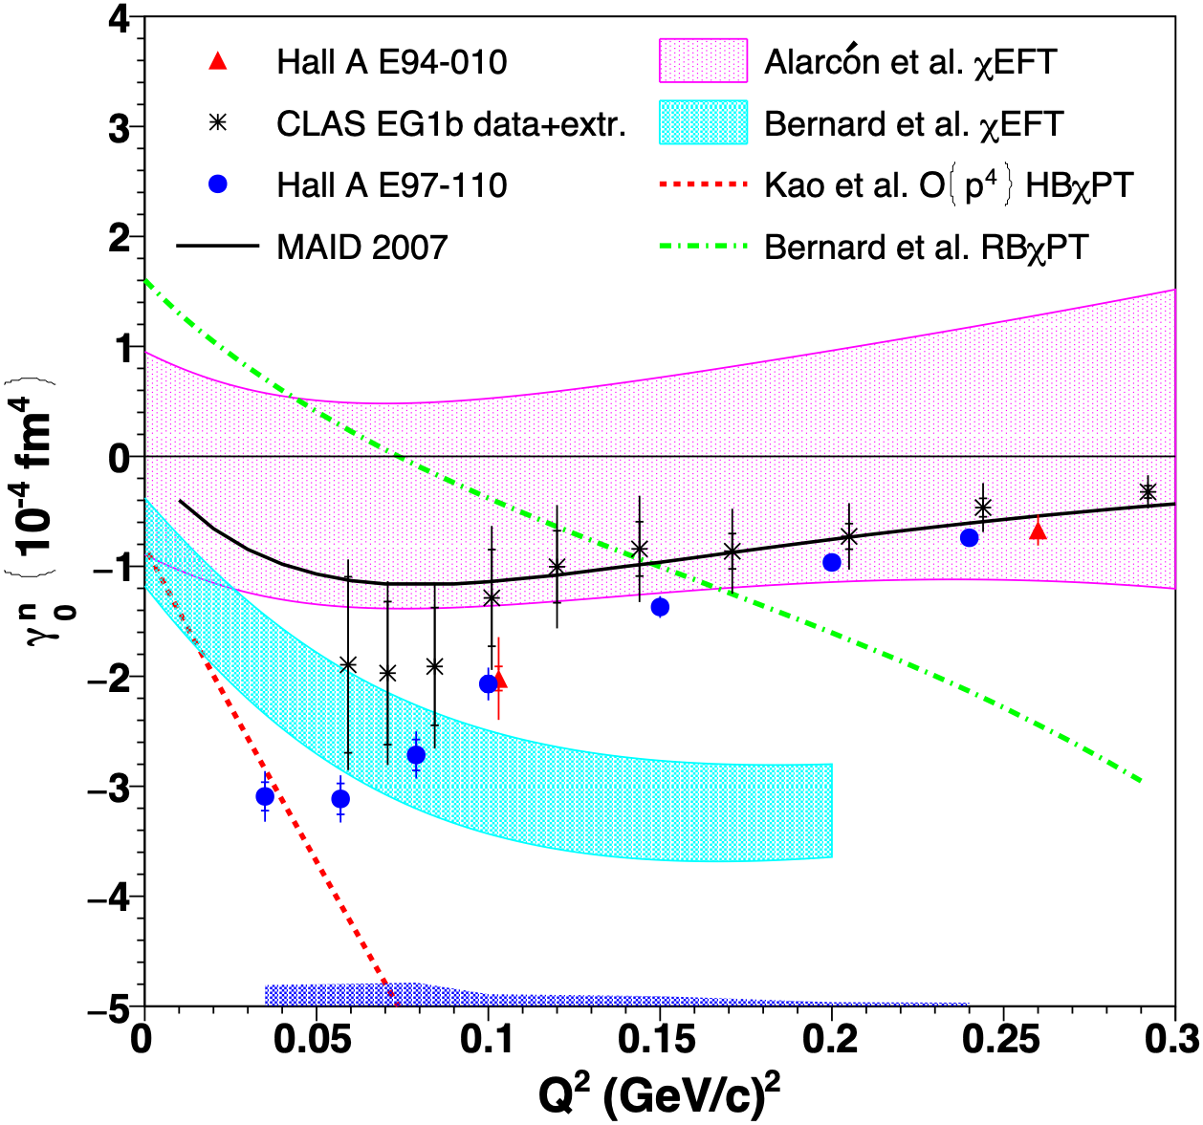
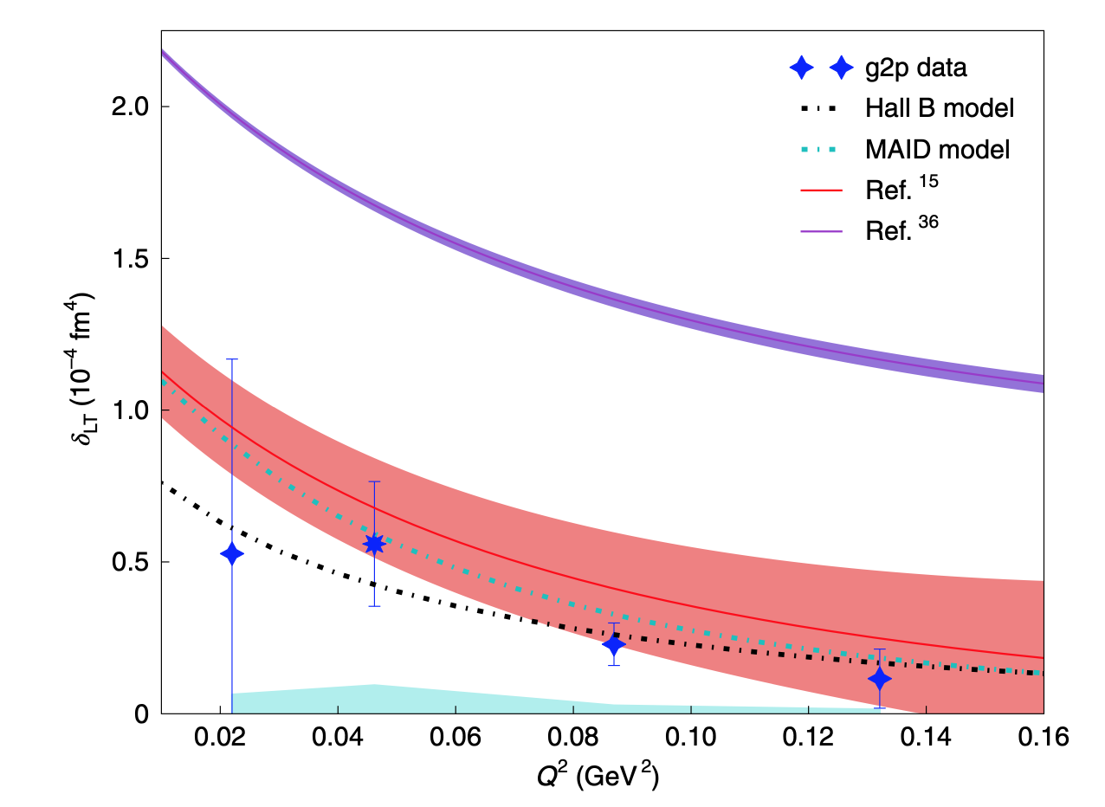
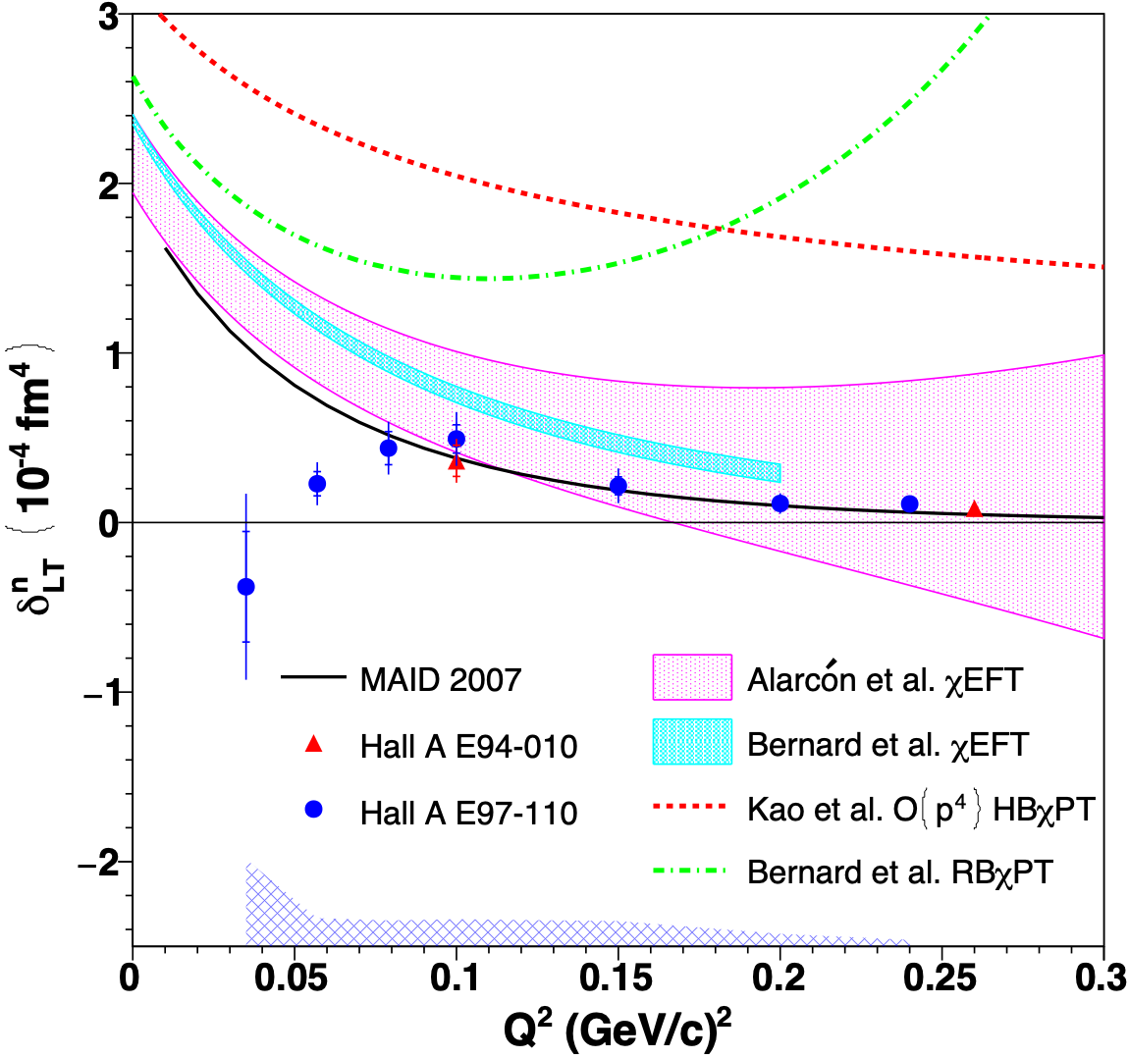
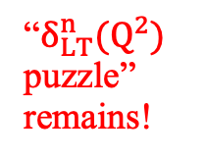
Spin Polarizabilities γ₀$\left(Q^{2}\right), δLT\left(Q2\right)for proton and neutron$
proton
neutron
γ₀
Nature Physics, 17, 736-741 (2021)
Nature Physics, 17, 687 (2021)
Nature Physics
18, 1441 (2022)
δ _{LT}
Comparisons with χEFT calculations: favor Alarcon et al., strong disagreement with Bernard et al.
“$δ_{LT}^{n}(Q^{2})$ puzzle” remains!

Slide 11
Highlights of JLab12 Spin Program
spin structure in valence region
Overview of RGC@CLAS12: A1p (A1d) @high-x
Preliminary results from A1n(³He)@high-x:
color polarizability/color Lorentz force
Preliminary results from d2n(³He) in Hall C and SoLID projection

Slide 12
A₁ at High-x: World Data
a clean domain where QCD (and many other models) can make predictions for (the ratio of) structure functions
ratios of pol/unpol pdfs at x→ 1 provide unambiguous, scale invariant, non-perturbative features of QCD

Slide 13
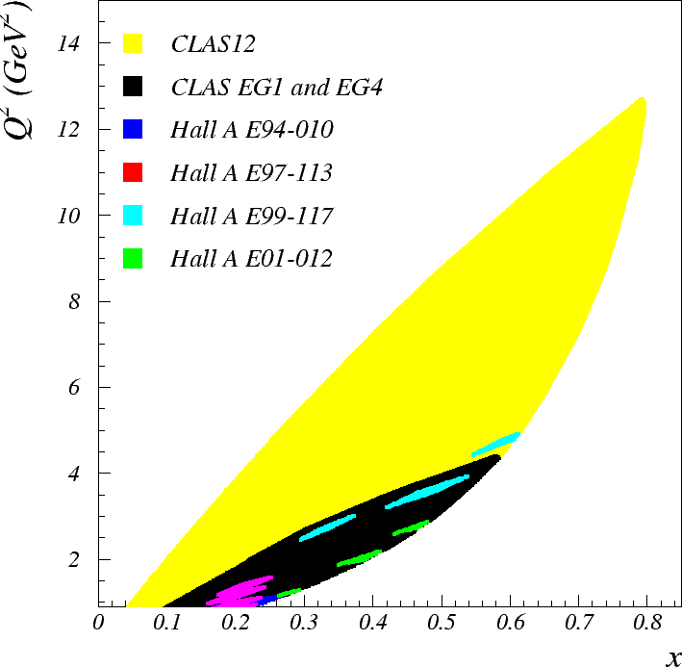
Reaching Deeper Valence Quarks Region with 12 GeV
CLAS12 Kinematics
Hall C A₁^{n} Kinematics

Slide 14
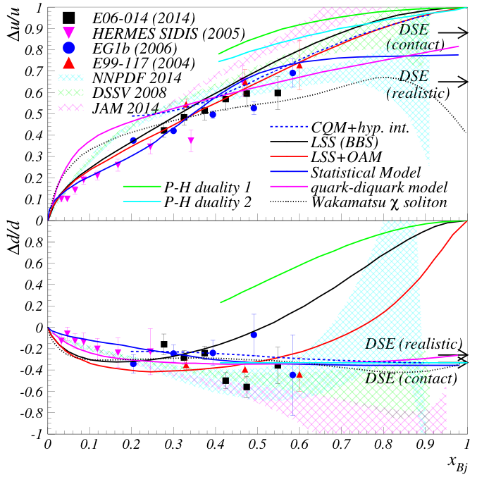
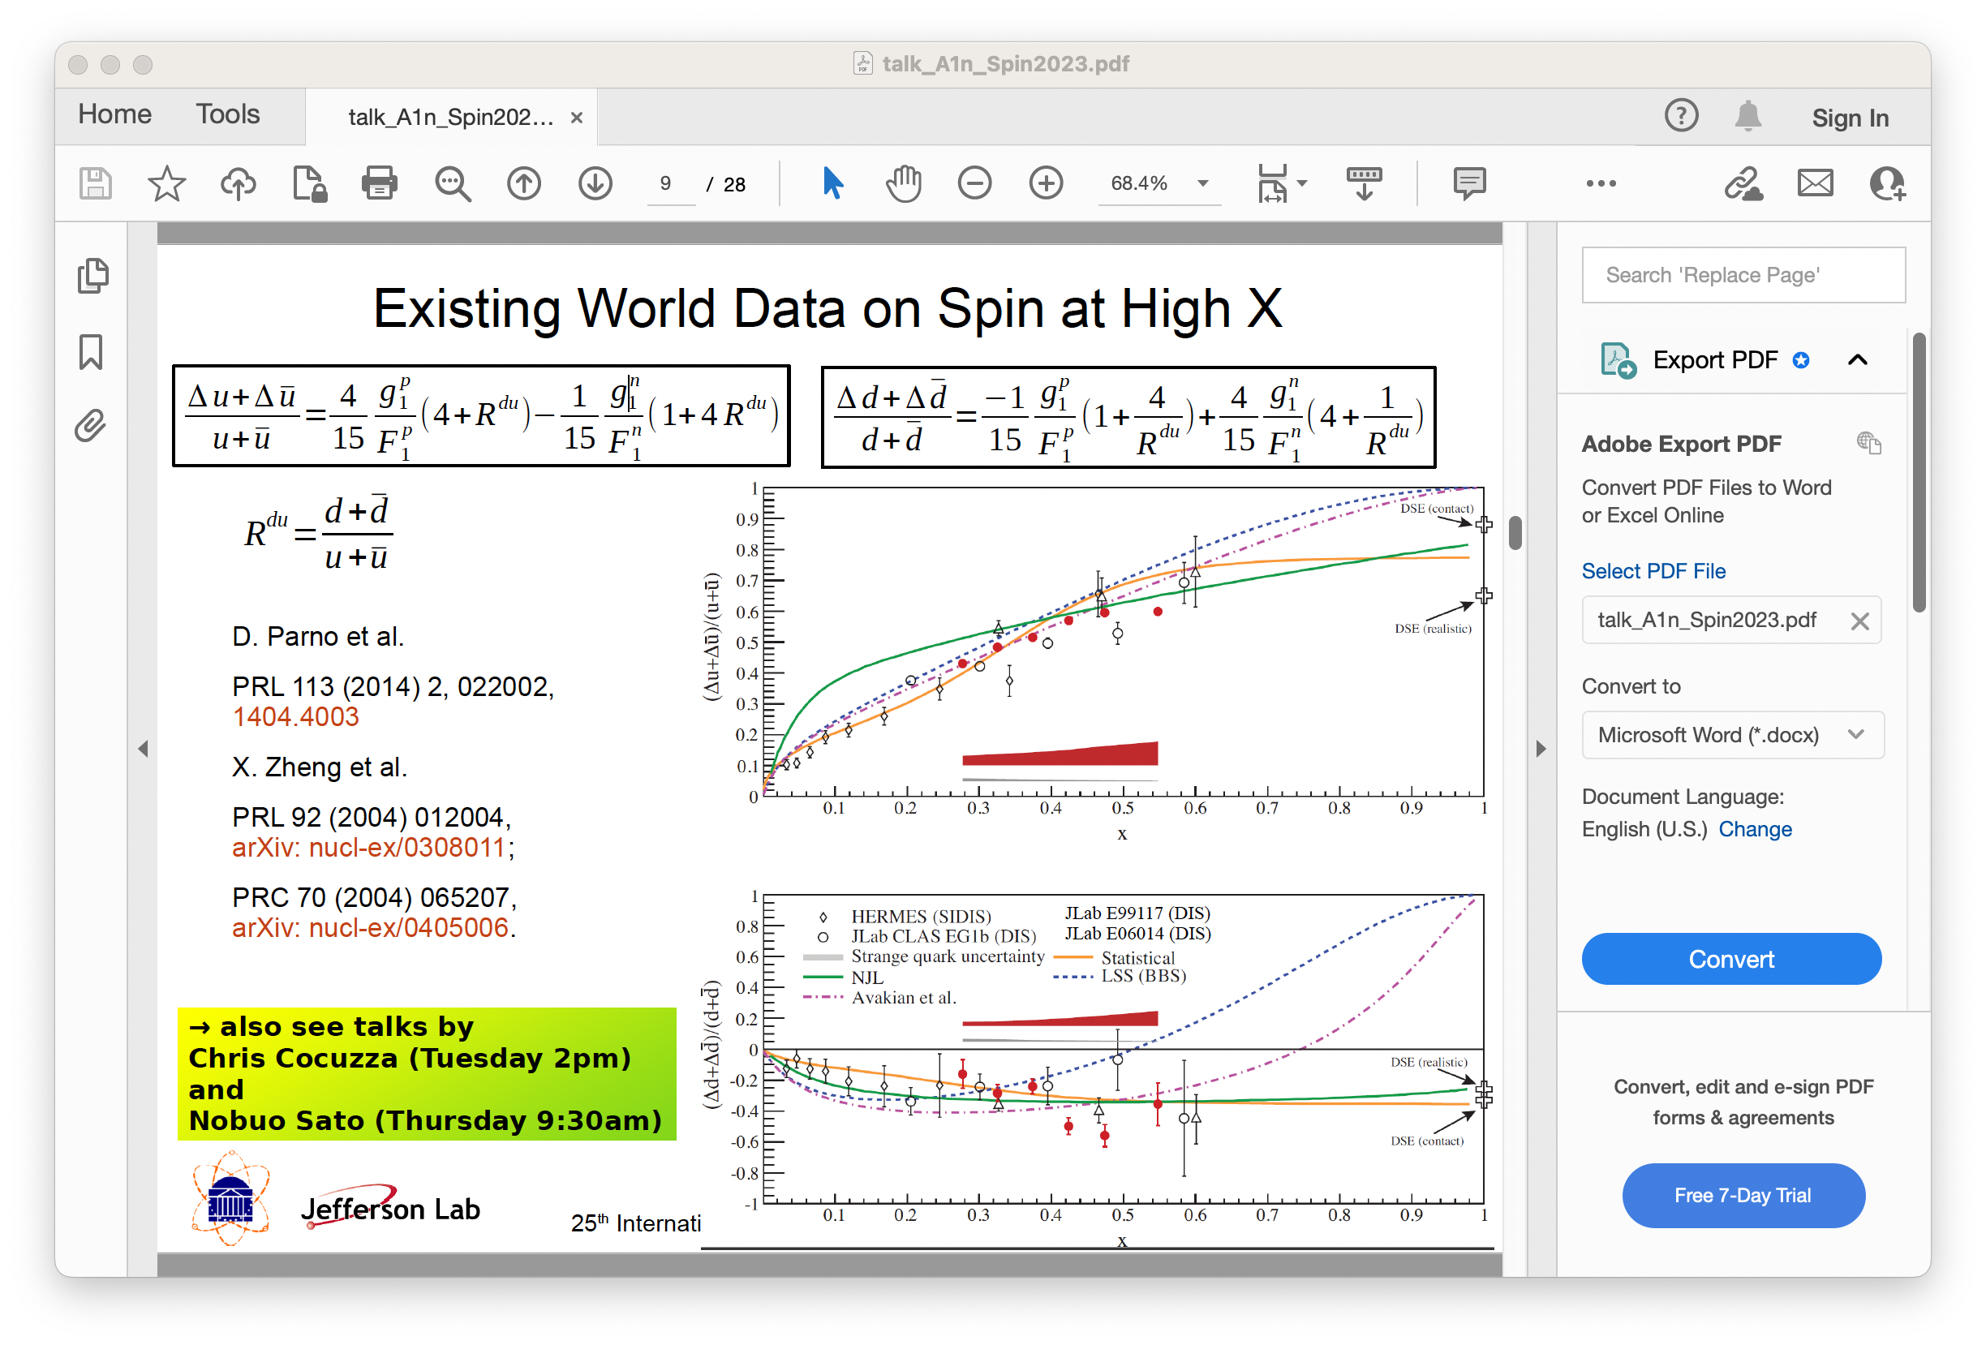
Simple Spin-flavor Decomposition at High-x
pQCD with quark OAM,

Slide 15
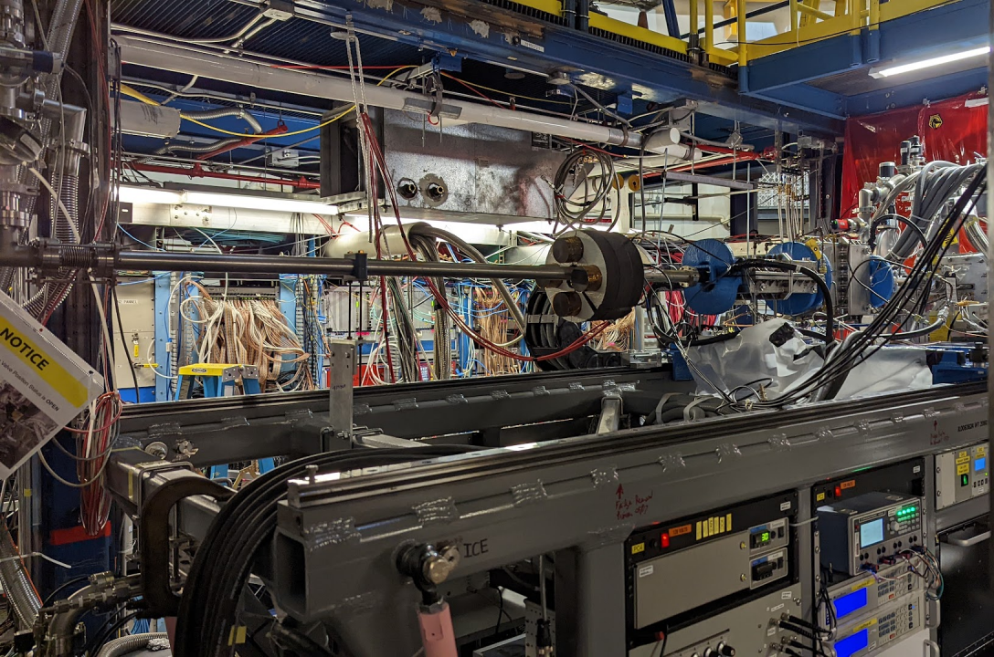
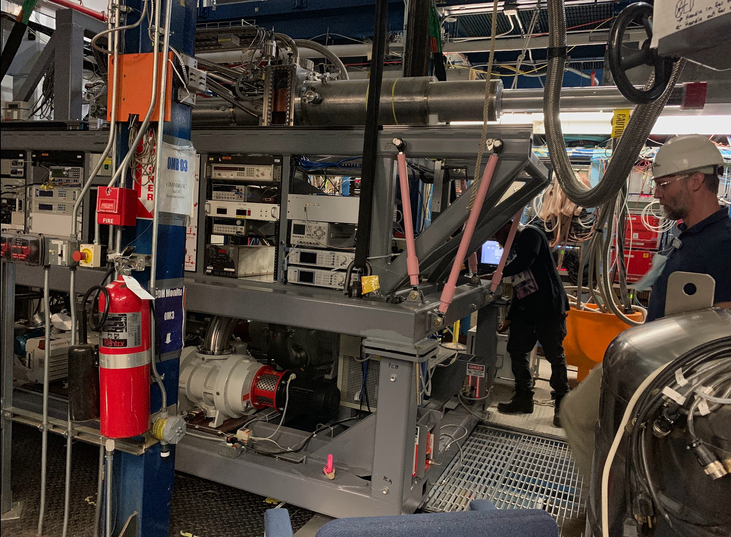
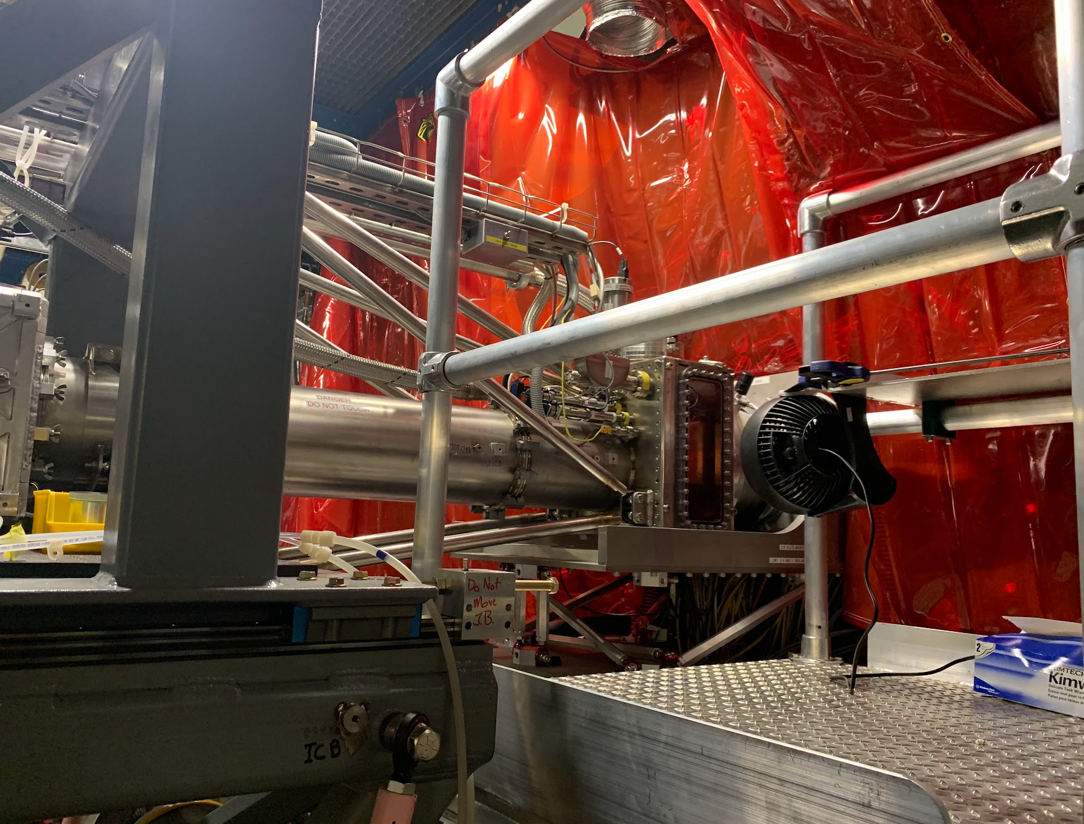
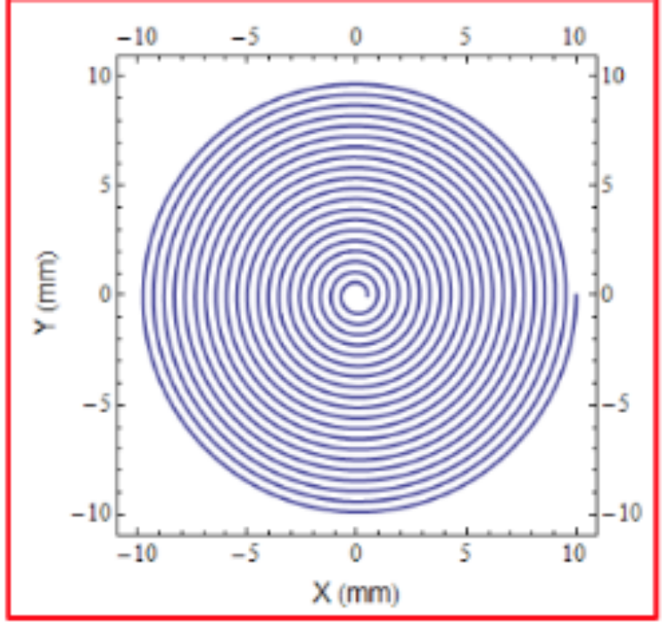
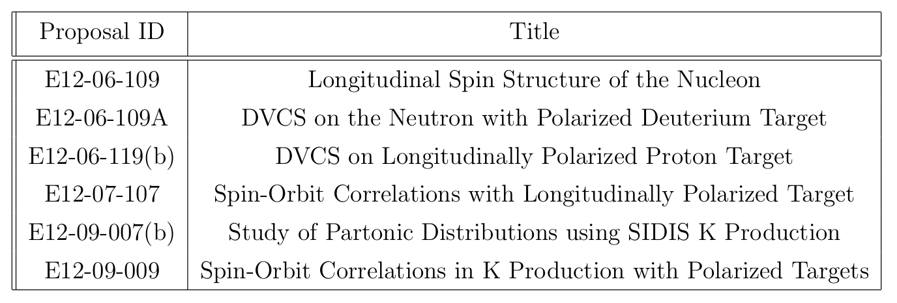
RGC@CLAS12 with Longitudinally Polarized proton/deuteron Targets
P. Pandey
Evacuated Beamline
Raster magnets
RGC scheduled for 9 calendar months (240 calender days), data collected for 190 days, 80% of allotted beam time.
Collected data from 06/11/2022 to 03/20/2023 with some breaks due to Magnet power supply failure (firmware issue) and configuration changes.

Slide 16
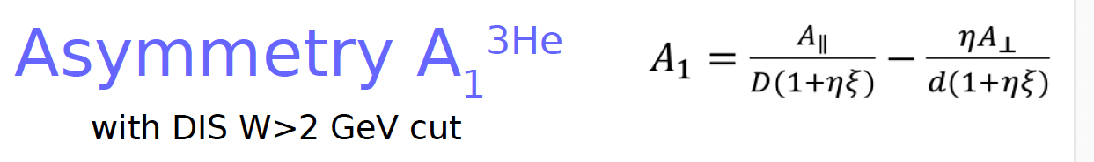
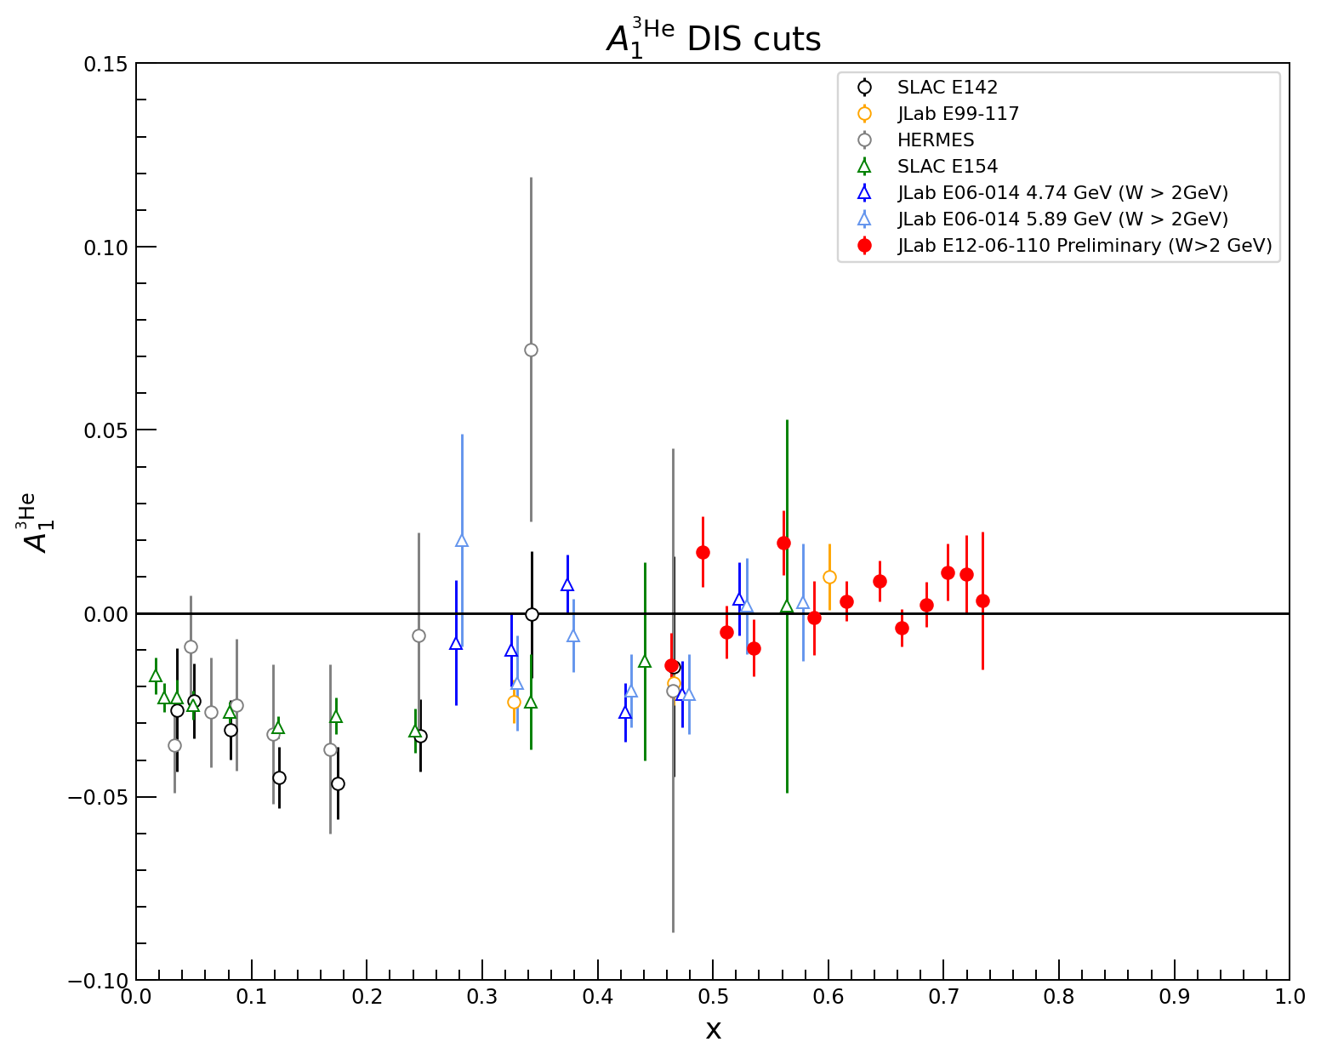
Hall C: A1n@High-x: Preliminary Results (A₁³He)
Preliminary
X. Zheng, M. Nycz

Slide 17
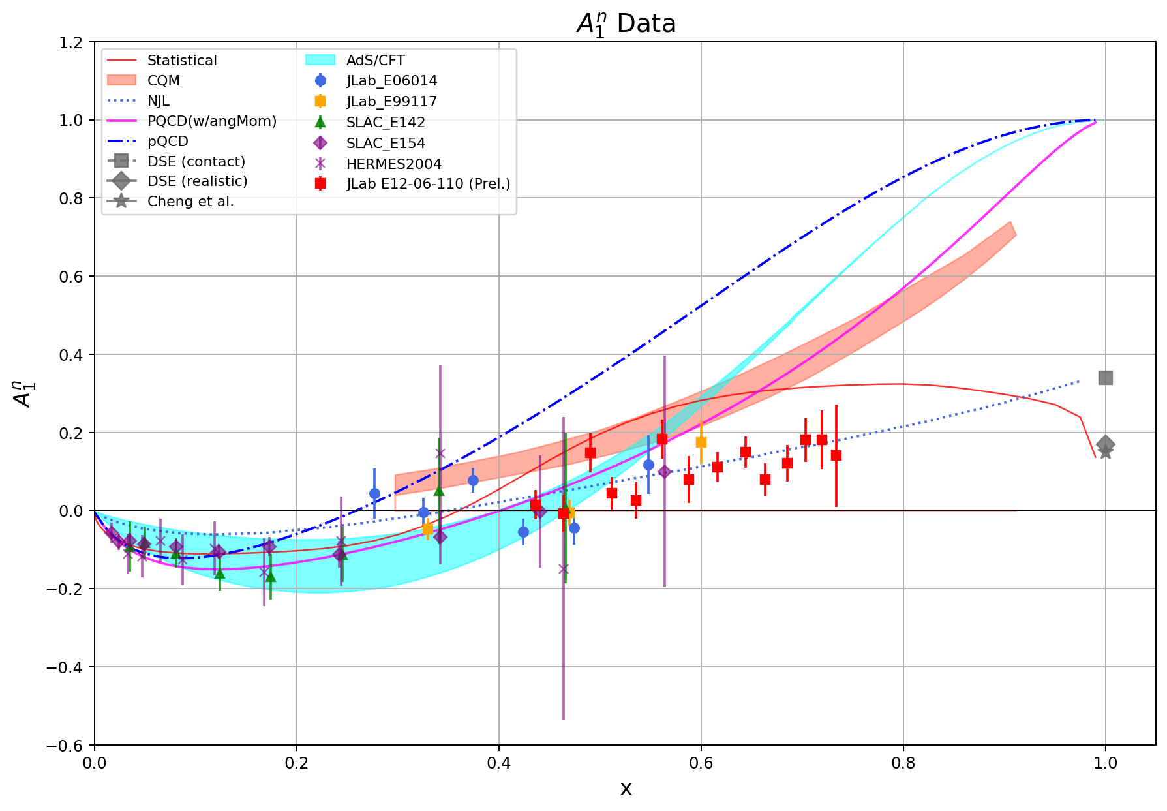
A1n@High-x: Preliminary Results on A₁^{n}
X. Zheng, M. Nycz
Preliminary
A1n extracted using effective polarizations, the global fits for the proton A1p, and F1F2-21

Slide 18
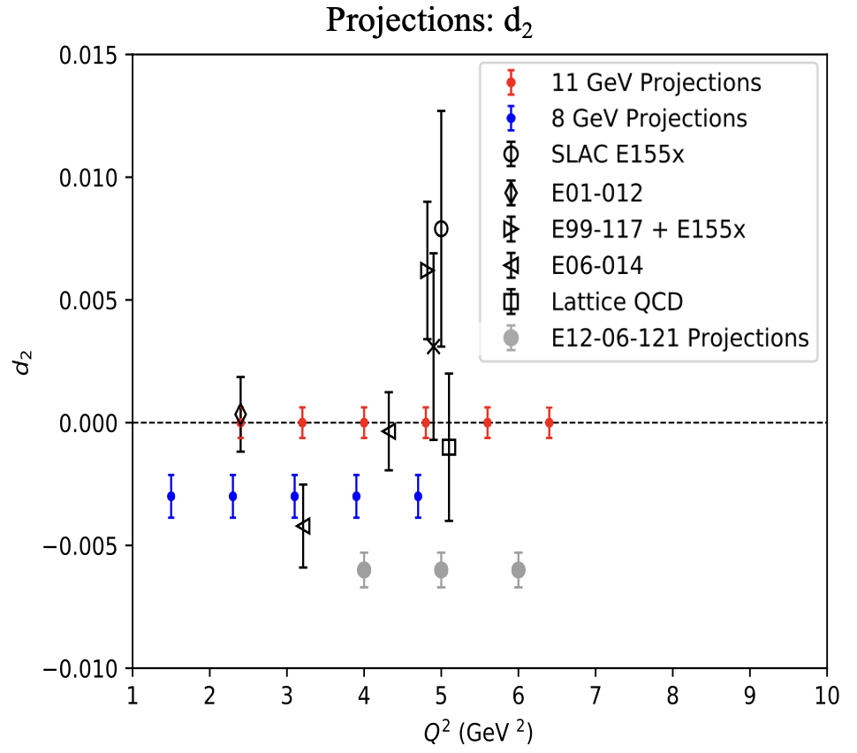
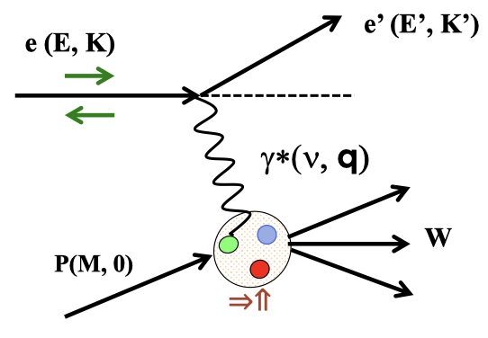
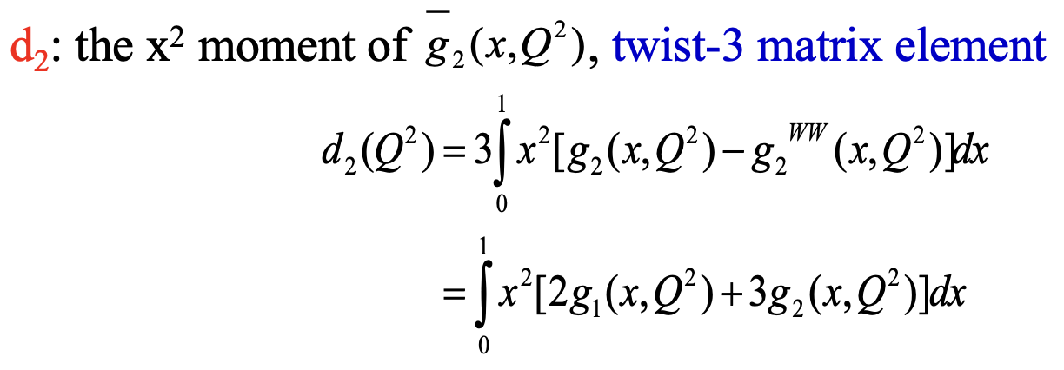
Inclusive g₂ , d₂ on a Polarized ³He: Hall C and future SoLID
Y. Tian
Polarized electron beam
Polarized target
0
0
Benchmark test of Lattice QCD predictions
A clean way to access twist-3 contribution
Dominated by high x data because of weighting

Slide 19
Future Precision Spin Program with SoLID
Flavor separation – polarized valence and sea
α_{s} extraction with JLab22 + EIC

Slide 20
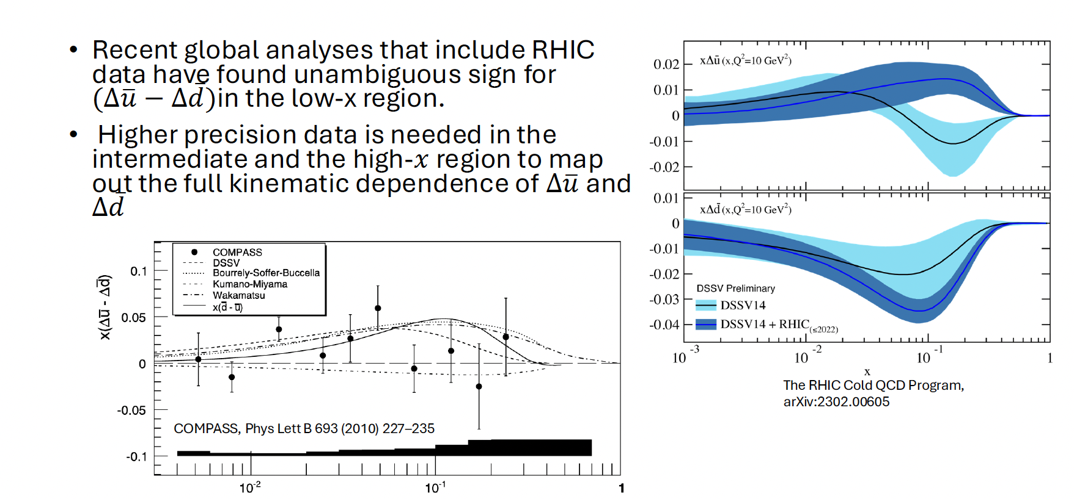
RHIC/COMPASS: Polarized Sea

Slide 21
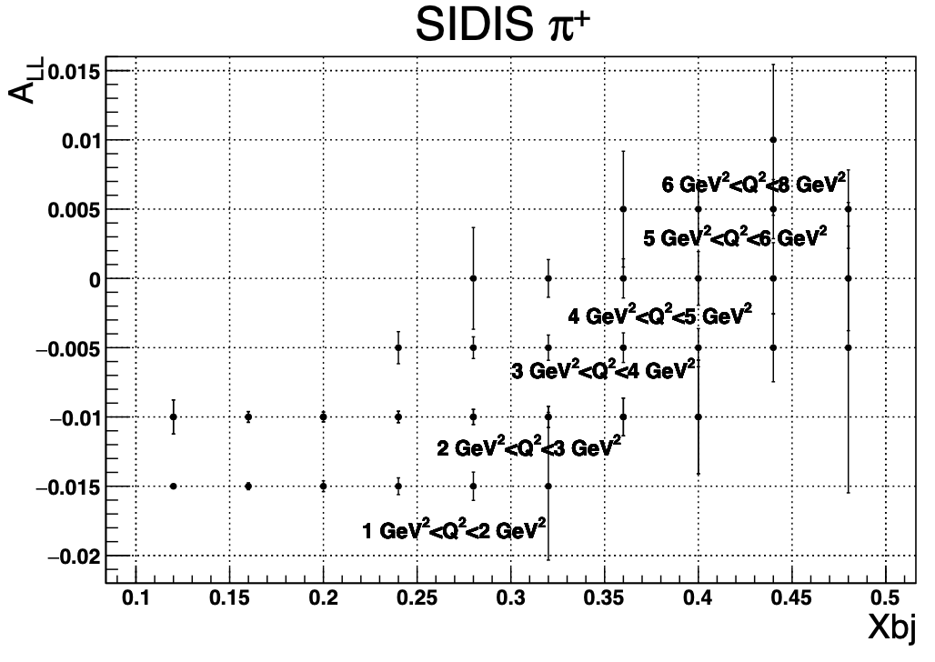
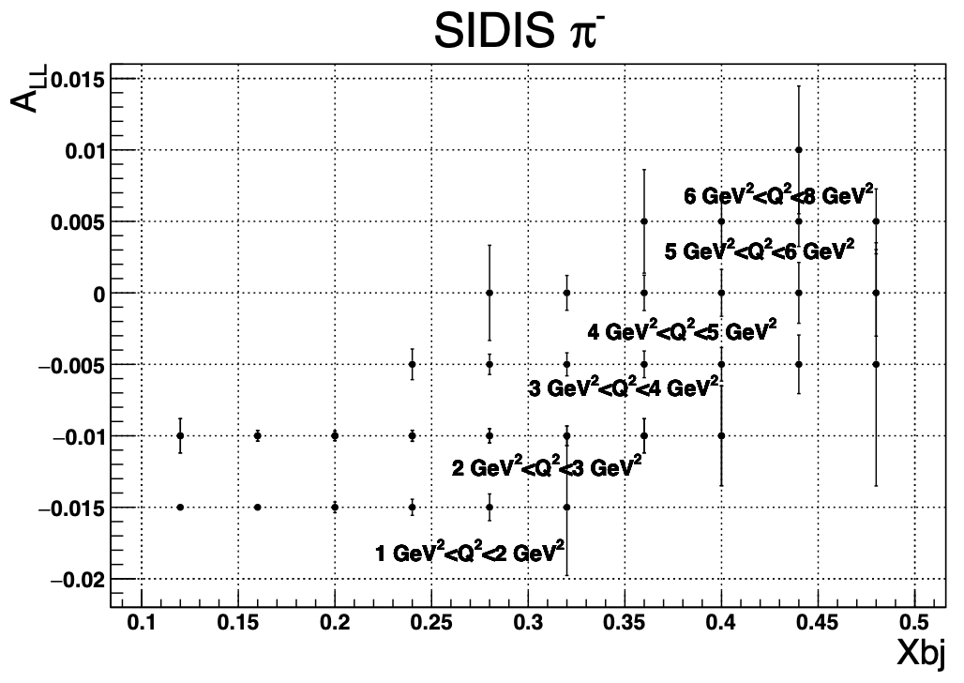
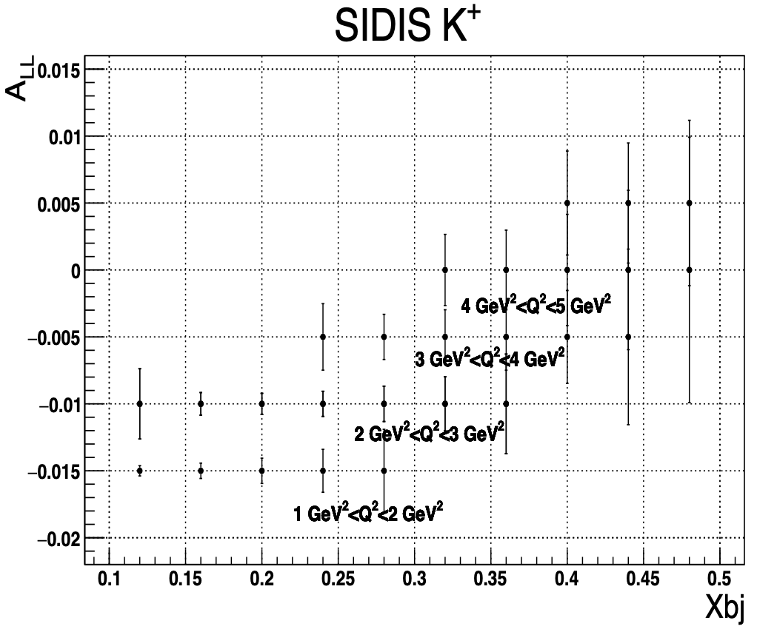
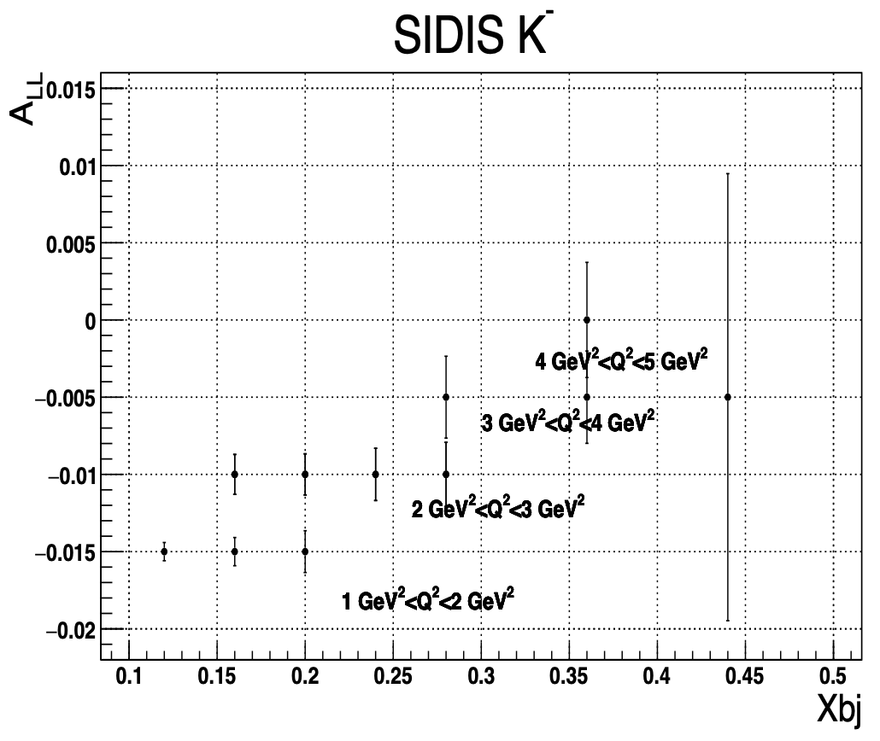
SoLID @ 11GeV SIDIS Polarized Asymmetries: π/K on n
Ching Him Leung
π-
Statistical uncertainty only

Slide 22
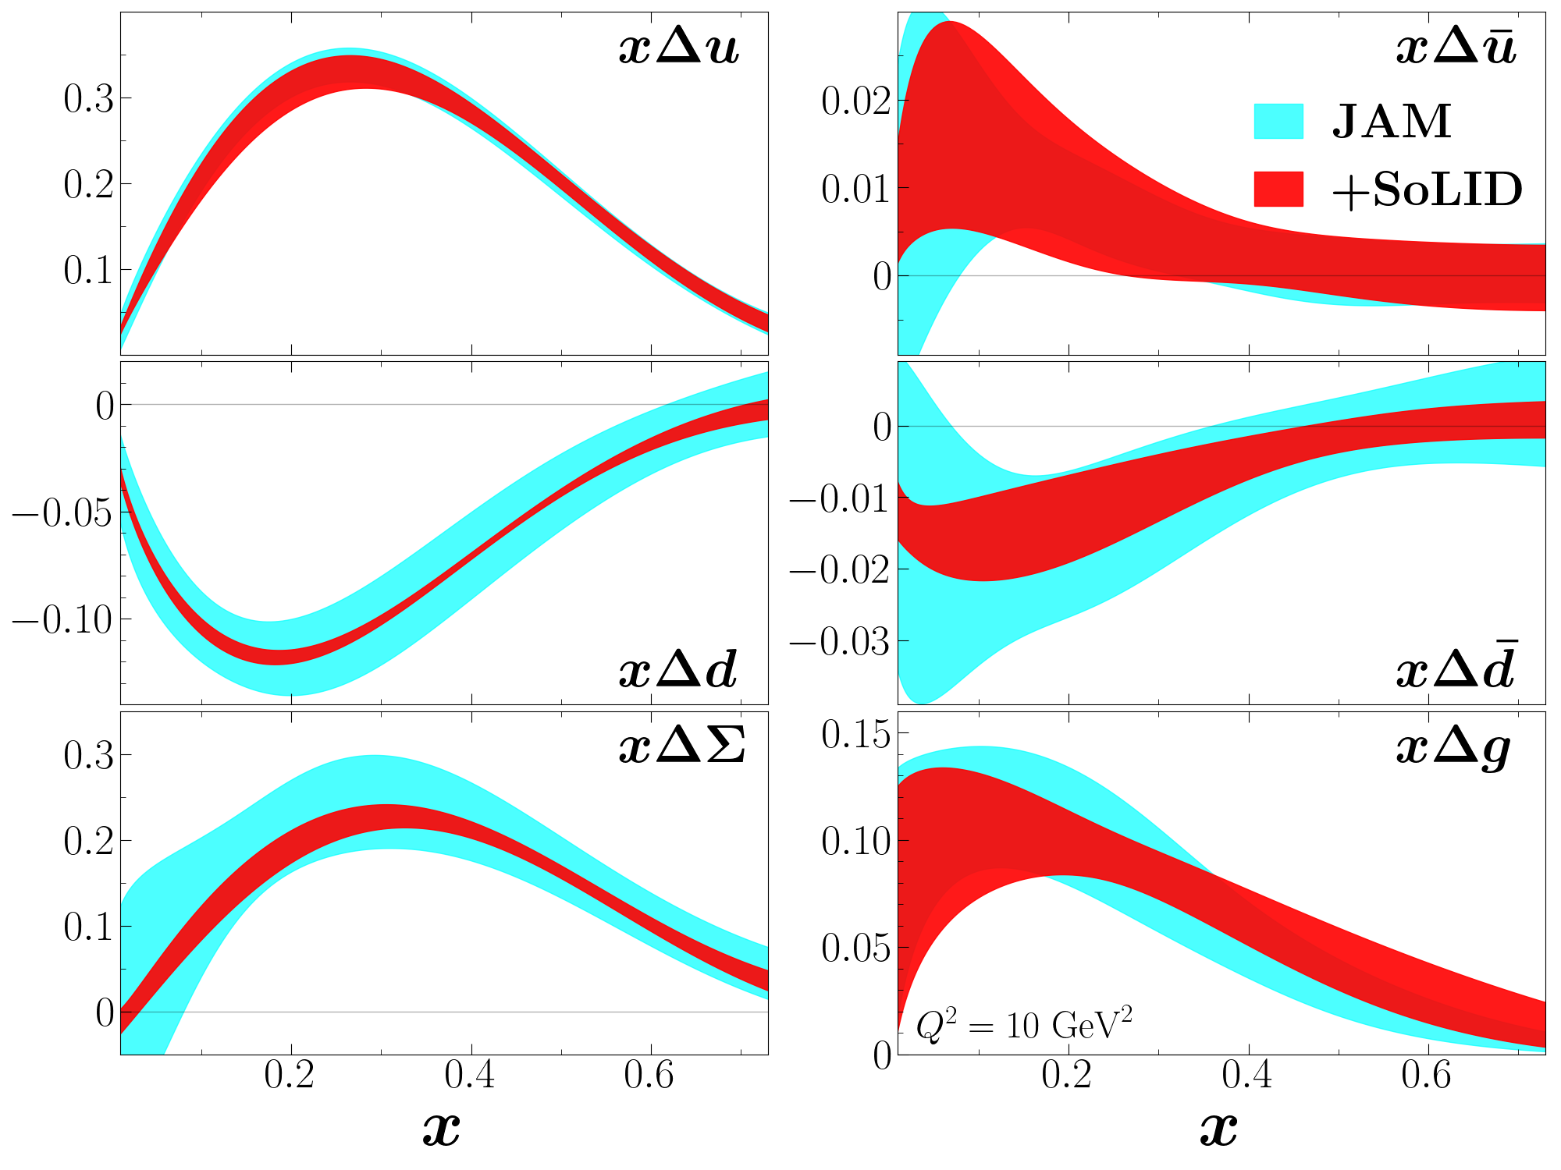
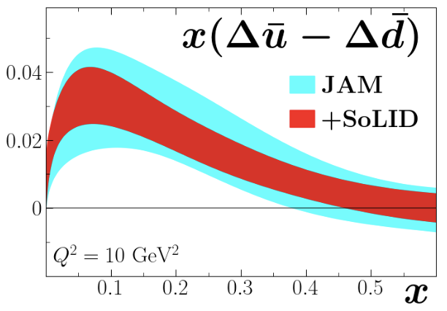
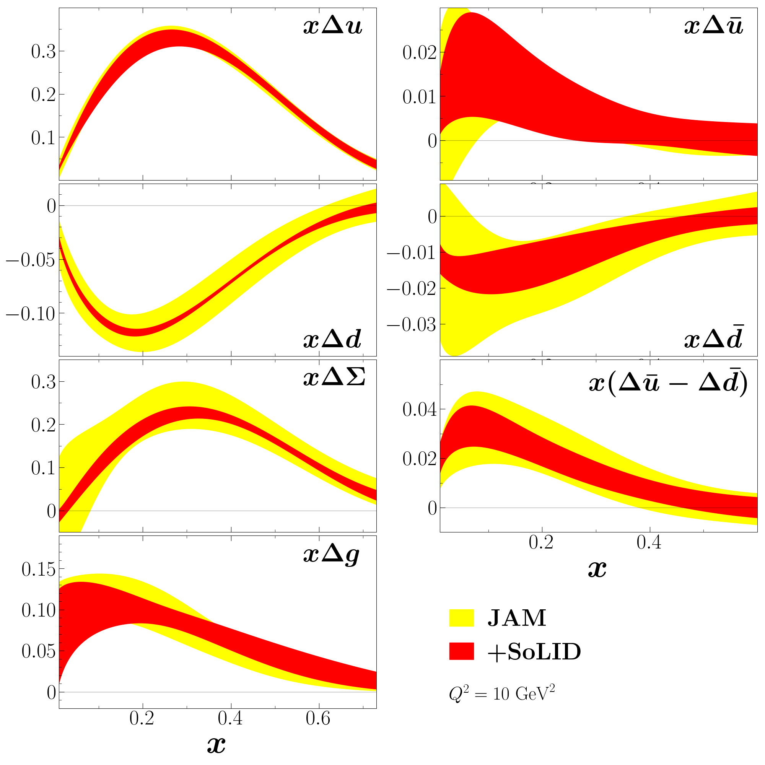
SoLID Constrains Sea Asymmetry and Total Valence Polarization
JAM QCD global analysis framework: – Inclusive & semi-inclusive DIS A_LL​ – Jet production in polarized pp collisions – W/Z boson production at RHIC
Y. Tian
from Christopher Cocuzza
SoLID helps test if the polarized sea is flavor asymmetric, just like the unpolarized sea
SoLID’s polarized ³He SIDIS data will tighten uncertainties on both valence and sea helicity PDFs, with main impact on d and d_bar quarks
Notes:
Left: Flavor asymmetry x(Δuˉ−Δdˉ)x(Δuˉ−Δdˉ) • Right: Total sea polarization x(Δuˉ+Δdˉ)x(Δuˉ+Δdˉ)
We perform an impact study of the projected SoLID data on helicity PDFs, within the JAM QCD global analysis framework. The analysis is based on theory calculations computed at next-to-leading order accuracy in perturbative QCD. The extraction of the helicity PDSs from the pseudodata includes fitting to all of the world's available data that dependent on helicity PDFs, including double-spin asymmetries in inclusive and semi-inclusive DIS, jet production in polarized $pp$ collisions, and weak vector boson production in polarized $pp$ scattering at RHIC.

Slide 23
SoLID @ JLab22 SIDIS Polarized ubar/dbar PDFs
Ching Him Leung
Bands are current uncertainties from NNPDF

Slide 24
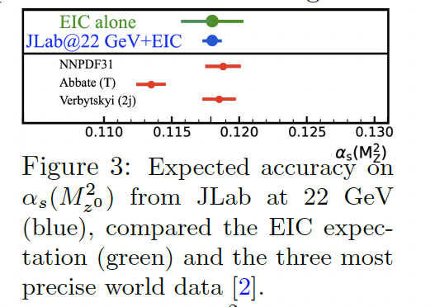
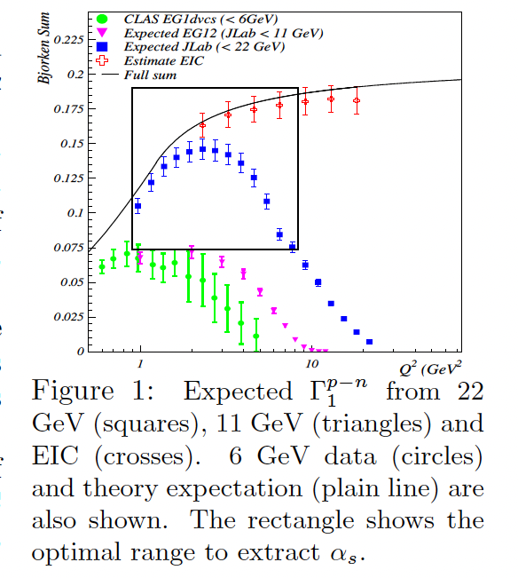
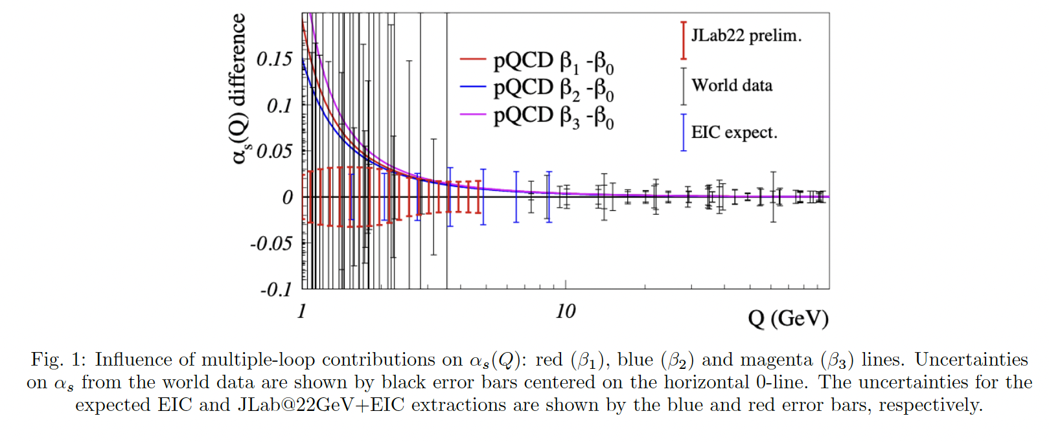
α_{s} Extraction from Bjorken Sum with JLab22+EIC
A. Deur

Slide 25
3-d Structure Study I: TMD/SIDIS
Hall B/CLAS12 RGC: SIDIS with L. Pol. p/d
Hall C: SIDIS to study P_t dependence, test CSV, L/T Separation
Future: SoLID-TMD Program

Slide 26
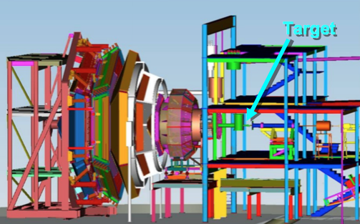
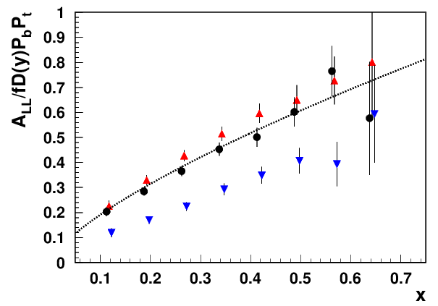
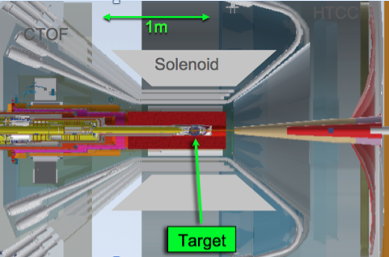
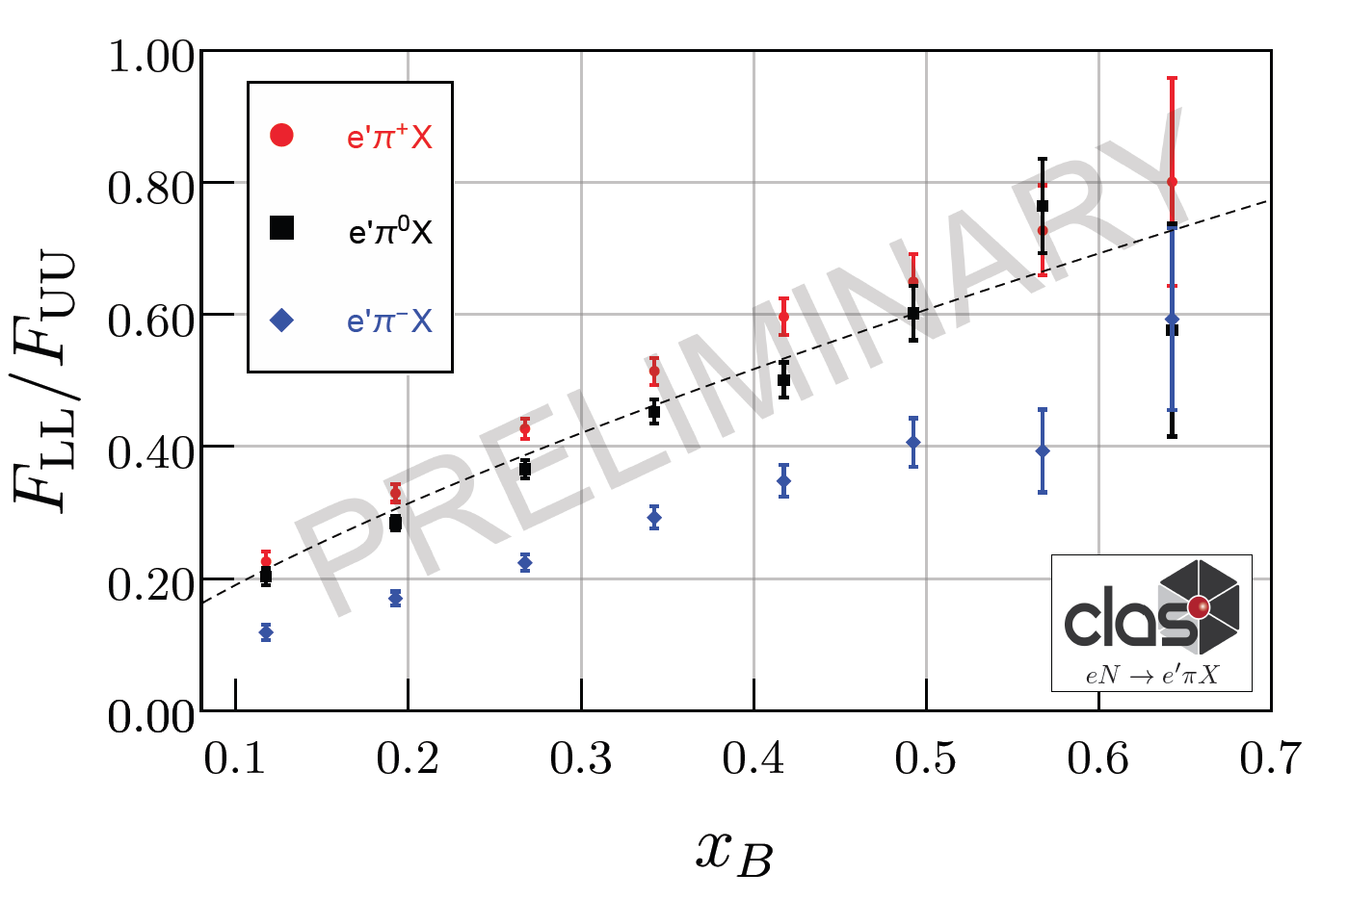
CLAS12 RGC experiment with longitudinally polarized target
CLAS12
Electroproduction on longitudinally polarized NH3 and ND3
H. Avakian
E12-06-109, E12-06-119, E12-07-107, E12-09-009
Dynamic Nuclear Polarization (DNP)
Notes:
5 mm Radial Clearance inside the SVT
The actual time for swapping the Target Cell is ~15 min
The Target Cell is comprised of a 50 mm long perforated PCTFE (polytetrefluoroethylene) cylinder with a wall thickness of 0.5 mm and sealed with 20 μm thick Al foil beam windows upstream and downstream. These cells are made in two diameters, 15 and 20 mm. The cell is supported in the bath my an Al frame with a removable foil window upstream and fixed foil down stream.
NH₃, ND₃, CH₂, CD₂, C, Empty and Optical Targets

Slide 27
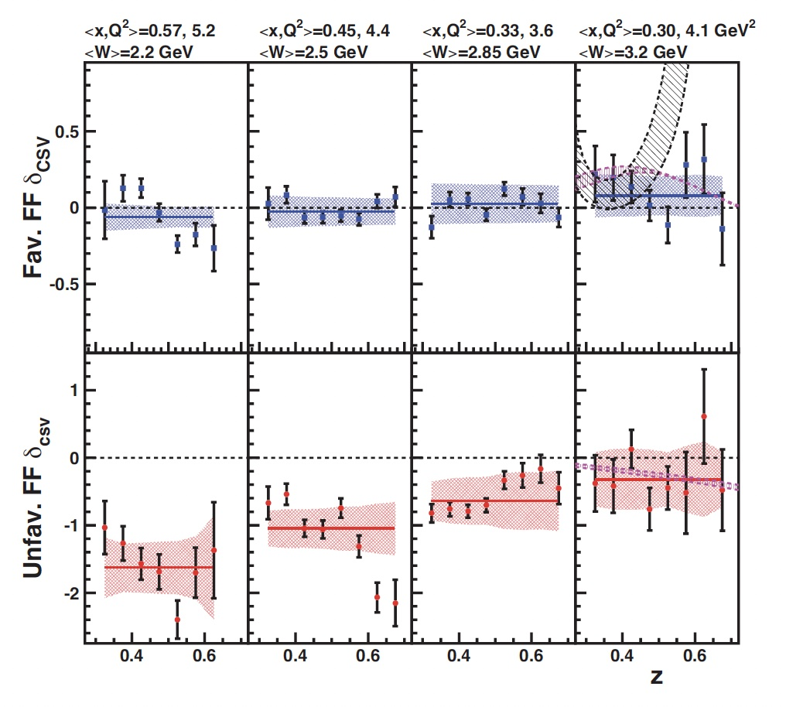
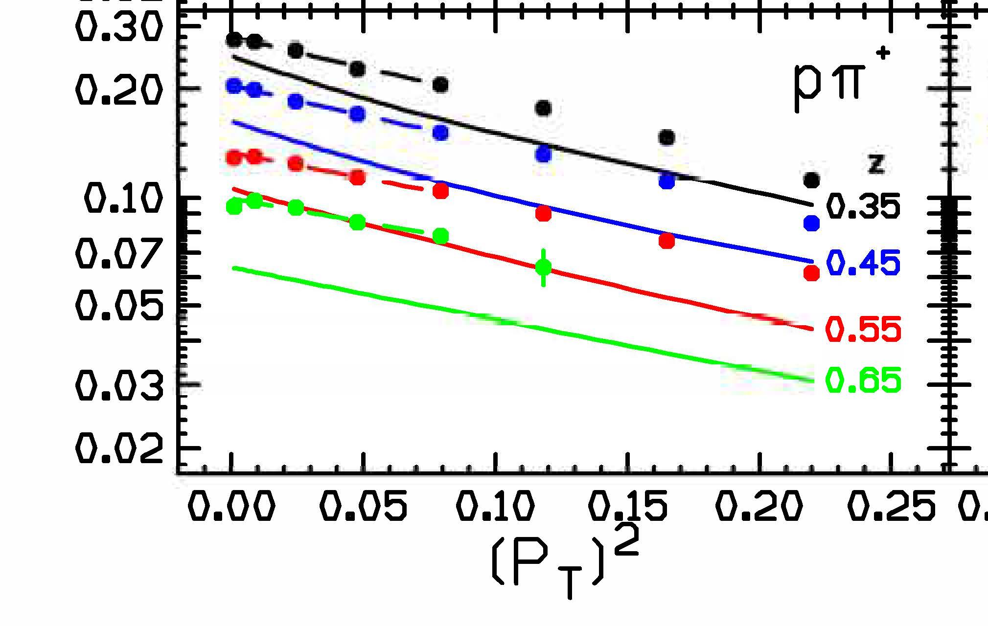
Overview of SIDIS Experiments in Hall C
E. Kinney
Precision studies using the spectrometers with high luminosity
Study of p_{T} dependence of charged pion and kaon SIDIS (2018)
Study of charge symmetry violation in charged pion SIDIS (2018)
Phys.Lett.B 865 (2025) 139485
Longitudinal/transverse cross sections of neutral pion SIDIS (2023-2024)
Longitudinal/transverse cross sections of charged pion SIDIS (2025-part 1 completed!)
Tagged DIS from meson (conditionally approved)
Multiplicities P_{T} Dependence
Consistent with MAPS fit?
CSV: violation
for Unfavored
Fragmentation
Function
p_{T} SIDIS

Slide 28


SoLID-SIDIS: Precision Mapping in Multi-Dimension
SoLID-SIDIS program: Large acceptance, Full azimuthal coverage + High luminosity
4-D mapping of asymmetries with precision
Constrain models and forms of TMDs, Tensor charge, …
Lattice QCD, QCD dynamics
Transversity
4-D binning for the first time!
More than 1400 bins in x, Q², P_{T} and z for 11/8.8 GeV beam.
Sivers: Confined quark motion
Quantum correlations between nucleon spin
and quark motion
QCD dynamics

Slide 29


SoLID Impact on Tensor Charge
Definition
A fundamental QCD quantity: matrix element of local operators.
Moment of transversity distribution
Valence quark dominant.
Precision calculations available from lattice QCD.
Probe new physics combined with EDMs
SoLID Projections

Slide 30
3-d Structure Study II: GPD
Hall B/CLAS12 RGC: DVCS with L. Pol. p/d
Hall A/C: DVCS
Future: SoLID-GPD Program: DDVCS, …

Slide 31


pDVCS on NH₃ @CLAS12: TSA, Comparison with models
S. Rafael
The model points are computed at the average kinematics of each specific phi bin, and the model line is computed at the kinematics of the Q², xb, t bin
1 < Q² <2.2 GeV²
2.2 < Q² < 10 GeV²
xb
-t

Slide 32

Hall A DVCS (p) Results
C. Camacho

Slide 33

Hall A DVCS (n) Results
C. Camacho

Slide 34



Future: SoLID-GPD Program: DDVCS and more
DDVCS with SoLIDμ (SoLID+muon detector): C1 approval with A rating
(another DDVCS proposal with μCLAS12: C1 approved with A rating)
Deep Exclusive Meson Production: approved run-group experiment
TCS (Time-like Compton Scattering): approved run-group experiment
Probability Distribution

Slide 35
Summary
Highlights of Spin Structure Study @ JLab:
Exciting results from 3 JLab low-Q spin experiments (spin moments)
Γ₁, Γ₂, γ₀, δ_{LT} for p and n: 3 nature physics, 1 PRL, 2 PLB, + more (α_{g1})
A1p@CLAS12: data taken 2022-2023, analysis on-going
Preliminary results on A1n @ high-x in Hall C: valence behavior
Preliminary results on d2n in Hall C and Future SoLID projection
Future SIDIS measurements with SoLID: polarized valence and sea
Highlights of 3-d Structure Study @ JLab:
SIDIS with long. pol p/d@CLAS12: preliminary single and double spin asymmetries
SIDIS program@Hall C: CSV for unfav. Fragmentation
Future precision multi-d mapping with SoLID, tensor charge, …
DVCS with long. pol p/d @ CLAS12: preliminary SSA and DSA
DVCS @Hall A/C with JLab12, Cross Sections and BSA for p/n
Future SoLID GPD program: DDVCS and more

Slide 36
Backup

Slide 37


α_{g1} Extracted from the Bjorken Sum data
Bjorken sumΓ₁^{p-n} measurements
Effective coupling α_{g1}
1
α_{g1}
Γ₁^{p-n}≙ g_{A}(1- )
6
π
A. Deur, et al.
Physics Letter B
825 (2022) 136878
A. Deur, V. Burkert, J. P. Chen and W. Korsch
Particles, 5-171 (2022)

Slide 38

Impact on the quark polarization (fitting directly measured A_par and A_perp of 3He)
Down quark remains negatively polarized up to x ~ 0.7
JAM Group

Slide 39

6 GeV Results for d2 Moment
Dynamic twist-3 matrix element
Proton from SANE,
PRL 122, 022002 (2019)
12 GeV d₂^{n}

Slide 40


12 GeV d₂^{n}: Color Polarizability/Lorentz Force
Measurement of g₁ and g₂ structure functions and d₂ moments at 3 GeV² < Q² < 5.5 GeV² for the neutron using a polarized ³He target
Study quark-gluon correlations (twist-3) and provide a benchmark test of LQCD calculations.
Completed data taking in 2020
Preliminary Results on g2n

Slide 41
SoLID @ JLab22 SIDIS Polarized Asymmetries: π/K on n
Ching Him Leung
π+
π-
Κ⁺
Κ⁻

Slide 42

SoLID @ JLab22 SIDIS Polarized u/d PDFs
Ching Him Leung
LO extraction
(assuming x-z factorization)
Using LO Fragmentation Function DSSFFLO
Solving/ChiSQ fit all asymmetry data → polarized PDFs

Slide 43

SoLID-SIDIS: precision tomography in 3D momentum space
u quark
d quark

Slide 44










Preliminary Analysis: pDVCS on NH₃
G. Matousek
GPDs give a 3-d partonic picture in terms of longitudinal momentum, transverse spatial position, and their correlations
pDVCS (${NH}_{3}$) measurements at RG-C give access to $A_{LU}$, $A_{UL}$, $A_{LL}$
With nDVCS (${ND}_{3}$) → Separation of $u$, $d$ Compton Form Factors
FT $γ^{′}s$widen coverage
Flavor Decomposition
${(e}^{′}γp′)$ Missing Mass (exclusivity)
Forward-Tagger Photon $Φ$ distribution

Slide 45

Comparison with models, DSA
S. Rafael
The model points are computed at the average kinematics of each specific phi bin, and the model line is computed at the kinematics of the Q², xb, t bin
1 < Q² <2.2 GeV²
2.2 < Q² < 10 GeV²
xb
-t

Slide 46

C. Camacho
DVCS in Hall C: Data Taking Completed

