Slide 1

Revision of the LHC Helium WG Introduction to HL Cryogenics
S. Claudet, CERN_TE-CRG
pour le compte des équipes projets, et
en qualité de responsable de la partie cryogénie pour les derniers 10 ans
09-Jan-2025, Meeting#1
https://indico.cern.ch/event/1491143/

Slide 2
Content
Introduction: from HL magnets to P1/P5 cryolines
Sectorisation (TCC#141, mid 2021)
He release considerations so far (Aut'23)

Slide 3
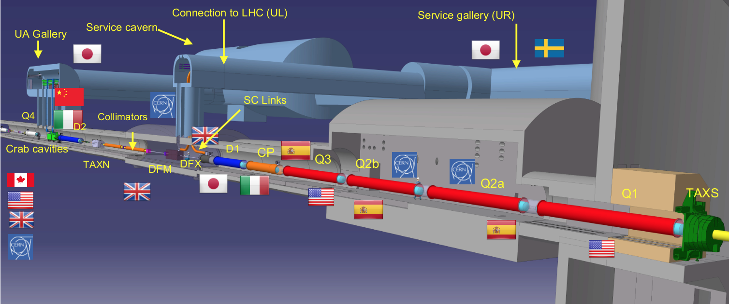
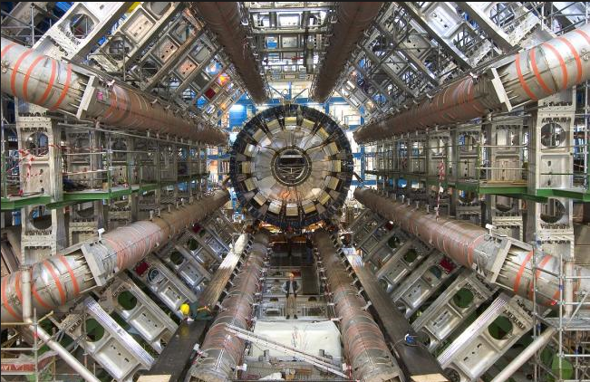
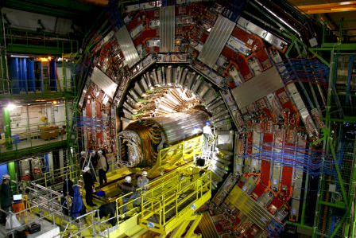
New insertion regions (Q1 to Q4)
Stronger focussing quadrupoles (Q1-Q2-Q3) with larger beam pipes

Slide 4
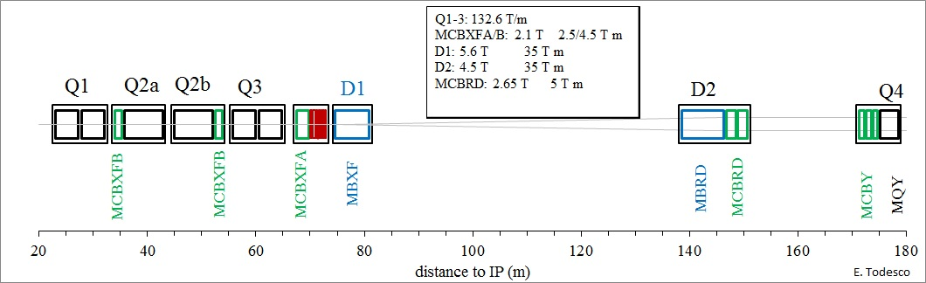
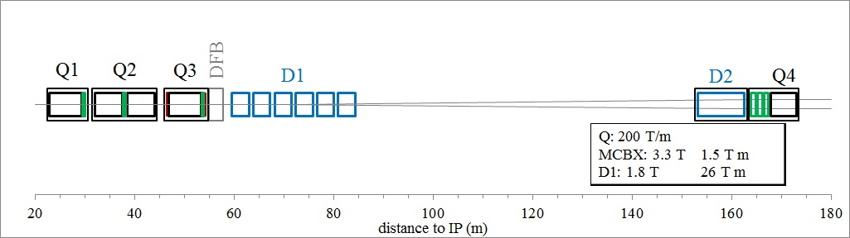
Final focussing area, superconducting magnets
HL-LHC 2026-2035
LHC 2008-2023
LHC
HL-LHC
Longer inner triplet continuous cryostat & multiple stand-alones

Slide 5
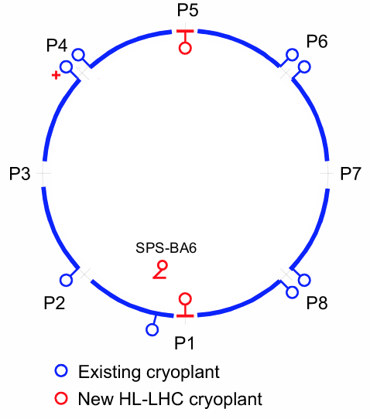
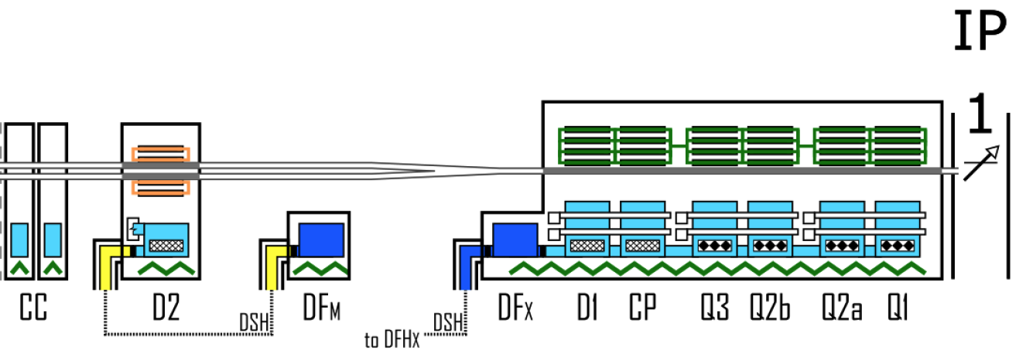
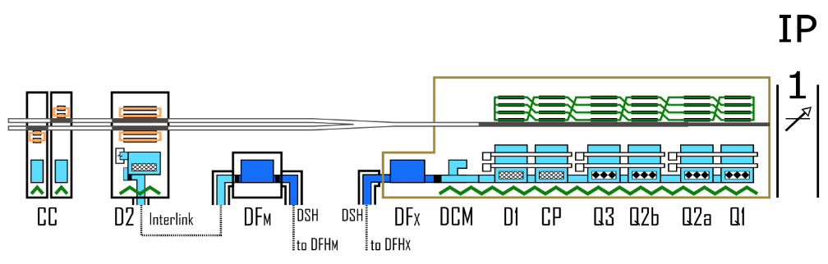
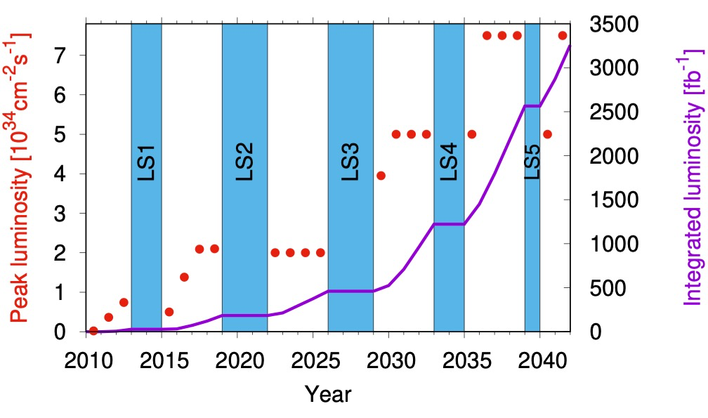
HiLumi-WP9-Cryogenics, Global scope overview
P1-P5: 2 new cryoplants (~14 kW @ 4.5 K incl. 3.25 kW @ 1.9 K ) and 2 x 750m cryo-distribution for high-luminosity insertions
P4: upgrade (+2 kW @ 4.5 K) of an existing LHC 18 kW @ 4.5K cryoplant
SPS-BA6: SRF test facility with beam primarily for Crab-Cavities
To provide adequate cooling for:
P1-P5 machine devices
HL-LHC performance

Slide 6
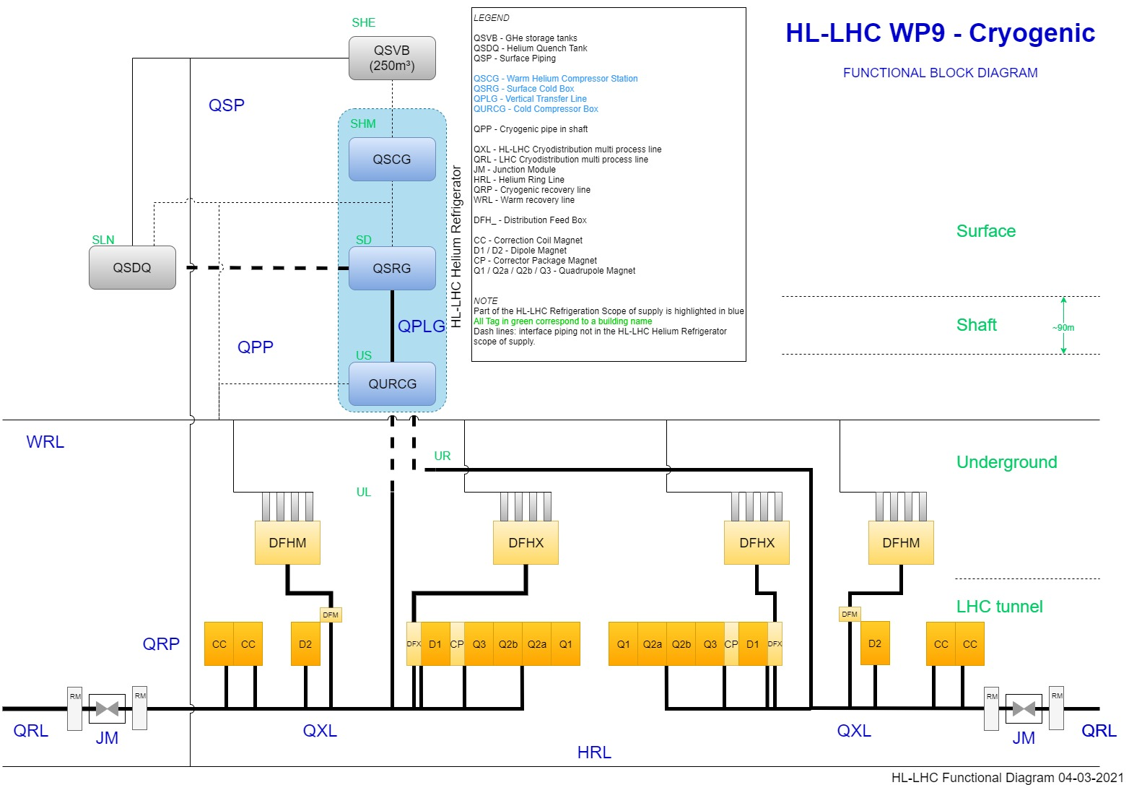
HL-LHC P1/P5 Cryogenic architecture
QSCG : Compressor station providing gaseous helium 20 B
QSRG : 4.5K refrigerator providing supercritical helium at 3 bara and 4.6 K
QXL : Distribution line distributing C,E and returning B,D,F
70 m for the common branch
270 m for the long branch
60 m for the short branch
QPLG : Vertical transfer line (~100 m height)
QURCG : Cold compressor box providing cooling capacity at 1.8 K
RM/JM : Return module and junction module at extremities for transient handling and back-up
Users at tunnel level

Slide 7
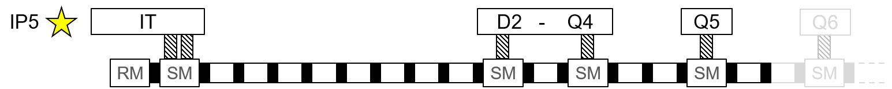
Radiation Safety: Waste Management
Remove
Move
LHC Untouched
LS3 requirement
Estimated Mass
Sub-assemblies
RP Action
Storage Required
~ 20 ton.
4 x SM
6 x PE
Temporary storage
Modification underground in UX65 before reinstallation in tunnel
Move
Spares
Up to
~ 10 ton.
2 x RM
2 x SM
1 x PE
Long term storage
BUFFER ZONE
Classification of elements as LSA 1 or 2
100 m² long term spares storage – Location TBC
Short term ≈ 800 m²
PE’s disassembly and cutting
Location TBC
Remove
Up to
110 ton.
2 x RM
10 x SM
43 x PE
Warm pipes
Disposal
Long term ≈ 100 m²
SM’s awaiting destruction with HSE-RP-RWN

Slide 8
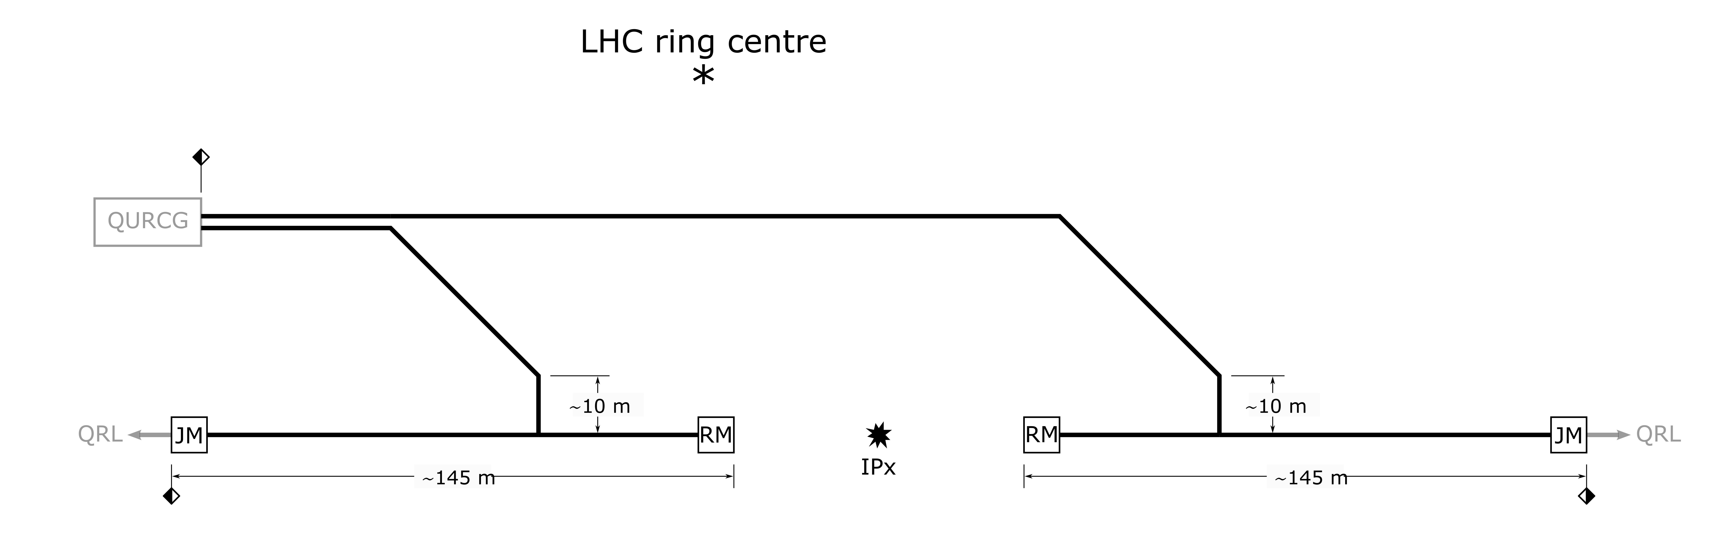
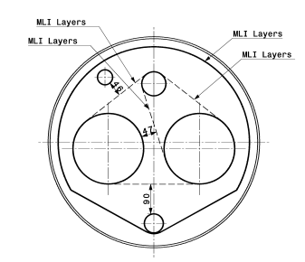
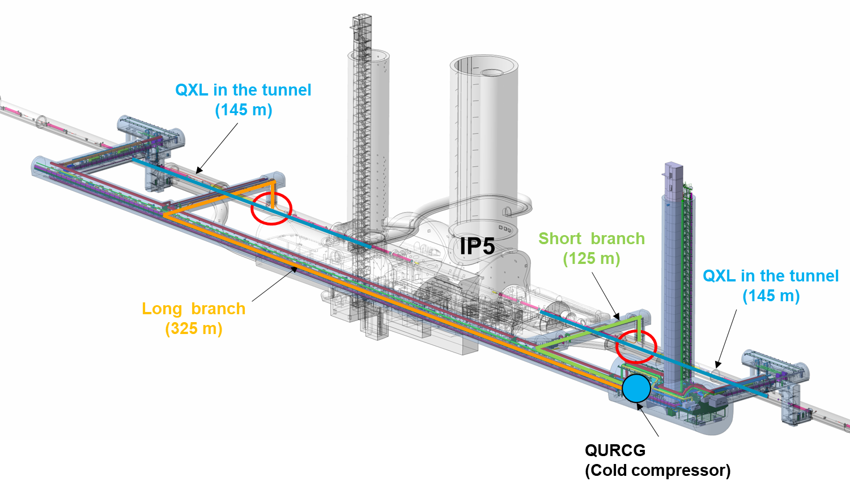
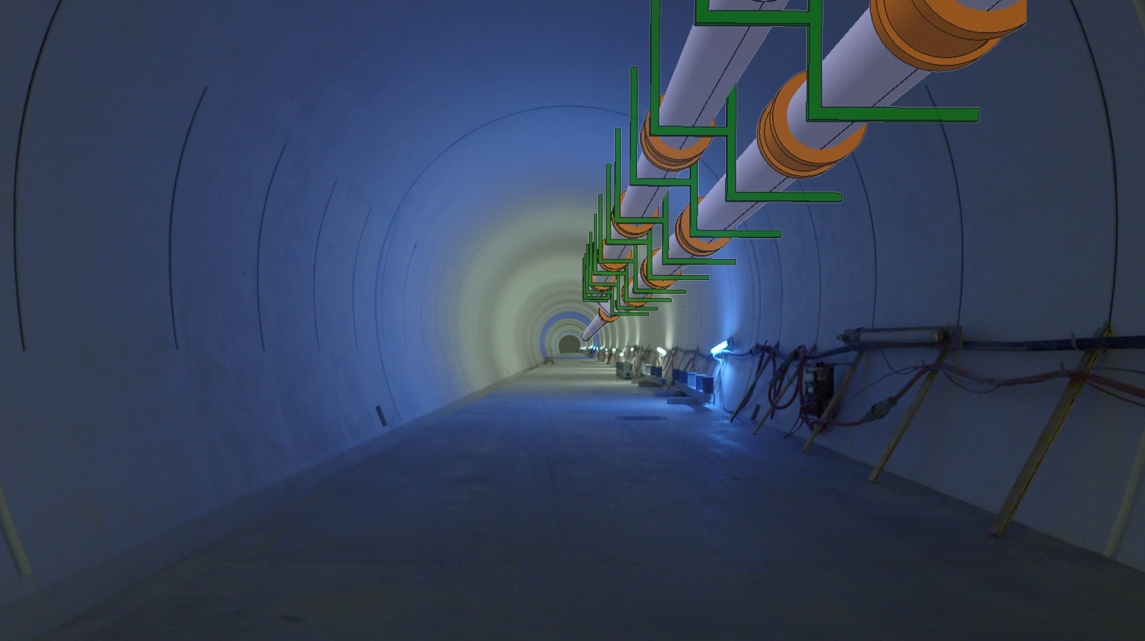
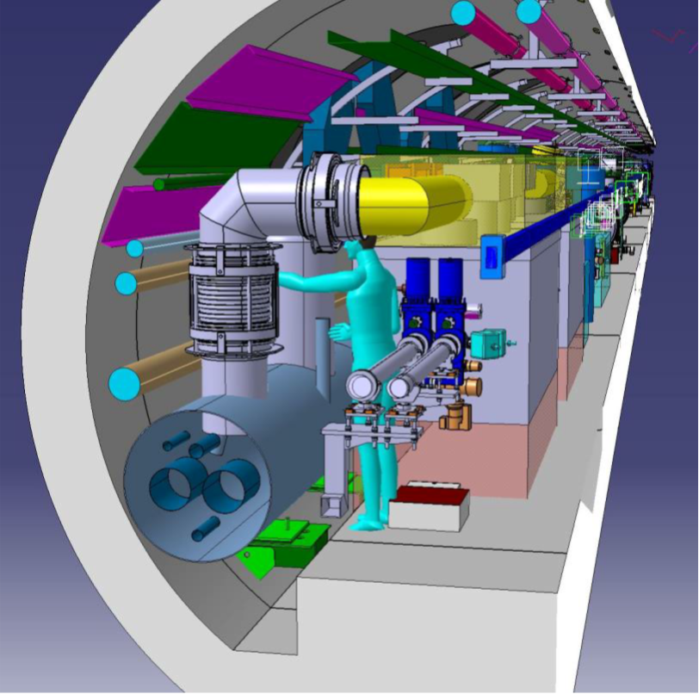
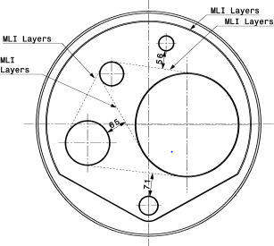
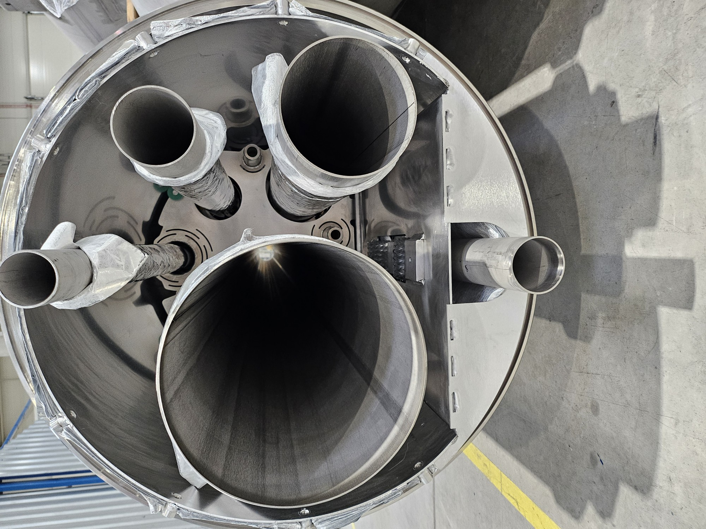
HL-LHC Cryogenic distribution system (QXL)
2x750m, five process pipes DN40 to DN250, Vac. jacket 660-900mm
Tunnel QXL
C
Underground Galleries
EH
D
B
FH
LHC tunnel
LHC tunnel
Installation strategy in two steps:
Phase 1: in the underground galleries, independent from LHC machine operation
Phase 2: in the LHC tunnel, after when the machine dismounting during Long Shutdown 3
Service Galleries QXL
Ph 1
Ph 2
C
EH
EH
D
B
C
FH
B
D
CRAB CAVITY
F_{H}
CRYOLINE

Slide 9
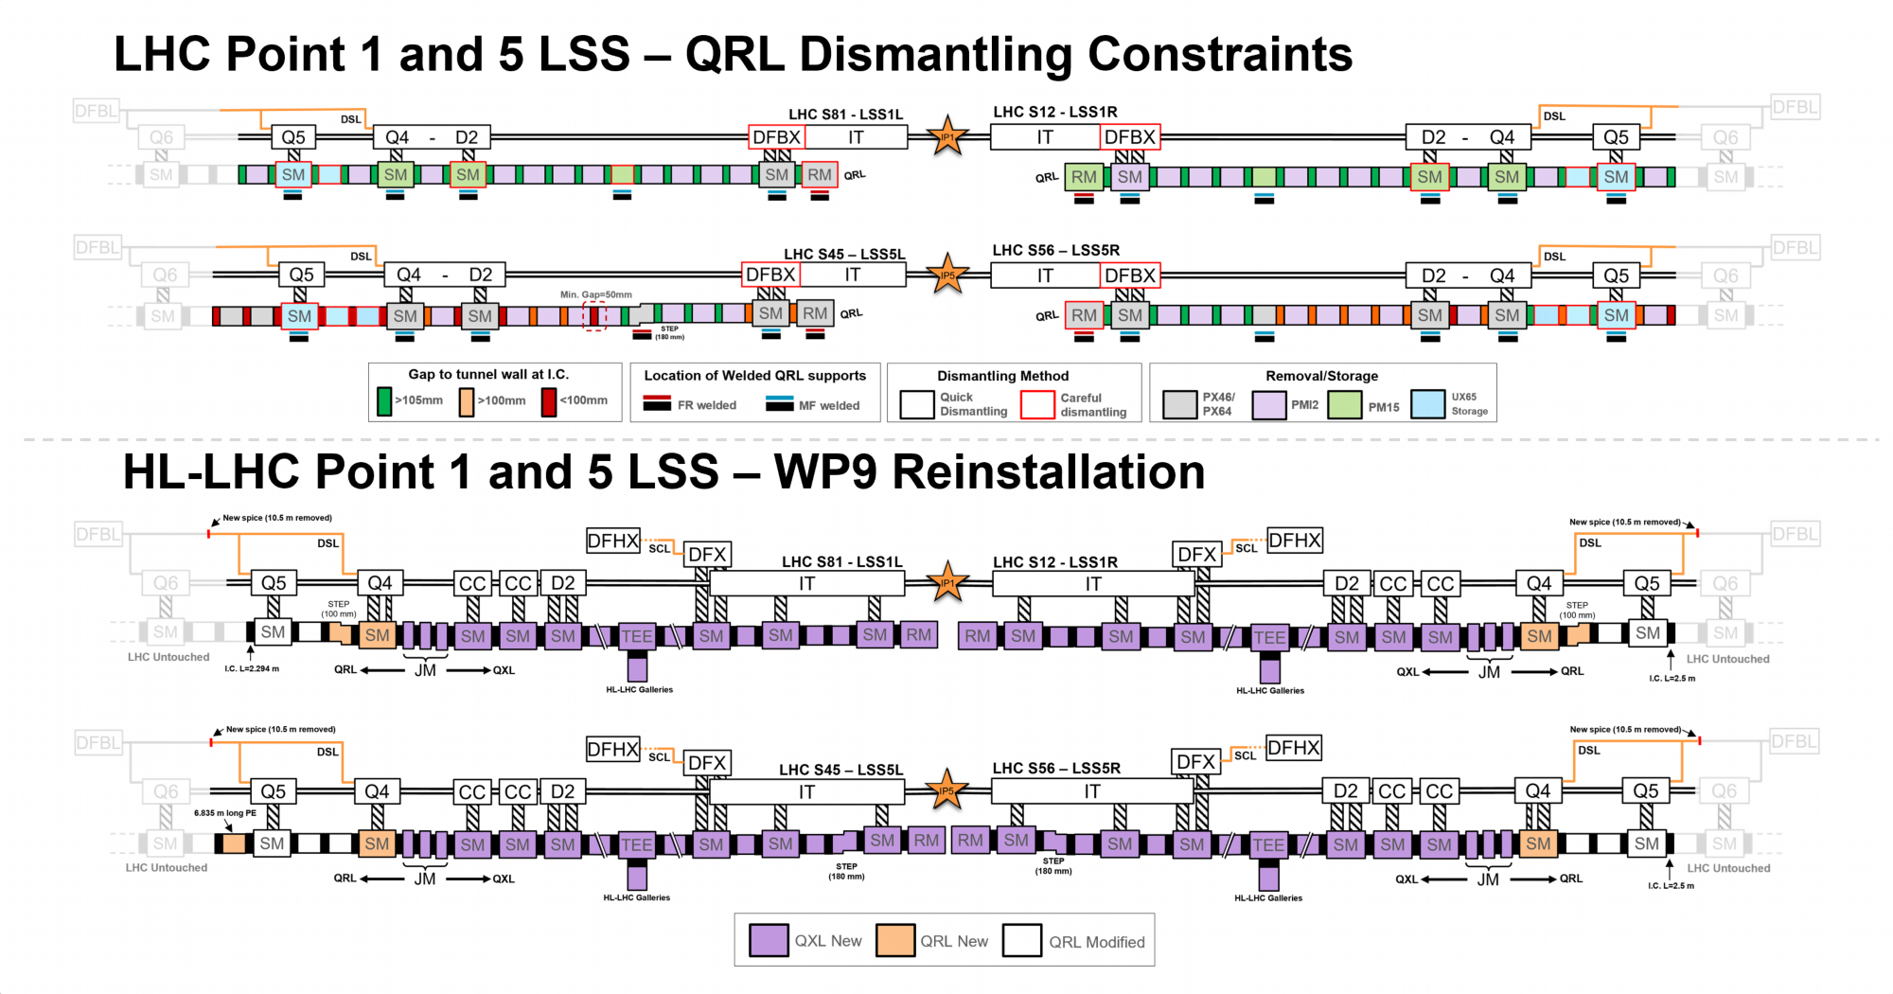
QRL Layout Overview

Slide 10
Content
Introduction: from HL magnets to P1/P5 cryolines
Sectorisation (TCC#141, mid 2021)
He release considerations so far (Aut'23)

Slide 11
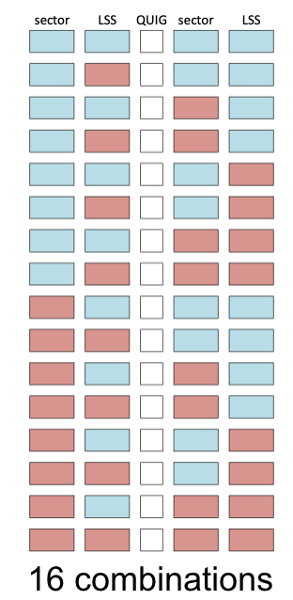
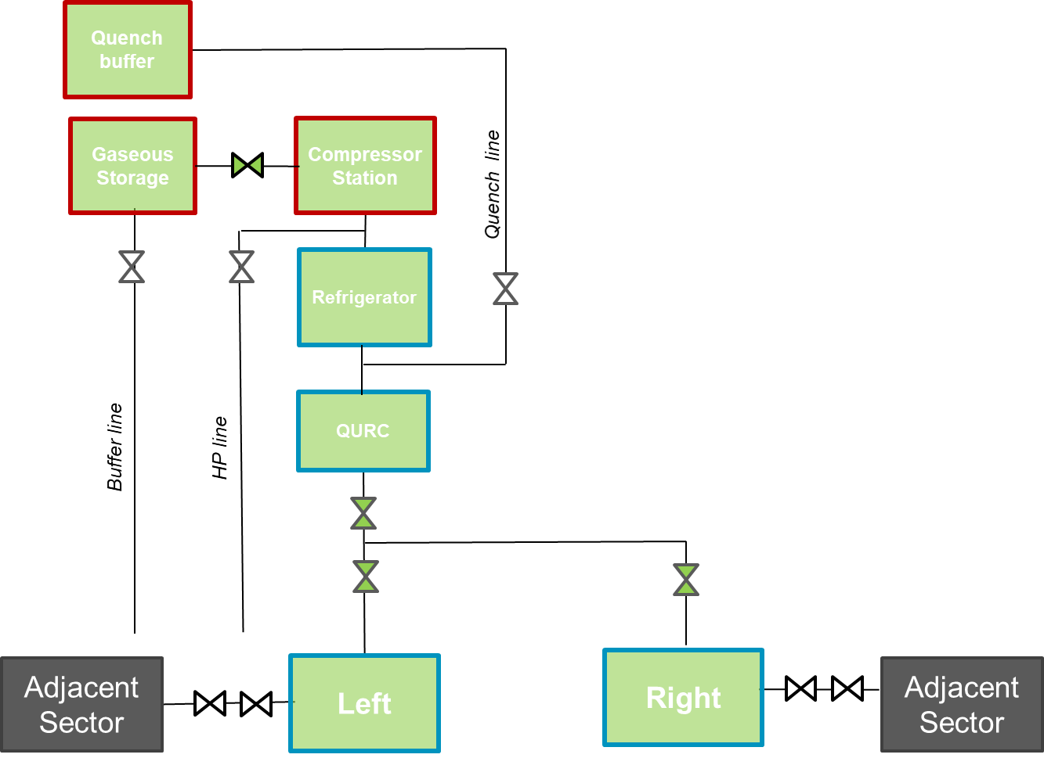
(HL-TCC#141) Sectorisation
HiLumi magnets/users can be cooled by :
  Adjacent sectors
  New Refrigerators which will be installed
Several considerations :
  HiLumi baseline is to cool-down both LSS at the same time
  Due to access constraints during cooldown, at this stage, LSS/sector have to be in same state.
  Periodic testing configuration shall be covered
LSS
sector
C/W
Normal operation
C
If Intervention needed on one LSS, need for double valve for left and right sides
(Not in HiLumi baseline)
W
W
C
Early commisionning of one LSS- (Not in HiLumi baseline)
A follow-up of presentation done at TCC#138_08July'21
Specific meetings held during the summer with project-safety and cryo operation
Expressed need to develop usual cases (nominal, respective CD, repairs)
C
C/W
Doubling or not these valves ?
W
Symmetry

Slide 12
Considerations independant from decision
All modes known today with LHC will be possible (Pressure tests, lock-out, cool-down or warm-up, stable operation at 80K, 20K, 4.5K, 3K, 1.9K, IT@20K-LSS/ARC@nominal)
"only" one refrigerator at P1/P5 does not allow to operate the 2 LSS in a different mode. A different status of LSS can only be considered with at least one connection to an adjacent arc
OdH and ventilation (dedicated wg to confirm):
  Early cooling (or powering) of adjacent arc would prevent access/work in LSS
  Early cooling of LSS could be envisaged while working in adjacent arc(s)

Slide 13
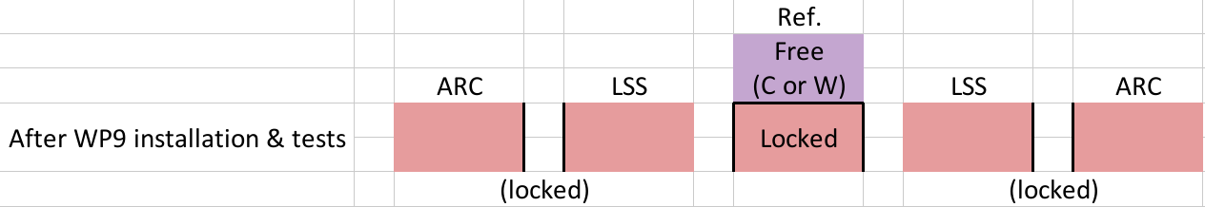
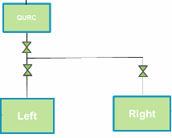

Some typical cases illustrated (1/4)
Basic
After HL-WP9-Cryo Installation work (LS3):
3 valves closed with pressure control and bleed in between
Nominal situation during Run:
3 valves open
valves closed
valves closed

Slide 14
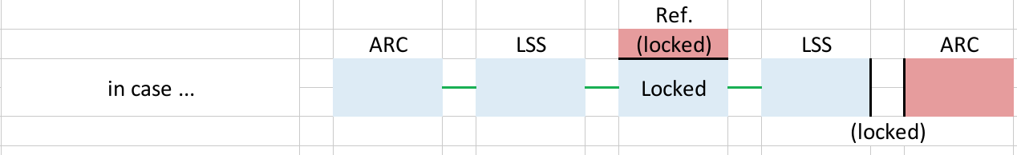
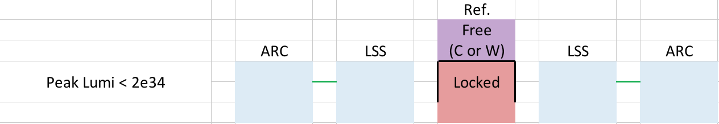
Some typical cases illustrated (2/4)
in case ...
For any reason, ... :
For any reason, compatible for peak luminosity below 2e34:
valves open
valves open

Slide 15
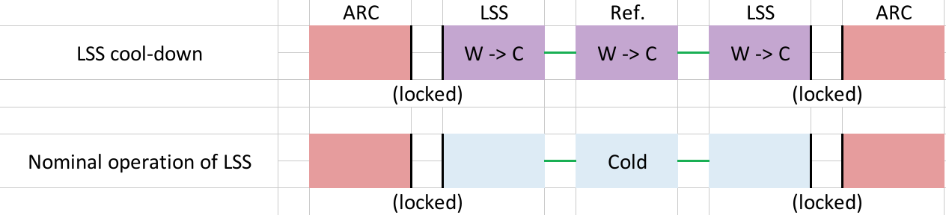
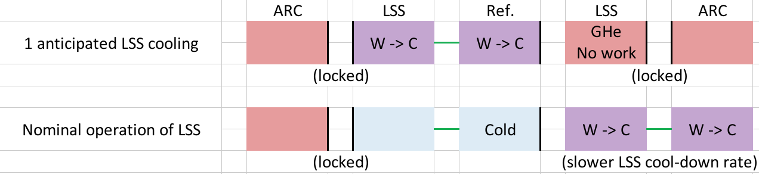
Some typical cases illustrated (3/4)
Early CD
Early cool-down of 2 HL-LSS:
Early cool-down of 1 HL-LSS:
(sectorisation in QUIG would have allowed to keep working in warm LSS)

Slide 16
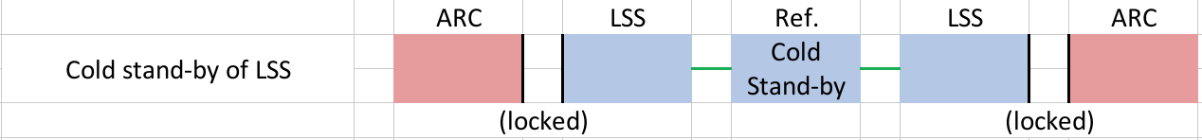
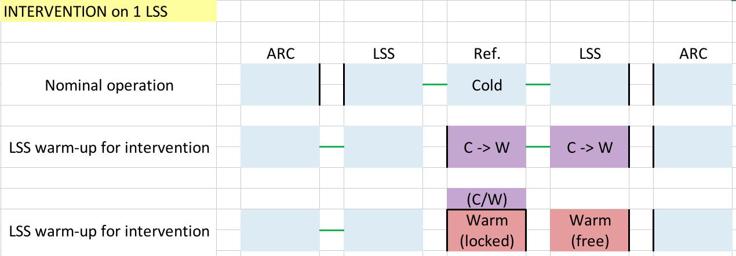
Some typical cases illustrated (4/4)
Possible
HL-LSS cold stand-by, arcs warm (LS?):
To be kept in mind: HL refrigerator will need 2-3 months maintenance as well (independant from the proposed simplification)
(and if later 1 LSS has to be warmed-up, 2nd will follow as 1 Ref. = 1 mode)
Intervention on 1 HL-LSS:
(No need for QUIG for that, the 1+2 valves in QURCG could do the job)

Slide 17
Content
Introduction: from HL magnets to P1/P5 cryolines
Sectorisation (TCC#141, mid 2021)
He release considerations so far (Aut'23)

Slide 18
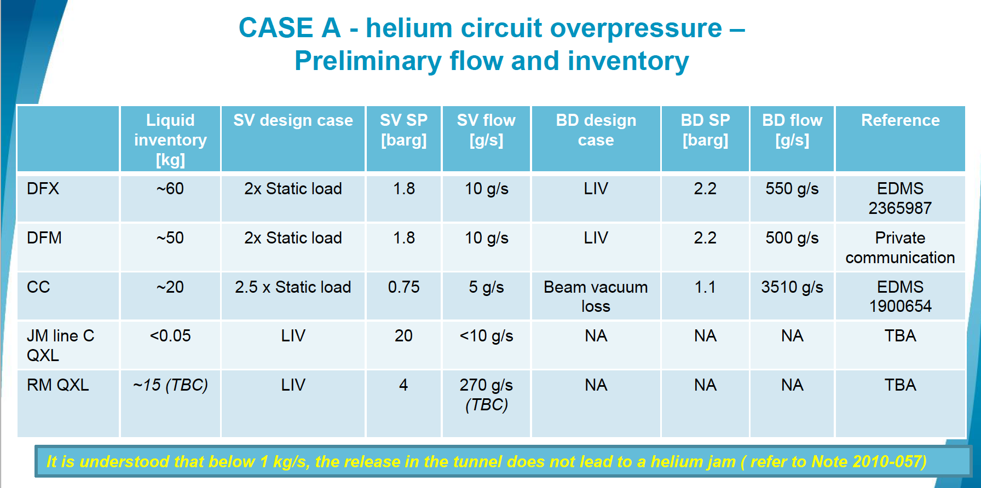
HL-WP9-Cryo He release studies, Aut'23
Typical cases considered:
A. Helium circuits
(protection against over-pressure)
B. Helium pipe breach
(into insulation vacuum)
C. MCI or any case
(due to powering energy)
=> Sizing of safety devices
=> Propose access conditions
(limited inventory, failure open outlet process valve)

Slide 19
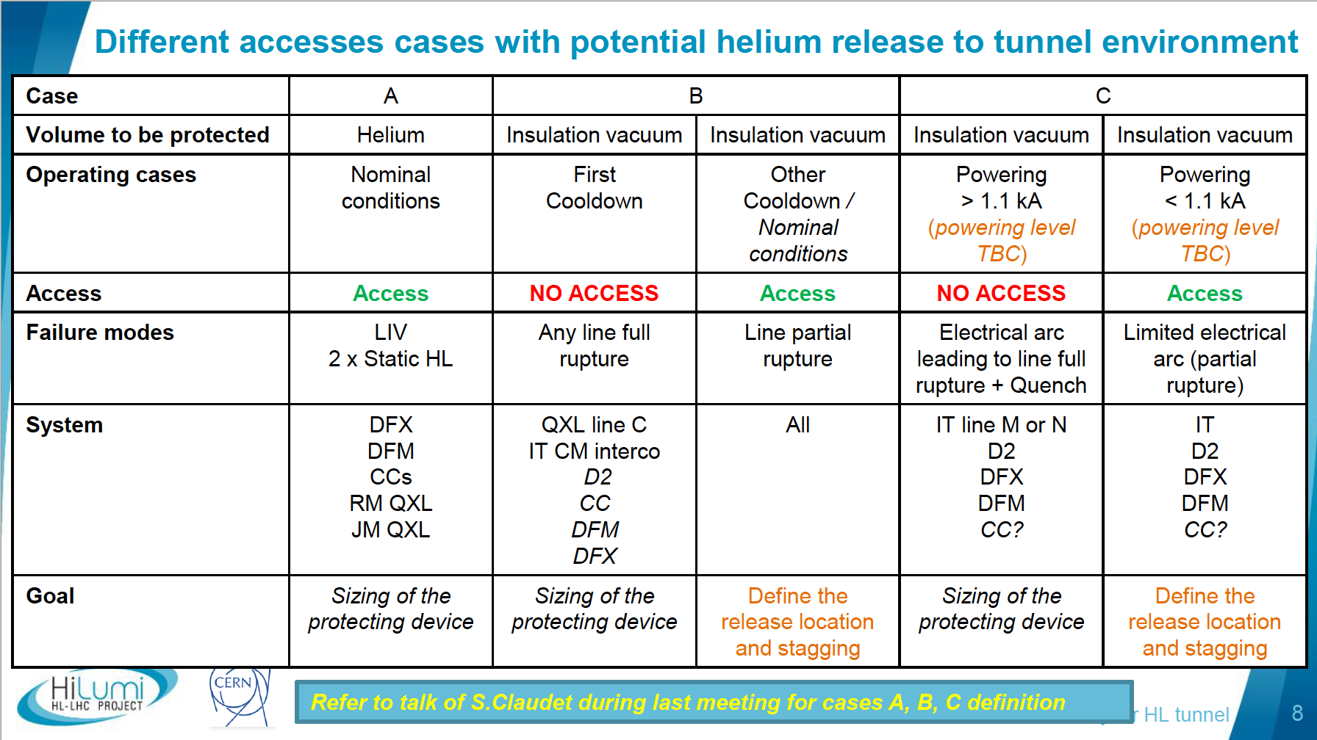
HL-WP9-Cryo He release studies, Aut'23
(approach proposed to HL-PSO, well aligned with LHC current practice)

Slide 20
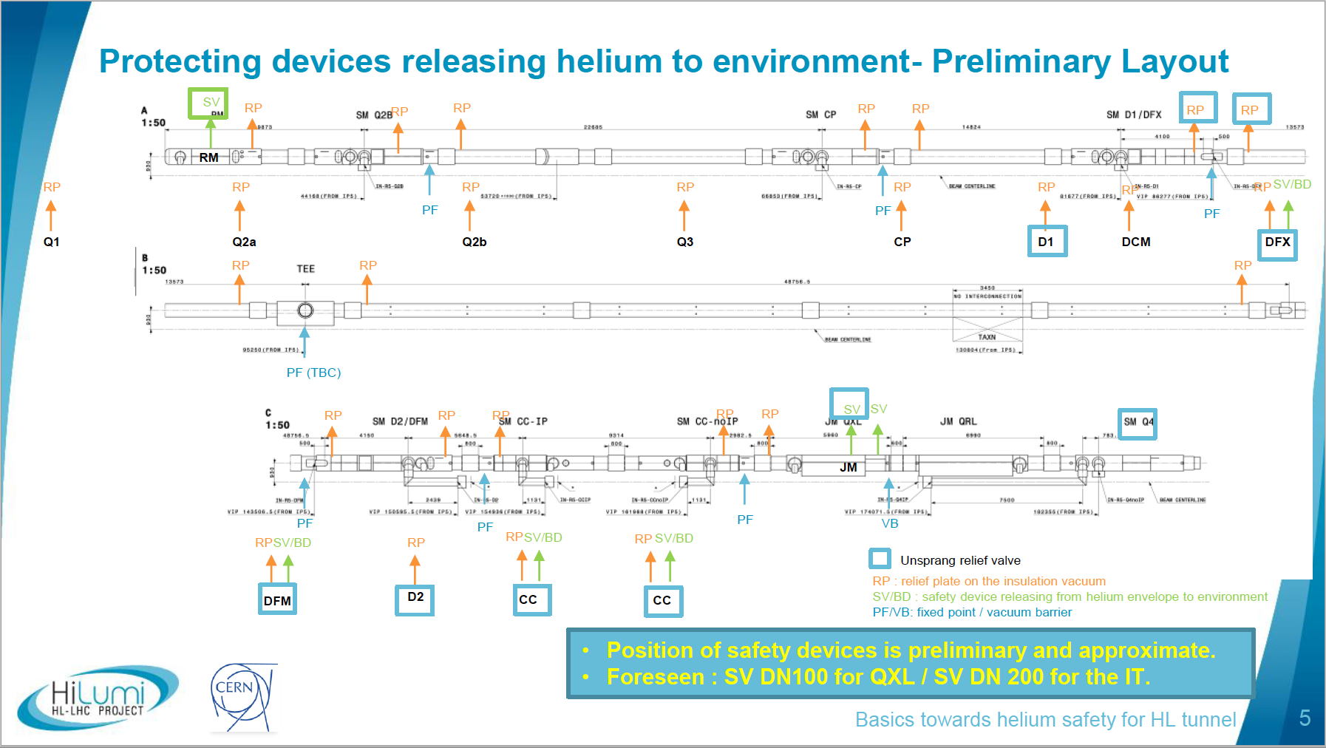
HL-WP9-Cryo He release studies, Aut'23
(approach proposed for possible stagging of safety devices)

Slide 21
Complements

Slide 22
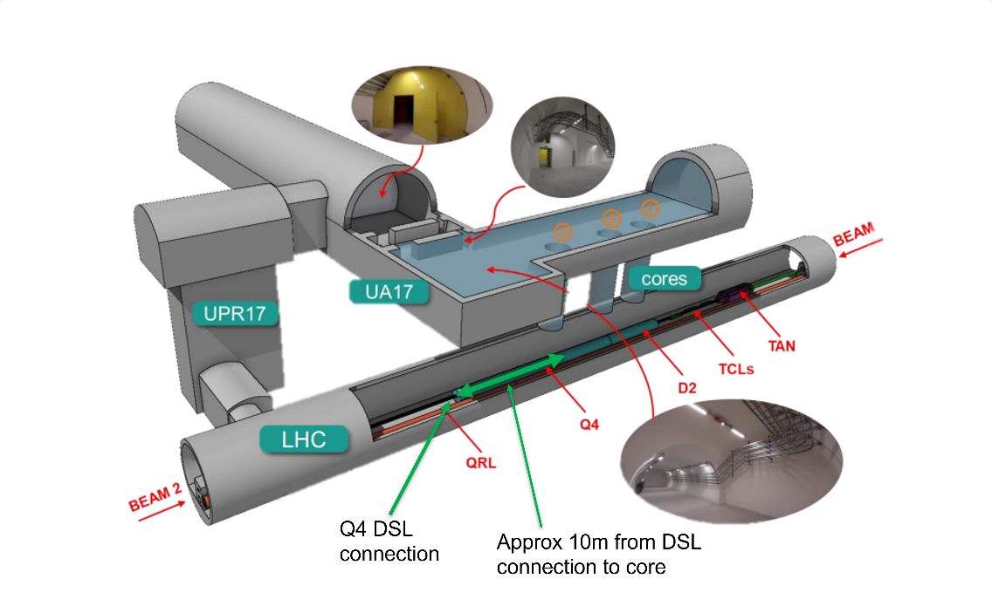
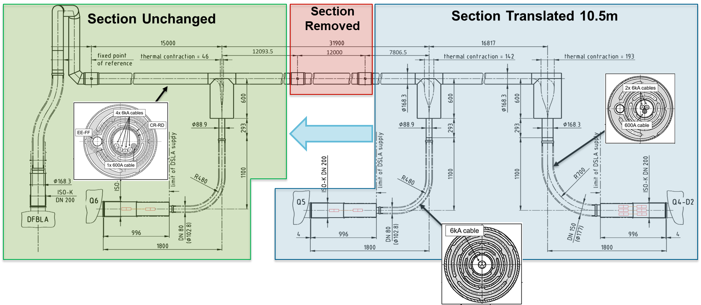
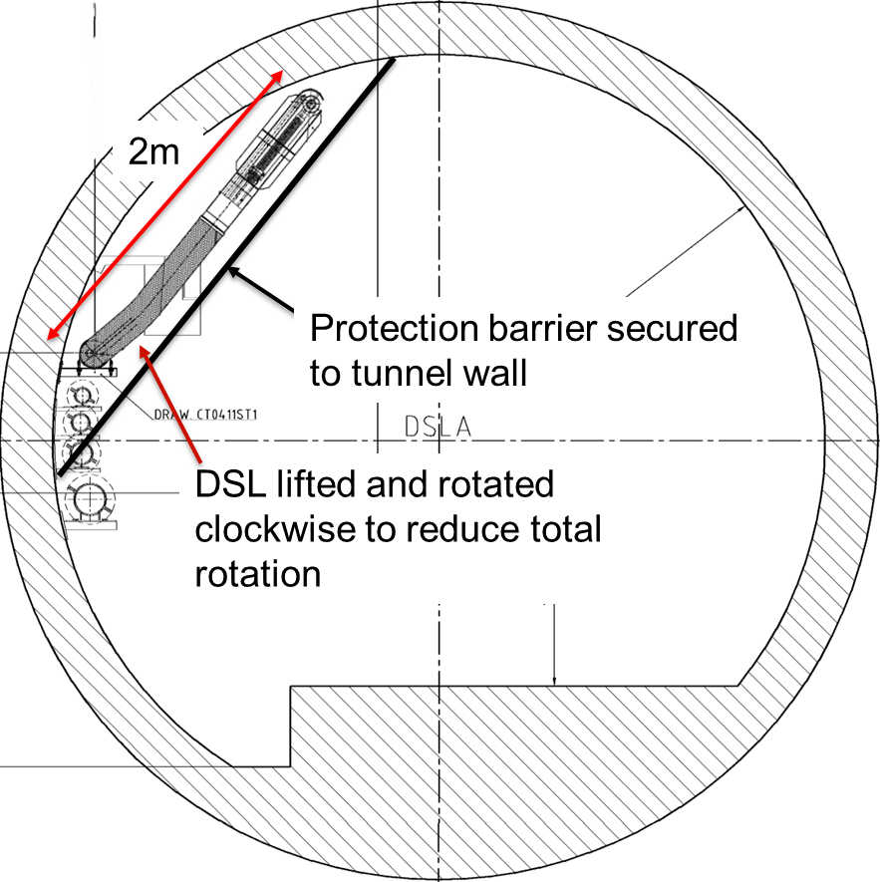
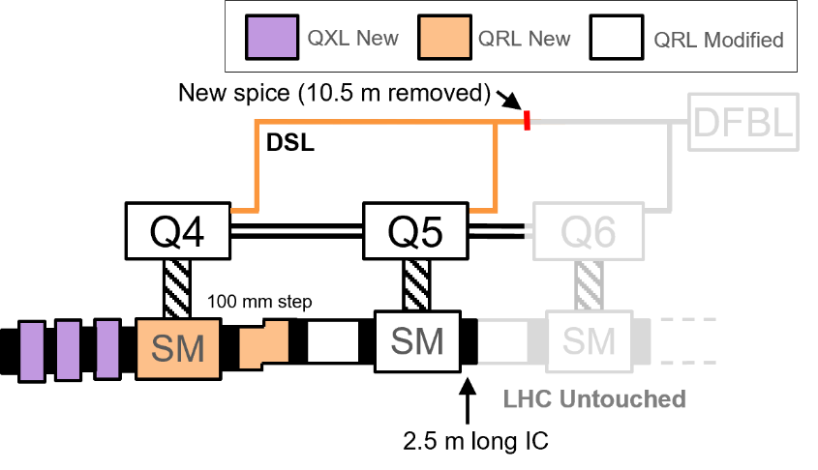
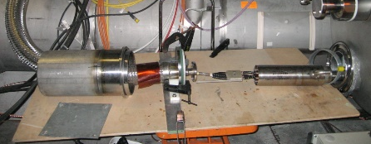
DSL dismantling / re-installation
One new splice box required : Mechanical design of splice box in collaboration with TE-MSC-LMF.
Store the superconducting link in the tunnel during LS3 : require a DSL protection and tooling to rotate the DSL.
Translate DSL to final location and reconnection.
Q6
Q5
Q4
Connection Box

Slide 23
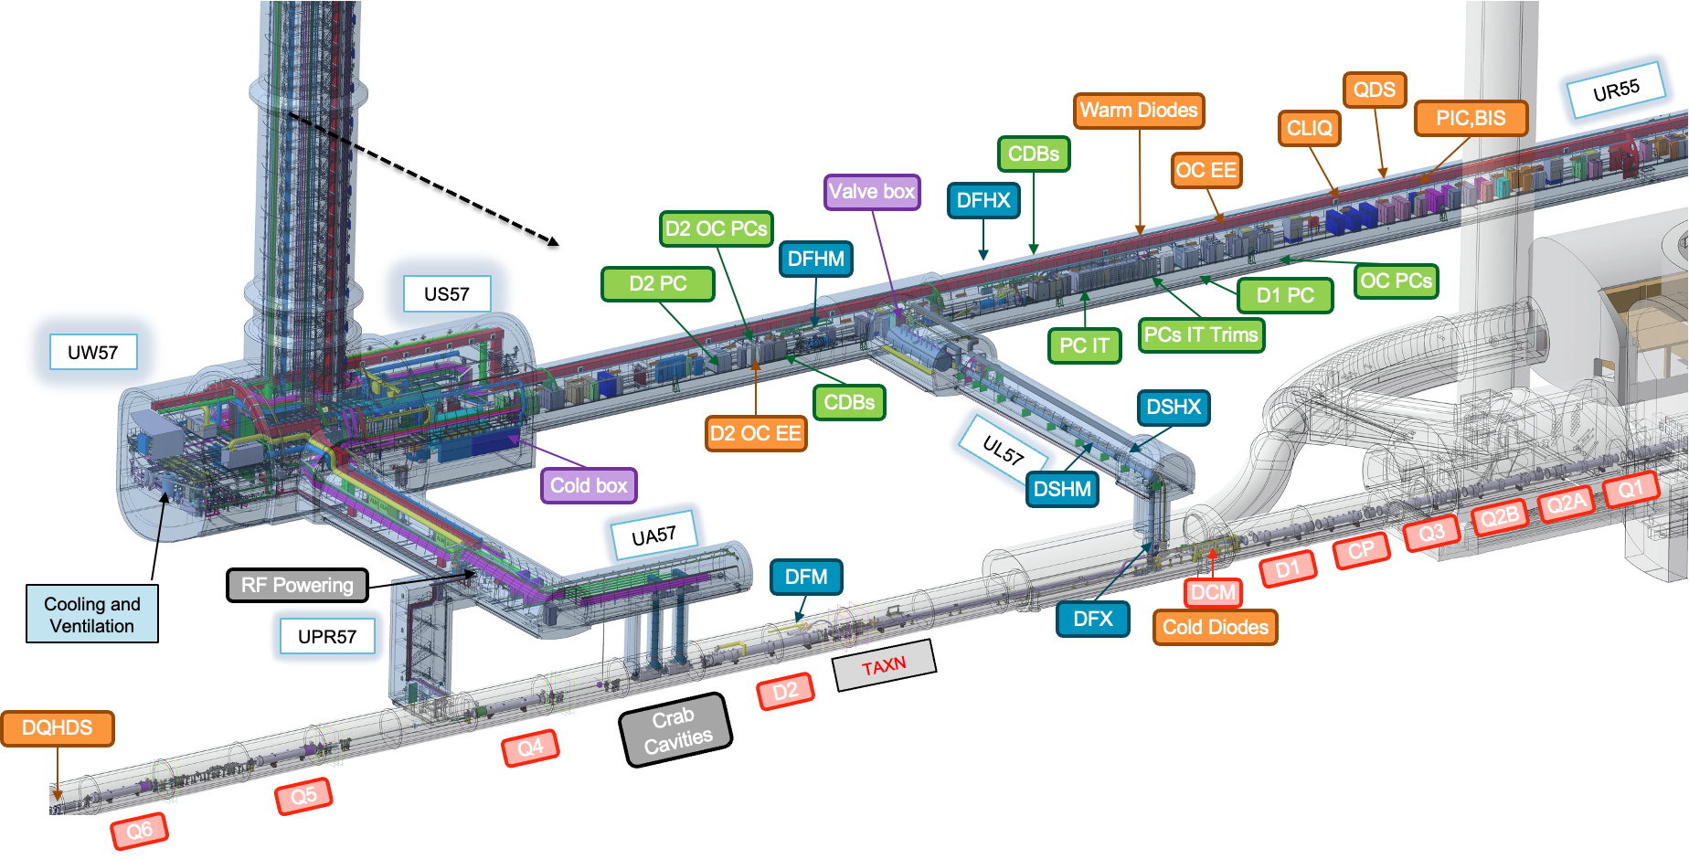
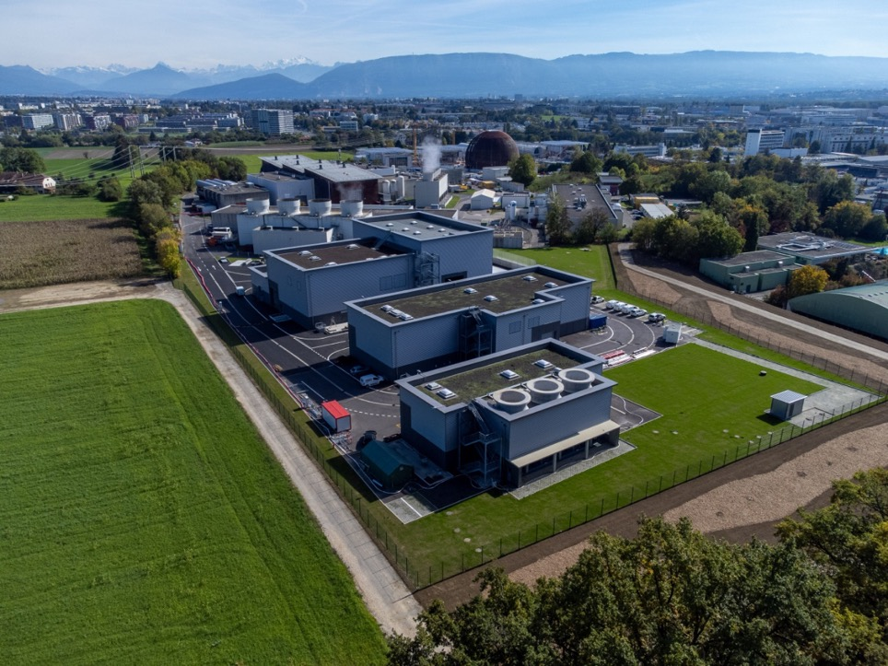
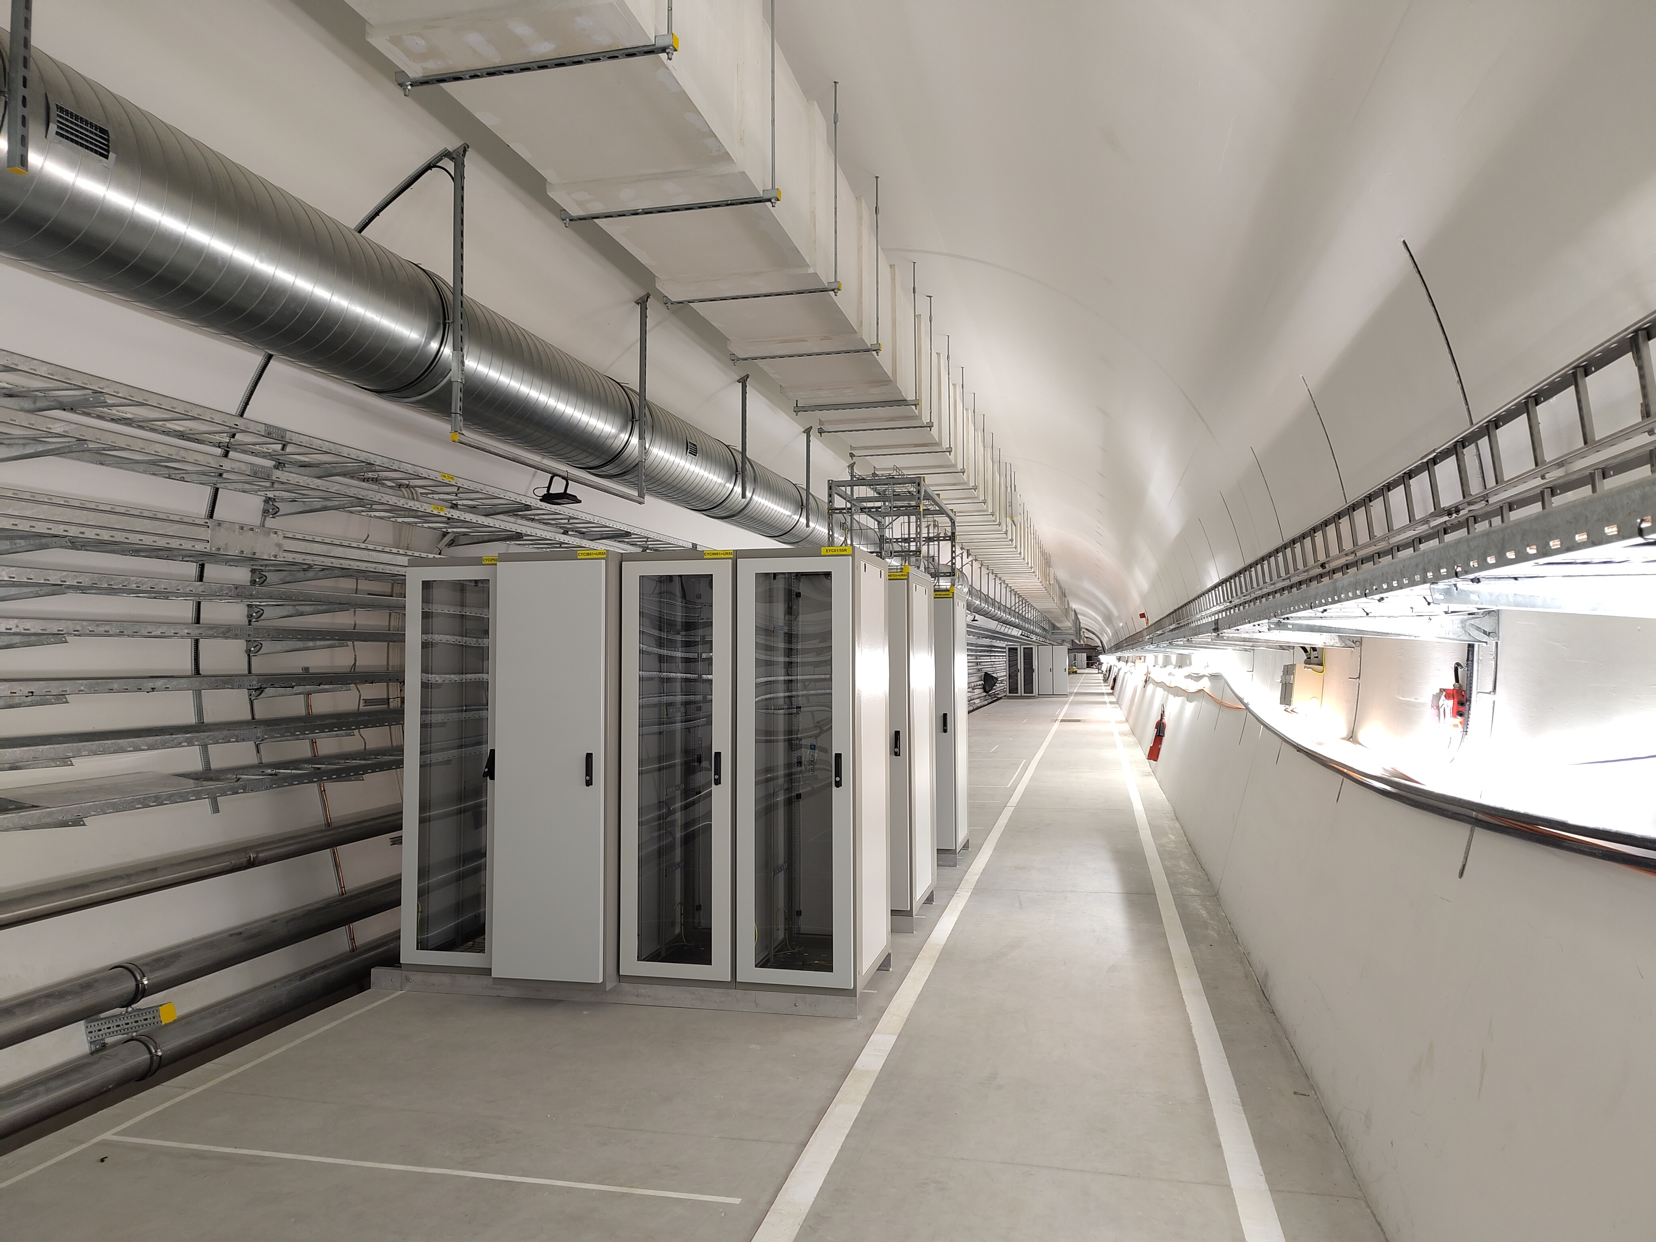
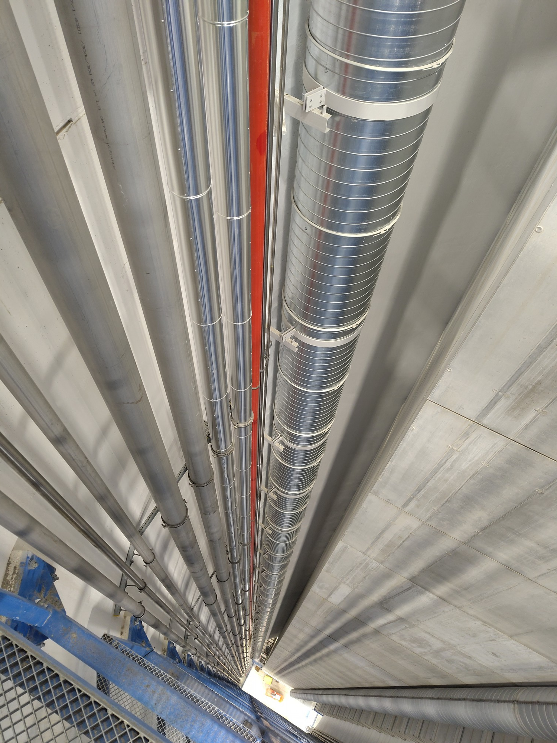
New infrastructure required and built (surface-shaft cavern-galleries)

Slide 24
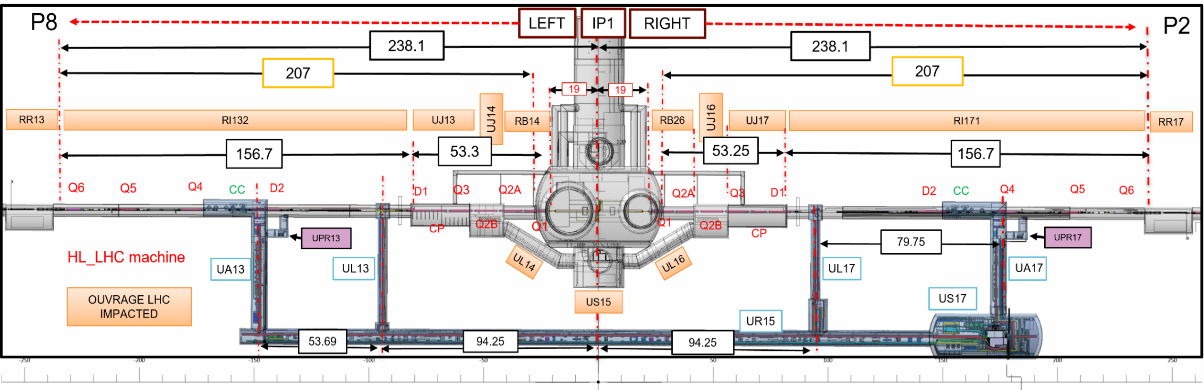
Configuration in case of access
IP1 ZONE
Many relief plates to be expected:
- Q1 to DFX and QXL "T" below ULx3-x7 cores
- D2/DFM to Q4

Slide 25
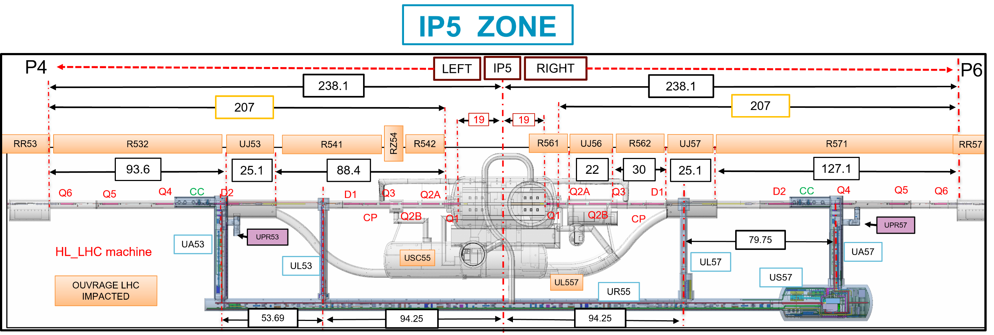
Configuration in case of access
Many relief plates to be expected:
- Q1 to DFX and QXL "T" below ULx3-x7 cores
- D2/DFM to Q4

