Slide 1
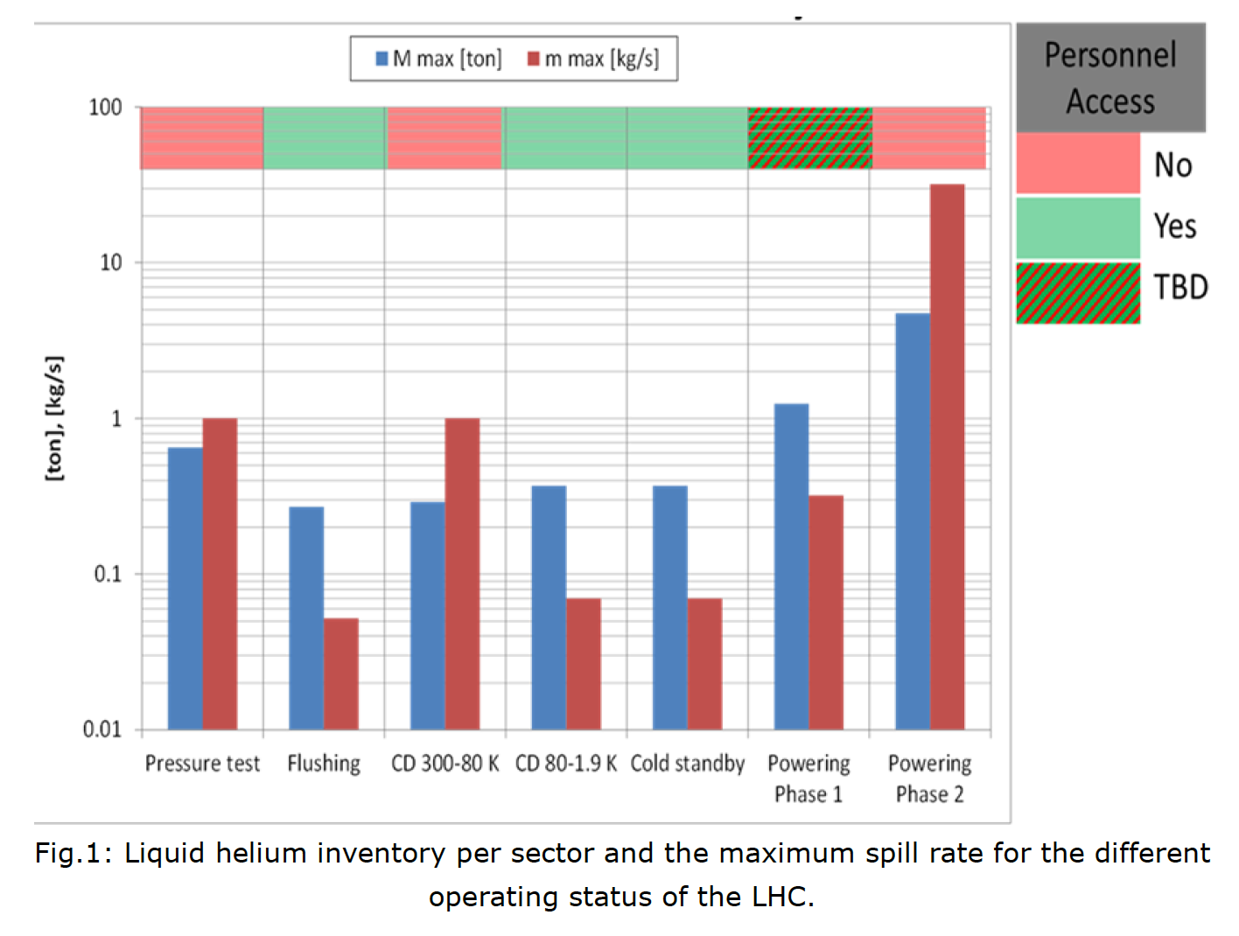
He spill WG, Rates & Inventory, EDMS#1410247
Helium spill tests performed to benchmark simulations, at various rates defined according to operating modes, with He spill WG recommendations to ATSMB for approval
< 100 g/s: Rupture of an instrumentation tube
"Only a human mistake can provoke such a spill"
< 320 g/s: Hole due to 30kJ arc
corresponding to "Powering Ph1a"
<1 kg/s: Rupture of a pipe or 100kJ arc (1kA)
could happen during P_test, Cool-down 300-80K, Powering Ph1b (Ph2 arc at 12kA <=> 30kg/s)
Rmk: safe access to LHC when granted, with slow ODH propagation compatible with normal/walking evacuation

Slide 2
Specific cases already asked/envisaged
Chronological order
Warm-up before LS3:
- Possible work in LSS on room-temperature equipment by specific teams (VSC, x?)
Cool-down after LS3:
- Possible cool-down of arc with work in HL-LSS: New ODH at arc extremity, barriers?
Operation after LS3:
- General: extension of present recommendations, specific conditions & procedures
- Degraded ventilation conditions: how would this impact LHC, specific case of HL-LHC?
- Specific for HL-triplets:
- inspections: less than 10 min, no work on magnets nor QXL: OK with LHe
- work for RP, VSC, Survey: OK with LHe ?, except for adjustment of FRAS hard limits

