Slide 1

HL-LHC WP9 Cryogenics
Safety studies
V. Gahier
06 Feb 2025

Slide 2
Content
Introduction
Preliminary Layout for the protecting devices
Case A : helium circuit overpressure – inventory and preliminary flows
Case B : Helium pipe breach to Insulation vacuum– inventory and preliminary flows
Case C. MCI or any case due to powering energy - inventory and preliminary flows
Way forward

Slide 3
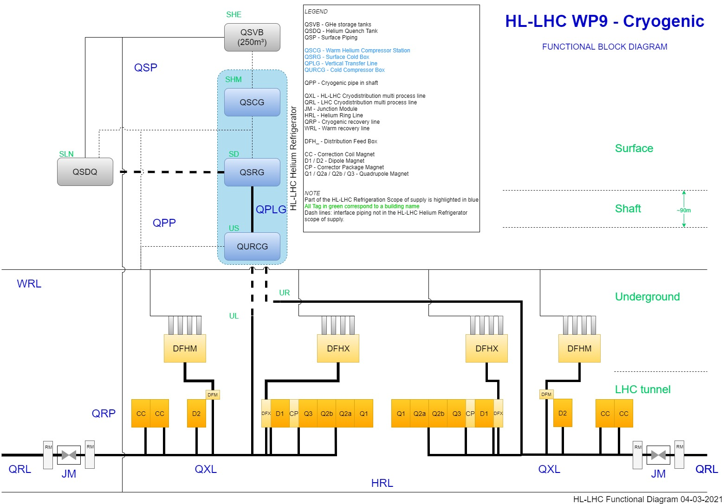
HL-LHC P1/P5 Cryogenic architecture
QSCG : Compressor station providing gaseous helium 20 B
QSRG : 4.5K refrigerator providing supercritical helium at 3 bara and 4.6 K
QXL : Distribution line distributing C,E and returning B,D,F
70 m for the common branch
270 m for the long branch
60 m for the short branch
QPLG : Vertical transfer line (~100 m height)
QURCG : Cold compressor box providing cooling capacity at 1.8 K
RM/JM : Return module and junction module at extremities for transient handling and back-up
Users at tunnel level

Slide 4
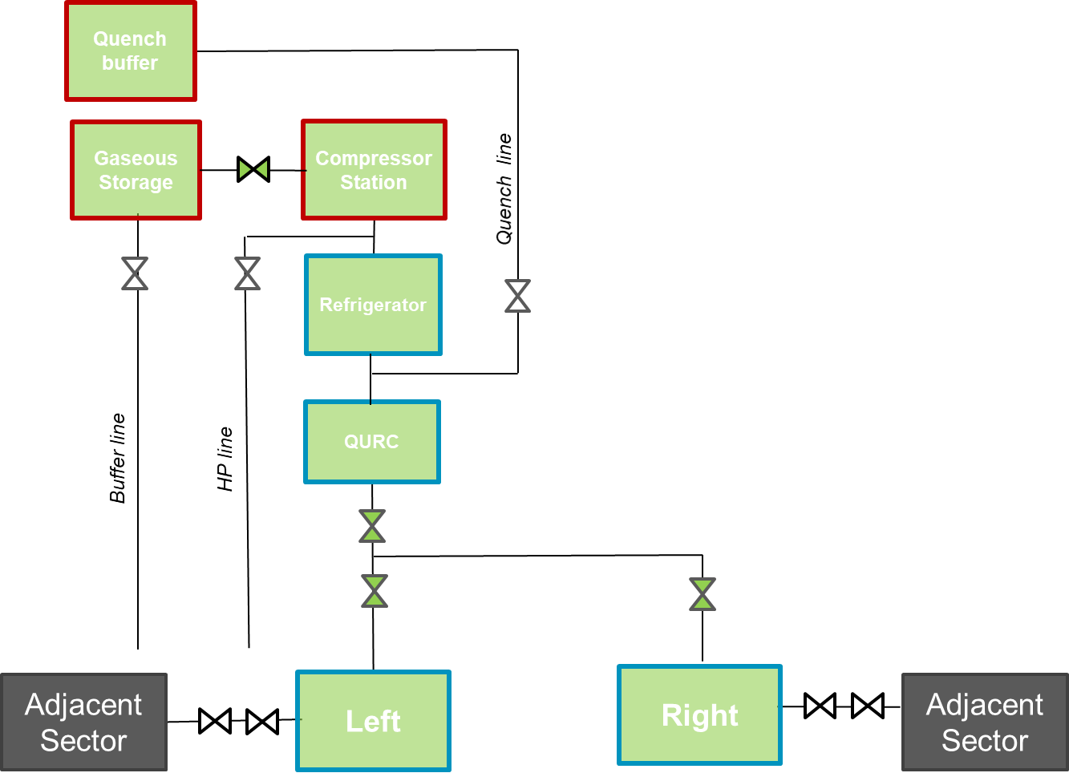
Operating modes and dependency with adjacent sector
All operating modes (similar as for LHC) will be possible:
    Pressure tests,
    Lock-out,
    Cool-down or warm-up,
    Stable operation at 80K, 20K, 4.5K, 3K, 1.9K, IT@20K-LSS/ARC@nominal,
    Maintenance / Technical stop,
    Intervention at magnets level.
"Only" one refrigerator at P1/P5 does not allow to operate the 2 LSS in a different mode → HL-LHC LSS independent from LHC operation thanks to sectorization.
  HiLumi magnets/users can be cooled by :
    New HL Refrigerators → nominal HL performances
    Adjacent sectors – up to twice the LHC nominal luminosity → Degraded operation
  Flexibility during the maintenance period of the HL-LHC cryoplant thanks to the Junction Module functionalities.
  Possible to cooldown one LSS per point independently.

Slide 5
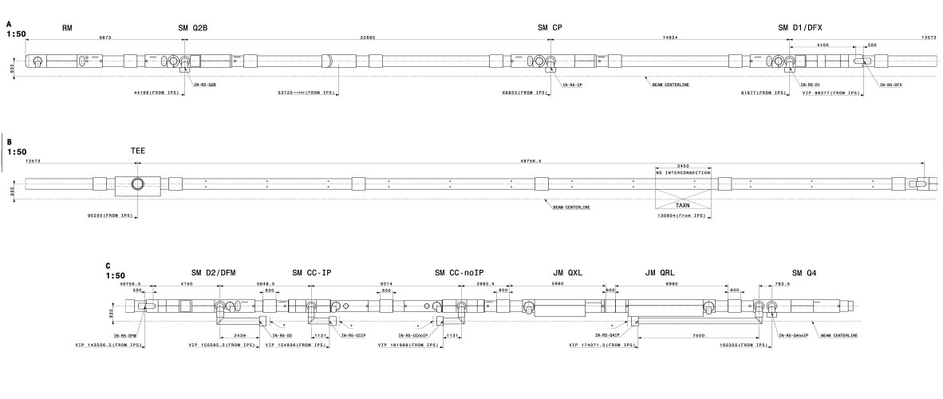
Protecting devices releasing helium to environment- Preliminary Layout
SV
RP
RP
RP
RP
RP
RP
RP
RM
RP
RP
RP
RP
RP
RP
SV/BD
RP
RP
PF
PF
PF
Q1
Q2a
Q2b
Q3
CP
D1
DCM
DFX
RP
RP
RP
PF (TBC)
SV
RP
RP
RP
RP
RP
SV
JM
PF
PF
PF
VB
RP
SV/BD
SV/BD
SV/BD
RP
RP
RP
Unsprang relief valve
RP : relief plate on the insulation vacuum
SV/BD : safety device releasing from helium envelope to environment
PF/VB: fixed point / vacuum barrier
DFM
D2
CC
CC
Position of safety devices is preliminary and approximate.
Magnet DCM RP TBC
Foreseen : SV DN100 for QXL / SV DN 200 for the IT.
QXL tunnel design is still in preliminary phase.

Slide 6
Failure modes and cases considered for helium release in the tunnel
POWERING
Electrical arc
Tube rupture
(full or partial)
Loss of insulation vacuum by helium ingress
Loss of insulation vacuum by air ingress
Case C: release via RP due powering. Impact may change according the powering level
Case A : release via BD/SV due to overpressure in helium envelope
Static loads
(with adequate margin)
Gas blow by (from HP circuit to LP circuit)
Case B: release via RP due pipe breach in vacuum
Blocked outlet
CD
Vibration / unplanned mechanical displacement
Tube rupture
(full or partial)
Loss of insulation vacuum by helium ingress

Slide 7
Different accesses cases with potential helium release to tunnel environment
Case | A | B | B | C | C
Volume to be protected | Helium | Insulation vacuum | Insulation vacuum | Insulation vacuum | Insulation vacuum
Operating cases | Nominal conditions | First Cooldown | Other Cooldown / Nominal conditions | Powering > 1.1 kA (powering level TBC) | Powering < 1.1 kA (powering level TBC)
Access | Access | NO ACCESS | Access | NO ACCESS | Access
Failure modes | LIV 2 x Static HL | Any line full rupture | Line partial rupture | Electrical arc leading to line full rupture + Quench | Limited electrical arc (partial rupture)
System | DFX DFM CCs RM QXL JM QXL | QXL line C IT CM interco D2 CC DFM DFX | All | IT line M or N D2 DFX DFM CC? | IT D2 DFX DFM CC?
Goal | Sizing of the protecting device | Sizing of the protecting device | Define the release location and stagging | Sizing of the protecting device | Define the release location and stagging

Slide 8
CASE A - helium circuit overpressure –
Preliminary flow and inventory
 | Liquid inventory [kg] | SV design case | SV SP [barg] | SV flow [g/s] | BD design case | BD SP [barg] | BD flow [g/s] | Reference
DFX | ~60 | 2x Static load | 1.8 | 10 g/s | LIV | 2.2 | 550 g/s | EDMS 2365987
DFM | ~50 | 2x Static load | 1.8 | 10 g/s | LIV | 2.2 | 500 g/s | Private communication
CC | ~20 | 2.5 x Static load | 0.75 | 5 g/s | Beam vacuum loss | 1.1 | 3510 g/s | EDMS 1900654
JM line C QXL | <0.05 | LIV | 20 | <10 g/s | NA | NA | NA | TBA
RM QXL | ~15 (TBC) | LIV | 4 | 270 g/s (TBC) | NA | NA | NA | TBA
Addition of Relief device for the operational case of RM considered.
It is understood that below 1 kg/s, the release in the tunnel does not lead to a helium jam ( refer to Note 2010-057)

Slide 9
CASE B – Helium pipe breach to Insulation vacuum–
Preliminary flow and inventory
1st cooldown : NO ACCESS
Full tube rupture
Other : ACCESS
Partial tube rupture – 1 kg/s
 | Liquid inventory [kg] | flow [kg/s]
QXL line C (long branch) | 243 | 2.2 - 4.6
IT cold mass interconnect | 418 | TBC
DFX | ~60 | TBC
DFM | ~50 | TBC
CC | ~20 | TBC
D2 | ~70 | TBC
Pressure [bara] | Temperature [K] | Area [mm2] | Diameter [mm]
4 | 4.8 | 124 | 12.6
20 | 65 | 255 | 18
1.3 | 1.9 | 336 | 20.7
1.8 | 10 | 1078 | 37.1
1.8 | 4.55 | 280 | 18.9
15 | 25 | 206 | 16.2
Similar to LHC
Above 280 mm2 defined in Access and powering LHC doc
Above 500 mm2
Dynamic simulation to be run for evaluation
Local pressure in the vacuum enclosure still be checked with the longitudinal vacuum impedance
It is understood that below 1 kg/s, the release in the tunnel does not lead to a helium jam ( refer to Note 2010-057)

Slide 10
CASE C – MCI or any other case due to powering energy- –
Preliminary flow and inventory
Powering >1.1 kA - NO ACCESS
Full tube rupture + Quench
Powering <x kA - ACCESS
Partial tube rupture – 1 kg/s
 | Liquid inventory [kg] | flow [kg/s]
IT line M or N | 418 | ~10 (TBC)
DFX | ~60 | 2.4
DFM | ~50 | 0.3
D2 | ~70 | TBC
CC? | ~20 | TBC
 | Liquid inventory [kg] | Diameter of hole [mm]
IT line M or N | 418 | 20.7
DFX | ~60 | 18.9
DFM | ~50 | 18.9
D2 | ~70 | 20.7
CC? | ~20 | TBC
Work in progress
Local pressure in the vacuum enclosure still be checked with the longitudinal vacuum impedance
It is understood that below 1 kg/s, the release in the tunnel does not lead to a helium jam ( refer to Note 2010-057)

Slide 11
Way forward
Sizing to be completed
Impedance in the vacuum enveloppe to be calculated when design is further progressed for the QXL.

Slide 12
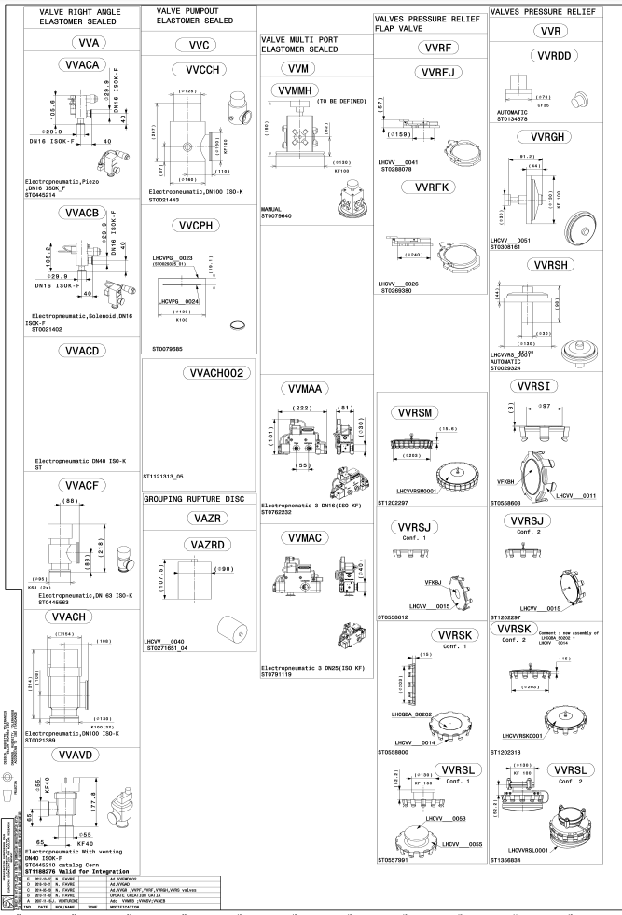
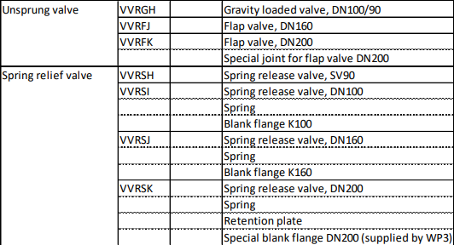
Vacuum safety valves

Slide 13
Volumes to be protected and protecting devices
SYSTEMS
VOLUME TO BE PROTECTED
PROTECTING DEVICES
SV spring loaded
QXL
M. Sisti
Case B, C
Vacuum
opens at 69 mbar to 134 mbar
DN65 to DN90
Relief plate with spring
D2 – WP3
D. Ramos - A. Lees
Beam
Insulation
opens ranging 30-165 mbar
DN65 to DN230
Covered by VSC
Relief plate w/o spring
IT/D1/DCM – WP3
D. Ramos - R. Van Der Weelderen and P. Tavares
opens lower than 10 mbar
DN65 to DN230
Case A
Helium
Safety valve
Cold Pow – WP6a
Y. Leclercq –V. Gahier
Generally for operating cases
Closes after event
Beam screen
Thermal shield
Cold mass
Magnet HX
Liquid helium
Burst Disc
Crab Cavities – WP4
T. Capelli / L. Dassa - L. Delprat / K. Brodzinski
60-80 K
~18 bar
60-80 K
~18 bar
1.9 K
~1.3 bar
1.8 K
~0.018 bar
4.6 K
~1.5 bar
or
Generally for MCI
Requires intervention for replacement
4.5-20 K
~1.5 bar

Slide 14
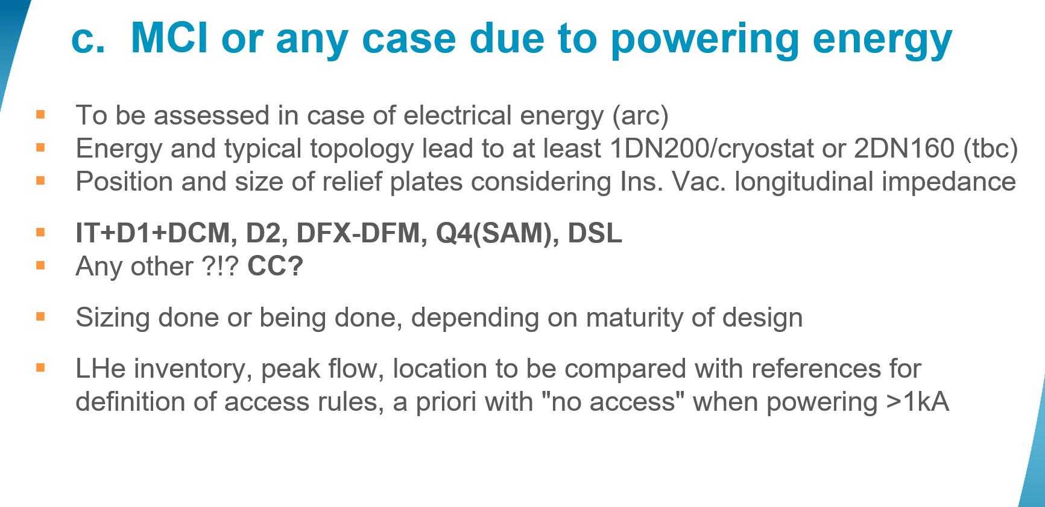
Failure modes –
MCI or any other case due to powering energy- CASE C
Tube rupture
(full or partial)
Loss of insulation vacuum by helium ingress
POWERING
Electrical arc
Quench
According to the lesson learnt of 19th of Sept. 2008 incident, the MCI should consider full rupture of the pipe at the magnet interconnection.
Quench and electrical arc failure modes are linked with powering and consequences are linked with the powering level.
One failure mode can provoke other failure modes in cascade (refer to 19th of Sept. 2008 LHC incident)

Slide 15
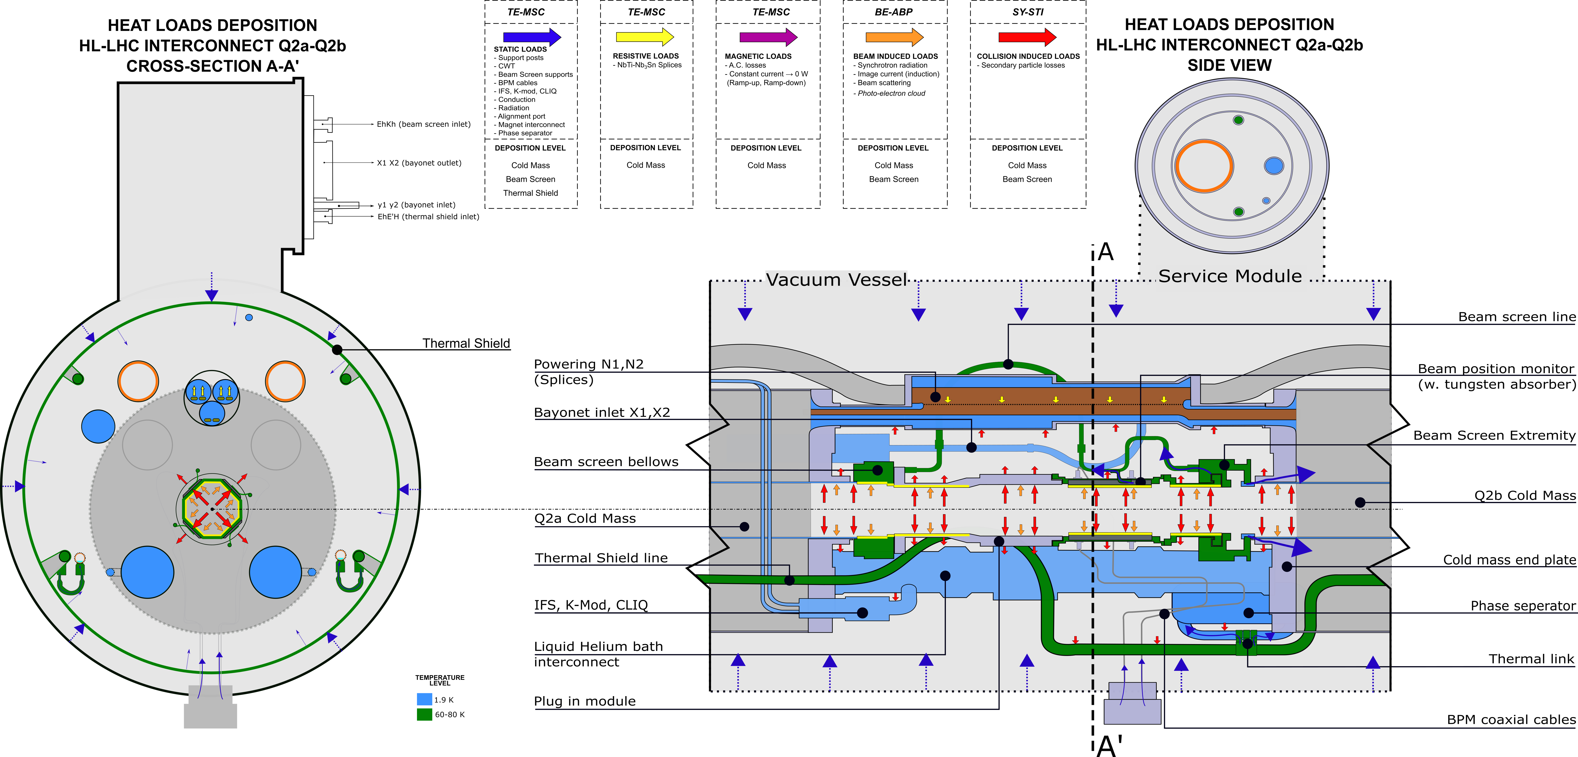
Inner triplet process data and inventory (1/2)
Line | ID [mm] | Area** [cm2] | P [bara] | T [K]
N1 / N2 | 50 | 19.6 | 1.3 – 17* | 1.9 – 22.2*
LD | 40 | 12.6 | 1.3 – 17* | 1.9 – 22.2*
Cold mass interco | 100 | 78.5 | 1.3 – 17* | 1.9 – 22.2*
CY1 / CY2 | 14 | 1.5 | 0.05
TS | 34.2 | 9.2 | 10-22 | 60-80
BS | 25.5 |  | 10-22 | 60-80
XB1 / XB2 | 100 | 78.5 | 0.020 | 1.85
*Conditions indicated for a 39.1 MJ quench
** Area indicated is the cross section for corresponding ID

Slide 16
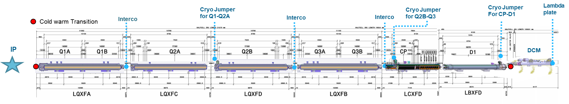
Inner triplet inventory given in helium litre (2/2)
 |  | DCM | D1 | CP | Q3 | Q2A | Q2B | Q1 | Line N | Total
Length [m] |  | 6.17 | 9.1 | 7.95 | 11.1 | 10.78 | 10.78 | 11.56 | 56
Inventory [kg] | 1.9 K cold mass | 16.3 | 31.0 | 72.4 | 68.0 | 68.0 | 68.0 | 68.0 | 27.6 | 418.2
The total liquid inventory at 1.9 K is much higher (43.5 l/m) than the previous considerations at 25 l/m.

Slide 17
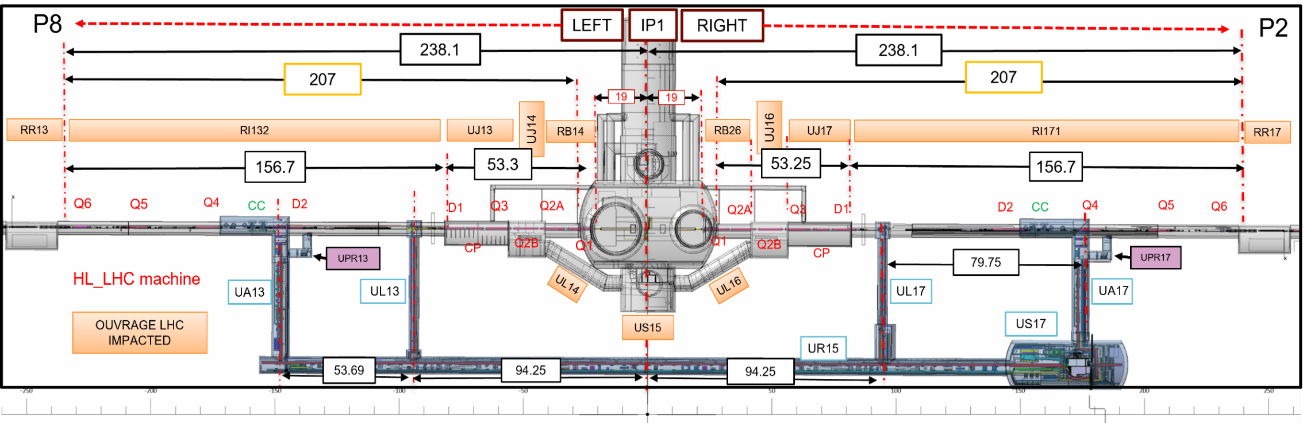
Configuration in case of access
IP1 ZONE
Many relief plates to be expected:
- Q1 to DFX and QXL "T" below ULx3-x7 cores
- D2/DFM to Q4

Slide 18
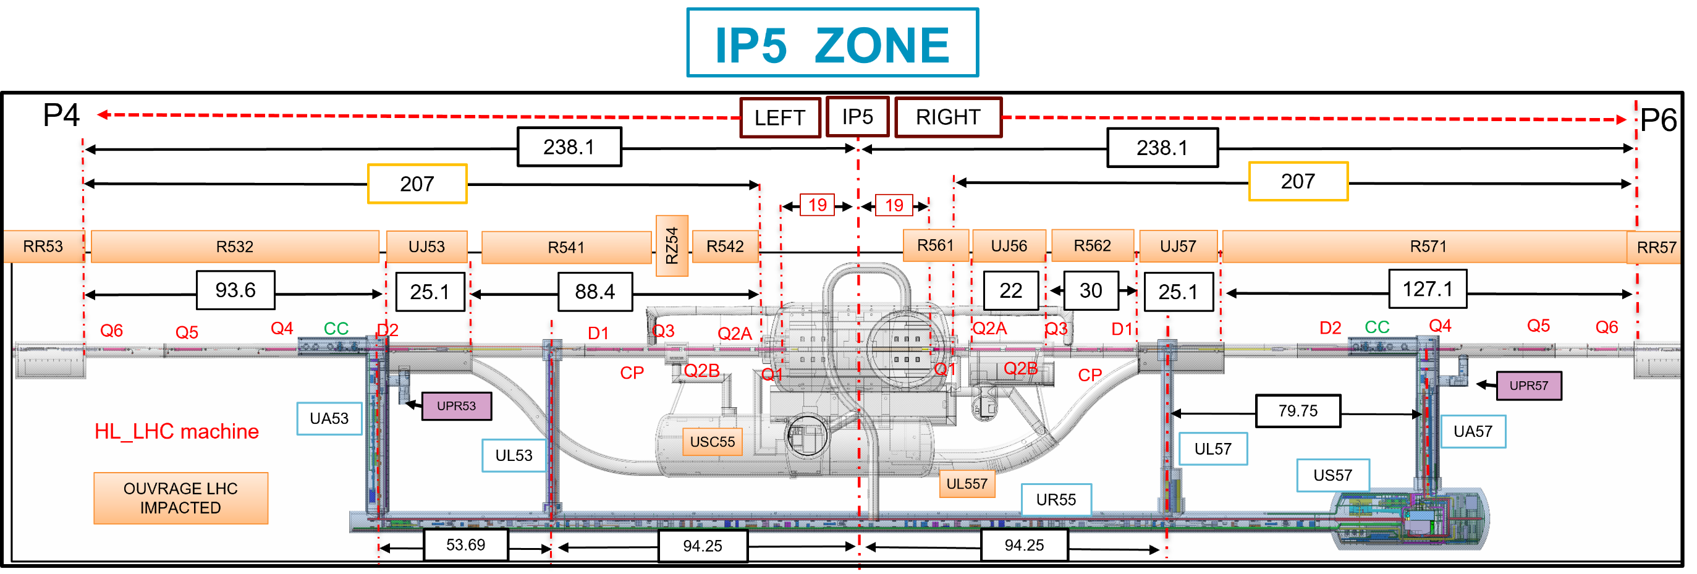
Configuration in case of access
Many relief plates to be expected:
- Q1 to DFX and QXL "T" below ULx3-x7 cores
- D2/DFM to Q4

Slide 19
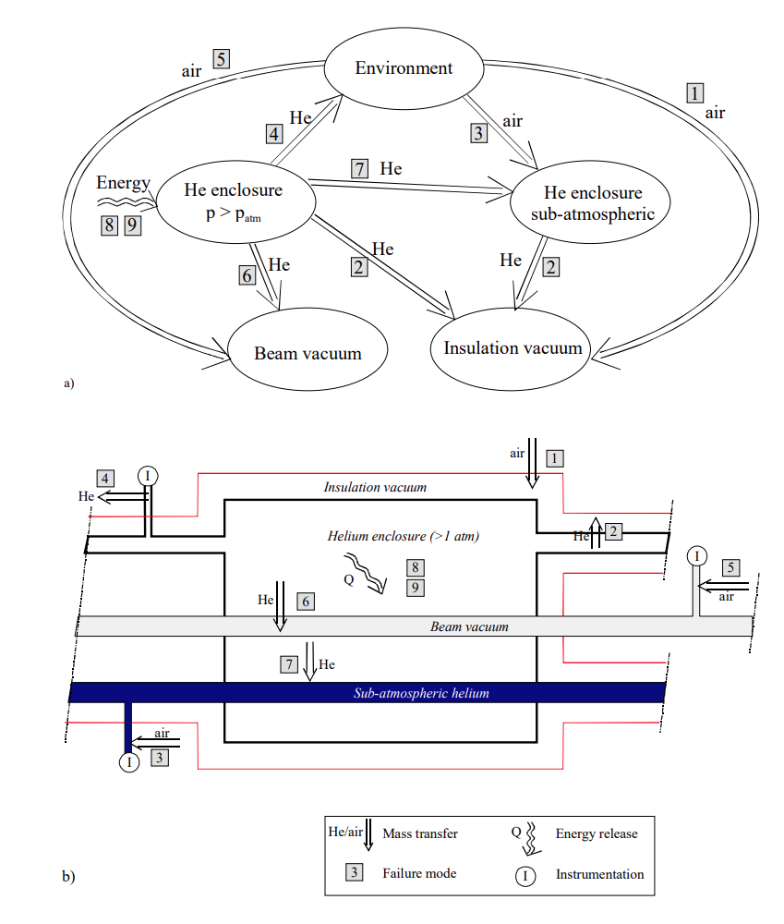
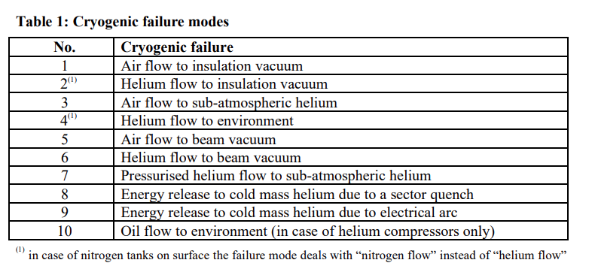
Reminder of all LHC failure modes
Extract of Preliminary risk analysis of the LHC cryogenic Project Note 177.

Slide 20
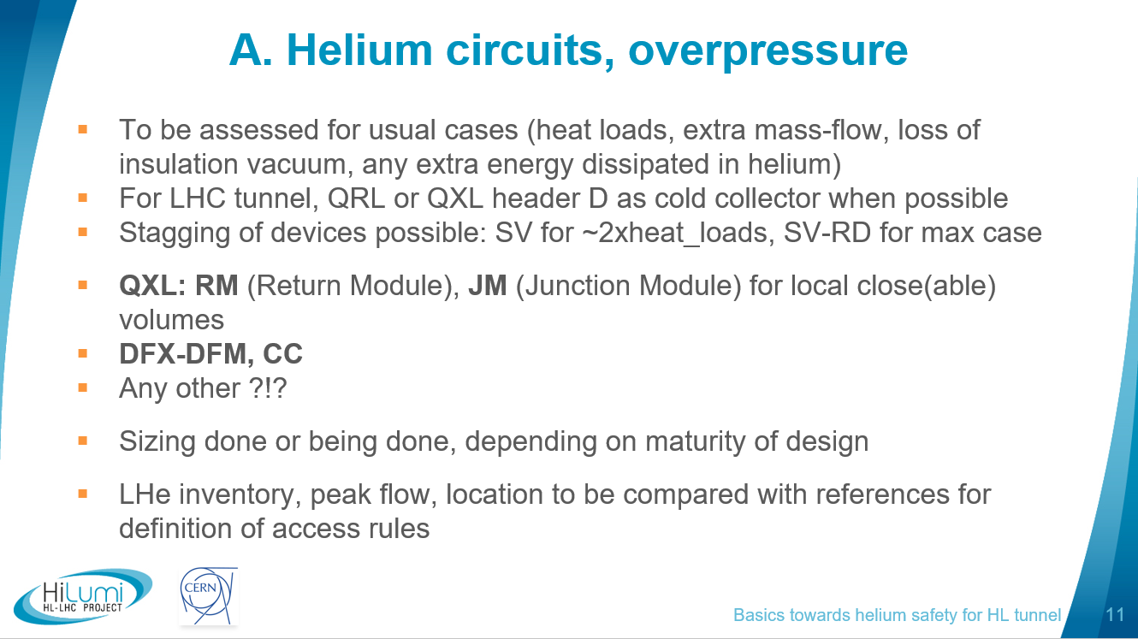
Failure modes leading to helium circuit overpressure - CASE A
POWERING
Quench → helium release to line D via quench valve
Loss of insulation vacuum (LIV) by air ingress
Static loads
(with adequate margin)
Gas blow by (from HP circuit to LP circuit)
Blocked outlet
Helium is released to the atmosphere when it is not possible to collect it in the line D (low pressure equipment such as CC, Cold powering system, RM module)
When the helium release is limited, as an example: protection of double valves system at JM

Slide 21
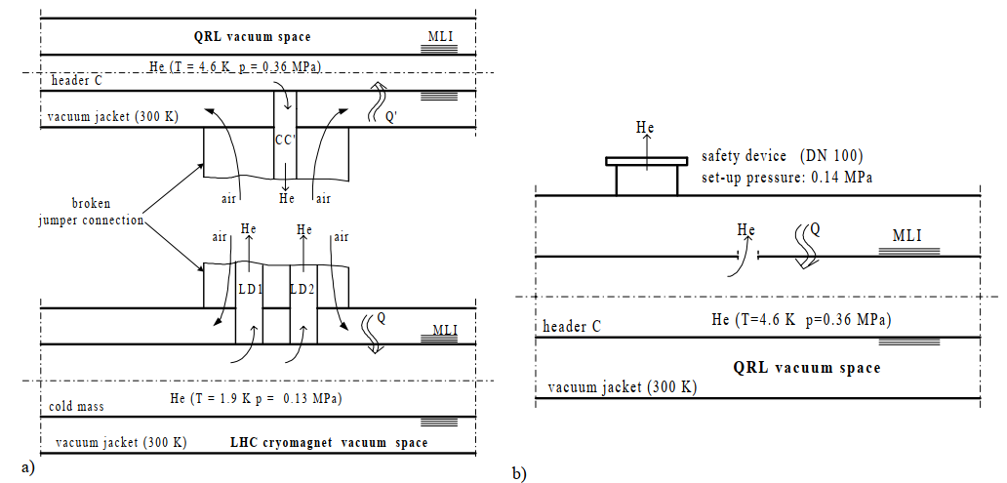
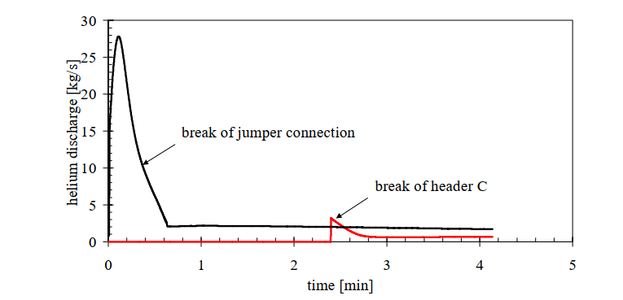
LHC model benchmark
 | Cold mass | Header C | QRL vacuum jacket
Pressure [bar] | 1.3 | 3.6 | 10-9
Temperature [K] | 1.9 | 4.6 | NA
Helium sub-sectorization [m] | 214 | 3300 | NA
Vacuum sub-sectorization [m] | 214 | 428 | 428
Helium Mass per sub-sector [kg] | 475 | 3300 | NA
Volume per sub-sector [m3] | 3.21 | 26 | 88.04
Diameter | 0.58 | 0.1 | 0.61
Area of heat transfer [m2] | 389.93 | 134.46 | 820.2
Two cases were considered as sizing for LHC for helium discharge in the tunnel (prior the sept 2009 incident)
  Jumper connection rupture – air to insulation vacuum – not considered for HL-LHC
  QRL line C rupture to insulation vacuum
Those cases were modelled in Ecosim for benchmark.
Max ~ 28kg/s
Max ~ 3kg/s
Extract from PN 381 – helium discharge and dispersion in the LHC accelerator tunnel in case of cryogenic failure

Slide 22
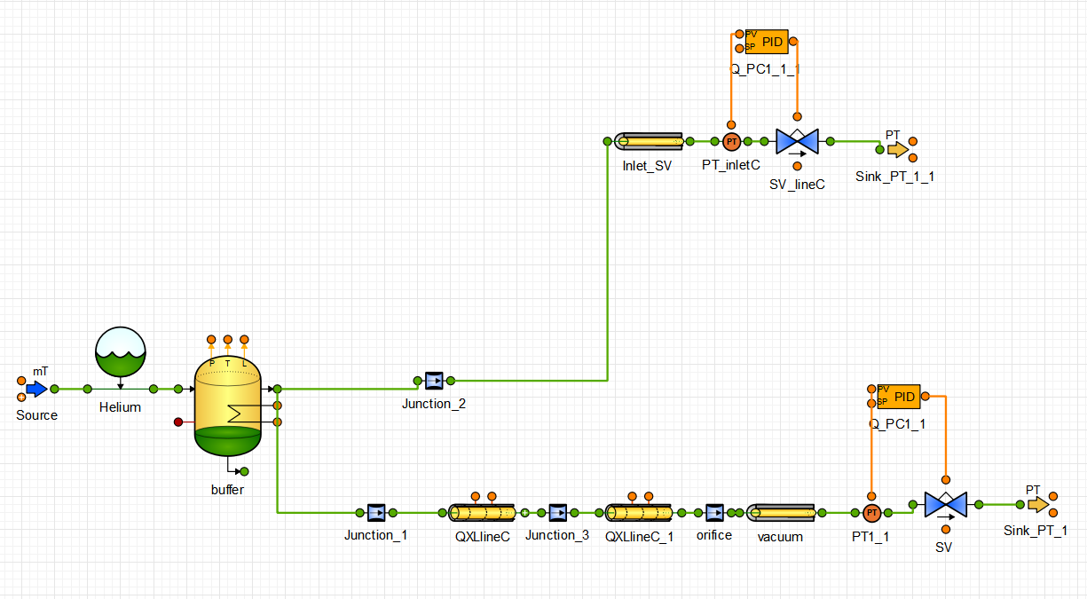
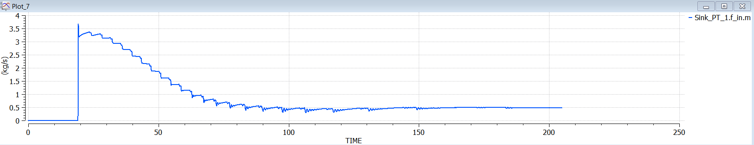
QRL line rupture
Max ~ 3kg/s
 | Header C
Heat load [W] | 40200
Heat Load [W/cm2] | 0.03
SV on vacuum [m2] | 3 x 0.005
SV set pressure [bara] | 1.3
Vacuum initial temperature [K] | 75
Orifice diameter [mm] | 100
3 SVs of DN100 were considered.
Heat load as per PN381.
Vacuum initial temperature considered to the shield temperature.
Max helium flow rate discharged to the atmosphere is similar to the value found in PN381 though the opening occurs after ~20 s whereas it occurs after 2 min 40 in PN381.

Slide 23
HL-LHC model – case B
 | Cold mass IT | Header C Long branch | QXL vacuum jacket
Pressure [bar] | 1.3 | 4 | 10-9
Temperature [K] | 1.9 | 4.8 | NA
Helium sub-sectorization [m] | 60 | 530 | NA
Vacuum sub-sectorization [m] | 60 | 155 | 155
Helium Mass per sub-sector [kg] | 418 | 275 | NA
Volume per sub-sector [m3] |  | 2.3 | 30.7
Diameter | 0.58 | 0.065 | 0.6
Area of heat transfer [m2] | 113 | 1.13 – 17.55 | 292
For helium leak to insulation vacuum, the heat load considered is the convective transfer from the vacuum space at the shield temperature to the cold mass.
Heat coefficient is considered to 17 W/m2/K.
Heat load is calculated to ~ 0.15 W/cm2 versus 0.03 W/cm2.
Cases considered :
  1. Line C for QXL – vacuum sectorization limited between fixed point
    Partial – 189 mm2
    Full
  2. Cold Mass IT
    Partial
    Full at interconnect

Slide 24
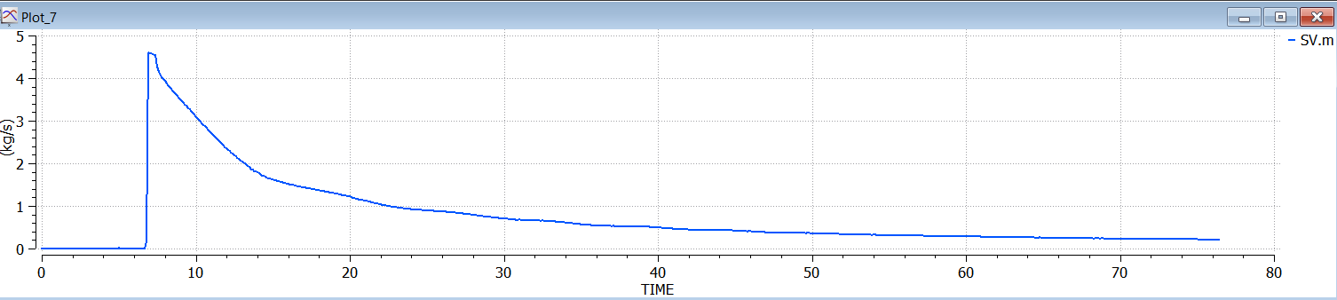
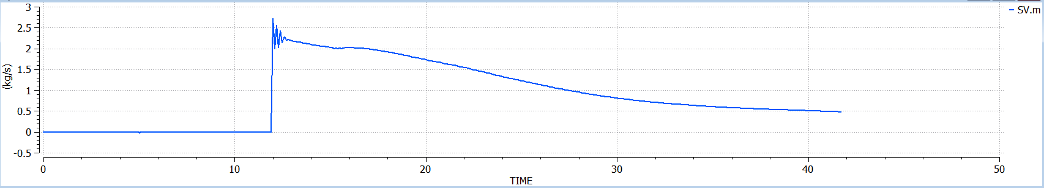
QXL line C full rupture – case 1
Heat load : 232500 W
Heat load : 46500 W
 | Header C 0.03 W/cm2 | Header C 0.15 W/cm2
Heat load [W] | 46500 | 232500
Heat Load [W/cm2] | 0.03 | 0.15
SV on vacuum [m2] | 0.02 | 0.02
SV set pressure [bara] | 1.3 | 1.3
Vacuum initial temperature [K] | 90 | 90
Orifice diameter [mm] | 65 | 65
Peak flow [kg/s] | 2.2 | 4.6
3 SVs of DN100 (assumed at 5000 mm2 each) were considered.
Vacuum initial temperature considered to the shield temperature at 90 K
Peak flow in the vacuum is 4.6 kg/s.

Slide 25
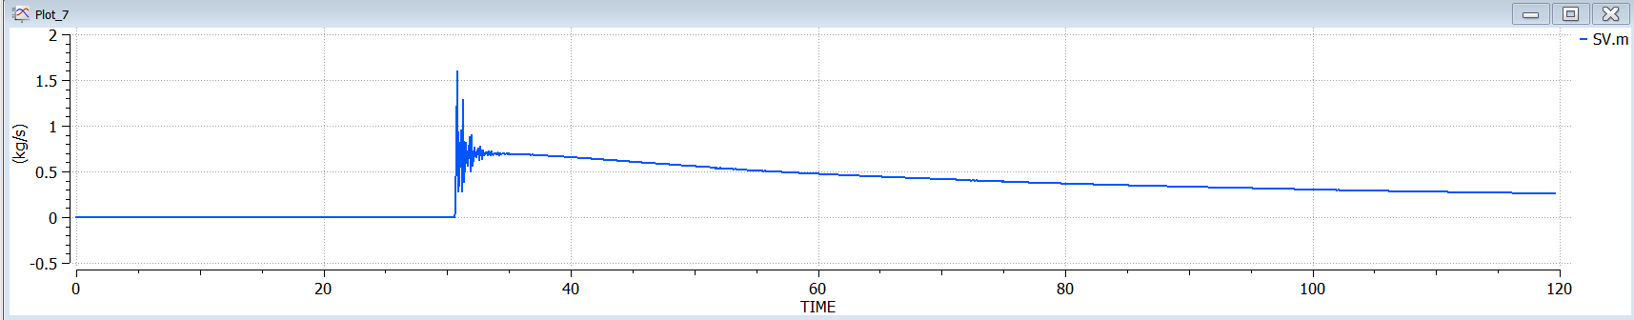
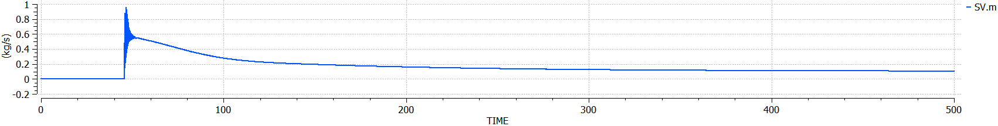
QXL line C partial rupture – case 1
Heat load : 232500 W
Heat load : 46500 W
 | Header C 0.03 W/cm2 | Header C 0.15 W/cm2
Heat load [W] | 46500 | 232500
Heat Load [W/cm2] | 0.03 | 0.15
SV on vacuum [m2] | 0.02 | 0.02
SV set pressure [bara] | 1.3 | 1.3
Vacuum initial temperature [K] | 90 | 90
Orifice diameter [mm] | 12.6 | 12.6
Peak flow [kg/s] | 0.5 | 0.7
3 SVs of DN100 (assumed at 5000 mm2 each) were considered.
Vacuum initial temperature considered to the shield temperature at 90 K
Peak flow in the vacuum is 4.6 kg/s.

Slide 26
Pressure drop evolution versus the discharge length
Hypotheses:
  DN200 SV: kv = 900 m3/h
  Vacuum enclosure: free section = 0.35 m2, hydraulic diameter = 135 mm
  Mass flow = 1 kg/s

