Slide 1

MS design and technology, including potential LS3 installation
Marcin Chrząszcz (IFJ PAN)
8th Workshop on LHCb Upgrade II

Slide 2
Geometry Developments
All code used for plots in this presentation is available on GitHub: [click here]

Slide 3
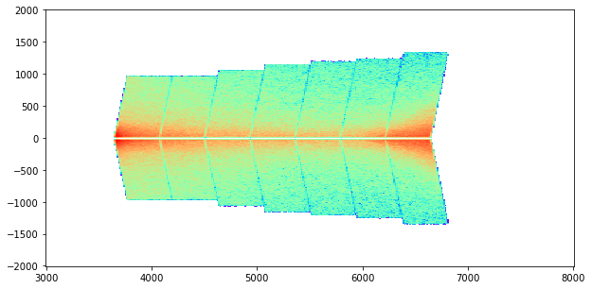
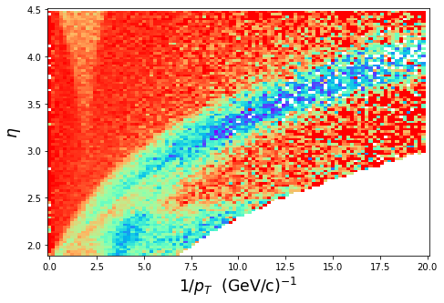
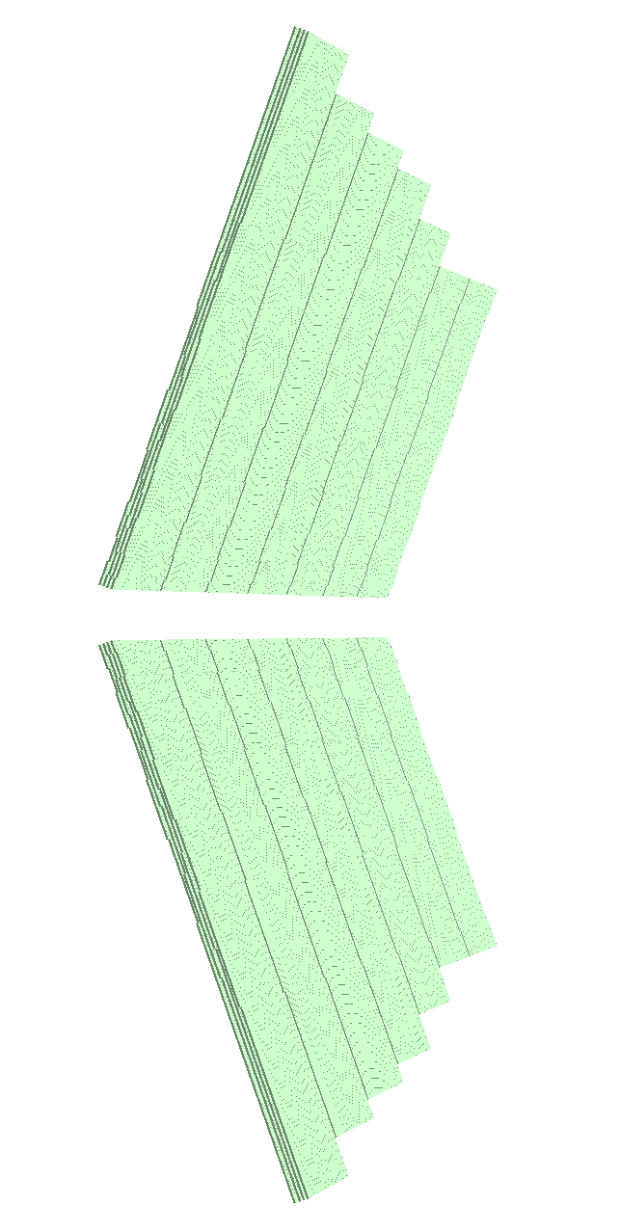
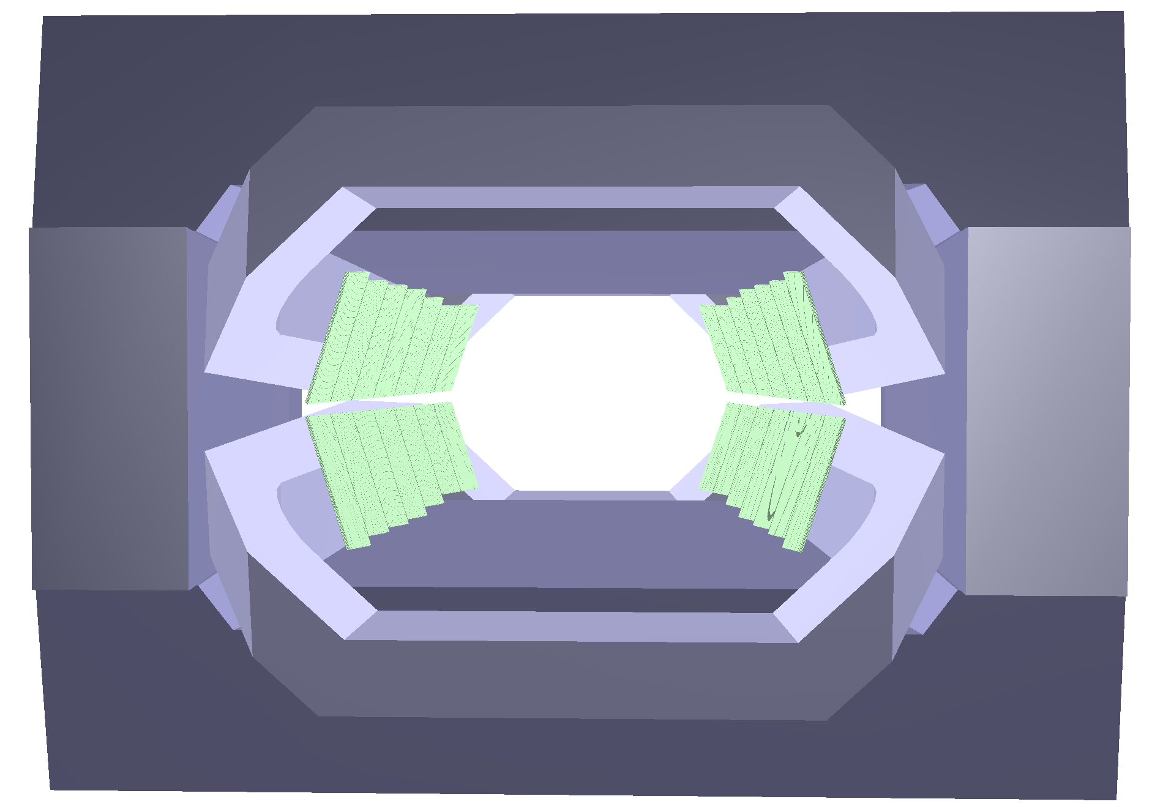
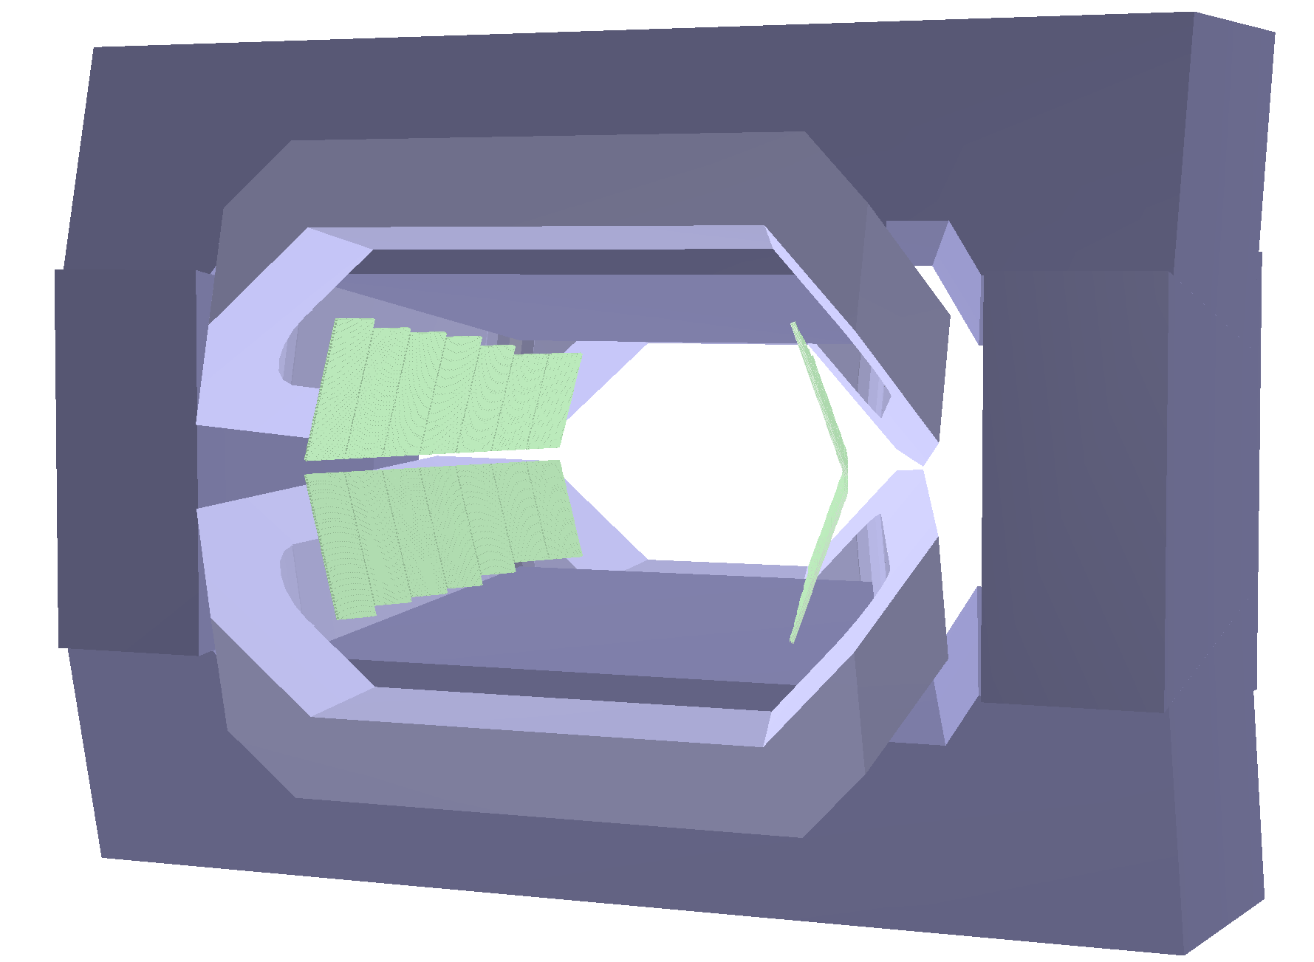
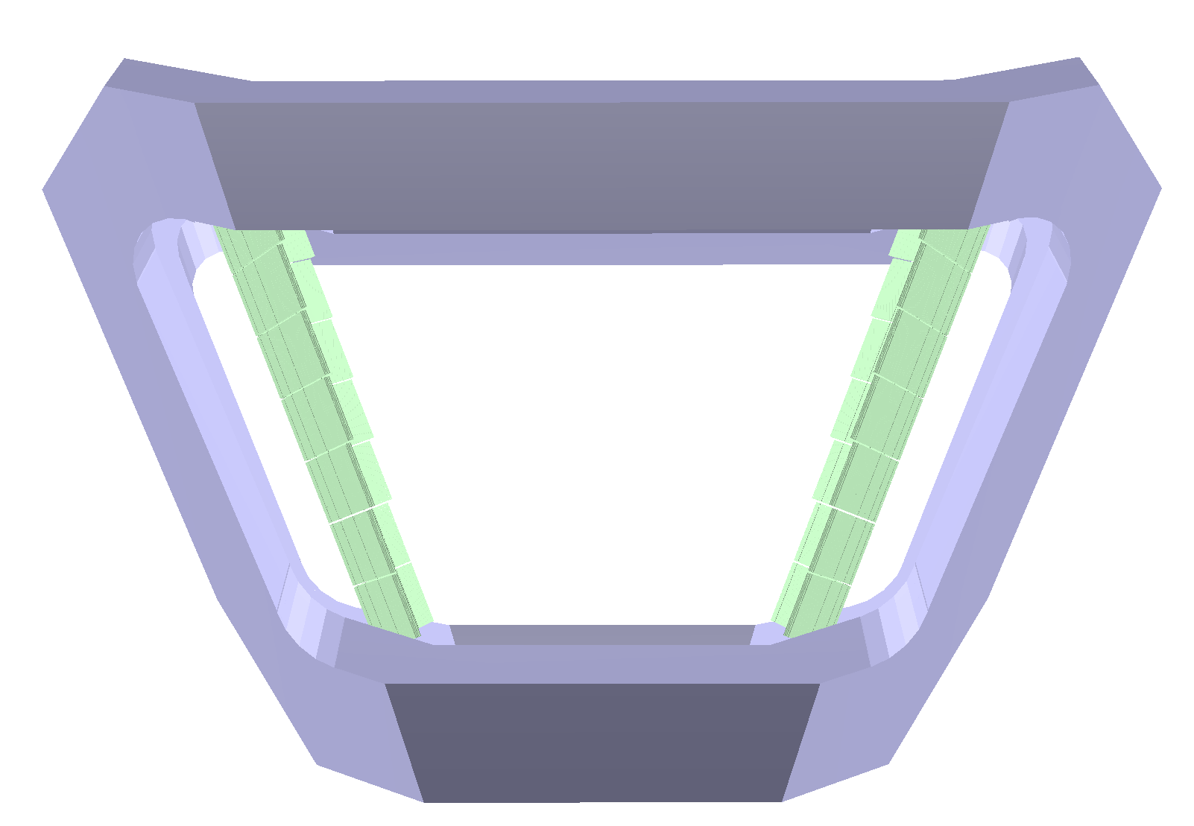
Reminder – Initial design
7 Modules starting coverage from about z = 3.5m onward
Modules oriented on tilted planes (4 segments) facing the beam pipe
Module height from 1.0 to 1.4m depending on z-position
74k channels (each individual scintillator bar counts as channel)
Pros:
  Easy support structure for large plane detector
Cons:
  Not perpendicular to particle trajectory
  Acceptance gap between MS and SciFi tracker
  No support structure
Acceptance
loss
Nicolas Schmidt

Slide 4
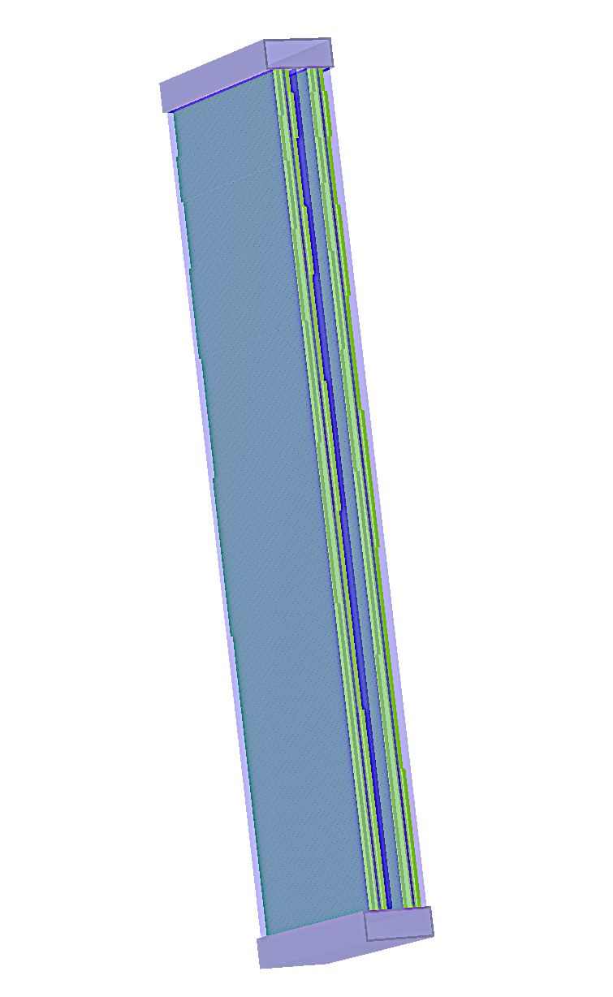
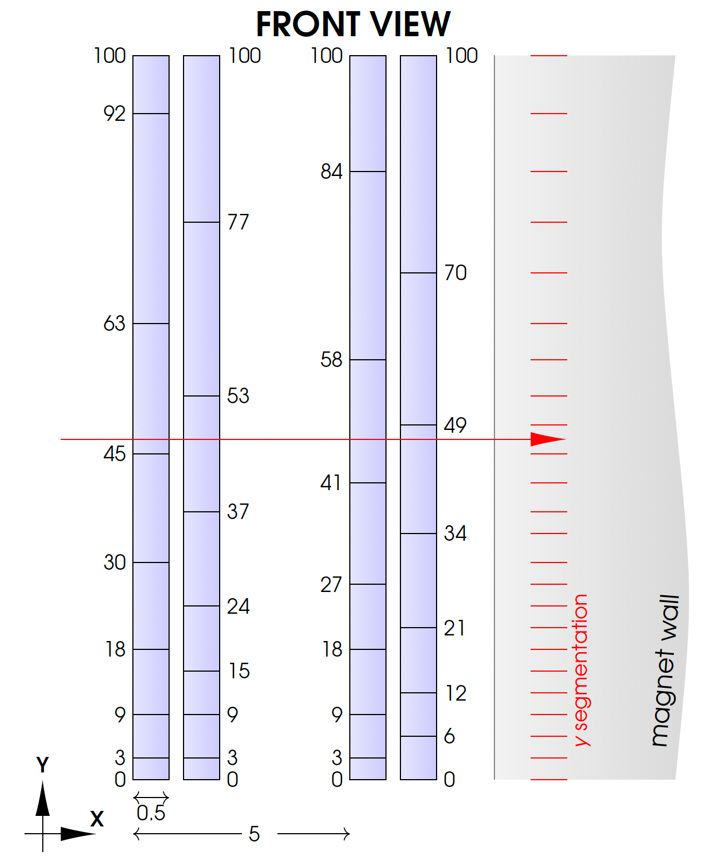
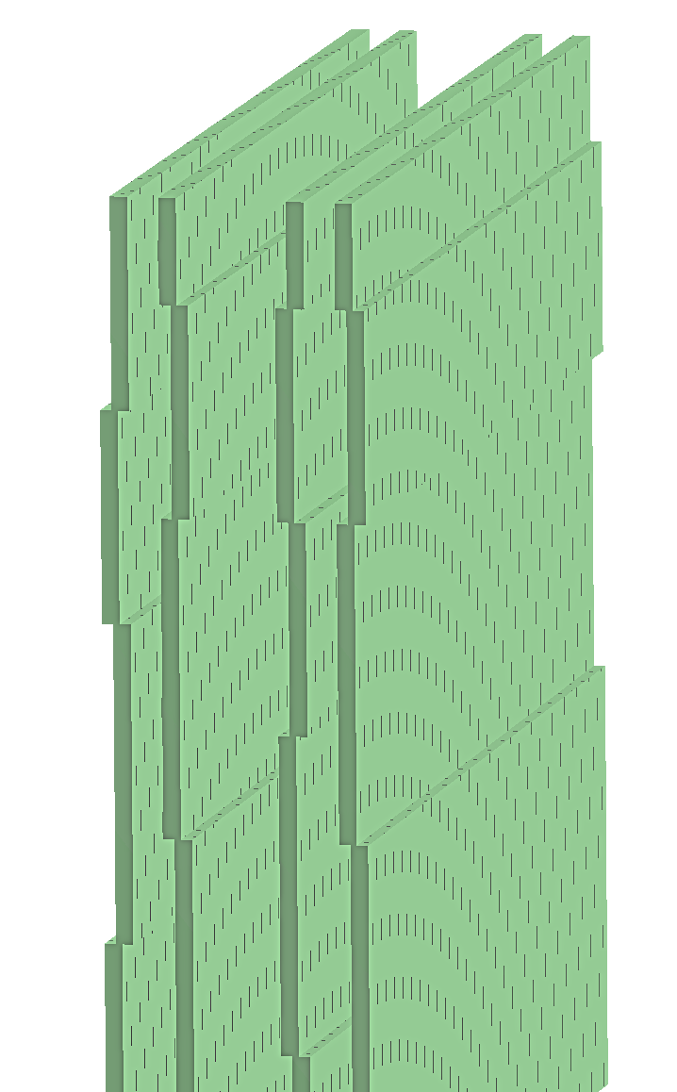
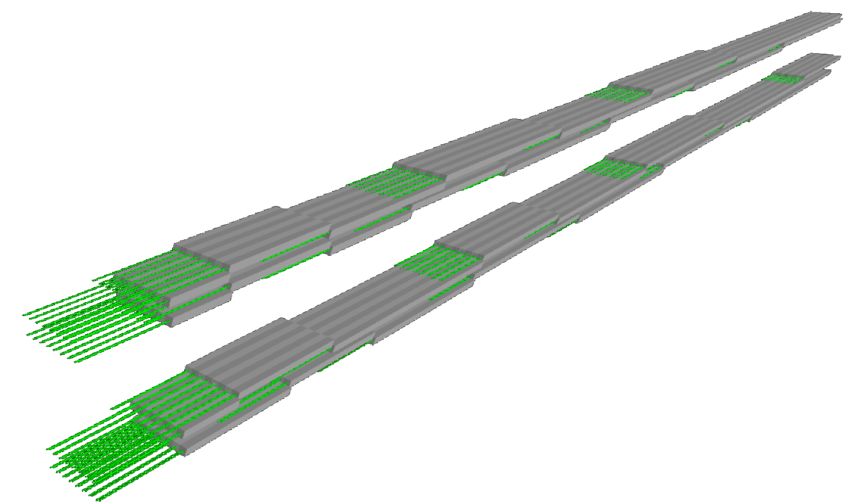
Bar segmentation and passive material of modules
4 layers per module
Varying segment length per layer
  Produces desired granularity in y-direction
  Adjustment for varying module length
Each segment made of 57 scintillator bars
  5x5mm² square bars with 200micron separation to account for tolerances in final assembly
Alternating offset of segments
  Allows for routing of fibers
Passive material implemented
  Carbon fiber sheets and plastic bar trays
Segment with 57 bars
Image from Hubert
Nicolas Schmidt

Slide 5
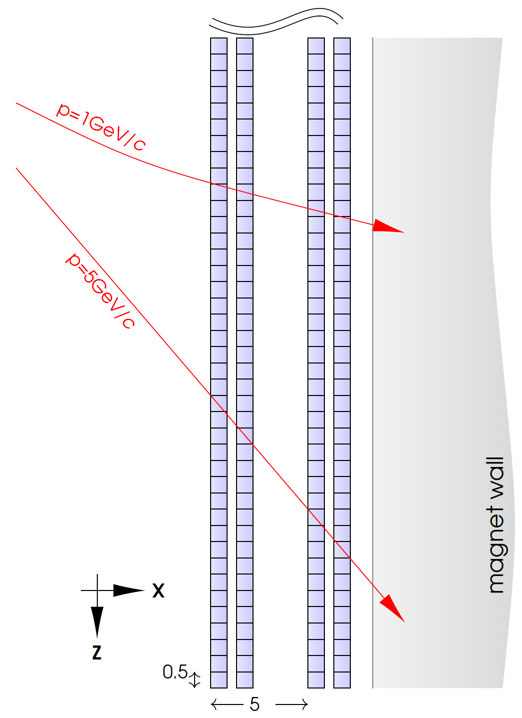
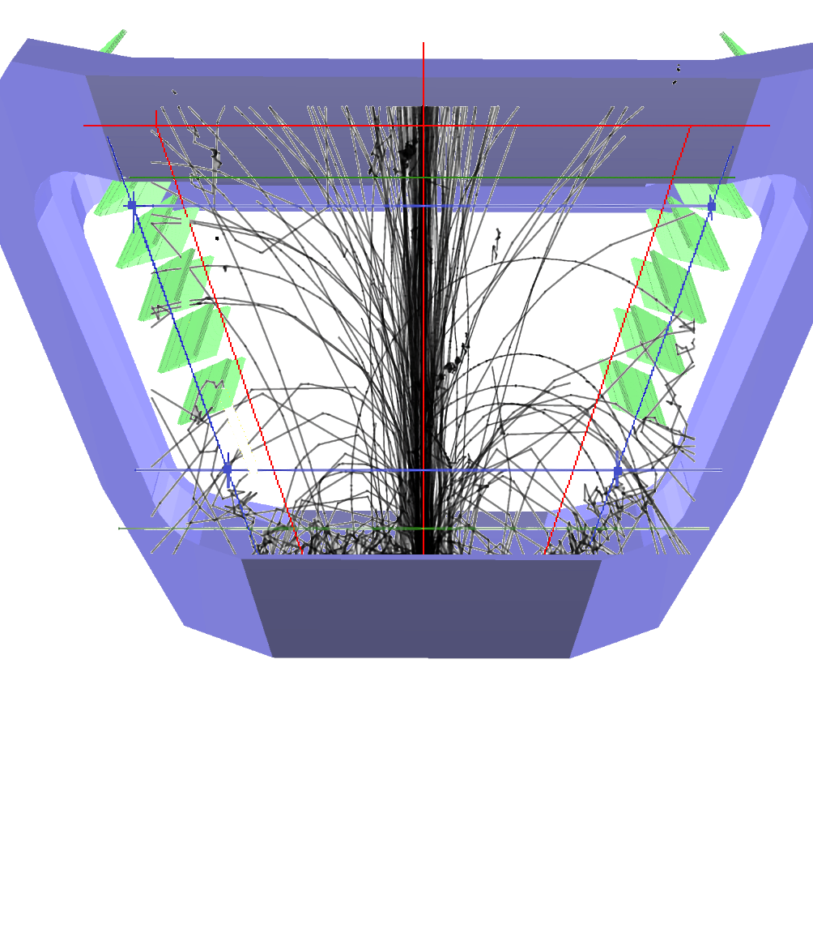
Incident Angle Optimization
Without module rotation
With module rotation
Rotation of modules around y-axis for average perpendicular incident angle of particles
Rotations between 40 and 57 degrees
  Increasing rotation with distance from IP
Increases tracking performance and reduces occupancy
  E.g. from crossing of two bars in single layer
Nicolas Schmidt

Slide 6
Acceptance Optimization
before
Removal of first two modules
  Negligible impact on acceptance (removes small fraction of very soft particles)
  Frees up about 20k channels AND significant portion of fiber material (longest fibers for readout in first layers)
Addition of modules at larger z
  Closes gap between MS and SciFi tracker
  Improves acceptance significantly
  Last module close to SciFi and outer Magnet edge
after
Nicolas Schmidt

Slide 7
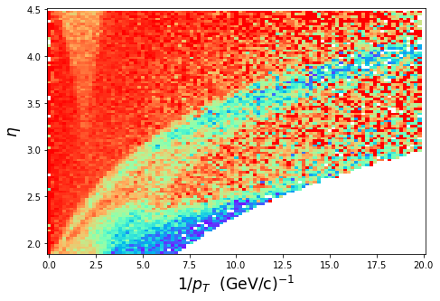
Acceptance Optimization
before
Removal of first two modules
  Negligible impact on acceptance (removes small fraction of very soft particles)
  Frees up about 20k channels AND significant portion of fiber material (longest fibers for readout in first layers)
Addition of modules at larger z
  Closes gap between MS and SciFi tracker
  Improves acceptance significantly
  Adds 20k channels
  Last module closer to SciFi and outer Magnet edge
after
Nicolas Schmidt

Slide 8
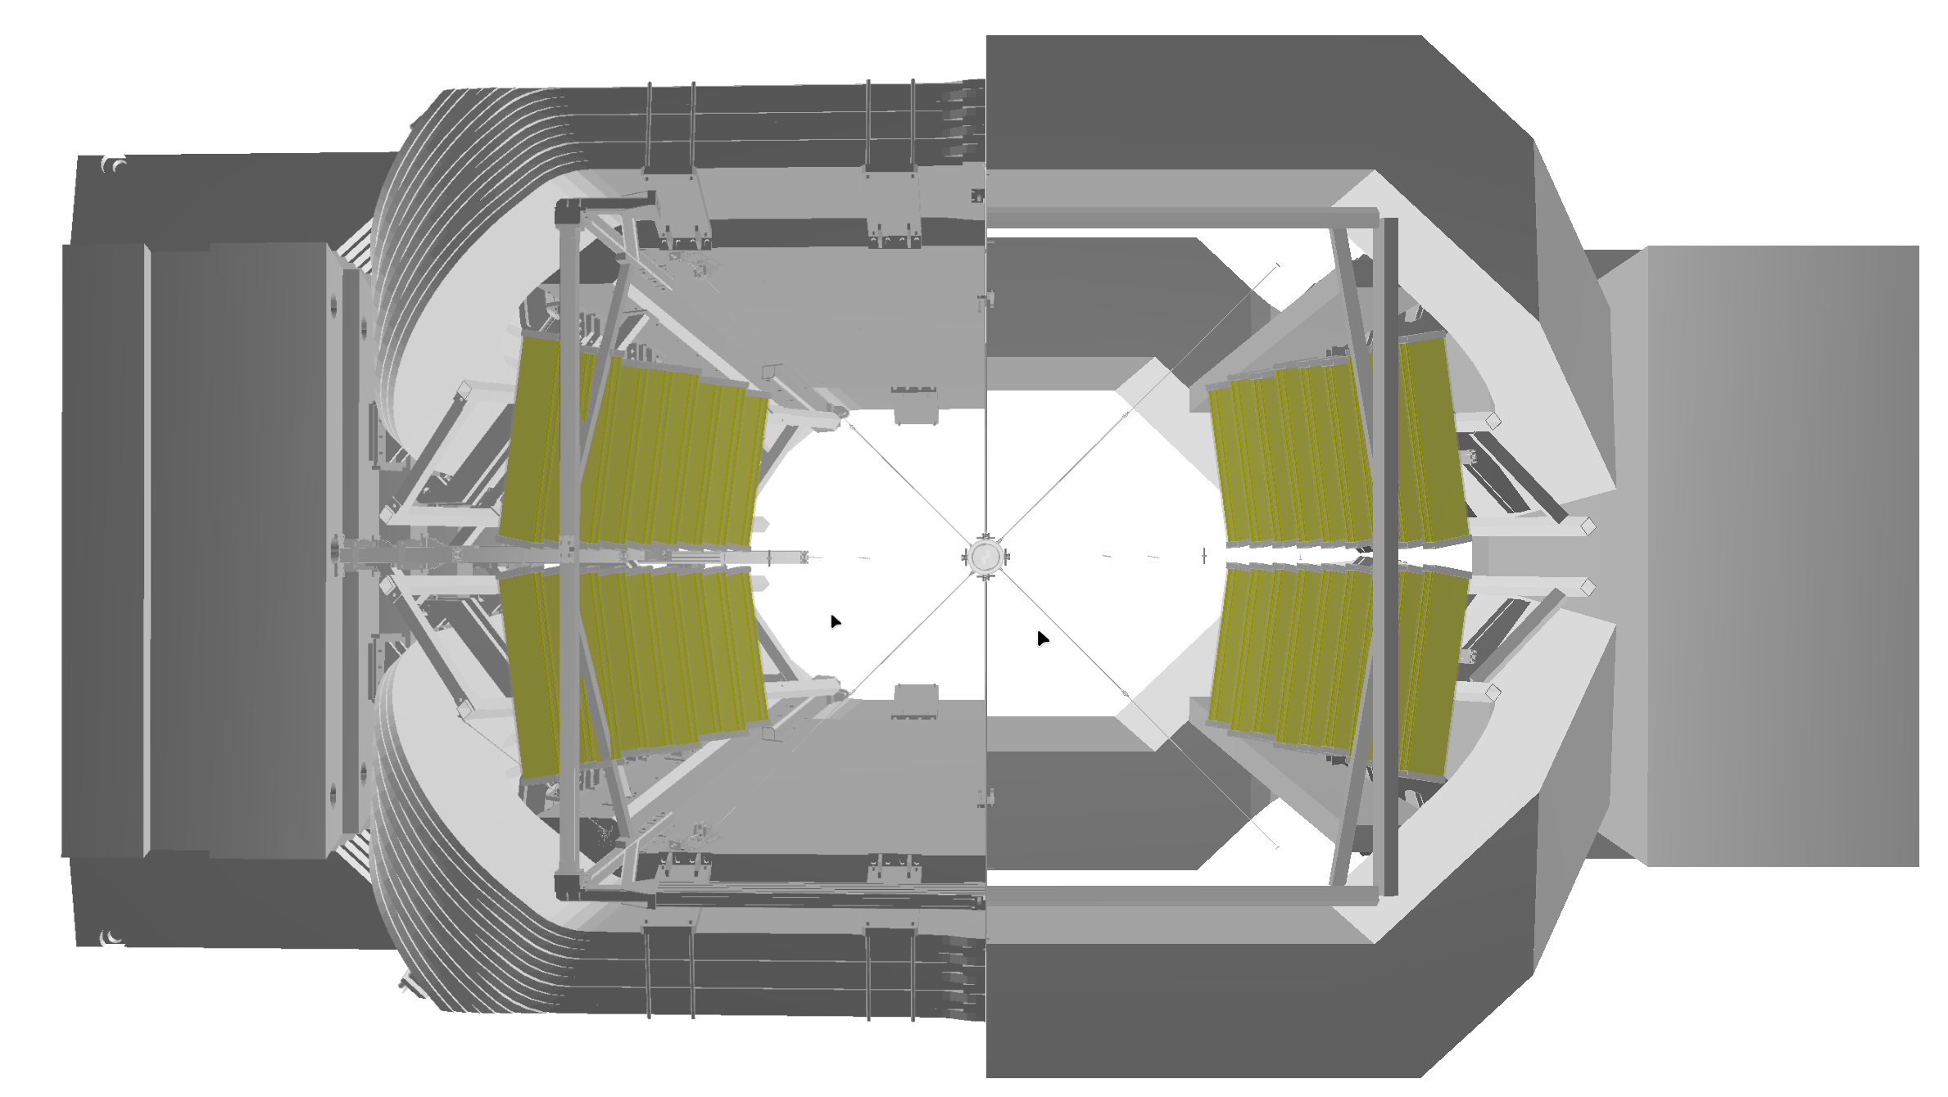
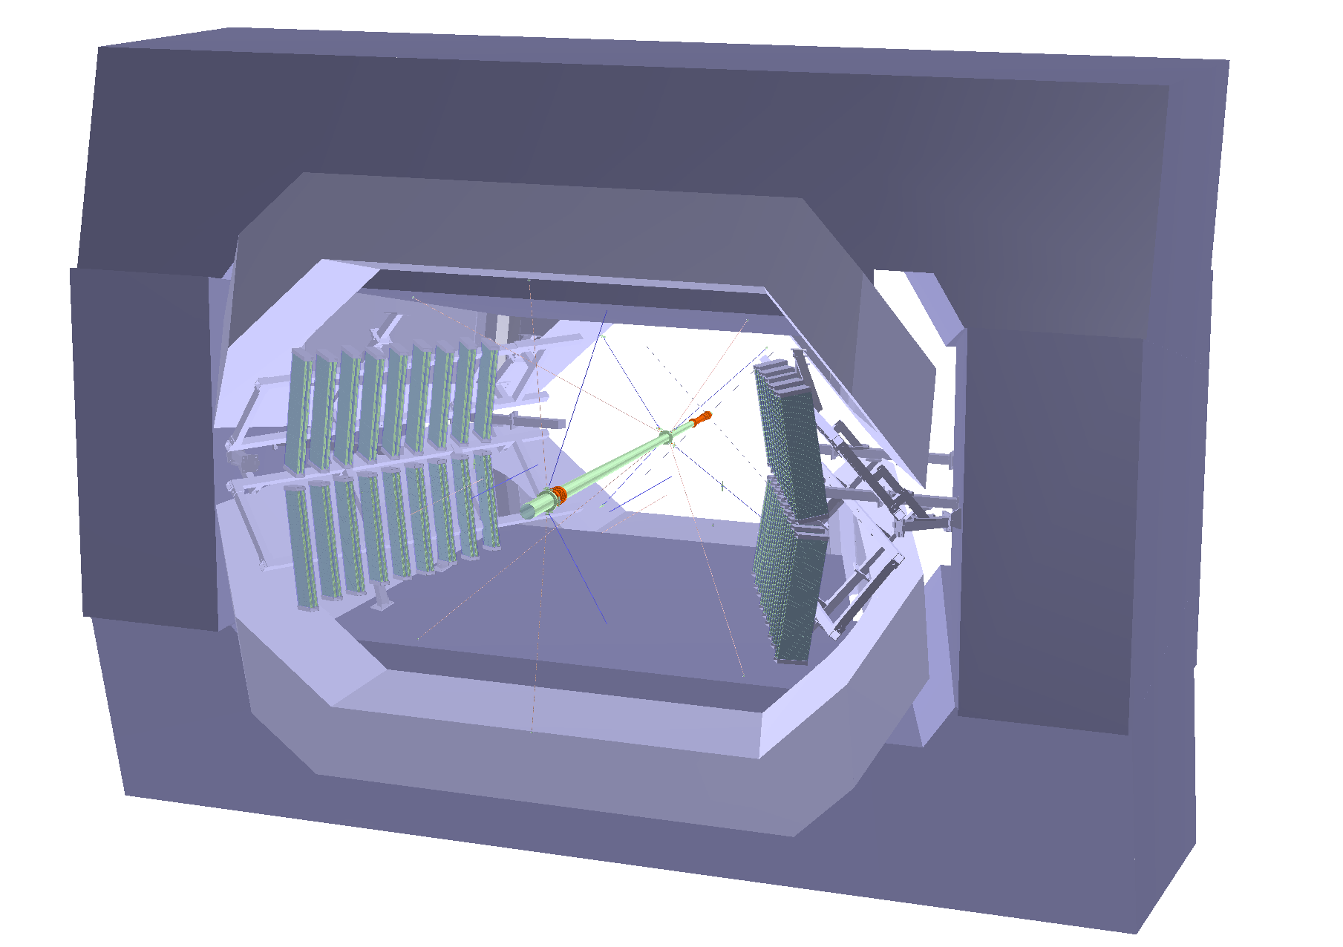
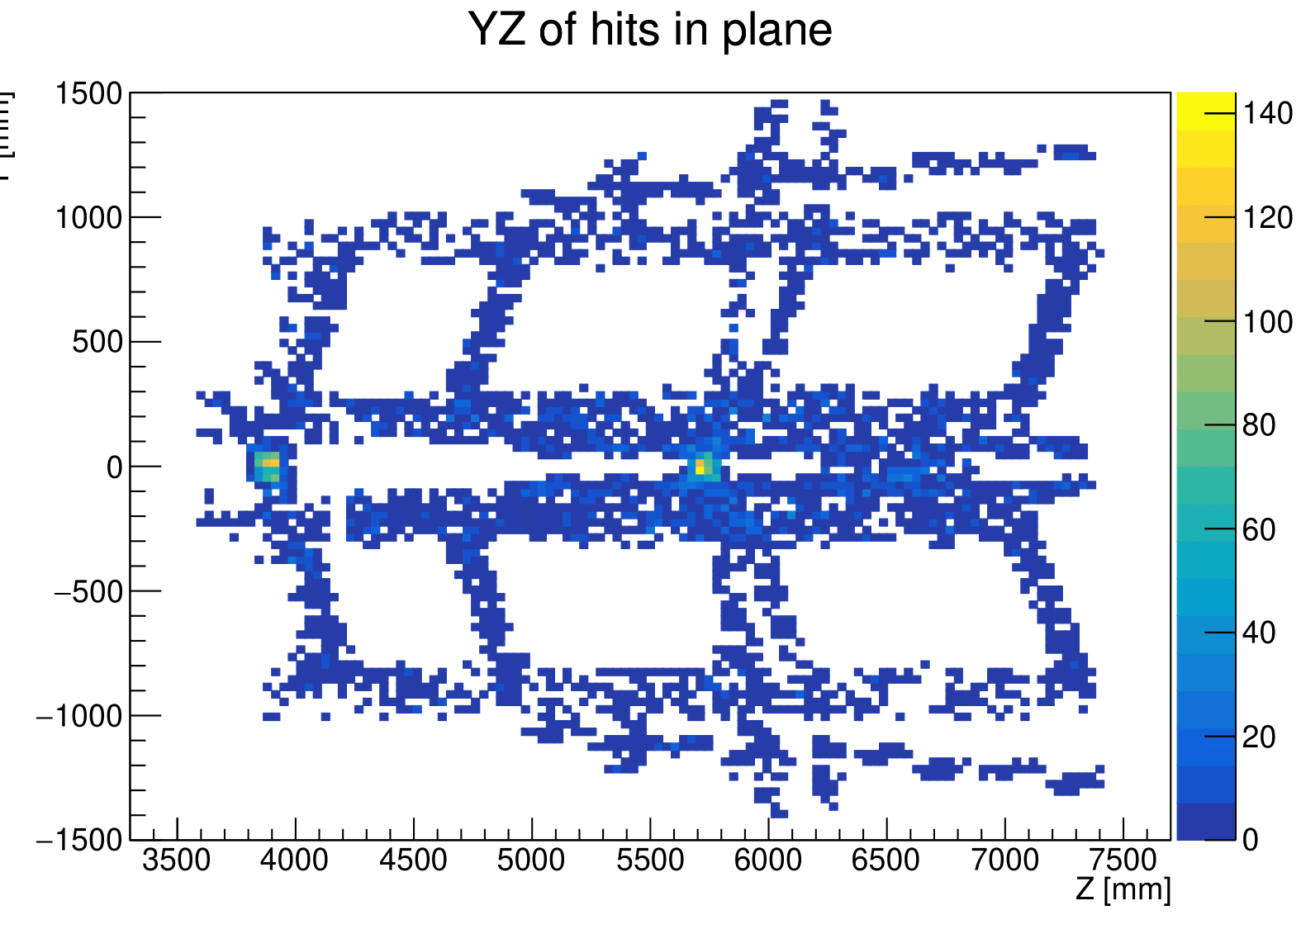
Support structures and CAD model import
NEW CAD based detector geometry
Old crude detector
geometry
Magnet station support structure imported from CAD model
  Mesh conversion and GDML export
Exact placement of structures for optimization of MS panel placement
Revealed slight issues with panels at large z compared to crude geometry
  Fixed by optimized placement
Geant 4 hit distribution in imported support structures
Nicolas Schmidt

Slide 9
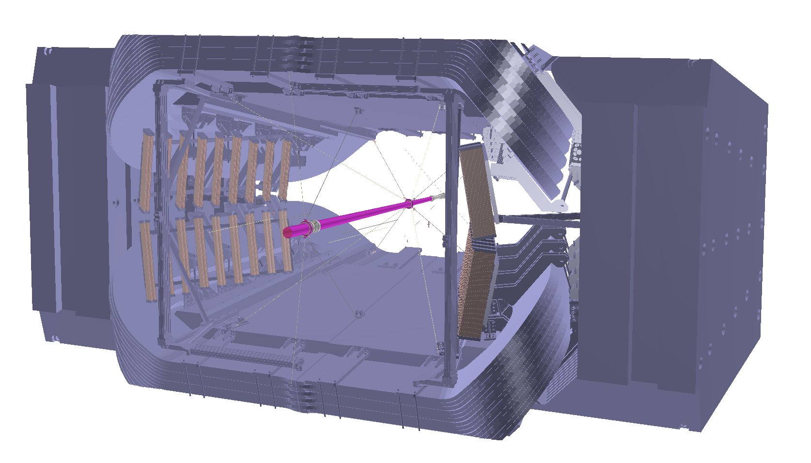
Summary of geometry changes
Optimized clearance of support structures
Small tilt of 8.6 degrees of stations (less than initial version)
Modules:
9 Modules
  30cm wide
  30cm spaced
  0.95m tall first module (larger modules at larger z)
Approximately 64k channels
Main support structures added to Geant4 model
Based on CAD file
Perfect placement of structures
y-gap between stations increased from 10cm to 20cm
Reduction of coverage in high activity region
dd4hep code here: [click me]
Nicolas Schmidt

Slide 10
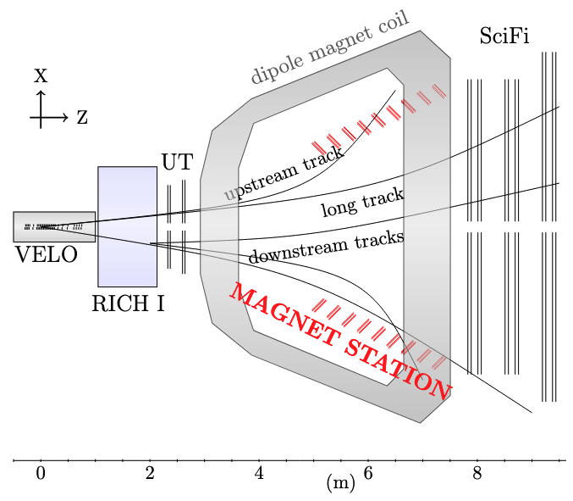
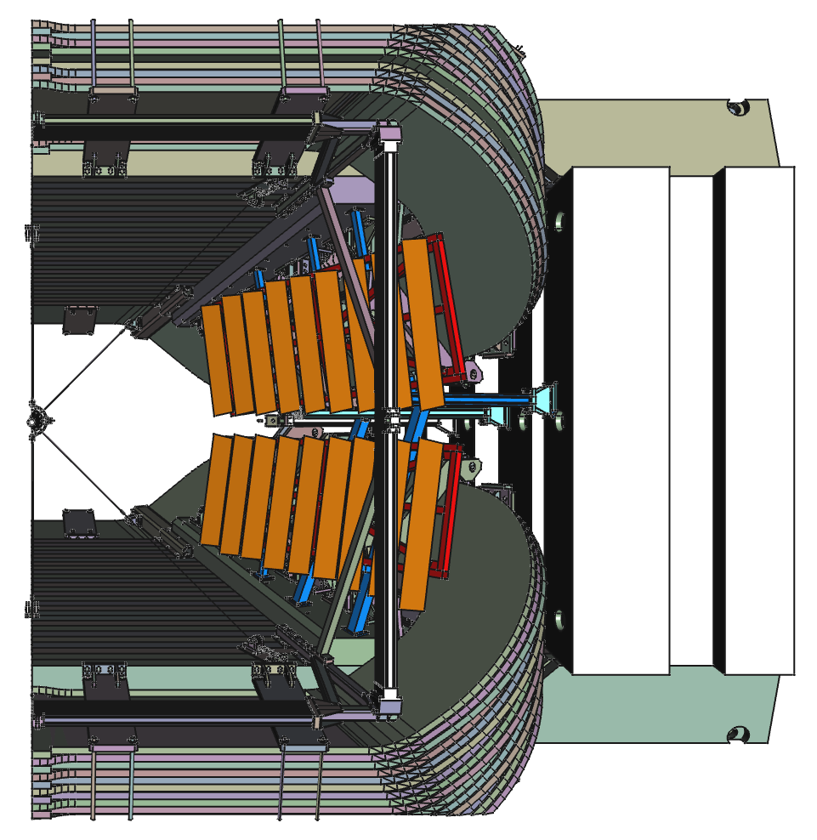
NEW CONFIGURATION
optimized position and angle of MS stations for tracking and occupancy. MS modules are more projective to the collision point.
36 modules fit between the long track acceptance and magnet walls.
covering only the middle to upstream of the magnet without significant physics loss
Smaller number of channels : 90K → 60K

Slide 11
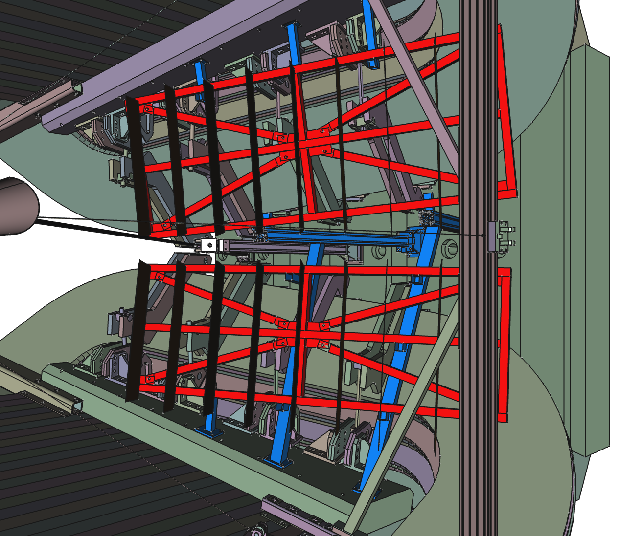
Thanks Lukasz Felkowski (PK/Poland) for providing a near complete support structure model !

Slide 12
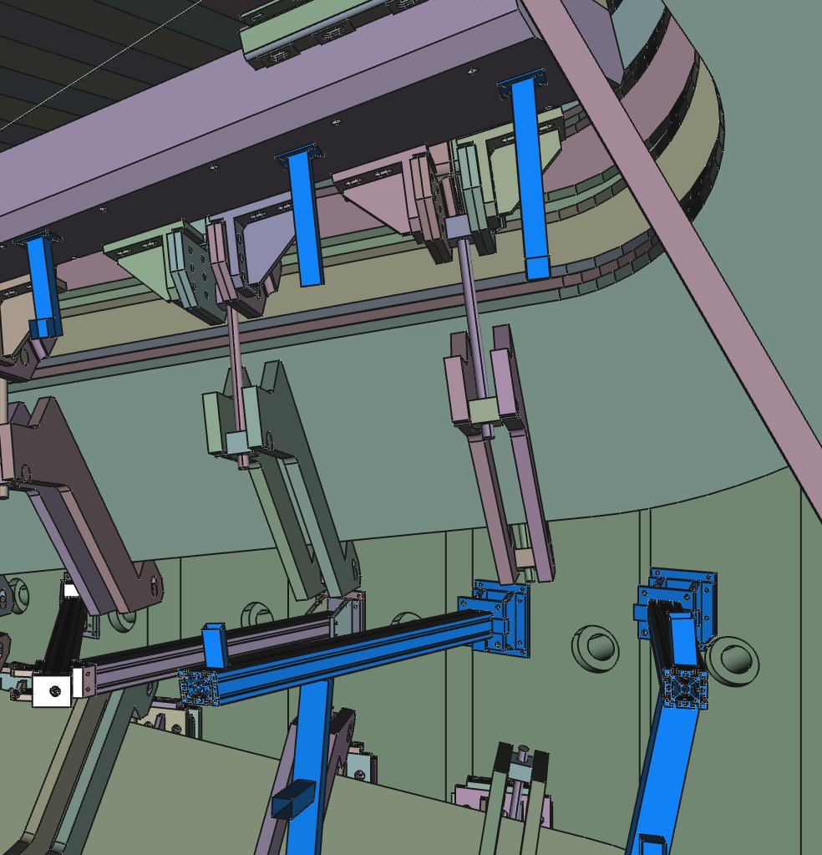
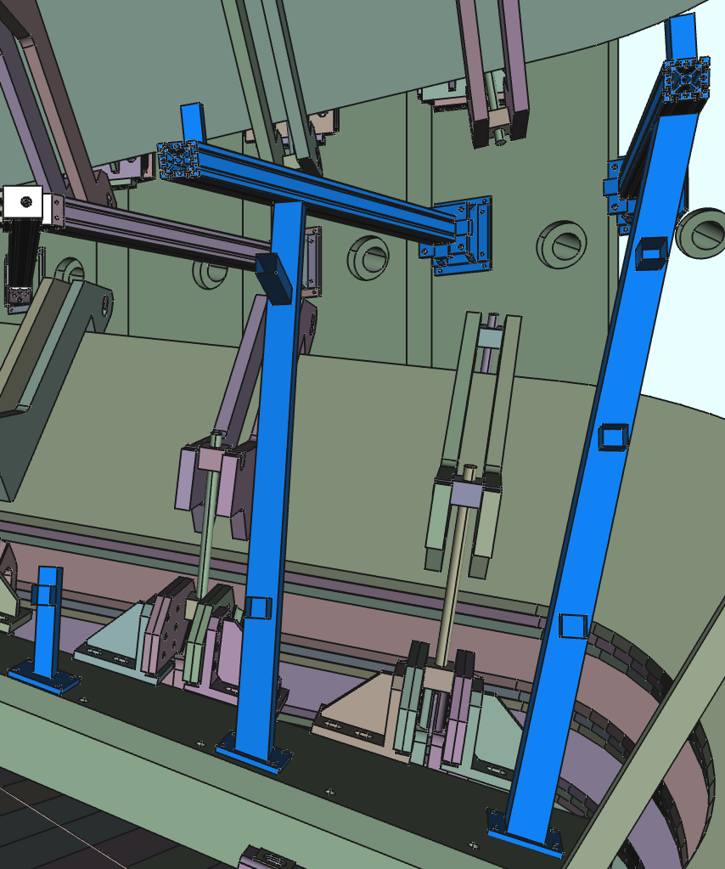
Mounts at the Magnet Wall
Łukas Felkowski

Slide 13
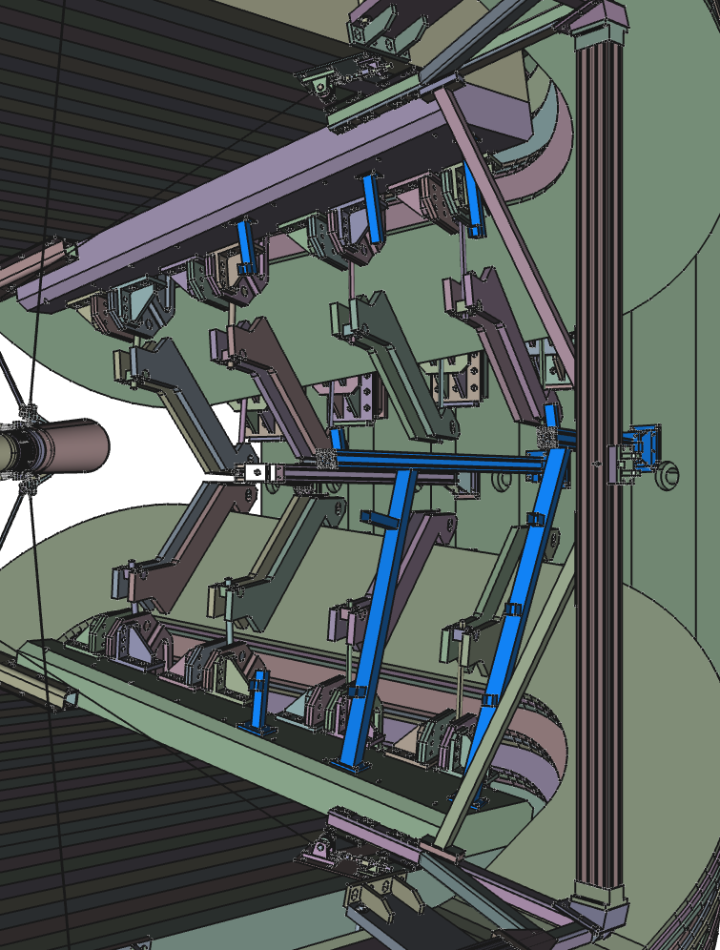
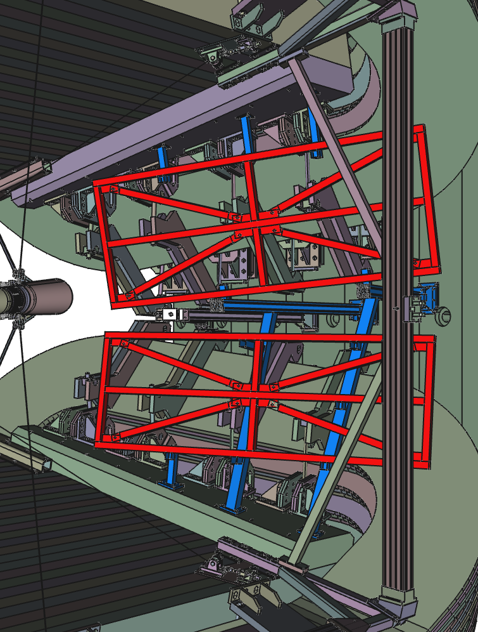
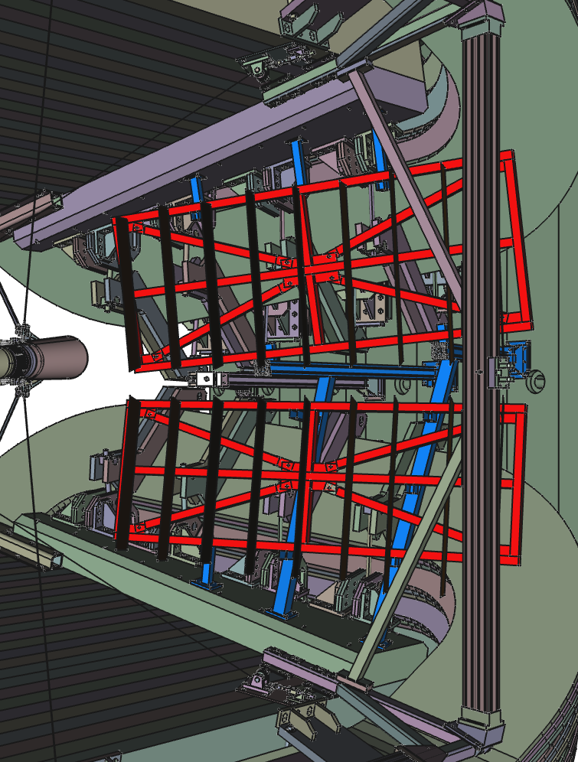
Assemble steps
Mounting to the magnet wall
Main frame
Modules mounting on the main frame
Łukas Felkowski

Slide 14
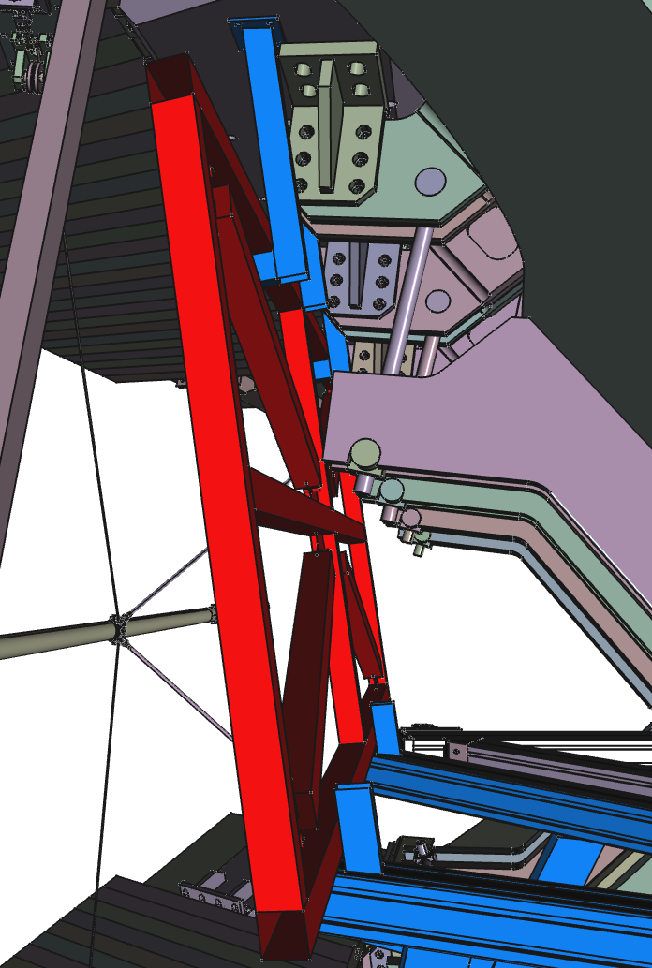
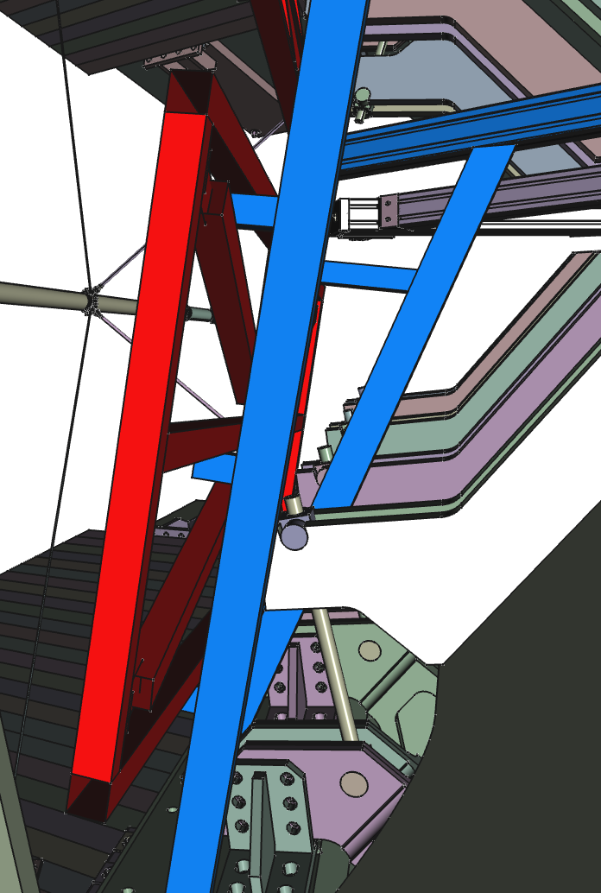
Main frame mounting
Łukas Felkowski

Slide 15
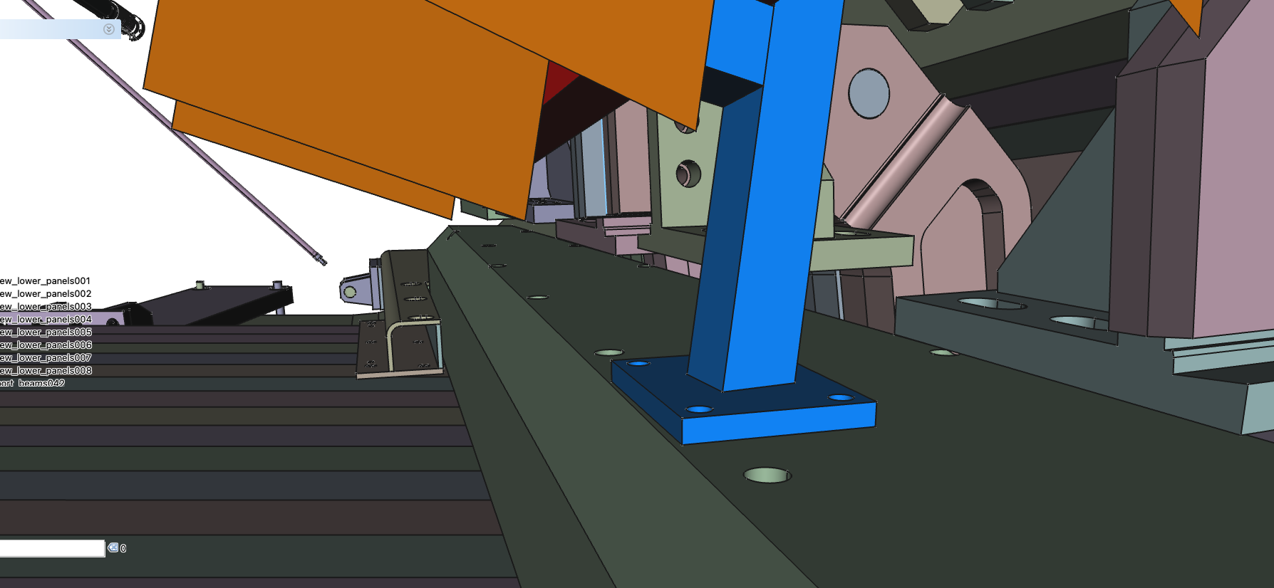
Suggestion for the clear fibers
Sketch of a gutter for the clear fiber bundles.

Slide 16
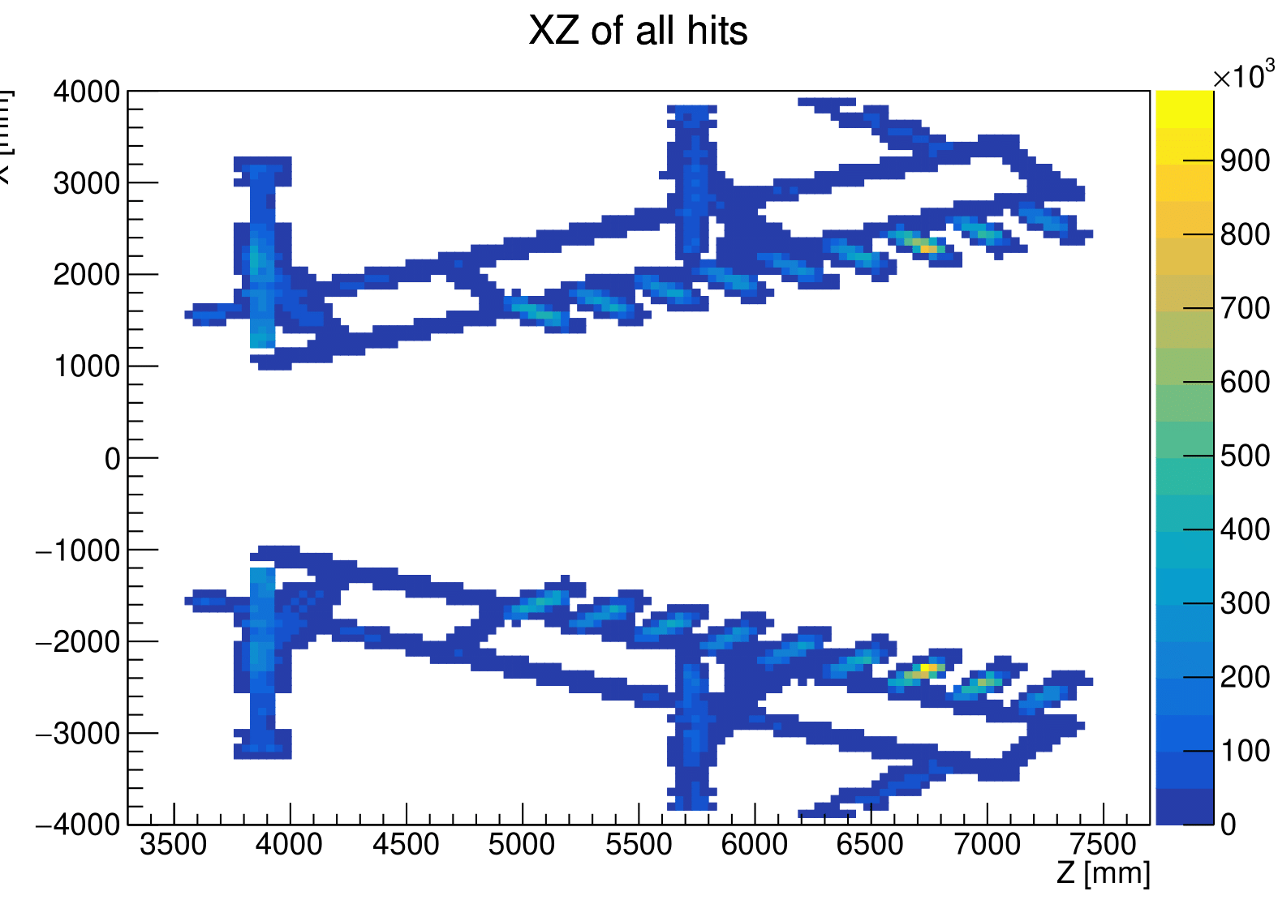
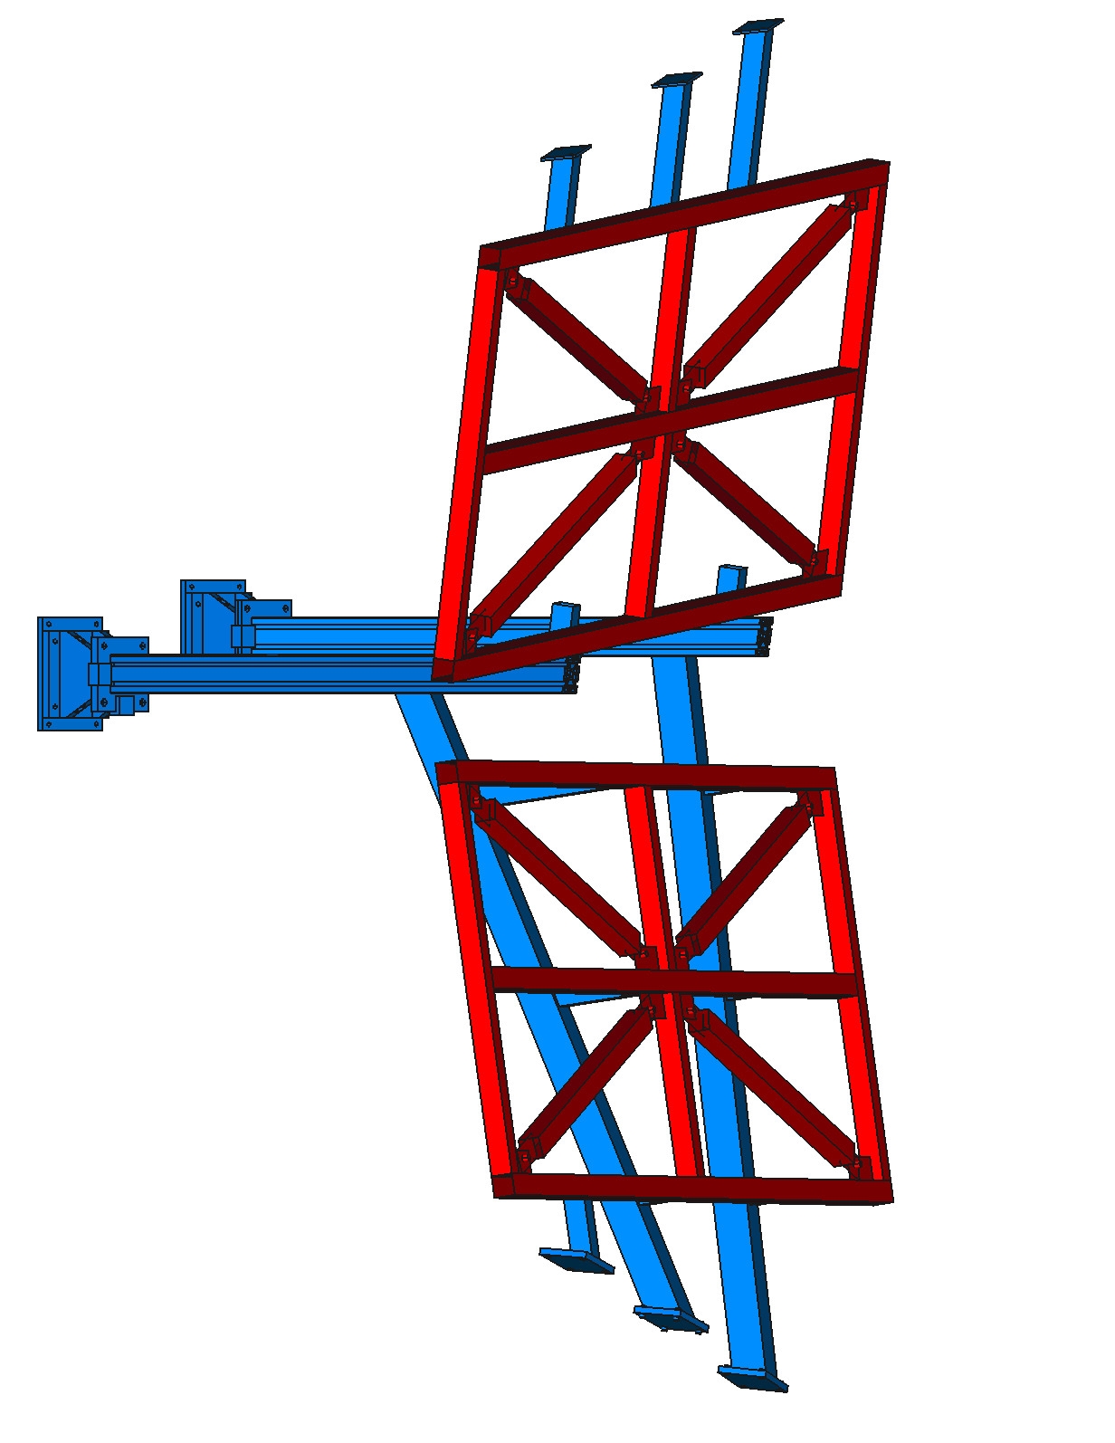
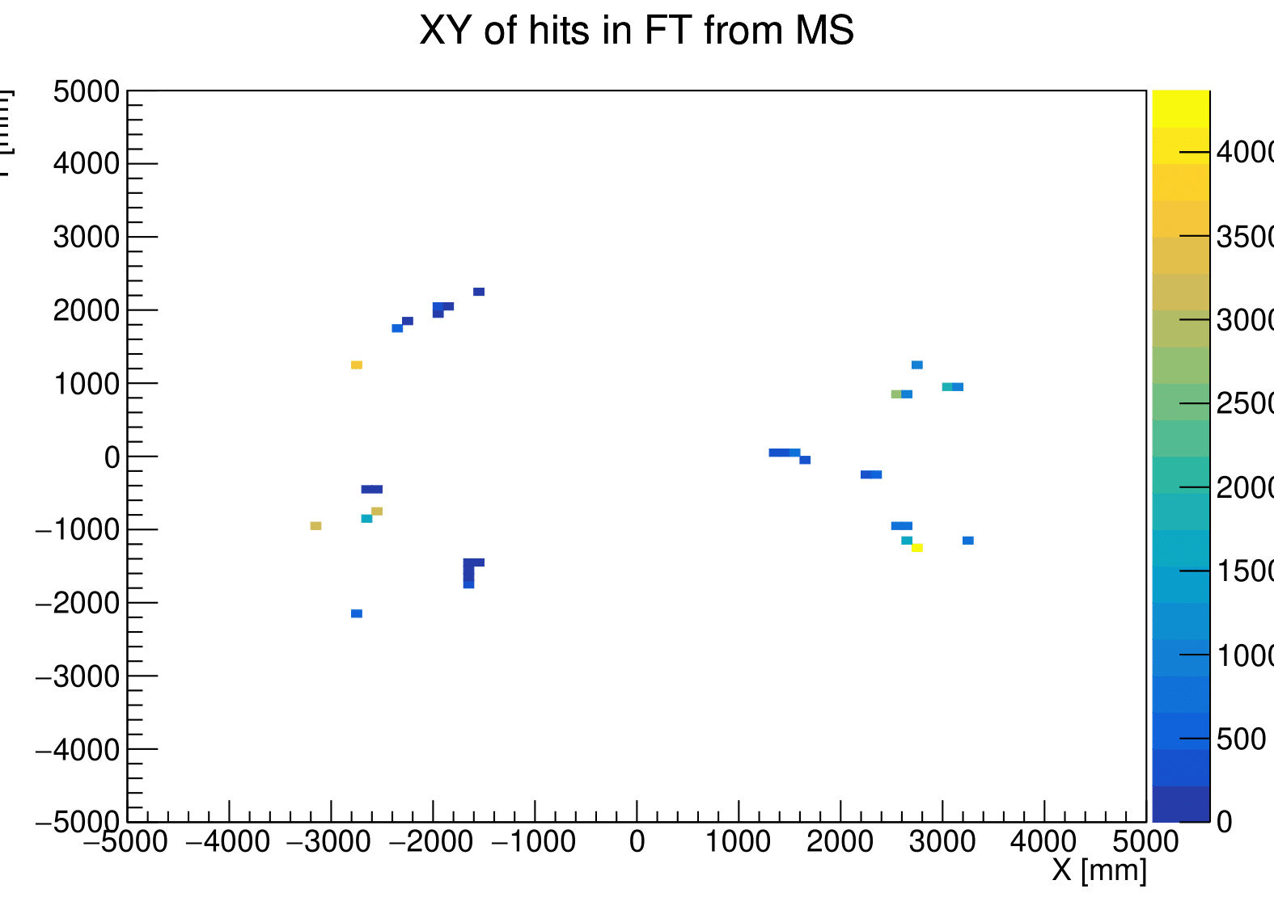
MS impact on SciFi
Nicolas Schmidt (LANL)
Particles traversing the active and passive material of MS can scatter or produce daughters within SciFi acceptance
Simulation studies performed
  Check if hits in SciFi came from particles that had interaction with MS or MS support (particle itself, or mother, or grandmother)
Studies based on old overengineered support structure
  New study to be performed once support for new geometry finalized
MS support structures with visible high interactions
Only 0.04% of SciFi hits trace back to MS!
Negligible effect on SciFi

Slide 17
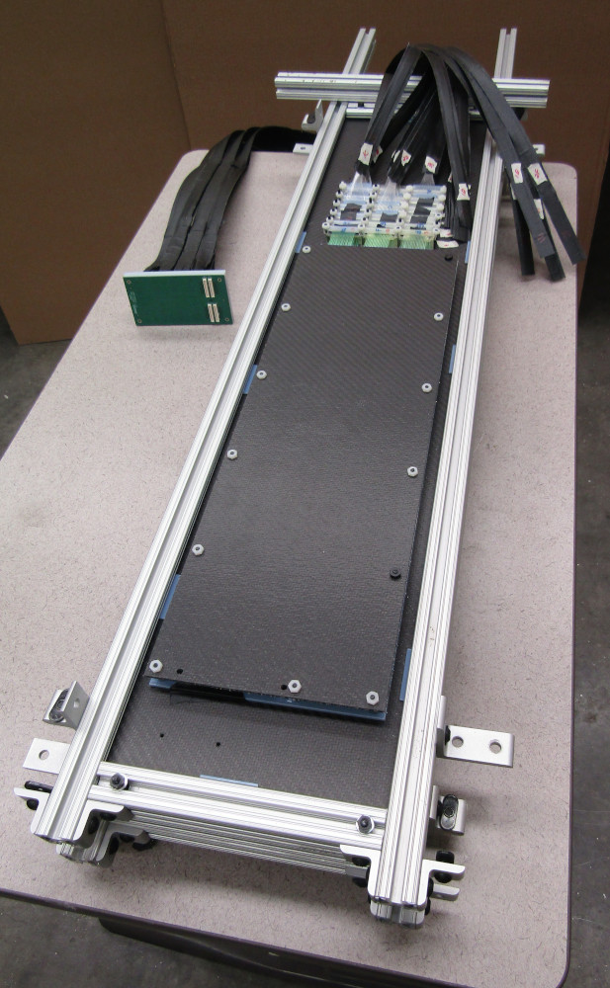
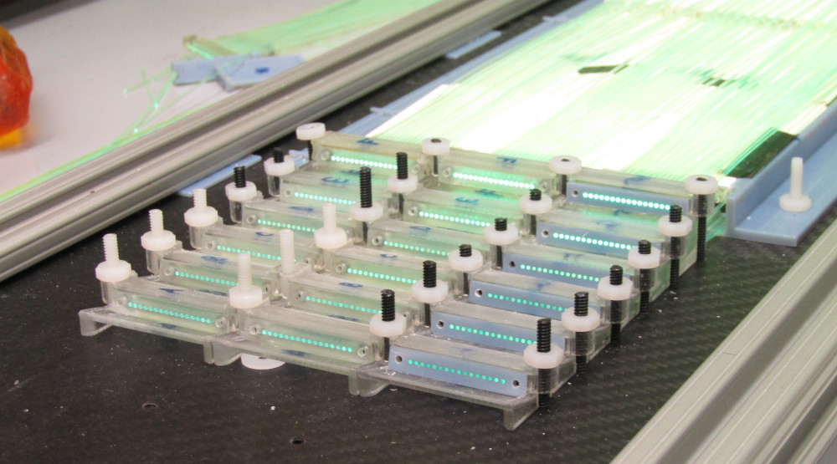
Module prototype.
Clear fibers ribbon
SiPM board
4-layers module prototype assembled with 1152 channels.
Identified a company in Albuquerque/NM(USA) for assembly of panels.
It will take btw. 6-9 months to produce all modules.

Slide 18
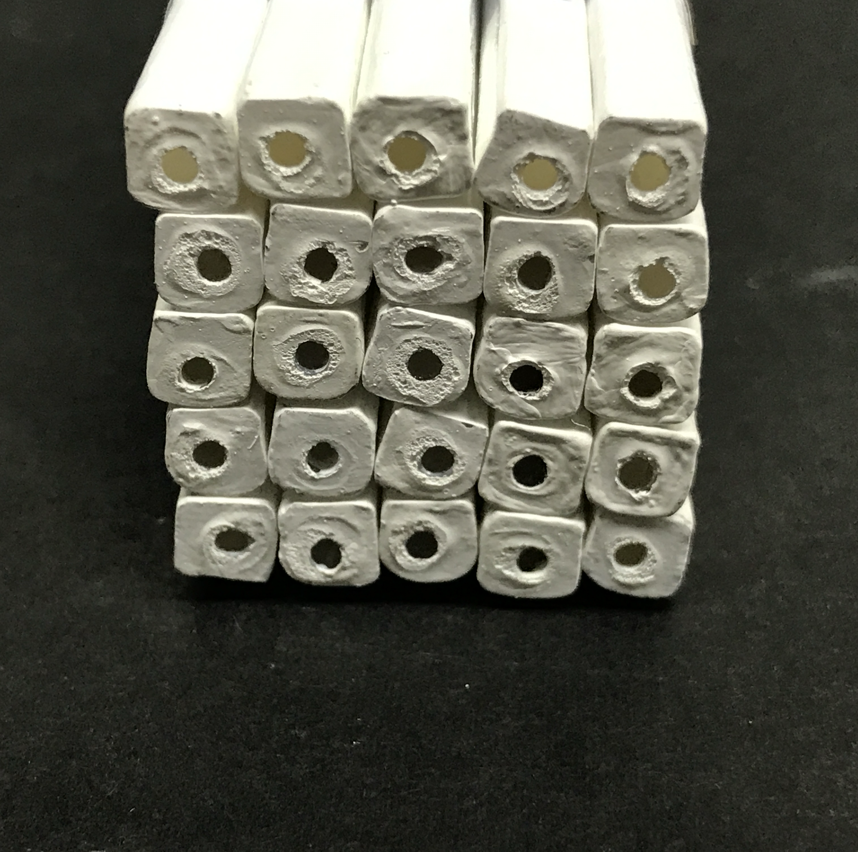
ISMA (Ukraine) finished the production of a batch of square bars for prototyping.
Still needs some work on edges of the bars

Slide 19
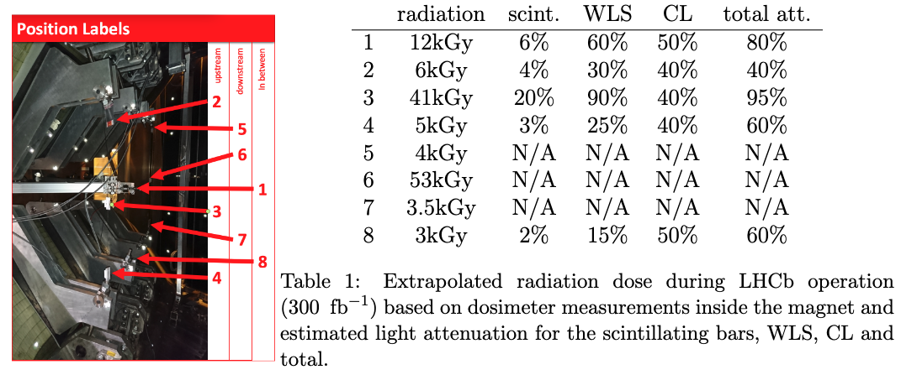
Radiation effects
Attenuation estimated from previous measurements from literature (see backup slides)
Conclusion:
  some of the light attenuation can, in principle, be handled by changing the gain in PACIFIC++
  however, at least the MS modules at the upstream side of the magnet may need to be replaced before the end of LHCb operation
  That will require the possibility to remove panels during short shutdowns

Slide 20
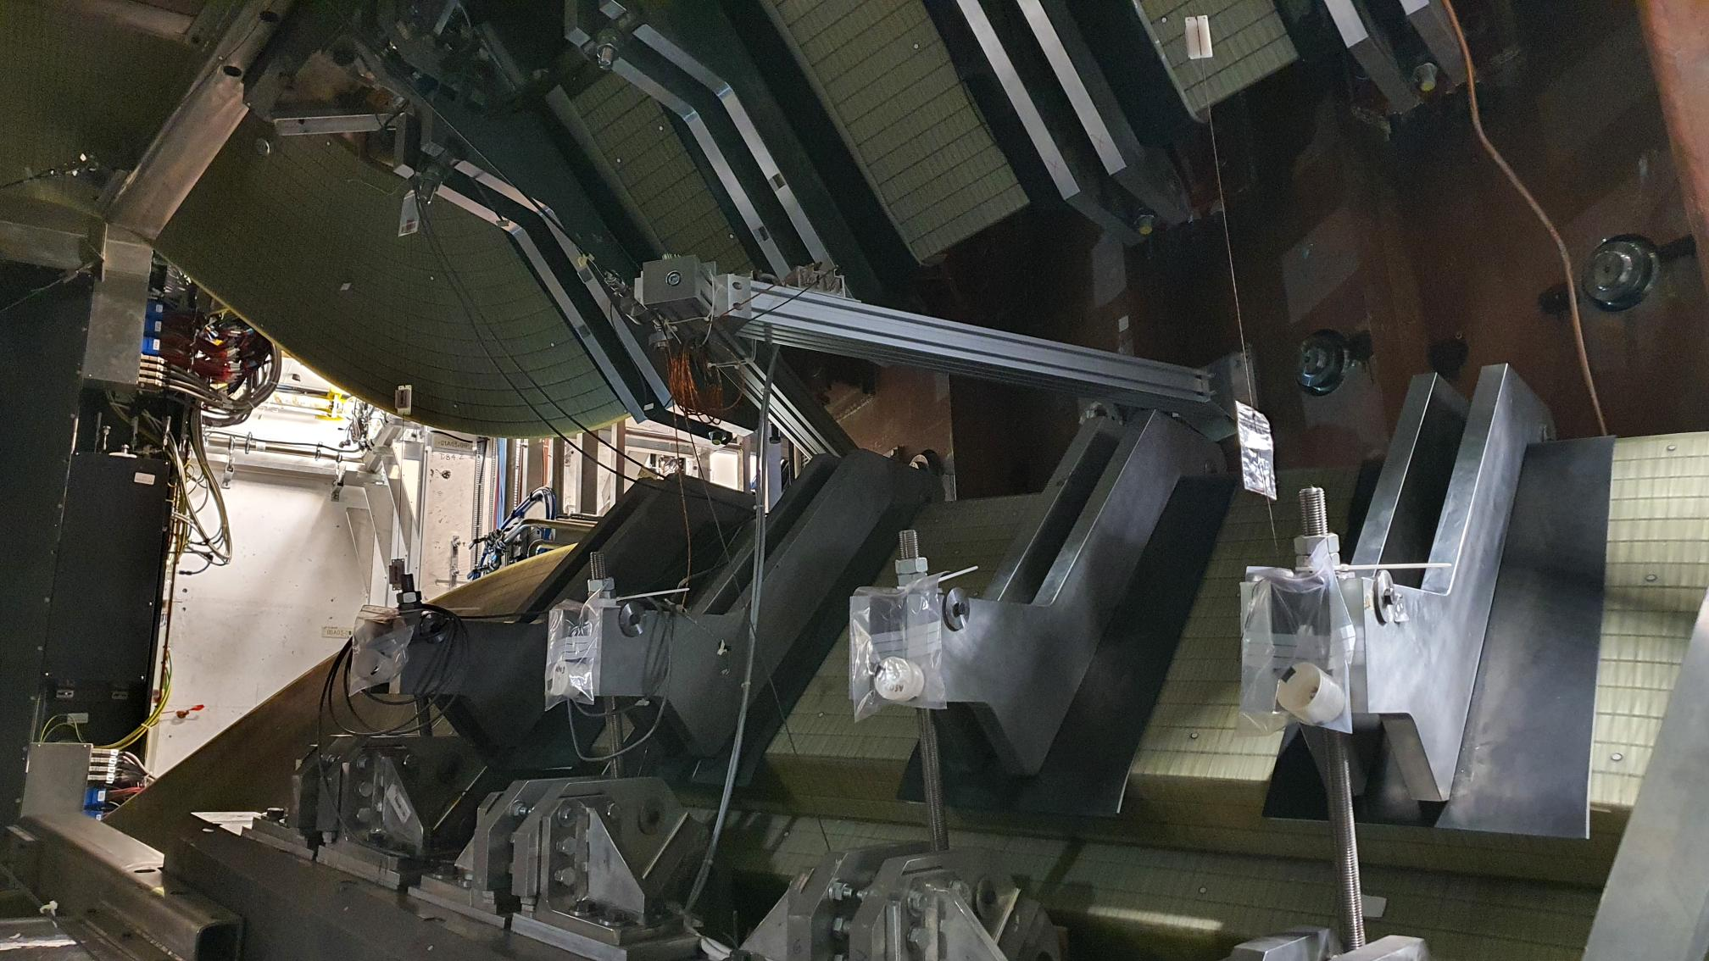
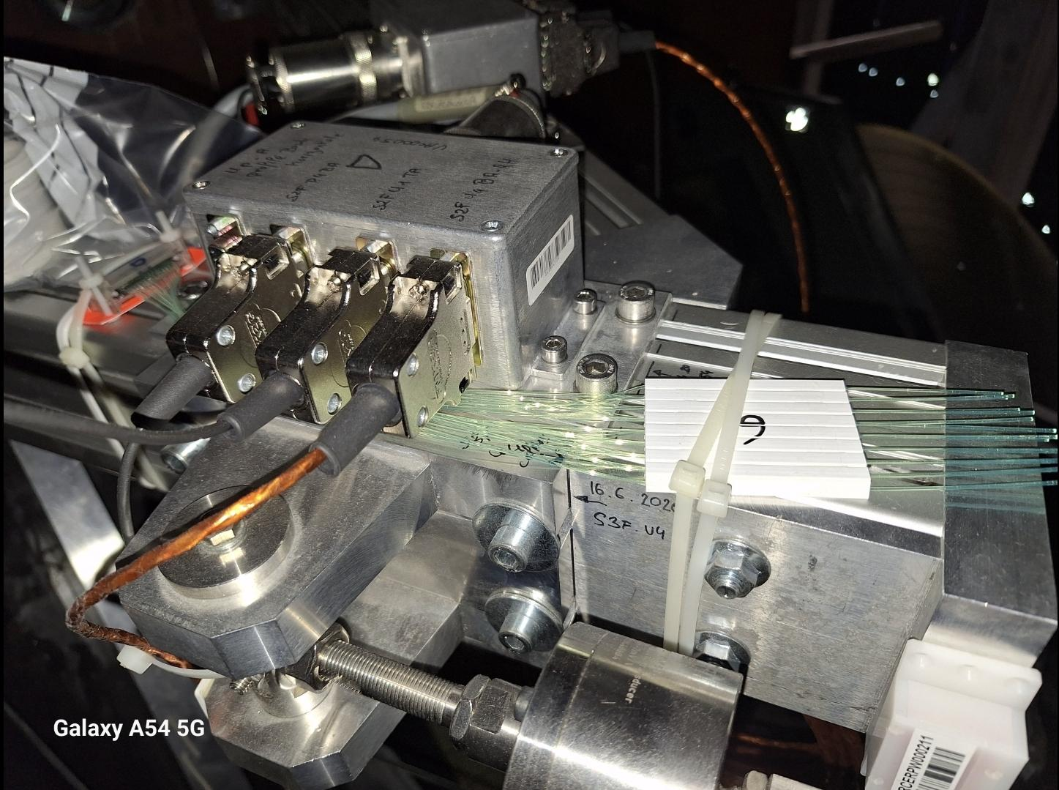
Matthias Karacson started the removal of fibers placed inside the magnet for radiation damage studies
Fibers were exposed to a delivered luminosity of 10.9 fb⁻¹ , compared to 300 fb⁻¹ expected for run4+run5
Light yield analysis of these fibers can provide a better estimation of their attenuation length
tunable

Slide 21
Electronics

Slide 22
PACIFIC++
Existing specification
Parameter | PACIFIC | PACIFIC++
Technology | 130 nm | 65 nm
Number of channels | 64 | 64
Power consumption | 0.5W | <1W
Channel input | single-ended, DC coupled | single-ended, DC coupled
Signal polarity | positive | positive
Gain | 4 different gains | 4 different gains (MS?)
Sensor bias | adjustable | not needed
Shaping | tunable tail cancellation | tunable tail cancellation
ADC | multi-threshold (3) | 10 bit ADC(*)
TDC | none | 0.39 ns, 6 bit
DSP | none | basic operations+clusters?
IO/ interface | 16 SLVS 320MHz serialisers | <4 x eLink@1.28 Gbit/s
Slow control / TFC | I2C / FPGA | I2C / eLink
*10-bit ADC only for baseline, between 1-4 bits for standard operation
Marek Idzik

Slide 23
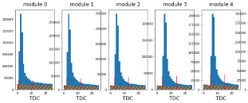
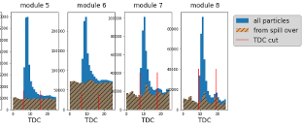
PACIFIC++ (& PACIFIC+8)
Recent specification agrements
Nr channels (PACIFIC+8) | ~8 (one with ADC&TDC only)
Channel pitch | 120um
Analog front-end | Voltage comparator after fast shaper
ADC std operation | ADC converts only when comparator fires (maybe configurable since CM can not be removed). If comp. does not drop below Vth within Tclk, subsequent ADC conversion
ADC in raw mode | ADC conversion @each Tclk
**e-links | 4 x 1.28 Gb/s lpGBT problem(max7)!!!
Clustering | For SciFi it’s a must, for MS an earlier prototype w/o possible
Design prod.-ready | ~2028 for MS, ~2029 for SciFi
Deadtime in BX period | ~5ns (20ns should be enough for signal processing)
TDC info* | ToA of 1st particle enough for SciFi ToA of 1st , 2nd, and if possible 3rd particle for MS

Slide 24
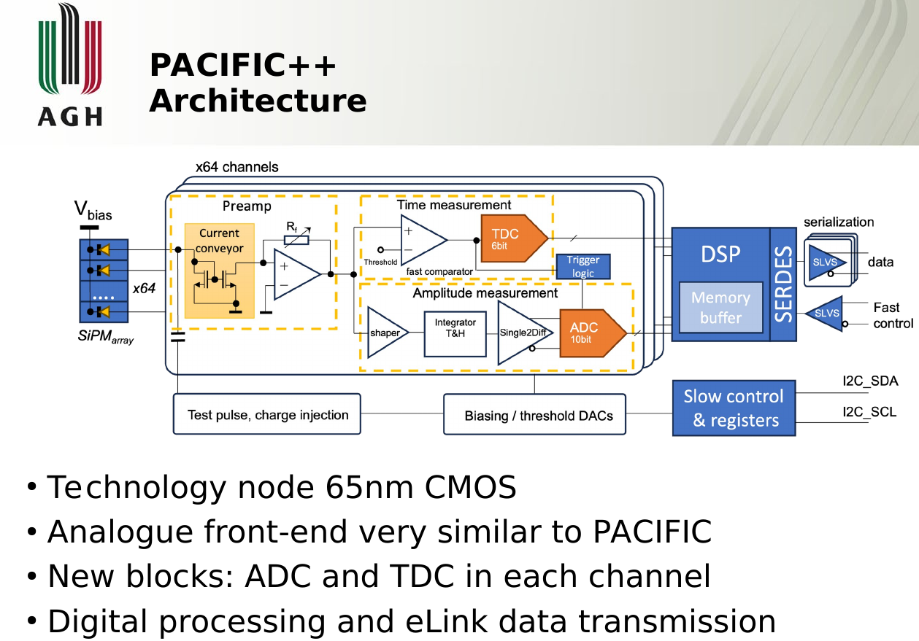
For Magnet Station :
3 to 4-bit ADC
6-bit TDC (390 ps)
No need of clusterization
SciFi requires it
Can develop an ASIC version for MS (Run4) without clusters and another version for SciFi (run5)
Estimated streaming per 64-channels chip and 2% occupancy :
>=1.25 Gb/s (still needs to evaluate occupancies )
Plans to have a version of the PACIFIC++ without clustering available by 2028 for LS3 installation.
3/26/25
24

Slide 25
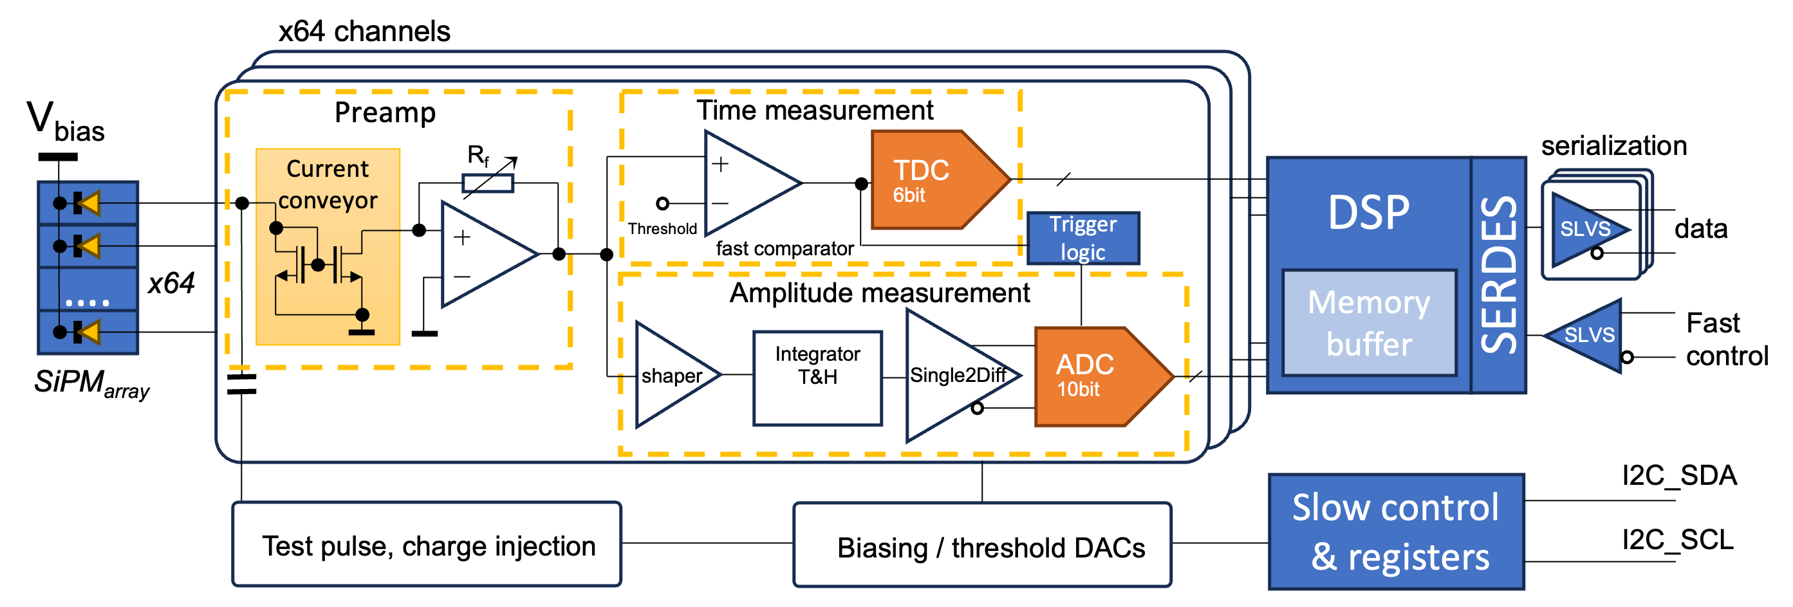
PACIFIC++
Task sharing and Schedule
Task sharing
  Barcelona group responsible for analogue front-end
  AGH responsible for “right” part (ADC, TDC, DSP) & integration
  Other groups may join the design of dedicated blocks (Costa Rica interested in verification and not only...)
Current schedule
  1st 8-channel prototype – PACIFIC+8 - with key functionalities ready for submission by end of May 2025
  Test-setup to be prepared at AGH, details to be discussed...
  2nd prototype – the full scale 64-channel chip – design in 2025-2026, time for ~2 submissions/iterations and production up to ~2028 (MS) and ~2029 (SciFi)
  When clustering should be added ?
  We are considering to move to DigitalOnTop design methodology (online course at CERN end of March)

Slide 26

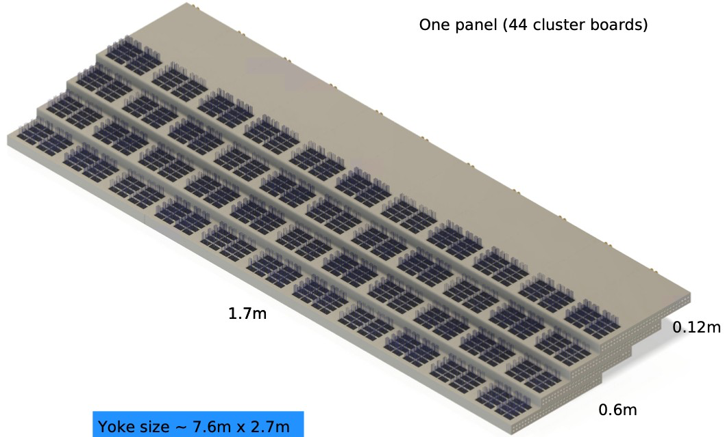
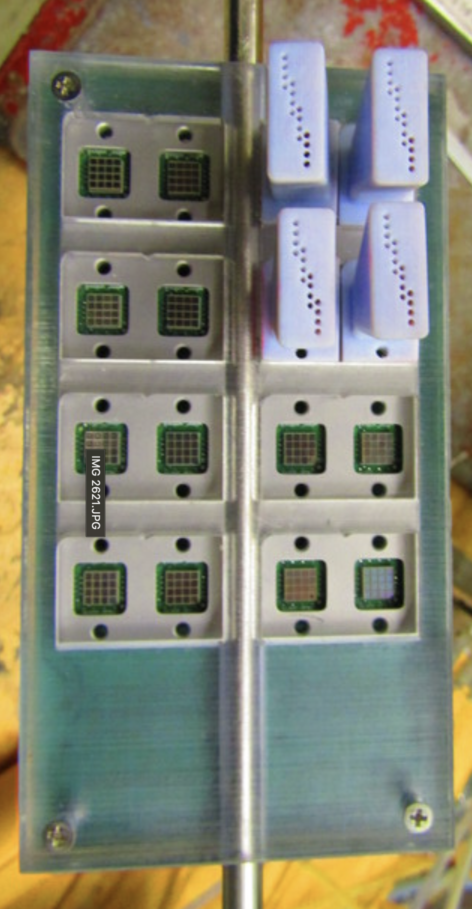
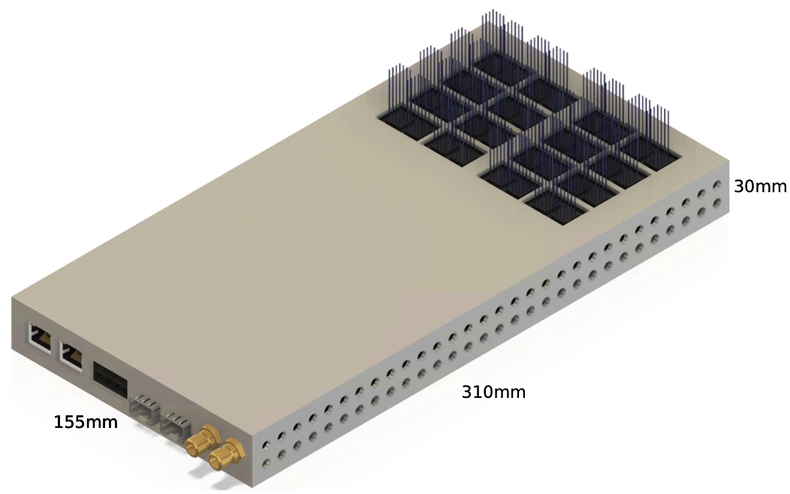
SiPM + electronics racks
SiPM board
Rack for an entire station (quadrant).
SiPM + PACIFIC++ board
Jakub Moron (AGH)

Slide 27
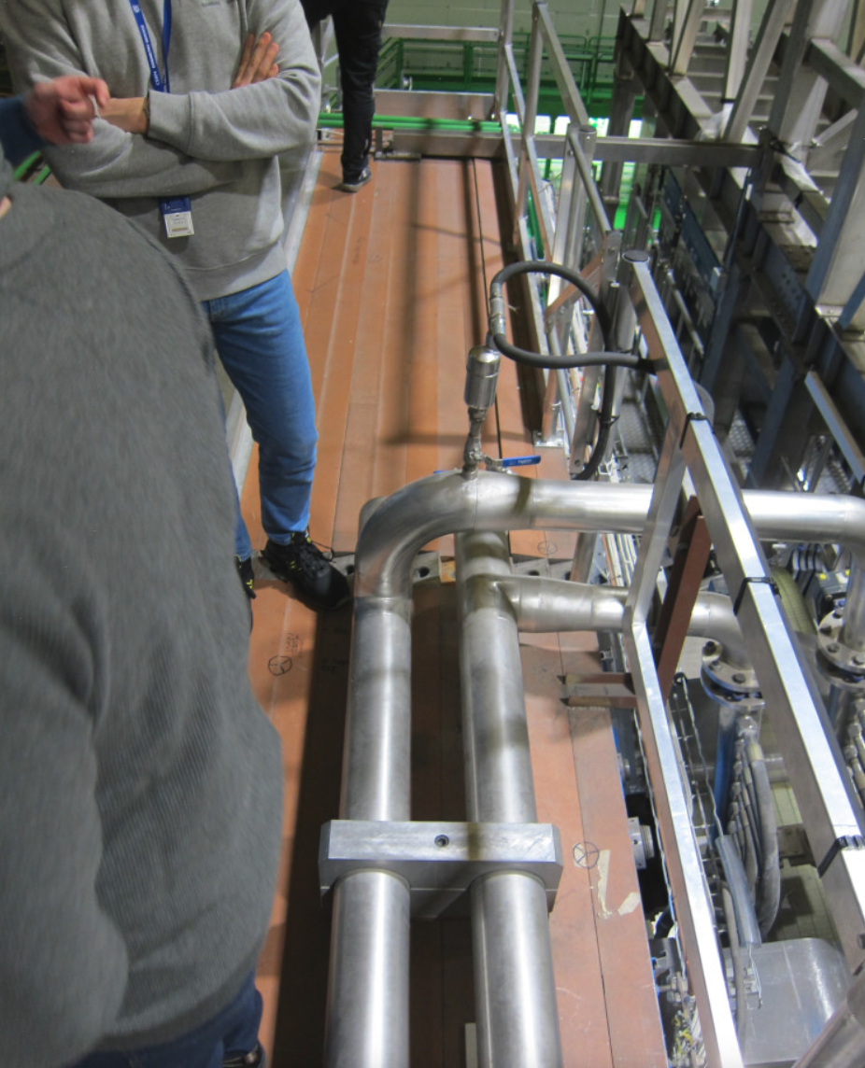
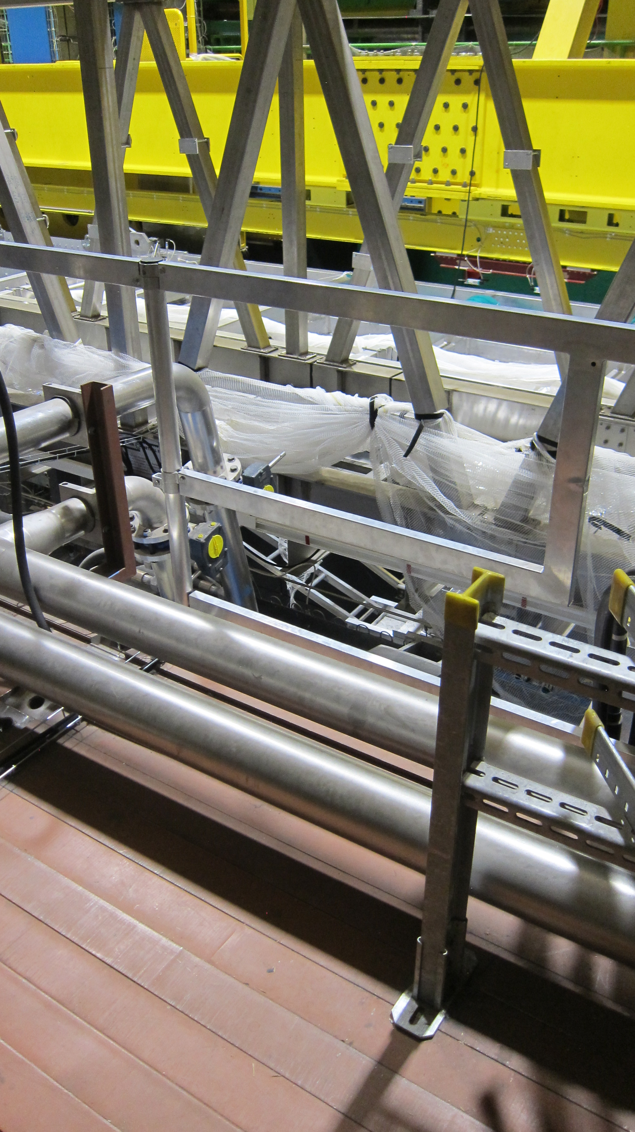
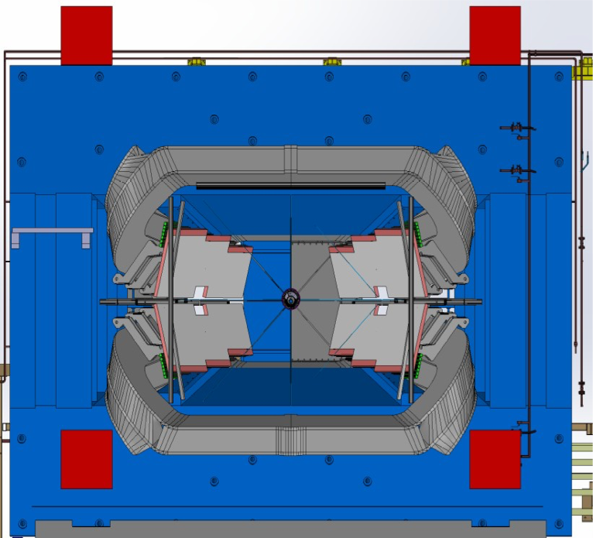
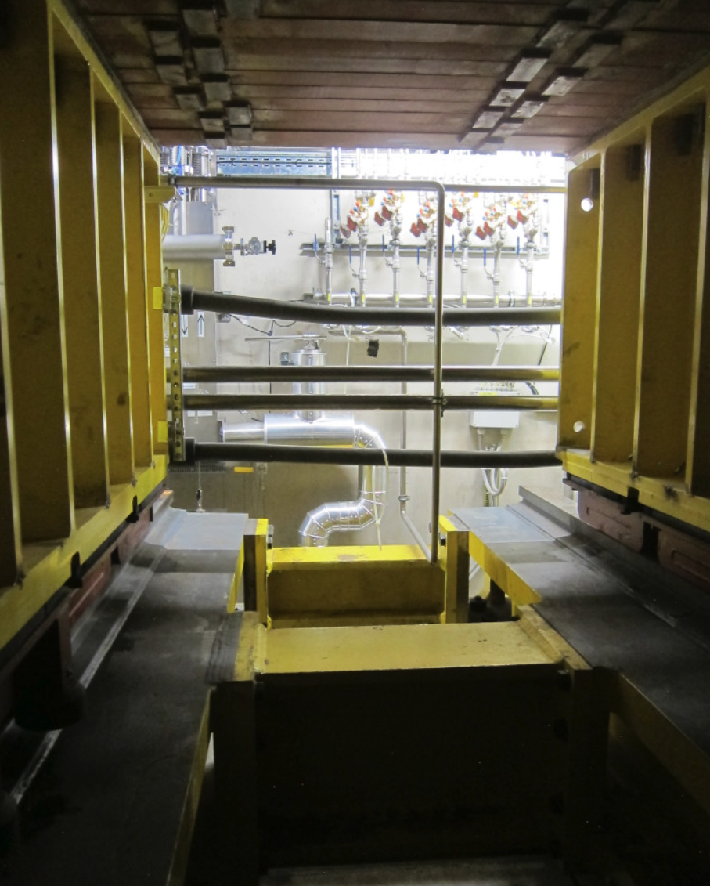
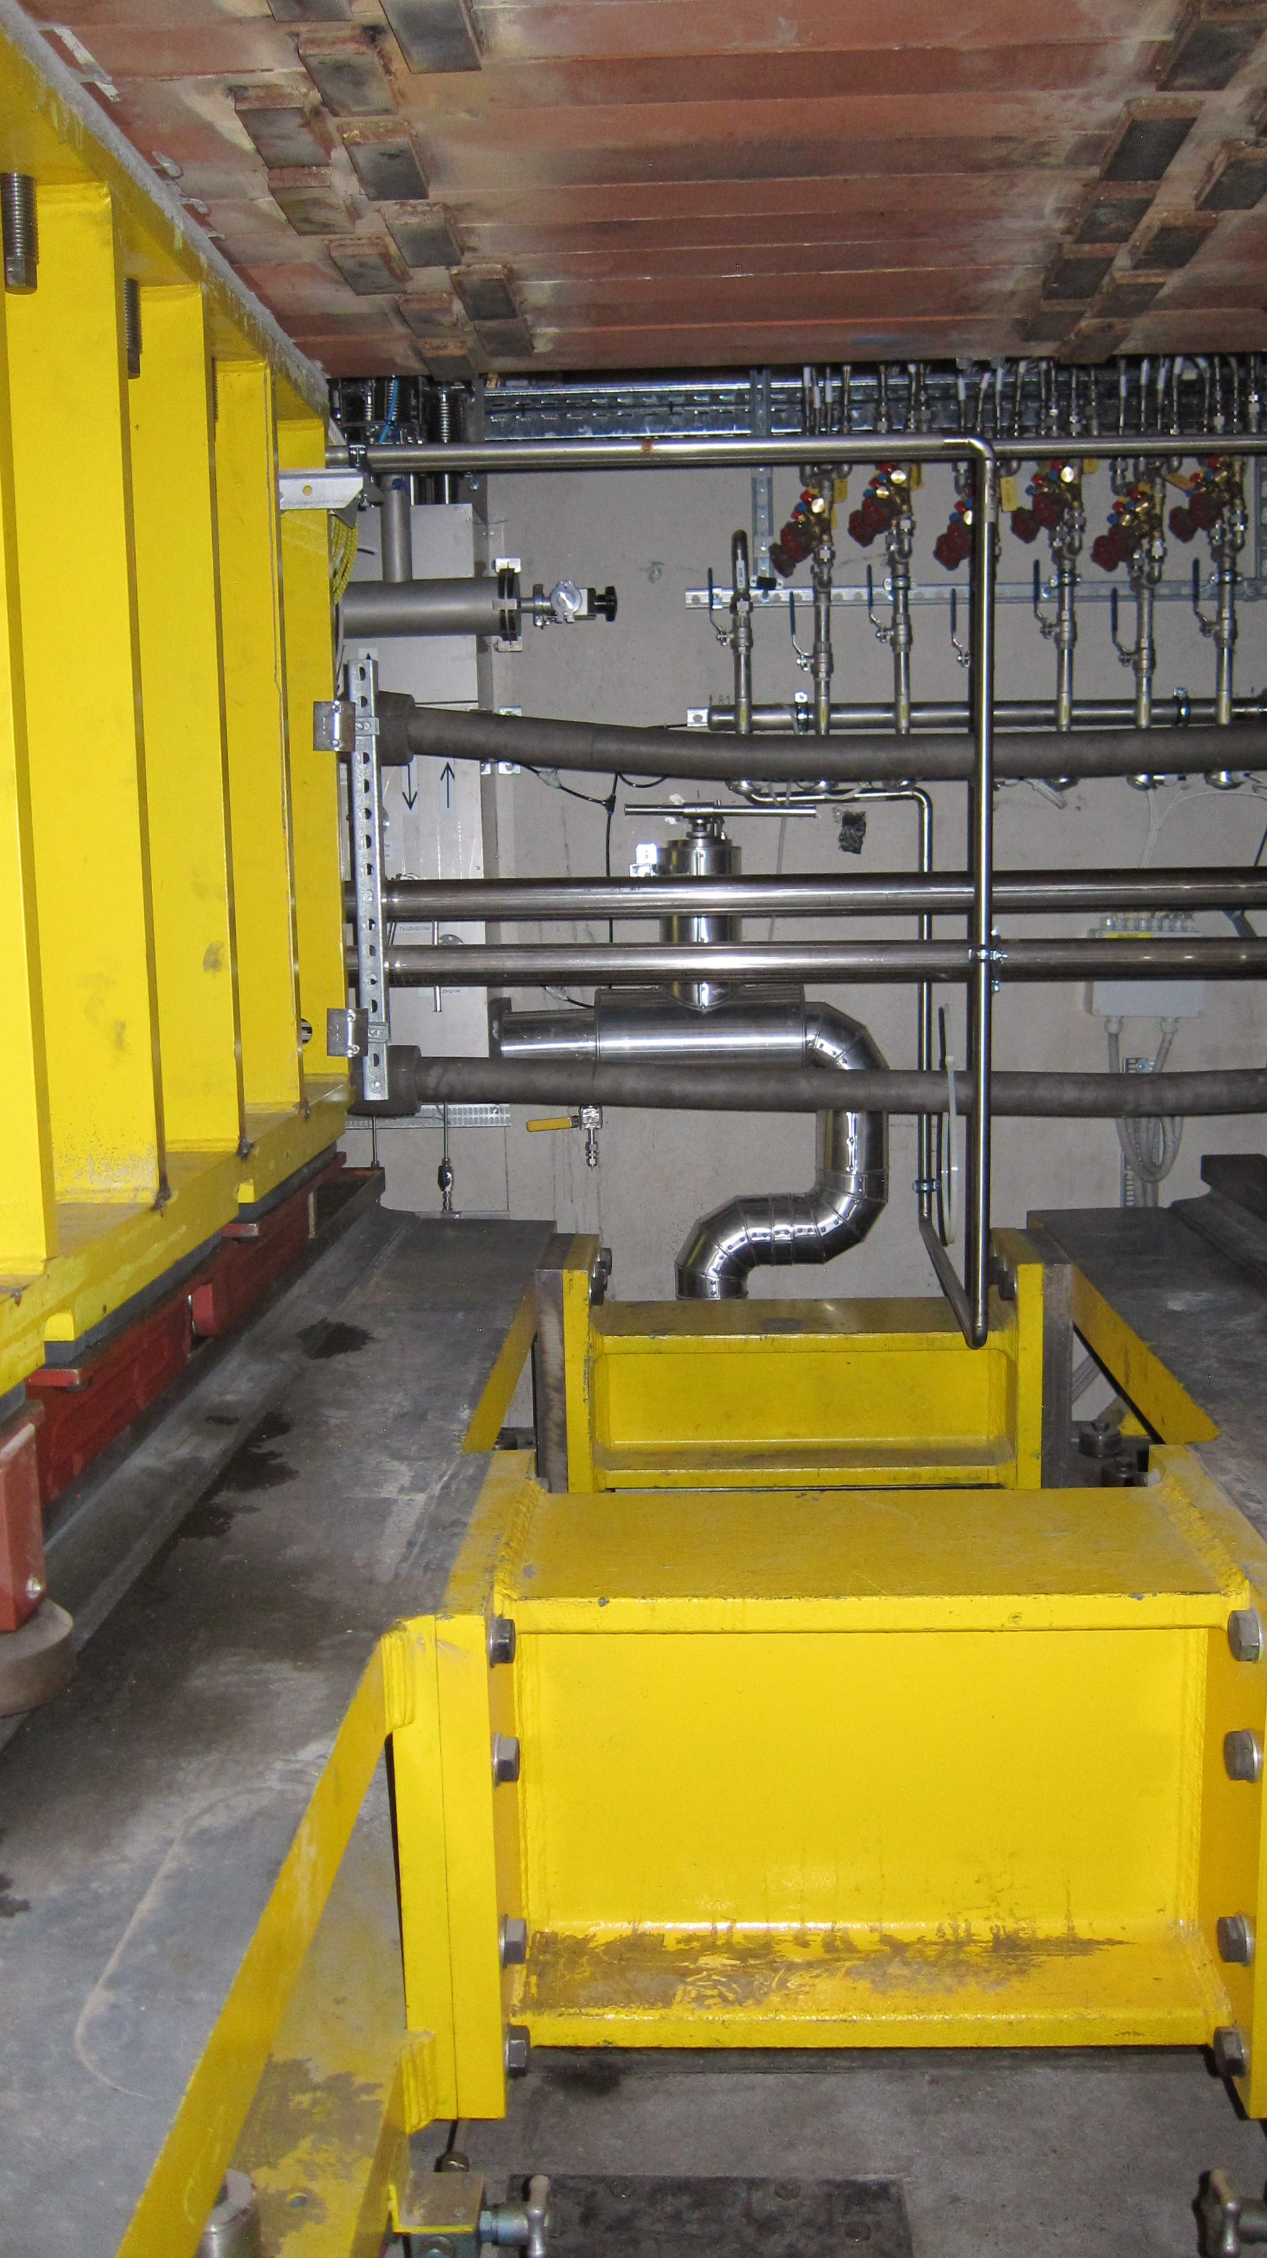
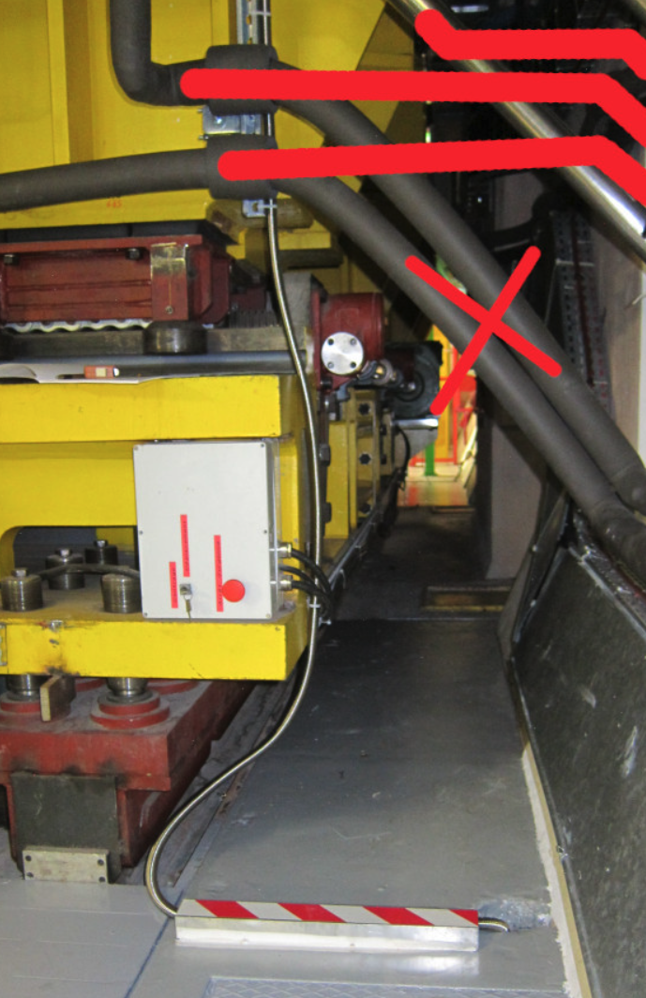
Needs to move some pipes.
Difficult access to the bottom of the magnet.
Can some pipes be rerouted ?
Needs a fake floor and few step stairs
Needs a fake floor and few step stairs

Slide 28

Cooling Needs
Needs regular water to cool
  1000 PACIFIC++ chips, < 1W each
  ~ 30 lpGBTs, 800 mW
keep SiPMs with temperature < 5C. Initially assumed 5C water was enough, however two factor made us changed our minds
  Difficult access to cold water at LHCb, we would be the first to use it
  Additional neutron flux from ECAL’s tungsten has a potential to damage SiPMs at the top and bottom of the magnet
Novek is easily accessible and can bring SiPM temperatures to < -10C
MS modules would need dry nitrogen flow to deal with condensation
SiPM + PACIFIC++ board
1 MeV neutron fluence in U2

Slide 29
LS3 suggested installation procedure
Magnet Station is still a Upgrade2 project, but LS3 will have a chance to advance LS4 efforts. Large part of the Magnet Station installation can be performed in LS3
  Support structure installation : frames and gutters
  Access to MS SiPM+electronics rack locations
  Access to cooling (Novek), power supply and data fibers
Stretch efforts if PACIFIC++ is available:
  Slide in at least some of the MS panels+fibers
  install SiPM+PACIFIC boards on the racks
  Incremental installation during YETS after LS3 if necessary

Slide 30


Slide 31
Backup

Slide 32

PACIFIC+8
Layout&Padring
For PACIFIC+8 the layout/padring will be based on existing 8-channel ADC ASIC in CMOS 65nm, designed&fabricated in the past by AGH.
Layout of existing 8-channel ADC
Size: 1.85 x 1.83 mm²

