Slide 1










Tracking performance:
Downstream and upstream
LHCb Upgrade II Workshop
Xuhao Yuan
IHEP, China
2025-03-28

Slide 2
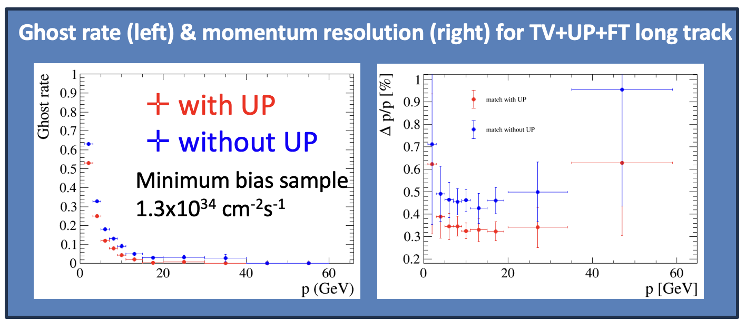
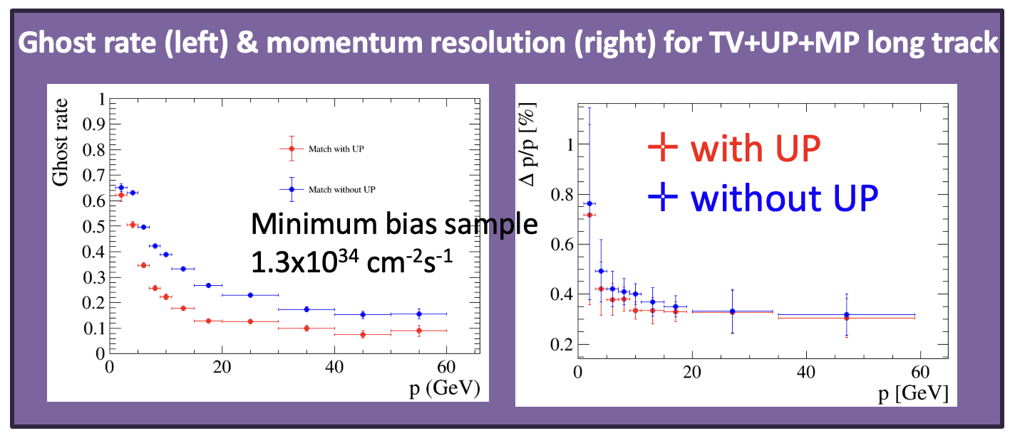
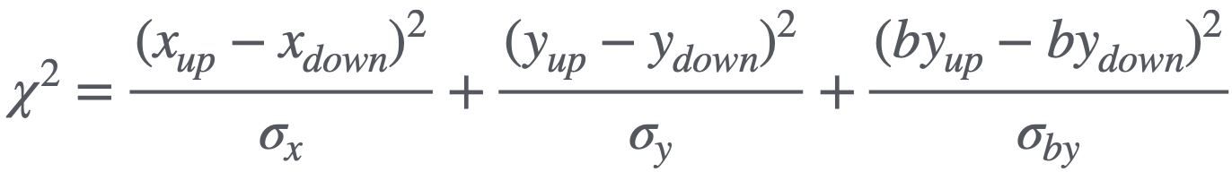
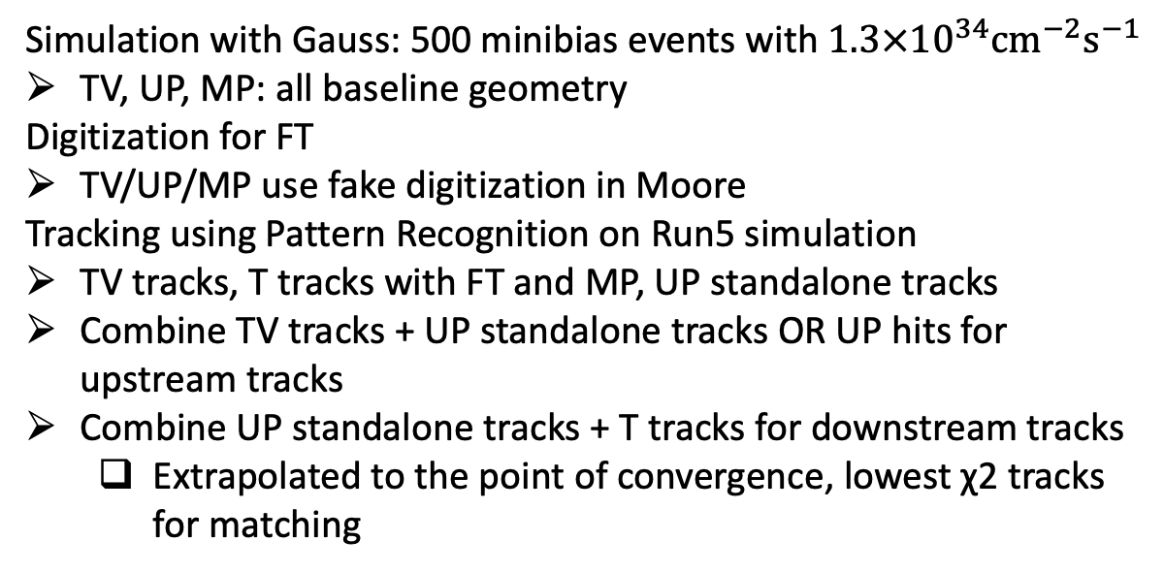
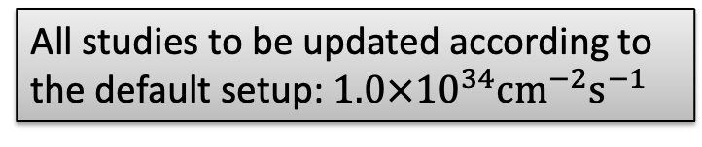
Downstream/upstream tracks at LHCb
All studies to be updated according to the default setup: $1.0×{10}^{34}{cm}^{−2}s^{−1}$
Simulation with Gauss: 500 minibias events with $1.3×{10}^{34}{cm}^{−2}s^{−1}$
TV, UP, MP: all baseline geometry
Digitization for FT
TV/UP/MP use fake digitization in Moore
Tracking using Pattern Recognition on Run5 simulation
TV tracks, T tracks with FT and MP, UP standalone tracks
Combine TV tracks + UP standalone tracks OR UP hits for upstream tracks
Combine UP standalone tracks + T tracks for downstream tracks
  Extrapolated to the point of convergence, lowest χ2 tracks for matching
Only pp collisions focused in this talk
More details on Benjamin Audurier’s talk https://indico.cern.ch/event/1342873/
Focus on UP functions in LHCb upgrade II tracking system
Sensitivity for UP acceptance …
Plots from Mingjie Feng @ RTA: WP2-6 U2, 17Dec2024

Slide 3
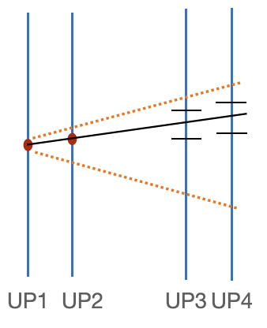
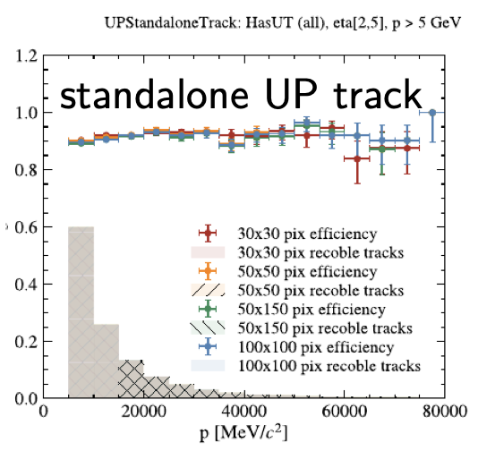
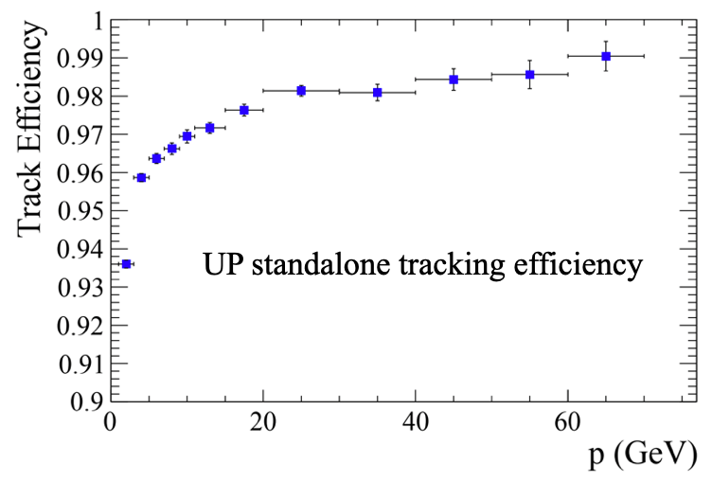
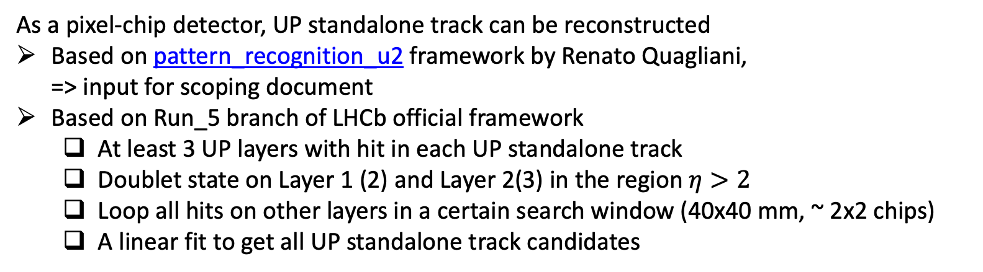
UP standalone track
As a pixel-chip detector, UP standalone track can be reconstructed
Based on pattern_recognition_u2 framework by Renato Quagliani,
=> input for scoping document
Based on Run_5 branch of LHCb official framework
  At least 3 UP layers with hit in each UP standalone track
  Doublet state on Layer 1 (2) and Layer 2(3) in the region $η>2$
  Loop all hits on other layers in a certain search window (40x40 mm, ~ 2x2 chips)
  A linear fit to get all UP standalone track candidates
Minimum bias sample
1.3x10³⁴ cm⁻²s⁻¹
“Standalone” tracks
See C. Langenbruch’s talk in MP WS @Heidelberg, last Oct, plots by Carlos Barbero Pretel
Plots from Mingjie Feng @ RTA: WP2-6 U2, 17Dec2024

Slide 4
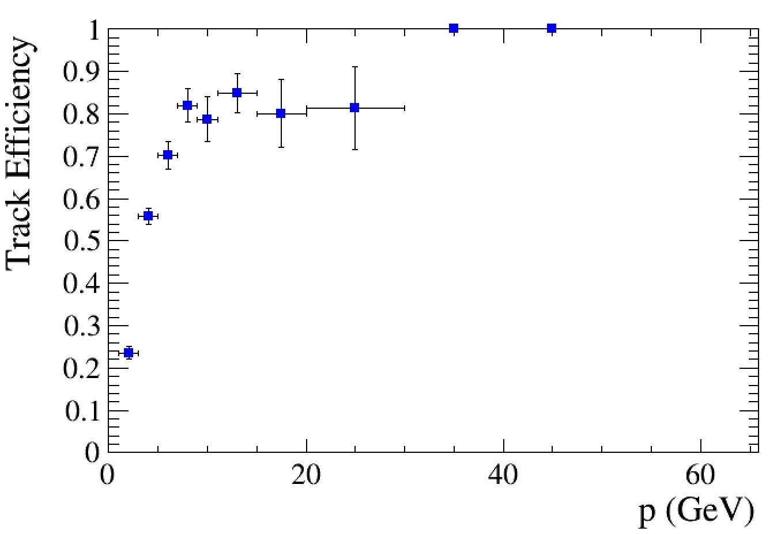
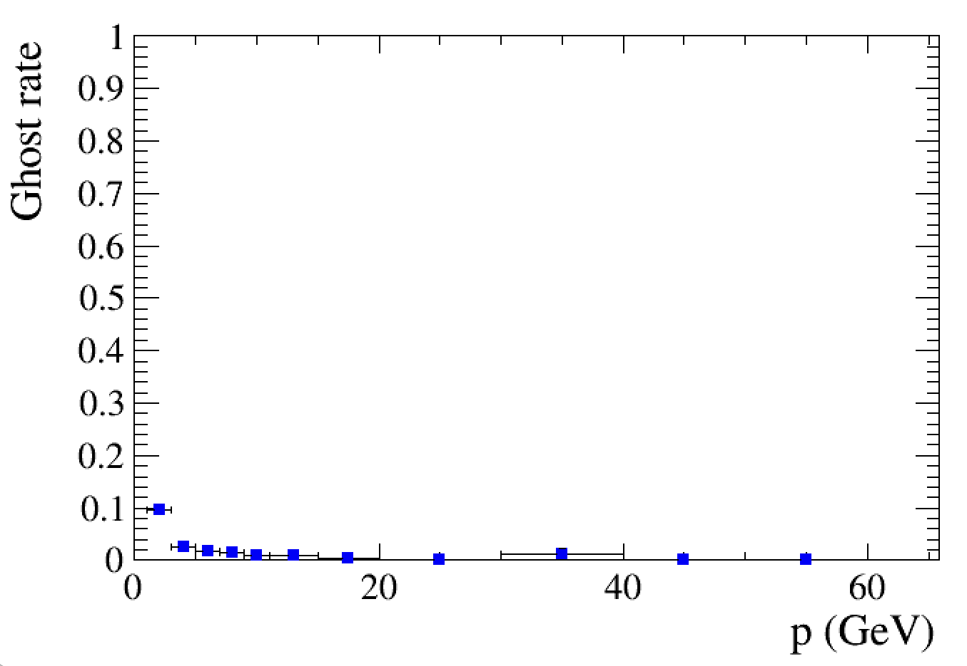
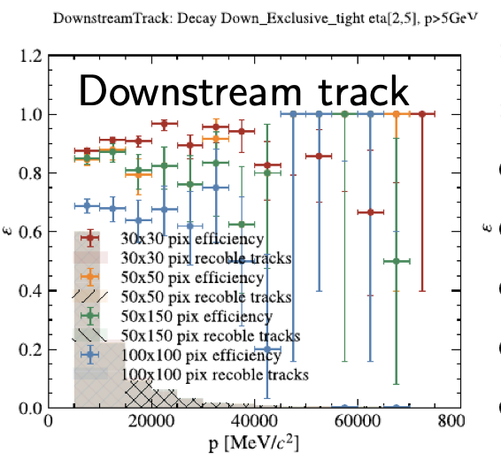
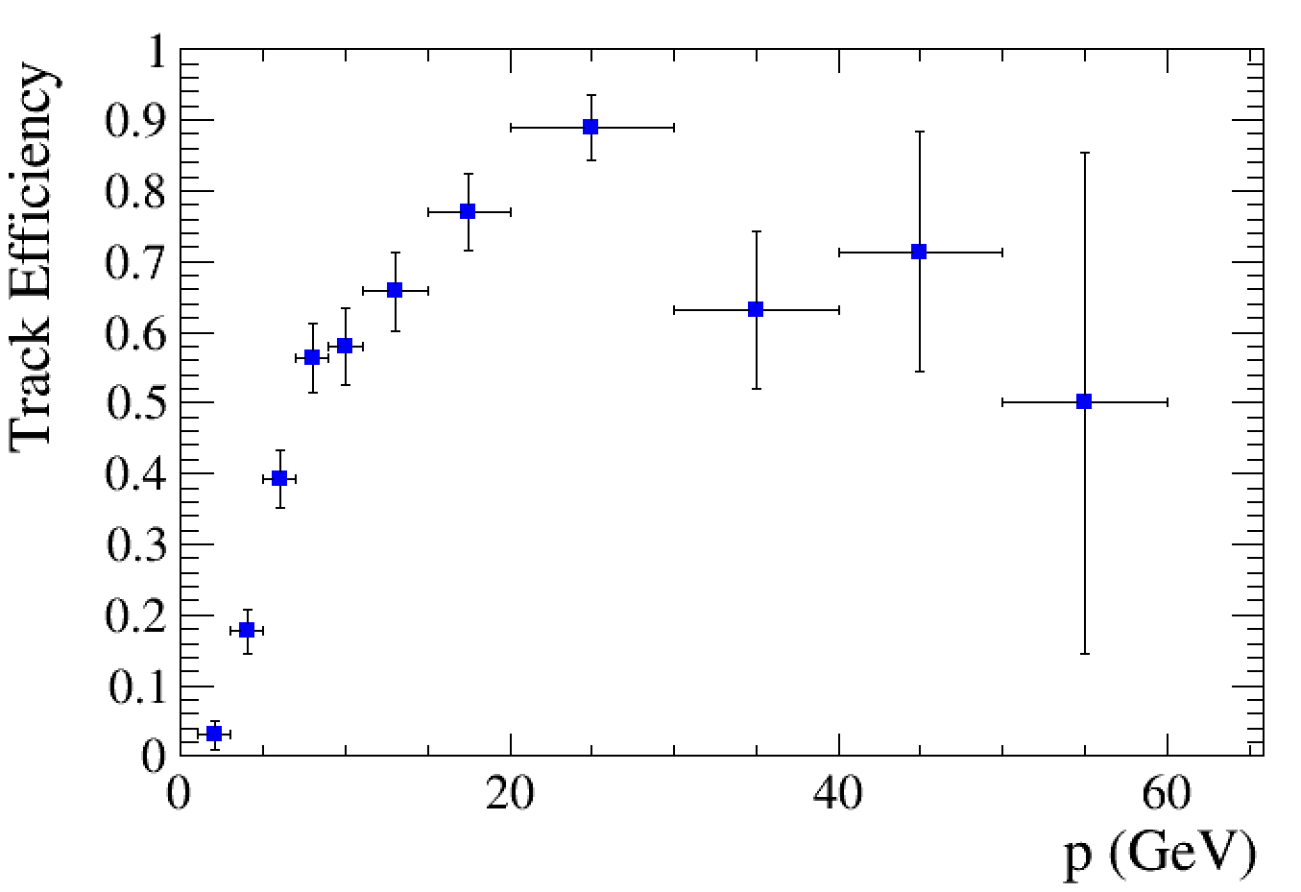
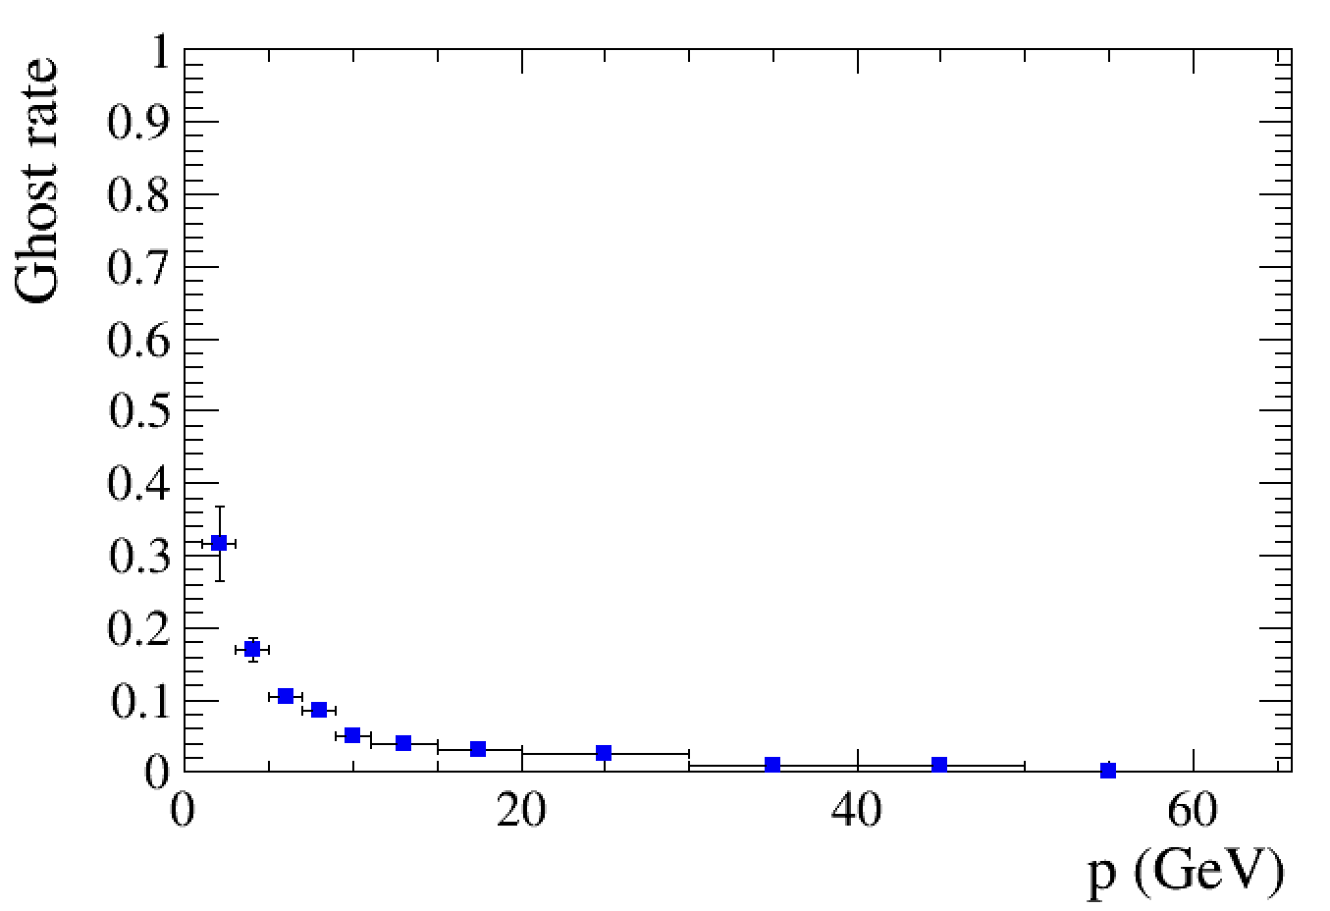
Downstream tracks
No big diff. when size no larger than 50x150 μm²
$ε(p)$ (left) and Ghost rate (right) for UP+FT downstream track
$ε(p)$ (left) and Ghost rate (right) for UP+MP downstream track
“Standalone” tracks (UP- and T-tracks) extrapolated and combined using spatial χ2 criterion
See C. Langenbruch’s talk in MP WS @Heidelberg, last Oct, plots by Carlos Barbero Pretel
Tracking (PR+Track fit/Kfilter) using Moore (run_5 branch)
T track using FT/MP
Combining with UP standalone track
Plots from Mingjie Feng @ UP mini WS, 22Jan2025

Slide 5
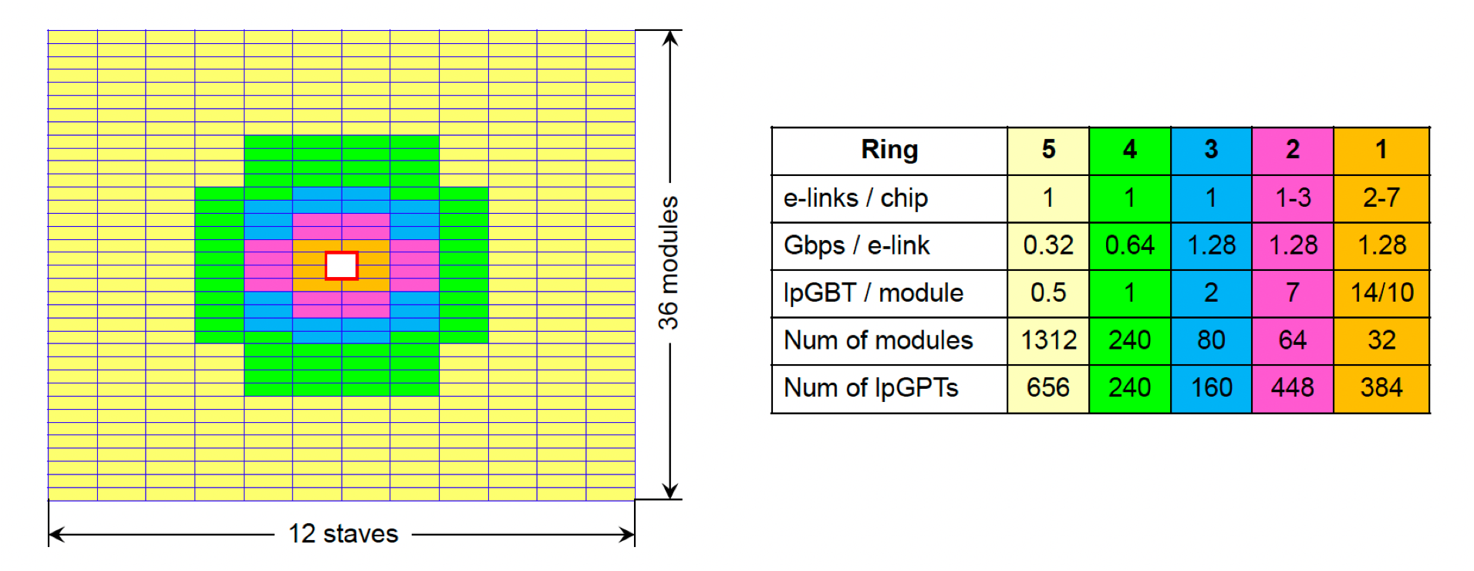
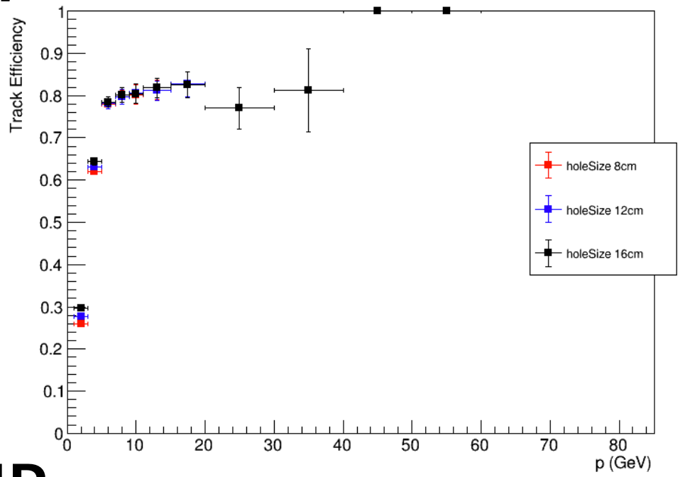
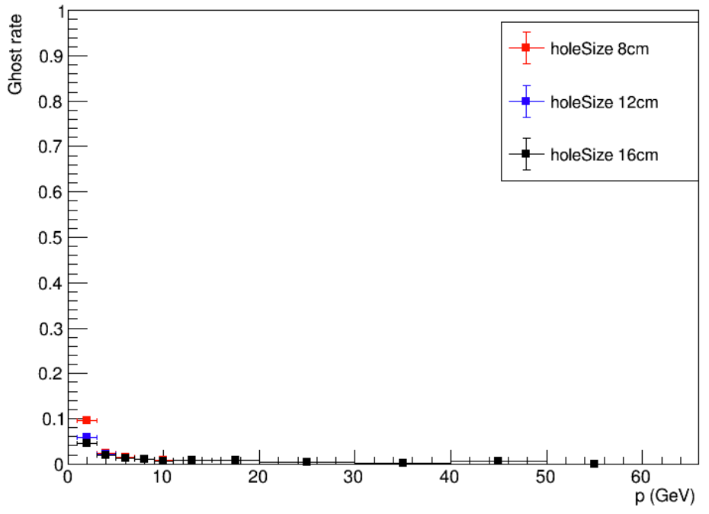
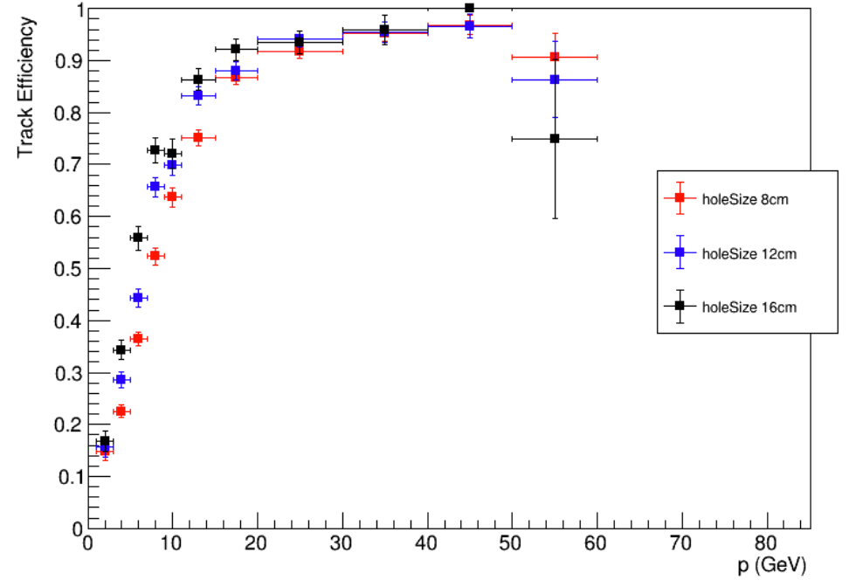
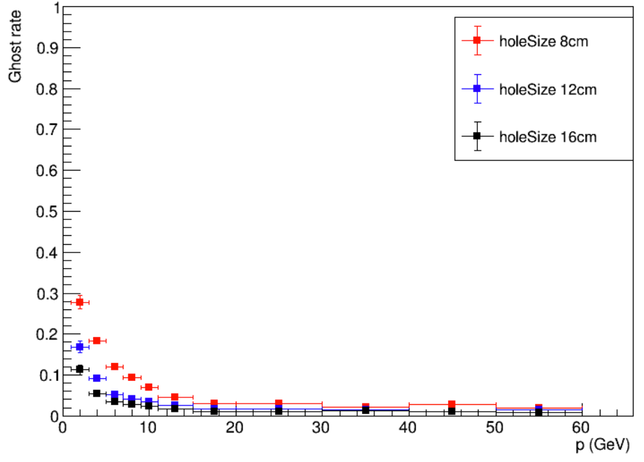
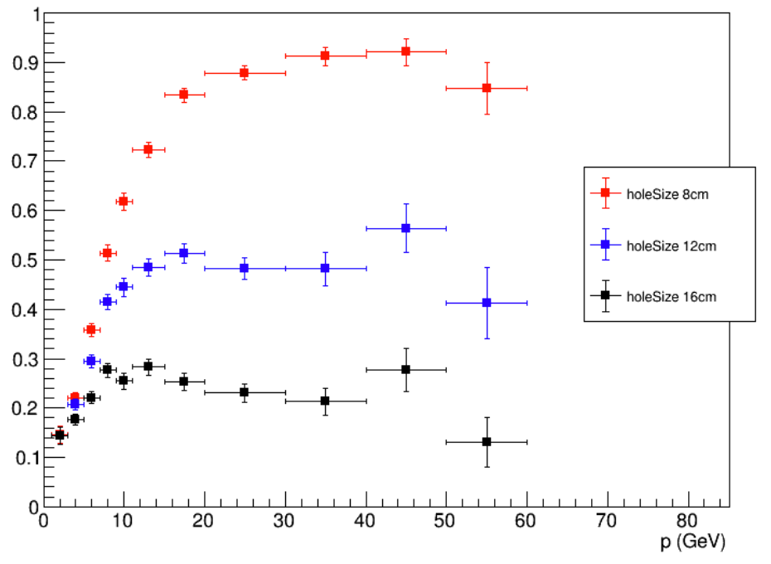
UP acceptance impacts for Downstream Track
$ε(p)$ (left) and Ghost rate (right) for UP+FT downstream track
8x8 cm @ FTDR
12x12 cm
16x16 cm
✛ holeSize 8 cm
✛ holeSize 12 cm
✛ holeSize 16 cm
Definition of “reconstructable downstream track”
hasUP&&hasFT(MP)&&!hasTV
2<η<5
No electron
$ε(p)$ (left) and Ghost rate (right) for UP+MP downstream track
✛ holeSize 8 cm
✛ holeSize 12 cm
✛ holeSize 16 cm
Rec. Efficiency
Huge drop for the efficiency due to the acceptance effects
Plots from Mingjie Feng and Yisheng Fu on UP mini WS, 22Jan 2025

Slide 6
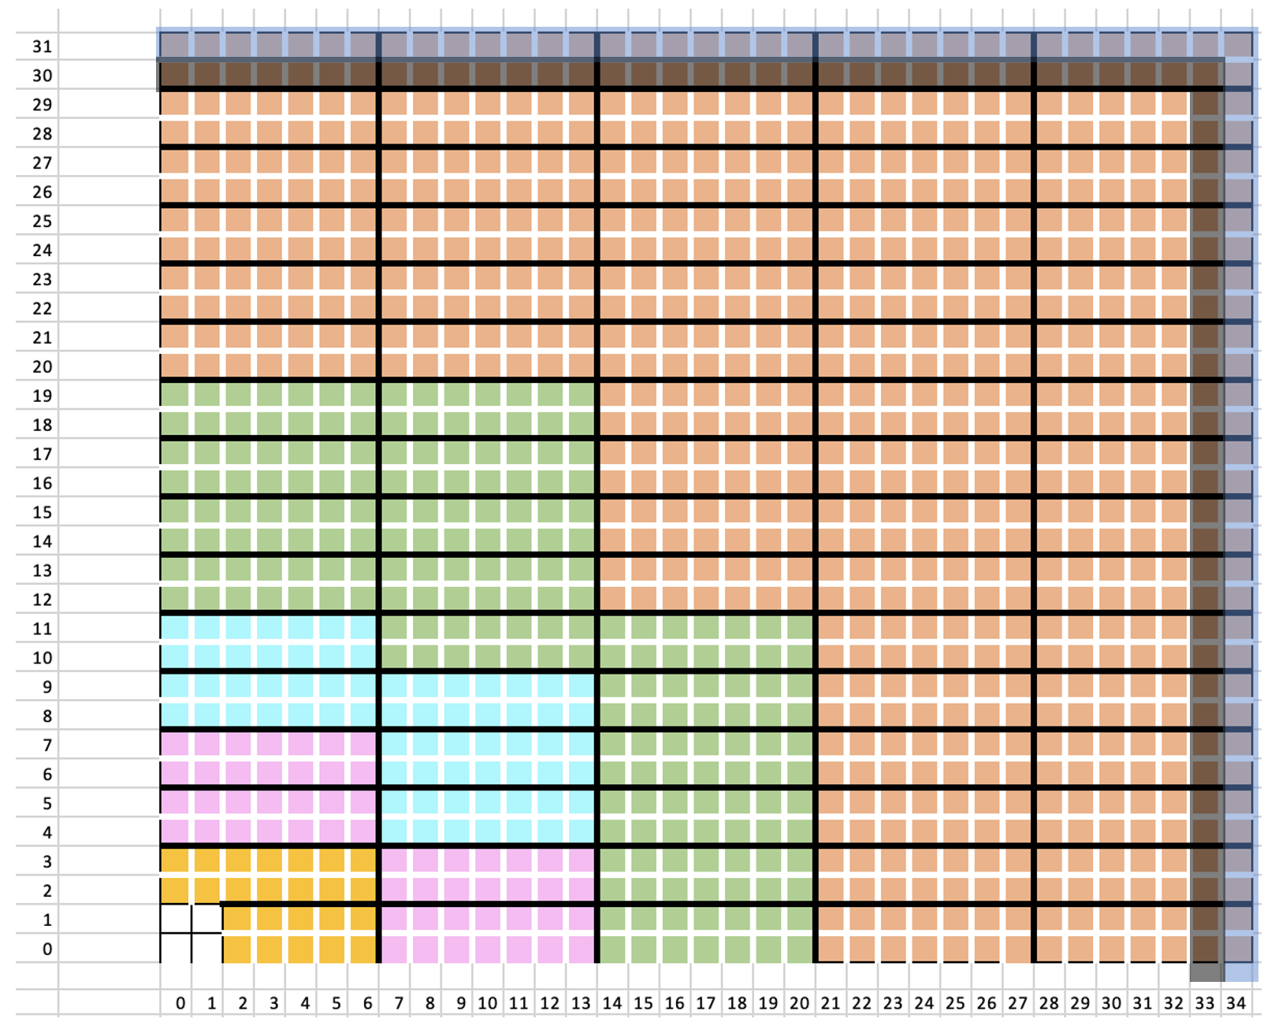
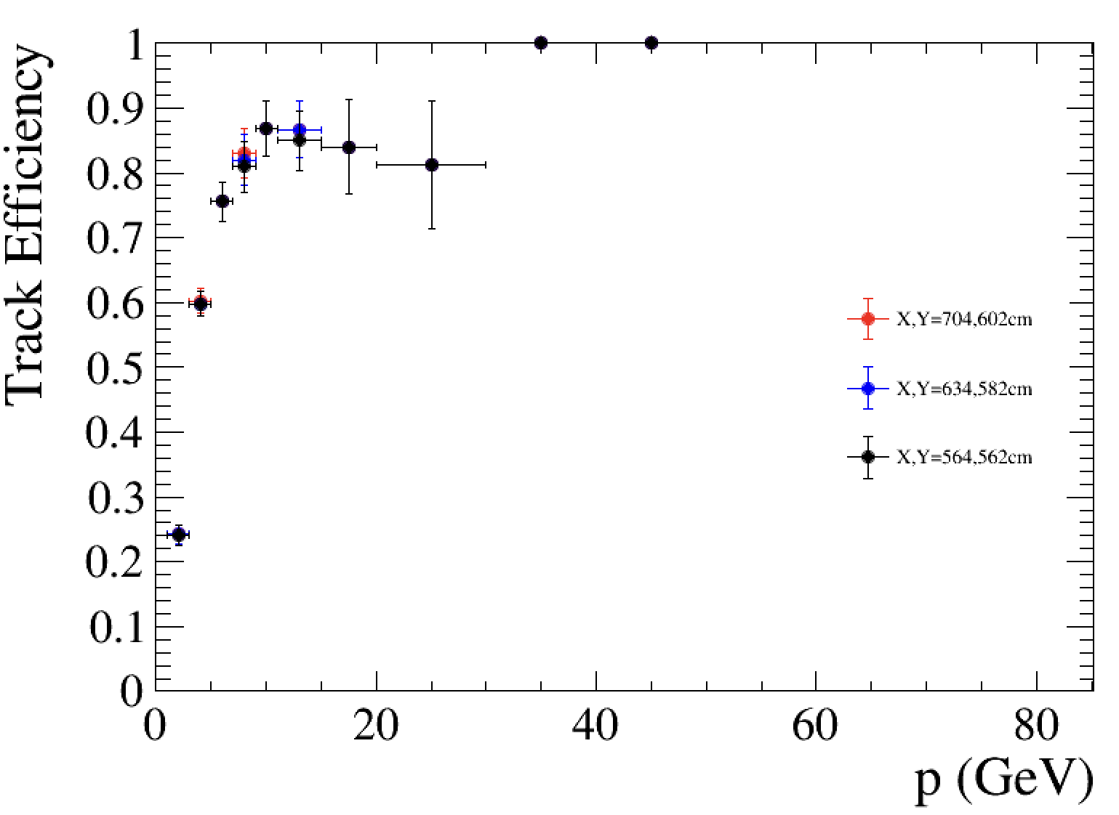
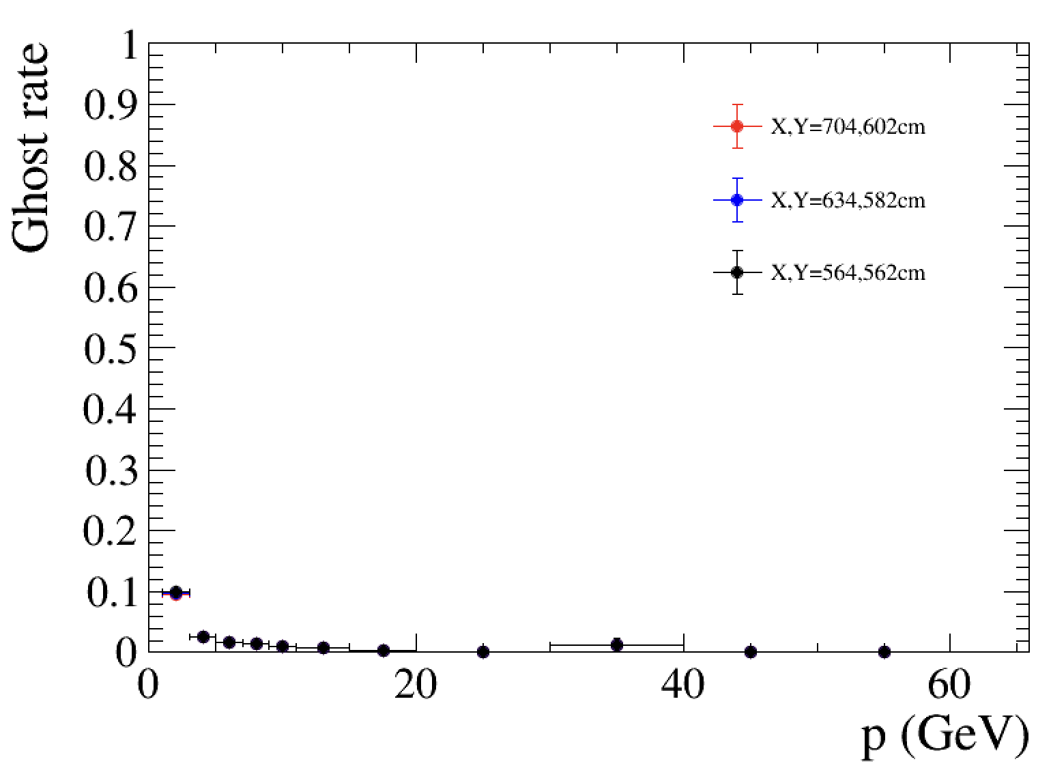
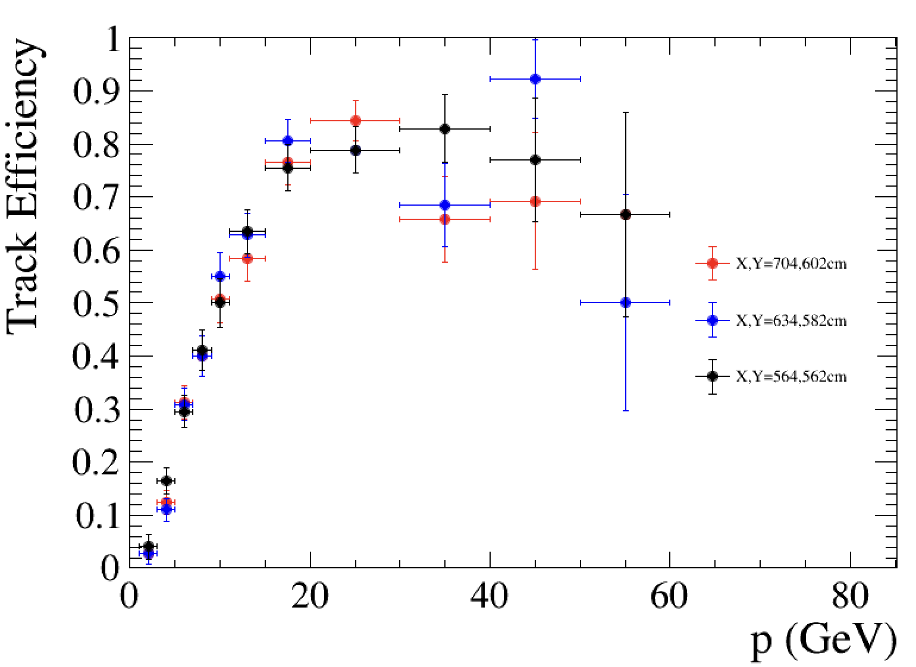
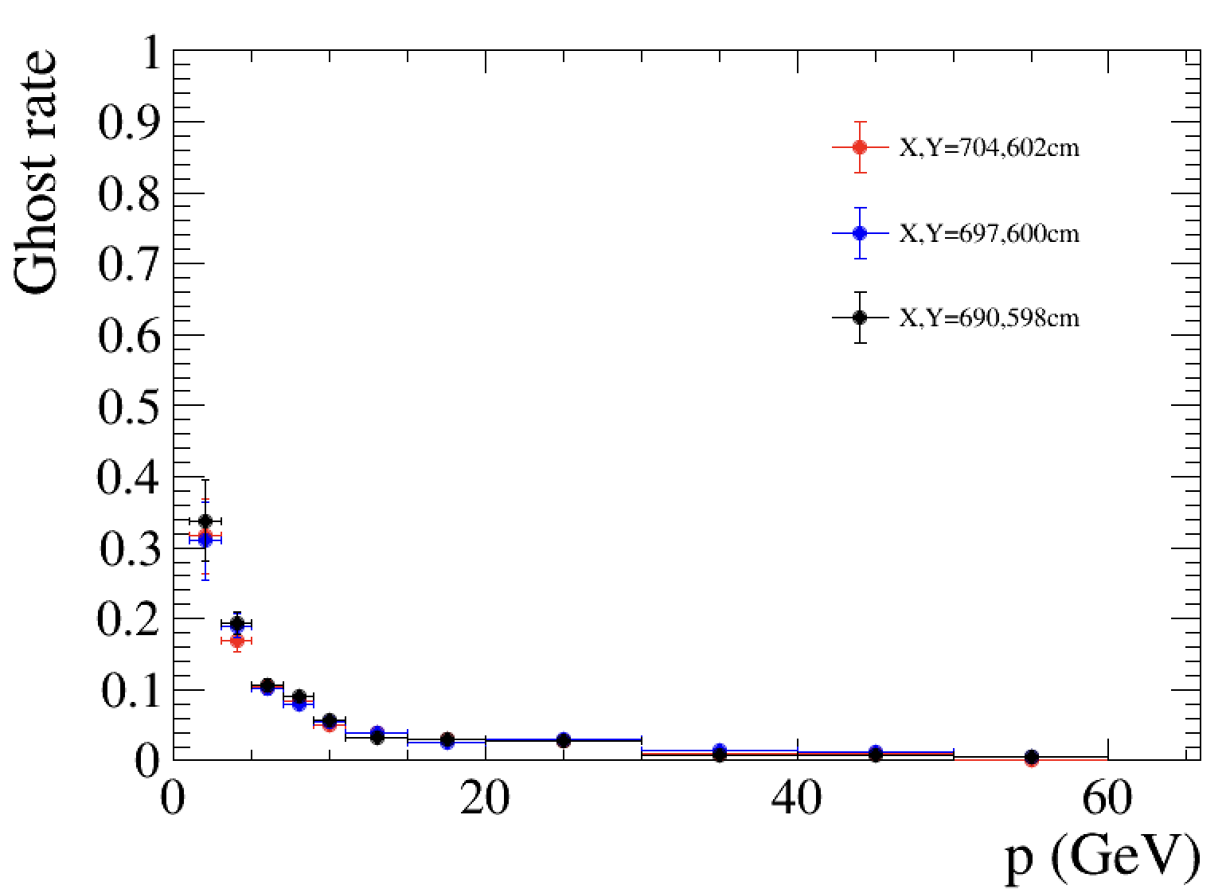
UP acceptance impacts for Downstream Track
UP-FT tracks (hasUP) in 100 events
1/4 UP layer
✛ X,Y = 704 cm
✛ X,Y = 634 cm
✛ X,Y = 564 cm
UP-MP tracks (hasUP) in 100 events
✛ X,Y = 704 cm
✛ X,Y = 634 cm
✛ X,Y = 564 cm
Rec. efficiency
No significant difference observed with the “smaller” UP acceptance
Plots from Mingjie Feng @ UP mini WS, 22Jan2025

Slide 7
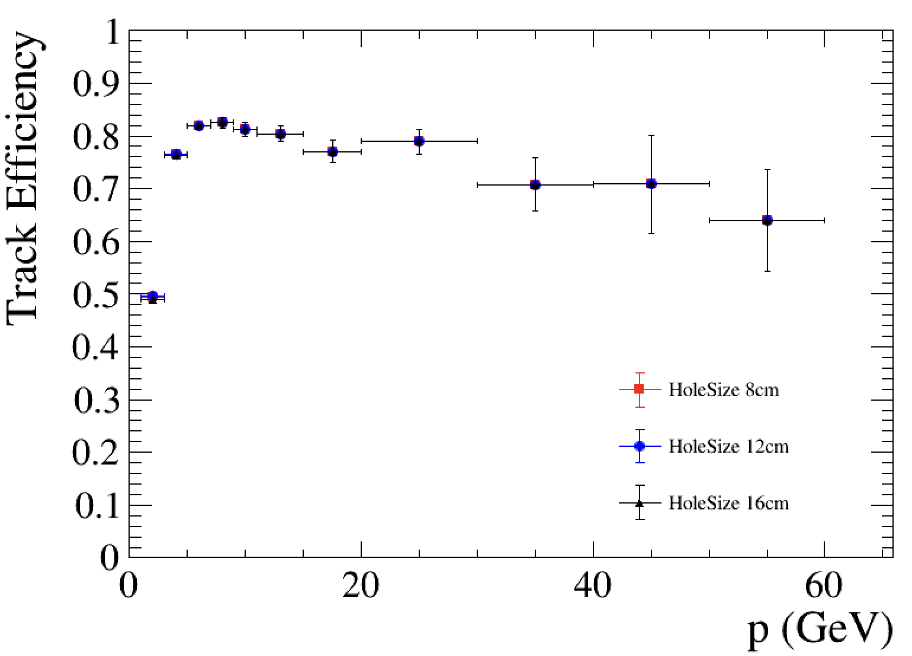
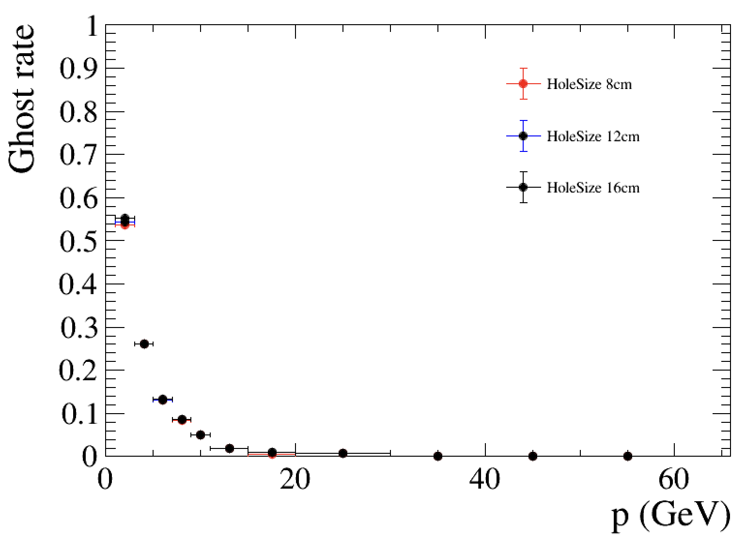
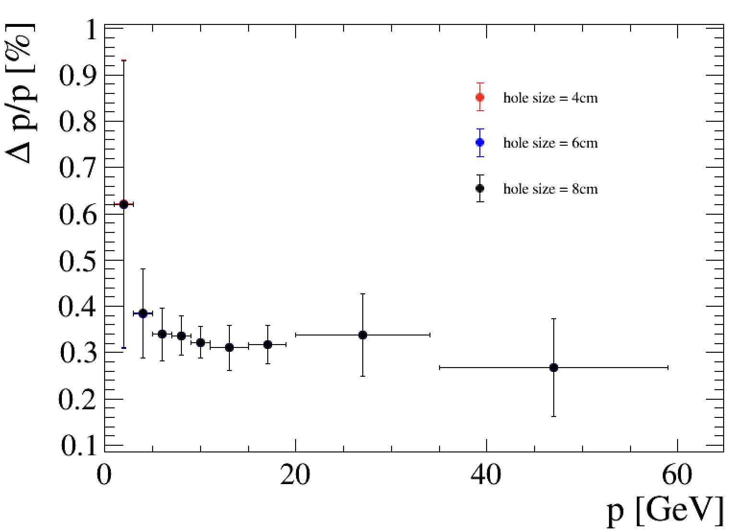
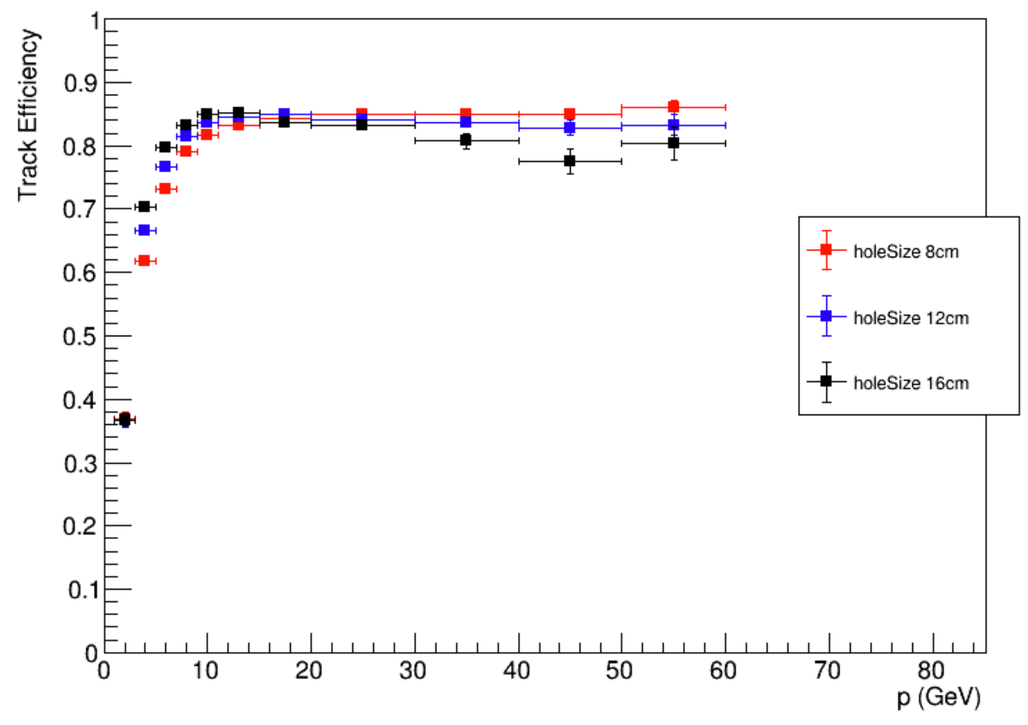
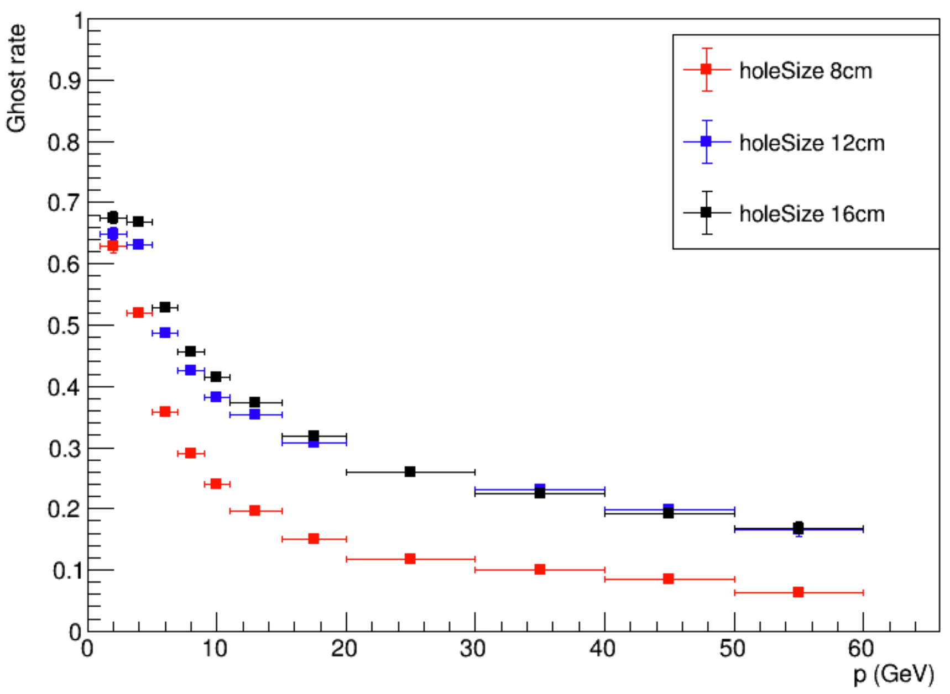
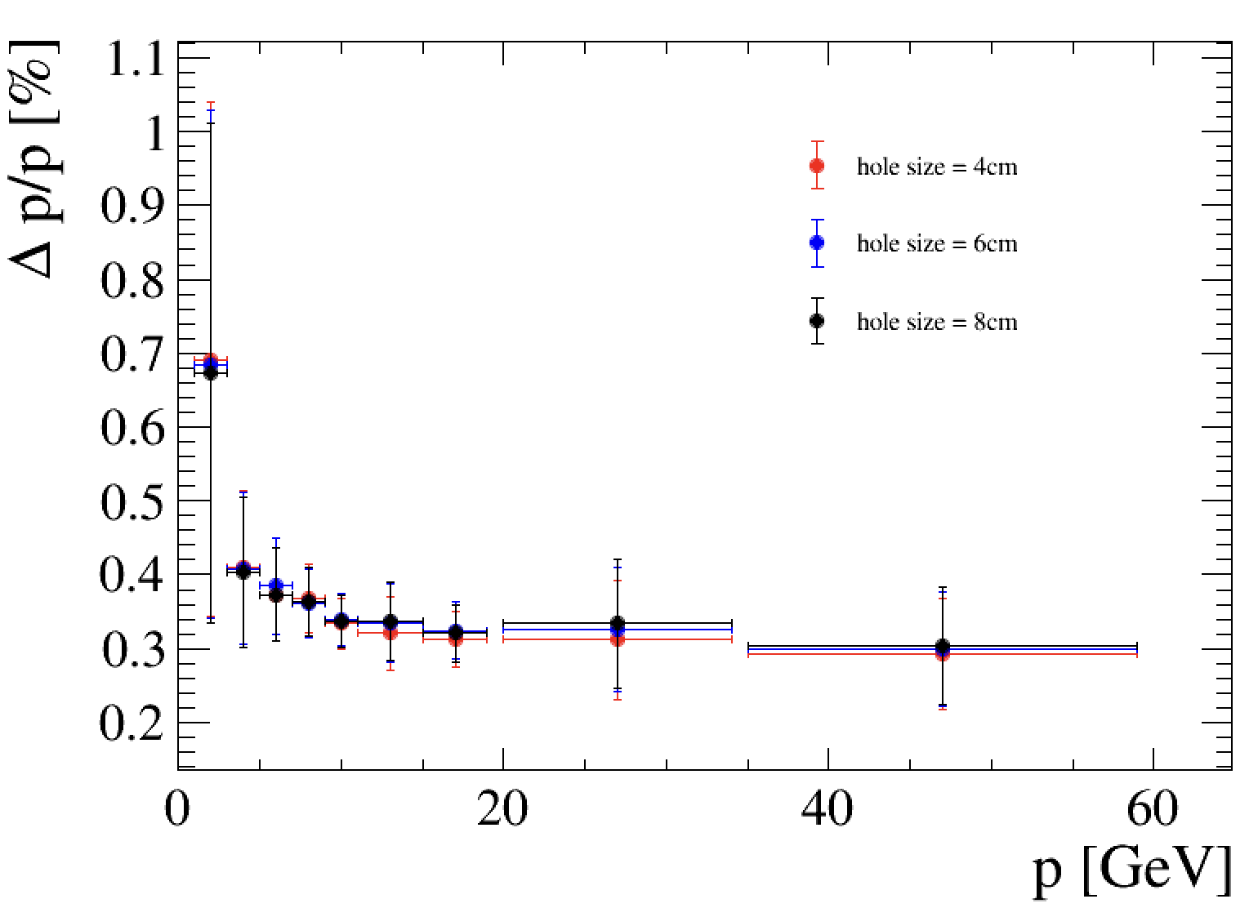
UP geometry (beampipe hole) impacts to long track
TV-UP-FT track
TV-UP-MP track
Plots from Mingjie Feng and Yisheng Fu on UP mini WS, 22Jan 2025

Slide 8
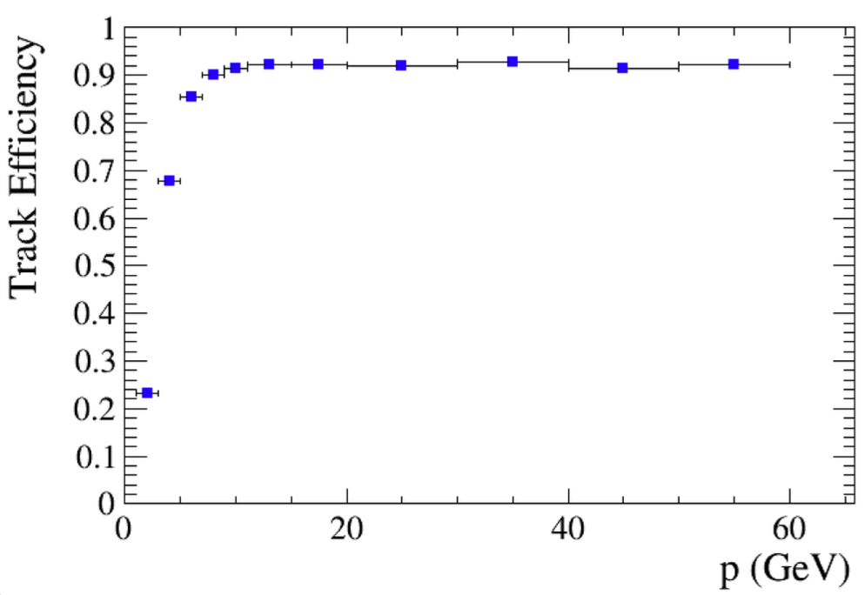
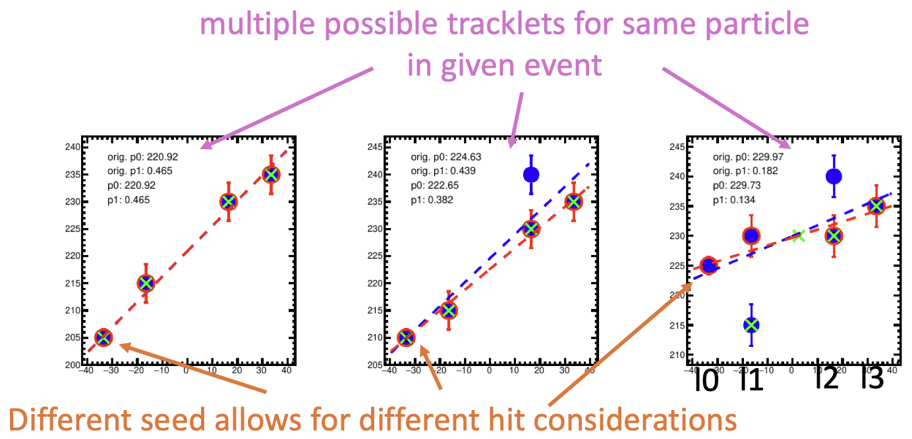
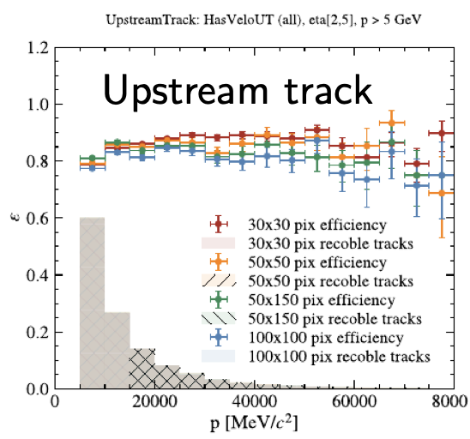
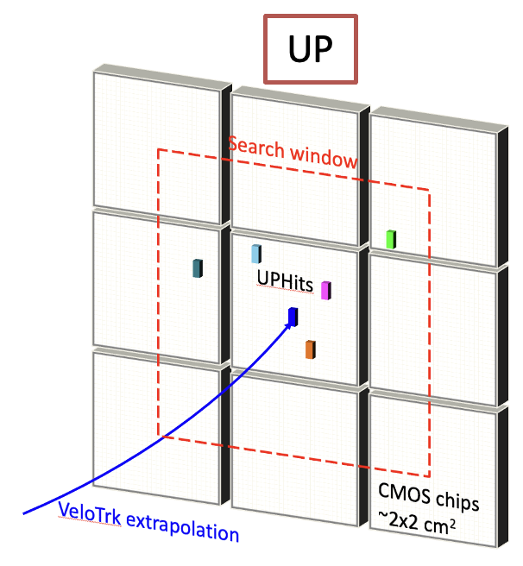
Upstream tracks
Two methods for upstream track reconstruction
TV track combining with UP standalone track: based on pattern_recognition_u2 framework by R. Quagliani, input for scoping document
TV track with UP hits: based on Run_5 branch of LHCb official framework
  TV track extrapolated on each UP layer
  Loop all hits in search window (~2x2 chip area)
  Linear fits applied in UP region to get the best track candidates
Upstream track combining with MS next step
See C. Langenbruch’s talk in MP WS @Heidelberg, last Oct, plots by Carlos Barbero Pretel
<Tracklet creation in MS>
See more details in Nicolas Schmidt’s talk on WP2-6 18Mar 2025
Plots from Mingjie Feng @ RTA: WP2-6 U2, 17Dec2024

Slide 9
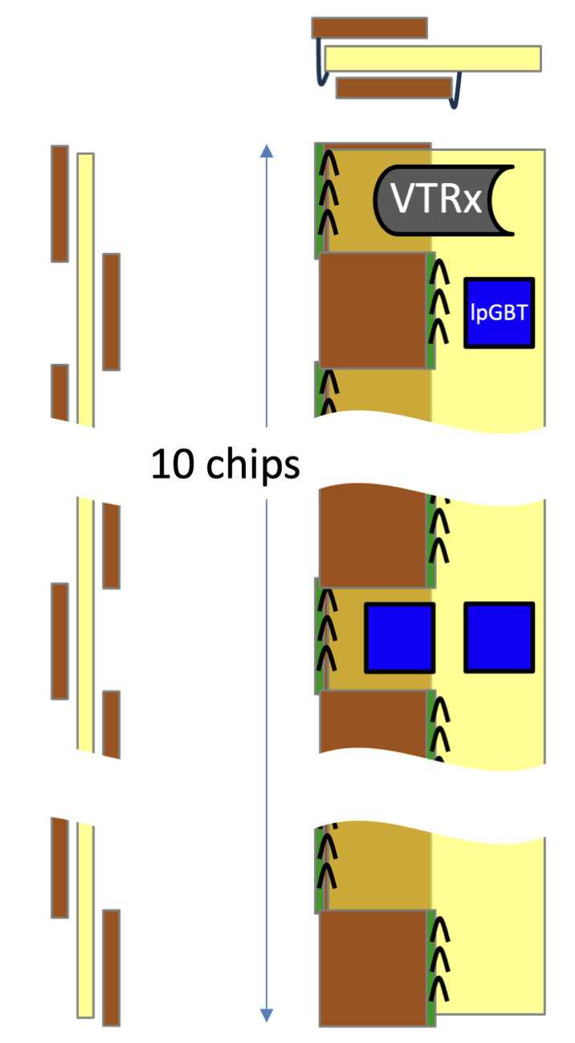
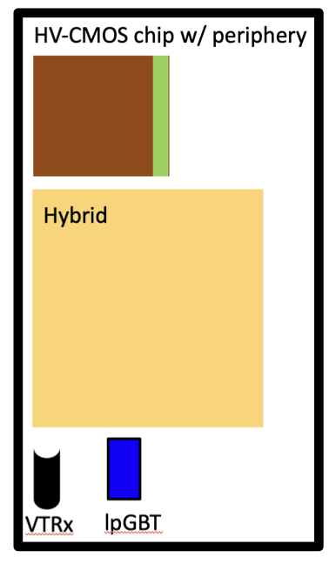
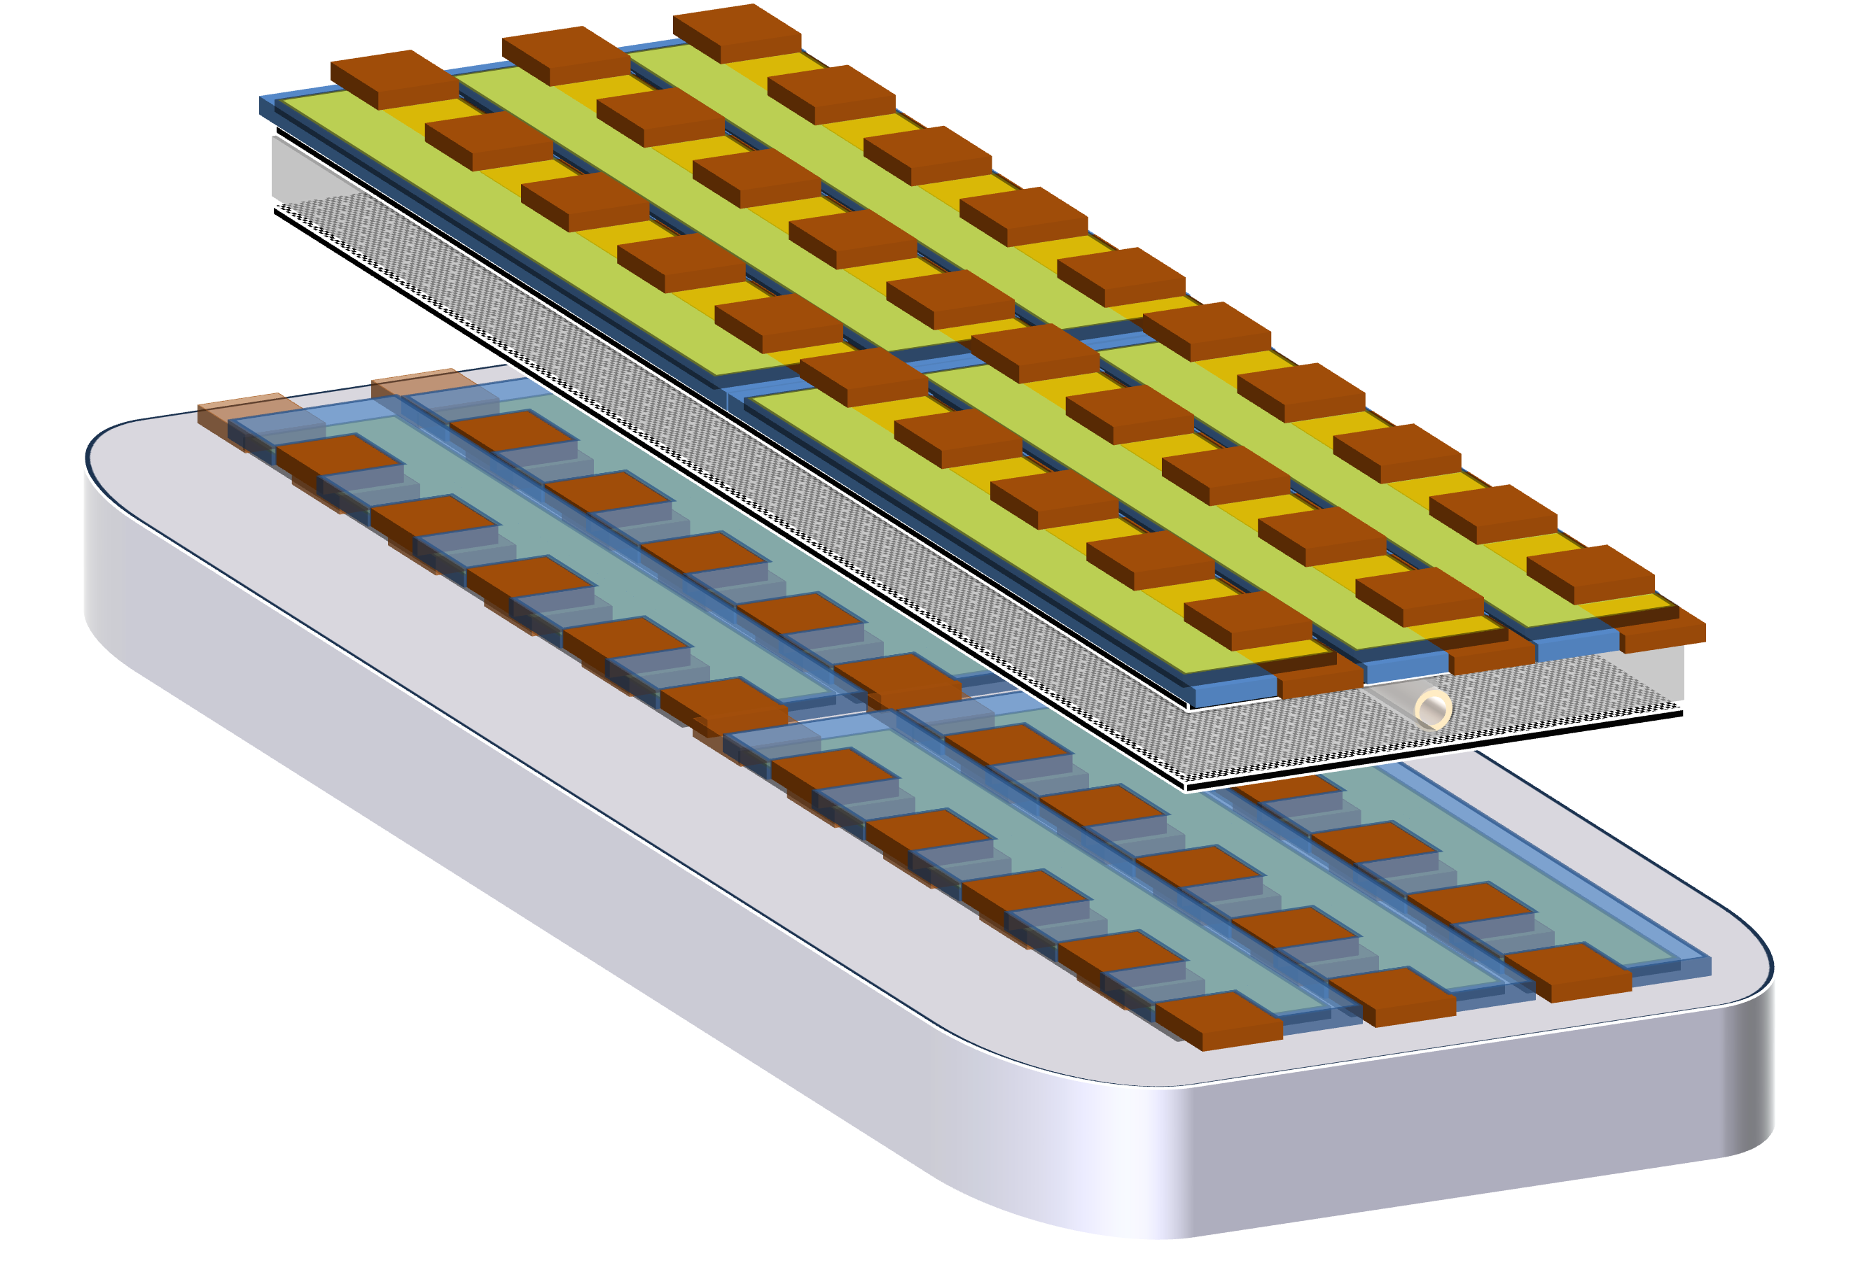
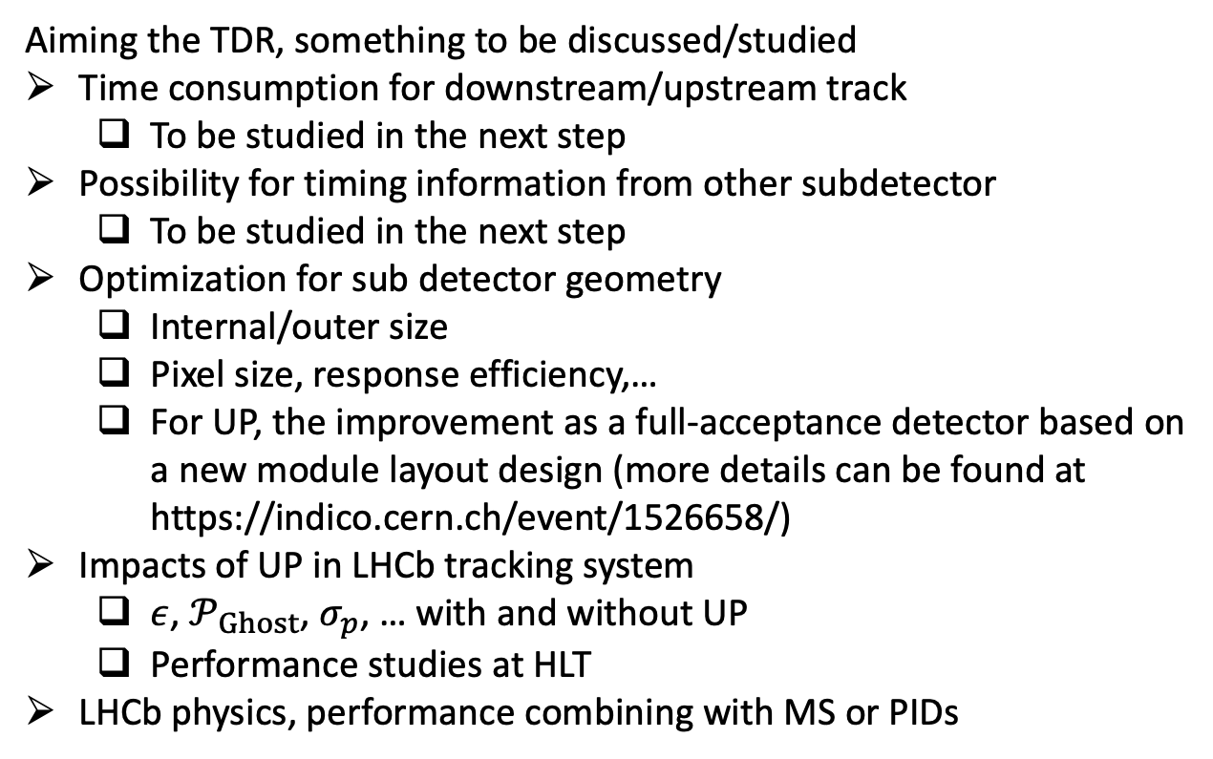
To-do list for downstream/upstream track
Many thanks for inputs from Renato
Layout of UP module with full acceptance
Aiming the TDR, something to be discussed/studied
Time consumption for downstream/upstream track
  To be studied in the next step
Possibility for timing information from other subdetector
  To be studied in the next step
Optimization for sub detector geometry
  Internal/outer size
  Pixel size, response efficiency,…
  For UP, the improvement as a full-acceptance detector based on a new module layout design (more details can be found at https://indico.cern.ch/event/1526658/)
Impacts of UP in LHCb tracking system
  $ε$, $𝒫_{Ghost}$, $σ_{p}$, … with and without UP
  Performance studies at HLT
LHCb physics, performance combining with MS or PIDs
The optical can be at FE or at end of stave

Slide 10
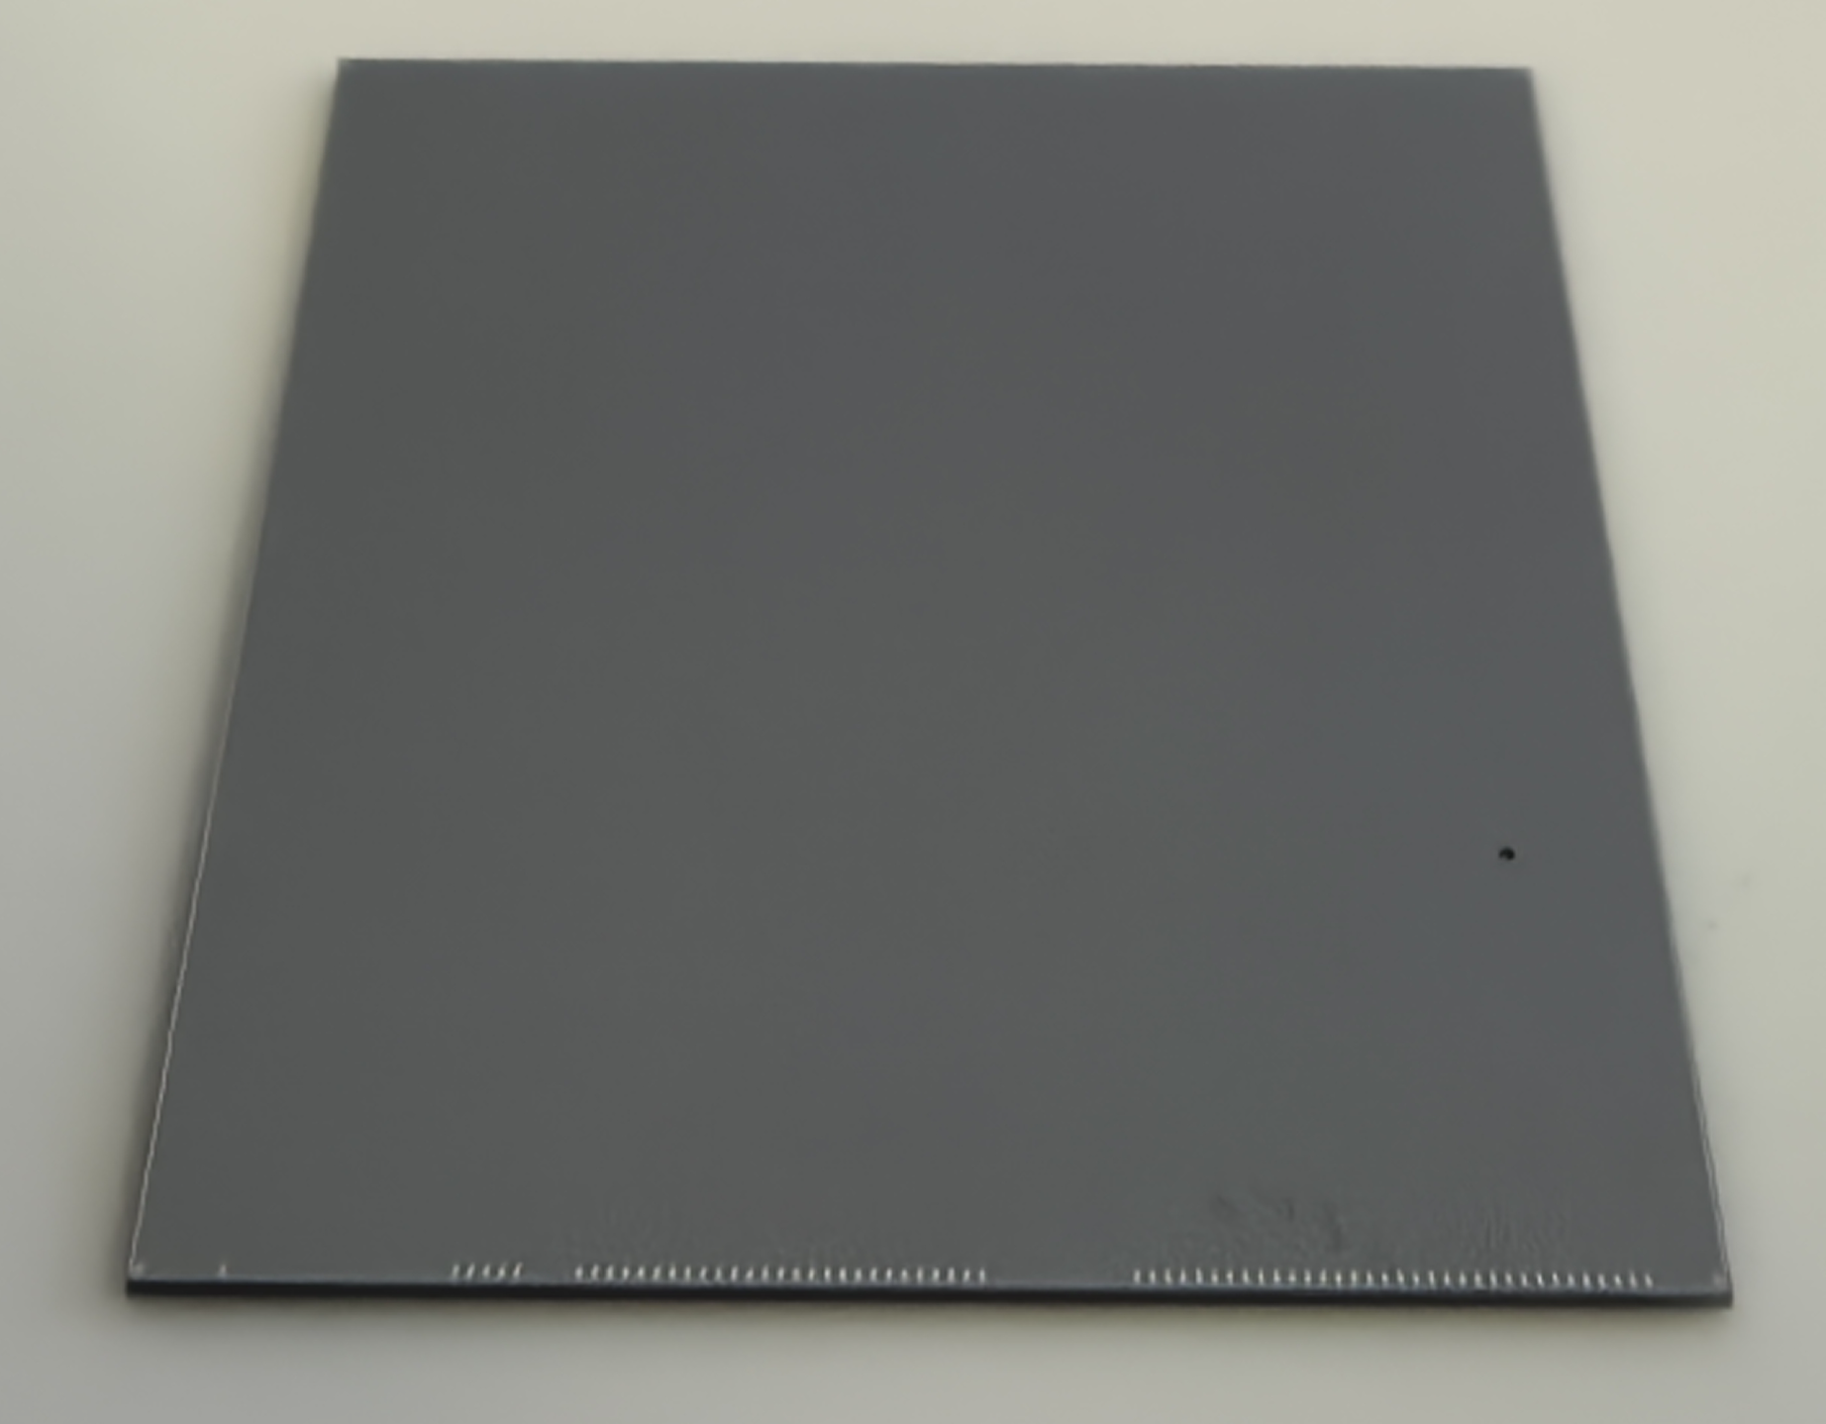
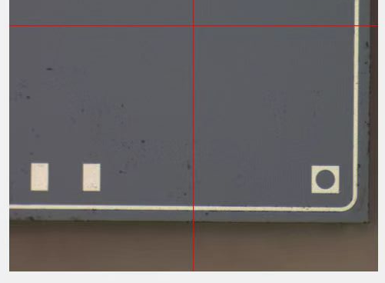
To-do list for downstream/upstream track
Many thanks for inputs from Renato
Aiming the TDR, something to be discussed/studied
Time consumption for downstream/upstream track
  To be studied in the next step
Possibility for timing information from other subdetector
  To be studied in the next step
Optimization for sub detector geometry
  Internal/outer size
  Pixel size, response efficiency,…
  For UP, the improvement as a full-acceptance detector based on a new module layout design (more details can be found at https://indico.cern.ch/event/1526658/)
Impacts of UP in LHCb tracking system
  $ε$, $𝒫_{Ghost}$, $σ_{p}$, … with and without UP
  Performance studies at HLT
LHCb physics, performance combining with MS or PIDs
For both MT-CMOS and UP
the size is a reasonable guesstimation for the CMOS technologies. but we can revise it when necessary, so are the binding pads
Dummy CMOS chip
@ IHEP, 28Mar 2025

Slide 11
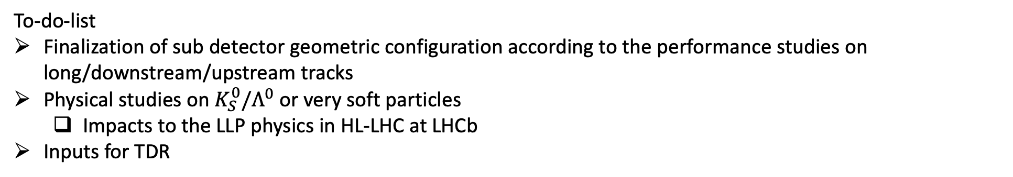
Conclusion
Reconstruction & performance studies
Downstream/upstream tracking algorithm presented
Efficiency, ghost, momentum resolution studies
  Impacts of the UP geometry to the tracking performance discussed
To-do-list
Finalization of sub detector geometric configuration according to the performance studies on long/downstream/upstream tracks
Physical studies on $K_{S}^{0}/Λ^{0}$ or very soft particles
  Impacts to the LLP physics in HL-LHC at LHCb
Inputs for TDR
Thanks for your attention

