Slide 1


RICH and TORCH roadmap for TDR
Antonis Papanestis / Tom Blake
On behalf of the RICH and TORCH projects

Slide 2


Slide 3
Optical geometry
Define the optimal geometry for PID assuming “complete” freedom (within the RICH1 and RICH2 z envelope)
No requitement for magnetic shielding
Improve Cherenkov angle resolution
Manage detector occupancy

Slide 4
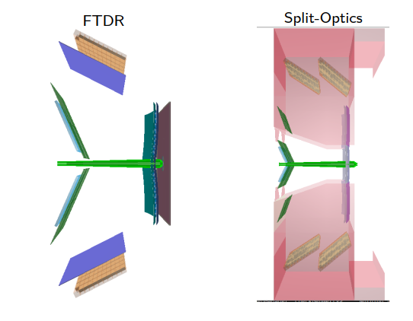
RICH1 layout
Currently two options:
  FDTR Geometry
  Split Optics
FTDR is well defined and ready for further studies
Split optics will require modifications to the reconstruction due the extra detector planes

Slide 5
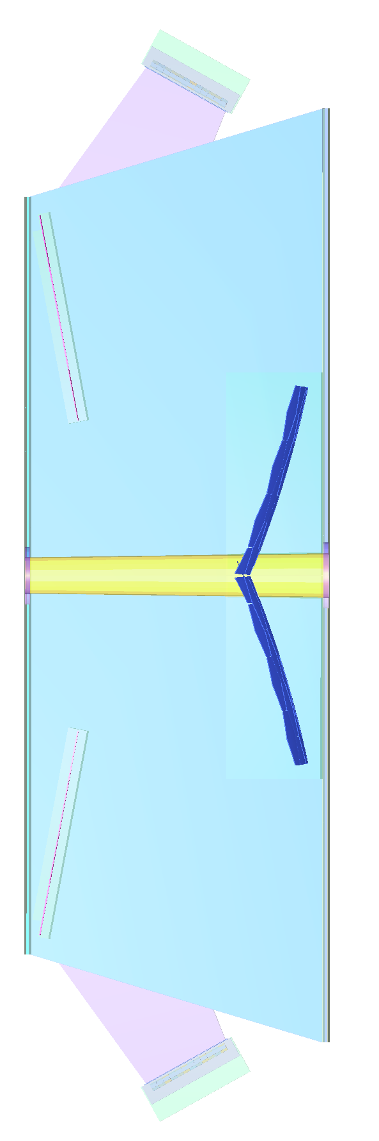

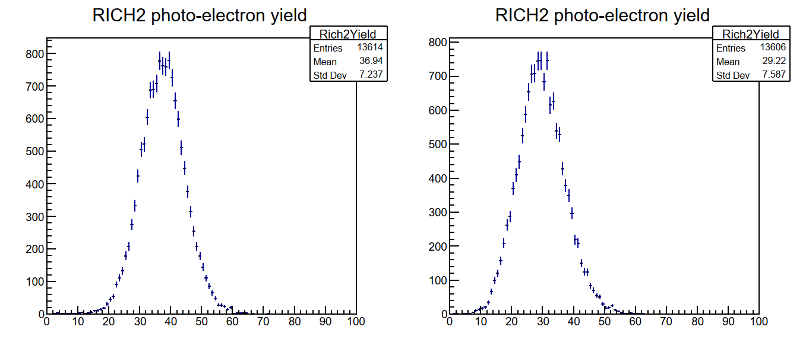

RICH2 layout
Same outer envelope
Currently implementing the FTDR layout in Gauss
22% fewer photons
In Scoping document
24% reduction

Slide 6
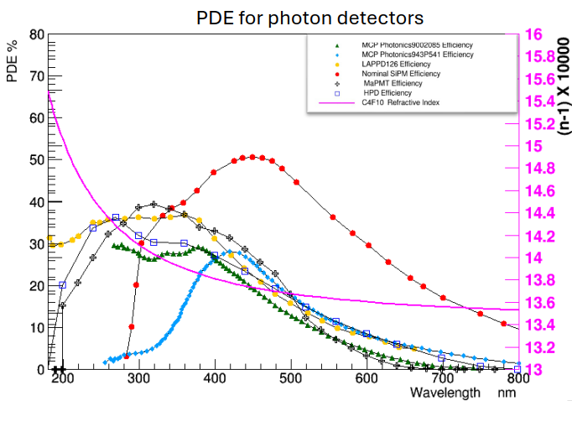
PID performance
Run Gauss and Moore with the different geometries and realistic photon detectors (QE, signal response, dark counts) to establish relative PID performance and optimise design
  With both RICH and TORCH
Include as much as possible the material from Upgrade II tracker
  Possibility of significant amounts of extra material from Mighty Pixel services
  Upgrade II tracking would also be desirable
Ideally with Run 5 tracking performance

Slide 7
Milestones/Task towards RICH TDR
Define RICH2 geometry [Q2 25]
  RAL, Genova
Define RICH1 geometry [Q3 25]
  RAL, Genova, Edinburgh
Establish acceptable dark count rate [Q3 25]
  Milano, CERN, Ljubljana
PID performance from simulation and reconstruction [Q4 25]
  RAL, Cambridge
Feasibility of cryostat/cool-box [Q1 26]
  CERN

Slide 8
(continued)
Verify suitability of FastRICH [Q1 26]
  CERN, Bucharest, Ljubljana
Readout electronics [Q1 26]
  CERN, Cambridge, Bucharest, Ljubljana
Specify baseline photon detector option [Q1 26, and beyond]
  Genova, Ferrara, Milano, Perugia, Padova, Edinburgh, RAL, CERN, Bucharest, Ljubljana

Slide 9
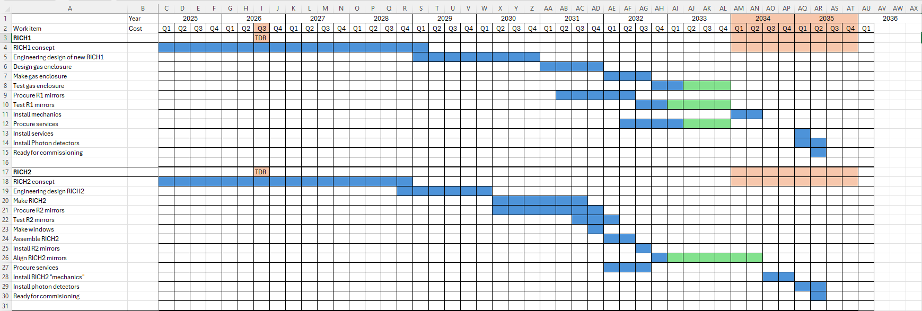
RICH Mechanics Up II schedule

Slide 10


Slide 11
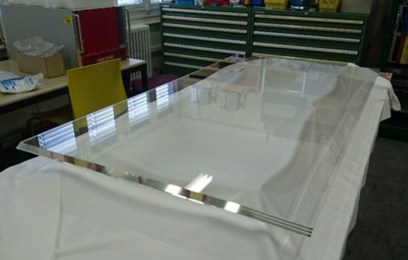
Optimisation of module layout
Aim to perform studies to optimise the layout of the individual TORCH modules and converge on a preferred overall layout for the TDR; this depends on the chosen scoping scenario.
Within current constraints there is flexibility to optimise the module size, focusing block geometry and various properties of the radiator for the TDR.
We will need to continue dialogue with vendors to understand cost implications of the various design choices. The quartz cost is a significant cost driver of the project.
A new vendor for the quartz polishing has been identified through USTC. Checking the suitability of quartz polishing from this supplier could be an intermediate milestone

Slide 12
Baseline photon detector choice
Aim to define a baseline choice for the photon detector technology and a suitable back-up.
Need to identify a technology with a development pathway that will be viable by 2028.
  MCP-PMTs are currently assumed as the baseline.
Lifetime and rate capability are a concern, and they may not be suitable across the full detector acceptance.
SiPMs are currently considered as an alternative choice.
  Development will be needed to achieve a pixelated detector with the desired time resolution.
  If SiPMs are used, we will likely need cryogenic cooling and will need a conceptual design for the TDR illustrating how a cryostat could be implemented within the limited TORCH envelope.

Slide 13
Design of front-end electronics
Aim for a preliminary design of the front-end electronics for TORCH and a specification of the TORCH data format. The intention is to profit from synergy with the FastRICH development.
Aim to evaluate the FastRICH ASIC with MCP-PMTs and SiPMs in laboratory test stands.
Aim to understand whether modifications are required to the FastRICH (e.g. operating without a gate) and to demonstrate that the FastRICH can be used without sending TOT information.

Slide 14
Conceptual design of an integrated RICH-TORCH detector
Aim to provide a conceptual design illustrating how RICH 2 and TORCH can be accommodated within a common detector envelope.
We are assembling a prototype TORCH support structure for use in a test beam in July 2025.
Experience from the test beam will give confidence in the design for the TDR.
Successful completion of the prototype could be an intermediate milestone.
Requirements for services to be defined
Space at the bottom of RICH2 very tight

Slide 15
Proposed milestones towards a TDR
 | Milestone | Date
1 | Definition of photodetector requirements and dependence on the module location | Q1 2025
2 | Definition of baseline photodetector and backup solution based on R&D progress | Q2 2026
3 | Readout of MCP-PMT/SiPM with FastRICH ASIC in lab | Q1 2026
4 | Decide on need for modification of the FastRICH gating through simulation studies | Q1 2025
5 | Completion of full-size prototype module and test of its mechanical properties | Q2 2025
6 | Analysis of test-beam data taken with the full-size prototype module | Q1 2026
7 | Complete conceptual design for integration of TORCH and RICH2 in a common structure | Q1 2026
8 | Complete optimisation of the optical layout of the TORCH modules | Q3 2025
9 | Assess vendors for suitably polished quartz | Q1 2026
10 | Demonstrate reconstruction can be run on hardware accelerators | Q4 2025
11 | Evaluate detector performance of preferred detector configurations | Q1 2026

Slide 16
Synergies
RICH and TORCH could potentially use the same photon detectors. We should cooperate more, starting with joint meetings
  Probably not if RICH uses LAPPDs
Both RICH and TORCH would benefit from simulation with realistic material in the tracking stations
  And verification of performance with Run 5 tracking
Having combined PID would benefit the optimisation of the design of the RICH detectors
A realistic conceptual design is required by TORCH before any redesign of RICH2

Slide 17
Summary
There is a lot of work towards a PID TDR, but the tasks are well defined and should be achievable
  Good progress on the software side
  A baseline design for the RICH is expected by Q3
Both projects will benefit by working closer together
The photon detector choice will not be made by the TDR, but a baseline should be defined

