Slide 1
Machine infrastructure and performance
Matteo Solfaroli
for the ATS feasibility study team
8th WS on LHCb upgrade II
Heidelberg, March 27th, 2025
Material from: R.Alemany, R.Bruce, R.Calà, F.Cerutti, R.de Maria, S.Kostoglou, G.Lerner, M.Pezzetti

Slide 2
Outline
Studies on impact to equipment installed in:
  LHC tunnel: state of the art
  service caverns (UX85, US85, UL84/86, UW85): recent development
Observations from 2024 run
Considerations on machine performance and ION plans for Run5

Slide 3
Upgrade II
European Strategy Update 2020 "The full potential of the LHC and the HL-LHC, including the study of flavour physics, should be exploited”
Upgrade I
Upgrade II
LHCb Upgrade II aims at fully exploiting the potential of the LHC regime in flavour physics by
operating the detector at 1.5∙10³⁴cm⁻²s⁻¹ (about factor 7.5 higher)
collecting ~50 fb⁻¹/year (about factor 5 higher) reaching a total integrated luminosity of 300/350 fb⁻¹
ION run in Run5 approved (pending ALICE 3 confirmation)

Slide 4
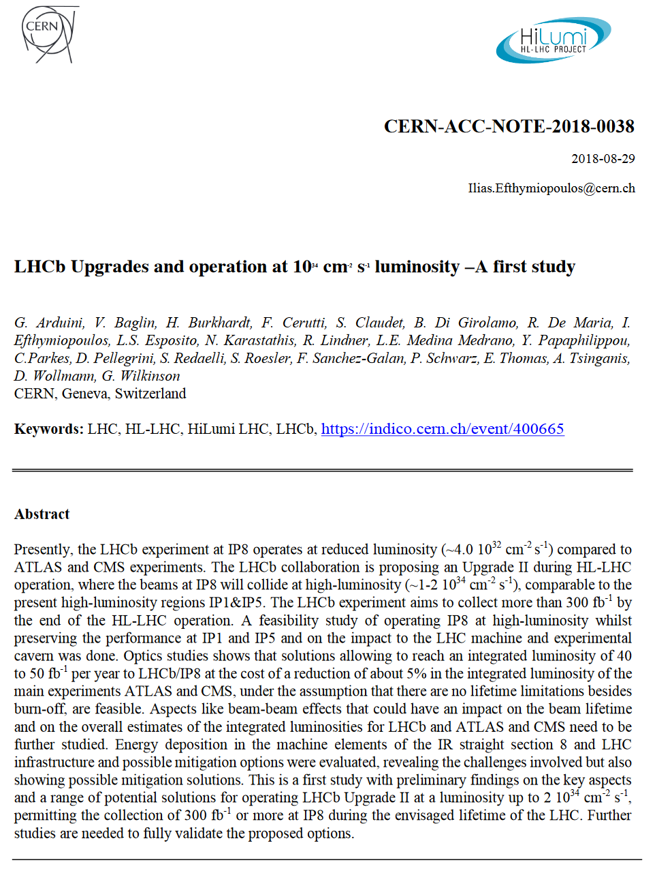
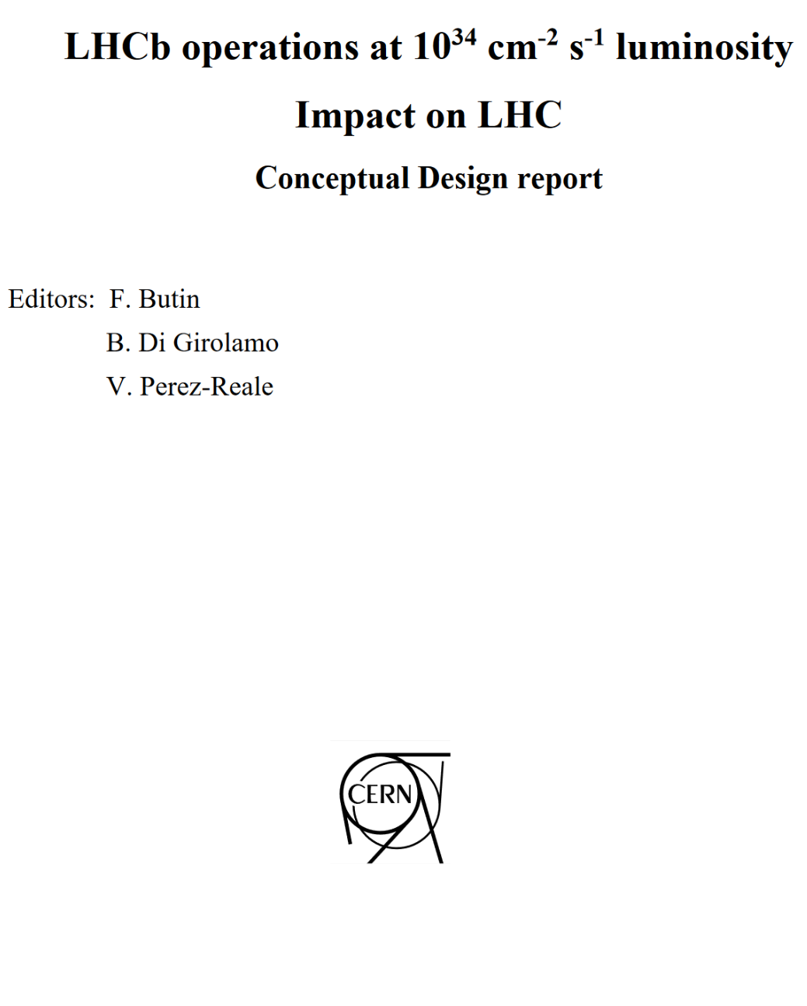
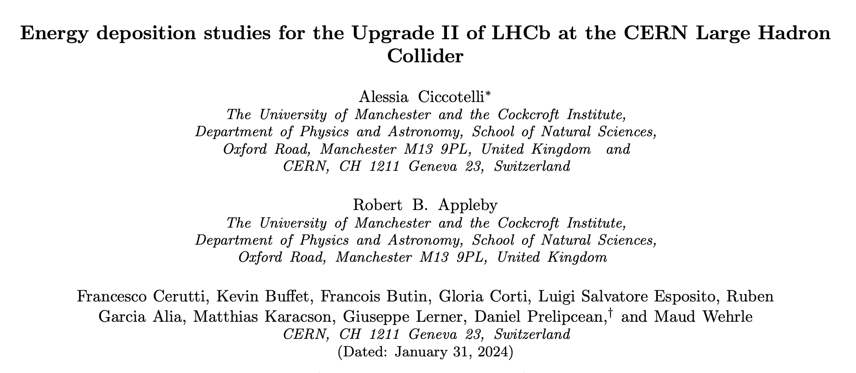
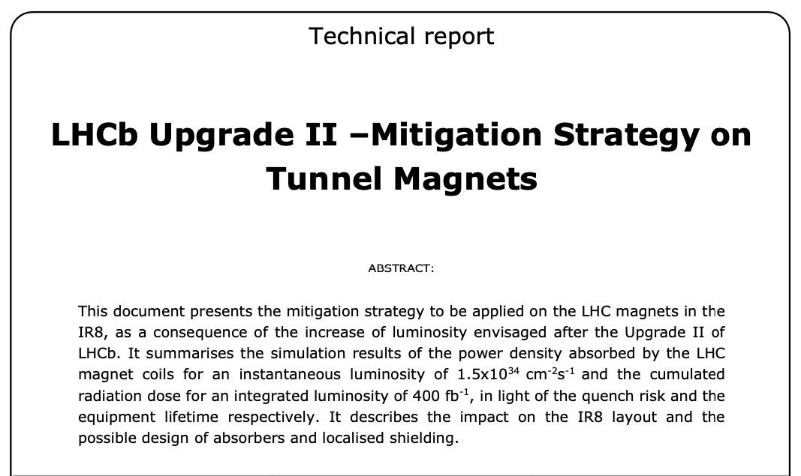
Upgrade II – impact on LHC
Studies on machine aspects are ongoing since a long time…
First study
2015-2018
CERN-ACC-2018-038
CDR
2018-2021
CERN-ACC-2023-xxx
2021-2023
Energy deposition studies for the Upgrade II of LHCb at the CERN Large Hadron Collider, Alessia Ciccotelli et al., Phys. Rev
EDMS 2930726
04.23 onwards
Preliminary studies on the performance and protection of LHC equipment, installed in US85-UX85
ATS feasibility studies are NOT part of HL-LHC project
Detailed configurations and assessment of impact on HL program of ATLAS/CMS need to be studied further

Slide 5
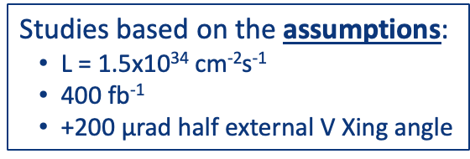
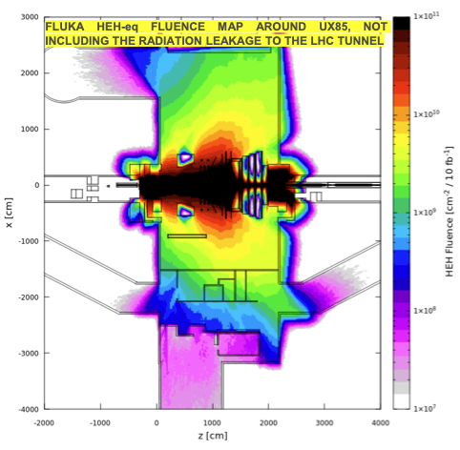
Upgrade II - impact on LHC
Compared to P1-P5, the non-hermeticity of the LHCb detector implies that the radiation levels in US85 and the nearby alcoves are relatively high
With increased luminosity, potential limitation to machine availability
  From higher instantaneous luminosity value
    Heat deposition on superconducting magnets -> quench
  From higher integrated luminosity
    Electronics failure induced by Single Event Effects (SSE)
    Cumulative degradation of components and systems
These aspects were identified early on as potential showstoppers, so resources have been dedicated to assessing feasibility issues in these areas

Slide 6
Outline
Studies on impact to equipment installed in:
  LHC tunnel: state of the art
  service caverns (UX85, US85, UL84/86, UW85): recent development
Observations from 2024 run
Considerations on machine performance and ION plans for Run5

Slide 7
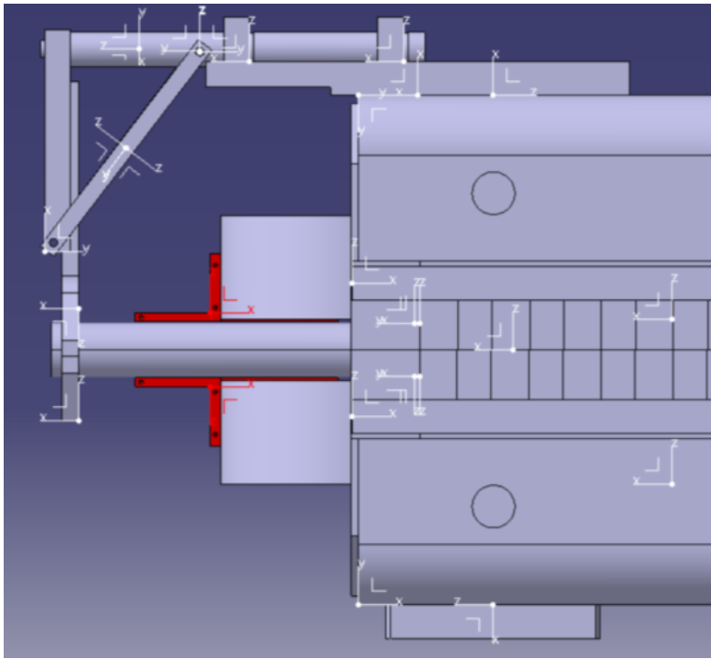
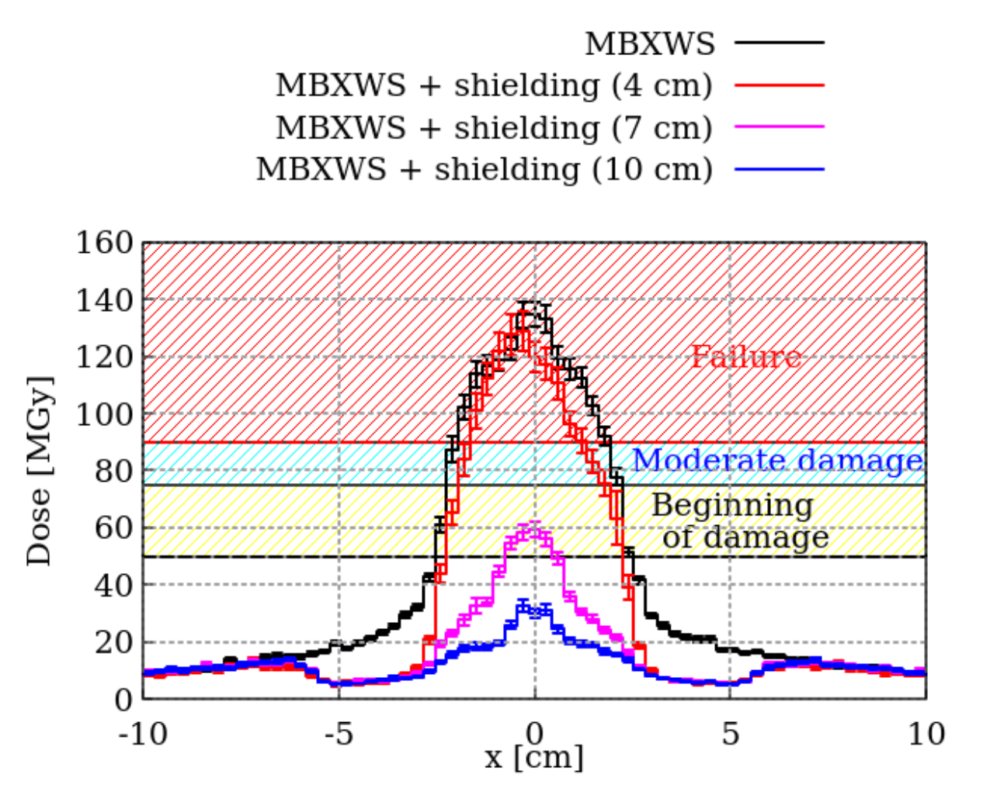
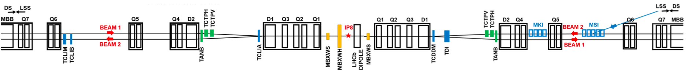
Warm compensators
FLUKA simulations show:
Dose on MBXWH would reach 48 MGy, below damage onset ➔ NO required action
Dose on MBXWS up to 140 MGy, while damage limit is 75 MGy ➔ tungsten shield allows dose reduction up to a factor ~5
IP8

Slide 8
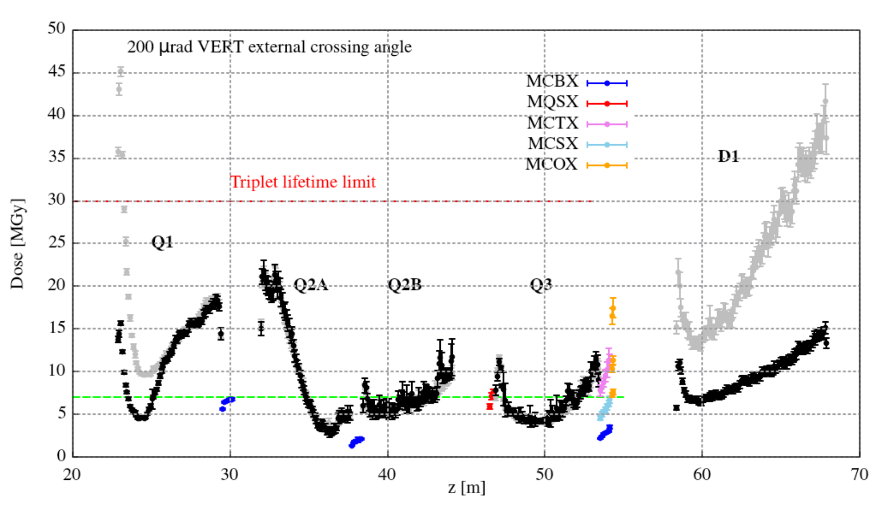
Q1/D1 protection
Transform MBXWS into a TAS-like object (lack of space for TAS), by filling the space between the magnet yoke and the vacuum chamber with absorbing material
  Power density (on Q1) to values safely exceeded during Run 2 in IP1/5
Replace D1 beam screen with a smaller one (identical to Q3), allowing to add a layer of internal shielding, reducing D1 aperture
  Significant reduction of peak power density on non-IP side of D1
The grey dots are current layout, while black ones with the shielding options
Extend the shielding towards Q3 and through DFBX (major engineering challenges & additional power)
  Protect the IP side of D1
IP8

Slide 9
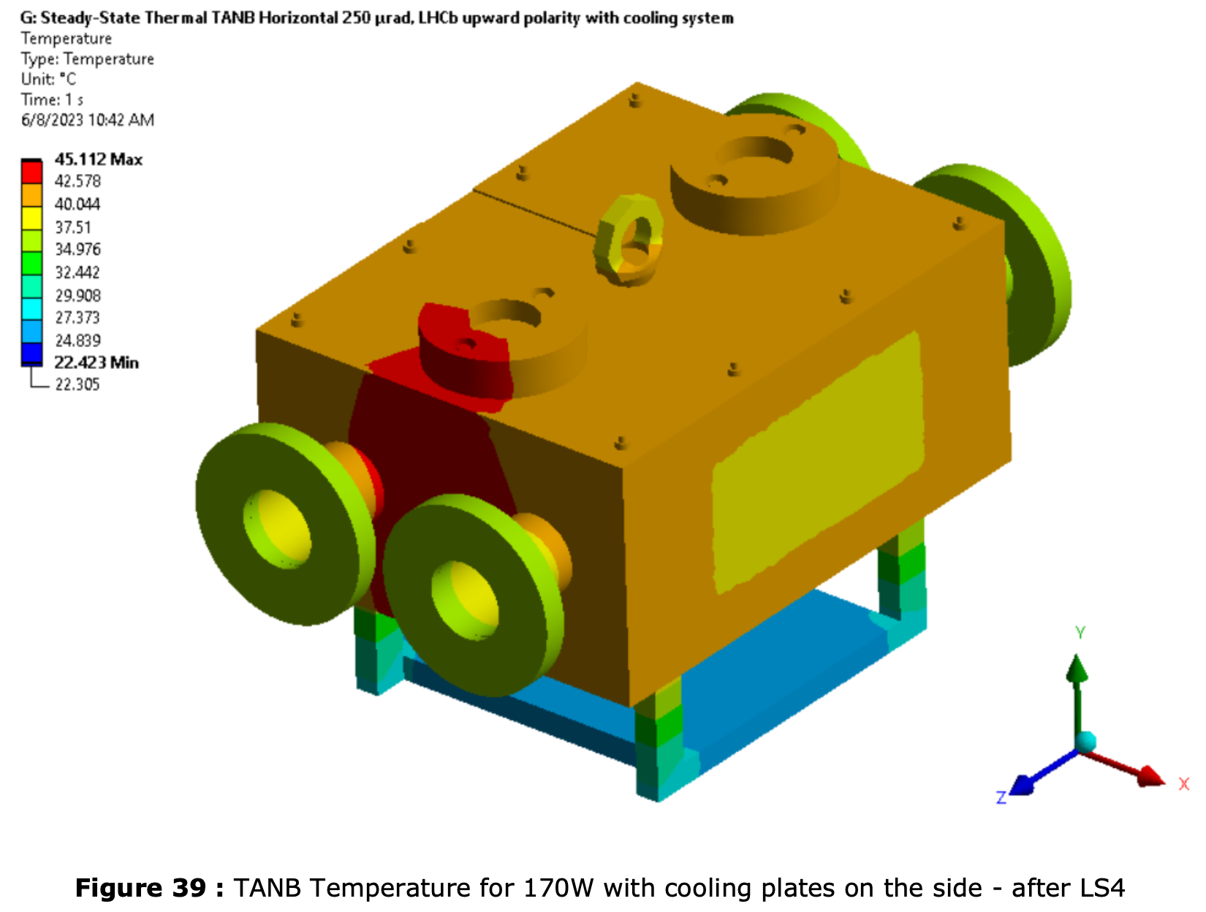
D2 and beyond
Simulations show TANB is effective to protect D2. Thermal simulations suggest that a cooling system may be needed
Studies show no need to protect Q5-Q6-Q7
Recent observations show that a TCL6 collimator may be required to protect the Dispersion Suppressor (Q8-Q10), see later
IP8

Slide 10
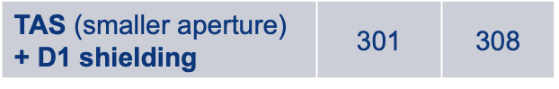
Cryogenic system – inner triplet
Power between 390 W (NO changes) and ~345 W (ALL changes) will need to be extracted on both inner triplets in IP8
Upgrade junction module between refrigerator and triplet (as installed in ATLAS/CMS) to allow extraction of 325
Reduce aperture of MBXWS-TAS to lower power deposition to ~300 W
Increase cooling power in 4.5 K refrigerators for IT/D1
  Exchange the refrigerator ➔ very costly
  Additional carbon coating on beam screens to recover power from ARCs ➔ coating efficacy to be evaluated
Modification(s) | IT-D1 total power
 | IP8-L | IP8-R
Upgrade II | 331 | 388
TAS | 297 | 307
TAS + D1 shielding | 338 | 346

Slide 11
Outline
Studies on impact to equipment installed in:
  LHC tunnel: state of the art
  service caverns (UX85, US85, UL84/86, UW85): recent development
Observations from 2024 run
Considerations on machine performance and ION plans for Run5

Slide 12
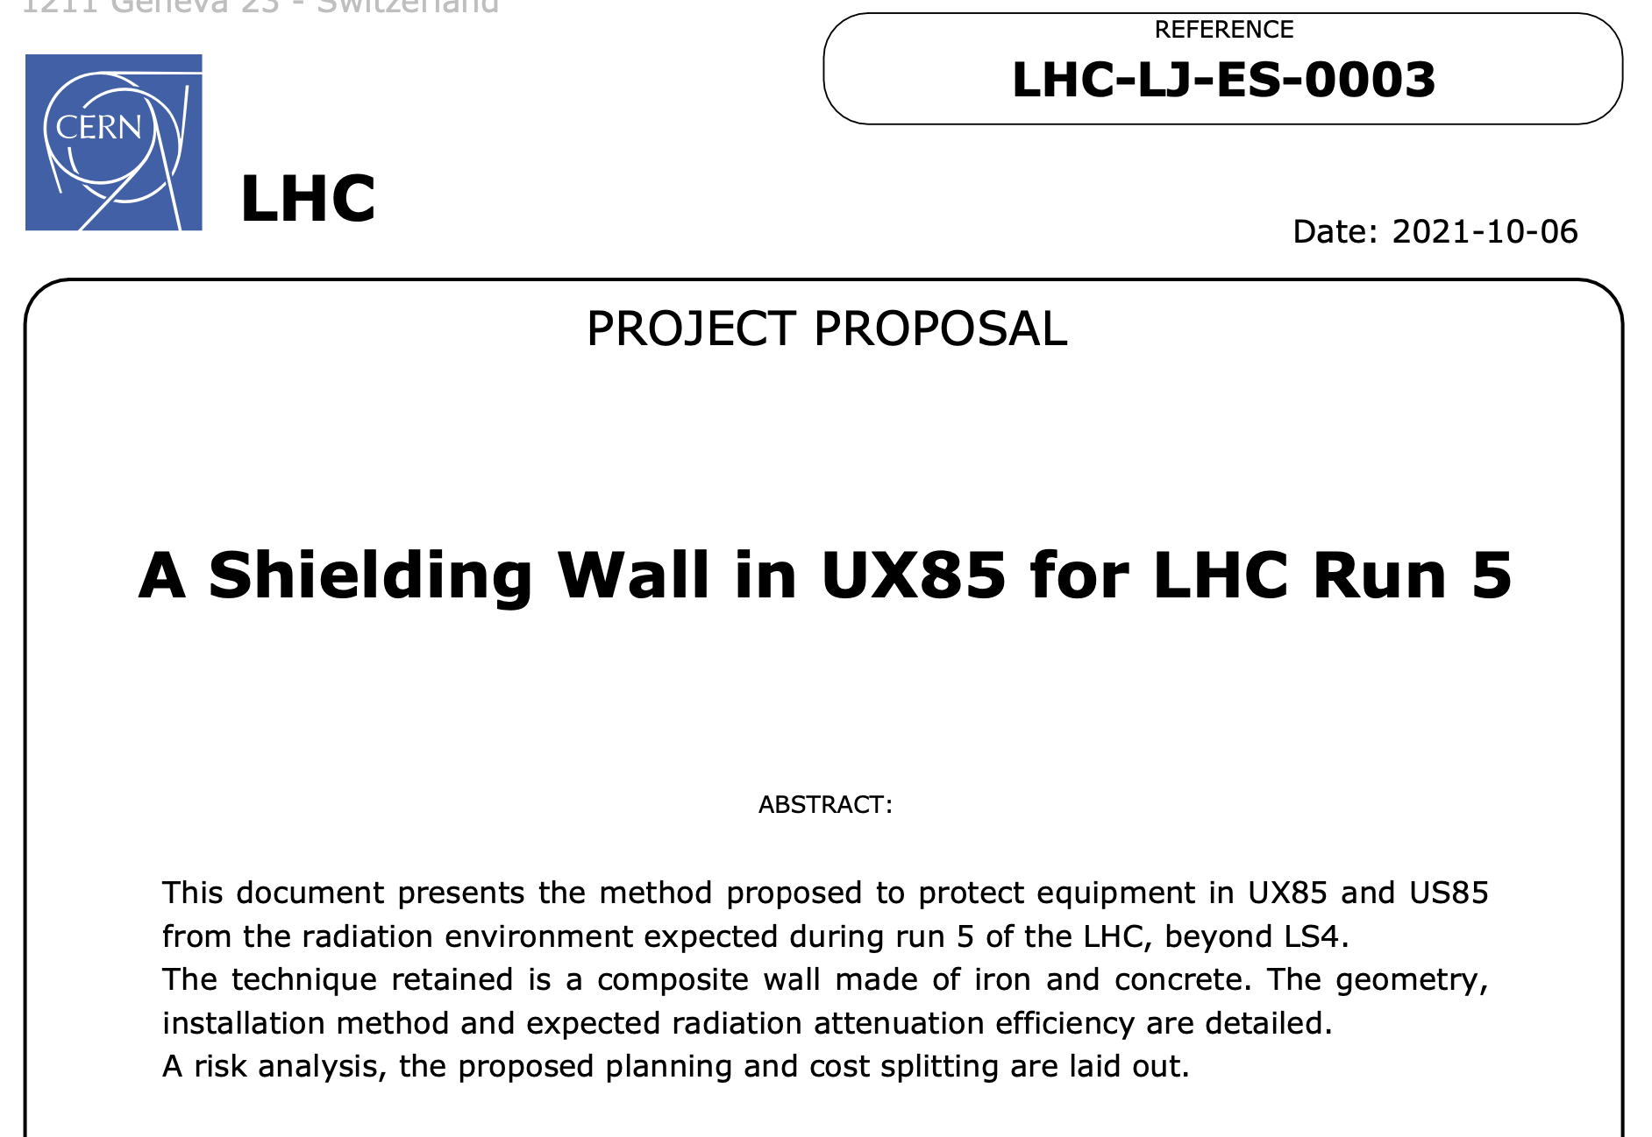
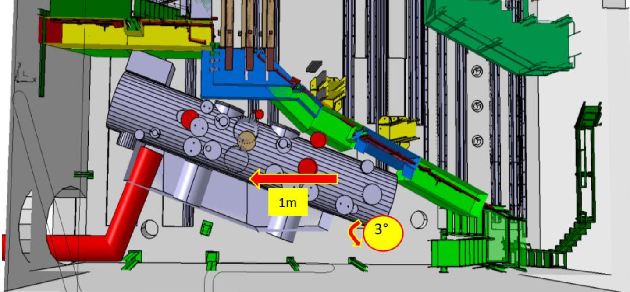
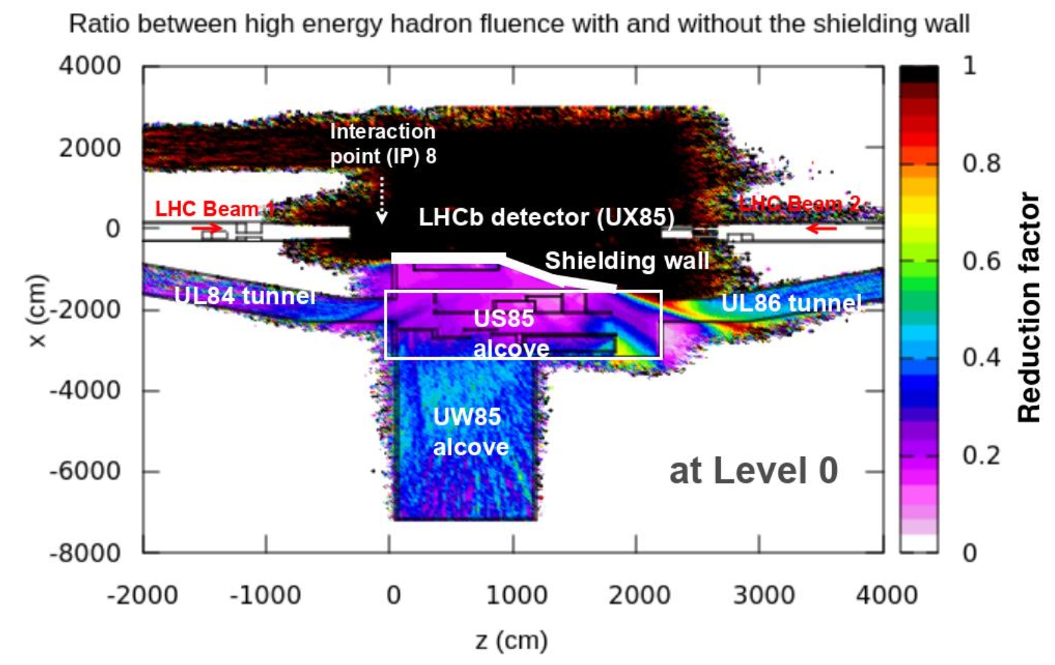
The shielding (UX85)
The UX85 cavern, housing LHCb experiment has the peculiarity to also house extensive amounts of LHC machine equipment, mainly cryogenics
Shielding wall between LHCb detector and LHC equipment was proposed to reduce radiation levels by a factor of ~5, to compensate the increase in annual integrated luminosity
  Original idea: shielding in UX85
  NO consensus on design
  Need to drift and rotate large cryogenic equipment
  Movement of large blocks in reduced space
  Reduced time
      no cohabitation in LS4 in UX85
  Large cost

Slide 13
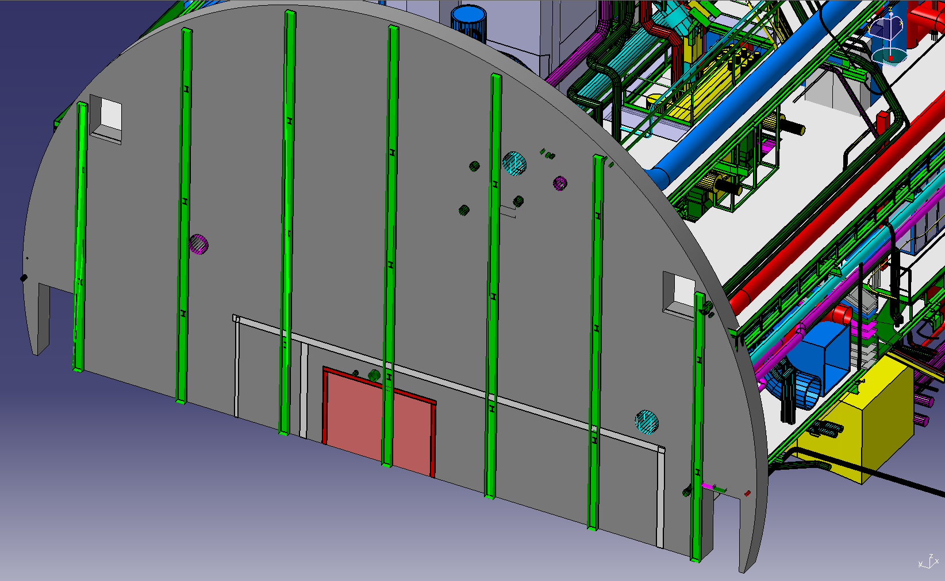
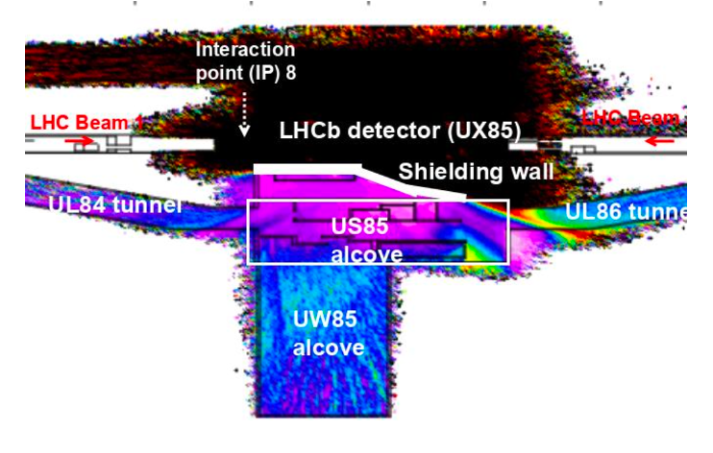
The shielding (UX85-US85)
A new solution is identified, by construction of a concrete wall betweek UX85 and US85 (present wall is made of SIPOREX blocks):
Easier to install
Possible to be done in LS4
Needed modifications are significantly easier
This option provides similar radiation attenuation in US85, but NO protection for equipment in UX85 (acceptable)

Slide 14
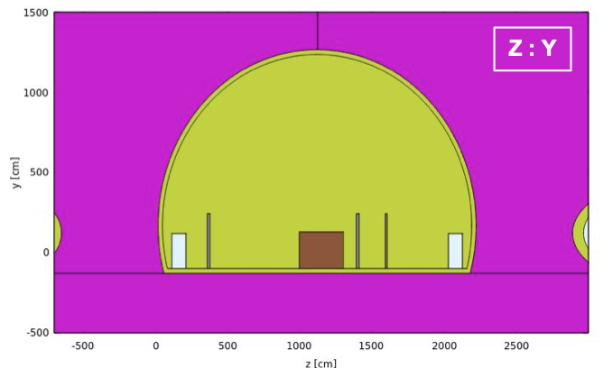
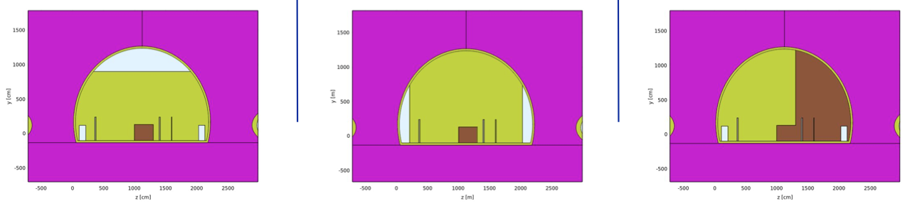
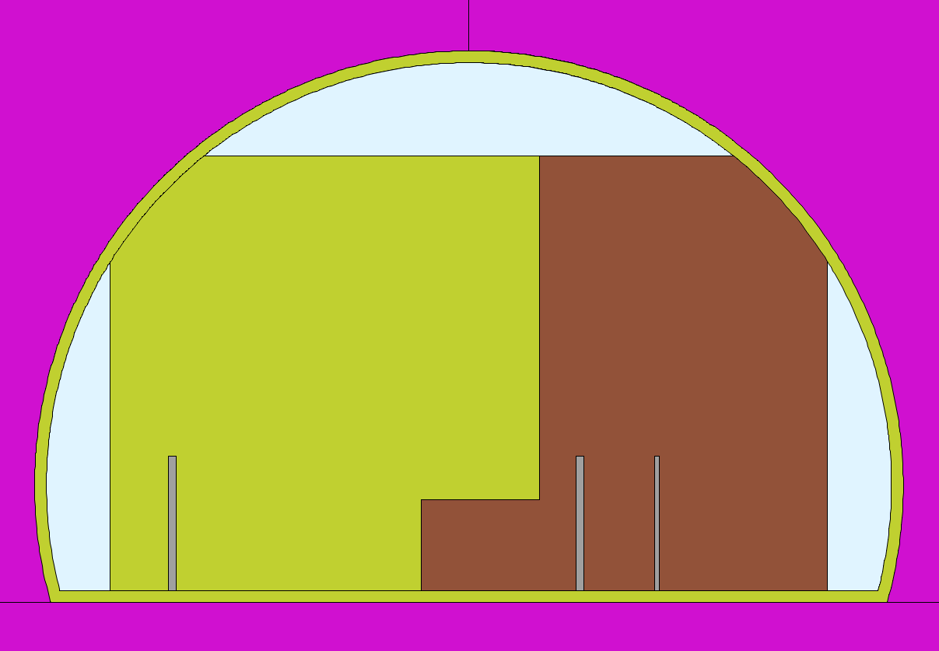
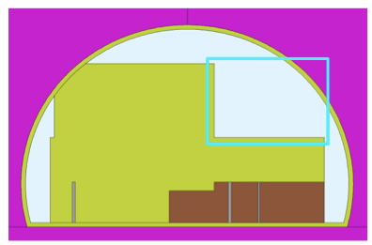
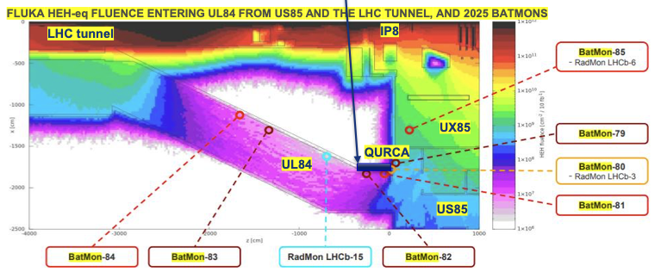
The shielding (UX85-US85)
Main challenges
  Charge on the soil
  Stability of the present wall during installation
  Modification of equipment attached to the wall:
    gaine de ventilation
    Optical fibers (LHCb) ➔ installation in LS4
    Pipes (demineralised water, fire brigade, etc)
Radiation mapping
  Several Radiation monitors installed in US85 & UX85 to characterise radiation and benchmark simulations
Design optimisation
  Large effort in semplification
  Simpler designed being achieved by re-design of critical equipment, rack displacement and local shielding

Slide 15
Outline
Studies on impact to equipment installed in:
  LHC tunnel: state of the art
  service caverns (UX85, US85, UL84/86, UW85): recent development
Observations from 2024 run
Considerations on machine performance and ION plans for Run5

Slide 16
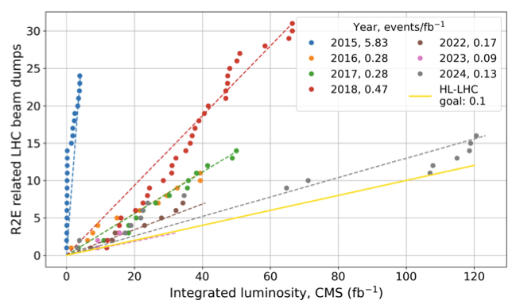
Recent observations
Order of magnitude of annual dose in the Dispersion Suppressor (DS) (cells 8-9) of P8 reached in 2024 that of P1 (where a COLL is installed to protect the DS), with different profile due to optics
Six of the 16 R2E dumps in 2024 were in P8 (compared to 0 in past pp runs), which shows an outsized impact with >0.5 dumps/fb⁻¹
  HL-LHC goal < 0.1 dump/fb-1 (achieved in other points)
 | 2022 | 2023 | 2024 | 2024/2023
P1 | 41 fb⁻¹ | 32 fb⁻¹ | 125 fb⁻¹ | ~4
P5 | 41 fb⁻¹ | 32 fb⁻¹ | 123 fb⁻¹ | ~4
P8 | 1 fb⁻¹ | 0.5 fb⁻¹ | 11 fb⁻¹ | ~20
Note: LHCb integrated luminosity increased by ~20x in 2024 wrt 2023
(and over 4x more than previous record of 2.45 fb⁻¹ in 2018)
Courtesy of FLUKA team

Slide 17
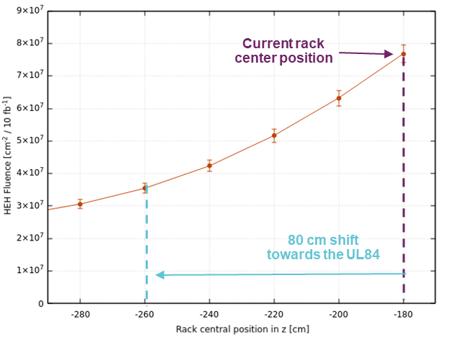
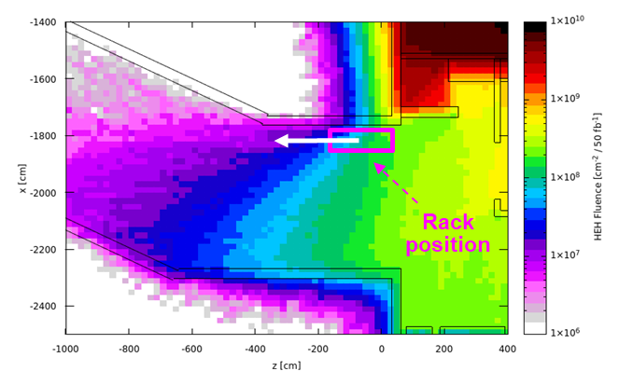
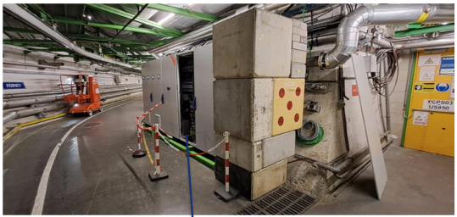
Recent observations - mitigations
Electronics controlling the cryogenic system was affected by 2 single event effects, resulting in ~60h LHC downtime
  Mitigation measures during the YETS 24/25 to reduce radiation levels:
    Racks moved by 80cm towards UL84 + installation of concrete shielding
    Simulations indicate that radiation levels will be reduced by a factor ~3.5
Preliminary studies show that a TCL collimator would substantially reduce radiation levels in the DS, with no impact on downstream losses
Courtesy of FLUKA team

Slide 18
Outline
Studies on impact to equipment installed in:
  LHC tunnel: state of the art
  service caverns (UX85, US85, UL84/86, UW85): recent development
Observations from 2024 run
Considerations on machine performance and ION plans for Run5

Slide 19
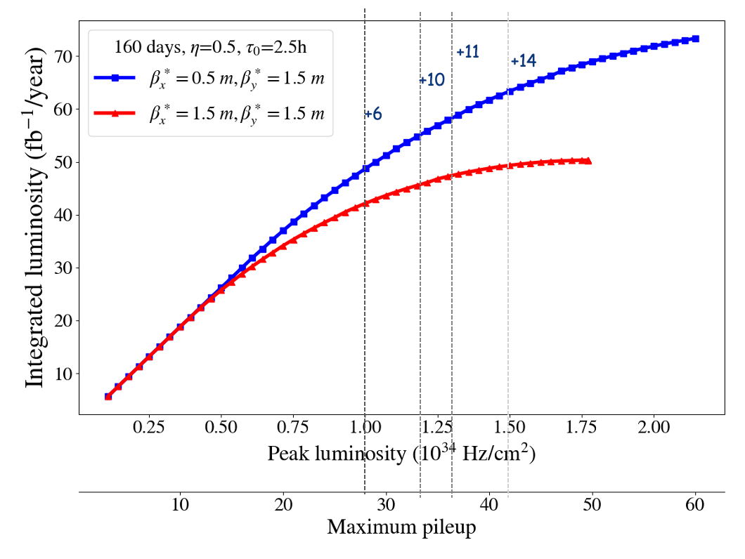
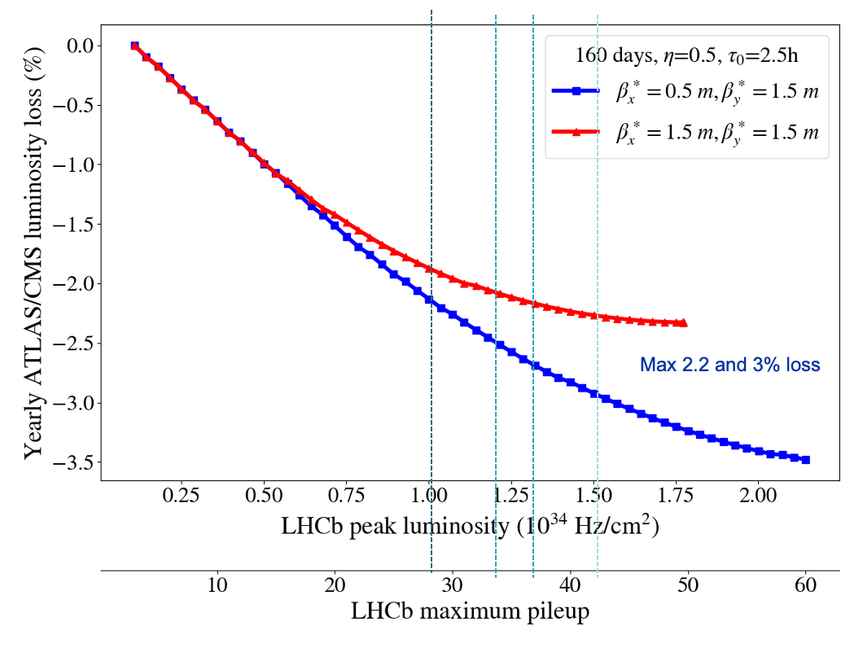
Optics and lumi
Increased performance with flat optics (β*_{H}=0.5 m – β*_{V}=1.5 m) wrt to baseline of round (β*_{H}=1.5 m – β*_{V}=1.5 m):
  Higher integrated luminosity: 15-20% gain (7-14 fb⁻¹)
  Leveling time increase ~2 hours
Maximum loss of ATLAS/CMS integrated lumi around 2.5% for round and 3% for flat
Flat optics configuration must be verified with Dynamic Aperture studies and MDs
Peak pile-up density increase by 25% and shorter longitudinal luminous region by 12% between flat and round
Skew crossing and orthogonal offset: shift of peak pile-up density from z=0 with flat optics
  ➔ it can be mitigated by non-fullly orthogonal separation
No reason identified today that would prevent flat optics from being used
Deployment of flat optics in P1/P5 in 2025 will allow for increased confidence
Courtesy of S. Kostoglou, more info

Slide 20
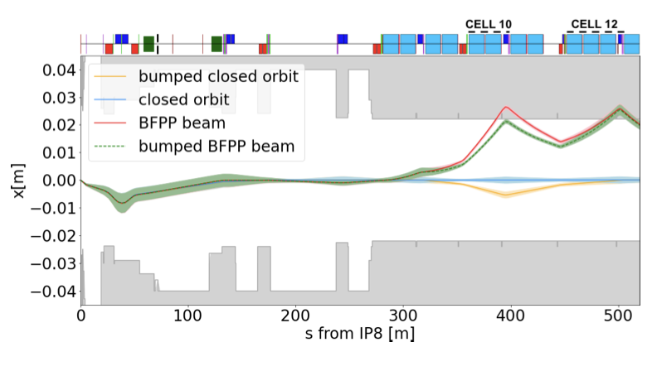
IONS in Run3 and Run4
2024 luminosity production in single fills largely surpassed HL-LHC projections
  significantly higher bunch intensity from injectors
  Mitigation of LHC limitations
Plan for Run 3 & 4: continue production as in 2024
  Incremental improvements may be within reach, but probably not big factors
LHCb specific:
  Run3 – attempt to reduce beta* to 1m in 2025
  Adding TLCD collimators in cell 11 (as for ALICE) could allow a significant increase in peak luminosity (minimal gain in integrated luminosity) - presently not foreseen
    TLCD are available (11 T dipoles inheritage)
    Further studies and checks (energy deposition, budget, feasibility…) are needed
Courtesy of A. Frasca R. Bruce, more info

Slide 21
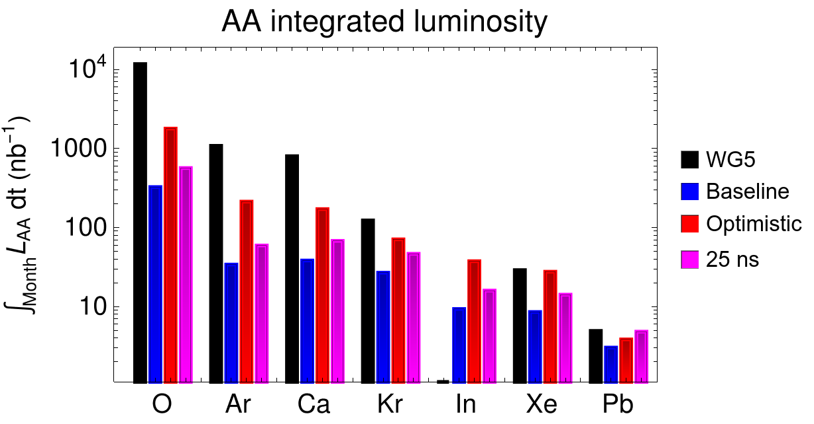
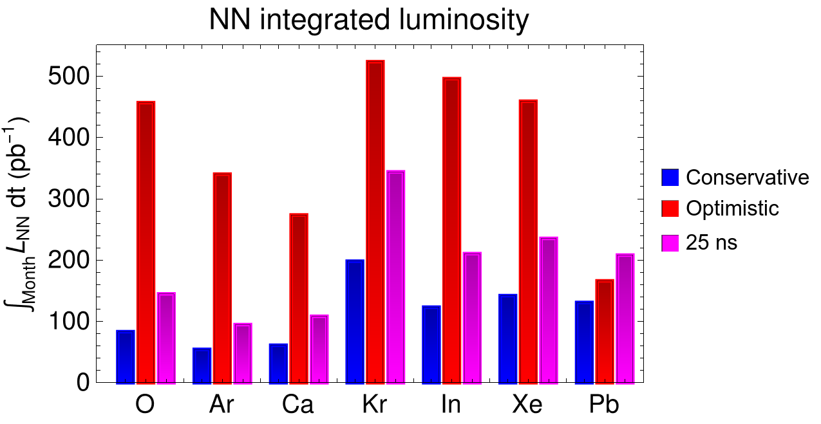
IONS in Run5
Plots refer to ALICE luminosity to be used for reference. The gain factors for LHCb might be different
Different ways to nucleon-nucleon luminosity higher than HL-LHC Pb-Pb
Further optimizations to the beam production scheme in the injectors
  50 ns (present baseline) without PS splitting, and several optimistic assumptions in the injectors and LHC
  25 ns spacing
    Requires upgrade of RF system in PS
    40% more bunches in LHC but longer injection time
Use other ion species than Pb
  Potential to achieve higher bunch intensities and NN luminosity
Optimistic
  They rely on assumptions not yet proven
25 ns
In baseline scenario, up to 50% gain using Kr instead of Pb
25 ns pays off the best for the heavier ions (about 60% gain over Pb in baseline scenario)
Courtesy of R. Bruce, more info

Slide 22
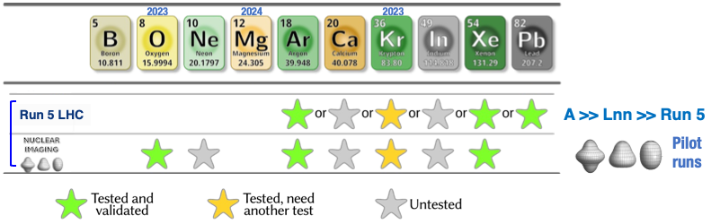
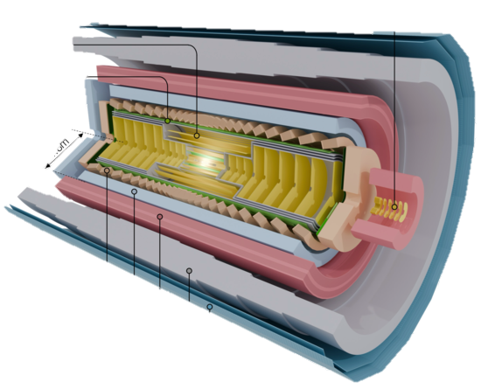
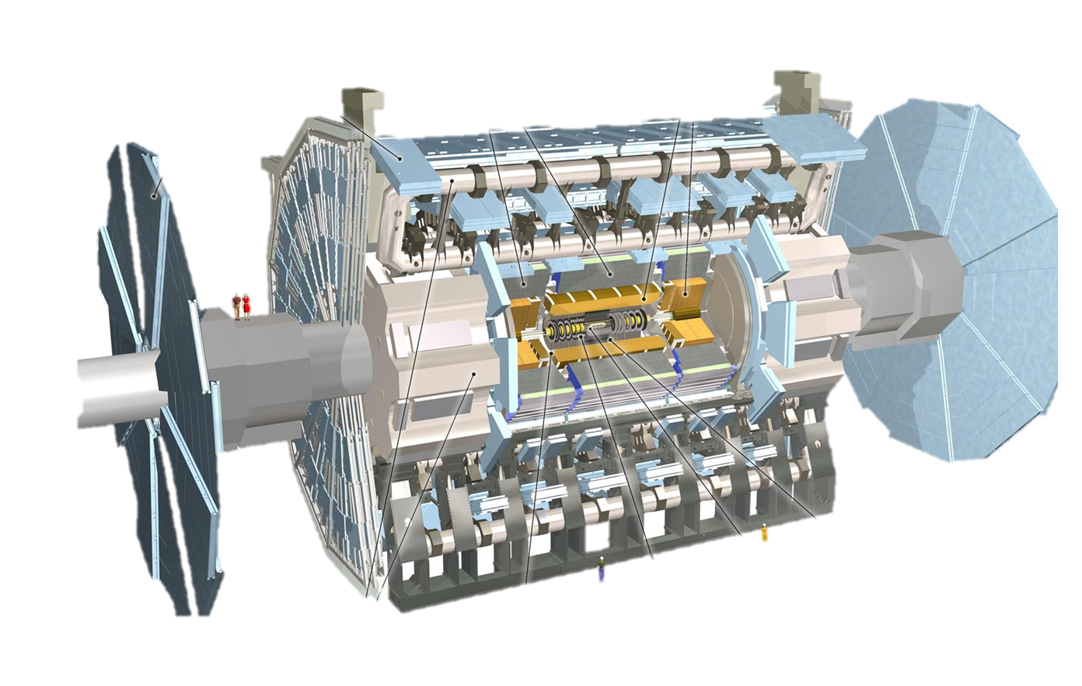
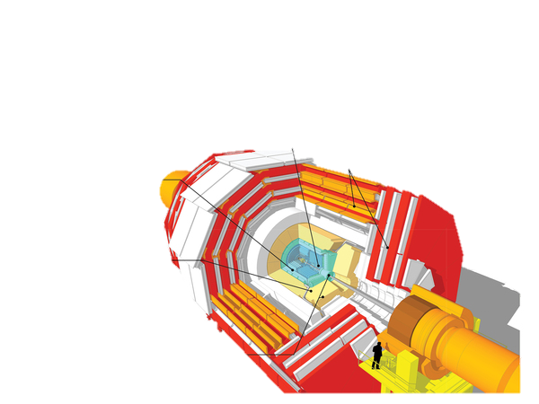
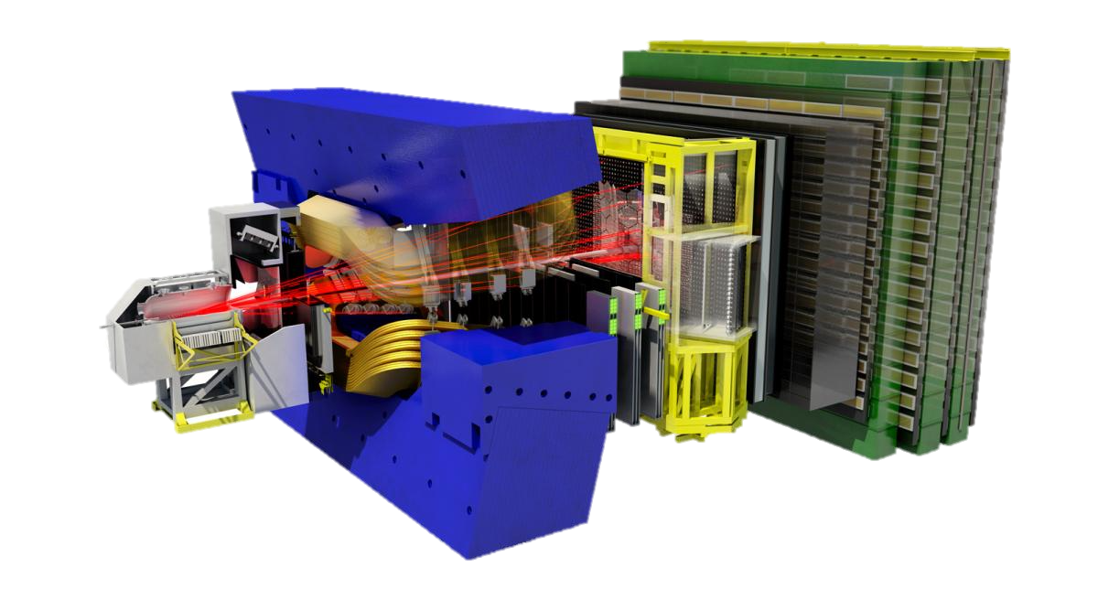
IONS – more species
Proposals, not approved
(except high-intensity LHC ions operation in Run 4&5)
LIGHT(er) IONS
How different nuclear structure influences QGP formation
Onset of deconfinement vs system size
ALICE3
ATLAS
LHCb
CMS
Concurrent feasibility studies during a LHC and NA physics year are challenging
  One ion source for development and operation:
    New ions can potentially contaminate the source
    Limited time for studies
Ion Complex Upgrade under preparation
  Second additional ion source
  New PS RF cavities for 25 ns
  Alternative stripping before PS
QGP: Quark-Gluon Plasma
Courtesy of R. Alemany, more info

Slide 23
Impact on LS3
NO activity is strictly required to be carried out during LS3
  Installation of the wall in LS3 was considered, but discared for technical reasons and resources availability:
    Critical LHCb optical fibers to be displaced
    Partial installation (LS3+LS4) may pose problem of contractors
    Resources committed
We could profit to anticipate some activities to LS3 (pending resources availability):
  Potential further displacement of cryo rack (if confirmed to be required by 2025 observation)
  Modification of MBXWS into TAS?
  Installation of shielding on MBXWS?
  TCL collimators to protect DS?
  TCLD collimators for BFPP losses?

Slide 24

Conclusions
As result of the LHCb upgrade, the yearly integrated luminosity at IP8 (consequently radiation levels) will increase by a factor ~5
Long-term studies identified viable solutions for equipment
  LHC tunnel
  technical caverns: ensured by reinforcing the UX85-US85 wall
    UX85 shielding wall installation discarded
      Installation possible in LS4
      Design being finalised to prioritise simplification
Significant performance improvement can be achieved with flat optics
  Gaining experience in P1/P5 in 2025 is important
ION beam performance from injectors has already exceeded HL-LHC expectations, with further improvement under discussion

Slide 25
SPARE

Slide 26
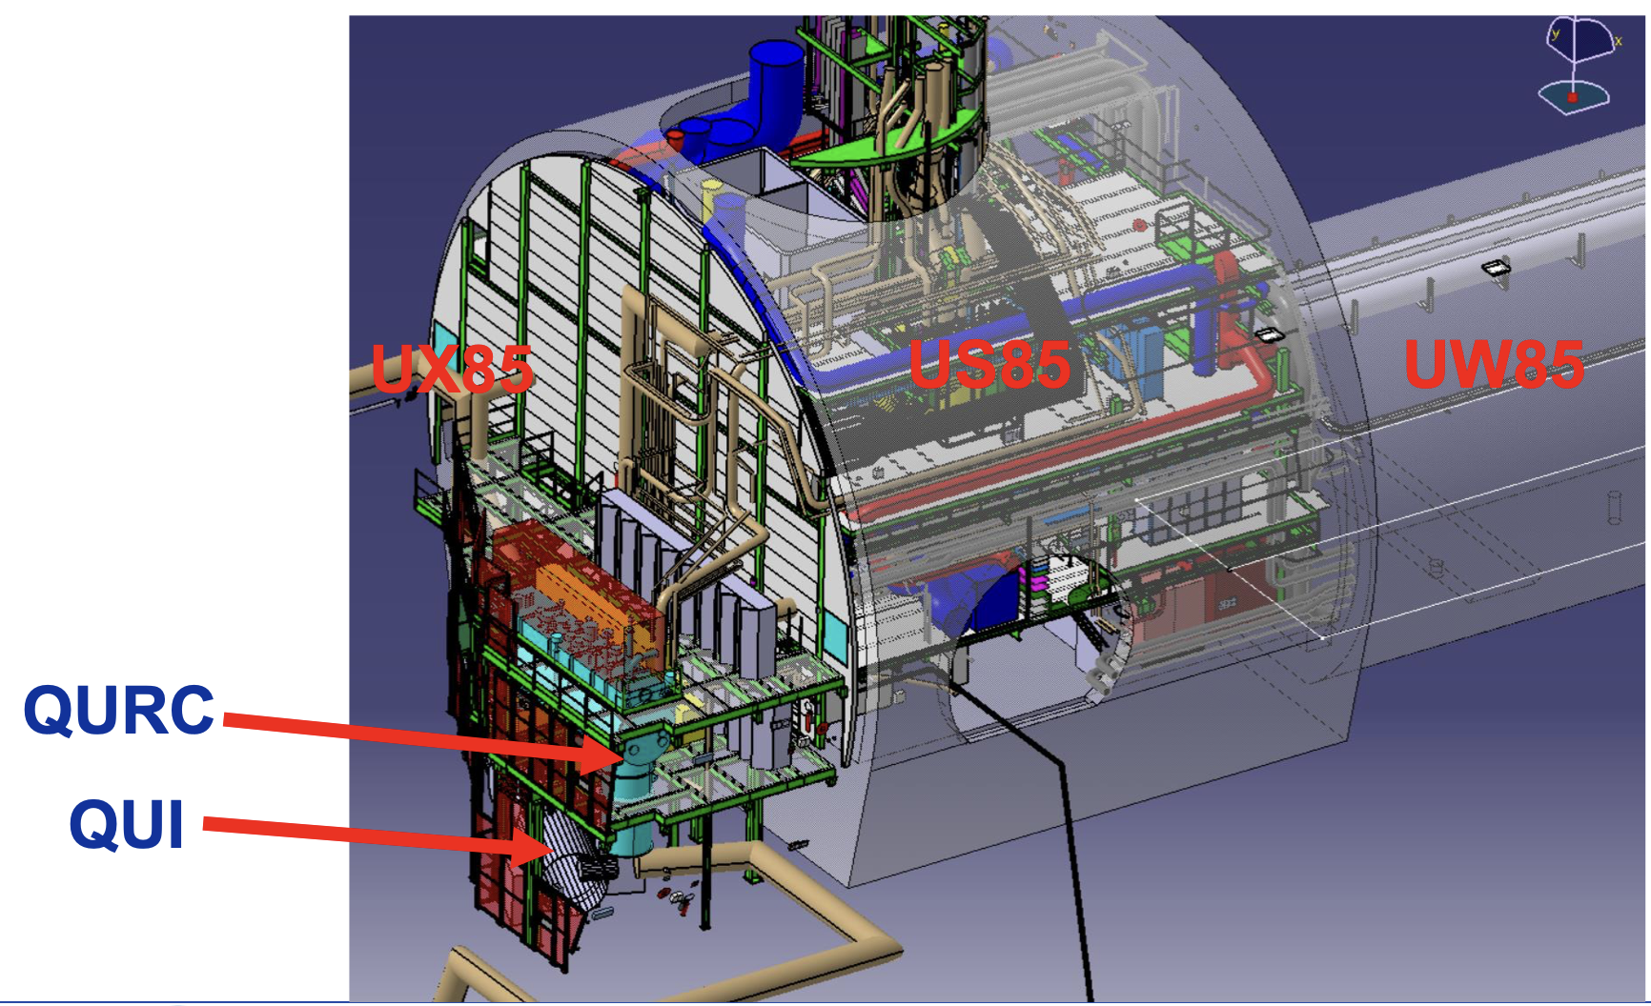
Service caverns
The UX85 cavern, housing LHCb experiment has the peculiarity to also house extensive amounts of LHC machine equipment, mainly cryogenics
Radiation effects to electronics are a source of LHC downtime, SEEs and cumulative degradation of components and systems
The many efforts done in the past (Radiation to electronics (R2E)) allow to safely and reliably run the LHC in Run3/4 (upgrade I)
However, with LHCb upgrade II, the equipment in UX85 and US85 technical cavern would be subjected to substantial increase of radiation, possibly leading to downtime and failure

Slide 27

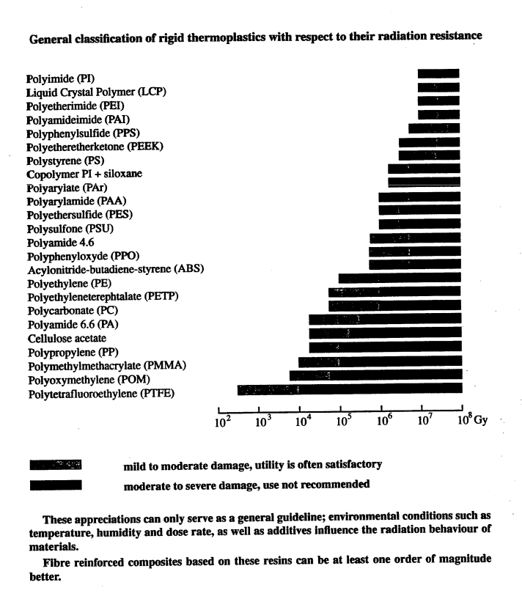

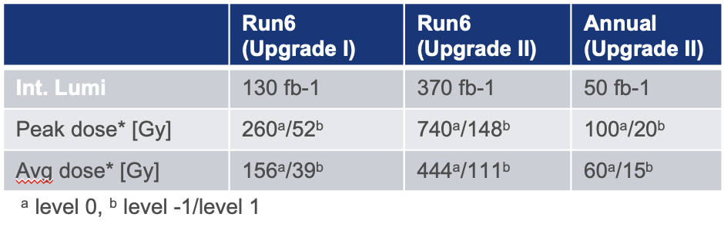
Impact on cryogenics
Use NOT recommeded
Impact on electrical/mechanical components:
While exhaustive mapping of Run3 radiation levels is ongoing, NO showstopper is identified to expose the equipment in the UX85 cavern to the expected level of radiation
Dose at 7m (worst case) from IP8
Evaluate the degree of degradation vs radiation level:
“W.r.t. Schonbacher (1998) the thermoplastic radiation resistance is not affecting in long term the lifetime of the material of the most common equipment (cabling and sensor present in the QURC and QUI).”

Slide 28
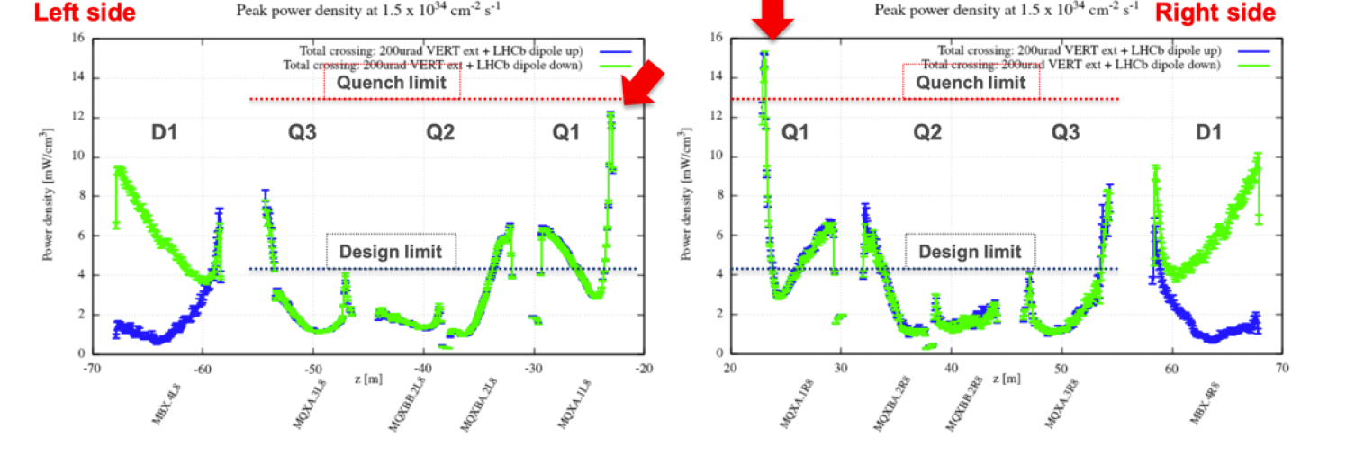
Main challenges
The following is based on studies, under the assumptions:
L = 1.5x10³⁴ cm⁻²s⁻¹
400 fb⁻¹
+200 μrad half external vertical crossing angle
Impact on downstream magnets
The inner triplet and D1 magnets must be protected from collision debris (no TAS in IP8)
  The deposited power could cause quench issues to Q1 and D1
  Q1 and D1 exceed lifetime limits for 400 fb⁻¹
D2 & DS protection
Heat load exceeds installed capacity

Slide 29
Discarded options
Options considered for relocation of cryogenic equipment:
surface building
  abandoned already during studies for the LHC project in 1995- 2000, due to the hydrostatic overpressure of the gaseous helium
New service cavern underground to be used as an extension of the present service cavern (US85), to relocate the cryoplants underground
  discarded because it would require major civil engineering that would generate costs in the range of 50 MCHF, considered prohibitive
DELPHI cavern
  partial dismantling of counting houses) is considered NOT an option by LHCb
  (VERY) long cryo connections to UX85 technically NOT acceptable
US85/UW85
  Due to the very large size, some of the components (QURC, QUIC) cannot be relocated

Slide 30
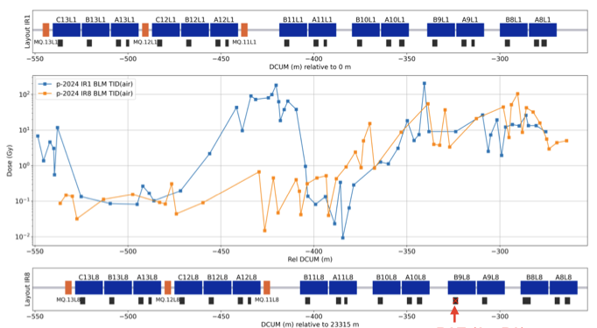
Recent observations
Main observation: order of magnitude of annual dose in the Dispersion Suppressor (DS) of P8 similar in 2024 to that of P1 (where a COLL is installed to protect the DS), with different loss profiles and a left-right asymmetry in P8
Simulations benchmarked to the 2024 BLM data of P8 DS
Preliminary studies show that as in P1-P5, a TCL collimator would substantially reduce the radiation levels in the tunnel in the DS (cells 8-9), with no impact on the downstream losses
Studies will continue to check settings and optics and to identify any potential side-effects (e.g., radiation hotspot around the TCL)
Possibility to order additional TCLs in the framework of the current HL-LHC production contract (as options)
Courtesy of FLUKA team

Slide 31
IONS in Run5
Aim at significantly higher nucleon-nucleon luminosity than HL-LHC Pb-Pb
Different ways to further increase luminosity
  Further optimizations and upgrades to the Pb beam production scheme in the injectors
    50 ns (present baseline), no splitting in the PS
      Higher bunch intensity but fewer bunches and longer injection time
    Any of the above scenarios with optimized charge state or isotope
    Any of the above scenarios with additional electron stripping between LEIR and PS
    25 ns spacing
      Requires upgrade of RF system in PS
      40% more bunches in LHC but longer injection time
      Consider also scheme with 6 bunches from PS instead of 4 → more bunches in LHC and faster injection time, but lower bunch intensity
  Use another ion species than Pb (need to estimate potential luminosity)
    Potential to achieve higher bunch intensities from the injectors, and higher NN luminosity
    Electromagnetic cross sections in the LHC collisions scale with powers of the charge – less limiting
  Could combine all ways…

Slide 32
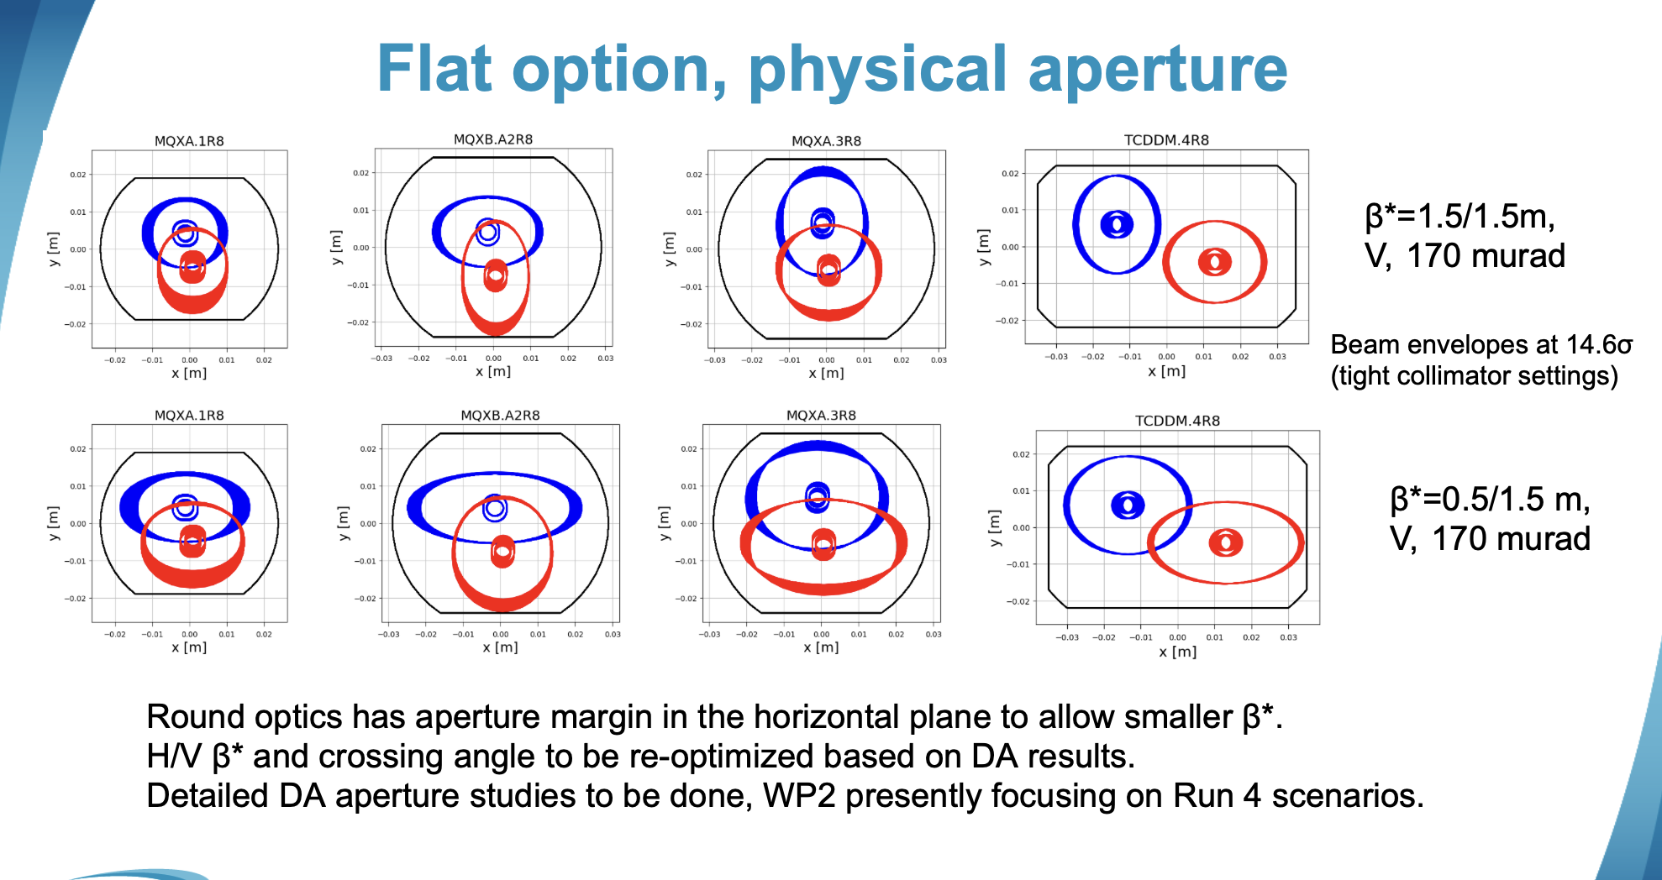

Slide 33
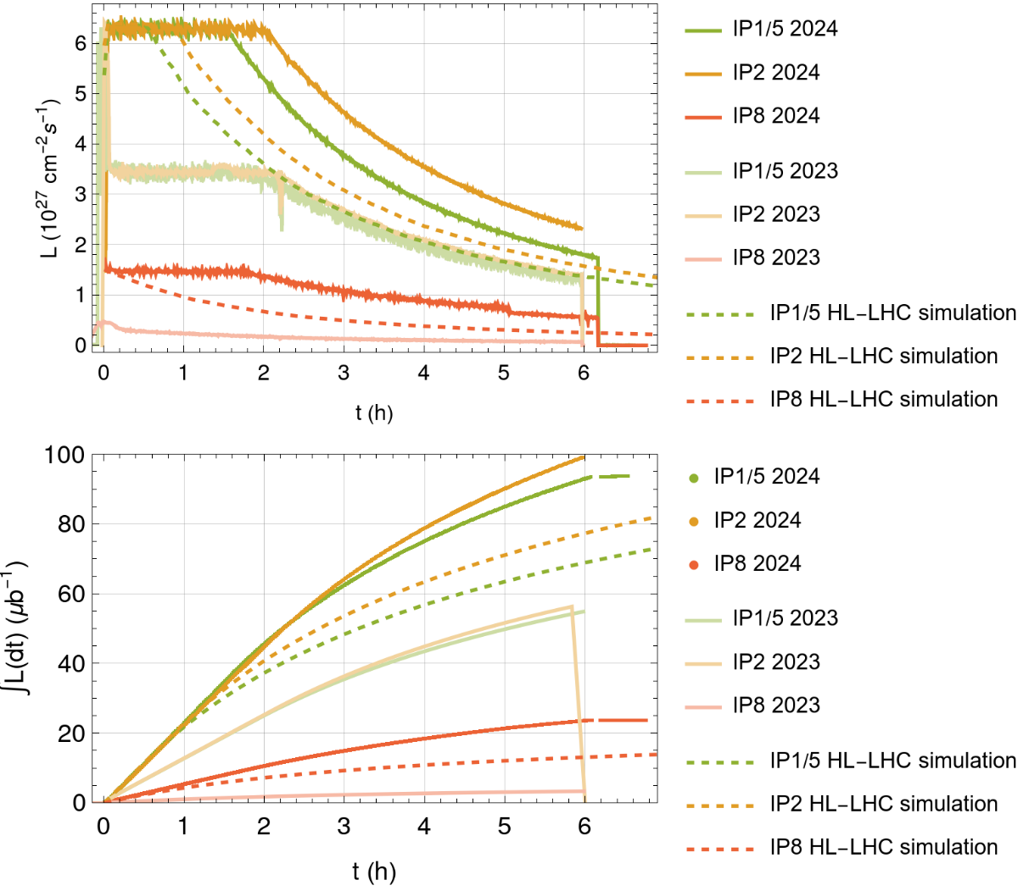
IONS in Run3 and Run4
2024 luminosity production in single fills largely surpassed HL-LHC projections
After 6h, LHCb has 80% more data than in HL-LHC prediction
  significantly higher bunch intensity from injectors
  Mitigation of LHC limitations
Plan for Run 3 (and 4): continue production as in 2024
  Optimizations in injectors already gave >3 higher bunch intensities and >2 more bunches in 2024 than in LHC design report (2004)
  Incremental improvements may be within reach, but probably not big factors
  LHCb: beta* = 1m will be tried in 2025
Fill 10400 (2024) vs Fill 9285 (2023)
Courtesy of R. Bruce, more info

Slide 34
IONS in Run4
Orbit bump allowed to reduce losses in cell 10, effectively moving the peak losses to cell 12 (higher BLM thresholds)
Adding TLCD collimators in cell 11 (as used for ALICE) would be a viable alleviation, allowing an increase in peak luminosity of ~2x (minimal gain in integrated lumi) - presently not foreseen
  TLCD are available (11 T dipoles inheritage)
  Further studies and checks are needed
    Energy deposition studies in cell 11
    Manufacturing of connection cryostat?
    Budget?
    Feasibility of installation (manpower, infrastructure etc)
Courtesy of A. Frasca, R. Bruce

