Slide 1
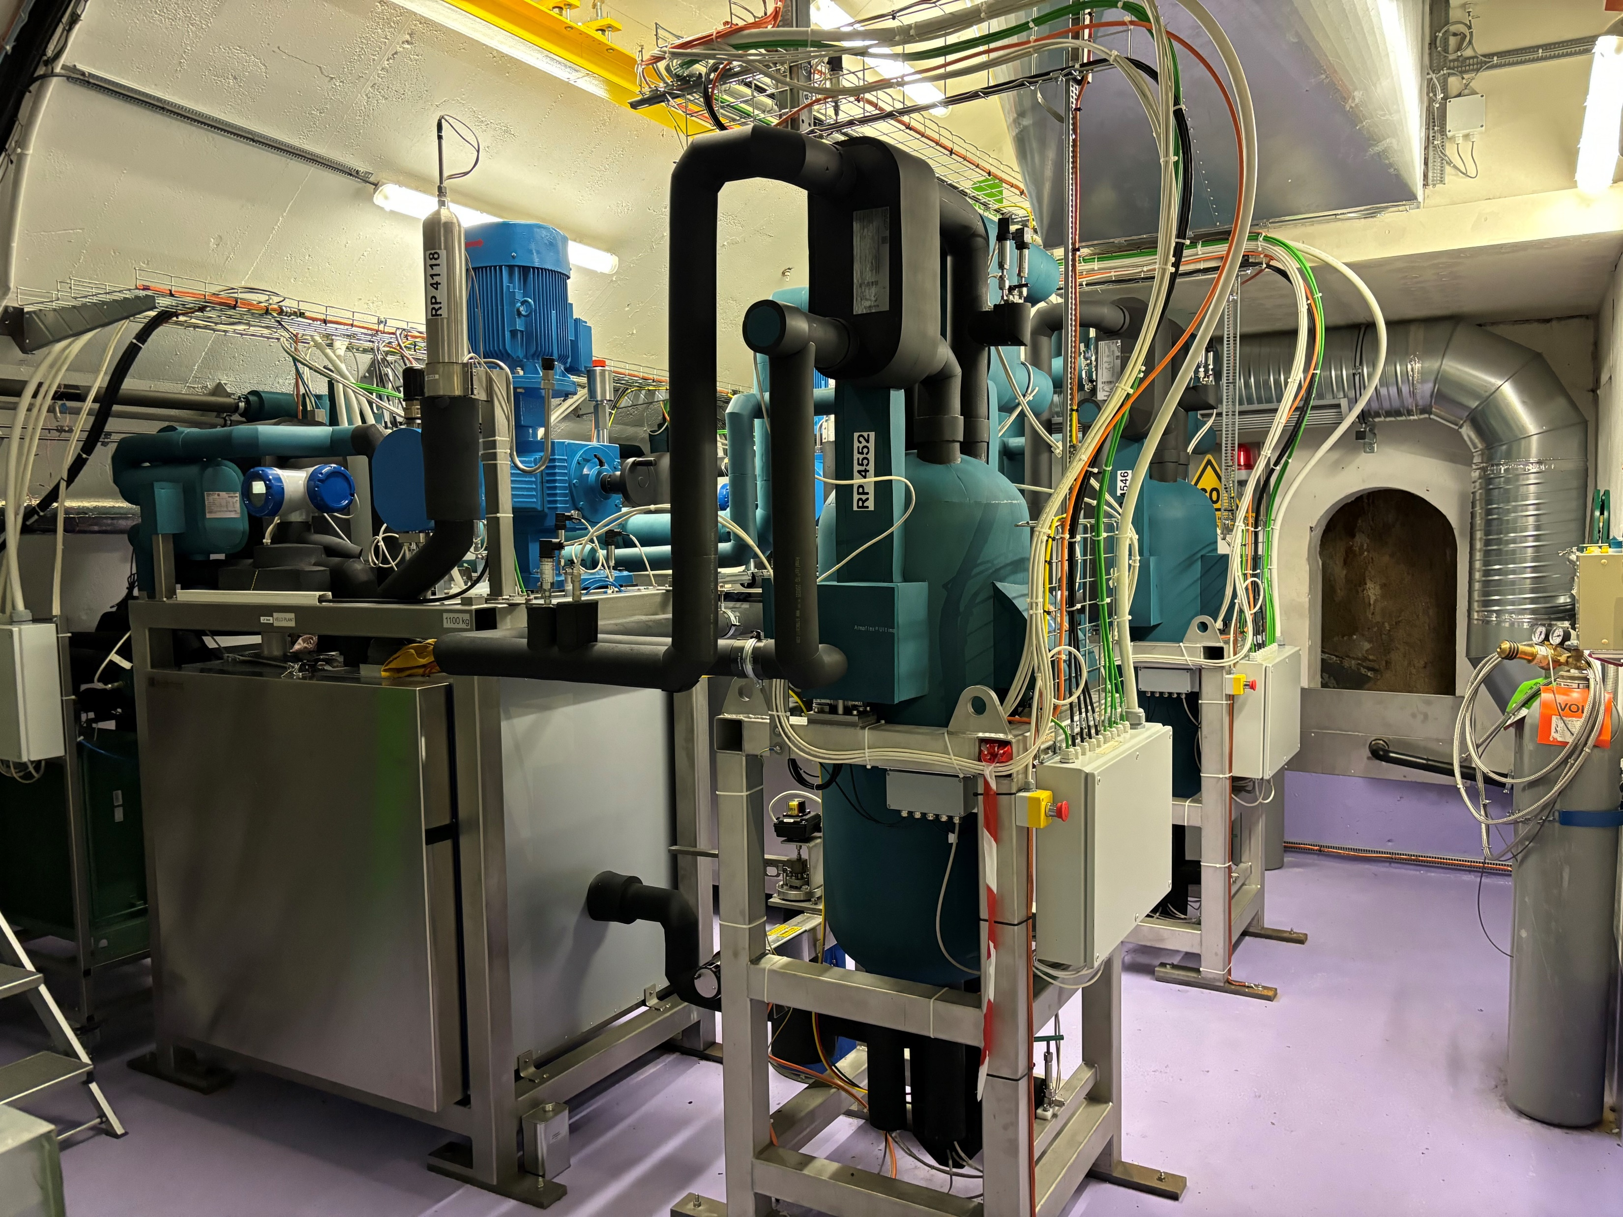
Detector
Cooling
8th Workshop on LHCb Upgrade II
Wiktor Byczynski

Slide 2
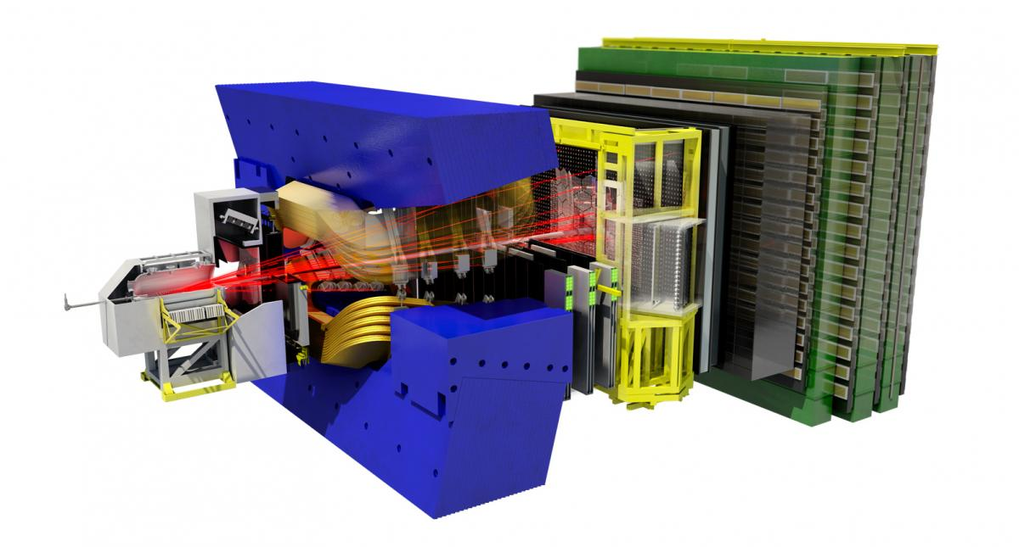
Cooling Requirements
VELO
  Pixel~ 4 kW (temp betwen -40°C to – 100°C)
    CO₂ 2PACL
    Krypton
    Cryogenics
    Other (not 1 phase)
RICH I + RICH II
  SiPM ~10 kW ~ -190 °C
    Cryogenics
  Electronic Readout ~ 20 kW
    Demi Water
UP
  Pixel 20 kW (temp betwen -20°C to – 40°C)
    CO₂ 2PACL
  Electronic Readout
    Demi Water
Magnet Stations
  Electronics Readout 3 – 8 kW +15°C
    Mixed Water/Demi Water
  SiPM ?? kW temp betwen ?? °C (sensor)
    CO₂ 2PACL
    Mixed Water/Demi Water/Chilled Water
    Other (1 phase)
SCiFi/MT
  SiPM ~ 3 kW ~ -190 °C
    Cryogenics
  Front End
    Demi Water
  Pixel ~54 kW
    CO₂ 2PACL
    Other
  Pixel Patch Panel Cooling ?? kW, ?? °C
    Other (1 phase?)
TORCH
  MCP 4.15 kW temp between 10°C to 15°C
    Mixed Water
    Other
  SiPMs ?
    Cryogenics
MUON
    Mixed Water
* differences compared to :
7th Workshop on LHCb Upgrade II

Slide 3
Cooling Requirements
UII Cooling Technologies
CO₂
Water
Others
Cryogenics

Slide 4
Cooling Requirements
UII Cooling Technologies
CO₂
Water
Others
Cryogenics

Slide 5
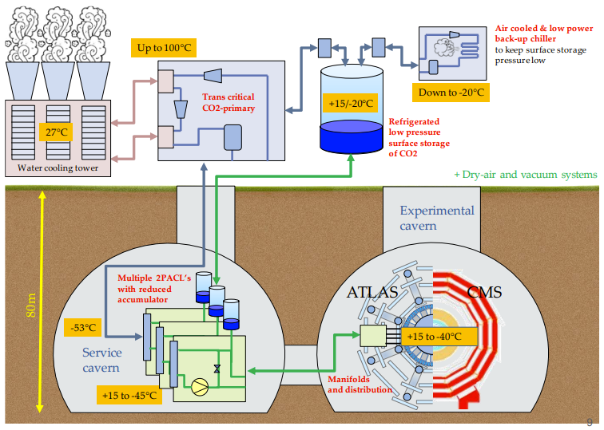
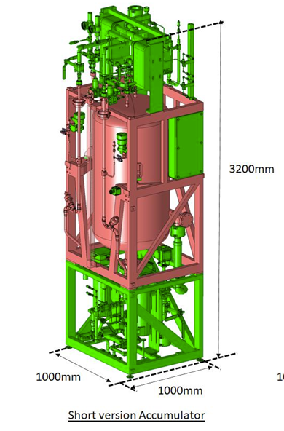
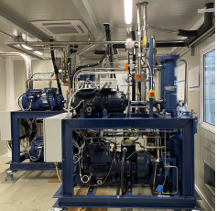
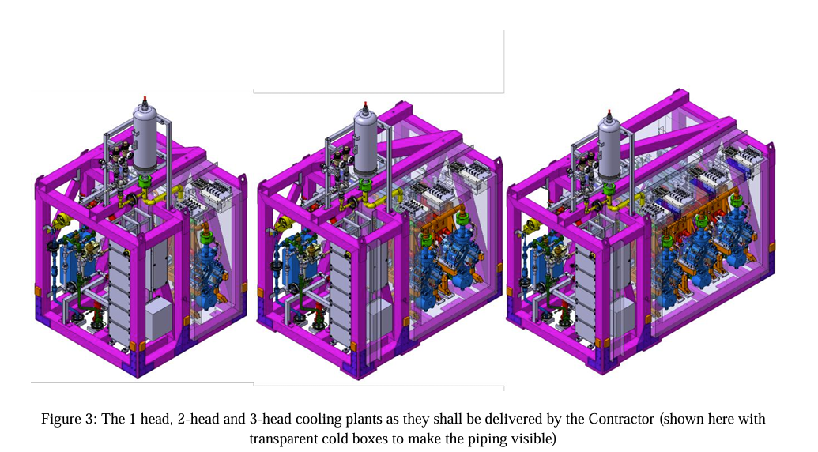
2PACL CO₂ – ATLAS & CMS Upgrade example
K.Sliwa
Y.Herpin

Slide 6
How many units ?
1 head unit
30kW CO₂ @ -40°C
1 unit per detector
no coolant sharing
process parameters flexibility
Redundancy/backup mode?
Sharable units
coolant sharing
process parameters must be the same
  DP setting
  Temperature setpoint
Redundancy/backup mode?
2 head unit
60kW CO₂ @ -40°C
Sharable unit + Back Pressure Regulator
require testing the principle
coolant sharing
process parameters flexible
Redundancy/backup mode?
3 head unit
90kW CO₂ @ -40°C

Slide 7
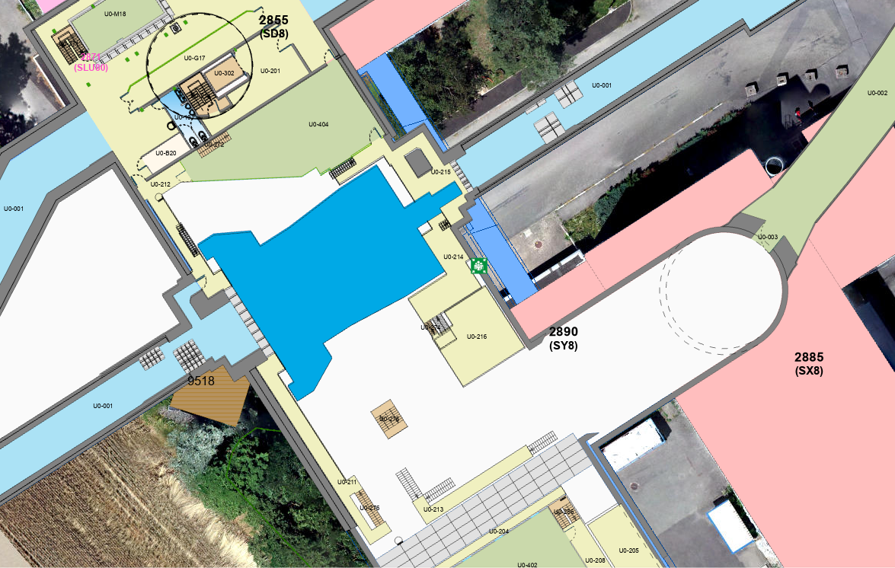
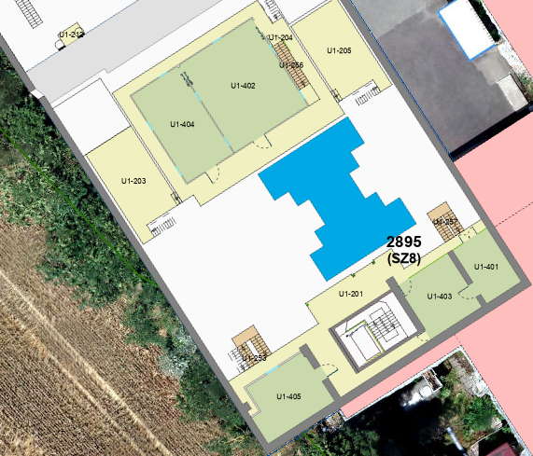
2PACL CO₂ system piping – Upgrade II
5th MT workshop link
CO₂ Supply lines ( Accumulator, main plant, detectors)
CO₂ Primary circuit (Main plant, Main chiller on surface)
~ 20 m (straight line)
+ 100 m to the surface
~ 50 m (straight line)
Pipework in LS3 ?
3 x 440 l (for example)

Slide 8
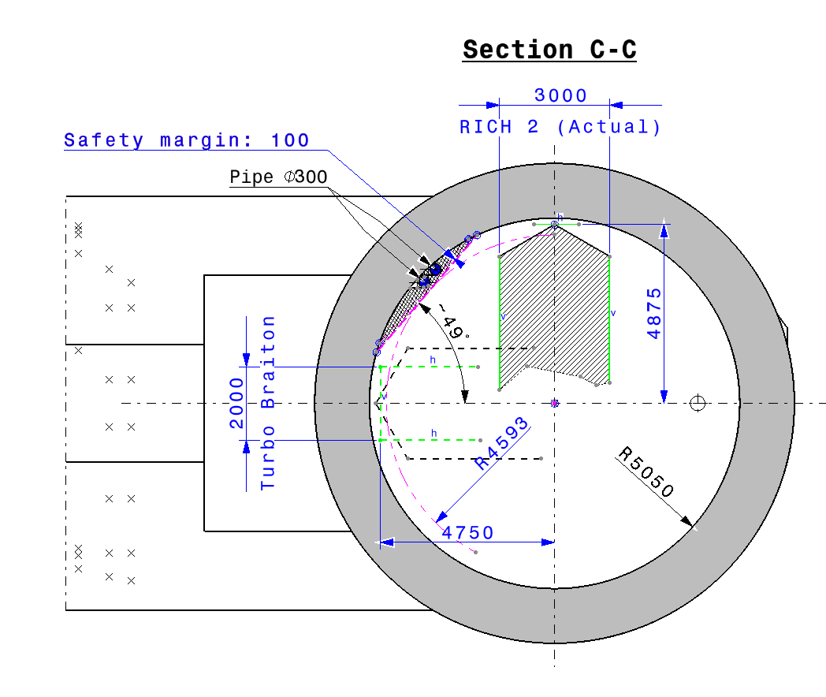
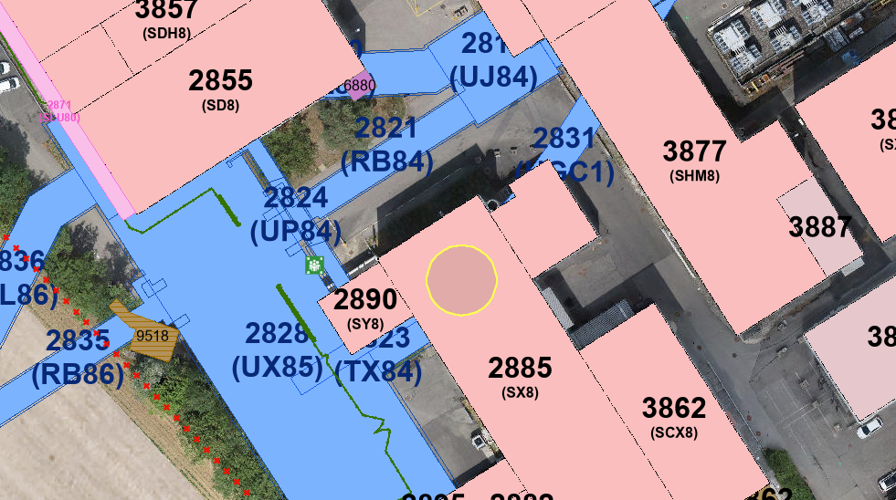
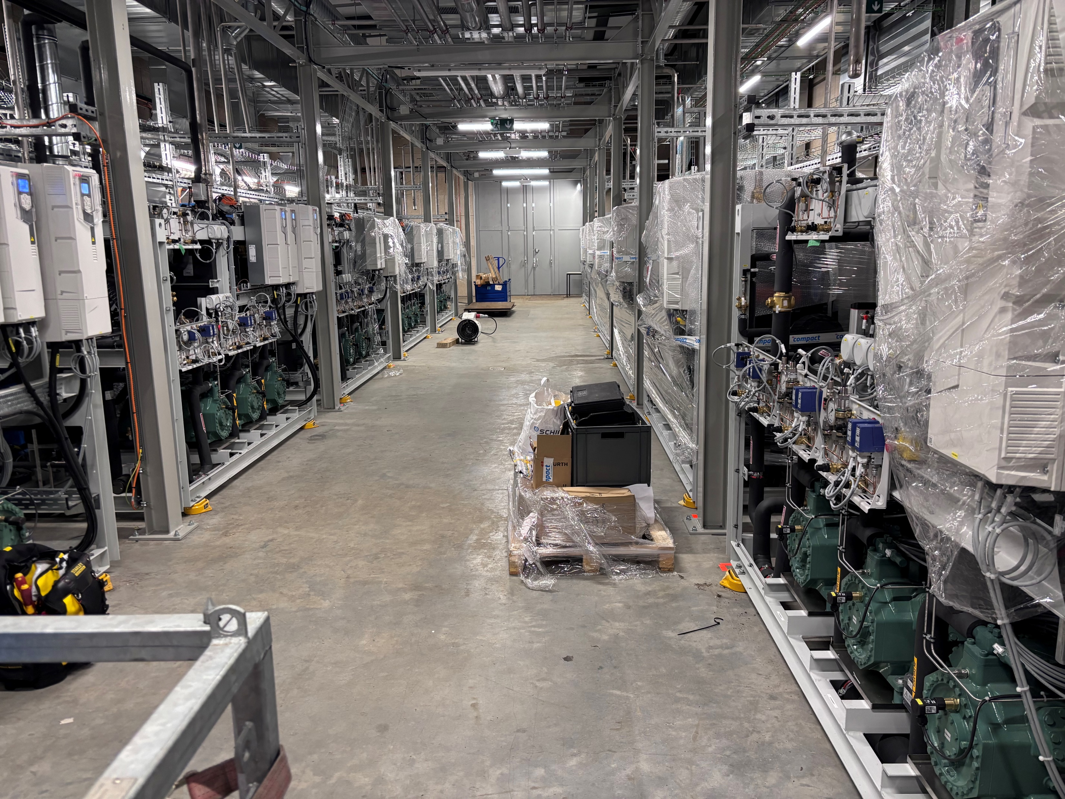
New cooling services building ?
Pipework in LS3 ? +Subcooler on surface ?
O.Jamet
CMS – primary chiller CO2

Slide 9
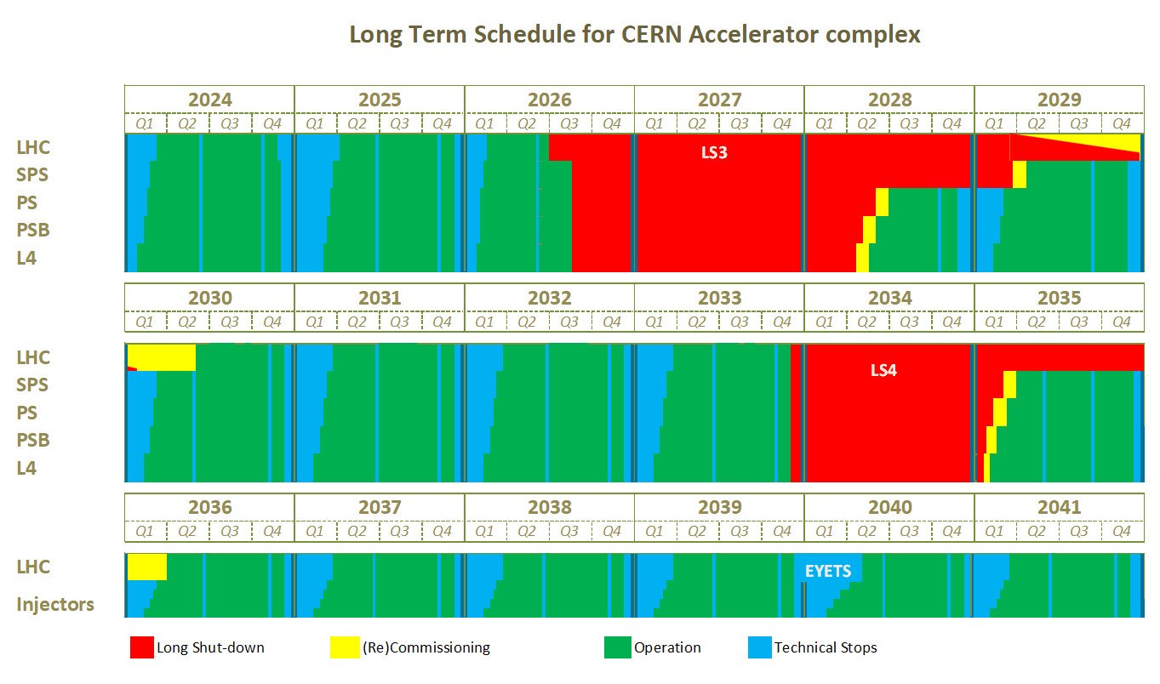
Timeline - prediction
Communicate
needs - baseline
Potential “window”
for EP-DT development
Groups availability
should increase
Latest start date
of production process
CO₂ 2PACL & CO₂ chiller
Long Term Schedule

Slide 10
Cooling Requirements
UII Cooling Technologies
CO₂
Water
Others
Cryogenics

Slide 11
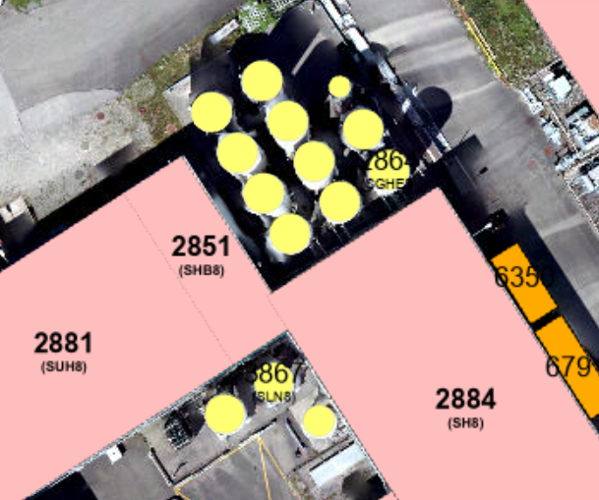
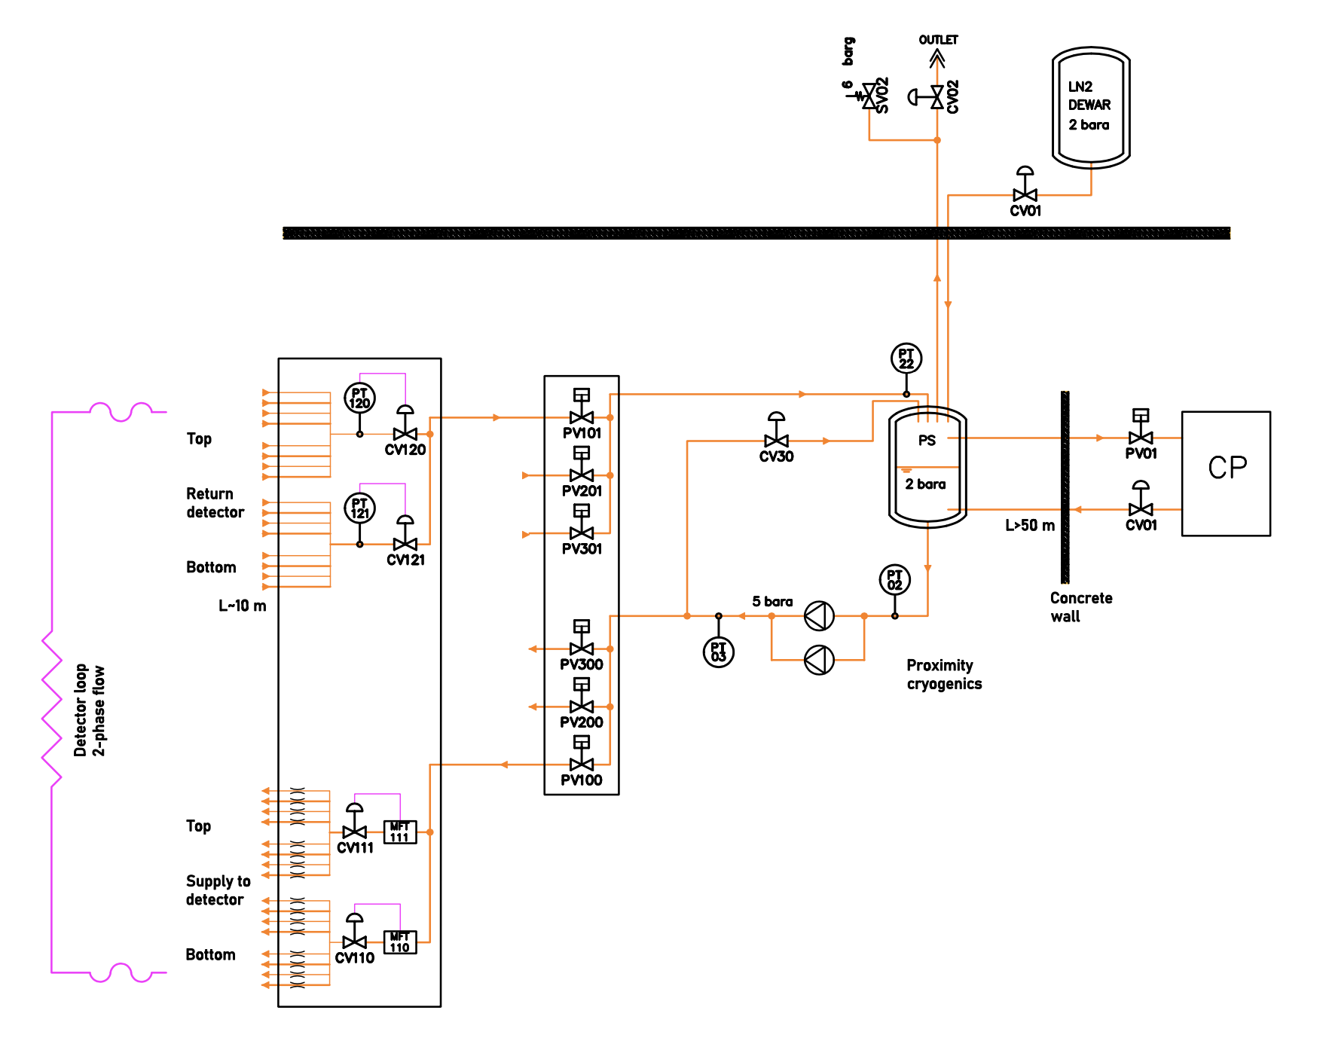
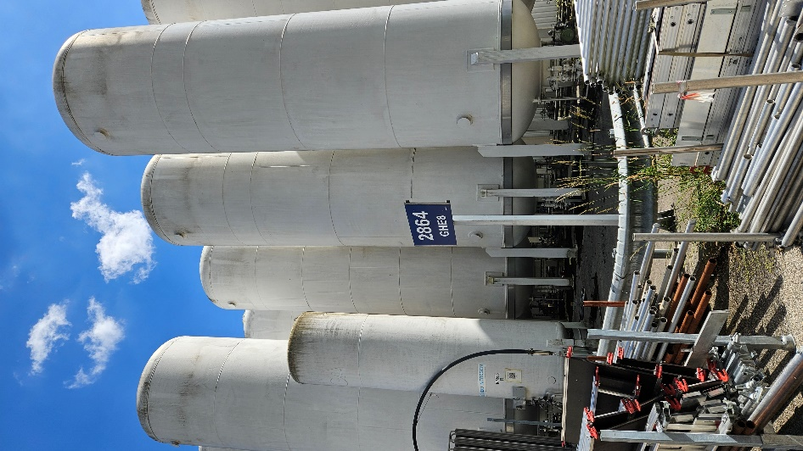
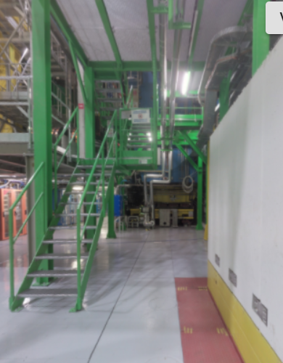
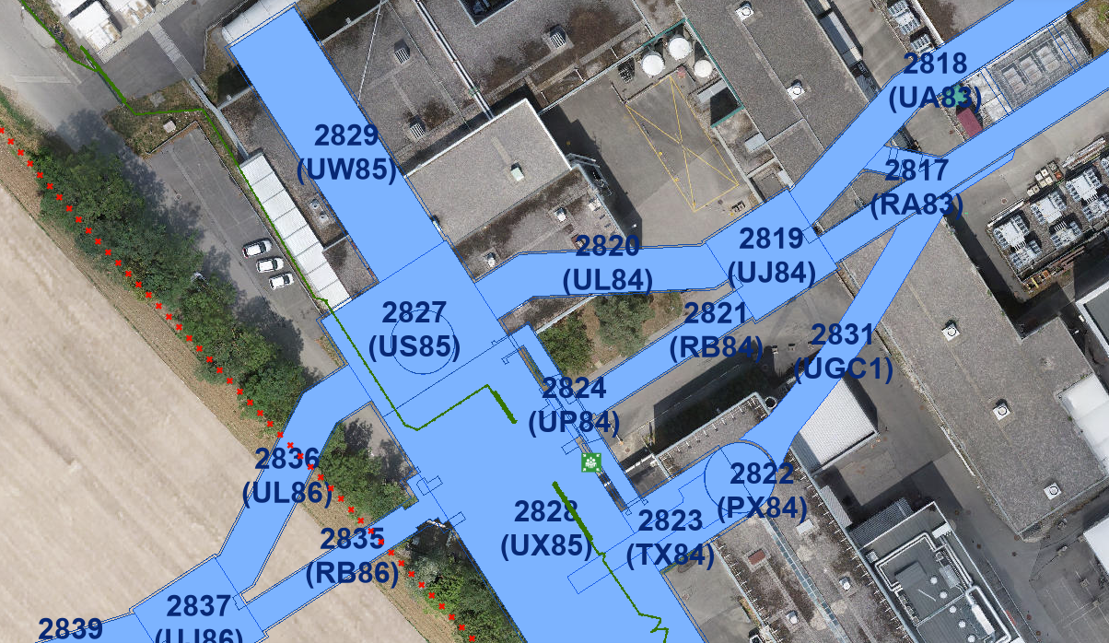
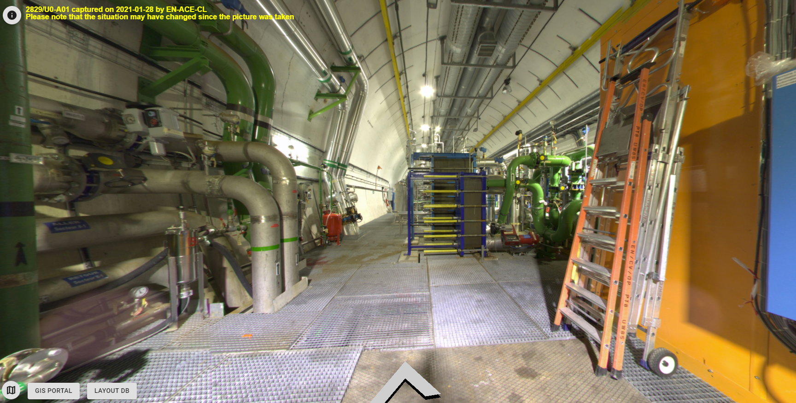
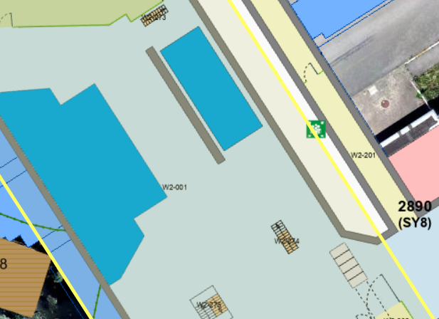
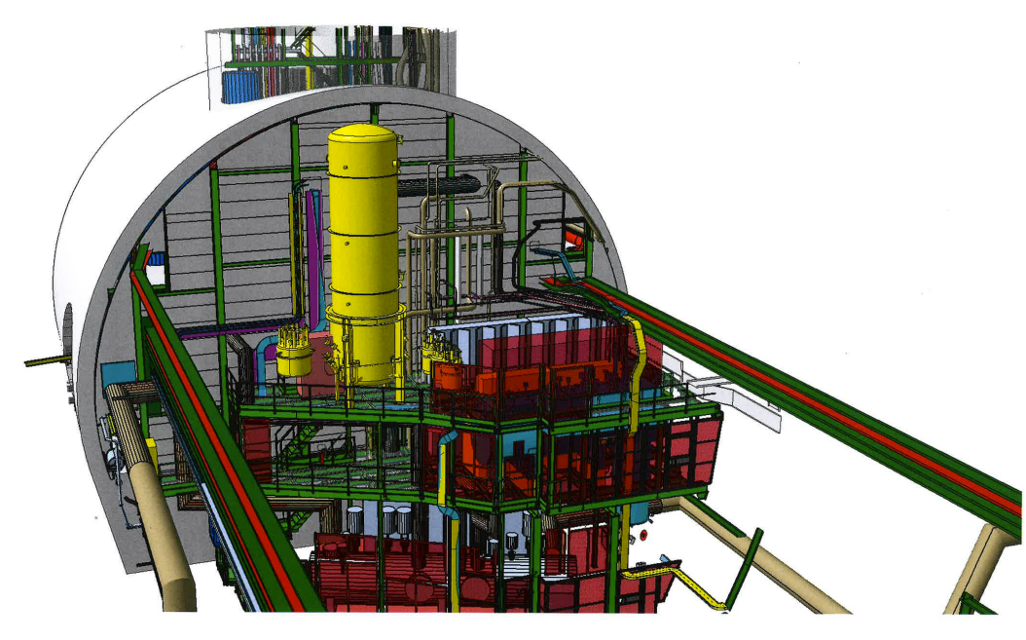
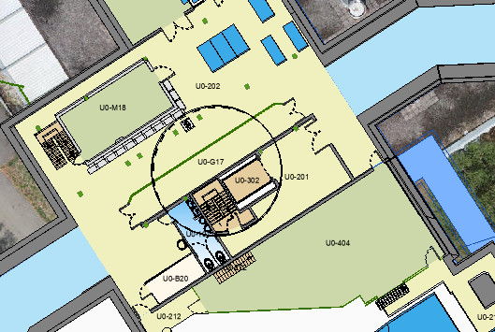
Cryogenics
Use for testing ?
J.Liberadzka-Porret
Surface
2829/U0-A01
SciFi Manifold
O.Jamet
2828/W2-001
2828/U0-404

Slide 12
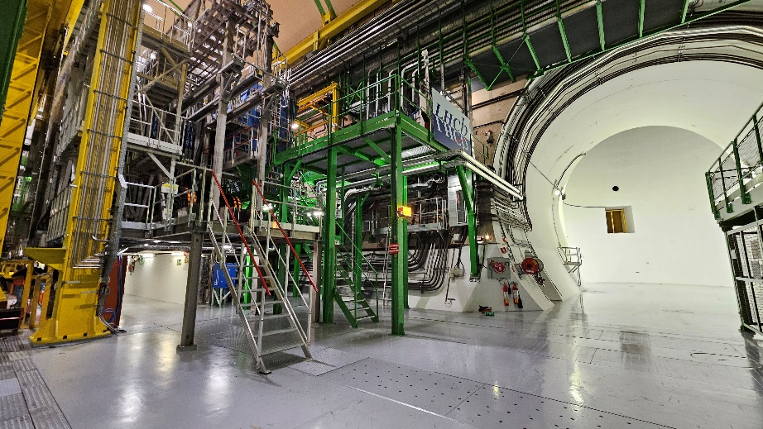
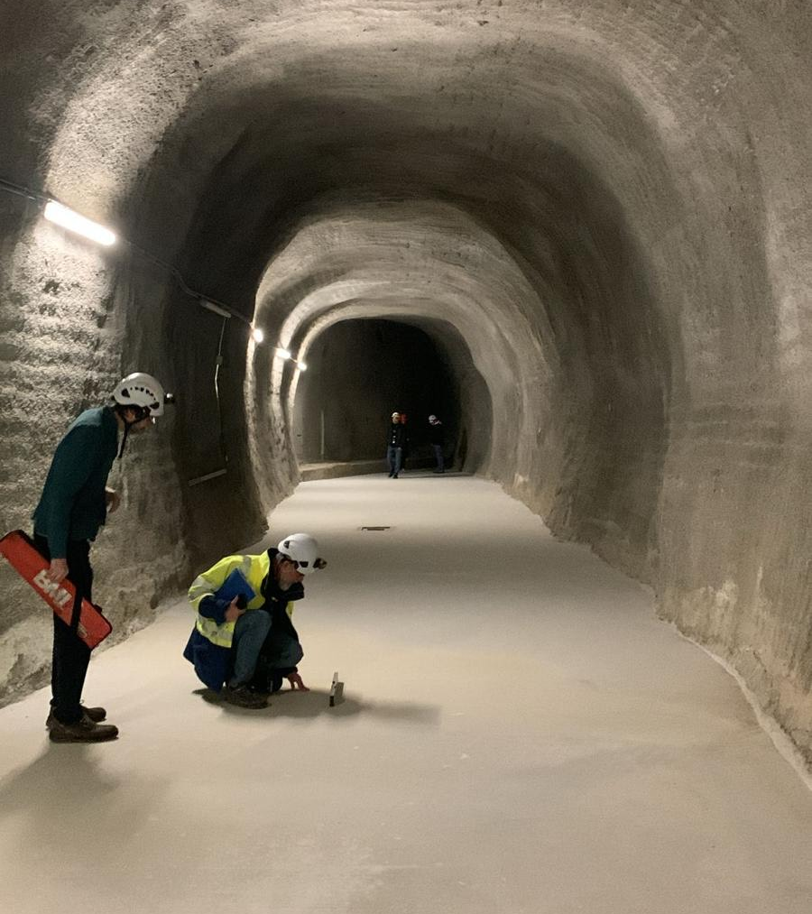
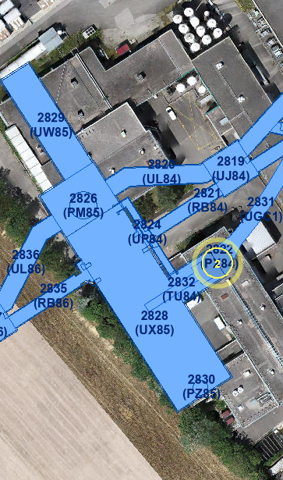
PX84 UGC1 (2831)- ?

Slide 13
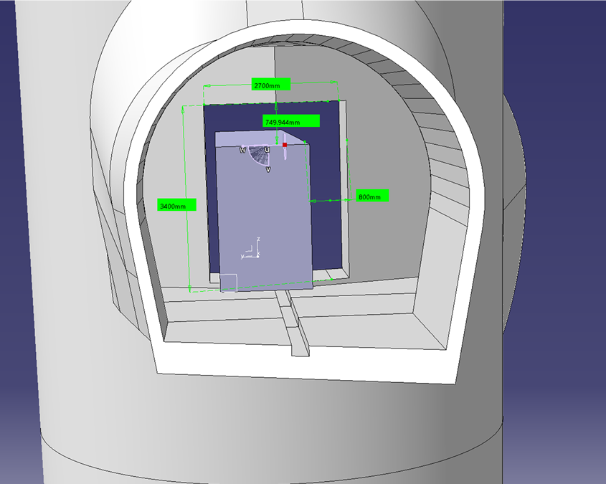
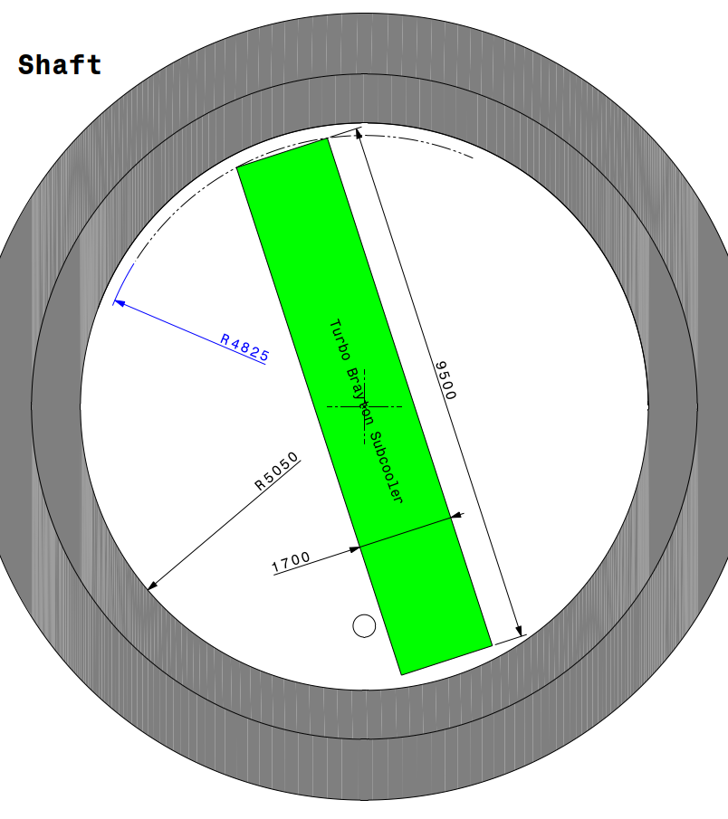
Yes!
Opening enlargement required; structural calculations necessary.
O.Jamet
PX84 UGC1 (2831) – Will it fit?

Slide 14
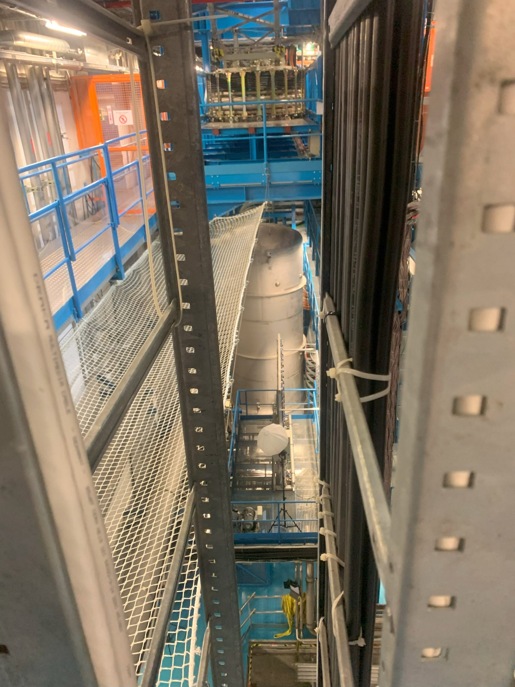
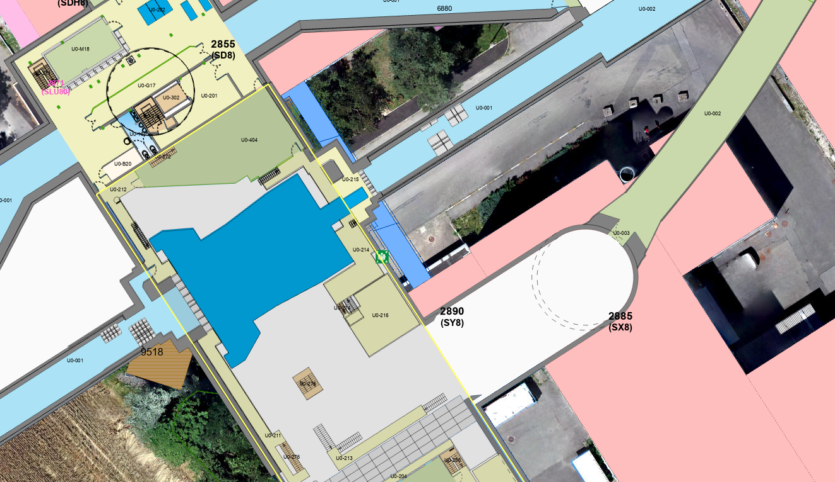
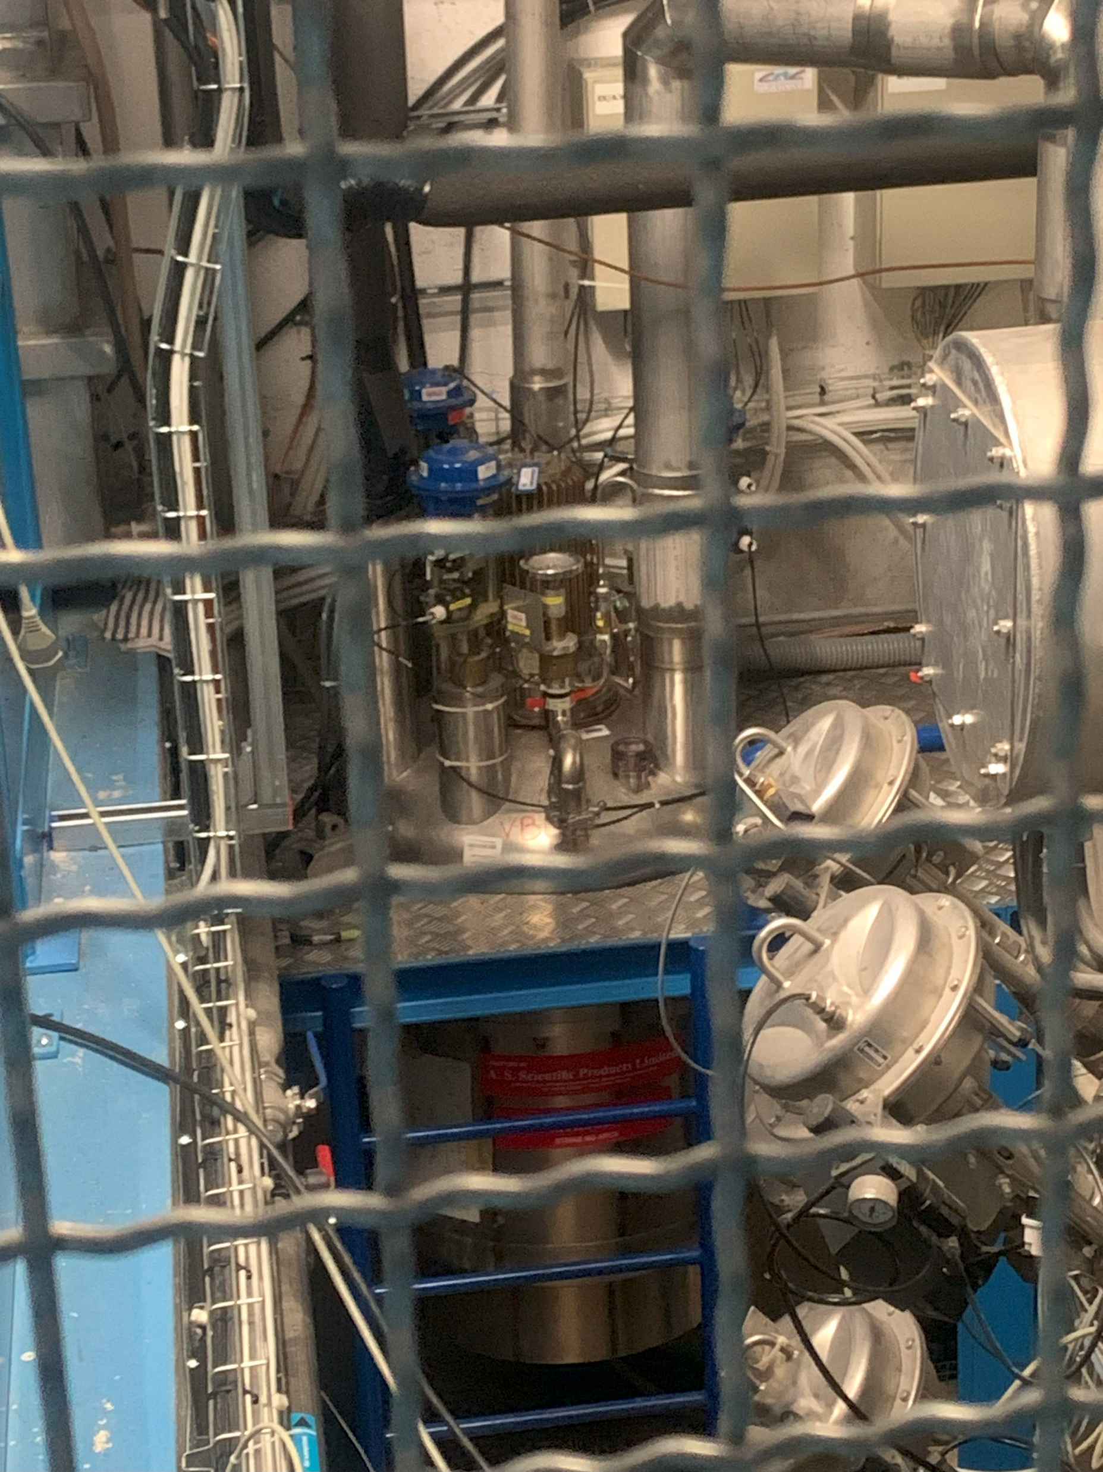
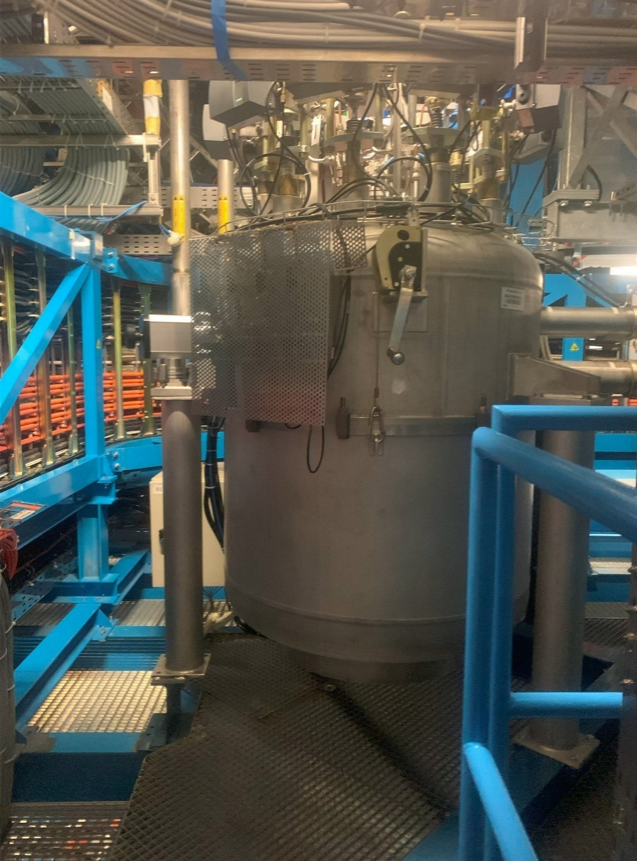
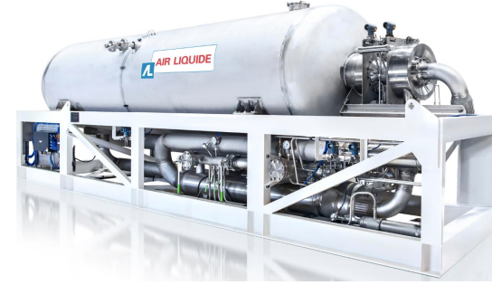
Cryogenic system piping – Upgrade II
5th MT workshop link
Vent line (to the surface)
Backup Supply line (to the surface dewar)
Primary circuit (phase separator – subcooler)
Supply line (Nitrogen to the detectors)
Phase Separator
Pipework in LS3 ?
Preliminary – may not be possible
Pumps
Regulation Valve Boxes
Subcooler

Slide 15
Cryogenic system piping – Upgrade II
5th MT workshop link
Vent line (to the surface)
Backup Supply line (to the surface dewar)
Primary circuit (phase separator – subcooler) 2 options
Phase Separator
Supply line (Nitrogen to the detectors)
Pumps
Subcooler – on surface ?
Regulation Valve Boxes

Slide 16
Subcooler on surface?
O.Jamet
?
Feasible to install on surface with additional
hardware (pumps, vessel, etc.) - possibly close to the shaft
Determine safety implications of long vertical transfer
lines with permanent presence of liquid nitrogen.

Slide 17
Timeline - prediction
Vertical transfer line
Safety approval
System commissioning
Requirements freezing
deadline
Surface subcooler
commissioning (if all installed)
Long Term Schedule

Slide 18
Cooling Requirements
UII Cooling Technologies
CO₂
Water
Others
Cryogenics

Slide 19
Cooling Requirements
UII Cooling Technologies
CO₂
Water
Others
Cryogenics
Interest in Krypton project?
Interest in different technology?
  * Not considering to use NOVEC after LS4

Slide 20
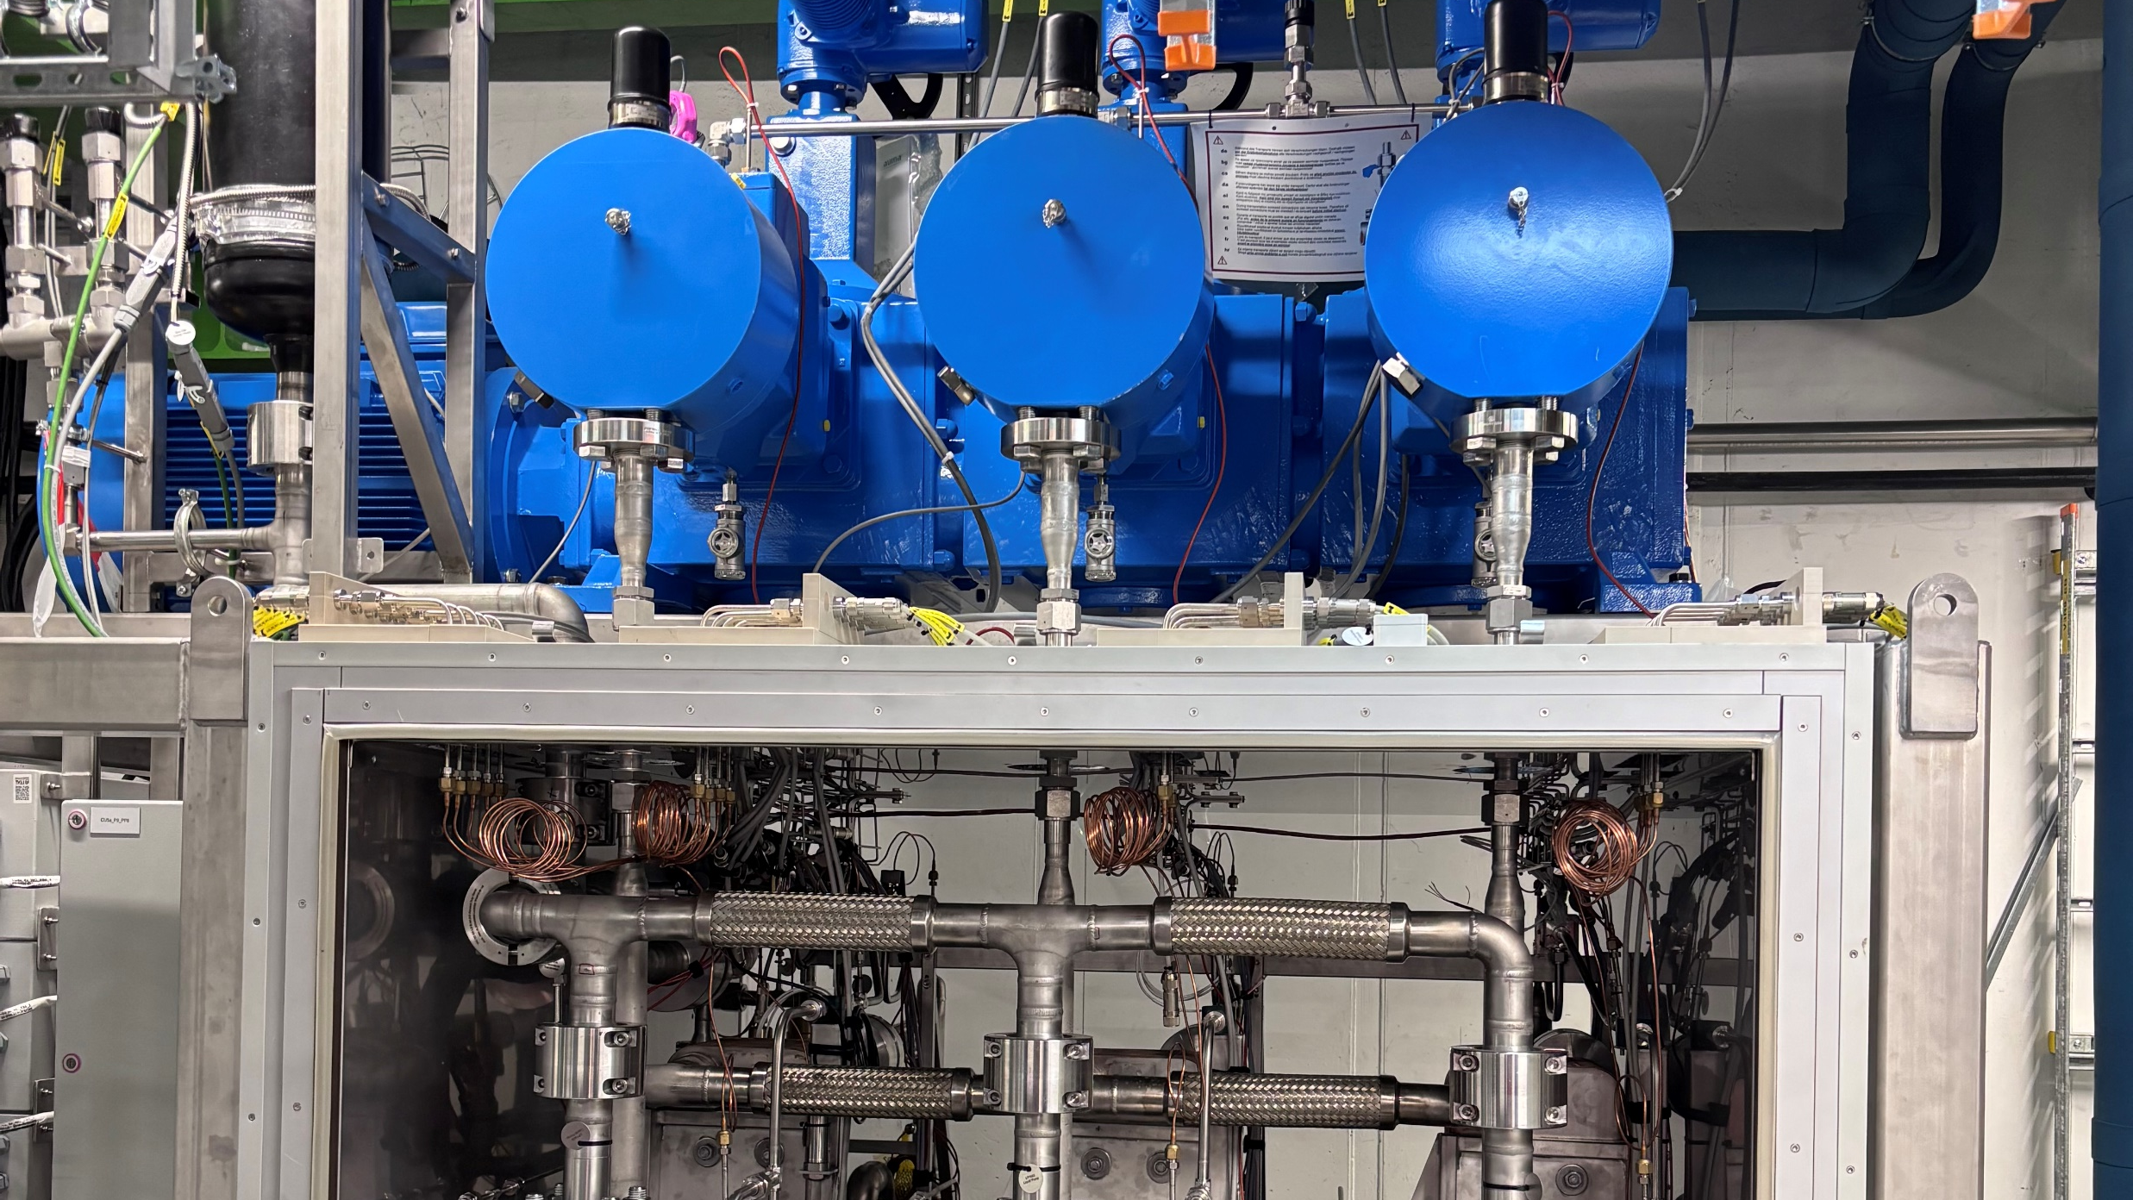
Summary
Check requirements – communicate changes
To anticipate potential pipework in LS3 – clear view of system structure and its capacity is necessary
Cryogenics project – approval of long active vertical transfer lines in shafts are necessary
Provide feedback on interest in other cooling technologies (for example Krypton)

Slide 21
Thank You!

