Slide 1
ZANON SS-Ti transition
Claudia Santos EN-MME
14.11.2024

Slide 2
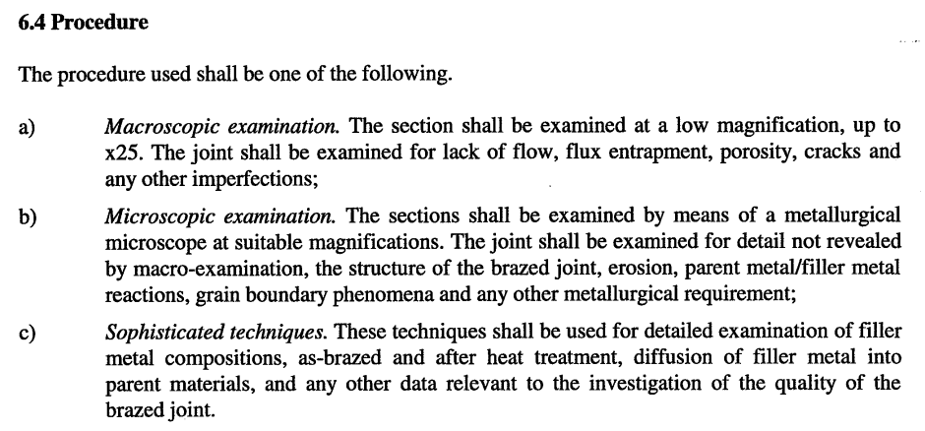
Context:
Brazing qualification is acc. to Eng. Spec EDMs 1389669.
For the metallographic examination we follow acc. to EN 12797 (below).
At CERN, we did:
Microscopic examination from 40x to 700x of magnification
Sophisticated techniques: detailed examination from regions that at 100x minimum showed major defects such as cracks.
*Zanon qualification by APAVE was up to 200x mag
During metallographic qualification it was observed the presence of cracks in the shear lap region, on the Ti side.
The Brazing procedure was reviewed and compared for both CERN and ZANON (shown in next slide)
  CERN does stress relief of the SS-tube and applies a Ni-plating of 1µm in all the brazing area.
  Is the Ni-plating forming less brittle IMCs due to diffusion towards the Ti-parent material?
  Is there a chemical composition difference of the IMCs between CERN and ZANON procedure?
Notes:
The reaction of metallic elements (especially Cu and Fe) with Ti → formation of brittle intermetallic phases in the joint = weakening the mechanical/fatigue strength of the joint
The considerable mismatch of thermal expansion between stainless steel (SS) and titanium during the heating and hence the variation of joint clearance and residual stresses

Slide 3
Brazing procedure CERN vs ZANON:
CERN | ZANON
SS tube is stress relieved at 950°C | NOT SPECIFIED/MENTIONED (?)
Surface treatment and cleaning: Ti tube is degrease/etch SS tube is degrease/etch + Wood’s strike of Ni (1 um) on brazing surface (both shear lap and toe region) Tubes are pack with Al foil and stored in PE bags | NOT SPECIFIED/MENTIONED (?) - Ni strike in SS tube???
Vacuum brazing: Filler material ‘Gapasil-9’ Load applied during brazing in Ti-tube >10kg, insert>2kg Atmosphere: vacuum < 5x10-6mbar Program: 820°C (300°C/h), dwell for 60min, goes up to 915°C (500°C/h), dwell until T reaches 905 (+10°C) then 915°C to 700°C (600°C/h), dwell for 1h, cool down in furnace | Vacuum brazing: Filler Gapasil-9 diameter of 1mm Load apply ?? Atm vacuum: ? Program: 820°C (300°C/h), dwell for 120min, goes up to 915°C (500°C/h), No dwell, then goes down to 700°C (600°C/h) dwell for 1h, furnace cooling

Slide 4
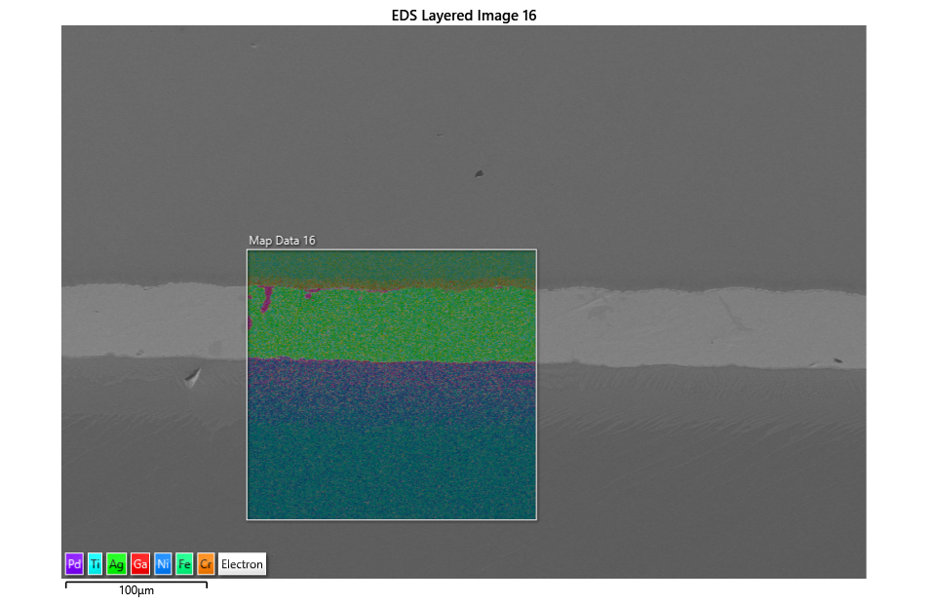
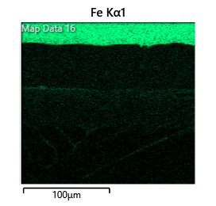
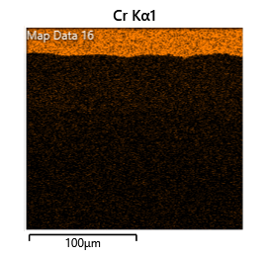
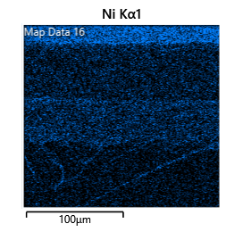
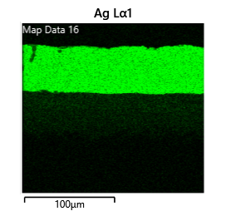
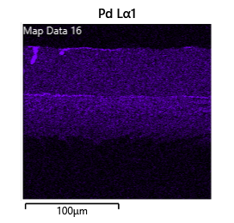
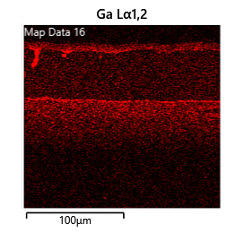
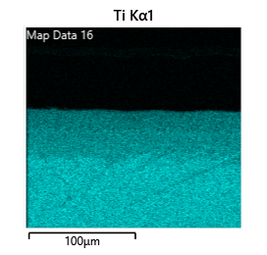
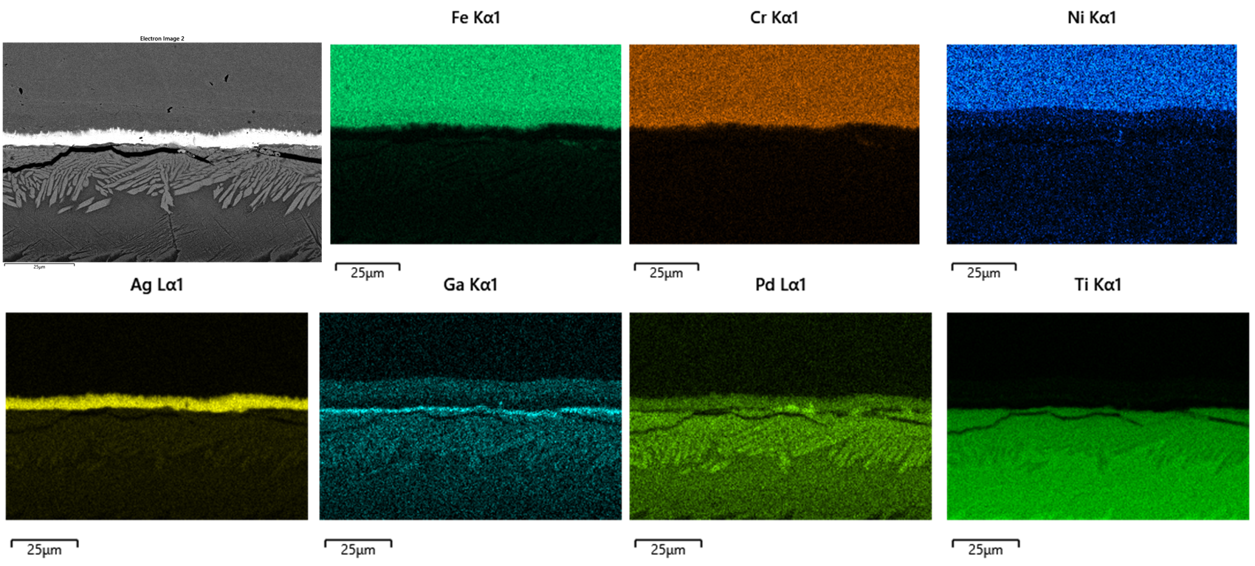
CERN / ZANON
CERN
(Shear lap region)
Diffusion of Ni to the Ti region
IMCs of Pd-Ga-Ni-Fe
NO or minimal diffusion of Ni to the Ti region
IMCs of mostly Pd-Ga-Ti
Strong formation of α-phase → very fragile → more stress concentration when stress relief by cutting
ZANON
(Shear lap region)

Slide 5
Remarks:
ZANON Brazing 2024:
  Based in BPQR:
    No Stress relieved was applied to SS
    No Ni-plating was applied
  Based on EDX maps
    The are abundant IMCs of Pd-Ga-Ti, which are believe to be more brittle than Ga-Pd-Ni
    The brittle IMCs (Pd-Ga) near the Ti region makes that area more constrain → promotes crack initiation → will propagate through the Ti.
  The observation of cracks only after metallographic cut, might be induced due to the stress relief and the high presence of the brittle Pd-Ga-Ti IMCs and the presence of α-phase → Very brittle/fragile regions
To reduce the brittle IMCs and the strong presence of α-phase, we strongly recommend:
  Apply Ni-plating
  For the brazing cycle: to reduce the dwell time of 820 °C.
Recommendations

