Slide 1
Status of BI for AWAKE run 2c
S. Mazzoni for the BI team
21st AWAKE BI Meeting, 21 January 2025

Slide 2
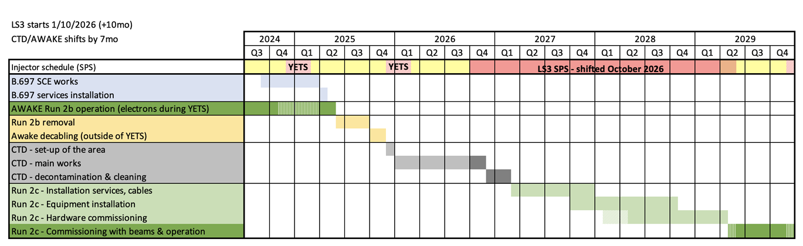
Latest AWAKE schedule
As presented at last TB (27 November 24)
Run 2b end in June 25
CNGS dismantling ends Q1 2027
BI work in tunnel (installation > commissioning) start Q1 2027 until Q12 2029

Slide 3
BI work for Run 2c
Follow up / perform de-connection, transport and storage of Beam Instruments due to CNGS dismantling.
Attend CSCP meetings for layout, integration, racks, cables, …
Design and produce instrumentation for 150 MeV line
Add digital cameras for laser lines
Perform / follow up transport and connection of instrumentation of proton, 18 MeV, common, exp. hall instrumentation
Instruments setup and commissioning with beam
Support institutes (infrastructure for BI systems)

Slide 4
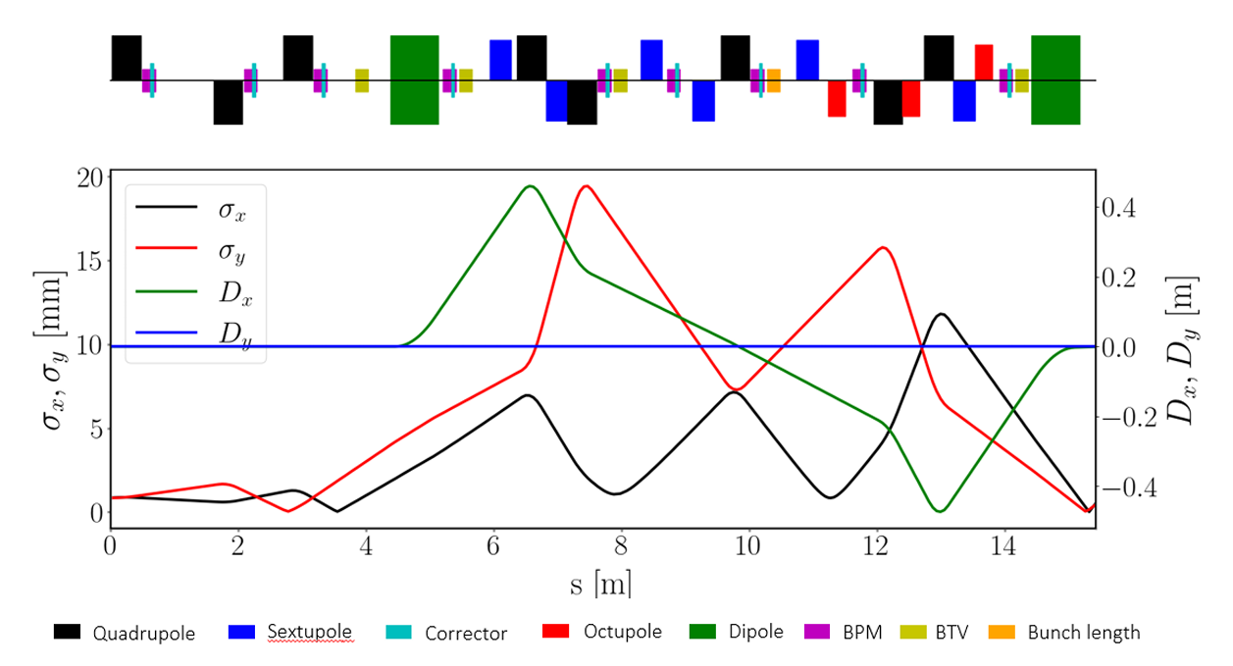
150 MeV line
Agreement on number of instruments and line aperture based on line design by E. Belli
Line aperture 40 mm except for high beta region
5 (+2 spares) screens (for transverse profile)
8 (+2 spares) 40 mm aperture BPMs
1 (+1 spare) 60 mm aperture BPMs
Bunch length monitor
Bunch charge monitor

Slide 5
150 MeV instrumentation: BPMs
BPM body: production based on TRIUMF design. Modification of feedthrough (not welded on body but on flange). First meeting with MME. Manufacturing instructions from Paul Dirksen (TRIUMF).
Will produce 8 x 40 mm aperture, 1 x 60 mm. 3 spares (body + acquisition).
BPM electronics: multiplexing + LP filtering + RF SoC. Performance OK for proton line (20 um res.), additional work needed for electron (10 um for 40 mm, 15 um for 60 mm).
Schedule: initiate production in 2nd half 2025 (to be confirmed with MME), two years.

Slide 6
150 MeV instrumentation: BTVs, ICT, BL
Commercial linear actuator with OTR, scintillator, calibration target whenever possible, will depend on beam size at BTV location
Screen at 45 deg (standard choice), measures to reduce DoF possible
Design will start in 20205, production 2026-27
In-flange ICT from Bergoz, installation in 2027
Bunch length: EOSD (CERN), Coherent ChDR (UMan), coherent radiation imaging (ULiv)

Slide 7
Resources / changes / actions
AWAKE BI WP presented at BI project board on 16 Jan 25:
  origin tech (ML) start moved from 2025 to Q3 2026
  origin tech (BP) start moved from 2025 to 2027
  Quest (SW) start moved to Q3 2027
  Check all DICs (ICT not included) - open
  New: investigate alternatives to camera servers (incompatible with FESA, no need for storage) - open
  clarify position of BLMs (15 refurbished) - open

Slide 8
Issues / uncertainties
cost of cables for TT41 BPM electronics refurbishment NOT included
supports NOT included\
Pepper-pot diagnostics not used in 18 MeV line. Convert into screen? (Steffen)
Add in-flange transformer to 18 MeV line? (Steffen)
ChDR / HF BPMs: more R&D needed for good performance with nominal (3E11 p+) proton bunch. NOT INCUDED in budget request. Present system not really used by AWAKE collab. Decision needed (keep as is / upgrade / descope).

