Slide 1



ChDR Bunch Length Monitor Tests at CLEAR
Jack McGunigal, C. Davut, P. Karataev, G. Xia, S. Mazzoni

Slide 2
Outline
Recap of the experimental setup
Installation plan
Goals of the experiment
CST simulations
Conclusions
Notes:
Fixed-Field alternating gradient Accelerator

Slide 3
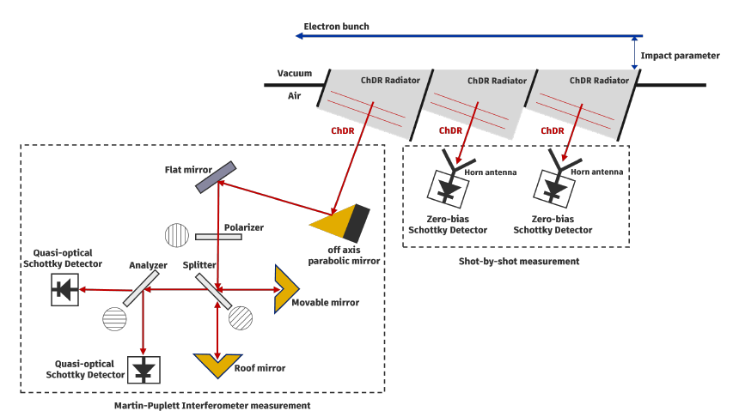
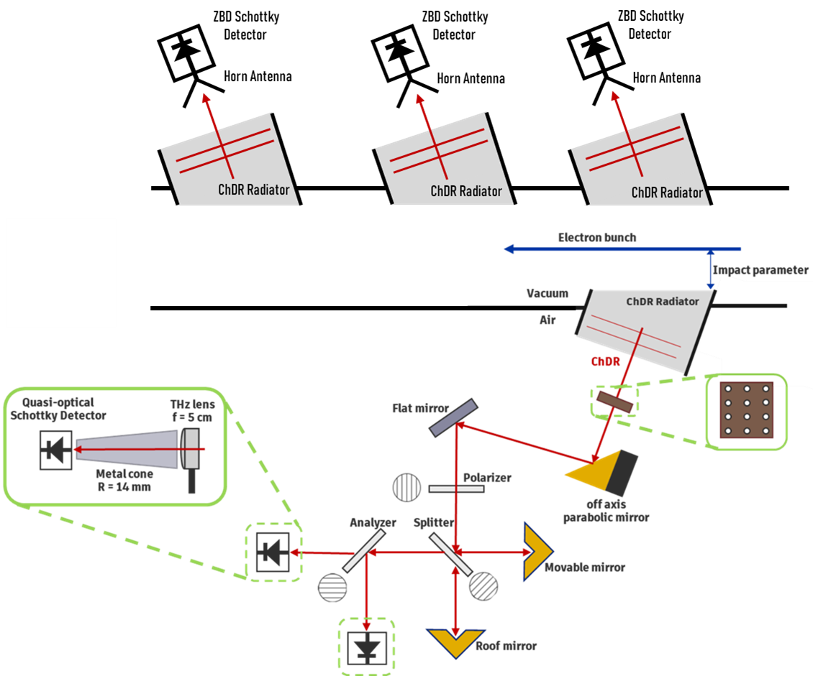
Recap of the experimental setup
Previous Experimental Setup
Experimental Setup
RMS Bunch Length Measurements: 3 Zero-bias Schottky diodes with the following frequency ranges.
  50-75 GHz
  90-140 GHz
  400-600 GHz
Bunch Profile Measurements: A Martin-Puplett Interferometer with QODs with a frequency range of 0.1 - 1 THz
Notes:
Fixed-Field alternating gradient Accelerator

Slide 4
Installation Plan
CLEAR beam will run between March and end of June. The vacuum chamber will be installed in February along with breadboards and supports.
Make adjustments to the alumina radiator configuration in the vacuum chamber with the help of Ben Moser.
New Equipment:
  50-75 GHz and 90-140 GHz diodes with attenuators (Arriving mid March).
  THz lens for 400-600 GHz to improve S/N ratio.
Beamtime requested for 2 weeks. Approximately 1 week end of May and 1 week end of June.
Parasitic measurements before dedicated beamtime.
Notes:
Fixed-Field alternating gradient Accelerator

Slide 5
Goals of the Experiment
The experiment will be focussed more on the RMS bunch length measurements from the ZBDs. However, some MPI profile measurements may be taken along side these.
Parasitic Measurements:
  Observe Signal from all detectors
  Check S/N ratio
  Perform alignments
  Test attenuation/amplification scheme
2 weeks dedicated beamtime:
  Charge scan
  Bunch length scan
  Impact parameter scan
  Angular jitter scan
Notes:
Fixed-Field alternating gradient Accelerator

Slide 6
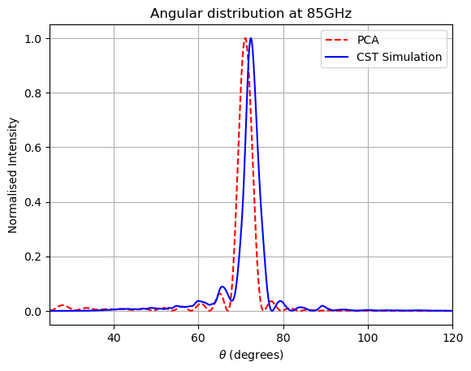
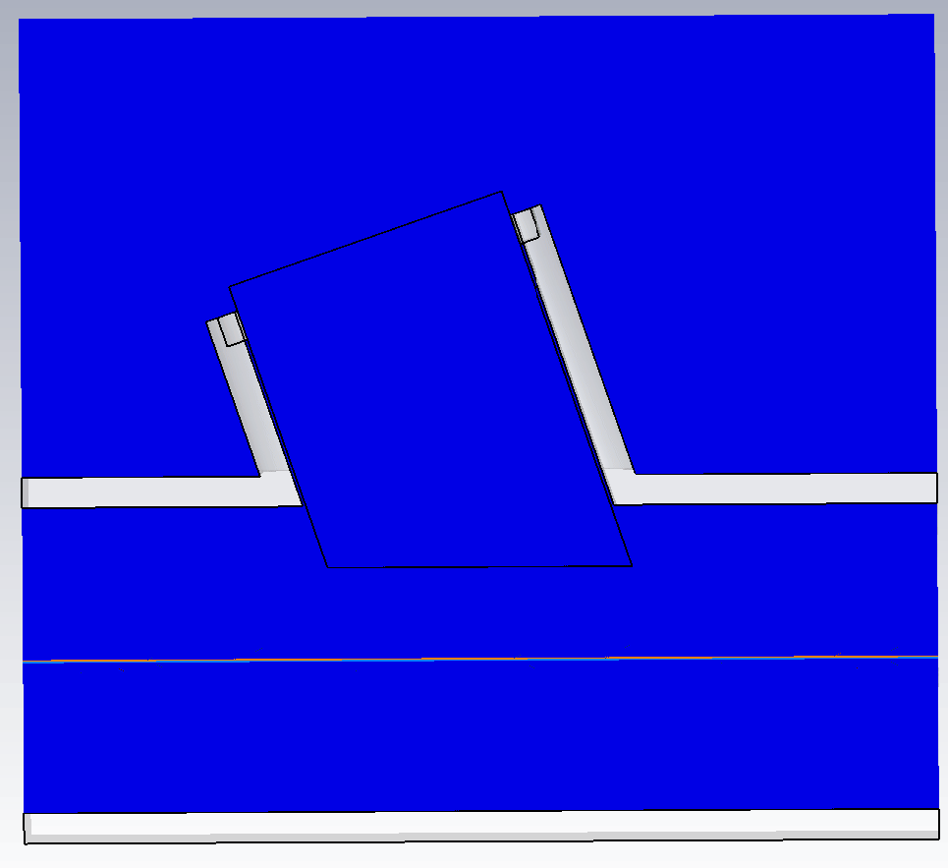
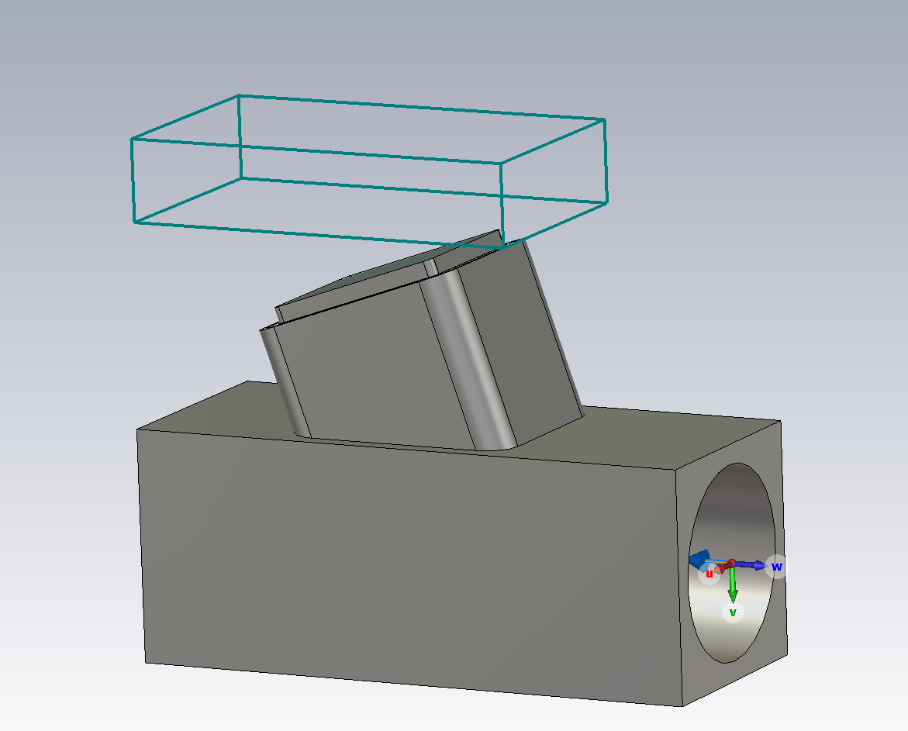
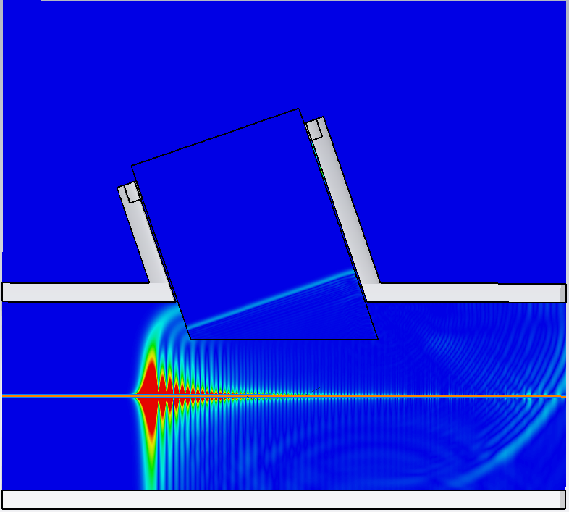
CST simulations
Model based off dimensions of the vacuum chamber and radiator we use.
The simulations show a 2ps electron bunch with a 100 pC charge and beam energy 150 MeV
The angular distribution shows a similar distribution with a slight shift
The snapshot on the left shows the field curving after transversing along the radiator
Notes:
Fixed-Field alternating gradient Accelerator

Slide 7
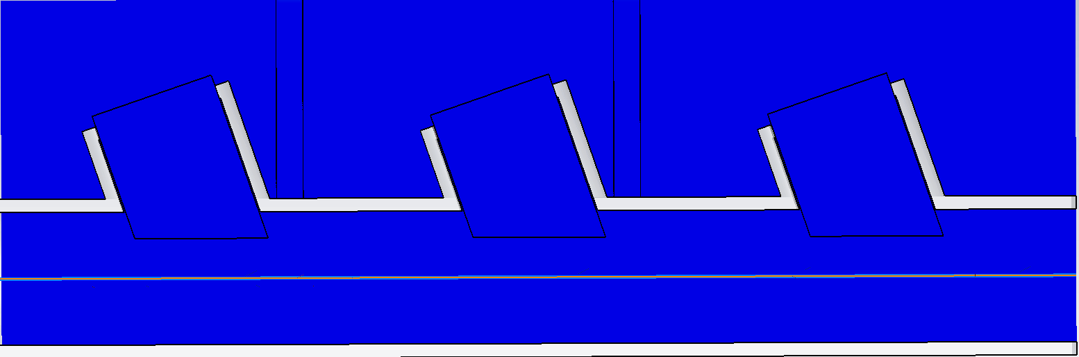
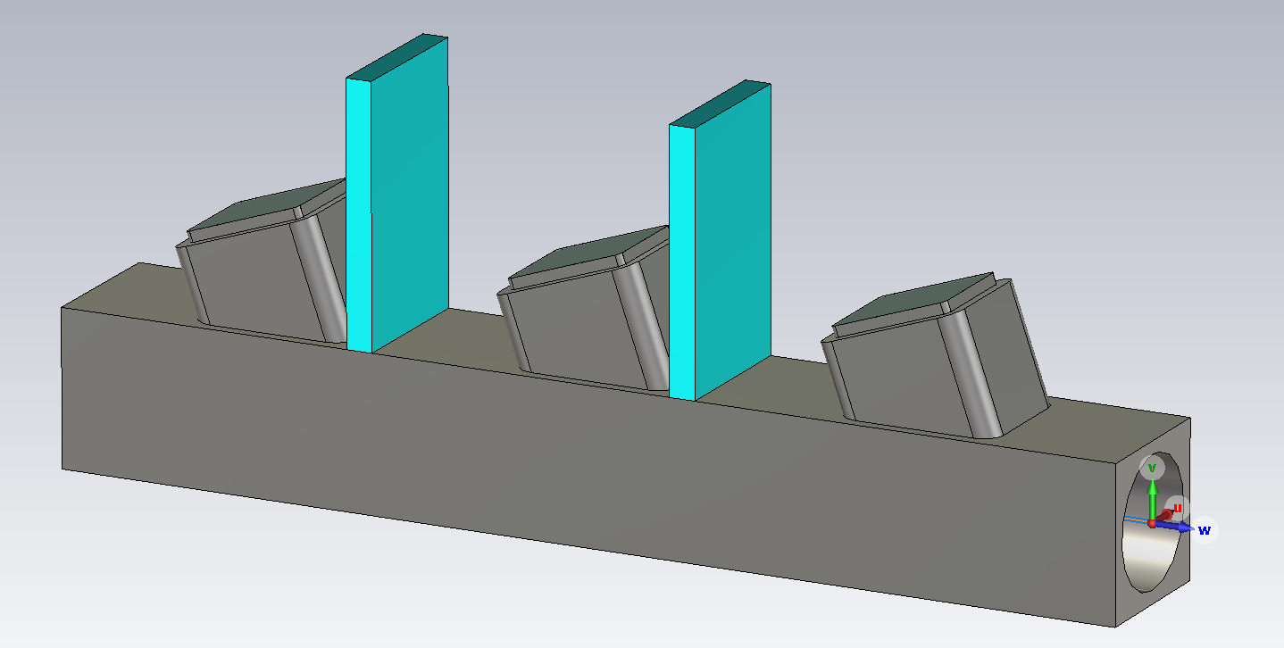
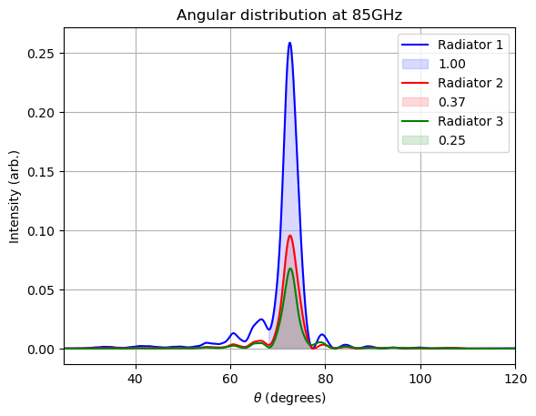
CST simulations
The gap between the radiators are based on the vacuum chamber we have (76.914 mm).
In blue is some shielding to prevent radiation from being detected from other radiators
Notes:
Fixed-Field alternating gradient Accelerator

Slide 8
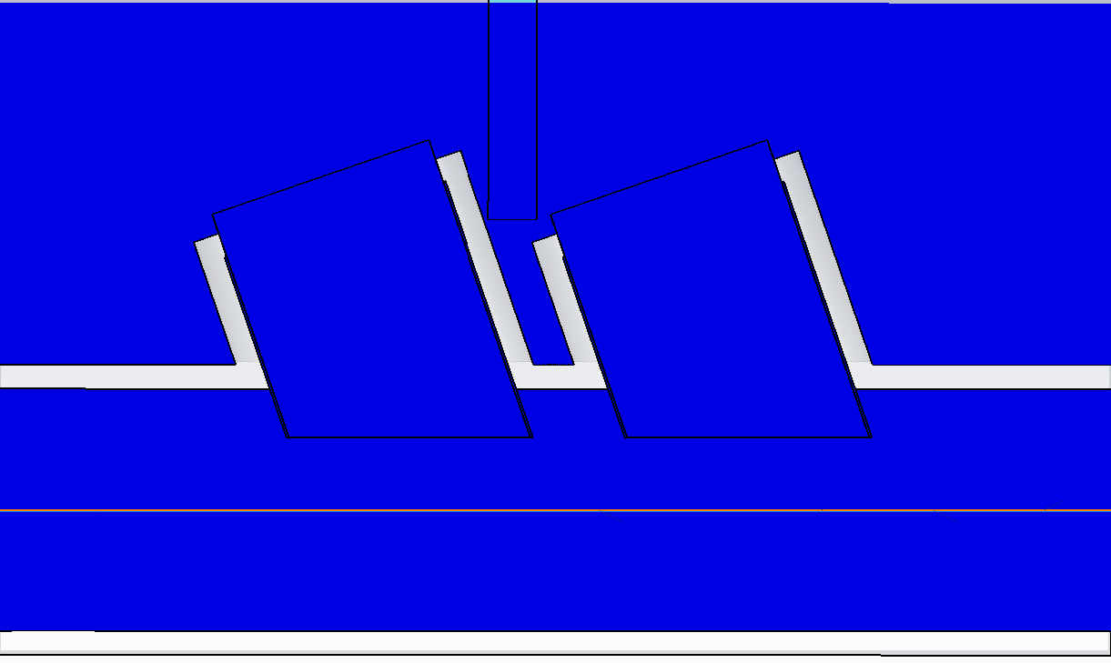
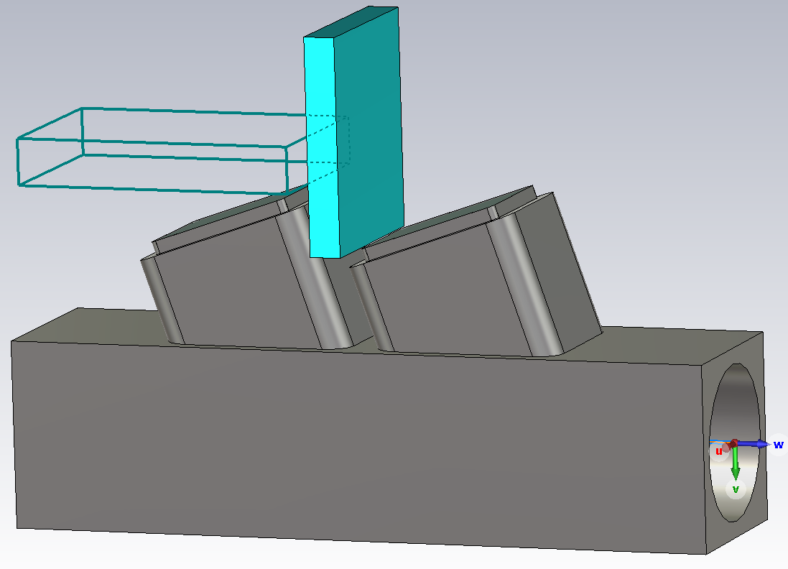
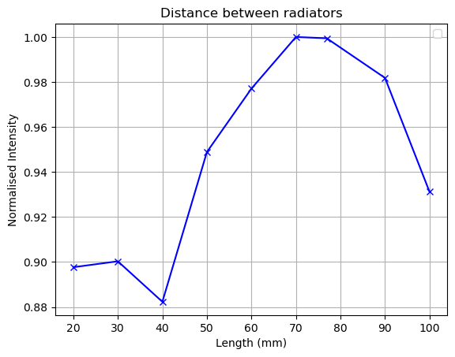
CST simulations
This study is to measure the ChDR intensity when changing the distance between the radiators
We should expect to see the intensity increase when increasing the gap between radiators.
Notes:
Fixed-Field alternating gradient Accelerator

Slide 9
Summary
The vacuum chamber, breadboards and supports will be installed in February.
I have requested beamtime for 2 weeks: 1 week in May & 1 week in June.
In addition to dedicated beamtime, we will collect parasitic measurements.
I performed CST simulations to calculate:
  the angular distribution and compare to PCA calculations.
  the difference in intensity between each radiators based on our existing vacuum chamber.
  the difference in intensity when changing the gap between radiators.
  I will repeat the simulation studies involving shields and use faces at the exit of the radiators.
Notes:
Fixed-Field alternating gradient Accelerator

Slide 10
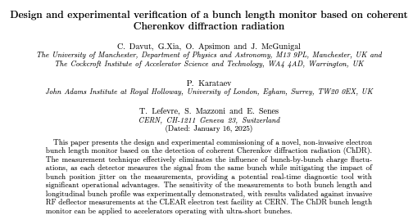
Congratulations to Can Davut for having his paper accepted to PRR for publication based on his ChDR bunch length monitor studies!
Notes:
Fixed-Field alternating gradient Accelerator

Slide 11
Thank you for Listening!
Notes:
Fixed-Field alternating gradient Accelerator

Slide 12
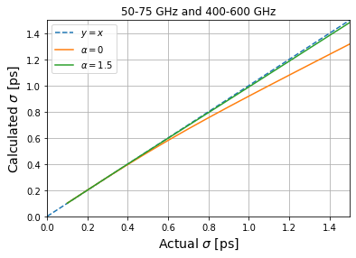
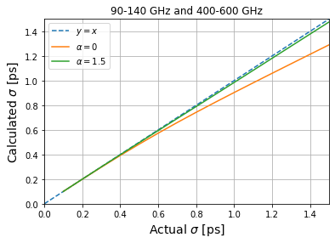
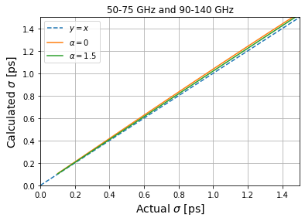
Numerical Bunch Length Calculation
The bunch length can be calculated using the following for a Gaussian ($α=0$) and Skew-Gaussian bunch:
$$σ_{t}=\sqrt{\frac{1}{\left|ω_{2}^{2}−ω_{1}^{2}\right|}\left|\ln\left(\frac{I_{1}\left(ω_{1}\right)I_{e2}\left(ω_{2}\right){|F}_{sk2}\left(ω_{2}\right){\left.​\right|}^{2}}{I_{2}\left(ω_{2}\right)I_{e1}\left(ω_{1}\right){|F}_{sk1}\left(ω_{1}\right){\left.​\right|}^{2}}\right)\right|}$$
$$F_{sk}(ω)=(1−\operatorname{erf}\left(\frac{ασ_{t}ω}{\sqrt{1+2α^{2}}}\right))$$
Where:
Notes:
Fixed-Field alternating gradient Accelerator

