Slide 1
X-Boxes Update
22.01.2025

Slide 2
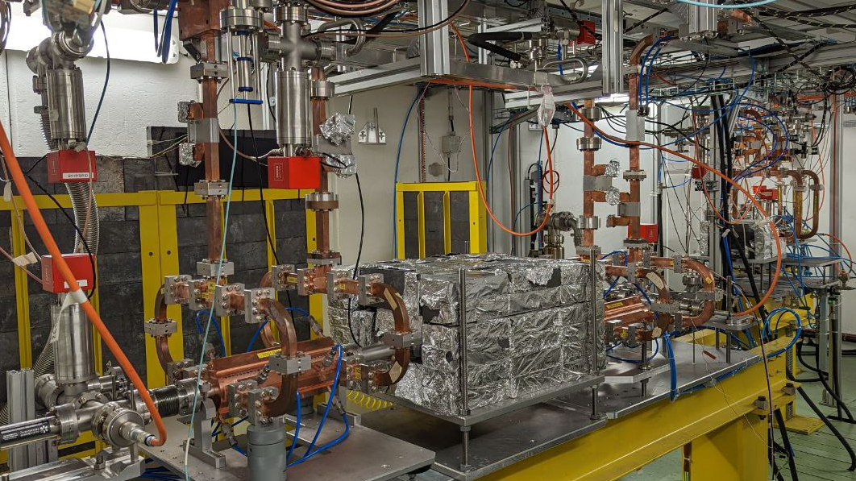
Xbox 2
XBOX2
Conditioning of TD31N3 and N4
Soon: refurbishing of the modulator

Slide 3
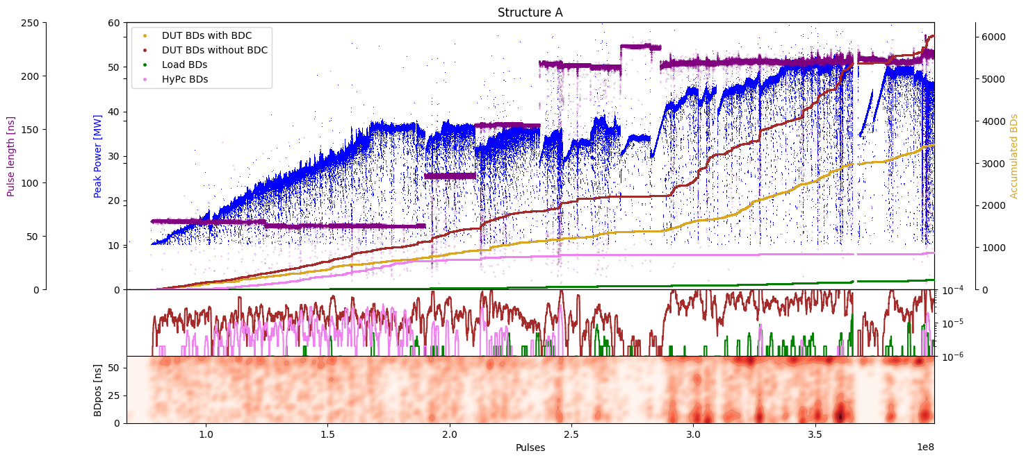
Xbox 2 TD31
TD31N3 conditioning history
Structure A/B 50:50
Structure A 100:1
Achieved unloaded Peak Power 36.1MW
Max. Peak Power achieved 50MW (~80 MV/m)

Slide 4
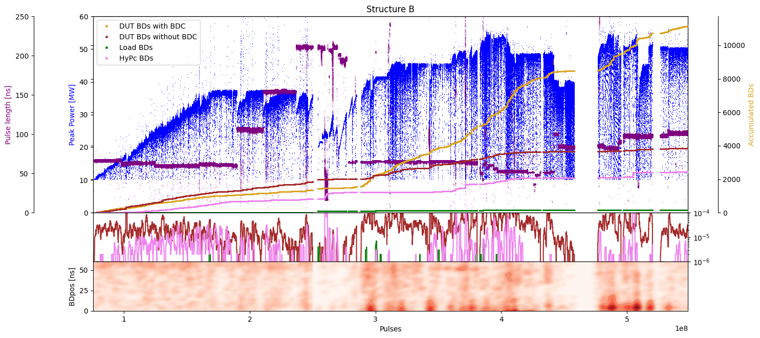
Xbox 2 TD31
TD31N4 conditioning history
Structure A/B 50:50
Structure B 1:100
Achieved unloaded Peak Power 36.1MW
Max. Peak Power achieved 54MW (~89 MV/m)

Slide 5
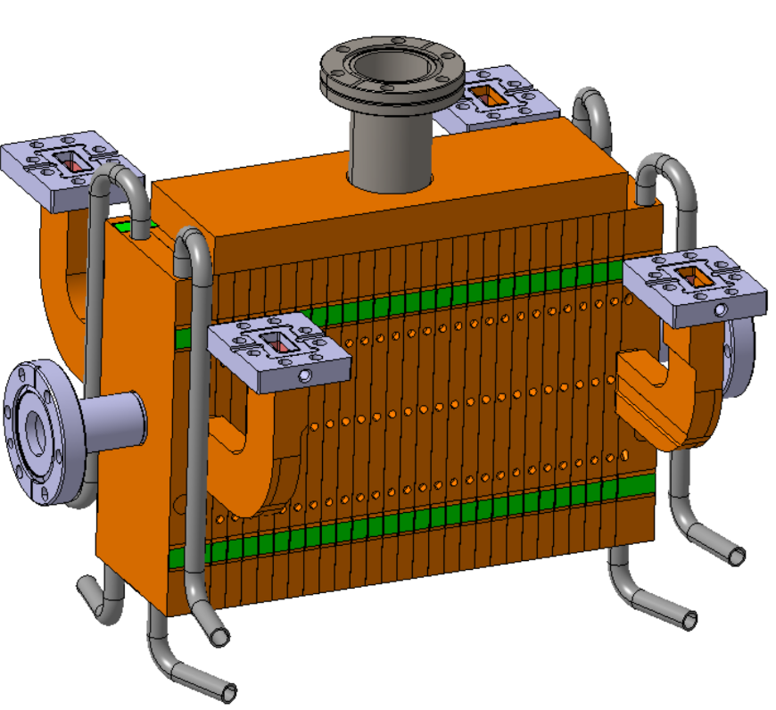
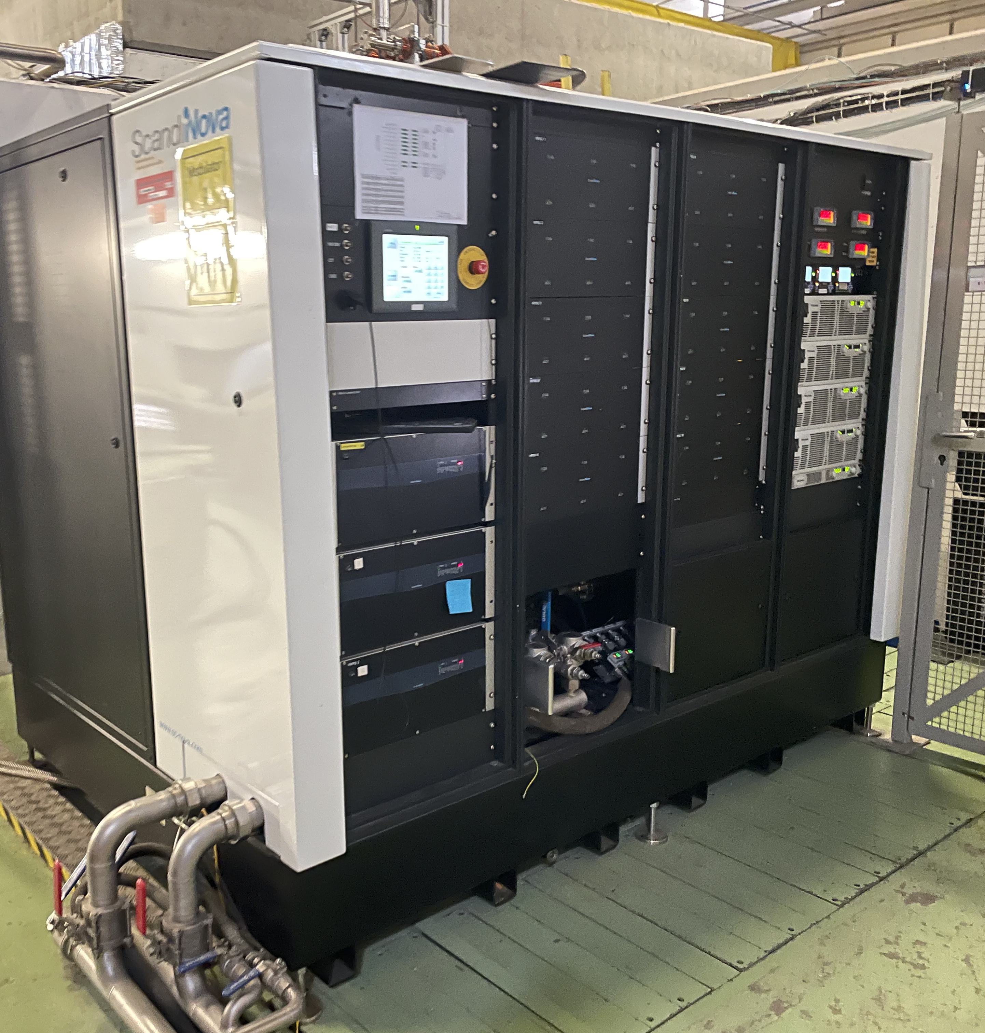
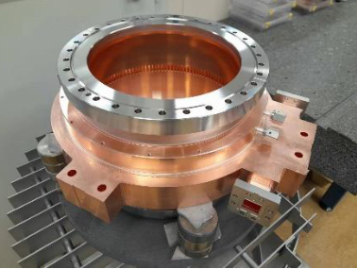
Xbox 2 future plans
Refurbishment of Scandinova modulator to improve operation at higher voltages
Integration of Barrel Open Cavity pulse compressor for high power testing
Integration and high power testing of Smartcell

Slide 6
Xbox 2
XBOX3
Canon E37117 klystron tested
Next: new integration (TD31 and TD26)

Slide 7
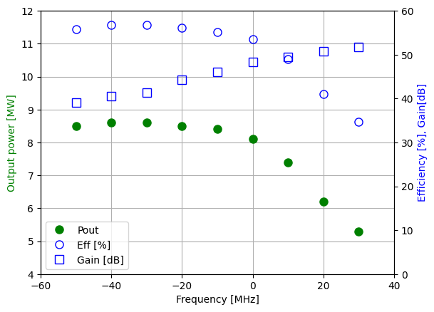
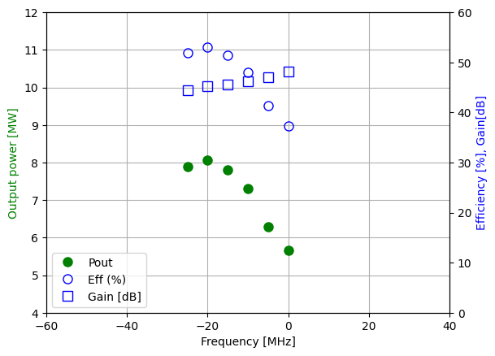
Xbox 3 HEK test results
22G002
Canon results
CERN results

Slide 8
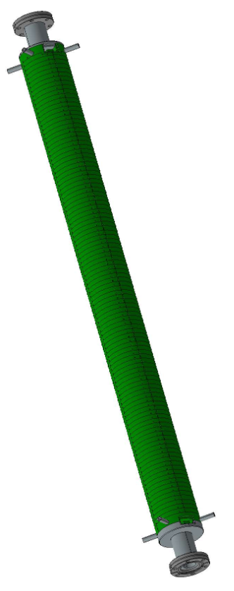
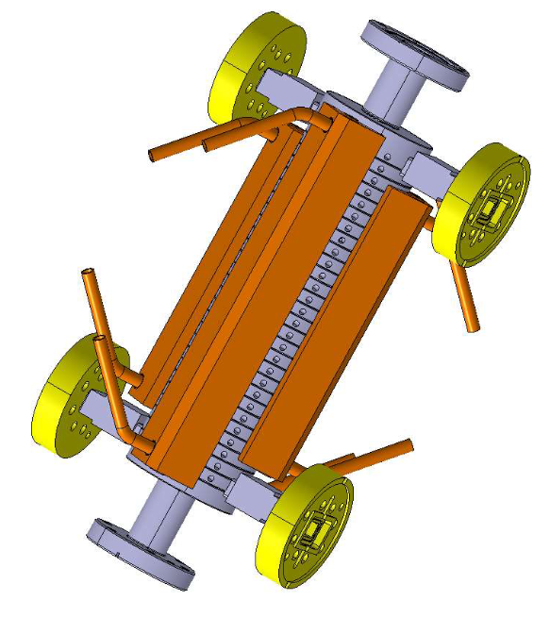
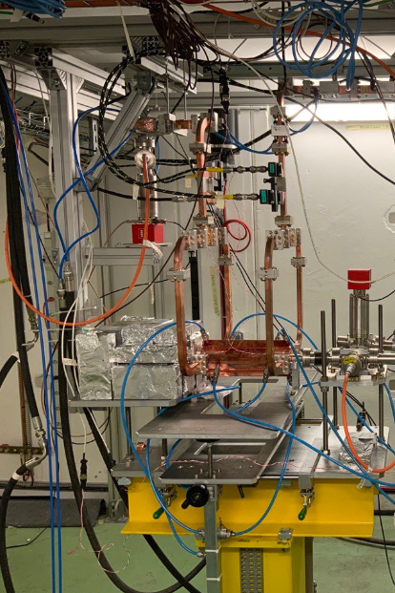

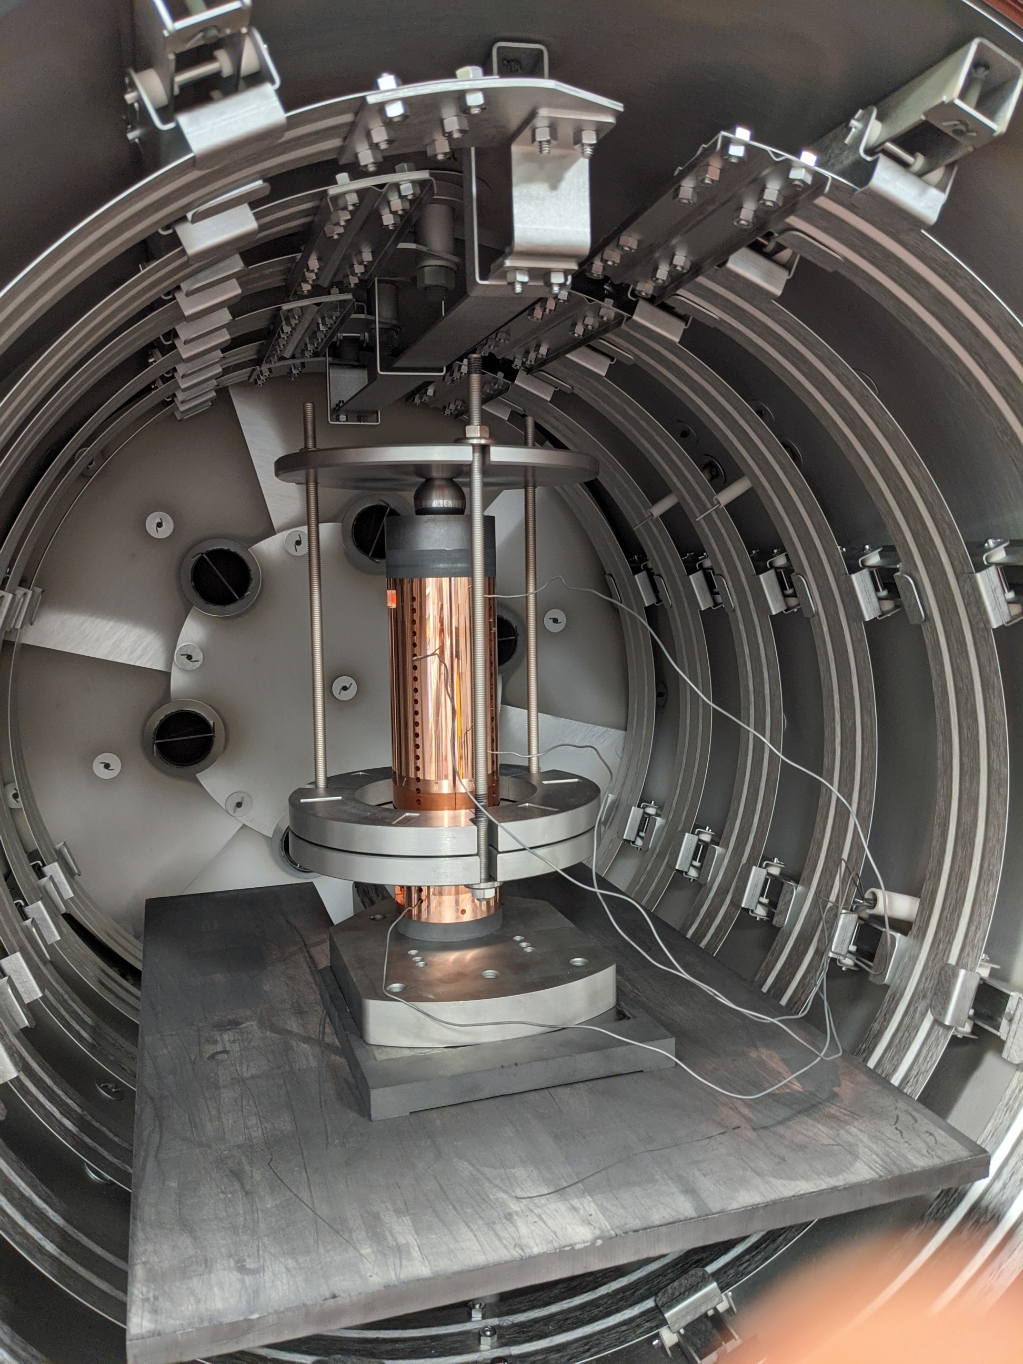
Xbox 3 future plans
Continue conditioning of TD31 N1 and N2
Integration and conditioning of structures TD26 from CIEMAT
Integration and conditioning of iFast accelerating structure

Slide 9
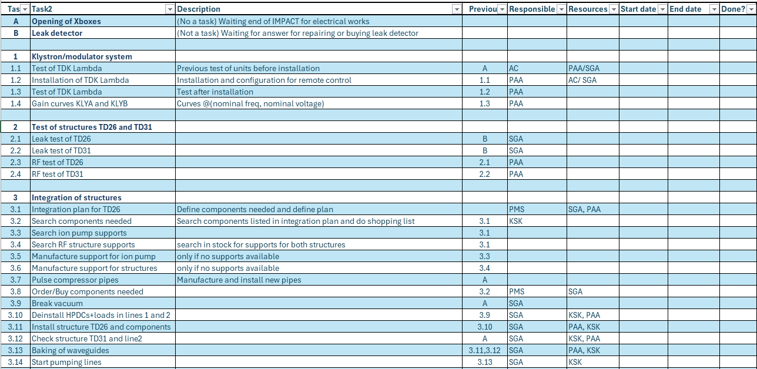
Xbox 3 –Integration planning
Continue conditioning of TD31 N1 and N2
Integration and conditioning of structures TD26 from CIEMAT
Integration and conditioning of iFast accelerating structure

Slide 10
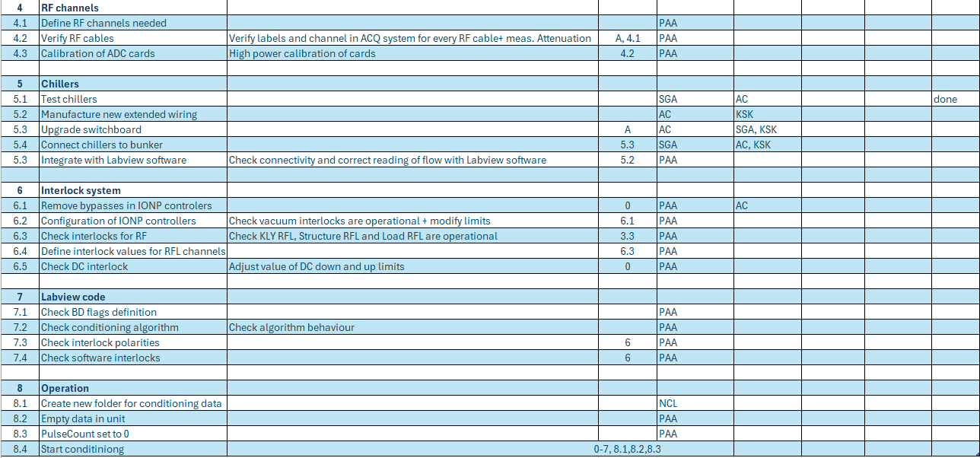
Xbox 3 - Integration planning
Continue conditioning of TD31 N1 and N2
Integration and conditioning of structures TD26 from CIEMAT
Integration and conditioning of iFast accelerating structure

Slide 12
X-Box 2: Reminder on BD classification
BD_Flag_PER_log
BD Load
TRUE
BD_Flag_DC_DOWN
DC Up >=140
DC Down>=100
BD DUT w. BDC
BD_Flag_DC_UP
FALSE
BD_Flag_PSR_log
BD DUT wo. BDC
BD_Flag_PKR_log
BD HyPC
No BD

